Slide 1
Monte Carlo Investigation of Muons in a Liquid-Argon TPC
Kevin Ingles, University of South Alabama
Thomas Junk, Alberto Marchionni
SIST Presentations
15 August 2017

Slide 2
Objective
A liquid argon TPC allows for the identification of particles and the measurement of their energy. This requires the calibration of the ionization energy loss. In order to do this, a thorough investigation of the differences between the analytical energy loss models and the GEANT4 numerical predictions is is done.

Slide 3
Why understand the differences?
Particle physics uses simulation to determine what known events look like in a detector and compare these events to the data in order to extract the information.
This process is analogous to using someone’s voice patterns to find a person in a crowd.
If the particle species is known, we can calibrate the detector response by matching the measured ionization energy to theoretically computed values.
These calibration constants are then applied to all events in the detector.

Slide 4
Our Understanding of Ionization
The analytical model:
The Bethe-Bloch equation gives the average, or expected, energy loss of particles in a material.
Compare this to the expected number when you roll dice.
The Landau distribution describes the energy loss by a single particle and gives the most probable energy loss value (MPV). The Landau-Vavilov-Bichsel (LVB) equation gives how the MPV ($Δ_{p}$) changes with momentum.
This can be compared to a function that shows how the probability of rolling a 6 changes if the dice are weighted.

Slide 5
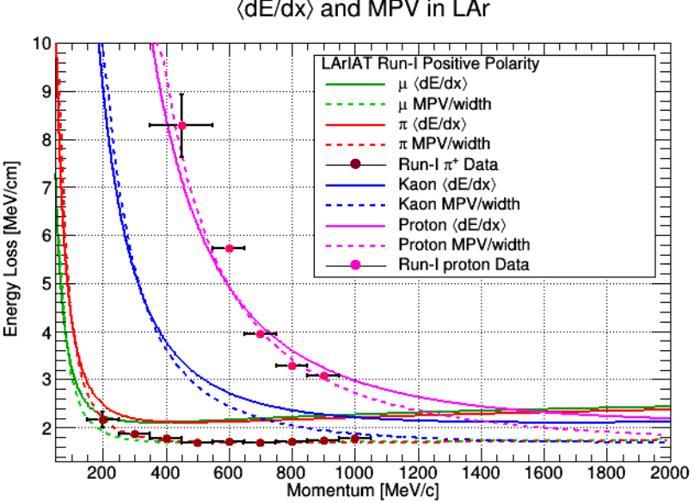
Bethe-Bloch and LVB Plot
LAriAT tuning data to my curves

Slide 6
Simulation Tool
GEANT4
Gamers can think of GEANT4 as a physics engine in their video game.
But really it is a computer program that contains all the physics equations/models we know best describe the world we see.
This program then combines various models together to produce a physics event.

Slide 7
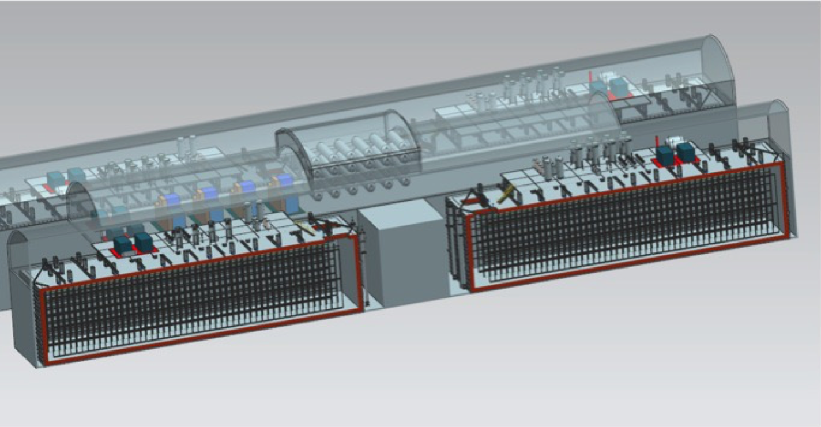
How do we compare?
Simulate!
We simulated close to 12k $μ$at twelve different energies to give a range of MPV values for comparison.
GEANT4 is used to simulate the detector response of shooting the $μ$ into the detector. In our case the detector was a 10 kt module of the DUNE Far Detector.
$μ$⁻

Slide 8
Analysis
To get MPV’s we added up the charge collected on the first 20 wires and filled a histogram for each wire and divide the charge collected by the $μ$ path length.
Then, we fitted the histogram with two Landau distributions over two ranges and recorded the measured MPV’s.
We took the average of the MPV’s as the GEANT4 predicted value and the difference as the systematic error.
1 GeV $μ$

Slide 9
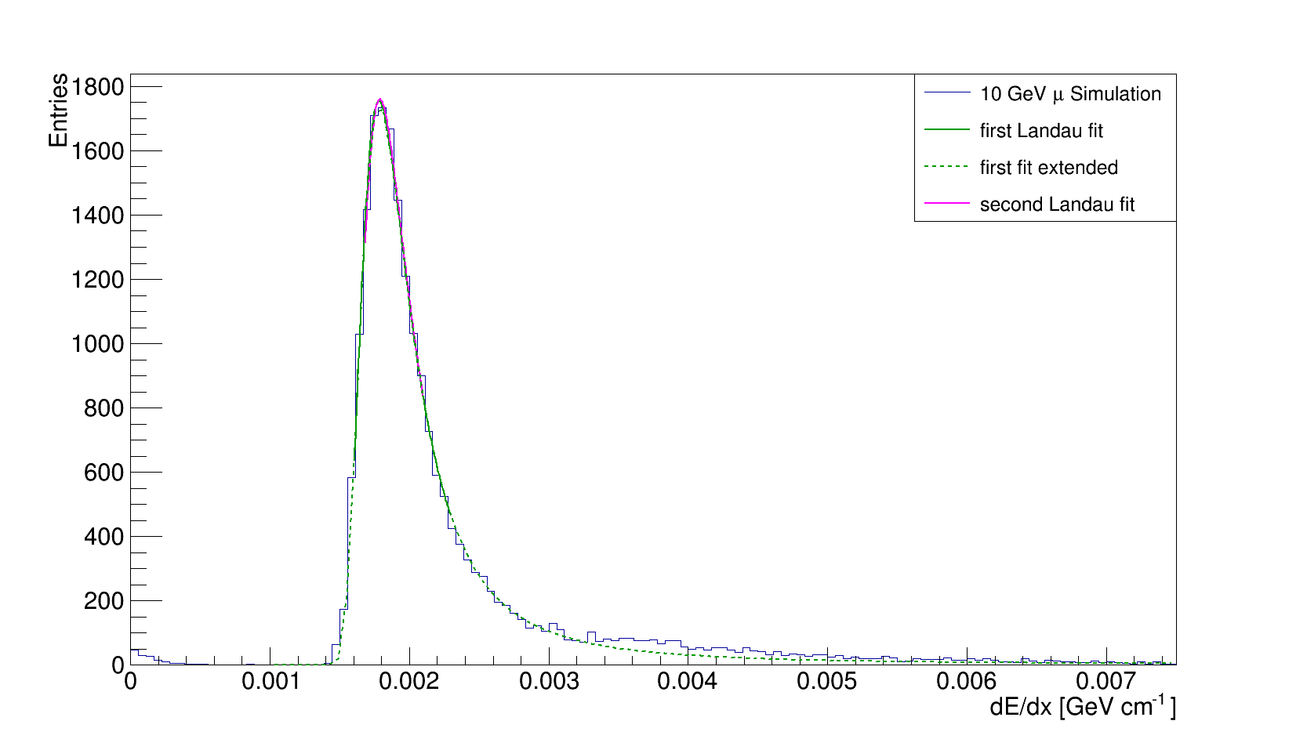
Results
Histogram of charge collected on individual wires with fits

Slide 10
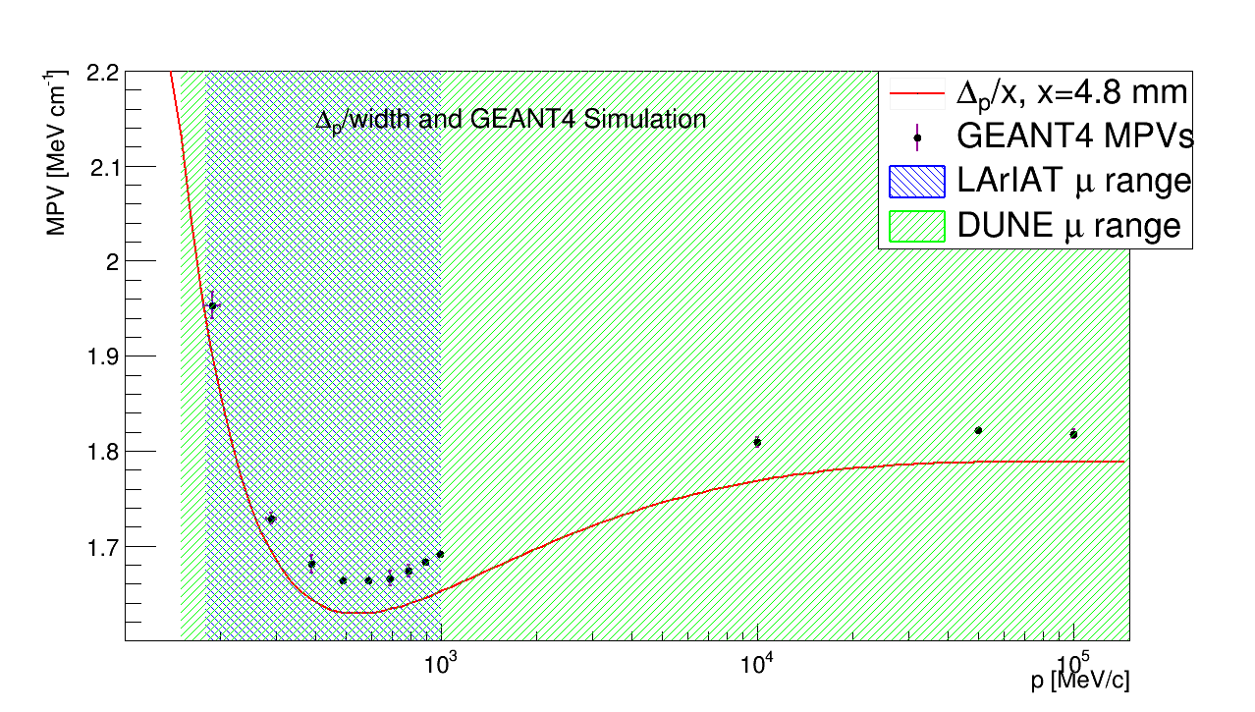
Results
Analytical predictions vs GEANT4 predictions

Slide 11
Delta Rays

Slide 12
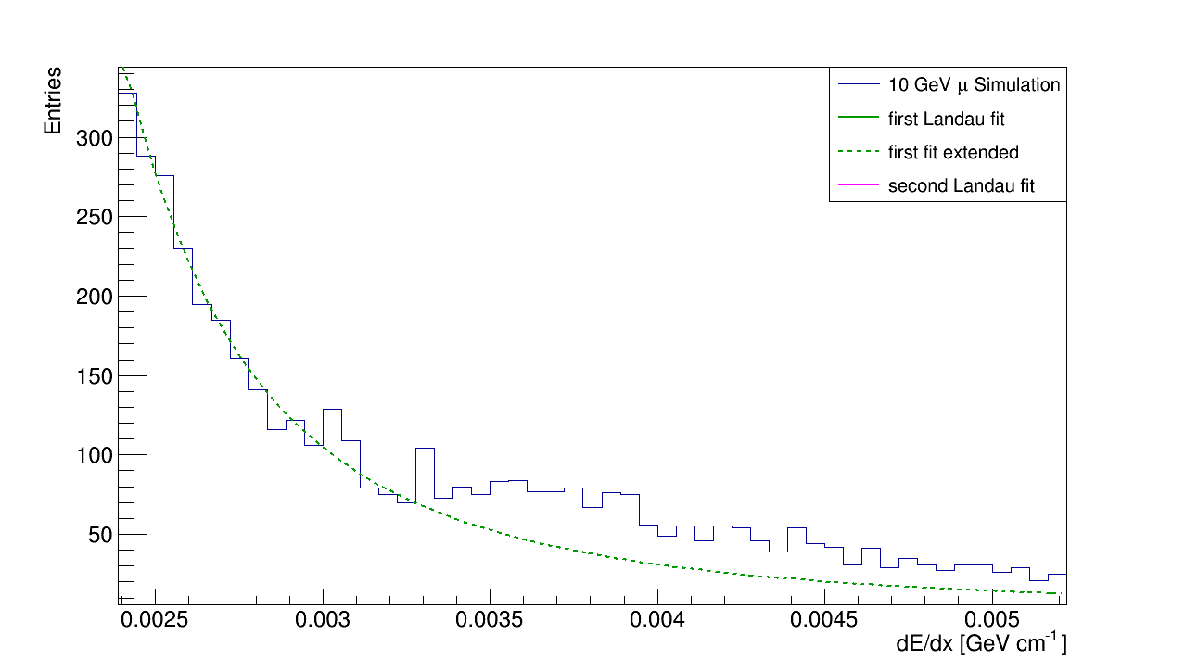
Delta Rays

Slide 13
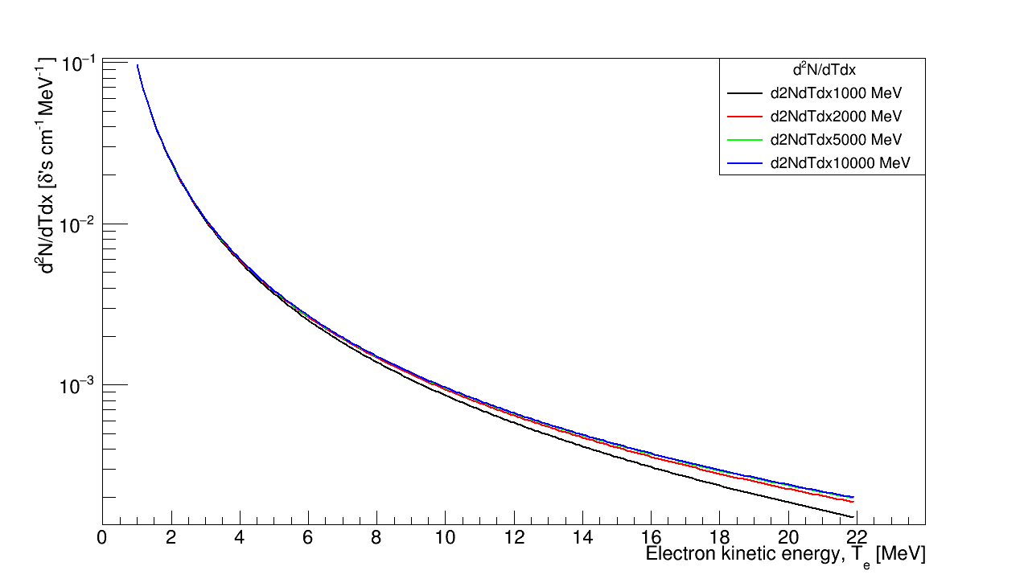
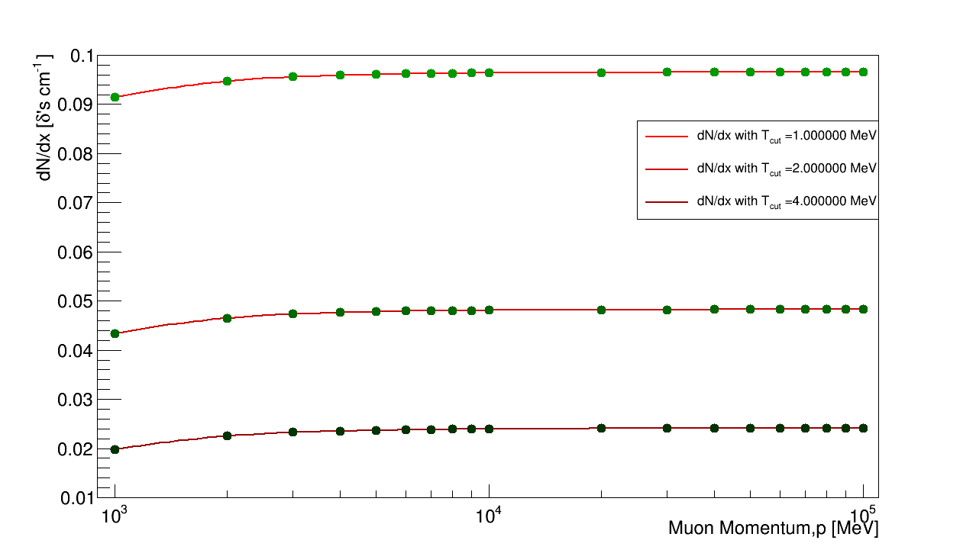
Delta Rays
$δ$ rays are electrons that were given enough energy to escape their atoms and can travel freely. All collected charge comes from $δ$ rays.
Some $δ$ rays are energetic enough to travel across more than one wire. On these wires we see twice the energy deposition on a wire ($μ$ plus $δ$ rays)

Slide 14
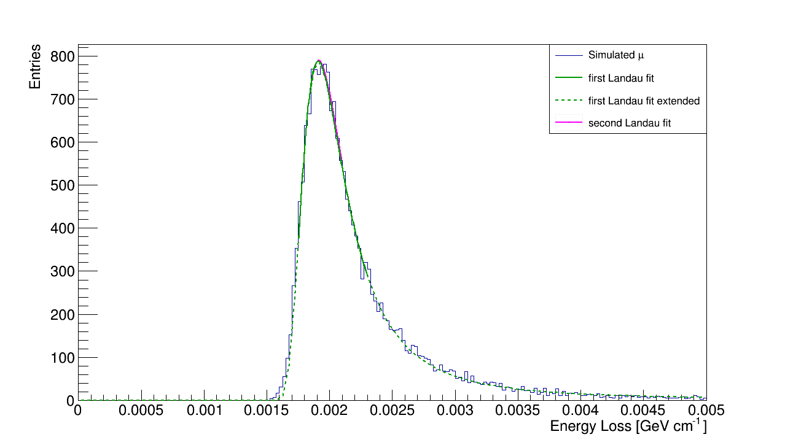
GEANT4 Simulated Energy Loss
To look at the true energy loss, we increased the number of steps in GEANT4 simulation.
Took difference of two consecutive steps, total of 340 steps (20x17)
Filled histogram for every 17 steps, similar to wire pitch.
Then fit histograms as described previously.

Slide 15
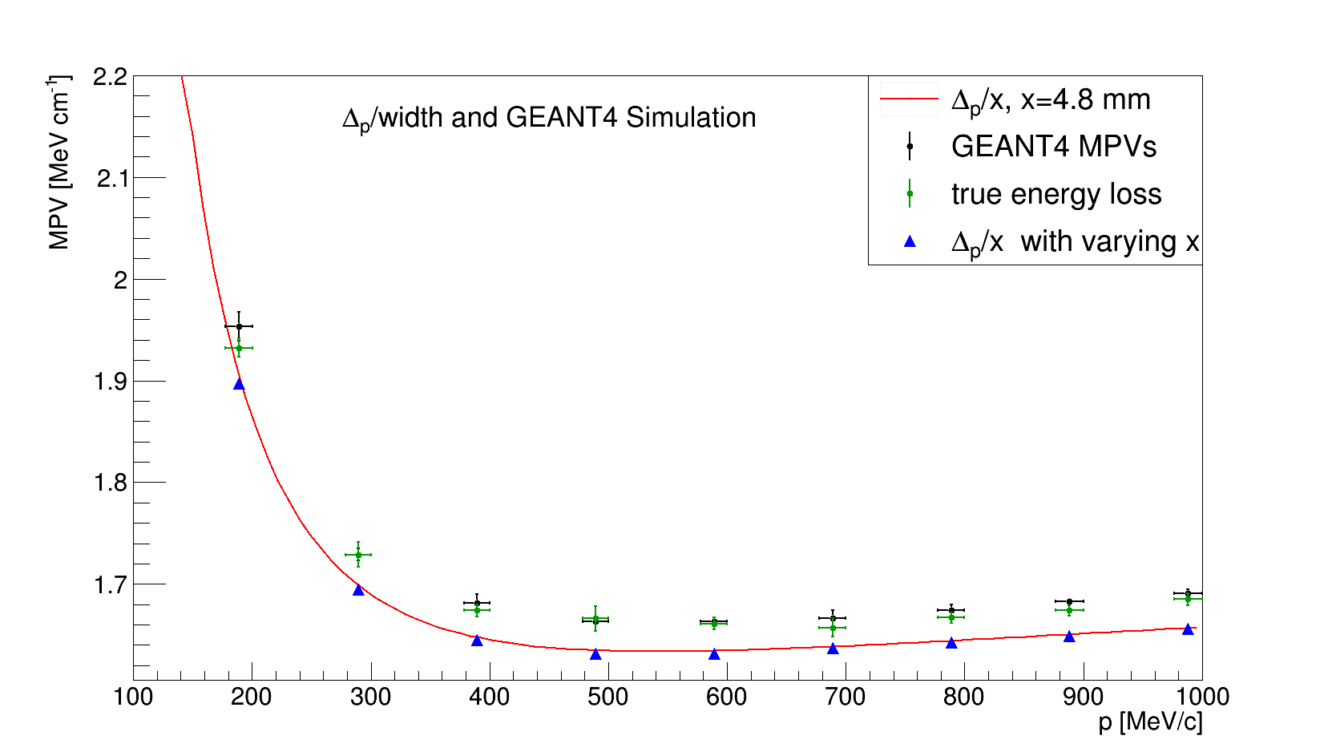
True Energy Loss and Analytical Prediction

Slide 16
Results and Conclusion
The shape of the GEANT4 prediction is consistent with that of the analytic prediction.
Both energy deposition and energy loss are ~2% higher than the analytical prediction.
We observe that $δ$ rays distort the tail of the Landau distribution. This indicates a difference between energy loss and energy deposition.
$δ$ rays and MPV’s are poor at helping resolve particles and their energy.

Slide 17
Future Work
Pair Meter Method
High energy $μ$ create large electromagnetic showers when they travel through materials, we propose to develop an algorithm which estimates the $μ$ energy based on the number of EM showers along the $μ$ track.

Slide 18
Acknowledgements
SIST and Fermilab for internship opportunity
Supervisors: Alberto and Tom
Mentors: Dave and Donovan
References
[1] H. Bichsel, D.E. Groom, and S.R. Klein, Passage of Particles through Matter Chin. Phys. C, 40, 100001 (2016).
[2] S. Agostinelli, et al. Nucl. Instrum. Methods A 506 (2003) 250
[3] J. Allison, et al., Nucl. Instrum. Methods A 506 (2003) 250.
[4] J. Allison, et al., Nucl. Instrum. Methods A 835 (2016) 186.

