Slide 1
Binary Neutron Star rate predictions from observations of dwarf galaxies
Karen Pérez Sarmiento, Macalester College
Supervisors: Alex Drlica-Wagner and Marcelle Soares-Santos
SIST Final Presentations
15 August 2017

Slide 2
Motivation
Binary Neutron Stars (BNS) mergers are expected to produce:

Slide 3
Motivation
Binary Neutron Stars (BNS) mergers are expected to produce:
Gravitational Wave (GW) signals, detectable with GW interferometers (e.g. LIGO)

Slide 4
Motivation
Binary Neutron Stars (BNS) mergers are expected to produce:
Gravitational Wave (GW) signals, detectable with GW interferometers (e.g. LIGO)
Electromagnetic signatures, observable with telescopes (e.g. DECam at Blanco Telescope).

Slide 5
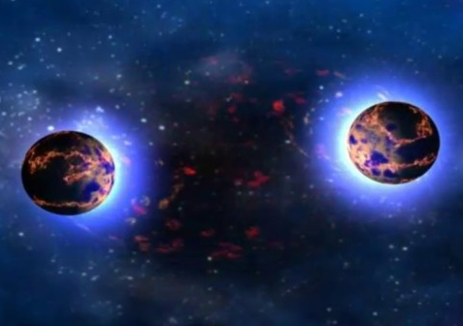
What is a Binary Neutron Star (BNS)?
NASA/Goddard Space Flight Center/Dana Berry
Gravitationally bound system of two neutron stars.
A neutron star is the remnant of a core-collapse supernova for M_{ZAMS} < 25 M☉.

Slide 6
Binary Neutron Star Merger
Merger is the result of the shrinking of the distance between the neutron stars due to emission of gravitational waves.
They are rare events (not detected yet).
NASA

Slide 7
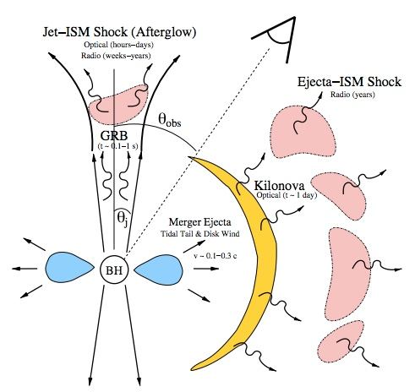
Electromagnetic signatures of BNS
Short Gamma Ray Burst (SGRB)
Kilonova
Afterglow
Metzger and Berger 2012.
Notes:
this is just a model (don’t know for sure if SGRB come fro BNS, haven’t observed kilonova
Talk about SRGB beaming angle (magnetic …)

Slide 8
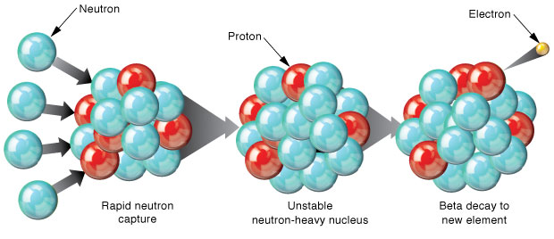
R-process nucleosynthesis
Rapid neutron capture (r-process) is the process by which heavy radioactive elements are formed (Metzger et al 2010).
Borg and Brennecka 2014.
Notes:
Neutron stars because they are neutron rich, are great places for r-process nucleosynthesis
Talk about why r-proces does not occur before merger

Slide 9
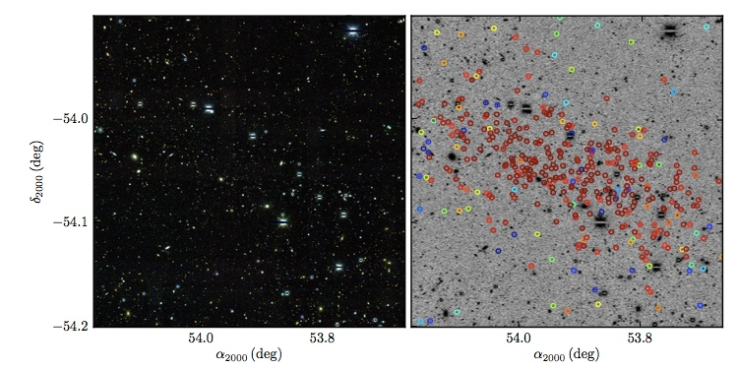
Reticulum II
Dwarf galaxy in the local group.
High-resolution spectra analysis of the nine brightest members of Ret II done by Li et al 2016.
A promising mechanism to explain metal abundance in Ret II is a binary neutron star merger.
Bechtol et al 2015
Notes:
emphasize it is an isolated system

Slide 10
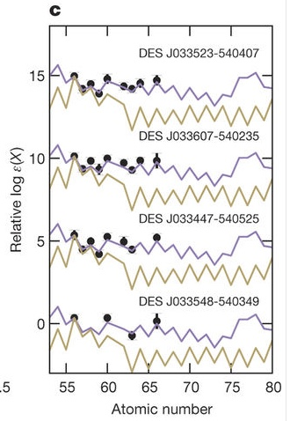
High Resolution Spectroscopy on Reticulum II
Seven of the stars have high neutron-capture element abundances, consistent with r-process pattern.
Ji et al 2016
Notes:
emphasize that ret ii is only dwarf to have a r process event
emphasize why ret ii is so interesting : haven’t observed

Slide 11
Goal
To calculate a lower limit to the astrophysical rate of Binary Neutron Star Mergers from the event in the dwarf galaxy Reticulum II.
To analyze the observational selection effects of LIGO.
Predict number of observable events with LIGO

Slide 12
Lower limit approximation for rate of BNS
Based on the event in Reticulum II: At least 1 event observed in 13 dwarf galaxies (galaxies with high-resolution spectroscopy analysis) in the timescale of a few Gyr.

Slide 13
Lower limit approximation for rate of BNS
Based on the event in Reticulum II: At least 1 event observed in 13 dwarf galaxies (galaxies with high-resolution spectroscopy analysis) in the timescale of a few Gyr.

Slide 14
Lower limit approximation for rate of BNS
Based on the event in Reticulum II: At least 1 event observed in 13 dwarf galaxies (galaxies with high-resolution spectroscopy analysis) in the timescale of a few Gyr.

Slide 15
Lower limit approximation for rate of BNS
Based on the event in Reticulum II: At least 1 event observed in 13 dwarf galaxies (galaxies with high-resolution spectroscopy analysis) in the timescale of a few Gyr.
Assumption: Number of BNS mergers scales up with stellar mass!

Slide 16
Two methods to approximate galactic stellar mass / luminosity
Schechter Mass Function:
Yields spatial density of galaxies as a function of their stellar mass.
Galaxy catalog of nearby universe (<200 Mpc):
To estimate luminosity (proxy for stellar mass) at different distances.

Slide 17
Schechter Mass Function
M* determines where the mass function changes slope
M is the mass
ɸ* is the normalization
𝜶 is the slope for fainter, lower mass galaxies.
Multiplying the function by 10^{M} and integrating for the limits 10⁶-10¹² M☉ yields an estimate of the stellar mass in 1 Mpc³.

Slide 18
Building galaxy catalog to estimate stellar mass
Initial catalog put together by Jim Annis.
i-Band < 15.9 catalog of galaxies over the whole sky.
4 catalogs used to update the distances:
EDD
NED-D
NED
SDSS DR12
The catalog has
RA, Dec, redshift
Distance
i-magnitude, g-i color
Absolute magnitude
Stellar mass
Taylor et al (2011)
Annis (2016)

Slide 19
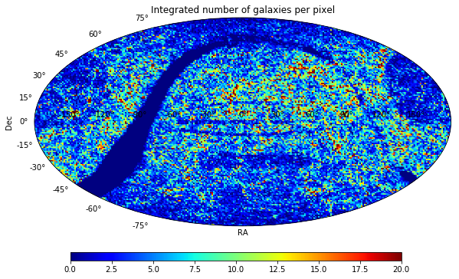
Building galaxy catalog to estimate stellar mass
Artificial features around galactic plane and SDSS footprint due to difference in catalog source for redshift and color.
Annis 2016
Number of galaxies
Notes:
skip

Slide 20
Building galaxy catalog to estimate stellar mass
I worked on rebuilding the catalog (<200 Mpc) to eliminate artificial features:
I used 2MASS Extended Source Catalog as the base catalog and added distances from other surveys in the following preferential order:
1) Distances from NED and EDD
2) Spectroscopic redshifts from NEDZ and SDSS
3) Photometric redshifts from 2MPZ catalog

Slide 21
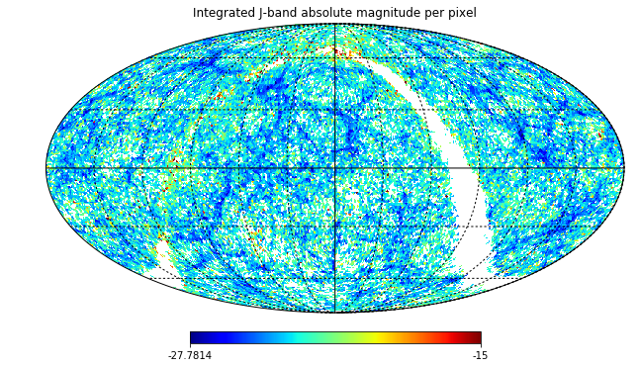
Results from New Galaxy Catalog
J-Band Magnitude

Slide 22
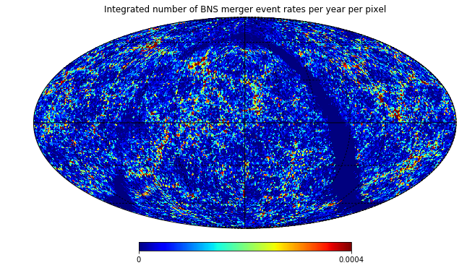
Results from New Galaxy Catalog
BNS event rates (yr⁻¹pixel⁻¹)

Slide 23
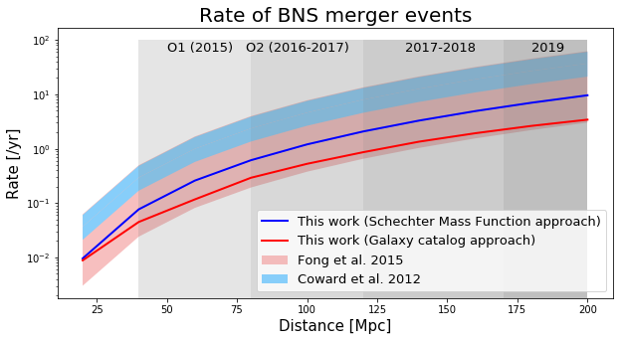
Comparison with literature values
Rate with Schechter Function approach = 286 Gpc⁻³yr⁻¹
Rate with Galaxy catalog approach = 135 Gpc⁻³yr⁻¹

Slide 24
LIGO observational selection effects
LIGO has observational selection effects for certain regions of the sky (Chen et al 2016) : more sensitive to some regions of the celestial sphere than others.
This depends on:
Declination (latitude) due to location of interferometers
Right Ascension (longitude) due to nonuniform daily and annual cycle.

Slide 25
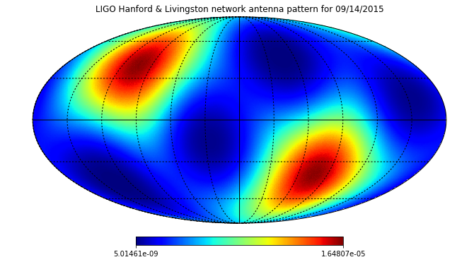
LIGO observational selection effects
Chen et al. 2016
Probability per deg²
Notes:
explain again ra and dec dependence

Slide 26
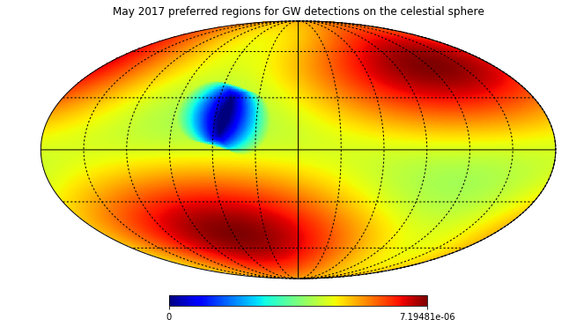
LIGO observational selection effects
Chen et al. 2016
Probability per deg²
Notes:
explain again ra and dec dependence

Slide 27
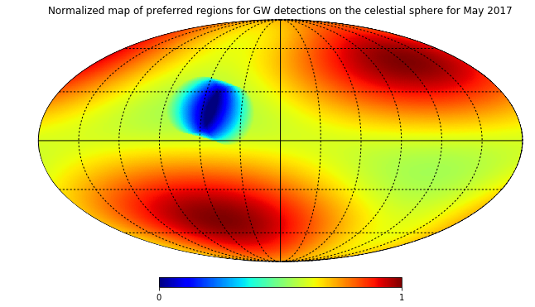
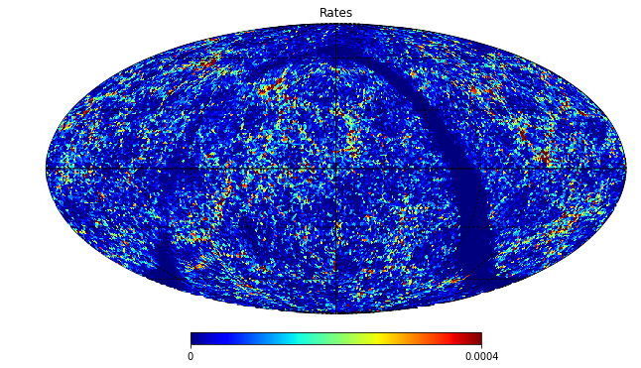
Predicting observable rates of BNS with LIGO
Multiply LIGO sensitivity map (for every month and rates map.

Slide 28
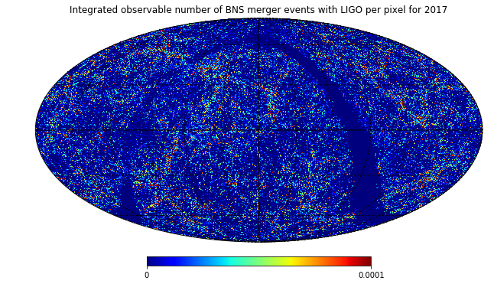
Predicting observable rates of BNS with LIGO
We get an expected number of observable events with LIGO of ~2.4 yr⁻¹.

Slide 29
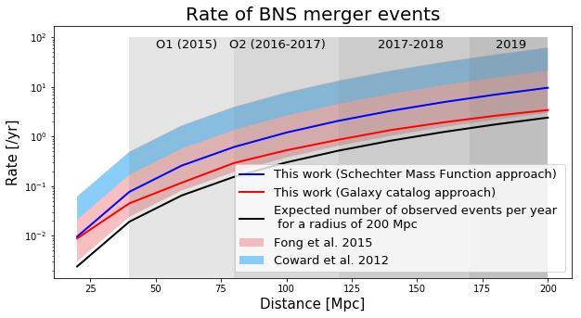
Literature comparison

Slide 30
Future steps
Build LIGO sensitivity maps for sources at different distances in order to make a better prediction of the number of observable BNS merger events.
Consider DECam footprint and use this work to inform future EM follow-up.

Slide 31
References
Annis, J., et al. Private communication (2015).
Bechtol, K., et al. ApJ 807, no. 1 (2015): 50.
Chen, H. Y., et al. ApJ 835, no. 1 (2017): 31.
Conselice, C. J., et al. ApJ 830, no. 2 (2016): 83.
Coward, D. M., et al. MNRAS 425, no. 4 (October 1, 2012): 2668–73.
Fong, W., et al. Ap J 815, no. 2 (2015): 102.
Ji, A. P., et al. ApJ 830, no. 2 (2016): 93.

Slide 32
Acknowledgements
I would like to thank my project advisors Marcelle Soares-Santos and Alex Drlica-Wagner for their guidance and mentorship througout this project.
I would also like to thank Hsin-Yu Chen and Jim Annis (Dark Energy Survey collaborators) for their invaluable input.
Finally, special thanks to the SIST committee and mentors: Sandra Charles, Elliot McCrory, Judy Nunez, Bill Freeman, Camille Ginsburg and Raul Campos.

Slide 33
Collaborations / Partnerships

