Slide 1
Mu2e: Tracker Electronics
Daniel Aguilera
Final Presentations
15 August 2017

Slide 2
Overview
Mu2e Experiment
What is it looking for and why?
Mu2e Tracker
What makes up the tracker and how does it work?
Mu2e Tracker Electronics
Data Acquisition from the tracker!
Field Programmable Gate Array (FPGA)
Research: Integrating an analog-to-digital conversion into the FPGA
Additional Tasks: Preamplifiers
Anode & Cathode Connectors

Slide 3
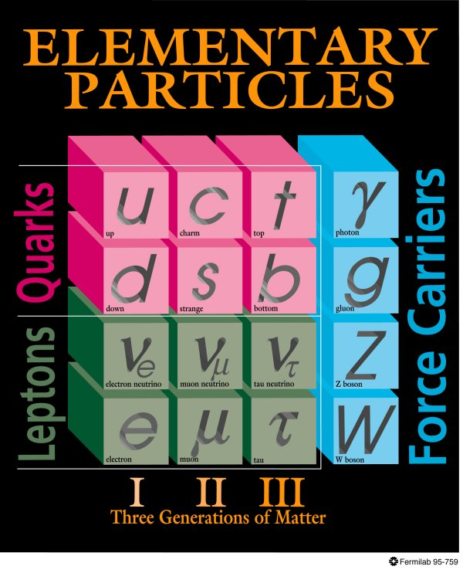
Mu2e Experiment
What are we looking for?
In Mu2e, we would like to detect neutrino-less conversions of Muons to a high energy electrons (105MeV).
Typically a Muon would decay into two neutrinos and a low energy electron.
What is a muon?
A muon is a charged lepton with a charge of -1e and a ½ spin.
It can also be thought of as a heavier electron.
Why does this matter?
The detection of the rare neutrino-less conversion would hint towards new physics.

Slide 4
Mu2e Detector
The detector setup has 3 main parts: Production Solenoid (PS), Transport Solenoid (TS), and the Detector Solenoid (DS)
First, protons with energies of 8GeV will strike a tungsten target creating a number of particles, one being pions which decay into muons.
The PS collects the muons and send them to the TS.
The TS will send the muons to the aluminum capturing target.
From here, the muons can convert to high energy electrons to be detected
Notes:
Atoms that capture muons to replace electrons are known as muonic atoms. They allow the muon to decay into a high energy electron with no neutrinos.

Slide 5
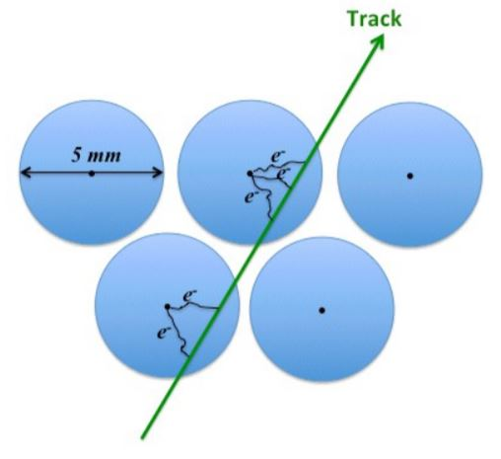
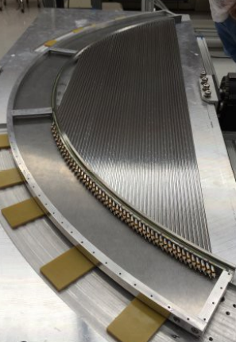
Mu2e Tracker
When a muon decays into a high energy electron, the electron gains a very specific momentum of 105MeV.
To detect the high energy electrons, the tracker uses low mass Mylar drift tubes, filled with an Ar/CO₂ gas mixture, and a high voltage gold plated tungsten sense wire along the center.
Or straws
As a high energy electron passes through a straw, the gas inside will ionize, which will trigger an electron avalanche. The avalanche will create a measurable signal for us to work with.

Slide 6
Mu2e Tracker Electronics
The signal from the electron avalanche will then go through the preamplifiers (one at each end) which will shape and amplify the signal.
Digitization is being done with a combination of analog-to-digital converters (ADC) and time-to-digital converters (TDC).
The TDC compares the time difference between the signals at each end to estimate the position in which the event occurred.
The ADC digitizes the amplitude of the signal to distinguish between particles.

Slide 7
Mu2e Tracker Electronics
If the event was a high energy electron, the ADC and TDC will send their information to the Output Control & Buffer to associate the corresponding amplitude and timing of the signal before being sent to the Readout Controller (ROC).
From the ROC, the digital information will be sent to Data Acquisition (DAQ).

Slide 8
Mu2e Tracker Electronics
If the event was a high energy electron, the ADC and TDC will send their information to the Output Control & Buffer to associate the corresponding amplitude and timing of the signal before being sent to the Readout Controller (ROC).
From the ROC, the digital information will be sent to Data Acquisition (DAQ).
The setup seems pretty good, why do we need to change it?

Slide 9
Consolidation
The electronics used in the tracker will be exposed to radiation over an extended period of time.
Over time, IC’s will be affected by the radiation and will stop working properly.
To fix this, replace damaged ICs or buy ICs that can withstand prolonged exposure to radiation.
To minimize the number of possible failures and cost of buying expensive ICs that should withstand prolonged exposure to radiation, we can integrate some ICs into a single FPGA.
Currently, the TDC, Output Controller & Buffer, and the ROC are all designed and implemented within the FPGA.
The next possible chip to be “built” into the FPGA is the ADC.
Multiple ICs Into one FPGA

Slide 10
FPGA – Analog-to-Digital Conversion
To implement an ADC within the FPGA, we need to use Low Voltage Differential Signaling (LVDS).
LVDS takes in two signals; the analog signal to be sampled (100KHz) and the sampling clock (3.5MHz) and it check when the sampling clock goes above the analog signal.
When the sampling clock is above, the LVDS outputs logic low.
Similarly, when the sampling clock goes below, it outputs logic high.
The output (Y) is then sampled at a higher frequency (350MHz) and keeps a count (up to 350MHz/3.5MHz) of how many clock cycles Y is at high logic.
The count is then stored and reset to zero every period of the sampling clock.

Slide 11
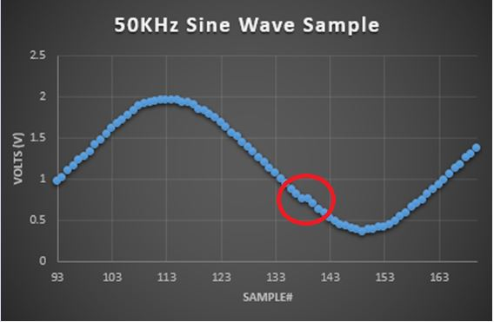
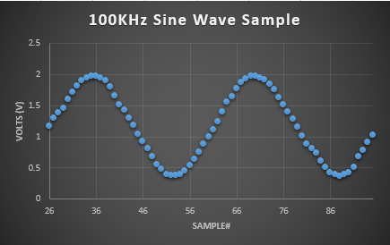
Results
The “counts” that are stored can be converted back to voltage levels and each count becomes a voltage sample.
Sample = V_{range} * ( count / count_{max} )
With the described setup, this is the analog-to-digital conversion of a 50kHz and a 100kHz sine wave:
From these two plots we see two things:
1. The resolution falls drastically from between the 50kHz and 100kHz sine wave
2. Even in the 50kHz sine wave we see samples that don’t make sense

Slide 12
Future Work
From the previous plots, it is not possible to determine the performance of the ADC made.
To quantify this, we need to look at the Integrated Non-Linearity (INL) of the sample.
This quantity is measure by looking at the maximum deviation of the sample from the ideal wave
This number can also tell us the performance of each ADC when using different I/O pins.
This is critical because each board uses two ADC each containing 8 channels.
Further work still needs to be done to increase out resolution of the ADC
One way it can be done is by implementing a time-to-digital converter into our current ADC.
Increasing the resolution of the ADC will also help increase the accuracy the INL.

Slide 13
Additional Tasks: Preamplifiers

Slide 14
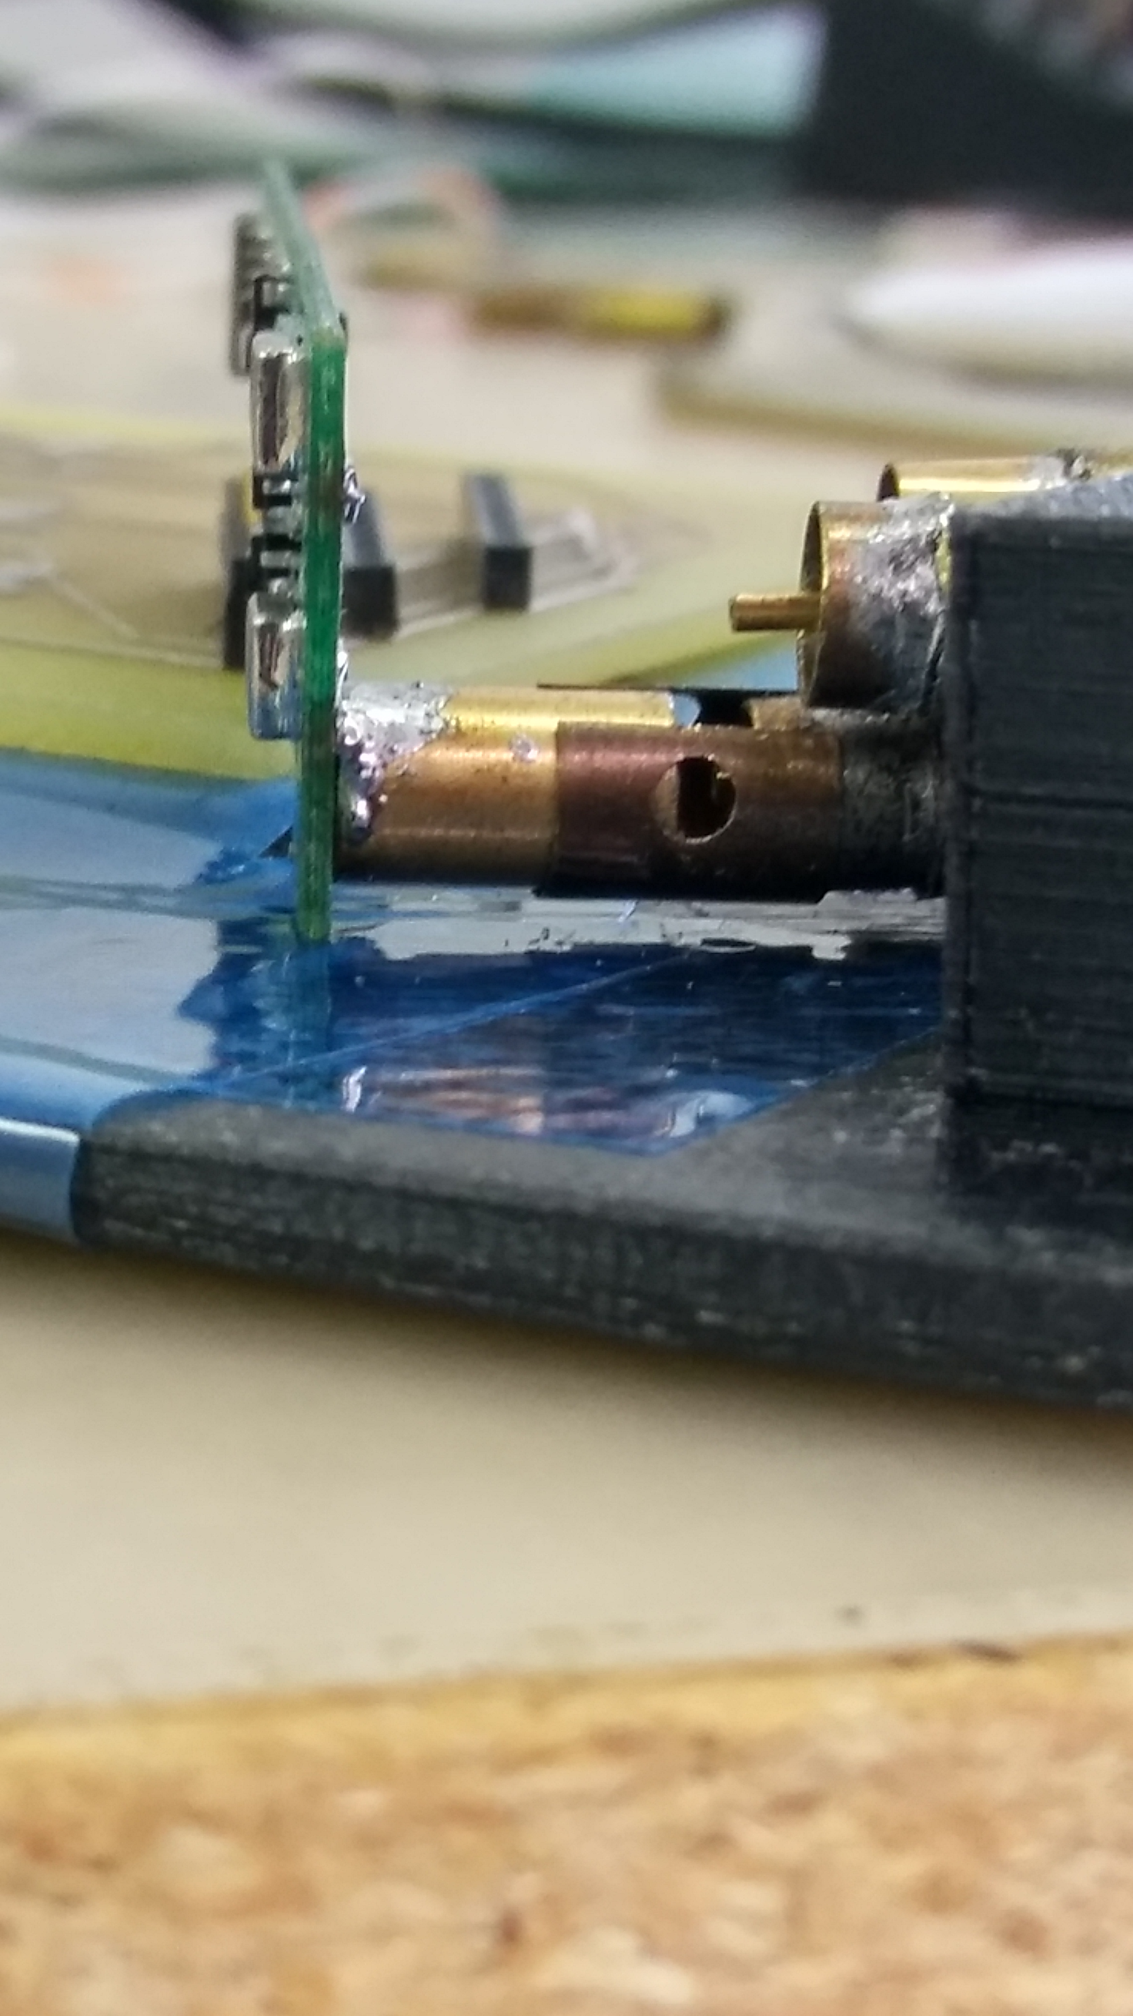
Preamplifiers – Anode & Cathode Connectors
Each straw is connected to two preamps (one on each side).
The issue is that there are 20,000 straws with two anodes and cathodes that need to be connected to the preamps.
There needs to be a quick and easy way to make these connections.
One solution:
Increase the tolerance of the cathode connections by using sliding sleeves with an “expandable” circumference to increase ease of connection.
Standardize the length of the anode cable to increase ease of connection. (8mm)
Notes:
The preamp shapes and amplifies the signal coming from the sense wire before being sent to the digitizers: ADC & TDC.

Slide 15
Acknowledgements

