Slide 1
Cold Mass Position Sensor Mu2e
Josh Helsper
Northern Illinois University
SIST Intern Presentation
15 August 2017

Slide 2
Outline
The Mu2e experiment
My summer project: The Cold Mass Position Monitoring System
Results & Outlook

Slide 3
Background of Mu2e
Purpose of Mu2e - To observe neutrinoless muon to electron conversion in order to better understand their relationship
Importance - An observed charged-lepton flavor violation would provide evidence for physics beyond the standard model

Slide 4
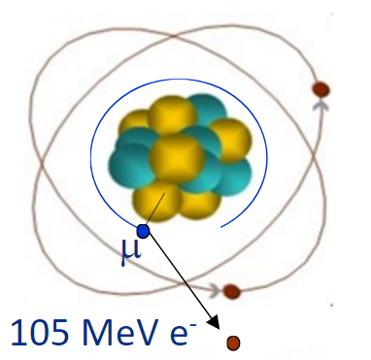
Background cont.
Protons → Production Solenoid → Muons
Muons → Transport Solenoid → Detector solenoid
Here they hit an aluminum target block,
and are captured by the nucleus
105 MeV electron can then be detected

Slide 5
Background cont.
Problem
During cooling and powering on, the solenoids will shift in position by up to 37 mm (from simulation)
Location of the field map must be known to within 1 mm to accurately calculate momentum of conversion electrons
Solution
The Cold Mass Position Sensor - CMPS for short

Slide 6
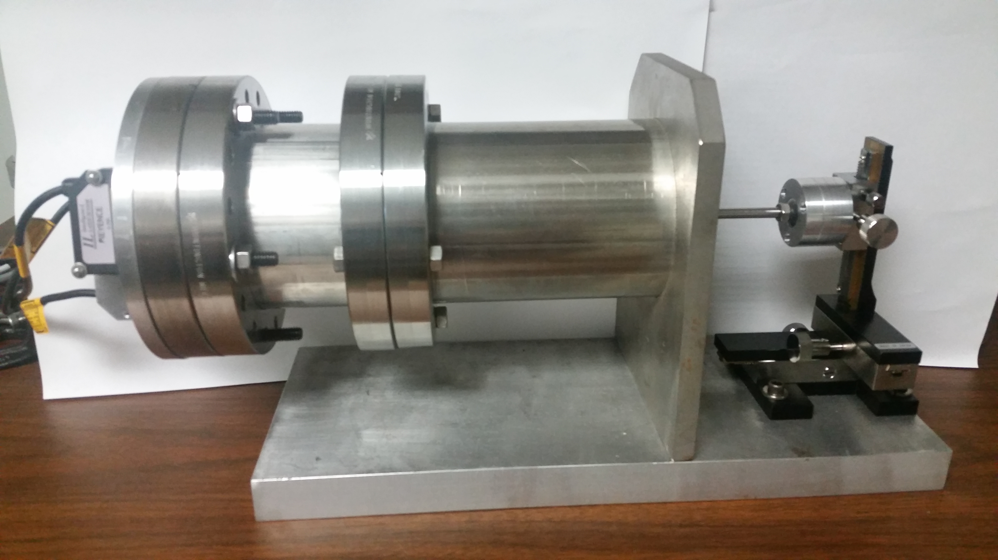
Cold Mass Position Sensor testing stand
Distance Sensors
Connecting Rod
XYZ adjustment
stand
Laser Paths
Sensor Plate

Slide 7
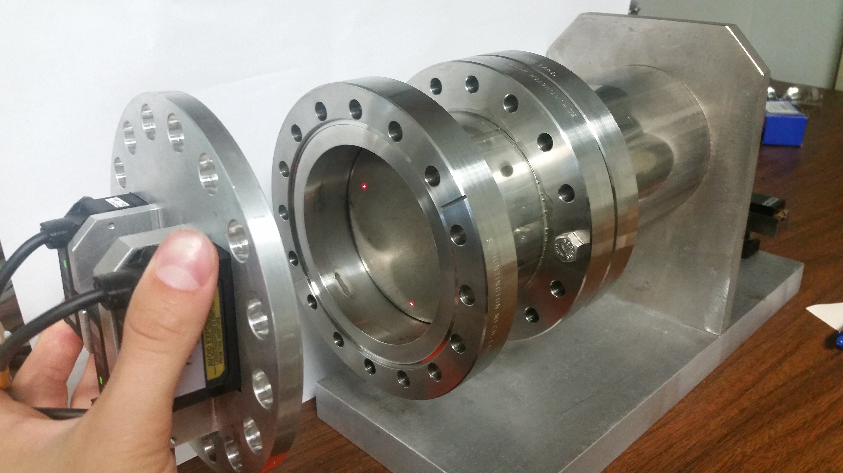
Cold Mass Position Sensor

Slide 8
Cold Mass Position Sensor locations

Slide 9
Cold Mass Position Sensor locations

Slide 10
CMPS Readout Boxes

Slide 11
Initial results
Initial error on measurement: 800 microns
Goal: <1,000 microns
Could be much better
Major things I have done:
Accounted for error in the system
Written program to calculate location of solenoid
Assembled CMPS equipment boxes

Slide 12
Ideal vs actual laser spacing at long range

Slide 13
Survey Methods

Slide 14
List of measured values
Straightness of each laser path
Thickness of plate
Length of connecting rod
Straightness of connecting rod
Axis of the tube the plate resides in

Slide 15
Program specifics
Constants
Length of rod
Origin of each laser
Vector of each laser
Axis of Port Tube
Input
Three laser distances to plate
Output
Location of Cold Mass (units in microns)

Slide 16
Program specifics Cont.
Logic structure
Use constants to determine vector for each laser path
Using input distance, determine point each laser contacts plate
Calculate plane equation for plate and normal vector of plane
Use with rod length to determine point of Cold Mass
Language used: Structured Text

Slide 17
Structured Text

Slide 18
Cold Mass Positions

Slide 19
Summary
Cold Mass positions read using Kepware Server

Slide 20
Predicted Sources of Error
Source | Amount ( µm )
Keyence Laser | 2
Laser mounting | 2
Port tube axis | <25
Rod length | <25
ANSYS modeled rod cooling | <10
Plate tilt | X: 20 , Y: 20, Z: 2
Sphere position | <25
Cumulative Error | Amount ( µm )
X direction | 48
Y direction | 48
Z direction | 45
Total | 81
Error goal: 1000 µm

Slide 21
Measured Amount of Error
Source of error:
Point where rod joins plate is not exactly perpendicular
Causes for a 1mm change in XY plane over 30 cm
Helps to explain the error in our measurements
Average Absolute Error | Amount ( µm ) | Expected ( µm )
X direction | 115.55 | 48
Y direction | 271.36 | 48
Z direction | 152.03 | 45
Total | 331.81 | 81

Slide 22
Future direction
Determine how to lessen the error caused by the rod-plate connection
Survey all 12 Cold Mass Position Sensors
Use information gathered from all the sensors to determine where the magnetic field map has moved

Slide 23
Acknowledgements
I would like to thank everyone who helps make the SIST program what it is:
Sandra Charles, Judy Nunez, Elliot McCrory, Charlie Orozco, Donovan Tooke, and Dave Peterson, and everyone in the SIST and GEM program
I’d also like to thank Thomas Strauss, my supervisor, and everyone I worked with in the Magnetic Sector Department

Slide 24
Questions?

