Slide 1
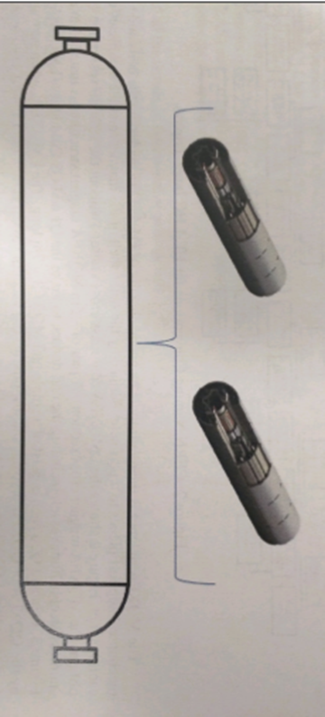
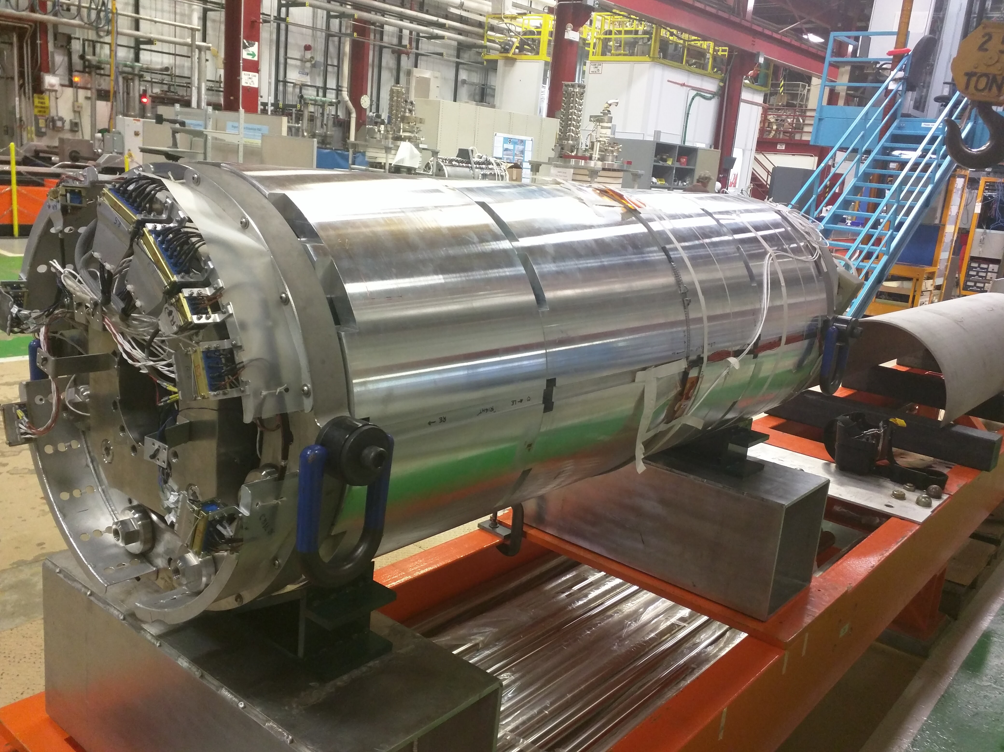
Development of Liquid Helium Flow Rate and Heat Transfer Models for LMQXFA Cold Masses
Coleman Tolliver
Roger Rabehl

Slide 2
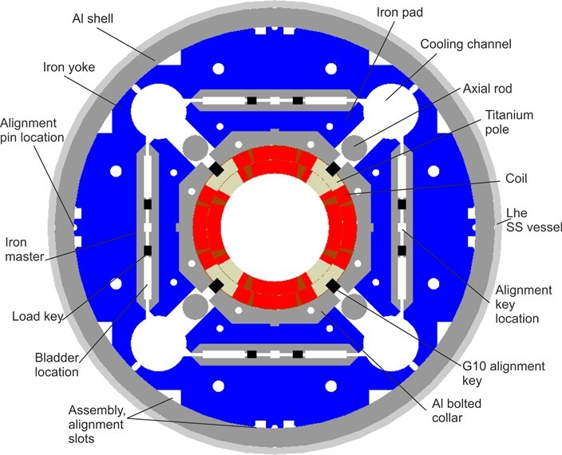
intro
LMQXFA magnets are quadrupoles used for beam focusing
Cooled to 4.5 K with helium
Goal is to mathematically model the flowrate and heat transfer
Helium flows through three types of channels
Notes:
Talk about picture being a prototype
Plans to upgrade in 2025
Explain the 3 different openings for the next slide

Slide 3
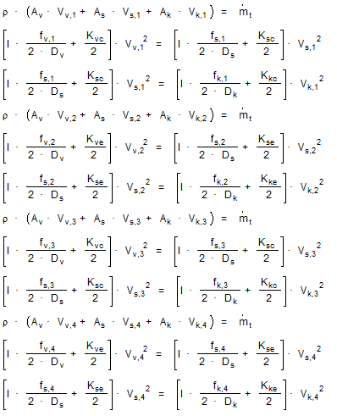
Methods & Results – Flow Rate
Total helium entrance flow rate is 20g/s
Pressure drop across the openings is unknown, but constant
Assumed the magnet to be one continuous pipe first trial
Assumed Key holes to be circles and shim slots to be rectangles
Created turbulent pipe flow system of equations
The flow rate outputs: Keyholes – 0.01823 kg/s, Shim slots – 0.001097 kg/s, Vents – 1.516E-5 kg/s
Notes:
Mention this is first time with fluid dynamics and heat transfer
Explain the 4 sets are for the 2 sudden expansions and 2 sudden contractions
Difference between first and second is first had one set, with no minor loss coefficients.

Slide 4
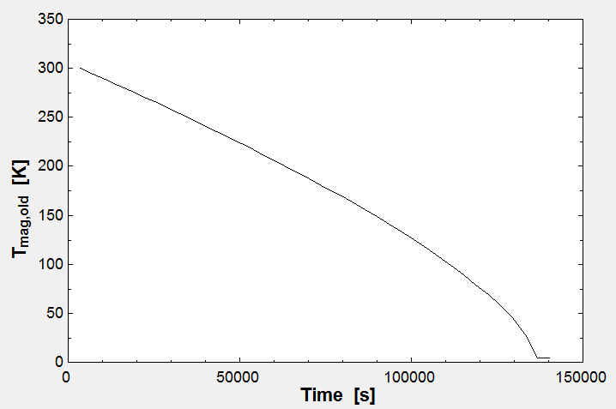
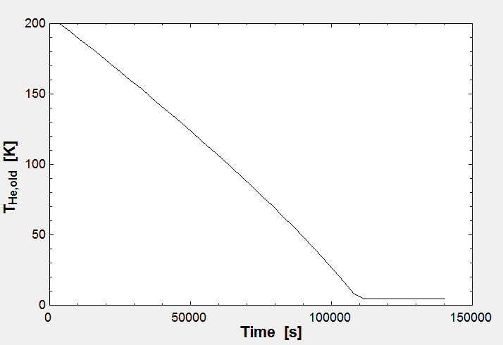
Methods & results– Heat Transfer 1
Magnet starts at room temperature, helium at 200 K
Assumed magnet to be one mass with one dimensional heat transfer first trial
Notes:
Explain time scale
Placing hot metal into a bucket of water. No temperature gradient. Assumed it cooled at the same rate

Slide 5
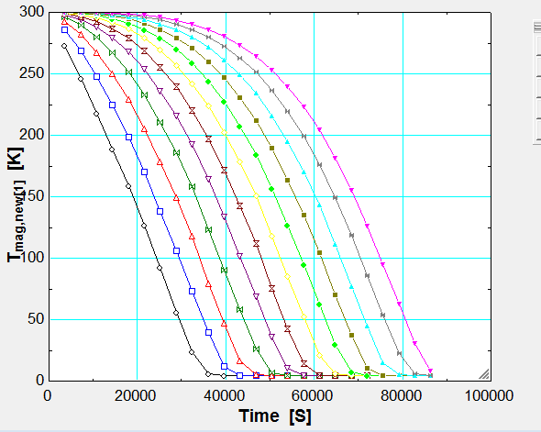
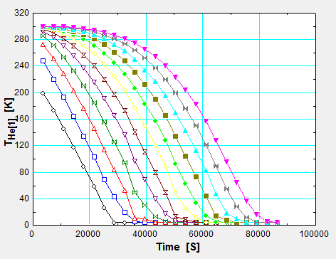
Methods & results– Heat Transfer 2
Divided cold mass into twelve sections in second trail to
Allowed for helium temperature gradient
Notes:
The temperature of helium is always 100K difference or less for the section it is in

Slide 6
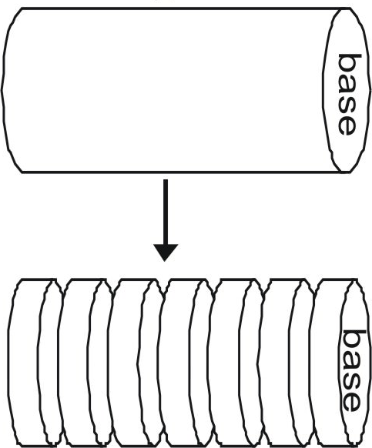
Methods & results– Heat Transfer 2
Notes:
First q equation is the energy transfer; it relates the magnet section temperature to the temperature of the helium passing through
The second q equation is the energy stored equation

Slide 7
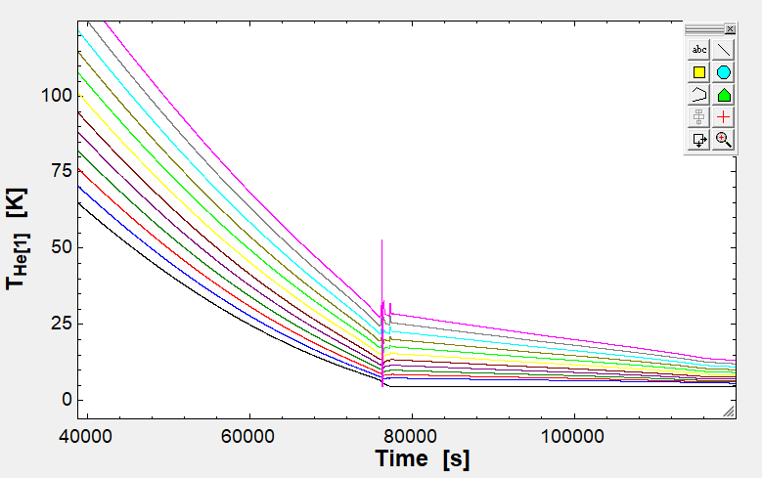
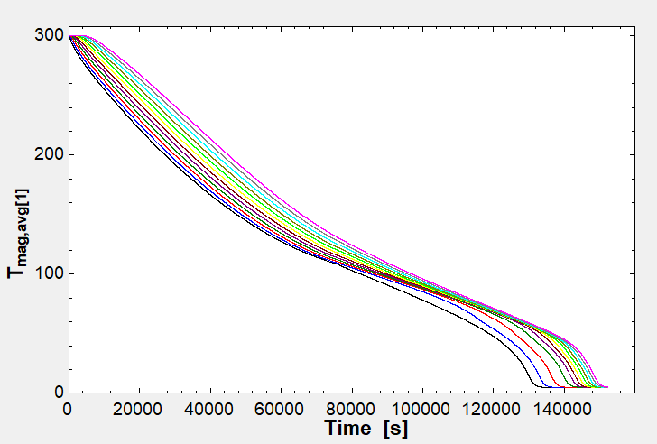
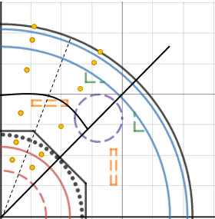
Methods & results– Heat Transfer 3
Introduced two-dimensional heat transfer equations third trial
Notes:
Explain the elements are the areas around the nodes are elements
Graphical glitch
Time scale: 1.75 days

Slide 8
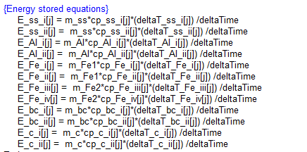
Methods & results– Heat Transfer 3
Notes:
First set same as second trial, but now there’s energy transfer from previous nodes
Explain the Temperature difference
Energy stored in nodes is second set

Slide 9
Conclusion
Results were within expectations
Cannot verify the data yet, the magnet is not operational
These calculations will be useful for when the magnet is running
Continuing this project, more accurate depictions of openings would be useful for the flow rates
The next step would be a thermal stress analysis

Slide 10
Acknoledgements
This project would not have been possible without the guidance of Roger Rabehl and the help of Antonios Vouris

Slide 11
Questions?

Slide 12
Sources
Foundation, CK-12. "8.6: Cylinder: Base Area, Lateral Area, Surface Area and Volume DRAFT." CK-12 Foundation. CK-12 Foundation, 13 Jan. 2015. Web. 14 Aug. 2017.

