Slide 1
Analyzing Lock-In Amplifier Techniques Using Python
Doneisha Steele
SIST/GEM Final Talks
15 August 2017

Slide 2
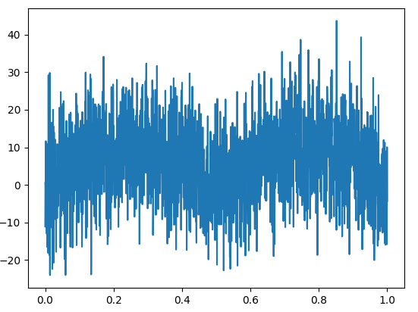
Objectives
Statistical analysis of two mathematical approaches for the implementation of a lock-in amplifier to aid in noise reduction
Develop lock-in amplifier simulation in Python

Slide 3
Background – Particle Detectors
Detect, track and identify ionizing particle
Major challenges include background noise, high detection rates , neutron neutrality, and low neutron energies.
Icarus

Slide 4
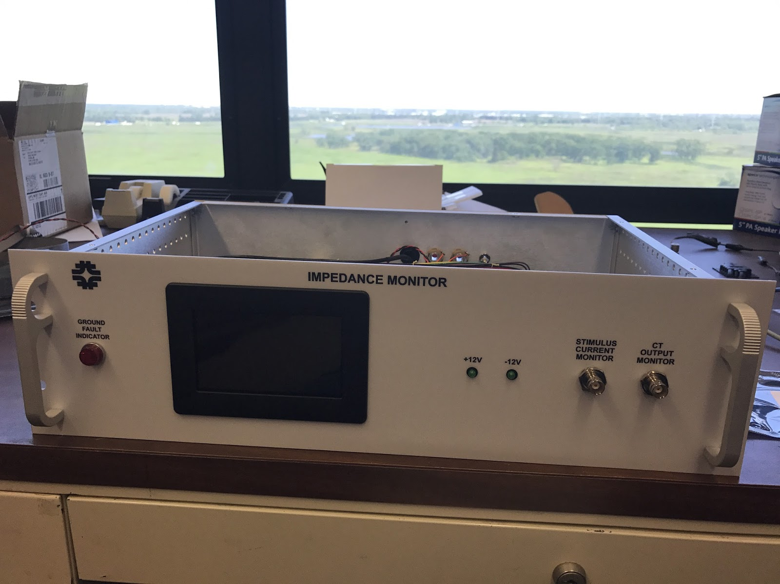
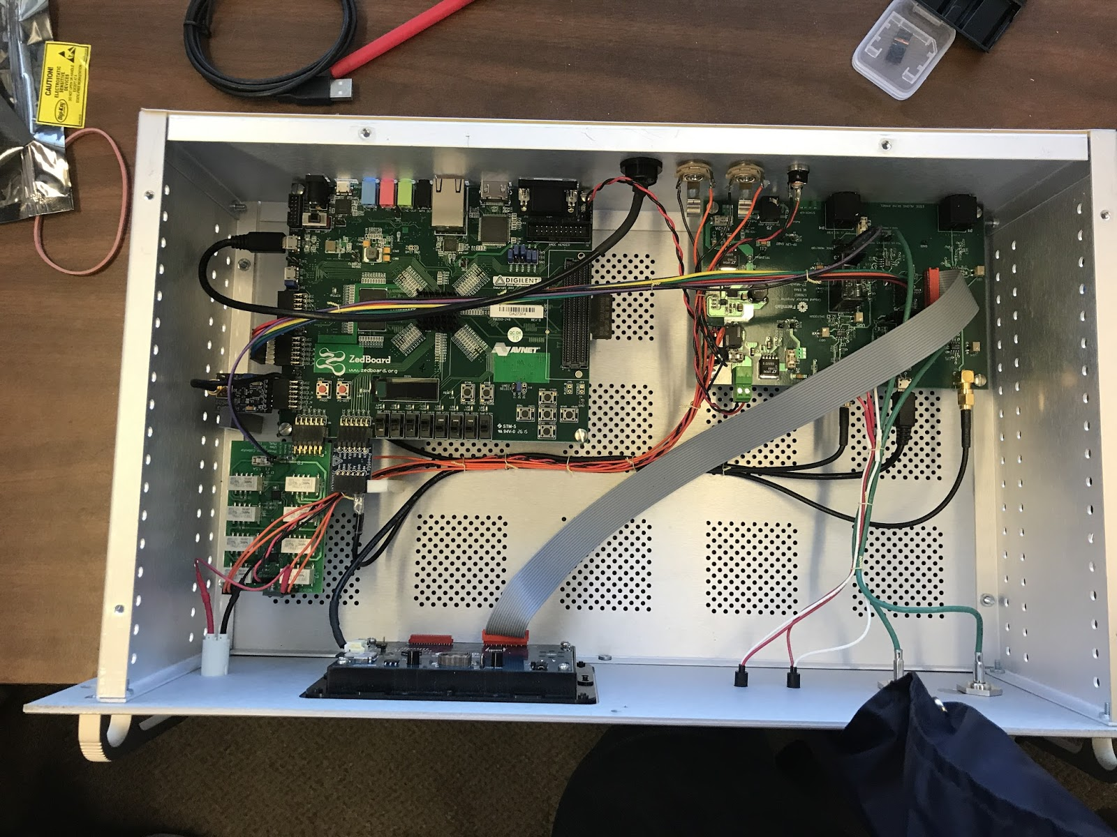
Ground Impedance Monitor
Measures the impedance between the “isolated” detector ground and building ground
Built for the ProtoDUNE, Icarus, SBND and DUNE

Slide 5
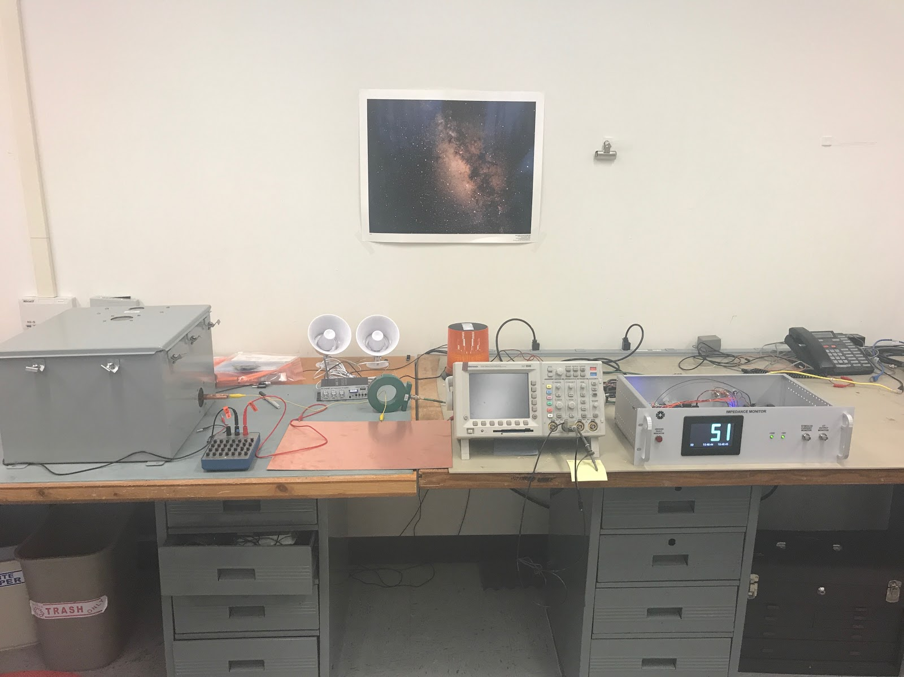
Ground Impedance Monitor
Detector
Audible Alarm
Current Transformer
Impedance Display/Monitor

Slide 6
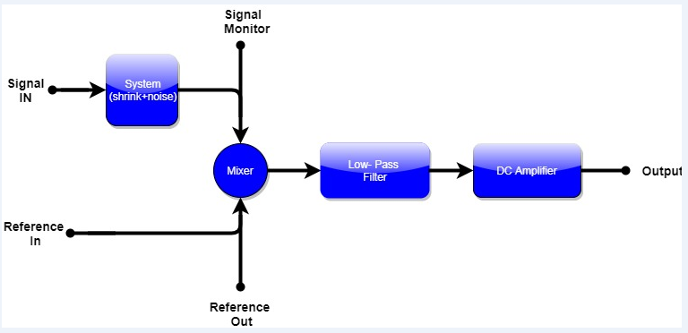
Lock – In Amplifier
The output of the PSD is simply the product of two sine waves. Vpsd = VsigVLsin(wrt + θsig)sin(ωLt + θref) = 1/2 VsigVLcos([ωr - ωL]t + θsig - θref) - 1/2 VsigVLcos([ωr + ωL]t + θsig + θref)

Slide 7
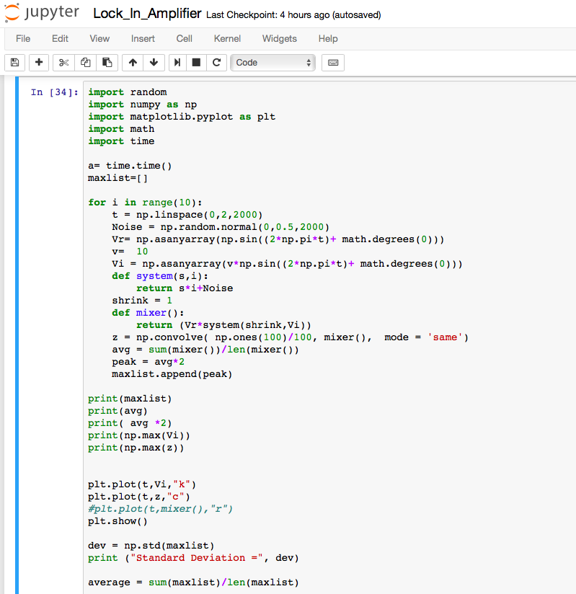
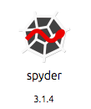
Python

Slide 8
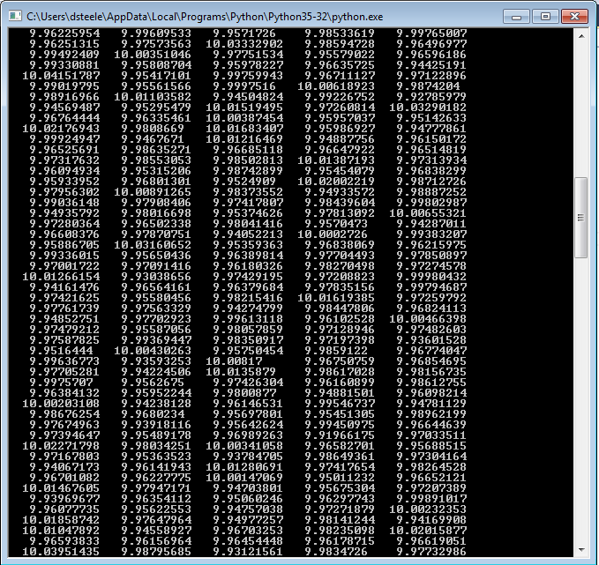
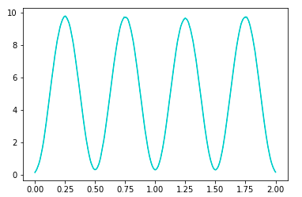
Simulation

Slide 9
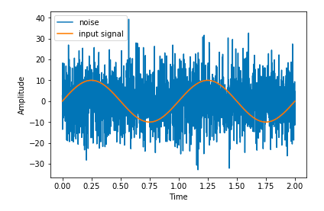
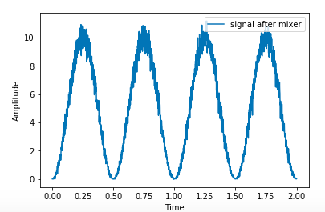
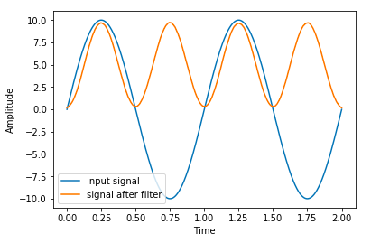
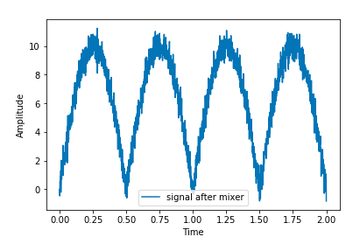
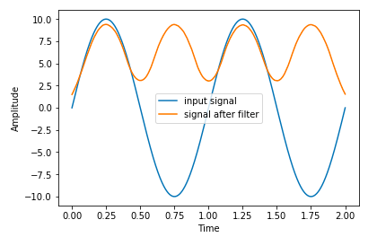
Results
Sine Wave
Square Wave

Slide 10
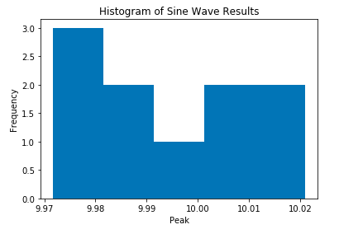
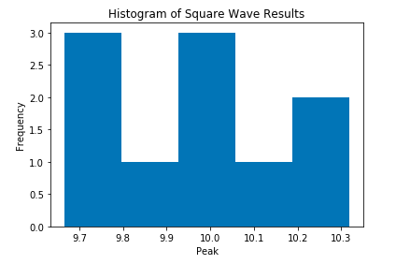
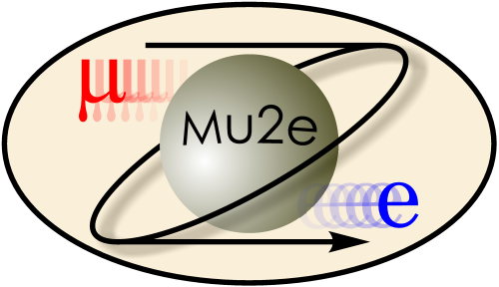
Results
Average : 9.99394
Error: -0.06053 %
Standard Deviation: 0.01531
Run Time: 1.37s
Average : 9.97856
Error: -0.21434 %
Standard Deviation: 0.01123
Run Time: 1.67s

Slide 11
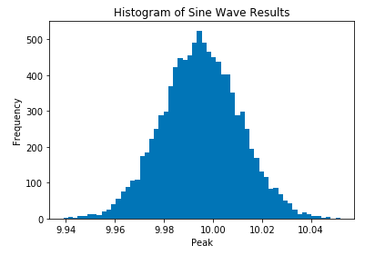
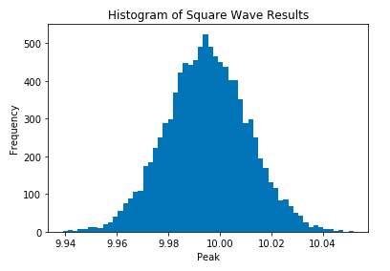
Results
Average : 9.99501
Error: -0.04984 %
Standard Deviation: 0.01587
Run Time: 9.26s
Average : 9.98916
Error: -0.10831 %
Standard Deviation: 0.01744
Run Time: 15.68s

Slide 12
Conclusion/Future Work
Sine wave provides better return on accuracy and run time
Increasing the number of runs increases the accuracy
In the future, remove all the noise, eliminate bias
# of Runs | Time | Average | Error | Std. Dev.
10 | 1.37s | 9.99394 | -0.06053% | 0.01531
 | 1.67s | 9.97856 | -0.21434% | 0.01123
100 | 1.52 | 9.99585 | -0.41450% | 0.01778
 | 1.99s | 9.9927 | -0.07227% | 0.01573
1000 | 2.08s | 9.99417 | -0.58290% | 0.01588
 | 2.14s | 9.98967 | -0.10326% | 0.01778
10000 | 9.08s | 9.99501 | -0.04984% | 0.01587
 | 15.68s | 9.98916 | -0.10831% | 0.01744

Slide 13
References
Armen , Dr. G. Bradley. “Phase Sensitive Detection: the Lock-in Amplifier .” The University of Tennessee , 2008.
Rubinov, Paul, and Michael Utes. Ground Impedance Monitor. 4 June 2017.
“An International Mega-Science Project.” Deep Underground Neutrino Experiment, www.dunescience.org/
Doneisha Steele | Analyzing Lock-In Amplifier Techniques Using Python

Slide 14
FIN

