Slide 1
Week 2: Shutdown 2017
Cons Gattuso

Slide 2
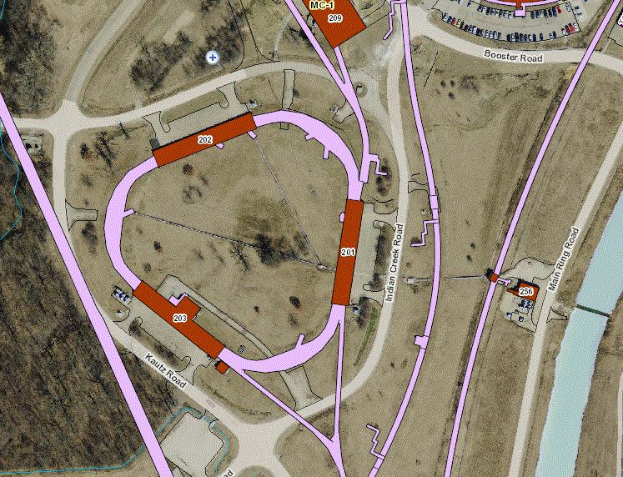
Road Closure/Limited access
Crane Usage
August 5th (Saturday)
AP30 Transformer change out maybe 10 as well
AP10 transformer
AP30 parking lot
AP30 transformer

Slide 3
Jobs that will scheduled
Water leaks in the MI collimator region
Secondary collimator region 307 and 303 locations
Dose rates in the are 250 mr/hr
Repairs Schedule to happen in the last 3 weeks of the shutdown.
ALARA plan is in the works
NuMI Beam pipe ion pump replacement
3-4 days replace in the ion pumps
Around the Q113-115 region
Week 13
Week 5-7

Slide 4
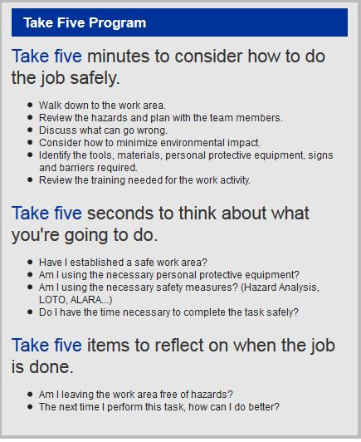
Remember !!!

