Slide 1
Summer Shutdown Status
7/24/17
Cons Gattuso

Slide 2
Proton Source Shutdown Work list
RIL
Source maintenance
Einzel Lens maintenance
RFQ maintenance
General maintience
Linac
Marx modulator project -~25% Done
Fabrication and Testing underway
Planning to installed 2 modulator in 2017
Duration ~6-7 Weeks for the removal of old and installation of new
LE tasks (performed by Linac techs) ~43% Done
Modulator/driver maintenance
Inductrol maintenance
Water skid maintenance
HE tasks (performed by Linac techs) ~45% Done
CS & PFN maintenance
PFN cap bank maintenance
QPS PM
Water skid maintenance
Heat exchanger maintenance
Booster
BRF21 and BR22 installation ~6-8 weeks
IPM Installation
Controls Rack installation
Tunnel component installation
General Maintenance
Power supplies
Cooling Systems
Vacuum
~30% Done
~5% Done
~15% Done

Slide 3
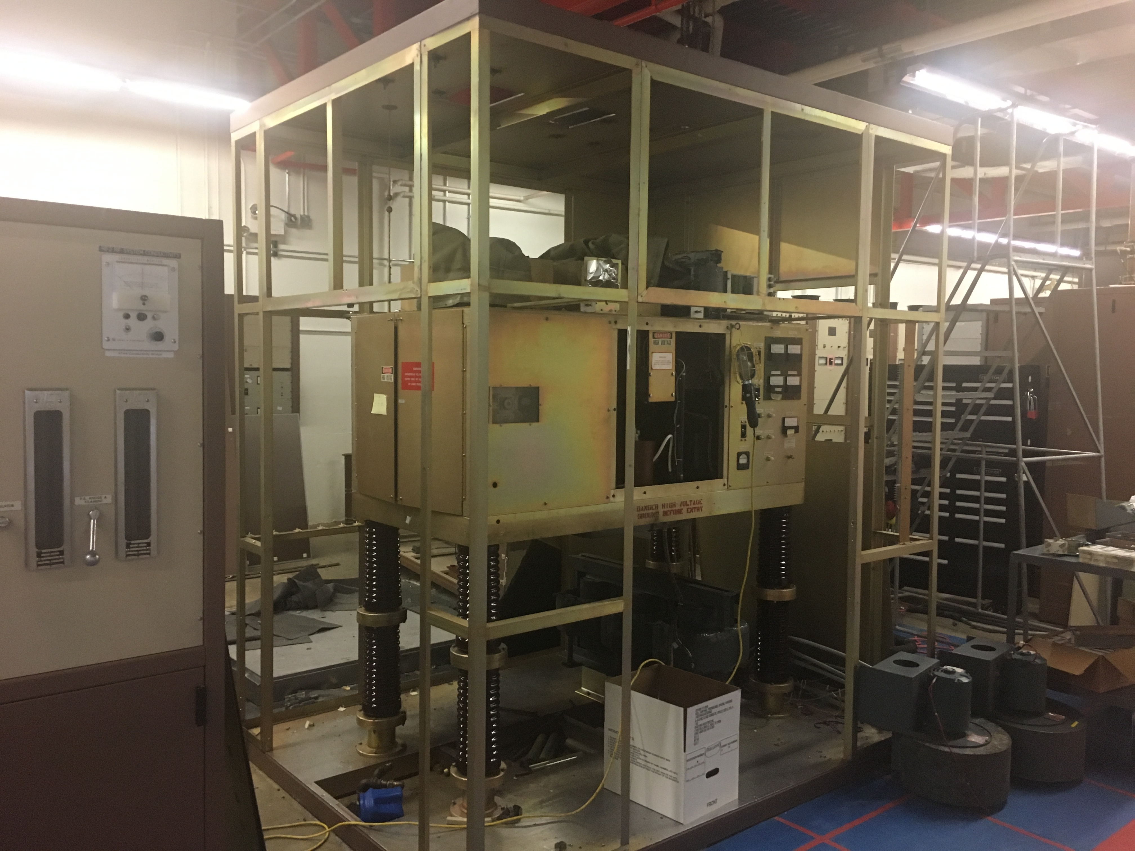
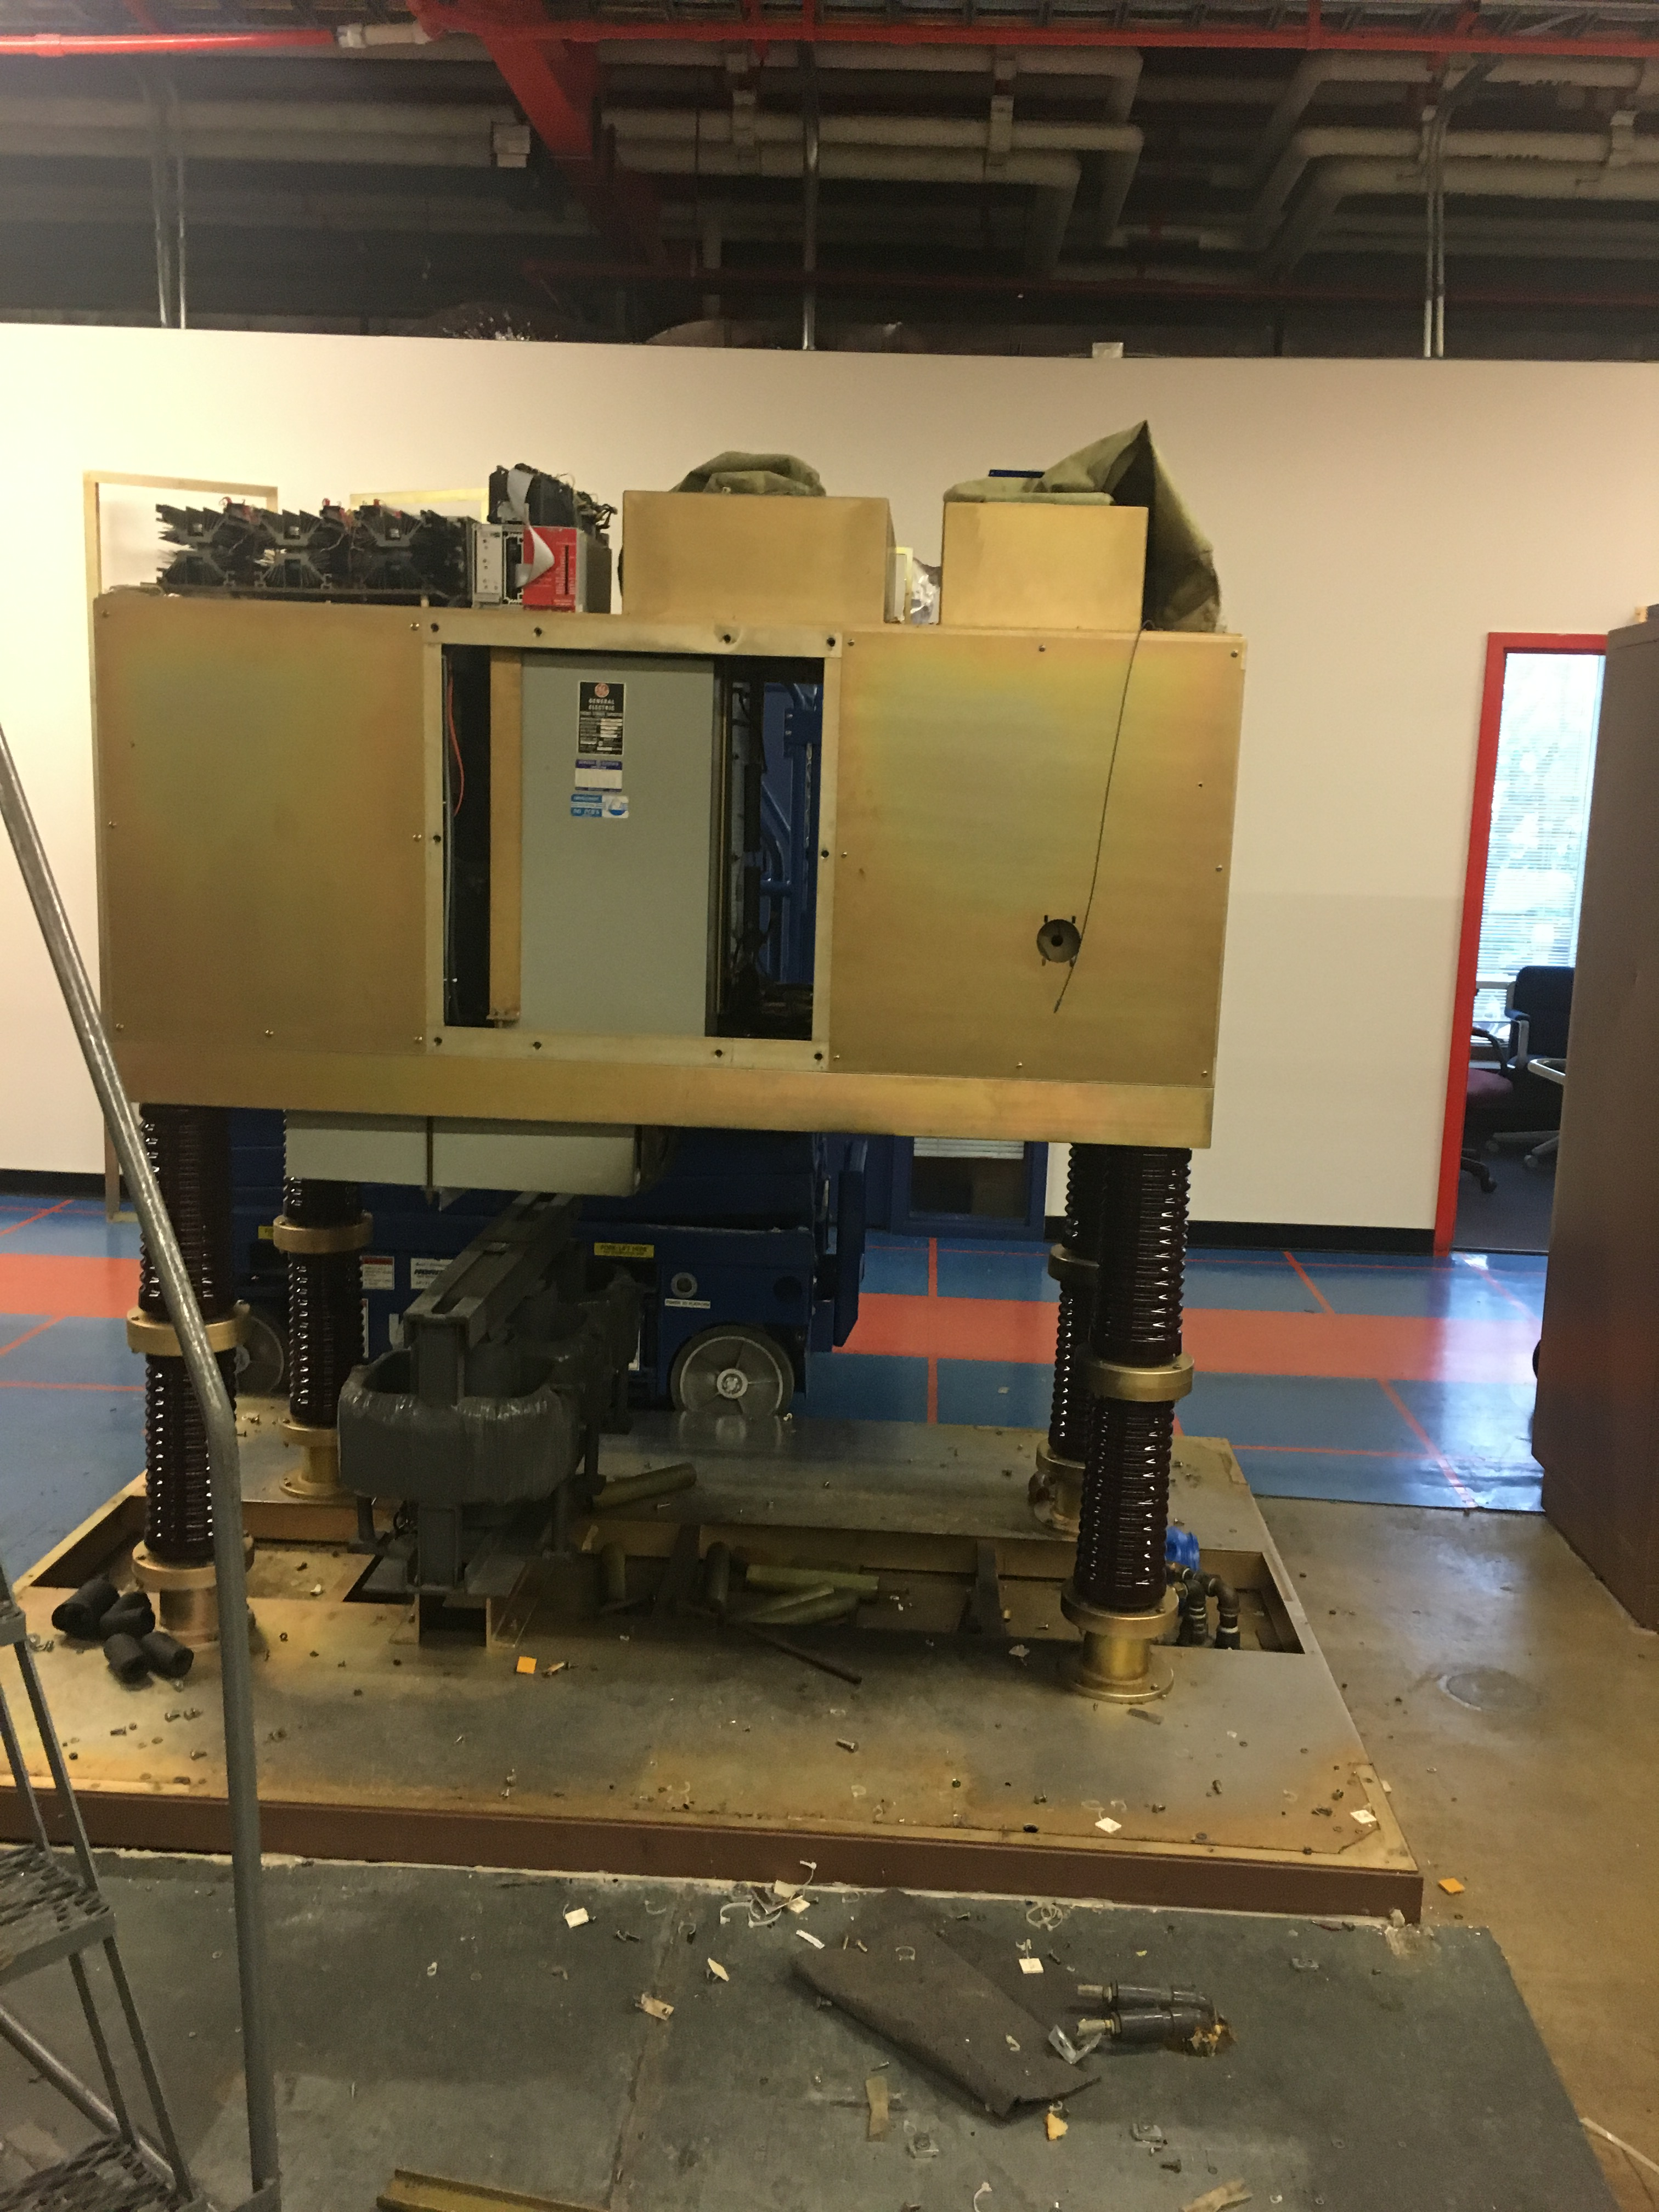
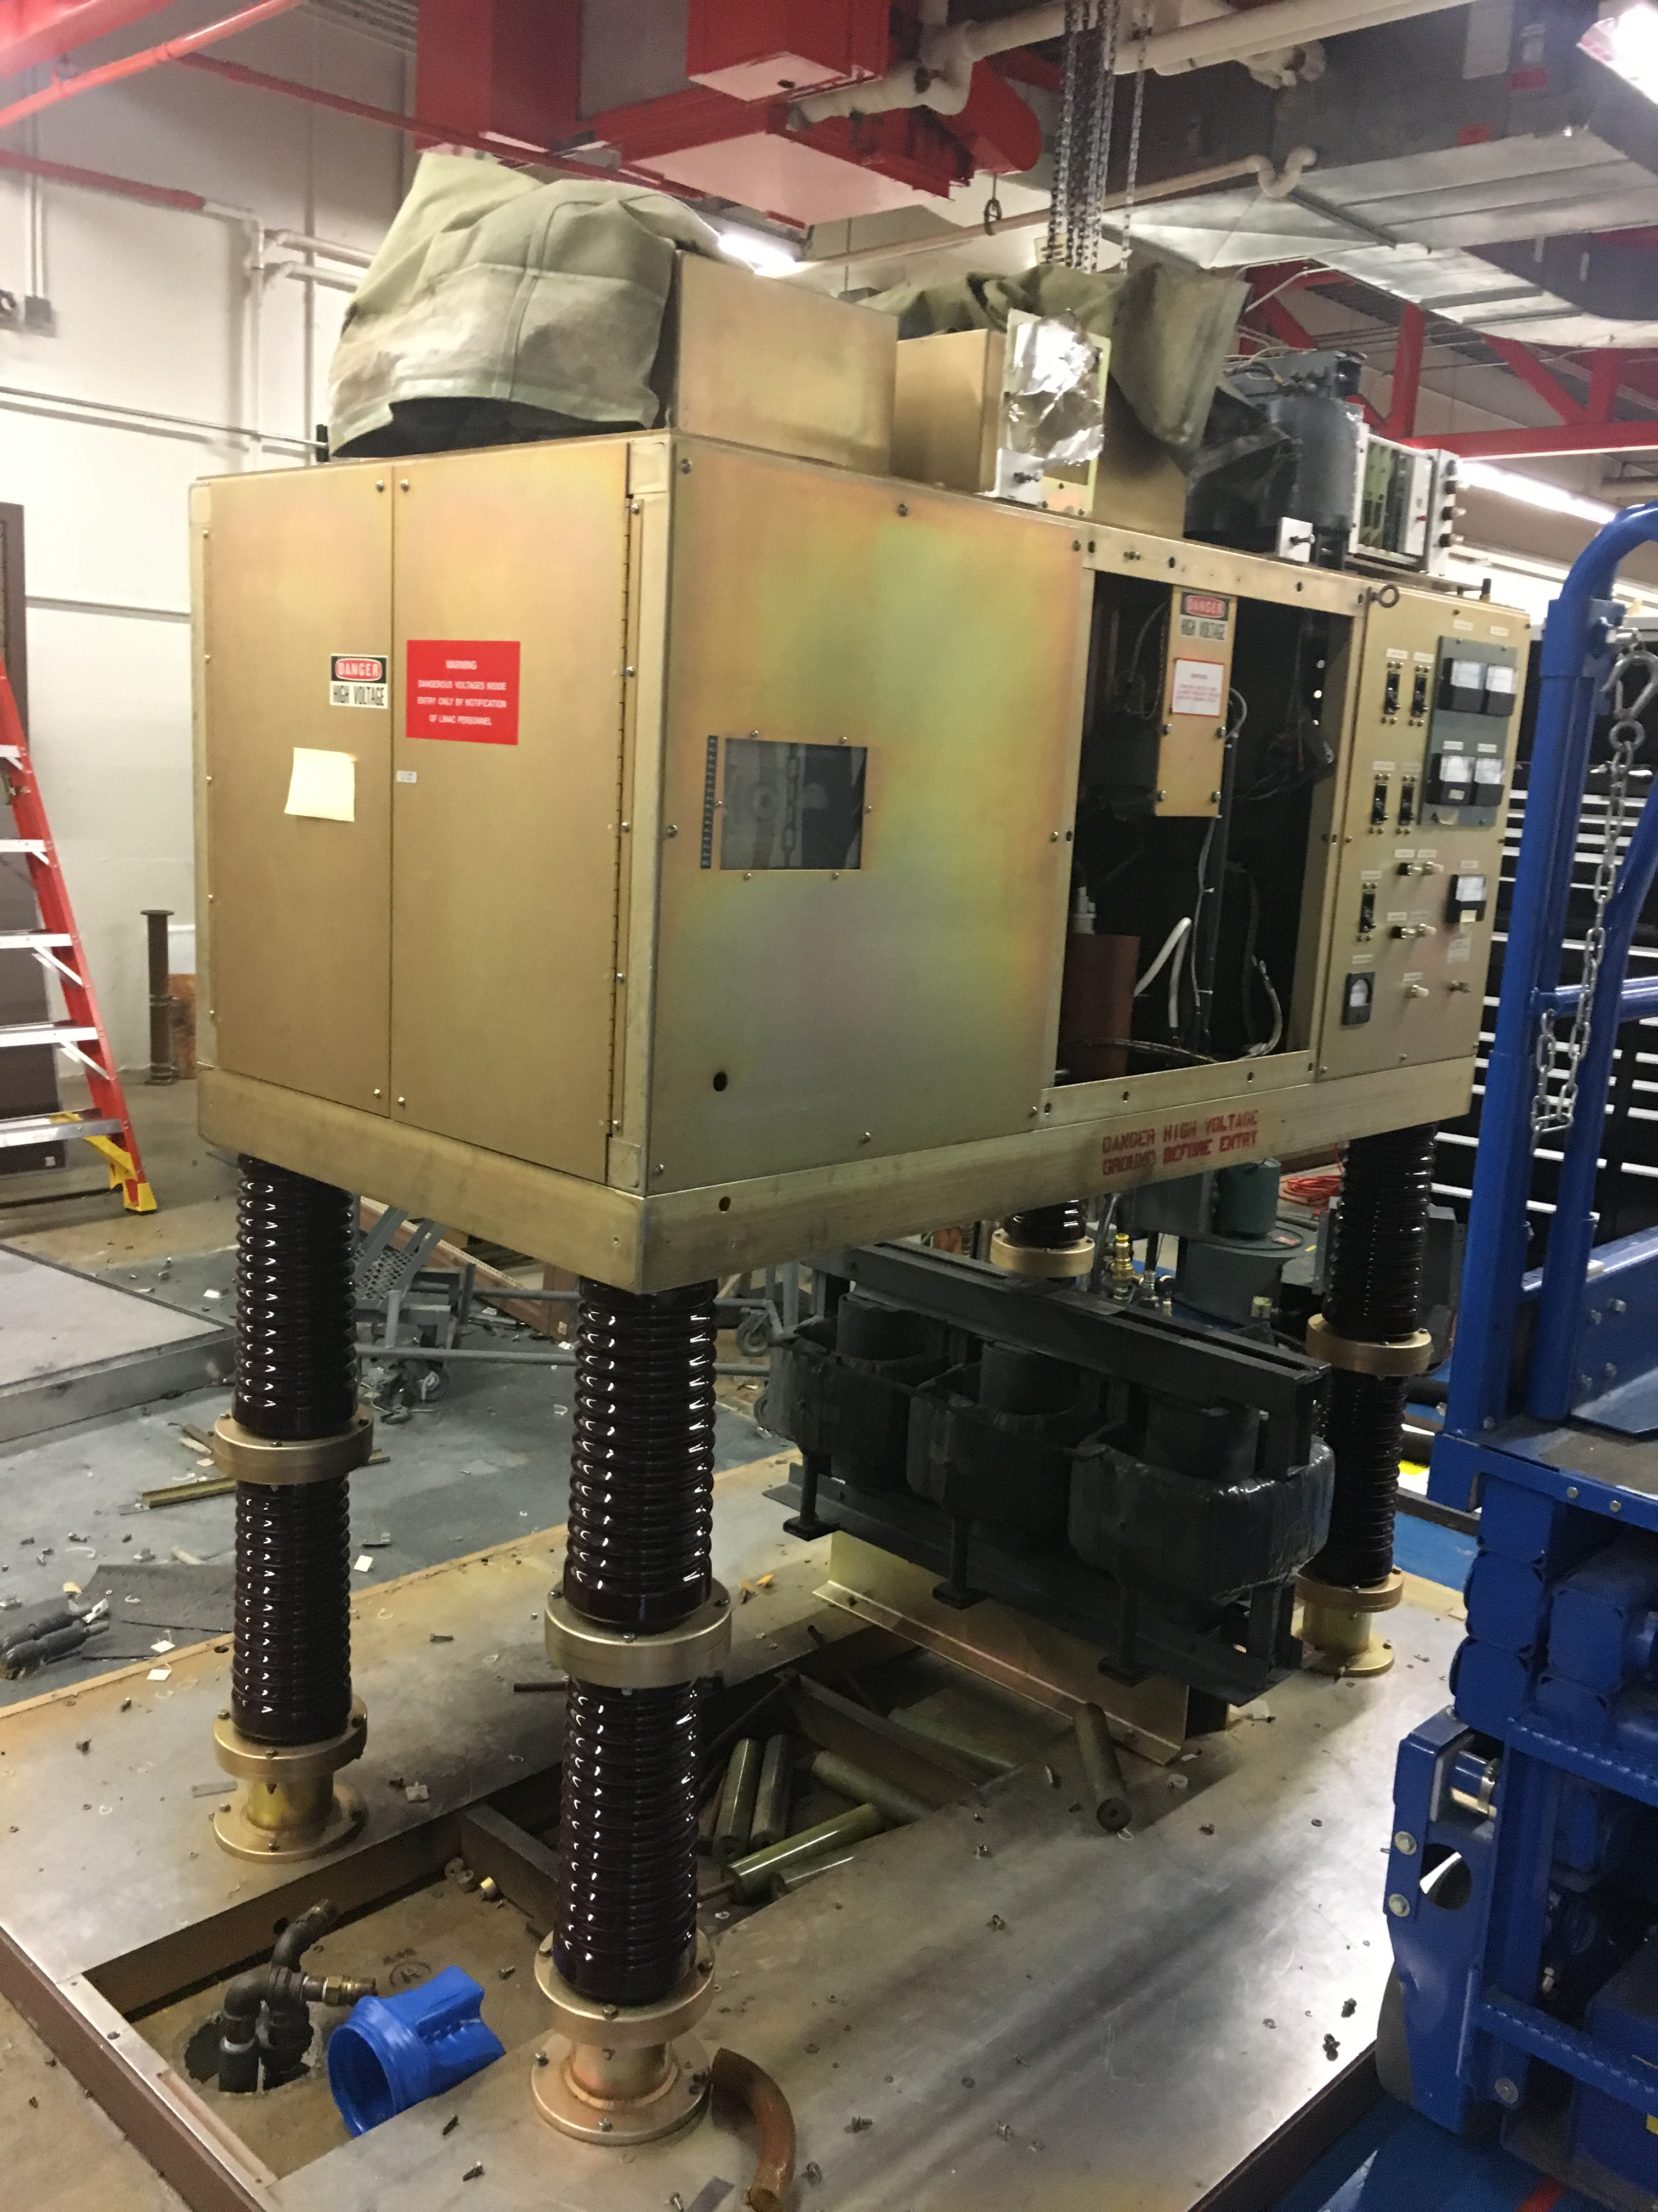
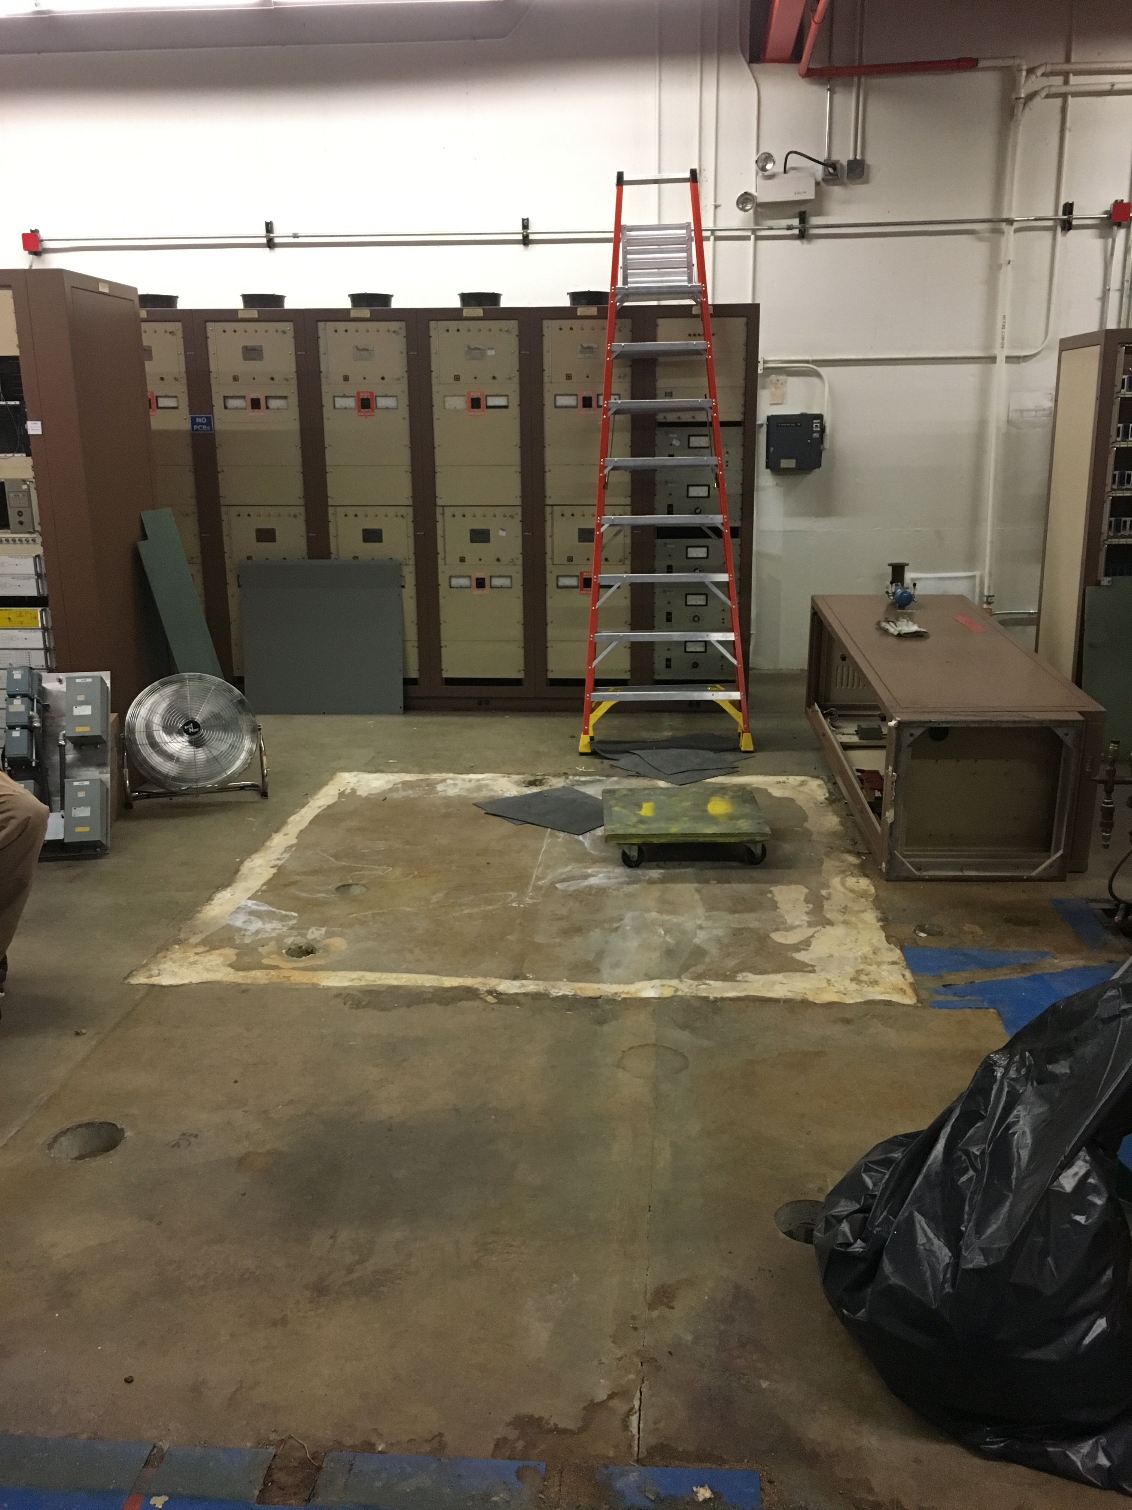
LRF2 Disassembly

Slide 4
Main Injector/Recycler
MI
Replace MI RF station 6 or 4 ~5% Done
~1.5-2 weeks
Ion pump maintience
~1-2 Weeks
8 Gev line
Ion pump Maintenance
~1-2 weeks
Vacuum leak check
~1-2 Weeks
Multi wire replacement (2)
~1 Week
General maintience for MI/RR ~10% Done
~2-3 weeks
Tunnel and service building
Replace the beam pipe in Q504 -95% Done
Vacuum leak on BPM feed through
Switching Flourinert in the MI-10 and 60 kicker systems
Replacing FC-77 to FC-40
RR
TSP upgrade from 106-229 -~20% done
10-11 weeks
Aperture improvement at the RR 402 and 520 locations
~3 weeks at the 402
~1.5 weeks at the 520 ~3% Done
Recycler Abort lamberstons replacement
~3 weeks at the 402
Recycler Sextupole stand change out ~2% Done
~3 weeks
New Pinger installation in the 10 region
Rebuilding and putting back into operations RRRF Anode power supply ~10% Done

Slide 5
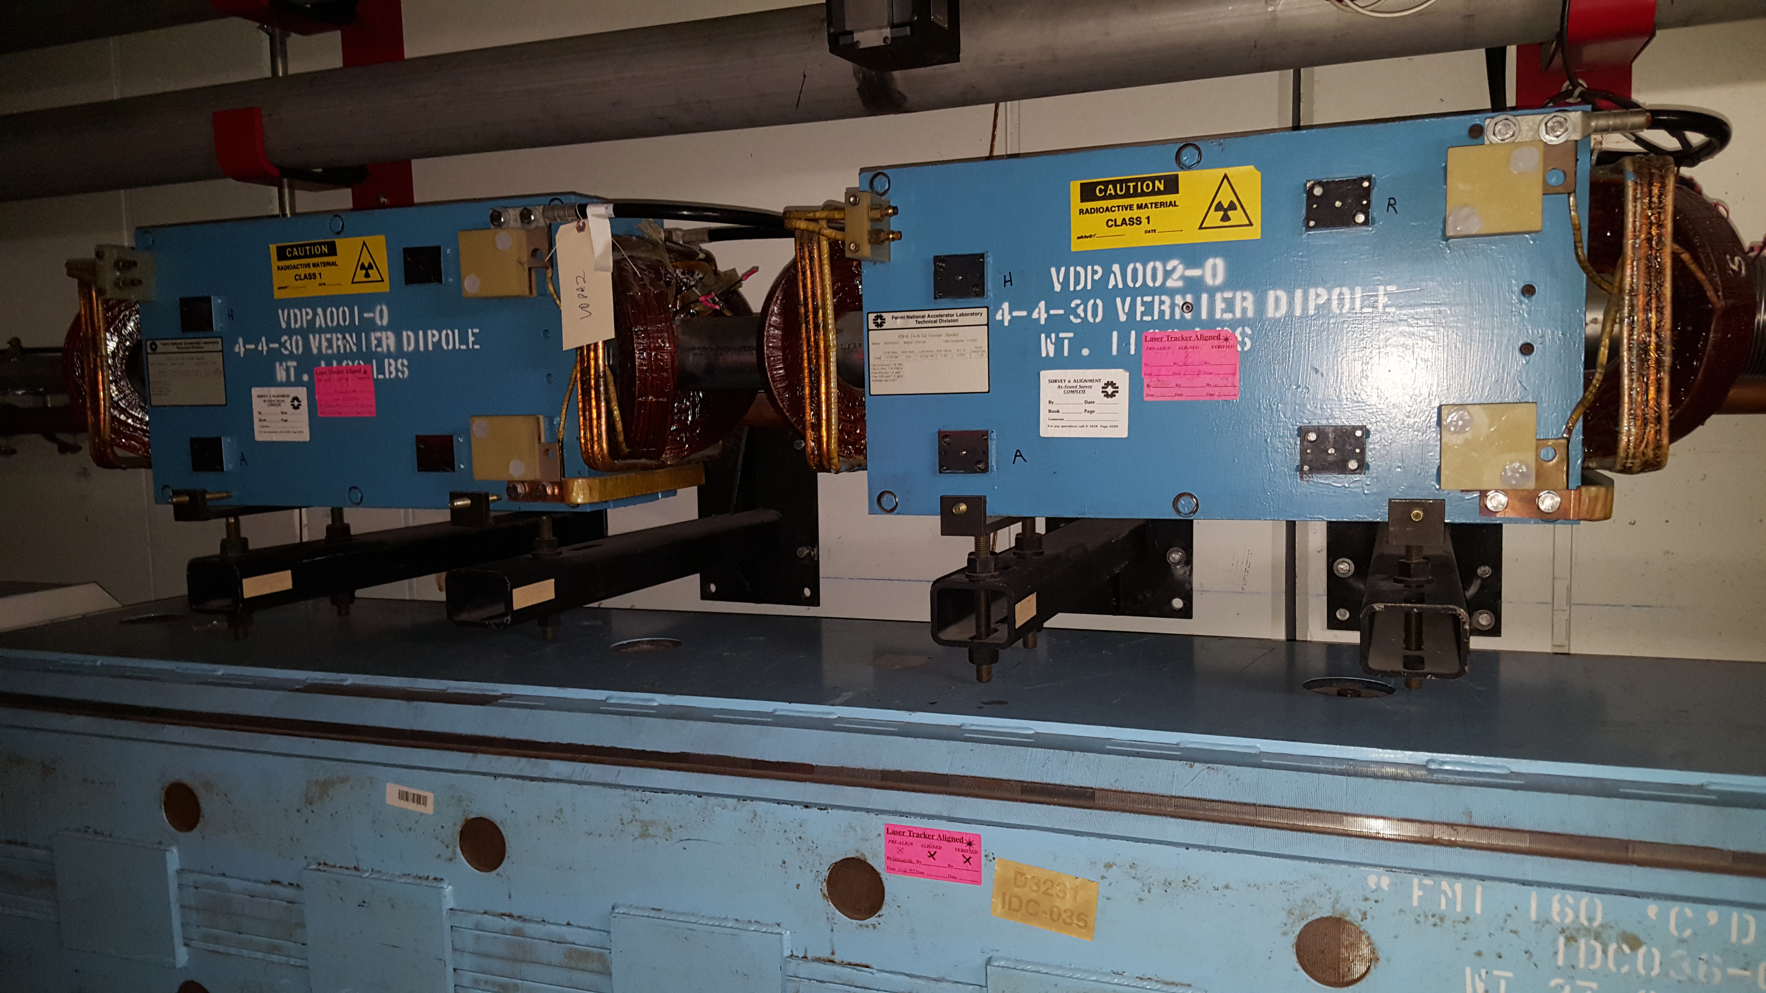
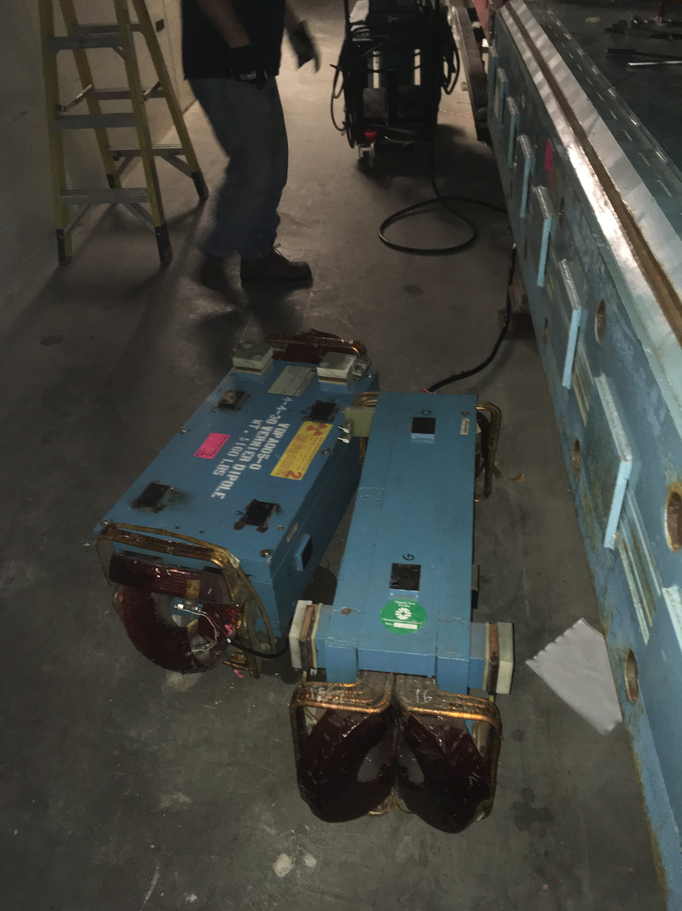
Work Stoppage
On Friday July 21st we had two VDPA (4-4-30 dipoles) fell off of there stands.
Normal installed configuration
8 magnets in total
4 in each of the decommissioned RR to MI beamlines

Slide 6
Welder in position prior to magnet falling

Slide 7
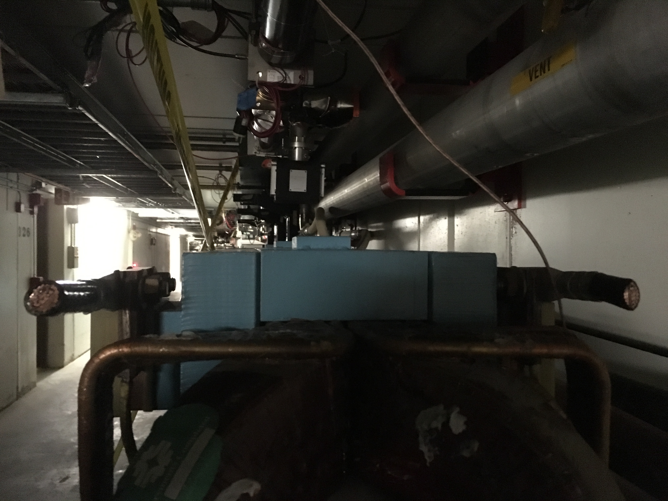
z
up down
x
y
Beam direction
In out
If the bottom of the magnet had been flat
Tipping force ~ 130 lb as designed
Tipping force ~40-60 lb

Slide 8
Action taken
Complete work stoppage in the MI tunnel
Friday afternoon with safety's approval we started abating the immediate tunnel hazard.
This consisted of removing 8 VDPA from there stands
This was completed this morning
Completed several walkthrough of the MI tunnel verifying that we don’t have any other issues
A hand full of magnets will be looked at….
Tip calculation run on them.
We have also asked all of the other machines to complete walk throughs as well
Magnets that may be issues in that are currently used in operations
Stored in the tunnel
Or in Decommissioned lines

Slide 9
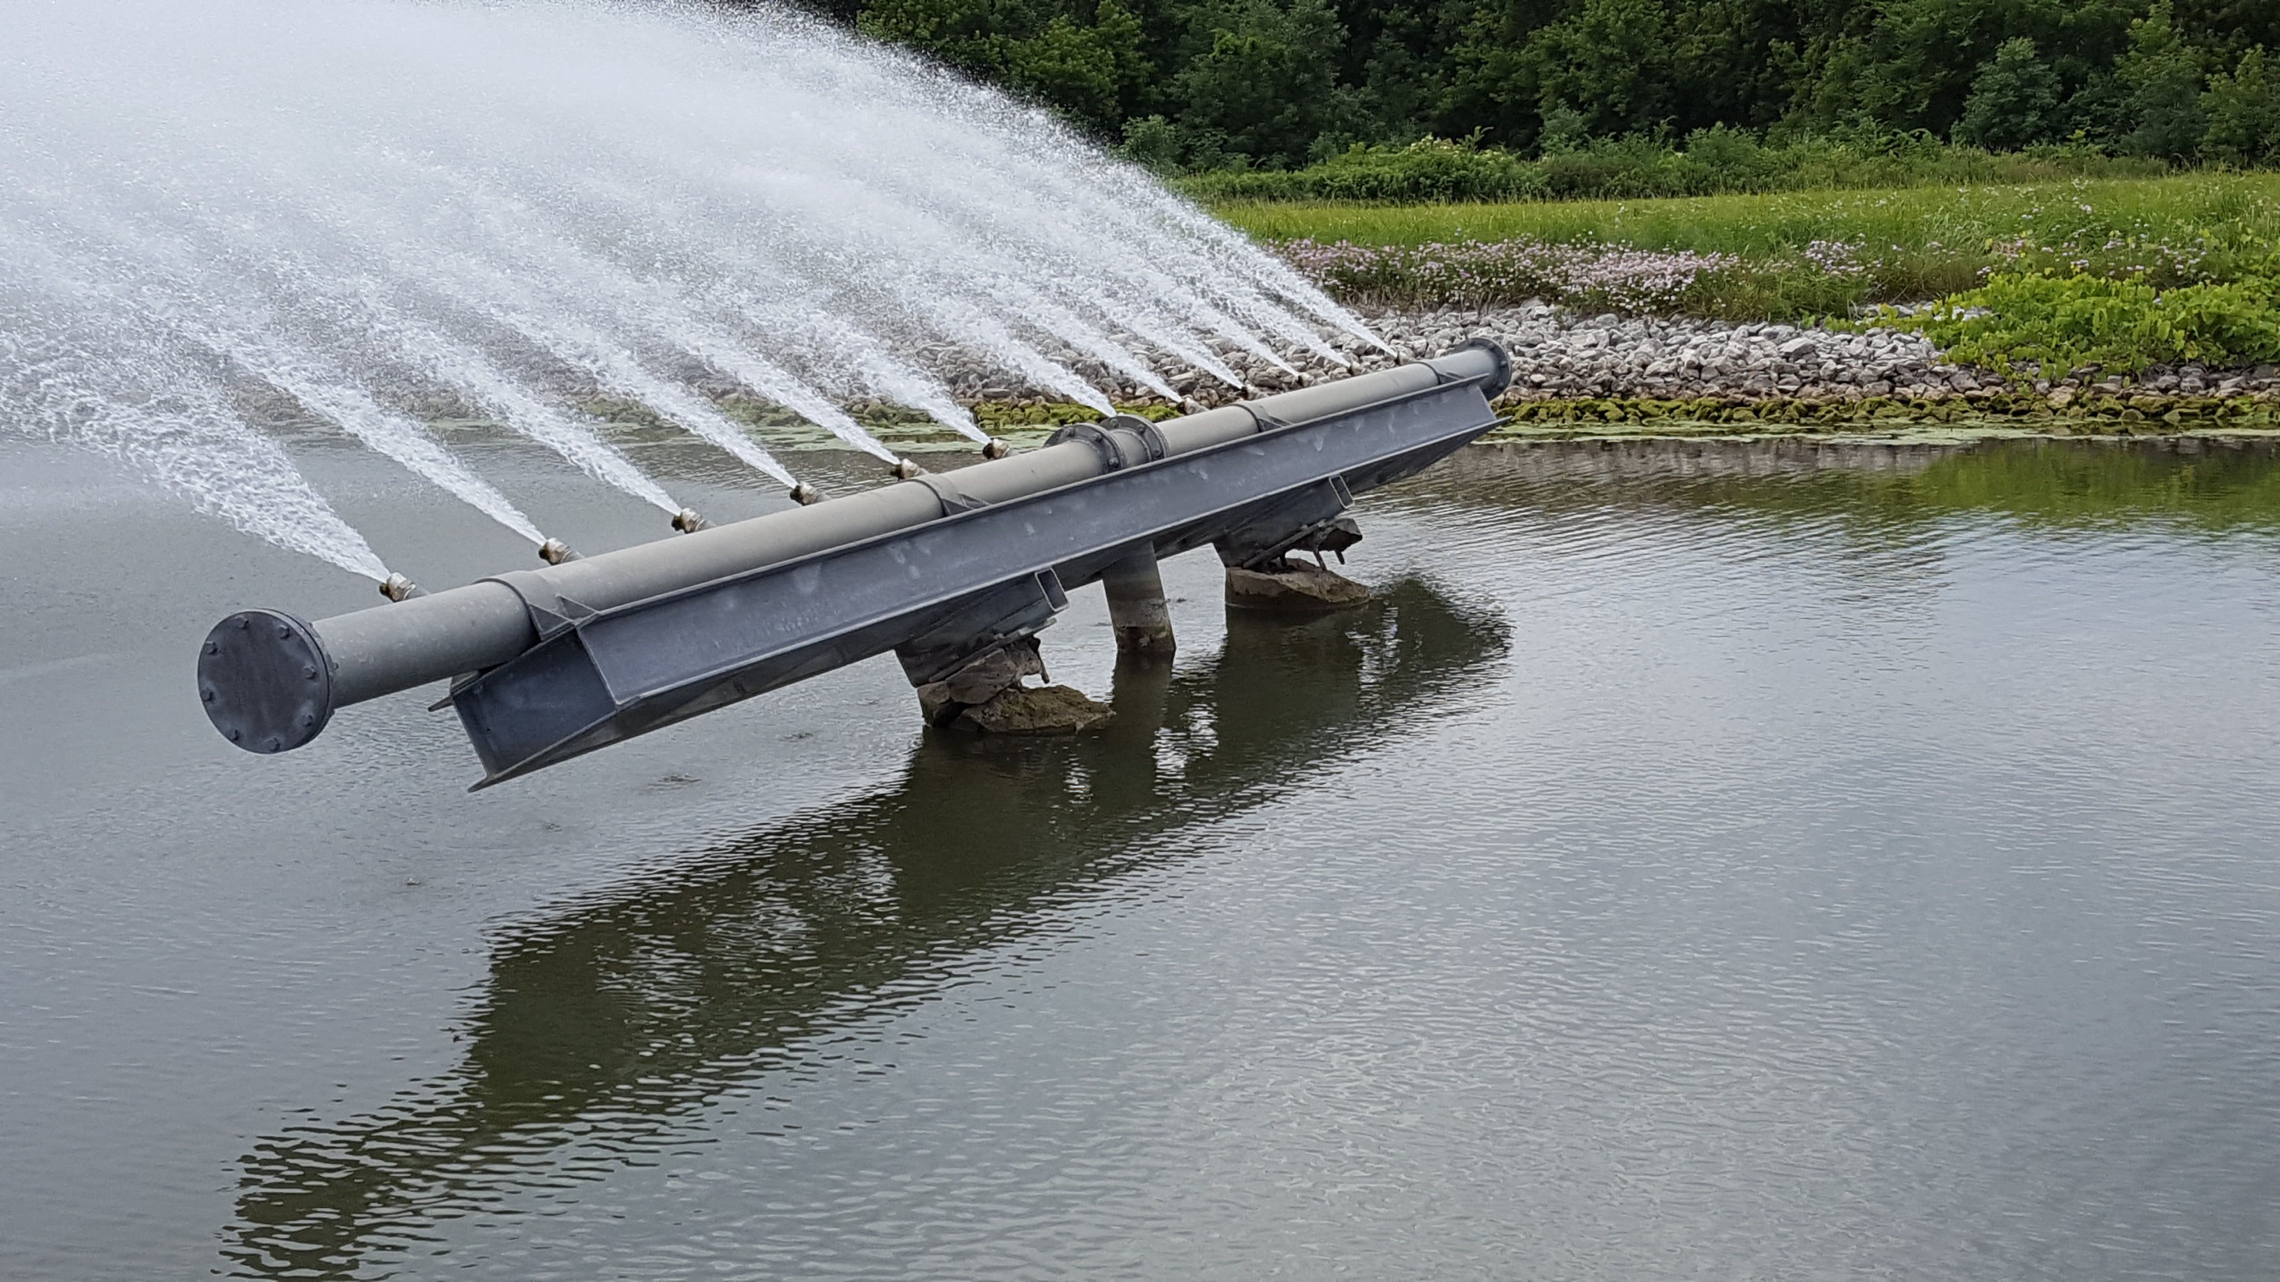
External Beam line
P3 rough vacuum ~45% Done
F3 House IP to Turbo Station upgrade (~2 weeks)
Run 4" vacuum pipe from service buildings down stairwells to tunnel
Install Roots blower stations in service buildings, one per house.
Switch controls over to Tevatron CIA crates, rename parameters
Remove and cap ion pumps.
Cable mitigation in the Meson and Neutrino Muon areas: (~6-7 weeks)
Separating the Booster 95 LCW system from Switchyard (~3-4 weeks)
Switchyard would be its own separate stand alone system. Feed from the F-Sector old MR system.
On hold until Mid August
Osprey Fly the coop
BNB
Relocation of the of the
DI bottles (~2 weeks)
~50% Done
~30% Done

Slide 10
External Beam line (continued)
NuMI (~10-12 weeks)
Target removal for beam scan of the horns
General maintience
Dehumidifiers
Replace Filter and water in the Absorber and Decay pipe cooling system
Drain tile cleaning
Ext.
Water system repair
Repaired cracked nipple on LCW supply manifold in Pre-Target enclosure near Q115.
Repaired cracked weld on Decay Pipe RAW system in Absorber Hall.
~30% Done
~95% Done

Slide 11
Muon Campus Work
Mu2e work
M4 line installation ( first half to absorber) ~10% Done
Stand and magnet and cable pulls installation (7-9 weeks)
In support of g-2
Delivery ring straight section
Injection septa (1-2 weeks)
Removal and reinstallation of ring for the M4 line installation ~ Done
Rotate Q207 and Q210 BPMs ~ 2-3 days
Relocation of ELAM ~2-3 days
Abort line
Extraction septa (1-2 weeks)
Magnet replacement Internal water leaks
H212 ~ 1 week
Q211 ~2 days
V742 ~ 1 week ~ Done
Instrumentation Repair
PWC and IC’s ~ 1-2 weeks

Slide 12
2017 Shutdown Pocket Dosimeter Reports – Week 1

Slide 13
Shutdown Duration Drivers
Linac Marx Modulator installation
Station 2 upgrade is underway
Station 3 will follow
RR TSP to IP conversion
Progressing
Muon Campus Overlap with Switchyard crews
Crew is responsible

