Slide 1

Introduction to FIFE
Grid submission tutorial
Mike Kirby
DUNE Software Tutorials
Aug 14, 2017

Slide 2
Introduction to FIFE
The FabrIc for Frontier Experiments aims to:
Lead the development of the computing model for non-LHC experiments
Provide a robust, common, modular set of tools for experiments, including
  Job submission, monitoring, and management software
  Data management and transfer tools
  Database and conditions monitoring
  Collaboration tools such as electronic logbooks, shift schedulers
Work closely with experiment contacts during all phases of development and testing
https://web.fnal.gov/project/FIFE/SitePages/Home.aspx

Slide 3
Centralized Services from FIFE
•Submission to distributed computing – JobSub, GlideinWMS
•Processing Monitors, Alarms, and Automated Submission
•Data Handling and Distribution
– Sequential Access Via Metadata (SAM) File Transfer Service
– interface to dCache/Enstore/storage services
– Intensity Frontier Data Handling Client (IFDHC)
•Software stack distribution – CERN Virtual Machine File System (CVMFS)
•User Authentication, Proxy generation, and security
•Electronic Logbooks, Databases, and Beam information
•Integration with future projects, e.g. HEPCloud

Slide 4

Job Submission and management architecture
Common infrastructure is the fifebatch system: one GlideInWMS pool, 2 schedds, frontend, collectors, etc.
Users interface with system via “jobsub”: middleware that provides a common tool across all experiments; shields user from intricacies of Condor
  Simple matter of a command-line option to steer jobs to different sites
Common monitoring provided by FIFEMON tools
  Now also helps users to understand why jobs aren’t running
User
FNAL GPGrid
Jobsub client
Jobsub server
Condor schedds
OSG Sites
Monitoring (FIFEMON)
GlideinWMS pool
GlideinWMS frontend
Condor negotiator
AWS/HEPCloud

Slide 5
Lets start with the basics
What happens when you submit jobs to the grid?
You are authenticated and authorized to submit – discussed later
Submission goes into batch queue (HTCondor) and waits in line
You (or your script) hand to jobsub an executable (script or binary)
Jobs are matched to a worker node – what does this mean?
Server distributes your executable to the worker nodes
Executable running on remote cluster and NOT as your user id – no home area, no NFS volume mounts, etc.
fifebatch/GPGrid
OSG

Slide 6
Basics of job submission
interactive node
submission
server
Alice1
Alice2
Bob1
Alice3
Bob2
Bob3
Bob4
Alice4
Chuck1

Slide 7
Basics of job submission
interactive node
dunegpvmXX
fifebatch
servers
Alice1
Alice1
Alice2
Alice2
Bob1
Bob1
Alice3
Alice3
Bob2
Bob2
Bob3
Bob3
Bob4
Bob4
Alice4
Alice4
Chuck1
Chuck1

Slide 8
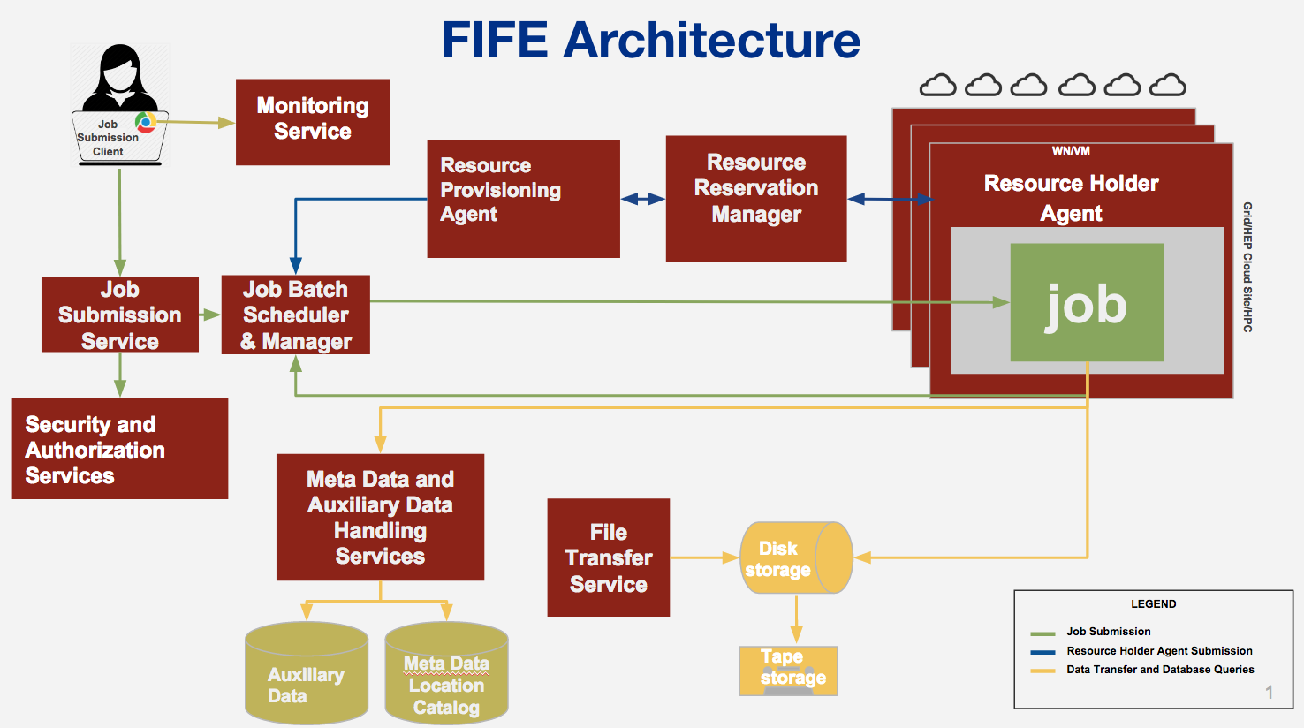
More complicated picture

Slide 9
Example script and submission command
kinit
ssh -K dunegpvm01.fnal.gov #don't everyone use dunegpvm01, spread out and use 02-10
Now that you've logged into DUNE interactive node, create a working area and copy over some example scripts
cd /dune/app/users/${USER}
mkdir dune_jobsub_tutorial
cd dune_jobsub_tutorial
cp /dune/app/users/kirby/dune_may2017_tutorial/*.sh `pwd`
ls
There should be three scripts located in your current directory: basic_grid_env_test.sh, lar_grid_test.sh , and second_grid_test.sh
Note that this shape begins commands you can cut and paste

Slide 10
Look inside the basic grid env test script
<dunegpvm01.fnal.gov> more basic_grid_env_test.sh
#!/bin/bash
printenv
set -x #start bash debugging at this point
echo Start `date`
echo Site:${GLIDEIN_ResourceName}
echo "the worker node is " `hostname` "OS: " `uname -a`
echo "the user id is " `whoami`
echo "the output of id is " `id`
set +x #stop bash debugging at this point
cd $_CONDOR_SCRATCH_DIR
echo "pwd is " `pwd`
Sleep $[ ( $RANDOM % 10 ) + 1 ]m #sleep for random integer of minutes between 1-10 inclusive
echo Stop `date`
exit 0;

Slide 11
How do you submit that script to run on the OSG?
source /cvmfs/fermilab.opensciencegrid.org/products/common/etc/setup
This establishes a UPS product working area (more about this later)
setup jobsub_client #with no options, get version declared "current"
jobsub_submit -N 2 -G dune --expected-lifetime=1h --memory=100MB --disk=2GB --resource-provides=usage_model=DEDICATED,OPPORTUNISTIC,OFFSITE file://`pwd`/basic_grid_env_test.sh
https://cdcvs.fnal.gov/redmine/projects/jobsub/wiki/Jobsub_submit
N is the number of jobs in a cluster
G is the experiment group
expected-lifetime is how long it will take to run a single job in the cluster
memory is the RAM footprint of a single job in the cluster
disk is the scratch space need for a single job in the cluster

Slide 12
Things to note upon job submission
<dunegpvm01.fnal.gov> jobsub_submit -N 2 -G dune file://`pwd`/basic_grid_env_test.sh
/fife/local/scratch/uploads/dune/kirby/2017-05-15_161406.077316_7456
/fife/local/scratch/uploads/dune/kirby/2017-05-15_161406.077316_7456/basic_grid_env_test.sh_20170515_161407_2384341_0_1_.cmd
submitting....
Submitting job(s).
2 job(s) submitted to cluster 17067704.
JobsubJobId of first job: 17067704.0@fifebatch1.fnal.gov
Use job id 17067704.0@fifebatch1.fnal.gov to retrieve output

Slide 13
How do I check up on my submitted jobs?
jobsub_q --user=${USER}
JOBSUBJOBID OWNER SUBMITTED RUN_TIME ST PRI SIZE CMD
17067704.0@fifebatch1.fnal.gov kirby 05/15 16:14 0+00:00:00 I 0 0.0 basic_grid_env_test.sh_20170515_161407_2384341_0_1_wrap.sh
1 jobs; 0 completed, 0 removed, 1 idle, 0 running, 0 held, 0 suspended
user specifies the uid you want the status of on jobsub server
--jobid can be used to get the status of a single job
job statuses can be the following:
  R is running
  I is idle (a.k.a. waiting for a slot)
  H is held (job exceeded a resource allocation)
-G to get the group
--hold: for all the held jobs
--run: for all the running jobs
--better-analyze do condor_q -better-analyze on job (must use with --jobid) to list matching
use better-analyze with caution! can overload the server by repeatedly trying
https://cdcvs.fnal.gov/redmine/projects/jobsub/wiki/Jobsub_q

Slide 14
Additional commands to consider
Full documentation of the jobsub client here
https://cdcvs.fnal.gov/redmine/projects/jobsub/wiki/Using_the_Client
jobsub_history – get history of submissions
jobsub_rm – remove jobs/clusters from jobsub server
jobsub_hold – set jobs/clusters to held status
jobsub_release – release held jobs/clusters
jobsub_fetchlog – get the condor logs from the server

Slide 15
Fetching your logs from jobs submitted
Need to remember the jobid for the cluster you submitted
make sure you setup the jobsub_client UPS product
setup jobsub_client
mkdir basic_log; cd basic_log
jobsub_fetchlog -G dune --jobid=17067704.0@fifebatch1.fnal.gov
#replace with the jobid that we highlighted earlier
Downloaded to 17067704.0@fifebatch1.fnal.gov.tgz
ls -1
17067704.0@fifebatch1.fnal.gov.tgz
tar xzf 17067704.0\@fifebatch1.fnal.gov.tgz
#replace with output of the ls -1 command (tab complete)

Slide 16
Inside the jobsub log tarball
ls –alrt
total 52
-rwxr-xr-x 1 kirby dune 450 May 15 16:14 basic_grid_env_test.sh
-rwxr-xr-x 1 kirby dune 6473 May 15 16:14 basic_grid_env_test.sh_20170515_161407_2384341_0_1_wrap.sh
-rw-r--r-- 1 kirby dune 2254 May 15 16:14 basic_grid_env_test.sh_20170515_161407_2384341_0_1_.cmd
-rw-r--r-- 1 kirby dune 0 May 15 16:14 .empty_file
-rw-r--r-- 1 kirby dune 6903 May 15 16:43 basic_grid_env_test.sh_20170515_161407_2384341_0_1_cluster.17067704.0.out
-rw-r--r-- 1 kirby dune 869 May 15 16:43 basic_grid_env_test.sh_20170515_161407_2384341_0_1_cluster.17067704.0.err
-rw-r--r-- 1 kirby dune 4983 May 15 16:43 basic_grid_env_test.sh_20170515_161407_2384341_0_1_.log
-rw-r--r-- 1 kirby dune 7048 May 15 17:00 17067704.0@fifebatch1.fnal.gov.tgz
These files are in order:
  shell script sent to the jobsub server
  wrapper script created by jobsub server to set environment variables
  condor command file sent to condor to put job in queue
  an empty file
  stdout of the bash shell run on the worker node
  stderr of the bash shell run on the worker node
  condor log for the job
  the original fetchlog tarball

Slide 17
More complicated script to run on the grid
This script prints the environment
changes to the scratch area
based upon the $EXPERIMENT variable sets the $SCRATCH directory in dCache (a.k.a. pnfs space)
prints information about the grid proxy
sets up the Fermilab common UPS product area
sets up the IFDH client UPS product
echoes the environment to a user created log and error files
tries to list contents of the not-mounted /dune/data volume
determines the GRID_USER from the proxy if not set
sleeps for random time
copies log files to $SCRATCH directory

Slide 18
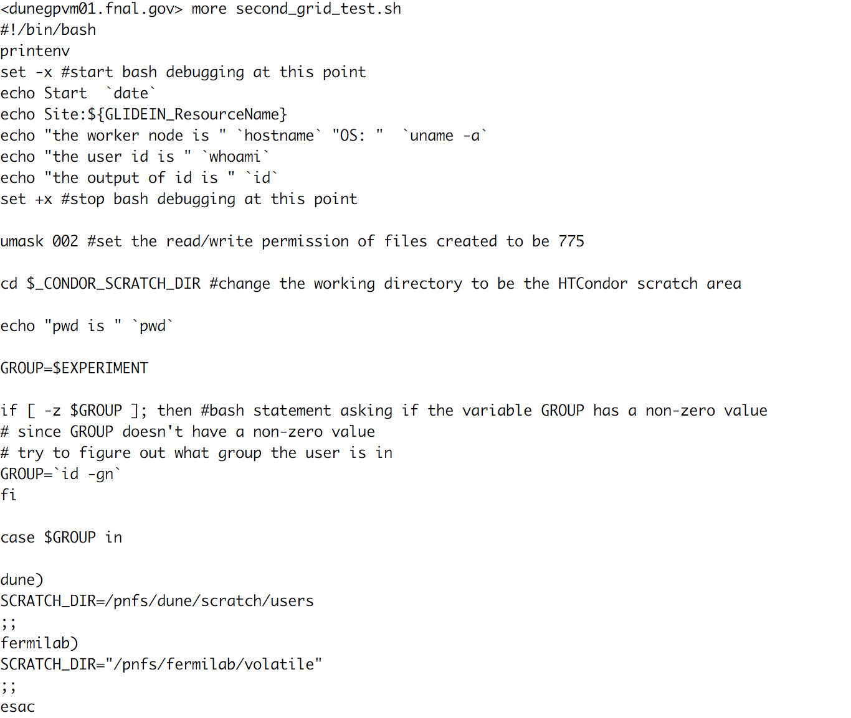
second grid submission script – part 1

Slide 19
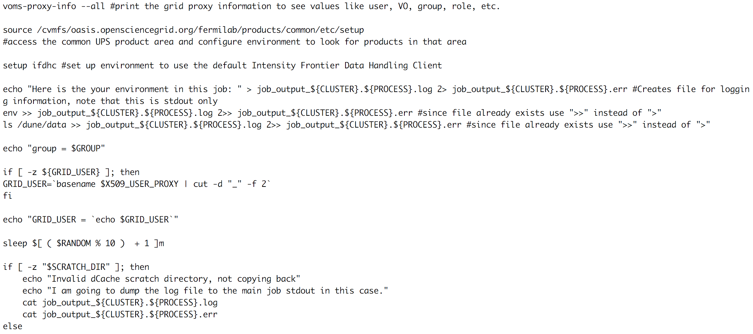
second grid submission script – part 2

Slide 20
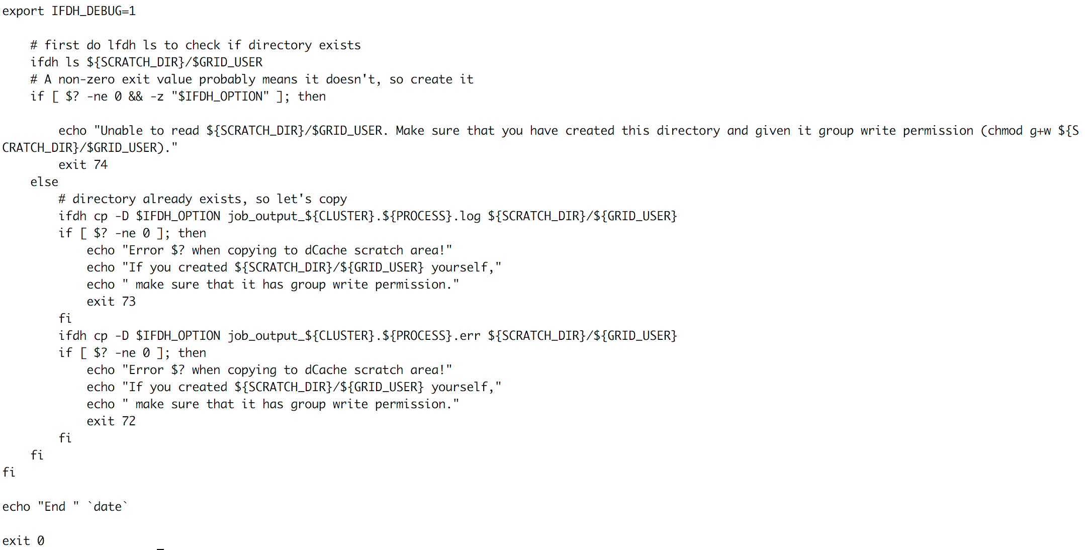
second grid submission script – part 3

Slide 21
Notes about accessing software and libraries on OSG
The standard repository for accessing software and libraries is CVMFS (CERN Virtual Machine File System)
  mounted on all worker nodes
  mounted on all interactive nodes
  can be mounted on your laptop
  used for centralized distribution of packaged releases of experiment software – not your personal dev area
  not to be used for distribution of data or reference files
locally built development code should be placed in a tarball on dCache, transferred to the worker nodes from dCache, and then unwound into the scratch area
details about tarball transfers available here:
https://cdcvs.fnal.gov/redmine/projects/jobsub/wiki/Jobsub_submit

Slide 22
Submitting the second script
cd /dune/app/users/${USER}/dune_jobsub_tutorial
jobsub_submit -N 2 -G dune --expected-lifetime=1h --memory=100MB --disk=2GB --resource-provides=usage_model=DEDICATED,OPPORTUNISTIC,OFFSITE file://`pwd`/second_grid_test.sh
/fife/local/scratch/uploads/dune/kirby/2017-05-15_171818.710430_8037
/fife/local/scratch/uploads/dune/kirby/2017-05-15_171818.710430_8037/second_grid_test.sh_20170515_171820_3877085_0_1_.cmd
submitting....
Submitting job(s)..
2 job(s) submitted to cluster 19874357.
JobsubJobId of first job: 19874357.0@fifebatch2.fnal.gov
Use job id 19874357.0@fifebatch2.fnal.gov to retrieve output

Slide 23
What do I need to know when I launch a script?
What number of CPUs does the job need?
How much total memory does the job need? does it depend on the input? have I tested the input?
How much scratch hard disk scratch space does the job need to use? staging input files from storage? writing output files before transferring back to storage?
How much wall time for completion of each section? Note that wall time includes transferring input files, transferring output files, and connecting to remote resources (Databases, websites, etc.)

Slide 24
Submitting a dunetpc job
mkdir -p /pnfs/dune/persistent/users/${USER}/
mkdir -p /pnfs/dune/scratch/users/${USER}/
cp /pnfs/dune/persistent/users/kirby/tutorial_prodsingle_dune35t.fcl /pnfs/dune/persistent/users/${USER}/tutorial_prodsingle_dune35t.fcl
cd /dune/app/users/${USER}/dune_jobsub_tutorial/
jobsub_submit -N 1 -G dune --expected-lifetime=10m --memory=2000MB --disk=4GB --resource-provides=usage_model=DEDICATED,OPPORTUNISTIC,OFFSITE file://`pwd`/lar_grid_test.sh
/fife/local/scratch/uploads/dune/kirby/2017-05-15_173103.937045_4879
/fife/local/scratch/uploads/dune/kirby/2017-05-15_173103.937045_4879/lar_grid_test.sh_20170515_173105_4053202_0_1_.cmd
submitting....
Submitting job(s).
1 job(s) submitted to cluster 19874534.
JobsubJobId of first job: 19874534.0@fifebatch2.fnal.gov
Use job id 19874534.0@fifebatch2.fnal.gov to retrieve output

Slide 25
Some additional links useful for writing scripts
List of environment variables on worker nodes:
  https://cdcvs.fnal.gov/redmine/projects/jobsub/wiki/Jobsub_enviornment_variables

Slide 26
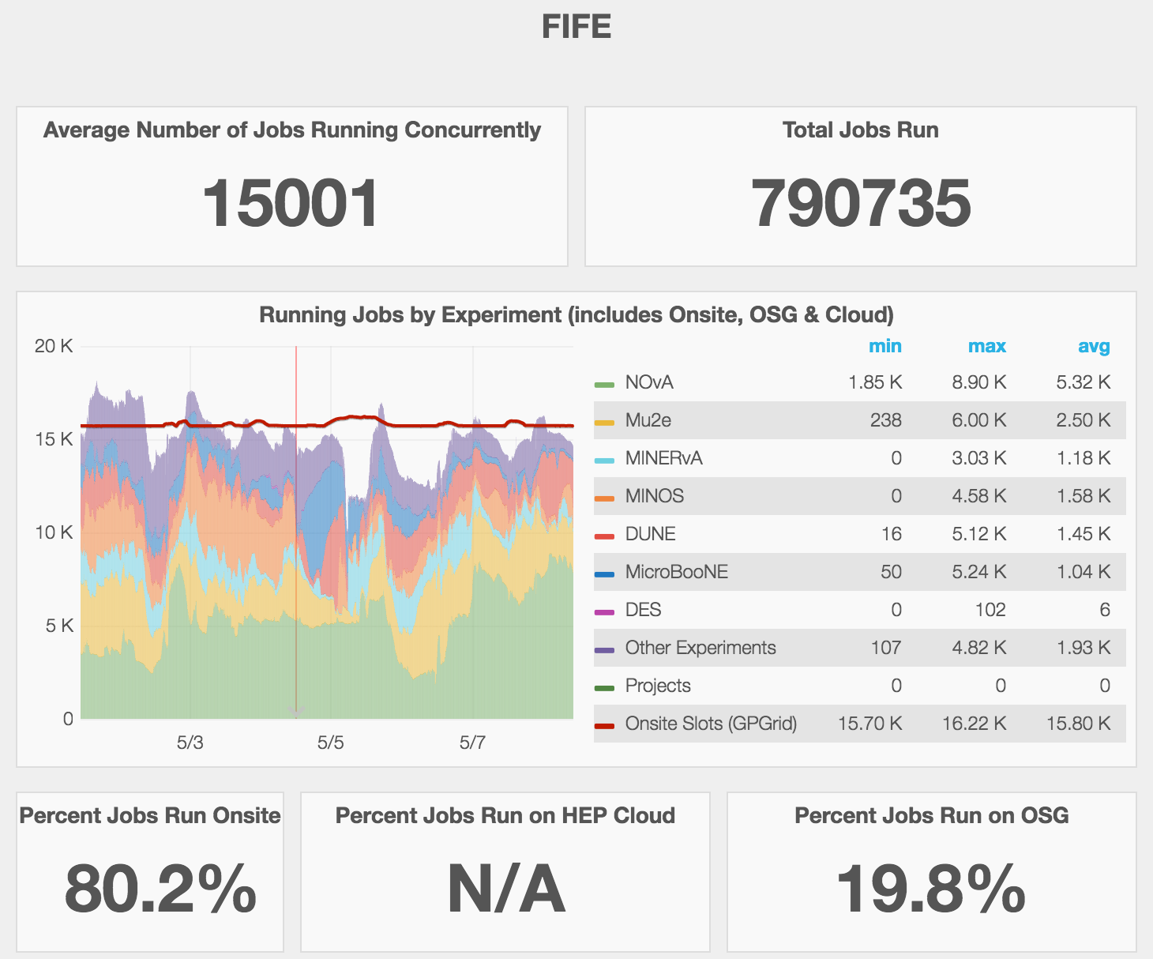
FIFE Monitoring of resource utilization
Extremely important to understand performance of system
Critical for responding to downtimes and identifying inefficiencies
Focused on improving the real time monitoring of distributed jobs, services, and user experience
fifemon.fnal.gov

Slide 27
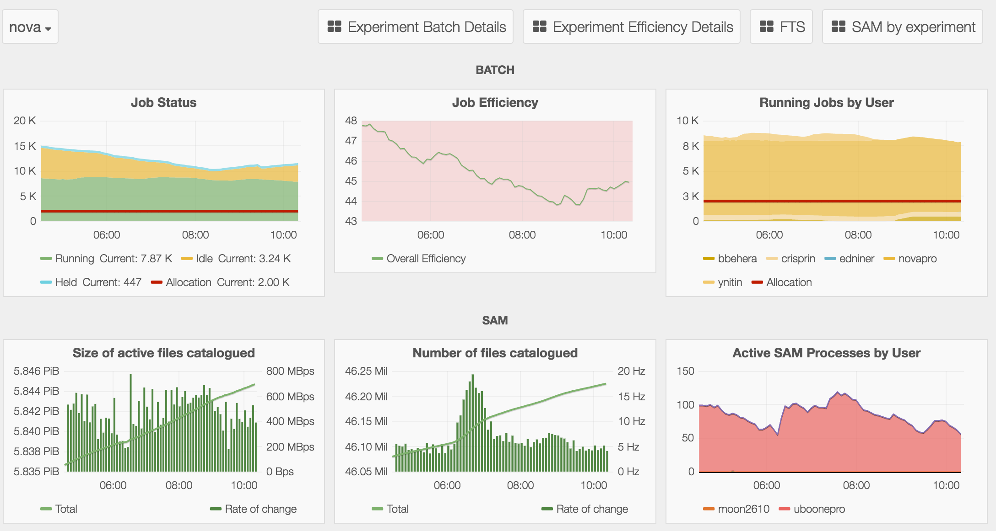
Detailed profiling of experiment operations
Allows identification for inefficiencies, potential slow downs,
or blocking conditions in workflows
Notes:
update to DUNE version

Slide 28
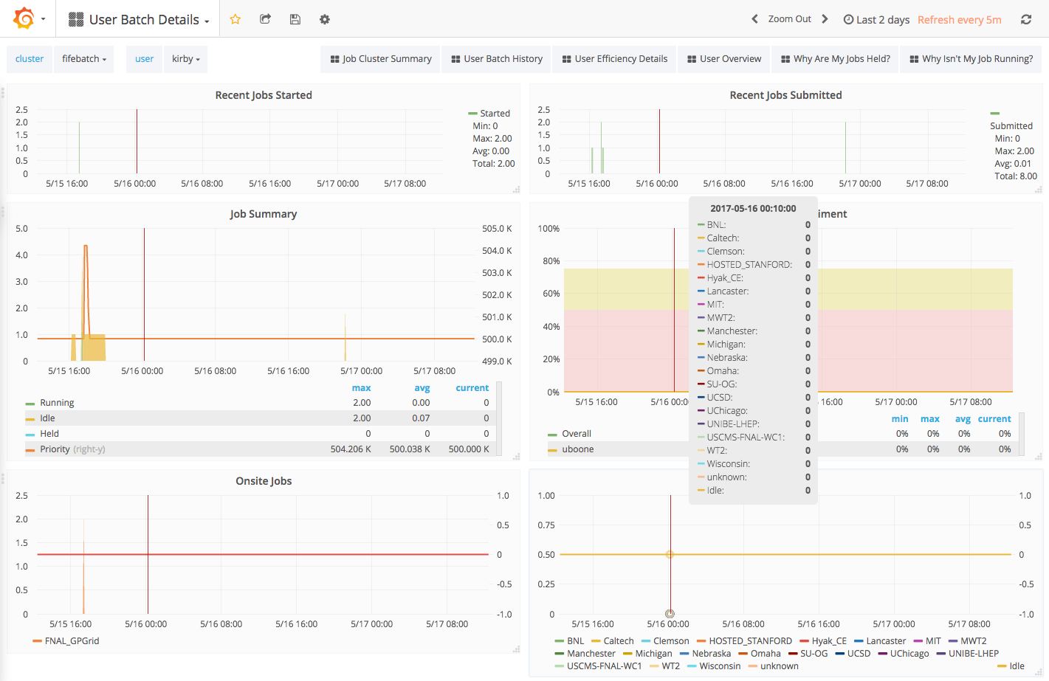
User Batch Details Dashboard

Slide 29
Backup

Slide 30
What if I want to do this in larbatch?
https://redmine.fnal.gov/redmine/projects/larbatch/wiki/User_guide
the configuration file for larbatch is an xml file
examples is found here:
https://cdcvs.fnal.gov/redmine/projects/dunetpc/wiki/Using_project_python
<fcl>/pnfs/dune/persistent/users/kirby/tutorial_prodsingle_dune35t.fcl</fcl>
<outdir>/pnfs/dune/scratch/users/kirby<outdir>
<logdir>/pnfs/dune/scratch/users/kirby/log<logdir>
<workdir>/pnfs/dune/scratch/users/kirby/work<workdir>
<numjobs>2</numjobs>
<numevents>1</numevnts>
<group>dune</dune>
project.py --xml /dune/app/users/kirby/dune_may2017_tutorial/dune_tutorial.xml --stage gen --submit

