Slide 1
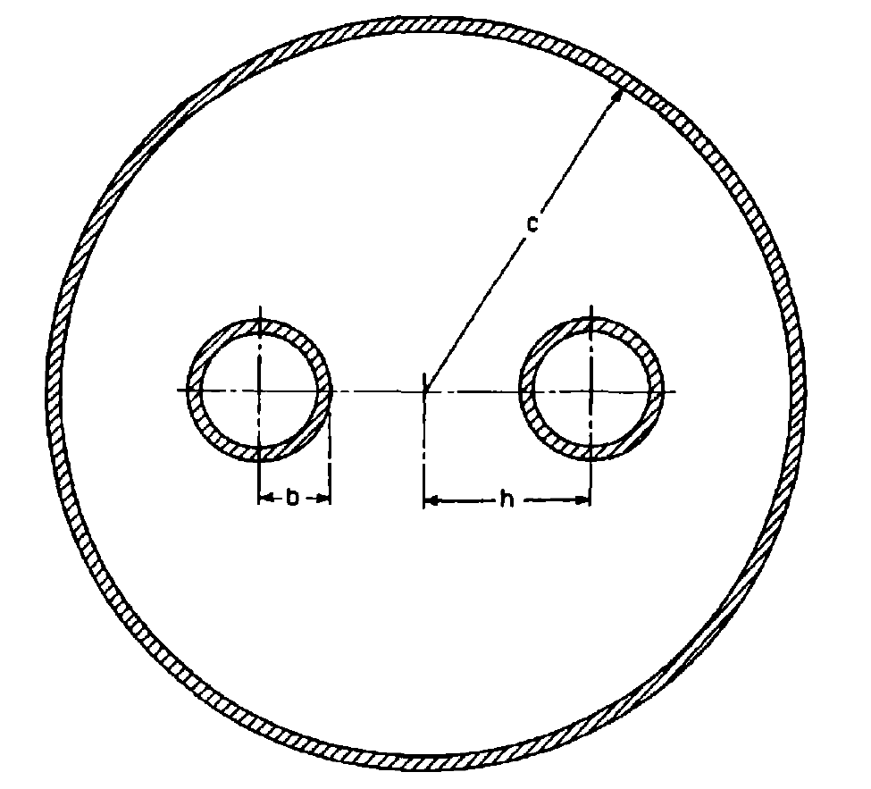

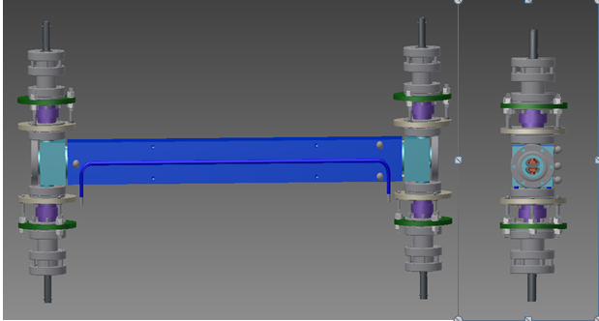
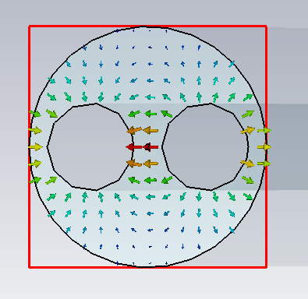
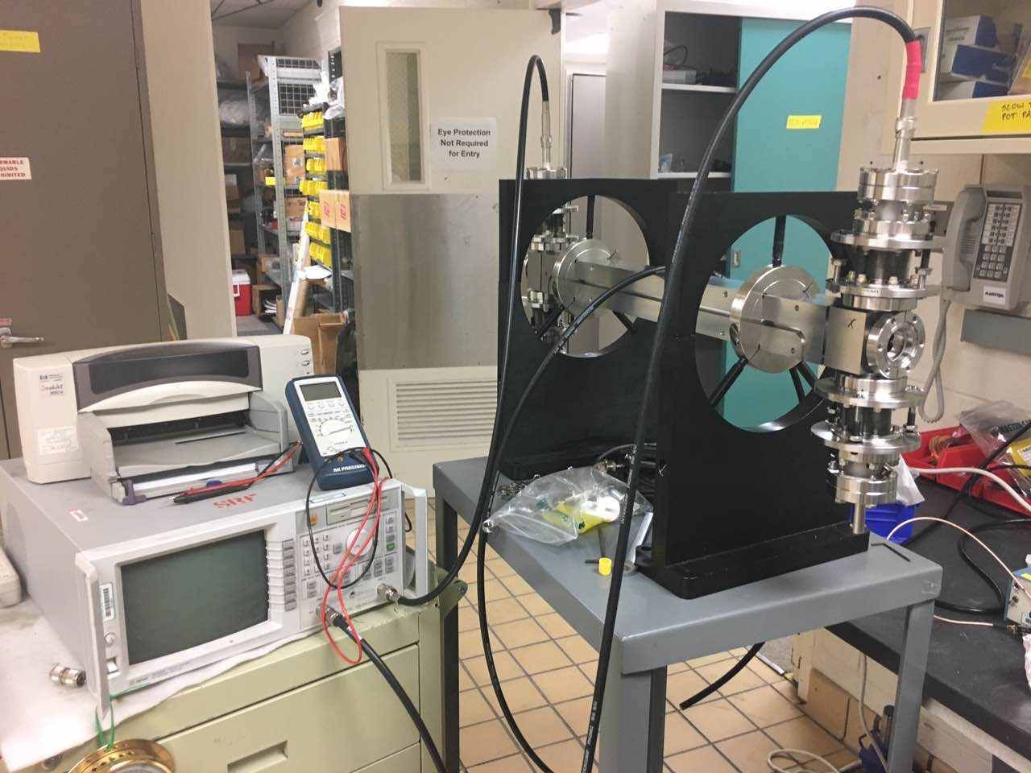
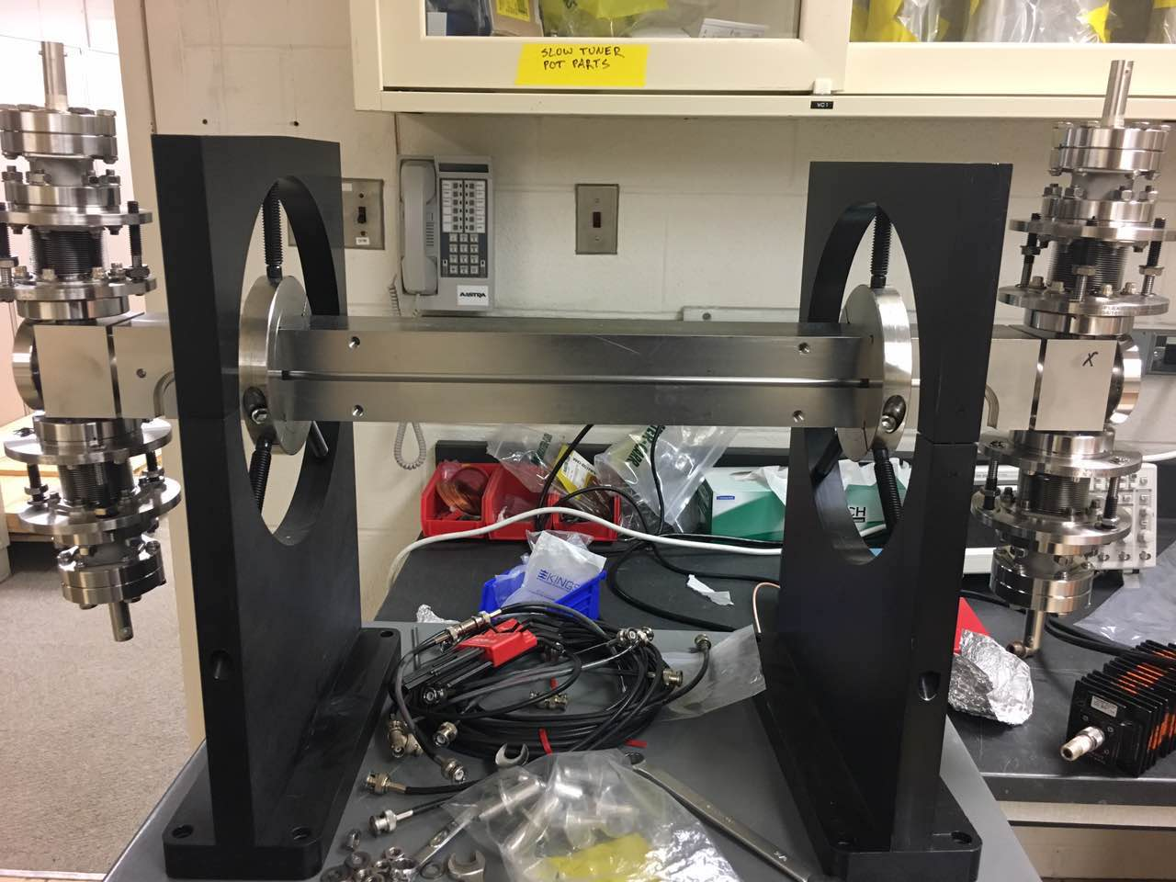
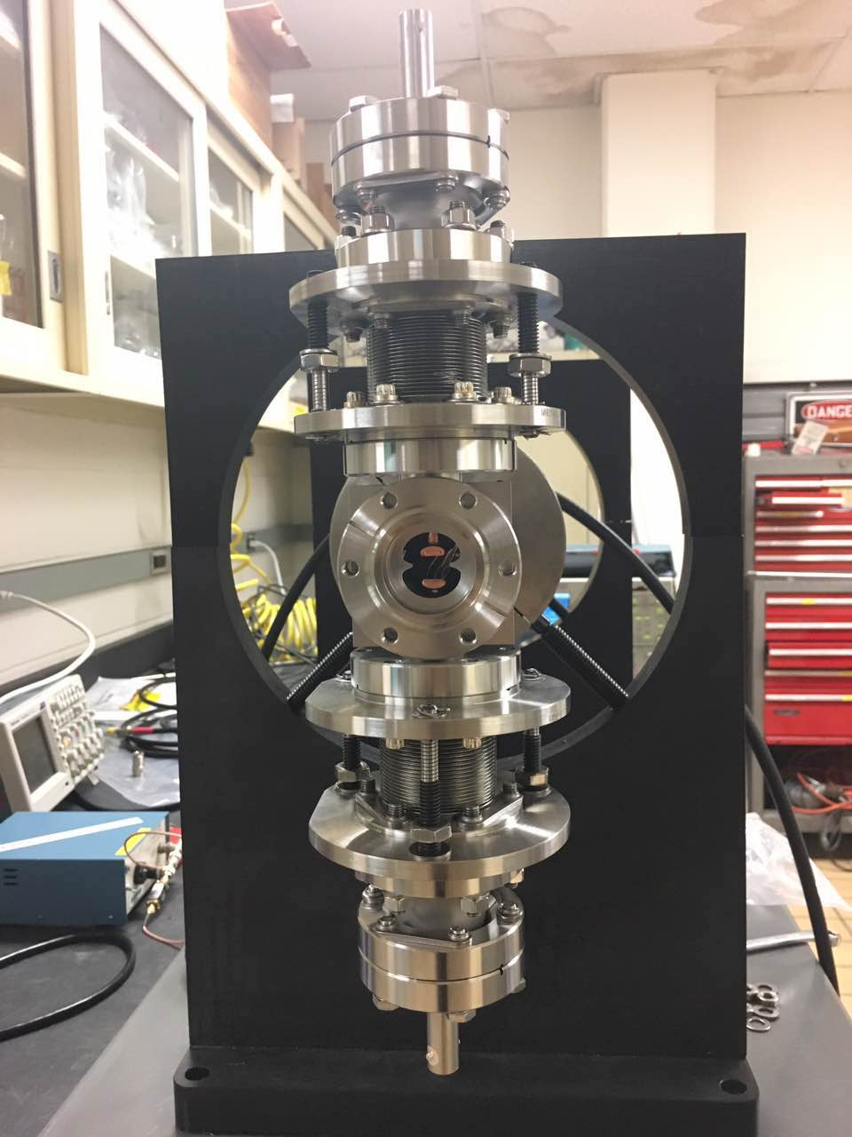


Development of Stripline Kicker for APS
Yifan Su, Cornell University – Lee Teng Program
Advisor: Zachary Conway, Argonne National Laboratory
Introduction and Background
Theory vs. Simulation vs. Measurements
Time Domain Reflectometry
We are developing a set of new 22-nanosecond stripline kickers to transfer a 200 milliamp 6 GeV electron beam from the injector to stable orbits within the proposed storage ring.
The stripline kicker pulse is intended to have a 6 nanosecond rise, flat-top and fall time.
The stripline kicker transmission line has two TEM-like modes which strongly couple to the beam: (1) an even mode where the potential on both blades is the same and (2) an odd mode where the potential on both blades have opposite polarity.
Both the odd and even modes are designed to have an impedance as close to 50 ohms as possible to reduce reflections.
Figure 1: Solid model of the transverse stripline kicker, front
and side view.
Our goal is to measure the impedance of our device and effect misalignments and imperfections have on the impedance.
This is done to understand how we should minimize the reflected waves which arise from impedance discontinuities.
Reducing the amplitude of the reflected wave mitigates against undesirable beam deflections and damage to the pulsers driving the entire system.
Figure 2: Picture of the transverse stripline kicker at Argonne National Lab, front and side view. (Right) Notice the two copper blades in the middle of the stripline kicker. These are the blades which kicker the beam and will be excited to +/-15 kilovolts in operation with a 22 ns pulse. The blade length is roughly ¾ meters.
The purpose of our analytic model, simulation and measurements is to find how the position of inner conducting blades affect the impedance of the device.
1. Analytical Model:
The simplified model is a shielded dual conductor transmission line. The characteristic impedance of the model is given by the following formula, where b is inner conductor radius, c is outer radius, h is half center to center distance,
σ = h/c, ν = h/b, and η = 377Ω:
Figure 3: Simplified analytical model.
2. Microwave Studio Simulation:
With CST microwave simulation, we can build a solid model of the device and simulate the electromagnetic field and the impedance.
Figure 4: Electric field simulation. Figure 5: Network Analyzer lab setup.
3. Network Analyzer Measurement:
Network Analyzer is a powerful tool for us to characterize a microwave device. We can measure the impedance of our kicker under the synchrotron frequency with Network Analyzer.
Figure 6: Analytical, simulation and measurements results comparison.
Time Domain Reflectometry (TDR) is a measurement technique used to determine the characteristics of transmission lines by observing reflected waveforms. By employing TDR, we can examine where the impedance discontinuities are in our device and how large they are.
Figure 7: Impedance analysis result from time domain reflectometry.
From the TDR result, we can see that the feed-through on both sides of the kicker have slightly smaller impedance than the cable and the kicker.
From our measurement, we found that the impedance of our kicker is generally resistant to small perturbations in blade position.
One of the next steps is to repeat the comparison of simulation, analytic solution and measurements for the cases with angular offset in blades.
The TDR shows that our device is generally symmetric as designed.
[1] C. Belver-Aguilar, A. Faus-Golfe, F. Toral, M. J. Barnes, Phys. Rev. ST Accel. Beams 17, 071003 (2014).
[2] E. I. Green, F. A. Leibe, and H. E. Curtis, Bell System Tech. Journal 15, pp. 248–284 (April 1936).
[3] Simon Ramo, J. W. Whinnery, and T. V. Duzer, Fields and Waves in Communication Electronics, 3rd ed., p. 250.
Conclusion and Next Steps
Reference
August 10, 2017

