Slide 1
Beam Echoes in the Presence of Coupling
Axel Gross
Mentor: Tanaji Sen
9 August 2017
Notes:
My name is Axel Gross, over the summer I worked with Tanaji Sen on the topic of beam echoes.

Slide 2
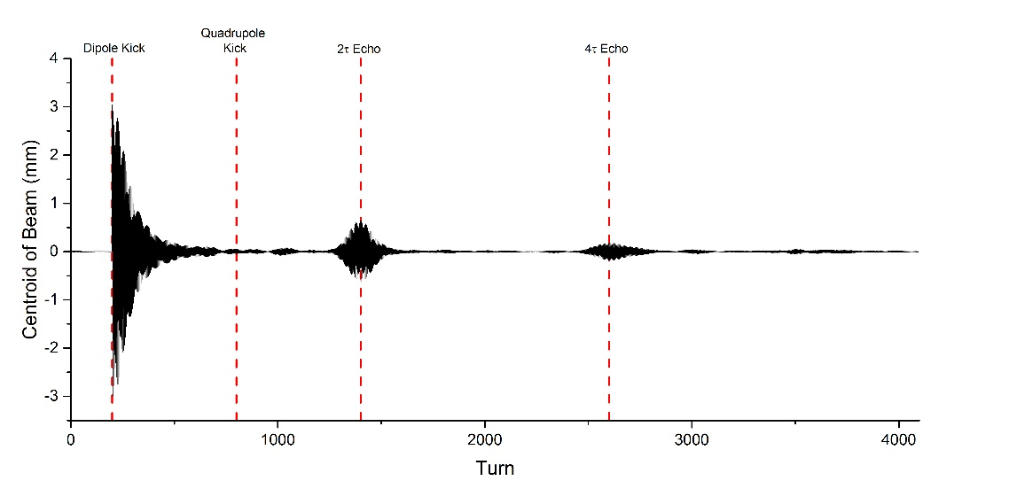
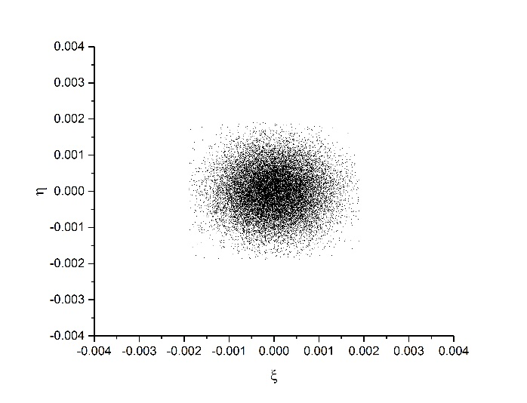
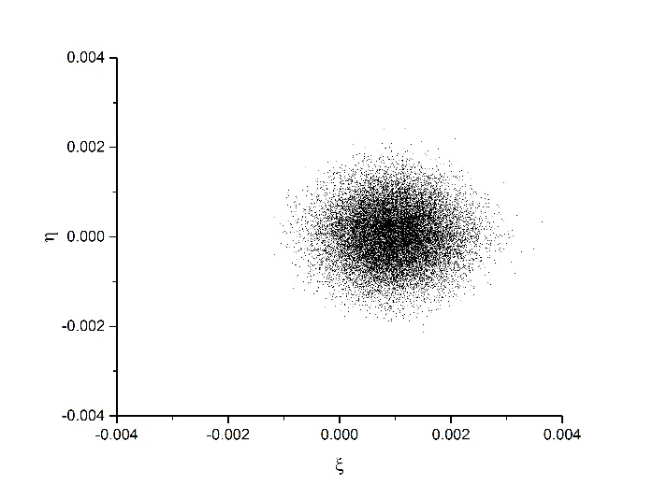
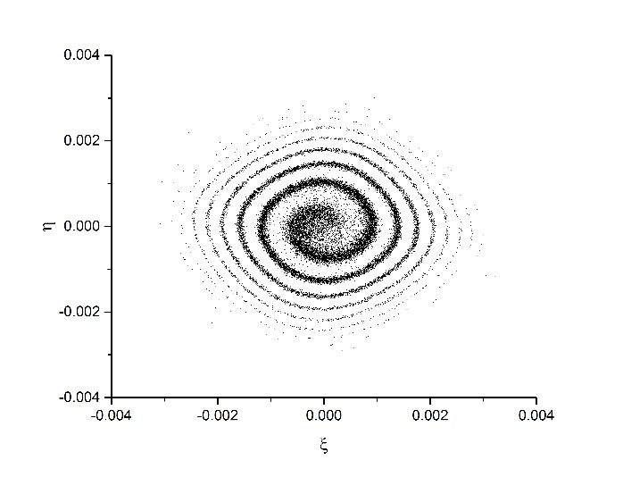
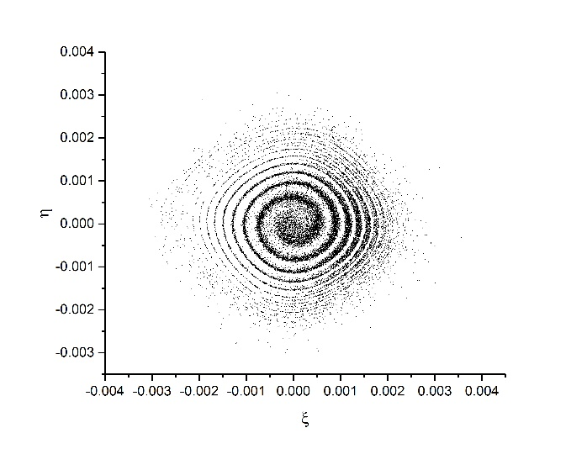
What is a beam echo?
Initial proton beam distribution
At t=0, apply a one-turn dipole kick
At t=$τ$, apply a one-turn quadrupole kick
Echoes will occur at t=2$τ$, t=4$τ$, etc.
Far Left: Initial Beam Distribution
Left: Distribution after Dipole Kick
Far Bottom Left: Distribution after decoherence
Bottom Left: Distribution at 2$τ$ Echo
Coordinates used are standard Floquet coordinates:
$$ξ≡\frac{x}{\sqrt{β}} η≡\sqrt{β}x^{′}$$
$x$ is the transverse beam deviation from the center
$x^{′}$ is the transverse beam velocity
$β$ is the beta function
Notes:
What is a beam echo? Say you have an initial distribution of protons, like the one shown in the phase space plot HERE. This distribution is represented in Floquet coordinates, defined HERE , which provide for easy propagation of the particles around the ring. In these coordinates, as the particles progress around the ring, they rotate in circles around the center. At the time we will define to 0, acting on the beam with a one turn dipole kick will shift each particle by the same amount, shown by the phase space plot HERE. If there are significant nonlinearities in the beam, as in this case, particles at different radius from the center rotate at different speeds. This causes the phase of the particles to become out of sync, causing what is known as decoherence, shown HERE. This is also shown HERE. The centroid of the beam is the position of the average particle. Here is the dipole kick, and here is the beam undergoing decoherence. Slight pause. Long after the beam has undergone decoherence, at the time we will call tau, we act on the beam with a single-turn quadrupole kick. Nothing significant appears to happen immediately, but we begin to see brief periods where the beam becomes recoherent, at 2tau, at 4tau, and so on. We call this phenomena beam echoes, and can see them on the centroid graph HERE, and the phase portrait at the echo HERE.

Slide 3
Motivation
Beam echoes provide a new way of measuring diffusion in particle beams.
We seek to develop the theory further to understand how many factors influence the echo strength and profile.
Explore beam echoes in 2D with coupling effects
Explore beam echoes in 2D with diffusion effects
Explore beam echoes with both coupling and diffusion effects
Eventual goal is to provide recommendations to IOTA (Integrable Optics Test Accelerator) for upcoming echo experiment.
Notes:
You might be asking, that’s cool and all, but why do we care? It turns out that the strength of the beam echoes are directly correlated with the diffusion rate of the beam. The current method of measuring diffusion, beam scraping, requires large amounts of time to complete, which is not only annoying, but also completely unfeasible for some accelerators, which cannot maintain a beam for that long. Currently, beam echoes are a promising technique to measure the diffusion of a beam, as they would potentially take seconds to complete, instead of hours, but the theory underlying the effect is very underdeveloped. Last summer the relationship between many common beam parameters and echo strength was explored in 1 dimension, and the results were used to develop a nonlinear theory of beam echoes. This summer we started exploration into beam echoes in 2 dimensions, particularly to explore the relationship between diffusion, coupling effects, and echo amplitude, with the hope that we can use the results to develop a theory of beam echoes that incorporates coupling between dimensions. The eventual goal of the research is to provide recommendations to the upcoming echo experiment at IOTA.

Slide 4
Simulation Elements
Phase Advance
Simulates motion through a FODO Lattice
Transfer matrix:
$${\left[\begin{matrix}ξ \\ η\end{matrix}\right]}_{new}=\left[\begin{matrix}\cos{φ} & \sin{φ} \\ −sin{φ} & \cos{φ}\end{matrix}\right]{\left[\begin{matrix}ξ \\ η\end{matrix}\right]}_{old}$$
where $φ$ is the fraction of the total ring phase advance ($2πν)$ in the segment
Octupole Magnets
Simulate nonlinearities that cause the decoherence of the beam
Transfer map:
$$ξ_{x}=ξ_{x}$$
$$ξ_{y}=ξ_{y}$$
$$η_{x}=η_{x}+k(3β_{x}β_{y}ξ_{x}ξ_{y}^{2}−β_{x}^{2}ξ_{x}^{3})$$
$$η_{y}=η_{y}+k(3β_{x}β_{y}ξ_{x}^{2}ξ_{y}−β_{y}^{2}ξ_{y}^{3})$$
Skew Quadrupole Magnets
Provides coupling between the dimensions
Transfer matrix:
$$ξ_{x}=ξ_{x}$$
$$ξ_{y}=ξ_{y}$$
$$η_{x}=η_{x}−k\sqrt{β_{y}}ξ_{y}$$
$$η_{y}=η_{y}−k\sqrt{β_{x}}ξ_{x}$$
Common Simulation Parameters, based off of RHIC
Number of Particles | 20000
Initial Emittance | 1.5E-7
Initial X Tune | 0.235
Initial Y Tune | 0.215-0.225
Betatron at BPM, Quadrupole, and Dipole (m) | 10
Quadrupole Kick Strength (1/m) | 0.007
Dipole Kick Strength | 3.E-4
Time between Dipole and Quadrupole Kick | 600-3000 Turns
Notes:
The results we obtained were the result of a simulation, written in C. The simulation had three primary components, which were interspersed to create the effect of all of them acting at once. The phase advances simulated motion through a standard FODO lattice, which keeps the particle beam focused in both dimensions. The octupole magnets provided the nonlinearities which caused the phase decoherence. The skew quadrupole magnets were the primary source of the coupling between the dimensions (there is a small amount form the octupoles). Most of the simulation parameters were based off the previous echo experiment at RHIC.

Slide 5
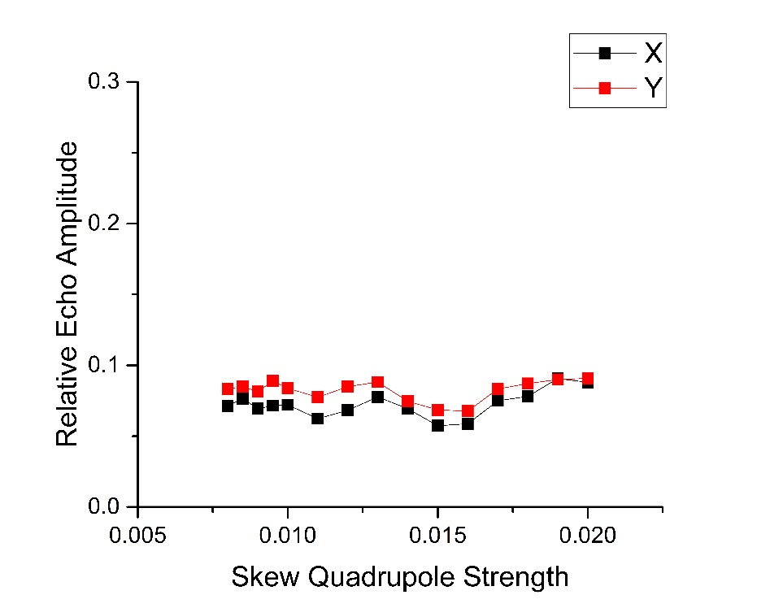
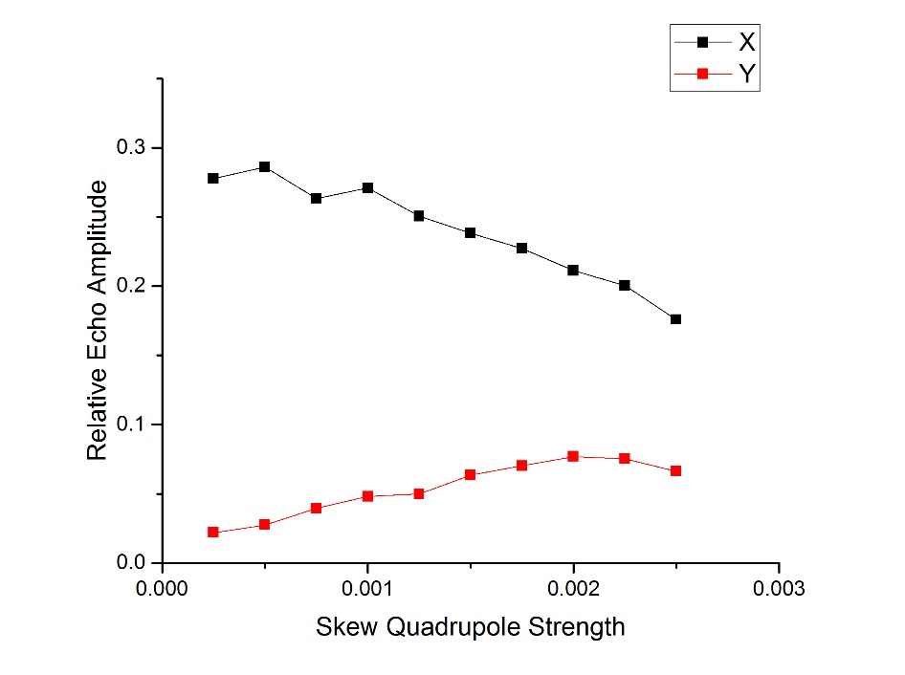
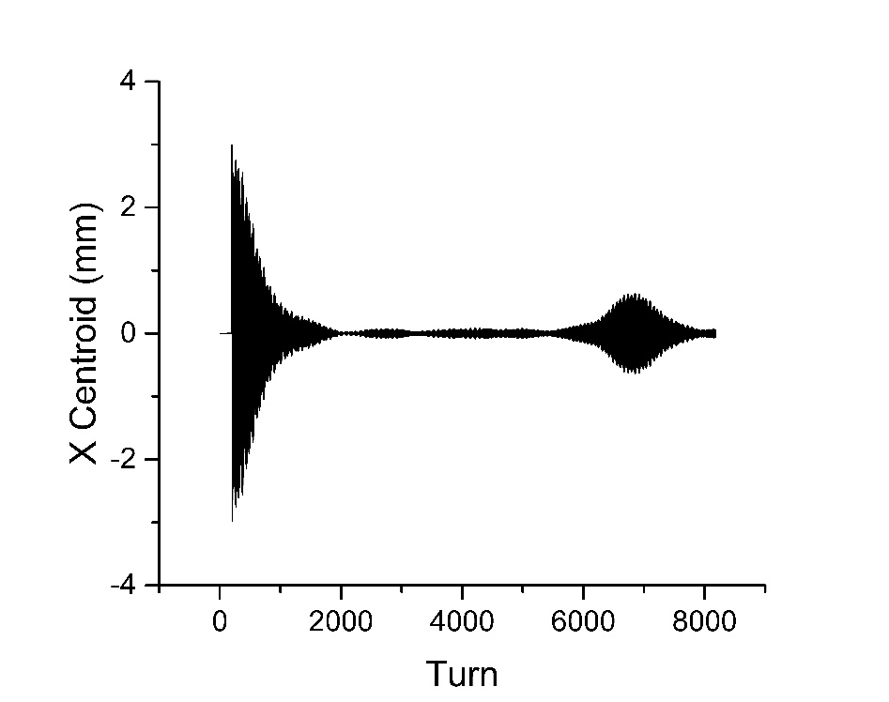
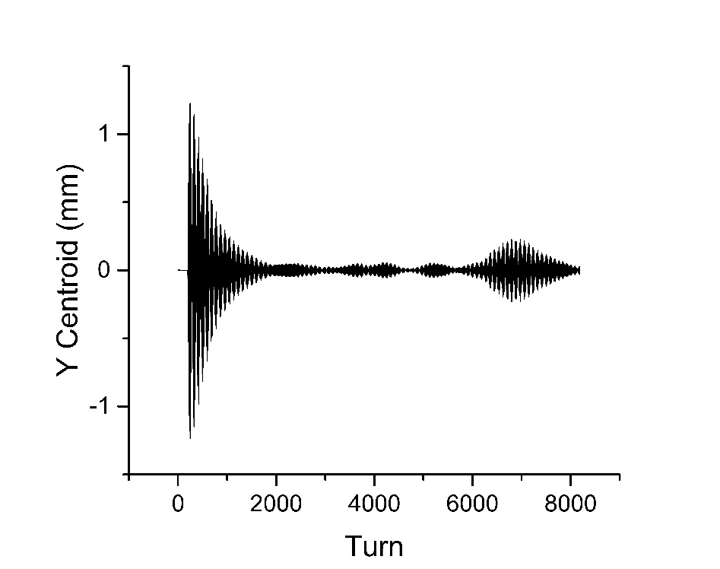
Coupling
Notes:
One of the questions we hoped to answer was: Are echoes destroyed by coupling effects? Simulations show that the answer to this question is no. We also discovered that a dipole kick in only the x direction can cause an echo in both the x and y directions. This can be seen HERE (bottom, then gestures top) We can see that increasing the coupling strength will increase the y echo amplitude at the cost of x echo amplitude. The relative echo amplitude is the maximum echo amplitude divided by the dipole kick amplitude, that is, it is this height divided by that height. At high coupling strengths, it was expected that the echoes would be destroyed, but data so far seems to indicate that the echo strength remains at a constant non-zero value. This is a good result, as many accelerators have strong coupling effects, but it is a bit unexpected. You may have noticed that there is a big gap in the middle of these two graphs? What is happening there? The echo amplitude in this region was measured to essentially be zero. Upon further inspection…

Slide 6
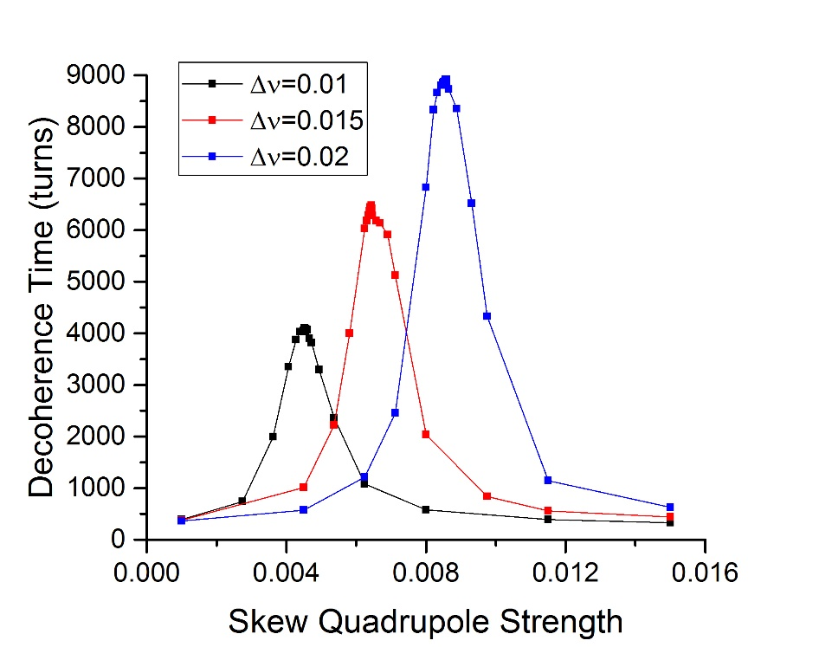
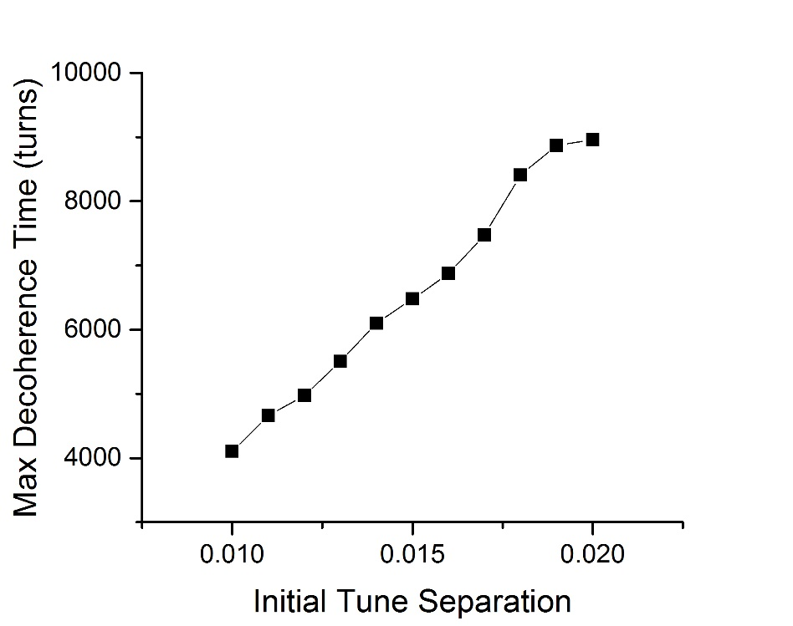
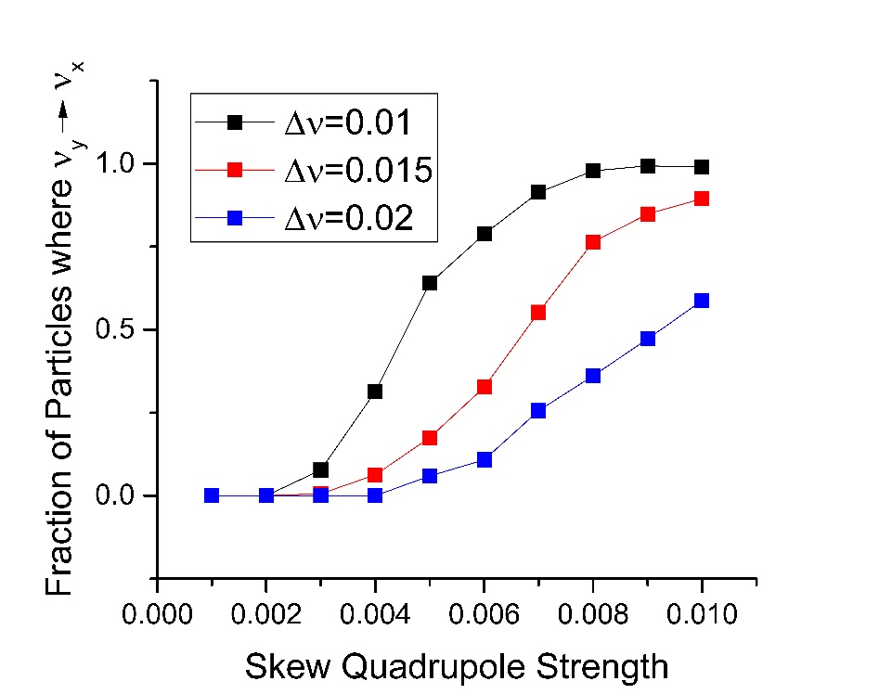
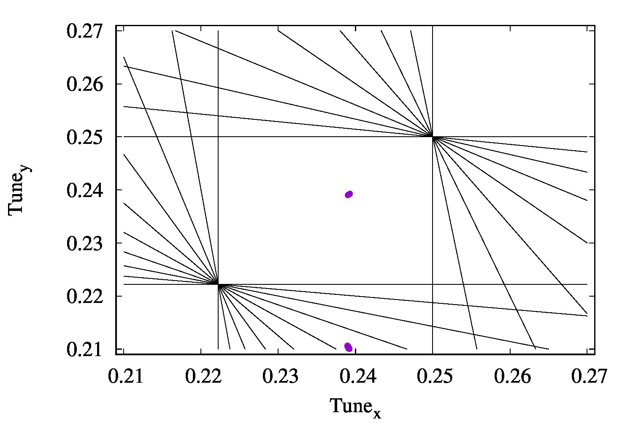
Decoherence Effect

Slide 7
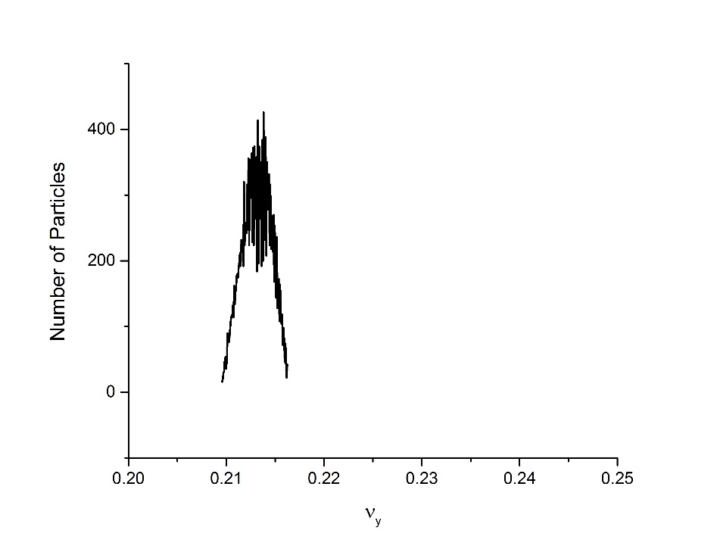
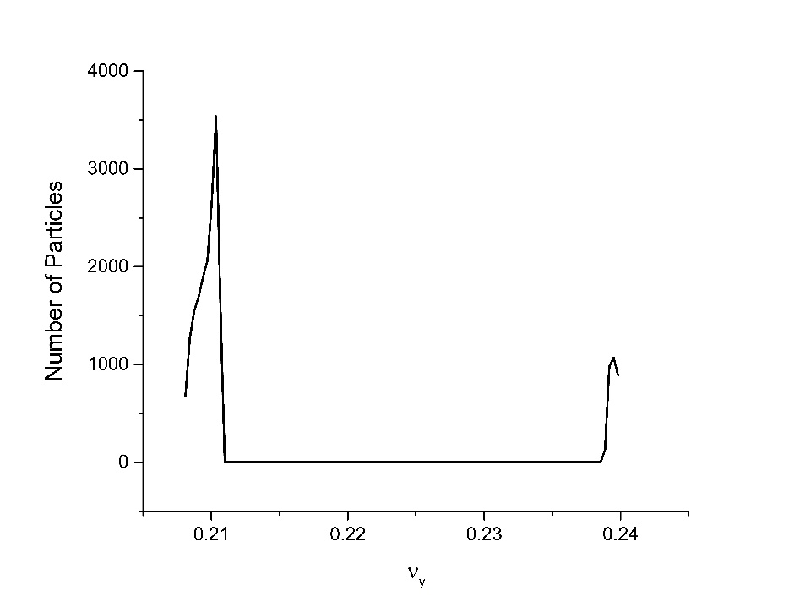
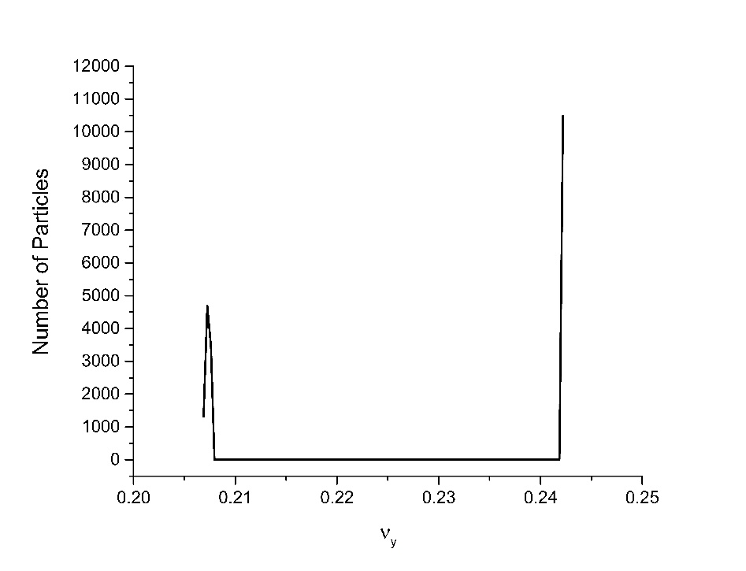
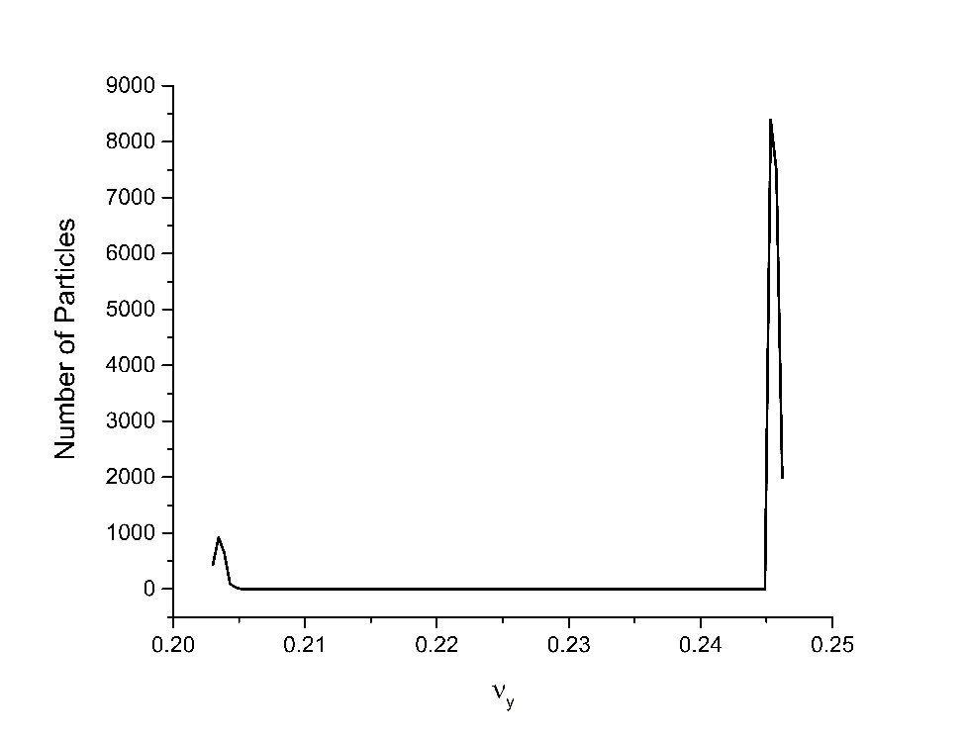
Decoherence Effect (continued)
Notes:
For some reason there is a massive increase in the Decoherence time at certain coupling strengths, as you can see HERE (black is from the data before). Because the signal has to decohere significantly before the quadrupole kick for the echo effect to occur, the echoes were being destroyed. But what is causing the decoherence effect? The particles have different initial x and y tunes to avoid resonance effects, but what appears to be happening is as the coupling strength increases, particles begin to shift their y tune to the value of the initial x tune, more and more at higher coupling strengths. This is an effect dependent on the initial tune separation, the difference between the initial x and y tunes, as you can see HERE. HERE you can see the tune footprint when some of the particles shift, here is the particles that haven’t moved, here are the particles that have. We can also see that the maximum decoherence time is also proportional to the initial tune separation HERE, which is a bit unexpected. For some reason, as the particles approach half the particles shifted, the tune spread narrows, as is shown

Slide 8
Conclusions and Further Questions
Echoes exist in both dimensions.
Why don’t echoes disappear in strong coupling?
Lack of echoes in intermediate coupling explained by decoherence, which is explained by tune spread.
Why does this tune spread occur?
How does diffusion work in 2 dimensions, and how does it interact with coupling?
Notes:
For some reason there is a massive increase in the Decoherence time at certain coupling strengths, as you can see HERE (black is from the data before). Because the signal has to decohere significantly before the quadrupole kick for the echo effect to occur, the echoes were being destroyed. But what is causing the decoherence effect? The particles have different initial x and y tunes to avoid resonance effects, but what appears to be happening is as the coupling strength increases, particles begin to shift their y tune to the value of the initial x tune, more and more at higher coupling strengths. This is an effect dependent on the initial tune separation, the difference between the initial x and y tunes, as you can see HERE. HERE you can see the tune footprint when some of the particles shift, here is the particles that haven’t moved, here are the particles that have. We can also see that the maximum decoherence time is also proportional to the initial tune separation HERE, which is a bit unexpected. For some reason, as the particles approach half the particles shifted, the tune spread narrows, as is shown

Slide 9
Acknowledgements
Tanaji Sen
Eric Prebys
Rosa Foote
Yuan Shen Li
Alex Chao
USPAS
Illinois Accelerator Institute
Fermilab
Notes:
I would like to thank all of these people and organizations for making this research possible. I had an amazing summer, and will continue my research in the fall with much enthusiasm.

