Slide 1
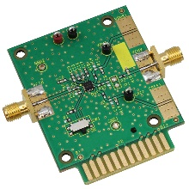
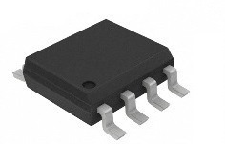
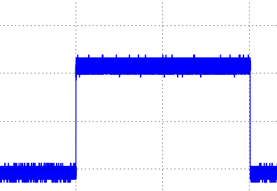
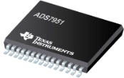
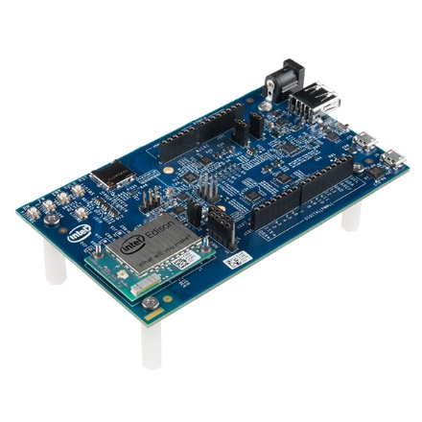
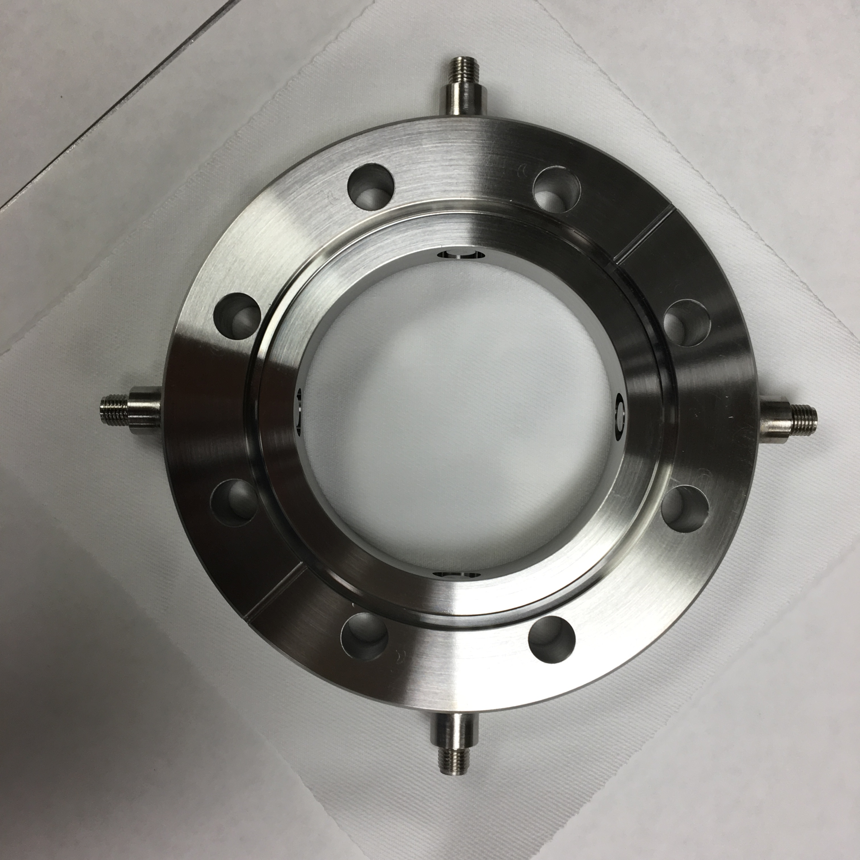


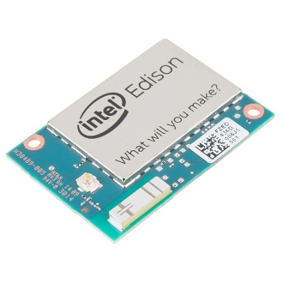
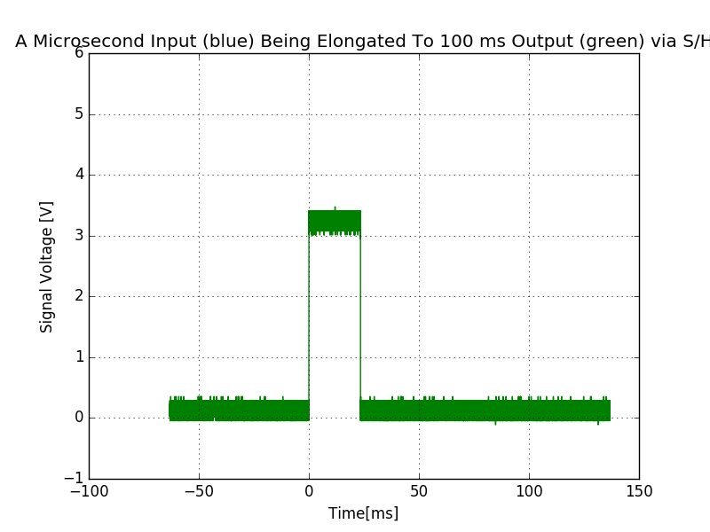
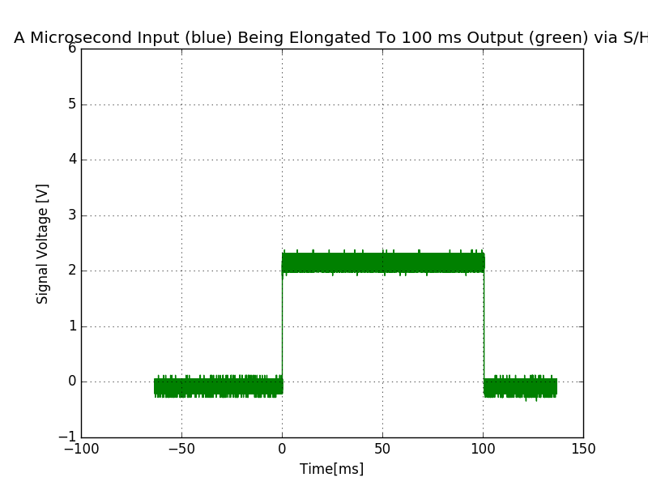
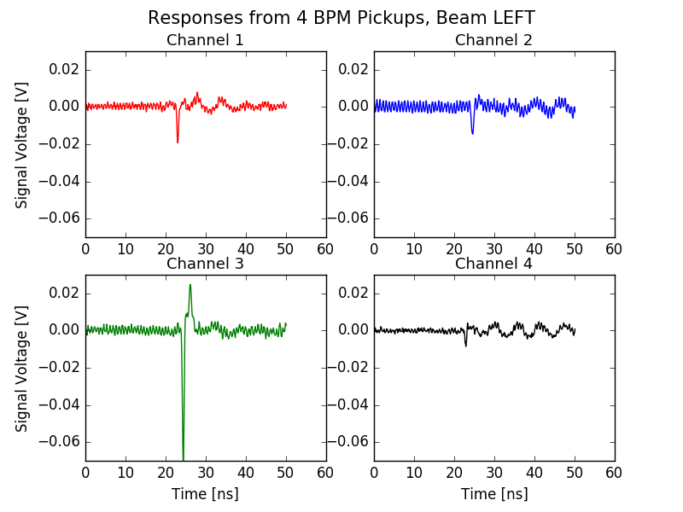
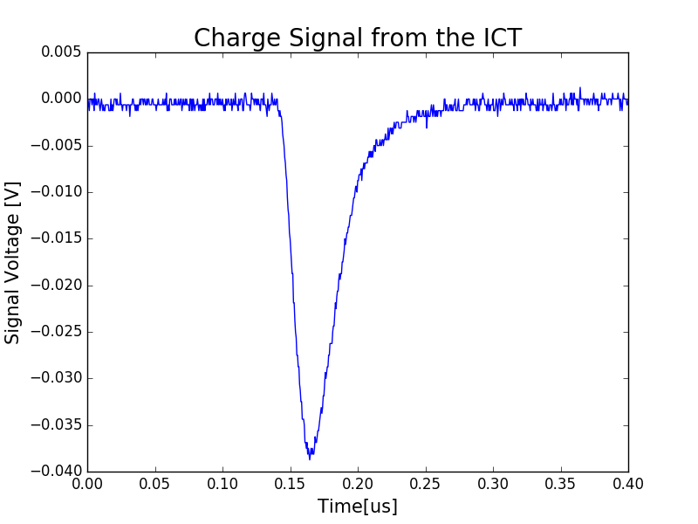
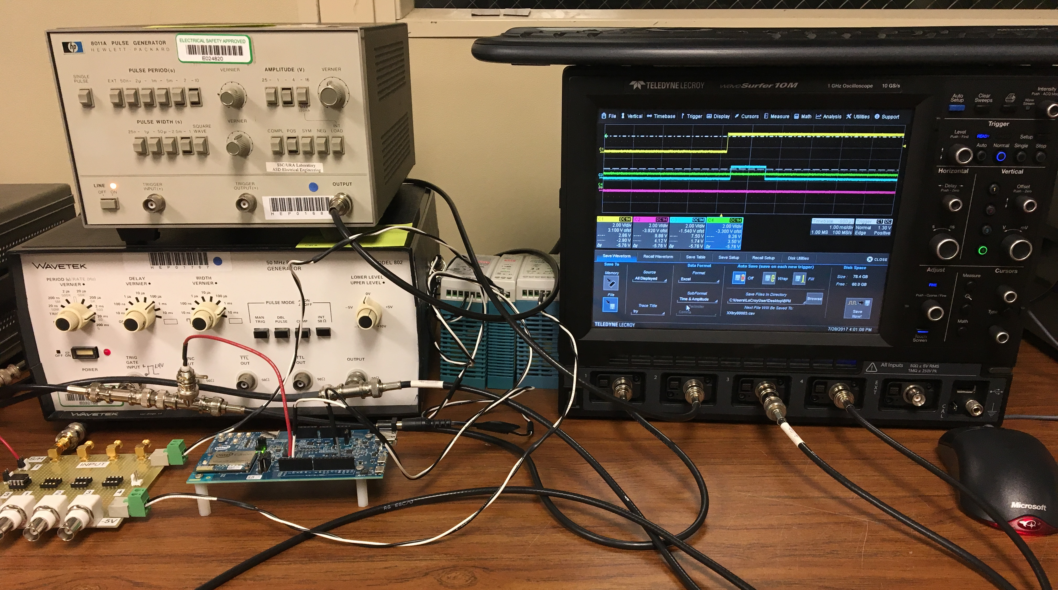
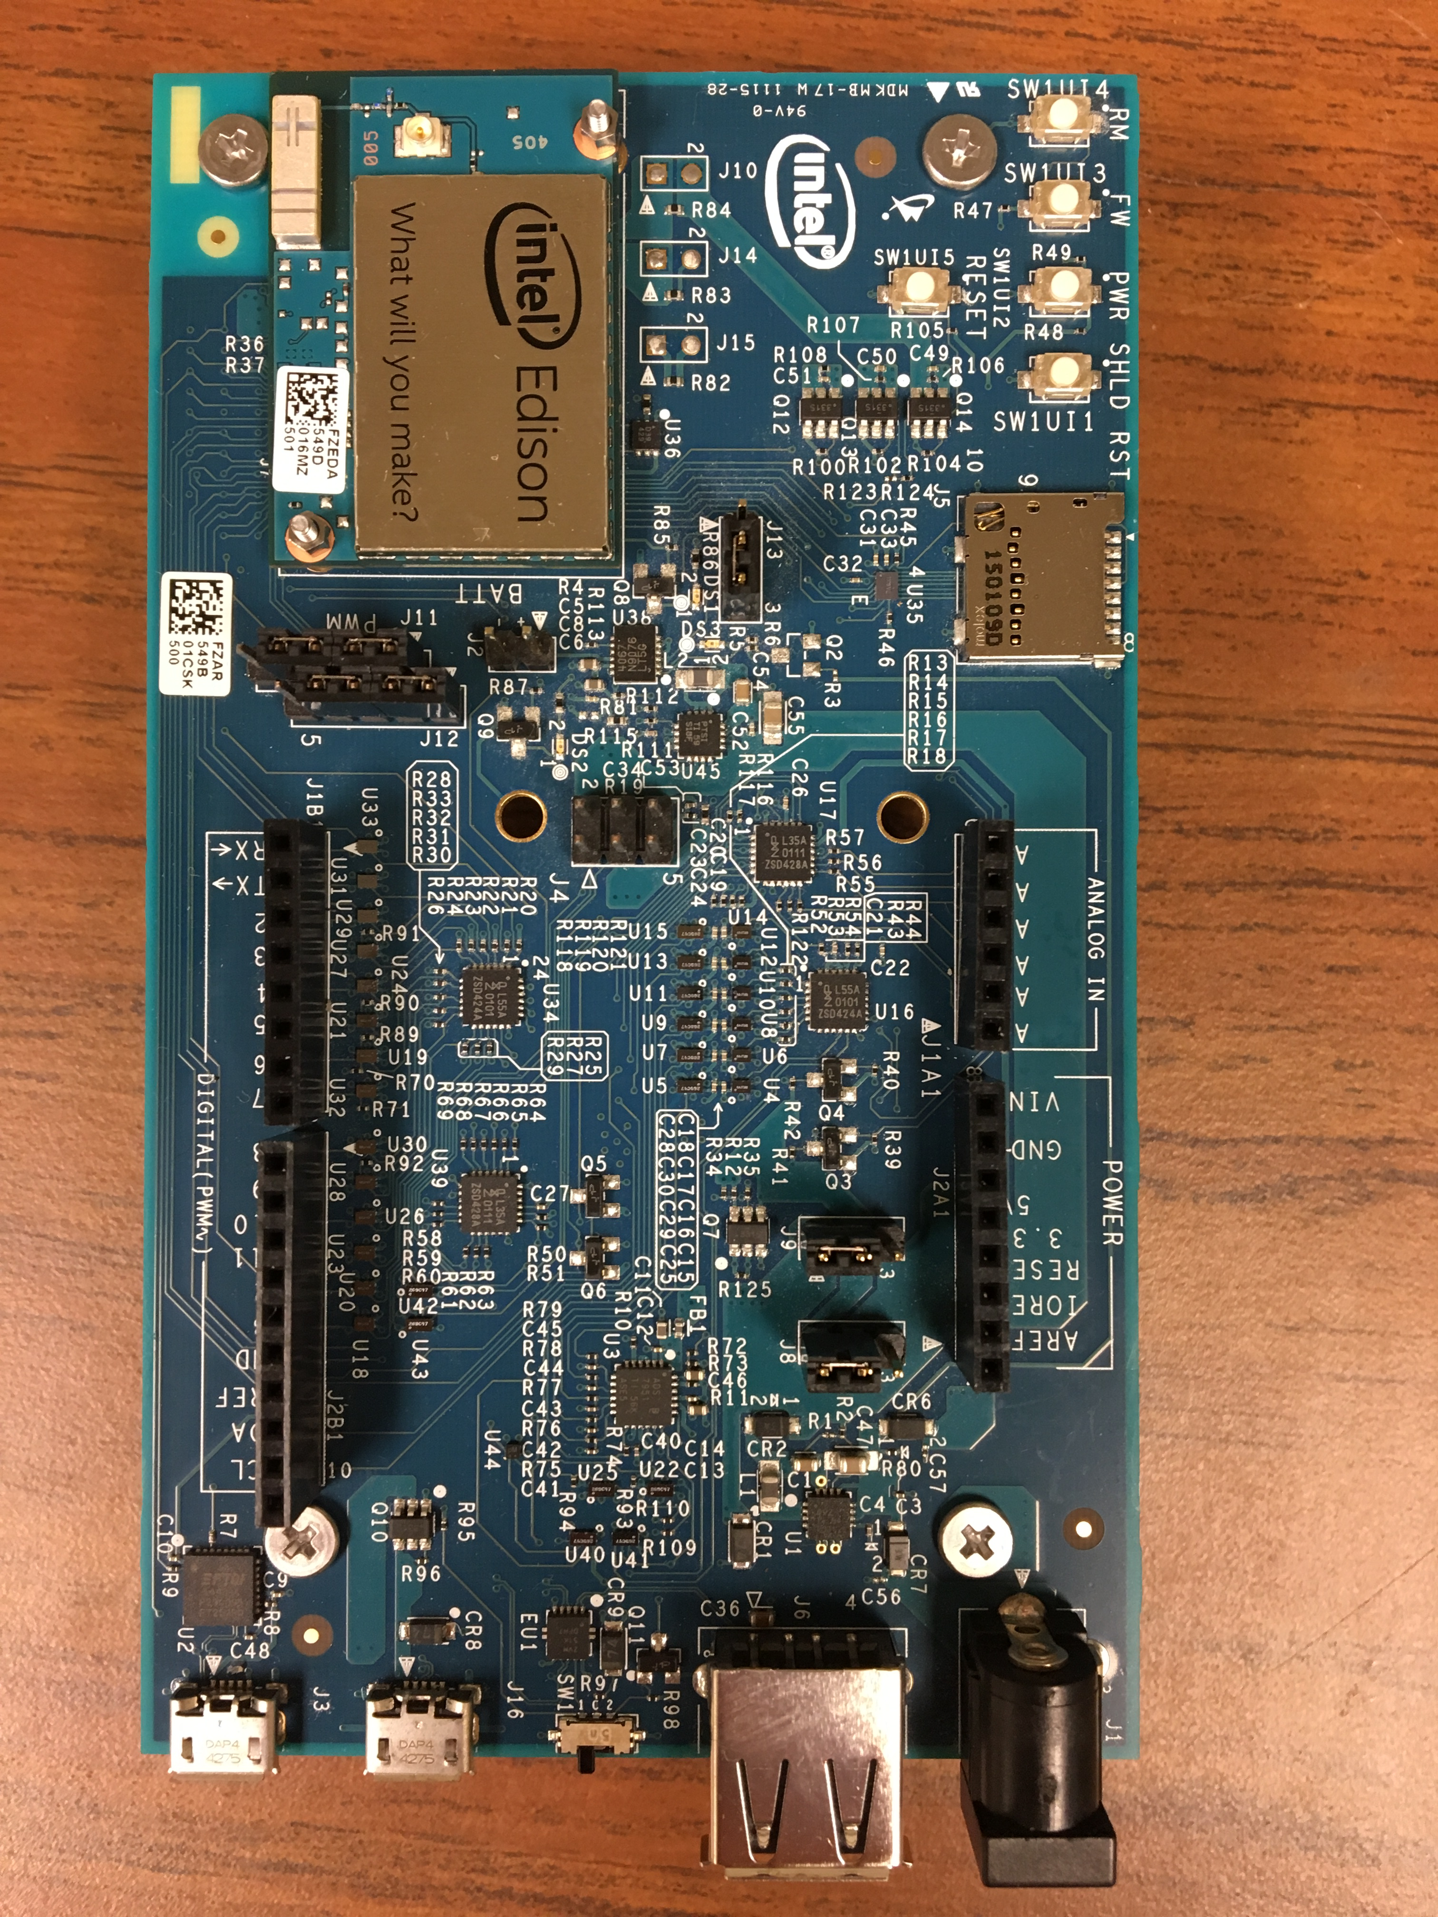
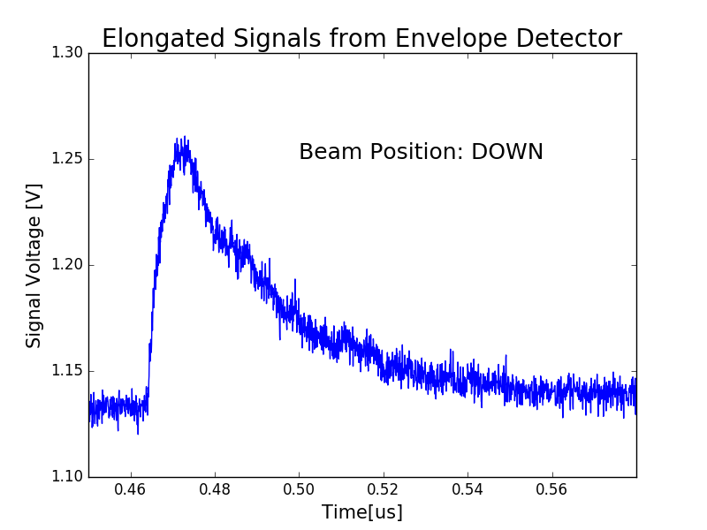
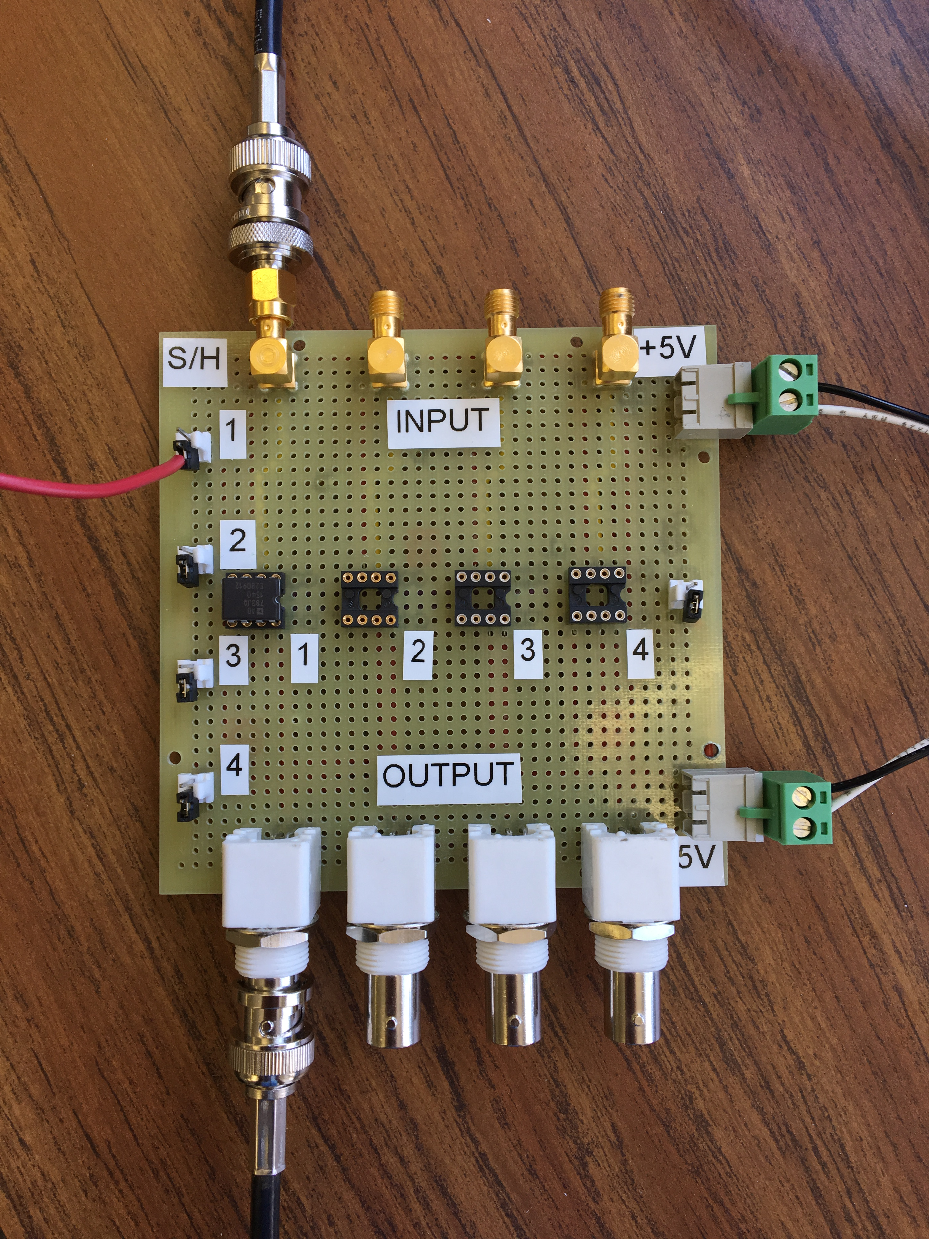
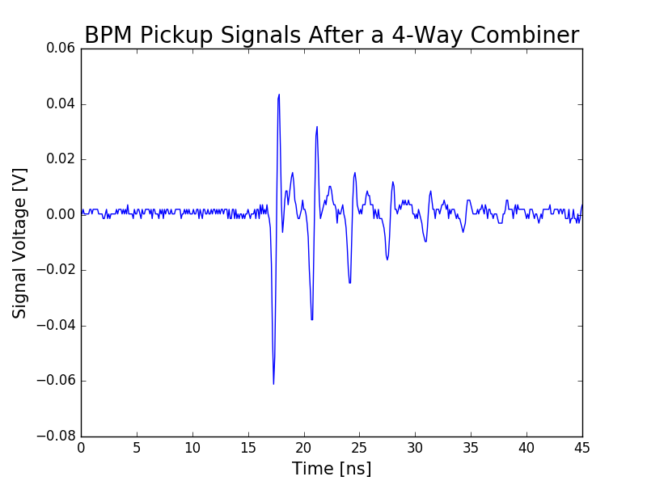
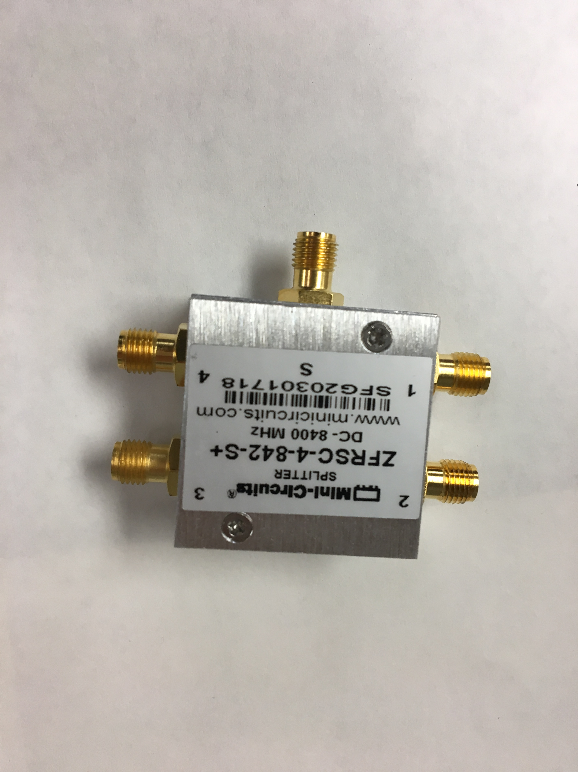
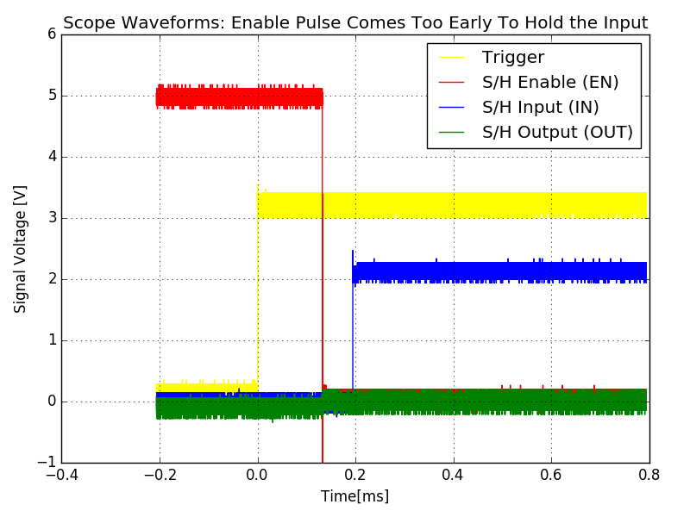
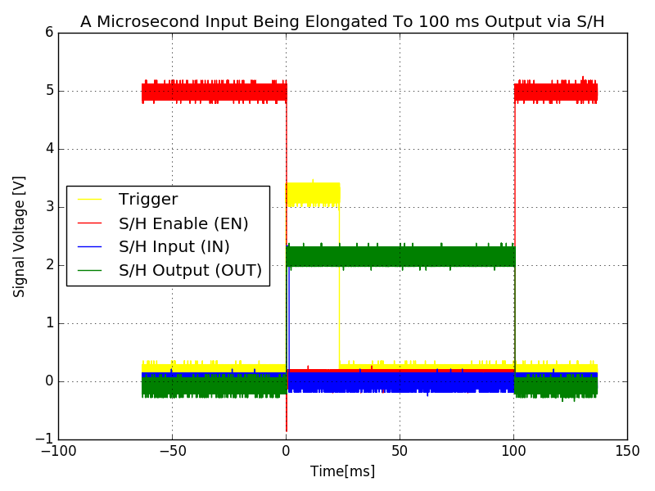
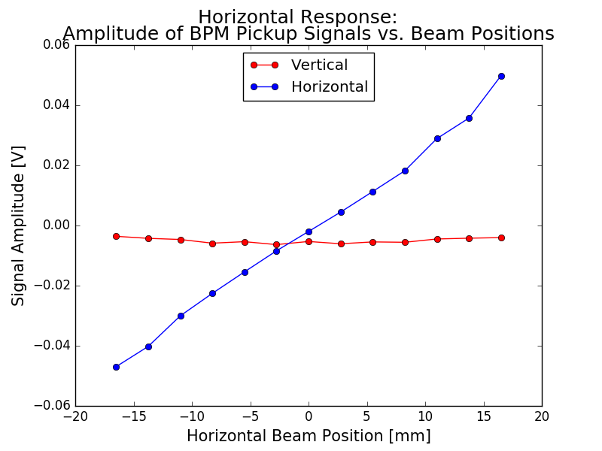
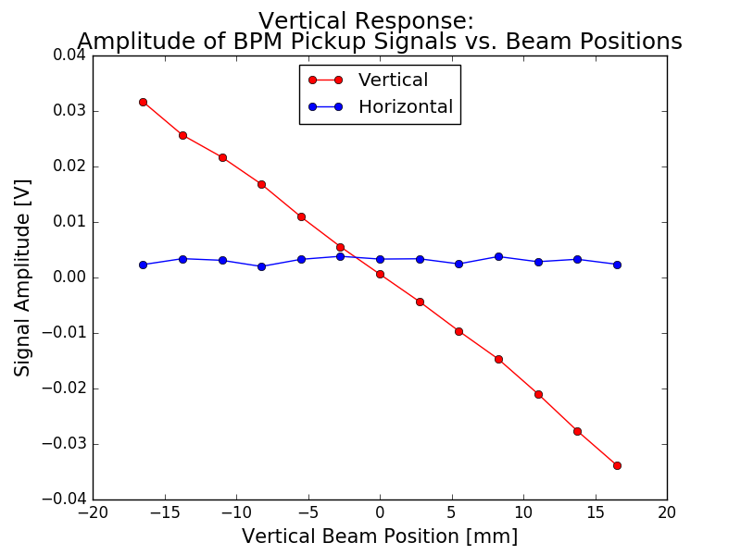
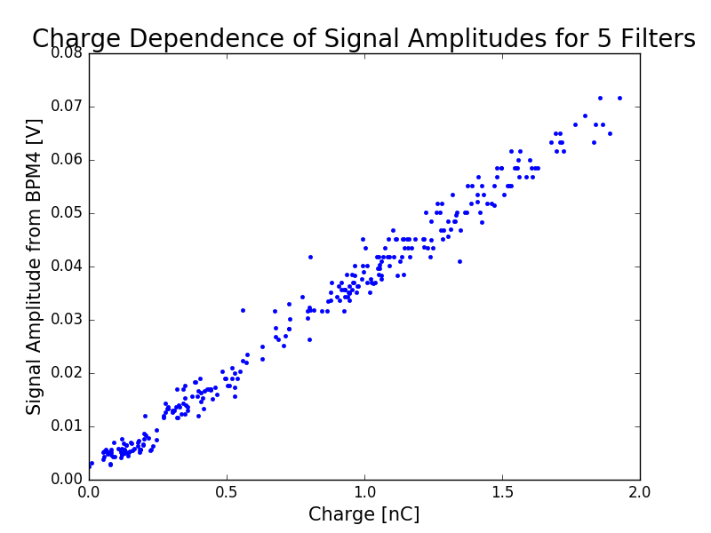


Improved Measurements of Beam Moments at AWA
Chuan Yin, John Power, Jiahang Shao, Chunguang Jing
University of Chicago, Argonne Wakefield Accelerator, Euclid Techlabs LLC
Introduction
A Beam Position Monitor (BPM) system is essential to beam diagnostics for almost all particle accelerators, both linear and circular types. Composed of signal pick-up hardware and processing electronics, BPM detects the centroid position and the charge of a passing beam non-destructively. Too often, a typical BPM system contains customized hardware and specialized processing electronics. This results in a higher fabrication cost and a barrier to creating electronics standards. For small accelerators such as R&D linacs, university accelerators (for research), medical and industrial accelerators (for business), strict constraints are placed on compactness and cost-efficiency. Thus, Argonne Wakefield Accelerator facility (AWA) aims to prototype a cheap, compact and universal BPM system via mass-produced hardware, fast integrated circuits, and noise-protected Wi-Fi communication. This month at AWA, I focused on developing the processing electronics and characterizing the BPM.
Workflow of the
BPM system
ADL5511
Signal
AD783
ADS7951
Intel Edison Board
Signal
Analog x4
1 ns
Envelope detector
Analog x4
100 ns
Sample-and-Hold
(S/H)
Analog x4
100 ms
(pulse height depends on signal)
A/D Converter
Digital x4
100 ms
Controller
Accelerator
Intel Edison Board
Enable
Program
Trigger
Edison
Wi-Fi Module
Digital package
x1
Digital sample
x4
Analog x1
1 ms
S/H trigger generator
Digital trigger x4
100 ms
Control room
Beam test
BPM pickup signals are linear with beam displacement and charge.
Cold test
Sample and Hold Amplifier (S/HA): 100 ns → 100 ms
Visible to the later components such as the A/D converter.
S/HA OFF
S/HA ON
Future work
1) Beam test for sample-and-hold circuit 2) Apply shielding to increase the signal-to-noise ratio of the envelope detector output
August 10, 2017

