Slide 1
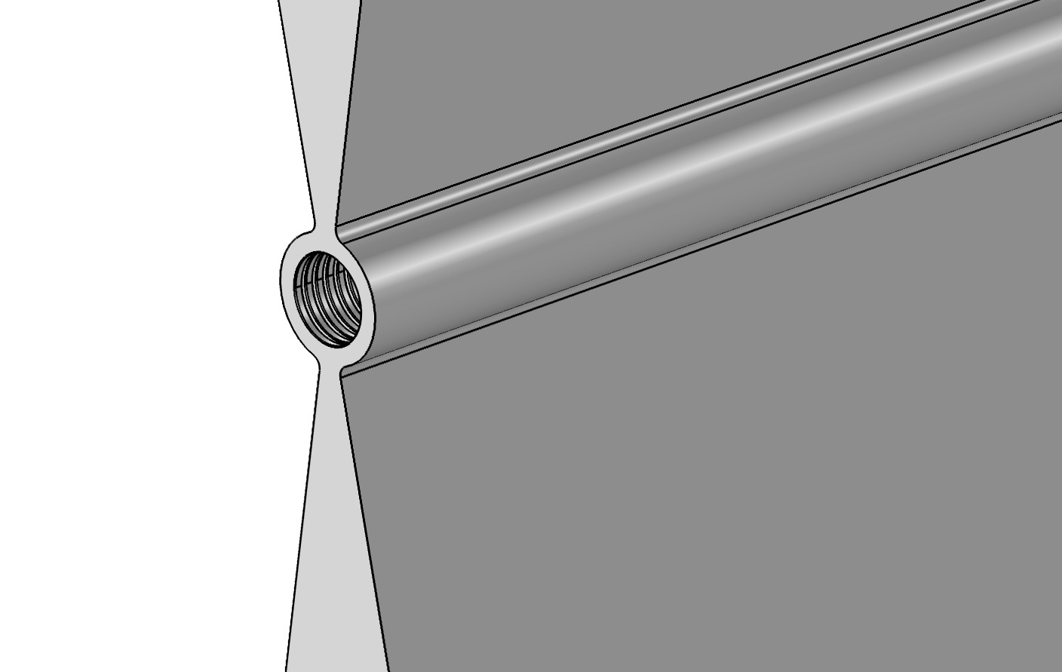
Corrugated Waveguide Simulations
8/9/2017
Hector Perez
Summer Intern APS Engineering Support, MED Mentors: Kamlesh Suthar, Geoff Waldschmidt

Slide 2
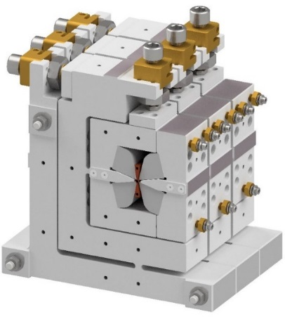
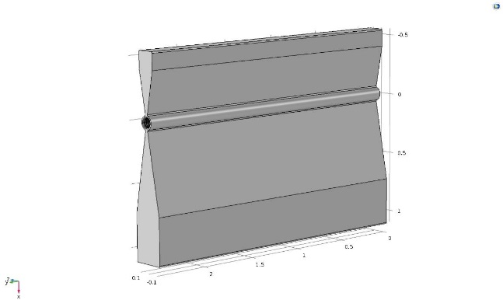
Wakefield AcceleraTOR
High Gradient Accelerating Structure
Wakefields accelerate beam
Quadrupole focuses beam
Heat deforms corrugations
Magnetic Field
Wake field
waveguide walls
Beam bunches

Slide 3
Project Details
Find resonance frequency of electromagnetic wave
Cool via water channels
Model deformation

Slide 4
Simulation outline
Modeled using Creo Parametric and COMSOL Multiphysics
Creo
Import to COMSOL
RF
CFD & Heat Transfer
Structural Mechanics

Slide 5
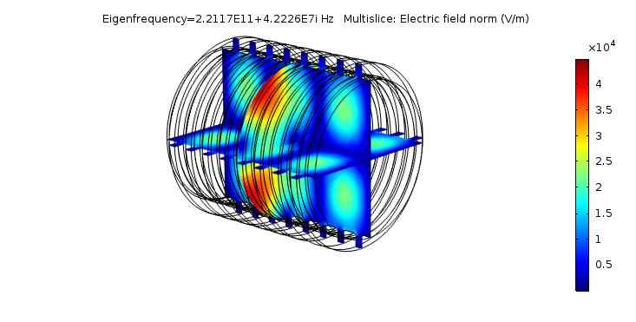
RF Simulation
Found resonant frequency
Can potentially obtain heat deposited using power of the wave

Slide 6
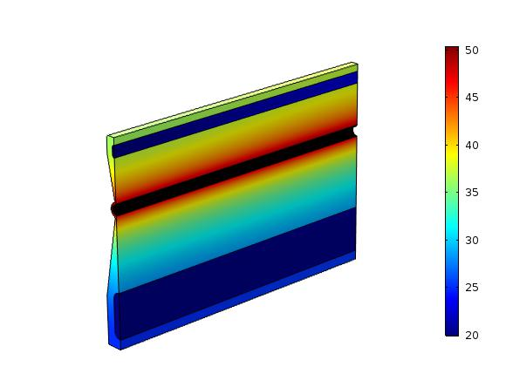
Temperature Distribution
Used 20 W/cm
Turbulence using k-ε and k-ω models
deg. C
deg. C

Slide 7
Deformation
Only obtained for k-ε models
meters

Slide 8
Next Steps
Look further into deformation
Create single simulation
RF
Resonant Frequency
Heat Dissipation
CFD and Heat Transfer
Water removes heat
Obtain Temp. distribution
Structural Mechanics
Deformation
Evaluate Performance
Design Channel

