Slide 1
NuMI Shutdown Activities – Week 3
Marty Murphy
AD 09:00 Scheduling Meeting
28 July 2017

Slide 2
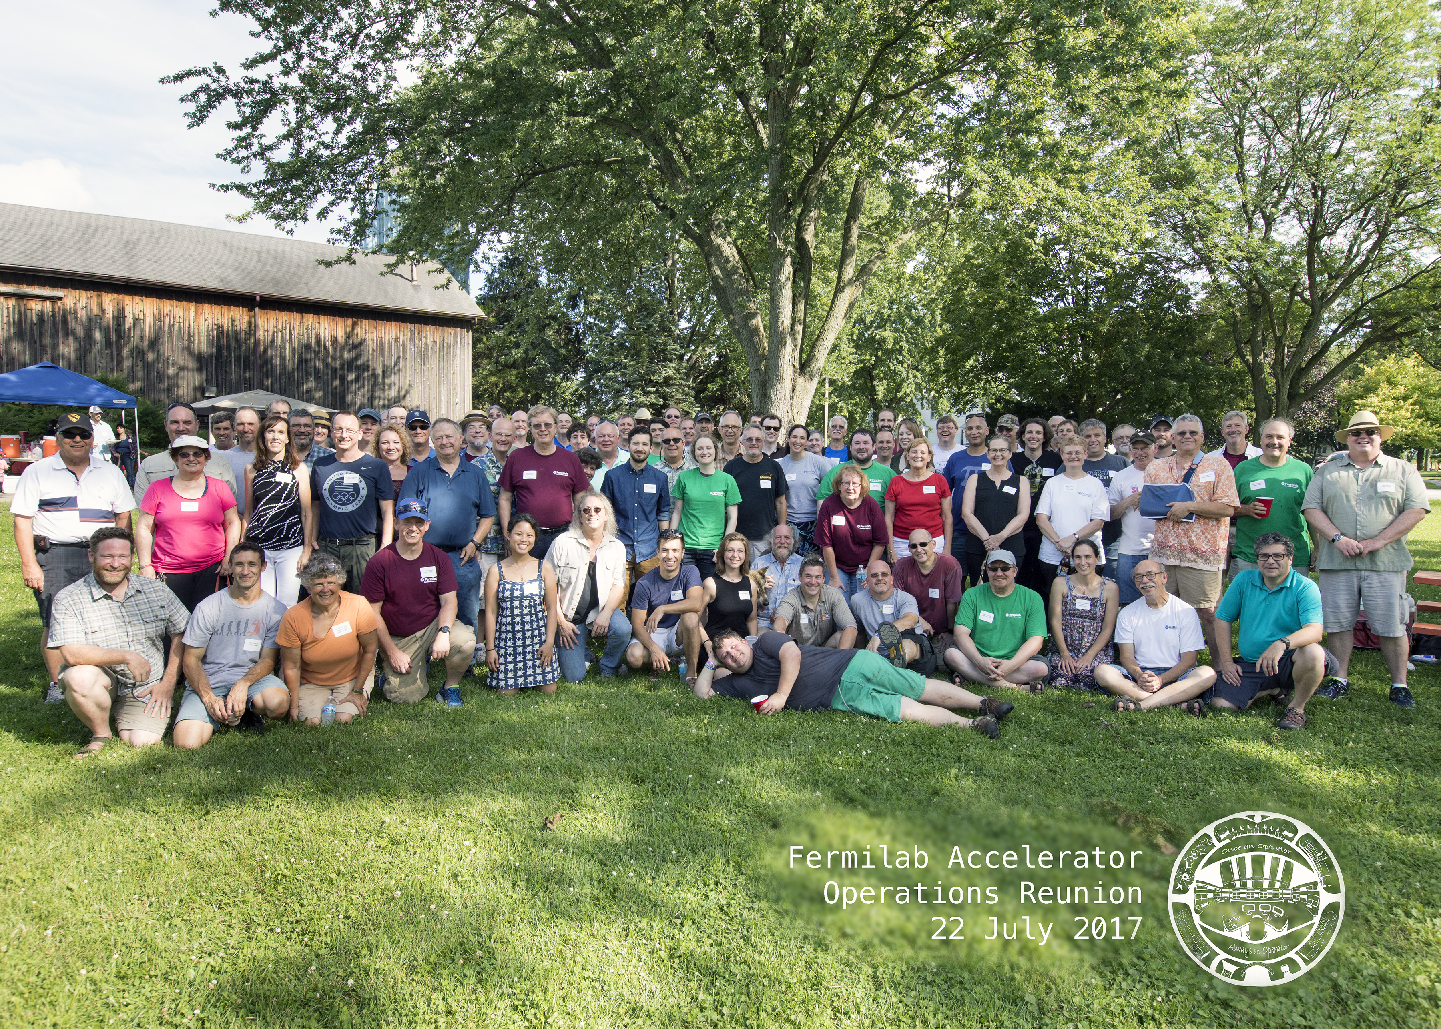

Slide 3
Week-3 Jobs
Boroscope Target Hall Underdrains 100% - complete
Condensate pump electrical switch repair – 100% complete
Target & Horn Skids filter replacement – 100% complete
Absorber Hall Seresco Dehumidifier repair –Prism) today.
Added new pressure sensors to RAW skids – 100% complete
PM of Target Hall ”Stack-o-5” dehumidifiers – 20% complete

Slide 4
Week-4 & 5 Jobs:
Week-4
  Continue PM of “Stack-o-5” TH dehumidifiers
  Complete TH Camera installation for remote operation
Week-5
  Install Rail system
  Remove Shielding blocks from target & both horns
  Install module shielding for jobs in chase.
  Continue Horn-1 RAW leak hunt.

Slide 5
Upcoming Jobs for T&M or Alignment
Week-6 or Week-7:
  As-Found alignment of H1, H2 and Target.
  Electricians for Target Hall cable pulls
Week-8 (August 14):
  Move MET-01 from morgue to C0 – security, driver, etc.
  Multistack chiller heat exchanger installation – Fitters.

Slide 6
Marty on Vacation Until August 8
Cory Crowley will coordinate until August 5
Tony Busch will coordinate from August 6 to August 8

