Slide 1


Azimuthally differential pion femtoscopy relative to the second harmonic in Pb-Pb collisions at √s_{NN} = 2.76 TeV from ALICE
Mohammad Saleh - Wayne State University
on behalf of the ALICE Collaboration
US LHC Users Association Meeting, Nov 3, 2017

Slide 2
Outline
Introduction
ALICE at the LHC
Azimuthal HBT:
  second harmonic
  third harmonic
Summary
PRL 118, 222301 (2017)
Not included in this presentation
Mohammad Saleh US-LHC Meeting 11/03/2017

Slide 3
Introduction: Heavy Ion Collisions
Mohammad Saleh US-LHC Meeting 11/03/2017

Slide 4
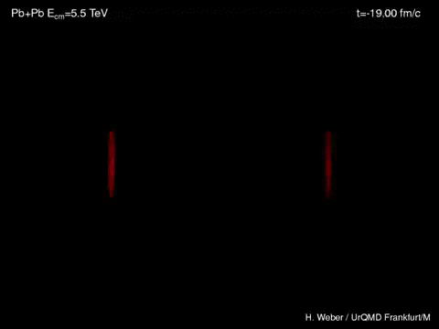
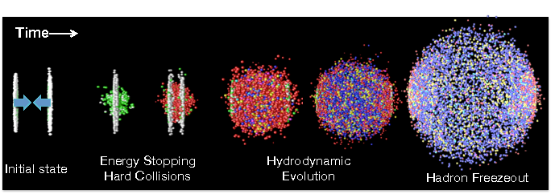
Introduction: Heavy Ion Collision
arXiv:1702.01612
Initial state
Hard
collisions
QGP: Quark Gluon Plasma
and hydrodynamic expansion
Not included in this presentation
Hadron freeze-out
Mohammad Saleh US-LHC Meeting 11/03/2017

Slide 5
Introduction: Heavy Ion Collisions
arXiv:1702.01612
Initial state
Hard
collisions
QGP: Quark Gluon Plasma
and hydrodynamic expansion
Not included in this presentation
Hadron freeze-out
We want to study the QGP
We measure the correlations between identified particles
Mohammad Saleh US-LHC Meeting 11/03/2017

Slide 6
Experimental setup
Mohammad Saleh US-LHC Meeting 11/03/2017

Slide 7
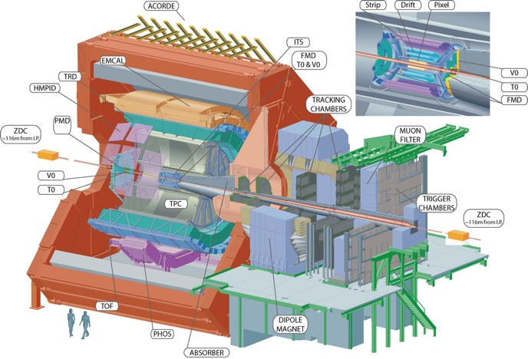
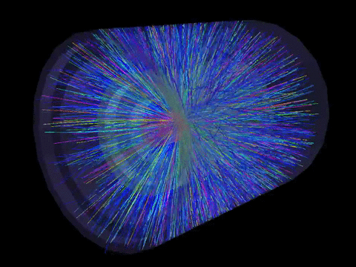


ALICE at the LHC
V0
TPC
CENTRALITY %
TOF
Centrality: V0 multiplicity, Centrality: 0-50%
Main tracking device: Time Projection Chamber (TPC),
Particle identification (PID): TPC (dE/dx) & TOF (time of flight), pions were used in this analysis
100%
Mohammad Saleh US-LHC Meeting 11/03/2017

Slide 8
Analysis Methods
Mohammad Saleh US-LHC Meeting 11/03/2017

Slide 9
HBT
HBT: Hanbury Brown and Twiss, measured the angular diameter of Sirius
A very powerful tool to study the source space-time extension in heavy-ion collisions
Theory
Experiment
Bowler and Sinyukov:
Fitting
A(q) is the measured (same-event) pair distribution in relative momentum
N: normalization; K: Coulomb correction; λ: chaoticity
B(q) is the measured (mixed-event) pair distribution in relative momentum
.
Our goal is to estimate G(q), the source function
Mohammad Saleh US-LHC Meeting 11/03/2017

Slide 10
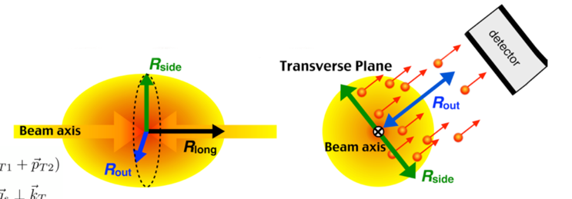
3D HBT radii
Gaussian parametrization of the source function in the out-side-long system
R_{out}: source size along the pair transverse momentum direction
R_{side}: source size perpendicular to pair transverse momentum direction
R_{long}: longitudinal size
R_{os}: out-side cross term
Y. Sinyukov, R. Lednicky, S. Akkelin, J. Pluta, and B. Erazmus, Physics Letters B 432 (1998)
Mohammad Saleh US-LHC Meeting 11/03/2017
S. Pratt, T. Csorgo, and J. Zimanyi,” Phys. Rev. C 42 2646–2652.
Notes:
Experimentally , the correlation function is defined as the ratio of the relative particle momenta from same event divided by the relative particle momenta from mixed event

Slide 11
Azimuthal HBT w.r.t v₂ plane
Initial source
Initial elliptic source
Mohammad Saleh US-LHC Meeting 11/03/2017

Slide 12
Azimuthal HBT w.r.t v₂ plane
reaction plane
Initial elliptic source
v₂ plane (𝚿₂)
Stronger in-plane expansion
Mohammad Saleh US-LHC Meeting 11/03/2017

Slide 13
Azimuthal HBT w.r.t v₂ plane
reaction plane
Stronger in-plane expansion elliptic flow (v₂)
Initial elliptic source
Initial source
v₂ plane (𝚿₂)
Final eccentricity can be measured by azimuthal HBT w.r.t second harmonic event plane
  It depends on initial eccentricity, lifetime and dynamics of the source evolution
Mohammad Saleh US-LHC Meeting 11/03/2017

Slide 14
Azimuthal HBT w.r.t v₂ plane
reaction plane
Stronger in-plane expansion elliptic flow (v₂)
Initial elliptic source
Initial source
𝛆₂ > 0
out-of-plane
v₂ plane (𝚿₂)
Final eccentricity can be measured by azimuthal HBT w.r.t second harmonic event plane
  It depends on initial eccentricity, lifetime and dynamics of the source evolution
Mohammad Saleh US-LHC Meeting 11/03/2017

Slide 15
Azimuthal HBT w.r.t v₂ plane
reaction plane
Stronger in-plane expansion elliptic flow (v₂)
Initial elliptic source
Initial source
𝛆₂ > 0
out-of-plane
𝛆₂ < 0
in-plane
v₂ plane (𝚿₂)
Final eccentricity can be measured by azimuthal HBT w.r.t second harmonic event plane
  It depends on initial eccentricity, lifetime and dynamics of the source evolution
Mohammad Saleh US-LHC Meeting 11/03/2017

Slide 16
Azimuthal HBT w.r.t v₂ plane
reaction plane
Stronger in-plane expansion elliptic flow (v₂)
Initial elliptic source
Initial source
𝛆₂ > 0
out-of-plane
𝛆₂ < 0
in-plane
v₂ plane (𝚿₂)
𝛆_{final}?
Final eccentricity can be measured by azimuthal HBT w.r.t second harmonic event plane
  It depends on initial eccentricity, lifetime and dynamics of the source evolution
Mohammad Saleh US-LHC Meeting 11/03/2017

Slide 17

Azimuthal HBT w.r.t v₂ plane
reaction plane
Stronger in-plane expansion elliptic flow (v₂)
Initial elliptic source
Initial source
𝛆₂ > 0
out-of-plane
𝞅_{pair}
𝛆₂ < 0
in-plane
v₂ plane (𝚿₂)
𝛆_{final}?
Final eccentricity can be measured by azimuthal HBT w.r.t second harmonic event plane
  It depends on initial eccentricity, lifetime and dynamics of the source evolution
Mohammad Saleh US-LHC Meeting 11/03/2017

Slide 18
Azimuthal HBT w.r.t v₂ plane
reaction plane
Stronger in-plane expansion elliptic flow (v₂)
Initial elliptic source
Initial source
𝛆₂ > 0
out-of-plane
𝞅_{pair}
𝛆₂ < 0
in-plane
v₂ plane (𝚿₂)
𝛆_{final}?
Final eccentricity can be measured by azimuthal HBT w.r.t second harmonic event plane
  It depends on initial eccentricity, lifetime and dynamics of the source evolution
Mohammad Saleh US-LHC Meeting 11/03/2017

Slide 19
Azimuthal HBT w.r.t v₂ plane
reaction plane
Stronger in-plane expansion elliptic flow (v₂)
Initial elliptic source
Initial source
𝛆₂ > 0
out-of-plane
𝞅_{pair}
𝛆₂ < 0
in-plane
v₂ plane (𝚿₂)
𝛆_{final}?
Final eccentricity can be measured by azimuthal HBT w.r.t second harmonic event plane
  It depends on initial eccentricity, lifetime and dynamics of the source evolution
Mohammad Saleh US-LHC Meeting 11/03/2017

Slide 20
Results
Mohammad Saleh US-LHC Meeting 11/03/2017

Slide 21

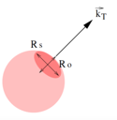
Results: Azimuthal HBT w.r.t v₂ plane
PRL 118, 222301 (2017)
As the value of k_{T} increases, the radii decrease.
  Space-momentum correlation =collective flow
Mohammad Saleh US-LHC Meeting 11/03/2017

Slide 22

Results: Azimuthal HBT w.r.t v₂ plane
PRL 118, 222301 (2017)
As the value of k_{T} increases, the radii decrease.
  Space-momentum correlation =collective flow
R_{side}
R_{out}
v₂ plane
Mohammad Saleh US-LHC Meeting 11/03/2017
R_{out} and R_{side} oscillate out-of-phase

Slide 23
Results: Azimuthal HBT w.r.t v₂ plane
PRL 118, 222301 (2017)
As the value of k_{T} increases, the radii decrease.
  Space-momentum correlation =collective flow
R_{side}
R_{out}
v₂ plane
Mohammad Saleh US-LHC Meeting 11/03/2017
R_{out} and R_{side} oscillate out-of-phase

Slide 24
Results: Azimuthal HBT w.r.t v₂ plane
Initial source
Final source
Mohammad Saleh US-LHC Meeting 11/03/2017

Slide 25
Results: Azimuthal HBT w.r.t v₂ plane
٭
Initial source
PRL 118, 222301 (2017)
Final source
0 < 𝛆_{final} (LHC) < 𝛆_{final} (RHIC) < 𝛆_{initial}
𝛆_{final} > 0
Final eccentricity is smaller than the initial eccentricity, but remains positive (still out-of-plane extended)
F. Retiere and M. A. Lisa, Phys. Rev. C 70, 044907 (2004)
Mohammad Saleh US-LHC Meeting 11/03/2017

Slide 26
Results: Azimuthal HBT w.r.t v₂ plane
PRL 118, 222301 (2017)
Initial source
Final source
𝛆_{final} > 0
The lines connect the hydro points
The 3+1D hydro calculations agree qualitatively but predict a more isotropic final source
3+1D hydro calculations from: P. Bozek, “Phys. Rev. C89,258,044904(2014)
Mohammad Saleh US-LHC Meeting 11/03/2017

Slide 27
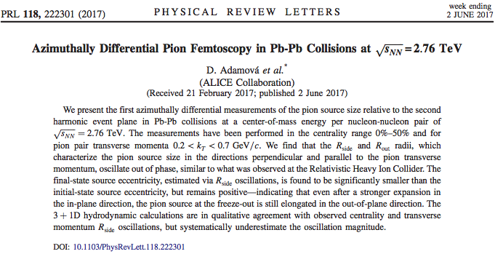
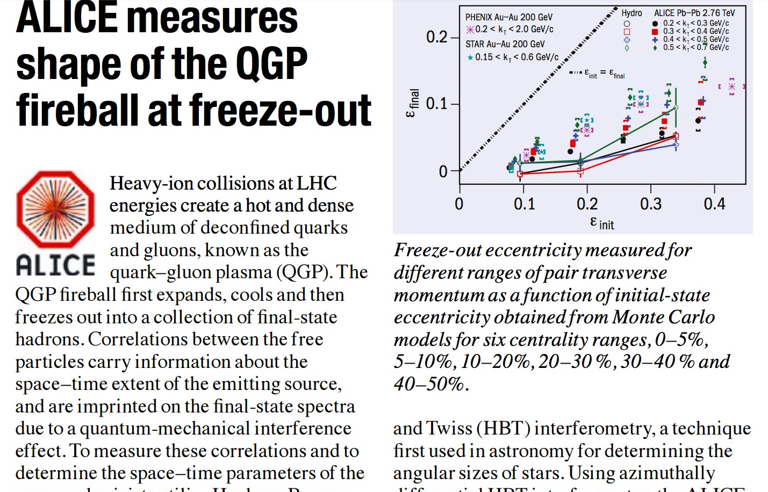
Summary
Azimuthal HBT w.r.t v₂ plane:
  Final eccentricity is smaller than the initial eccentricity, but remains positive (still out-of-plane), 0 < 𝛆_{final} (LHC) < 𝛆_{final} (RHIC) < 𝛆_{initial}
  The 3+1D hydro calculations for final eccentricity agree qualitatively but predict a more isotropic final source
PRL publication
CERN Courier, April issue
Mohammad Saleh US-LHC Meeting 11/03/2017

Slide 28
Thank you
Mohammad Saleh US-LHC Meeting 11/03/2017

Slide 29
Backup slides
Mohammad Saleh US-LHC Meeting 11/03/2017

Slide 30
Results: Azimuthal HBT w.r.t v₂ plane
arXiv:1702.01612
R_{out}, R_{side}, and R_{long} have clear centrality and k_{T} dependence
3+1D Hydro agrees qualitatively with ALICE data points
Average radii are larger for more central collisions which is related to the initial eccentricity
Mohammad Saleh US-LHC Meeting 11/03/2017

Slide 31
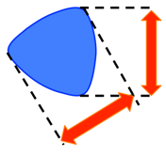
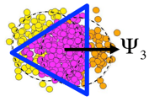
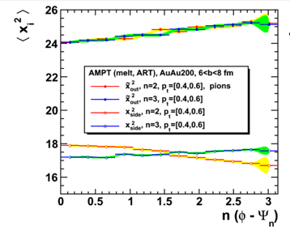
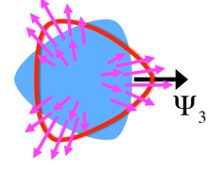
Motivation: Azimuthal HBT w.r.t v₃ plane
Initial geometry
Final source shape
??
For non-expanding source:
  no R_{side} oscillations should be observed w.r.t 𝚿₃
Triangular flow leads to Radii oscillations
Expected by
triangular flow (v₃)
S. Voloshin, QM2011
Radii oscillations will confirm the collective nature of triangular flow
AMPT model: B. Zhang, C. M. Ko, B. -A. Li, Z. -w. Lin, Phys. Rev. C61, 067901 (2000)
Mohammad Saleh US-LHC Meeting 11/03/2017

Slide 32
Azimuthal HBT w.r.t v₃ plane
Radii oscillations were observed for all centralities
Rout and R_{side} oscillate in-phase
Mohammad Saleh US-LHC Meeting 11/03/2017

Slide 33
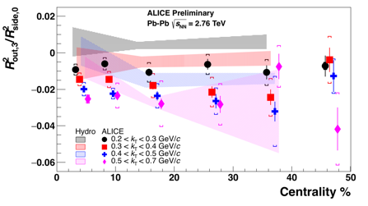
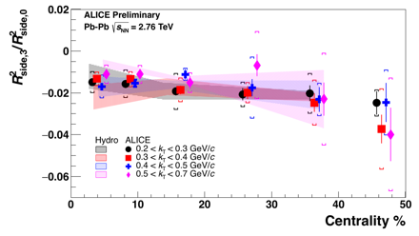
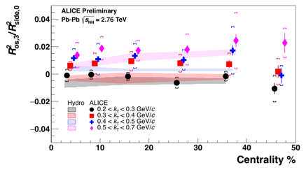
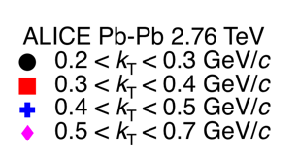

Results: Azimuthal HBT w.r.t v₃ plane
Amplitudes of the relative radii oscillations for R_{out} agree qualitatively with hydro while R_{side} and R_{os} agree quantitatively
*3+1D hydro calculations from: P. Bozek, “Phys. Rev. C89,258,044904(2014)
Mohammad Saleh US-LHC Meeting 11/03/2017

Slide 34
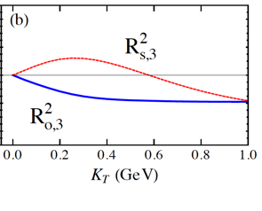
Results: Azimuthal HBT w.r.t v₃ plane
Toy Model
Triangular flow dominated
case (𝛆₃=0)
Toy model shows in-phase oscillations of R_{out} and R_{side} for k_{T} > 0.6 GeV
  Initial triangular deformation is washed-out, or even reversed.
Toy model: C. J. Plumberg, C. Shen, and U. Heinz, Phys. Rev. C 88 (2013)
Notes:
seperate to two pictures first stART EIRTH THE RESULTS

Slide 35
BW-model – Final Shape
a₃
𝞀₃
Isotropic final source, Initial trangular shape is washed out
Mohammad Saleh US-LHC Meeting 11/03/2017

