Slide 1
DOE Nuclear Physics Perspectives
U.S. LHC Users Association Meeting
November 2, 2017
FNAL

Slide 2
Nuclear Physics
FY 2018 Budget Status
Senate recommends $639,200,000 for NP. Recommends $97,200,000 for FRIB and encourages FRIB operations funding. Recommends $5,000,000 for SIPF MIE and $3,200,000 for GRETA MIE. Recommends $174,600,000 for RHIC ops, and optimal operations for CEBAF, ATLAS and BLIP.
House recommends $619,200,000 for NP. Recommends $97,200,000 for FRIB. Encourages optimal operations of RHIC and CEBAF.
NP currently operating at the FY17 level less a small rescission (around 0.7%).

Slide 3

The 2015 Long Range Plan for Nuclear Science
Recommendations:
Capitalize on investments made to maintain U.S. leadership in nuclear science (CEBAF, FRIB, RHIC).
Develop and deploy a U.S.-led ton-scale neutrino-less double beta decay experiment.
Construct a high-energy high-luminosity polarized electron-ion collider (EIC) as the highest priority for new construction following the completion of FRIB.
Increase investment in small-scale and mid-scale projects and initiatives that enable forefront research at universities and laboratories.
For the moment, NP is continuing to pursue the 2015 LRP Vision

Slide 4
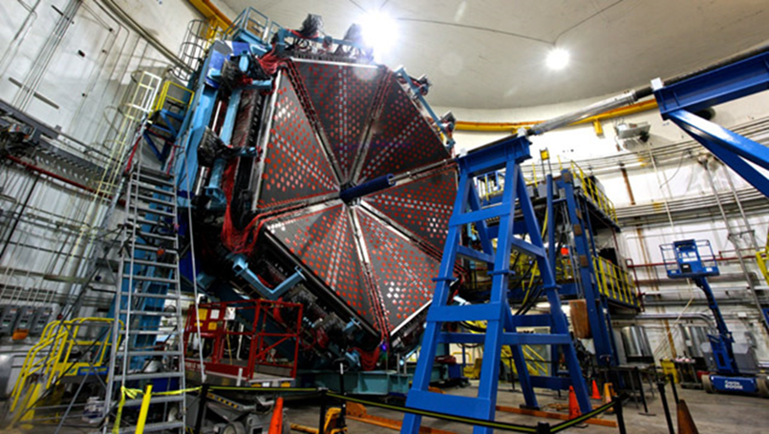
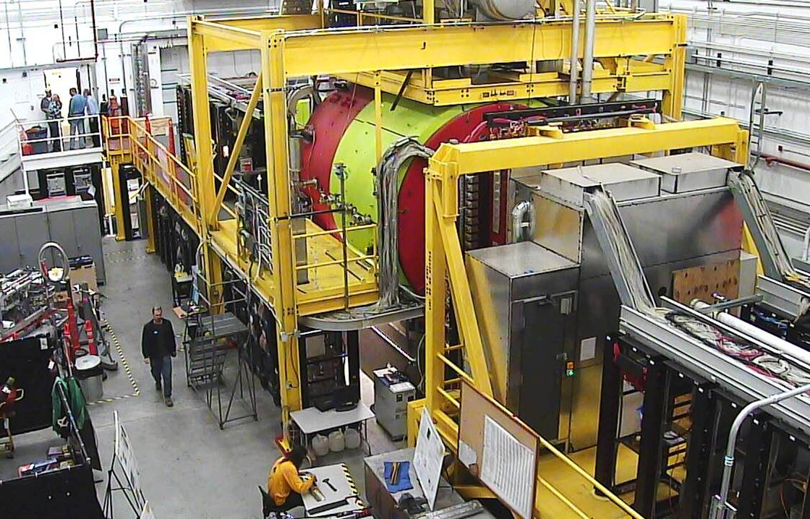
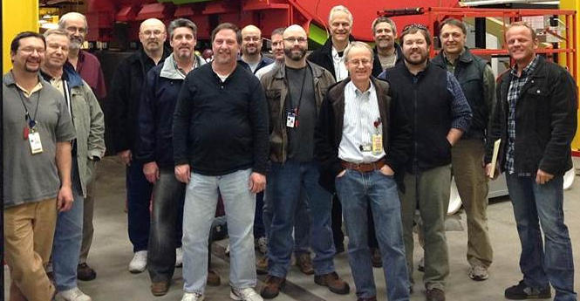
The Continuous Electron Beam Accelerator Upgrade is Successfully Completed
12 GeV CEBAF Upgrade Science Program being initiated:
The CEBAF science program restarts its first science data taking operations following the completion of the 12 GeV Upgrade.
While concurrent operation of the 4 experimental halls is constrained by resources, sequential data taking in the four experimental halls, including the recently constructed Hall D, gets underway.
Hall B Time of Flight Detector
With the completed 12 GeV CEBAF Upgrade, researchers begin experiments to:
Search for exotic new quark-anti-quark particles to advance our understanding of the strong force.
Find evidence of new physics from sensitive searches for violations of nature’s fundamental symmetries.
Gain a microscopic understanding of the internal structure of the proton, including the origin of its spin, and how this structure is modified when the proton is inside a nucleus.
Hall D Solenoidal Spectrometer
Lattice QCD is essential to 12 GeV Research

Slide 5
Continued support for LQCD Research is Crucial for JLAB Hall D Program
NP is making its own assessment of an optimal strategy for LQCD support going forward

Slide 6
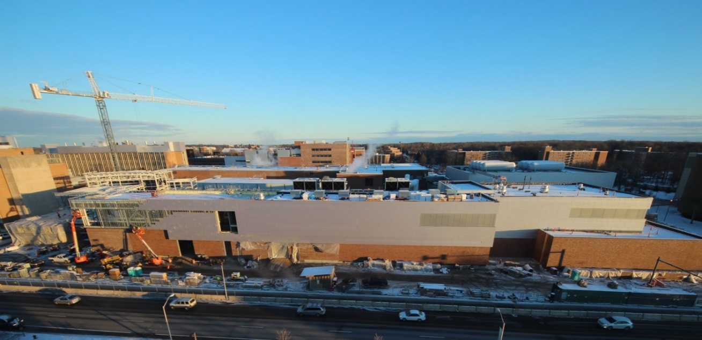
Facility for Rare Isotope Beams is > 80% Complete
FRIB will increase the number of isotopes with known properties from ~2,000 observed over the last century to ~5,000 and will provide world-leading capabilities for research on:
Nuclear Structure
  The limits of existence for nuclei
  Nuclei that have neutron skins
  Synthesis of super heavy elements
Nuclear Astrophysics
  The origin of the heavy elements and explosive nucleo-synthesis
  Composition of neutron star crusts
Fundamental Symmetries
  Tests of fundamental symmetries,
  Atomic EDMs, Weak Charge
  This research will provide the basis for a predictive model of nuclei and how they interact.
The FY 2018 Request supports:
Completing work on the fabrication and assembly of the cryogenics plant and distribution system.
Remaining major procurements; fabrication, assembly and installation of technical systems including cryo-modules and experimental systems.
Completing the commissioning of the FRIB ion source, and beginning the commissioning of the linear accelerator (linac) system.
First year of (limited) operations of completed elements

Slide 7
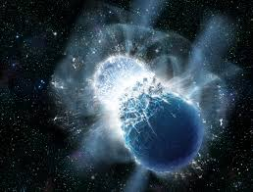
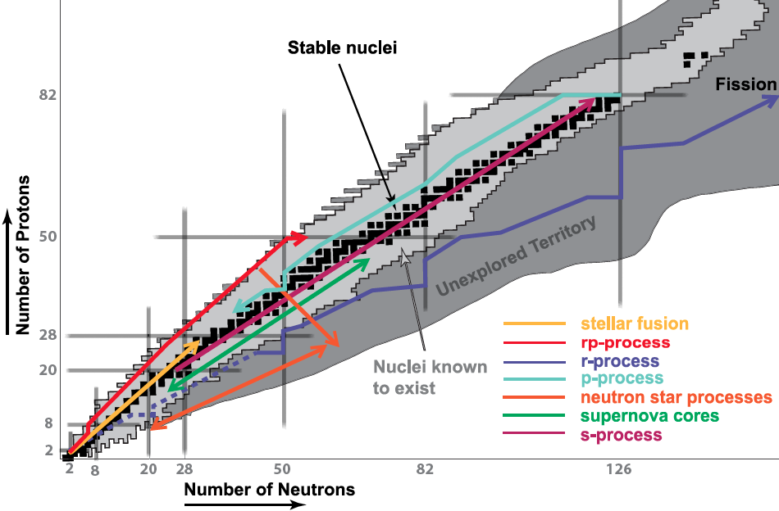
FRIB Promises a Watershed in Understanding Astrophysical Scenarios
FRIB can illuminate the r process rates for many nuclear reactions currently inaccessible, particularly for nuclei with an excess of neutrons
Possible New Paradigm for Production of Heavier Elements: Neutron STAR Mergers
LIGO can illuminate the frequency of such events
Together, LIGO and FRIB can finally “nail down” the cosmic nucleo-synthesis of heavy nuclei
8

Slide 8
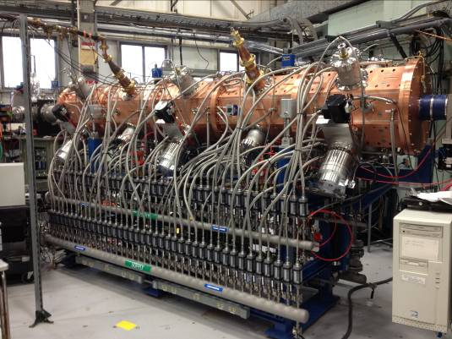
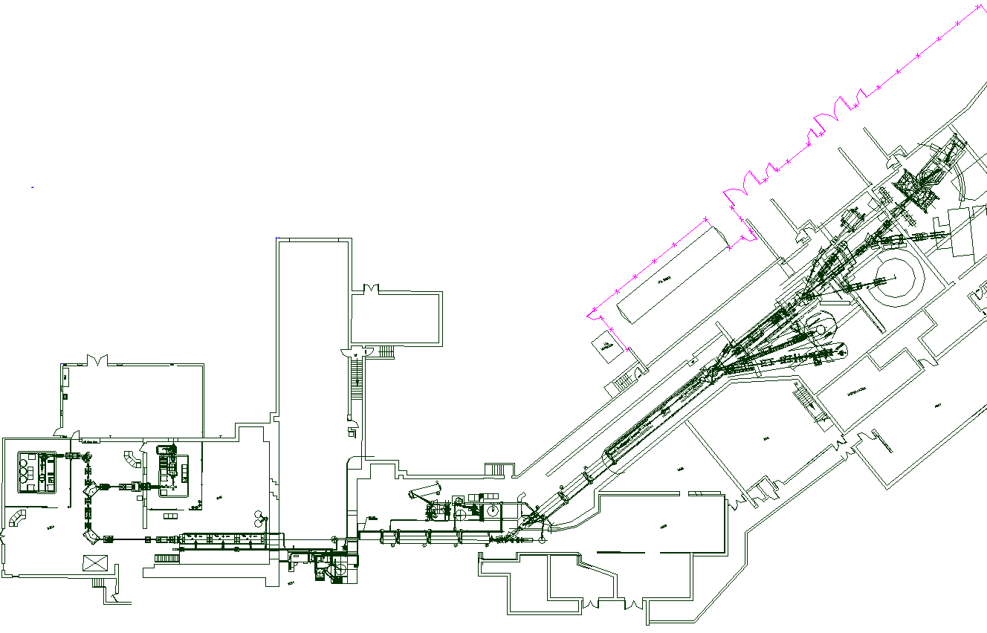
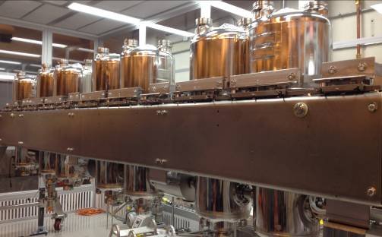
ATLAS After Recent Upgrades. Multi-User Upgrade Planned.
ATLAS is a unique premier Stable Beam Facility for research on Nuclear Structure & Nuclear Astrophysics
Improved instrumentation
New low-energy experimental hall
cryomodule and rebuncher rearranged
EBIS
CARIBU
Future in-flight separator (AIRIS)
MHB RFQ new cryomodule

Slide 9
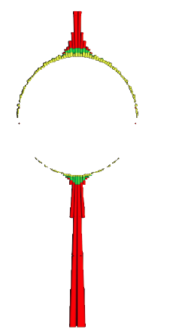
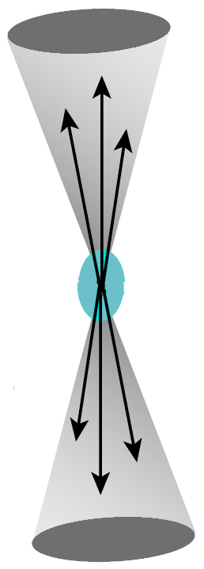
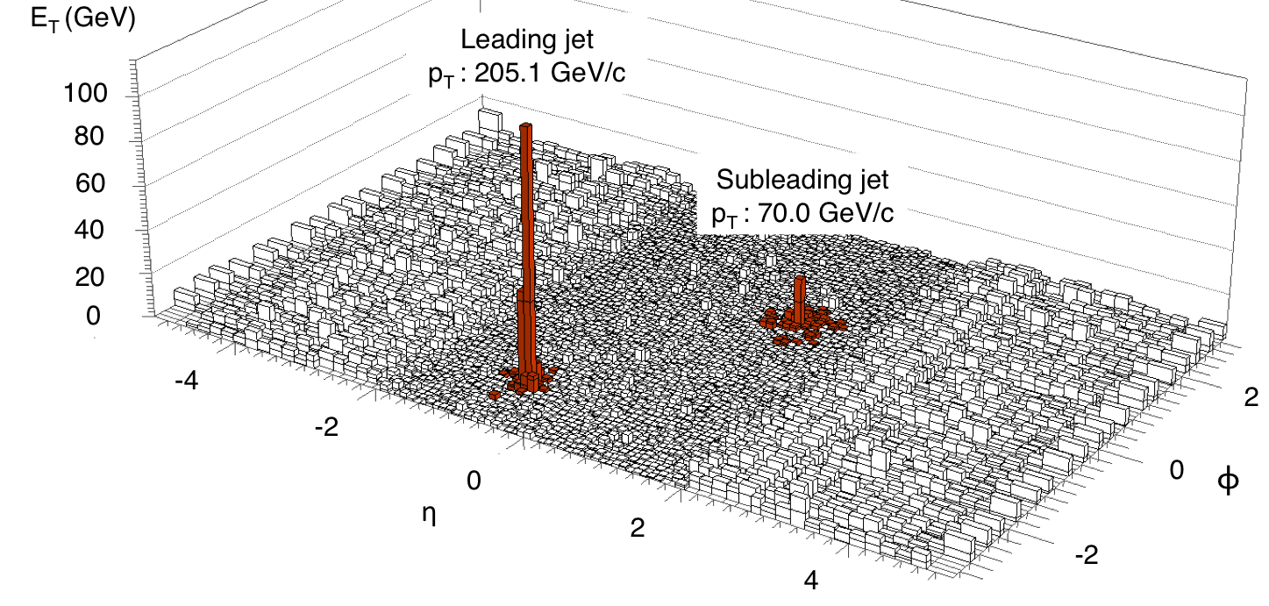
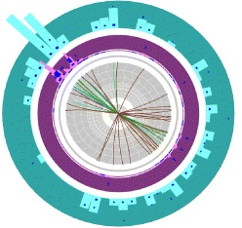
A Brief Reprise of The RHIC Discovery: A Strongly Interacting, Perfect Liquid of Quark and Gluons
The measurement of jets yields a signature discovery: “Jet Quenching”
Beam’s Eye
View
Observation of large asymmetric non back-to-back (jet) energy flow around the beam direction from the interaction of two energetic partons (quarks, gluons) in relativistic nucleus-nucleus collisions
Schematic of expected symmetric back-to-back energy flow (“jets”) around the beam direction from the interaction of two energetic partons (quarks, gluons) in proton – proton collisions
The matter, believed to have influenced the evolution of the early universe, has unique properties and interacts more strongly than any matter previously produced in the laboratory.

Slide 10
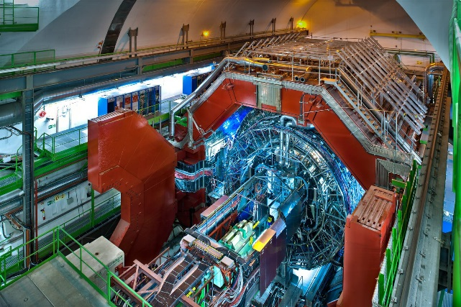
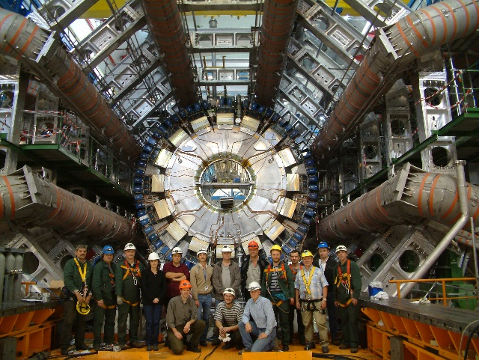
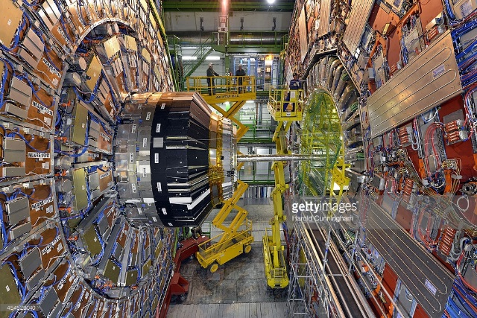
DOE NP Participation in the LHC Heavy Ion Program
NP DOE supports U.S. groups in ALICE, ATLAS, and CMS collaborations
  ALICE – 39 PhDs
    Leading role in ECal and Dcal
    Currently contributing to Inner Tracking System and Time Projection Chamber upgrades
    Tier 2 computing sites at ORNL and LBNL
  CMS – 27 PhDs
    Zero Degree calorimeter
    Trigger
    Tier 2 computing sites at Vanderbilt and MIT
  ATLAS – 6-7 PhDs
    Recently added U. of Colorado and Iowa State U.

Slide 11
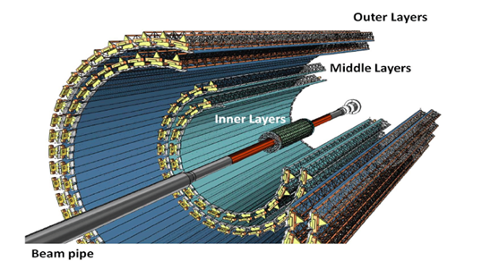
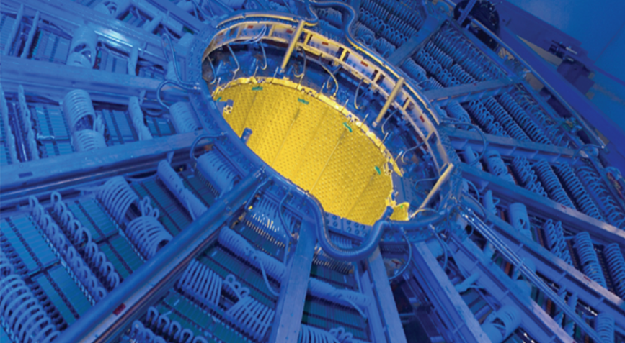
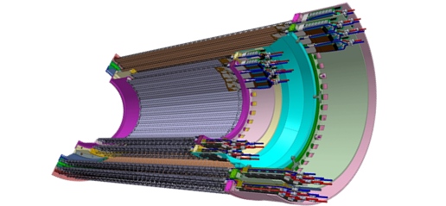
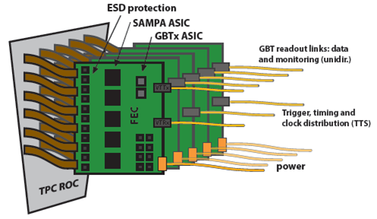
ALICE-USA – Targeted Investments
Continue modest participation in heavy ion program at the LHC – complimentary to RHIC program; provide scientific leadership and small equipment contributions (university led) to ALICE, CMS, and ATLAS
Middle Layer Staves
Limited and modest U.S. contribution to
Heavy Ion Program and upgrades
Composite Material Support Structure
U.S. contribution to ALICE:
Time Projection Chamber (TPC):
Inner Readout Chambers
Readout Electronics
Silicon Inner Tracker System (ITS)
Middle layer detector staves
Electronics readout system
Carbon Fiber support structure
TPC Electronics

Slide 12
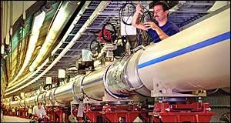
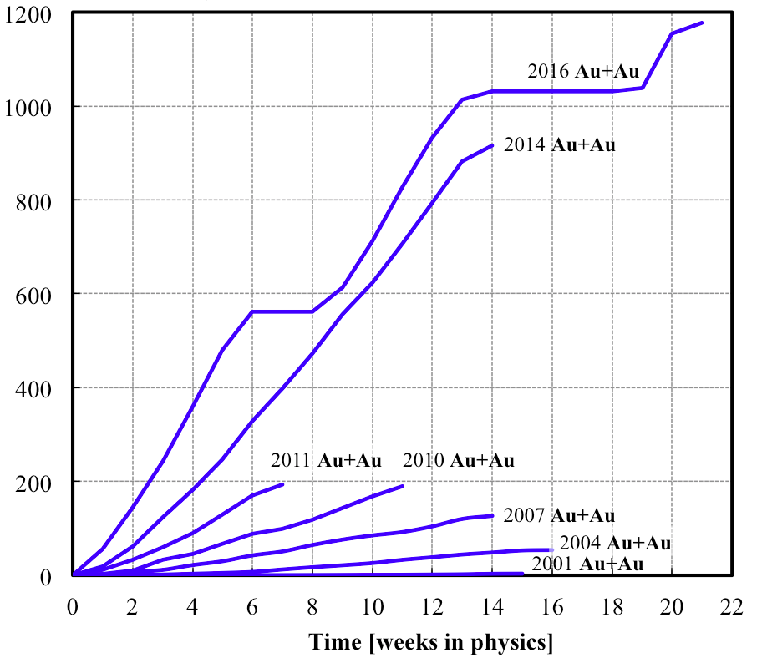
RHIC Machine Performance Continues to Set New Records
The FY 2018 request supports data taking to confirm the explanation of never-before-seen phenomena (chiral magnetic effect) in quark gluon plasma formation and preparations to search for a critical point between the phases of nuclear matter. A Critical Point search is the focus of FY19-20.
The RHIC Spin Program is continuing with a strong focus on transverse spin asymmetries
Au + Au runs
2014
2016
Higher luminosity in Run 16 than in all other RHIC runs combined
Integrated nucleon-pair luminosity L_{NN} [pb⁻¹]
Integrated luminosity L [pb⁻¹]
Consistently high facility availability ( ~ 85%)
No other facility worldwide, existing or planned, rivals RHIC in science reach and versatility as a heavy ion collider. It is the only polarized proton collider in the world.

Slide 13
The Same is True for Nuclear Matter But Statistics (Beam Time) is a Challenge
One striking fact is that the liquid-vapor curve can end. Beyond this “Critical Point” the sharp distinction between liquid and vapor is lost. The location of the Critical Point and of the phase boundaries represent two of the most fundamental characteristics for any substance.
Experimentally verifying the location of fundamental QCD “landmarks” is central to a quantitative understanding of the nuclear matter phase diagram..
A primary signature of the Critical Point will be non-Poissonian scaled kurtosis (net baryon number fluctuations)
Results from the first survey run appear tantalizing, but the statistics do not allow a conclusion. Fluctuations consistent with Poissonian behavior fall along the line at unity
∼ 10 weeks available for a search planned for a 2 year campaign (∼ 48 weeks)

Slide 14
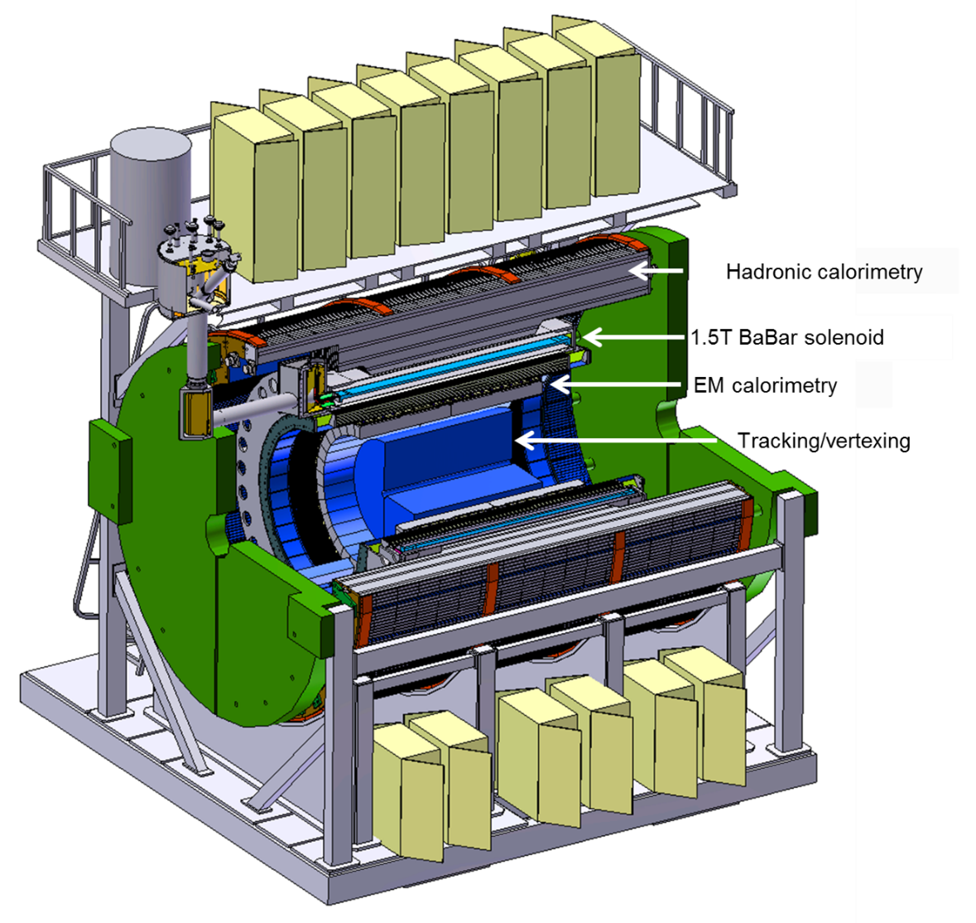
Within Available Funds, the sPHENIX Upgrade Is Being Pursued
mapping the character of the hadronic matter under extreme conditions by varying the temperature of the medium, the virtuality of the probe, and the length scale within the medium
understanding the parton–medium interactions by studying heavy-flavor jets
probing the effect of the quark–gluon plasma on the Upsilon states by comparing the p-p (proton-proton), p-A (proton-nucleus), and A-A (nucleus-nucleus) collisions.
implemented from within RHIC base by limiting operations to one detector and periodically not operating facility,
Successfully passed DOE Review of science case in April 2015. Preparing for CD1 Review.

Slide 15
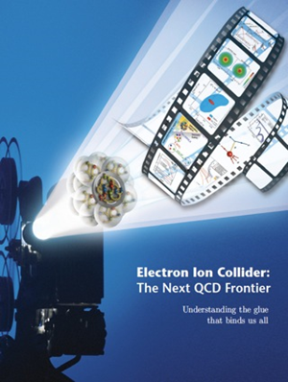
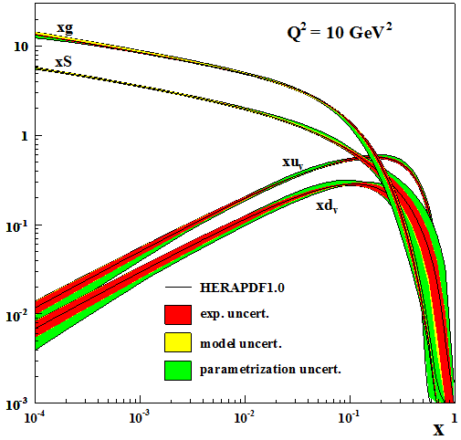
The Longer Term Future of QCD Research: an Electron-Ion Collider
Proton (and nuclei) and black holes are the only fully relativistic (high enough energy density to excite the vacuum) stable bound systems in the universe. Protons can be studied in the laboratory.
Protons are fundamental to the visible universe (including us) and their properties are dominated by emergent phenomena of the self-coupling strong force that generates high density gluon fields:
  The mass of the proton (and the visible universe)
  The spin of the proton
  The dynamics of quarks and gluons in nucleons and nuclei
  The formation of hadrons from quarks and gluons
The study of the high density gluon field that is at
the center of it all requires a high energy, high
luminosity, polarized Electron Ion Collider
The 2013 NSAC Subcommittee on Future Facilities identified the physics program for an Electron-Ion Collider as absolutely central to the nuclear science program of the next decade.
Notes:
9-1-15 version

Slide 16
Next Formal Step on the EIC Science Case is Continuing
THE NATIONAL ACADEMIES OF SCIENCES, ENGINEERING, AND MEDICINE
Division on Engineering and Physical Science
Board on Physics and Astronomy
U.S.-Based Electron Ion Collider Science Assessment
Summary
The National Academies of Sciences, Engineering, and Medicine (“National Academies”) will form a committee to carry out a thorough, independent assessment of the scientific justification for a U.S. domestic electron ion collider facility. In preparing its report, the committee will address the role that such a facility would play in the future of nuclear science, considering the field broadly, but placing emphasis on its potential scientific impact on quantum chromodynamics. The need for such an accelerator will be addressed in the context of international efforts in this area. Support for the 18-month project in the amount of $540,000 has been provided by the Department of Energy.
“U.S.-Based Electron Ion Collider Science Assessment” is now underway. The Co-Chairs are Gordon Baym and Ani Aprahamian. The formal outcome of this exercise expected next spring if not a little sooner.

Slide 17
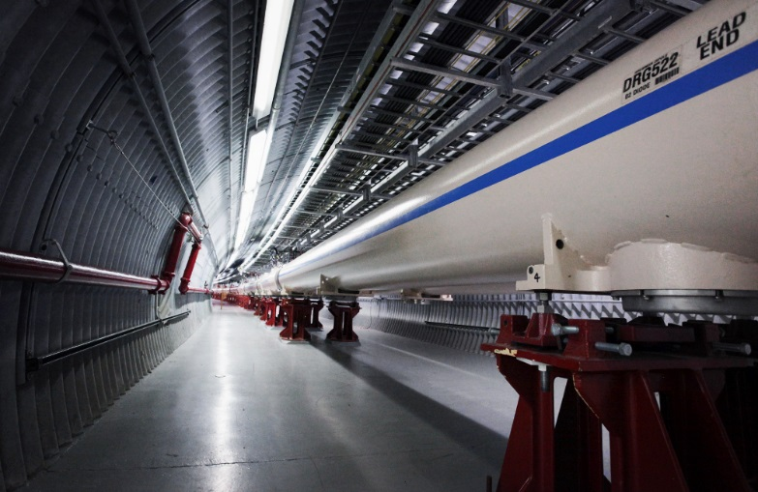
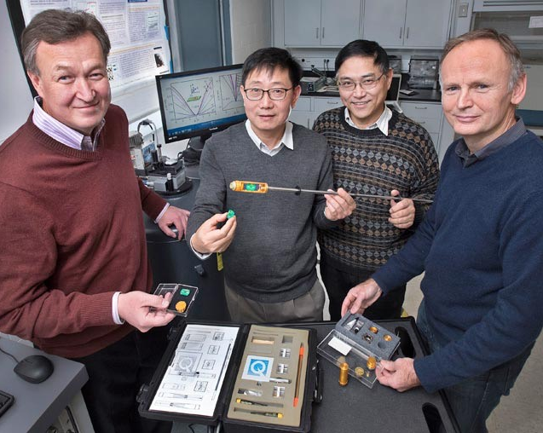
SC Interest in Quantum Information Science (QIS)
Possible Investment in QIS
  NP exploring participation in an FOA to invite transformational proposals
  Information will be solicited from community on current and possible activities in QC and QIS. Two workshops (INT and ANL) also planned.
  Isotope samples may also be produced for QIS
  A QIS theory effort is pursued $8.5M
Areas With Significant NP Expertise
Tool R&D for QIS
Detectors and metrology
Quantum sensors enabling precision measurements
Quantum computational tools
Superconducting RF cavities, laser cooling, neutral ion traps, spin manipulation technology, and isotope production
Chiral-magnetic superconductivity, discovered in nuclear collisions at the Relativistic Heavy Ion Collider, has been demonstrated in condensed matter systems providing a new avenue to dissipation-less current flow and preservation of quantum coherence in signal processing

Slide 18
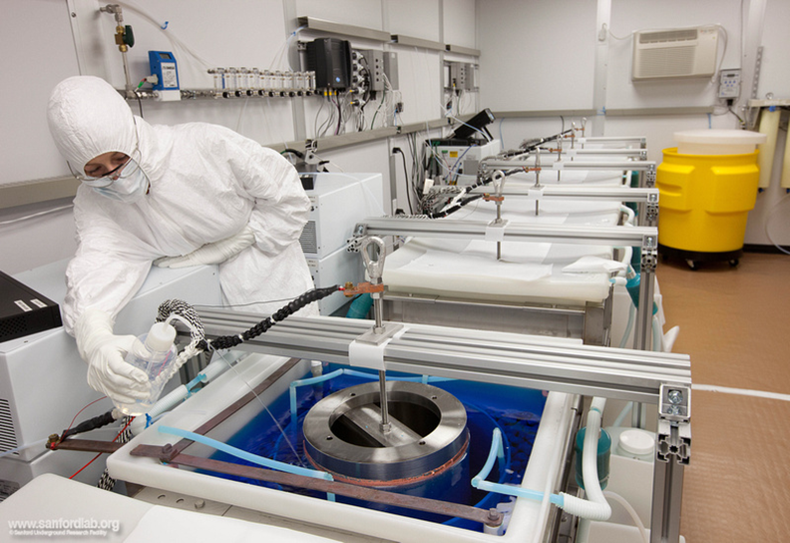
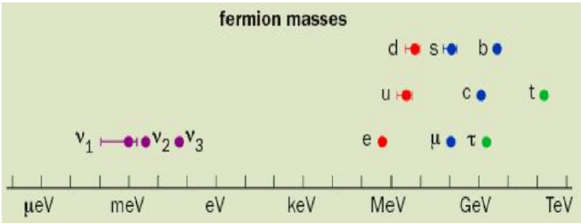
NP Has a Targeted Program in Fundamental Symmetries
With techniques that use nuclear isotopes inside cryostats, often made of ultra-clean materials, scientists are “tooling up” to study whether neutrinos are their own anti-particle.
NSAC charged to provide additional guidance on effective strategy for implementing a possible 2nd generation U.S. experiment
Neutrino-less Double Beta Decay
“Grand Challenge” science questions that will be addressed:
Is the neutrino its own anti-particle?
Why is there more matter than anti-matter in the present universe?
Why are neutrino masses so much smaller than other elementary fermions?
Mandrel insertion in MJD electroforming lab

Slide 19
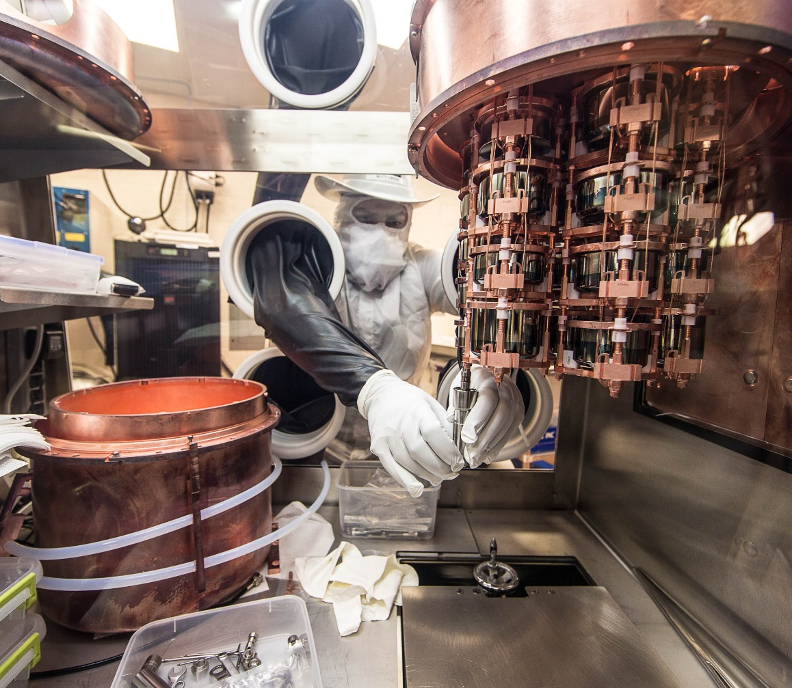
0νββ Demonstrators are Delivering
TeO₂ from CUORE and CUOREcino
1.5 × 10²⁵ years, 90% CL
Ge⁷⁶ from Majorana Demonstrator
1.9 × 10²⁵ years, 90% CL
Ge⁷⁶ from GERDA
8.0 × 10²⁵ years, 90% CL
Xe¹³⁶ from EXO-200
1.8 × 10²⁵ years, 90% CL
Xe¹³⁶ from Kamland-Zen
1.1 × 10²⁶ years, 90% CL
NP is engaging other stakeholders in discussion of a ton-scale experiment

Slide 20
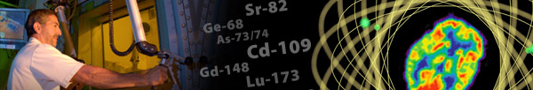
Isotope Program Mission
The mission of the DOE Isotope Program is threefold
Produce and/or distribute radioactive and stable isotopes that are in short supply, associated byproducts, surplus materials and related isotope services.
Maintain the infrastructure required to produce and supply isotope products and related services.
Conduct R&D on new and improved isotope production and processing techniques which can make available new isotopes for research and applications.
Produce isotopes that are in short supply only –
the Isotope Program does not compete with industry

Slide 21
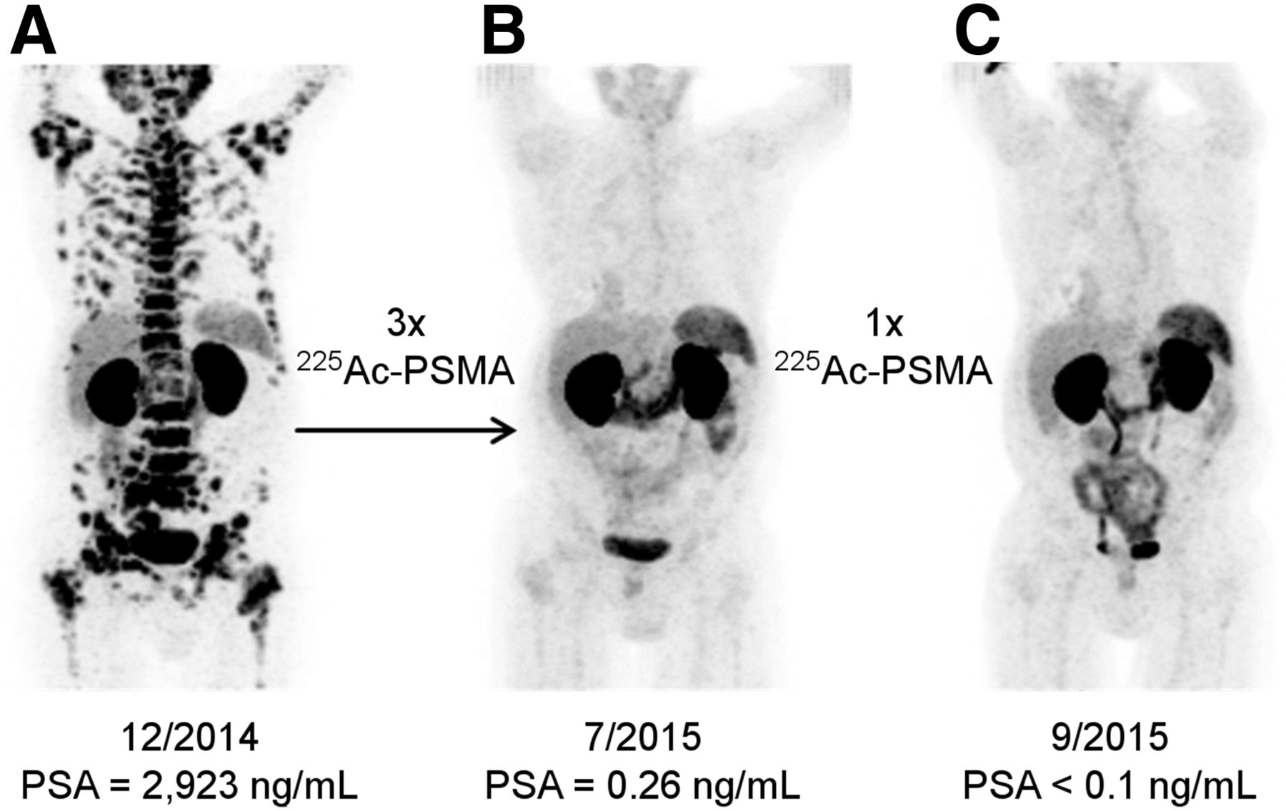
Support for Isotope Research/Mission Readiness is Literally Saving Lives
Ga-68 PET/CT scans of a different patient with metastatic prostate cancer. Image A shows pre-therapeutic tumor spread. Image B was taken 2 months after the third cycle of treatment with the α-emitting isotope Ac-225 attached to a tumor seeking drug. Image C was taken 2 months after one additional treatment dose. Clemens Kratochwil et al. J Nucl Med 2016;57:1941-1944

Slide 22
DOE Isotope Program Production Sites
Univ. of Washington
Pending supplier of research isotopes (e.g., At-211)
PNNL
Sr-90 Y-90 generator for cancer therapy
Ra-223 Cancer therapy
Np-237 Research
BNL (BLIP)
Ge-68 Ga-68 generator for tumor imaging
Sr-82 Rb-82 generator for cardiac imaging
Cu-67 Antibody labeling for targeted cancer therapy
INL (ATR)
Co-60 Gamma knife, sterilization of medical equipment
Univ. of Wisconsin
Pending supplier of research isotopes (e.g., Cu-64)
Y-12 (NNSA Facility)
Li-6 Neutron detection
Li-7 Radiation dosimeters
ORNL
HFIR:
Se-75 Industrial NDA
Cf-252 Industrial sources
W-188 Cancer therapy
Ra-223 Cancer therapy
Np-237 Neutron flux monitors
Stable Isotopes Inventory:
E.g., Ca-48, Ga-69, Rb-87, Cl-37, Pt-195, Nd-146, Sm-149, Ru-99, Zr-96
Radioisotopes Inventory:
Ac-225 Cancer therapy
UC Davis
Pending supplier of research isotopes (e.g., At-211, Zr-89, Y-86, Pb-203)
Univ. of Missouri (MURR)
Pending supplier of research isotopes (e.g., Ho-166, Lu-177, Sm-153)
LANL (IPF)
Ge-68 Ga-68 generator for tumor imaging
Sr-82 Rb-82 generator for cardiac imaging
As-73 Environmental tracer
Si-32 Oceanographic research
Washington Univ.
Pending supplier of research isotopes (e.g., Cu-64)
Duke University
Pending supplier of research isotopes (e.g., At-211)
SRNL (NNSA Tritium Facility)
He-3 Neutron detection
Fuel source for fusion reactors
Lung testing
Notes:
JSG 8-25-15

Slide 23
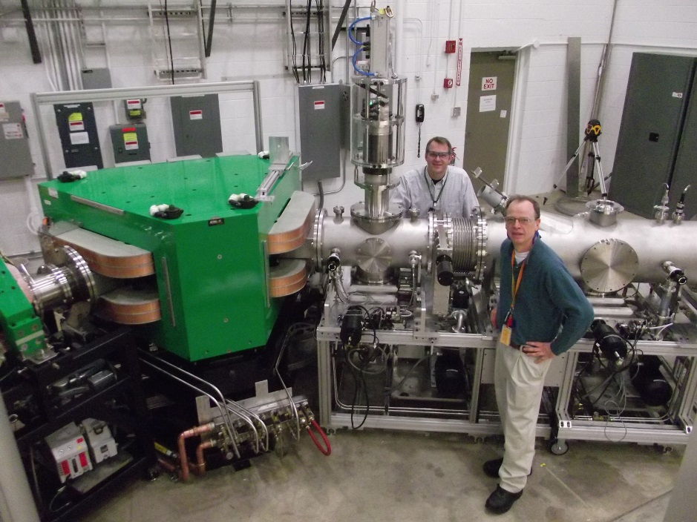
Construction of a Stable Isotope Production Facility (SIPF)
Project scope includes procuring and installing additional Electromagnetic Isotope Separator (EMIS) and Gas Centrifuge Isotope Separator (GCIS) machines in an existing building.
No green site; building modifications may be needed; fabricated as an MIE.
Hardware designs are known and proven in an existing well proven prototype pilot capability.
Project received CD0, Mission Need on September 4, 2015.
Funding Initiated in FY 2017
Estimated time frame for completion: FY 2021
The SIPF directly supports the DOE Isotope Program mission, restoring domestic capability that has been lacking since 1998. Renewed enrichment capability will benefit nuclear and physical sciences, industrial manufacturing, homeland security, and medicine.
Notes:
New – from CD0

Slide 24
The Outlook Today
There is a wealth of science opportunity near term at ATLAS, and longer term at FRIB which will be world leading. NP is beginning to position the low energy experimental community to take advantage of FRIB although the pace of discovery will be slowed by the pace of available funding for new instrumentation. Similar comments extend to the FRIB Theory Alliance (and support for theory in general) which is also crucial.
The U.S. currently has world leadership in experimental QCD research. CEBAF and RHIC are both unique and at the “top of their game” with compelling “must-do” science in progress or about to start. Long term, the future of QCD science is pointing to the need for an electron-ion collider. Efforts will continue with vigor but the expected pace of discovery will be slowed. Some opportunities will not be realized.
A very high priority for the NP community is a U.S. leadership role in the science of neutrino-less double beta decay.
If the out-year budget outlook is unchanged it does not allow for the possibility of a ton-scale neutrino-less double beta decay experiment.
Research and production efforts to meet the United States’s need for isotopes in short supply are being strengthened; re-establishing U.S. capability for stable isotopes will be a major advance and will help address community concerns in this area documented in the 2009 and 2015 NSACI Strategic Plans.

Slide 25
Additional Information

Slide 26
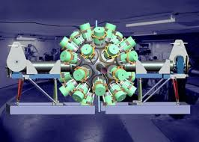
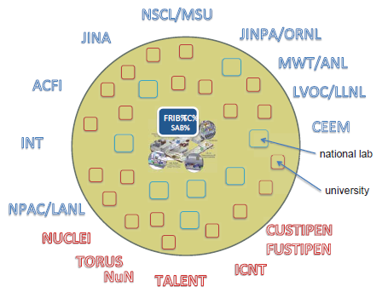
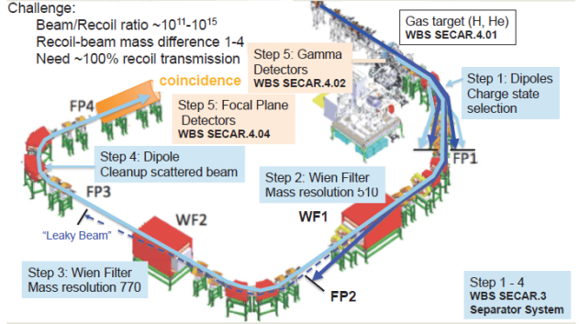
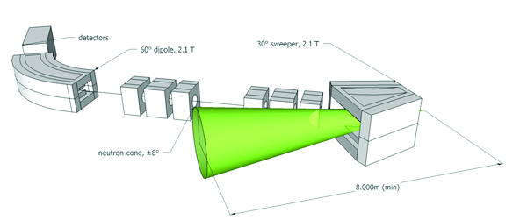
FRIB Instrumentation/Theory Effort Are Getting Underway
GRETA
FRIB Theory Alliance
SECAR
Pre-Conceptual High Rigidity Spectrometer (HRS)

Slide 27
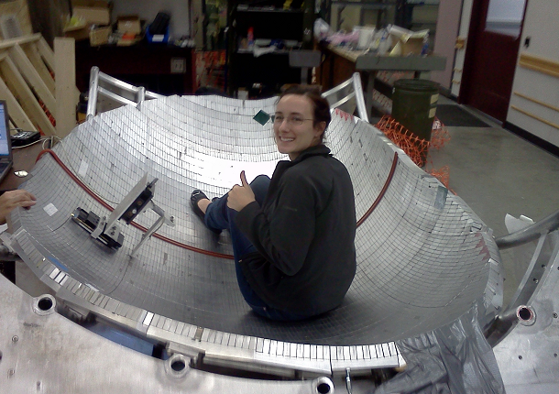
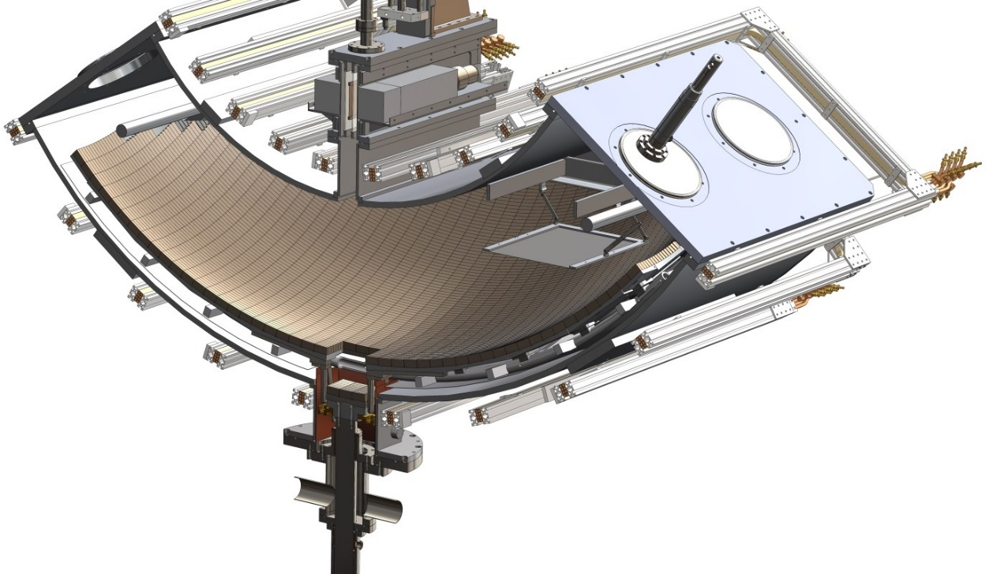
The UCNτ experiment testbed is operational and acquiring data to study systematic effects.
Feasibility Study for a Neutron Lifetime Experiment
Surviving neutrons detected using insertable active detector
Cubic meter trap stores tens of thousands of neutrons per fill, allowing rapid study of small effects.
Neutrons filled into trap here, then stored magnetically and gravitationally.
Key features of experiment:
Magnetic bottle has storage time much greater than free neutron lifetime, rapid phase space mixing
Rapid internal neutron detection scheme counts surviving neutrons with constant efficiency
No absolute counting efficiencies needed: only relative neutron counting
Progress in 2015-2016 LANSCE run cycle: commissioned an active in situ detector; performed intensive studies of neutron phase space evolution, superbarrier UCN removal (“cleaning”), normalization, and detector efficiency effects.

Slide 28
Recent Science News
The UCNtau collaboration at LANL recently unblinded results from engineering data taken during the 2016-17 and 2015-16 LANSCE run cycles at a collaboration meeting, and prepared a first physics result for the experiment with uncertainty approximately equal to the previous most precise neutron lifetime measurement, and that is the first sub-1-second-precision neutron lifetime measurement that did not require a systematic correction large compared to its stated uncertainty….
The latest UCNtau result is: 877.7 ± 0.7 (stat) +0.3/-0.1 (sys) s
The previous best result for a “bottle” type experiment was: 878.5 ± 0.8 s
And the best result for beams is: 887.7 ± 2.2 s
In addition, a publication that was released about the experimental method: "A new method for measuring the neutron lifetime using an in situ neutron detector," 30 May 2017, in Review of Scientific Instruments (Vol.88, Issue 5). It may be accessed via the link:
http://scitation.aip.org/content/aip/journal/rsi/88/5/10.1063/1.4983578

Slide 29

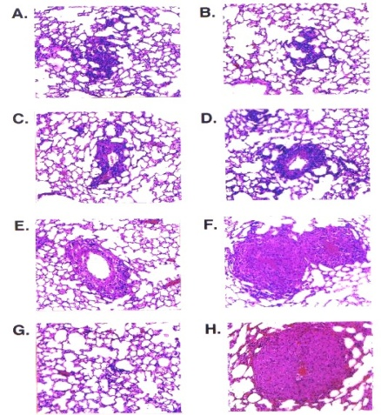
Isotope R&D Creates New Production Methods
Using proton beams, LANL and BNL could match current annual worldwide production of the actinium-225 in just a few days.
Ac-225 emits alpha radiation. Alpha particles are energetic enough to destroy cancer cells but are unlikely to move beyond a tightly controlled target region and destroy healthy cells. Alpha particles are stopped in their tracks by a layer of skin—or even an inch or two of air.
Times
Square
NYC
Treated
control
Day 0
Cancer-cell culture experiment: tumor cells exposed to Ac-225 radiopharmaceutical were radically reduced while untreated control cells proliferated
Day 1
Day 3
Day 5
29

