Slide 1



ATLAS Run 2 Physics Results
David W. Miller
University of Chicago
US LHC Users Association Annual Meeting
On behalf of the ATLAS Collaboration

Slide 2

Recent results confront the Standard Model with high-precision and state-of-the-art techniques
Advances in experimental methods for hadronic final states yield new insights and opportunities
Impacts felt across the ATLAS Physics Program
Will highlight this today with several high precision measurements and new physics searches in ATLAS

Slide 3
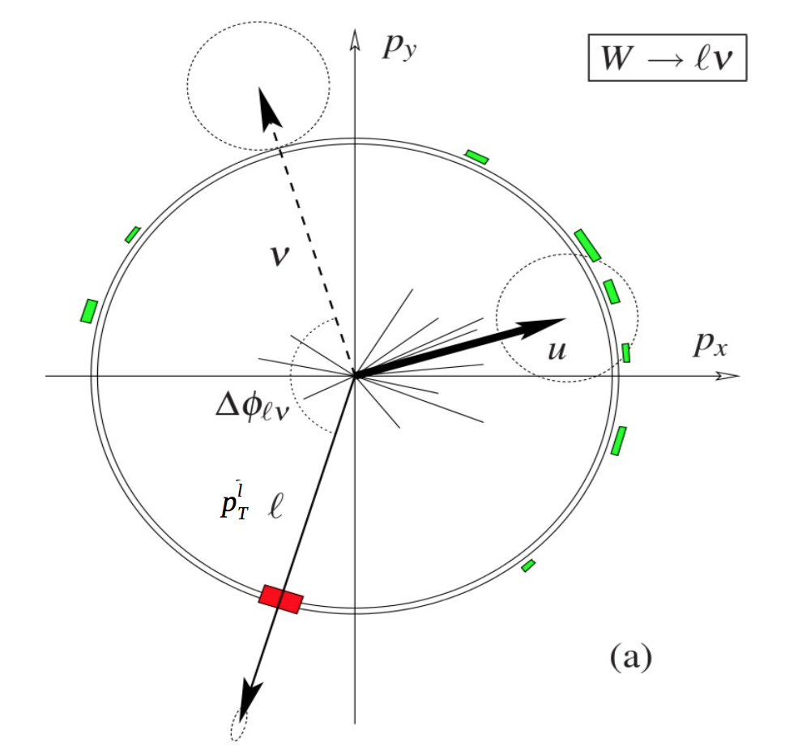
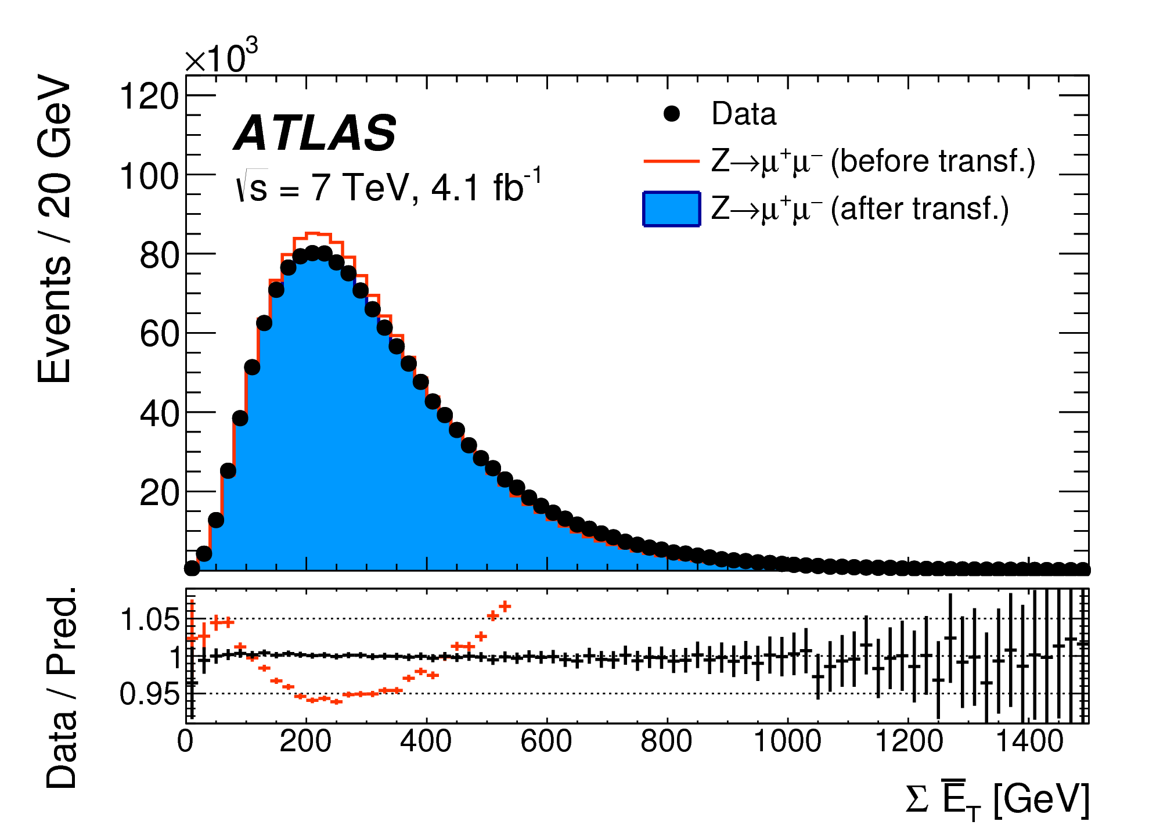
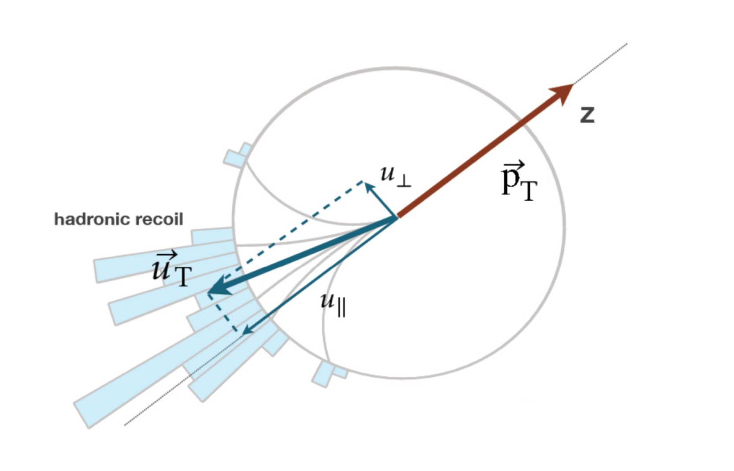
Recent precision W mass measurements
Sophisticated hadronic recoil measurements (u) and corrections allow for high-precision estimates of (missing) transverse momentum and mass of the W boson
Extensively tested and calibrated using leptonic Z decays
Systematic uncertainties for the transverse mass measurement of the W mass reduced to the level of 13 MeV due to these calibrations
arXiv:1701.07240

Slide 4
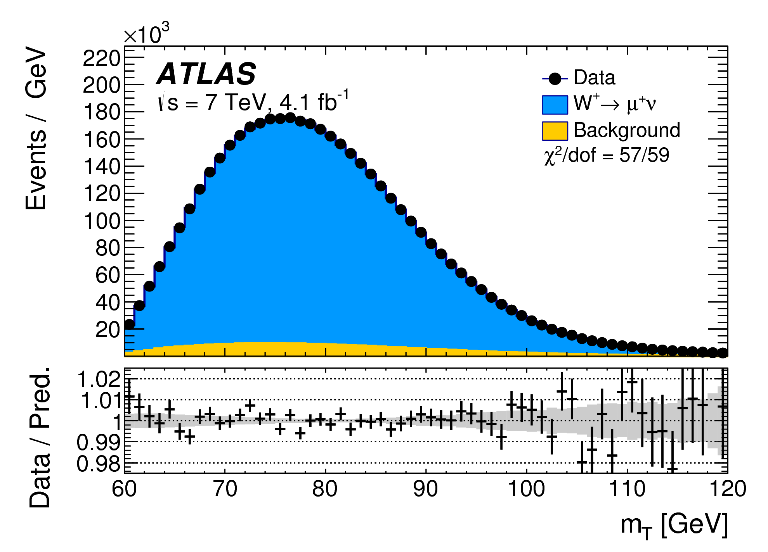
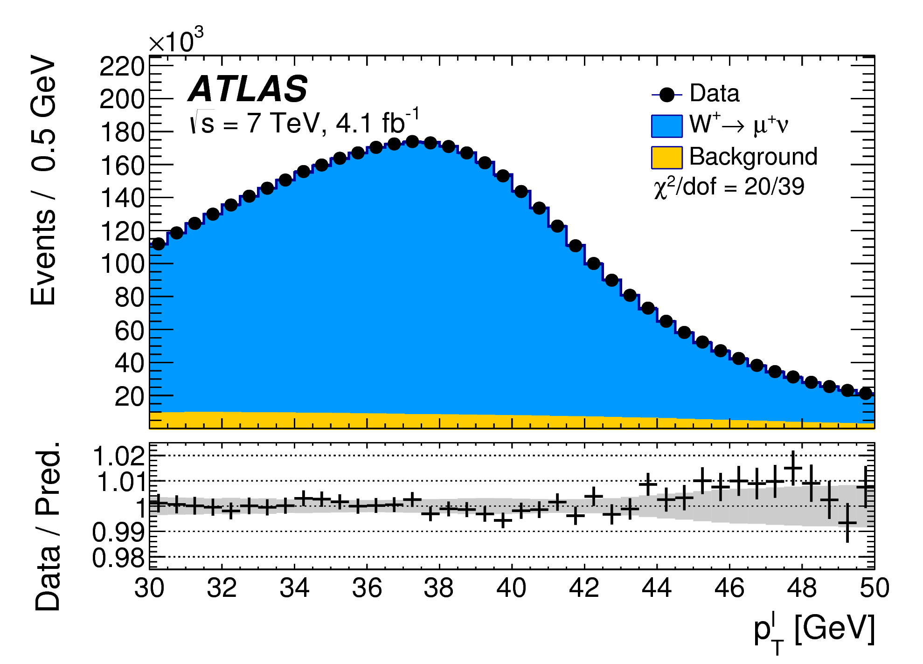
Recent precision W mass measurements
arXiv:1701.07240
Template fits to the transverse mass and the lepton transverse momentum are used to extract the W boson mass from the data.
Measurements are split among lepton flavor and charge.
Final W boson mass is determined from a combination of the lepton and transverse mass measurements.

Slide 5
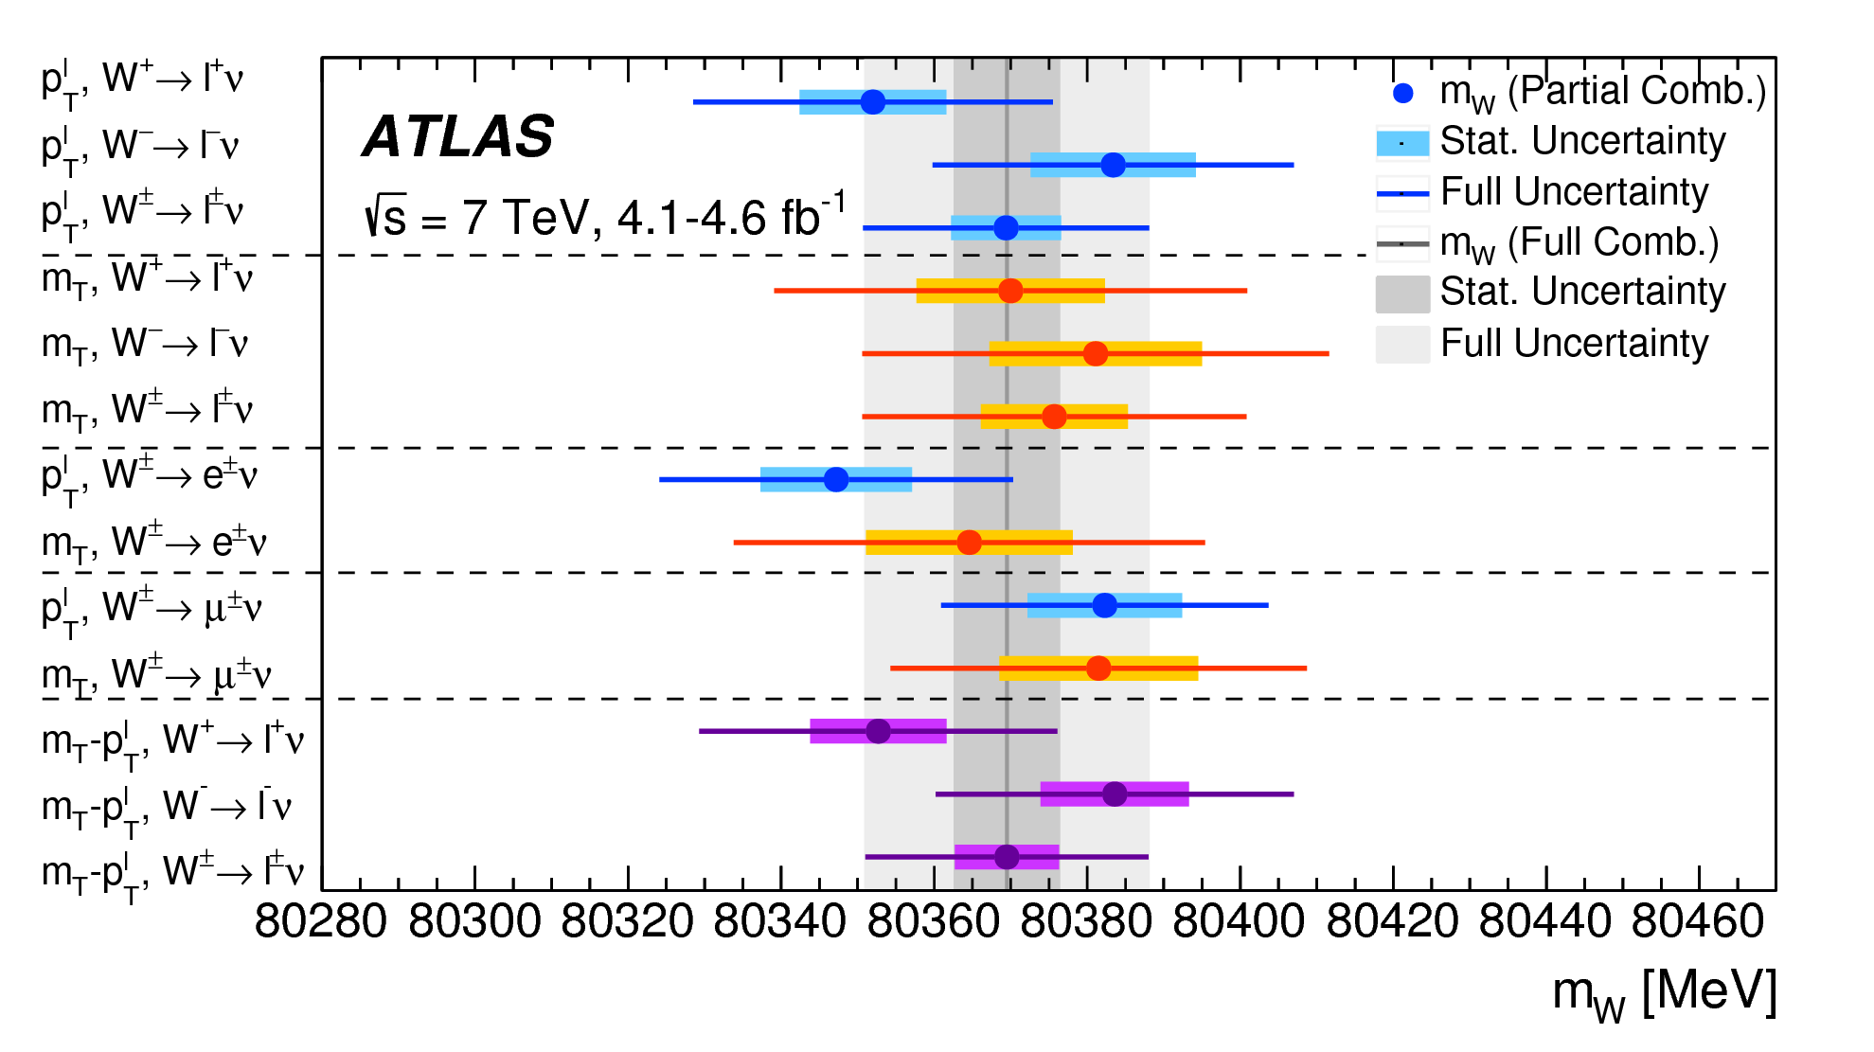
Recent precision W mass measurements
arXiv:1701.07240
Template fits to the transverse mass and the lepton transverse momentum are used to extract the W boson mass from the data.
Measurements are split among lepton flavor and charge.
Final W boson mass is determined from a combination of the lepton and transverse mass measurements.

Slide 6
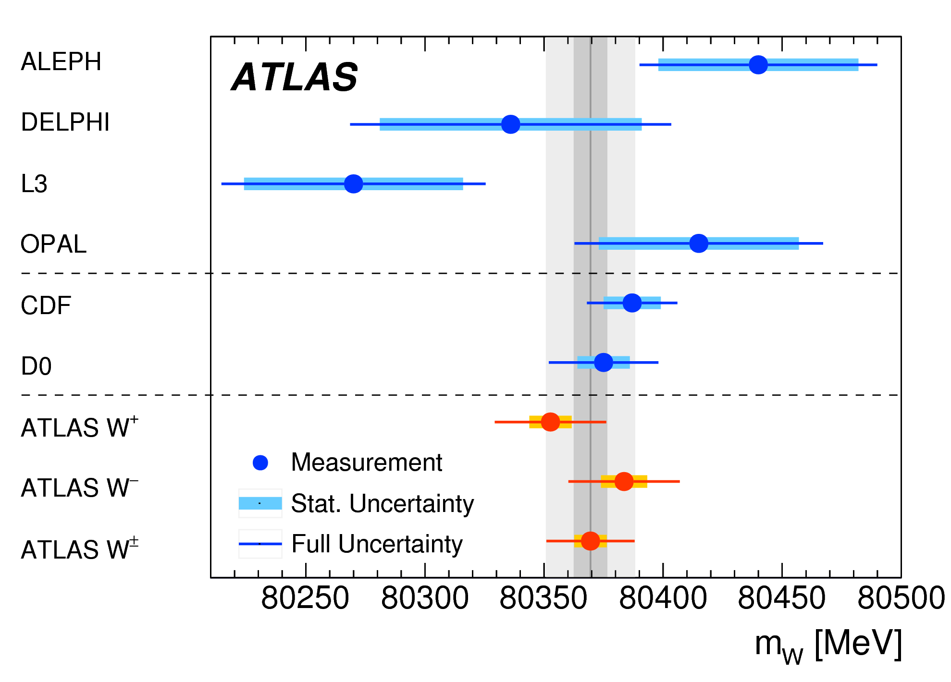
Recent precision W mass measurements
arXiv:1701.07240
19 MeV
23 MeV
19 MeV

Slide 7
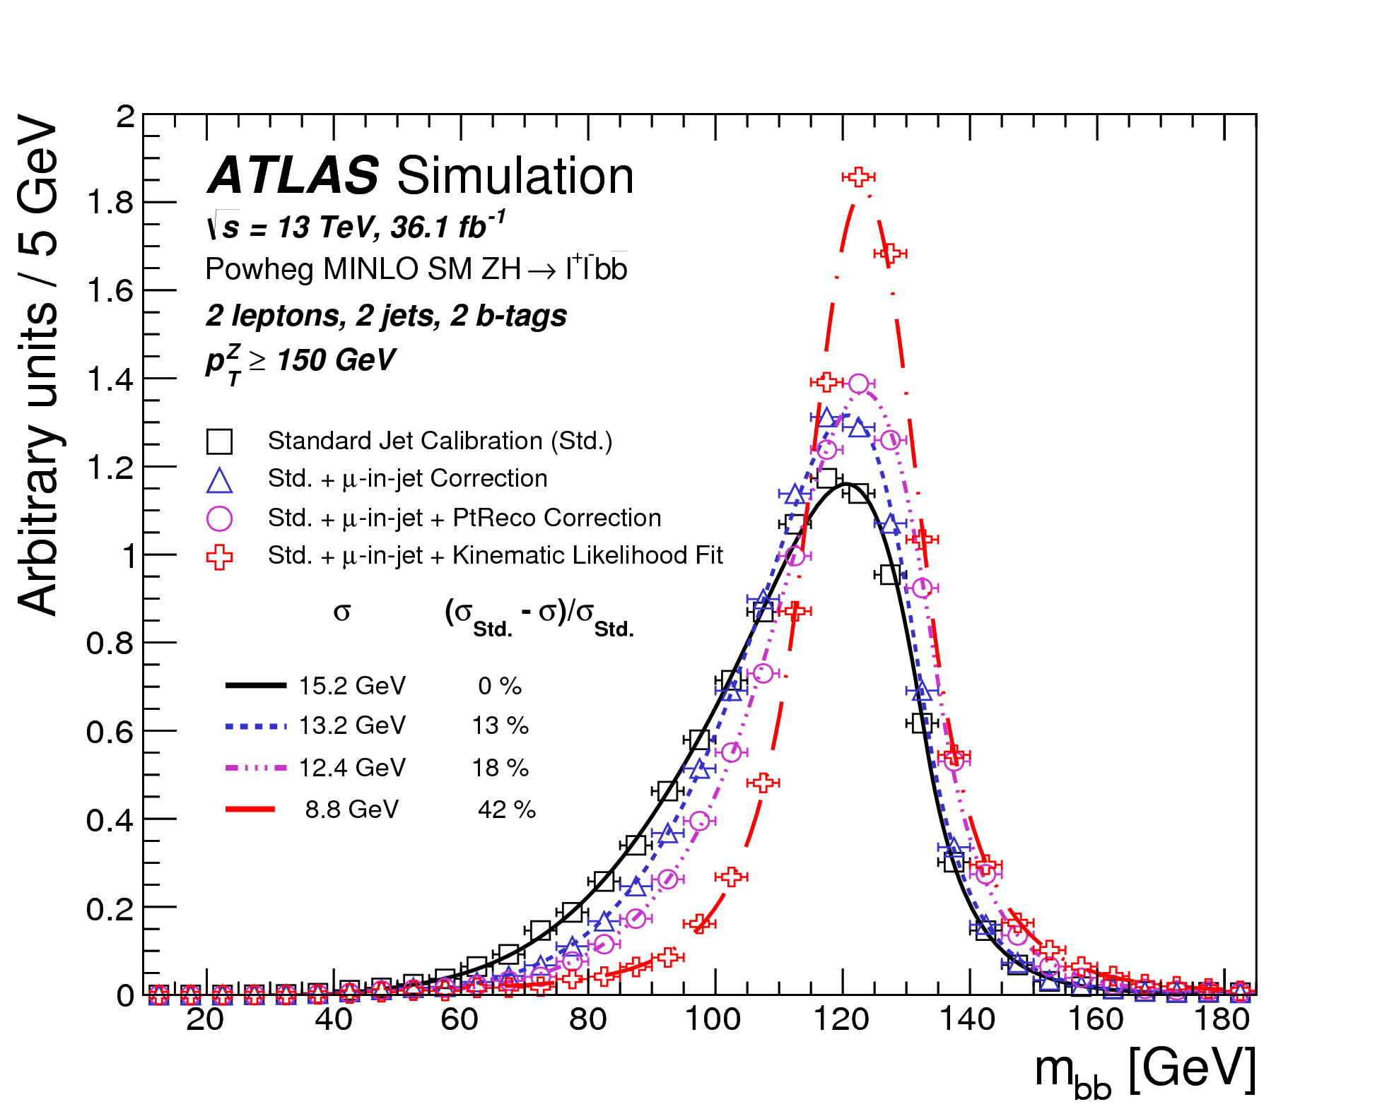
Higgs decays to heavy fermions
A crucial aspect of the endeavor to prove direct evidence of Higgs decays to pairs of b-quarks is the invariant mass resolution for this massive resonance.
A series of sophisticated jet kinematic calibrations is required to provide optimal performance in this challenging channel.
A 43% relative improvement results in a 7% fractional mass resolution in this complex final state
arXiv:1708.03299

Slide 8
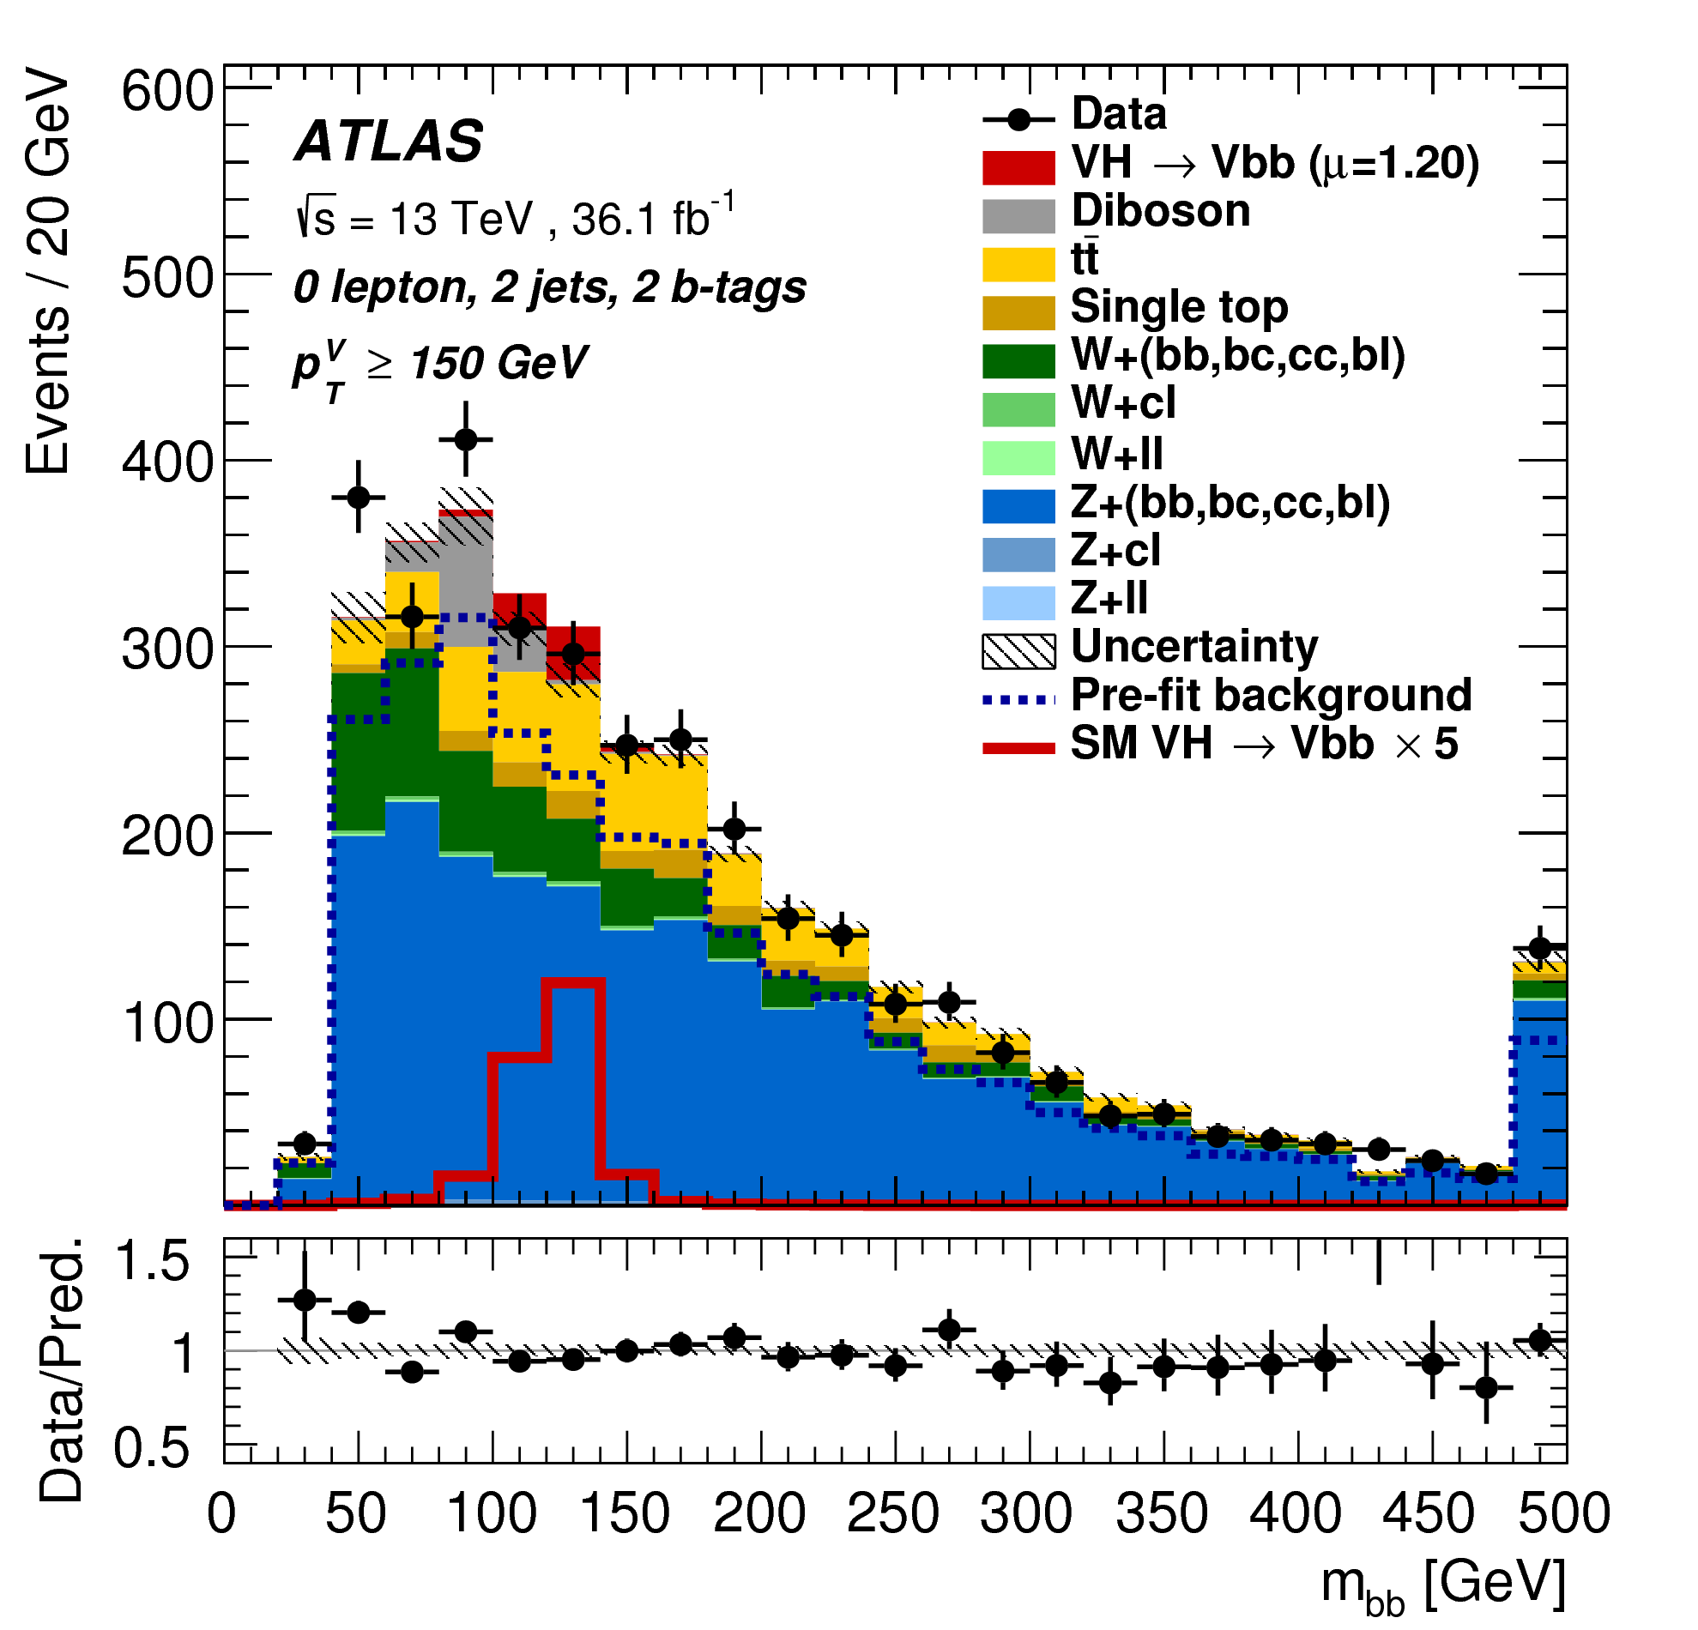
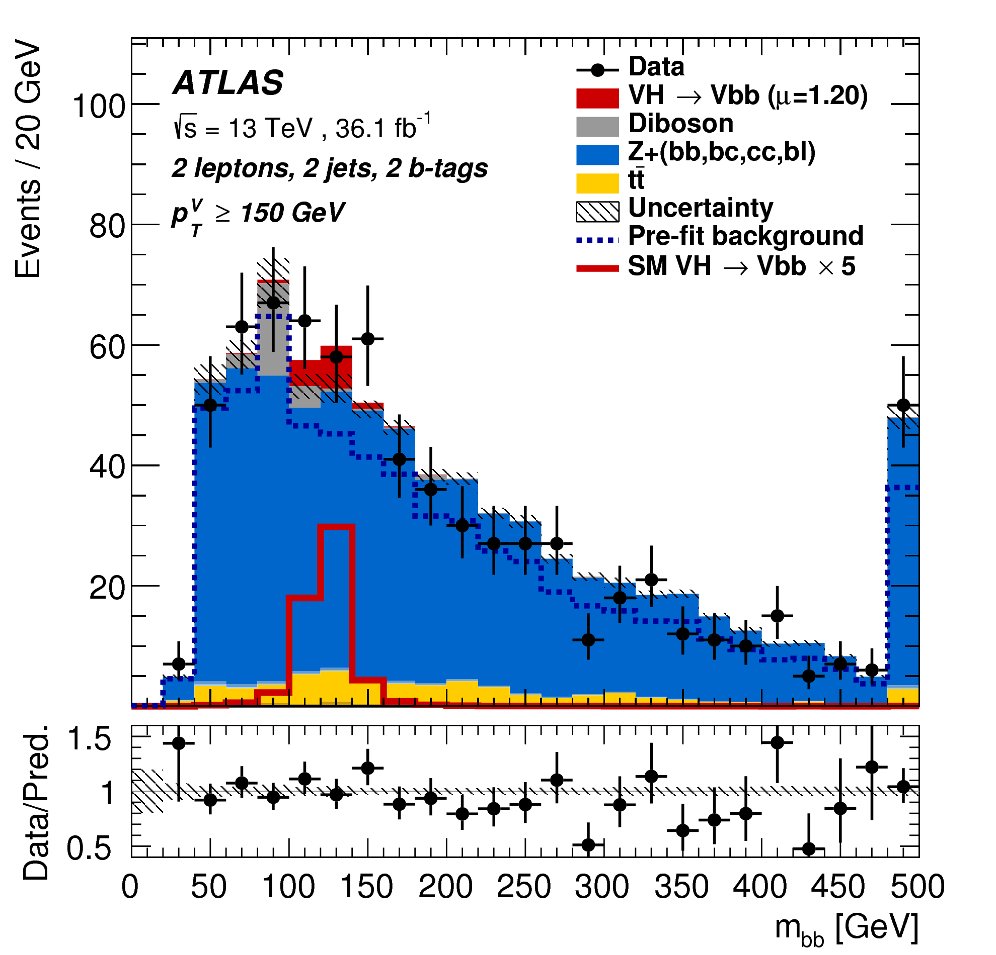
Higgs decays to heavy fermions
arXiv:1708.03299
Analysis is split into lepton multiplicities (0-2), jet multiplicities (2-3), and vector boson transverse momentum (75-150 GeV, 150+ GeV).
Primary analysis strategy is based on a multivariate (BDT) discriminant using up to 13 input variables. Validation performed using two alternative approaches, including an explicit dijet mass analysis.

Slide 9
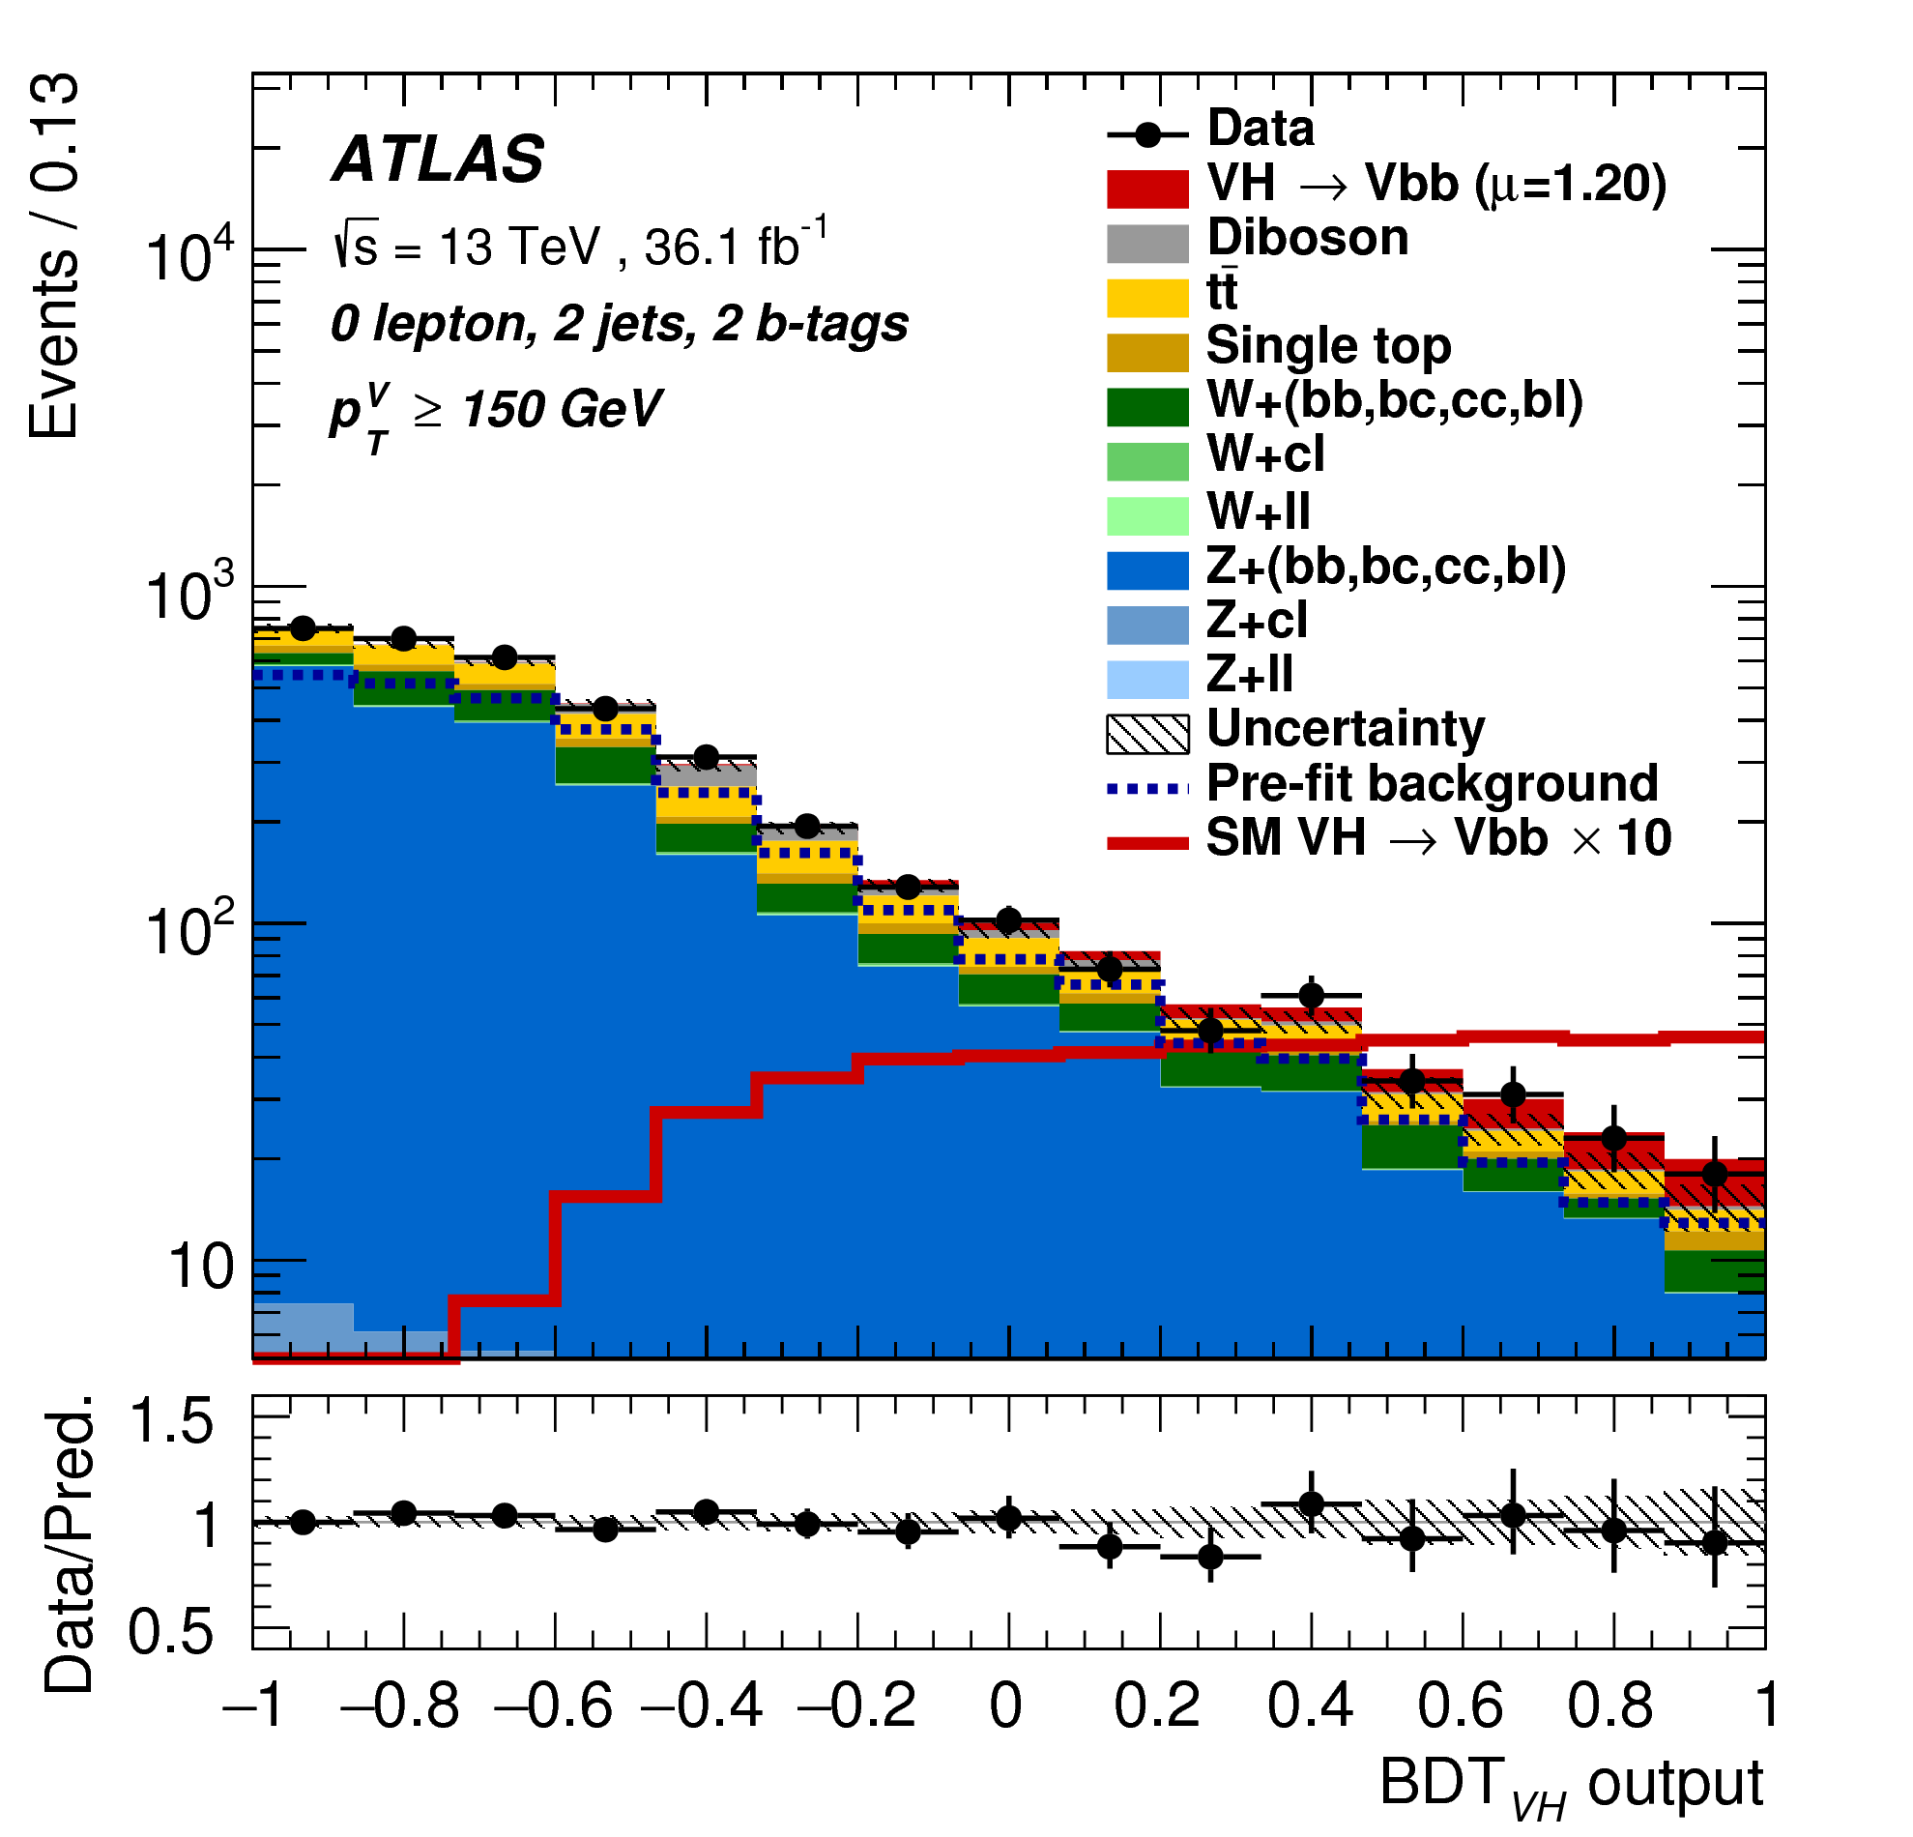
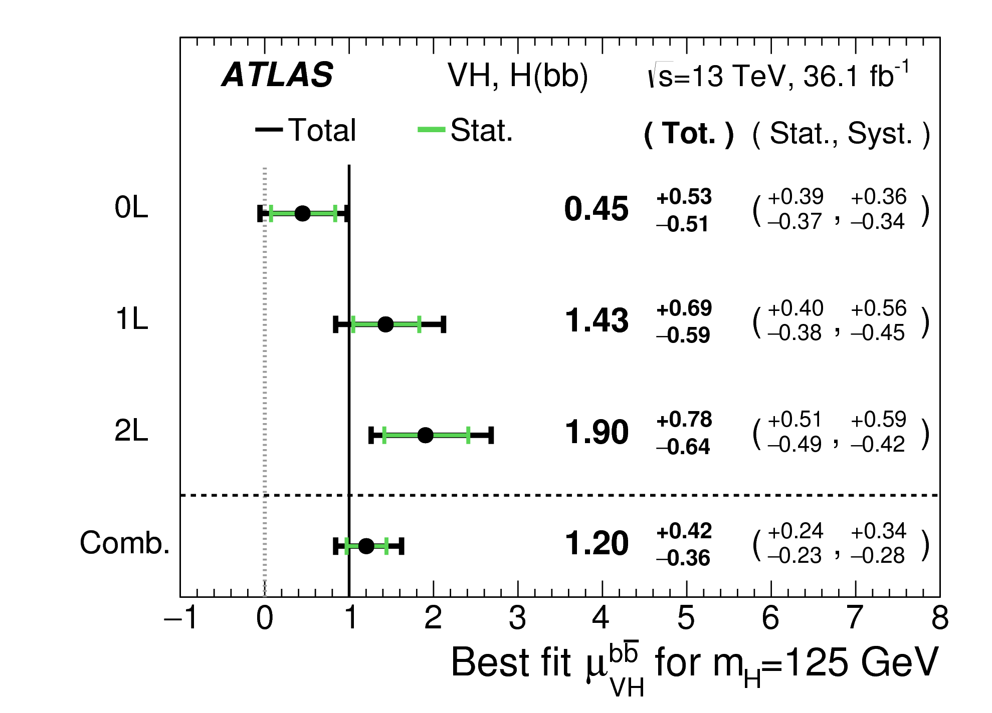
Higgs decays to heavy fermions
arXiv:1708.03299
Sensitivity dominated by 0-lepton selection (E_{T}^{Miss} > 150 GeV + angular selection criteria).

Slide 10
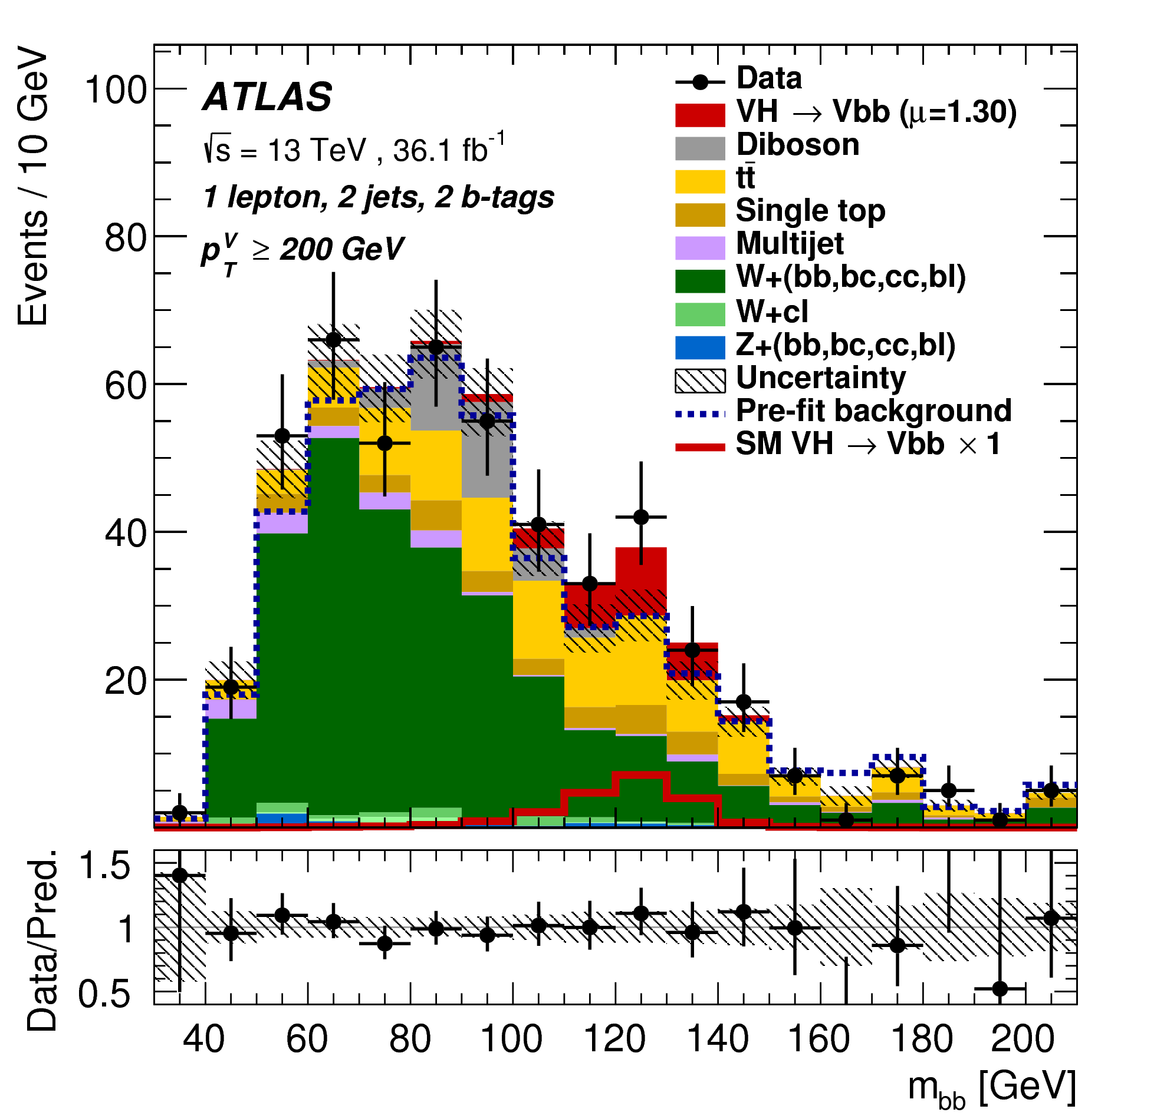
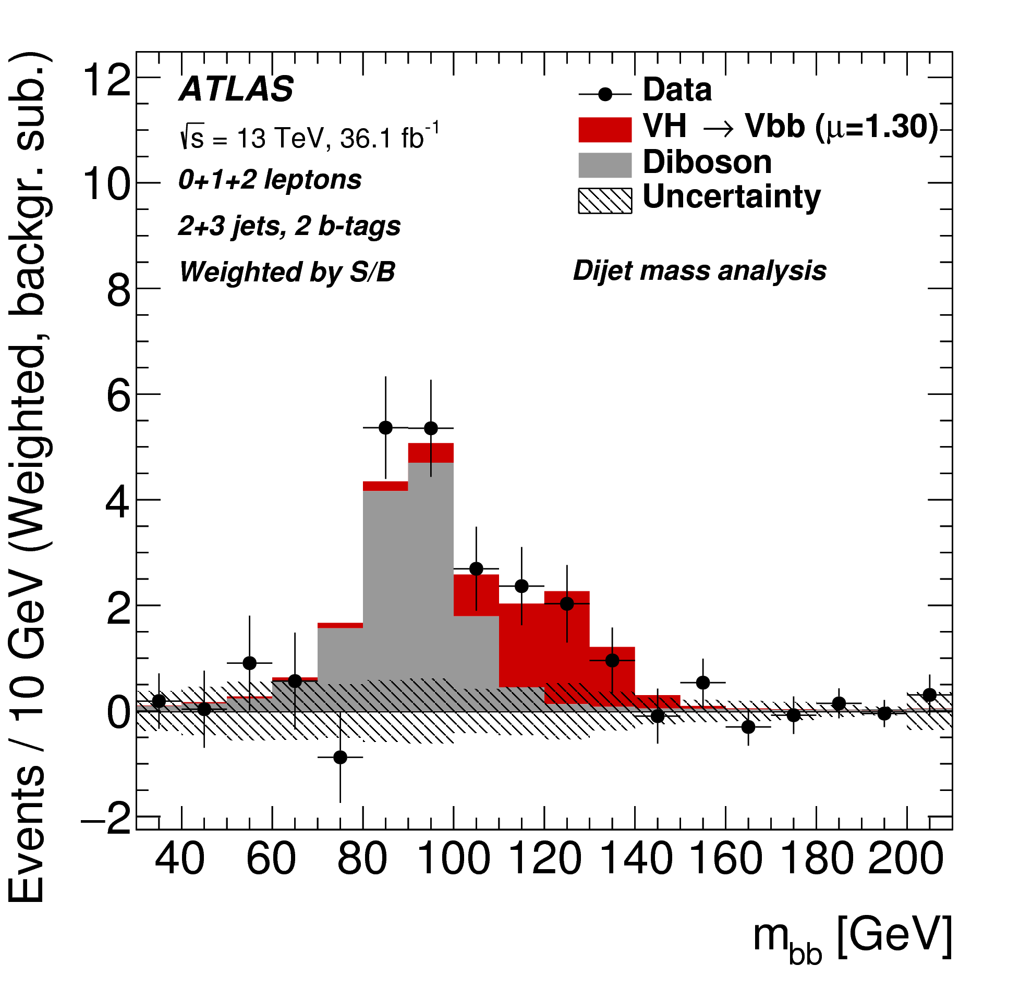
Higgs decays to heavy fermions
arXiv:1708.03299
Evidence for Higgs decays to heavy fermions
observed with a significance of 3.5σ.

Slide 11
Higgs coupling to top quarks
Significant open question in Higgs physics is the top Yukawa coupling and observation of Higgs production in association with top quark pairs.
New analysis released last week focuses on the multi-lepton final states for this process.
ATLAS-CONF-2017-077
All: 2+ light jets + 1+ b-jet

Slide 12
Higgs coupling to top quarks
ATLAS-CONF-2017-077
Most sensitive final states are the:
Same-sign 2-lepton signatures (with or without hadronic taus)
3-lepton signatures
Critical issues are associated production backgrounds (tt+Z, tt+W), fake hadronic taus, and non-prompt leptons

Slide 13
Higgs coupling to top quarks
Systematic uncertainties are dominated by modeling and hadronic final state measurement uncertainties
Jet energy scale
Flavor tagging
ATLAS-CONF-2017-077

Slide 14
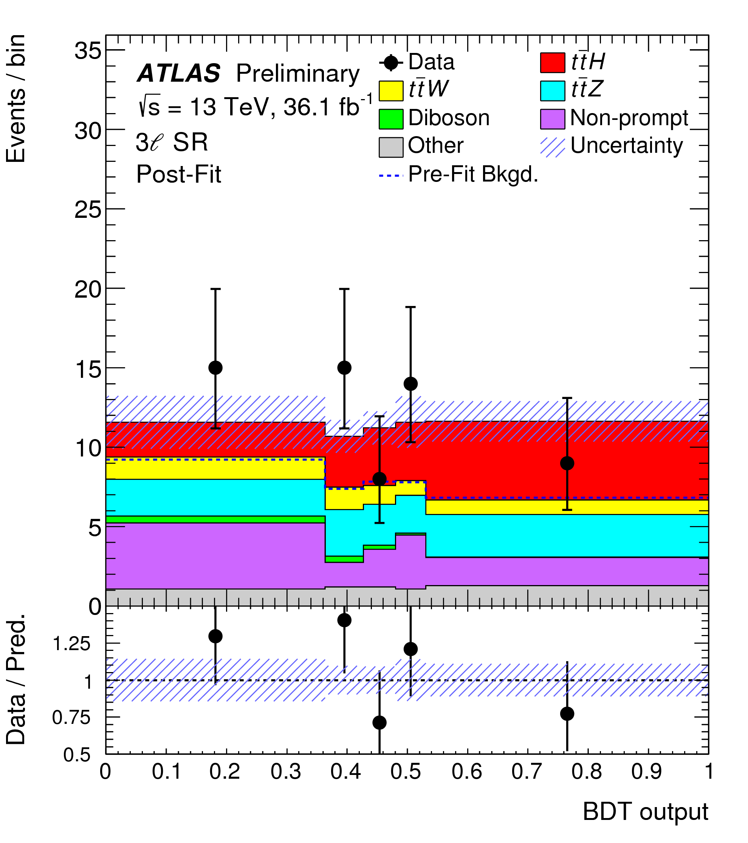
Higgs coupling to top quarks
ATLAS-CONF-2017-077

Slide 15
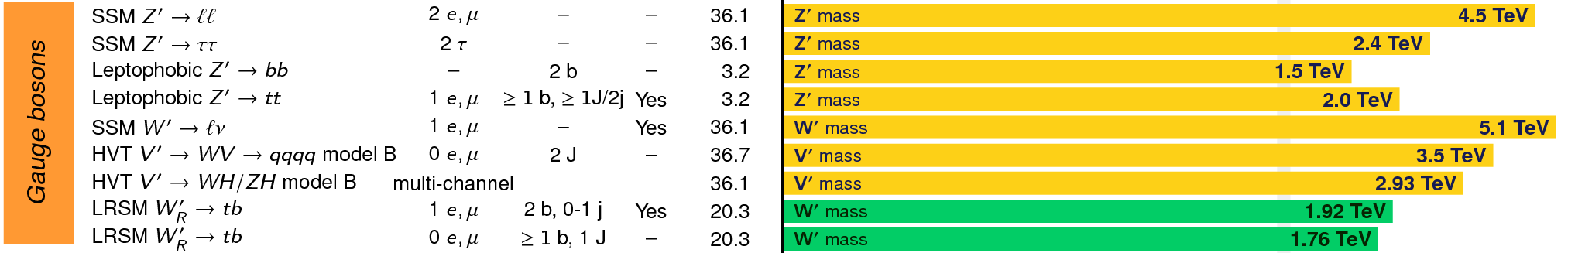
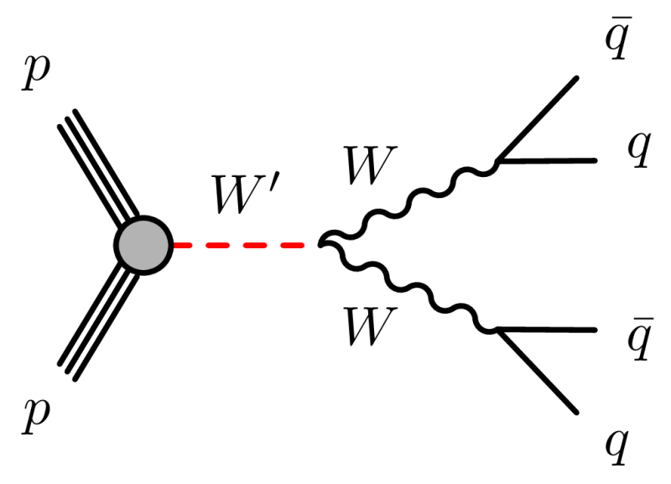
Searching for New Physics with Lorentz-boosted W/Z bosons
If M_{W’} >> M_{W} then significant Lorentz-boost for W, look for two-body structure!
New particles that decay to W boson pairs would indicate a new generation of matter !

Slide 16
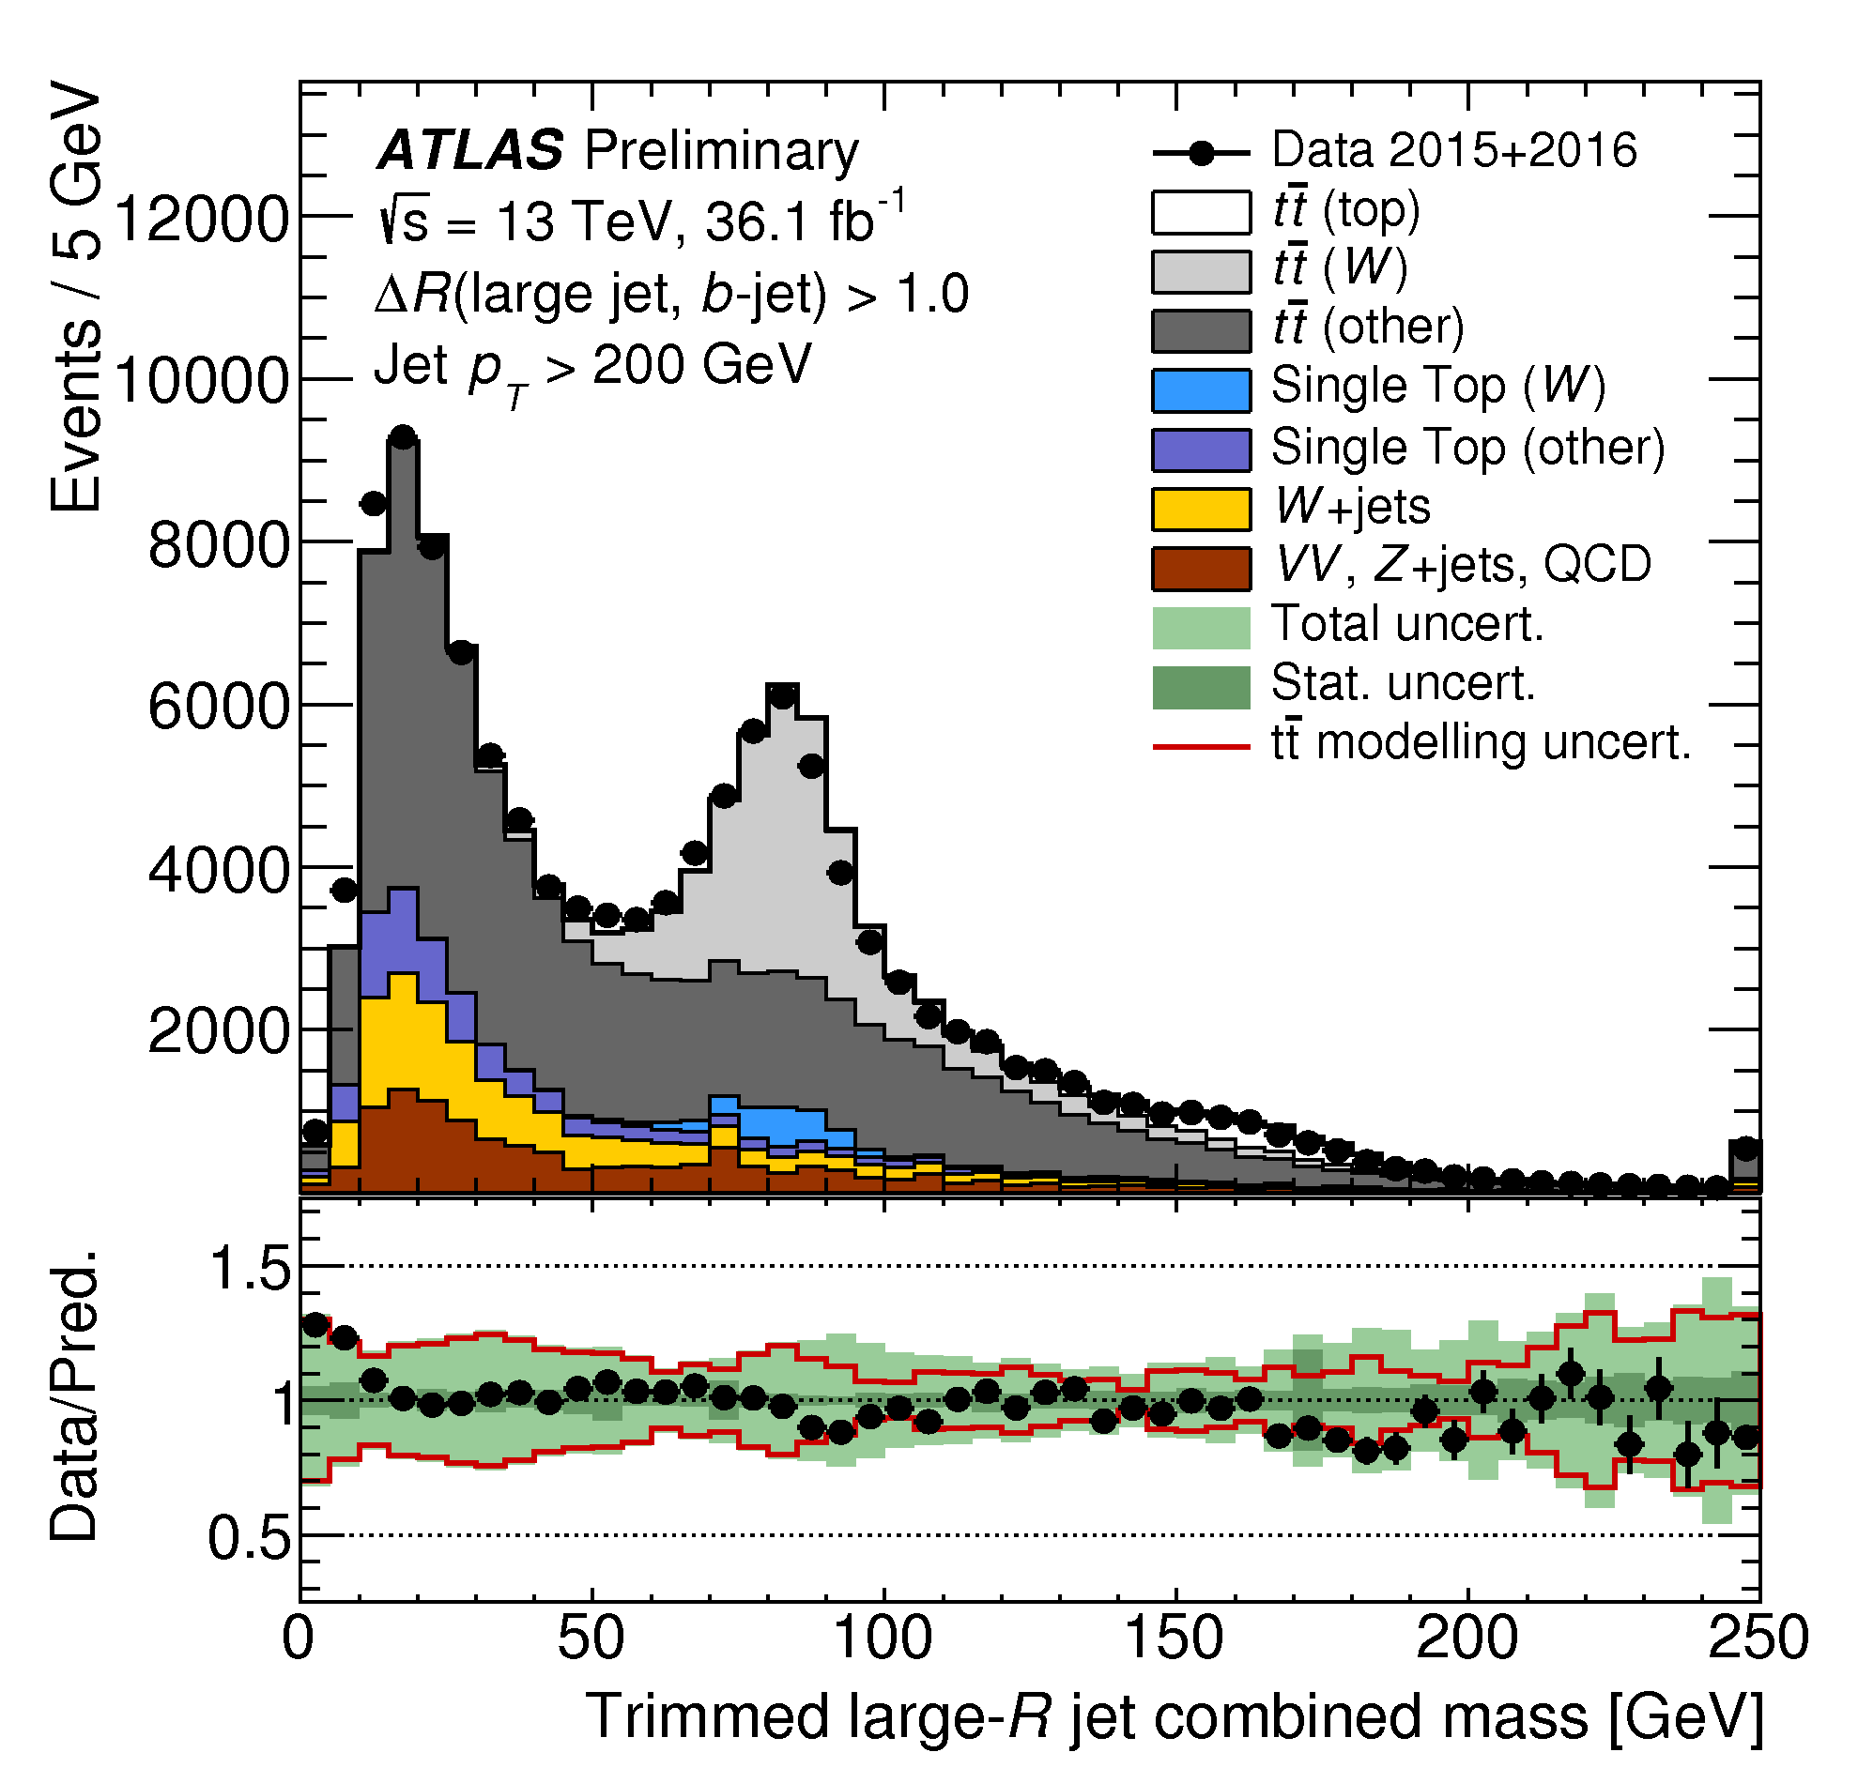
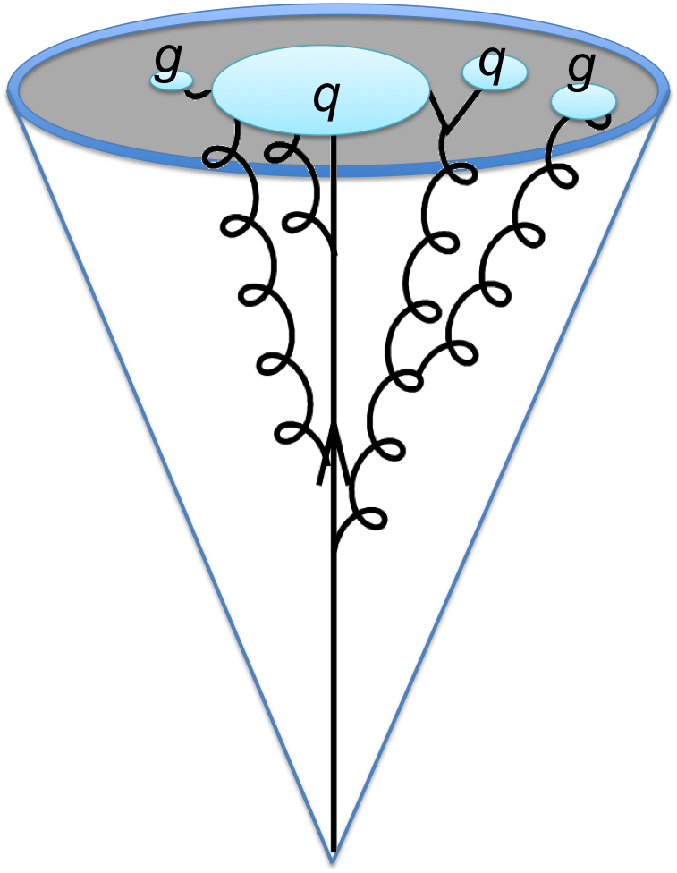
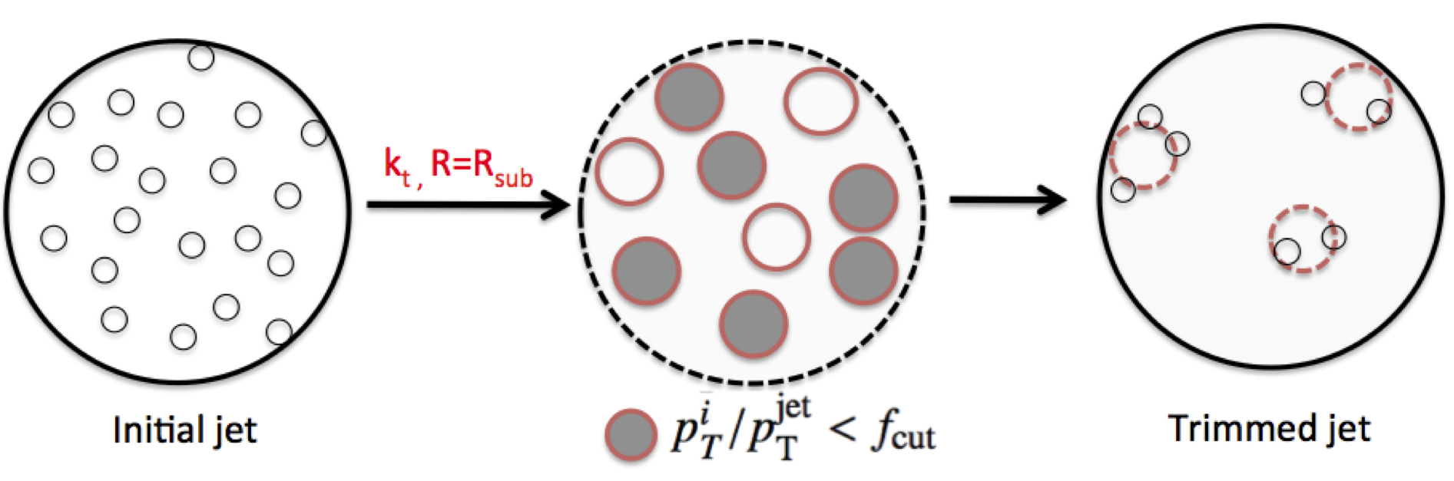
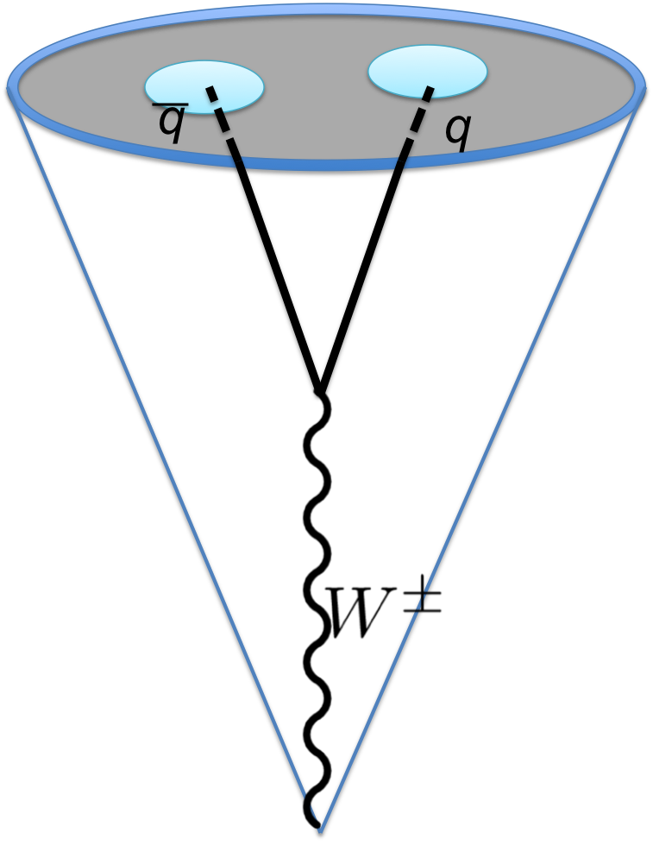
Imaging W jets in the data
ATLAS-CONF-2017-064
W boson mass
Apply a cleaning algorithm to the jet (“trimming”)
Calculate the invariant mass of the jet: clear peak at mass = 80 GeV!

Slide 17
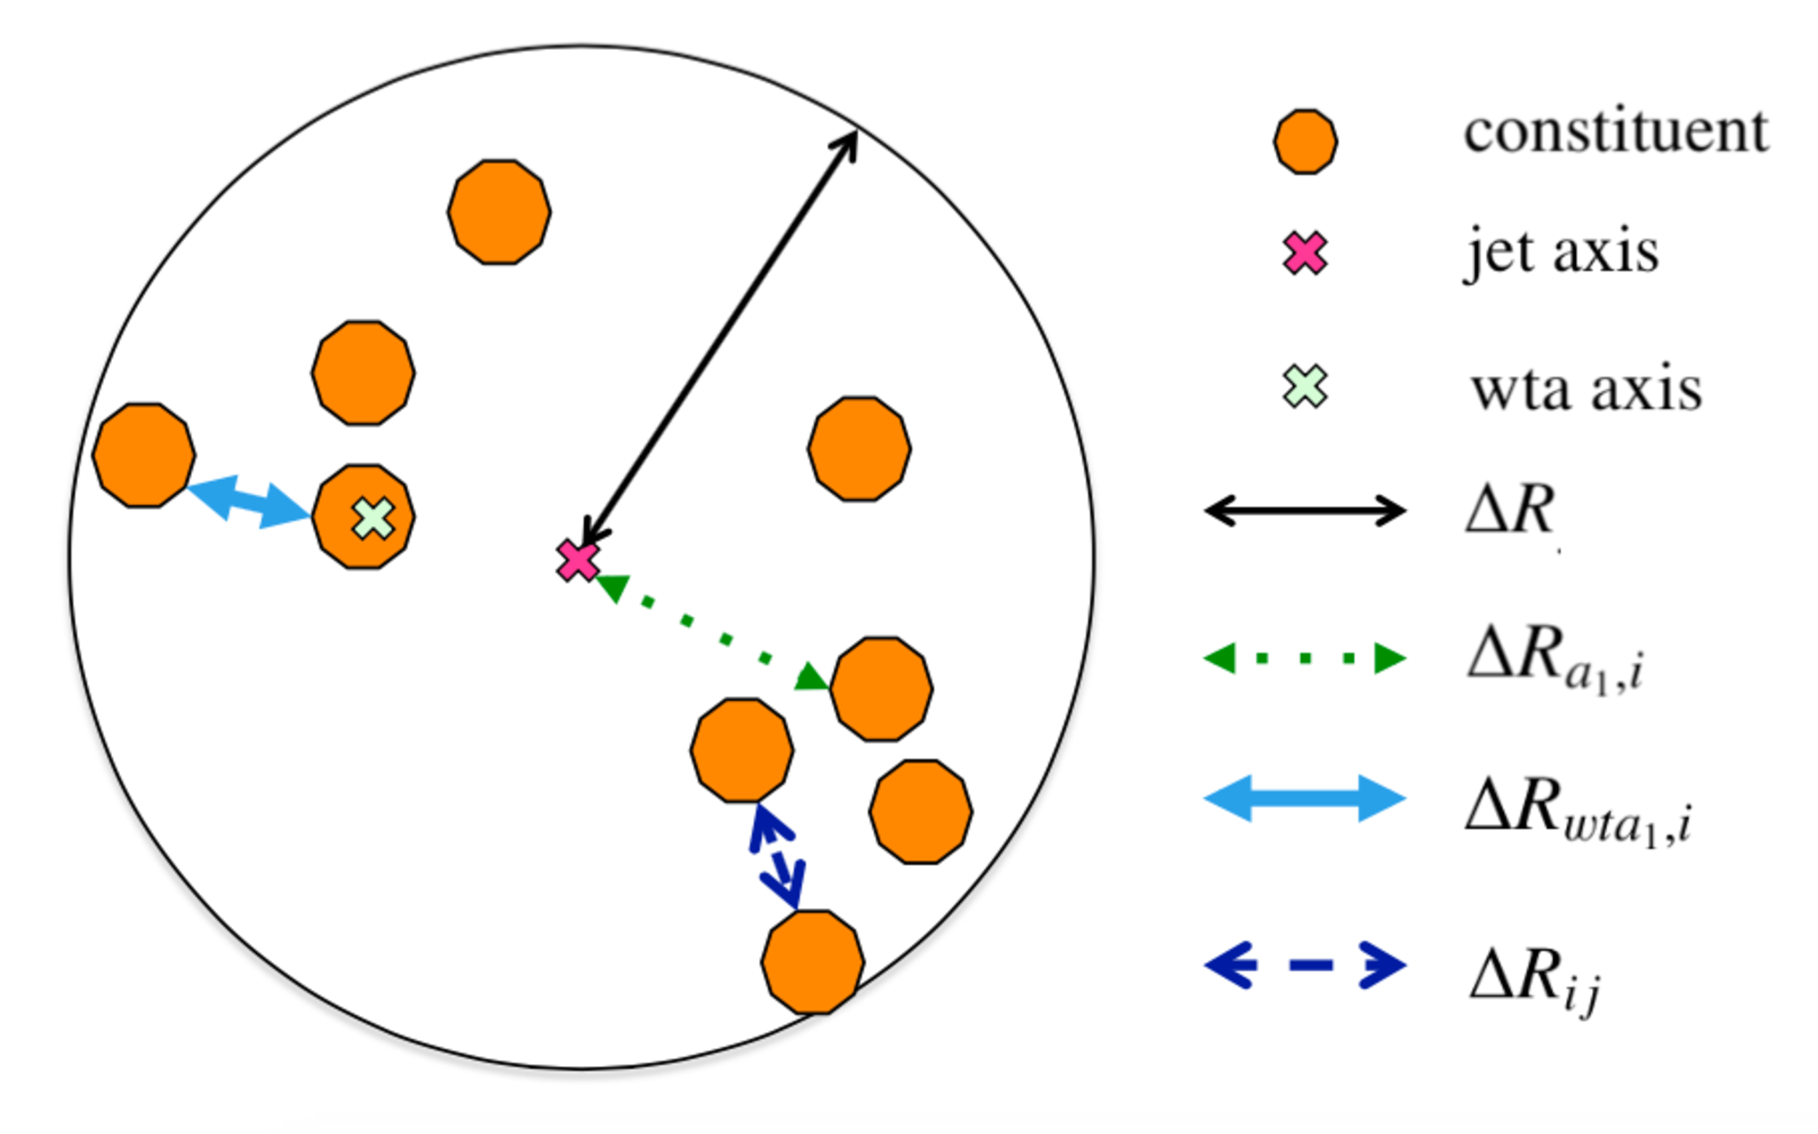
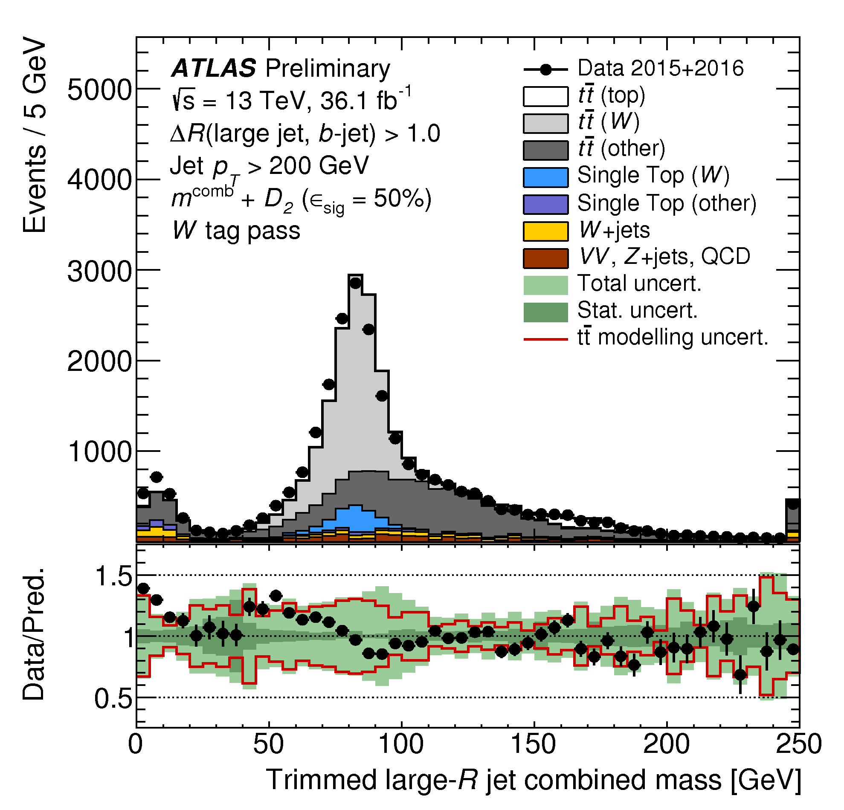
Imaging W jets in the data
ATLAS-CONF-2017-064
Refine the measurement with detailed structural information
  Energy-energy correlation functions (multi-point)
  Substructure multiplicity
Calculate the invariant mass of the the new jets: significant improvement of mass reconstruction!

Slide 18
Searching for new massive particles using
Lorentz-boosted W/Z bosons

Slide 19
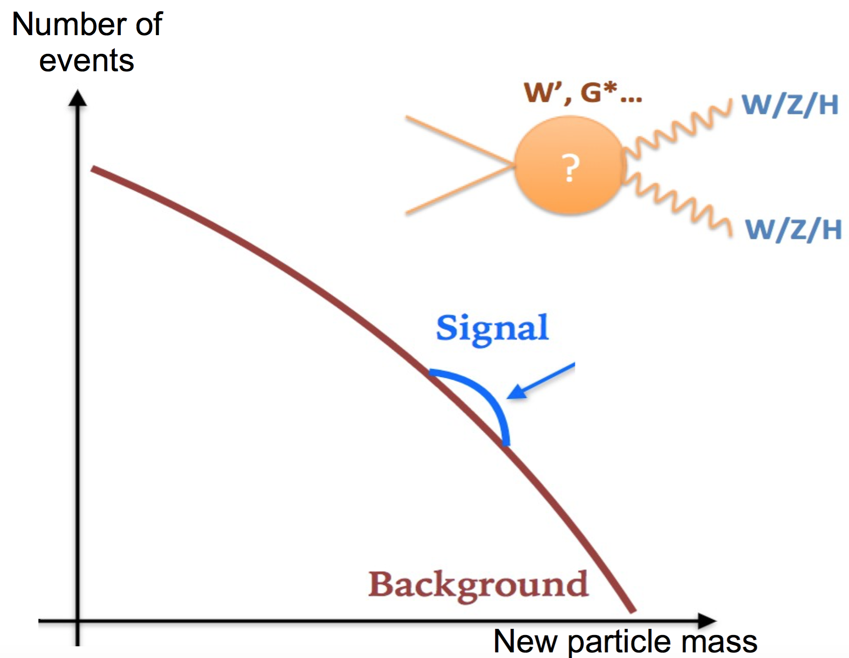
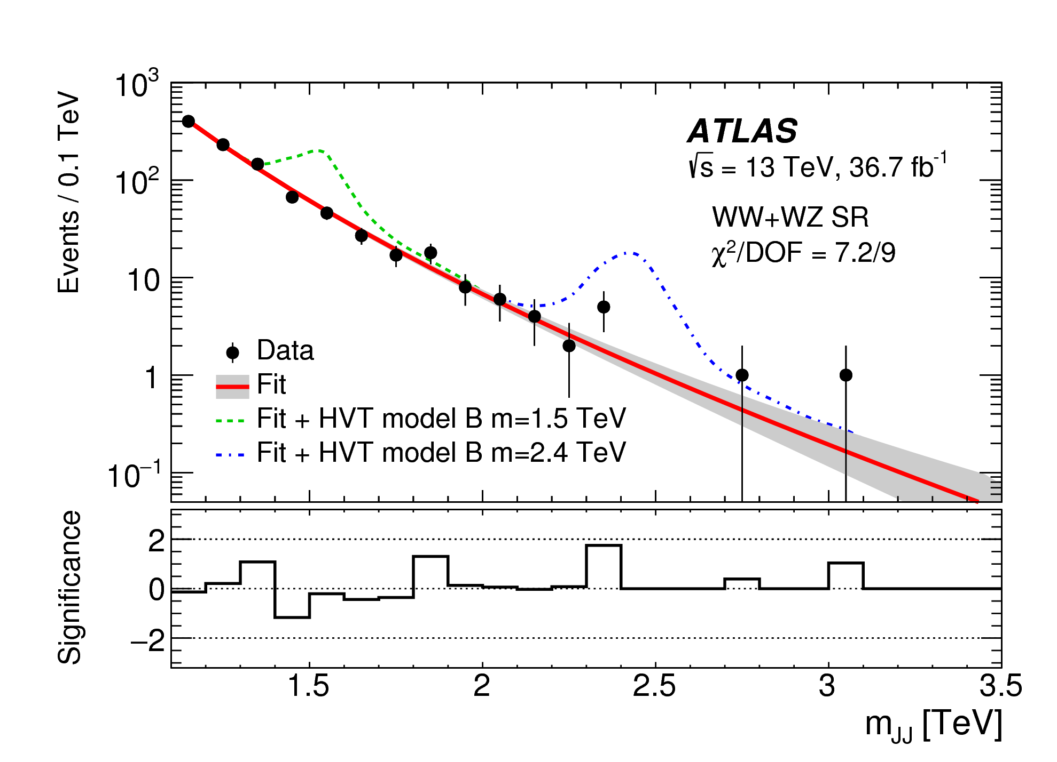
Searching for new massive particles using
Lorentz-boosted W/Z bosons
arXiv:1708.04445
Search for a mass peak corresponding to the new particle
Observe W candidate pairs with up to 2.5 TeV invariant mass
>1 TeV transverse momentum for each candidate W boson!

Slide 20
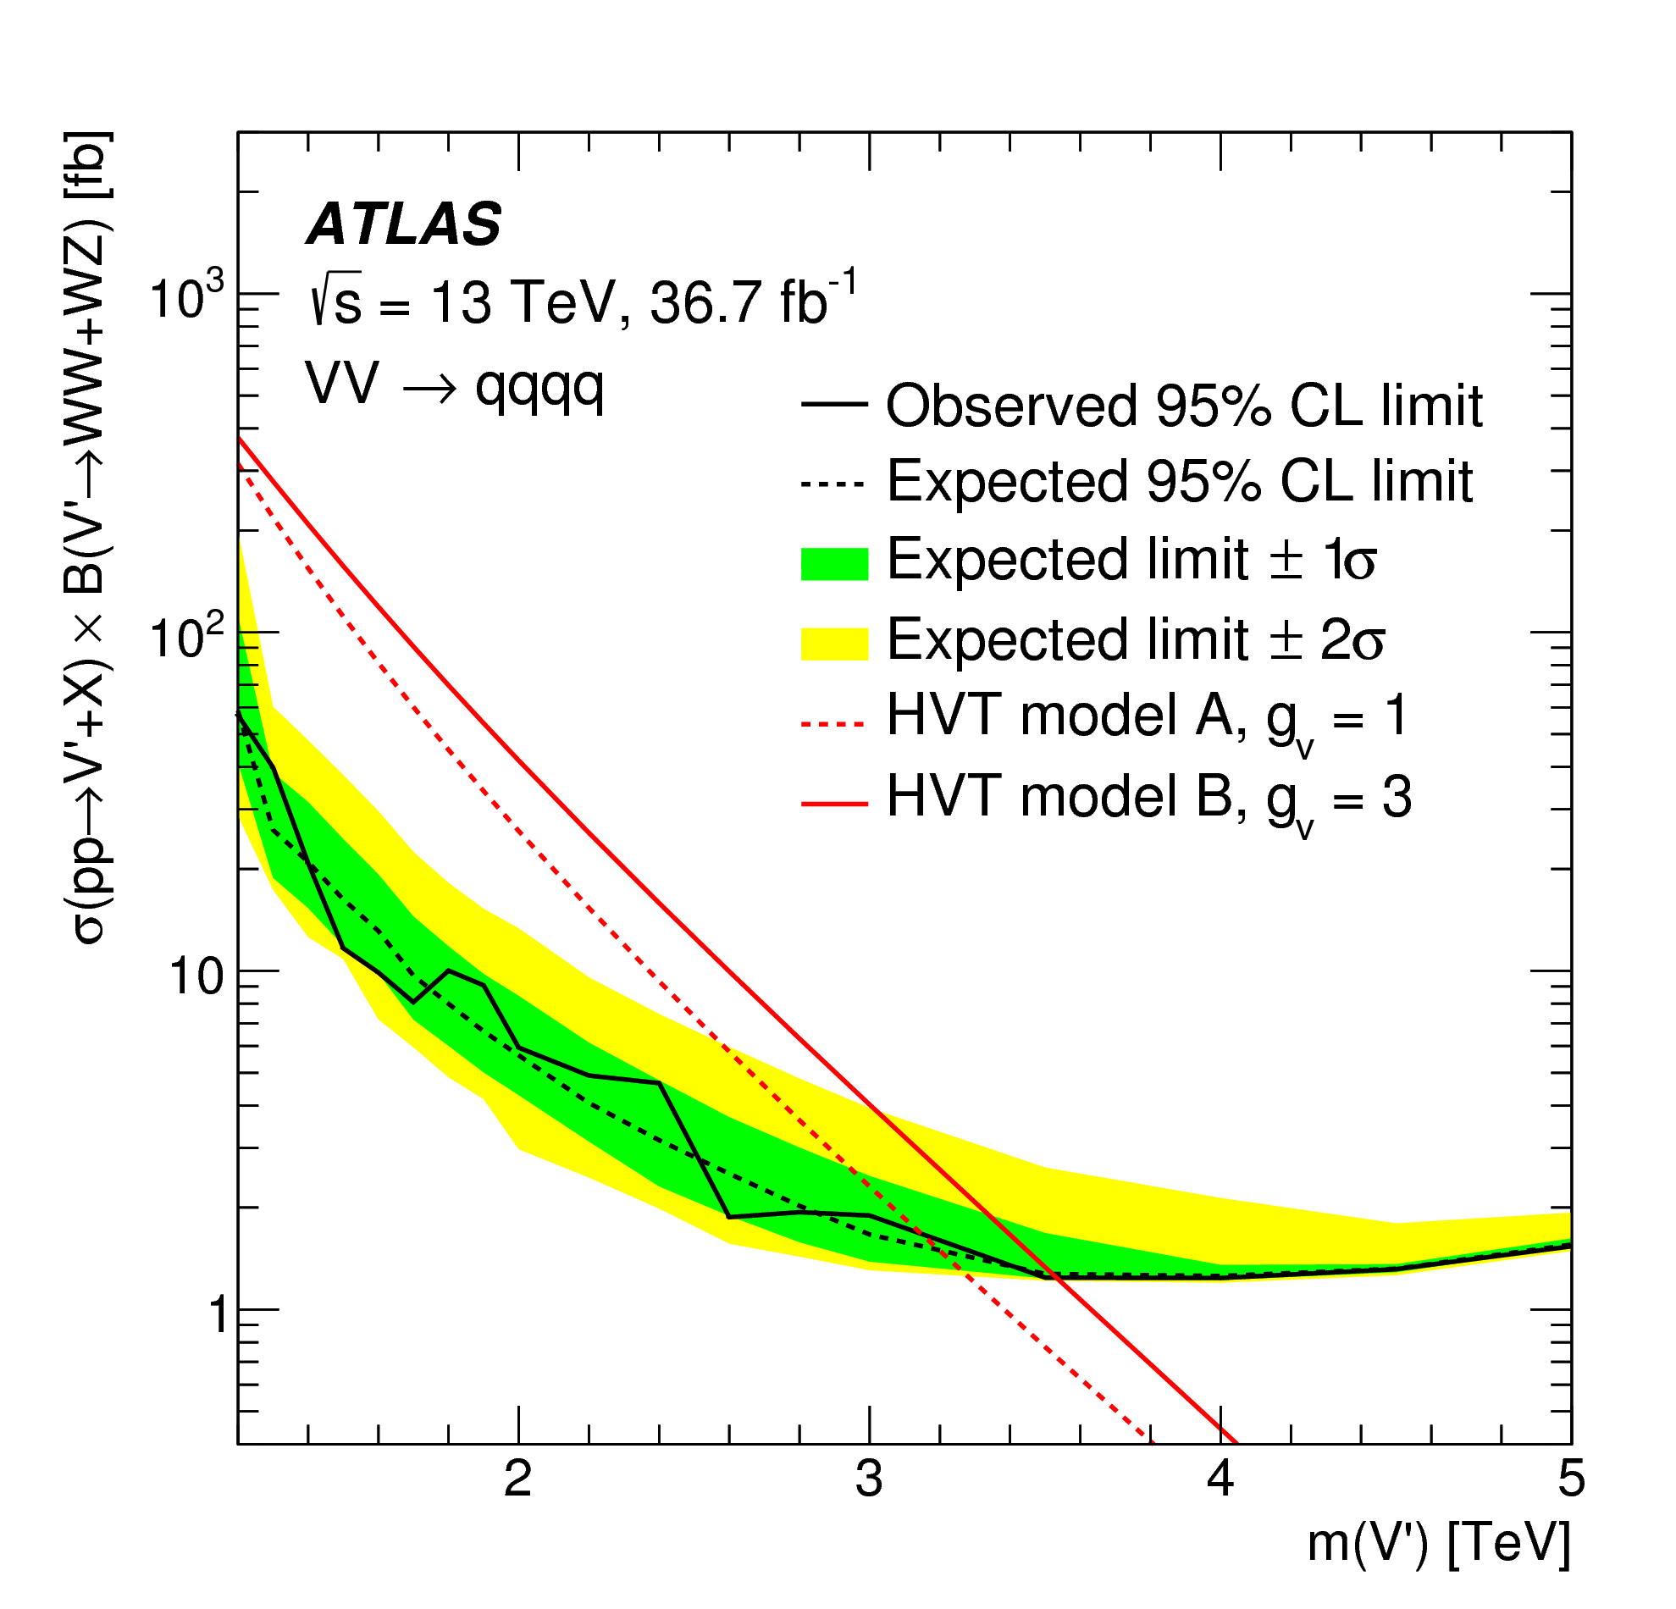
Searching for new massive particles using
Lorentz-boosted W/Z bosons
arXiv:1708.04445
Search for a mass peak corresponding to the new particle
Observe W candidate pairs with up to 2.5 TeV invariant mass
>1 TeV transverse momentum for each candidate W boson!

Slide 21
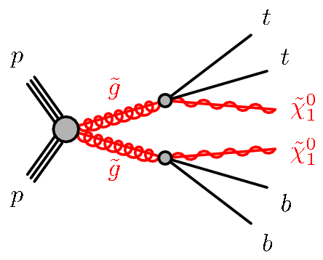
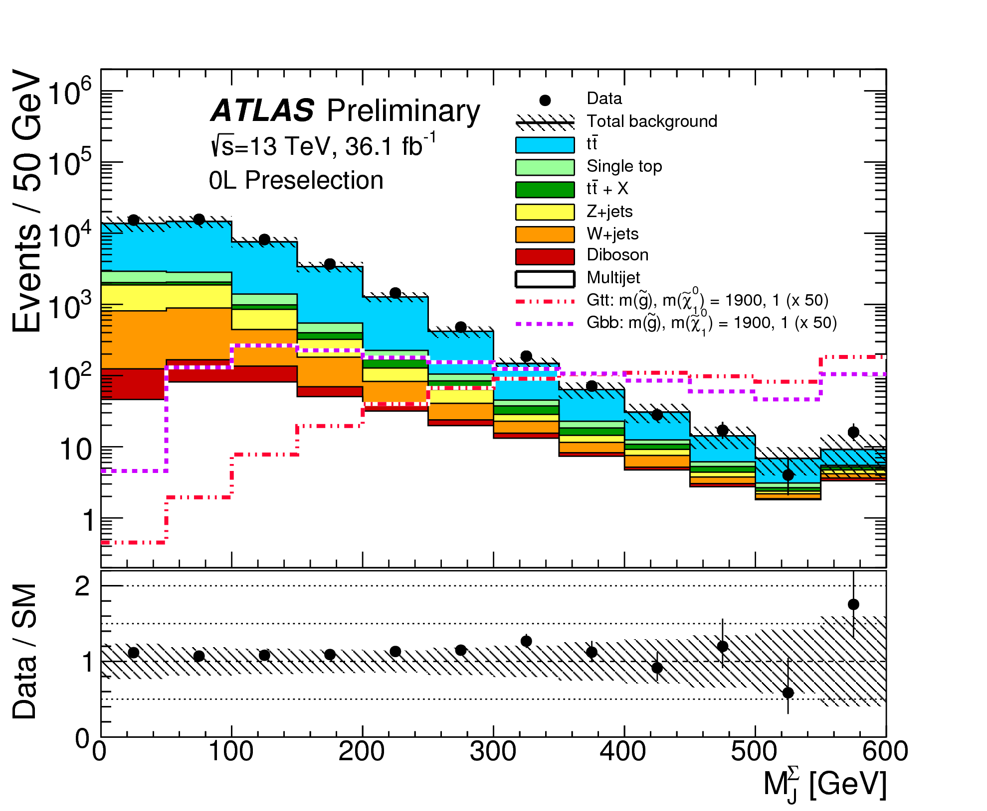
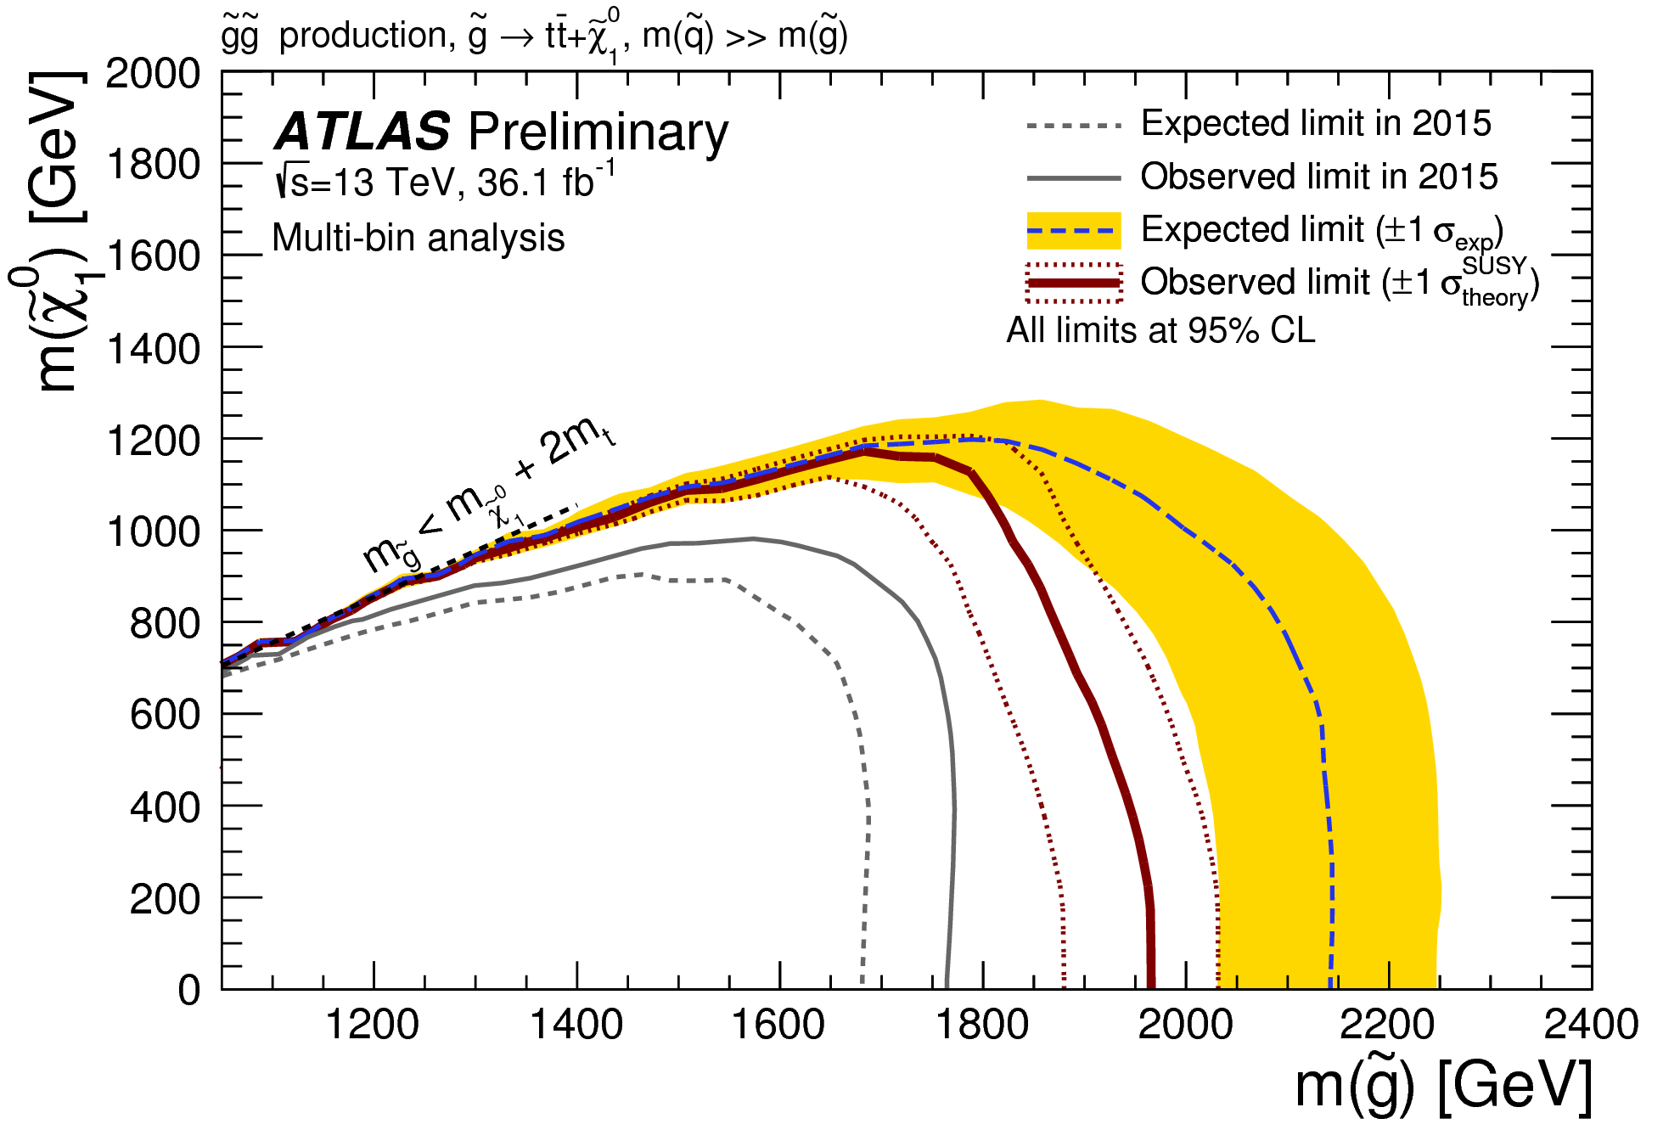
SUSY searches using these techniques
ATLAS-CONF-2017-021
Critical applications of these techniques in all aspects of our physics program.
Some of the most sensitive searches for strongly produced SUSY to date!

Slide 22
Recent results confront the Standard Model with high-precision and state-of-the-art techniques
Advances in experimental methods for hadronic final states yield new insights and opportunities
Impacts felt across the ATLAS Physics Program
Thank you!

Slide 23
Additional information

Slide 24
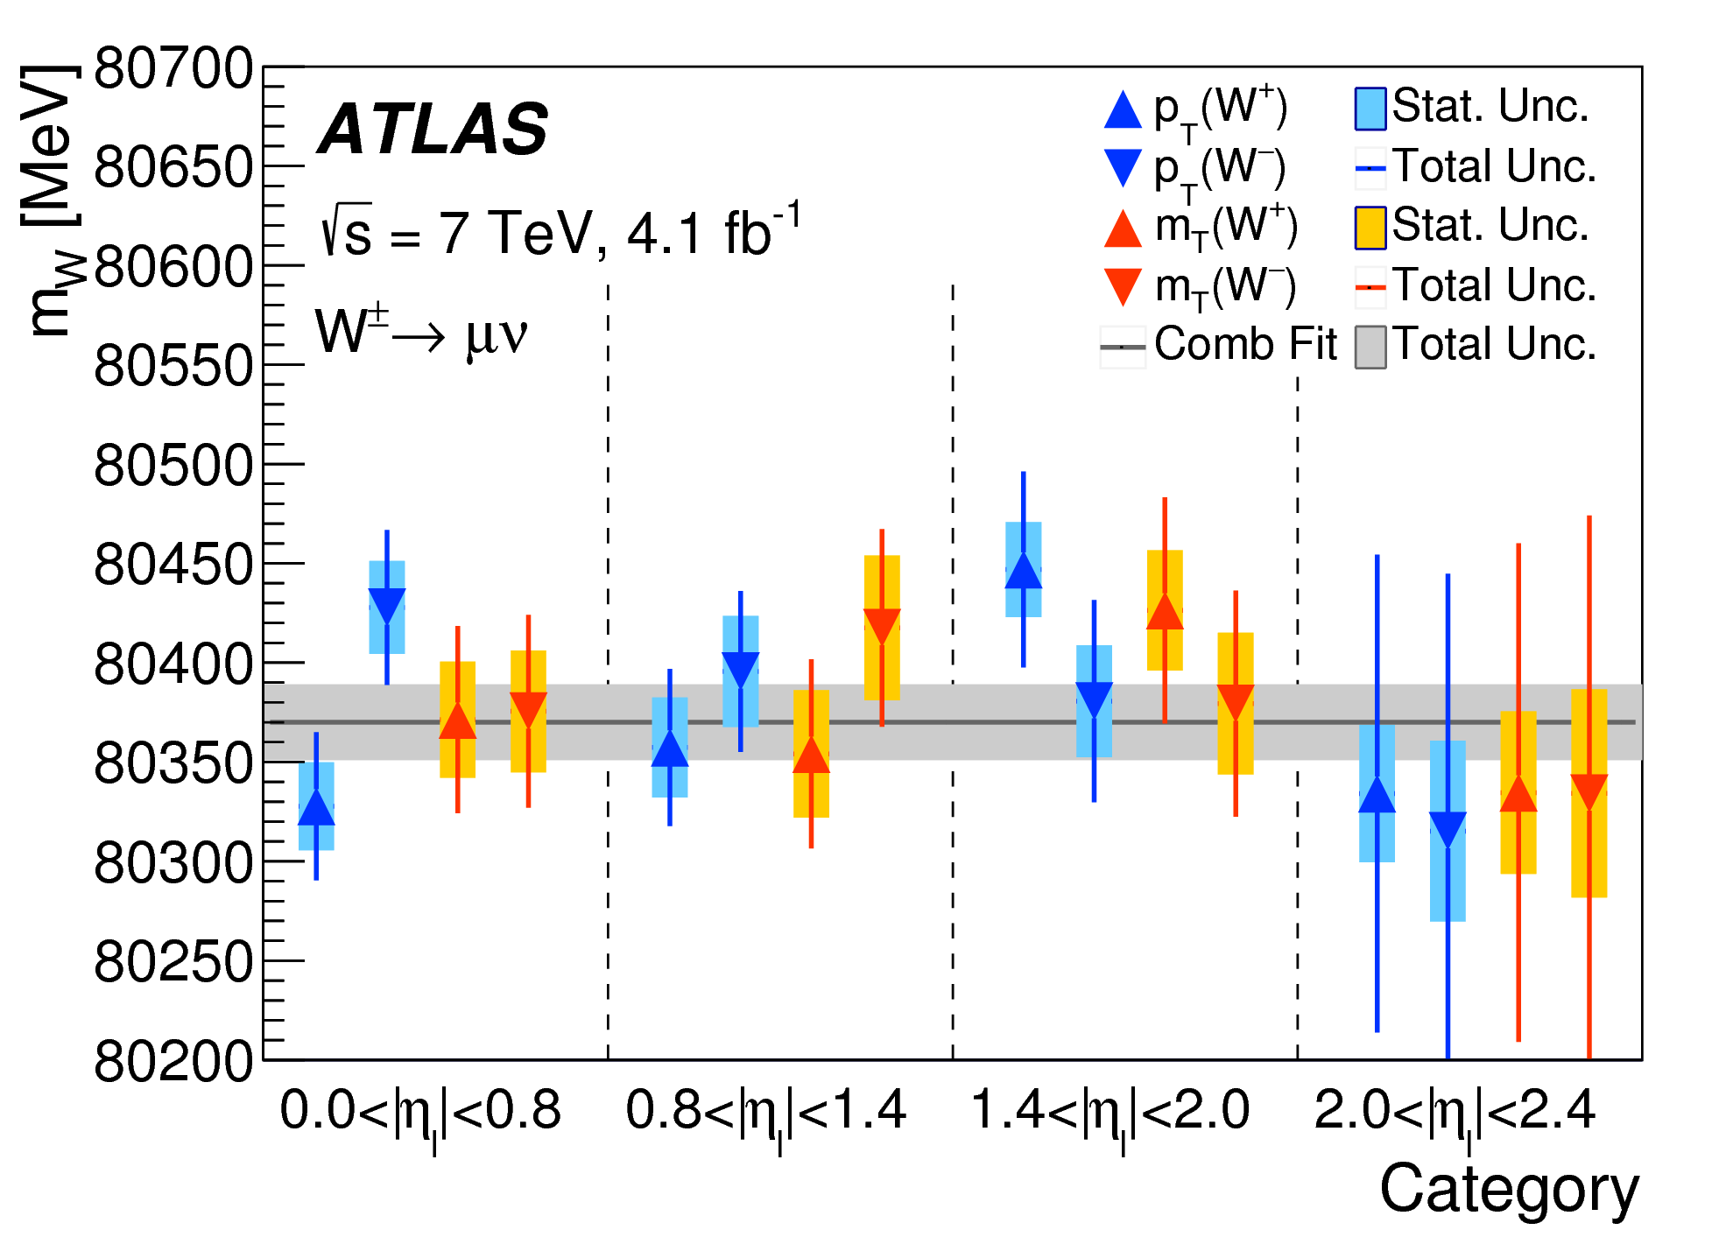
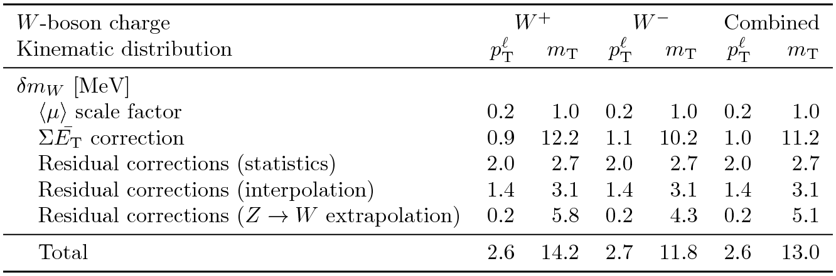
Systematic uncertainties for the W mass
Consistency checks across numerous channels and detector regions.
Detailed assessments of individual systematic uncertainties including dedicated corrections is what permits this excellent performance.

Slide 25
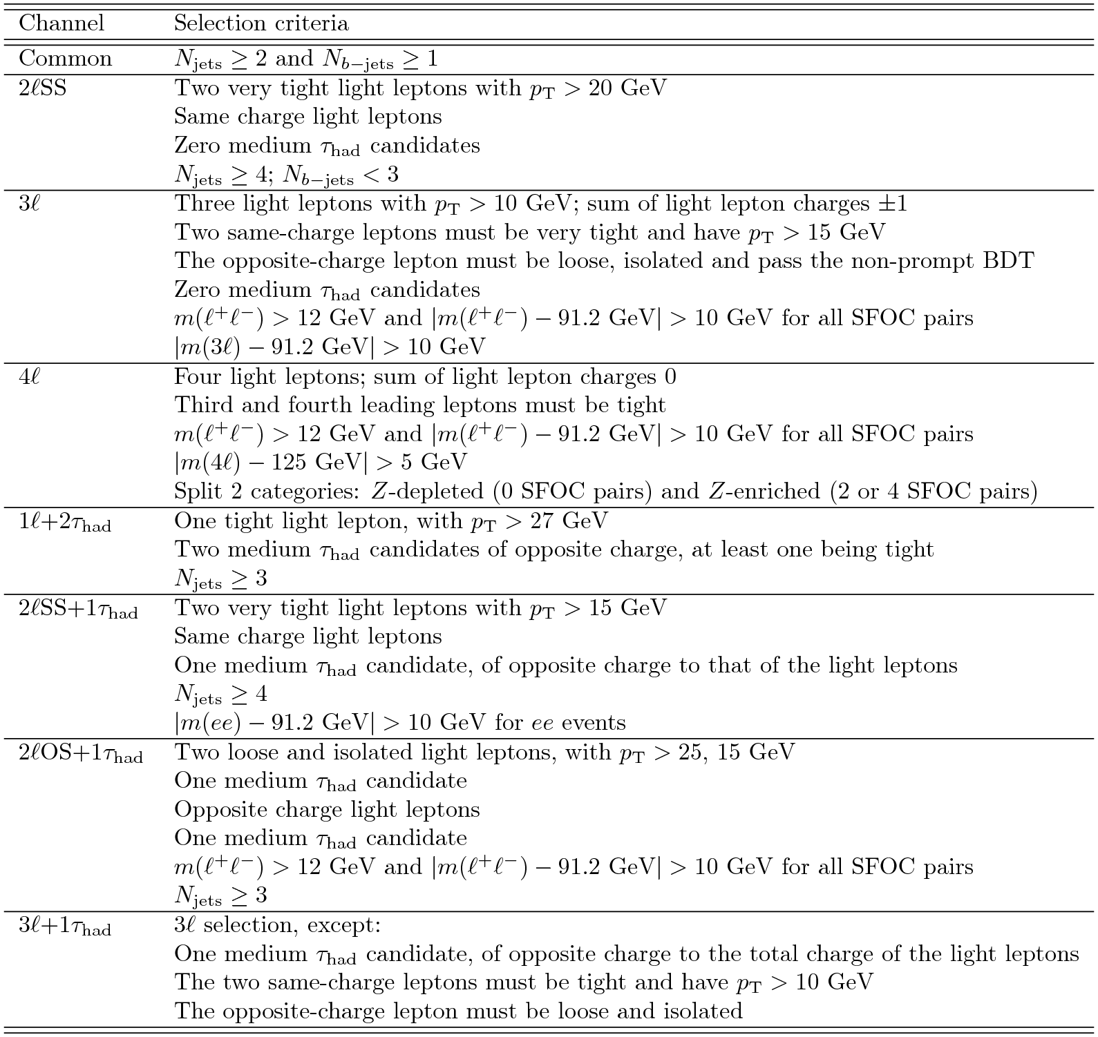
Selection criteria for Higgs+ttbar
Jet requirements: Njets ≥ 2, Nb-jets ≥ 1
  2lSS, 2lSS+1tau: Njets ≥ 4
  2lOS+1tau, 1l+2τhad: Njets ≥ 3
Signal to background ratio ranging from few % to >40% in some channels (4l, 3l+1tau)
Very different background contributions:
  Fake/non-prompt light and τhad leptons
  Irreducible backgrounds: ttW + ttZ and other rare Standard Model processes

Slide 26
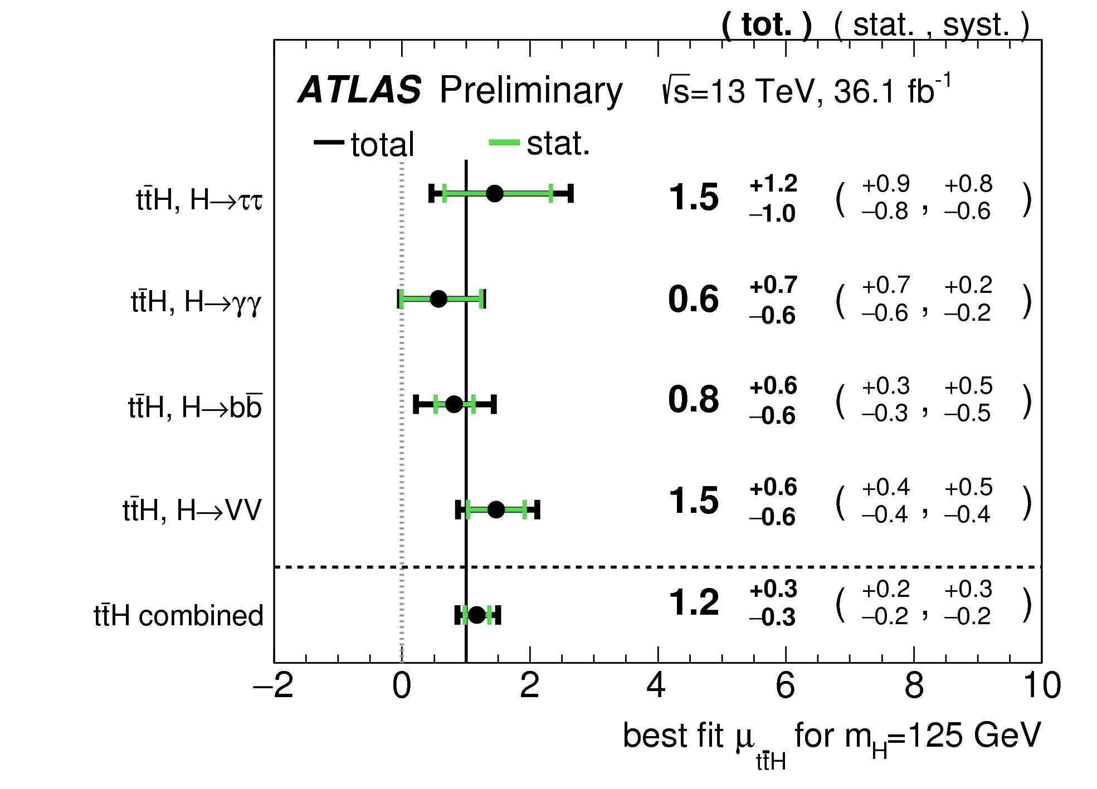
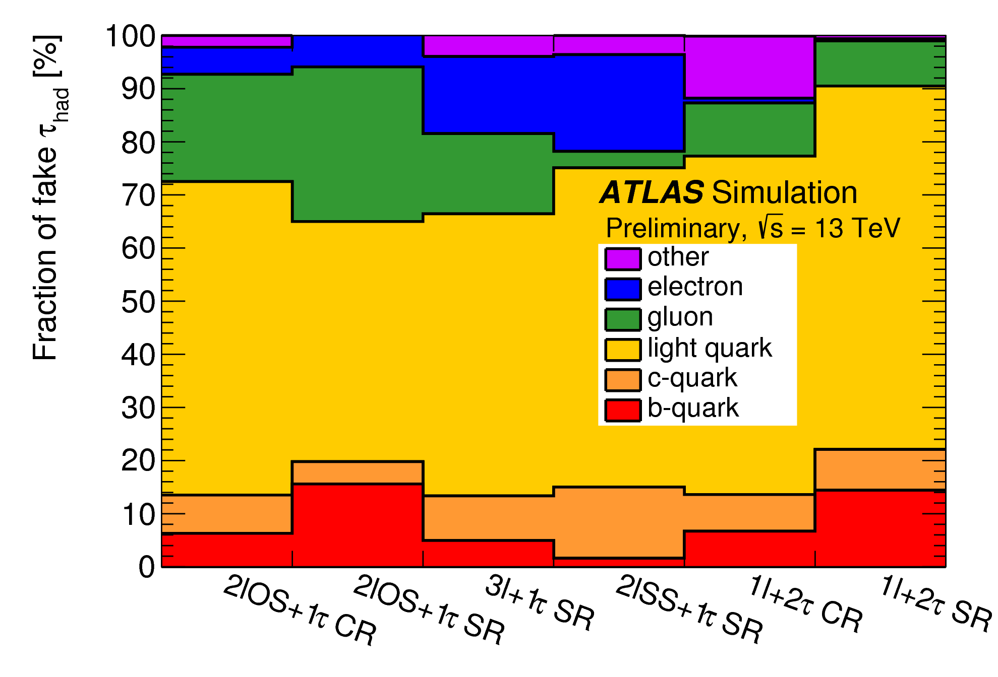
Details for Higgs+ttbar

Slide 27
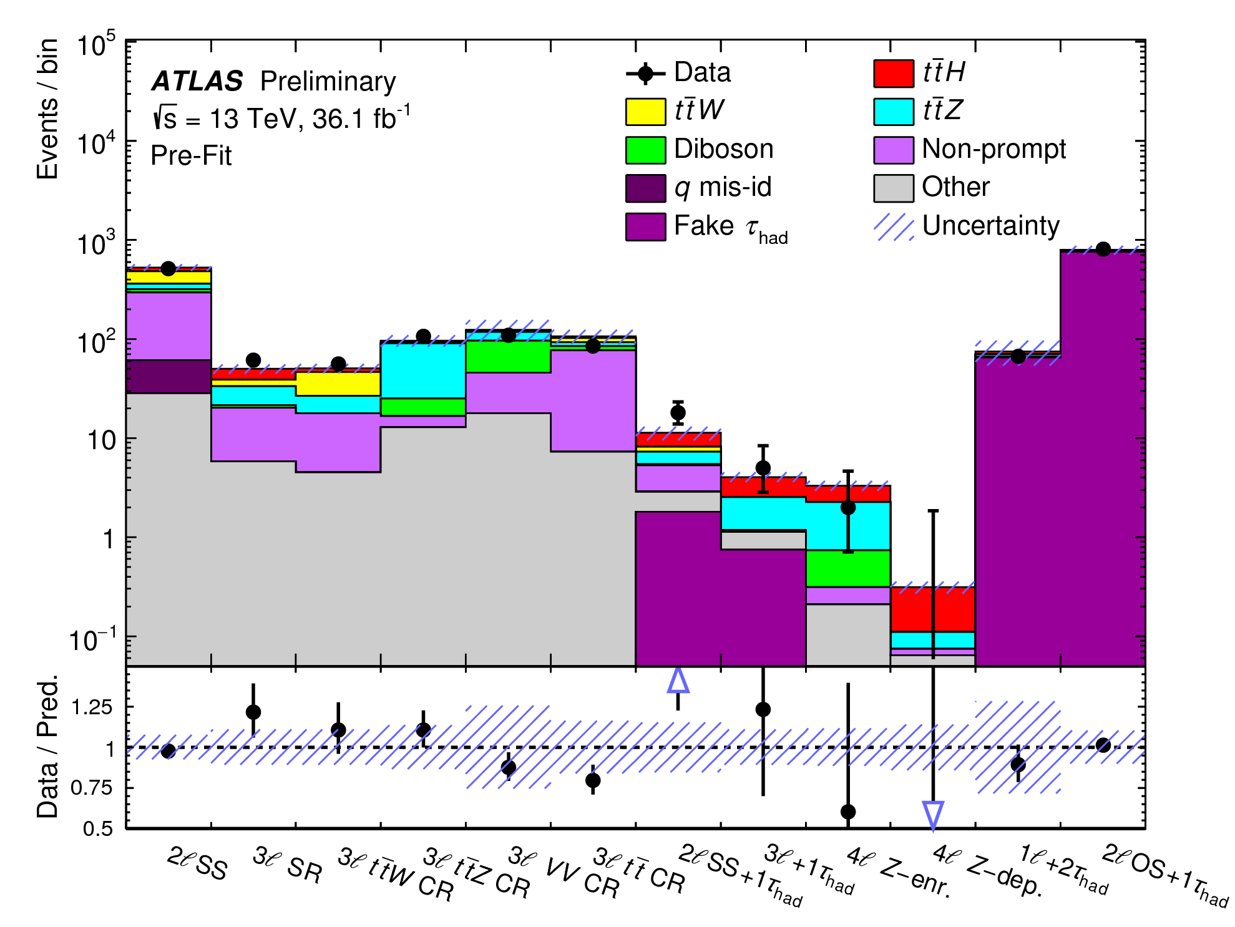
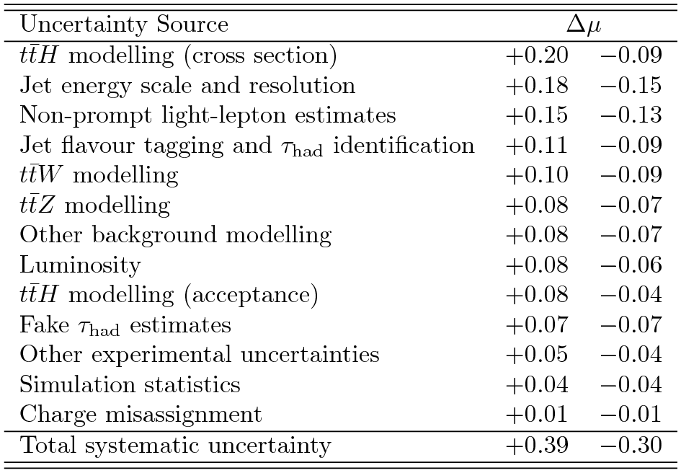
Details and uncertainties for ttH
Summary of the uncertainties affecting the combined value of μ.
Comparison of prediction to data before the fit in the eight signal and four control regions. The systematic uncertainties in the predicted yields are indicated by the hashed blue band.

Slide 28
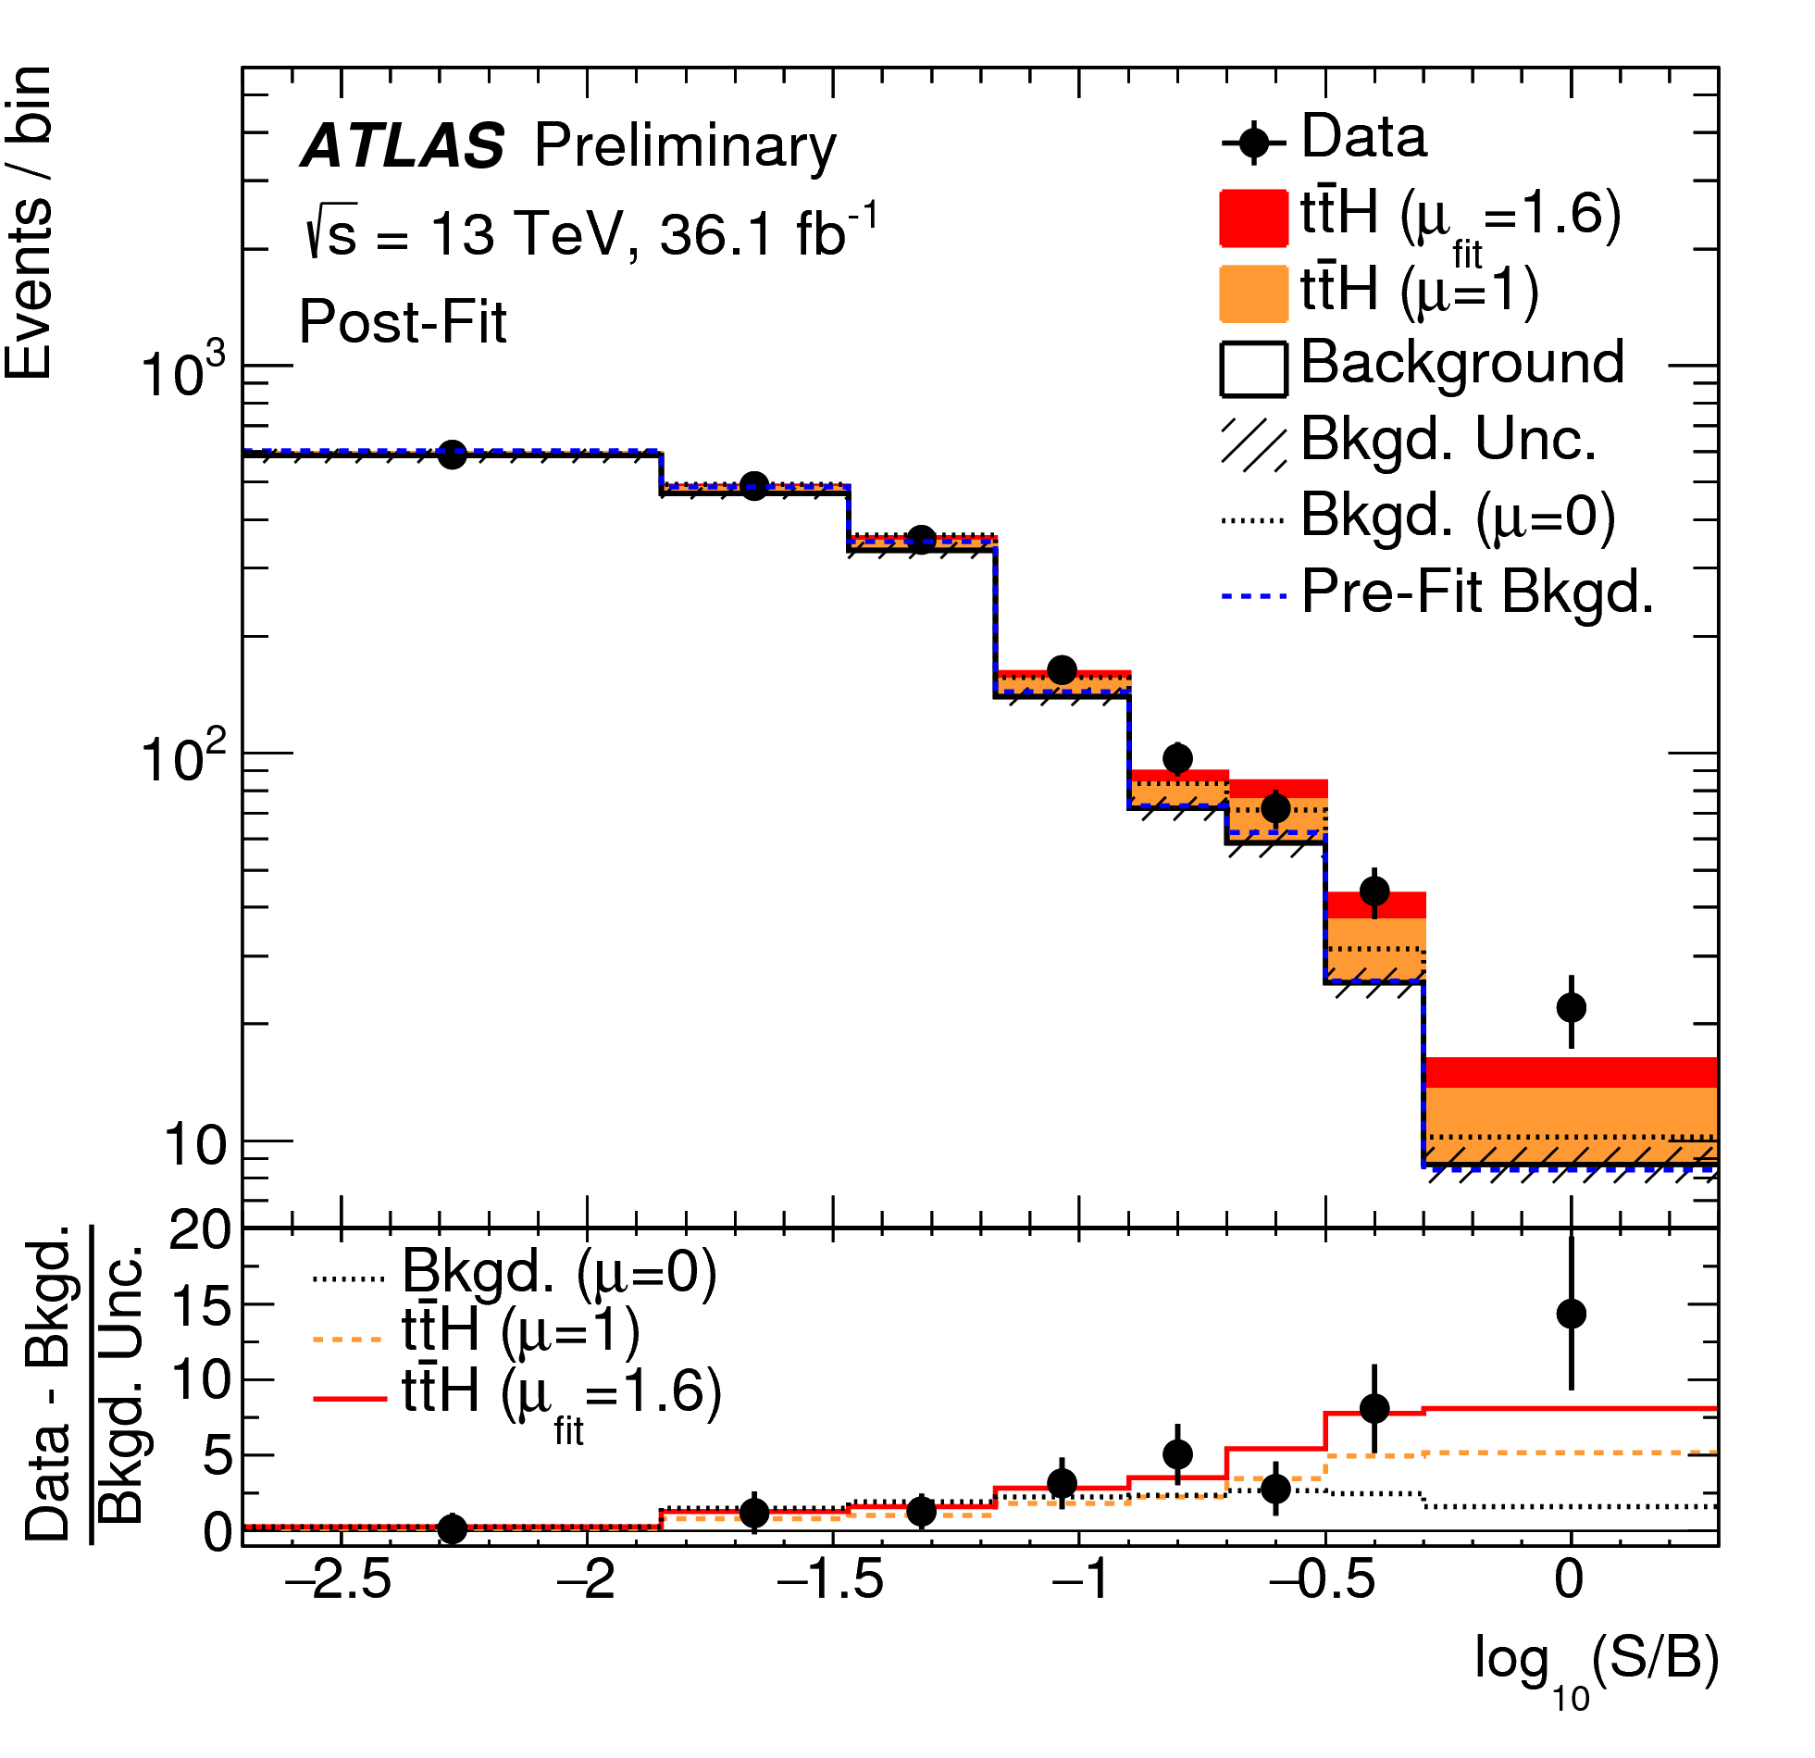
Details for Higgs+ttbar
Event yields as a function of log10(S/B) for data, background and a Higgs boson signal with mH = 125 GeV.
The discriminant bins in all signal regions are combined into bins of log10(S/B), where S is the expected signal yield and B the background yield from the unconditional fit.

Slide 29
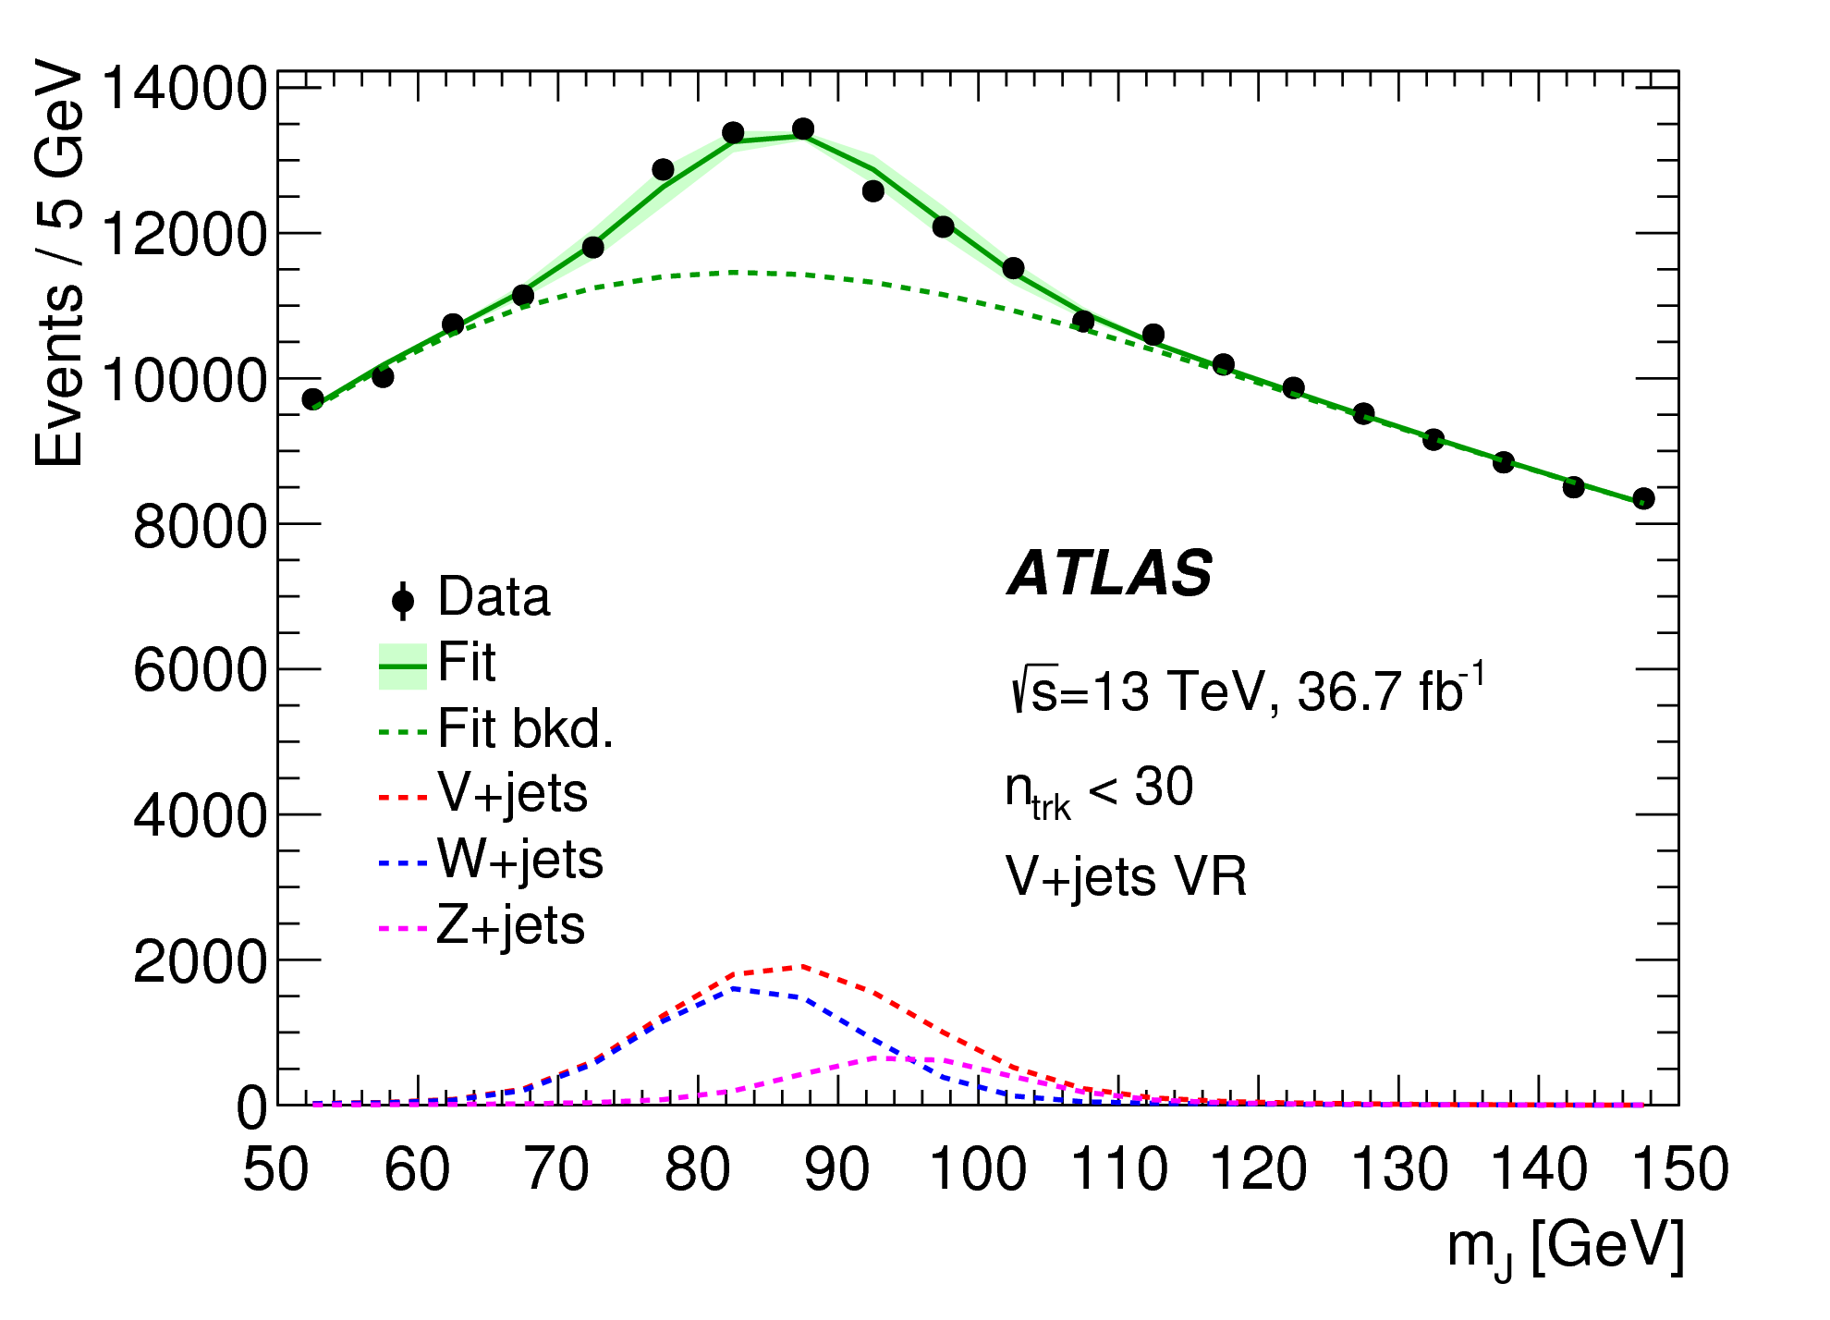
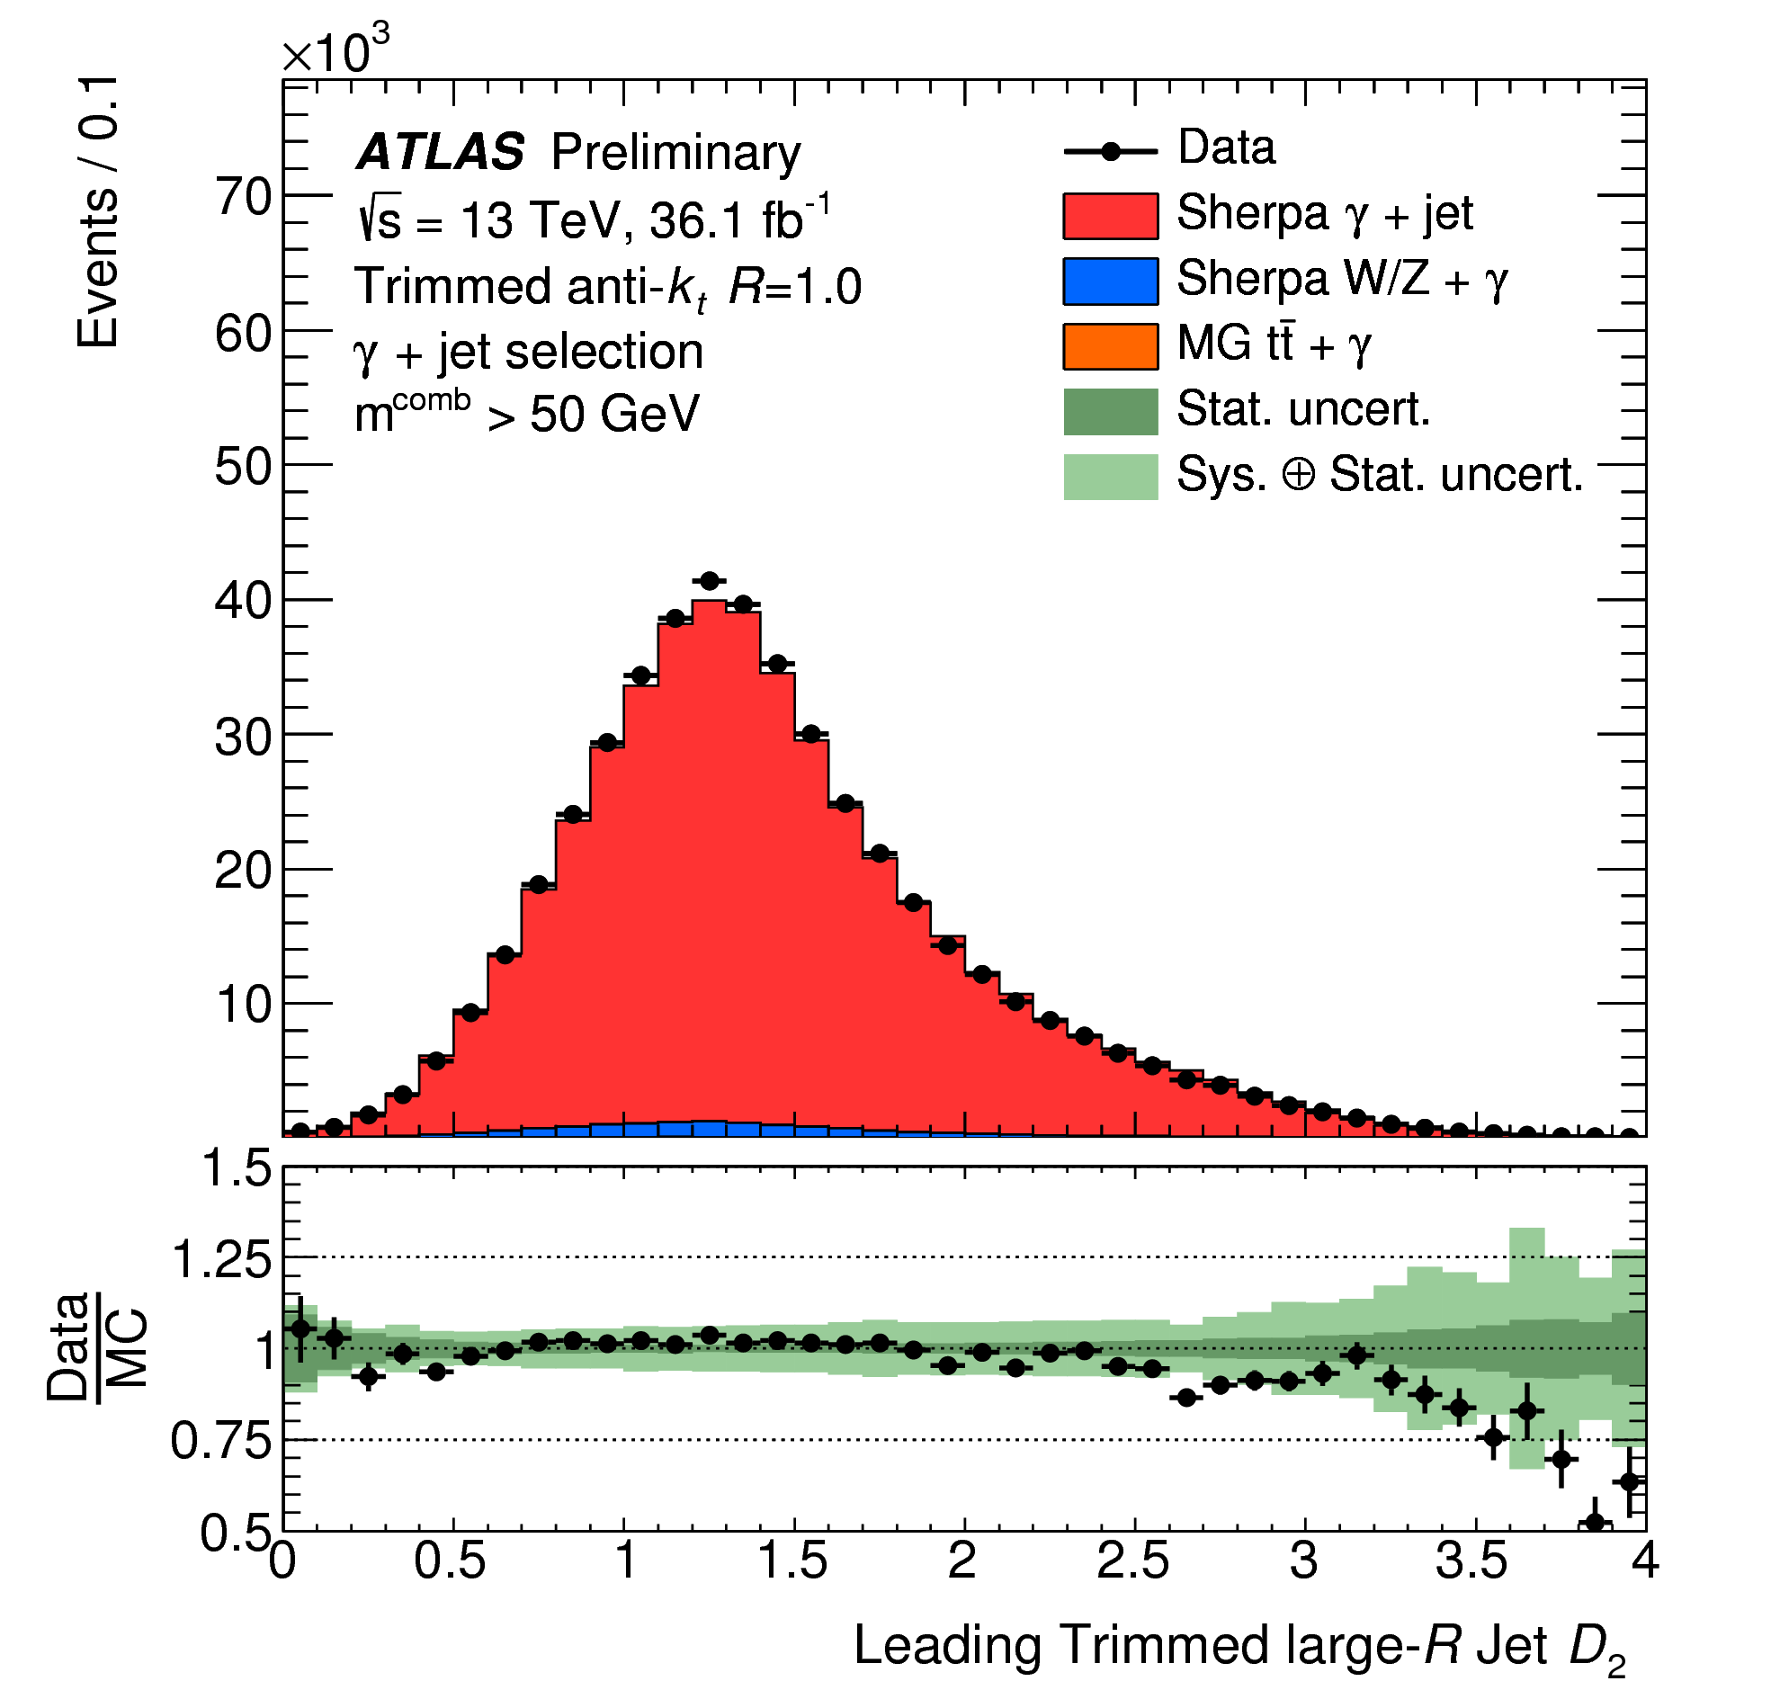
Validation of boosted boson tagging
In-situ tests of boson tagging with analysis selections →
← Detailed data/MC comparisons for all observables, including precision measurements

Slide 30
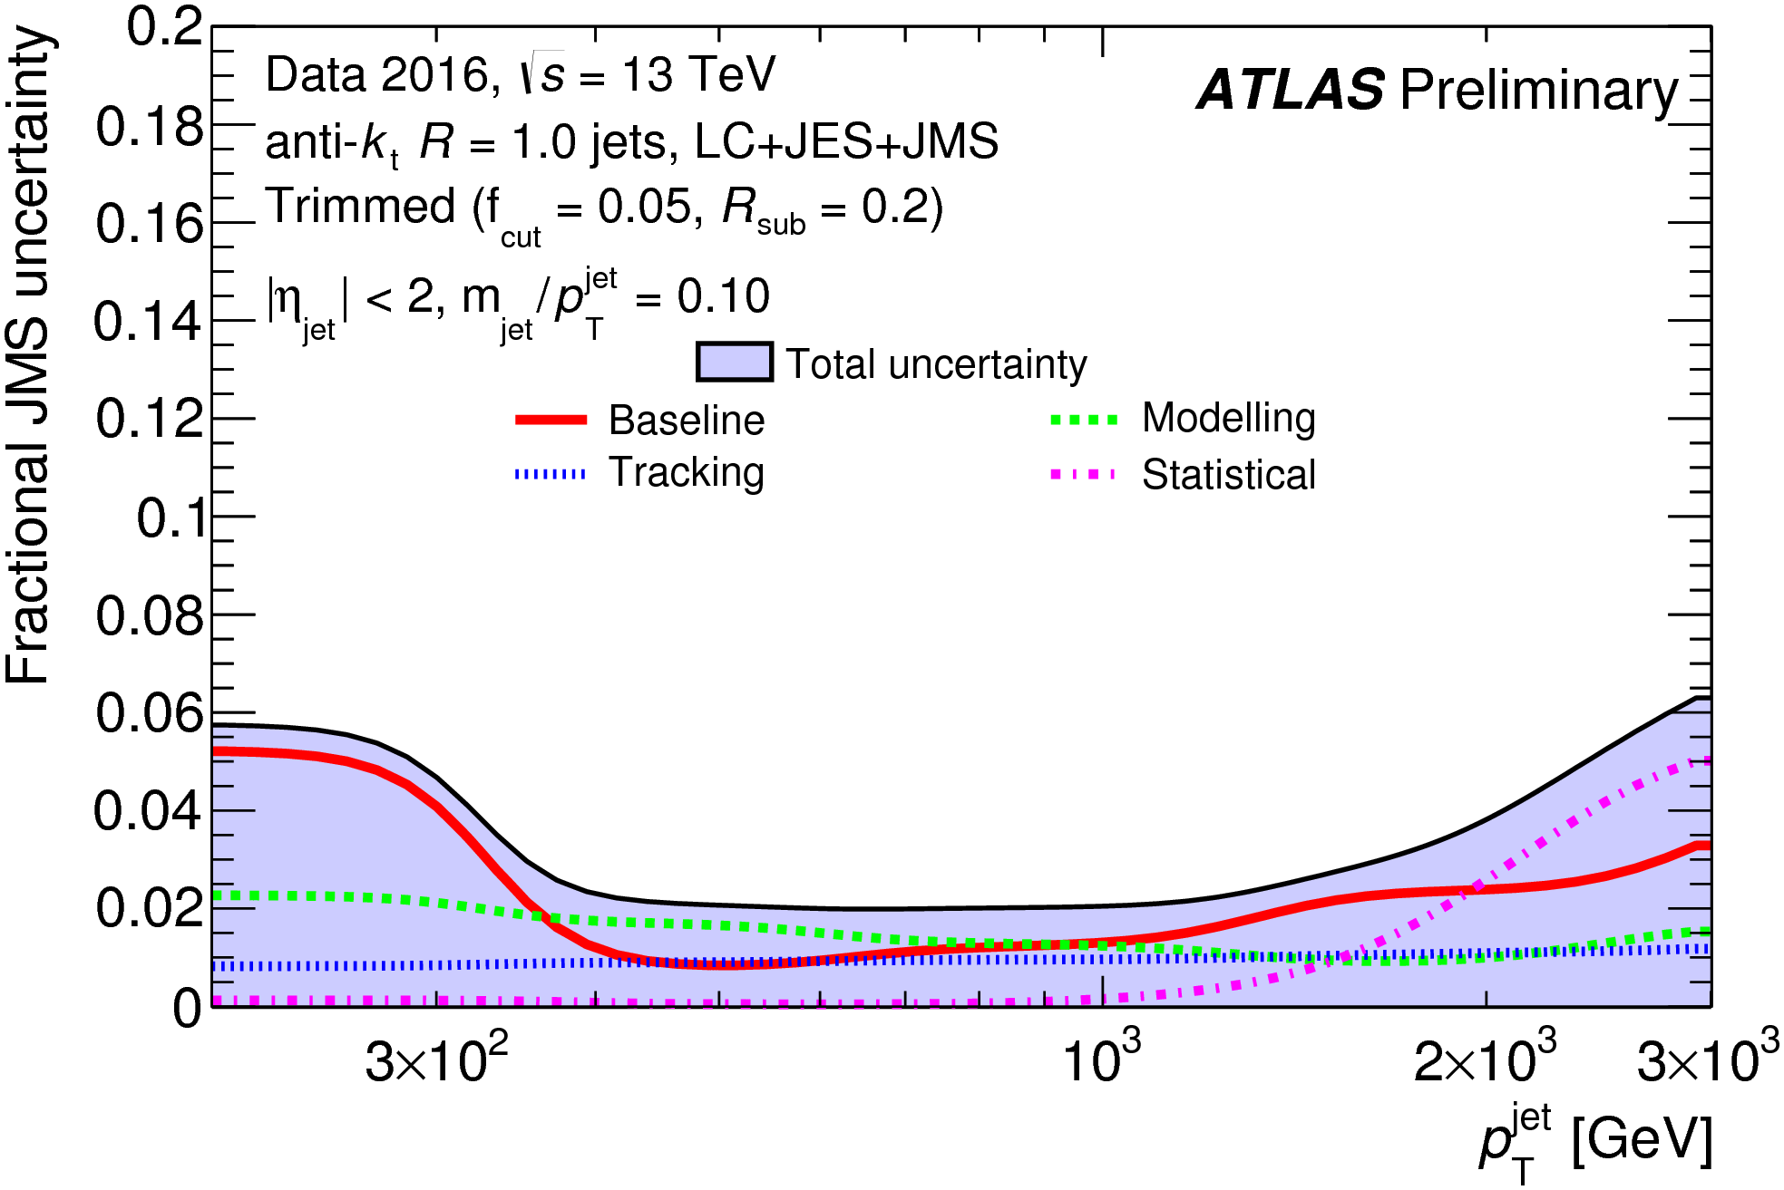
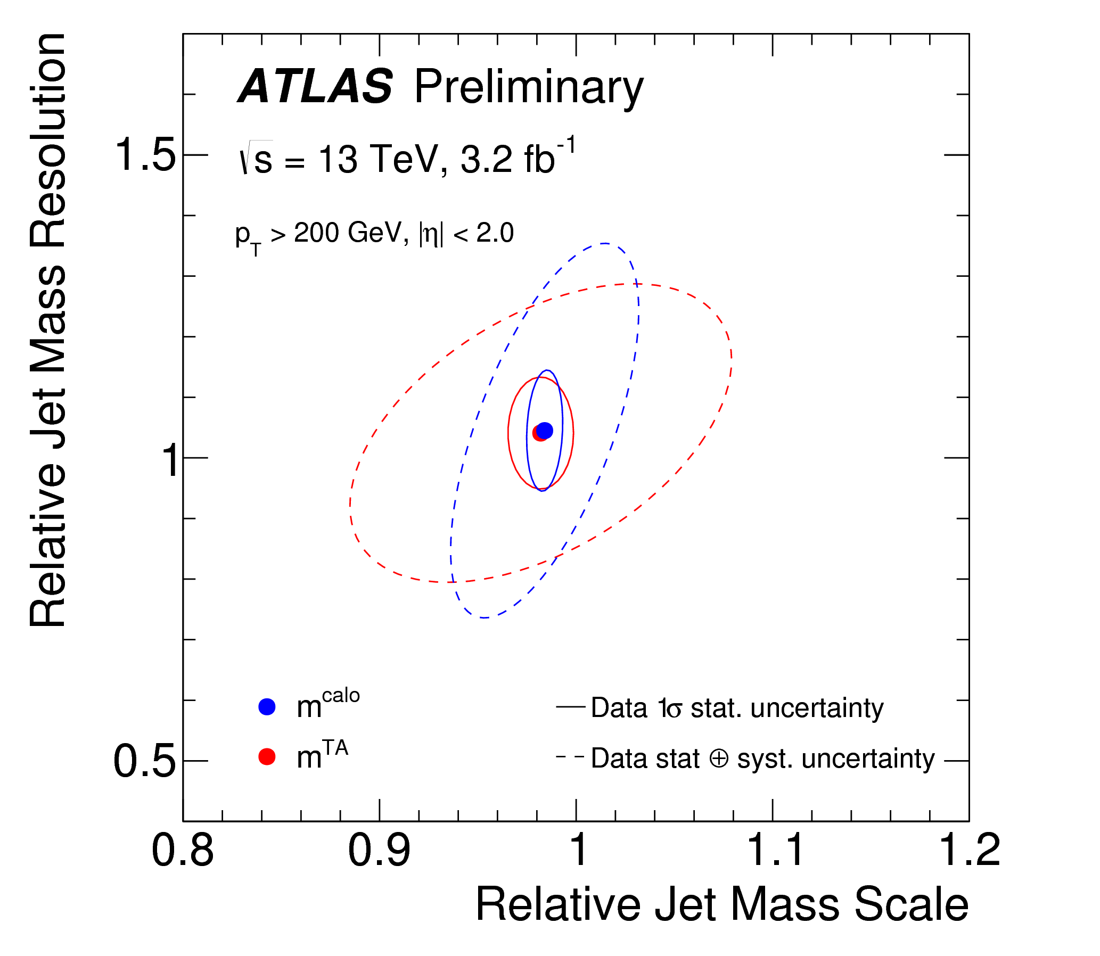
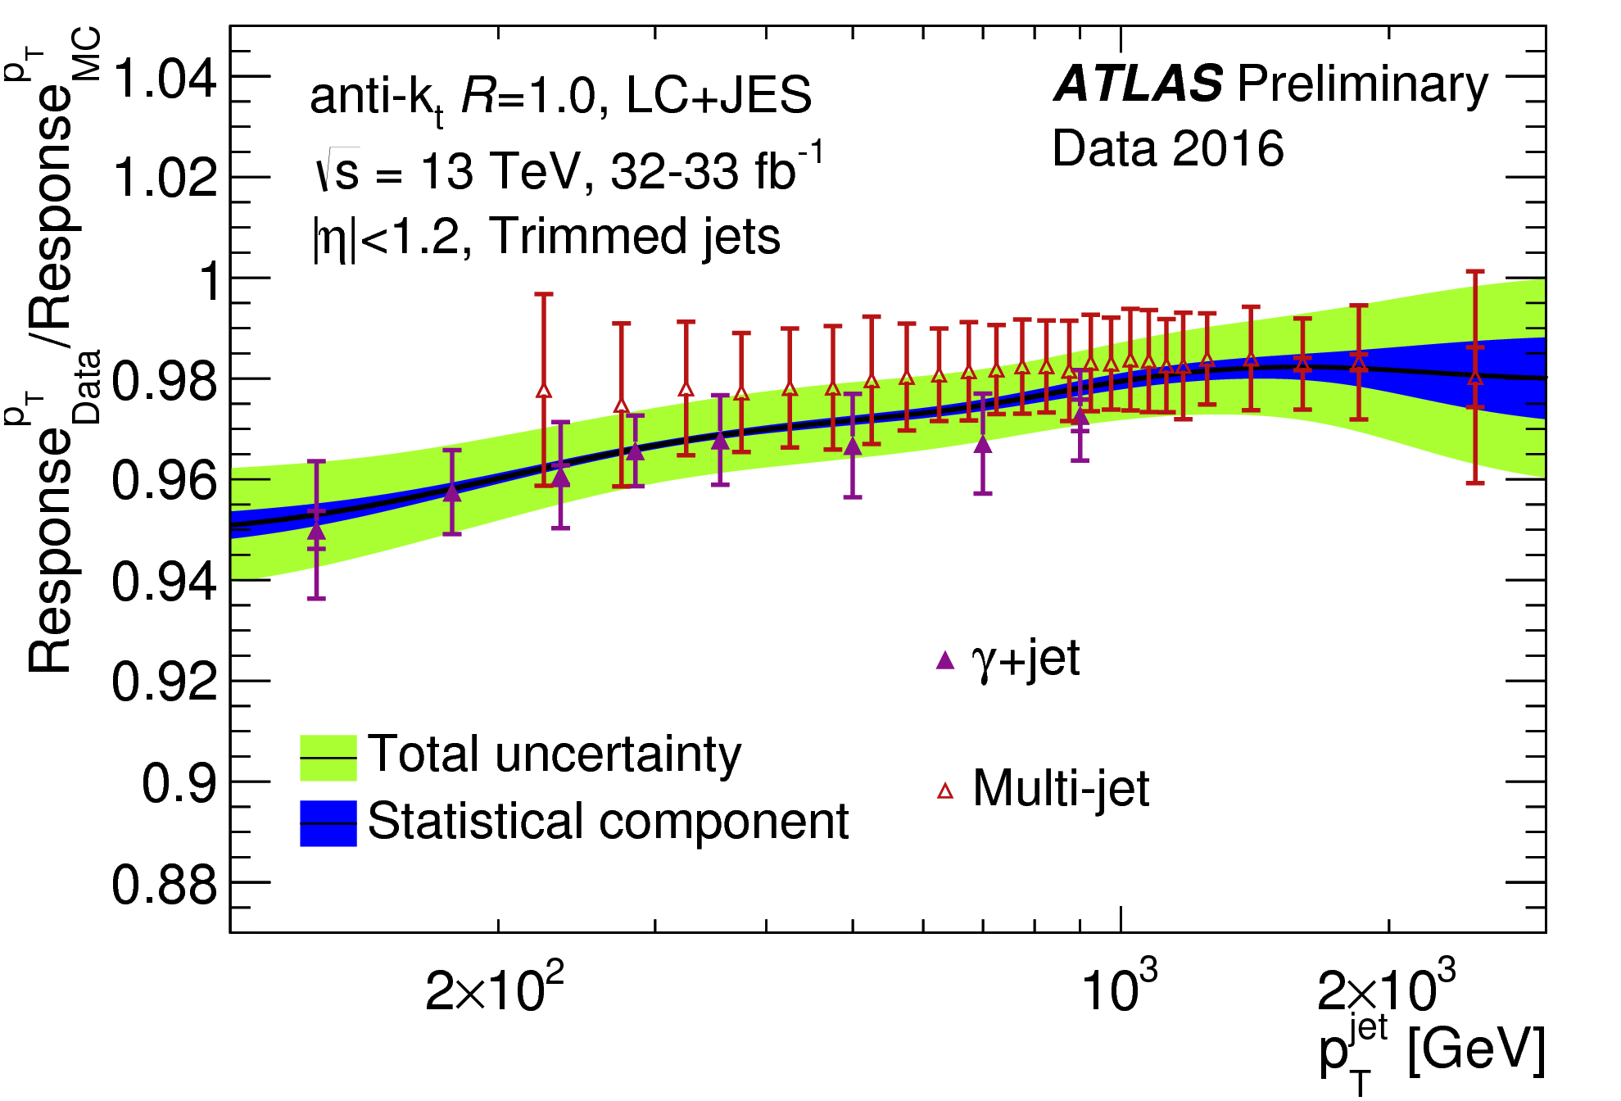
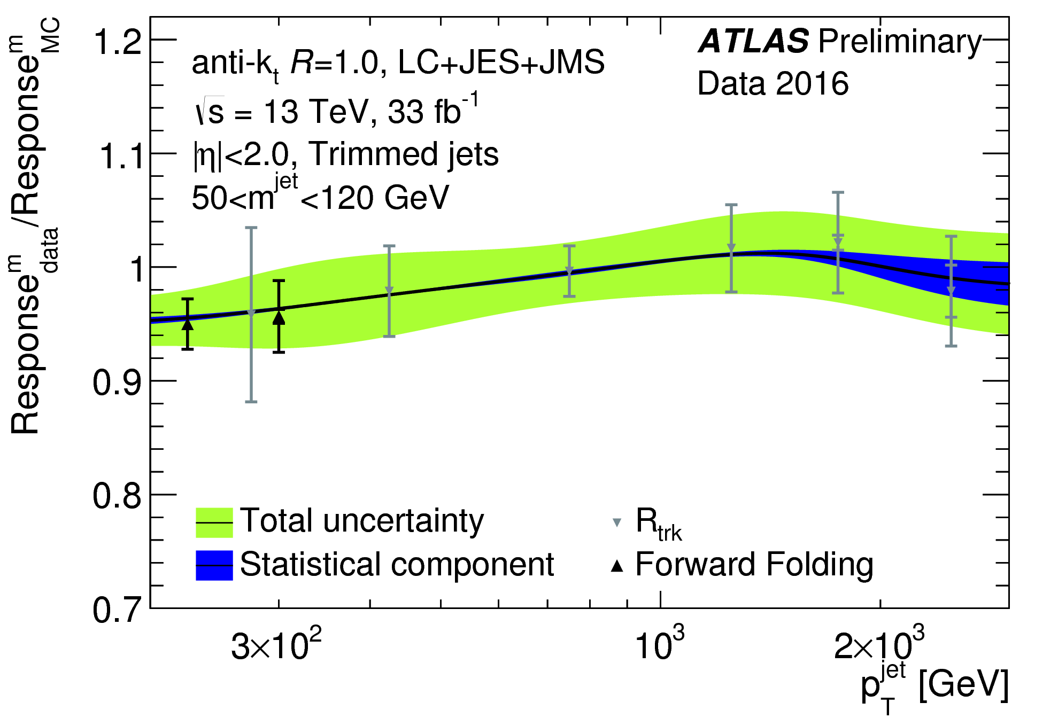
Boosted object calibrations and systematics

