Slide 1
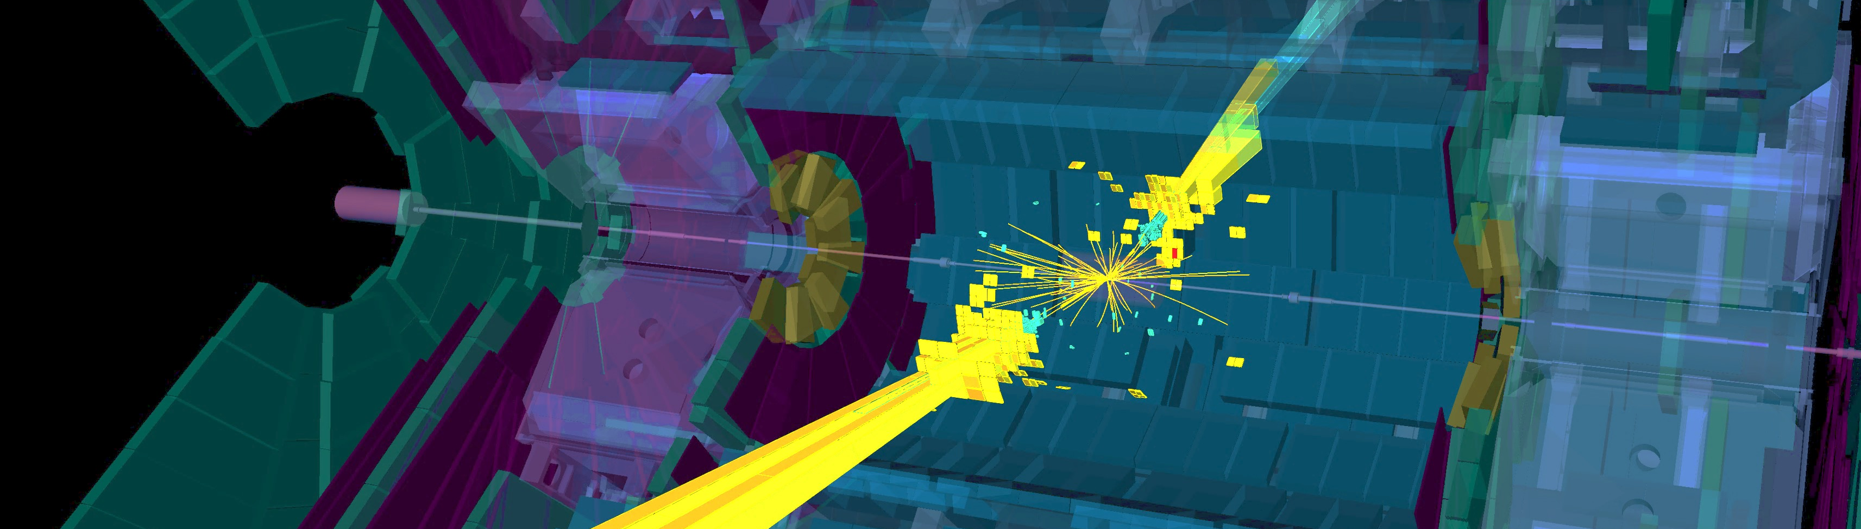
ATLAS Status and Outlook
Andreas Hoecker (CERN)
US LHC Users Association Meeting, November 1–3, 2017

Slide 2

ATLAS data taking has been smooth and efficient so far throughout Run-2
Status: Nov 2, 2017
Status: Nov 2, 2017
We thank the CERN accelerator team and all contributing services for the excellent performance of the LHC and injectors, and for finding a way to mitigate the Q16L2 problem

Slide 3
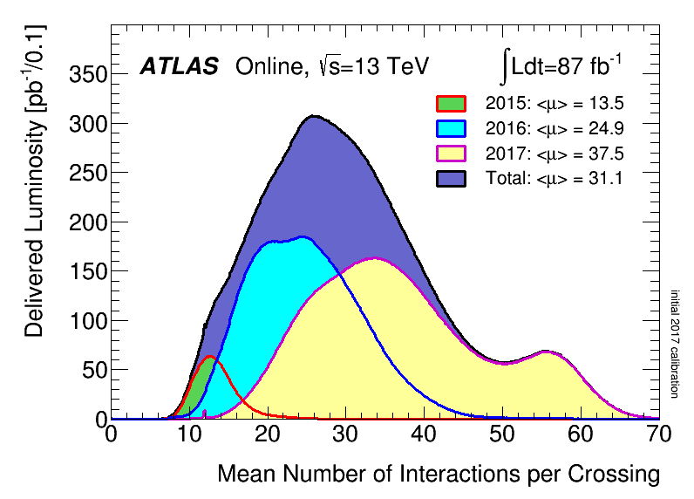
But the high pileup level is a challenge
Status: Oct 29, 2017
Status: Nov 1, 2017
The mitigation scheme (“8b4e” and ß* = 30 cm, peak L ~ 2 ∙10³⁴ cm^{–2}s^{–1}) is challenging…

Slide 4
Levelling at ~60 average pileup events
Records so far:
max L / day: 880 pb^{–1} (20 Oct)
max L / week: 5.2 fb^{–1} (16–22 Oct)
Levelling at the beginning of fill
ATLAS copes up to a pile-up of ~60 (limited by available HLT CPUs, now improved)
(for trigger thresholds optimised for 1.7 10³⁴ cm⁻² s⁻¹, ~80 kHz Level-1 rate)
Benefiting from improvements in hardware, as well as in firmware and software

Slide 5
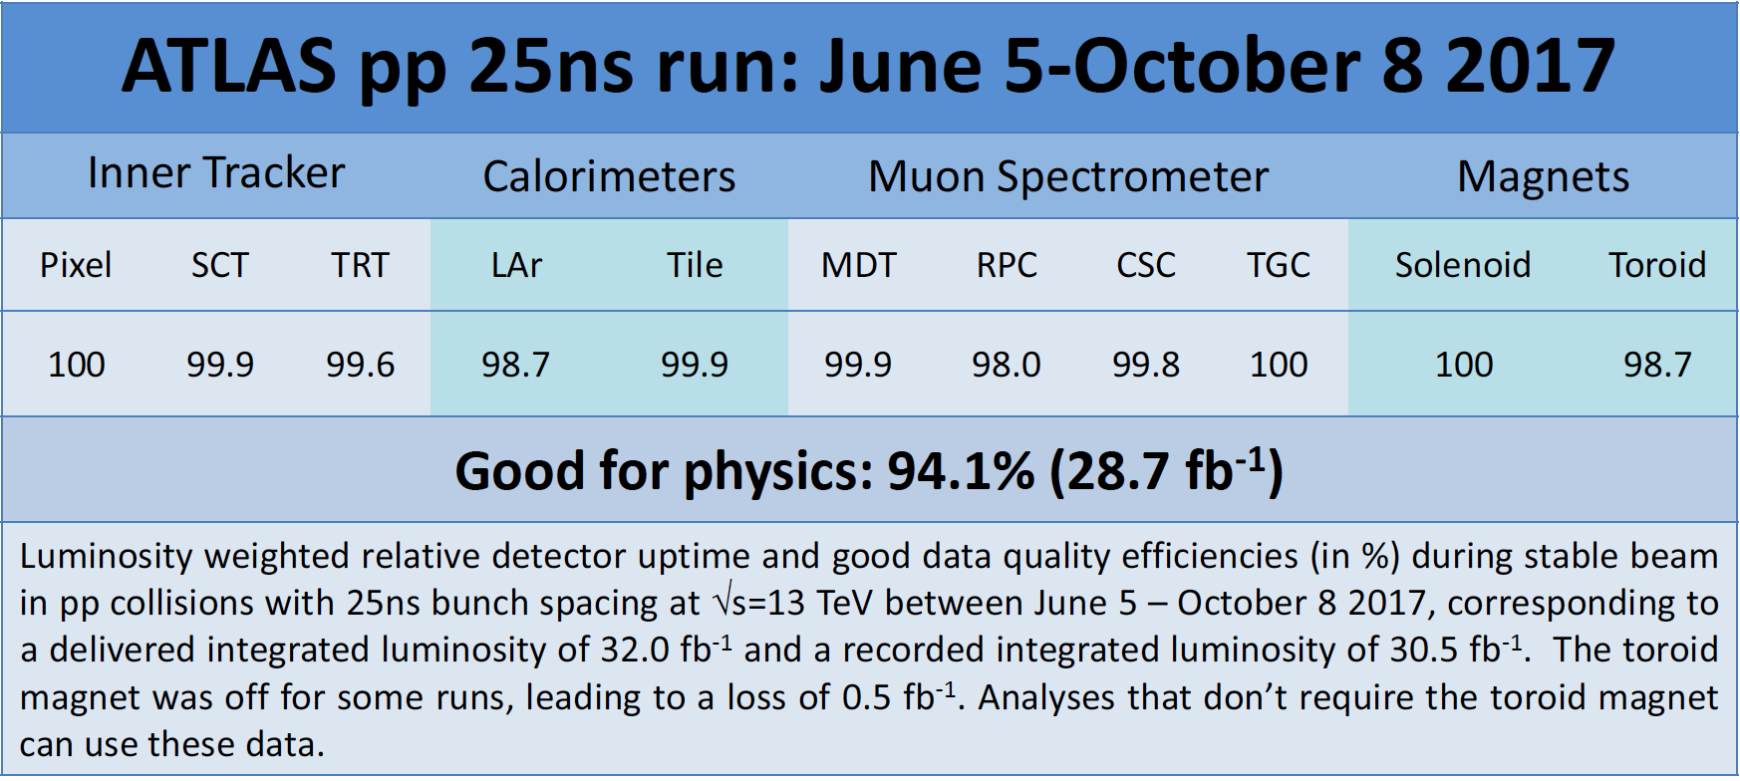
Overall, good data taking efficiency and quality
Data taking efficiency
Status: Nov 2, 2017
Data quality efficiency
Max. efficiency ~96%
Overall efficiency 93.3%
Overall data taking efficiency 93.3%, all-good physics data quality efficiency 94.1%
Largest losses from RPC HV crate failures, and toroid off (Aug 1–3)

Slide 6
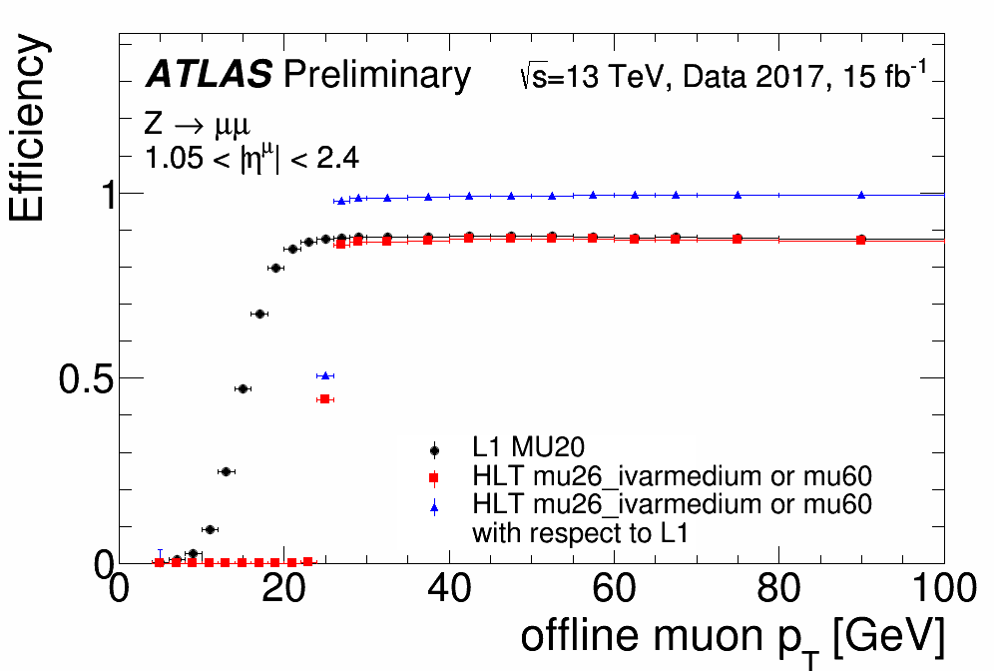
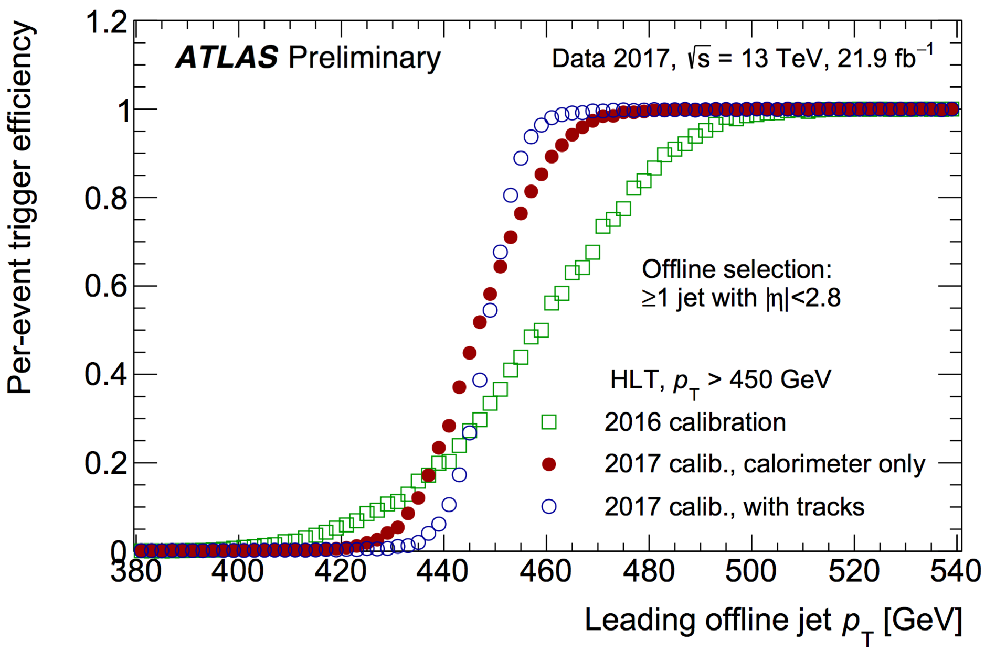
Robust trigger performance in 2017, thoroughly challenged by high pileup conditions
Maintaining single-lepton triggers at sufficiently low threshold
Trigger benefits from new L1 topological trigger boards and ~3% improved muon trigger acceptance
muons
electrons
E_{T} ^{miss}
jets
Sharpened turn-on with improved calibration

Slide 7
Good early physics objects performance in 2017 data with new software release 21
Physics results of 2015+2016 data based on well-understood rel. 20.7
Since 2017, use newest “Run-2” rel. 21. Earlier data and MC reprocessed
Work underway to update 2017 tracker and muon alignment, and efficiency and energy scale calibrations of physics objects
muons
Energy response (Z → ee) vs µ stable
within ±0.05%, slope tracked by MC
electrons
tt → eµ+bb+νν events
Small dependence of jet multiplicity on µ after vertex association
New MVA-based flavour tagger using (a.o.) RNN

Slide 8
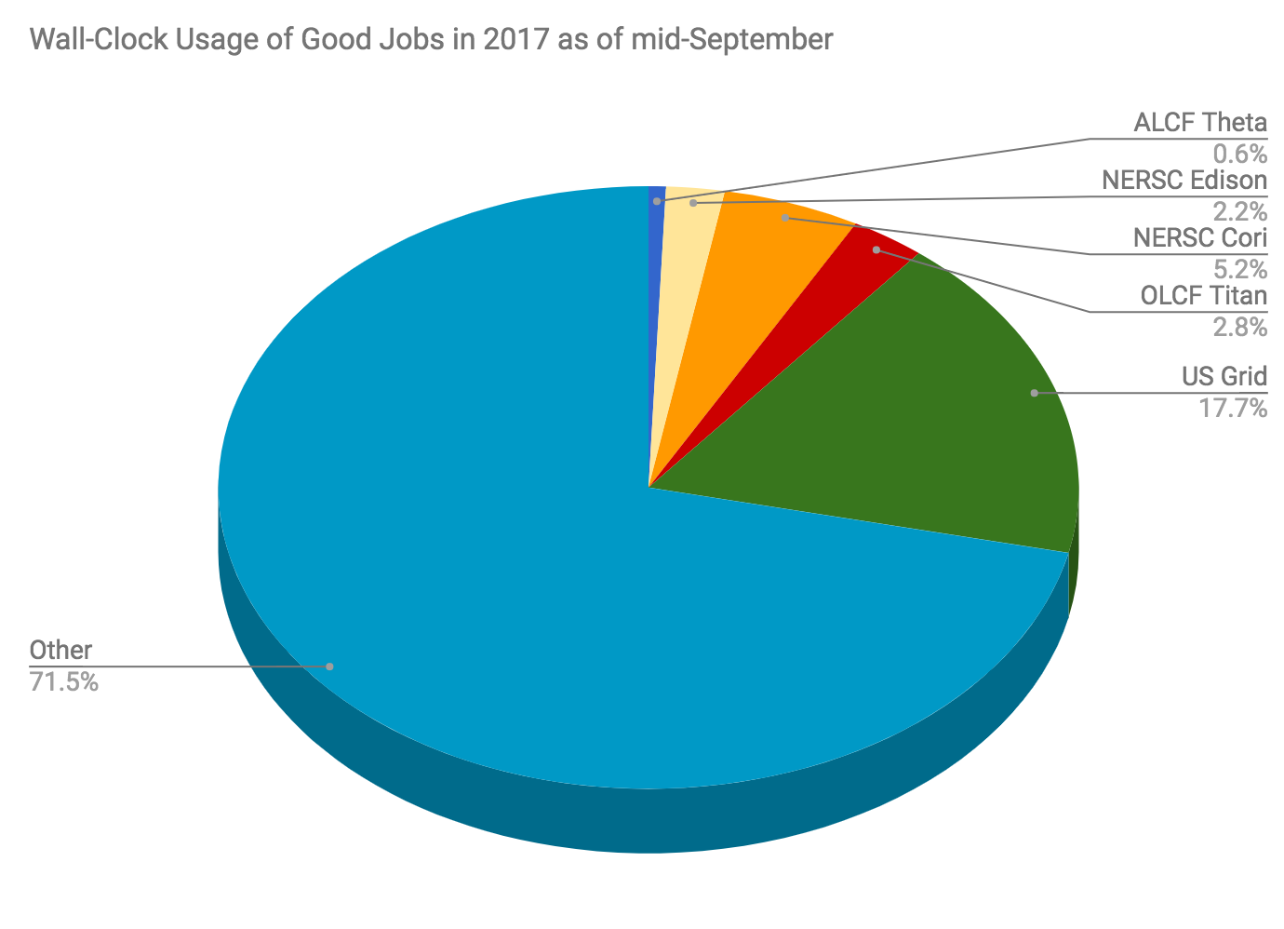
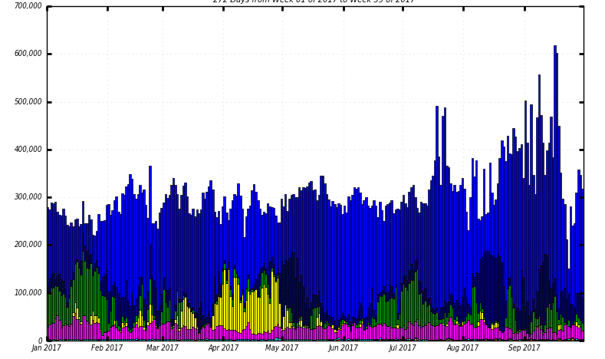
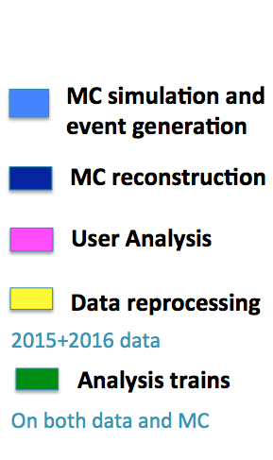
Computing in Tier-0 and grid sites cope well with high demands; good use of opportunistic resources
Can produce about 1B fully simulated MC events per month
Significant (~11%) use of supercomputers (HPC) for MC production
(event generation and GEANT4, while reconstruction and analysis are left at T1/T2s)
Slots of running jobs
282 days from Week 01–39, 2017
pledged resources

Slide 9
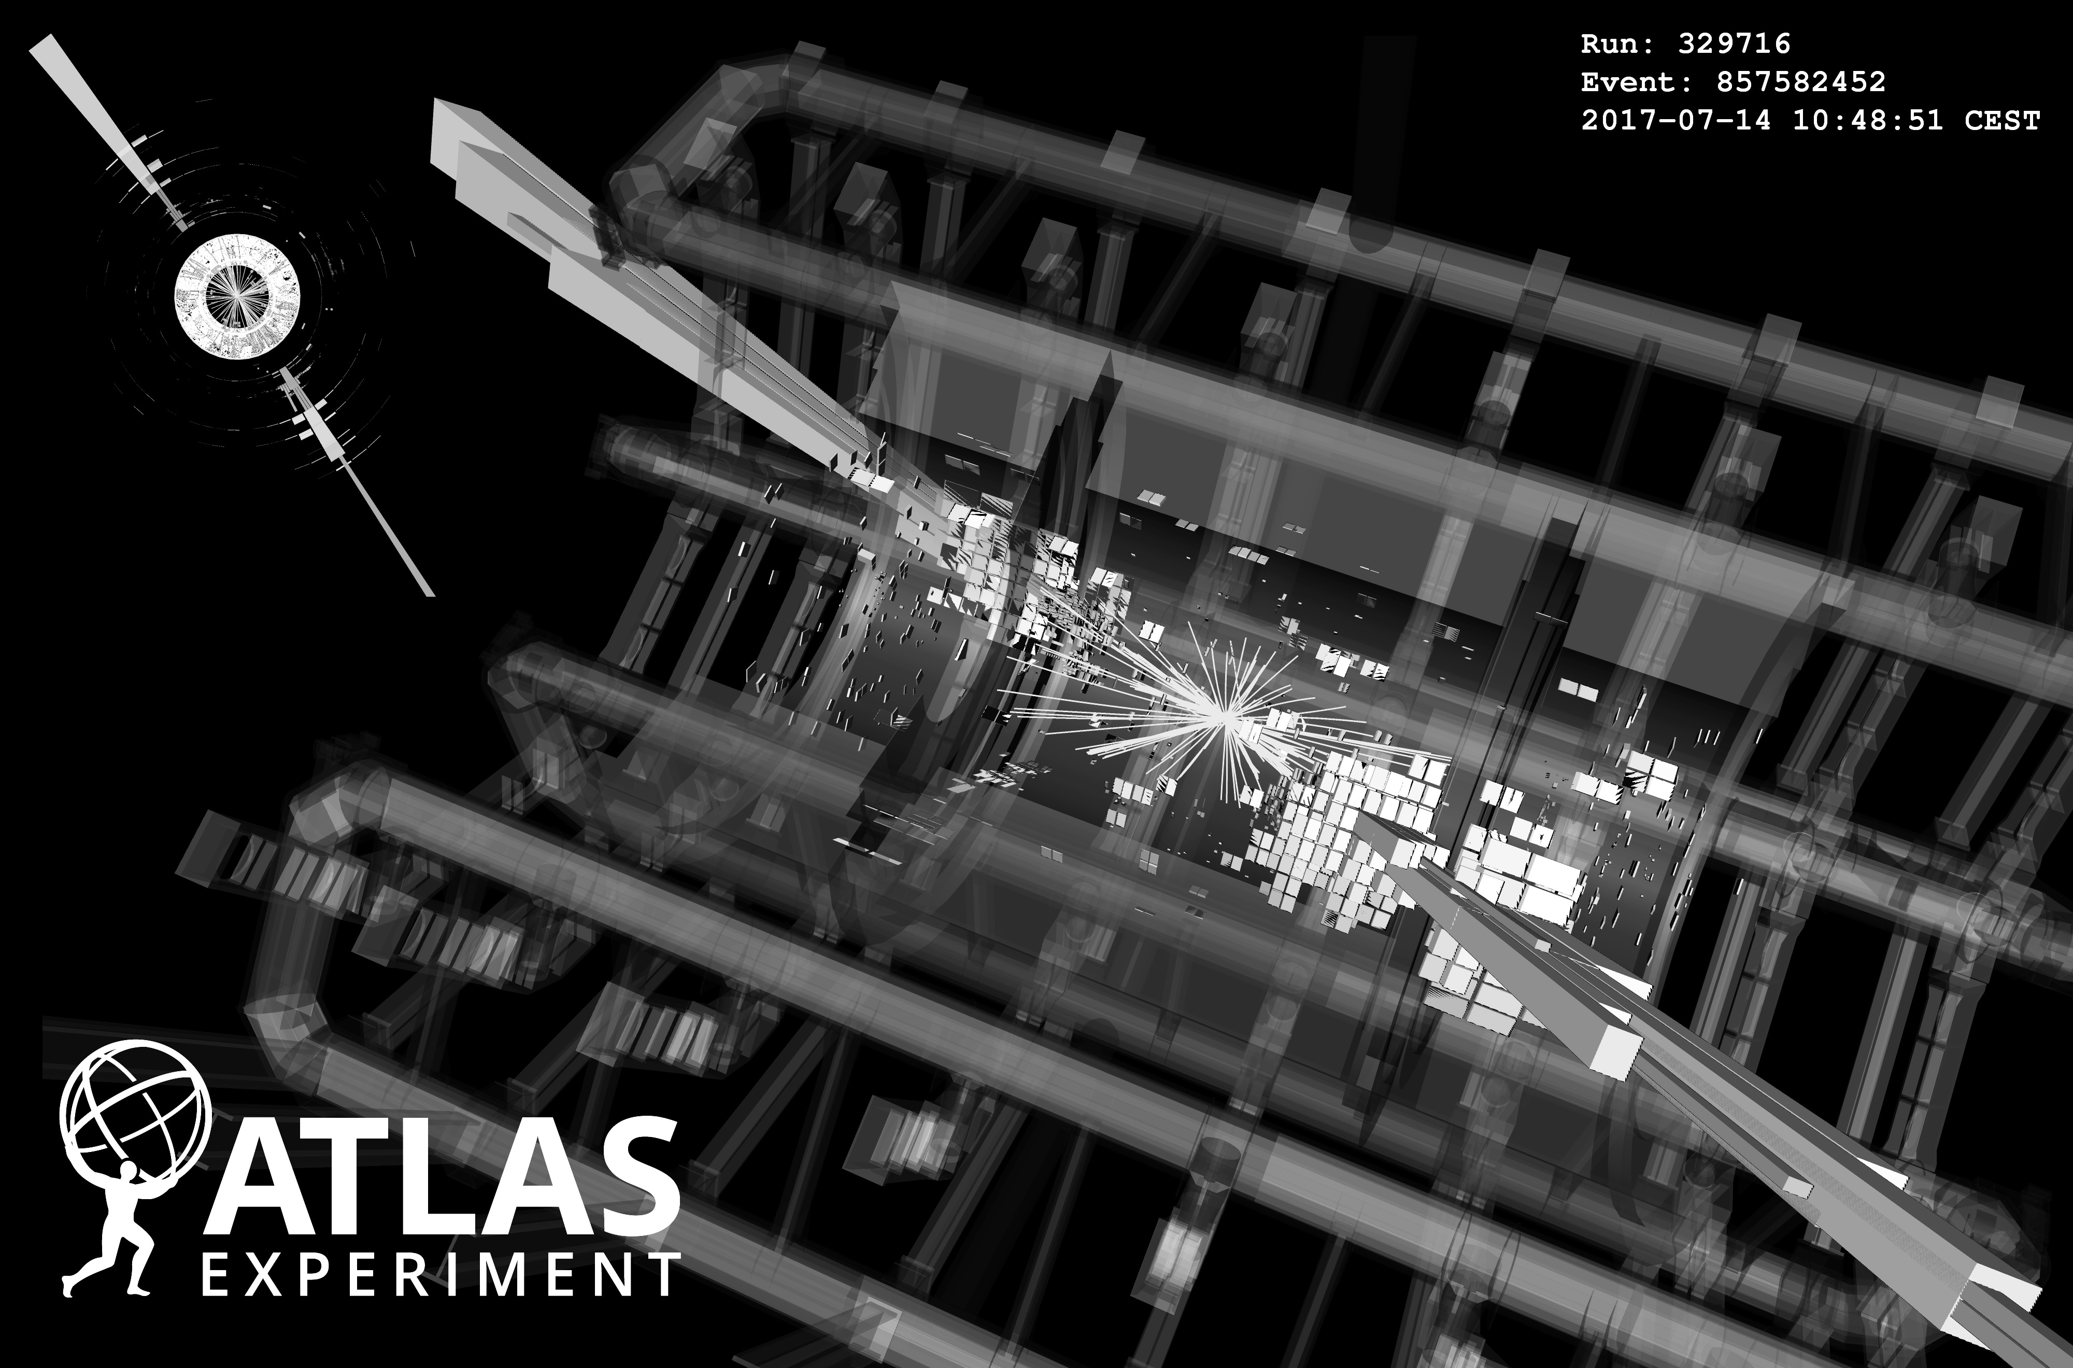
A small selection of recent physics highlights
→ Many more by David Miller this afternoon and throughout the meeting !
Total: 691
Continue prolific physics production: total of 691 papers on collision data
Run-1 data still used: extremely well understood dataset for high-precision measurements
It is a challenge to simultaneously operate the detector, analyse the data, construct Phase-I upgrades, and prepare Phase-II TDRs
Run-1:
582
Run-2:
109

Slide 10
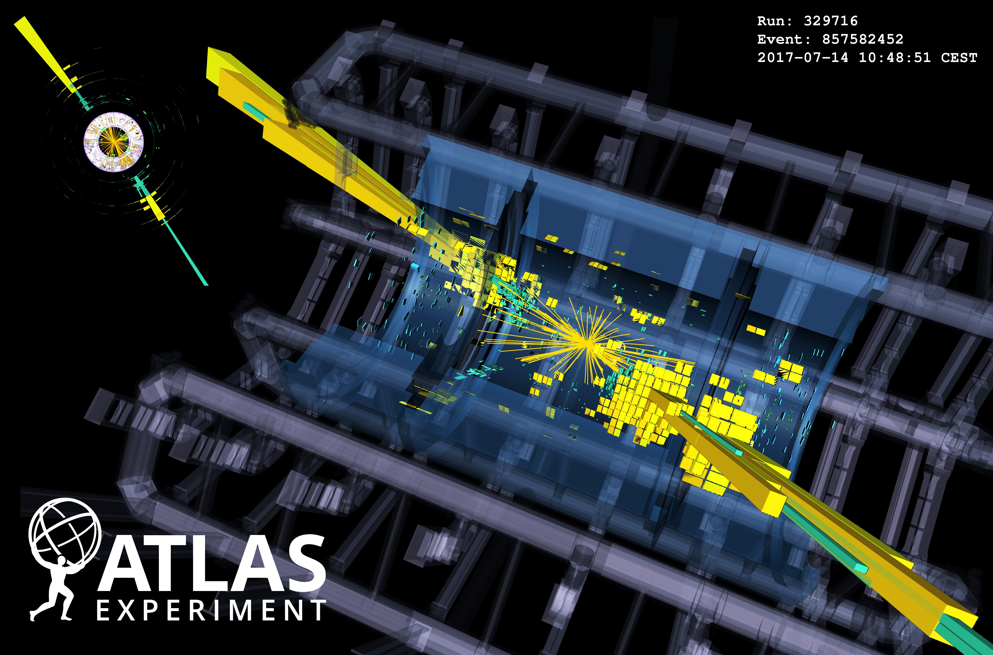
Display of huge di-jet event with m_{jj}=9.3 TeV, produced in pp collisions at √s = 13 TeV in 2017. The two high-p_{T} jets both have p_{T}=2.9 TeV, one is at η=–1.2 and the other at η=0.9.

Slide 11
Theory so far agrees with all measured cross-sections
Across widely different processes and rates
Harvest of cross-section measurements from ATLAS confirms the predictive power of the Standard Model

Slide 12
Ultimate precision is possible at the LHC
ATLAS measured the W boson mass to 0.02% precision
Measurement uses W → e𝜈, µ𝜈 events
Excellent agreement of results among e / µ channels, W⁺ / W– and p_{T,𝓁} / m_{T}
Combined result:
m _{W} (ATLAS) = 80370 ± 7 stat ± 11 exp syst ± 14 mod syst MeV
= 80370 ± 19 MeV
arXiv:1701.07240

Slide 13
Precision progress also for top mass
ATLAS measured the top quark mass to 0.3% precision
New 8 TeV dilepton and lepton+jets top mass measurements, the latter using 3D likelihood fit
Careful design reduces correlations among measurements to strengthen combination
Combined result:
m _{top} (ATLAS) = 172.51 ± 0.27 stat ± 0.42 syst GeV
= 172.51 ± 0.50 GeV
ATLAS-CONF-2017-071

Slide 14
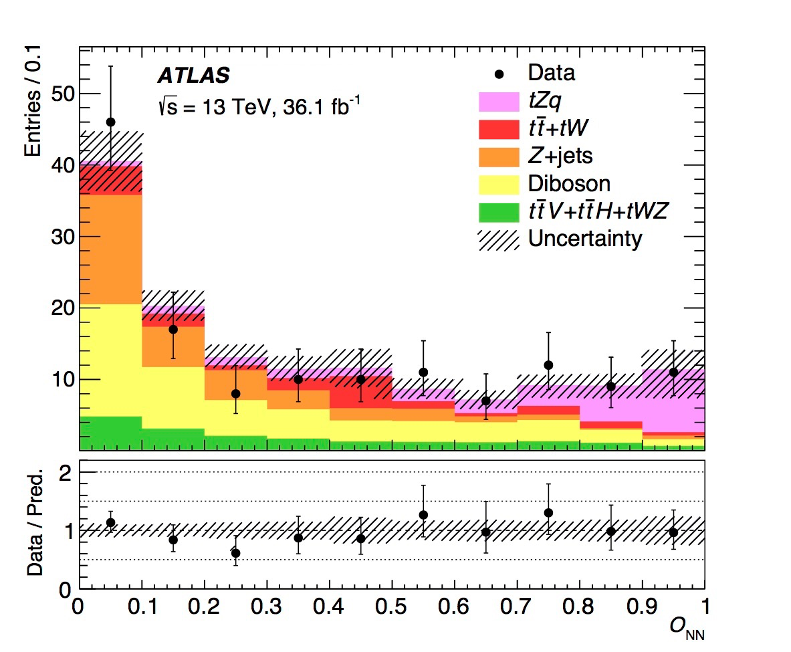
Rare top quark physics, single top
ATLAS measured t-channel and tW production, evidence (3.2σ) for s-channel (observed by CDF & D0)
(σ ~156 pb at 13 TeV)
(σ ~72 pb)
(σ ~1.0 pb)
Search for associated tZ production using 3-lepton events and full 2015+2016 13 TeV data
Evidence of 4.2σ observed for 5.4σ expected: cross section = 600 ± 170 stat ± 140 syst fb
Final MVA discriminant
arXiv:1710.03659

Slide 15
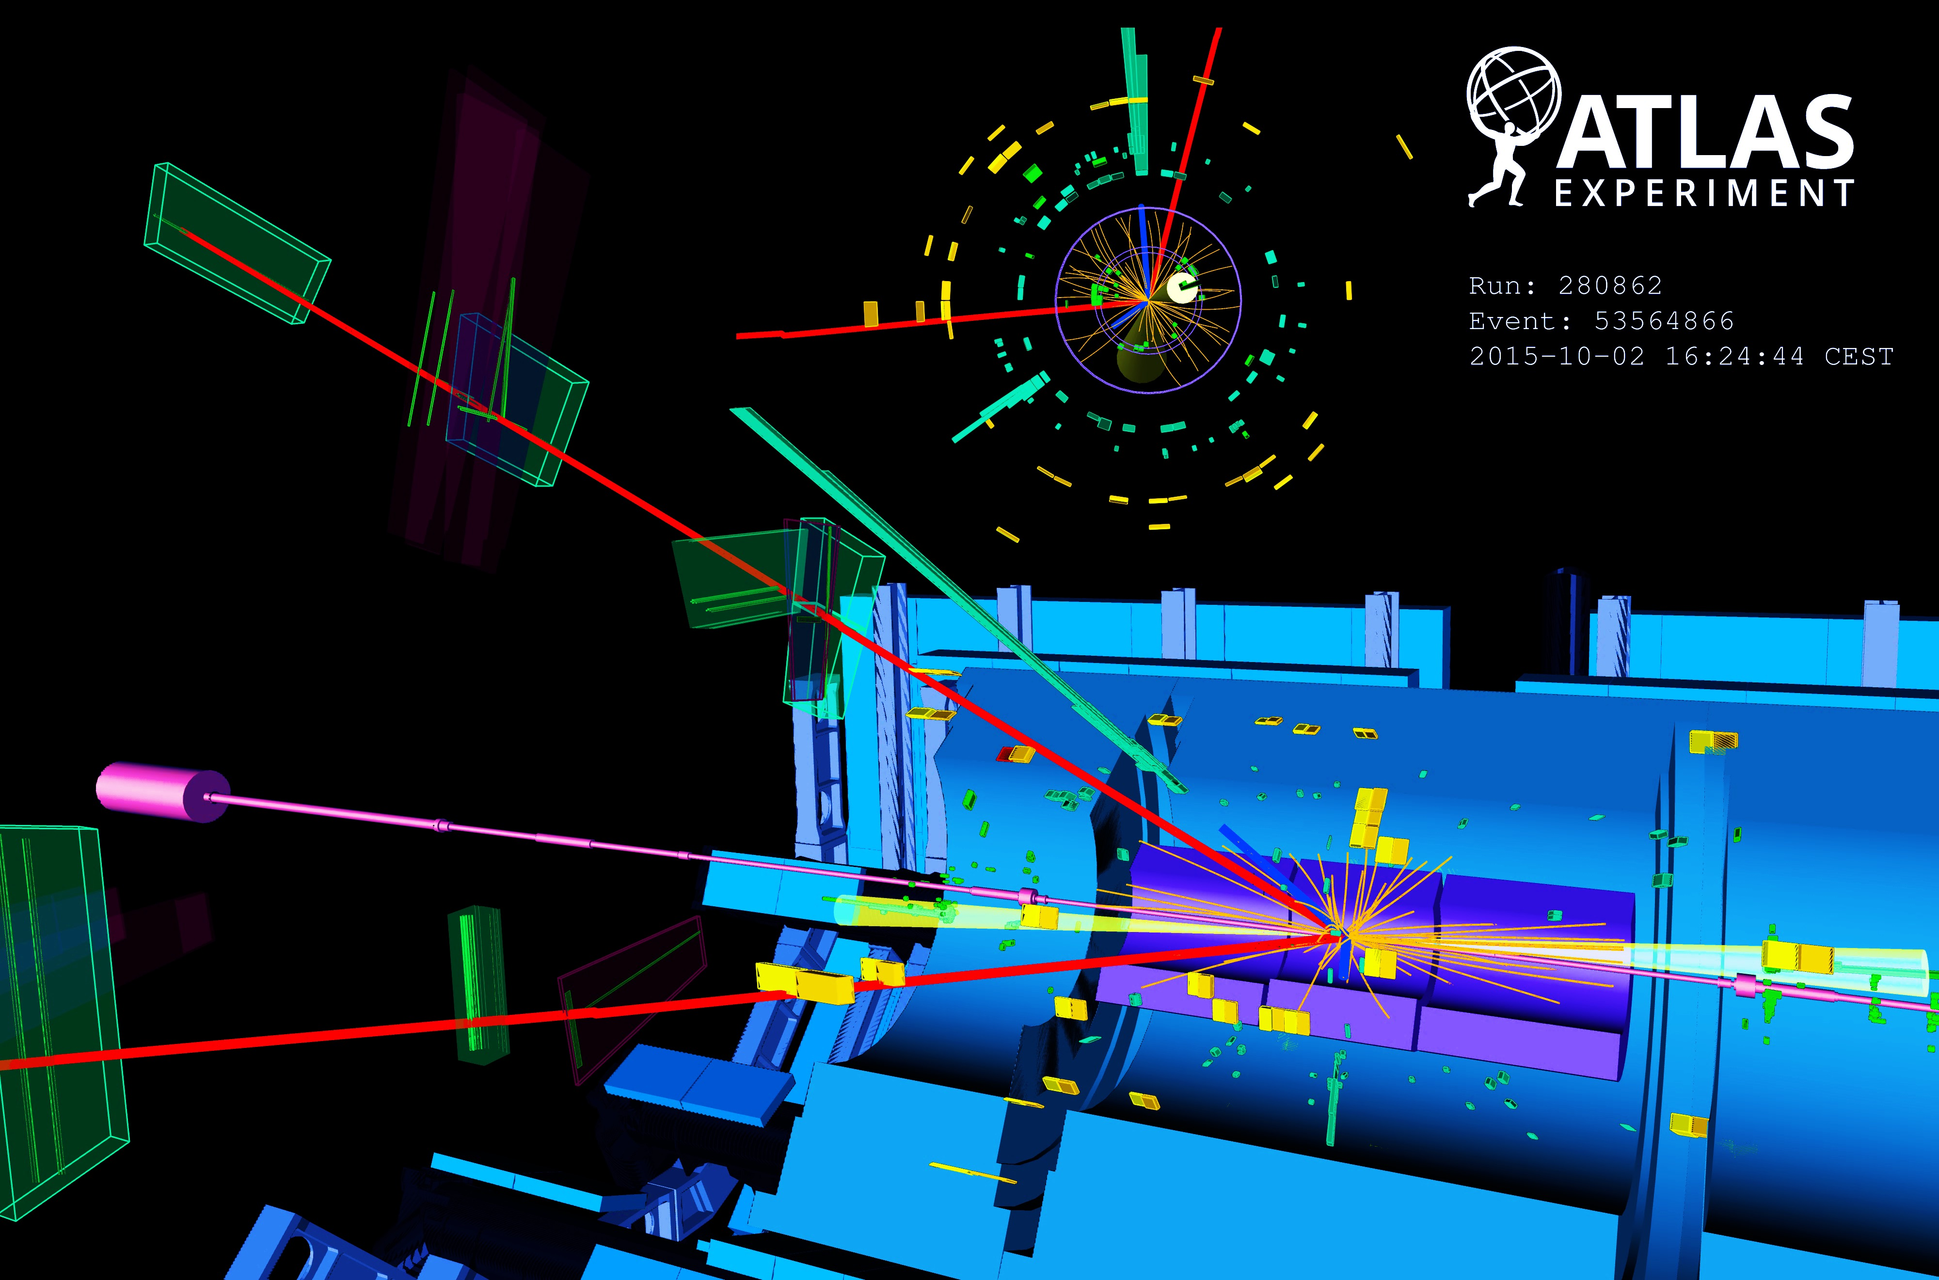
Rare top quark physics, single top
ATLAS measured t-channel and tW production, evidence (3.2σ) for s-channel (observed by CDF & D0)
Higgs boson physics at 13 TeV
Search for associated tZ production using 3-lepton events and full 2015+2016 13 TeV data
Evidence of 4.2σ observed for 5.4σ expected: cross section = 600 ± 170(stat) ± 140(syst) fb
Final MVA discriminant
arXiv:1710.03659
Display of VBF H → eeµµ + 2jets candidate from 13 TeV pp collisions. The electrons have a transverse momentum of 111 and 16 GeV, the muons 18 and 17 GeV, and the jets 118 and 54 GeV. The invariant mass of the four lepton system is 129 GeV, the dielectron (dimuon) invariant mass is 91 (29) GeV, the pseudorapidity difference between the two jets is 6.4 and the dijet invariant mass is 2 TeV.

Slide 16
Higgs in the bosonic channels
Reobservation at 13 TeV and improved property measurements
ATLAS-CONF-2017-047
+0.06 +0.06
– 0.05 – 0.05
Combination of γγ and ZZ* channels gives µ = 1.09 ± 0.09 stat exp theo
Combined measurement of Higgs mass: 124.98 ± 0.28 GeV (in agreement with Run-1 ATLAS & CMS)
arXiv:1708.02810
ATLAS-CONF-2017-045

Slide 17
Higgs in the bosonic channels
Reobservation at 13 TeV and improved property measurements
ATLAS-CONF-2017-047
Measurements of total, differential, and fiducial (incl. simplified template — STXS) cross sections
“Stage 1” STXS

Slide 18

Higgs in the fermionic channels
H → bb (BR: 58%), best channel: W/Z+H → 0 (+MET), 1, 2 leptons + H
Extremely complex and challenging analysis yielding H → bb evidence at 3.6σ (4.0σ expected)
Powerful validation channel: W/Z+Z(→bb) observed at 5.8σ (5.3σ expected)
Analysis benefits from improved b-tagging due to new innermost Pixel layer (IBL)
arXiv:1708.03299
µ(VH(bb)) = 0.90
+0.28
– 0.26

Slide 19
Higgs in the fermionic channels
tt+H production directly probes Higgs–top coupling
ATLAS-CONF-2017-076 ATLAS-CONF-2017-077
Combine large variety of final state depending on top and Higgs decays
Distinguish: tt+H(→bb), tt+H(→WW*, 𝜏𝜏), tt+H(→γγ), tt+H(→ZZ*)
ttH multi-lepton analysis
Heavy use of data-driven constraints and multivariate classification
Run-2 combination yields 4.2σ evidence (3.8σ expected)

Slide 20
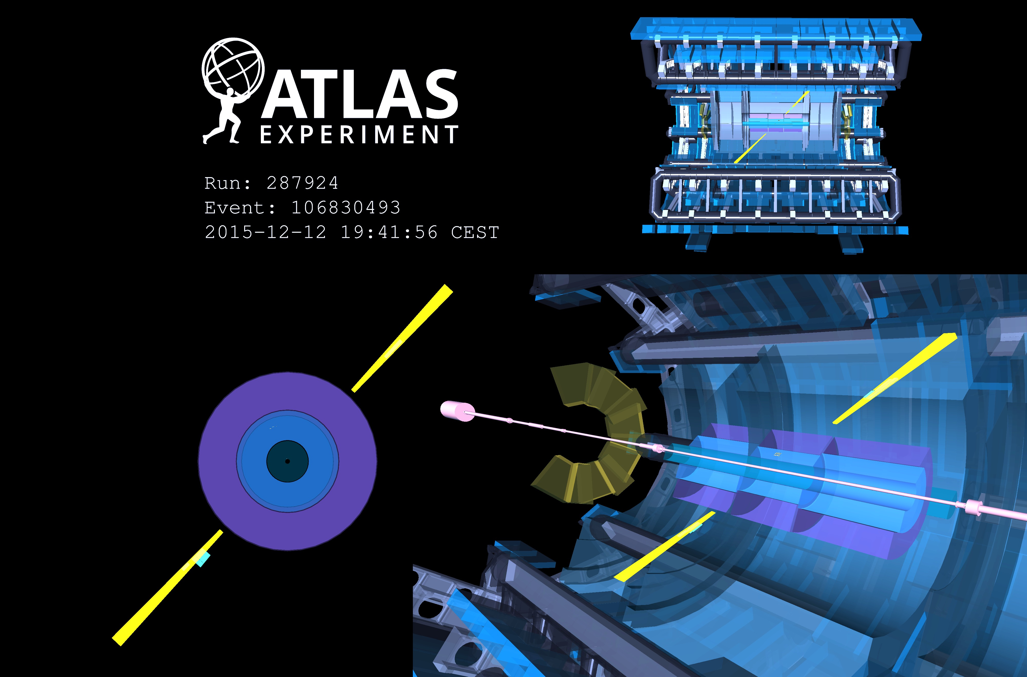
Evidence for γγ → γγ light-by-light scattering (LBLS) seen by ATLAS in 5.02 TeV ultraperipheral Pb+Pb collisions
13 events observed for 2.6 ± 0.7 expected background (4.4σ)
[ arXiv:1702.01625 ]
Field strength of up to 10²⁵ V/m reached
Picture shows LBLS candidate: two E_{T} = 4.9 GeV back-to- back photons with no additional activity

Slide 21
Searches for new physics
Cover all areas: high mass, electroweak production, long-lived particles, forbidden decays, …
Theory-agnostic, signature based searches, as well as highly targeted model-dependent ones
Most high-profile searches on 2015+2016 data released
No significant anomaly seen so far

Slide 22
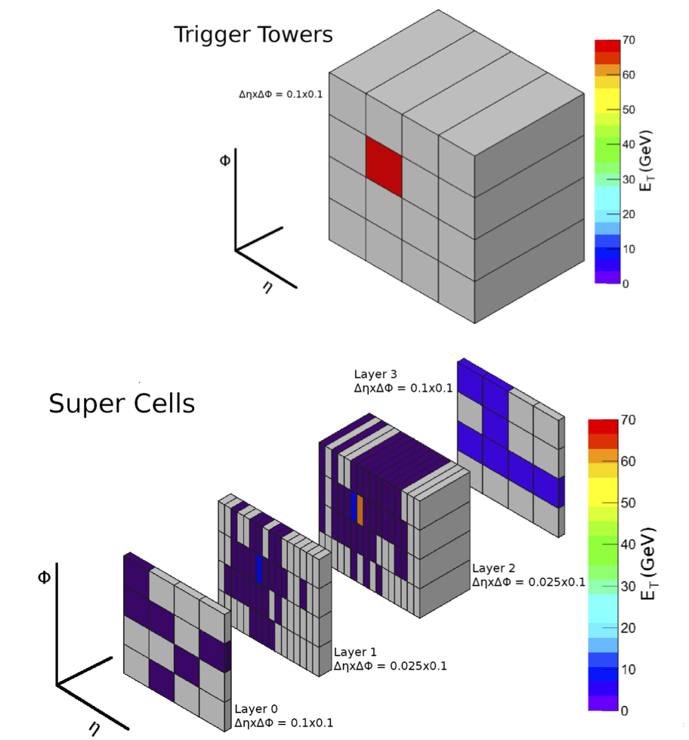
ATLAS Phase-I Upgrade
(all upgrades Phase-II compatible)
Two new systems under commissioning: hardware based Fast Track Trigger (FTK – two slices installed) all-tracks input to HLT, and the ATLAS Forward Proton detector (AFP – silicon tracking and time-of-flight in roman pots, complete) for forward physics (not part of Phase-I upgrade)
Liquid-argon calorimeter trigger electronics upgrade for higher granularity (“super cells”) to reduce (fake) electron / photon rates at high luminosity
Trigger / DAQ system
New feature extraction boards (e/gamma, jets, global) to accommodate super cells
New muon trigger logic boards to benefit from new detectors in inner station (NSW and BIS78 RPC+sMDT)
FELIX readout system (router between detector systems BE and network switches)
70 GeV electron as seen today (top), and with super cells (bottom)
Good overall progress

Slide 23
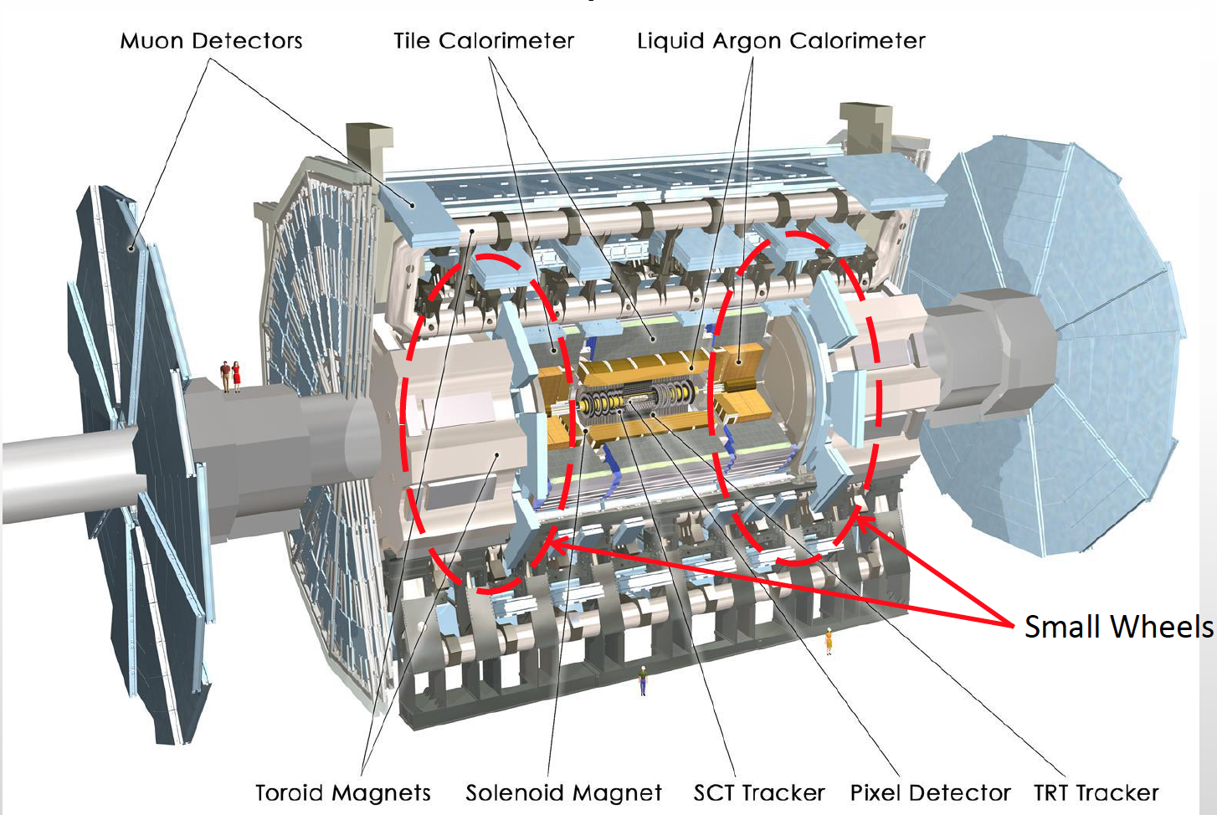
Muon New Small Wheel
New Small Wheel (NSW) for improved endcap muon trigger/tracking capabilities at high rate
Layers of two external small-strip Thin Gap Chambers (sTGC – mainly trigger) and two internal MicroMegas (mainly tracking)
Phase-II compatible electronics
Complex upgrade project on very tight timeline for installation in LS2. Full attention by ATLAS
MicroMegas production started (4 production sites)
sTGC chamber production started in 4 / 5 sites
Electronics with 4 ASICs in pre-production (one (ROC) still under validation) – critical path
FEB prototypes with chambers tested
Small Wheel
Detailed schedule developed that allows installation during LS2 — but no contingency
Next assessment at LHCC, Feb 2018

Slide 24
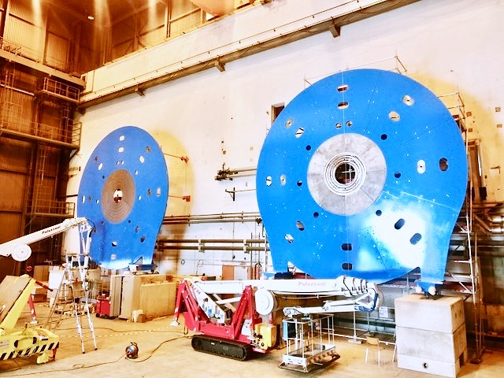
Muon New Small Wheel
Picture of NSW shielding and support disks (NJD)
[also for solenoid flux return]
(Oct 25, 2017)

Slide 25
ATLAS Phase-II Upgrade

Slide 26
ATLAS Phase-II Upgrade
Priority for 2017: TDRs for all Phase-II upgrade projects
Inner Tracker (ITk) – all silicon, extended tracking to |𝜂| = 4
Strip TDR approved by LHCC, UCG and the CERN Research Board (RB) in June 2017 (first approved Phase-II detector TDR)
Pixel TDR in preparation for submission to LHCC in Dec 2017
Calorimeters – new electronics (FE & BE), 40 MHz digital signal to BE
LAr & Tile TDRs submitted Sep 2017
Muon – new electronics, new inner barrel RPC+sMDT and endcap TGC to reduce rate, include MDT in L0 trigger
TDR submitted July 2017, under LHCC & UCG review
Trigger / DAQ: Level-0 with 1 MHz rate (10 µs latency), EF rate 10 kHz
TDR under preparation for submission to LHCC in Dec 2017

Slide 27
ATLAS Phase-II Upgrade
Priority for 2017: TDRs for all Phase-II upgrade projects
Inner Tracker (ITk) – all silicon, extended tracking to |𝜂| = 4
Strip TDR approved by LHCC, UCG and the CERN Research Board (RB) in June 2017 (first approved Phase-II detector TDR)
Pixel TDR in preparation for submission to LHCC in Dec 2017
Calorimeters – fully digital readout
LAr (mostly electronics) TDR submitted Sep 2017
Tile (mostly electronics + mechanics) TDR submitted Sep 2017
Muon: New inner barrel RPC+sMDT and endcap TGC to reduce rate
TDR submitted July 2017, under LHCC & UCG review
Trigger / DAQ: Level-0 with 1 MHz rate (10 µs latency), HLT rate 10 kHz
TDR under preparation for submission to LHCC in Dec 2017
Two additional projects under consideration:
High Granularity Timing Detector for improved pileup rejection in 2.4 < |𝜂| < 4.2
EoI / TP to be submitted in Nov 2017 to LHCC
Large-𝜂 mu
High |𝜂| Muon Tagger for muon ID in 2.7 < |𝜂| < 4.0

Slide 28
ATLAS Phase-II Upgrade
Priority for 2017: TDRs for all Phase-II upgrade projects
Inner Tracker (ITk) – all silicon, extended tracking to |𝜂| = 4
Strip TDR approved by LHCC, UCG and the CERN Research Board (RB) in June 2017 (first approved Phase-II detector TDR)
Pixel TDR in preparation for submission to LHCC in Dec 2017
Calorimeters – fully digital readout
LAr (mostly electronics) TDR submitted Sep 2017
Tile (mostly electronics + mechanics) TDR submitted Sep 2017
Muon: New inner barrel RPC+sMDT and endcap TGC to reduce rate
TDR submitted July 2017, under LHCC & UCG review
Trigger / DAQ: Level-0 with 1 MHz rate (10 µs latency), HLT rate 10 kHz
TDR under preparation for submission to LHCC in Dec 2017
Two additional projects under study:
High Granularity Timing Detector for improved pileup rejection in 2.4 < |𝜂| < 4.2
TP to be submitted in Nov 2017 to LHCC
Large-𝜂 mu
High |𝜂| Muon Tagger for muon ID in 2.7 < |𝜂| < 4.0
Physics at the HL-LHC (and HE-LHC) discussed this week at CERN in preparation of European Strategy Update
https://indico.cern.ch/event/647676/

Slide 29
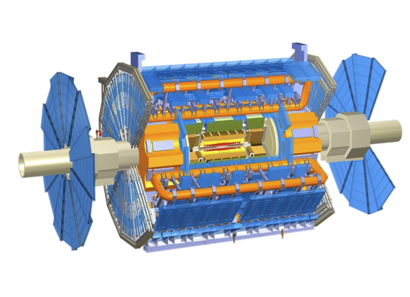
Conclusions
The ATLAS experiment is efficiently taking good quality data in 2017
ATLAS has a vibrant collaboration with 2900 scientific authors, 1200 PhD students and many hundreds of engineers and technicians who take up the challenges and drive physics and detector forward with strong commitment and new ideas
In physics and performance, deep and broad searches for new physics are continuing, the Higgs sector is explored with direct evidence for coupling to bottom and top, new Standard Model measurements push precision beyond expectation, new rare channels are explored
ATLAS thrives to make Phase-I upgrade a success, and to provide detailed and compelling Phase-II TDRs during 2017, in time for approval by the CERN RB in April 2018
We live in data-driven times, experiment must guide us to the next stage. The vast and diverse research programme of the LHC to which ATLAS contributes is key to progress in our field

