Slide 1
LHC Status & Outlook
Rende Steerenberg
CERN, BE-OP
With thanks to many colleagues for their input and material

Slide 2
Topics
General Status Overview 2017
The 16L2 Challenge
Successful LHC Beam Variants
Brief Outlook Until LS2

Slide 3
General Status Overview 2017

Slide 4
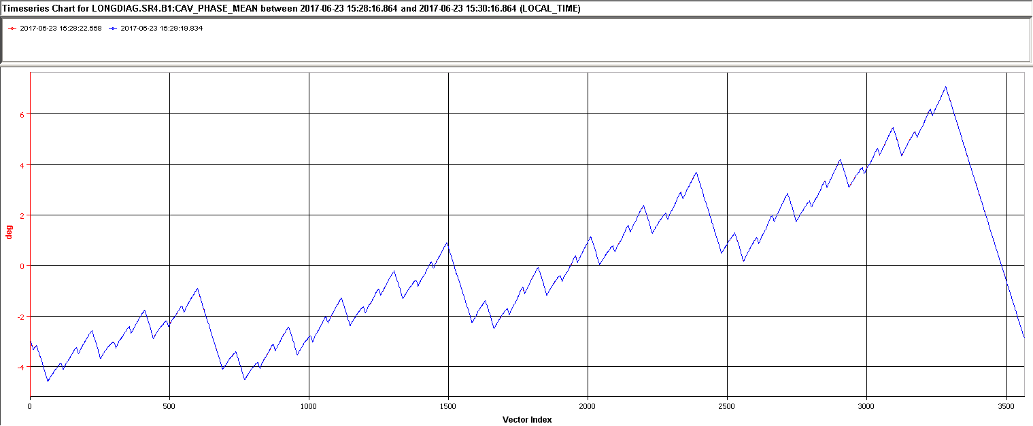
2017,…another eventful year
Jun 3rd
RF full de-tuning
operational
Sep 18th - 20th
TS #2
<100 ps p-p
May 23rd
First Stable Beams
Jul 20th
Orbit corrector
mitigation 16L2
Sep 21st
𝛽* 40 cm → 30 cm
Jul 3rd - 7th
TS #1
Oct 2nd
Switch to high
Brightness 8b4e
Dec 11th
End of 2017 run
EYETS
Apr 29th
First 2017 beam
Aug 9th
Record Peak
Lumi: 1.74x10³⁴
Dec 4th
2017
Jan Feb Mar Apr May Jun Jul Aug Sep Oct Nov Dec
Jul 19th
Stable beams
2556 bunches
Sep 4st
Switch to 8b4e
April 1st
Gradual start of powering tests
Nov 12th
Xenon ion fill
Jun 9th
1st time 2820
Bunches at 450 GeV
Aug 12th
16L2 beam induced Quench
Oct 30th
45 fb-1 reached
June 5th
1 week scrubbing run and1st signs of losses in 16L2
Aug 10th
Planned 16L2 beam screen flushing

Slide 5
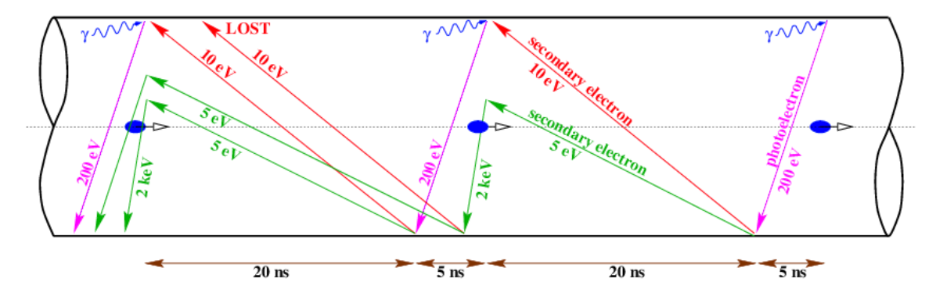
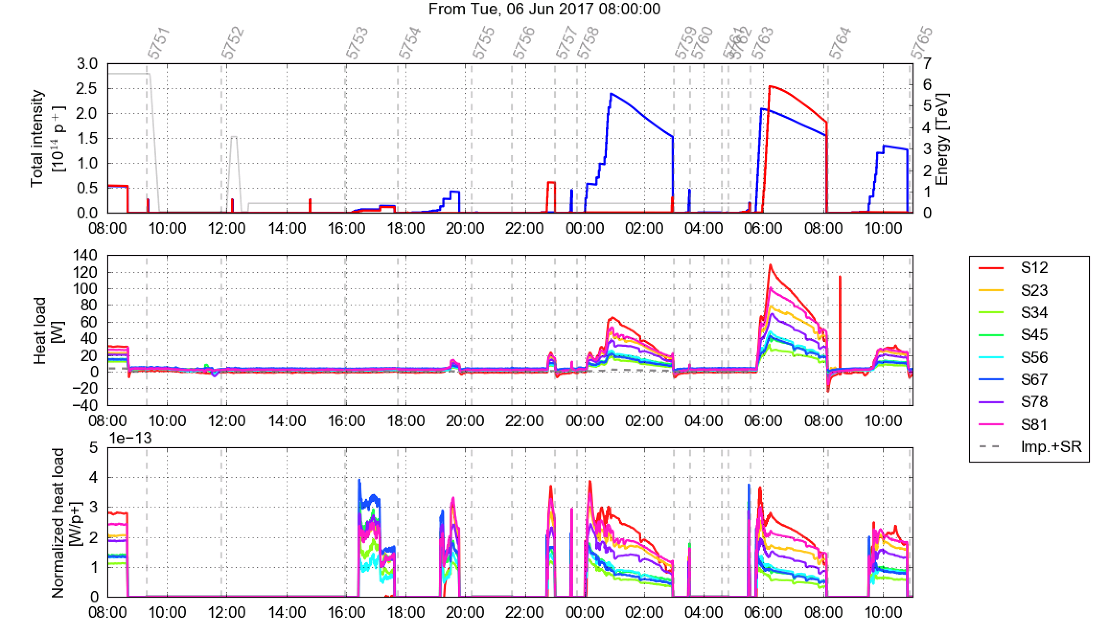
Electron Cloud Scrubbing
S12 magnet exchange in EYETS caused much higher initial heat load in the sector
Conditioning was fast, quickly back to 2016 conditions
Heat load “ranking” of the all sectors remained unchanged
No more issues with vacuum in injection regions, thanks to upgrade of pumping

Slide 6
2017 Intensity ramp up with BCMS
Technical Stop 1
Up to 1741 bunches
Smooth intensity ramp up, increasing the number of bunches
First dumps on 16L2 losses experienced

Slide 7
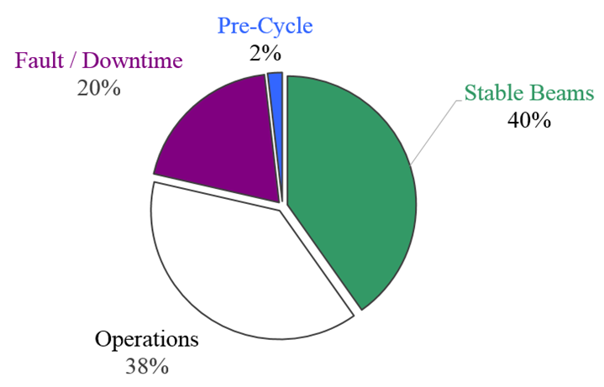
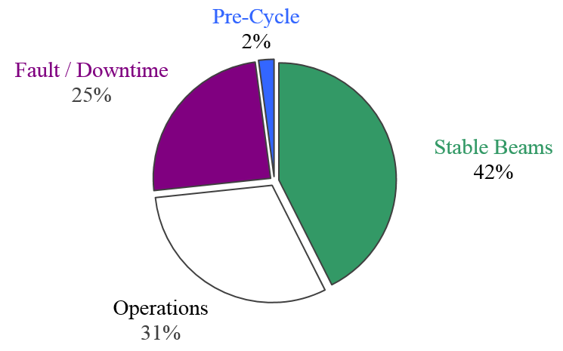
Time in Collision
Before Technical Stop 1
Technical Stop 1 – Technical Stop 2
Contains intensity ramp up period
VdM run and MD blocks excluded
Stable beam ratio of previous years:
2015 → 33%
2016 → 49%
 | Duration [h]
Stable Beams | 300.0
Operations | 286.4
Fault / Downtime | 146.2
Pre-Cycle | 13.6
 | Duration [h]
Stable Beams | 620.9
Operations | 443.3
Fault / Downtime | 364
Pre-Cycle | 30.8
= 746.2
= 1459

Slide 8
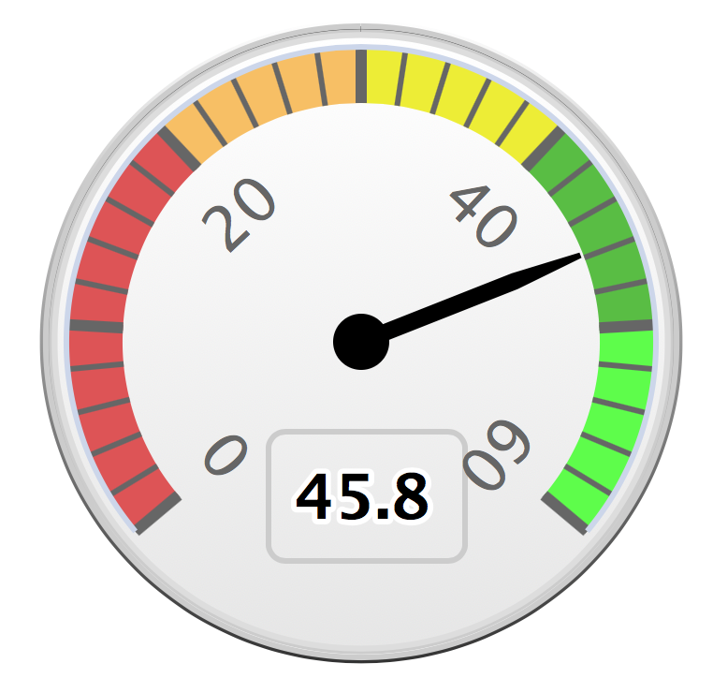
Integrated Performance
2017 integrated luminosity is 45.8 fb⁻¹ for ATLAS/CMS
  LHCb is at 1.6 fb⁻¹ for a target of 1.7 fb⁻¹ and 10.7𝜇b⁻¹ for ALICE
The total integrated luminosity since the start of LHC is now beyond 100 fb⁻¹
Despite a dip in peak performance during August, well on track for > 90 fb⁻¹ in 2017+2018
Nov. 1st
For ALICE & LHCb, Stable beam time and number of bunches is most important

Slide 9
LHC Physics Run 2017
The intensity ramp up for physics reached 2556 bunches end of June
The machine was operated at that level until early August, despite beam loss and stability issues related to arc cell 16L2 for both beams
  Luminosity record: 1.7x10³⁴ cm⁻²s⁻¹
An attempt to solve the 16L2 with a warm up of the beam screen failed, since then stable operation could only be achieved with 1916 bunches of the 8b4e beam
  Reduced e-cloud, hence reduced heat load
BCMS: Max 2556 bunches
8b4e: Max 1916 bunches

Slide 10
Long Term Performance
LHC is operating well above design peak luminosity, despite the 16L2 issue
  Well above 2x10³⁴ cm⁻²s⁻¹ was achieved, but no longer visible due to levelling at 1.5x10³⁴ cm⁻²s⁻¹
The integrated production of Run 2 is approaching 90 fb⁻¹ for ATLAS & CMS

Slide 11
Production Target & Achievement
Luminosity prediction corresponds to a model of the performance established before the start of the run, scaled down by ~20% resulting in ~ 45 fb⁻¹
The initial production was already well ahead of the prediction
The current production matches the slope to achieve ~50 fb⁻¹
Recently the special runs have been brought forward, reducing the days available for 25 ns physics in 2017
The target is actually
90 fb⁻¹ for 2017+2018

Slide 12
The 16L2 Challenge

Slide 13
16L2, at some point we were puzzled…

Slide 14
The 16L2 (Hi)Story
Most likely during the EYETS a certain amount of air went into the two beam vacuum pipes at the 16L2 interconnection
  Nitrogen, oxygen and water condensate / frost on the beam screen & cold bore
During the scrubbing run an abnormal high loss level was already observed in 16L2
  July 20th: Non-zero current in 16L2 orbit corrector reduced 16L2 induced beam dumps
Beam screen thermal cycle (flushing) was performed on August 10th
A beam induced quench in 16L2 on August 12th caused another beam screen flush
Slow ramp up to 1500 bunches BCMS, which seemed to be the limit
On September 4th a switch was made to 8b4e, which allowed to go up to 1900 bunches
On October 2nd the switch to the high brightness version of 8b4e was deployed
Decided definitive solution is warm up of S12 during YETS 2017-2018

Slide 15
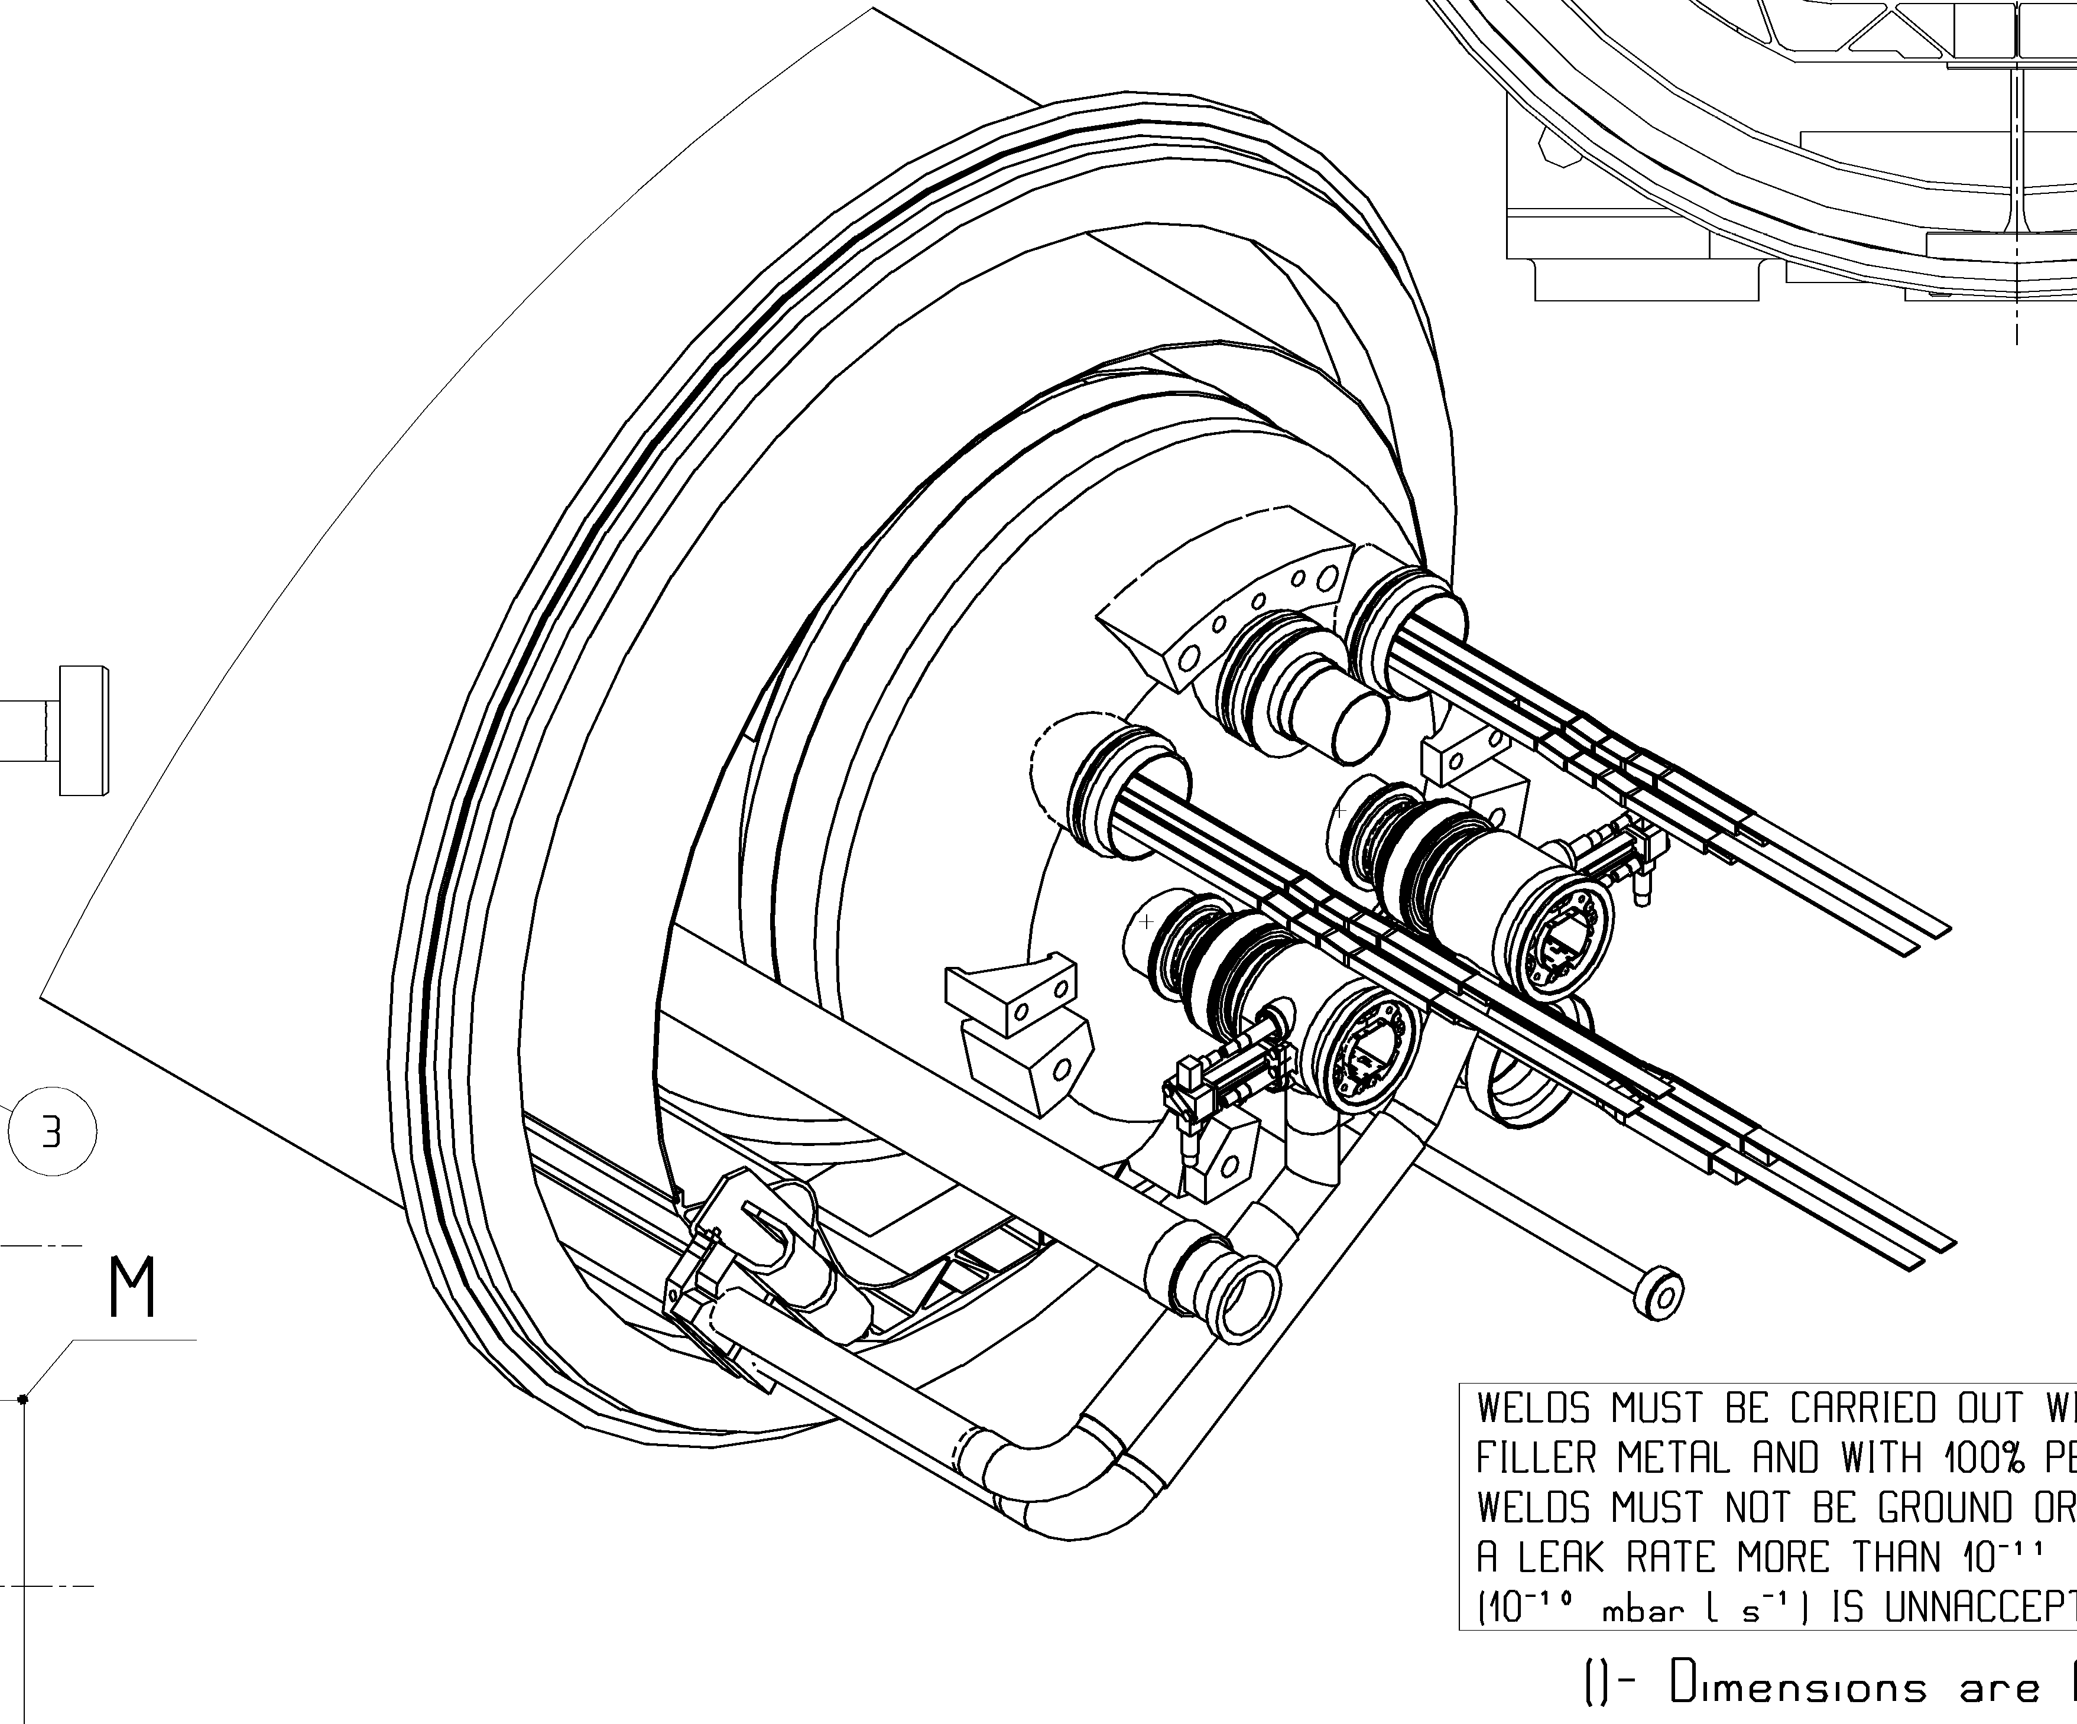
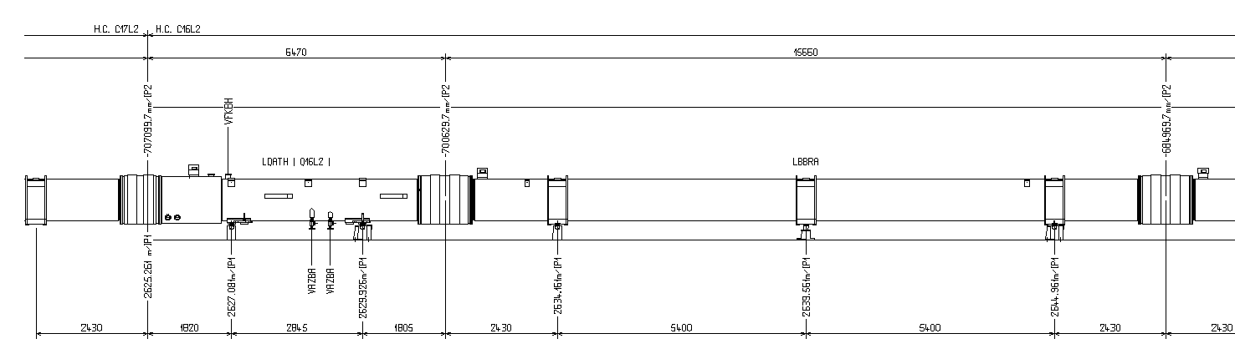
The 16L2 Layout
Interconnection
B1
B2
Thermal shield
at ~50K
P2
P1
MB17L2
Q16L2
MB16L2
P2
P1

Slide 16
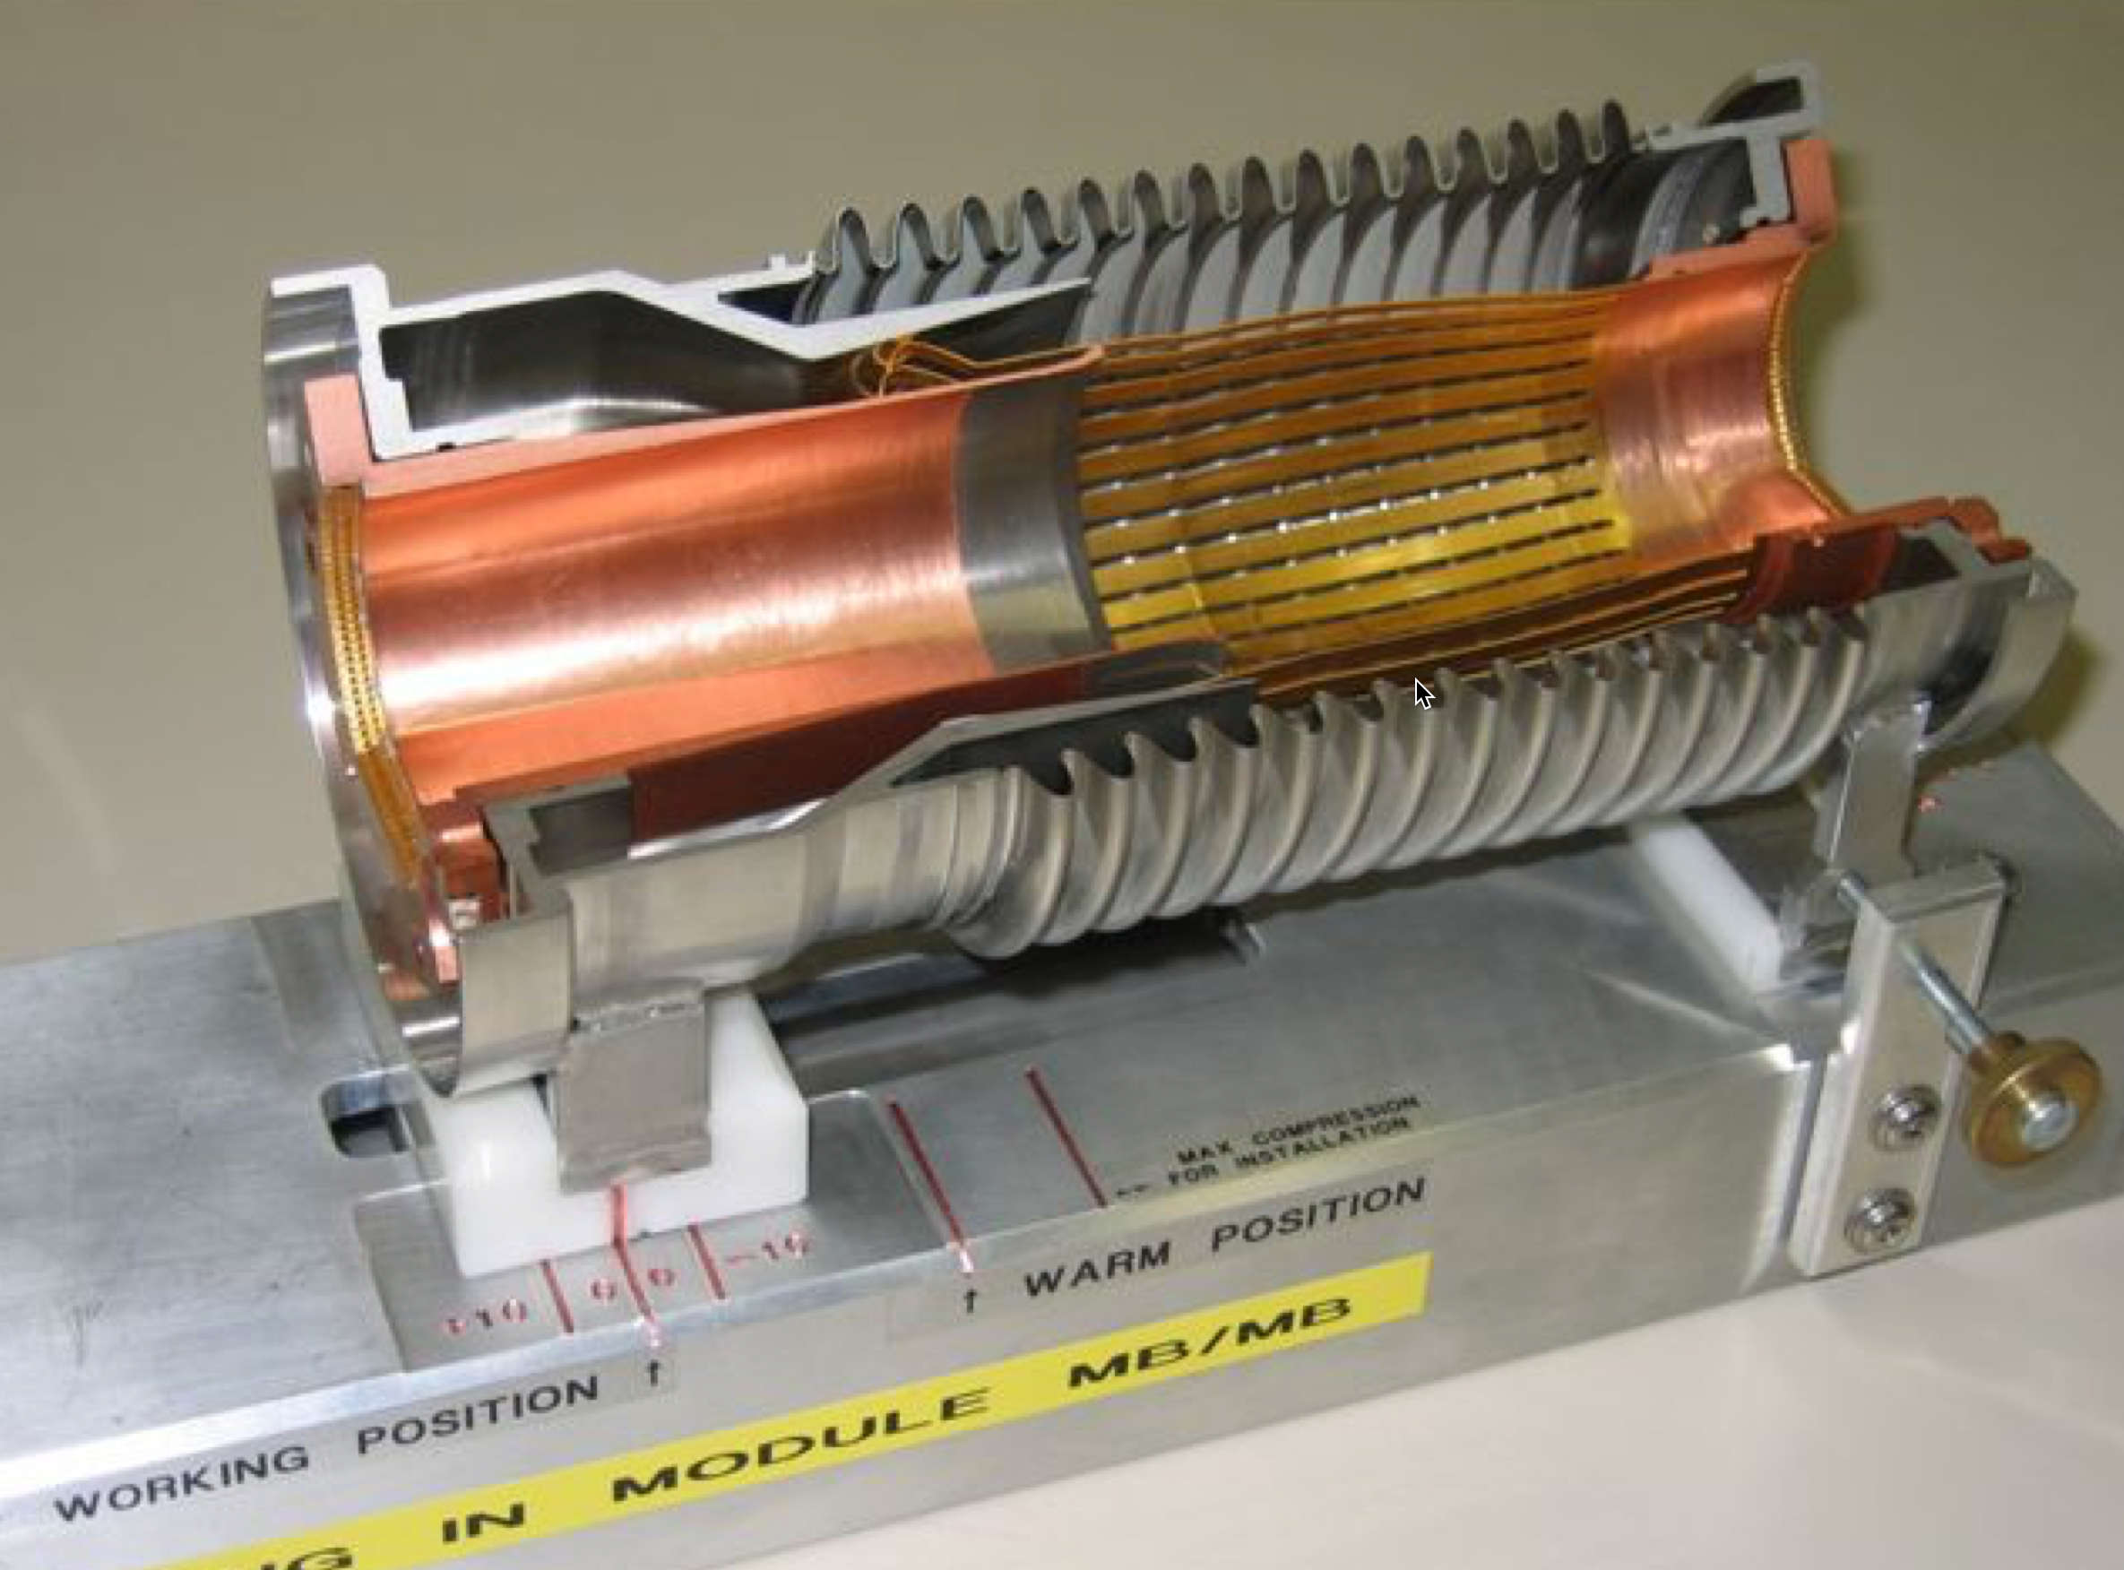
Beam Screen Flushing
Beam screen thermal cycle (flushing) was performed on August 10th
  Warm up the beam screen to 80K such that the gas evaporates and condensates on the cold bore, which remains at 1.9 K.
  Elsewhere this has proven to be beneficial
  For the 16L2 case the situation actually degraded

Slide 17
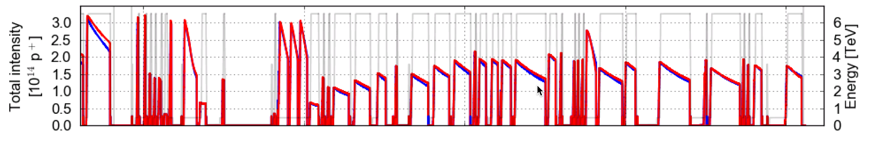
Losing and Reconditioning
Variation of number of bunches during the “struggle” period
Attempting 2556 bunches
Ramp up to 1500 bunches
Running with 1500 bunches & frequent dumps
BS Flush
16L2 Quench
16L2 Beam Loss “Signatures” that result in beam dumps

Slide 18
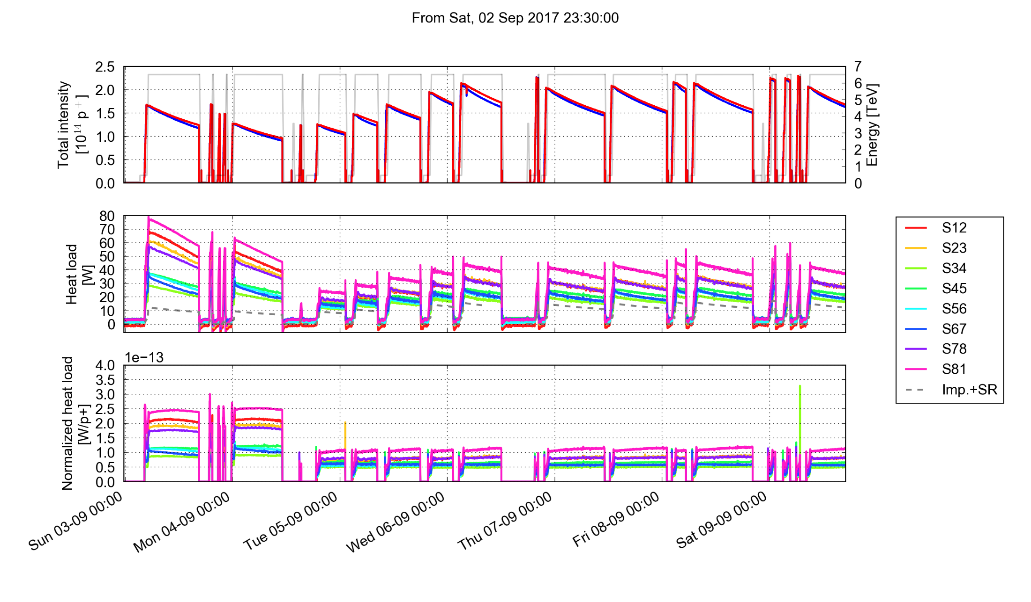
Cryo Heat Load: BCMS vs 8b4E
BCMS 1500 bunches
8b4e intensity ramp up
8b4e running with 1900 bunches
16L2
16L2
16L2
8b+4e

Slide 19
Successful LHC Beam Variants

Slide 20
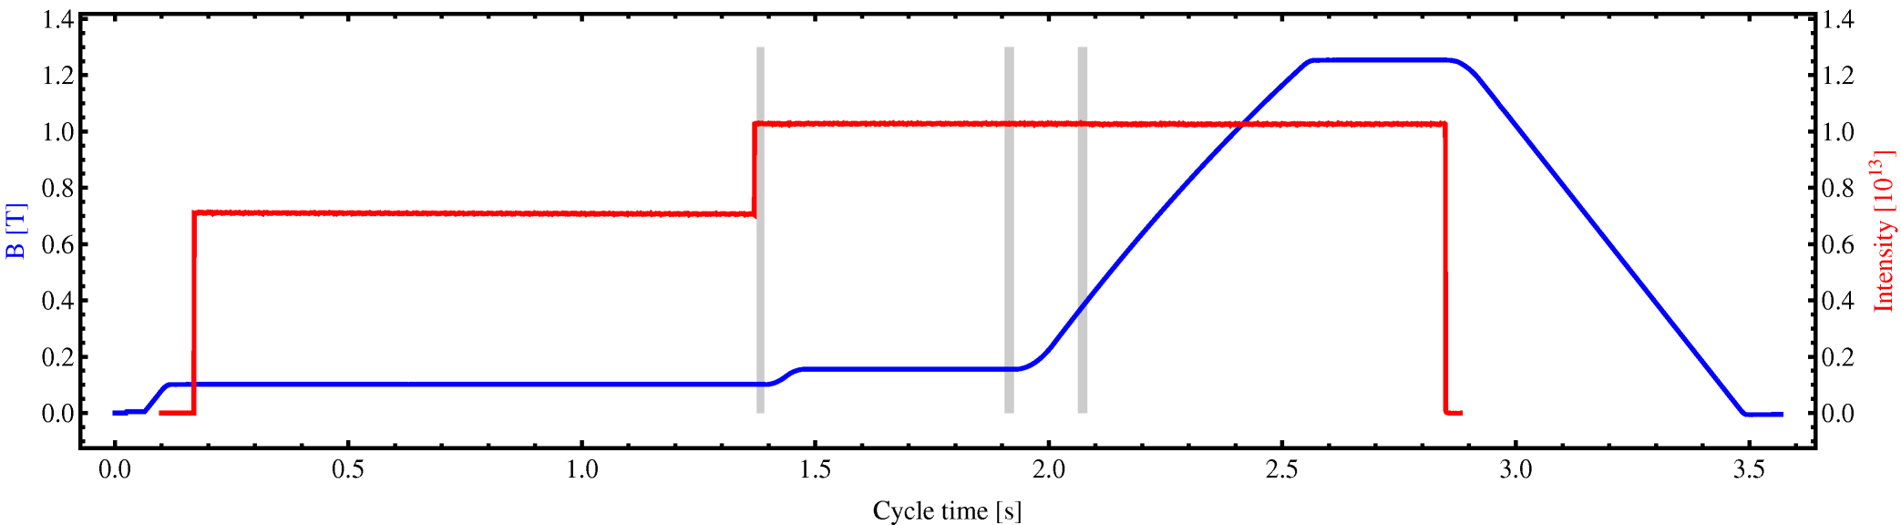
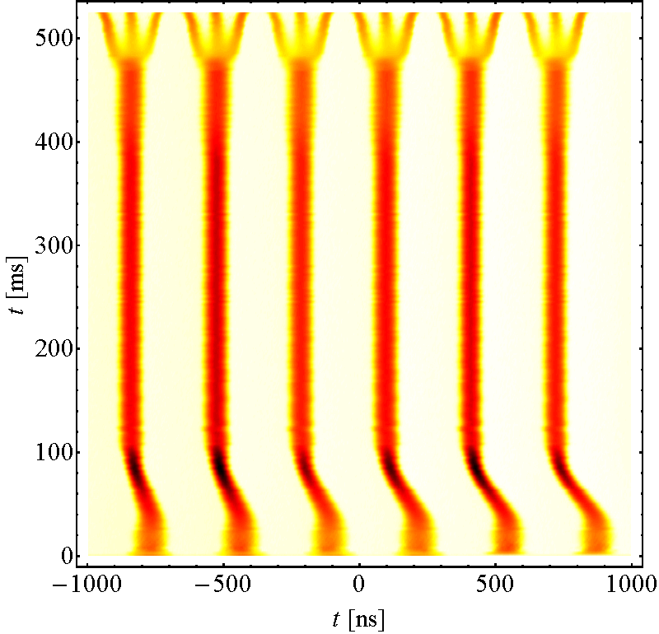
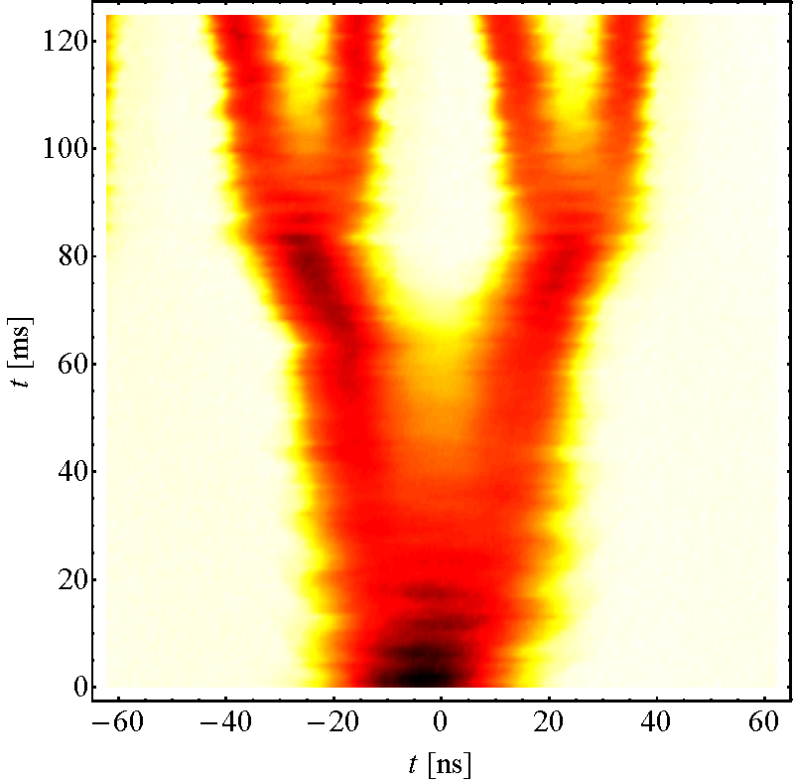
Standard 25 ns Beam
Injection
  1st: 4 bunches
  2nd : 3 bunches
Triple splitting
Acceleration
2 x splitting
  72 bunches at 25 ns
For 25 ns the intensity of a PSB bunches is divided by a factor 12
  I_{LHC} = 1.2x10¹¹ ppb
  I_{PSB} = 14.4x10¹¹ ppb
Inject 4+2 bunches
Controlled blow-ups
Eject 36 or
Eject 36 or
72 bunches
h = 7
h = 21
γ_{tr}
72 bunches
h = 84
Triple splitting at E_{kin} = 2.5 GeV
Split in four at flat top energy
25 ns
E_{kin} = 2.5 GeV
50 ns
2nd injection
26 GeV/c
25 ns: Each PSB bunch divided by: 12 → 6 x 3 x 2 x 2 = 72
50 ns: Each PSB bunch divided by: 6 → 6 x 3 x 2 = 36

Slide 21
PS Booster Multi-turn Injection
The PSB performs a multi-turn injection, accumulating the LINAC beam in the PSB horizontal phase space
  Increasing intensity also increases transverse beam size, hence more or less constant density
x’
1
3
2
x
PSB bunch intensity to be divided by 12 for standard 25 ns beam to reach bunch intensity of 1.1x10¹¹ protons

Slide 22
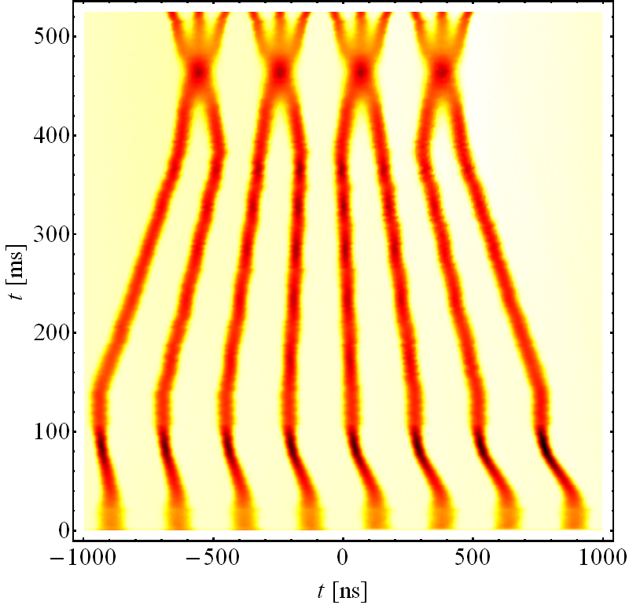
BCMS 25 ns Beam
BCMS = Batch Compression, Merging & Splitting
For same LHC bunch intensity PSB bunch intensity and transverse emittance is ~50% of standard scheme
For 25 ns the intensity of two PSB bunches are divided by a factor 6
  I_{LHC} = 1.2x10¹¹ ppb
  I_{PSB} = 7.2x10¹¹ ppb
Inject 4+4 bunches
Controlled blow-ups
Eject 36 or
Eject 24 or
48 bunches
h = 9
γ_{tr}
h = 21
72 bunches
h = 84
Batch Compression, merging & splitting
Split in four at flat top energy
25 ns
50 ns
2nd injection
E_{kin} = 2.5 GeV
BCMS
26 GeV/c
High brightness
25 ns: PSB bunches ‘divided’ by: 6 → 8/2 x 3 x 2 x 2 = 48
50 ns: PSB bunches ‘divided’ by: 3 → 8/2 x 3 x 2 = 24

Slide 23
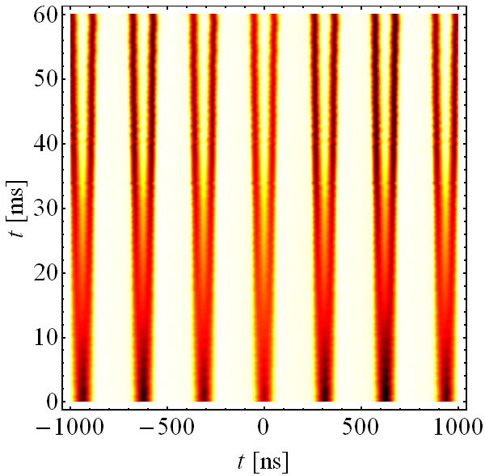
Standard 25 ns 8b4e Beam
8b4e = 8 bunches + 4 empty buckets
Inject 4+2 (3) bunches
Controlled blow-ups
Eject 36 or
Eject 48 or
56 bunches
Due to the gaps in the 25ns bunch trains the electron cloud production is largely suppressed
Similar scheme as for the 25 ns standard beam
At 2.5 GeV triple splitting, populating only two first buckets and leaving 3rd empty
γ_{tr}
72 bunches
h = 7
h = 21
h = 84
Double splitting at E_{kin} = 2.5 GeV
Split in four at flat top energy
25 ns
E_{kin} = 2.5 GeV
26 GeV/c
Empty buckets
High brightness
8b4e 25 ns: PSB bunches divided by : 2 → 7 x 2 x 2 x 2 = 56
Each PSB bunch divided by 2 leaving 1 bucket empty at h=21
At high energy each bunch/bucket split in 4 → 8b4e

Slide 24
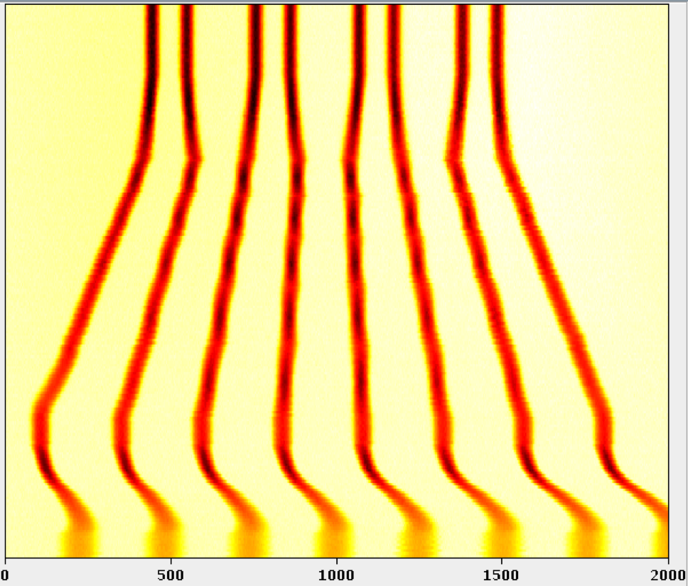
8b4e BCS Beam
8b4e = 8 bunches + 4 empty buckets
Inject 4+4 bunches
Controlled blow-ups
Eject 36 or
Eject 24 or
48 bunches
For same LHC bunch intensity PSB bunch intensity and transverse emittance is ~50% of standard scheme
No longer splitting but batch compression by adding empty buckets
h = 9
γ_{tr}
h = 21
72 bunches
h = 84
Batch
Compression
Batch Compression, merging & splitting
Split in four at flat top energy
25 ns
2nd injection
E_{kin} = 2.5 GeV
26 GeV/c
Empty buckets
High brightness
8b4e 25 ns: PSB bunches only merged: 8 → 8 x 2 x 2 = 32
At high energy each bunch/bucket split in 4 → 8b4e

Slide 25
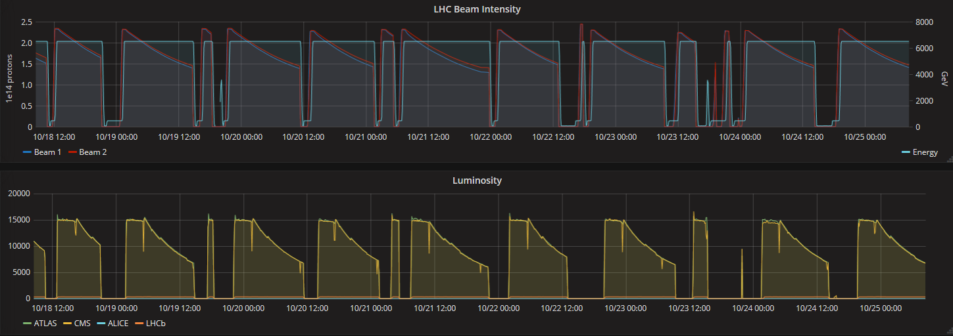
Luminosity Levelling & Anti-Levelling
Initially we level the ATLAS & CMS luminosity down to 1.5x10³⁴ cm⁻²s⁻¹, using beam separation
Once the luminosity burn-off kicks in we apply anti-levelling by reducing the crossing angle and increase the instantaneous luminosity

Slide 26
Brief Outlook Until LS2

Slide 27
LHC Schedule 2017 – Version 1.6
Special runs decided for 2017
  5 TeV p-p reference run
  Short Xenon run (1 – 2 shifts)
  Low energy high 𝛽* run
    Requires a few shifts to setup
Since the 45 fb-1 mark was reached ahead of schedule 3 extra machine development (MD)days were added, as was agree at the start of 2017

Slide 28
Summary Table 2017 - version 1.6
Phase | Days new | Ratio to total beam time
Commissioning & Intensity ramp up | 35 | 15%
Scrubbing | 7 | 3%
25 ns Proton Physics | 134.5 | 60%
Special Physics Runs (incl. Xe ion) | 17.5 | 8%
Machine Developments (MD) | 18 | 8%
Technical Stops (TS1 & TS2) | 8 | 4%
Technical Stop Recovery | 4 | 2%
Total | 224 | 100%
~ 58 days of 25 ns physics left until the end of the 2017 25ns run instead of 74

Slide 29
Breaking News: Earlier Stop 2017 Run
45
46
47
49
48
Only about 8 days left for luminosity production at 13 TeV
Therefore the 2017 run will end on Monday December 4th at 06:00
Details for updated schedule version 1.7 under discussion
YETS 1 week longer, but no delay for 2018 restart

Slide 30
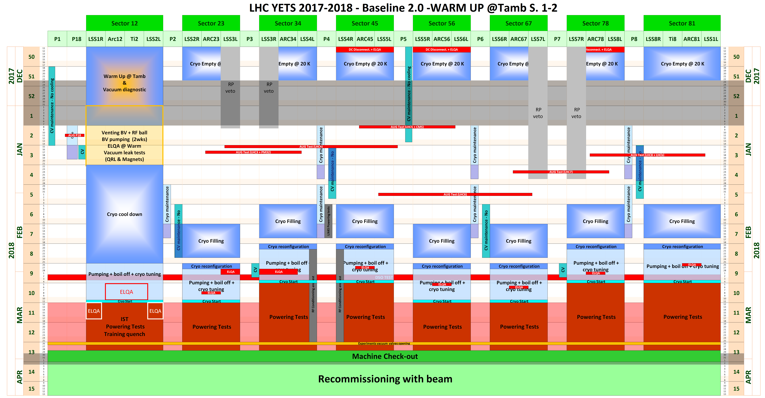
LHC-YETS 2017-2018 Baseline 2.0 – NEW

Slide 31
Preliminary look for 2018
The 2018 schedule is not yet fully defined, but is being worked on
  Majority of the special runs moved forward to 2017 → production year
  4 week Pb ion run, starting most likely November 11th
Recovery from YETS, S1-2 warm-up , requires 3 to 4 e-cloud days scrubbing
Start beam commissioning around Easter weekend
First stable beams expected around 18 April followed by intensity ramp up
Two technical stops and one short stop for conversion to Pb ions
End of run December 10th, remains to be confirmed (start of LS2)
  Might be 1 week earlier depending on 7 TeV magnet tests
Taking into account MDs and remaining special runs this should give around 150 days of 25 ns p⁺ physics

Slide 32
Any Questions

Slide 33
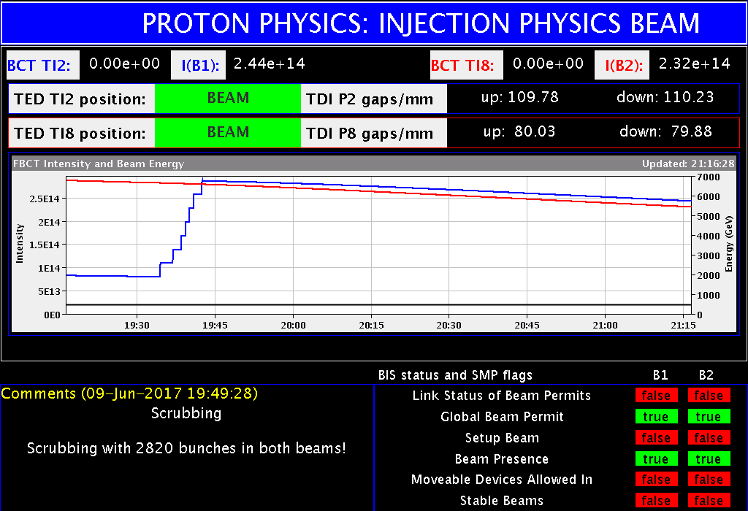
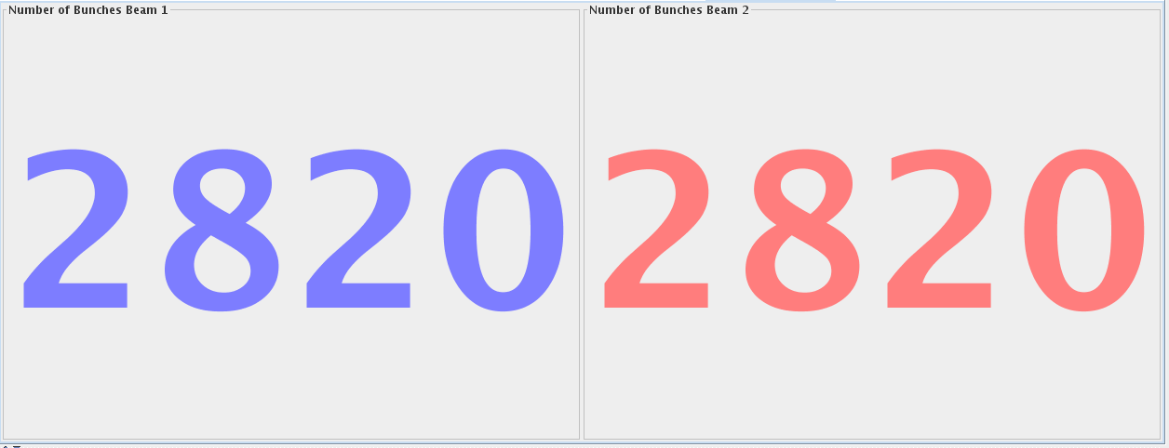
Electron Cloud Scrubbing
Both LHC rings were filled with 2820 bunches – a new record
Recipe for future scrubbing runs at 450 GeV
~12-24 h required after a Xmas stop with no arc venting
~3-4 days required to recondition a single arc after venting
~5-7 days required in case the full machine is exposed to air (more difficult to ramp-up the intensity due to instabilities and poor beam quality)

Slide 34
Top 5 Causes of Downtime
Root Cause System | Root Cause Duration [h] | % of Total Duration
Injector Complex Cryogenics Electrical Network | 82 61 32.4 | 22.9 17.2 9.1
Beam Instrumentation | 25.3 | 7.1
Quench Protection | 24.6 | 6.9
= 225.8 hours
= 63.2%
5 systems are responsible for more 63% of the down time
High-impact faults (>10 h):
  Faults related to the Injector Complex, notably SPS Mains failures, which occurred twice. On each occasions over one day of downtime was recorded.
  A fault on the 18 kV distribution with a duration exceeding 1 day.
  Beam screen flushing which took 15 hours.
  Failure of a dilution kicker power supply, resulting in over 12 hours of unavailability

Slide 35
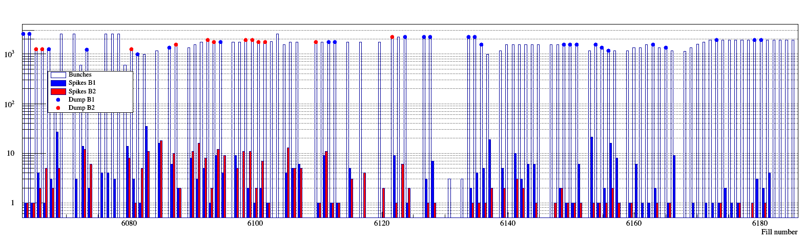
Loss Spikes in 16L2
Clear reduction of loss spikes following switch to 8b4e
  Resulting in more stable running, less dumps and longer fills
25ns BCMs
8b4e

Slide 36
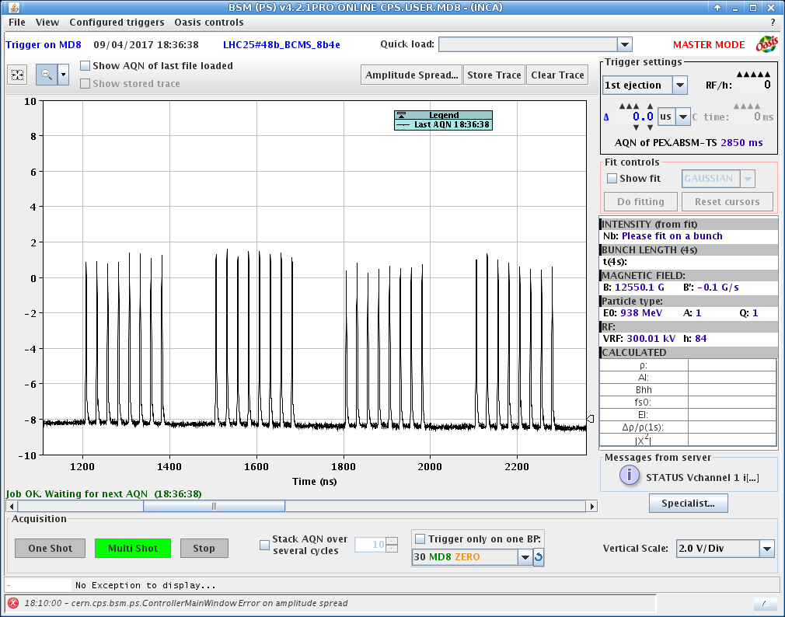
High Brightness 8b4e BCS
Type | Bunch intensity | Transverse Emittance
8b4e | 1.2x10¹¹ | 2.3 𝜋 mm mrad
8b4e (BCMS-like) | 1.2x10¹¹ | 1.3 𝜋 mm mrad
Some blow up in the LHC to be taken into account

Slide 37
High Lumi Test coming week
Cryo experts are interested in assessing the luminosity limit from triplet cooling by running without levelling ATLAS/CMS at start of a fill
  Initial theoretically: 1.75 x 10³⁴ cm⁻²s⁻¹
  Re-evaluation suggested 2x10³⁴ cm⁻²s⁻¹
Important to note that the cryo limit obtained from such a test would not necessarily be correct for non 8b4e beam
The total heat load (e-cloud in arcs + triplet load from lumi debris) is relevant, so with 25ns beam, a lower lumi limit from triplet should be expected
Also very interesting high pileup test for ATLAS/CMS
First part of fill high pileup test for ATLAS/CMS then second part physics fill

