Slide 1


From R&D to a Project:
LARP, HL-LHC AUP and all that !
Giorgio Apollinari
LARP/HL-LHC AUP Director
Fermi National Accelerator Laboratory

Slide 2
Goal of High Luminosity LHC (HL-LHC)
The main objective of HiLumi LHC Design Study is to determine a hardware configuration and a set of beam parameters that will allow the LHC to reach the following Nominal performance targets:
  A peak luminosity of L_{peak} = 5×10³⁴ cm⁻²s⁻¹ with levelling, allowing:
  An integrated luminosity of 250 fb⁻¹ per year, enabling the goal of L_{int} = 3000 fb⁻¹ twelve years after the upgrade.
This luminosity is more than ten times the luminosity reach of the first 10 years of the LHC lifetime.
Ultimate performance. With the same hardware and the same beam parameters, by using engineering margins:
  L_{peak ult} ≅ 7.5 10³⁴ cm⁻²s⁻¹
  Ultimate Integrated L_{int ult} ∼ 4000 fb⁻¹
LHC should not be the limit, if Physics requires more than nominal performance.

Slide 3
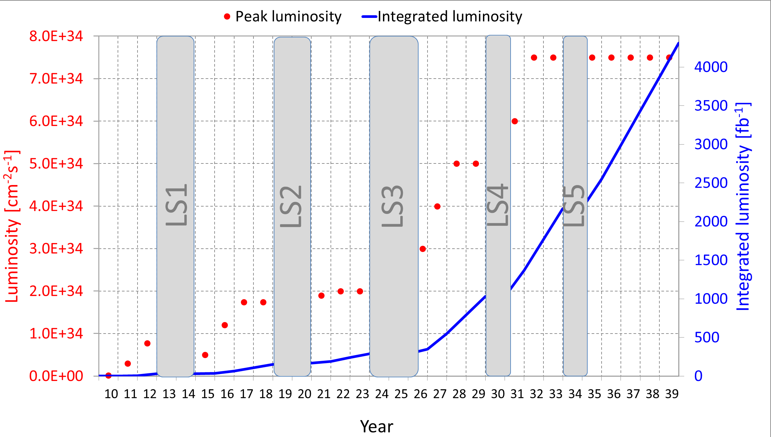
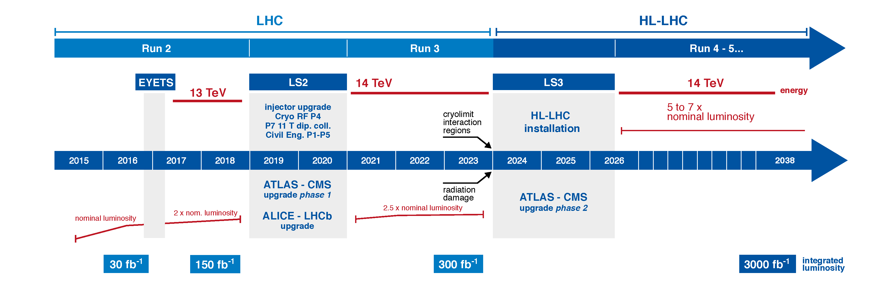
Luminosity profile and HL-LHC Timescale
Today
HL-LHC
Any “tunnel-bound” hardware for HL-LHC needs to be on CERN premises by early 2024.

Slide 4

Baseline for HL-LHC
More Luminosity: increase squeeze at interaction region
  Increase magnet aperture, therefore increase field.
  Use Nb₃Sn Technology as Baseline
More beam: larger beam-beam interactions in region where they are brought close together.
  Keep beam as separated as possible increasing crossing angle from 300 μrad to 600 μrad. Use Crab Cavities as Baseline to improve individual bucket overlap at IP
DOE created focused R&D Program (LARP) in ~2003 (with sizable funding from ~2006 onward) to enable development of leading-edge technologies (Nb₃Sn magnets, SRF Crab Cavities) aimed at LHC Luminosity increase
  LARP driven as project-like activity in last ~3 years to converge on final developments and design for potential US in-kind contributions to HL-LHC

Slide 5
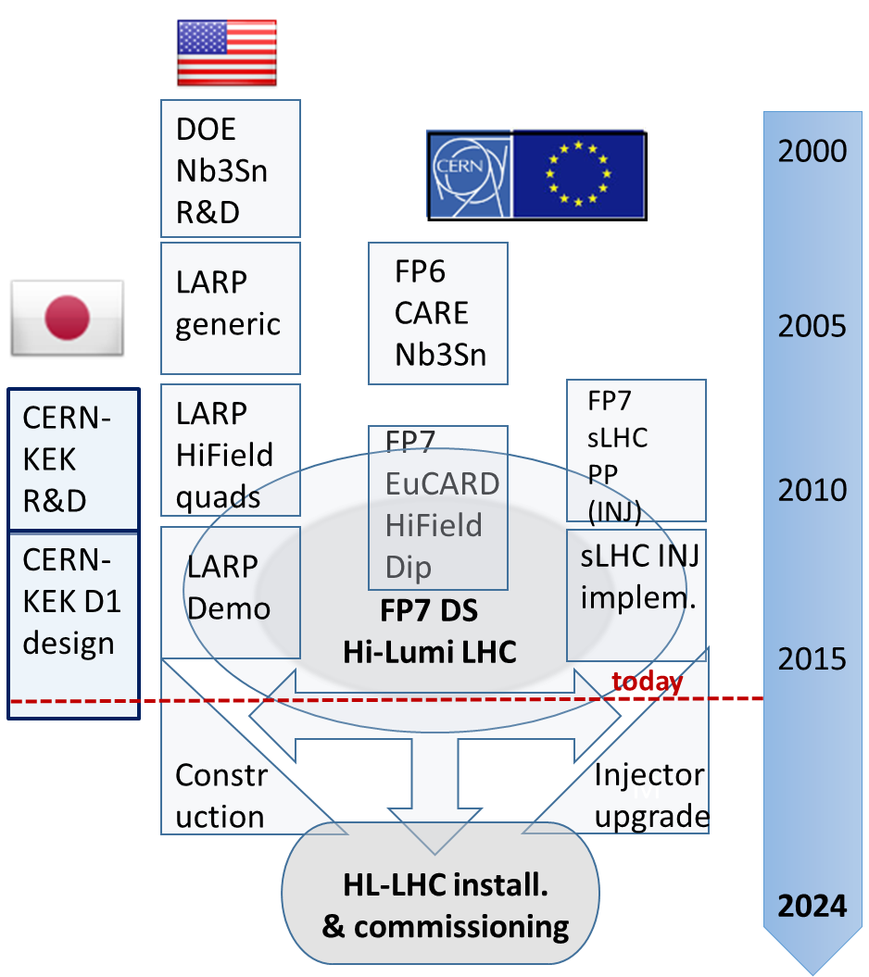
HiLumi & Collaborations: the Long Route
Beyond FP7:
CEA, INFN, UK
CIEMAT, Uppsala
Canada/Triumf?
China/IHEP?
Russia/BINP?
From L. Rossi

Slide 6
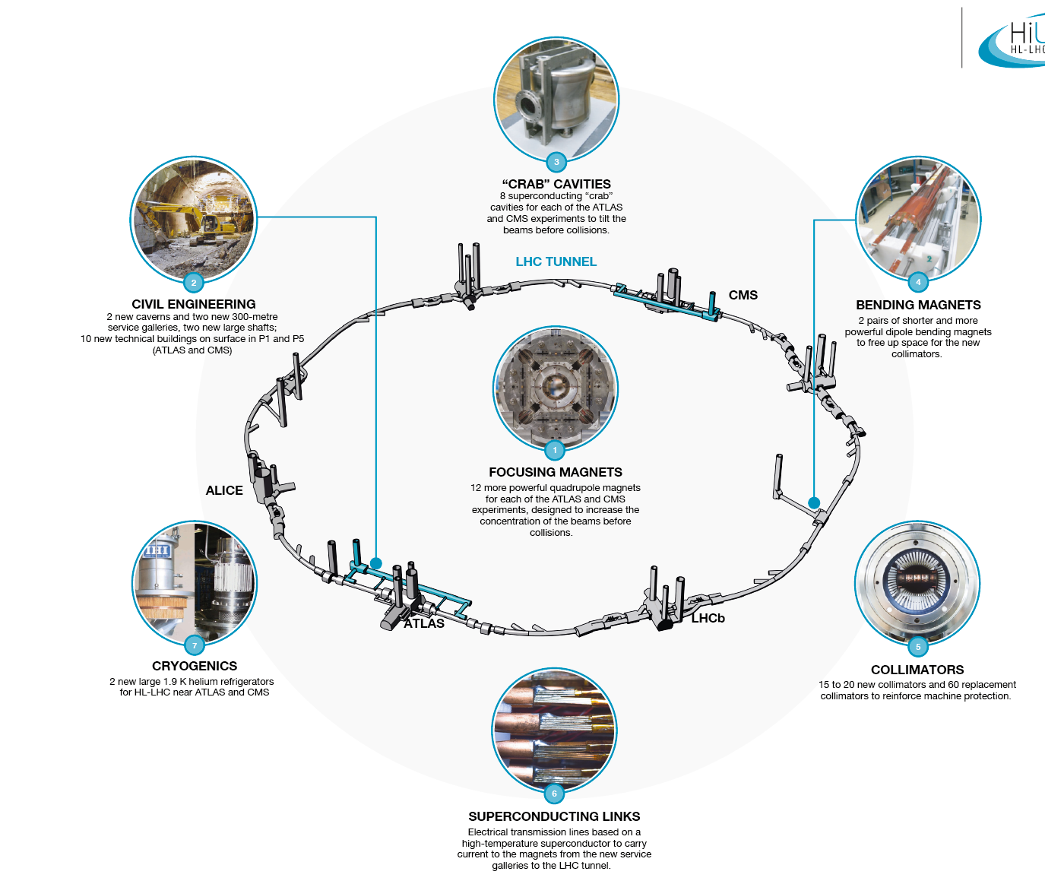
HL-LHC Landmarks
From L. Rossi

Slide 7







Inner Triplet regions with in-kind Contributions
Connection to LHC (UL)
Service gallery (UR)
SC Links
Q2a
Q1
TAXS
Q3
Q2b
D1
CP
DFX
DFM
UA gallery
Service cavern
(BBLR)
Q4
Crab cavities
D2
Collimators
TAXN

Slide 8
HL-LHC Accelerator Upgrade Project
(HL-LHC AUP)
HL-LHC AUP is a formal DOE Construction Project
A DOE construction project is governed by DOE Order 413.3B
  https://www.directives.doe.gov/directives-documents/0413.3-BOrder-b
  Applies to capital assets projects having a Total Project Cost greater than or equal to $50M
DOE projects typically progress through five Critical Decision (CD) gateways, which serve as major milestones
  Each CD marks an authorization to increase the commitment of resources by DOE and requires successful completion of the preceding phase or CD
  CD-0: Mission Need Approved Apr ‘16
  CD-1: Alternative Selection and Cost range
  Approved Oct ’17 !
  (also got CD-3a for LLI)
  CD-2: Baseline Approval Planned for late FY18
  CD-3: Construction Approval Phased in late FY18 and FY20
  CD-4: Project Complete

Slide 9
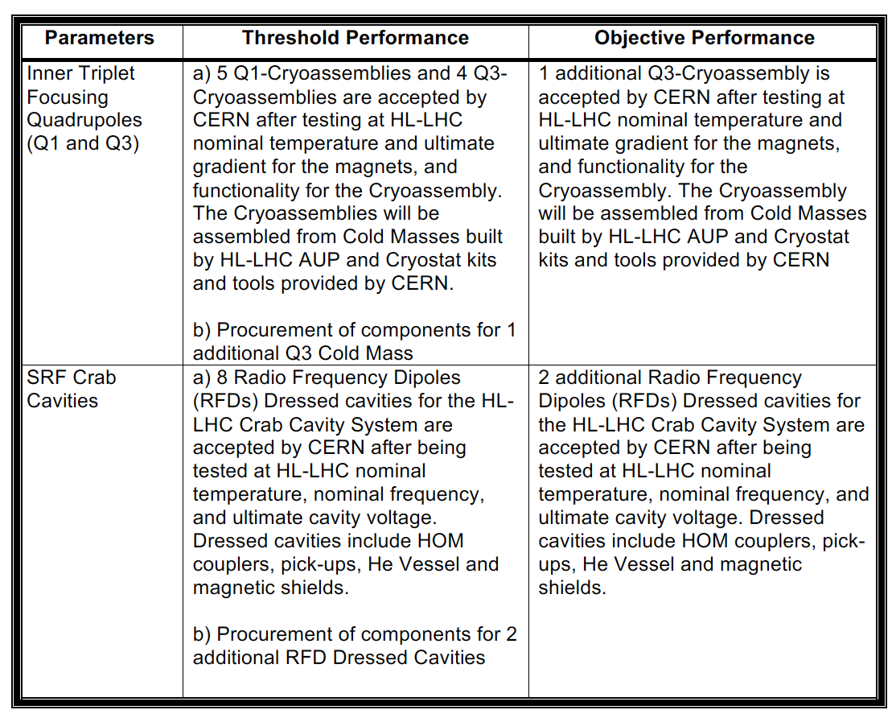
Project Scope as
Key Performance Parameters
KPP extracted from Prelim. Project Execution Plan
Need-by Delivery Date (from CERN):
  Q1/Q3 Cryoassembly #8 at CERN by Summer ’24
  RFD Dressed Cavity #8 at CERN by Summer-Fall ‘23
Deliverables:
5 Q1 and 5 Q3 Cryoassemblies
50% of the Q1/Q2a & b/Q3 Final Focusing Triplets of HL-LHC
Deliverables:
10 Dressed RFD Cavities
RFDs are 50% of the total number of Crab Cavities for HL-LHC
9

Slide 10
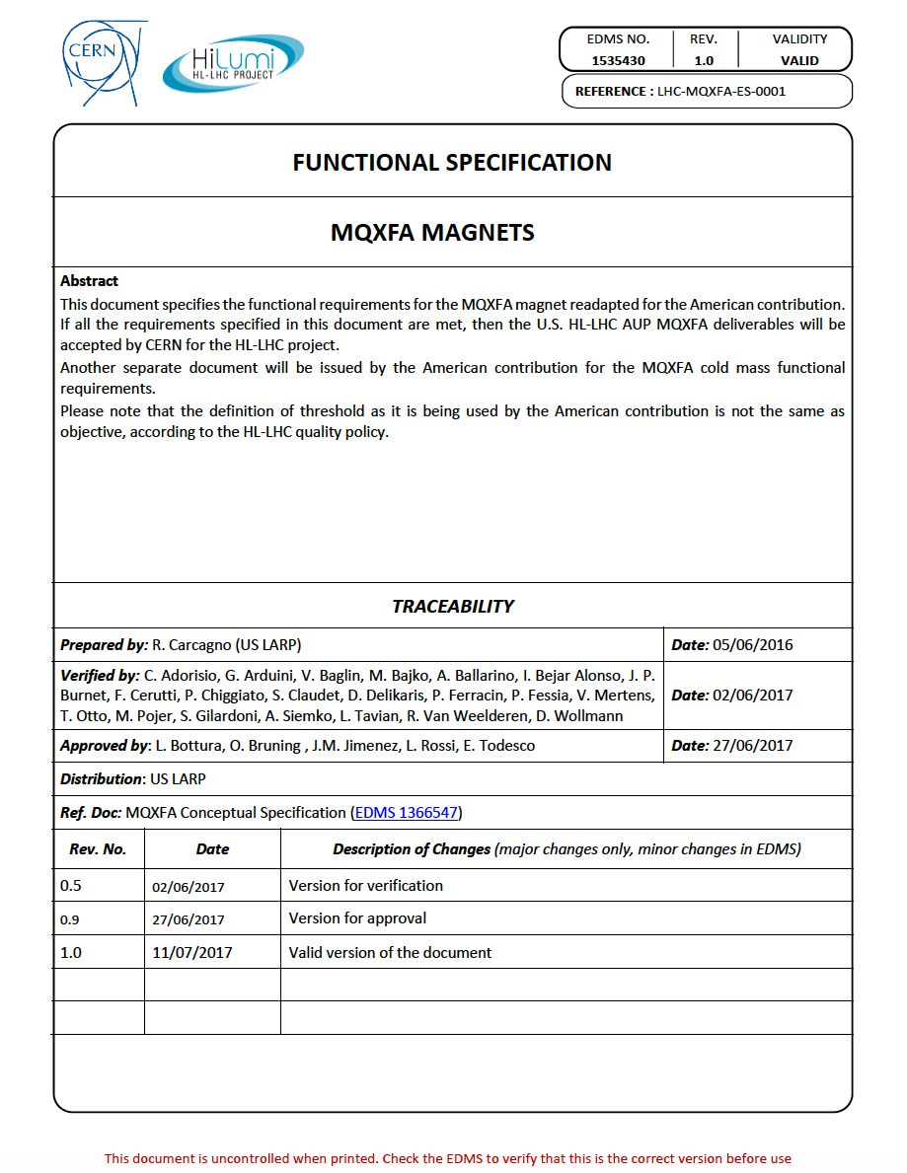
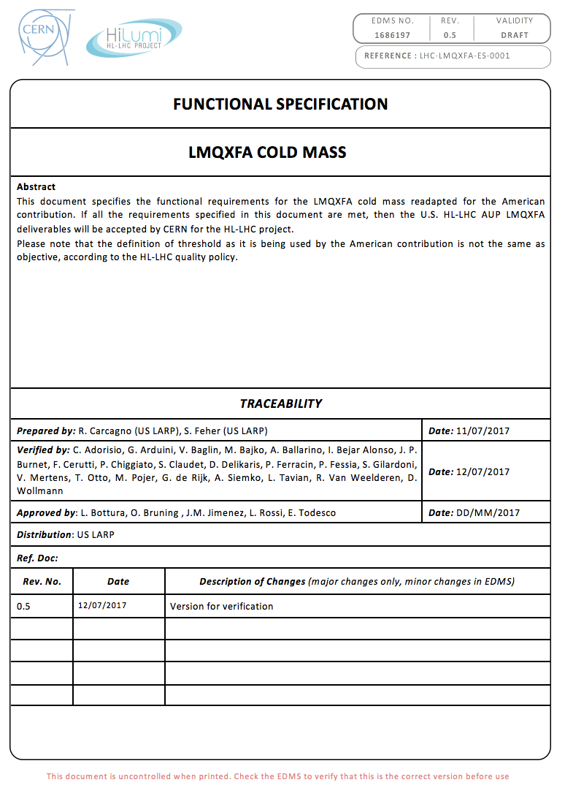
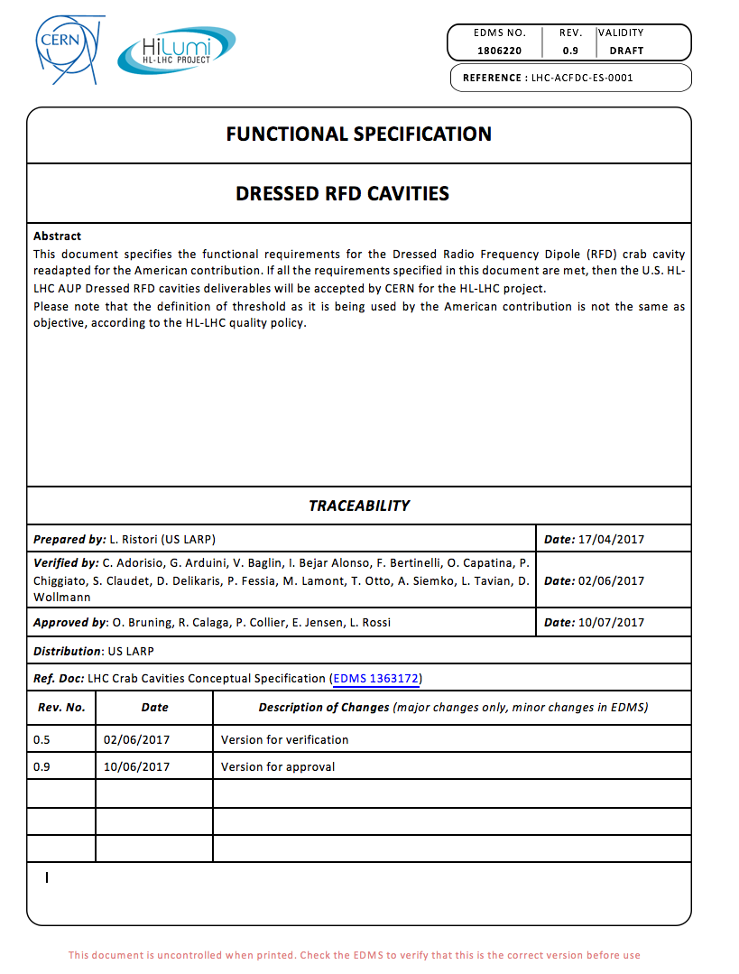
Performance Requirement
Requirements are documented in “Functional Requirements Specifications”
  Approved by CERN
  Accepted by H-LHC AUP
Us-HiLumi-doc-36
Us-HiLumi-doc-64
Us-HiLumi-doc-294

Slide 11
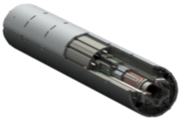
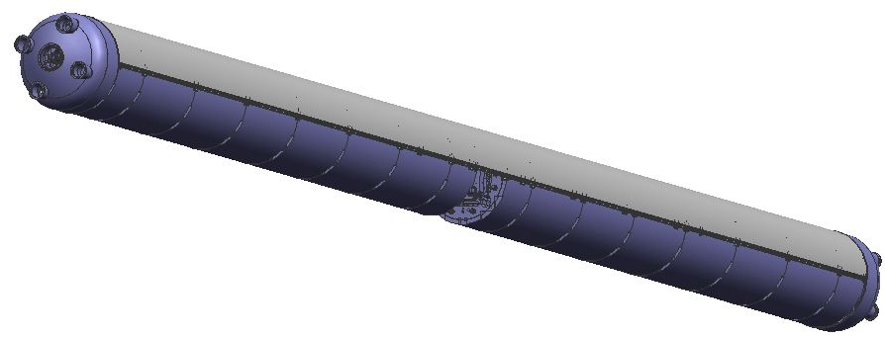
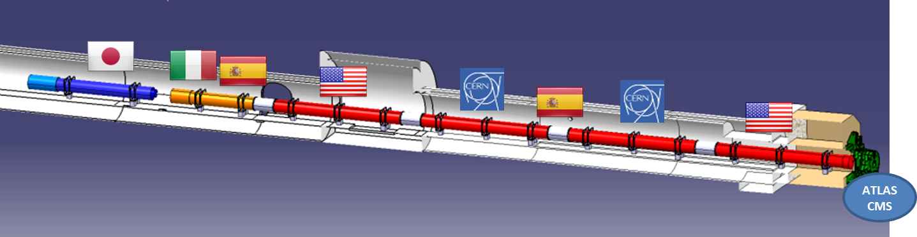
Q1/Q3 Magnet Deliverables
Q1/Q3 Cryostated Magnets (Cryo-assembly)
  Cold mass with two 4.2 m magnets (MQXFA)
  Cryostat parts provided by CERN (kit)
Magnet
(MQXFA)
Cryo-assembly
(LQXFA)
Cold Mass
(LMQXFA)

Slide 12
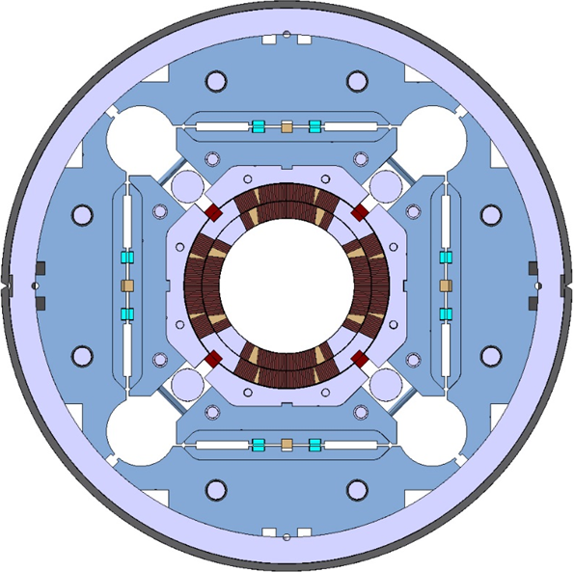
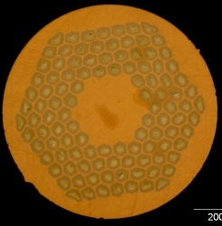
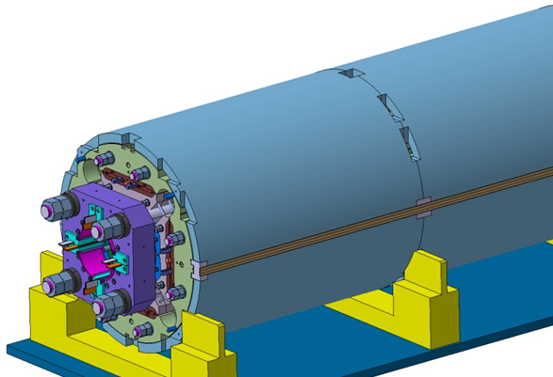
MQXFA Design
Parameter | Unit | MQXFA
Coil aperture | mm | 150
Magnetic length | m | 4.2
N. of layers |  | 2
N. of turns Inner-Outer layer |  | 22-28
Operation temperature | K | 1.9
Nominal gradient | T/m | 132.6
Nominal current | kA | 16.5
Peak field at nom. current | T | 11.4
Stored energy at nom. curr. | MJ/m | 1.2
Diff. inductance | mH/m | 8.2
Strand diameter | mm | 0.85
Strand number |  | 40
Cable width | mm | 18.15
Cable mid thickness | mm | 1.525
Keystone angle |  | 0.4
Nb₃Sn Conductor
LARP Technology
P. Ferracin et al., “Development of MQXF, the Nb₃Sn Low-β Quadrupole for the HiLumi LHC ” IEEE Trans App. Supercond. Vol. 26, no. 4, 4000207
G. Ambrosio et al., “First Test Results of the 150 mm Aperture IR Quadrupole Models for the High Luminosity LHC” NAPAC16, FERMILAB-CONF-16-440-TD

Slide 13
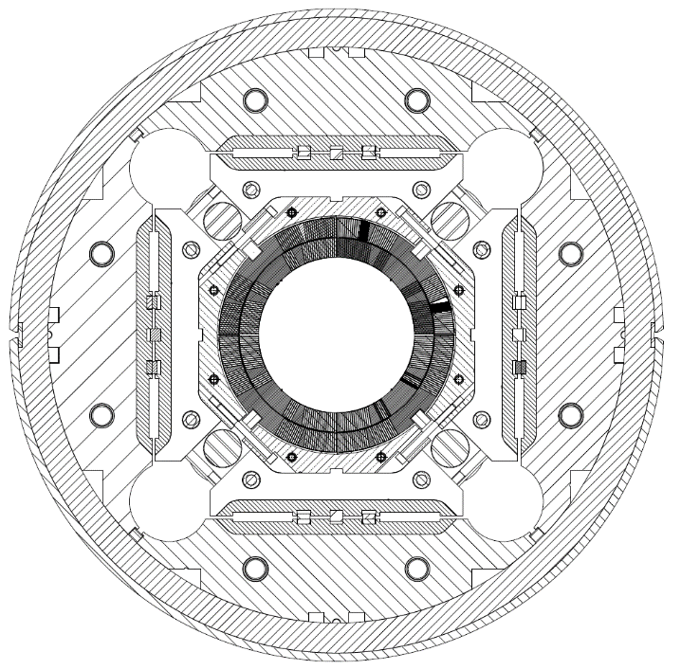
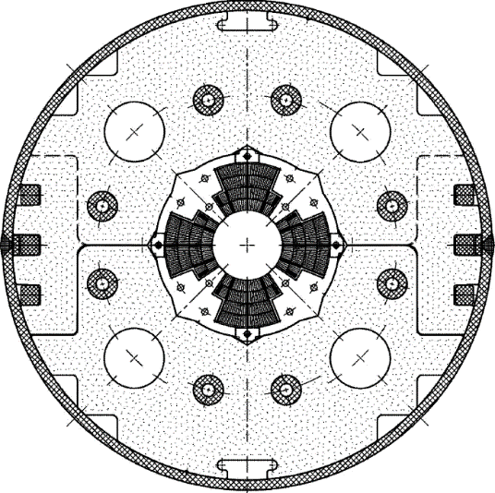
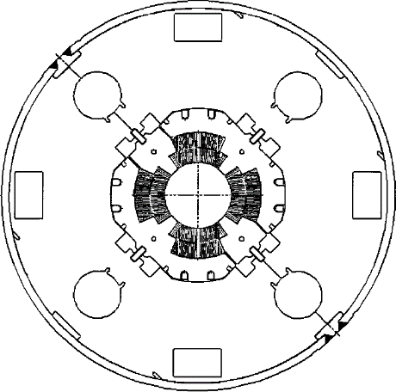
Low-β quadrupole magnets from LHC to HL-LHC
Cold mass OD from 490/420 to 630 mm
More than double the aperture: from 70 to 150 mm
~4 times the e.m. forces in straight section
~6 times the e.m. forces in the ends
State of the art quadrupoles at the time of LHC construction
MQXF
MQXA
MQXB
Same scale for all 3 plots

Slide 14
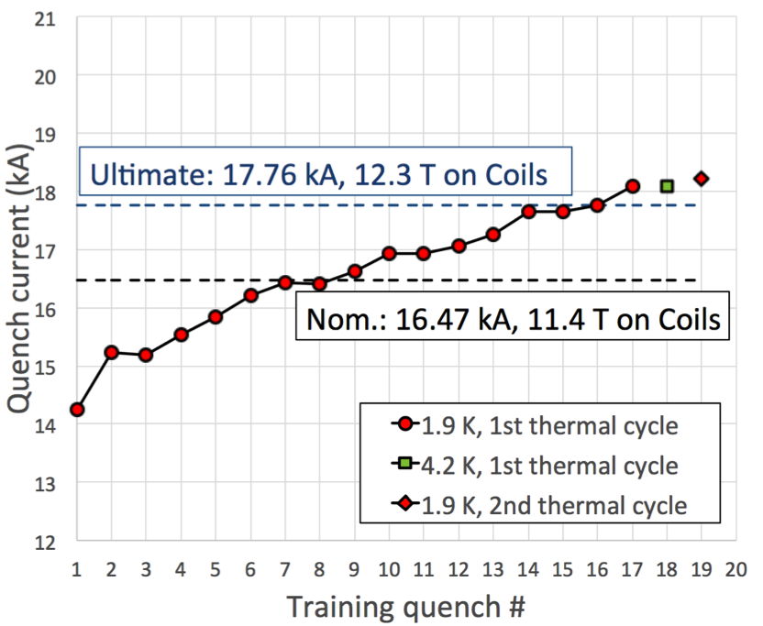
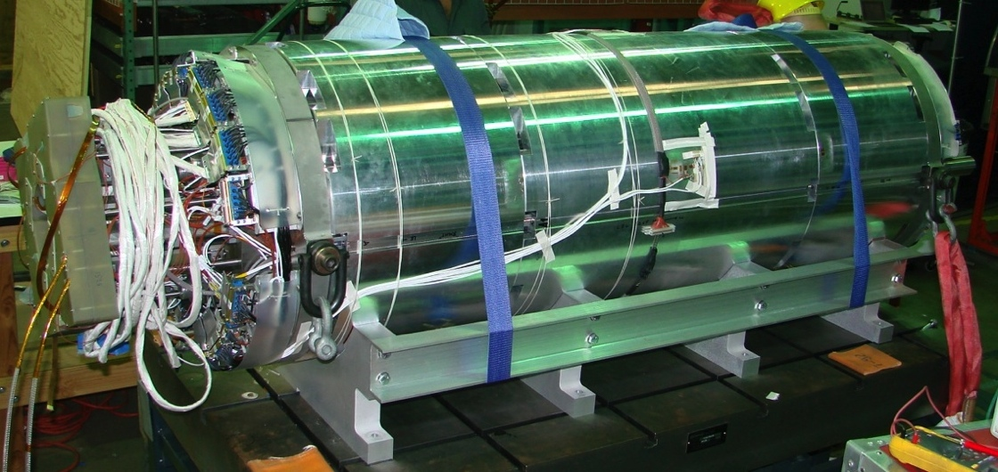
Test Results: MQXFS1
Short (1.2 m) MQXF magnet, with 2 coils by LARP, 2 coils by CERN, and segmented Al-shell
  Exceeded ultimate current
    Training was stopped to increase preload
  Demonstrated temperature margin
  Demonstrated excellent memory
Quench history of MQXFS1
tested at FNAL VMTF
First MQXF Short Model (MQXFS1)

Slide 15
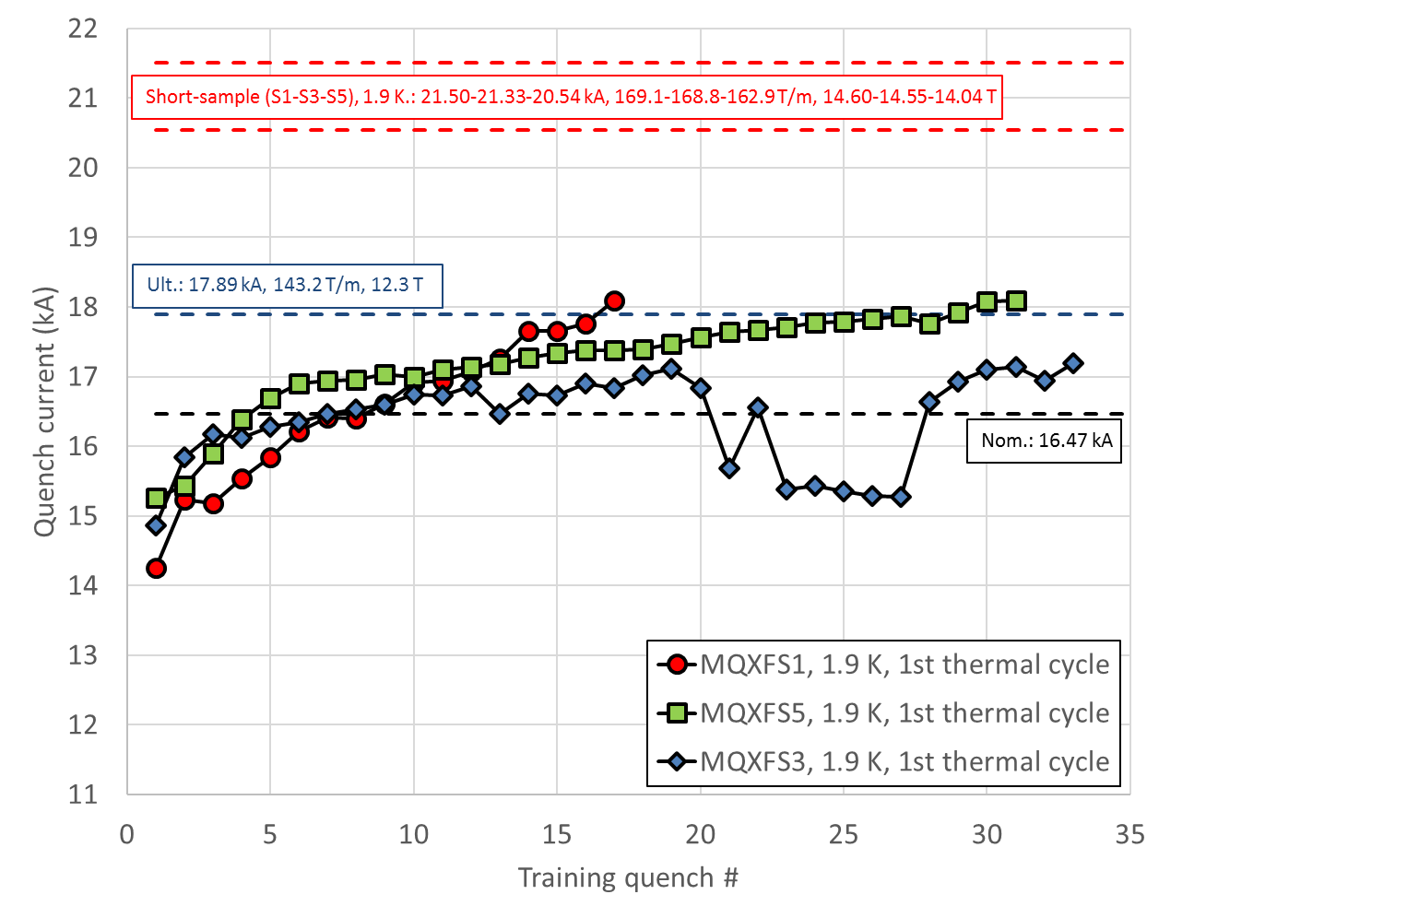

MQXFA1
4 m long coils (magnetic length)
  Conductor: RRP 108/127, 132/169, 144/169
Next Steps: Complete prototypes (MQXFA2) and Pre-series Magnets (MQXFA3 & 4)

Slide 16
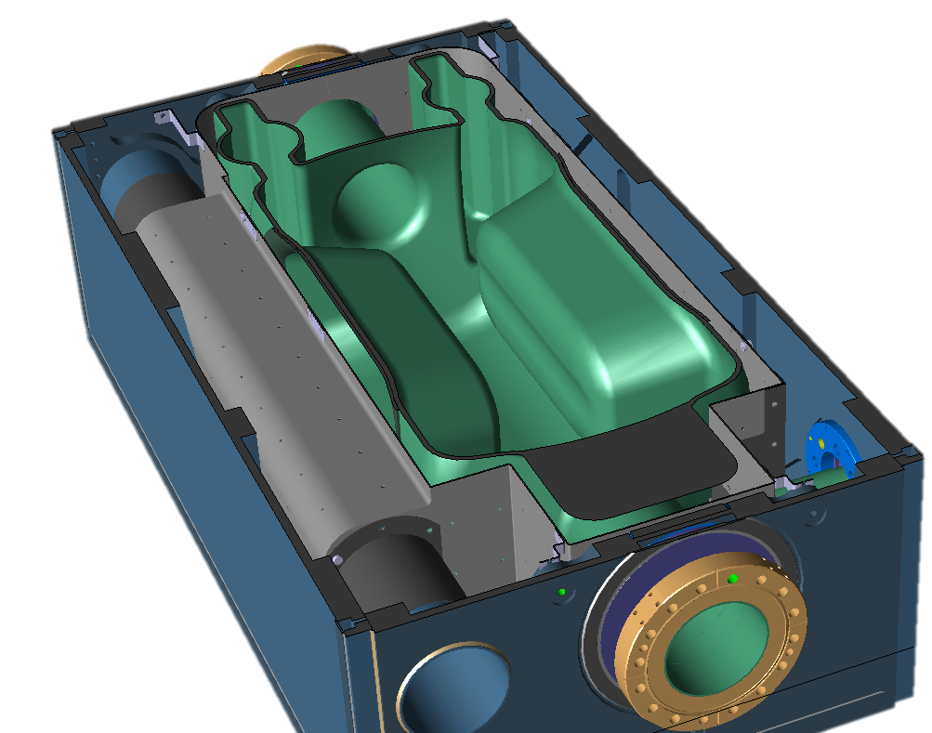
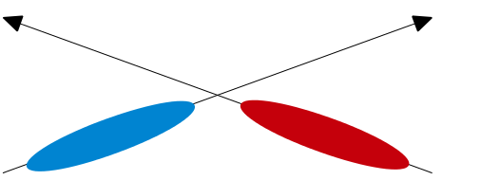
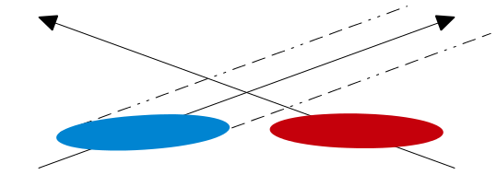
What is a Crab Cavity ?
OUT – “Crabbed” Bunch
Non crabbed bunches
Non head-on collisions
Time-dependent Electric Fields
Crabbed bunches
Head-on collisions
IN - Straight Bunch

Slide 17
RFD Scope and Deliverables
Dressed RFD Crab Cavity
  Assembly: Bare Cavity + Magnetic Shields + Helium Tank + RF Ancillaries
  Qualification at 2 K + Shipment to CERN
10 Dressed RFD Crab Cavities
  Qualified at FNAL (in VTS at 2K)
  Ready for integration in cryomodule (at CERN)
  (8) for tunnel installation (threshold KPP) – Need by: Summer-Fall 2023
  (2) additional at later time (objective KPP)

Slide 18
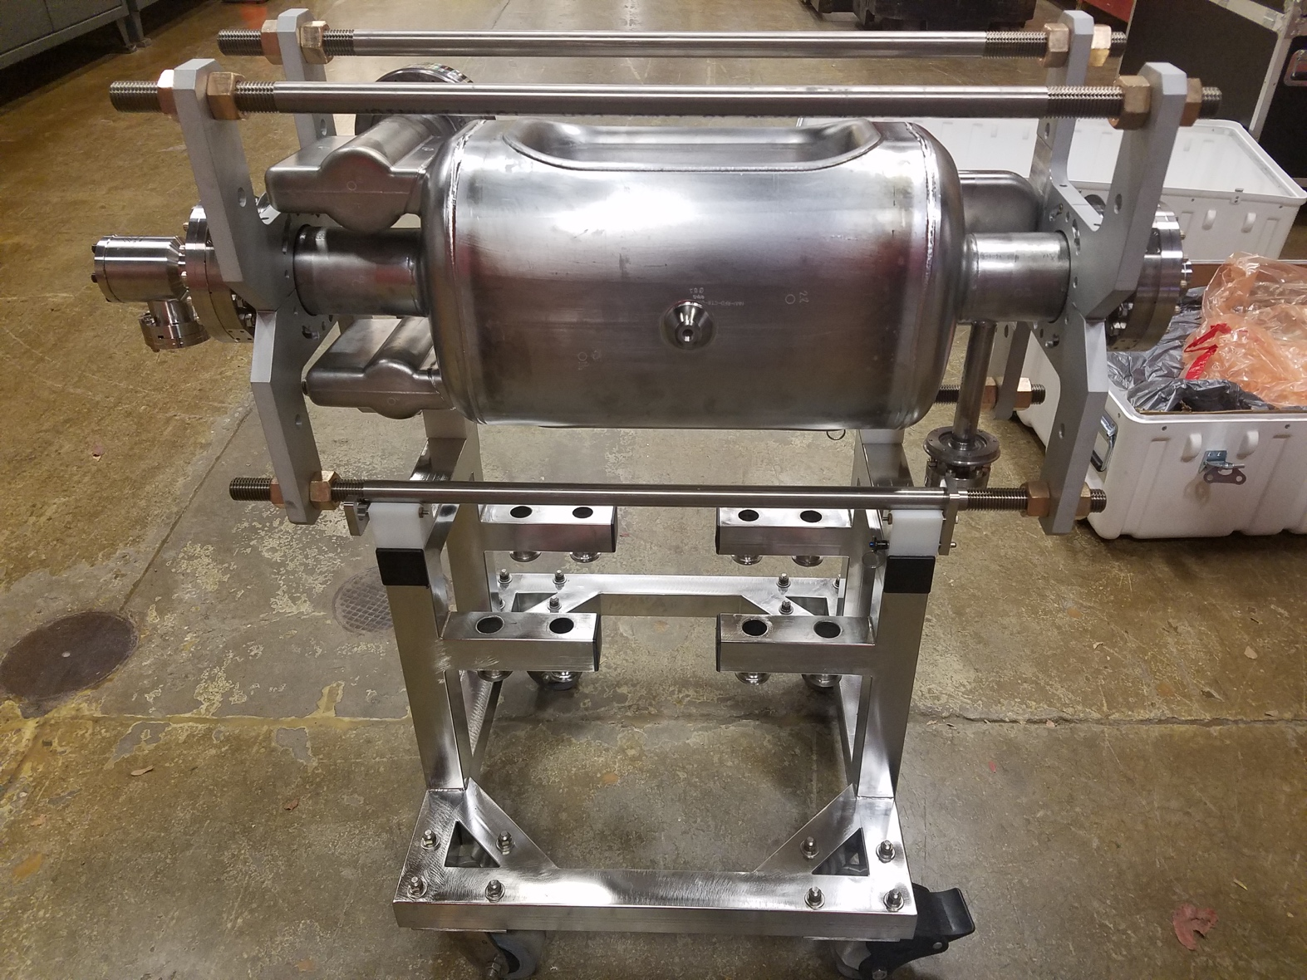
RFD Cavity Before Cleanroom Assembly

Slide 19
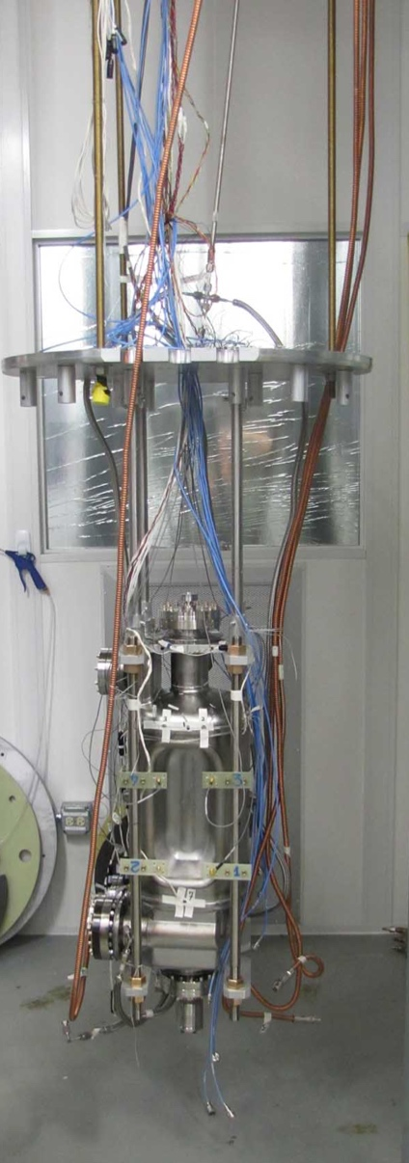
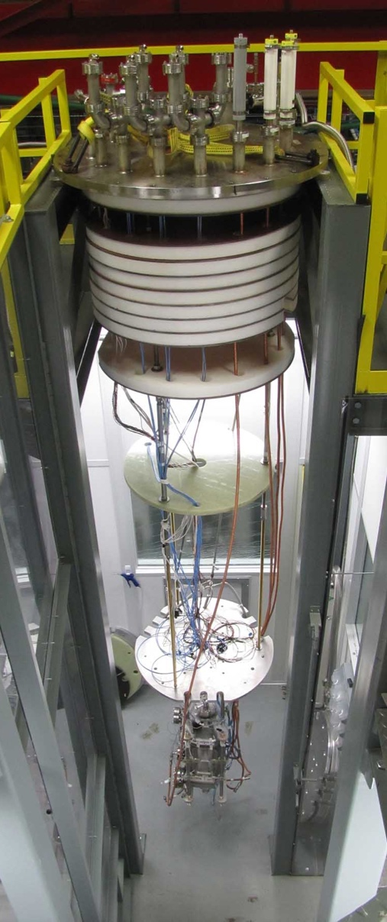
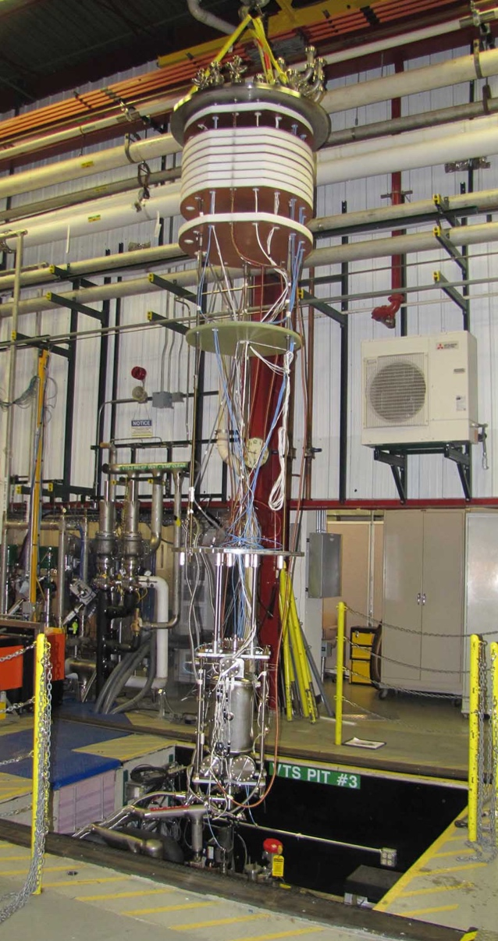
Cavity Insertion in FNAL - VTS #3

Slide 20
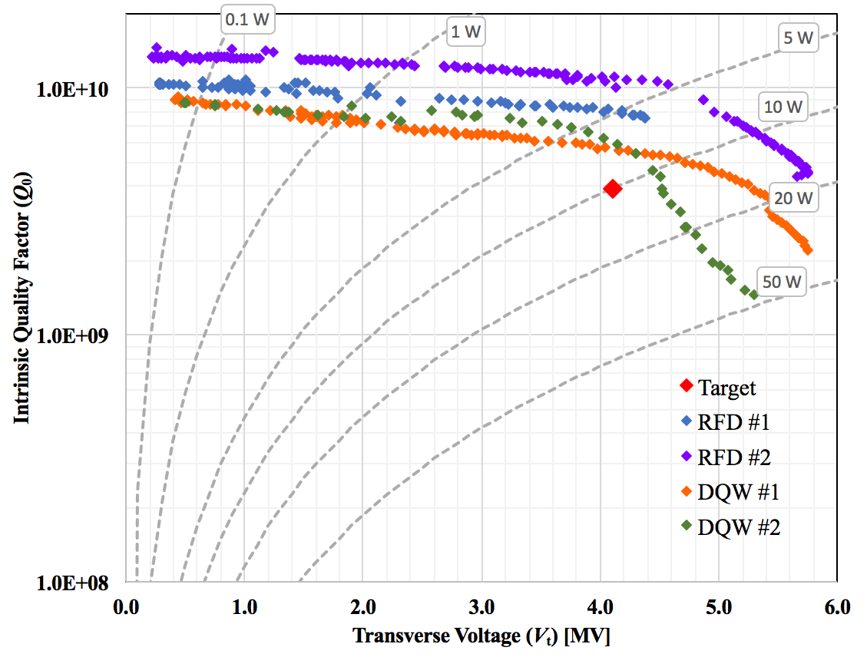
Previous Results from Tests at JLAB
Next Steps: Complete Pre-series Cavities

Slide 21
Remarks on LARP/HL-LHC AUP
Technology
Cutting edge-technology brought to fruition for Energy Frontier by US-LARP
First usage in accelerator for Nb₃Sn Superconductor
  ~50% higher fields than present LHC. Forces higher by x4-6
  Brittle superconductor, stress management a must
  Challenging technology with enabling features for future of HEP field (FCC, CepC,…)
First usage in hadronic collider of “crabbing” technology
Value Engineering has focused on reducing and minimizing risk:
  Insure performance achievement
  Manufacturability
  Availability of manufacturing facilities
  Long turn-around time for major “design improvements” (~3 years from conductor to tested magnet) will allow continued VE only on the above-mentioned elements of manufacturability and optimized usage of facilities

Slide 22
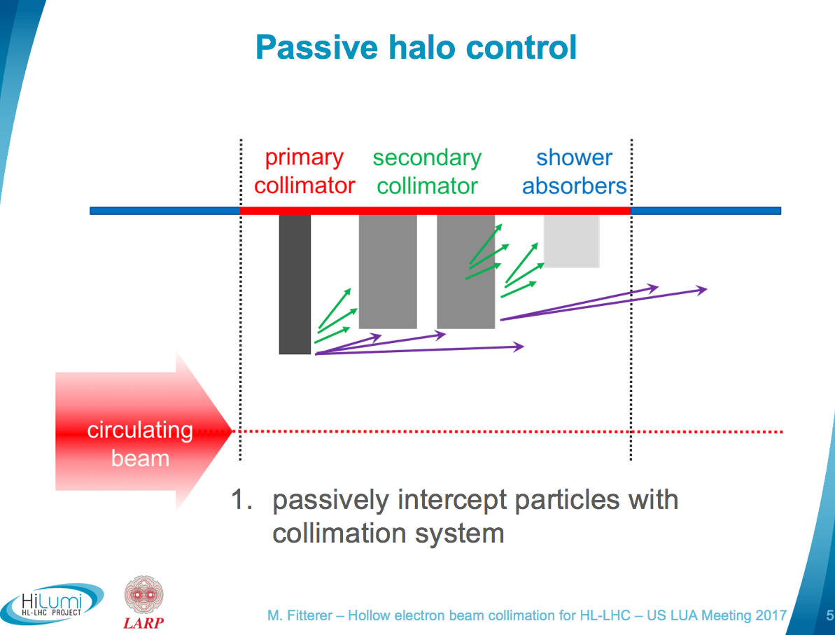
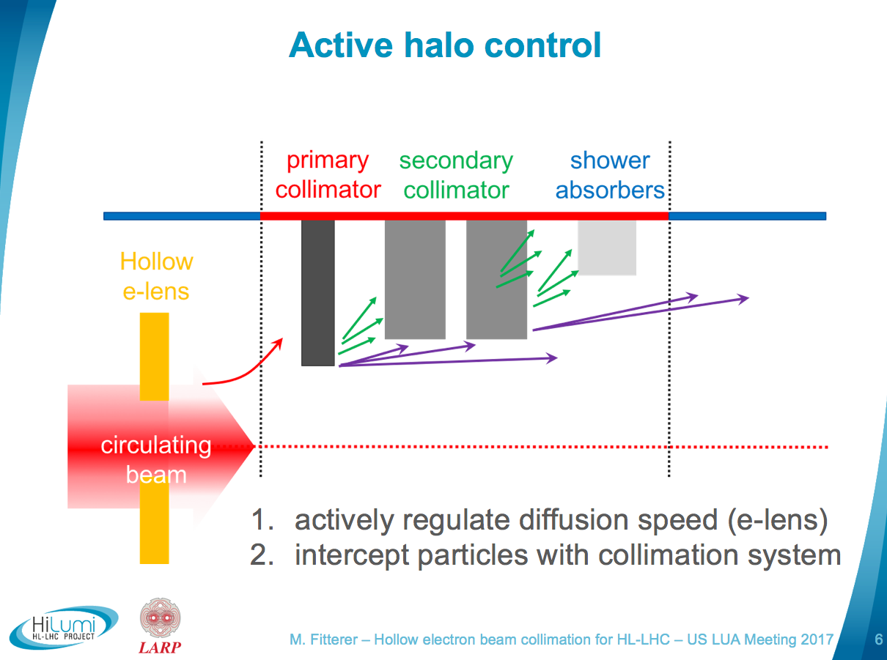
Remarks on LARP/HL-LHC AUP Technology(cont.)
LARP continues to support development of HL-LHC technologies
e-lens
  see Miriam’s presentation during the “Lightning Round” Session 1.

Slide 23
Cost Summary at CD-1 Approval
At CD-1 use methodology from DOE G 413.3-21:
Funding profile at CD-1/CD-3a ESAAB approval supports this cost range.
Cost Range: 209 M$ to 252 M$

Slide 24
Summary
HL-LHC AUP has obtained CD-1/CD-3a in October 2017
Analysis of Alternatives for HL-LHC AUP has converged on in-kind contributions to the HL-LHC Project at CERN
Requirements for HL-LHC AUP in-kind deliverables are defined at – or beyond – conceptual level (thanks to LARP).
Designs for HL-LHC AUP in-kind deliverables are defined at – or beyond – conceptual level (thanks to LARP) and have undergone extensive external reviews
Cost and Schedule ranges have been established based on bottom-up estimates:
  Cost Range: 209 M$ to 252 M$
  Schedule Range: 3QFY28 with 36 months float
Next step is to complete the prototype/pre-series program and obtain CD-2/CD-3b in late 2018.

