Slide 1
Proton Source Week 4
Joe Compton
9am Meeting
8/4/2017

Slide 2
RIL/Linac
RIL
Turned off Source A
Cleaning
Start up again next week
Continue to calibrate the new heater PS
Einzel lens spare testing/conditioning
Linac
Electricians installing infrastructure for the Marx Modulator at LRF2
P1 has been moved from A0 to the LRF5 region
HE general maintenance
General maintenance

Slide 3
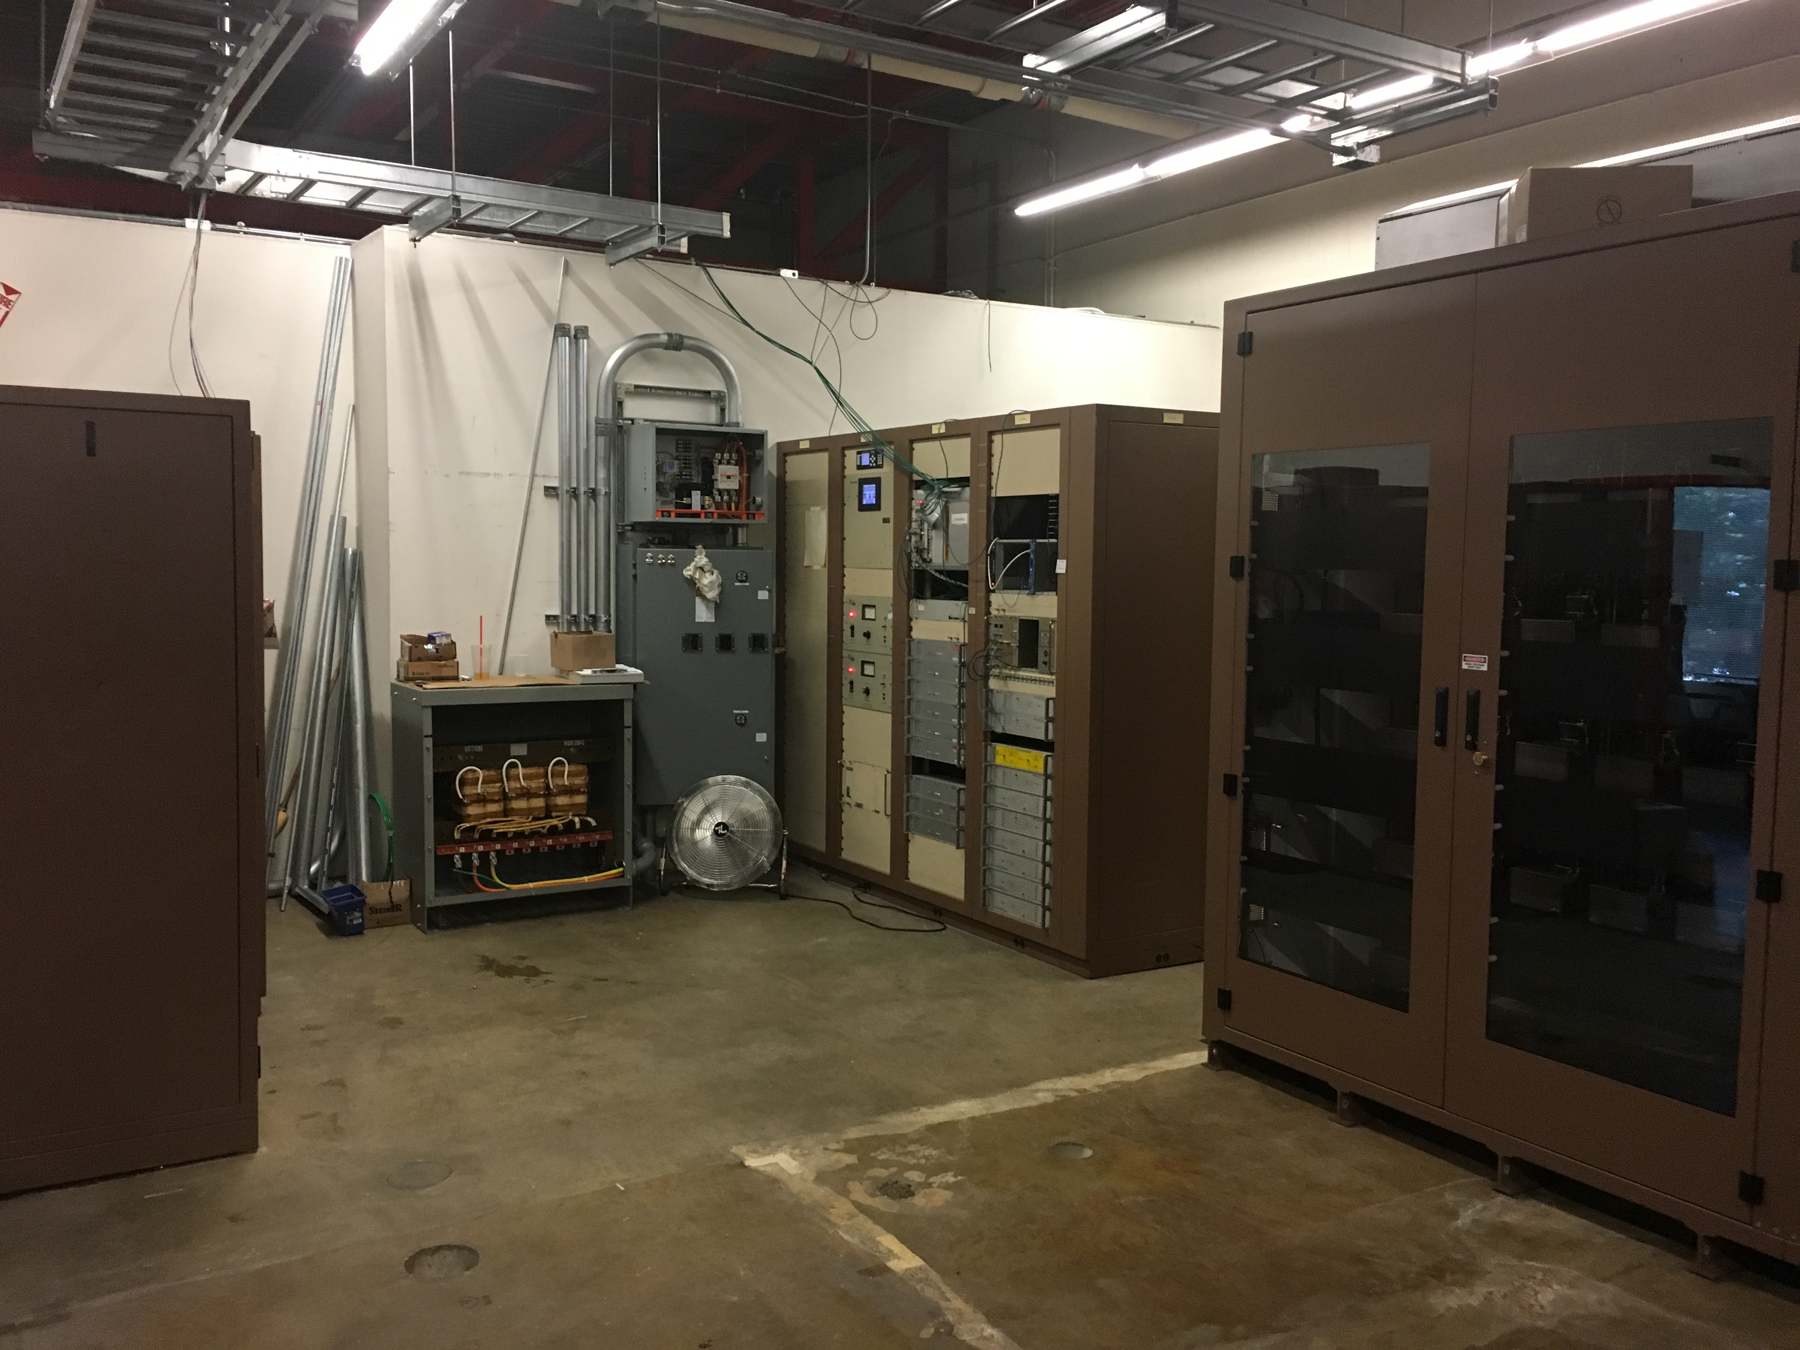
LRF2 Marx Modulator

Slide 4
Booster
Cavity for BRF22 delivered
Will be installed inside of next two weeks
Flanges need to be machined
Fluids group installed hosing for BRF22 in tunnel
Prepping PS room for BRF22
RF general maintenance
Kicker maintenance continues
Kicker loads inspected/repaired
Vacuum leak checking this week
400MeV turbo upgrade continues
Cables pulled for perpendicular cavity
General maintenance

Slide 5
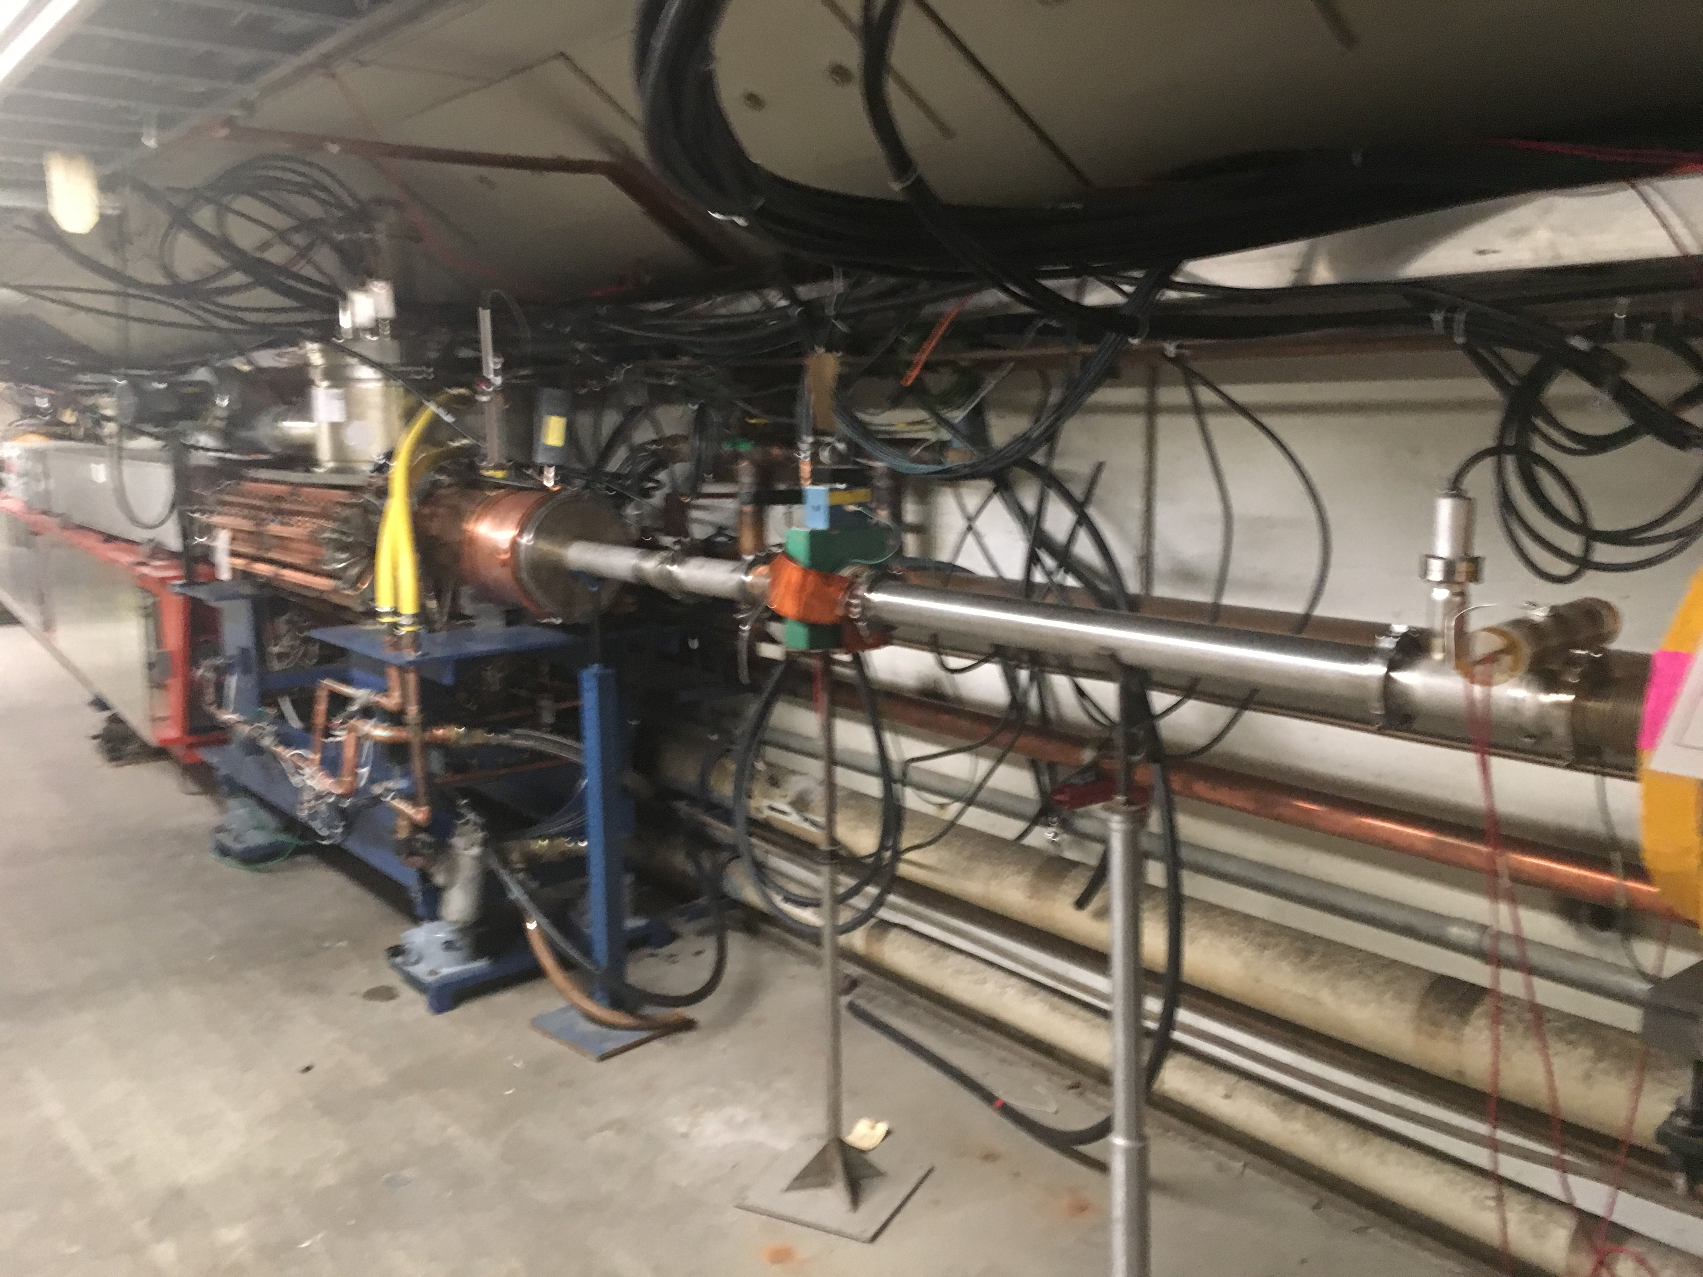
Booster BRF22

