Slide 1
CD1 / BOE Status
Paul Derwent
23 August 2017

Slide 2
CD1 Documents
 | Responsible Party | Status | Signatories
Acquisition Strategy | Adam / Paul | Assignments, draft in progress
Prelim PEP | Adam / Paul | Draft being updated
Risk Management Plan | Shekhar | Signed in Docdb #163 | PM, Deputies
Prelim HAR | Teri | Draft docdb #140 | PM, APM ESH&Q, Deputies, CSO or designee
CDR | Valeri | All but complete
High Performance & Sustainable Building | Steve D | Signed in Docdb, #184 | PM, APM ESH&Q, APM Civil
Integrated Safety Management Plan | Teri | Draft in docdb #141 | PM, APM ESH&Q, Deputies
Prelim QA Plan | Teri | Draft in Progress | PM, APM ESH&Q, Deputies, PEs
Prelim Vulnerability & Safety Assessment Report | Teri | Draft in docdb #143 | PM, Deputies
NEPA Strategy | Teri | EENF signed and with FSO, EA in FY18

Slide 3
CD1 Documents
 | Responsible Party | Status | Signatories
Assumptions Document |  | Signed in Docdb
Project FRS |  | Signed in TeamCenter
Project Management Plan | Shekhar | Draft in docdb #172 | PM, Deputies, Lab Director, Lab Chiefs
Procurement Management Plan | Paul/Luisella | Draft in docdb #522 | PM, Deputies, APM P&R
Interface Matrix Document | Paul / Fernanda | Started but lots of work to do
Design Review | Steve | Complete: P2MAC April 2017

Slide 4
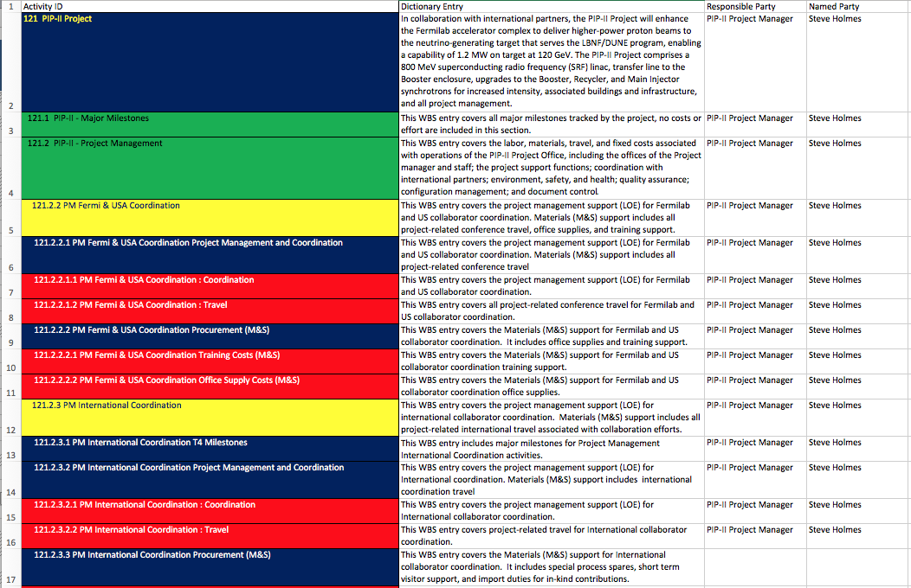
WBS Dictionary: Defining to Level 5
WBS defined to L5
~557 lines
color coded to match P6 colors
Pip2-docdb #599 has current draft version
will update as develops

Slide 5
BOE Documents
All documents have been created in Docdb
146 total documents
Word file: narrative description of the basis
Excel file: details of estimate
labor hours by type
M&S costs (in 2016 dollars)
Supporting documents
90% have data in docdb
Validation process
Reviewed with checklist by ‘independent’ project member
48 have been validated and approved

Slide 6
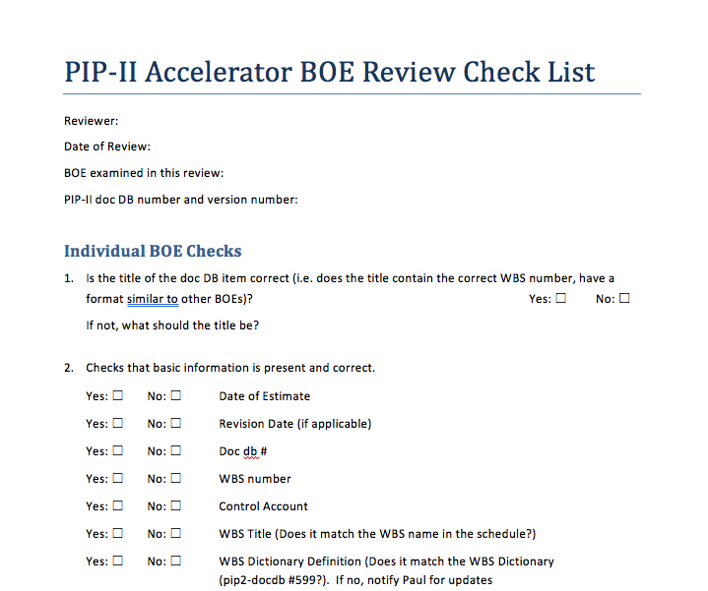
Checklist

Slide 7
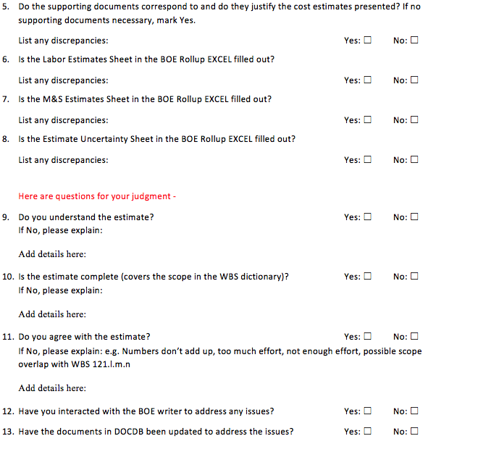
Checklist

Slide 8
BOE Validation Status
WBS |  | Estimator | Reviewers |  |  | checklist sent | how many | stated ready
121.2 | Project Management / Office | Steve Holmes | Paul Derwent, Dean Hoffer |  |  | yes | 1 | yes
121.3.1 | Linac Project Management | Fernanda Garcia | Steve Holmes |  |  | yes | 1 | yes
121.3.2 | Linac Accelerator Physics | Valeri Lebedev | Shekhar Mishra |  |  | yes | 2 | yes
121.3.3 | Linac Warm Front End | Lionel Prost | Shekhar Mishra |  | PFD in lieu of Shekhar | yes | 4 | yes
121.3.4 | Linac HWR | Allan Rowe | Shekhar Mishra, Fernanda Garcia |  |  | yes | 3
121.3.5 | Linac SSR1 | Donato Passarelli | Shekhar Mishra, Fernanda Garcia |  |  | yes | 7
121.3.6 | Linac SSR2 | Donato Passarelli | Shekhar Mishra, Fernanda Garcia |  |  | yes | 7
121.3.7 | Linac LB650 | Joe Ozelis | Shekhar Mishra, Fernanda Garcia |  |  | yes | 7
121.3.8 | Linac HB650 | Joe Ozelis | Shekhar Mishra, Fernanda Garcia |  |  | yes | 7
121.3.9 | Linac RF Power | Dave Peterson | Lionel Prost, Paul Derwent |  |  | yes | 12
121.3.10 | Linac RF Integration | Brian Chase | Lionel Prost, Jim Patrick |  |  | yes | 6
121.3.11 | Linac Cryo | Arkadiy Klebaner | Allan Rowe, Shekhar Mishra |  |  | yes | 3 | yes
121.3.12 | Linac Warm Units | Alex Chen? | Curtis Baffes |  | PFD in lieu of Curtis | yes (pfd) | 4
121.3.13 | Linac Magnet PS | Bruce Hanna | Lionel Prost |  |  | yes | 6 | yes
121.3.14 | Linac Beam Transfer Line | Shekhar Mishra | Curtis Baffes, Allan Rowe |  | PFD in lieu of Curtis | yes | 3
121.3.15 | Linac Beam Abort Line | Shekhar Mishra | Curtis Baffes, Allan Rowe |  | PFD in lieu of Curtis | yes | 4
121.3.16 | Linac Instrumentation | Vic Scarpine | Jim Steimel |  |  | yes | 9
121.3.17 | Linac Controls | Jim Patrick | Jim Steimel |  | PFD Assist | yes | 15 | yes to all but 1
121.3.18 | Linac Vacuum | Alex Chen | Curtis Baffes |  | PFD in lieu of Curtis | yes (pfd) | 3
121.3.19 | Linac General Support Services | Curtis Baffes | Paul Derwent |  |  | yes (pfd) | 4
121.3.20 | Linac Safety Systems | John Anderson | Shekhar Mishra |  | PFD in lieu of Shekhar | yes | 9
121.3.21 | Linac Test Infrastructure | Jerry L, Joe O, Alex M, Donato P | Jim Steimel, Bruce Hanna, Dave Peterson |  |  | Some | 10
121.3.22 | Linac Installation, Integration, Commissioning | Curtis Baffes | Shekhar Mishra, Fernanda Garcia, Allan Rowe, Jim Steimel |  |  |  | 5
121.4 | Booster/RR/MI | Ioanis Kourbanis | Lionel Prost |  |  | yes | 4 | yes
121.5 | Conventional Facilities | Steve Dixon | Steve Holmes, Shekhar Mishra |  |  | yes | 9 | yes

