Slide 1
PIP-II Project Manager’s Report
Steve Holmes
PIP-II Project Management Group
23 August

Slide 2
Outline
Goals
Financials
ES&H/NEPA
Technical/R&D
India Collaboration
Project Management
CD-1 Status

Slide 3
Project Goals
Milestone | Planned | Actual or Forecast
CD-0 | Q1 FY2016 | November 12, 2015 (A)
CD-1 | FY2017 | Q2FY2018
CD-2/3a | FY2019 | FY2019
CD-3 | FY2020 | FY2020
CD-4 | FY2026 | FY2026
CD-1 profile as receive from OHEP on July 17
We are in discussion with OHEP as to whether $20M is a more realistic number for FY18
We will be aligning the RLS with this profile, but may reallocate between OPC, PED, and TEC in years FY20 and beyond

Slide 4
Goals for FY17 (unchanged since July PMG)
Goal is to achieve CD-1 in ~January 2018
RLS
ICR
Documentation
Financial Goals
Live within the provided budget: $21.03M (includes FY16 carryover)
Cross the FY17/18 border with ~$2.0M unobligated (carryover)
ES&H Goals
Be prepared to initiate Environmental Assessment on 10/1/17
R&D Goals
Release CDR
Complete PIP2IT MEBT
Keep HWR and SSR1 on track for CY2018/19 delivery
India Collaboration Goals
Meet 2017 deliverable milestones
Establish confidence between the partners
Management Goals
Complete all CD-1 documentation and successfully navigate required reviews
Fill missing positions on organization chart

Slide 5
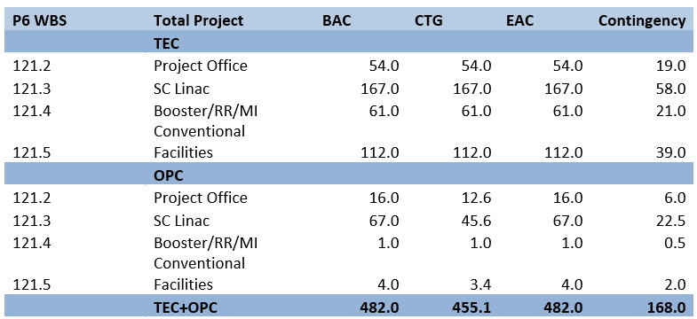
Financials (inception through 6-30-17)
Spending since CD-0
OPC/Project Office, Civil Const, and SC Linac are only areas of activity to date
5.6% complete

Slide 6
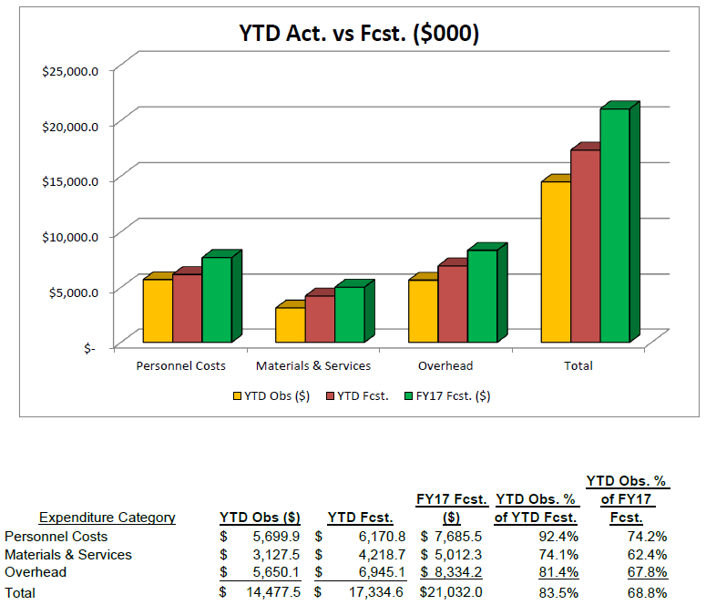
FY17 Financials (through 7-31-17)
RIPs: $531K
Current Management Reserve: ($75K)
Demands against Management Reserve: $71K

Slide 7
FY17 Financials/Management Reserve
Budgets adjusted following FY17 forecast-to-complete in April + adjustments from approved funding change requests
Current Management Reserve: ($75K)
OHEP + Directorate made available $127K of uncosted obligation on Pavac contract for application to HB650 dressed cavities (GARD funds)
This has been obligated!
Directorate provided $250K from reserve to support Lab 2 improvements
Thanks!
Management Reserve does not reflect anticipated SWF underrun of ~$2M
Unfunded Requests: $71K
PIP2IT RFPI $15K
LLRF $56K
Partially funded
CF subsurface documentation $20K
Have removed Environmental Assessment from this list as on track for early FY18 contract award

Slide 8
ES&H/NEPA
Wetlands Jurisdictional Determination
In process with USACE
If accepted, the wetlands located in the PIP-II footprint would be designated non-jurisdictional
If denied, a new wetlands permit application would be submitted in FY2018 to allow USACE the 1 year review period in order to meet a PIP-II start work date of late FY2019/early FY2020.
EENF submitted to DOE/FSO (Aug 18)
Expect determination from FSO Friday (Aug 25)
Environmental Assessment scope of work sent to Procurement for review
Preparing RFP with anticipated release date of ~Oct 1

Slide 9
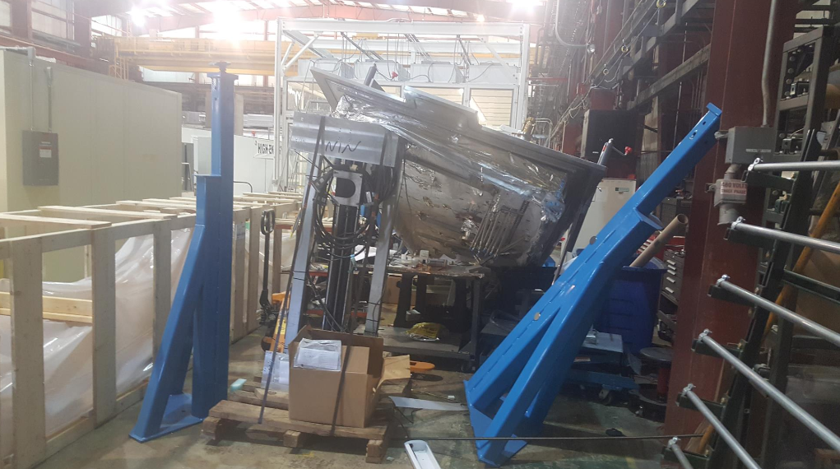
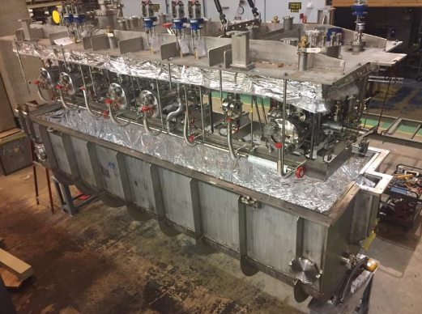
ES&H/Safety Incident
HWR accident at ANL (July 18)
Cryomodule lid fell to floor
Damage: cryo valves, bayonets, alignment pins
Category 3 event
Currently under investigation
Lid repair estimated at 24 weeks
Expect somewhat less delay in cryomodule delivery because lid not on critical path

Slide 10
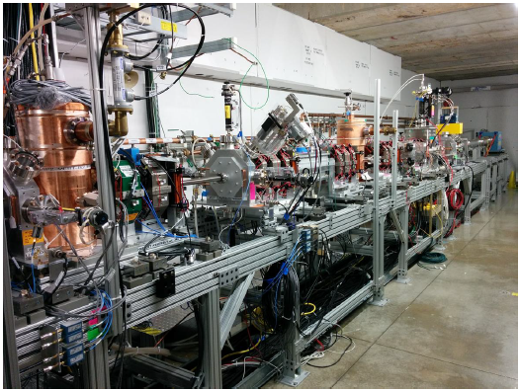
Technical/R&D Status
PIP2IT
2017 goal to complete MEBT and commission with beam
5 mA × 1 ms × 20 Hz to dump
Measure kickers’ effects on the beam
Completed installation of
MEBT in early August
Beam Commissioning
underway

Slide 11
Technical/SRF R&D Status
SSR1
Dressed cavities are showing FE in full power tests (at STC)
This is delaying the SSR1 schedule
Investigating, using the previously qualified cavity
Retest shows degraded performance (FE above 15 MV/m), but still meets spec
HB650
Goal is to qualify and dress four cavities in FY17
Two cavities are qualified
One ready for retest; other being prepared for retest
Couplers
New RFQ coupler design has been completed and reviewed
Procurement initiated
HB650 couplers RFP has been released
Best value procurement with pre-qualified vendors
Bids came in, substantially higher than estimate

Slide 12
Project Management/CD-1 Strategy
Timeline
Director’s Review September 19-21
DOE IPR/ICR November
ESAAB (CD-1) January 2018
Critical path is:
Complete RLS (technically limited, see L. Lari presentation)
Complete BOEs (see P. Derwent presentation)
Adjust TPC/UCR to fit into $700M box
Edit BOEs accordingly
Align RLS with BOEs and with CD-1 funding profile
Complete all required documentation
Good shape (see P. Derwent presentation)

Slide 13
Project Management/CD-1 Status
RLS
Major outstanding items are integration of all labor associated with cavities & cryomodules and installation & commissioning
BOEs
133/146 of BOEs have data in them as of last Friday (8/18)
48 have been validated through our review process
Expect to have everything in by Friday (8/25)
Adjust TPC/UCR to <$700M
Currently stand at ~$7XXM
With 30% contingency + 15% maturity contingency to UCR (50% total)
Scope reduction menu created. Will finalize on Friday (8/25).
Edit BOEs to align with UCR and align RLS with new BOEs
We must have this by 8/30 to stay on schedule for Director’s Review
Align RLS with funding profile
I am dubious that we can have this done for Director’s Review

Slide 14
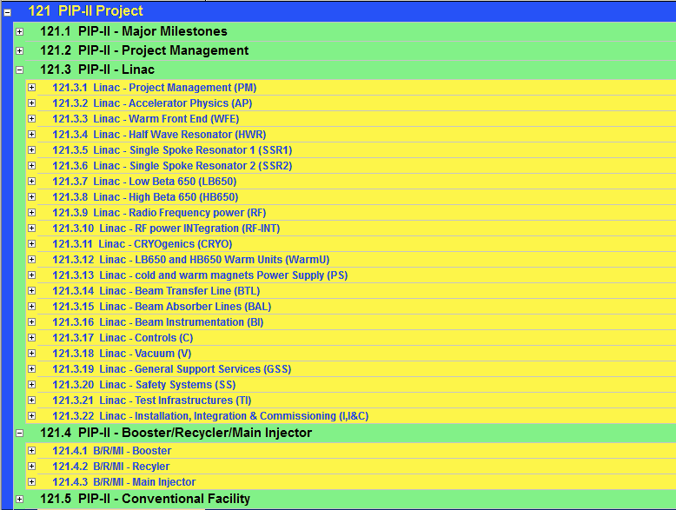
RLS status
Close to ready/ready
Advanced
WBS/BOE in P6
70%Detailed in P6
BOE data in P6

Slide 15
India Collaboration
Joint R&D Project Document
Addendum II: Documentation of Fermilab engineering deliverables.
DAE responded with 12 pages of comments to my July 5 proposal.
Addendum I: Modification to DAE deliverable dates to reflect delays in R&D program to FY2020
DAE to make Addendum I consistent with Addendum II
Visitors
Authorization to restart the long- and short-term visitors programs has been give to the Technical Coordinators
They are discussing the areas in which they would like to deploy the next cohort.
No opportunity for overlap with current visitors at this point
Exports
Procurement of MOSFETs for SSR1 RF sources is becoming critical
Identified potential distributor willing to sell with BARC as end user
Discussion with SC (Mike Salamon) on modification to DOC entities list
He will discuss possibility with DOC
SSR1 cavities
Leonardo Ristori and Paolo Berrutti will be visiting BARC in October for:
Witnessing of SSR1 He vessel welding
Review of SSR2 cavity design
We have advised DAE that we need these cavities on the Fermilab site by December 31, 2017 in order to incorporate into the prototype SSR1 cryomodule
IIFC Meeting
Moving meeting to Fermilab, immediately after the DOE Review, expected in November

Slide 16
Project Management
Personnel
No personnel actions this month
Issues that are impeding progress
Lab2 cleanroom not complete – requires substantial further investment to make usable – funds received from Directorate
Engineering support for SRF
Tom N (Mu2e) and Chuck G (LCLS-II) have very minimal availability
Much of the slack is being taken up by Vikas Jain (RRCAT visitor)
He returns to India in October → we will need access to Chuck starting in FY2018

Slide 17
Summary
Moving toward CD-1, with a newly-modified plan
Acceleration by ~2 months is a challenge, but is providing good motivation for the project.
India collaboration is taking a lot of attention
Improving interactions and information exchange
Need to add more staff prior to CD-1
Essentially there

Slide 18
Backups

Slide 19
FY18 Strategy @ $14.0M (unchanged since last month)
Currently forecasting FY17 underrun of $1.9M
Budget FY18 for $15.8M
Support 40 FTE
Standing army (20) + priority activities (20)
Compare to 54 FTE budgeted in FY17
SWF+OHD $10.7M
M&S + OHD $5.1M
Schedule ~$1M of M&S in Q4 FY18 = virtual reserve
Priorities
CD-1
CDS install at PIP2IT
MEBT absorber at PIP2IT
HWR (pCM)
SSR1 (pCM)
HB650
CF design start (site prep and buildings)
EA
Issues
Essential that we get operations support for Lab2 ($338K w/ovhd)
We need this asap to be ready for SSR1 assembly in Jan. 2018
We have requested from Laboratory Reserve – no response yet
Booster injection design

