Slide 1
Resource Loaded Schedule Status
Luisella Lari
PIP-II PMG meeting
23 Aug 2017
Thanks
To L3/L2 Managers,
To PIP-II Project Management Team
To J. Randall

Slide 2
Outline
PIP-II RLS Status vs BOEs
PIP-II RLS Working in Progress
PIP-II RLS Completion Strategy

Slide 3
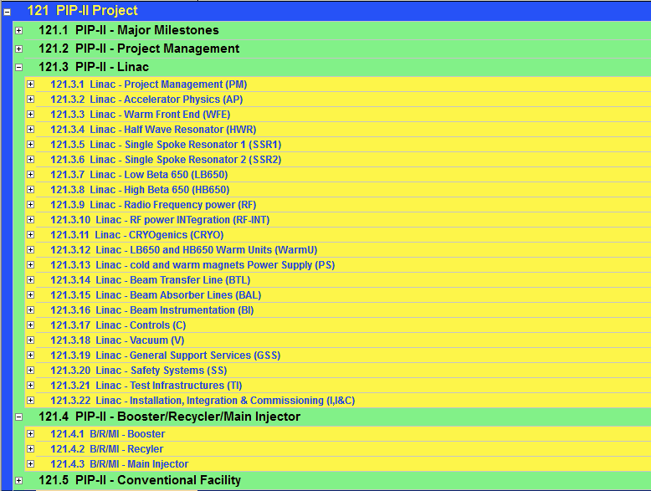
PIP-II RLS status vs BOEs (1/2)
WBS/BOE in P6
70%Detailed in P6
BOE data in P6
Close to ready/ready
Advanced

Slide 4
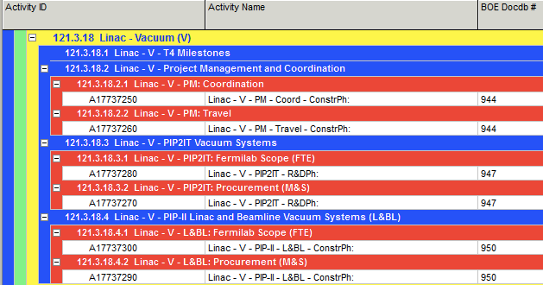
PIP-II RLS status vs BOEs (2/2)
Up-to-date: 146 BOEs in Total → 48 validated/approved and moved in P6
P6 WBS and activities are already created to allocate BOE data

Slide 5
PIP-II RLS working in progress
Preliminary BOE cost analysis shows the need of scrubbing costs
The validation of BOEs doesn’t mean that the costs are approved → working in progress to align P6 with on-going costs scrubbing.
CM FTE P6 implementation as well as the PIP-II critical path are depending by the approval of proposed cost reduction.
Approval of possible cost reduction → end of this week
Moreover we are working on align P6 to the new starting date i.e. Oct 17

Slide 6
PIP-II RLS completion strategy
BOE Validation, cost scrubbing and P6 Completion foreseen for August the 30th
From PMG 26 July 2017

