Slide 1
IOTA Proton Injector – August 4, 2017
Ion Source Status at MDB
Samantha Young, Dean Edstrom, and Kermit Carlson

Slide 2
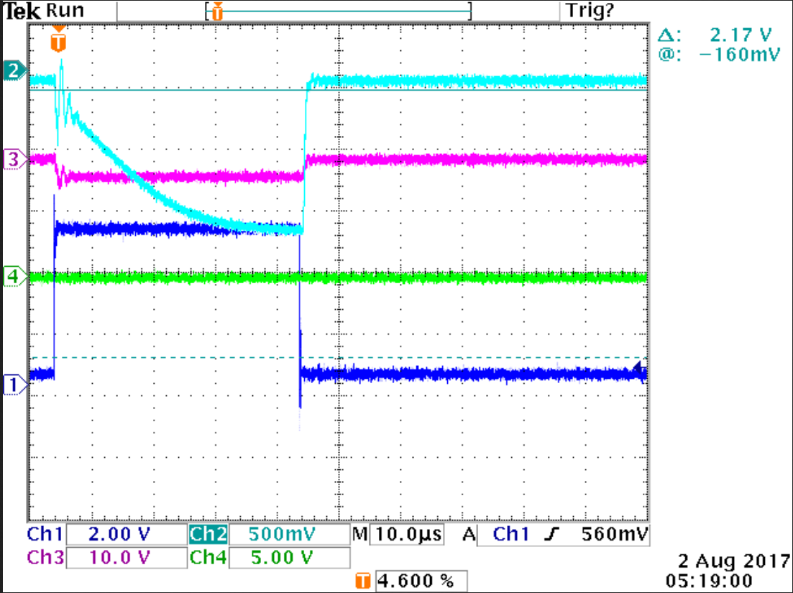

Slide 3
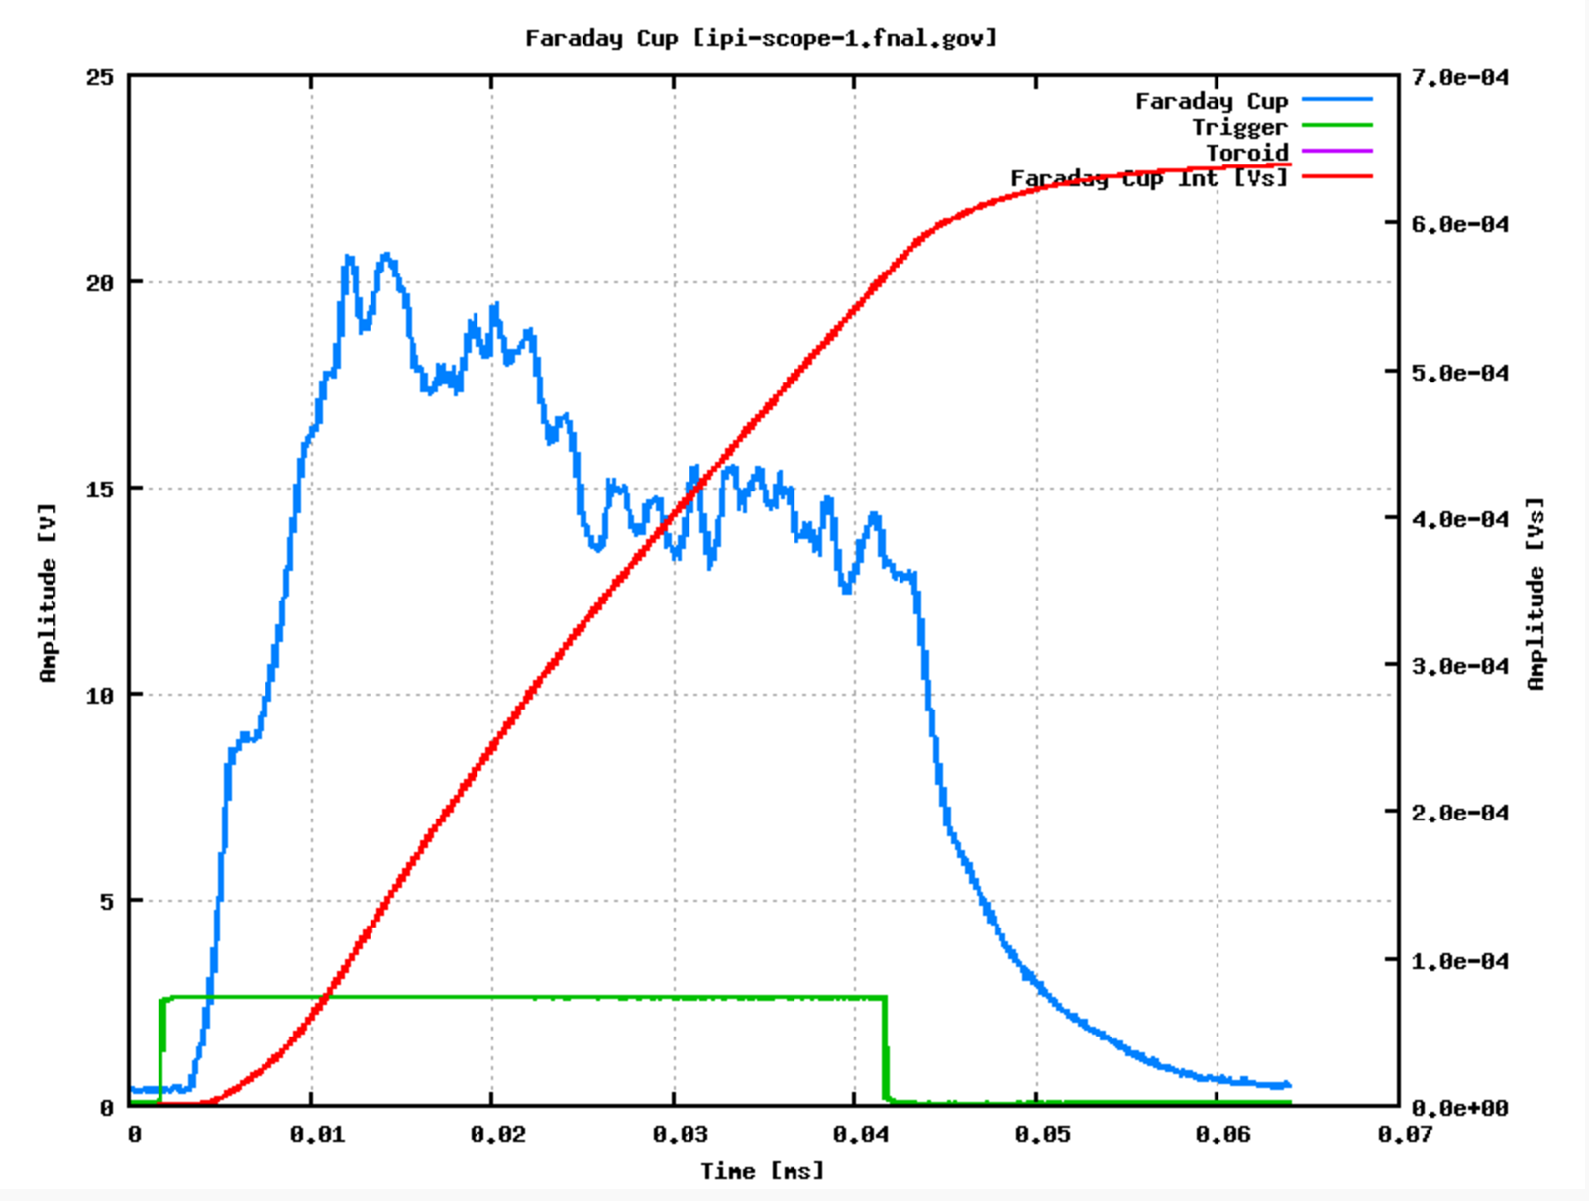

Slide 4
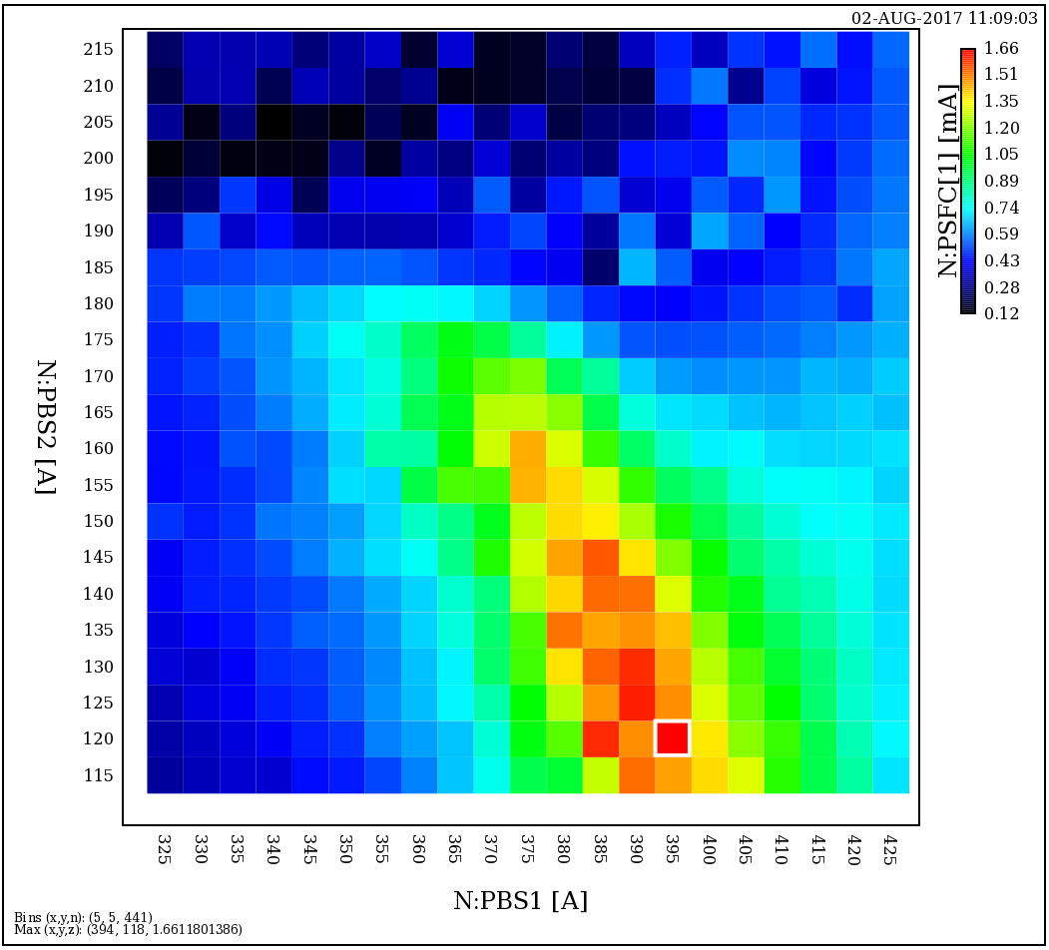

Slide 5
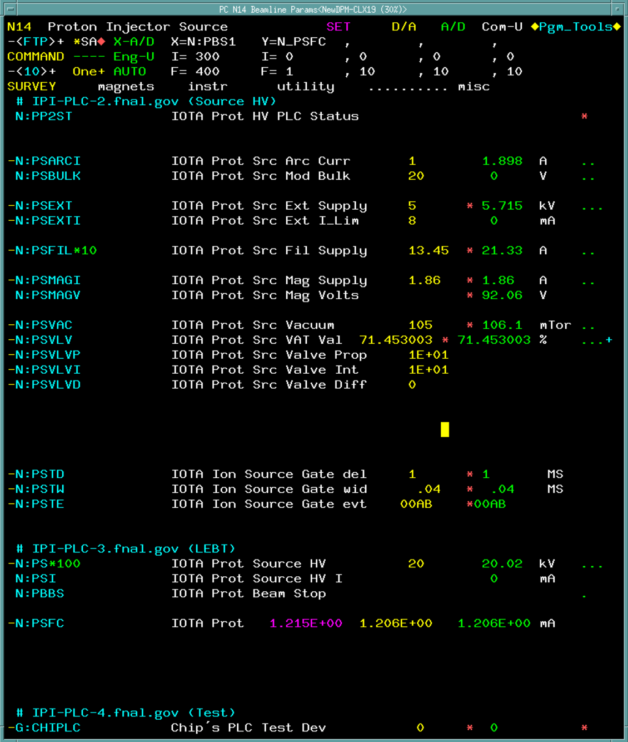
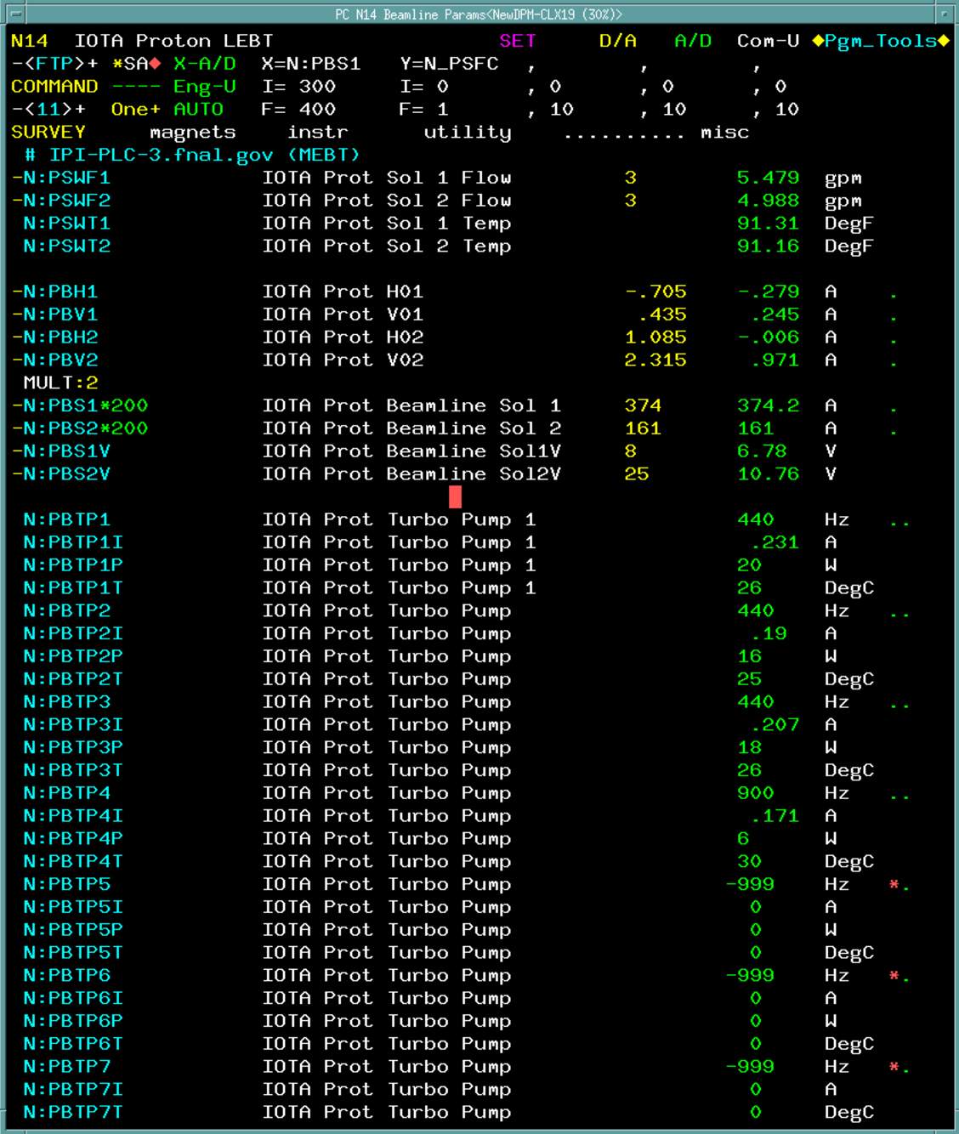
Parameters above yield 1.5-1.6 mA (safe operation)
Highest current achieved was 2.0 mA at 20 kV
  Source Mag = 2.4 A
  Beamline Solenoid 1,2 = 395, 120 A

