Slide 1
Magnetic Field Maps of the
IB2 Calibration Magnet
Samantha Lederman and Sundaram Thirukkurungudi

Slide 2
Background
The Mu2e experiment :
Search for the charged lepton flavor violating process of neutrino-less μ→e coherent conversion in the field of an aluminum nucleus.
About 7⋅10¹⁷ muons, provided by a dedicated muon beam line will be stopped in 3 years in the aluminum target.
The corresponding single event sensitivity will be 2.5⋅10⁻¹⁷.

Slide 3
Detector Solenoid
Inner Radius 1.050 m
Total Length: 10.15 m
Magnetic Field drops from 2 T to 1 T in the cone
The uniform Magnetic field Region 3.6 m long at 1 T

Slide 4
Purpose
The uniform Magnetic field in the detector solenoid is measured using hall probes mounted on an arm that can rotate about an axis and travel along the length of the magnet
These hall probes need to be calibrated to measure magnetic field correct to 10 micro Tesla
The calibration magnet must have at least have 5 to 6 mm wide cuboidal or ellipsoidal region of uniform magnetic field of 1 T for calibrating the hall probe
The current work pertains to identifying this region by mapping the field of the IB2 calibration magnet

Slide 5
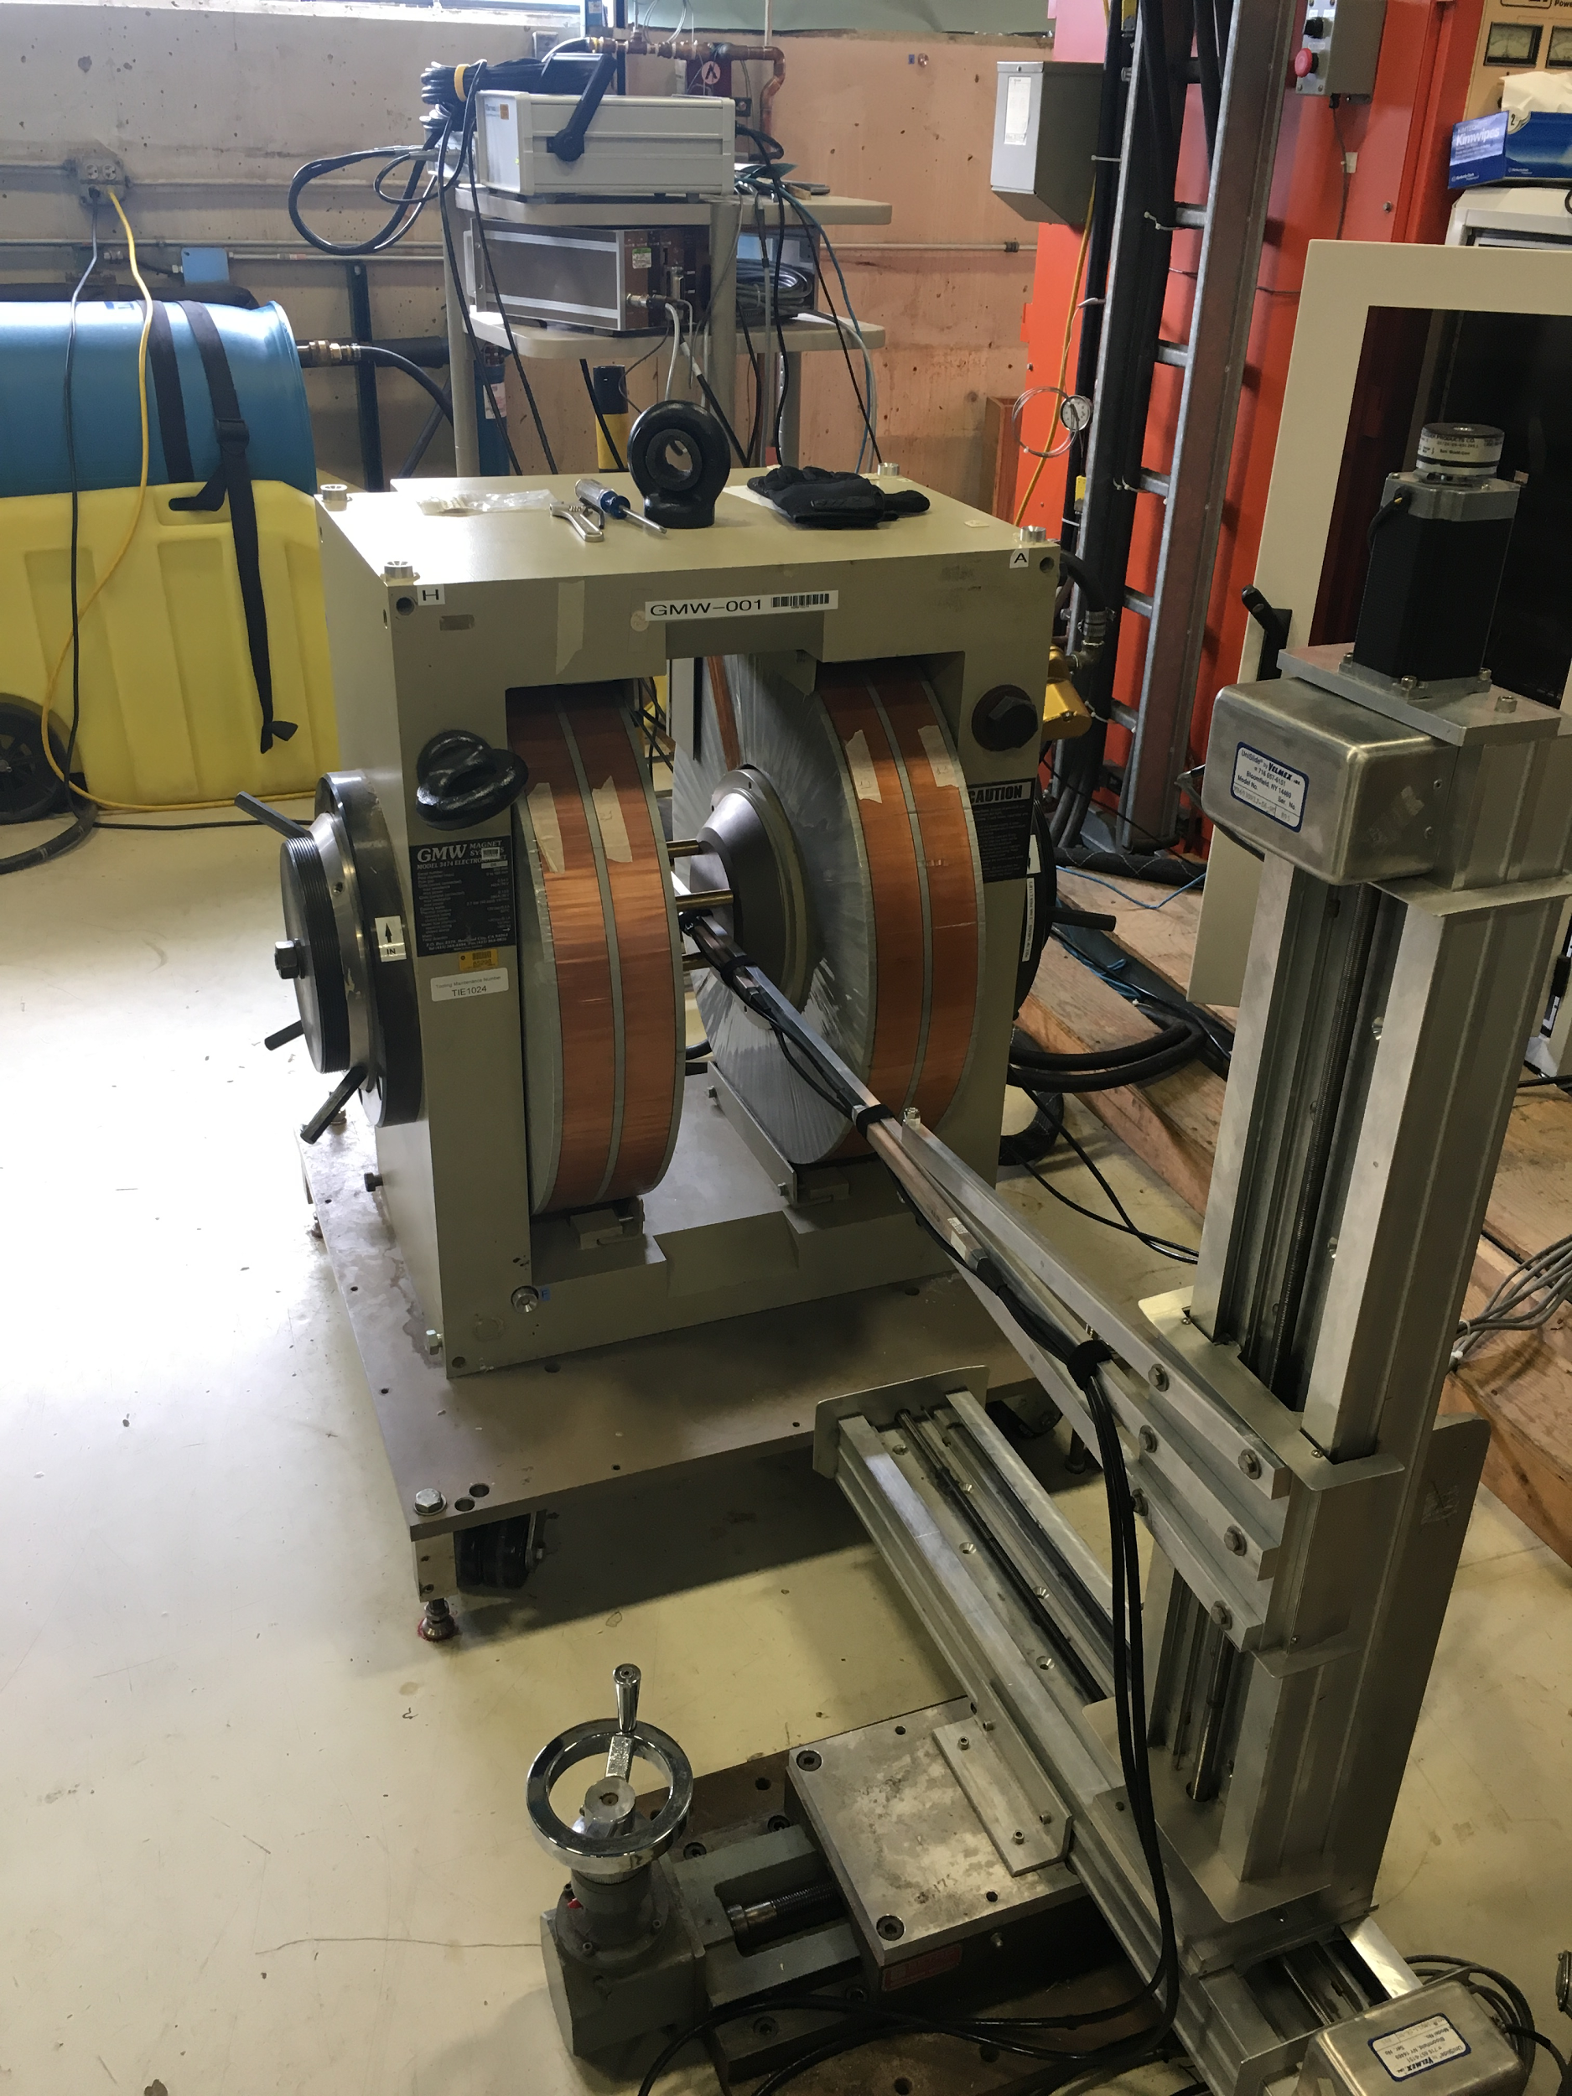
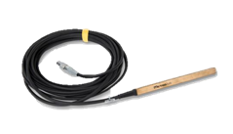
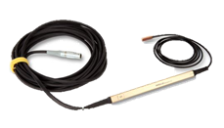
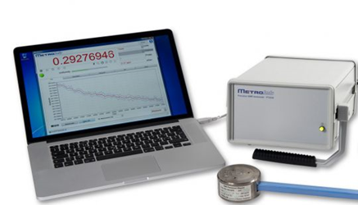
Probe 1: 0.26-0.78 T
Probe 2: 0.78-2.1T
Metrolab PT2026
Notes:
Calibration Magnet and Power Supply
Graphic of magnet and Graphic of Power Supply
Model and Make
Choice justified based on expected Characteristics from Documentation
Choice of Power Supply
Cooling system Requirement and refer to what Emanuel Aldana’s presentation

Slide 6
Coil Nomenclature
3
4
Left Outer
2
Right Inner
1
Right Outer
Left Inner
Notes:
Shows different ways coils are referred to in our data

Slide 7
Arm Mechanics
-
+
Axis 1 (remote controlled)
X - axis
Negative Steps = Into Magnet
Positive Steps = Away From Magnet
Axis 2 (remote controlled)
Y - axis
Negative Steps = Down
Positive Steps = Up
Axis 3 (hand crank)
Z-axis
Axis 2 (Y)
Axis 1 (X)
+
+
Axis 3 (Z)
-
-

Slide 8
Search of the required region
Identify the regions in which the magnetic field is measurable by the NMR at an approximately central layer
The layers along the z-axis in which B is measurable
The area in which the B is measurable in each layer
Identify the change in the dimensions of the region with increasing magnetic field
Identify the current needed for the desired magnetic field intensity of 1 T to 1.4 T

Slide 9
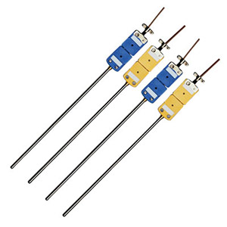
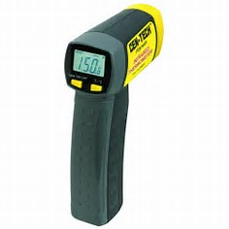
Stability of the Magnetic field
Depends on the stability of the current
Current stability depends on stability coil temperature
This depends on the ability to cool and warm the coils to maintain at a constant temperature
How are they measured
The temperature of the cooing system is measured using thermocouples and will be controlled using PLCs
The temperature of the coils is measured using an infrared thermometer with a laser pointing deice
The current is measured using the voltage of a transducer

Slide 10
Field Region Search Measurements
The field map were measured by increasing current in the central layer: 43 A ➔ 75 A➔ 107 A ➔ 126 A ➔ 136 A
The extent of the available region along z-axis was measured at 107 A
➔ 94 mm to 113 mm positions along z-axis
Temperature and transducer voltage were kept track of during these measurements

Slide 11
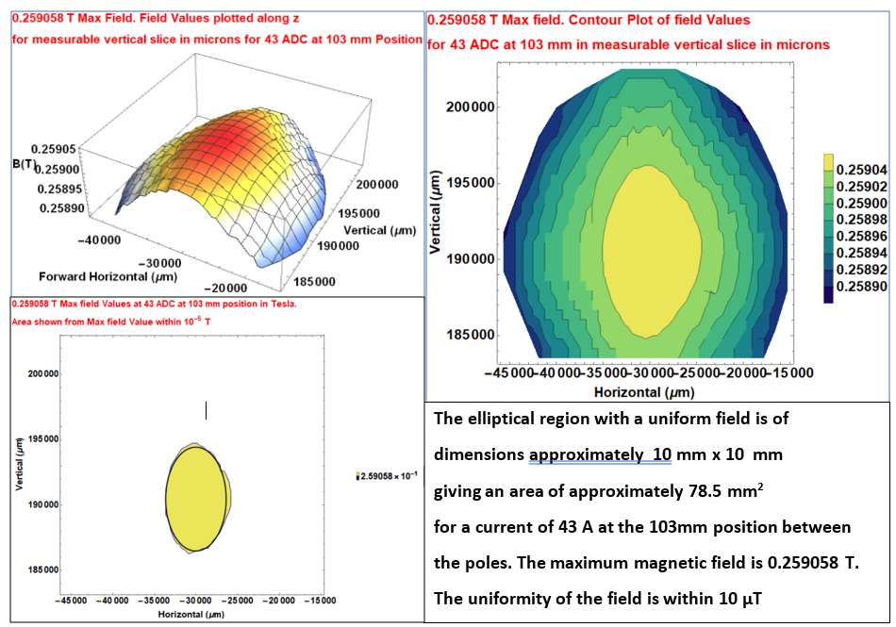

Slide 12
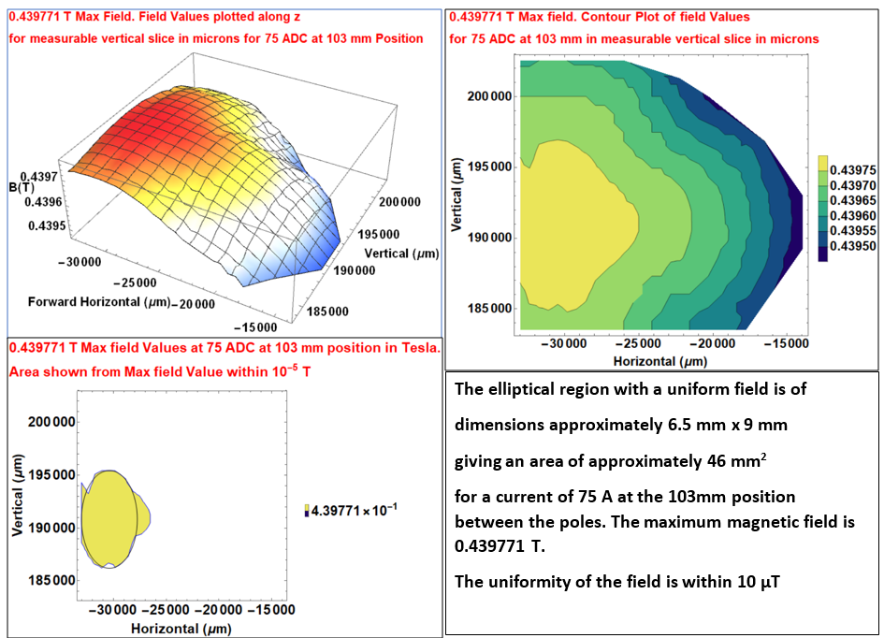

Slide 13
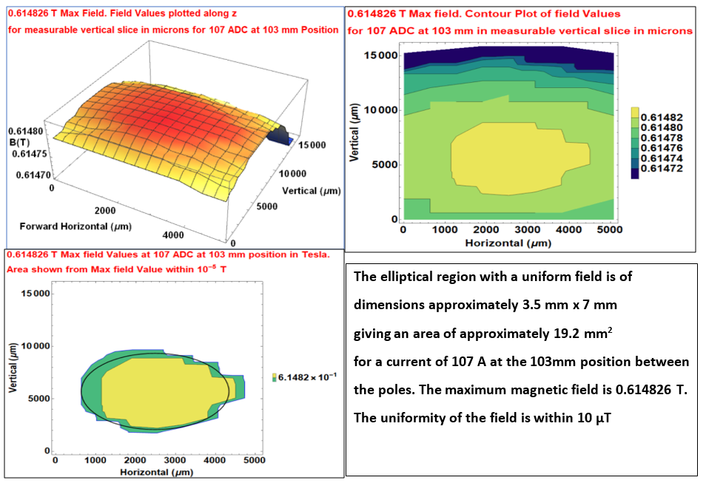

Slide 14
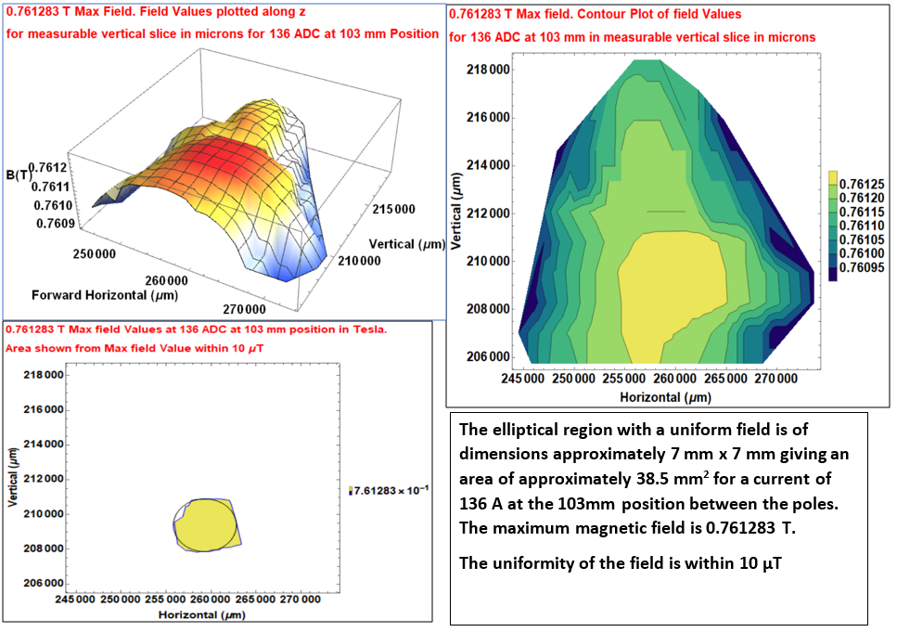

Slide 15
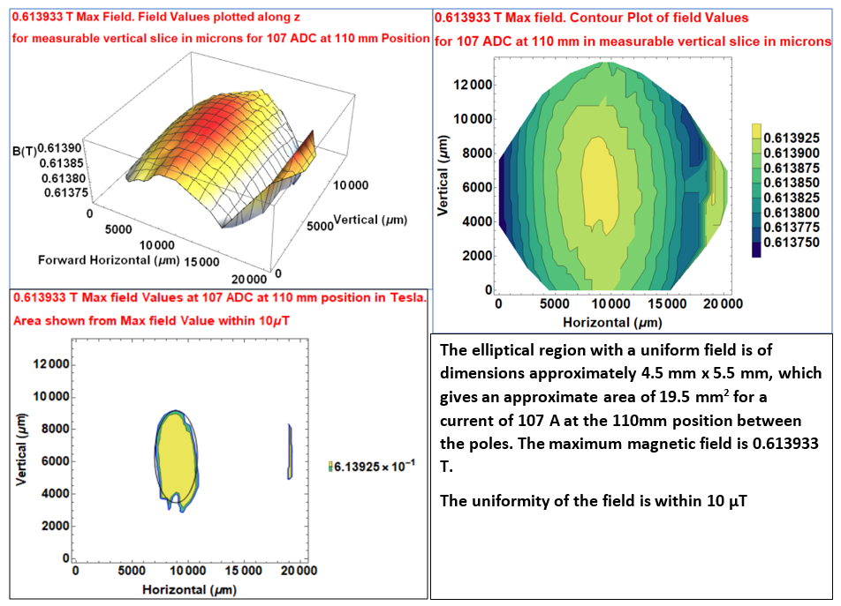

Slide 17
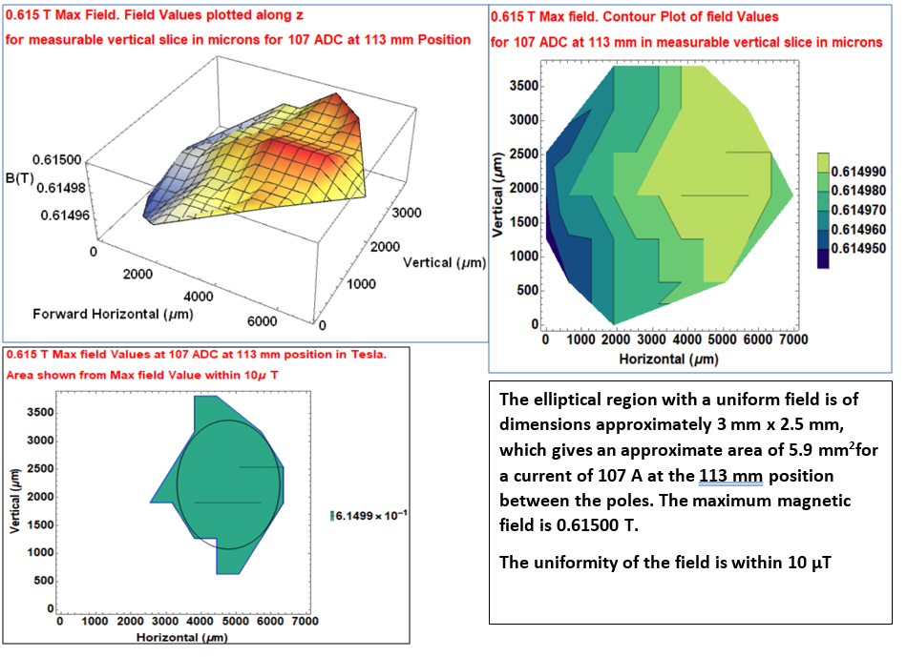

Slide 18
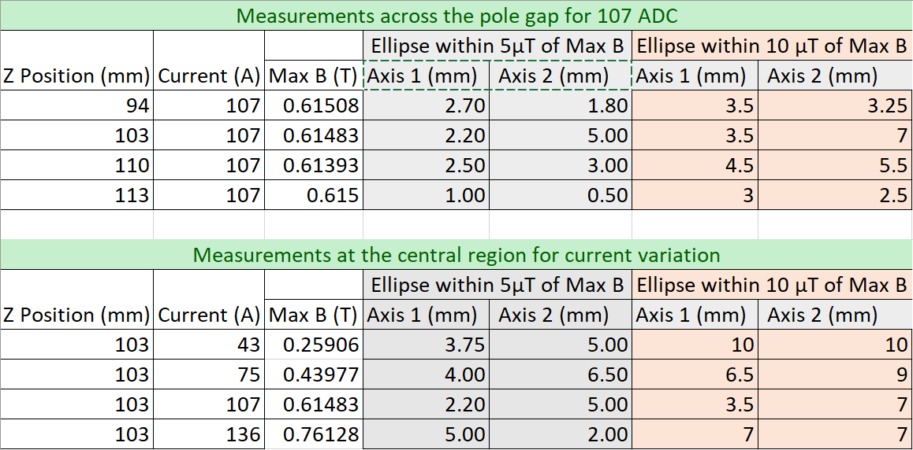

Slide 19
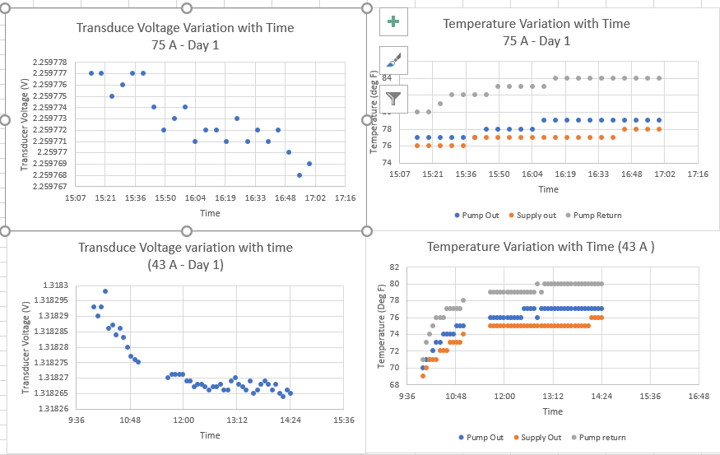

Slide 20
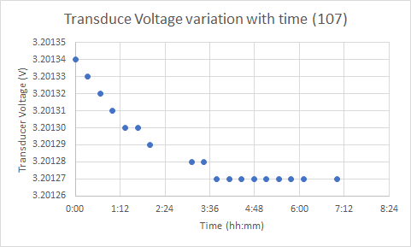
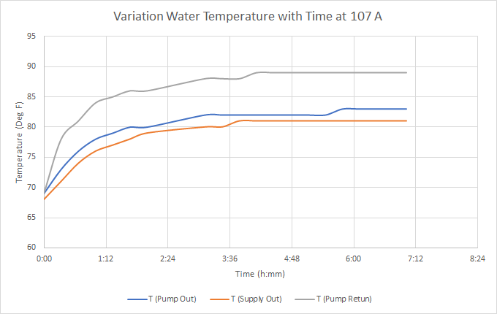

Slide 23
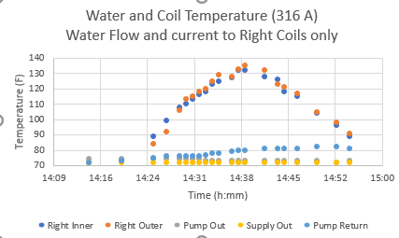

Slide 24
Key Decisions Made
Choose a field of 0.7 T to map
Focus on quality of the field using the NMR signal
Investigate also the region within 10microTesla from max value
Continue working on temperature stability and automation

Slide 25
NMR Signal Characterization
Red
Yellow
Green
Two or more distinct peaks
One peak with signs of another
One strong distinct peak

Slide 26
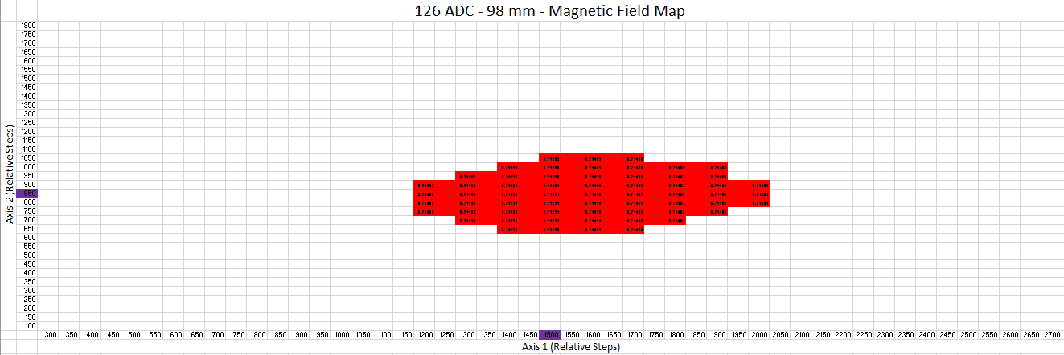
Z-Axis
Current
Y-Axis
X-Axis

Slide 27
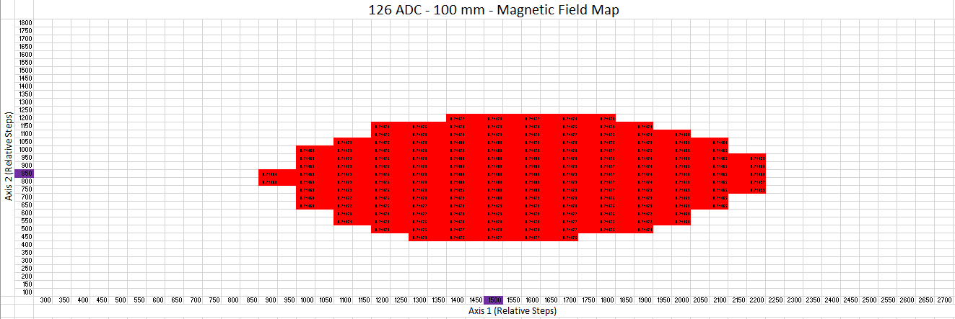

Slide 29
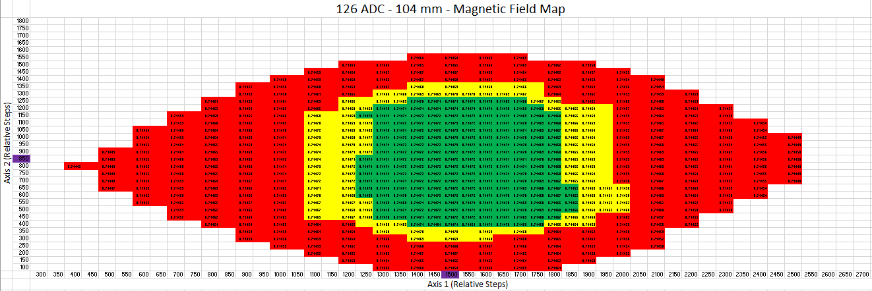
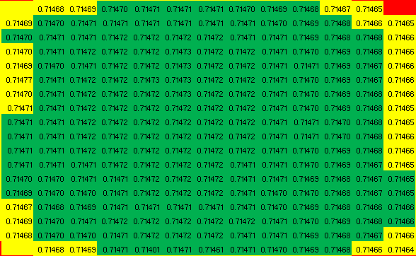
Single Peak Region
Axis 1: 550 steps
Axis 2: 750 steps
Area: 412,500 sq. steps
Notes:
6985 microns x 9525 microns
Single Peak region - good region <10-5 variation

Slide 30
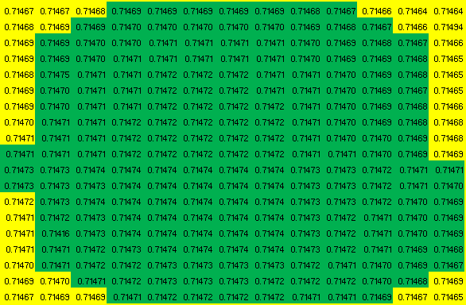
Single Peak Region
Axis 1: 550 steps
Axis 2: 750 steps
Area: 412,500 sq. steps
Notes:
6985 microns x 9525 microns

Slide 31
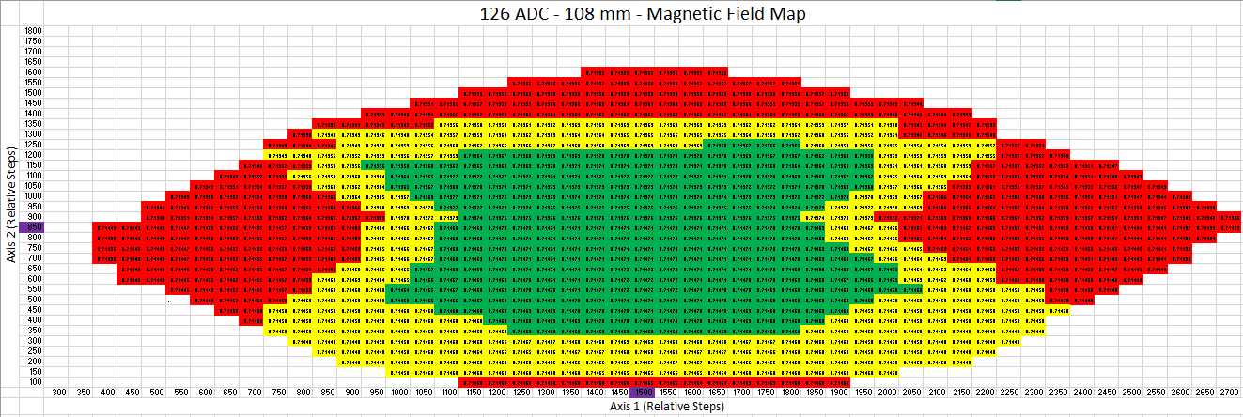
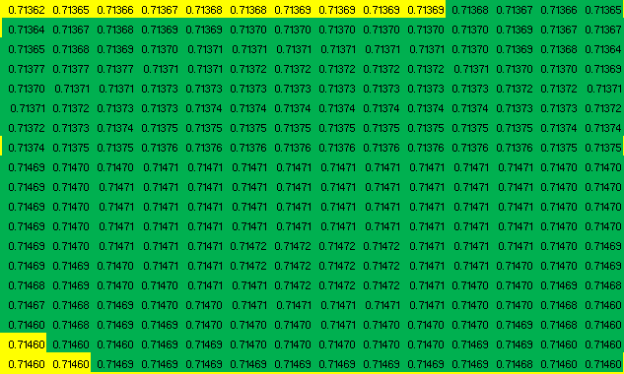
Single Peak Region
Axis 1: 700 steps
Axis 2: 800 steps
Area: 560,000 sq. steps
Notes:
8890 microns x 10160 microns

Slide 32
There is a sudden jump to the double peak region. It is possible that the measuring tape based measurement of z-distance was more than what was it was supposed to be (2mm) since the tape had some play. This was the first map. After the second map we used the head-scale on the clamp using the measured least count of the head scale instead of measurements using a measuring tape
Notes:
At this point… heard back from company that magnet should not overheat at 2__ ??, so we decided to try 250 ADC and monitor temperature
Maybe 1mm error on Z

Slide 33
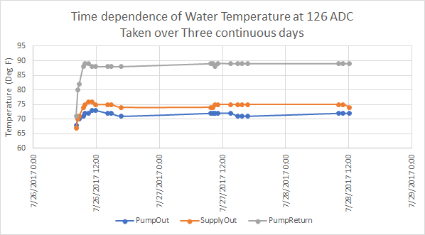
Notes:
Continues three day

Slide 34
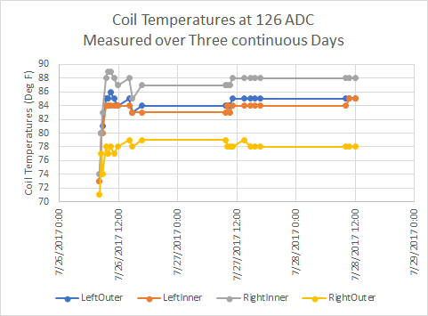
Notes:
How did you measure - temperature gun, long distance

Slide 35
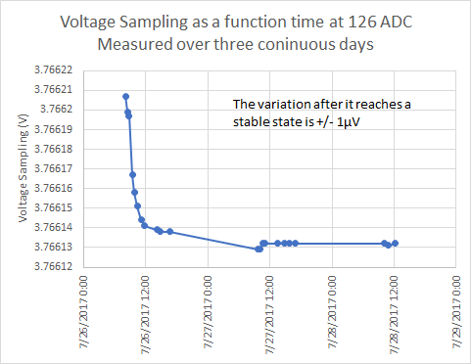
Notes:
Power Supply current as measured with the transducer

Slide 36
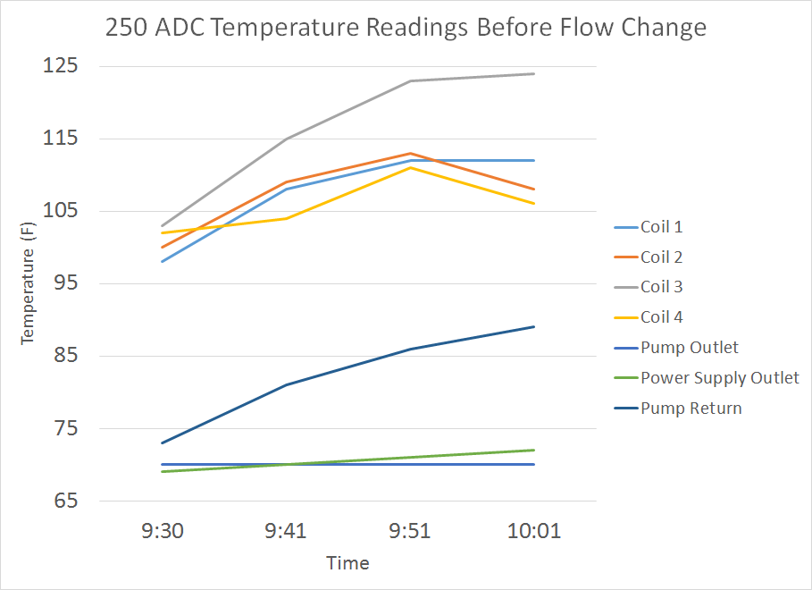
Overheated!
Notes:
Took about 30 min to overheat
First was flowing from left to right - distance between temperature gun and coils, not exact for coils
Changed to a parallel flow so the same amount of water flowed to both sides of magnet

Slide 37
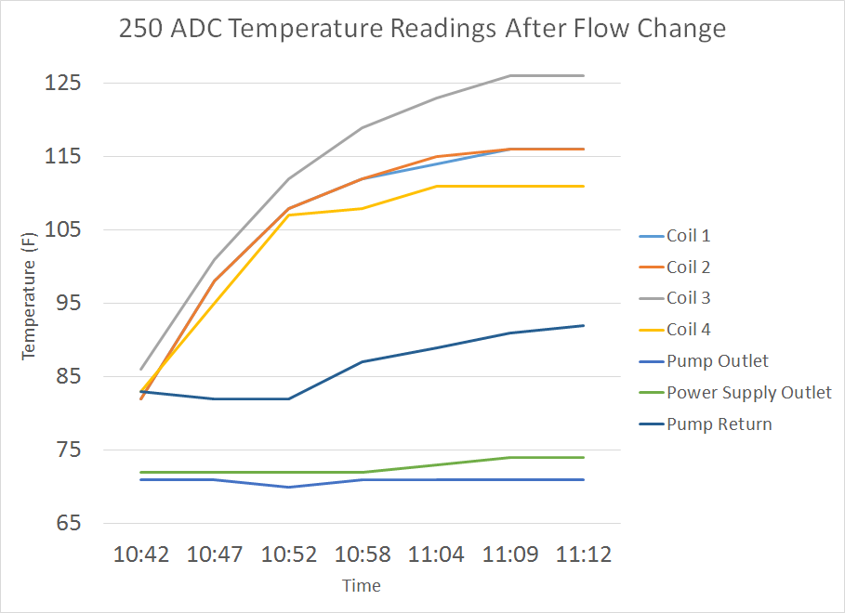
Overheated!
Notes:
After flow change, magnet still overheated after about 30 min
250 ADC wasn’t working, let’s try 200 ADC

Slide 38
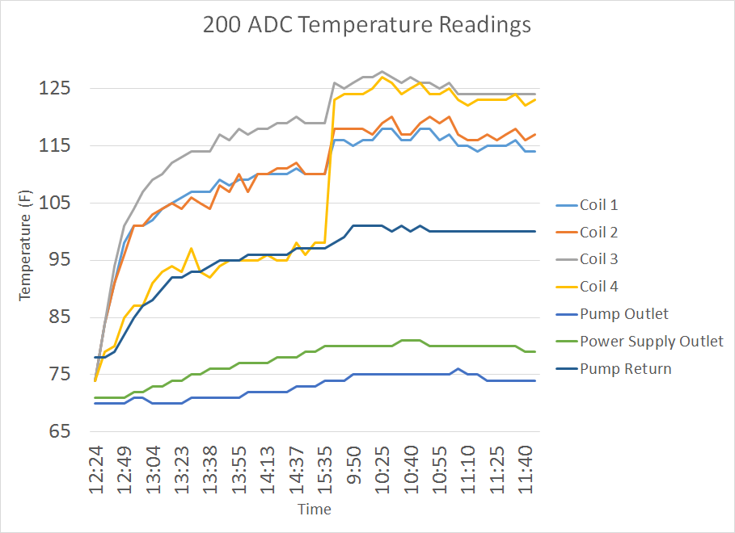
Taken over 2 days
Coil temps jump due to reading too far away with gun
Takes ~1 day to stabilize
Notes:
200 ADC didn’t overheat over the course of 2 days
Mention the fact that we were measuring coil temps in an inaccurate way, so that may explain the strange jumping around of temps (especially on the 4th coil)
Coil 3 and 4 get water first, so it’s strange they read a higher temp

Slide 39
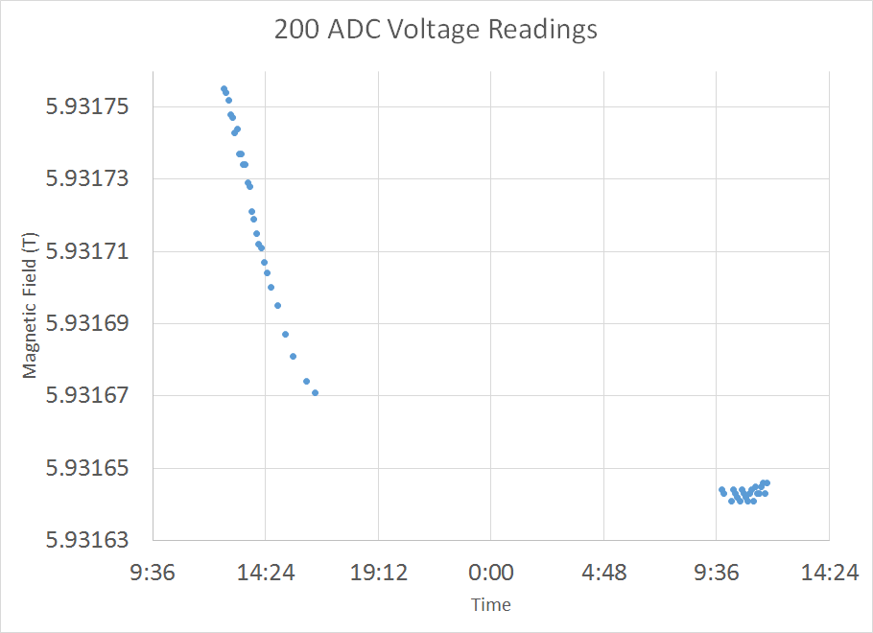
Taken over 2 days
Sharp drop during day 1
Takes ~1 day to stabilize
Notes:
Monitoring voltage over two days showed that it needs about 1 day to stabilize

Slide 40
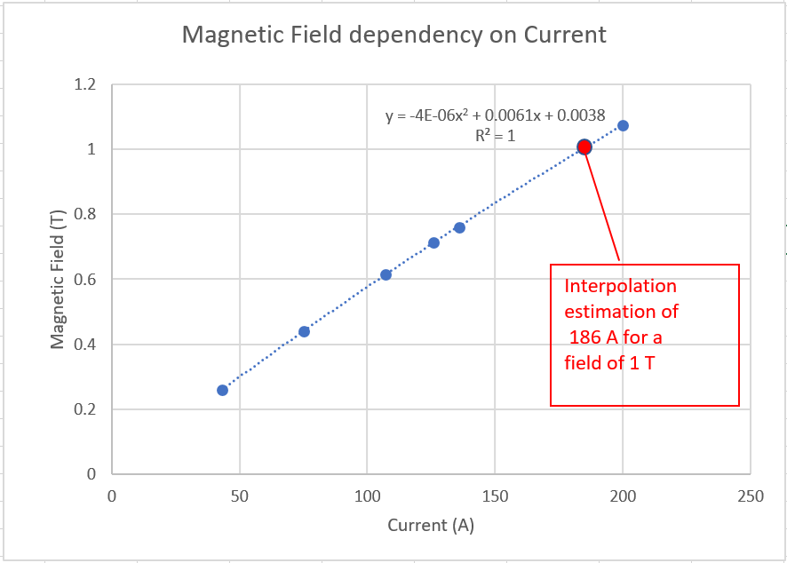

Slide 41
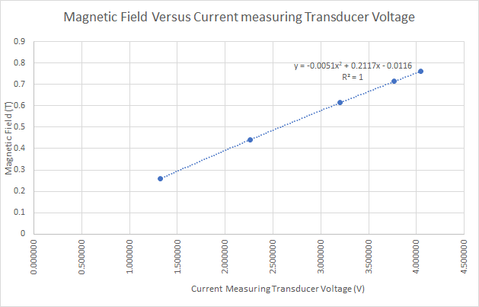
Notes:
Sampling is calle dtransducer voltage refers to current

Slide 42
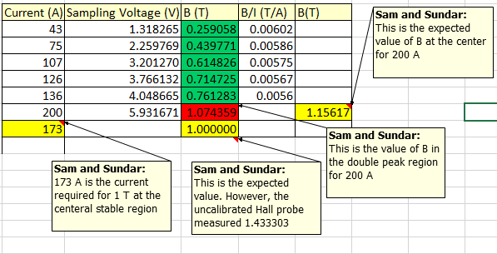
Notes:
Sampling is calle dtransducer voltage refers to current

Slide 43
Conclusions
126 ADC gives a stable mag field of 0.71470 T +/-0.00004 T
Single peak region ~550 x 750 - 700 x 800 steps on X/Y
~4 mm along Z
200 ADC gives us 1.07 T
Too early to see what the field map looks like
If 200 ADC may have less stable region than at 126 ADC
Lower field will give bigger map
About 180 ADC may be just about sufficient to get 1 T
Smaller gap will help to increase volume too
Magnet takes ~1 day to fully stabilize
This could be improved by improving the temperature controlling water circuit
If the data collection is automated more layers of data may be collected more efficiently and enable us to get a point cloud of uniform and stable magnetic field region

Slide 44
Educational Takeaways
Expanding the current plan of a Saturday club to introduce electronics, Arduinos, and RaspberryPis to also learning about PLCs. Funding will be sought during the coming year to implement this by the next academic year
I have already sent the interest form to the students for
Quantum Computing Club
Quarknet
If the QuarkNet initiative takes off well, I will enroll in the training to obtain the cosmic ray detector
Will provide feedback on my level of success in the quantum computing club to the TRAC members through Harry
Organize a telecon with Amanda Whaley for students working on cosmology research

Slide 45
Thank You
Sandor Feher
Thomas Strauss
Samantha Lederman
Emmanuel Aldana
All other TRAC participants Amanda, Joanne, Petar, Lucas, and Jeffrey
Most Importantly Harry Cheung

