Slide 1
Proton Source Week 5
Joe Compton
9am Meeting
8/11/2017

Slide 2
RIL/Linac
RIL
Restarted Source A after cleaning and gas valve repair
Running with extractor on
Testing new PS resiliency to sparking
Upgraded Source B heater PS chassis
Provide more accurate heater amperage readbacks
Linac
Electricians continue to install infrastructure for the Marx Modulator at LRF2
P1 Marx is being installed at LRF5
HE general maintenance
General maintenance

Slide 3
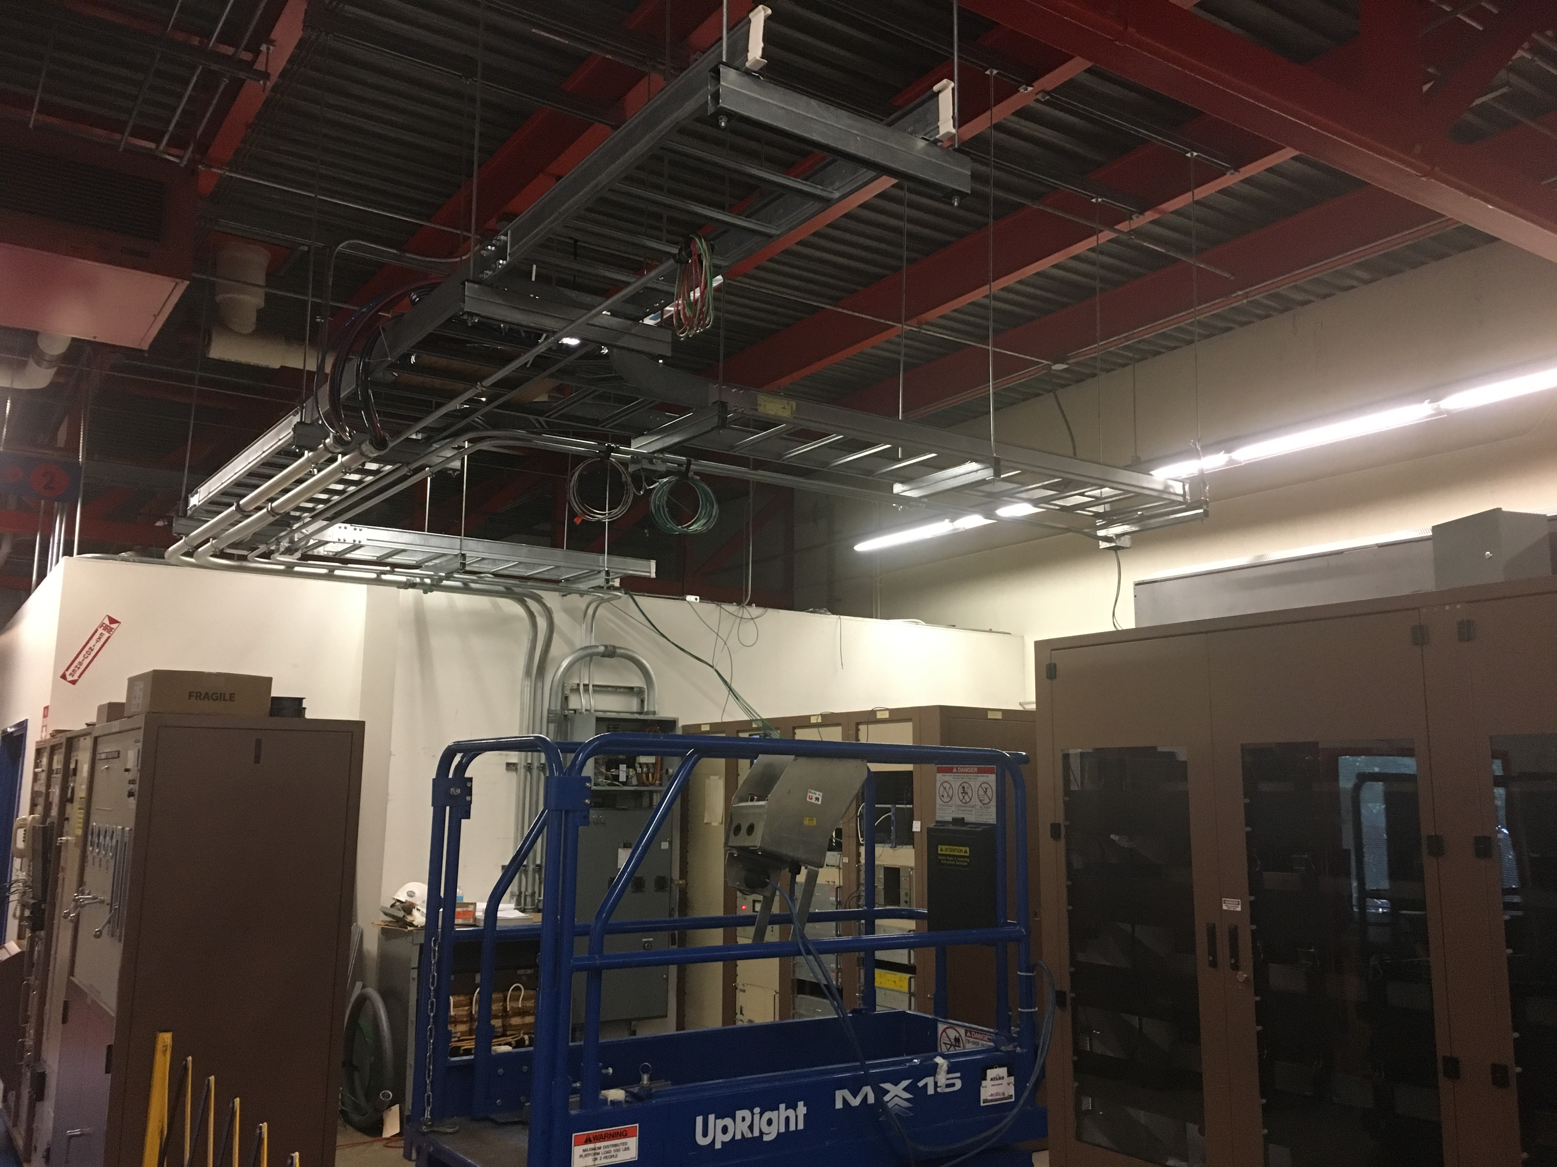
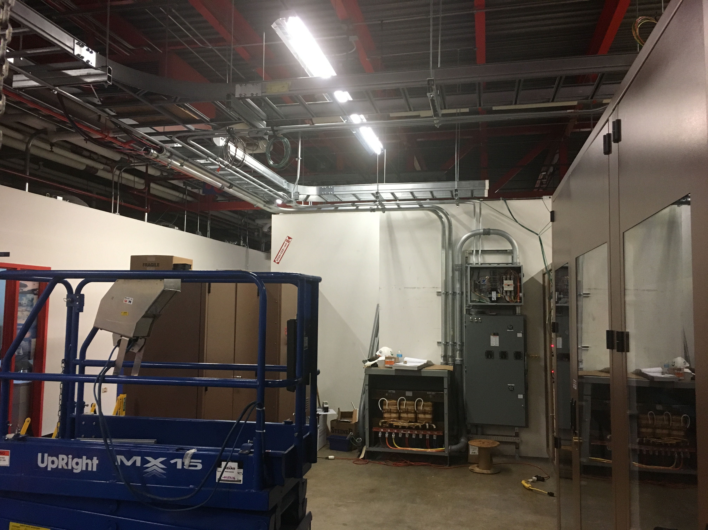
LRF2/LRF5
LRF2
LRF5

Slide 4
Booster
Cavity for BRF22 will be installed on Monday
Shielding tests for CHG0 torroid continues
Making tunnel electronics spare for CHG0
BRF22 PS room prep continues
Cable pulls for L11 perpendicular cavity today
Vacuum leak checking in progress
IP802 and IPRF22 replaced
IP61 and IP62 to be replaced next week
Work on vacuum electronics for new upstream IPRU20 & IPRF20 in progress
Kicker loads continue to be inspected/cleaned/repaired
General RF maintenance

