Slide 1
Overview of the HV System Connections Inside the NP04 Cryostat
Bo Yu
Sept. 26, 2017

Slide 2
Outline
Circuit diagrams of the system
More circuit diagrams
Component examples
Experimental features
Beam plug field shaping
Electron diverters
Summary

Slide 3
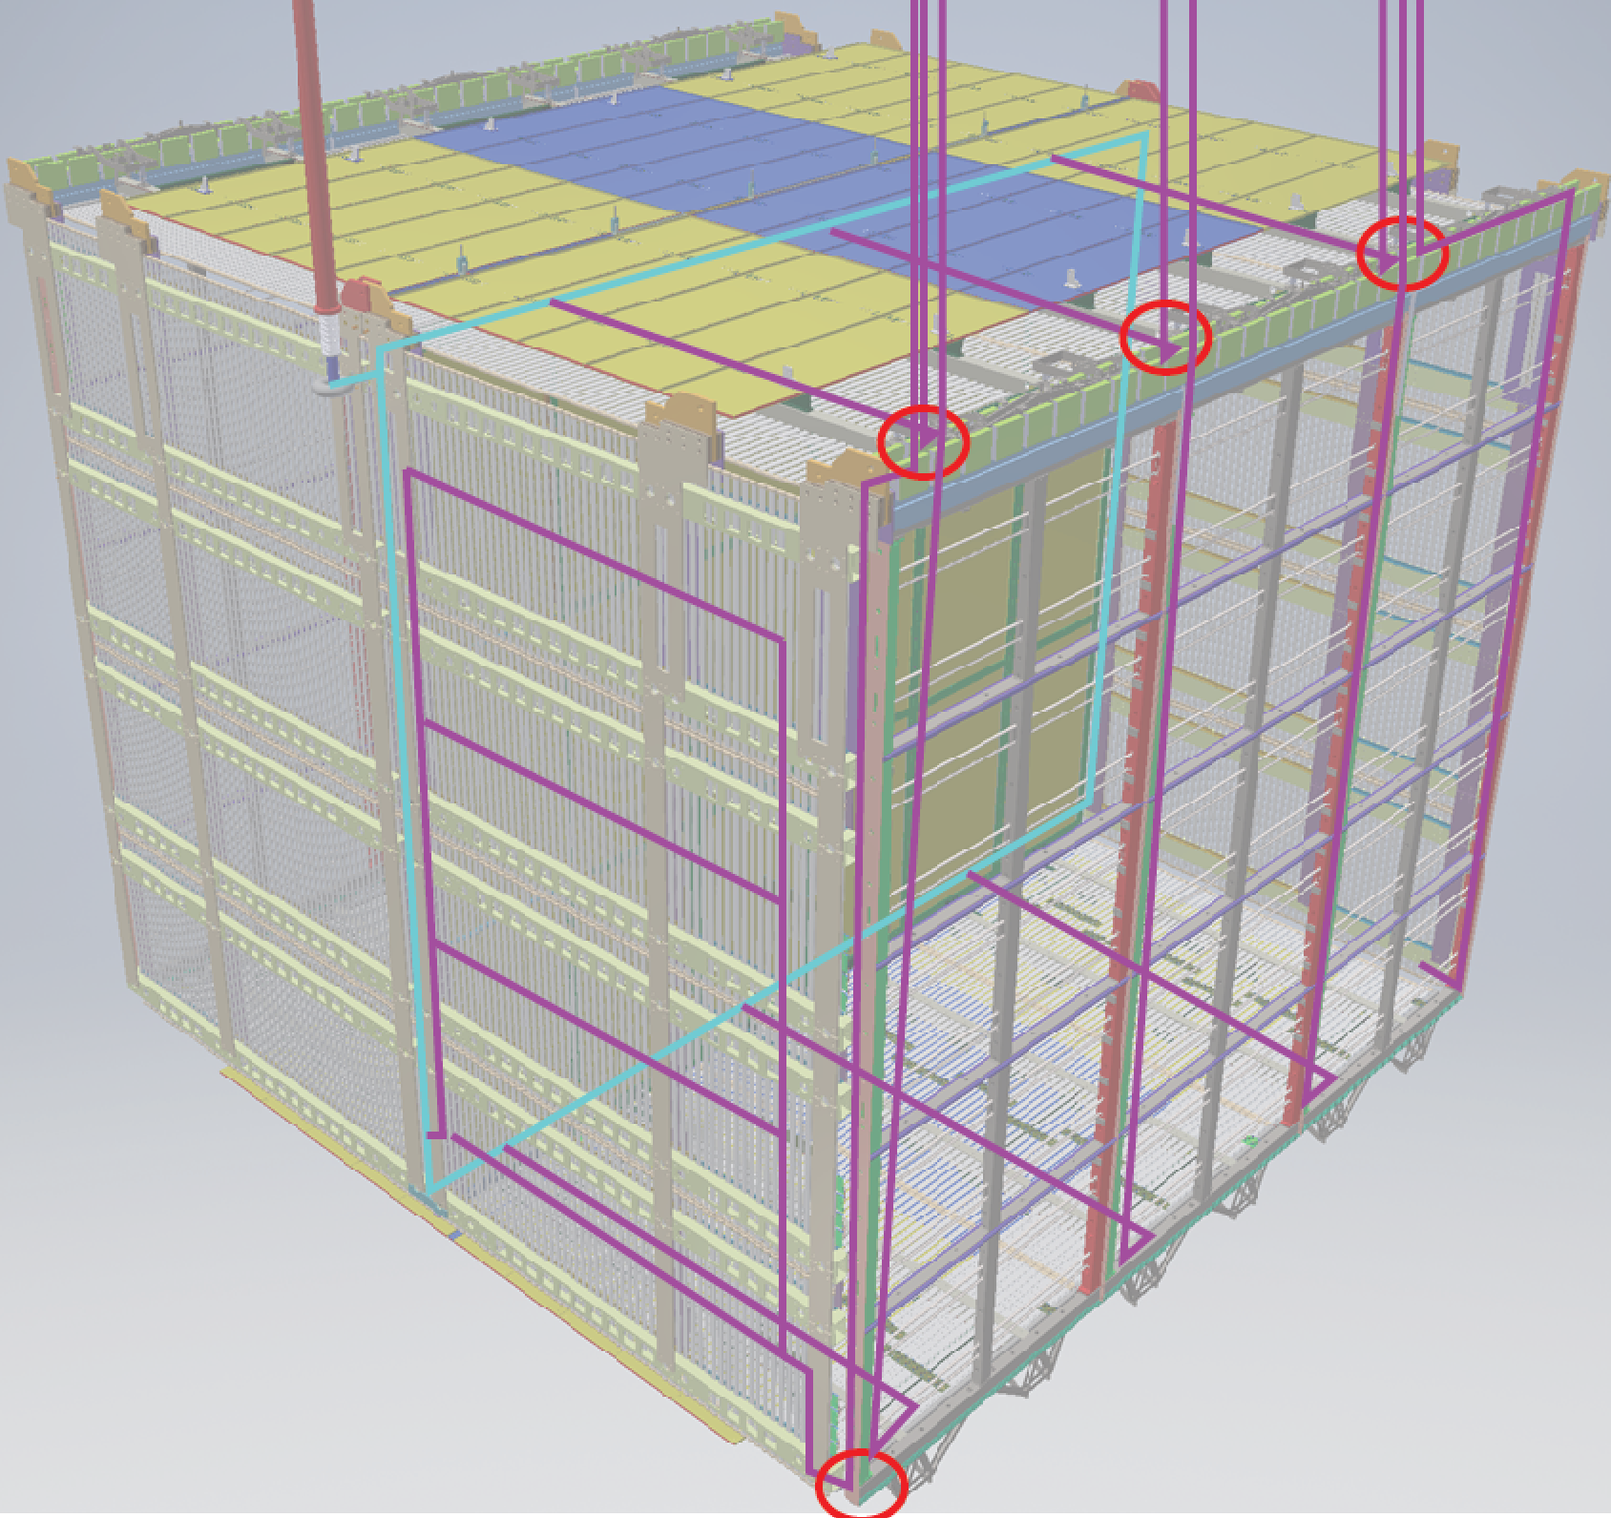
The NP04 TPC

Slide 4
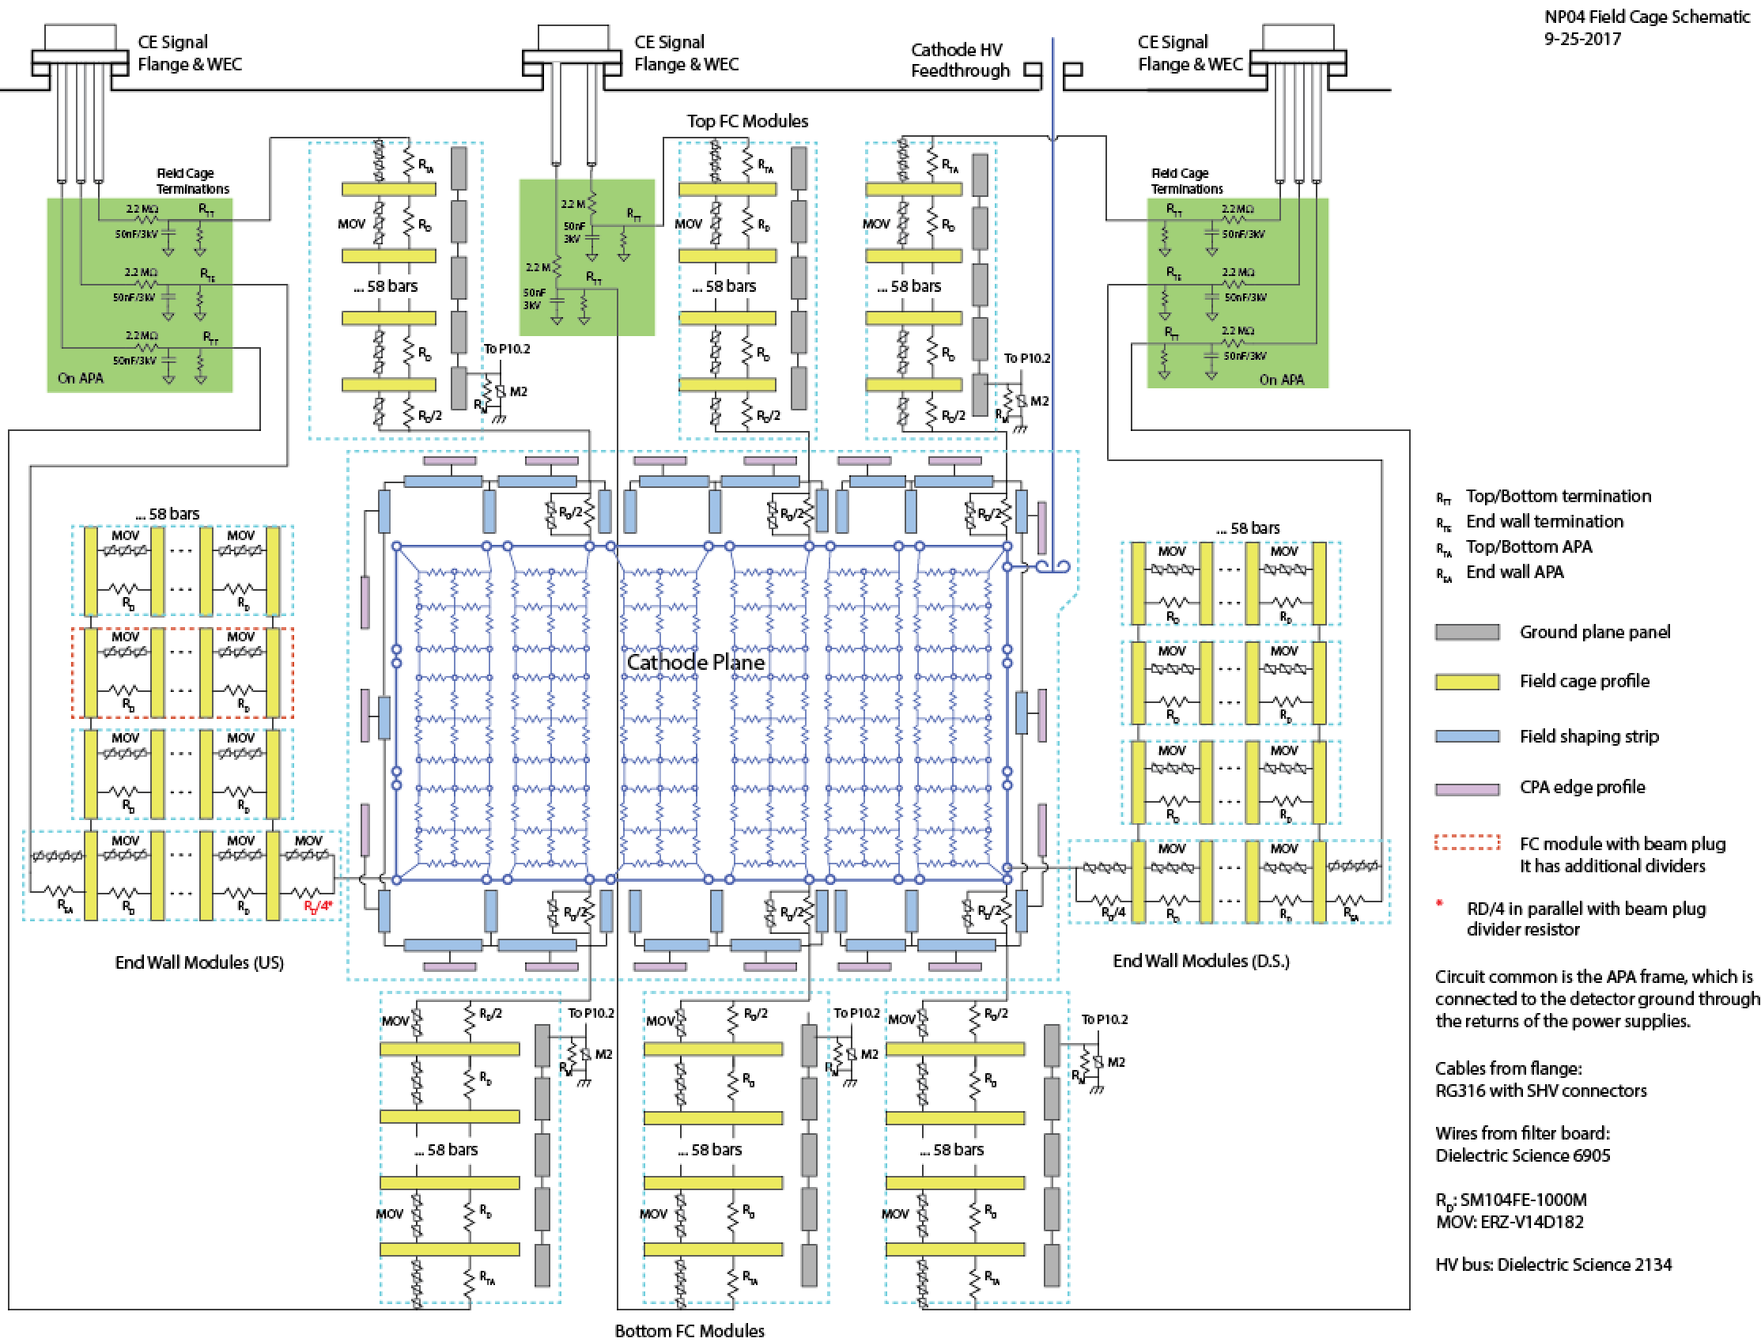
Overall Schematic Diagram

Slide 5
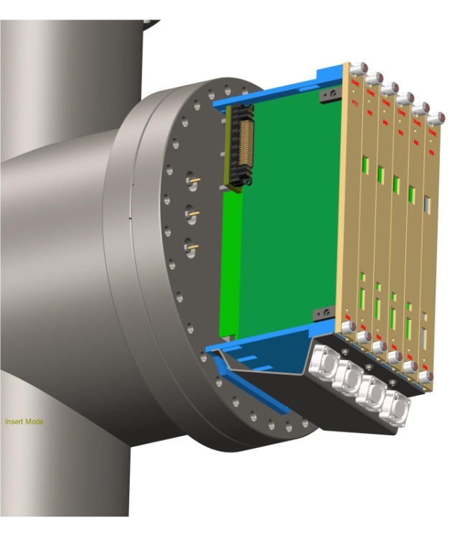
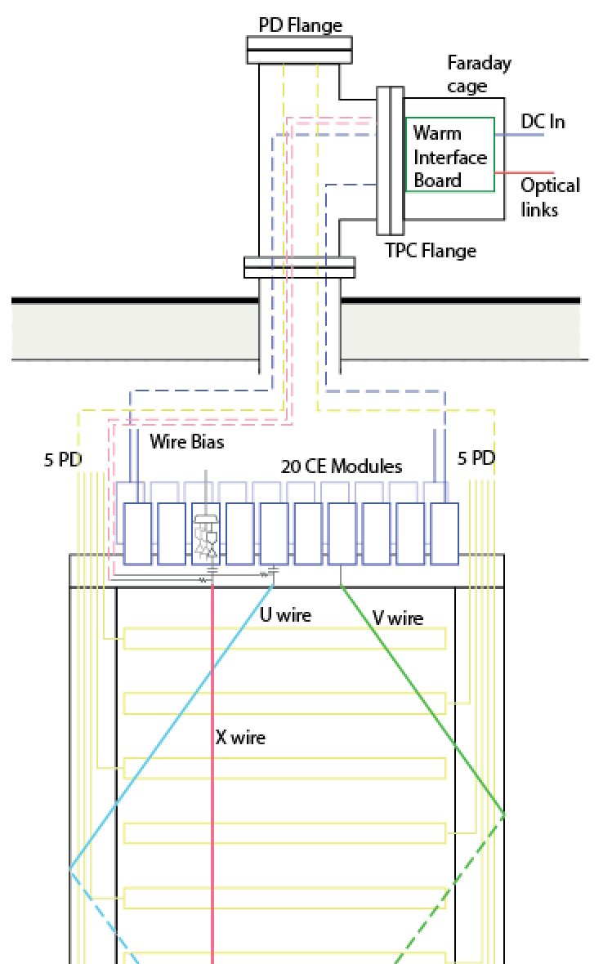
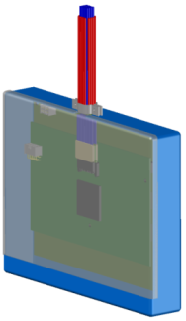
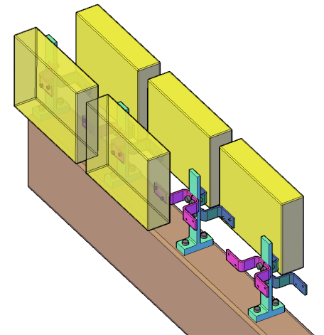
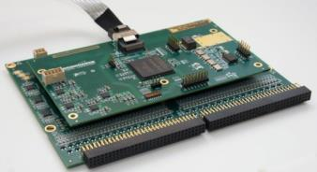
APA with Integrated Cold Electronics
Cold electronics module and its attachment to the APA frame

Slide 6
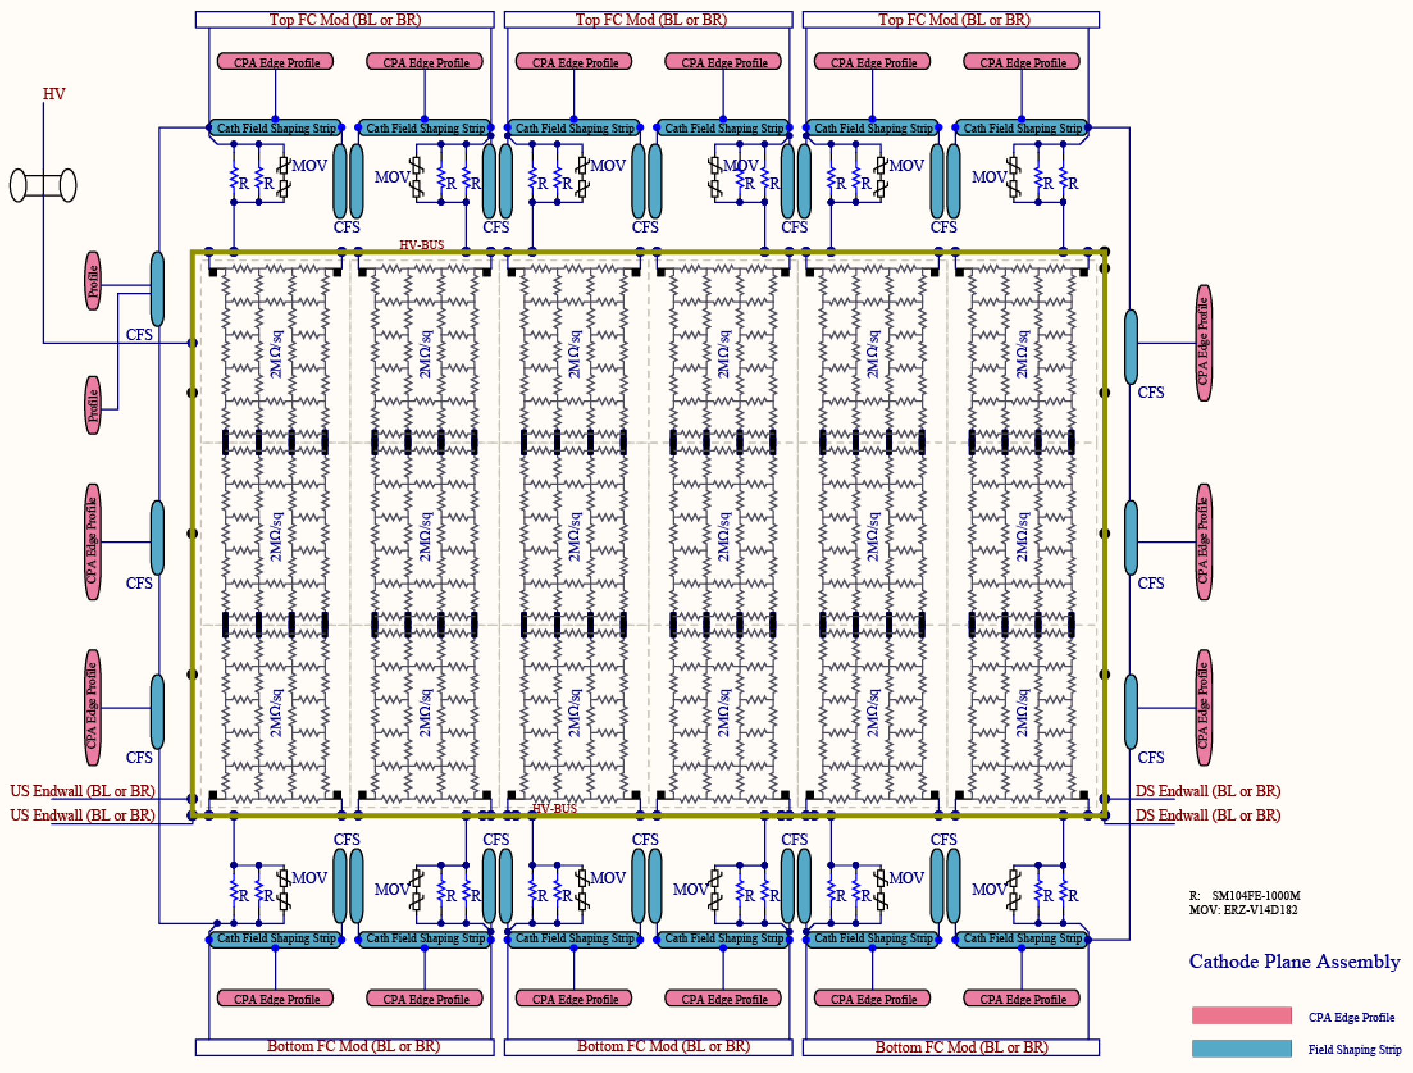
Schematic Diagram: the Cathode

Slide 7
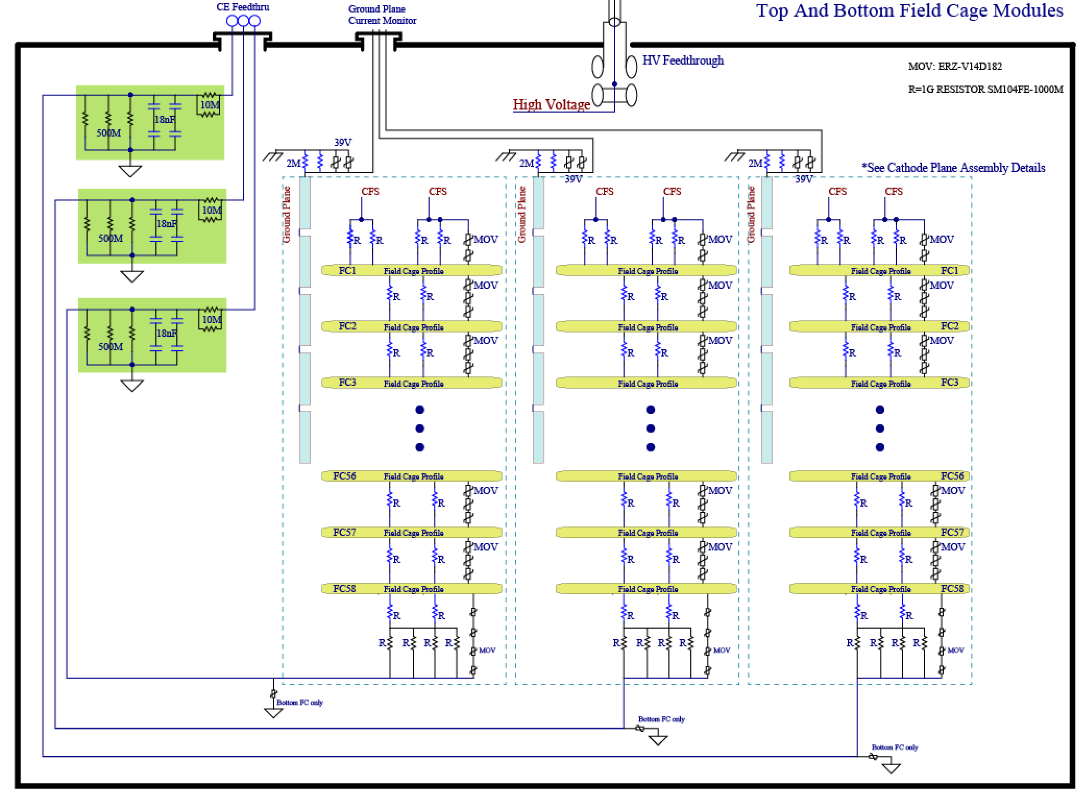
Schematic Diagram: the Top/Bottom Field Cage
All BR bottom FC modules use 5G resistors

Slide 8
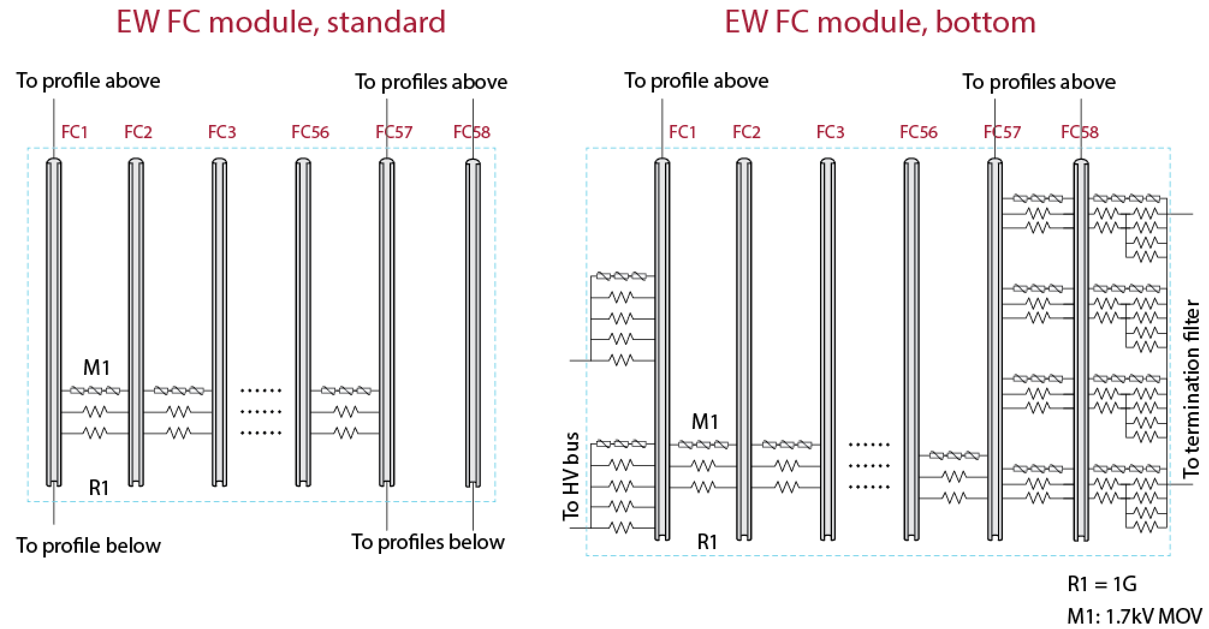
Schematic Diagram: Endwall FC Modules
“Standard”: all top 3 EW FC modules except the one with beam plug
R1 for all 4 BL.DS EW modules is 5G

Slide 9
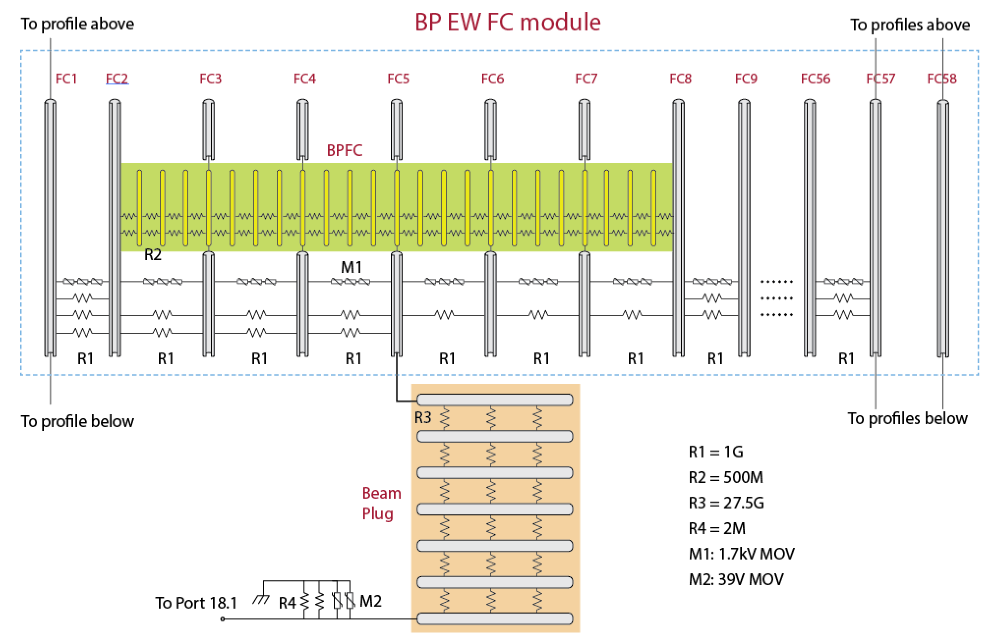
Schematic Diagram: EW FC with Beam Plug
On this EW assembly (BR.US), one of the 2 divider boards connecting to the CPA has one extra parallel R1.

Slide 10
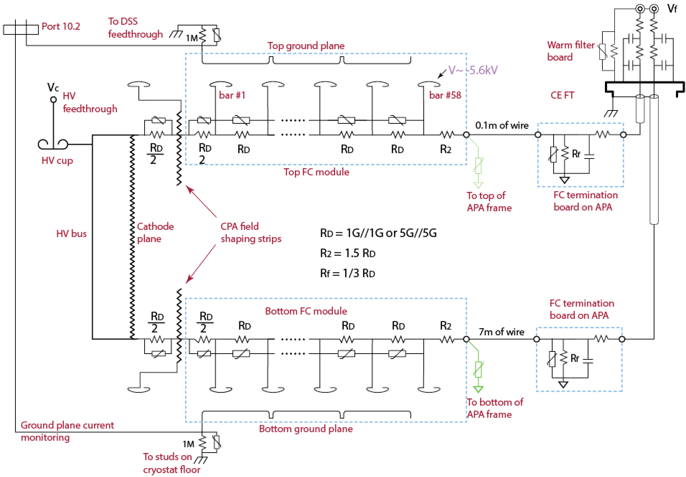
Terminating the T/B Divider Chain

Slide 11
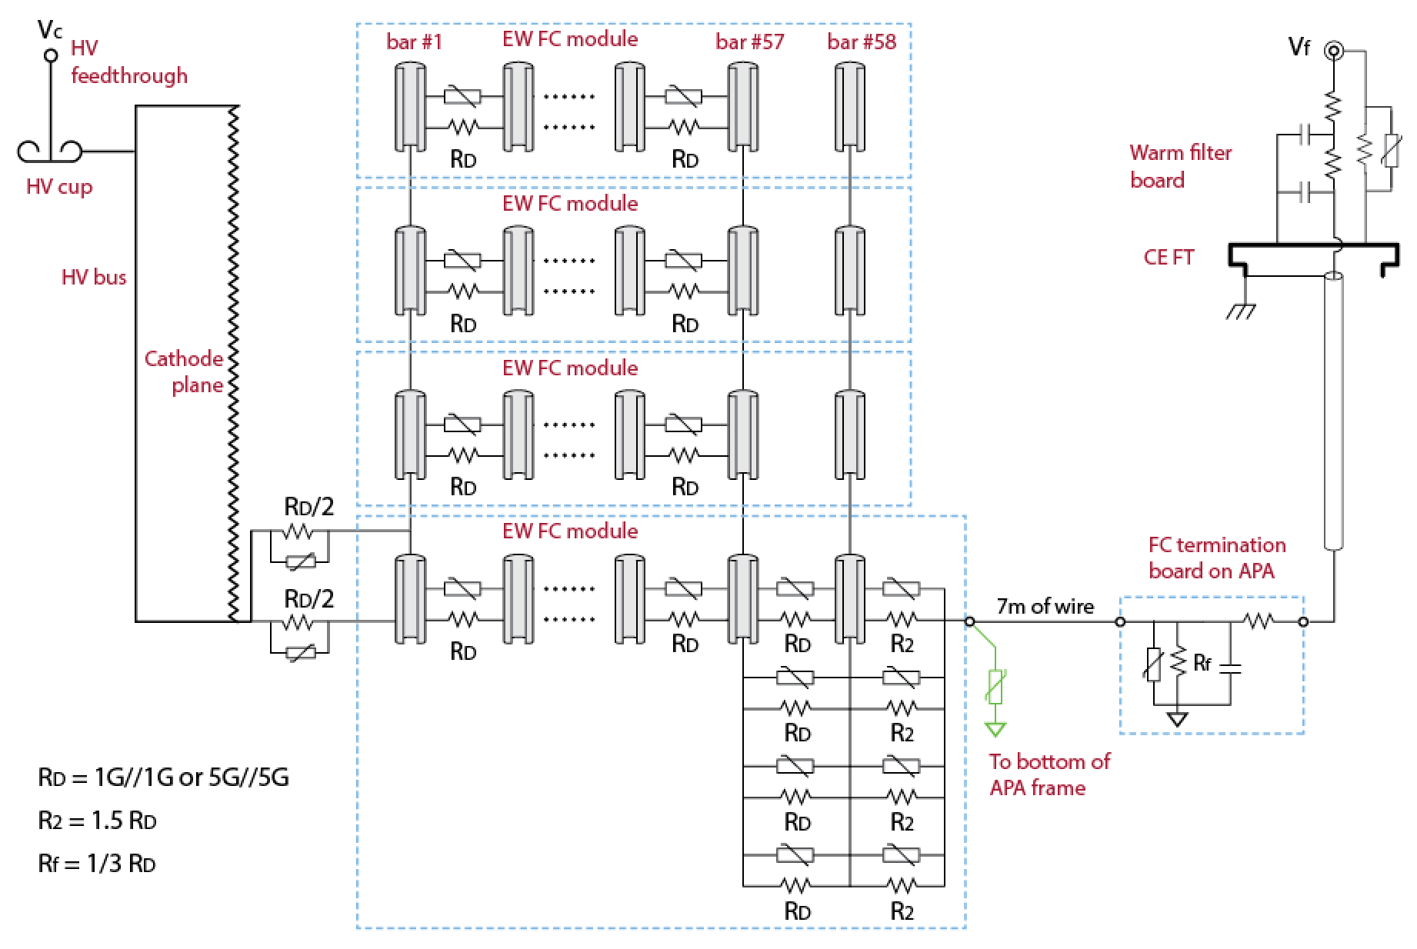
Terminating the EW Divider Chain

Slide 12
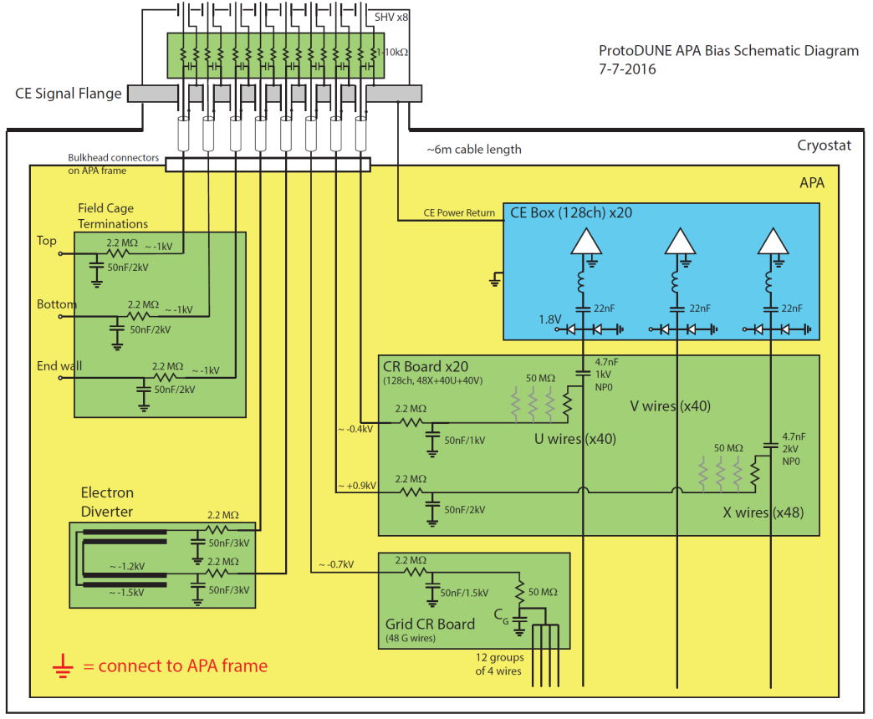
ProtoDUNE APA Bias Schematic Diagram
Up to 8 SHV connectors are on the CE feedthrough flange.
The cables (RG316) need to be terminated on the APA top end on a patch panel, with single ended wires reaching various connection points around the APA.
The filters for the field cage termination lines can be implements on a small PCB mounted on this patch panel.
Some of the RC values may have changed from this early diagram.

Slide 13
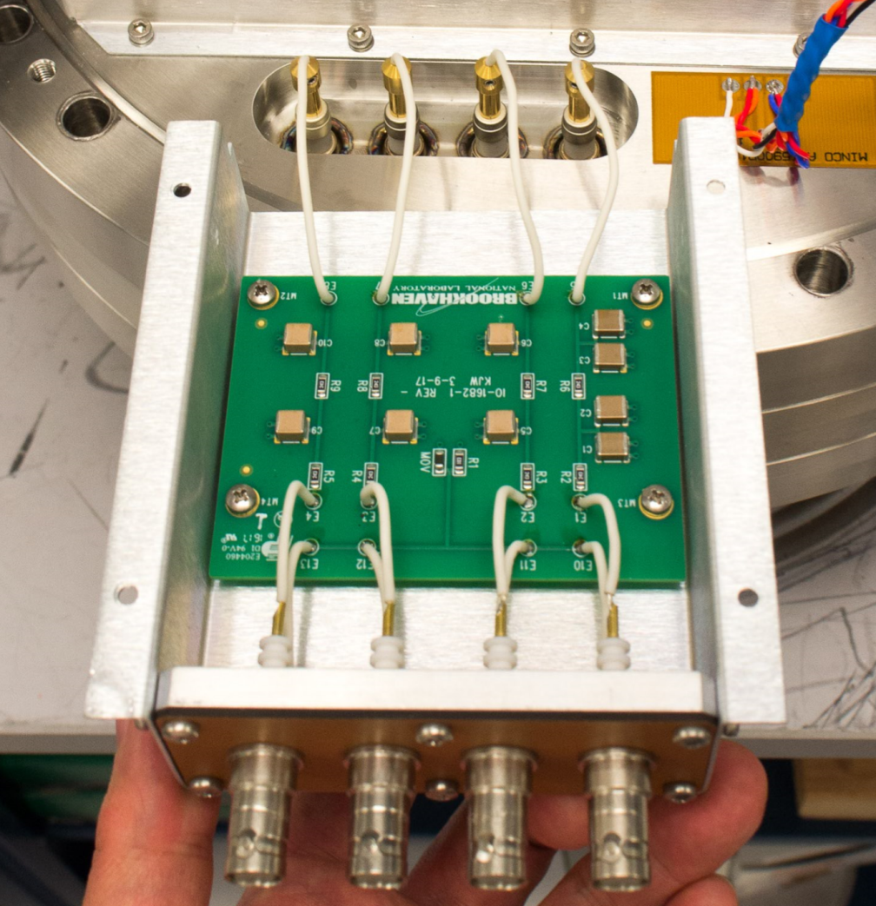
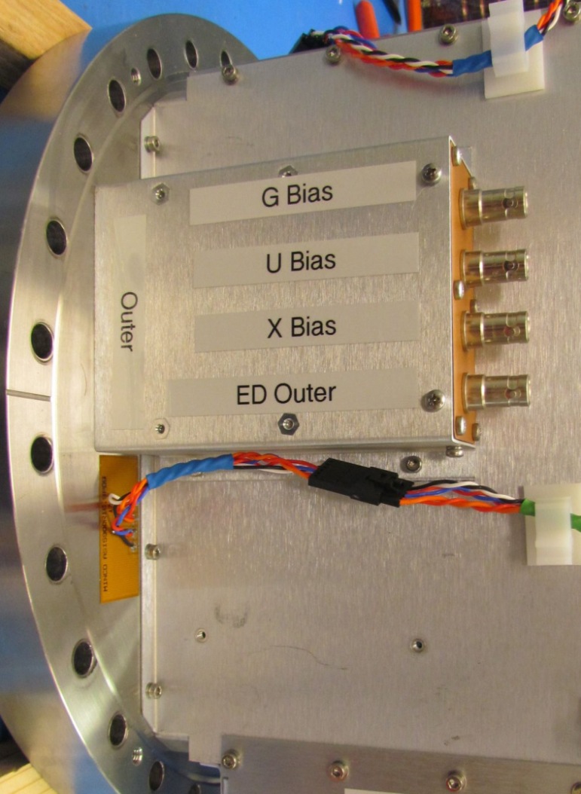
Bias Warm Filter Board
2 filter boards (8 ch. total) are mounted on the CE flange.
Linda and Terri are taking care of the power supplies and cables

Slide 14
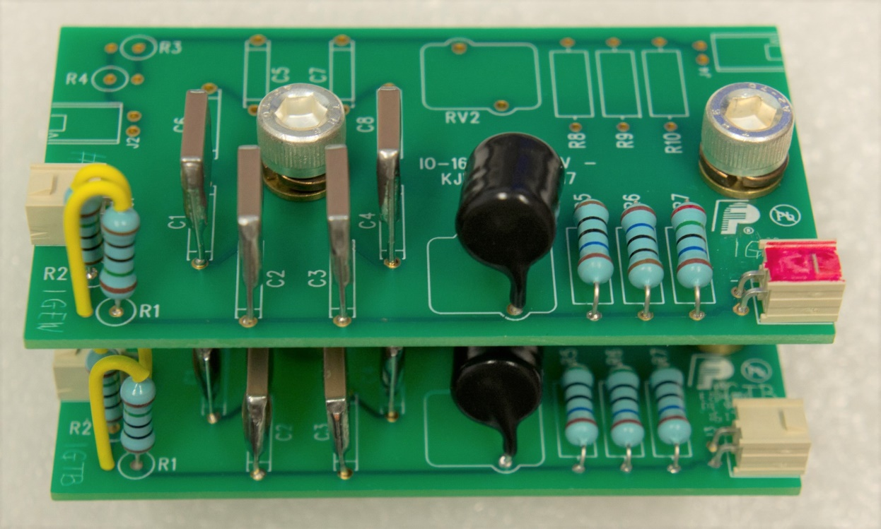
FC Termination Boards
Due to the fact that we are shorting the EW FC into a single channel, and we have 2 different field cage resistor values, we need to have 4 different termination resistance values for the TPC.
Flavor | Termination R | 3R configuration
1G Top/Bottom | 167M (1) | 500M//500M/500M
1G End Wall | 42M (x1/4) | 250M/100M/100M
5G Top/Bottom | 833M (x5) | 5G//2G//2G
5G End Wall | 208M (x5/4) | 1G/500M/500M

Slide 15
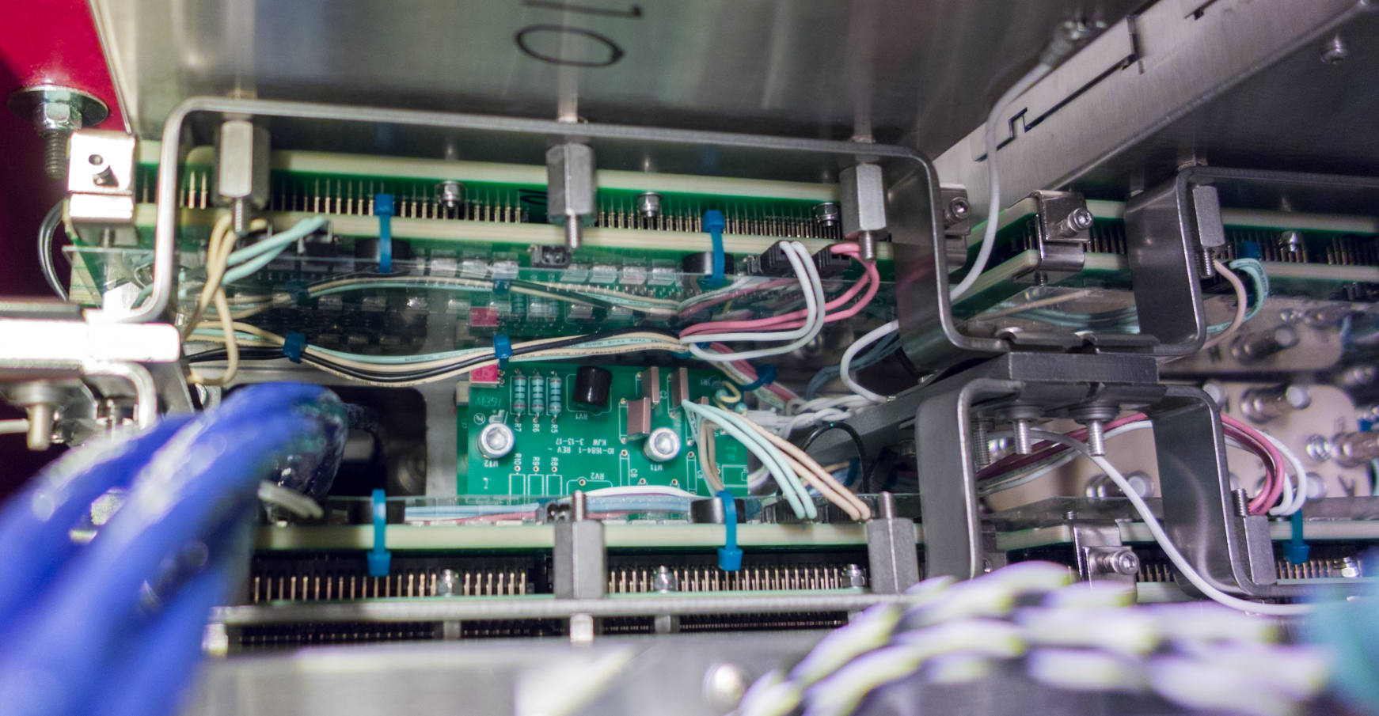
Locations of FC Termination Board
FC Termination Board (x2)
Bias SHV Connector Panel
Photo of a top corner of an APA

Slide 16
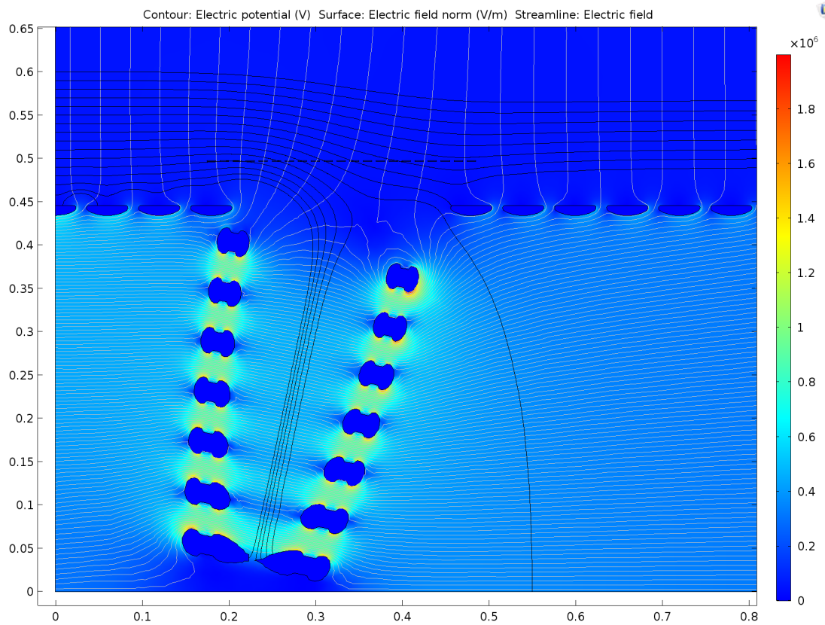
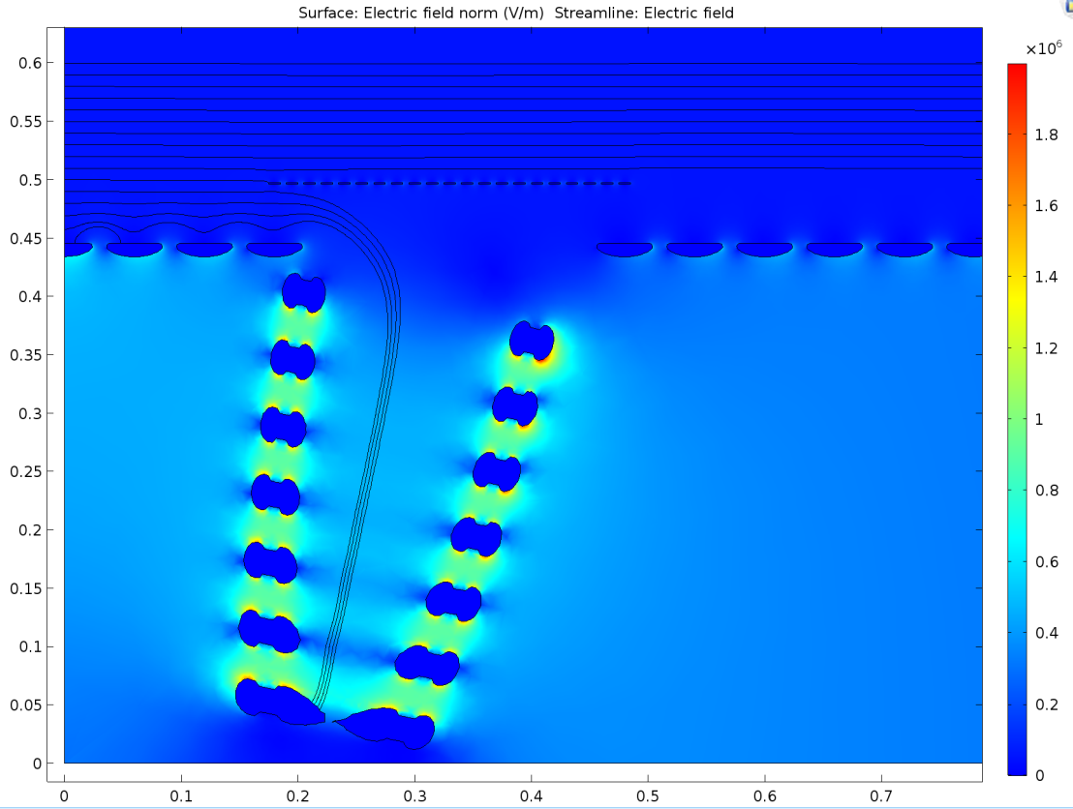
Beam Plug Field Shaping
Compare the drift field uniformity with or without the additional field shaping on the beam plug window.

Slide 17
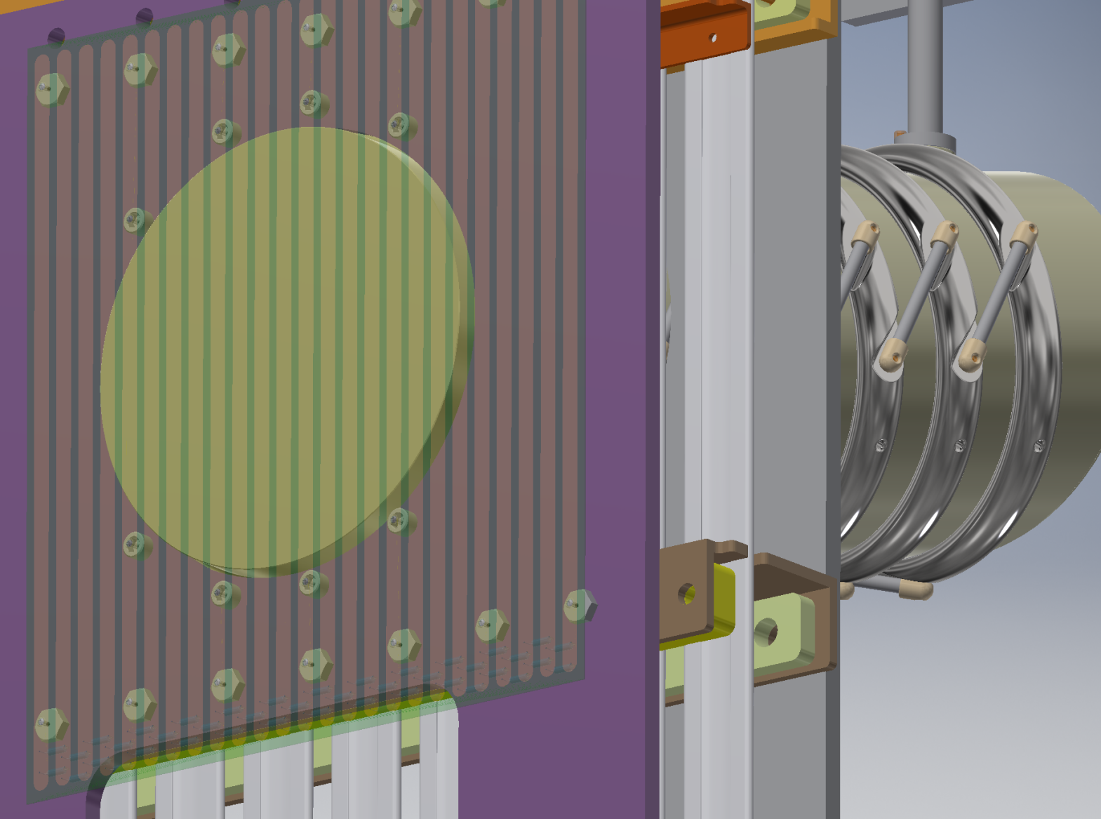
Beam Plug Field Shaping Board
Screws interconnect broken profiles
Redundant resisters on underside of the board

Slide 18
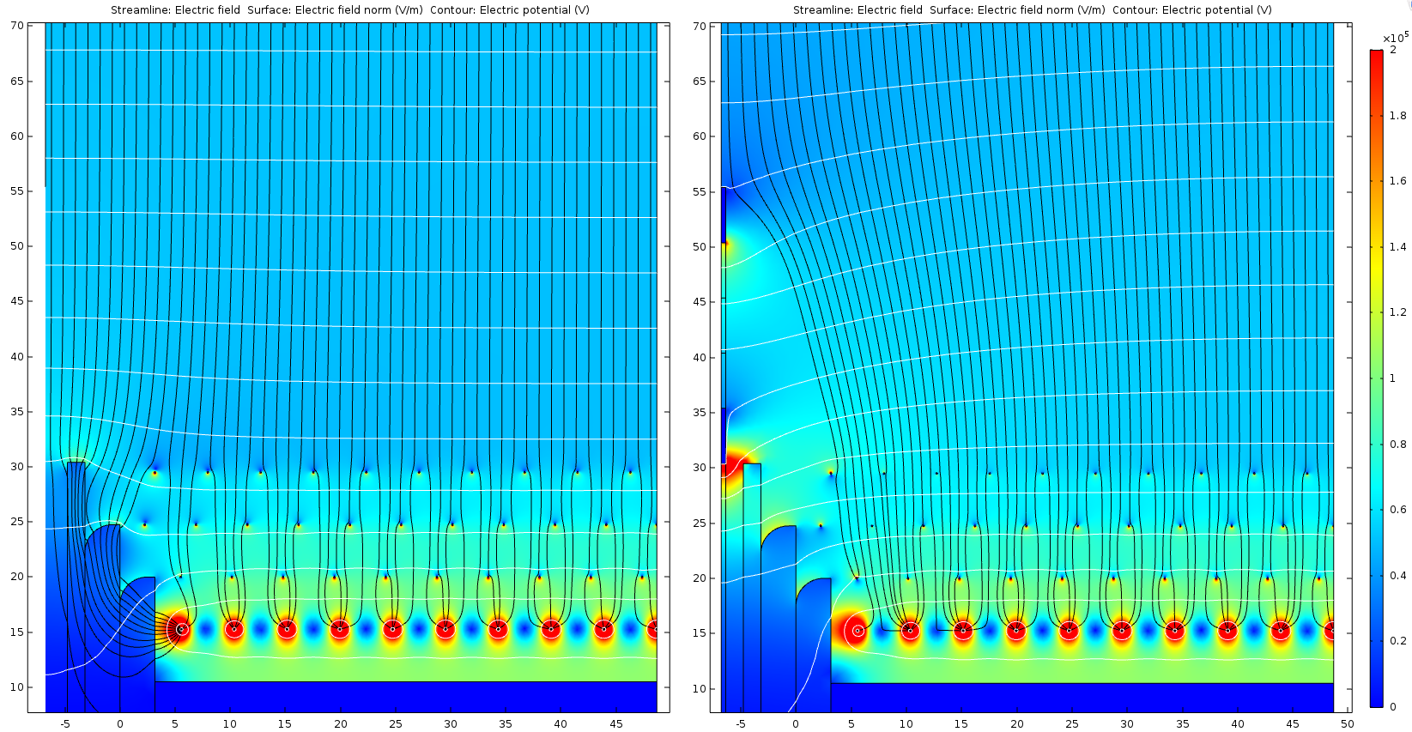
Electron Diverters
Current NP04 APA long edge without e-diverter
NP04 APA long edge with 2 electrode e-diverter (-2300V and -1300V)

Slide 19
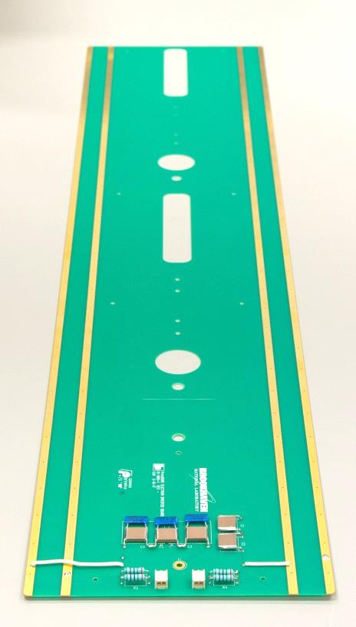
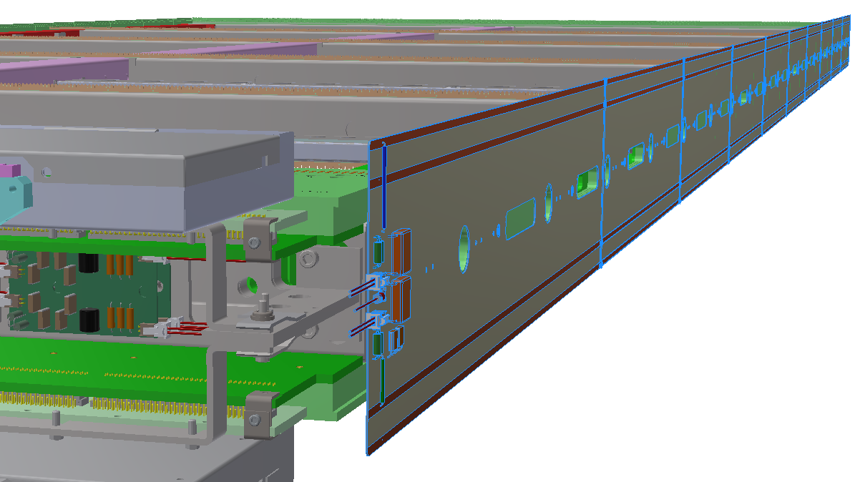
E-Diverter in NP04
A total of 10 printed circuit boards are interconnected to form a set of e-diverter between a pair of APAs. Two sets of them are to be installed between the 3 beam right APAs.
Simple RC networks provide filtering for the ripples in the bias voltage supplies.
The bias inputs come from the CE flange through the SHV connector panel. The ground reference of the filter comes from the T bracket next to the filter board.

Slide 20
Summary
All HV system connections (inter and intra subsystems) have been defined and documented. The official system schematic diagrams will be updated after the review.
Redundant wires/pins/connections, and failsafe features are designed into the critical components.
A few details on some design features are to be finalized. The most noticeable one being the ground plane monitoring system.
This review did force us to review our existing documentations and check for inconsistencies among them. Thank you.
More details from the following presentations…

