Slide 1
ProtoDUNE APA Wire Mapping and Bias Wiring Overview
Andrew Laundrie
Physical Sciences Laboratory
University of Wisconsin
Ver. 1

Slide 2
Signal paths from a APA wire segments to CE channels
Head board (wire plane and stack position)
Solder pad (1 thru 48 for X, 1 thru 40 for U & V)
CR board input pin (one of 128)
CR Board output connector & pin
Interface board: input and output pins
CE board input connector and pin

Slide 3
PSL is building a database for active wire segments to identify the following:
Wire Segment names, embedded therein:
  Wire layer (U, V, or X)
  Head Board Stack number (1 through 20)
  Solder Pad number (1 thru 40 or 1 thru 48)
  Which of up to three segments (A, B, or C)
X-Y Coordinates of wire endpoints

Slide 4
Database for wire segments
(under construction at PSL)

Slide 5
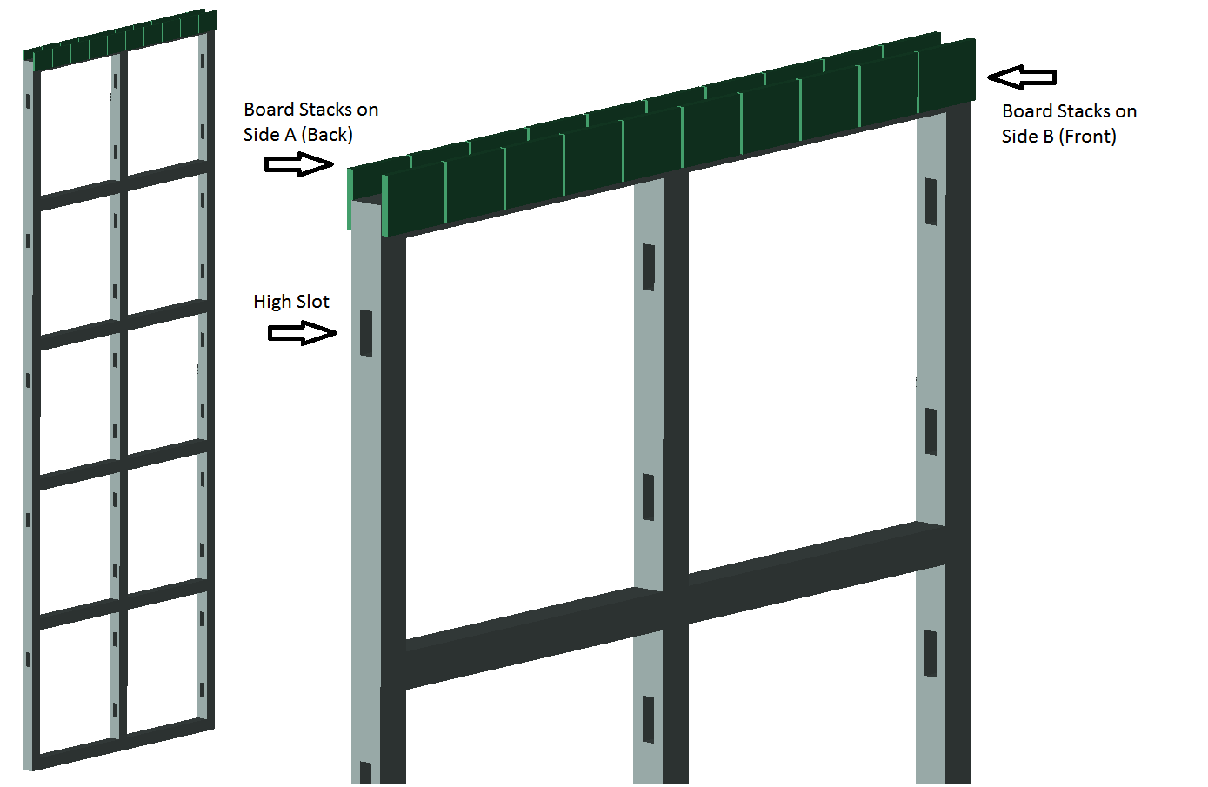
Board Stack identification

Slide 6
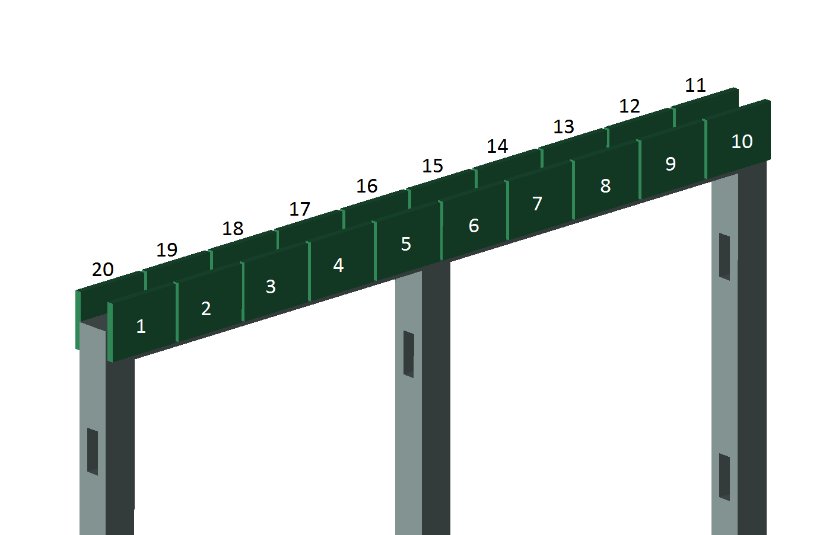
Board Stack numbering
(Front view = Side B view)

Slide 7
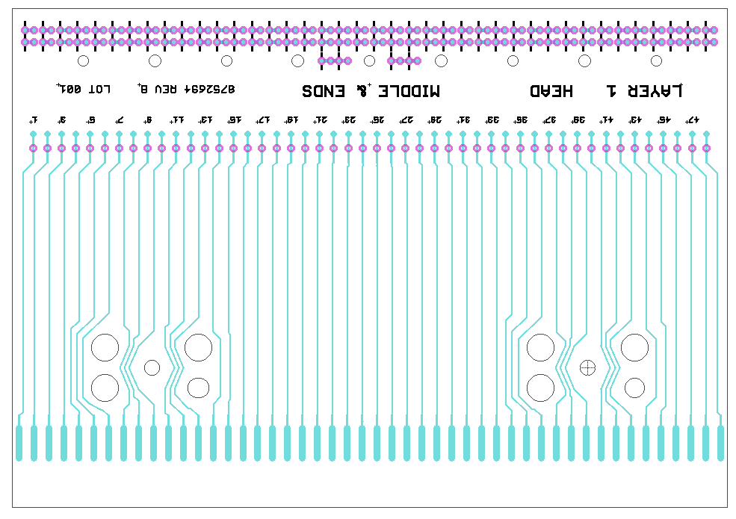
Wires are traceable to pins on the CR board
Pad 1
Pad 48

Slide 8
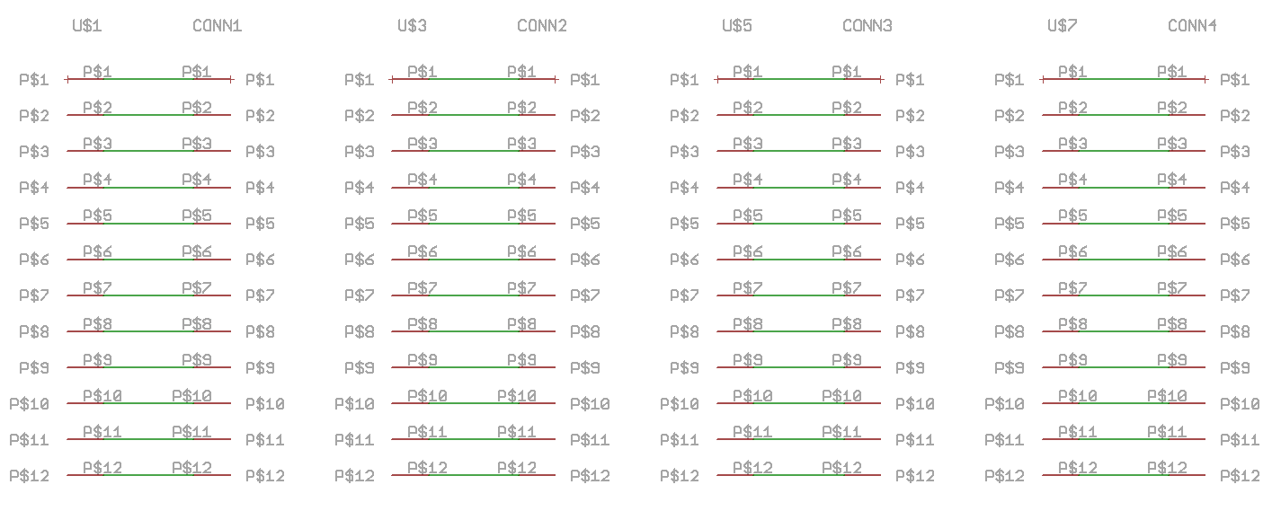
Head board schematic shows connections from pads to pins

Slide 9
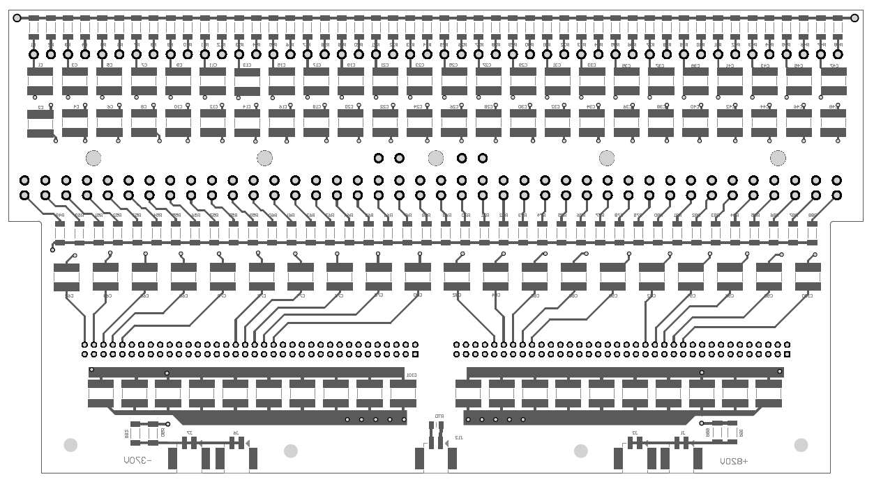
CR boards: connecting Head Boards to Adapter Boards

Slide 10
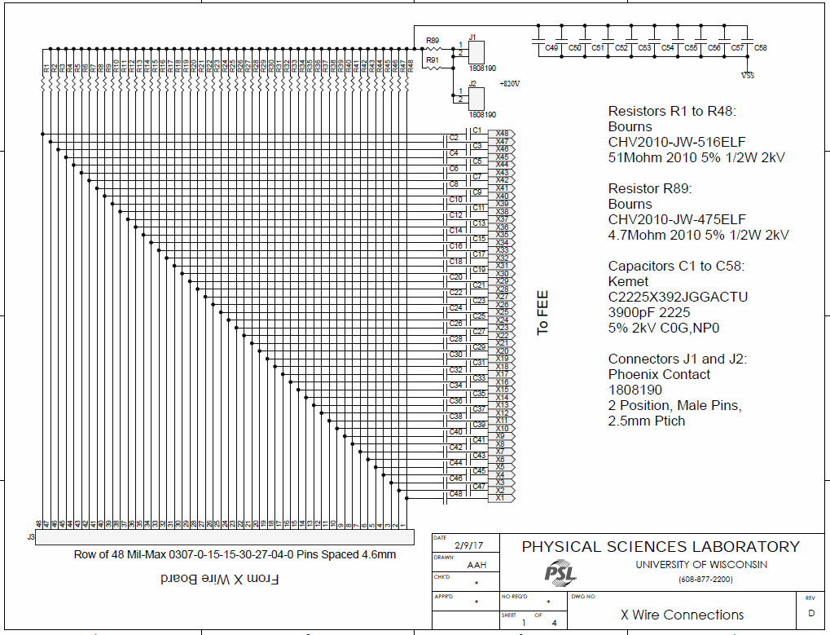
CR board schematic indicates signal paths
from Wire Boards to Adapter Boards

Slide 11
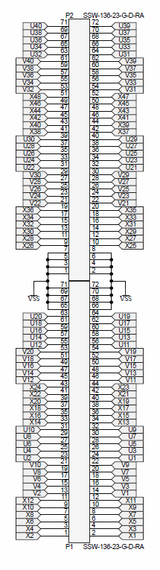
CR board schematic (continued)
Pins on connectors that mate with the Adapter board
are identified with APA wire names

Slide 12
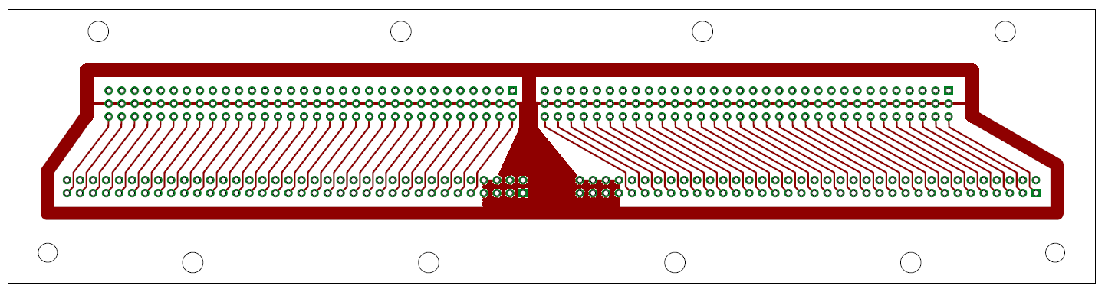
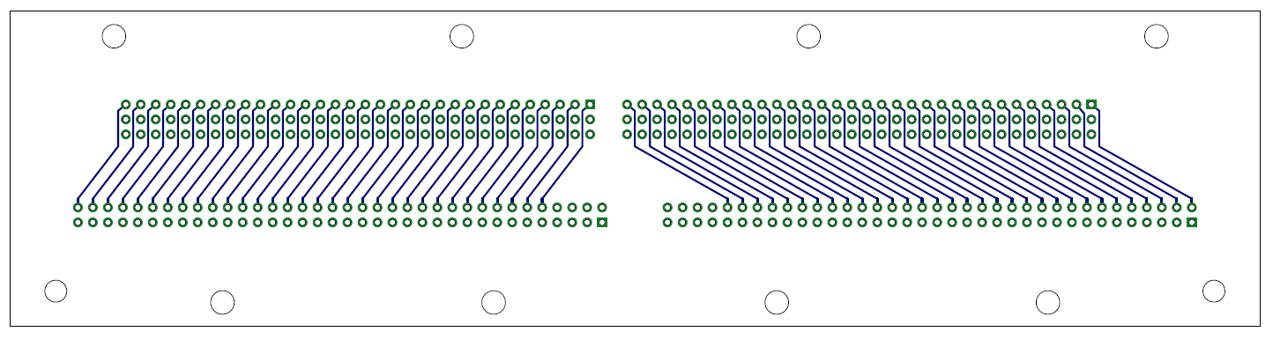
Adapter boards connect CR Boards to CE Boards

Slide 13
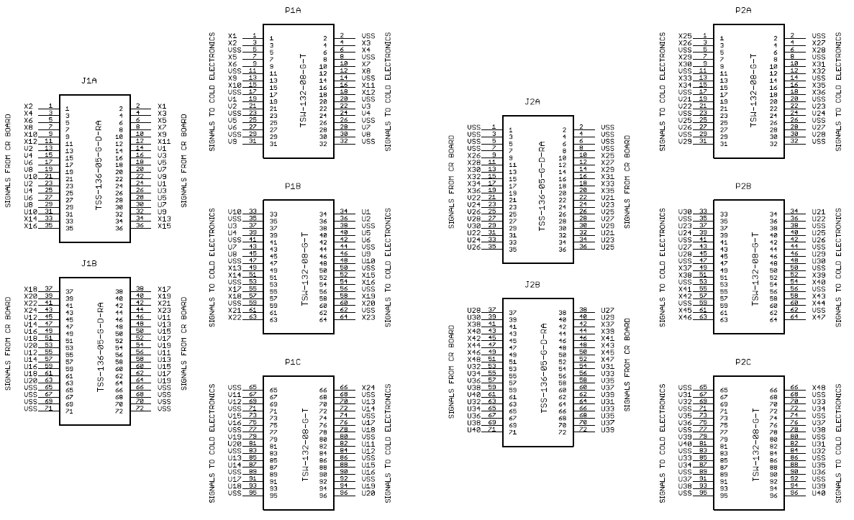
Pins on connectors that mate with the CE board
are identified using APA wire names

Slide 14
Connections between CR board
and CE board are tabulated
along with APA wire assignments

Slide 15
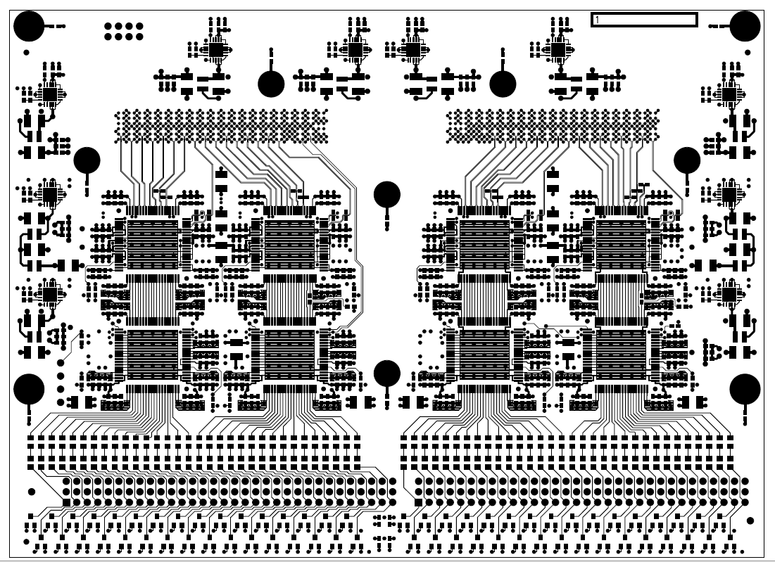
CE boards connect Adapter Boards to Digitizer ASICS

Slide 16
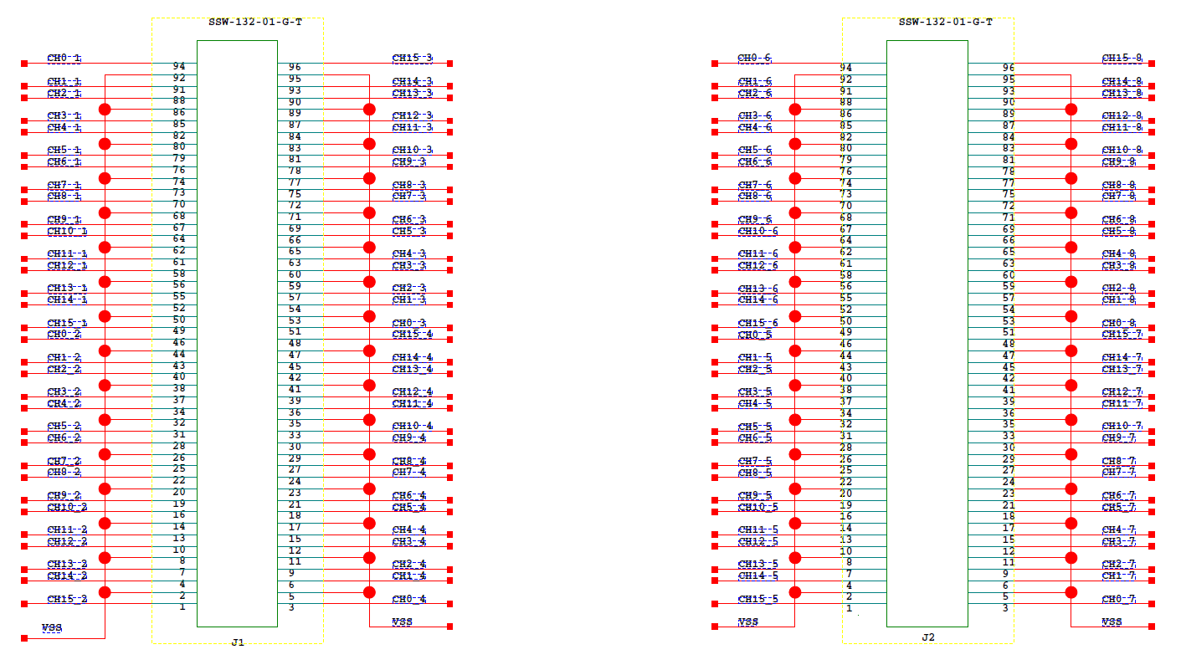
CE schematic from BNL indicates paths from
input connectors to digitizer channels

Slide 17
Summary of Wire Tracing
Documentation exists to support tracing active APA wires to CE channels
A partially completed PSL database provides endpoint coordinates for active wire segments
More help is needed to tie information together!

Slide 18
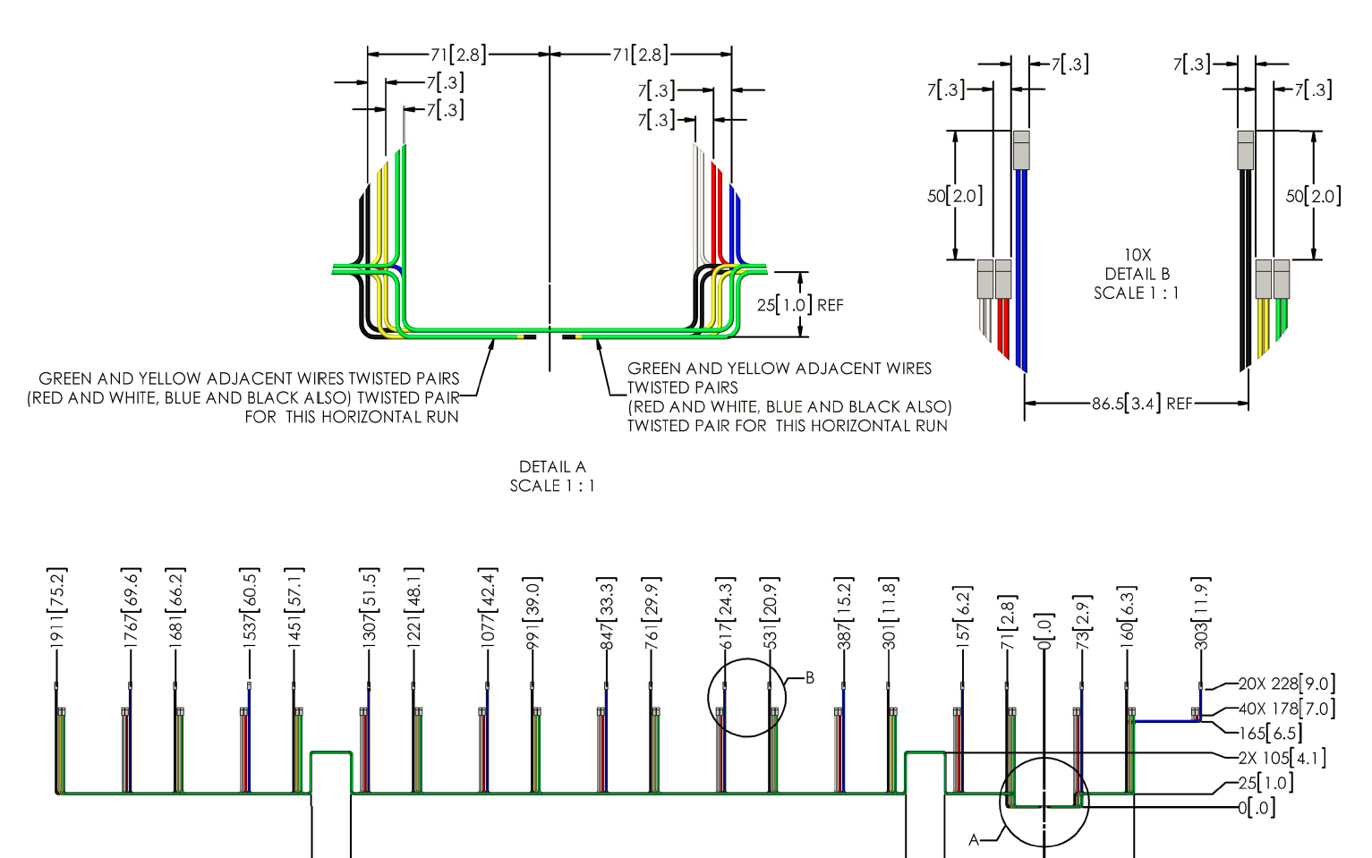
Bias wire bundles are captured in SW drawings

Slide 19
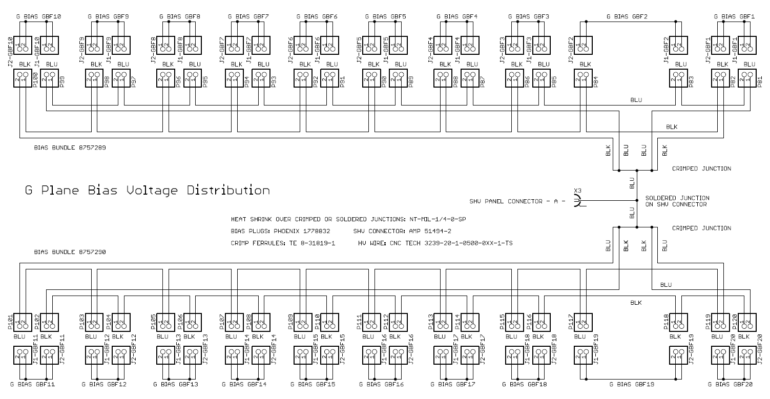
Bias wiring is also captured in electrical schematics

Slide 20
Bias Wiring Verification Options
Inspection
Simultaneously apply different levels of low voltage on bias cables and probe boards
Unplug a connector in each of the six bias loops and measure resistance across the connector’s pins to verify that all other connectors in the loop are attached

