Slide 1
HL-LHC Accelerator Physics Challenges and USLARP@Fermilab
Alexander Valishev
Fermilab, H.Edwards Internship Meeting
August 17, 2017

Slide 2
Content
Collider accelerator physics primer (with focus on LHC)
LHC vs. HL-LHC bird’s eye view
HL-LHC and USLARP challenges
Fermilab’s contributions to HL-LHC/USLARP

Slide 3
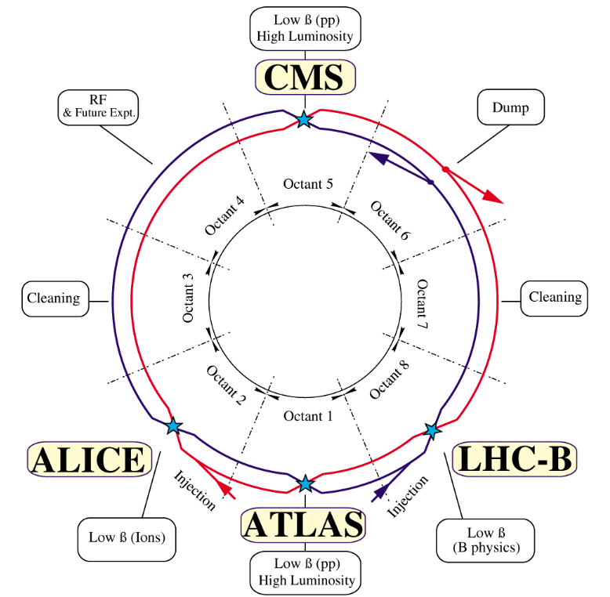


E = 7 TeV
B = 8.3 T
C = 27 km
$$R=\frac{pc}{eB}$$
$$\frac{2π pc}{C eB}=0.66$$
packing factor

Slide 4
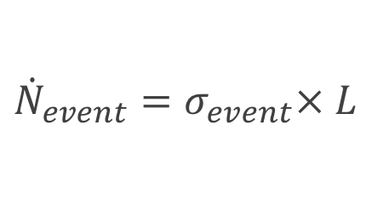
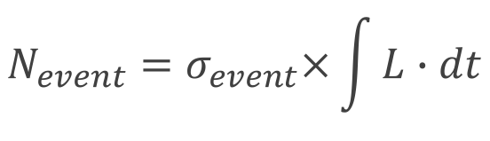
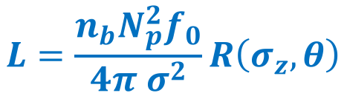






Luminosity of a Collider
$${\dot{N}}_{event}=σ_{event}× L$$
– instantaneous luminosity
$$N_{event}=σ_{event}×\int{L∙dt}$$
– luminosity integral
Initial luminosity
Luminosity lifetime
Particle burn-off
Coulomb intra-beam scattering
Synchrotron radiation
Noise/diffusion
Machine availability
$$L=\frac{n_{b}N_{p}^{2}f_{0}}{4π σ^{2}}R\left(σ_{z},θ\right)$$
$$n_{b}$$
– Number of bunches
$$N_{p}$$
– Number of protons/bunch
$$f_{0}$$
– Revolution frequency
$$σ$$
– Beam size at IP
$$σ_{z}$$
– Bunch length
$$θ$$
– Crossing angle

Slide 5




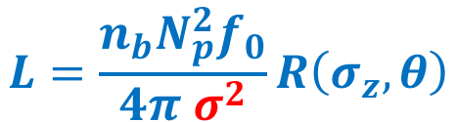






Luminosity – Final Focus
$$L=\frac{n_{b}N_{p}^{2}f_{0}}{4π σ^{2}}R\left(σ_{z},θ\right)$$
$$F$$
$$L^{∗}$$
$$F≈L^{∗}→G≈\frac{pc}{L^{∗}l}$$
$$σ^{∗}=\sqrt{εβ^{∗}}≈17μm$$
$$σ_{L}=σ^{∗}\sqrt{1+L^{∗2}/β^{∗2}}≈2 mm$$
$$pc$$
– Beam momentum
$$ε$$
– Beam emittance
$$G$$
– Quadrupole gradient
$$β$$
– Optical beta-function
$$l$$
– Quadrupole length
$$L^{∗}$$
– Final focus length

Slide 6
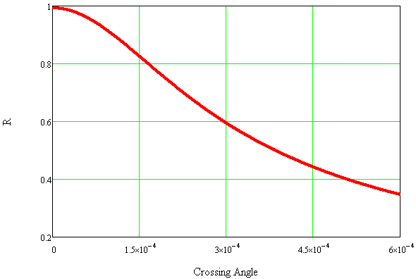

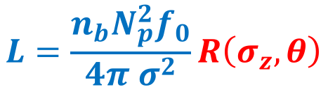
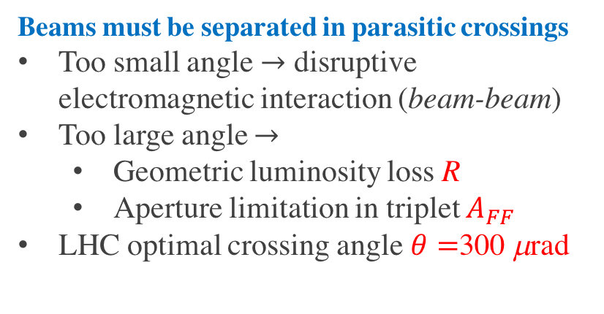

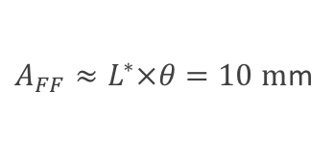

Luminosity – Crossing Scheme
$$L=\frac{n_{b}N_{p}^{2}f_{0}}{4π σ^{2}}R\left(σ_{z},θ\right)$$
Sketch not to scale!
$A_{FF}≈L^{∗}×θ=10 m$m
$z_{LR}=25ns×\frac{c}{2}=$3.75m
Beams must be separated in parasitic crossings
Too small angle $→$ disruptive electromagnetic interaction (beam-beam)
Too large angle $→$
  Geometric luminosity loss R
  Aperture limitation in triplet $A_{FF}$
LHC optimal crossing angle $θ=$300 μrad
$$R\left(θ\right)$$
$$θ/2$$

Slide 7
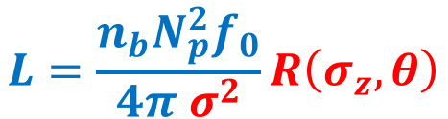



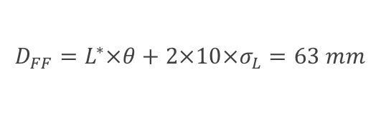
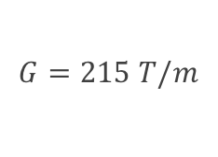
Final Focus (Low-Beta Triplet) Quadrupoles
$$L=\frac{n_{b}N_{p}^{2}f_{0}}{4π σ^{2}}R\left(σ_{z},θ\right)$$
Final Focus Quadrupole Magnet Challenges
Bore is determined by beam size and crossing angle/separation
Gradient is determined by beam energy, magnet length, beta-function, magnet technology
  NbTi conductor, 70 mm coil bore
  Gradient
  Peak field in coil 7.7 T
Must possess high field uniformity
Must withstand high levels of radiation / heat load near IP
$$D_{FF}=L^{∗}×θ+2×10×σ_{L}=63 mm$$
$$D_{FF}$$
$$A_{FF}$$
$$N×{σ }_{L}$$
$$G=215 T/m$$

Slide 8
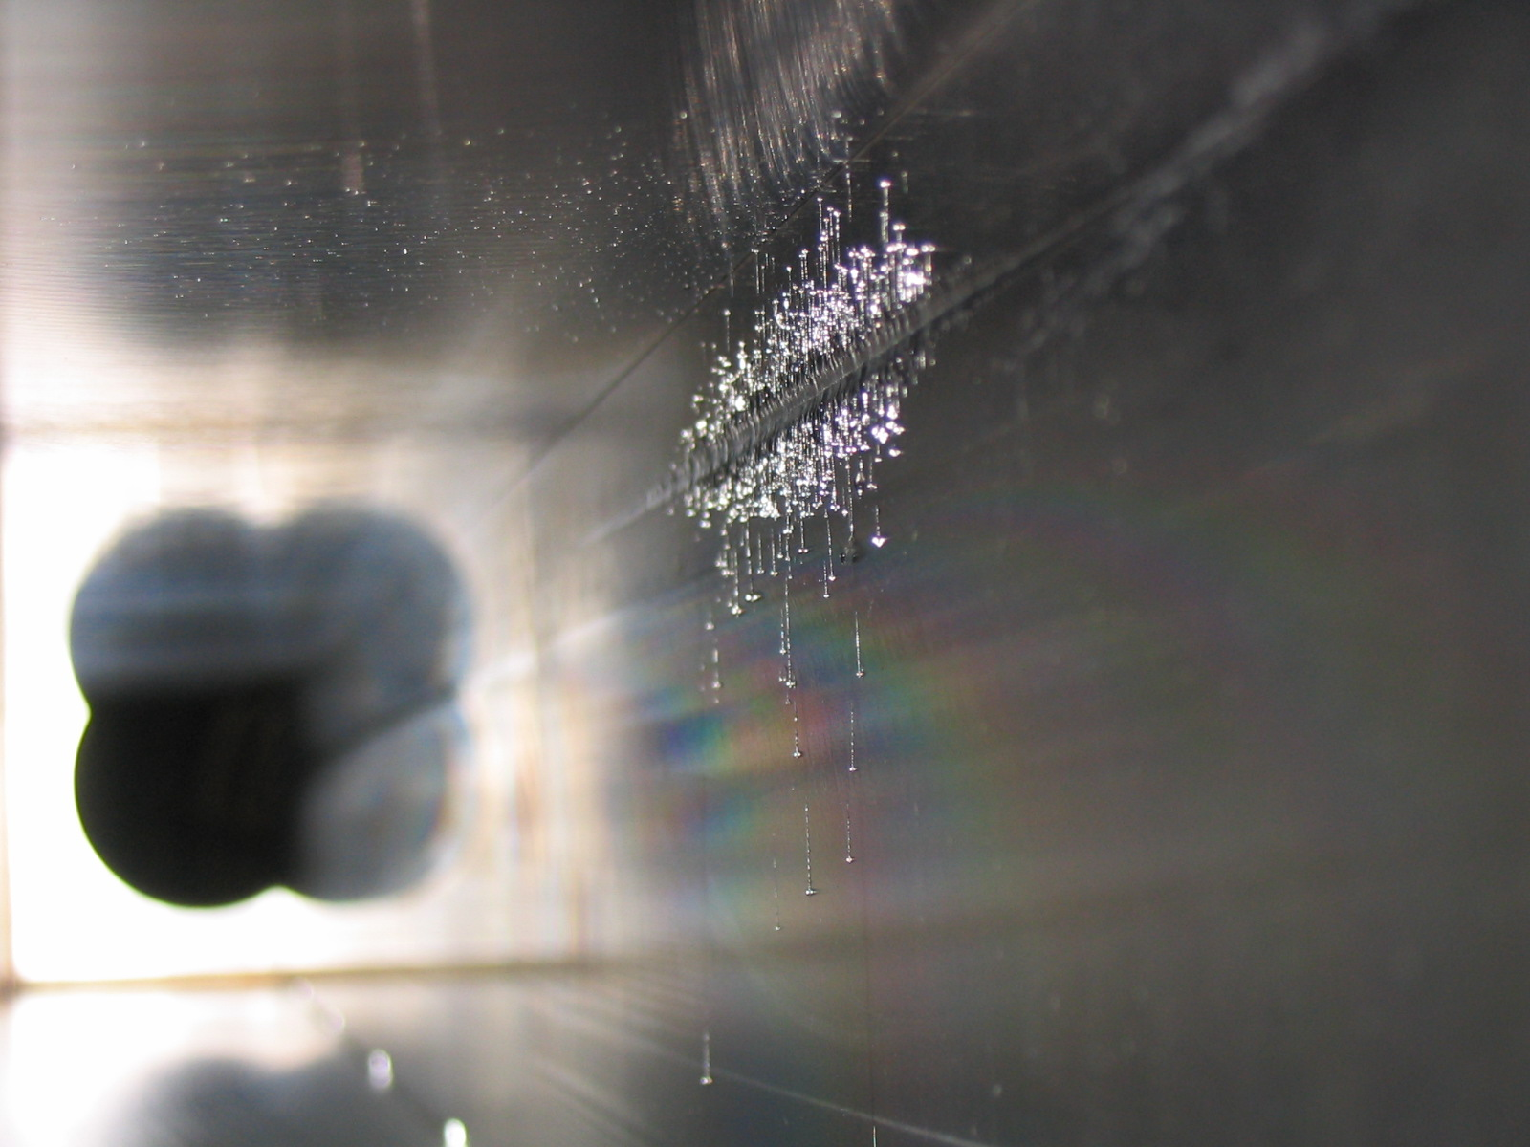
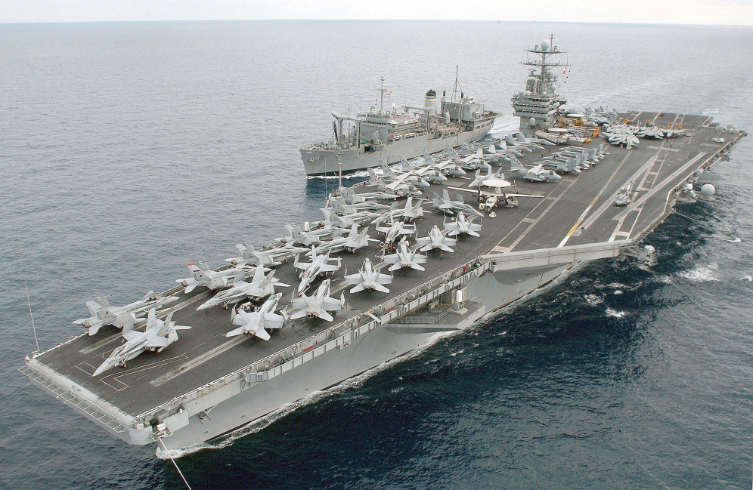
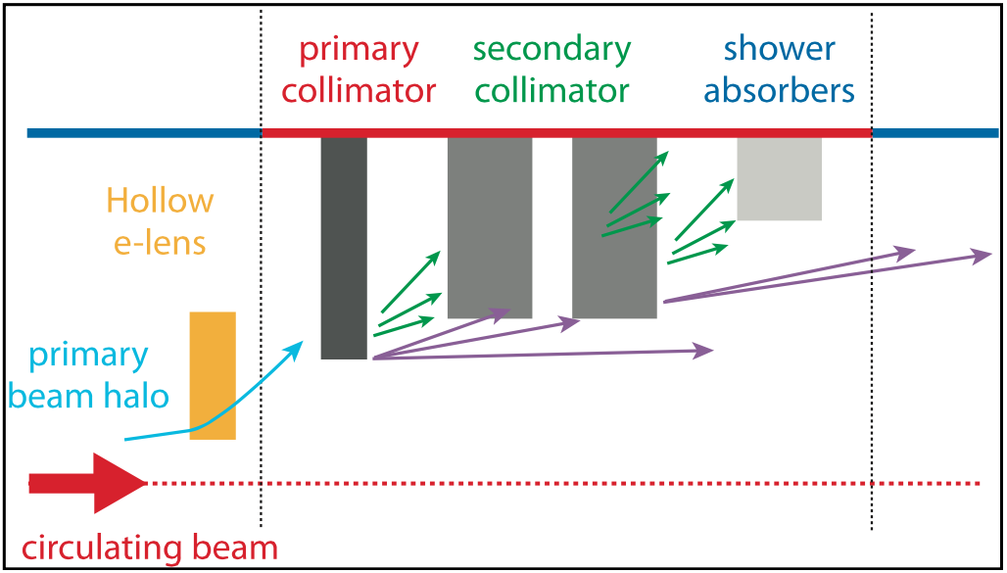
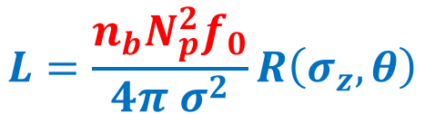
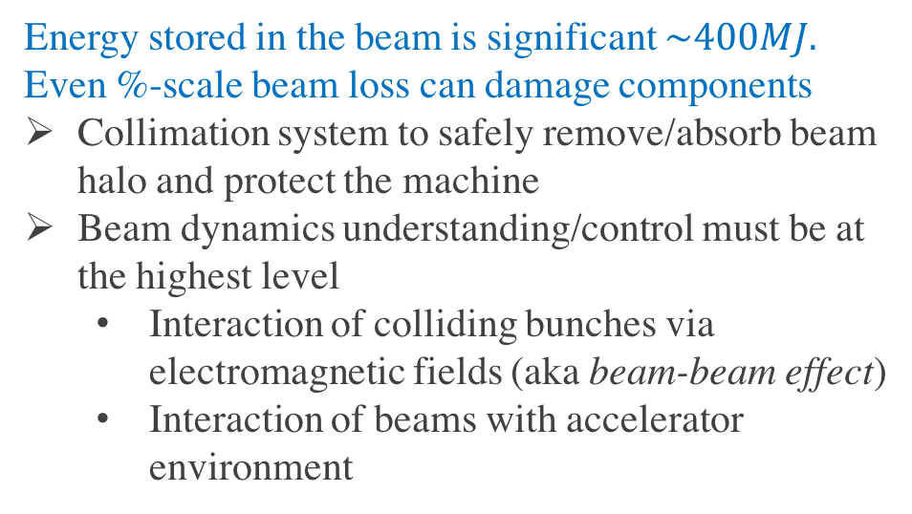
High-Current Issues
Tevatron
$$L=\frac{n_{b}N_{p}^{2}f_{0}}{4π σ^{2}}R\left(σ_{z},θ\right)$$
E03 1.5m collimator
Energy stored in the beam is significant $\sim 400MJ.$ Even %-scale beam loss can damage components
Collimation system to safely remove/absorb beam halo and protect the machine
Beam dynamics understanding/control must be at the highest level
  Interaction of colliding bunches via electromagnetic fields (aka beam-beam effect)
  Interaction of beams with accelerator environment
v = 7 knots

Slide 9
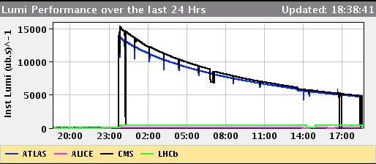
LHC Design Parameters
 | LHC nominal
Beam energy | 7 TeV
Number of bunches | 2808 (25 ns separation)
protons / bunch [10¹¹] | 1.15 (0.58A)
Energy in one beam [MJ] | 360
γε_{x,y} [μm], rms | 3.75
β∗ [m] at IP1-5 | 0.55
X-angle [μrad], separation | 285, 9.3 σ
Geometrical Luminosity loss factor | 0.83
Quadrupole bore [mm], gradient [T/m] | 70, 215
Peak luminosity [10³⁴] | 1.0
Pile up | 27
Machine configuration is static
in luminosity run!

Slide 10

Levelled Luminosity
$$L=5×{10}^{34}{cm}^{−2}s^{−1}$$

Slide 11
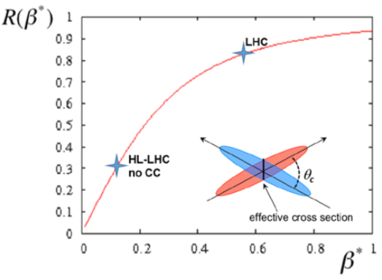
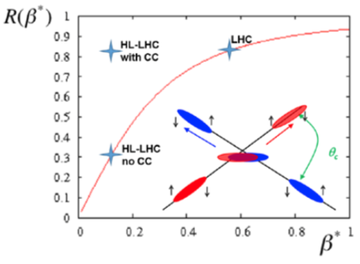
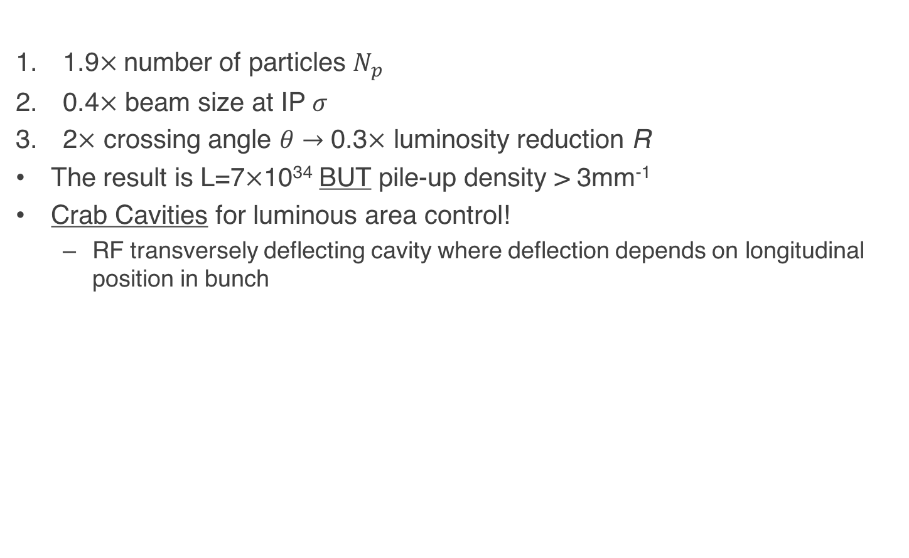

HL-LHC Luminosity Ingredients
1.9$×$number of particles $N_{p}$
0.4$×$ beam size at IP $σ$
2$×$ crossing angle $θ→$ 0.3$×$ luminosity reduction R
The result is L=7$×$10³⁴ BUT pile-up density > 3mm⁻¹
Crab Cavities for luminous area control!
  RF transversely deflecting cavity where deflection depends on longitudinal position in bunch
$$L=\frac{n_{b}N_{p}^{2}f_{0}}{4π σ^{2}}R\left(σ_{z},θ\right)$$

Slide 12
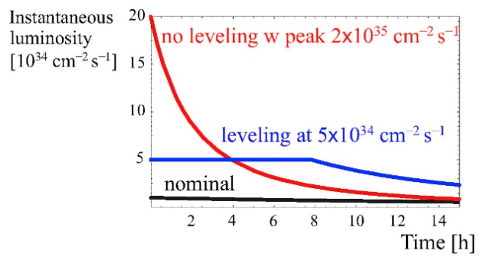
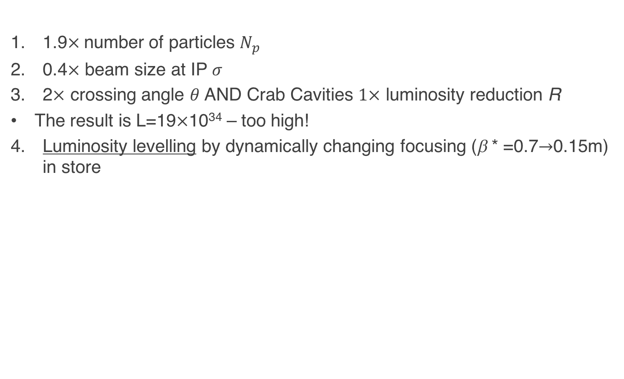

HL-LHC Luminosity Ingredients (2)
$$L=\frac{n_{b}N_{p}^{2}f_{0}}{4π σ^{2}}R\left(σ_{z},θ\right)$$
1.9$×$number of particles $N_{p}$
0.4$×$ beam size at IP $σ$
2$×$ crossing angle $θ$ AND Crab Cavities $1×$ luminosity reduction R
The result is L=19$×$10³⁴ – too high!
Luminosity levelling by dynamically changing focusing (β * =0.7$→$0.15m) in store

Slide 13
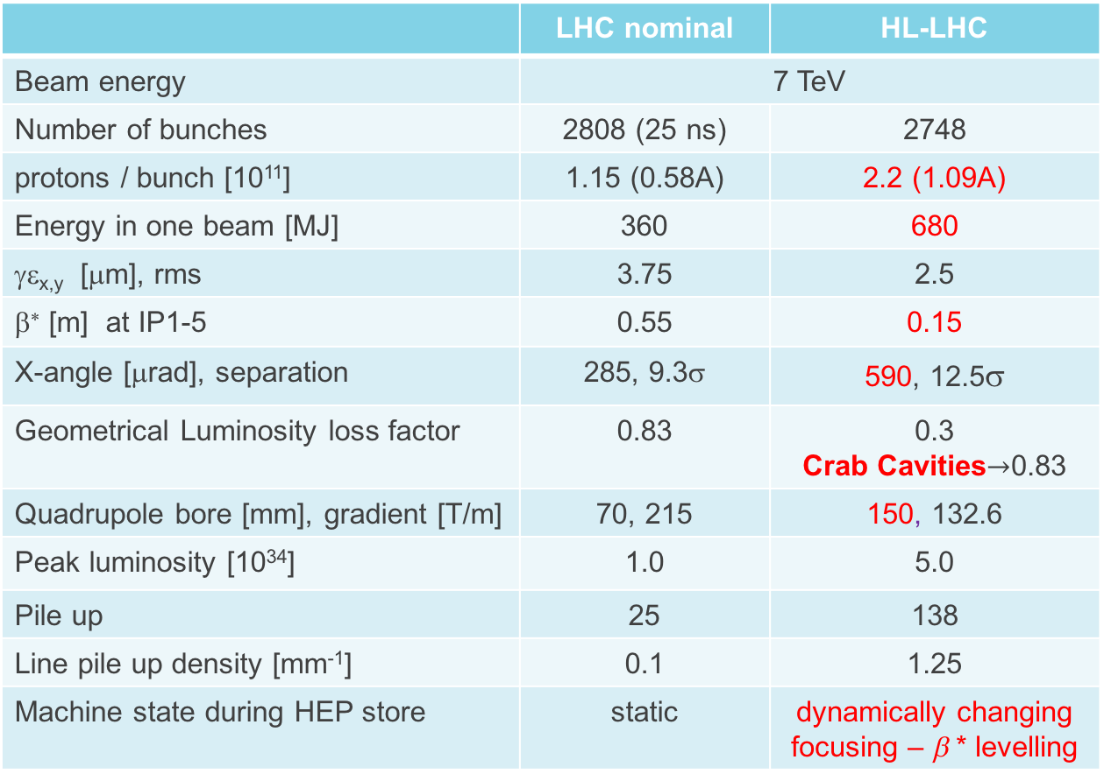
LHC vs. HL-LHC
 | LHC nominal | HL-LHC
Beam energy | 7 TeV
Number of bunches | 2808 (25 ns) | 2748
protons / bunch [10¹¹] | 1.15 (0.58A) | 2.2 (1.09A)
Energy in one beam [MJ] | 360 | 680
γε_{x,y} [μm], rms | 3.75 | 2.5
β∗ [m] at IP1-5 | 0.55 | 0.15
X-angle [μrad], separation | 285, 9.3σ | 590, 12.5σ
Geometrical Luminosity loss factor | 0.83 | 0.3 Crab Cavities$→$0.83
Quadrupole bore [mm], gradient [T/m] | 70, 215 | 150, 132.6
Peak luminosity [10³⁴] | 1.0 | 5.0
Pile up | 25 | 138
Line pile up density [mm⁻¹] | 0.1 | 1.25
Machine state during HEP store | static | dynamically changing focusing – β * levelling

Slide 14
HL-LHC

Slide 15
U.S. LARP
LHC Accelerator Research Program – National Program started in 2003
Coordinates and funds work by accelerator experts from FNAL, BNL, LBNL, SLAC, JLAB and several U.S. universities
Leverages the U.S. experience in collider/accelerator physics and technology, provides continuity of knowledge
Numerous contributions to the success of the LHC
  Magnets, Crab Cavities, Rotating Collimators, Luminosity Monitors, Beam Instrumentation, E-Lens, Wide Band Feedback System, Accelerator Physics, Irradiation assessment, etc.
Very successful personnel program
  Toohig Fellowship, Long-term visitor program

Slide 16
US LARP in Transition to HL-LHC
LARP:
  Continue LHC R&D with emphasis on minimizing risk of US in-kind deliverables for HL-LHC Project.
    Deliver Quadrupole Models/Prototypes & 4 dressed Crab Cavities
    Support Toohig Fellowship and select Accelerator Physics activities
US HL-LHC Accelerator Upgrade Project:
  US in-kind deliverable to HL-LHC
    Achieved CD-0 in April 2016
  Preliminary Scope:
    FF Quadrupole Cold Mass Assemblies
    Crab Cavities
    Other contributions under discussion (e-lens components, WBFS)
Future LARP’:
  Program to support US intellectual involvement in HL-LHC while US HL-LHC AUP is being executed or HL-LHC operates

Slide 17
LARP Accelerator Physics example
Beam-Beam Compensation

Slide 18
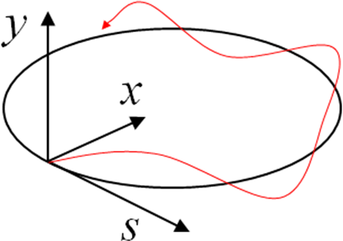



Particle Confinement in Rings
Charged particles are kept moving around a circular orbit with the use of static transverse magnetic fields.
x,y motion – betatron oscillations
Longitudinally the beam is kept bunched with time-varying electrical field. s-motion is usually weekly coupled to x-y
$$\vec{F}=e\vec{v}×\vec{B}$$
$$\left\{\begin{matrix}x”+K_{x}\left(s\right)x=0 \\ y”+K_{y}\left(s\right)y=0\end{matrix}\right.$$
$$K_{x,y}\left(s+C\right)=K_{x,y}\left(s\right)$$
Linear focusing – dipole and quadrupole magnets

Slide 19
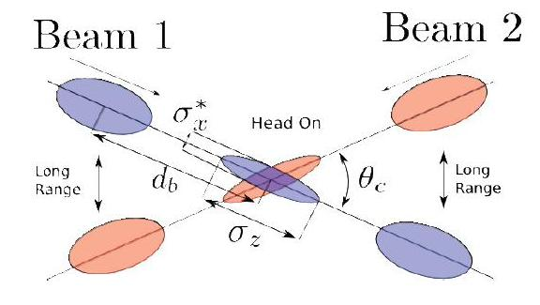
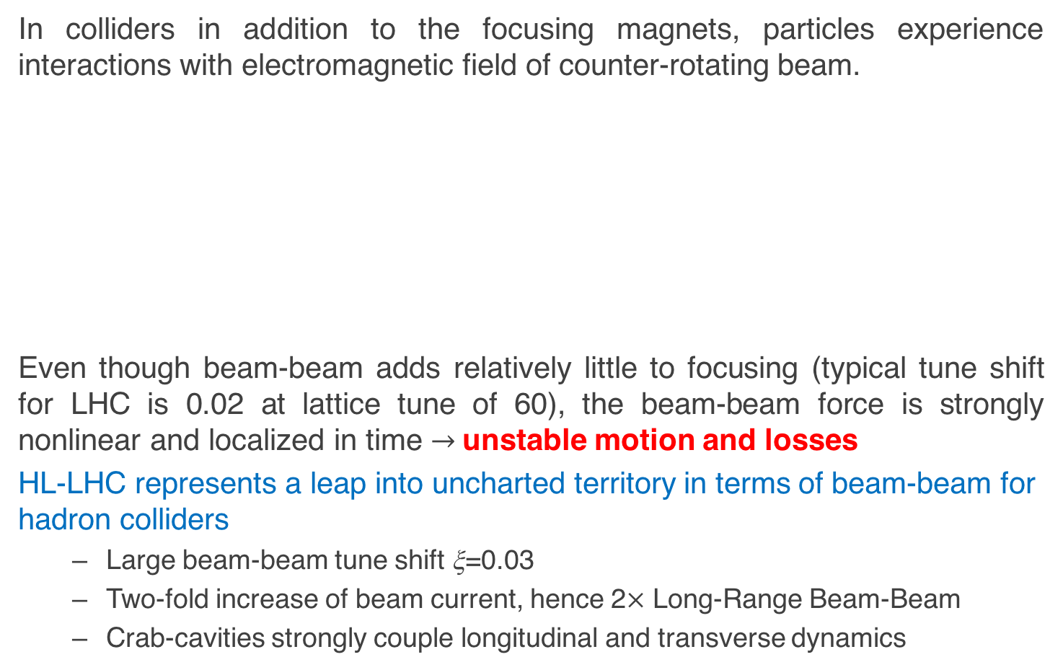

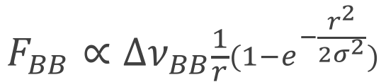
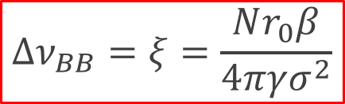
Beam-Beam Interactions
In colliders in addition to the focusing magnets, particles experience interactions with electromagnetic field of counter-rotating beam.
Even though beam-beam adds relatively little to focusing (typical tune shift for LHC is 0.02 at lattice tune of 60), the beam-beam force is strongly nonlinear and localized in time $→$unstable motion and losses
HL-LHC represents a leap into uncharted territory in terms of beam-beam for hadron colliders
  Large beam-beam tune shift ξ=0.03
  Two-fold increase of beam current, hence 2$×$ Long-Range Beam-Beam
  Crab-cavities strongly couple longitudinal and transverse dynamics
$$F_{BB}∝∆ν_{BB}\frac{1}{r}(1−e^{−\frac{r^{2}}{2σ^{2}}})$$
$$∆ν_{BB}=ξ=\frac{Nr_{0}β}{4πγσ^{2}}$$
b-b
tuneshift
$$x”+K_{x}\left(s\right)x=F_{BB}(x,y,s)$$

Slide 20
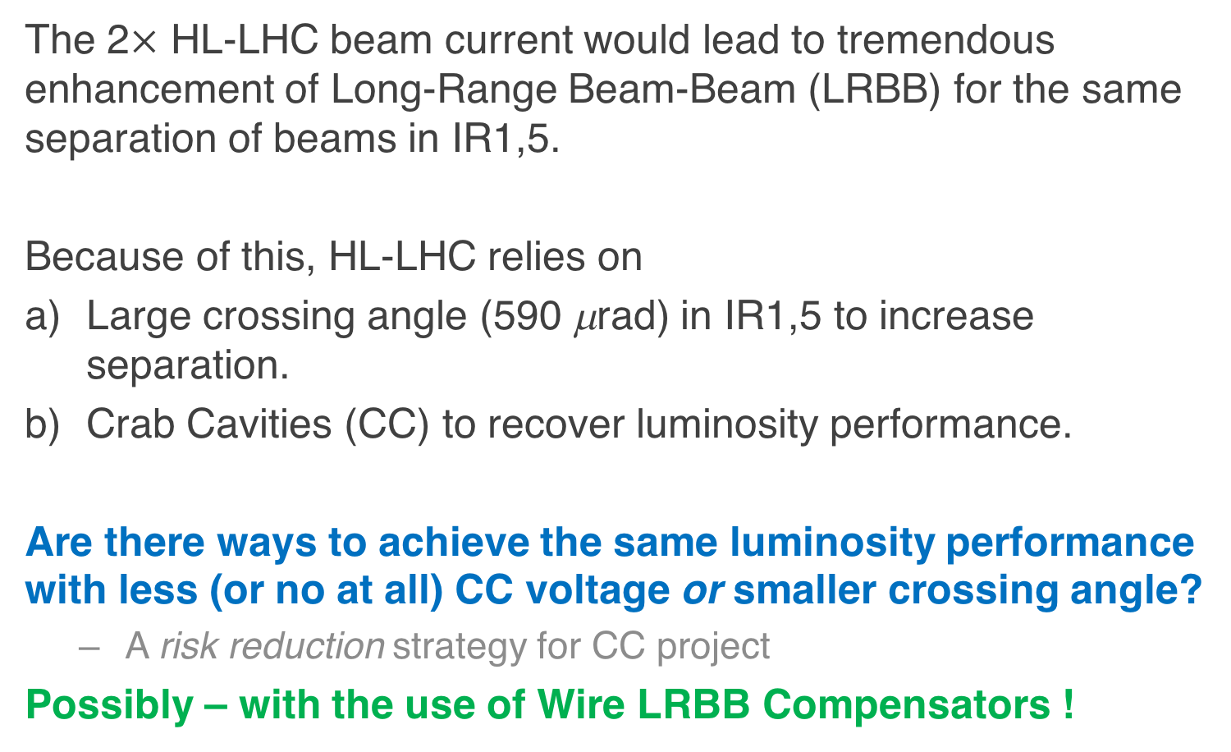
Long-Range Beam-Beam Compensation
The 2$×$ HL-LHC beam current would lead to tremendous enhancement of Long-Range Beam-Beam (LRBB) for the same separation of beams in IR1,5.
Because of this, HL-LHC relies on
Large crossing angle (590 μrad) in IR1,5 to increase separation.
Crab Cavities (CC) to recover luminosity performance.
Are there ways to achieve the same luminosity performance with less (or no at all) CC voltage or smaller crossing angle?
  A risk reduction strategy for CC project
Possibly – with the use of Wire LRBB Compensators !

Slide 21
Concept of LRBB Compensation
Beam-beam (LR) kick (round beams)
with beam separation

Slide 22
Concept of LRBB Compensation
Beam-beam (LR) kick (round beams)
with beam separation
Neglecting form factor (sufficiently large separation), can be approximated by an “infinite” wire

Slide 23
Concept of LRBB Compensation
Beam-beam (LR) kick (round beams)
with beam separation
Neglecting form factor (sufficiently large separation), can be approximated by an “infinite” wire
with wire separation
J.P.Koutchouk, LHC Note 223, 2000

Slide 24
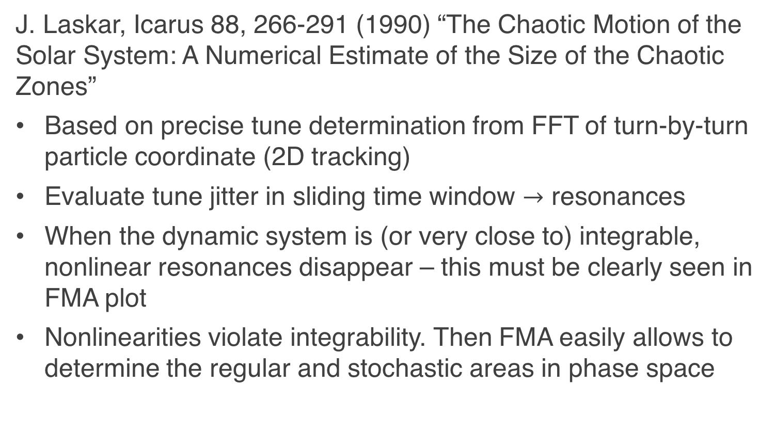
Tool – Frequency Map Analysis
J. Laskar, Icarus 88, 266-291 (1990) “The Chaotic Motion of the Solar System: A Numerical Estimate of the Size of the Chaotic Zones”
Based on precise tune determination from FFT of turn-by-turn particle coordinate (2D tracking)
Evaluate tune jitter in sliding time window $→$ resonances
When the dynamic system is (or very close to) integrable, nonlinear resonances disappear – this must be clearly seen in FMA plot
Nonlinearities violate integrability. Then FMA easily allows to determine the regular and stochastic areas in phase space

Slide 25
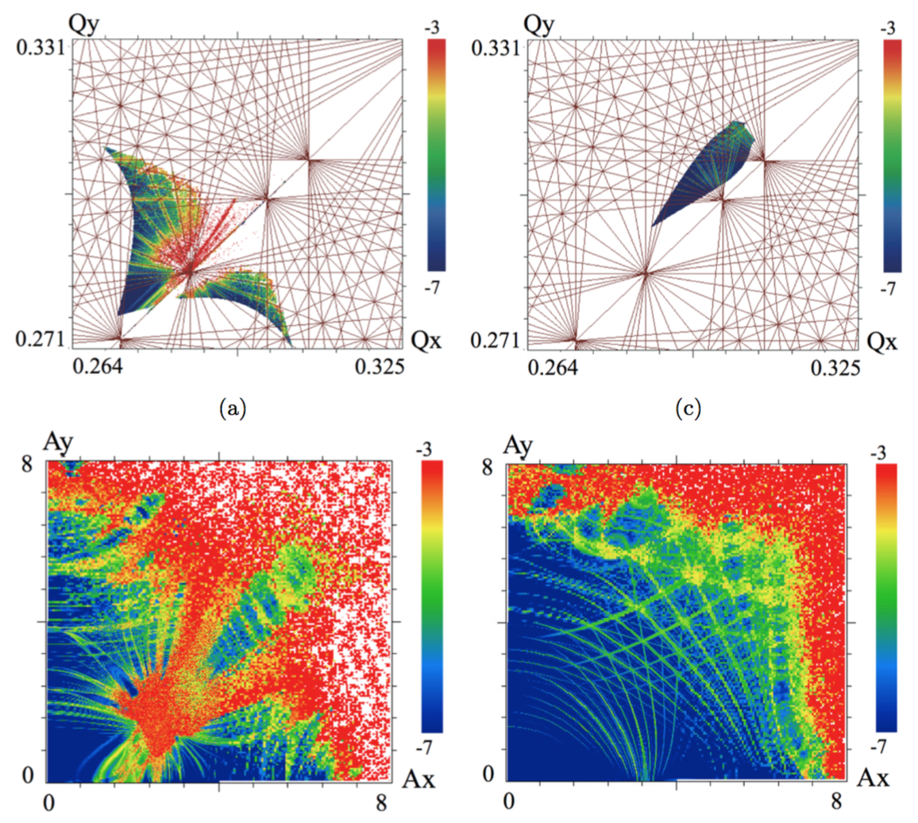
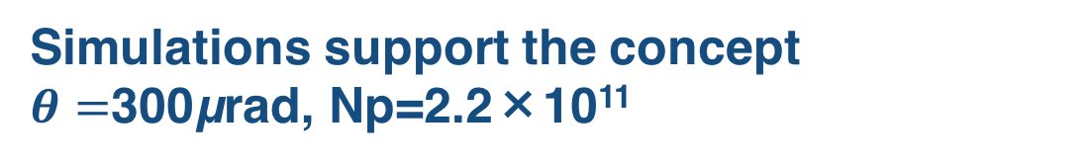
Simulations support the concept
$θ=$300μrad, Np=2.2×10¹¹
No compensation
With compensation
* Fartoukh, Valishev, Papaphilippou, Shatilov PRSTAB 18, 121001 (2015)

Slide 26
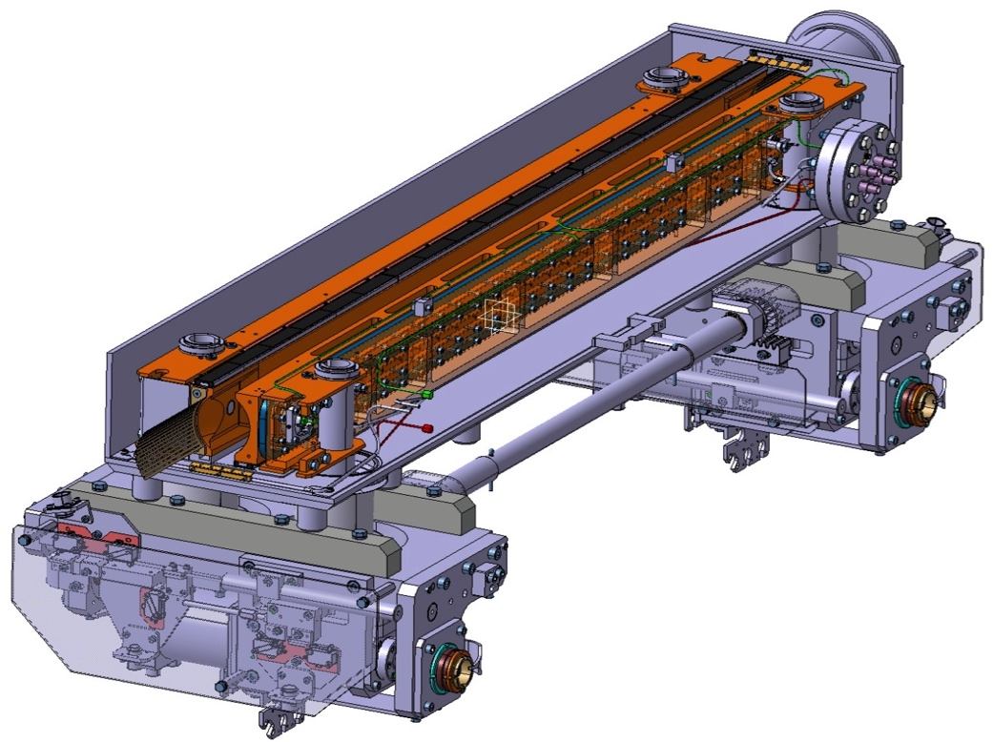
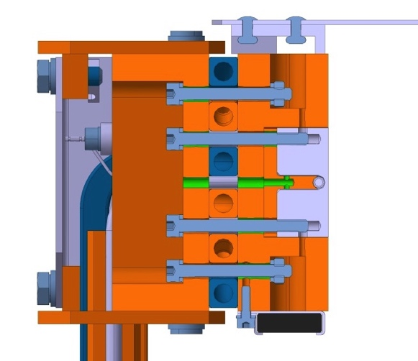
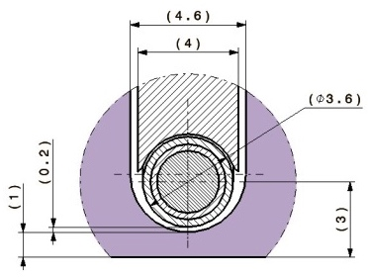
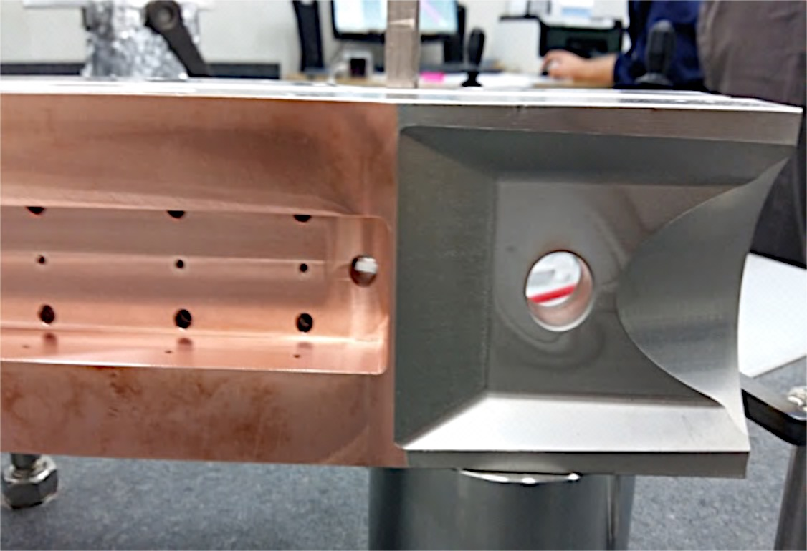
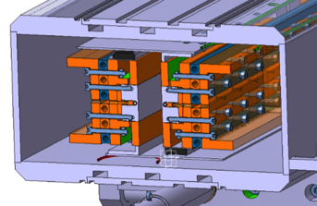

Design of wire in-jaw collimator
Cooling pipes CuNi10
Vacuum tank
Tungsten inserts
(Inermet® IT180)
Jaws
Design:
High DC current (up to 350 A)
Thin wire (Ø_{CU}≤ 2.5 mm)
In-jaw wire (depth ≤ 3 mm)
Maintain TCTP complete functionality!
BBLRC wire
Glidcop “T” support
Glidcop Al-15 housing and back stiffener
BPM button housing
L= 1000 mm
3mm
L. Gentini (EN-MME) & O. Aberle (EN-STI)
Holes for wire

Slide 27
Proof-of-principle test – July 1, 2017

Slide 28
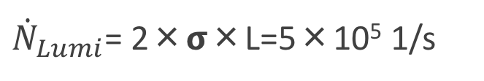

Compensation Effect
$$\dot{N}={\dot{N}}_{Lumi}+{\dot{N}}_{Beam−Beam}+{\dot{N}}_{vacuum}$$
${\dot{N}}_{Lumi}$= 2×𝞂×L=5×10⁵ 1/s

Slide 29
Compensation Effect

Slide 30
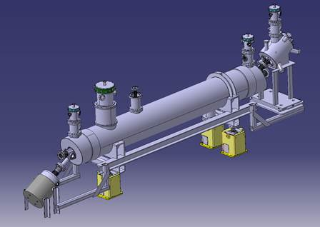
Summary of LRBB Compensation @ HL-LHC
Alternative HL-LHC scenario with reduced crossing angle to restore performance without CC is feasible with long-range beam-beam compensation
  Wires restore stable phase-space area (Dynamical Aperture) by factor 2 from 3 to almost 6 beam σ
Wires need to be close to the circulating beam (at 9.3 beam σ)
  Good for immaterial wire where the field is created with an Electron Lens
  Synergy with E-Lens for collimation
D. Perini
Gun + Solenoid
e-beam
superconducting
solenoid
p-beam
Correctors
Collector

Slide 31
Conclusion
HL-LHC is an exciting project from the accelerator physics/technology perspective with many novel and challenging problems to solve
U.S. LARP is a key player making significant contributions to HL-LHC
  Magnet technology
  Crab Cavities
  Advanced collimation technique using an Electron Lens
  Beam physics

Slide 32

HL-LHC Documentation
https://cds.cern.ch/record/2116337?ln=en

