Slide 1
2017 Main Injector/Recycler Shutdown
D. Morris
Dept. Meeting
August 16, 2017

Slide 2
Tunnel Work
MI-52 section
MI 520-521 vacuum work complete
  Replaced upstream septa
  Replaced e-cloud beam pipe
  Replaced ion pumps
  Removed toroid 521
Preparing to replace I:VP702 resonant BPM
Staging equipment for RR lambertson aperture improvements

Slide 3
TSP to IP Conversion
From 106 to 229 starting at the 229 end
Mu metal shielding removed 229 to106
Cuts made from 229 to 106
Ports welded on from 229 to 106
Pumps installed 229 to 108
Vacuum certified 229 to 204
Leak checking 204 to 125
New connectors for Quad locations
Re-installing shielding

Slide 4
Miscellaneous
Heat Exchanger cleaning:
All heat exchangers have been cleaned except the two
for MI RF
MI-52 tunnel sump discharge line repair has begun
A break has been located ~3m down from top of berm
MI pond from MI-10 to MI-60 will be lowered for MI-62 sprayer repairs as soon as MI-60 magnet pond system is back online. (Although a huge pump showed up yesterday)
Alignment is referencing Recycler sextupoles
Water group is fixing leaks on the compressed air system

Slide 5
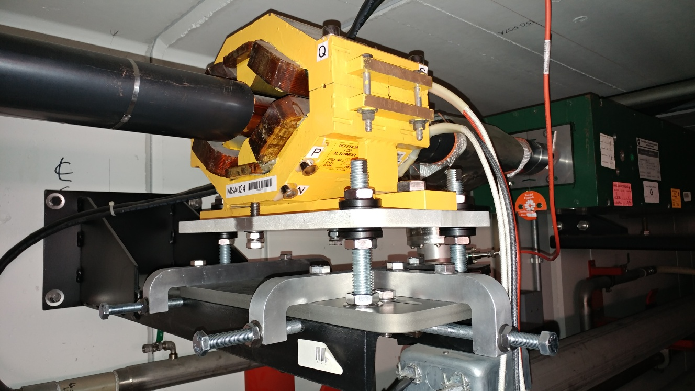
Miscellaneous

Slide 6
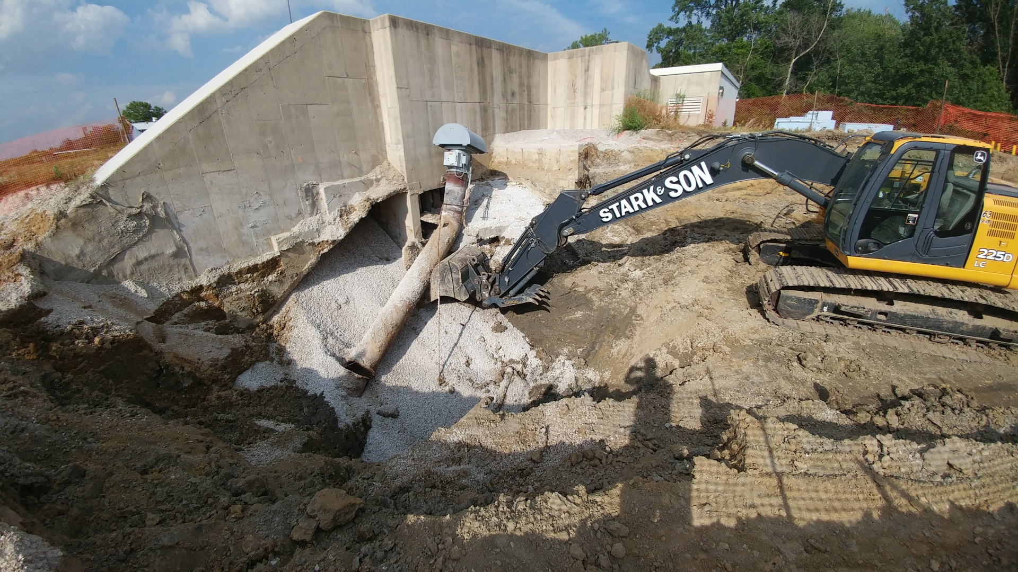
Miscellaneous

Slide 7
Going Forward
Jobs still on the schedule:
  MI RF cavity #4
  RR 104 HIPM MCP
  MI e-beam scanner
  8 GeV line ion pumps
  R52 aperture improvements
  R40 abort lamberston (MLAW) installation
  RR abort toroid replacement
  Install 18 more modified sextupole stands
  R-103 pinger kicker
  Tunnel cleaning

