Slide 1
Proton Source Week 6
Joe Compton
9am Meeting
8/18/2017

Slide 2
RIL/Linac
RIL
Ran source A all week with the new electronics
Running good with a fair amount of extractor sparking
Tested a card to turn off the extractor trigger during sparks
FESS worked on AC unit
Linac
Electricians worked all week on Marx modulator at LRF2
Should finish up today
Driver testing will begin shortly after
P1 Marx modulator being installed at LRF5
Power outage scheduled for September 8
L1, L2 & L3 substation maintenance
LE general maintenance

Slide 3
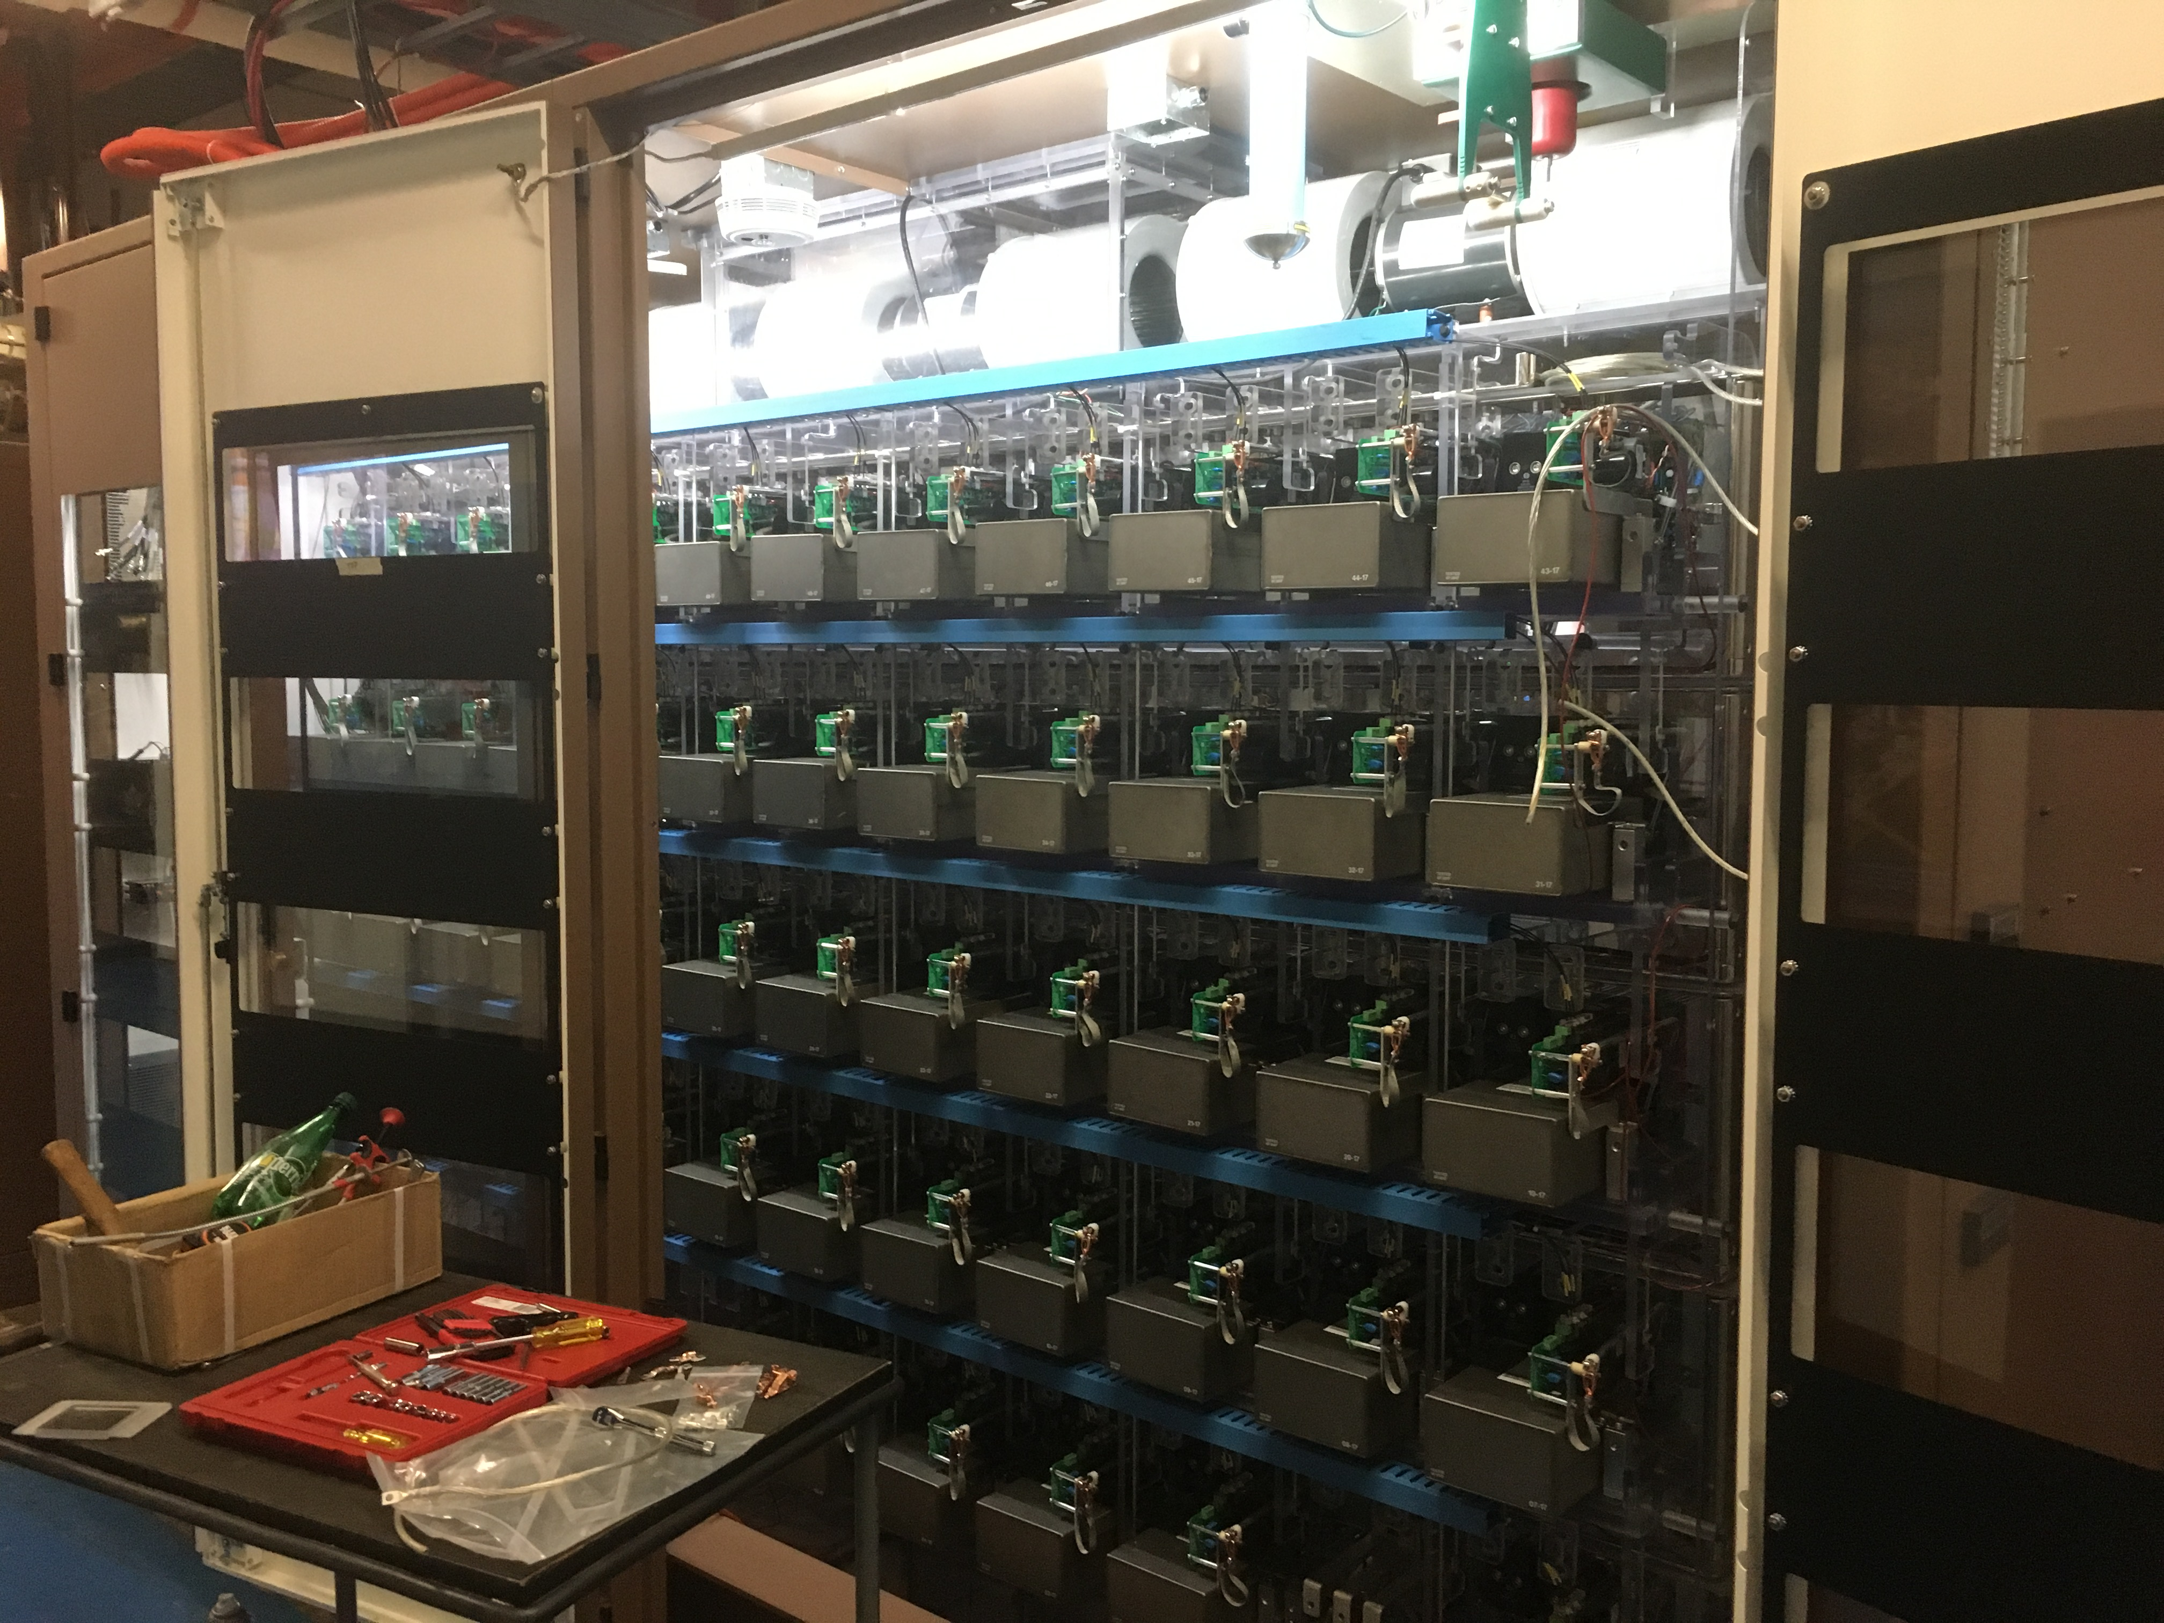
:LRF2/LRF5
LRF5
LRF2

Slide 4
Booster
BRF22 cavity installed
Aligned
CHG0 torroid moved
Shielding tests for CHG0 torroid continues
BRF22 PS room prep continues
Cable pulls for L11 perpendicular cavity
Kicker loads were inspected/cleaned/repaired
Correctors were inspected
Corrector at L10 was found to be suspect and was replaced
Corrector at L4 will be replaced today

Slide 5
Booster
Cleared out rack space for new BPM electronics installation
LCW leaks on back tuners on BRF1 and BRF17
LRF1 tuner was fixed in place
LRF17 needed to be pulled out for repair
Was re-installed yesterday morning after repairs
IP61 & IP62 will be replaced today
General RF maintenance
Notch absorber frame installed
Marble shielding still to be installed

Slide 6
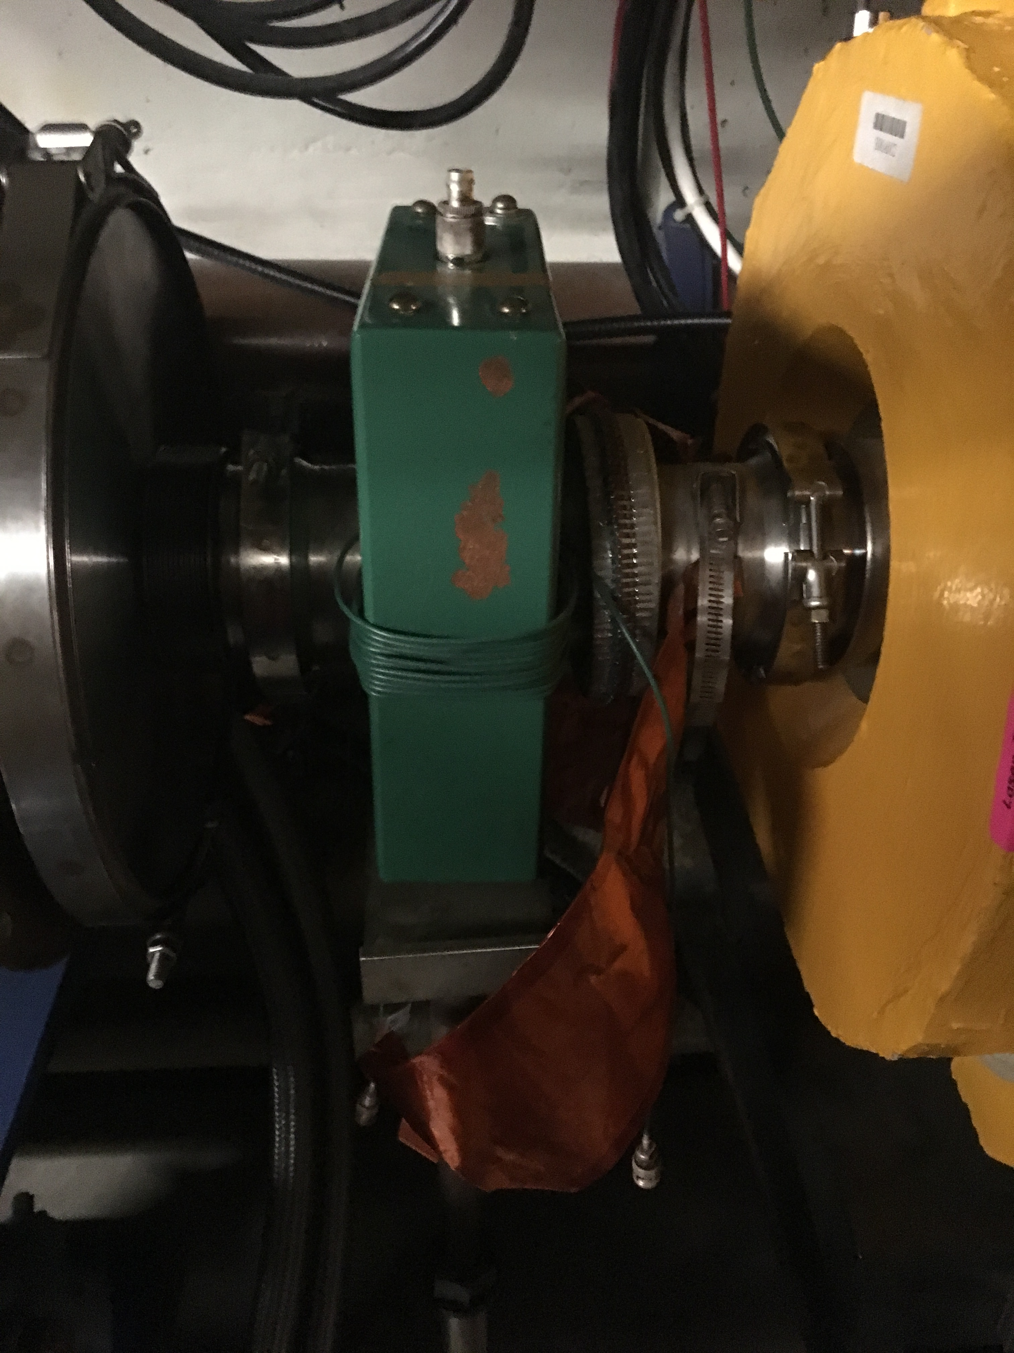
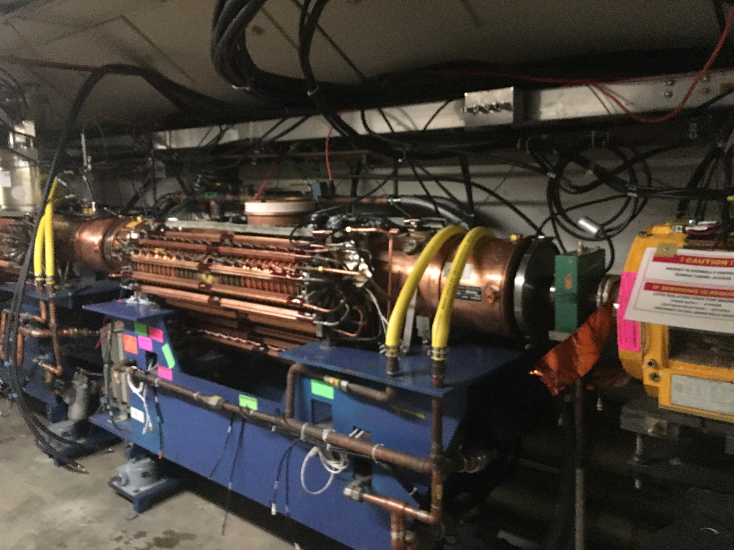
BRF22

Slide 7
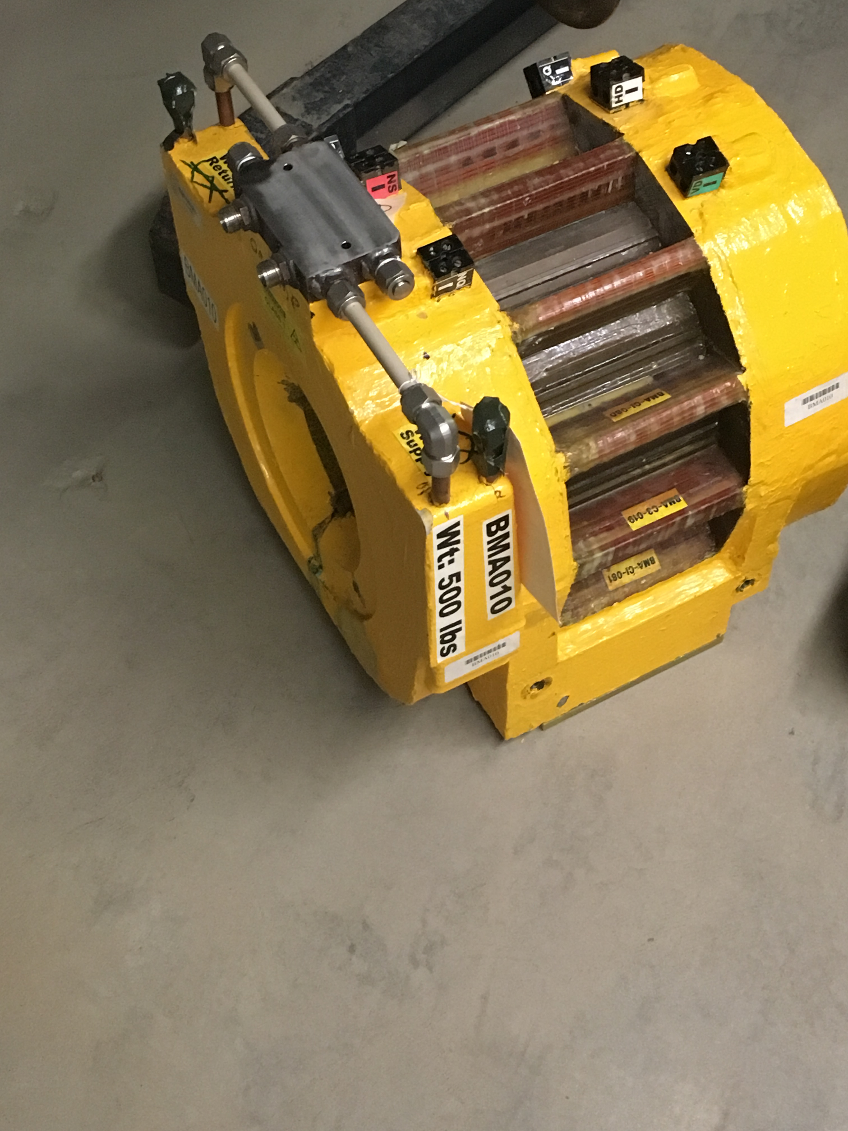
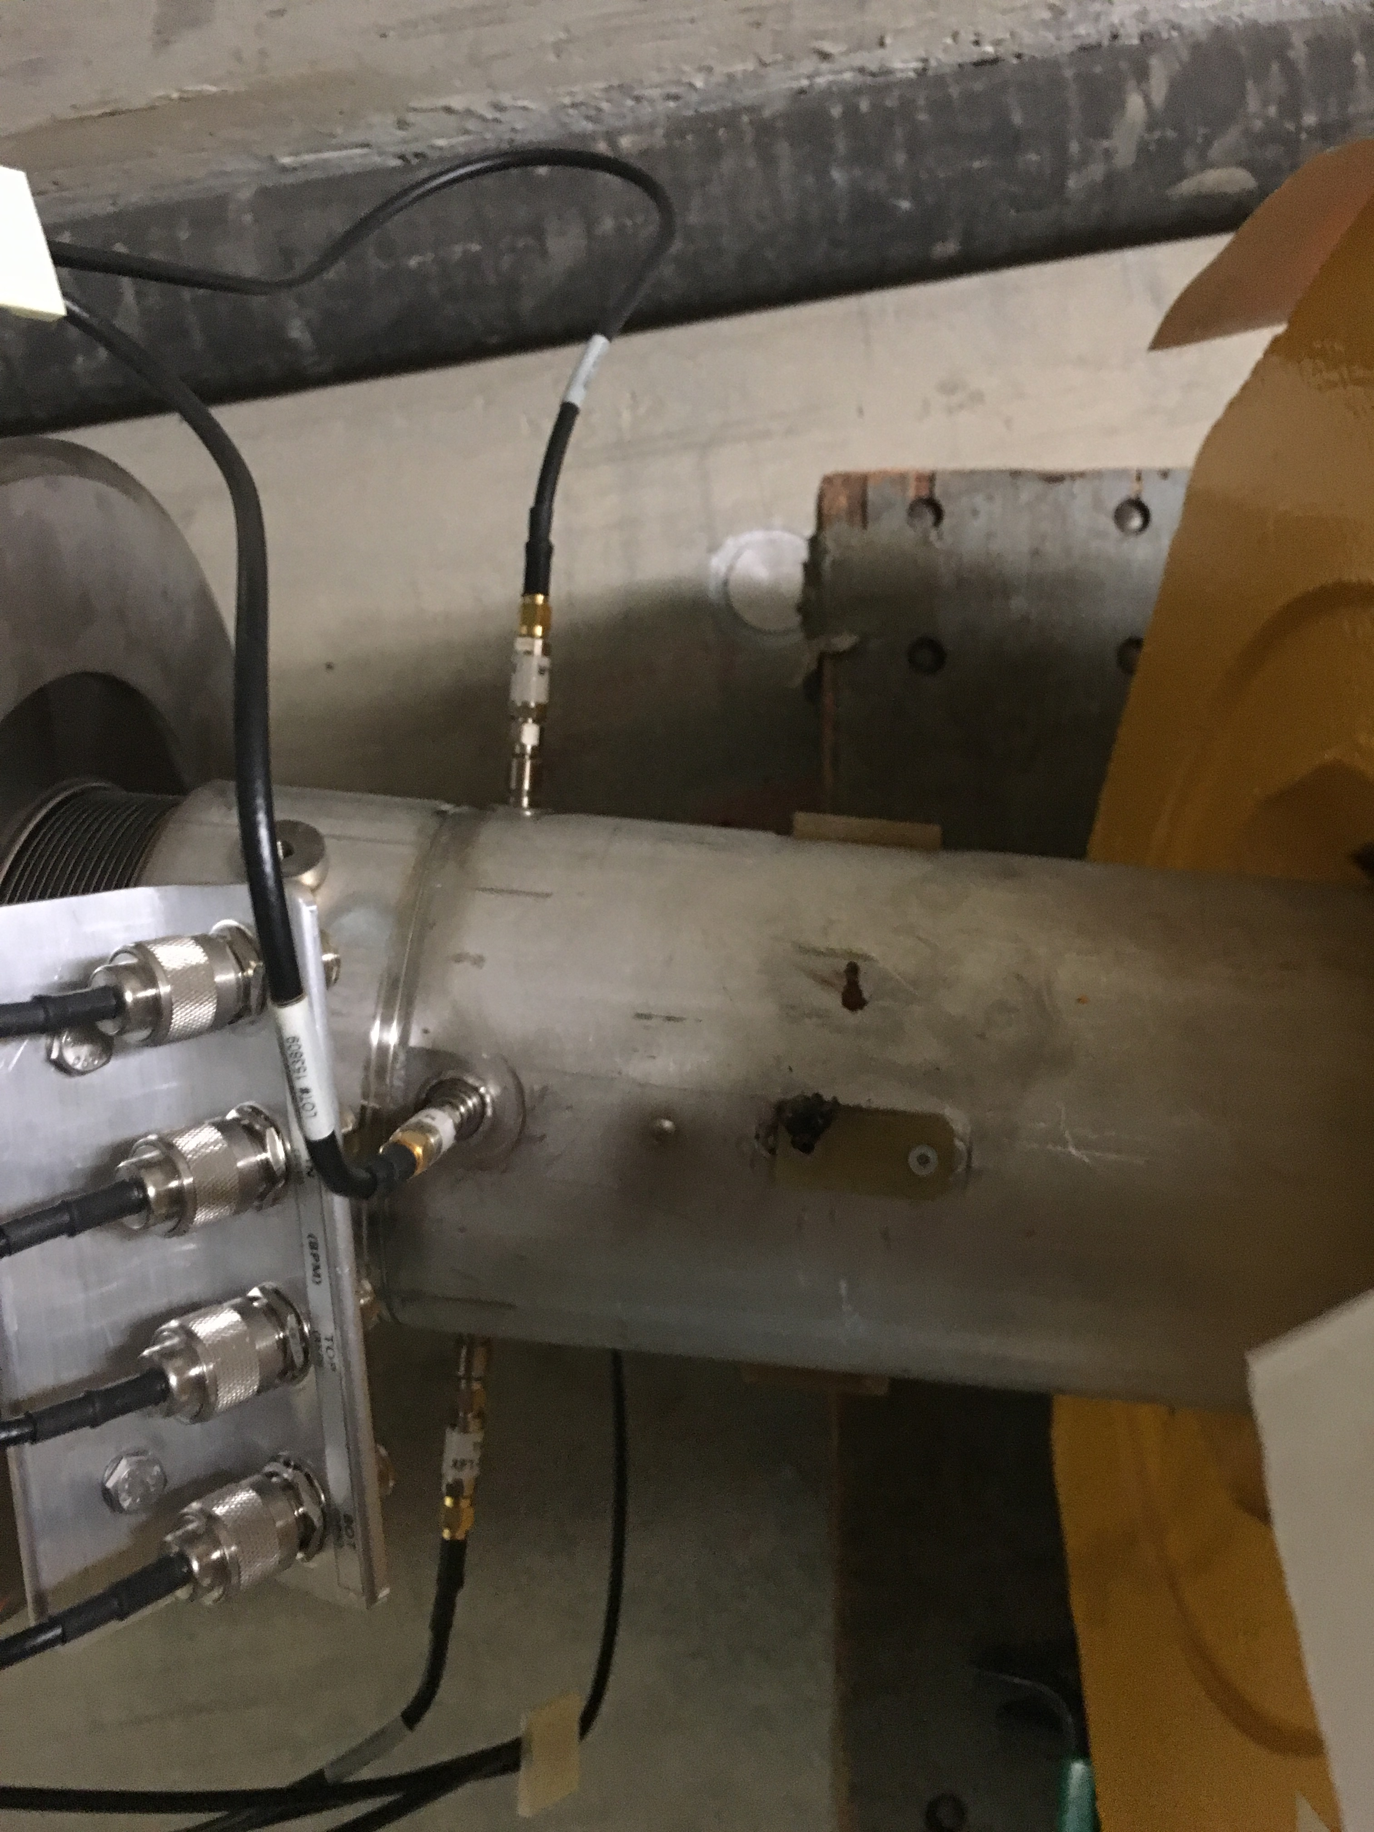
L10 Corrector

