Slide 1
Delivery Ring Update
Jerry Annala
Muon Campus Shutdown Status - week 6
18 August 2017

Slide 2
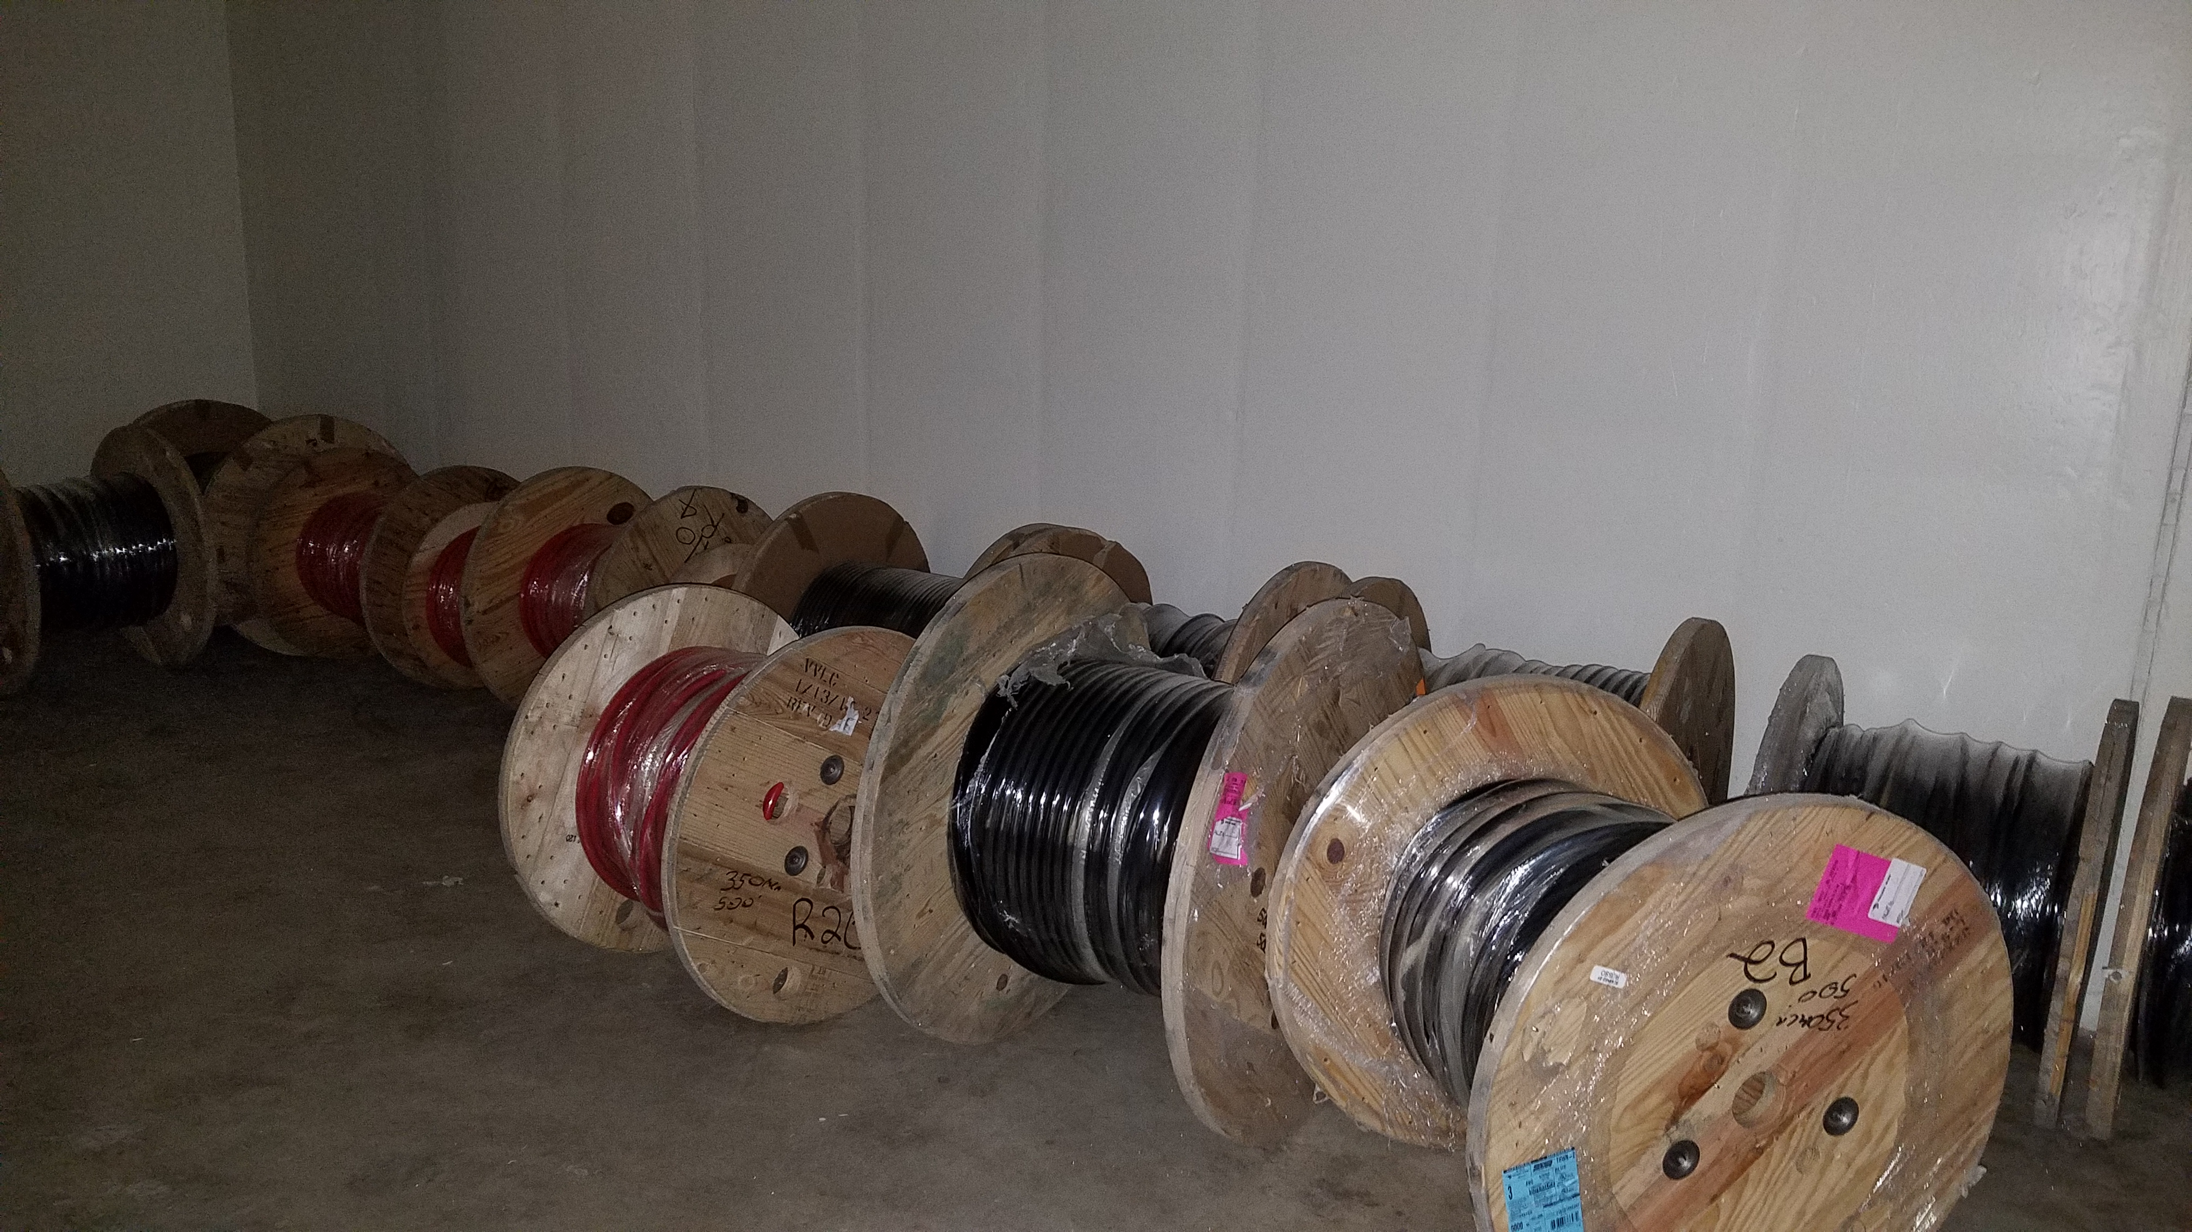
Major shutdown efforts
Install the M4 line
Magnets installed past the temp shield wall
Cable being staged for installation
Water connections removed to allow cable installation

Slide 3
Install new pulsed septa magnets
First Magnet is at NWA
Magnet has been pumping since 8/10/17
Vacuum pressure at 5e-4 torr yesterday
Power glitch Wednesday night set back the pump down by two days
Had planned to move magnet to tunnel on Monday and receive the second magnet for pump down.

Slide 4
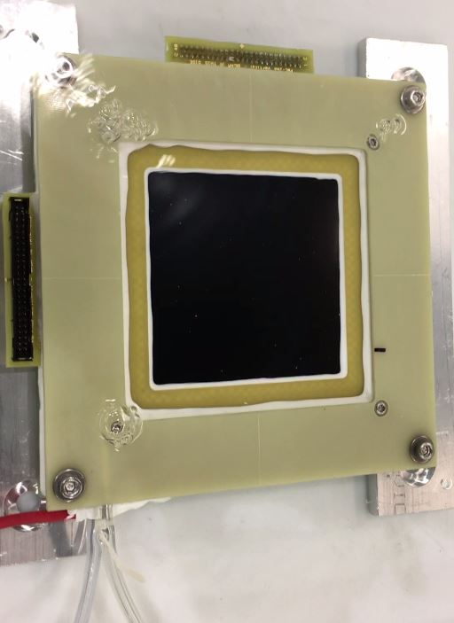
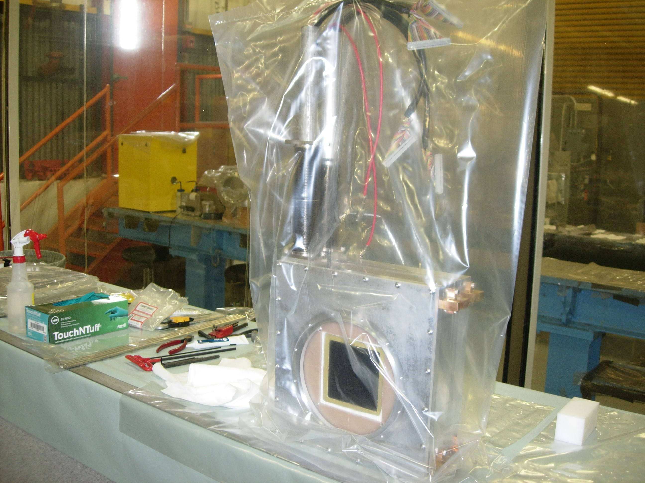
Repair of PWCs and Ion Chambers
25 instruments needed for installation
5 available for repair at this time
2 chambers are being used to evaluate repair process

Slide 5
Additional jobs
Installation of 3 extra correction elements
Need to manufacture stands for two
Search for aperture restrictions
Have inspected the M2 and M3 lines
Will still inspect the M4 and M5 lines

Slide 6
Schedule
Electricians begin pulling M4 line cable as soon as they can be moved to Muon Campus
Resume AP-0 pulse testing Monday
Begin installation of abort Septum magnet on Monday
Review the complete instrument repair procedure Monday with goal of moving to assembly line like repair.

