Slide 1
Final Report: Transfigured Electron Double Slit Experiment (TEDSE)
Phila Rembold Supervisor: Roger Dixon
University of St Andrews (UK)
Helen Edwards Internship – Final Report
8/24/2017
Notes:
Quantum experiment
Not heard
Introduce back ground

Slide 2
Structure
Background
Experiment Setup
Energy Loss
  Collisional
  Radiative
Wave Function
  Splitting
Summary
|Ѱ|²
I_{left}
I_{right}
x₀
x_{septum}

Slide 3
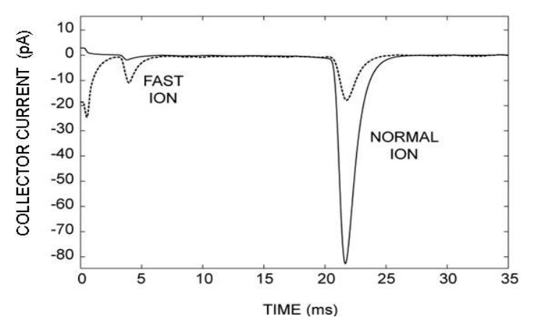


1. Background - Fractional Force
collector
Original Experiment:
Superfluid Helium
Insert electrons into He
  Bubbles form (“ions”)
Accelerate ions via ${\vec{E}}_{acc}$
Measure mobility $μ \sim R^{−\frac{1}{2}}$
Size should be constant
$${\vec{E}}_{acc}$$
grid
ion source
BUT: Fast Ions!!
Credit: Elser et al., Journ of Low Temp Phys, V 123, p7 (2001)
Notes:
Bubbles: 1eV higher E
Cavity radius R
Drag force (rotons, phonons)~R^2
Also measured photon energy excitation

Slide 4
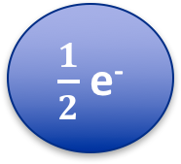
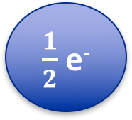
1. Background - Fractional Force
electron
$\frac{1}{2}$ e⁻
e⁻
electrinos
$\frac{1}{2}$ e⁻
How does an electric field influence each part?
partial vs full
wave function
Credit: Elser et al., Journ of Low Temp Phys, V 123, p7 (2001)
Notes:
Measurement: not full but partial wave
Repeated 3 times

Slide 5
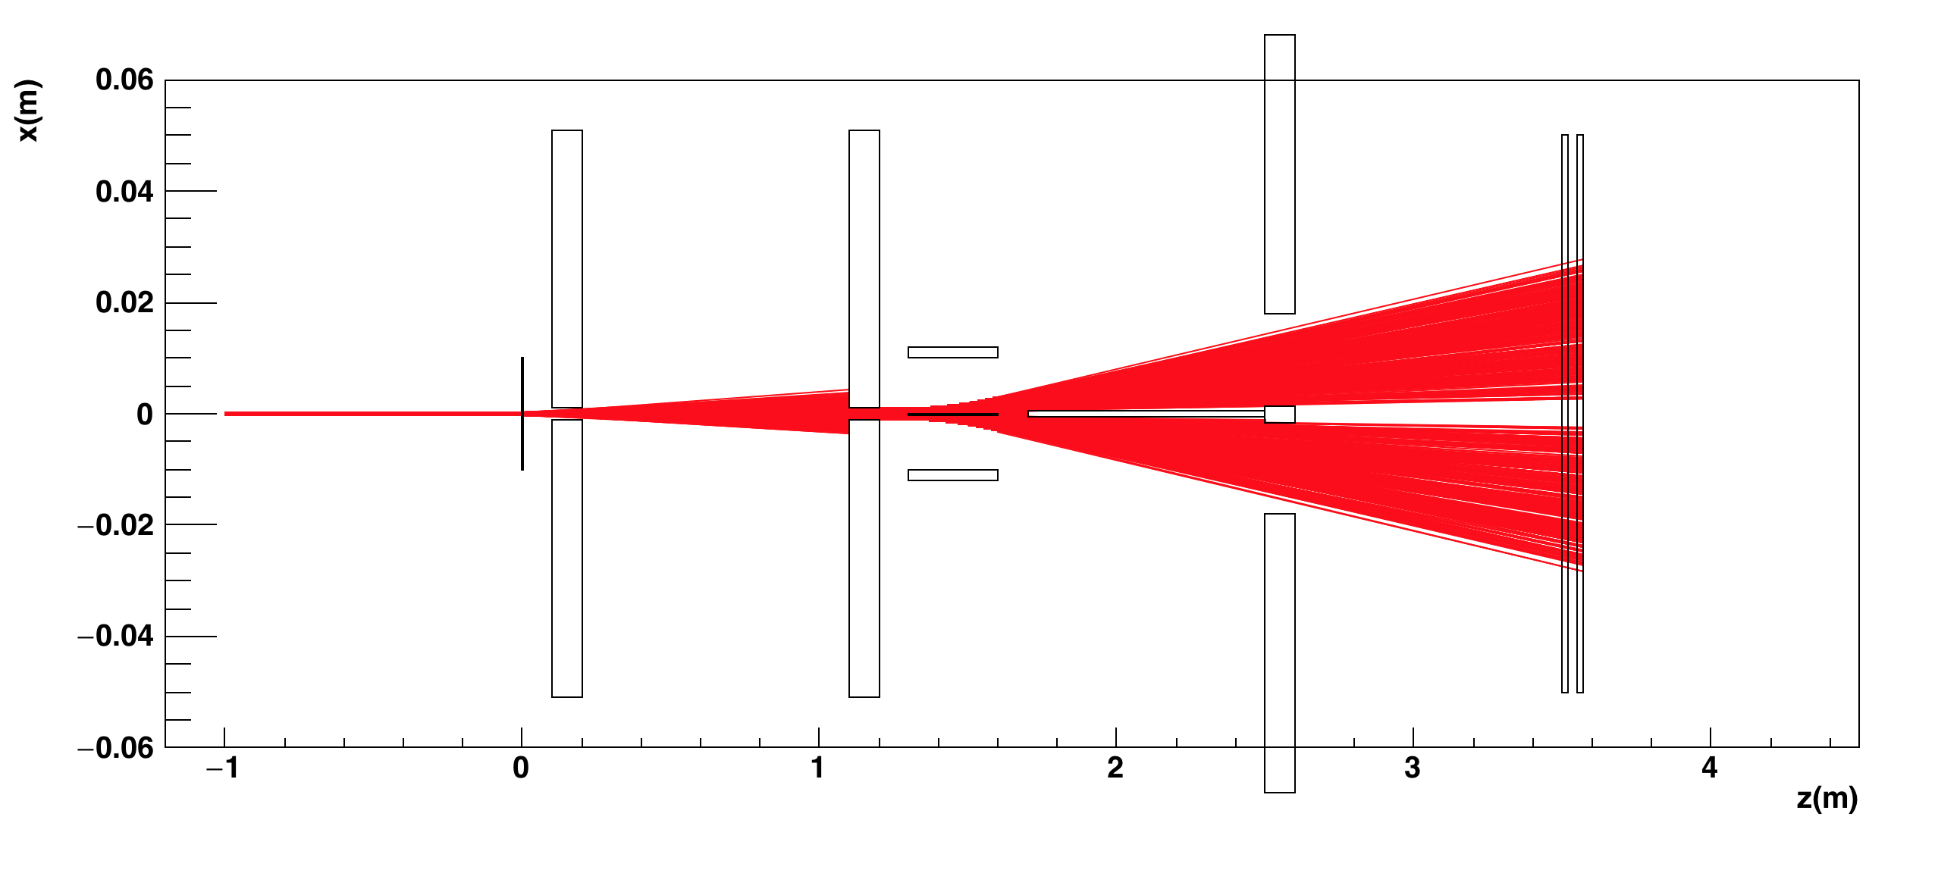
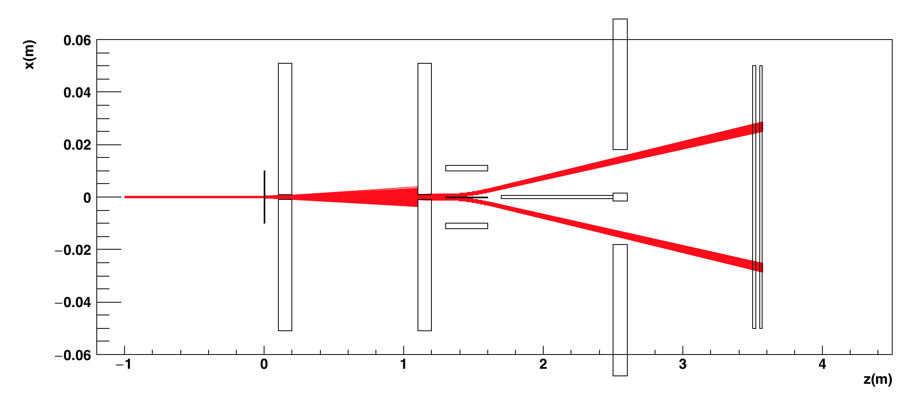
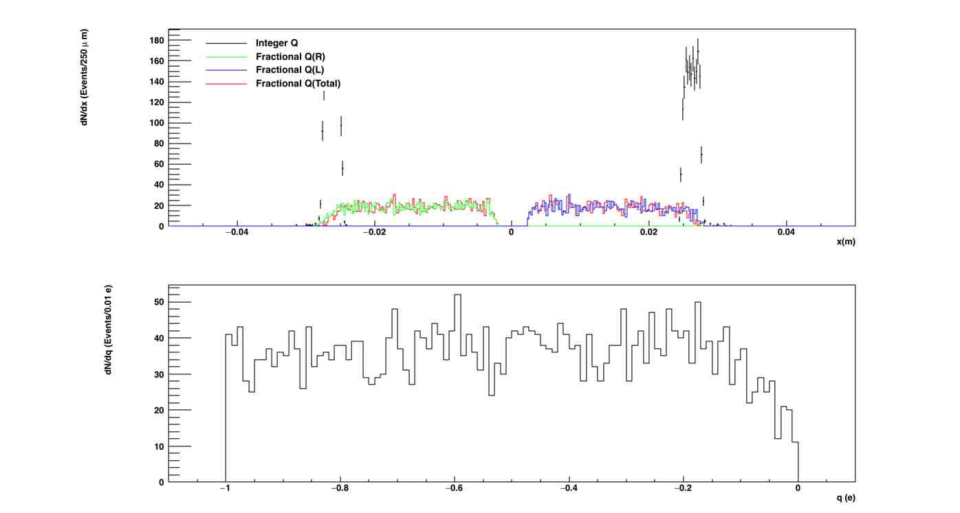

2. Experiment Setup
collimators
position detector
target
electron beam
E
septum
extended septum collimator
$$\vec{F}=q\vec{E}$$
Notes:
Center, outside detector

Slide 6
3.1 Energy Loss - Collisional
Scattering off atomic electrons in the target:
Ionization
Excitation
→ Heat
→ Dispersion of beam
→ Broader wave function
Credit: T Mehdi (2015) ARXIV:1501.00836

Slide 7
3.1 Energy Loss - Collisional
energy loss enabled
energy loss enabled
energy loss disabled
energy loss disabled

Slide 8
3.1 Energy Loss - Radiative
Bremsstrahlung
Problems: Photons Pair Produce
→ False Signals
Damage Detector
Electrons Get Strongly Bent
Solution: Magnet
→Bend Electrons Away
Catch Bent Electrons
Credit: https://de.wikipedia.org/wiki/Bremsstrahlung

Slide 9
3.2 Energy Loss - Radiative

Slide 10
3.2 Energy Loss - Radiative
By bending the electron beam, we effectively move the photon beam away from the important detector parts.

Slide 11
3.2 Energy Loss - Radiative

Slide 12
3.2 Energy Loss - Radiative
0.17mT
Byproduct: Momentum Selection

Slide 13
4.1 Wave Function - Splitting

Slide 14
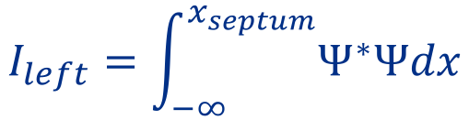

4.1 Wave Function - Splitting
|Ѱ|²
$$I_{left}=\int_{−∞}^{x_{septum}}{Ψ^{∗}Ψdx}$$
$$I_{right}={1−I}_{left}$$
I_{left}
I_{right}
x₀
x_{septum}

Slide 15
4.1 Wave Function - Splitting
full electron
full electron
uniformly split wave function
gaussian split wave function

Slide 16
5. Summary
Better understanding of backgrounds
  Collisional → produces signal tail
  Radiative → magnetic field to avoid brems-photons
Wave functions need to be understood better
  Possibly numerical simulations of TDSE to see
  effect of EM fields on wave function
Optimize detector further
Thank you for the support to:
Roger Dixon - Supervisor
Richard Tesarek - Co – Supervisor
Patrick Fox - theoretical advice
Alexander Valishev - IOTA specifications
Notes:
Find perfect IOTA beam conditions
Extra focus?

Slide 17
*Back Up (Experiment Setup)
collimators
position detector
target
electron beam
E
septum
extended septum collimator
$$\vec{F}=q\vec{E}$$
Notes:
Center, outside detector

Slide 18
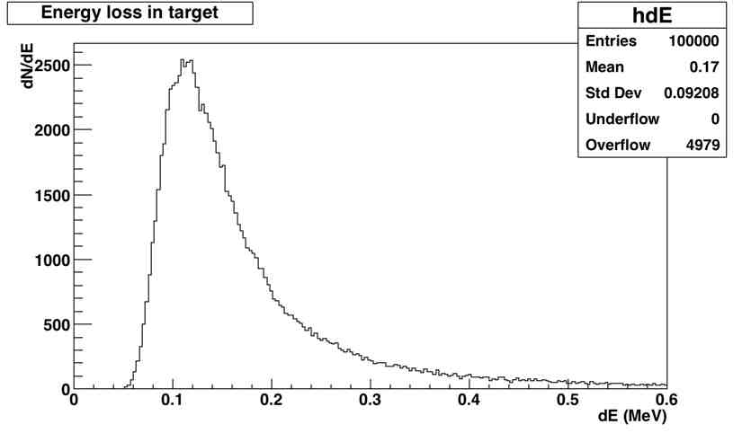
*Back Up (Energy Loss – Collisional)
fwhm
Bethe
Møller

Slide 19
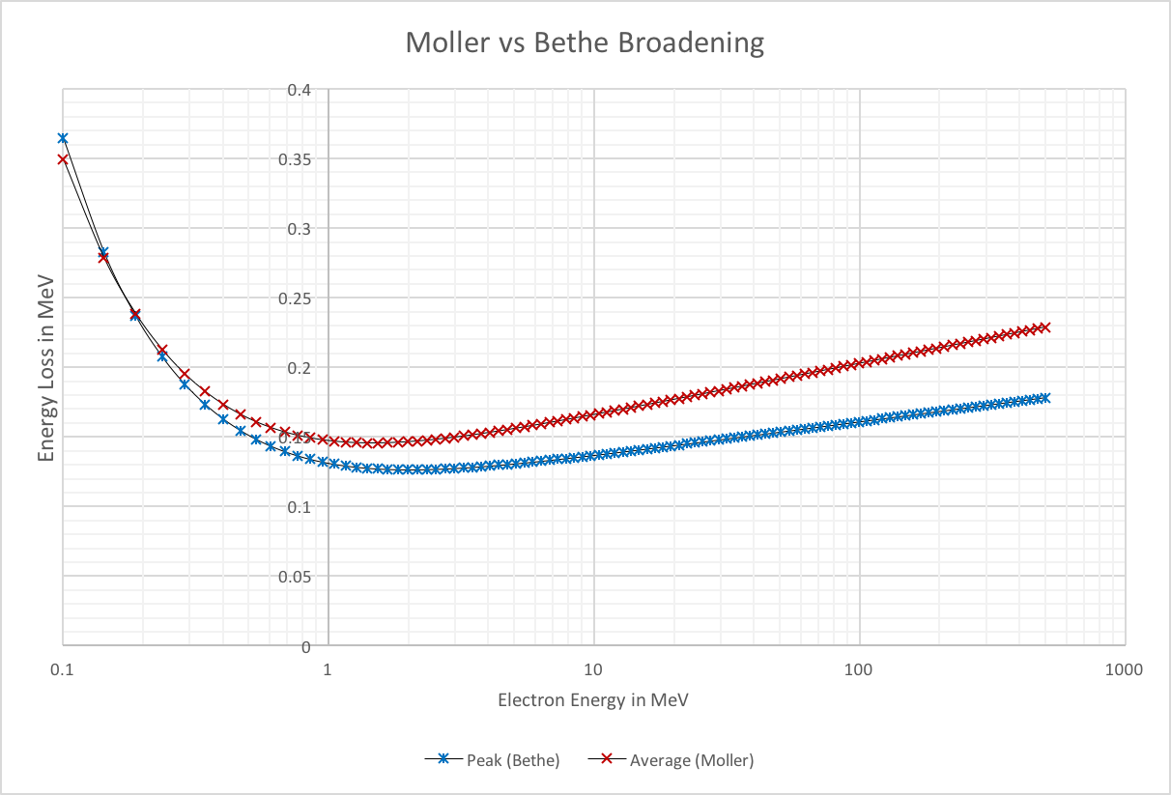
*Back Up (Energy Loss – Collisional)

Slide 20
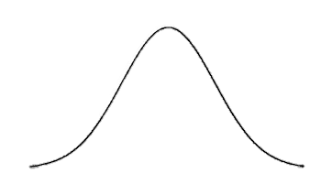




*Back Up (Wave Function – Force Calculations)
Partial Force
Differential Force
$$\vec{E}$$
$$\vec{E}$$
I_{left}
I_{right}
I_{left}
I_{right}
I_{left}
I_{right}
$${\vec{F}}_{par}=Iq\vec{E}$$
$${\vec{F}}_{dif}=(I_{left}−I_{right})q\vec{E}$$

