Slide 1
Characterisation of SRF Cavity Materials
George Lewis
Supervisor: Yulia Trenikhina
PARTI/Helen Edwards Final presentation
24 August 2017
Notes:
With focus on nitrogen treated niobium

Slide 2
Timeline of my Fermilab internship
Introductions
Reading
Analysis of a temperature series of nitrogen infused samples
In-situ baking and nitrogen treatment
Weeks at Fermilab
1 2 3 4 5 6 7 8 9 10
Solo use of SIMS
Coding of data analysis software
Analysis of samples prepared with variations on the 120 °C nitrogen infusion recipe
Analysis of previous work and ongoing experiments
Notes:
Explain contents of talk and that I will explain T series in greater detail and only mention a couple of the other experiments

Slide 3
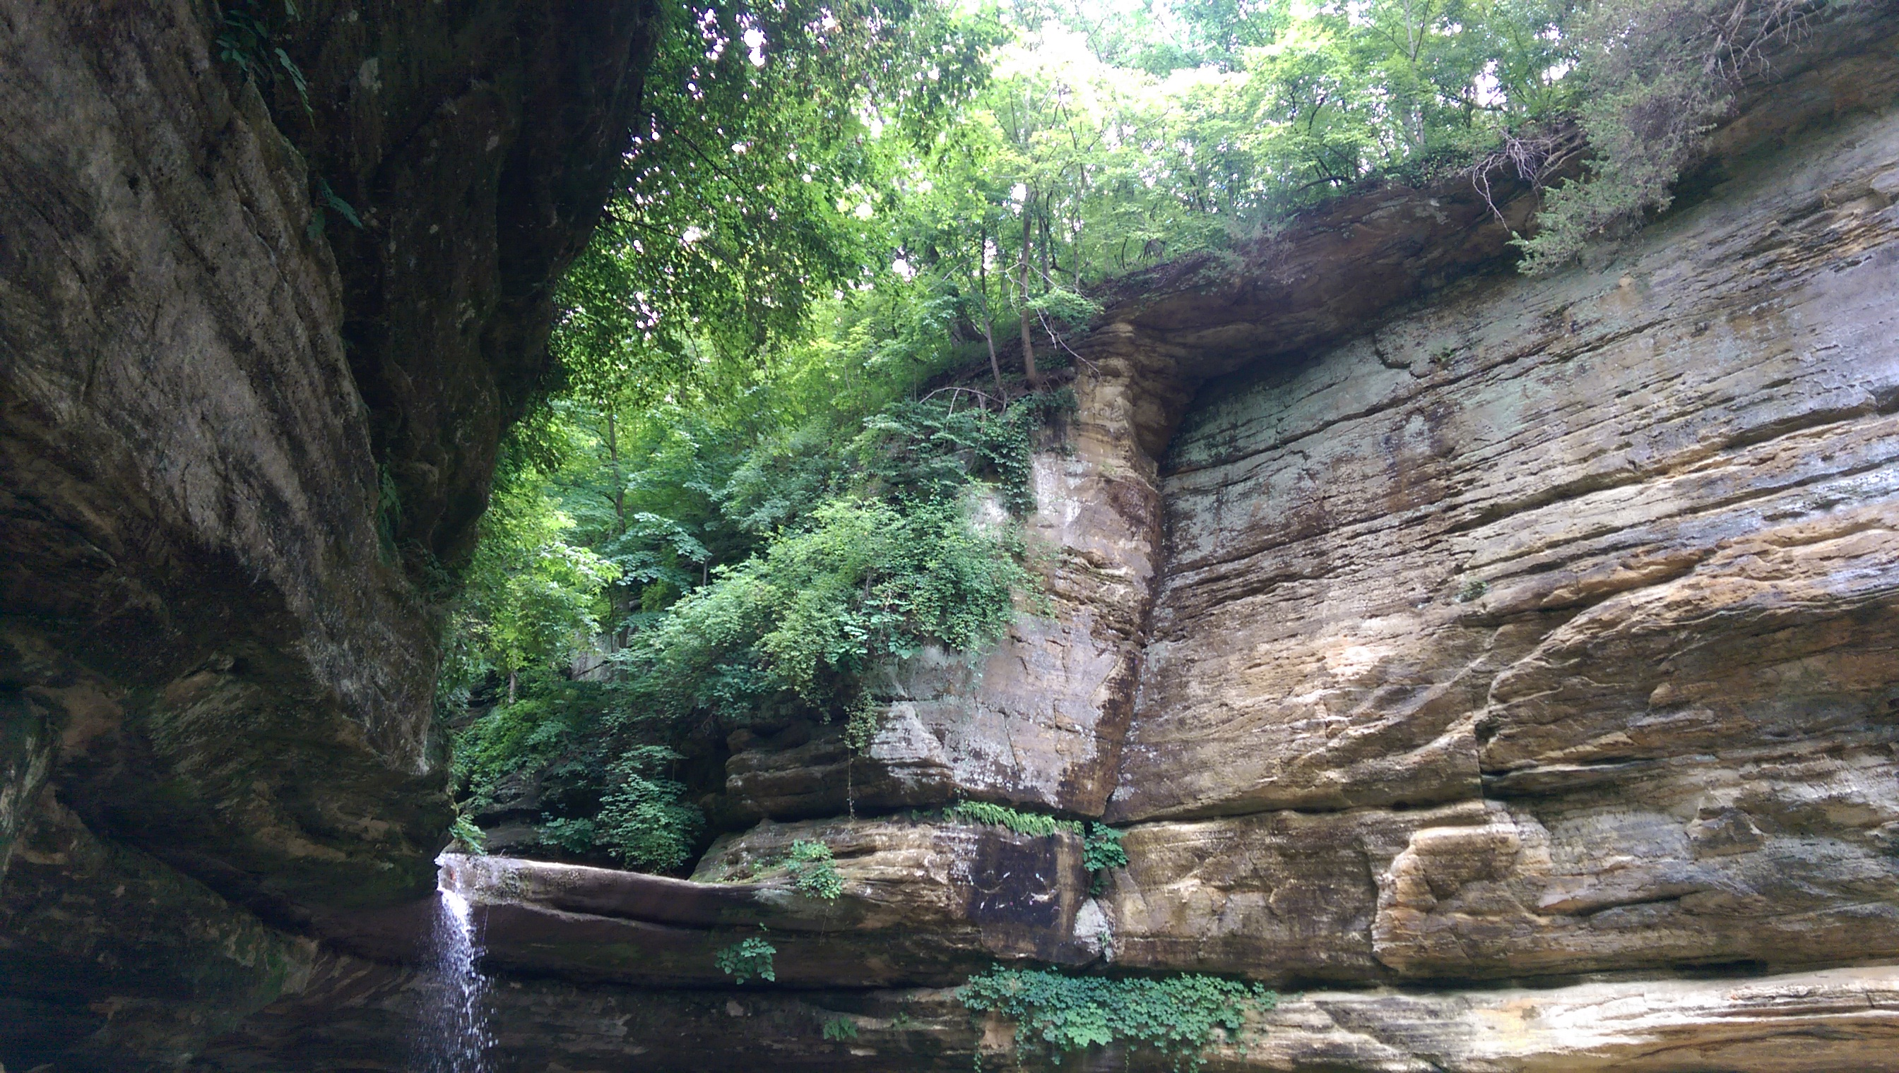
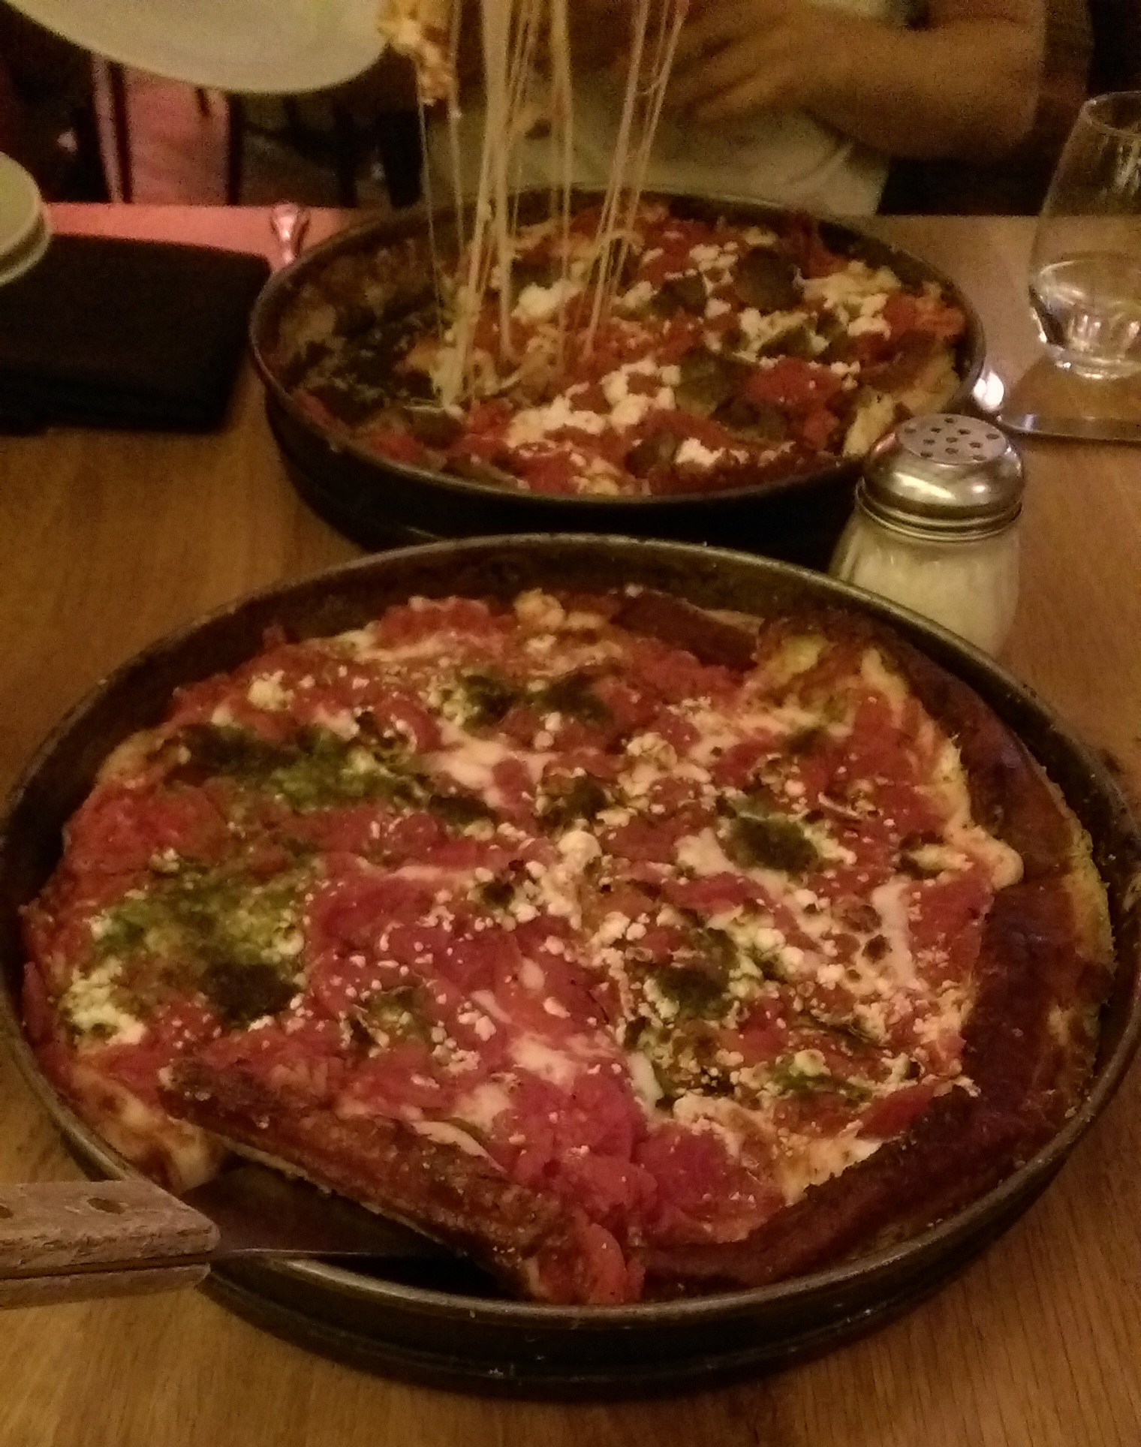
Timeline of my Fermilab internship
Weeks at Fermilab
1 2 3 4 5 6 7 8 9 10

Slide 4
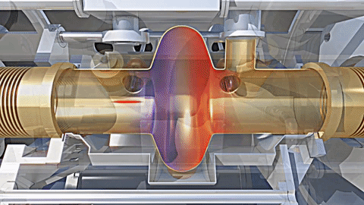
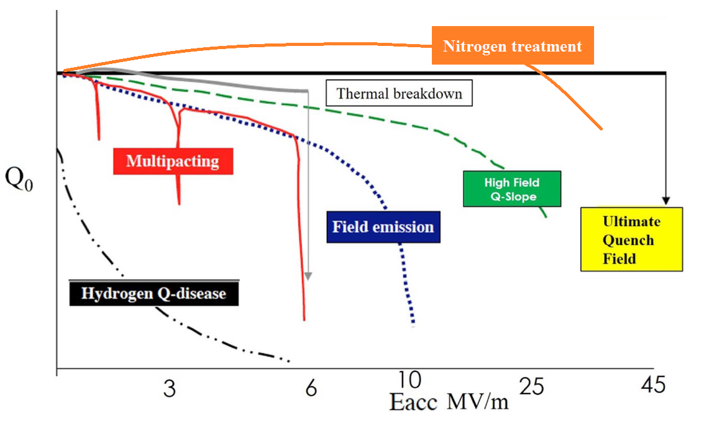
Background – SRF cavities and nitrogen treatment
Superconducting radio frequency cavities
Efficient accelerators
$$=$$
+ Less chance of voltage breakdown
+ Each bunch always sees accelerating field
+ Standing waves store large amounts of energy
+ Superconductivity reduces surface resistance
- Power is still dissipated in the cavity walls
- Costs per unit length are very high
Figure 1: Bunch acceleration in an SRF cavity¹
Even more efficient accelerators
Nitrogen treated SRF cavities
$$=$$
+ Nitrogen treatment lowers surface resistance
(Provides barrier to vortex nucleation)
+ Doping and infusion offer tailored benefits + Higher Q₀ means lower total costs
± We still need to know more about it!
Figure 2: Typical Q degradation caused by various phenomena²
¹ CERN, 2014 http://cds.cern.ch/record/1709737
² Modified from Padamsee, 2017
Notes:
FAST at Fermilab (27 cells),
LEP-II at CERN (176 cells)
ILC, future collider (144 000 cells)
RF beats electrostatic because less limited by breakdown
Work by putting standing wave in cavity, bunch always sees a field that accelerates it.
Time varying B field induces current in surface (Faraday’s law $∇E=−\frac{∂B}{∂t}$ ) so most energy is lost in the walls of the cavity – reducing resistance lowers losses.
SRF still has some loss because High frequency B field penetrates surface layer and induces oscillations in electrons not bound in Cooper pairs,
Nitrogen treatment appears to lower this resistance. Particle accelerators are used widely across science, industry, medicine and security, producing products with a net worth in excess of $500 billion [1]. Research is currently underway to produce Superconducting Radio Frequency (SRF) cavities which will enable the production of a new class of simple, compact and efficient accelerators that will find broad application throughout society [2].
The merit of an SRF cavity is measured by its average accelerating gradient $E_{acc}$ and its quality factor $Q_{0}$ which is a measure of the number of oscillations before the stored energy is dissipated. Typically, at medium $E_{acc}$ fields, it is found that $Q_{0}$ can drop a factor of two between 5 and 25 MV m⁻¹ [3]. However, with nitrogen doped cavities, a so-called anti Q‑slope is observed, whereby $Q_{0}$ is actually increased above the theoretical prediction for pure niobium over this range [4]. Research into optimising the doping process to produce high $Q_{0}$ for medium fields has been successful and a recipe for building cavities has been developed which depends upon the presence of low levels of interstitial nitrogen introduced by injection of nitrogen for 2 minutes and 6 minutes of annealing all at 800 °C, followed by removal of 5 µm by Electro-Polishing (EP) to remove poorly superconducting niobium nitride phases [5].

Slide 5
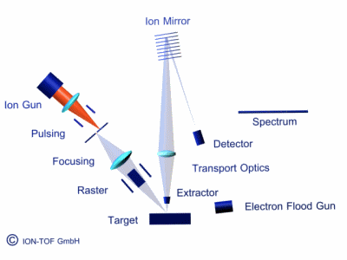
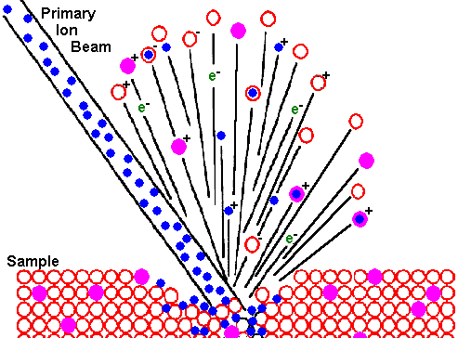
Background – Secondary ion mass spectrometry
¹
One of the most sensitive surface analysis techniques, can detect impurities < 1 ppm
Primary ion beam hits sample to produce secondary ions
Fine control over the primary beam is a major benefit
Can produce depth profiles and surface maps
Exact process is complex and cannot be accurately modelled
+ Detects all elements, including H
+ Extremely high sensitivity
+ Choice of primary ion beam gives many possibilities
- High degree of complexity
¹ SIMS animation by IONTOF
Notes:
Explain normal mass spec: Sample is ionized, accelerated by field, deflected by magnets and detected at the end.
What is the difference? We use a primary ion beam which can be finely controlled, and so we can consequently more precisely analyse the sample.
Things like XPS can’t detect H since there are no core electrons.

Slide 6
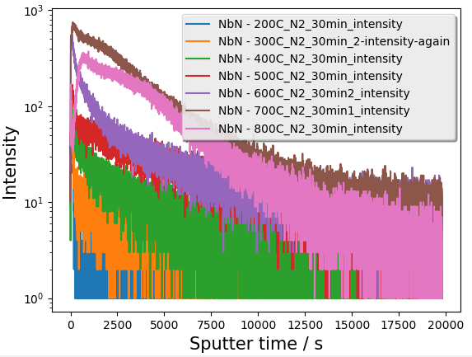
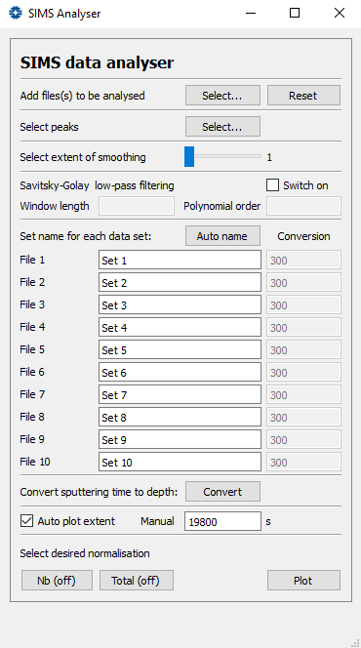
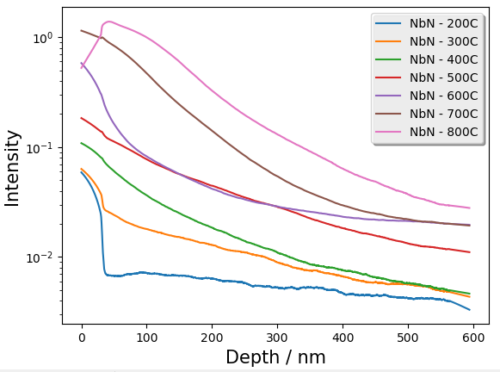
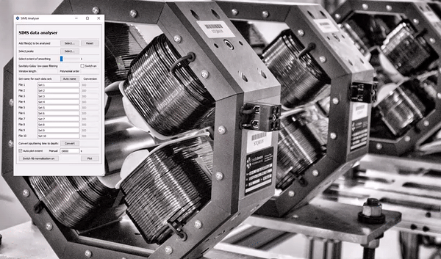
Data analysis
My analysis program
Raw data
Unmodified output
Modified output
Notes:
6000 lines of data
600 lines of code

Slide 7
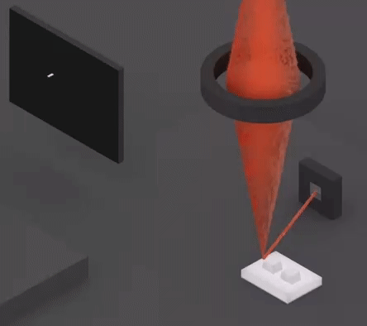
Experiments: Temperature series
At what temperature do poorly superconducting nitride phases form?
Sample preparation
3 hour bake at 800 °C
30 minutes nitrogen infusion at 7 different temperatures
Sample analysis
Depth profiles taken using SIMS
Surface images taken using SEM
Figure 3: Animation of a scanning electron microscope¹
Prediction
Temperature trend should roughly follow Fick’s laws
1st law: $J=−D∇φ$, where $D=D_{0}e^{− \frac{E_{A}}{kT }}$
A phase change should produce some visible difference
¹ Animation by Physics Reimagined
Notes:
1st law: flux goes from regions of high concentration to regions of low concentration
J = Diffusion flux (mol m-2 s-1)
D = Diffusion constant (m2 s-1) follows Arrhenius relation
Phi = Concentration by volume (mol m-3)
Beam scans the surface and impinging electrons eject secondary electrons, number depends on topography
Similar in principle but not destructive

Slide 8
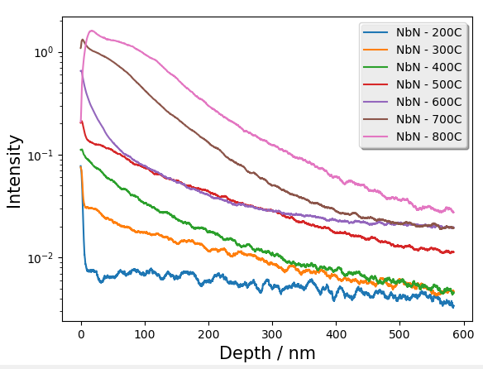
Experiments: Temperature series
At what temperature do poorly superconducting nitride phases form?
SIMS results

Slide 9
Experiments: Temperature series
At what temperature do poorly superconducting nitride phases form?
SEM results
800 ˚C
700 ˚C
600 ˚C
500 ˚C
400 ˚C
300 ˚C

Slide 10
Experiments: Temperature series
At what temperature do poorly superconducting nitride phases form?
Conclusion
700 ˚C
600 ˚C
Shape of depth profile changes from 600 to 700 ˚C
Accompanied by visual change from ‘star-shaped’ to ‘scaly’ nitrides
This possibly suggests a phase transition in the region 600 to 700 ˚C
Future XRD studies will provide further detail
Notes:
Different between grains

Slide 11
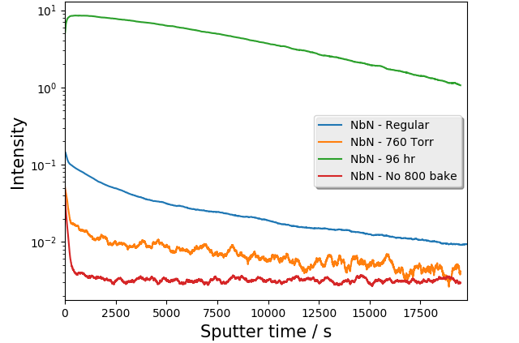
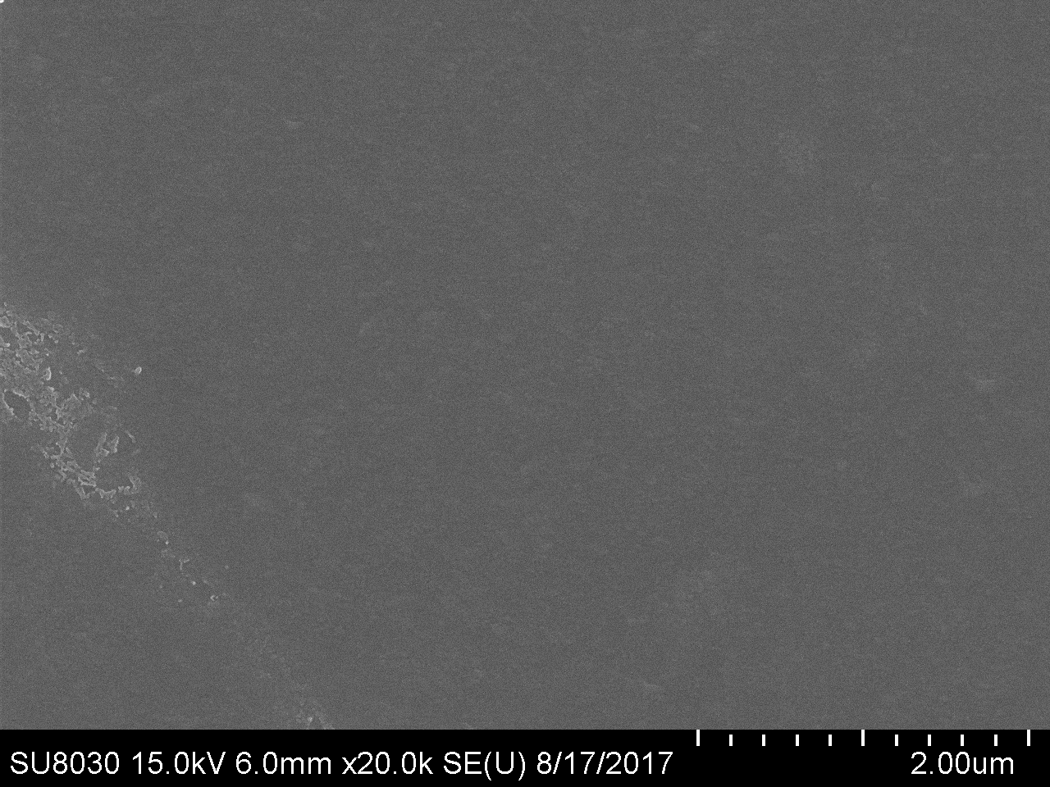
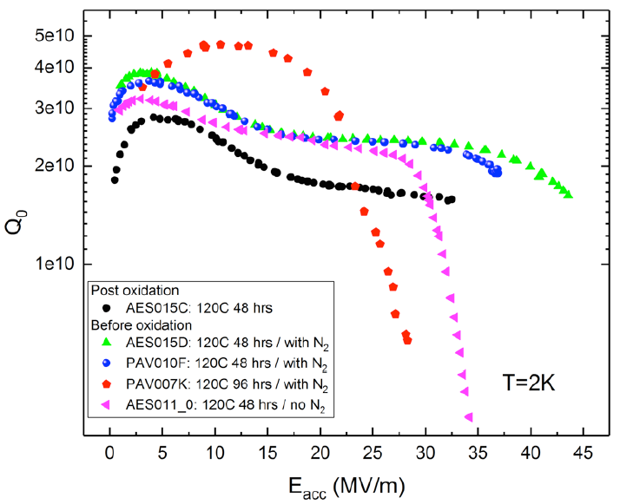
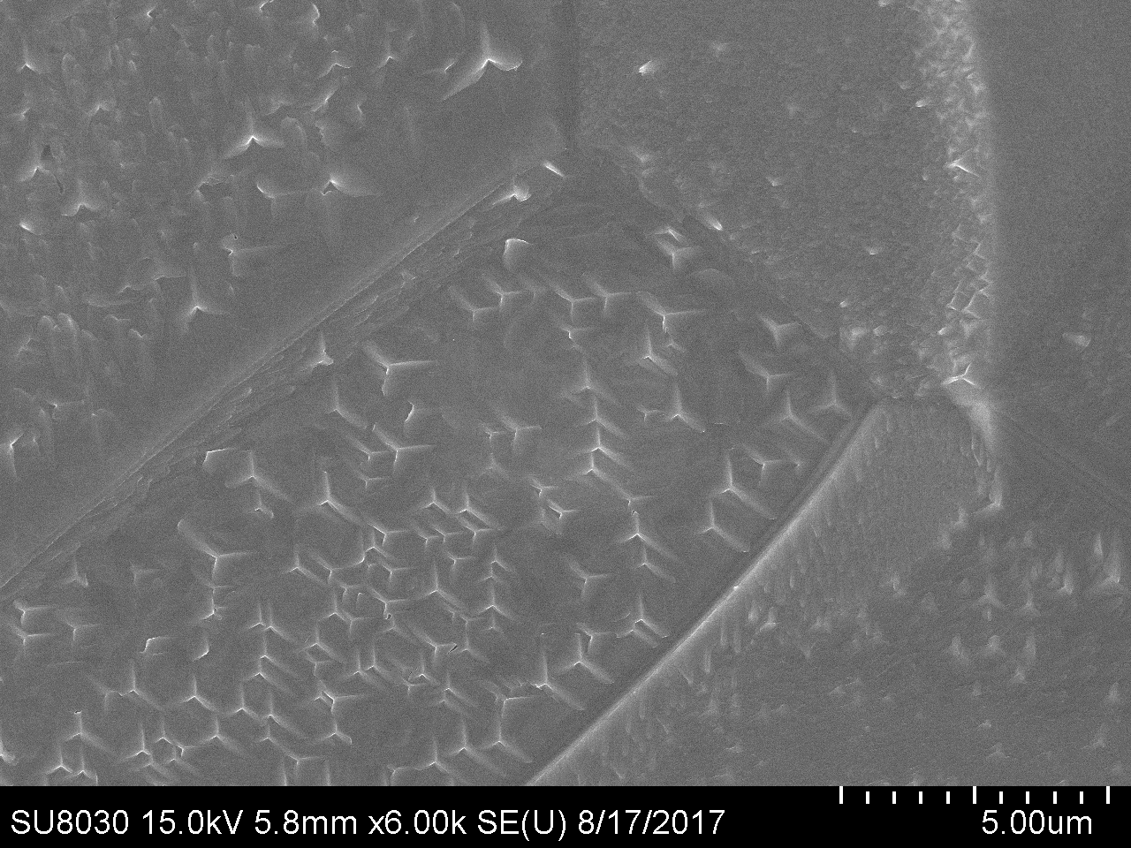
Experiments: 120 ˚C nitrogen infusion variations
What are the best parameters for a nitrogen infusion recipe?
Sample preparation
Standard = 3 hr bake at 800 ˚C, 48 hr nitrogen infusion at 120 ˚C & 25 mTorr
Variations: No 800 ˚C bake, 96 hr infusion, infusion at 760 Torr (1 atm)
Results
Regular
760 Torr
96 hr
No 800 bake
Conclusion
Specific treatments can be tailored for specific results
Notes:
- Real cavities for these samples provide v. useful insight.
- Each is intelligent empirical treatment
No bake allows to look at effect of oxide on infusion since 800 bake would destroy oxide
Got 2 pieces of puzzle, need more

Slide 12
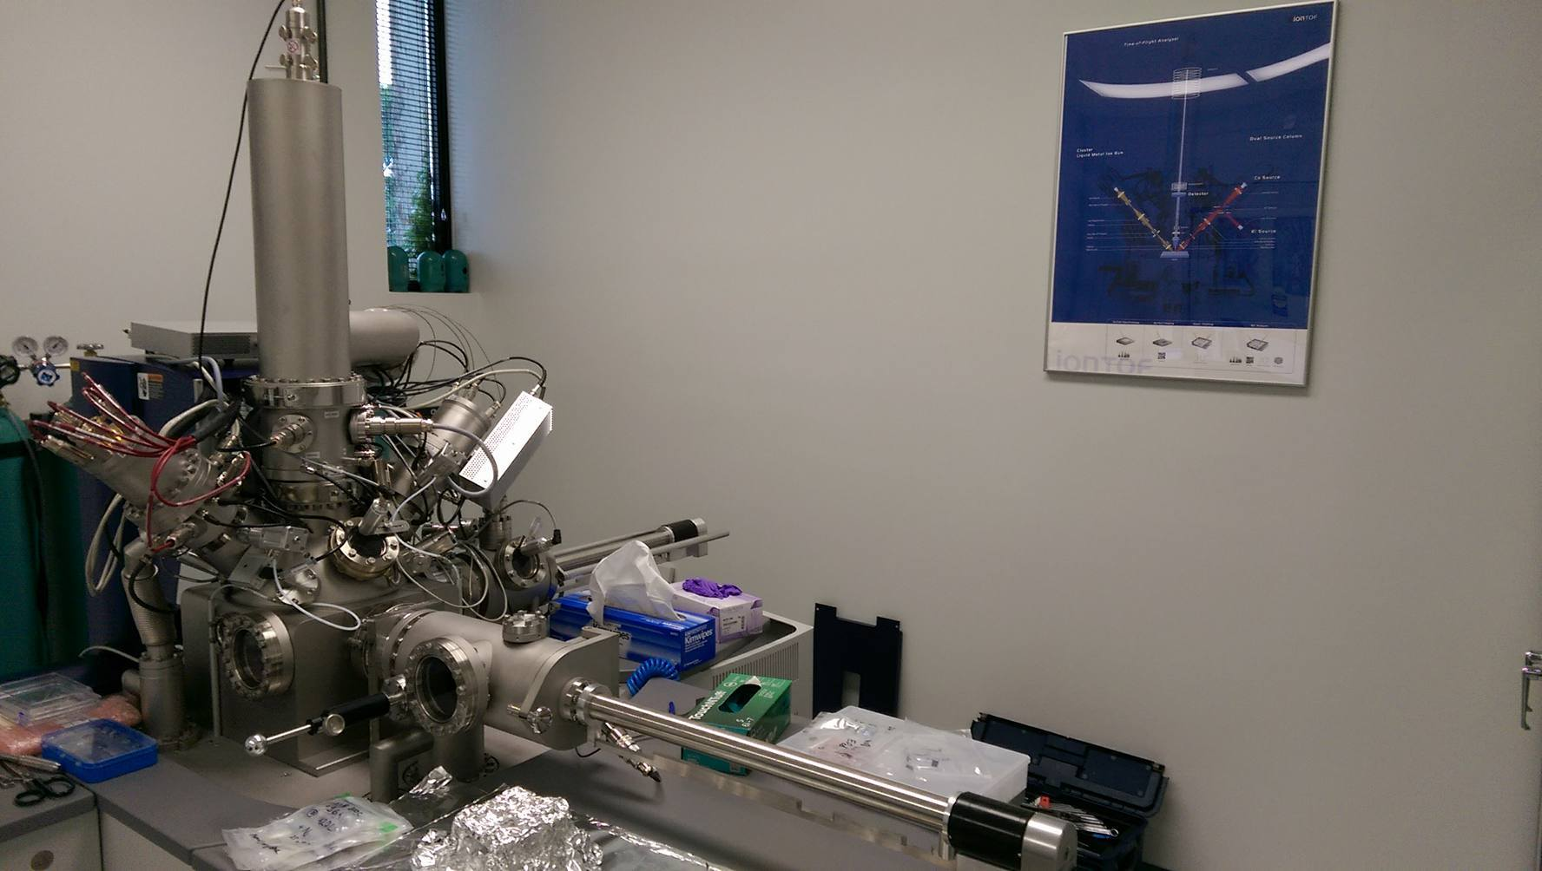
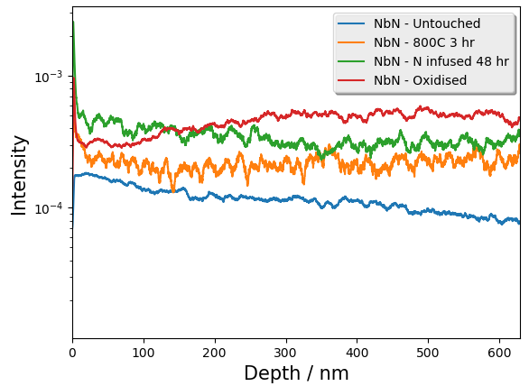
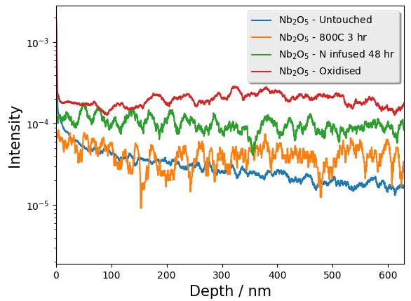
Experiments: In-situ sample preparation
How does oxidation change the nitrogen profile?
TOF detector
Analysis gun
Sputtering gun
Prep chamber
Analysis chamber
Baking chamber
Sample preparation
In-situ preparation allows surface analysis before exposure to oxygen
Results
Conclusion
Trial run using in-situ preparation was successful, oxide layer clearly visible

Slide 13
Conclusion
Several material characterisation experiments performed
Experience gained in SIMS, SEM, python, and being a scientist
Small contribution towards nitrogen-treated SRF cavity research
Finally, to Yulia and all the technical division staff,
the internship coordinators
and my fellow interns…

Slide 14
Further detail – What is an SRF cavity?
Superconducting Low surface resistance, small power loss
Radio Frequency Surface resistance scales as $f^{2}$above 3 GHz
(resonant) Cavity Ellipsoidal shape prevents multipacting
Provides efficient acceleration
Model cavity as LC circuit which produces oscillating E fields
Lorentz force $\overline{F}=q\left(\overline{𝓔}+\overline{v}×\overline{ℬ}\right)$
AC resonators permit high power
Thousands installed worldwide:
FAST at Fermilab (27 cells),
LEP-II at CERN (176 cells)
ILC, future collider (144 000 cells)
Figure 1: Bunch acceleration in an SRF cavity
(CERN, 2014 http://cds.cern.ch/record/1709737)
Notes:
- Normal conducting (Super proton synchrotron CERN) 52 Mw for 315 GeV, Superconducting (HERA) 6 MW for 920 GeV beam
SRF cavities work by creating a standing wave of RF frequency
Bunches of particles are timed to arrive such that they receive maximum acceleration
LEP-II is the biggest, over 400 m of SRF

Slide 15
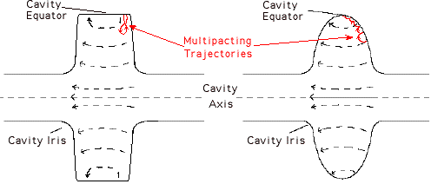
Further detail: Degradation phenomena
Hydrogen disease: Hydrogen dissolved in Nb can precipitate as a lossy hydride. De-gassing by baking at 800 °C and formation of protective oxide solves issue.
Multipacting: Localised, resonant process where an electron avalanche occurs. Requires the time between electron impacts to be an integer number of half RF periods and occur above a threshold energy – this happens at specific E_{acc}.
Thermal breakdown: Small defects (scratches, welding beads etc.) give local non-superconducting regions which heat up, this eventually warms the surrounding Nb above T_{crit} and the defect grows unstably, quenching the cavity. This can be avoided through taking great care in preparation and by increasing T_{c}.
Field emission: Micron sized particles lead to exponentially increasing electron currents which cause a rise in temperature and sharp decrease in quality factor. Advanced cleaning techniques such as HPR and the use of class 10 clean rooms. (Also possible to destroy particulates through RF manipulation).
High Field Q Slope: Q reduction around 25 MV m⁻¹, caused by nanohydrides at penetration depth, EP followed by baking at 120 °C provides an empirical solution.
Notes:
High pressure rinsing – 100 bar of ultra pure water
Class 10 – particles >0.3 microns totally filtered, less no more than 10 particles <0.1 microns per m^3

Slide 16
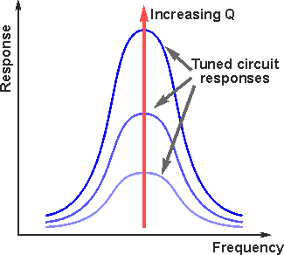
Further detail: Quality factor
Quality factors are widely used in physics to describe the selectivity of a signal, generally, Higher Q = Oscillations take longer to die out
There are several ways of defining Q:
$Q_{0}=\frac{f_{R}}{Δf}=2π\frac{Energy stored}{Energy dissipated } per cycle=\frac{ωU}{P_{d}}$
From $P=\frac{dU}{dt}=VI$ and for an inductor $V=−L\frac{dI}{dt}$:
$U=\int_{0}^{∞}{\frac{dU}{dt}}dt=\int_{0}^{i_{f}}{LI\frac{dI}{dt}}dt=\frac{1}{2}Li_{f}^{2}$
Using equation for inductance of coil $L=μ_{0}n^{2}lA$ and magnetic induction $B=μ_{0}nI (=μ_{0}H)$
we see that energy stored is $U=\frac{1}{2}μ_{0}\int_{V}^{ }{{\left|H\right|}^{2}}dV$
Similar manipulations yield $P_{d}=\frac{R_{s}}{2}\int_{S}^{ }{{\left|H\right|}^{2}}dS$
So we end up with:
$$Q_{0}=\frac{ωμ_{0}\int_{V}^{ }{{\left|H\right|}^{2}}dV}{R_{s}\int_{S}^{ }{{\left|H\right|}^{2}}dS }=\frac{G}{R_{S}}$$
Where G is the geometry factor and depends strongly on cavity shape (but not size).
Notes:
High pressure rinsing – 100 bar of ultra pure water
Class 10 – particles >0.3 microns totally filtered, less no more than 10 particles <0.1 microns per m^3

Slide 17
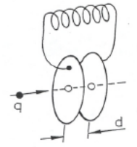
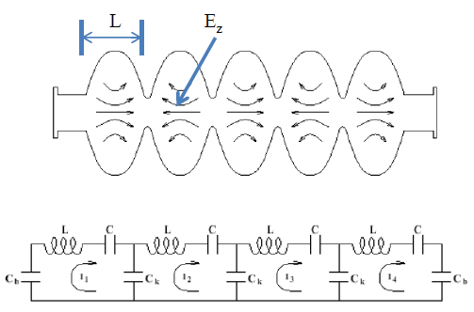
Further detail: SRF cavities as an LC circuit
Picture two capacitive plates with a parallel inductor
This creates a resonator with frequency $ω_{0}=\frac{1}{\sqrt{LC}}$
Now imagine the inductor becomes many single loops of wire, this eventually forms a pillbox cavity
Add a beam tube to allow particles to pass through
Further modify the pillbox cavity to an elliptical one for better field manipulation
=

Slide 18
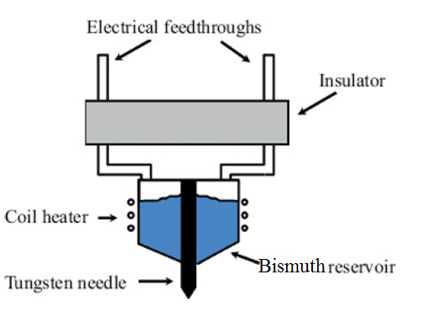
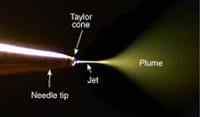
Further detail: Primary ion sources for SIMS
LMIG: Liquid Metal Ion Gun uses bismuth (traditionally Gallium but Bi offers a lower melting point)
Produces short, focused beams for analysis
DSC: Dual Sputtering Column fires cesium/oxygen to enhance yield of electro -positive/-negative atoms respectively and sputters sample fast enough to allow depth profiling

Slide 19
Further detail: Surface resistance in SRF cavities
$$R_{s}\left(T,B\right)=R_{BCS}\left(T\right)+R_{res}\left(B\right)$$
DC superconductors have zero resistance, but not for AC
High frequency B field penetrates surface layer and induces oscillations in electrons not bound in Cooper pairs
The motion of these electrons dissipates power
By considering the current in normal and superconducting regions of the material, it is possible to derive that
$$R_{BCS}∝λ_{l}^{3}ω^{2}le^{−\frac{Δ\left(T\right)}{k_{B}T}}$$
The residual resistance can be caused by impurities, trapped magnetic flux, and lattice distortions.

Slide 20
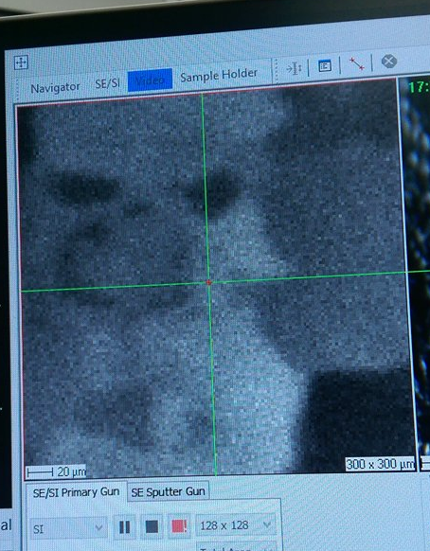
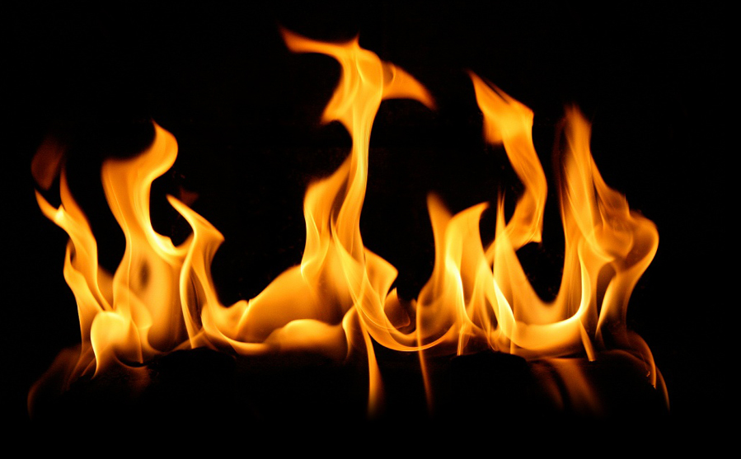
Further detail: Challenges
Instrument issues:
LMIG dropout
Side emission
Network issues
Serious hardware failures
Quantification of data
SIMS and SEM are by nature qualitative methods
Comparing SIMS profiles of different samples
Ion behavior varies depending on: operating currents, exposed crystal orientation, sample holder + many more....
Assimilation of data from different sources
Data from Q vs E curves, SIMS, SEM, XRD, TEM and more must be combined and interpreted coherently
Reduced time for data collection
Notes:
J = Diffusion flux (mol m-2 s-1)
D = Diffusion constant (m2 s-1)
Phi = Concentration by volume (mol m-3)

Slide 21
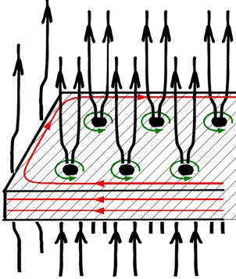
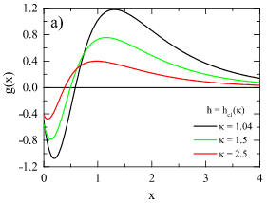
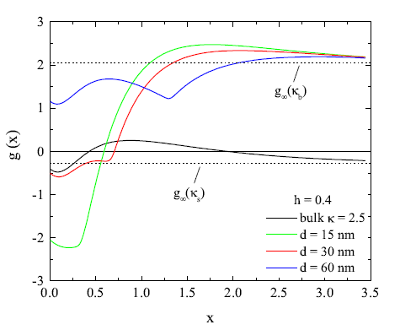
Further detail: Magnetic vortices and dirty surfaces
¹
Vortices can be thought of as a normal conducting core with superconducting currents encircling them which screens the magnetic flux that is confined within them.
Vortices experience an attractive Lorentz force pulling them to the superconductor’s surface due to interaction with currents
There is also a repulsive Lorentz force between the vortex and the applied field which pushes it into the bulk.
Integrating these forces gives the Gibbs free energy density as a function of depth for the vortex, which shows that there is an energy barrier which in the absence of nucleation points, prevents vortices residing in the bulk
$κ=\frac{λ}{ξ}$ the Ginzburg-Landau parameter can be viewed as a measure of the surface cleanliness (higher if dirty due to shorter mean free electron path), so by considering the case where it varies with depth allows us to analyse the effect of a dirty layer.
It turns out that a thin dirty layer means that vortices are less stable in the bulk and require a greater field to survive. Also its presence greatly increases the energy barrier which can explain a lower R_{BCS}.
¹ Graphs from M. Checchin
Notes:
$λ$ is London penetration depth
$ξ$ is coherence length

