Slide 1
Dual Phase Electronics Consortium
Dario Autiero (IPNL Lyon)
DUNE Meeting
August 18, 2017

Slide 2
A few reminders about the dual-phase electronics design
(see also presentation at the May DUNE meeting)
https://indico.fnal.gov/getFile.py/access?contribId=26&sessionId=13&resId=0&materialId=slides&confId=12345
Deliverables list (Info from two documents provided to Eric in July)
List of currently involved institutions
Perspectives
Some general slides discussed by the SPs at the CL meeting on Monday

Slide 3
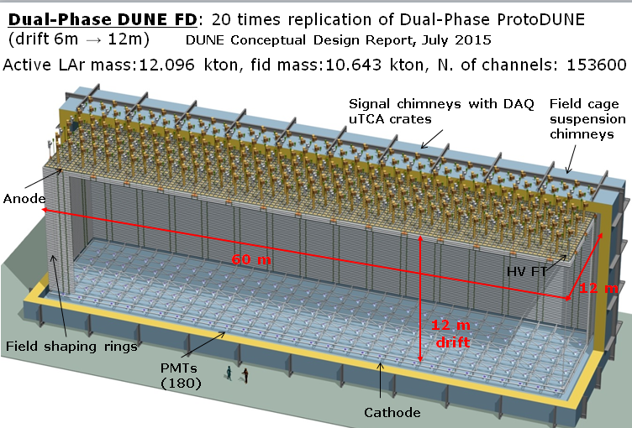
Dual-phase 10 kton FD module
80 CRP units
60 field shaping rings
240 signal FT chimneys
240 suspension chimneys
180 PMTs
153600 readout channels
Advantages of double-phase design:
Anode with 2 collection (X, Y) views (no induction views), no ambiguities
Strips pitch 3.125 mm, 3 m length
Tunable gain in gas phase (20-100), high S/N ratio for m.i.p. > 100, <100 KeV threshold, min. purity requirement 3ms → operative margins vs purity, noise
Long drift projective geometry: reduced number of readout channels
No materials in the active volume
Accessible and replaceable cryogenic FE electronics, high bandwidth low cost external uTCA digital electronics

Slide 4
Dual phase liquid argon TPC
6x6x6 m³ active volume
Event size: drift window of
7680 channels x 10000 samples ⇒ 146.8 MB
X and Y charge collection strips
3.125 mm pitch, 3 m long →7680 readout channels
Segmented anode
in gas phase with
dual phase amplification
3 m
E=0.5-1.0 kV/cm
Drift coordinate
6 m = 4 ms
sampling 2.5 MHz
(400 ns), 12 bits
10000 samples
per drift window
LAr volume
Drift
dE/dx → ionization
Prompt UV
light
6 m
6 m
Cathode
Photomultipliers
4

Slide 5
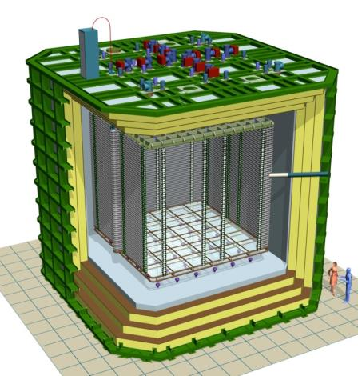
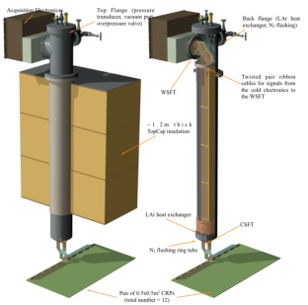
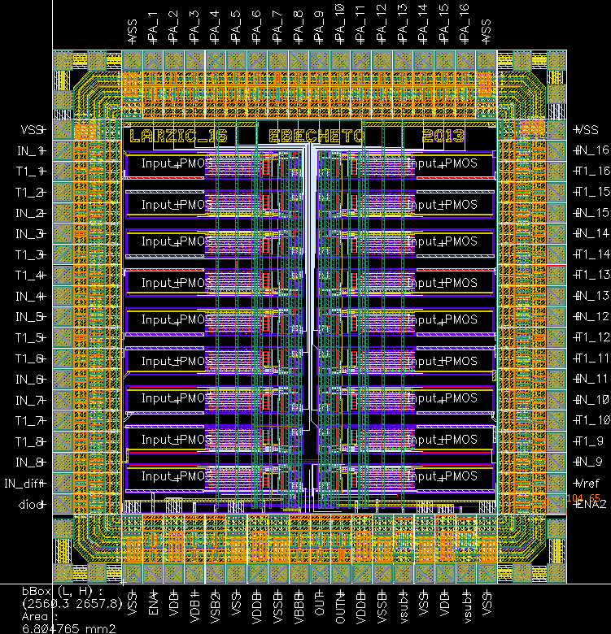
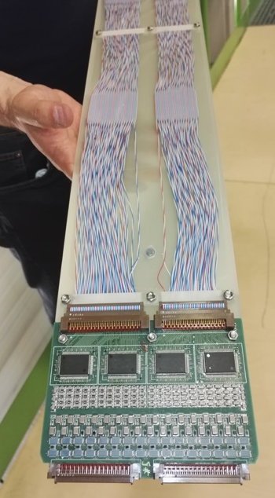
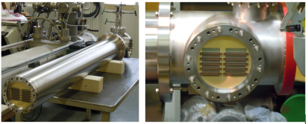
WA105 Accessible cold front-end electronics and uTCA DAQ system 7680 ch
Full accessibility provided by the double-phase charge readout at the top of the detector
Digital electronics at warm on the tank deck:
Architecture based on uTCA standard
1 crate/signal chimney, 640 channels/crate
→ 12 uTCA crates, 10 AMC cards/crate, 64 ch/card
Cryogenic ASIC amplifiers (CMOS 0.35um) 16ch externally accessible:
Working at 110K at the bottom of the signal chimneys
Cards fixed to a plug accessible from outside
→Short cables capacitance, low noise at low T
Warm
FE cards mounted on insertion blades
ASICs 16 ch.
(CMOS 0.35 um)
uTCA crate
Cold
CRP
Signal chimney
5

Slide 6
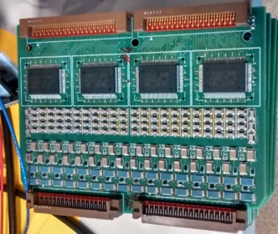
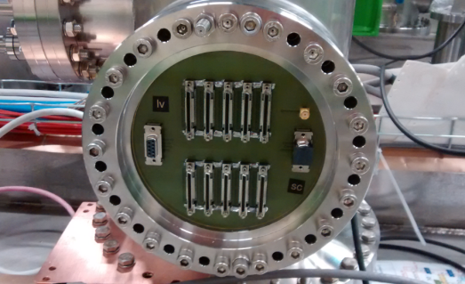
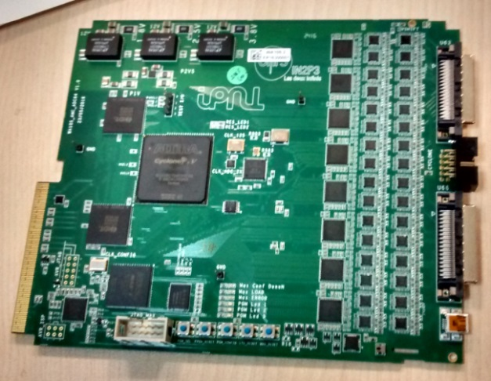
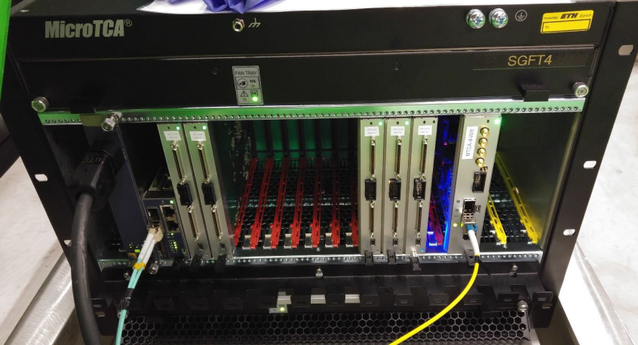
Analog cryogenic FE:
Full production 700 chips of cryogenic ASIC amplifiers procured at the beginning of 2016
64 channels FE cards with 4 cryogenic ASIC amplifiers designed and tested in the spring 2016
First batch of 20 cards (1280 channels) produced for the 3x1x1 operation, operational
Production of remaining 100 cards for 6x6x6 on 2017 budget
Digitization cards:
uTCA 64 channels AMC digitization cards (2.5 MHz, 12 bits output, 10 GbE connectivity)
20 cards produced by September 2016 to equip the 3x1x1, operational
Production of remaining 100 cards for the 6x6x6 launched in May with the 2017 budget
(main card components ADCs, FPGAs, IDT memories, already purchased in 2015 for the entire 6x6x6 production)
White Rabbit timing/trigger distribution system:
Components produced in 2016 for the entire 6x6x6, system operational on the 3x1x1

Slide 7
During spills it is needed a continuous digitization of the light in the +-4 ms around the trigger time (the light signal is instantaneous and keeps memory of the real arrival time of the cosmics)
→ Sampling can be coarse up to 400 ns just to correlate to charge readout
→ Sum 16 samples at 40MHz to get an effective 2.5 MHz sampling like for the charge readout
The LRO card has to know spill/out of spill
Out of spill it can define self-triggering light triggers when “n” PMTs are over a certain threshold and transmit its
time-stamp over the WR

Slide 8
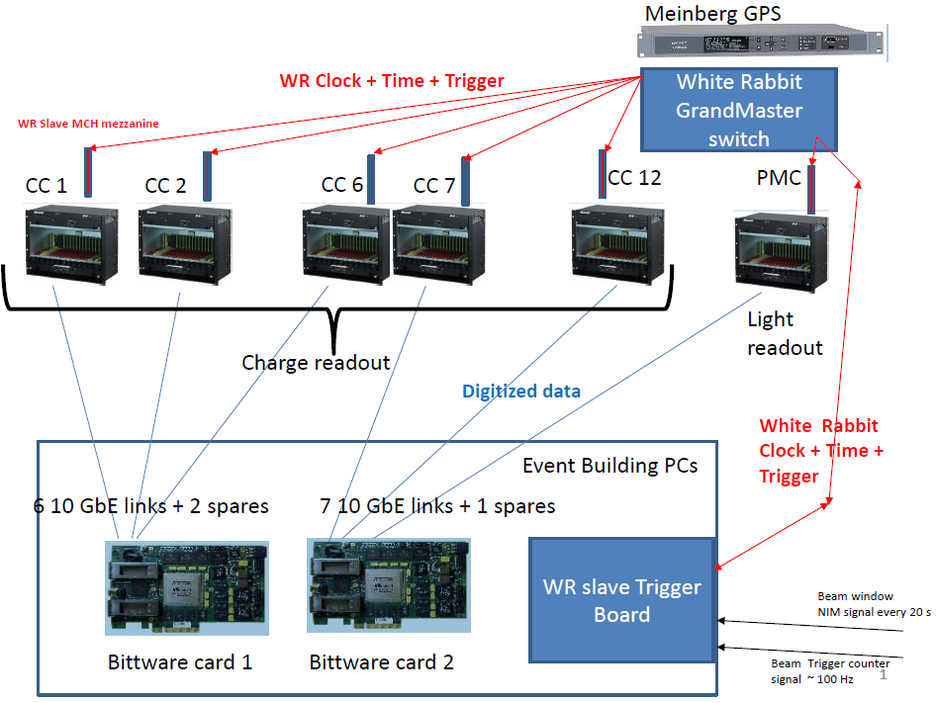
Global uTCA DAQ architecture
integrated with « White Rabbit » (WR) Time and Trigger distribution network
+ White Rabbit slaves nodes in uTCA crates +
WR system (time source, GM, trigger system, slaves)

Slide 9
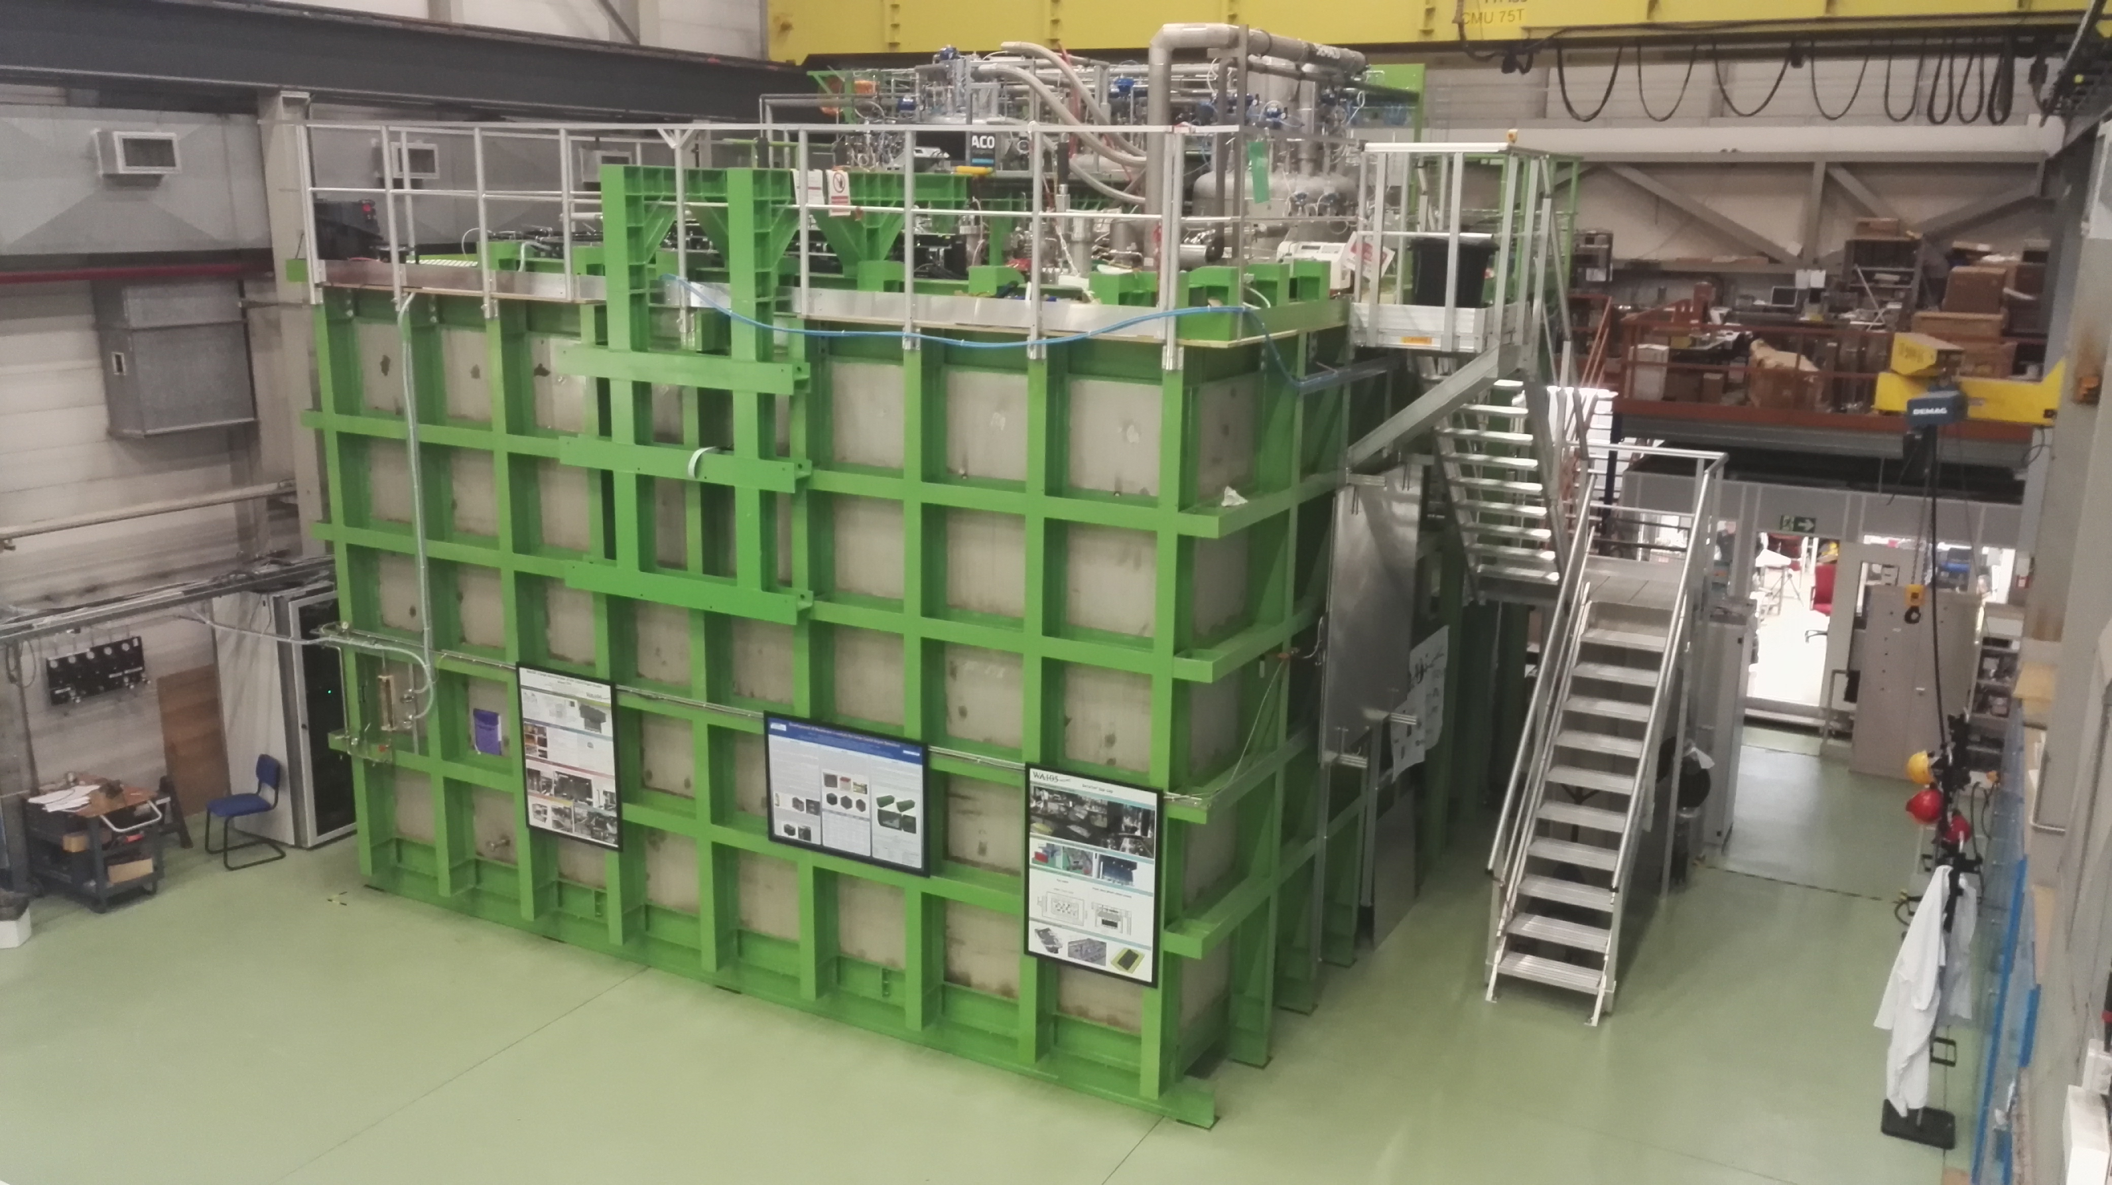
6x6x6: 12 uTCA crates (120 AMCs, 7680 readout channels)
3x1x1: 4 uTCA crates (20 AMCs, 1280 readout channels)
Event builder, network, GPS/White Rabbit GM,
WR Trigger PC
Signal Chimneys and uTCA crates

Slide 10
FE Electronics (analog+digital)/DAQ-online processing → FE and DAQ consortia
Directly scalable to 10 kton (digitization cards can already sustain continuous readout without zero suppression and scheme for offline trigger for SN events)
4 main sub-systems:
Analog CRO FE cards → FE
uTCA digitization cards → FE
White Rabbit timing system infrastructure→ DAQ
DAQ Back-end and online storage/processing servers) → DAQ
Includes:
ASIC amplifiers and FE cards (output differential lines) (x120 for the 6x6x6)
Signal chimneys (SFTs)
uTCA digitization cards (including shapers before ADCs last stage of analog system) input differential lines – output 10 Gbit/s lines (x120 for the 6x6x6)
uTCA LRO digitization cards (integrated in the same scheme as CRO) (x3 for the 6x6x6)
uTCA crates (x12 +1 for the 6x6x6)
White Rabbit uTCA cards, → FE other commercial uTCA components (Grand Master, GPS, → DAQ
DAQ back-end (input 10 Gbit/s links) event builders, network switches, storage servers, computing nodes → DAQ
→ From DP consortia meeting (CERN 27/6/2017)

Slide 11
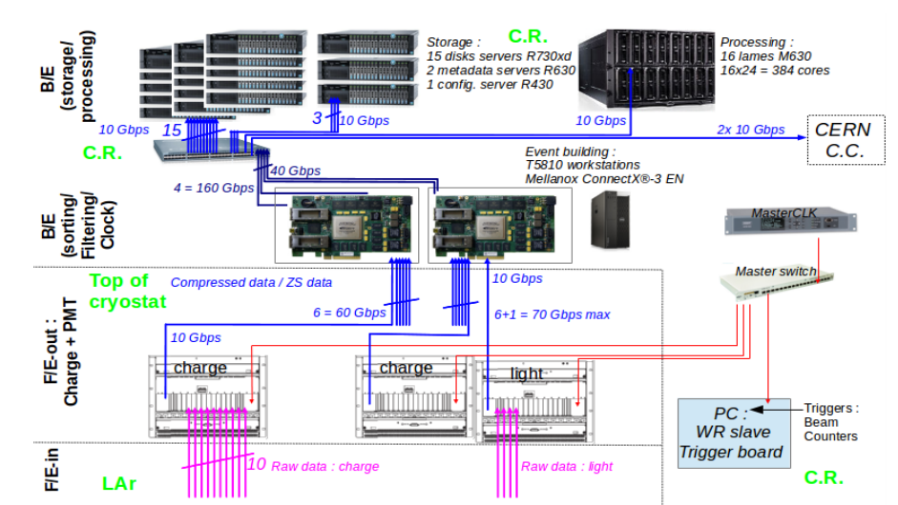
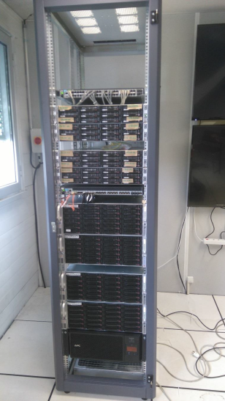
Online processing and storage facility: internal bandwidth 20 GB/s, 1 PB storage, 384 cores: key element for online analysis (removal of cosmics, purity, gain, events filtering)
Smaller test scale system of online storage/processing already installed and operative for 3x1x1 since last fall
→ Useful to perform tests to finalize the architecture of final online storage/processing facility.
C.R. stands for Counting Room

Slide 12
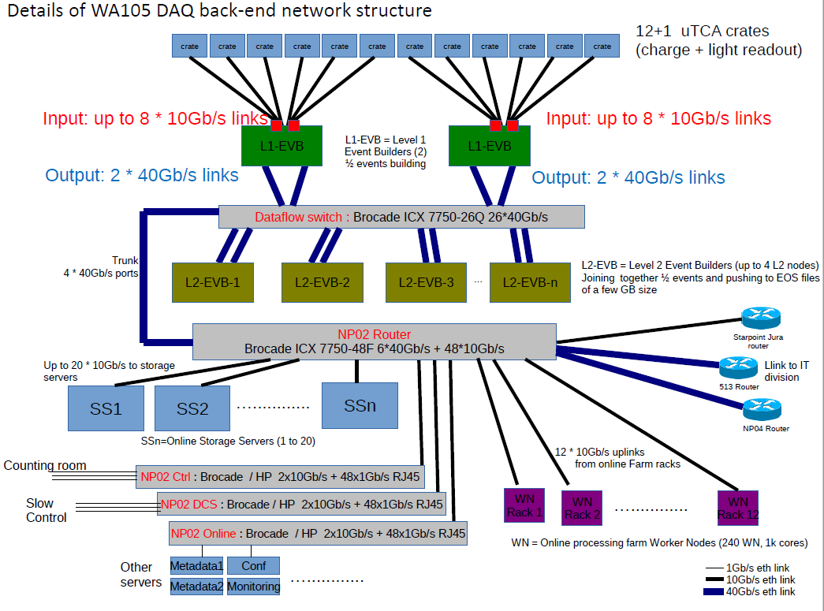

Slide 13
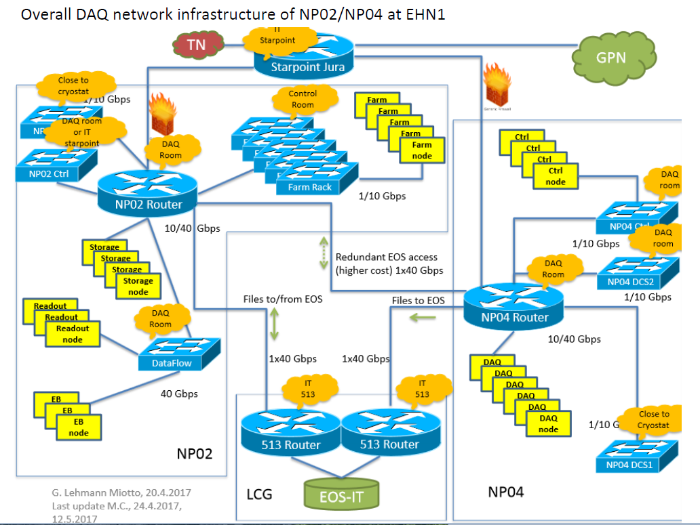

Slide 14
Front-End Electronics DP Consortium Deliverables
Introduction:
The Front-End Electronics DP consortium deals with the analog front-end cryogenic electronics for the charge readout (based on dedicated large dynamics dual-slope ASIC chips) and the FE digitization system (for both charge and light readout) which is hosted in uTCA crates located close to the signal feedthrough chimneys, for the charge readout, and near the PMTs signal feedthroughs of the light readout.
The charge readout system is designed for continuous, non-zero-suppressed, zero-loss-compressed readout of 3m long charge readout strips, arranged in two collection views of 3 mm pitch on the anode PCBs of the Charge Readout Planes (CRPs). Dedicated signal feedthrough chimneys allow operating the analog charge readout FE electronics at a temperature around 100K, while keeping the possibility of replacing the FE cards without contaminating the pure liquid argon volume. The analog FE cards, hosting the cryogenic ASIC chips, are plugged on a cold flange at the bottom of each chimney. The cold flange ensures the UHV tightness with respect to the pure liquid argon volume. The other side of the flange, inside the cryostat, is connected to the CRPs with flat cables. The FE cards are mounted on 2m long blades which support the connection cables for signals and LV and allow for the insertion or extraction of the FE cards in/from the cold flange connectors. The SFT chimneys are closed at the top by a warm flange which dispatches differential analog signals to the AMC cards in the uTCA crates and allows for the connections of the low voltage lines, calibration and control signals. The AMC cards include also a last stage of shaping at the input of the ADCs. The AMC cards host dual port memories and an FGA with a virtual processor (NIOS) which takes care of the readout and of the data transmission over the network. Digitized data are collected by the MCH switch in the each crate and transmitted from the uTCA crates to the DAQ back-end via optical fiber links at 10 or 40 Gb/s. The uTCA crates host the digitization AMC cards for the charge and light readout with a high channel density (with a minimal target figure corresponding to the present channel density already achieved in ProtoDUNE-DP of 640 channels per crate, 64 channels/card, 10 AMCs per crate). A White Rabbit slave node card is also inserted in each uTCA crate for timing/trigger distribution on the backplane of the crate to the AMCs.
The detection of the direct scintillation light is the main purpose of the light readout electronics in order to provide the absolute time. The system will also be capable to detect the so-called proportional scintillation light produced by the electrons extracted and amplified in the gaseous phase. The actual photon detectors are assumed to be coated PMTs located under the cathode. The system will group up to 16 PMTs to be read by a single AMC card in uTCA standard. The different cards are inserted in uTCA crates and the events are time stamped using the White Rabbit system of the charge readout by including in each uTCA crate a White Rabbit slave node card. The use of the uTCA standard allows a cost-effective integration of the light read-out electronics together with the charge readout electronics into the global DAQ system. As for the charge readout each crate is connected to the back-end via an optical fiber links for the data and White Rabbit.

Slide 15
DP Front-End Electronics Consortium Deliverables:
Hardware Deliverables
Front-end cryogenic ASIC
Design
Production
Testing
Front-end cryogenic cards
Design
Production
Testing
Cold flanges, cables and insertion blades of Signal Feedthroughs (SFT) chimneys
Design
Production/assembly
Testing
Warm flanges of SFT chimneys
Design
Production
Testing
SFT chimneys
Design
Fabrication
Assembly with cold and warm flanges
Testing
Installation (SURF)
Signal cables from SFT chimneys to uTCA crates
Selection/Validation
Fabrication/Procurement
Testing

Slide 16
7) Analog FE Low-voltage, pulsing and control Cables
Selection/Validation
Fabrication/Procurement
Testing
8) uTCA crates and MCH
Selection/Validation
Fabrication/Procurement
Testing
9) uTCA AMC digitization cards
Design
Firmware development
Production
Testing
10) uTCA White Rabbit slave nodes
Design
Production
Testing
11) Low-Voltage Power Supplies
Selection/Validation
Procurement
Testing
12) Light Readout FE electronics
i. Design and production of interface between PMTs and FE
ii. Development of the analog section
iii. Development of the digital section
iv. Integration into micro-TCA backplane
v. Component selection and procurement
vi. Cards production and testing
vii. Programming of FPGA to provide trigger and fast signal treatment
viii. Programming interface to micro-TCA back plane and DAQ
ix. Synchronization with White Rabbit

Slide 17
13) FE Electronics Infrastructure
Develop Cables Routing Plan (optical fibers for White Rabbit and data, LV, calibration and controls)
Design LV filtering/distribution boxes and cable support structures
Fabricate LV filtering/distribution boxes and cable support structures
Develop Installation Plan
Integration of LV power supplies
Install FE electronics + blades in the chimneys (SURF)
Installation of light readout FE electronics
Installation of uTCA crates + MCHs + AMCs + WR slaves (SURF)
Cabling of uTCA crates to SFT chimneys (SURF)
Cabling of LV, calibration and controls to chimneys (SURF)
Cabling of fibers (data and White Rabbit) to backend (SURF)
Test electronics/cables (SURF)
B) Software Deliverables
1) Simulation Code
Analog Signal Processing
Digital Readout
2) Calibration
Run Control Software
Analysis Software
Calibration Database
3) Hardware Database
QC Documentation
Component Tracking
4) Data Collection
Hardware Initialization/Configuration Code
Hardware Monitoring Code
5) Data Monitoring Code

Slide 18
C) Physics Deliverables
1) Validation of Cold Electronics Requirements with respect to Physics Performance
2) Cold Electronics Performance Validation via ProtoDUNE Data Analysis
3) Editing of TDR chapter
D) Integration Deliverables
1) Detector Grounding & Shielding Plan
2) Integration Test Facility
Design
Fabrication
Operation

Slide 19
Complement of information for the interface to the common SP-DP DAQ Consortium
The idea of this document, as also pointed out in the previous DAQ consortium Deliverables document, is to have a common DAQ Consortium for both single phase and dual-phase technologies.
The description of the DP specific digital FE electronics is contained in the Front-End electronics DP Consortium Deliverables document. The DP digital FE electronics deals with the digitization of both charge and light signals. The digitization is performed in high channels density AMC cards hosted in uTCA crates. The crates are then connected to the DAQ system with 10 or 40 Gbit/s Ethernet optical fiber links. A White Rabbit slave node card is also inserted in each uTCA crate for timing/trigger distribution on the backplane of the crate to the AMCs.
The charge readout FE digital system is designed in order to support continuous, non-zero-suppressed, zero-loss-compressed readout of 3m long charge readout strips, arranged in two collection views of 3 mm pitch on the anode PCBs of the Charge Readout Planes (CRPs). Similarly the light readout FE system can produce high bandwidth data and also issue light triggers transmitted via the White Rabbit network. The readout granularity corresponds, per 10 kton module, to 153600 charge readout channels and a few hundred light readout channels. The DAQ system common to SP and DP should as well be capable of supporting this high data bandwidth from the FE electronics.
The DAQ system, common to both single and dual phase, is expected to be a network based DAQ system capable of:
Collecting this high bandwidth data volume coming from the data links of the FE crates
Putting together the data streams from different crates in regions of interest or over the entire detector volume
Processing this data flow on an online processing farm in order to select relevant events to be recorded on disk: neutrino beam, and off-beam events.
Producing charge readout triggers independently on the light readout triggers and beam spill information. In particular triggers over a sliding timing window of about 10 seconds may be issued by the farm for the search of SN neutrinos on the basis of the presence of low energy depositions, in order to dump on disk the entire content of the SN trigger sliding time window.
It is assumed that the DAQ system will be constituted by a set of event building machines, high performance network elements, an online computing farm and a high bandwidth distributed storage system based on an array of storage servers operating in parallel. An example of such architecture, inspirational to the one still to be developed for the DUNE FD SP and DP DAQ system, can be obtained from the DAQ backend architecture actually foreseen at EHN1 for protoDUNE-DP. That system is already designed to be capable of supporting with a data bandwidth of 20 GByte/s.
The following list of deliverables is identical to the generic list already compiled for the SP, which was already generic enough to cover both technologies, with the addition of a requirement on the presence of a White Rabbit backbone network.

Slide 20
Present list of institutions in DP Electronics consortium

Slide 21
Perspectives
Present DP electronics design is the outcome of a long R&D process started in 2006 (since the beginning oriented to costs reductions)
Charge readout system already deployed on the 3x1x1 detector since the fall 2016 and successfully operational
Production of additional components being completed for the 6x6x6
Complete DAQ back-end and online processing scheme also developed for 3x1x1 and 6x6x6
6x6x6 design directly scalable to 10 kton (digitization cards can already sustain continuous readout without zero suppression and scheme for offline trigger for SN events)
Some further costs reduction optimizations are under study: increase channel density per uTCA card (x2), move to 40 Gbit/s MCH in uTCA crates, costs reductions on uTCA hardware
Already good knowledge of costing from 6x6x6 productions can be scaled to obtain a conservative costs estimates before further savings
Electronics DP Consortium groups also committed to work in the DAQ joint consortium:
a) Providing part of the White-Rabbit network infrastructure
Providing manpower and expertise for the common design of the back-end system by helping in the aspects related to the interface with the DP FE electronics and the treatment of the data and exporting the experience of the ProtoDUNE DP DAQ backend to the final common DAQ design
Mandate of consortium (as for other consortia) for two DP modules, large list of deliverables
→ New collaborating groups are very welcome in the DP electronics consortium

Slide 22
Consortium Leaders Meeting
Mark Thomson
DUNE Collaboration Meeting
Fermilab, 15th August 2017

Slide 23
Each consortium is unique…
Common consortium structure
But unique features:
Different size / level of scope
Different levels of international mix
Different TRLs
In some cases at (or close to) preliminary design, e.g. APA
In others, still design decisions, e.g. DAQ
Consequences:
Will be differences in internal consortia organization
Today’s CL Meeting
Will discuss general features
Parallel Consortium sessions – suggestion…
Repeat, but tailored to needs of individual consortium

Slide 24
Discussion Topics
Technical Leads
Roles
Should complement CL
Technical probably more important than project (at this stage)
Appointment
As soon as possible…
Driven by CL, in consultation with Spokes & TC
Would like to discuss with CLs in person this week
Converge as soon as possible

Slide 25
Discussion Topics
Short-term Consortium milestones (TBC)
Consortium meetings/organization fixed asap
Need a rapid start up
For next RRB meeting: November 2nd
Refined list of deliverables
WBS
Initial mapping of deliverables to institutions/funding agencies
There will be gaps
For Technical Proposal: Q2 2018
Technical Proposal, similar level to LHC upgrade projects
Cost and schedule
Full WBS with institutional/funding agency responsibilities
Likely to be gaps…

Slide 26
Discussion Topics
Technical Board
Frequency
Suggest bi-weekly
Start up as soon as possible
Attendance
TC (chair)
Co-Spokes (ex officio)
Project Office
Consortium Leaders
Technical Leads
Expect focused meeting topics
e.g. status of WBS, technical issues, …
Expect all CLs & TLs will attend these meetings

