Slide 1
DUNE SP TPC HV System Design
Bo Yu
Aug. 25, 2017

Slide 2
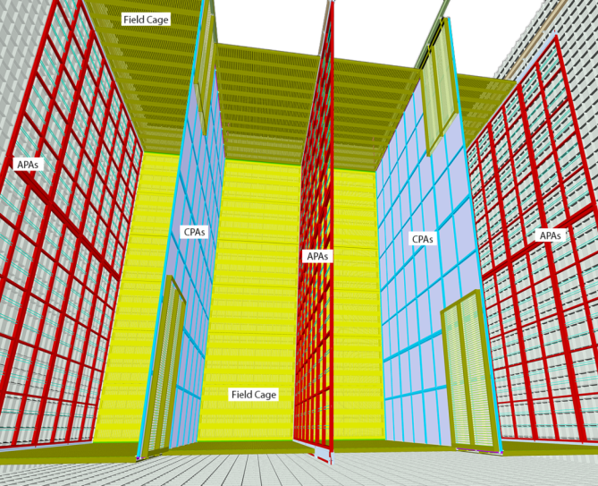
DUNE FD TPC (Single Phase)
10 kton fiducial cryostat.
Each has:
150 APAs, 200 CPAs
2000 m² field cage modules
385k readout channels
Active volume:
W: 14.5m, H: 12m, L: 58m
Installed under 5 mounting rails suspended under the cryostat ceiling.

Slide 3
Cathode Plane
Challenges
  @-180kV, a sudden collapse of voltage on the cathode plane due to a discharge could inject sufficient charge into the FEE on the APA to cause damage.
  Provide bias voltage/current to all field cage modules
  Must be flat to within +/- 1cm to maintain field uniformity and fiducial volume
  Withstand the pressure differential caused by the LAr convection flow in the cryostat
  Support 4 field cage modules per CPA pair during installation.
  Accommodate cryostat roof motion during LAr fill.
Solutions:
  Construct the cathode with highly resistive surfaces (1-100MΩ/□) so the discharge time constant is much larger than that of a metallic cathode. This will greatly reduce the peak power transfer to the cryostat and peak current injection into the front-end ASICs in a HV discharge.
  Thin resistive cathode surface supported by strong insulating frames. Field shaping strips covers the frame with tailored bias voltage
  Segmented CPA modules loosely constrained between each other to allow vertical movement
  A conductive HV bus is integrated into the CPA to provide stable bias voltage to the field cage divider chains

Slide 4

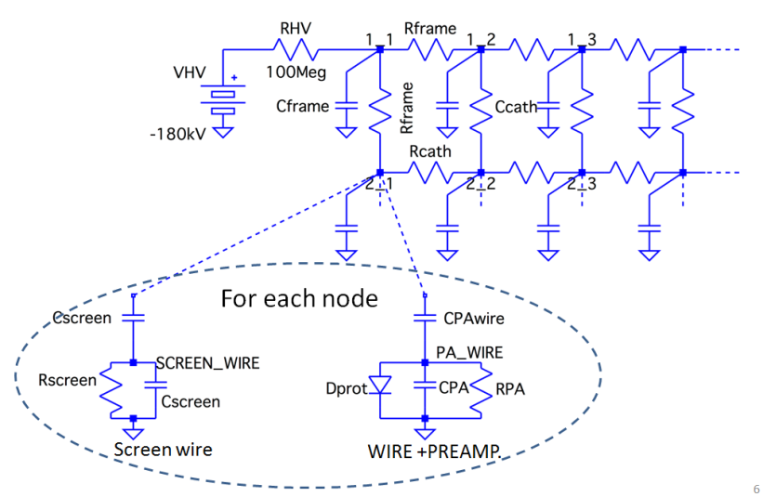
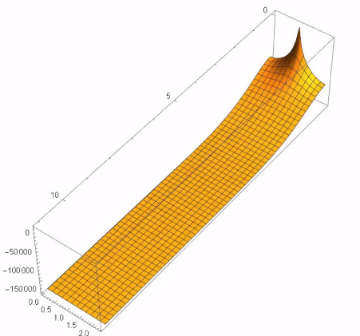
Study of the Charge Injection to the Electronics
By Sergio Rescia (LBNE docdb 10749,10865)
@200ms, 85% energy remains
Negligible charge injection
Divide 12mx2.3m Cathode into 10cmx10cm “cells” i.e. 120x23=2760 (or 2904 nodes) Each cell modeled as resistors to neighbors and capacitor to ground
SPICE simulation
C: 8737, R: 5668, tot: 14419
Acceptable resistivity range:
1kΩ to 100MΩ/sq for NP04

Slide 5
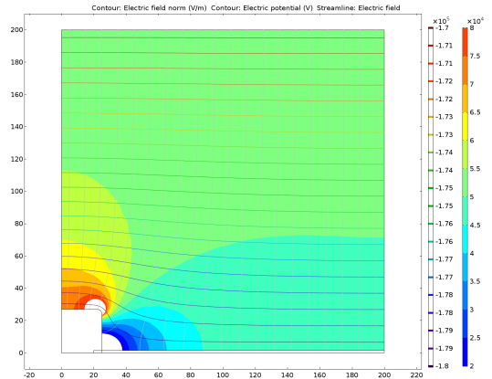
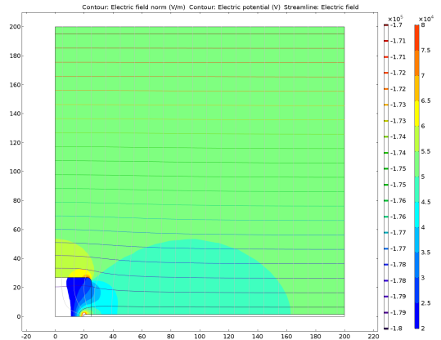
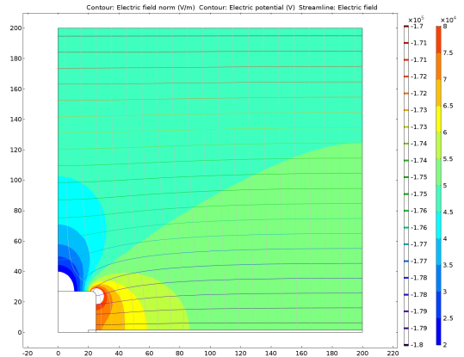
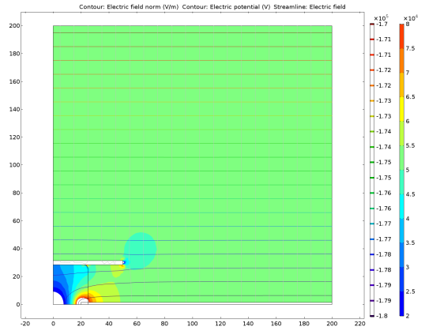
Minimizing E Field Distortion on the CPA
Conductive frame
G10 frame, no charge buildup
Each E contour step is 10% nominal drift field
G10 frame with charge buildup
G10 frame + field shaping strip

Slide 6
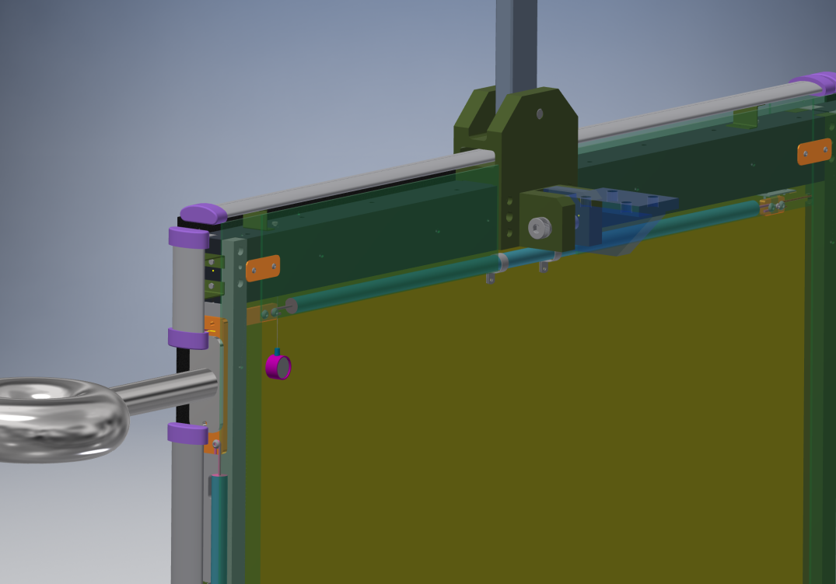
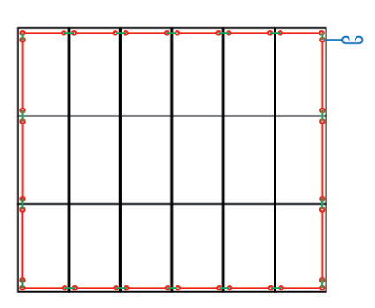
A CPA Module with Integrated HV Bus
Since the entire cathode is highly resistive, we must find a more conductive path to distribute the cathode bias voltage to all CPAs and all field cage dividers without significant voltage drop.
To avoid direct arcing to the HV bus during a discharge, it is made from a HV cable capable of holding 200kV.
FC profiles are mounted around all outer edges of the cathode plane. They are electrically connected to the cathode resistive sheets at locations away from the HV bus to resistive sheet connection points.
CPA lifting bar
Field cage hinge
FC profiles
Connection to the resistive sheet, and to next module
HV bus cable
HV cup
HV bus cable
Once installed, the CPA appears to be part of the field cage looking from outside.

Slide 7
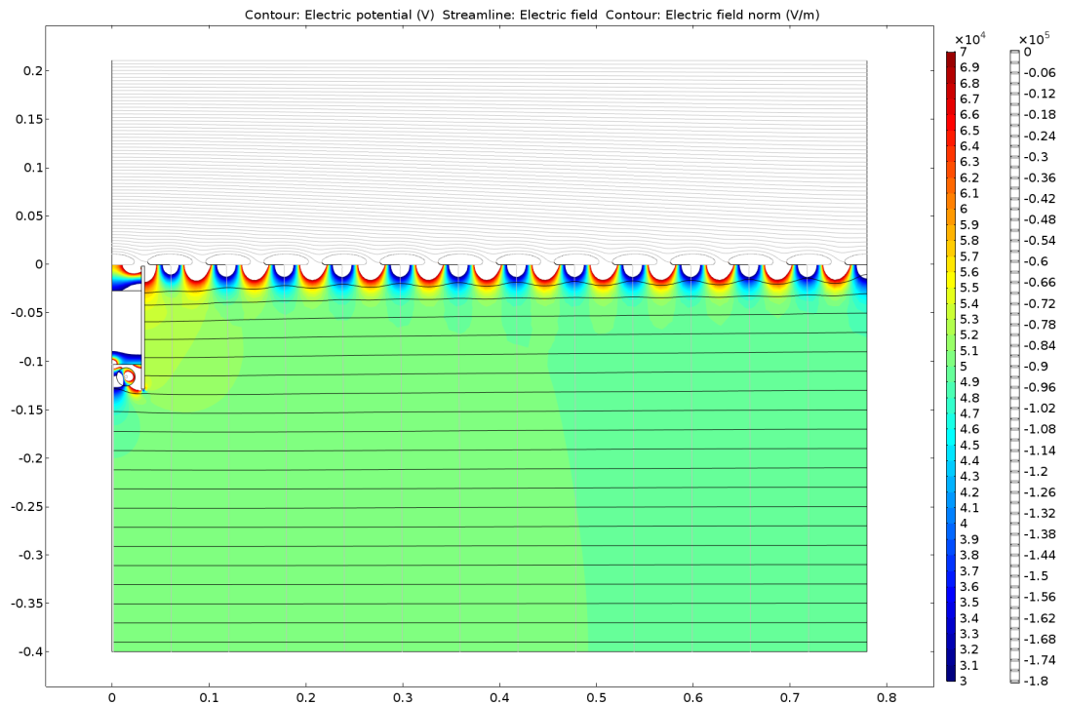
Drift Field Uniformity Near CPA Frame
Color contours: E amplitude, 2% of nominal drift field
Profiles at 6cm pitch, ground plane 20cm above
Active volume starts 5cm below the inside surfaces of the field cage profiles

Slide 8
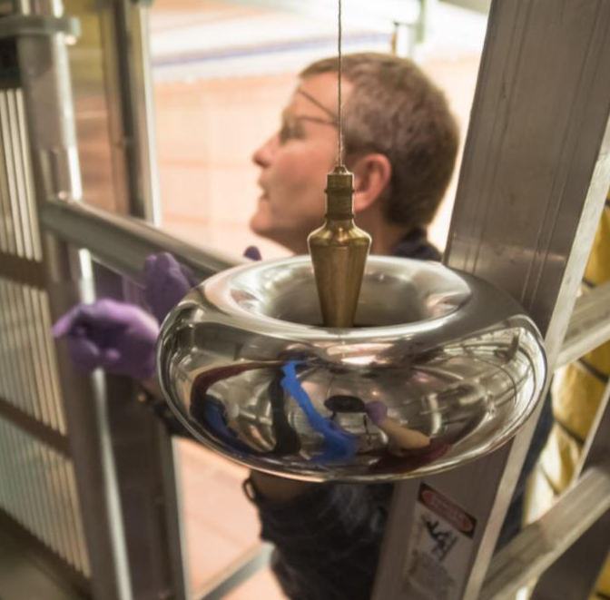
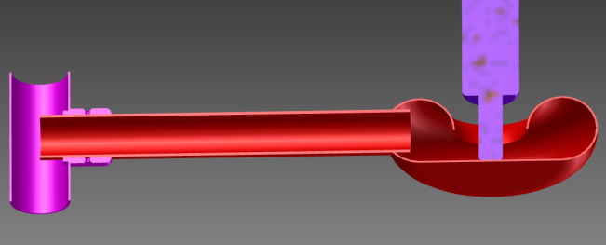
HV Feedthrough Receptacle
The HV feedthrough receptacle is made from a stainless steel donut with a flat bottom plate. It has an edge radius of 38mm, and a inner diameter of 76mm.
A slightly smaller version of it was used in the 35ton TPC.
This HV receptacle may not work for
the FD due to the +/- 10cm shrinkage
between warm and cold.
We need to design a spring loaded tip to allow height tolerance
The arm length can be a adjusted
Dan checks the alignment of the 35ton HV feedthrough receptacle.
The donut is completely vented

Slide 9
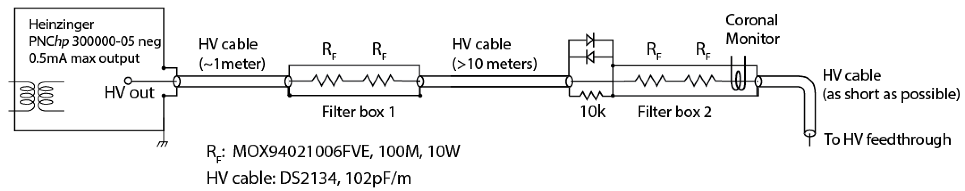
HV System Filtering Requirements
The Heinzinger PNChp power supply has a ripple spec of 10⁻⁵. In order not to inject significant charge to the ASIC (<100e ENC), we need to have a filter network between the power supply and the HV feedthrough with an attenuation factor of >2000 at the ripple frequencies.
ENC of ASIC | 600 | e
max noise injection | 100 | e
 | 1.6E-17 | c
capacitance of an APA to CPA | 5.09E-11 | F
capacitance of a G wire to CPA | 8.48E-14 | F
capacitance of a U wire to CPA | 1.70E-14 | F
maximum allowed ripple voltage | 9.43E-04 | V
Cathode Voltage | 180000 | V
Power supply output ripple @ 1E-5 | 1.8 | V
attenuation factor needed in the filter | 1908

Slide 10
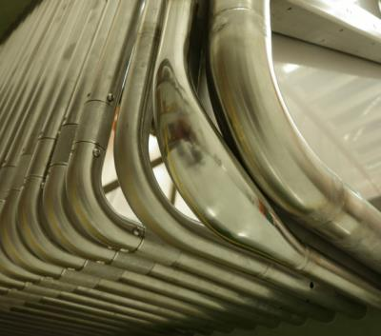
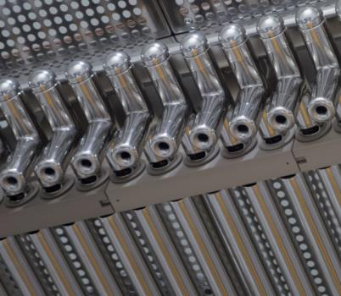
Modular Field Cage Design
Previous large liquid argon TPCs (Icarus, MicroBooNE) have used stainless steel tubes as the field cage electrodes to form continuous mechanical and electrical “rings” or “race tracks”.
There are disadvantages to scale this design to multi-kiloton LArTPCs such as the DUNE Far Detector:
mechanically, the field cage cannot be built as completely independent modules and therefore requires labor intensive steps to interconnect the electrodes, many at great heights inside the cryostat;
electrically, linking electrodes spanning more than 100m in length also increases the stored energy each electrode has and increase the risk of damaging the field cage components in a HV discharge.
These considerations lead to the development of a field cage concept that is completely modular: both mechanically and electrically independent field cage modules tiled to form the entire field cage. Each module has its own resistive divider network, which provide greater redundancy against resistor failure.
Instead of using tubes as the field cage electrodes, which must be vented frequently to avoid trapped volumes, roll-formed or extruded open profiles are investigated as potential electrode candidates.

Slide 11
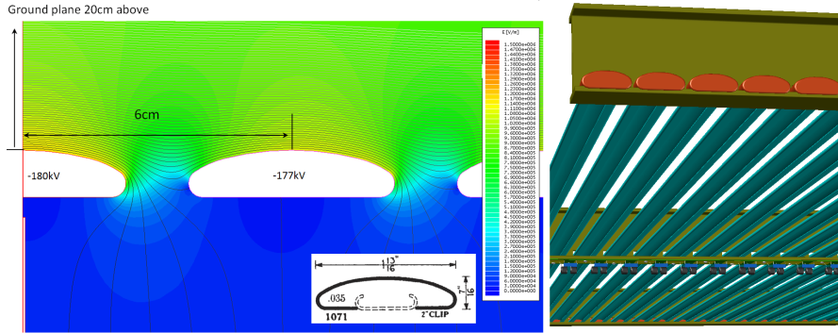
Field Cage with Roll-Formed Profiles
The example below shows the electric field on the highest biased field cage electrodes can be controlled to under 12kV/cm using the Dahlstrom #1071 profile even with only a 20cm ground clearance. If we can find a safe way of dealing with the ends of the profiles, this construction could allow a reduction in the top and bottom TPC clearance and make more efficient use of the LAr.
UHMW PE caps with wall thickness of 5-6mm are used to terminate each profile. The dielectric strength of the caps is capable of holding the full 180kV voltage.

Slide 12
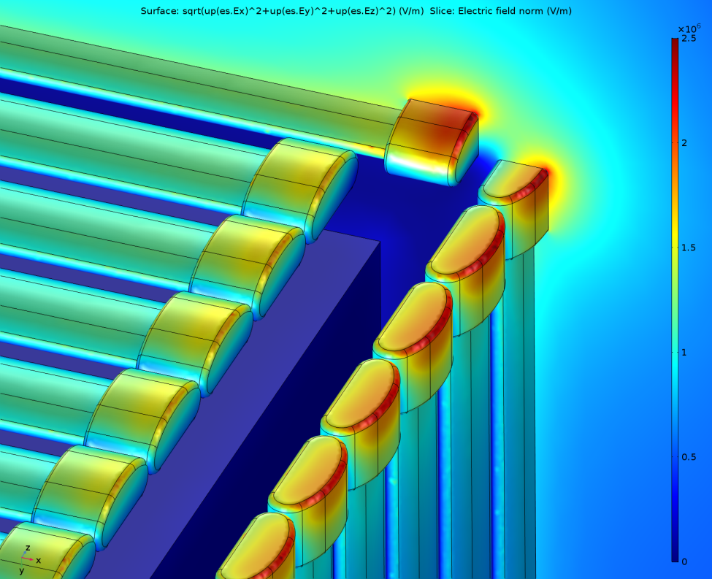
E Field at the Corner with PE Caps
Plot of the E field on the symmetry plane bisecting the metal profiles, as well on the surface of profiles and caps
20cm ground clearance above, 40cm on the side,
Cathode bias: -180kV, UHMW PE cap thickness: 6mm
The exposed field in the LAr is ~ 25kV/cm

Slide 13
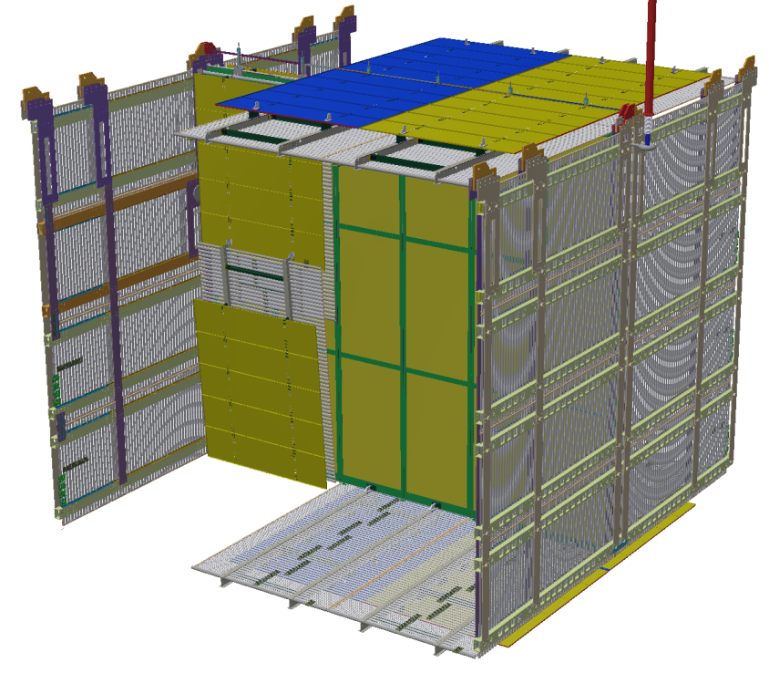
The Field Cage Components
Top and bottom field cage modules have integrated ground plane panels to shield the high field from leaking into the top and bottom service regions:
  Top: gas ullage and rails
  Bottom: cryogenic pipes
End wall field cage modules
have no accompanying ground
planes due to larger clearance.
Beam plug is integrated
into one end wall modules
Each field cage module has its
own resistive divider network to
maintain a linear voltage
distribution along its length.
The field cage profiles are
electrically isolated between
modules to minimize peak
energy dump in case of sparks

Slide 14
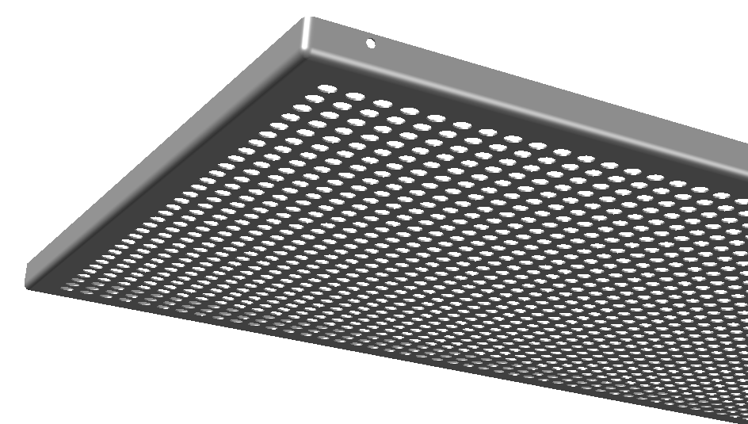
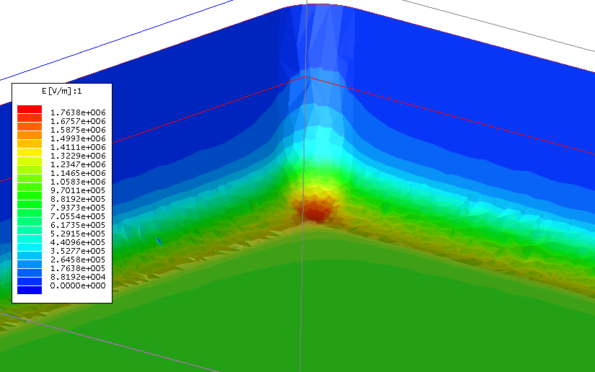
The Ground Plane
The purpose of the ground plane above the field cage is to shield the fringe field from the CPA/FC from entering the gas ullage to cause breakdown. It also shield the DSS and cryogenic components with sharp features from high electric field.
The top and bottom FC modules are designed to be symmetrical: there is a ground plane by default on the bottom.
The ground plane is stamped from
1mm thick stainless steel sheet.
With corner radii of 5mm.
The hole edges facing the
field cage are rounded
to ~ 0.5mm radius.
The grounding of the ground plane should be
made away from the APA/CE feedthroughs.
  Top: to DSS feedthrough / rail
  Bottom: to membrane

Slide 15
Field Cage Transient Response in a Discharge
The resistors along the divider provide a
linear DC voltage gradient.
However, at shorter time scale (<<1s), the
electrical behavior of the divider is determined
by the varies capacitances on and between
each electrodes. This divider is no longer
linear at this time scale.
A perfect capacitive divider requires the capacitance of each node to ground to be 0. In reality, there is always a finite capacitance from each node to ground. These capacitances “resist” change in the voltages on the nodes.
In the event of a HV breakdown between the cathode to ground (cryostat), the cathode voltage quickly collapses to ground, but the first field cage strip to ground capacitance keeps its voltage from changing instantaneously to follow the cathode voltage, results in a momentary larger voltage differential between the cathode and the first field cage strip.
This voltage differential can be a significant fraction of the cathode operating bias, large enough to cause HV breakdown between the two electrodes, or worse yet, destroy the resistors between the two electrodes.
The natural solution to this problem is to add additional capacitance between the nodes of this divider.
See MicroBooNE docdb 3307 for summary of the analyses

Slide 16
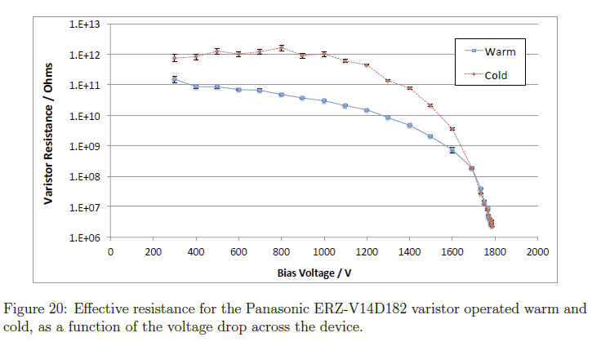
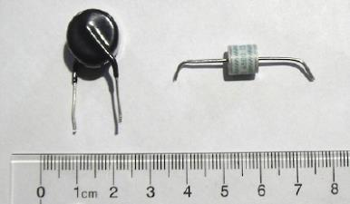
Surge Suppressor Studies
An alternative to adding capacitance between divider nodes is to use surge protection
Extensive tests have been done by MicroBooNE (docdb 3242, arXiv:1406.5216v2) on the use of varistors and GDTs (gas discharge tubes) as a mean of limiting the over voltage condition in the event of a HV discharge in the TPC.
Both types will work for the purpose of restricting the voltage differential between field cage rings in LAr temperature.
  A GDT quickly shorts the terminals when the voltage differential exceeds a threshold
  A varistor changes its resistance to keep the voltage differential near the threshold voltage.
The smooth transition and well defined clamping voltage of the varistors are preferred to the abrupt switching of the GDTs.
The varistors would also function as
redundant “resistors” in a divider chain.
Left: varistor
Right: GDT

Slide 17
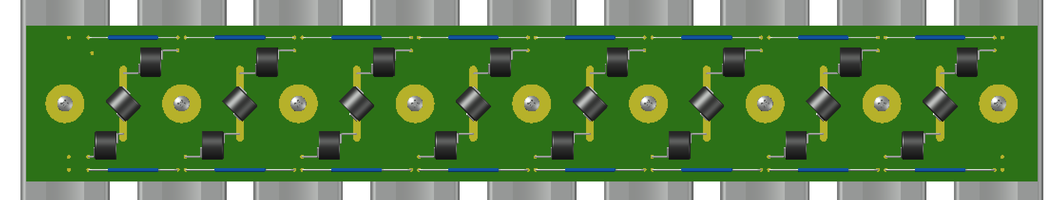
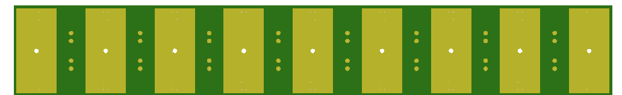
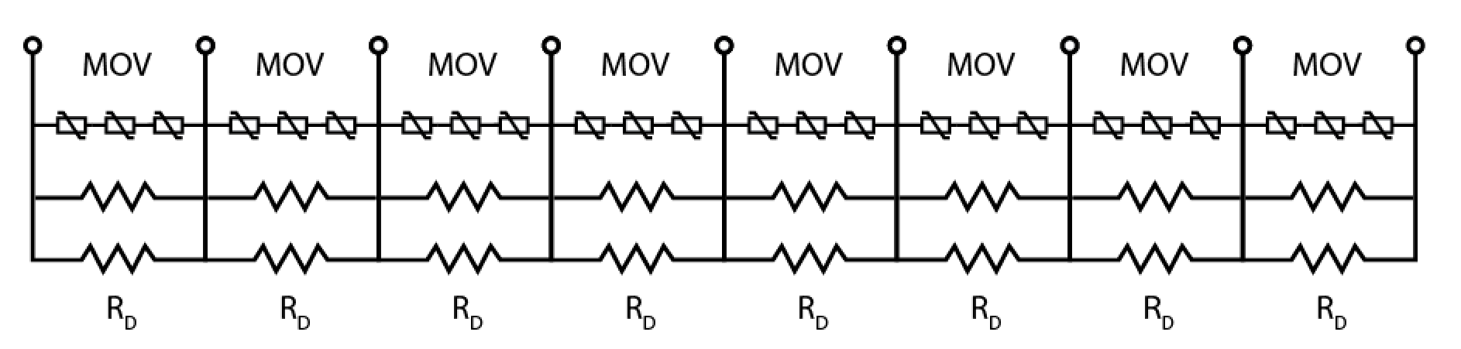
Resistive Divider Board
We need to use 3 such varistors in series between profiles if we want to have the ability to reach more than 500V/cm drift field in ProtoDUNE.
Two resistors in parallel to provide redundancy.
RD: SM104FE-1000M, MOV: ERZ-V14D182

Slide 18
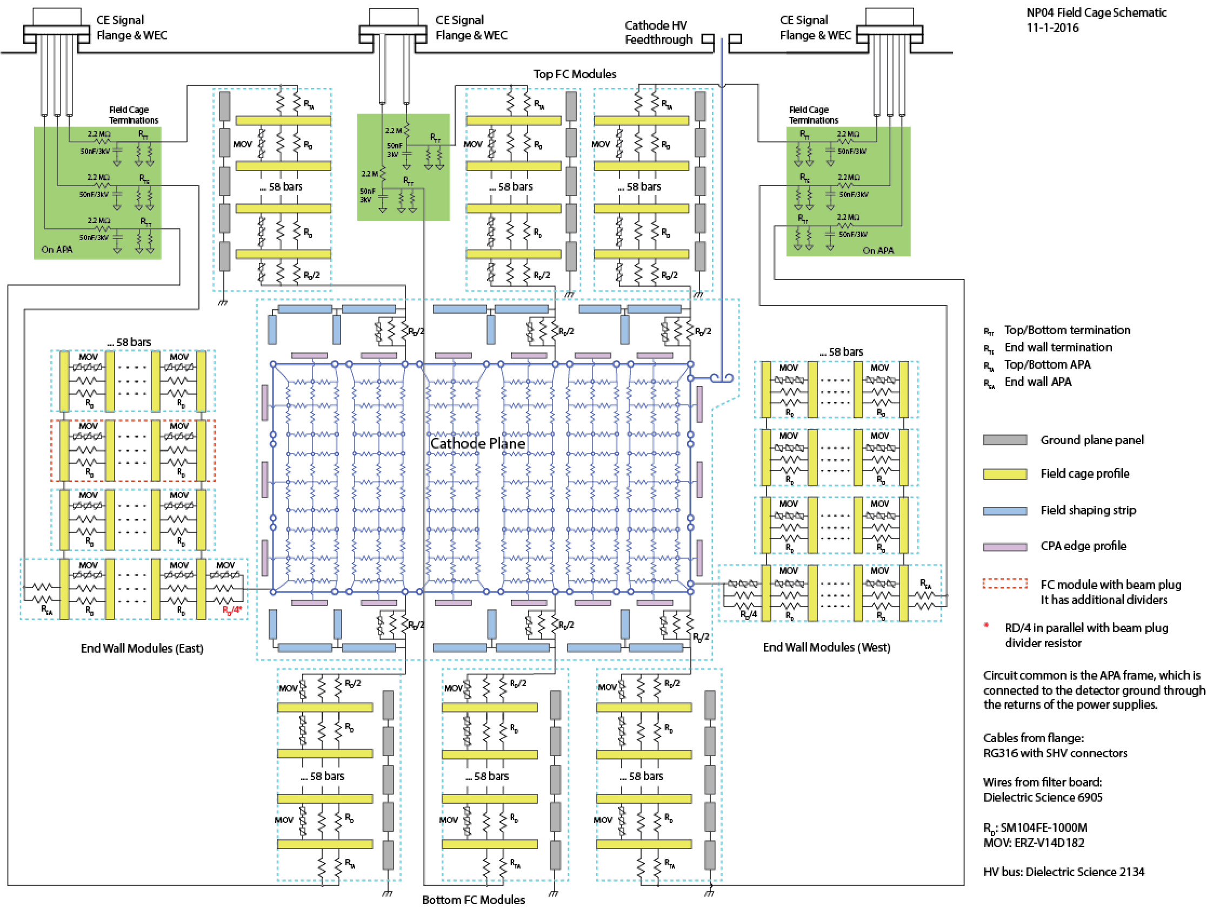
CPA/FC System Schematic Diagram

Slide 19
Summary
A new all resistive cathode has been developed using a commercial resistive film solution in order to mitigate the risk of high current injection into the cold electronics
  The design achieves good E field uniformity at the cathode, and minimal fiducial cut due to mechanical structures
A new design of independent, modular field cage using open metal profiles has been developed.
NP04 HV performance will be critical in determining whether we can duplicate the current design for the FD, or make changes to improve the safety margins.
The most challenging aspect might be the understanding of the charge buildup behavior on the insulating surfaces on the field cage modules.

Slide 20
Backup slides

Slide 21
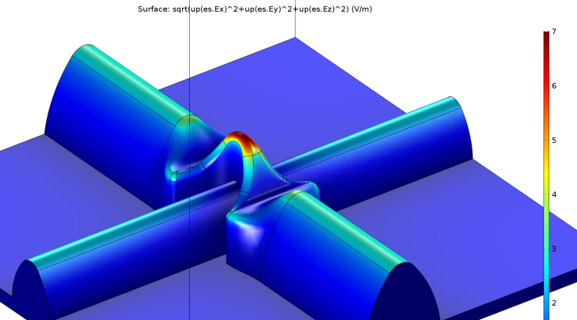
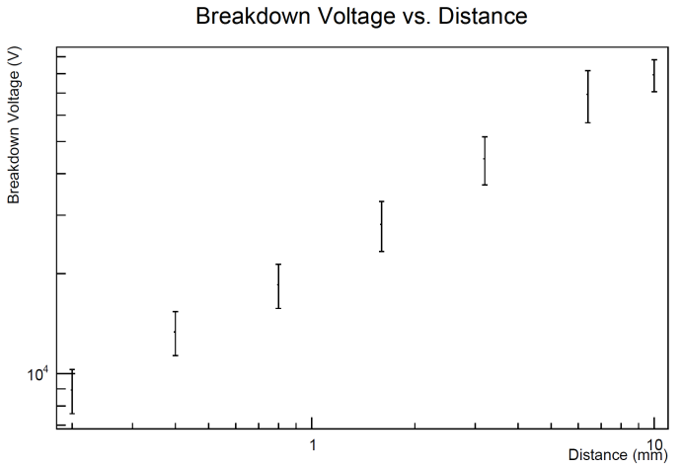
E Field on the Membrane Knuckle
This is an approximate model of the GTT membrane. The knuckle principle radii (16 and 4.5mm) were fitted from a scan of the membrane.
With 1V at 1m above the flat the membrane, the field enhancement factor on the knuckle is 7.
Scale this to the end wall of the cryostat (west), where the maximum E field is 180kV/43cm, the field at the knuckle is 29kV/cm.
Sarah Lockwitz has tested a piece of the GTT membrane against a flat electrode and found that the breakdown voltage is 80kV over a 1cm gap at the tip of the knuckle.

Slide 22
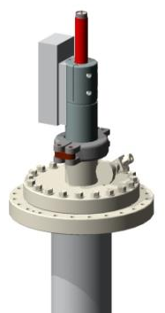
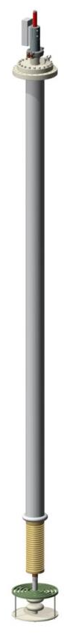
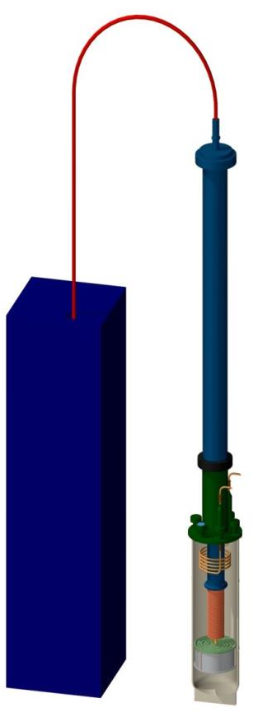
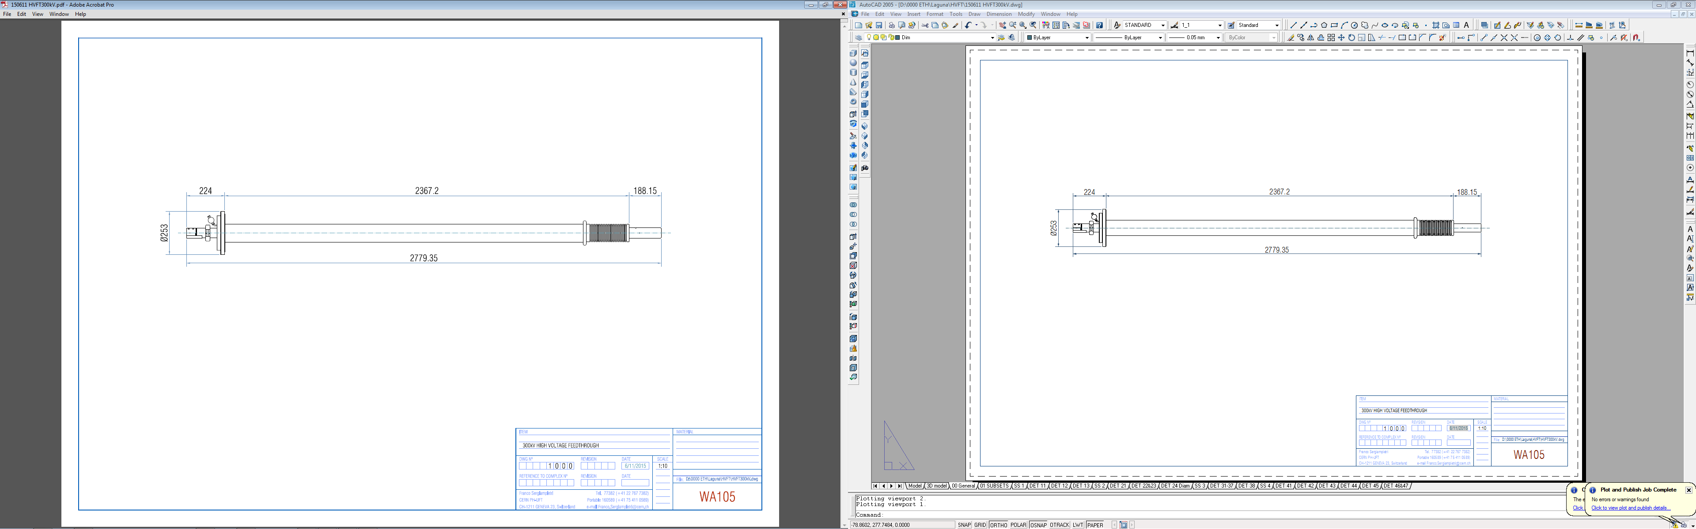
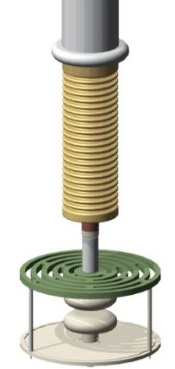
WA105 HV Feedthrough Design
HVFT for 300kV with Rogowsky profile electrodes

Slide 23
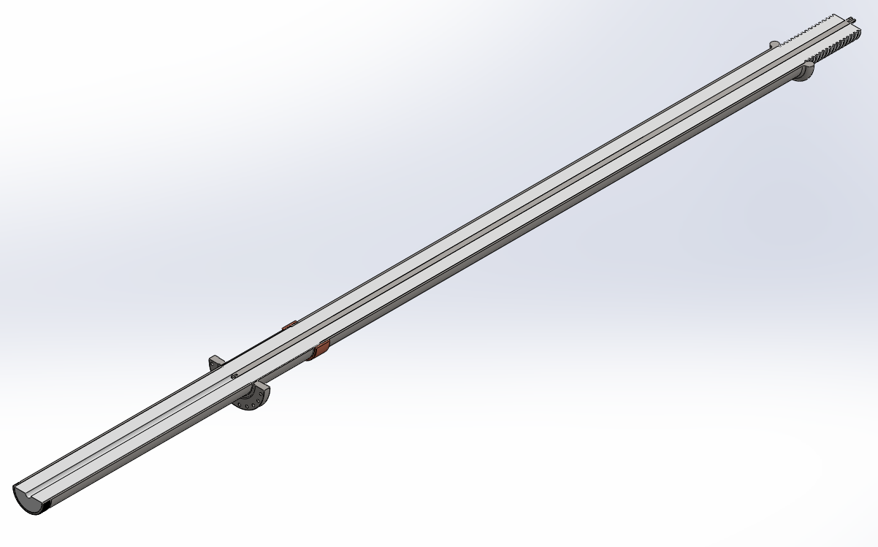
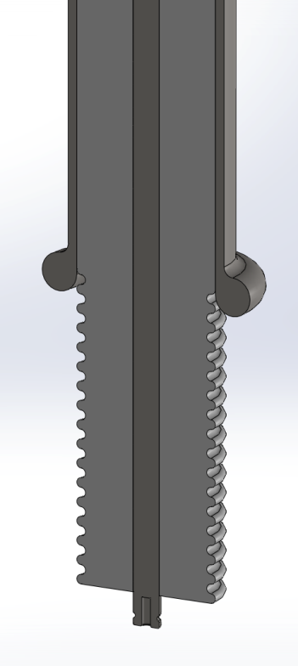
Proposed design of DUNE HV FT (UCLA)
Total length: 3 meters (30 inch airside, 88 inch argon side)
UHMW-PE Insulation: OD= 4in, ID = 0.75 inch
OD Stainless steel tube precision bored by gun barrel drilling company
UHMW-PE ID drilled by same same company
Inner conductor using solid core to avoid gas pockets:
10 inch long
cryo-fit seal
8 inch long grooved tip
Cable plug scaled from
existing plug design (not shown)
Integrated guide ring

Slide 24
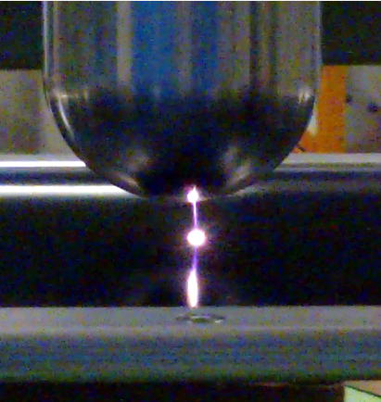
Evaluation of Resistive Materials
Carbon loaded Micarta
Zelec ESD powder mixed with polyurethane binder
ESD surface conducting G10 from Current Composite
Screen printed resistive ink on G10 substrate
DuPont resistive Kapton film on G10 substrate
Bonding strength
Resistivity uniformity, stability
Resistance to sparks, abrasion
See summary by Francesco Pietropaolo:
https://indico.fnal.gov/getFile.py/access?contribId=35&sessionId=10&resId=0&materialId=slides&confId=11632

Slide 25
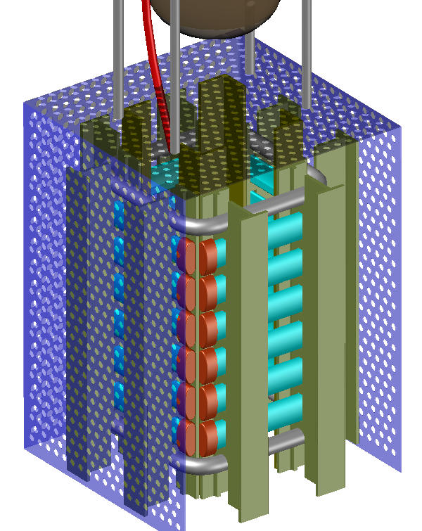
Roll-Formed Field Cage Test Setup
To validate the field cage concept in pure LAr
Designed to fit in the ICARUS 50 liter cryostat
Roll-formed metal profiles with UHMW PE caps
  Choice of metal (Al, SS) and surface finish
Pultruded fiberglass I-beams form 4 mini panels
All profiles are at same potential to simplify
HV connection
Ground planes only 66mm away
Requires 1/3 of FD bias voltage to reach
same E field
Ground planes can be connected to external
amplifiers to monitor micro-discharges
Video camera to monitor bubbles and sparks
Holding 100kV (see Francesco’s talk)

Slide 26
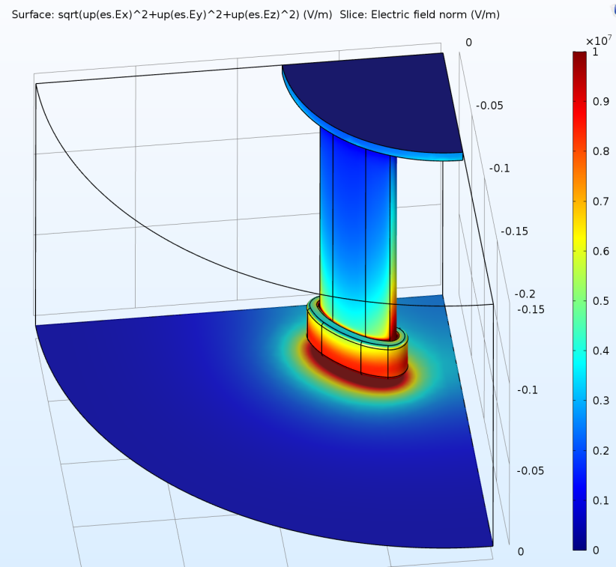
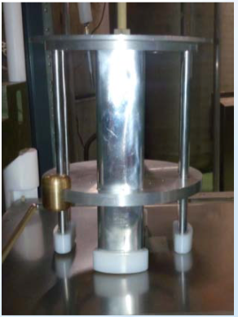
Small Field Cage Tests
-150kV through the caps and 5mm of LAr in an open Dewar

Slide 27
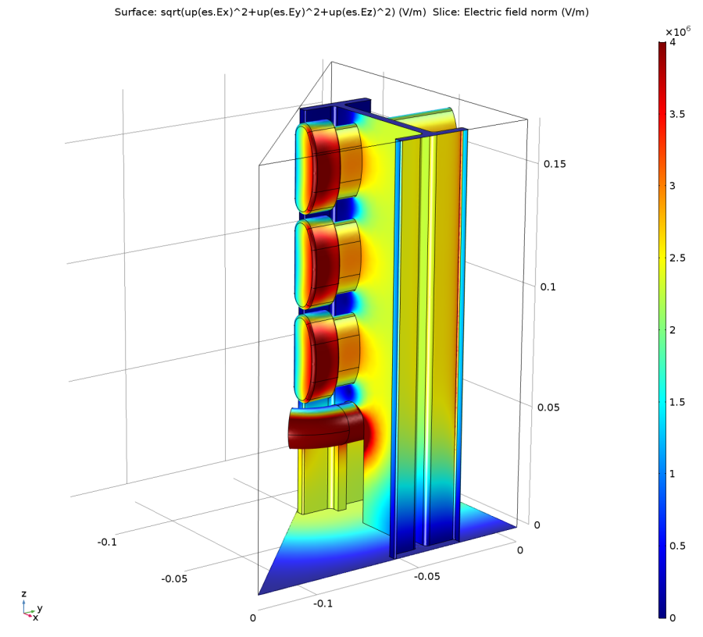
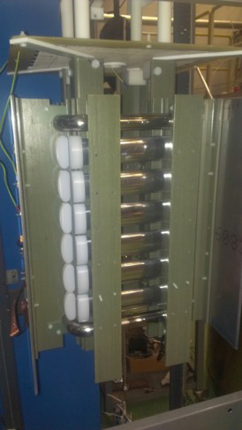
Small Field Cage Tests
-100kV on the profiles, 6.6cm to ground plane. Clean argon.

Slide 28
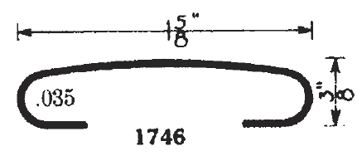
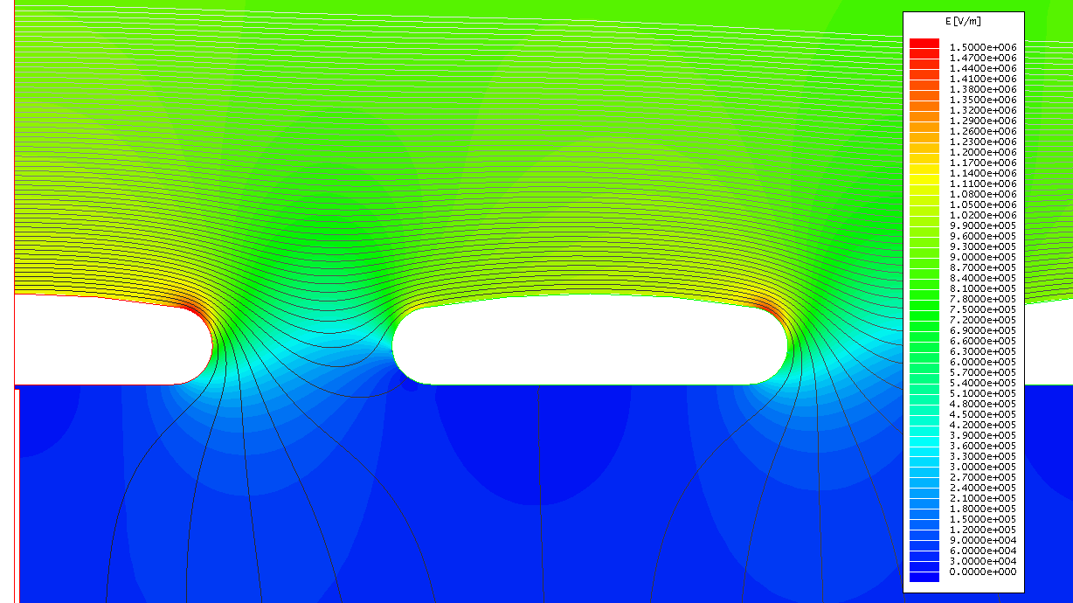
Field Cage with Profile # 1746
Pitch 6cm (3kV)
Max. E field ~15kV/cm
Ground plane 20cm above
6cm
-180kV
-177kV
-174kV

Slide 29
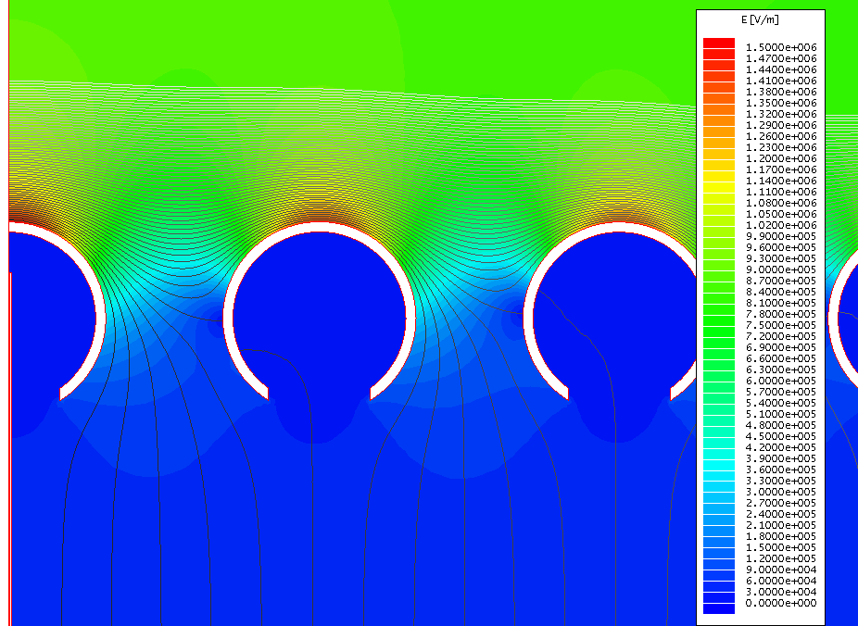
Field Cage with 38mm tube (1.5”)
Pitch 6cm (3kV)
Max. E field ~15kV/cm
Ground plane 20cm above
6cm

Slide 30
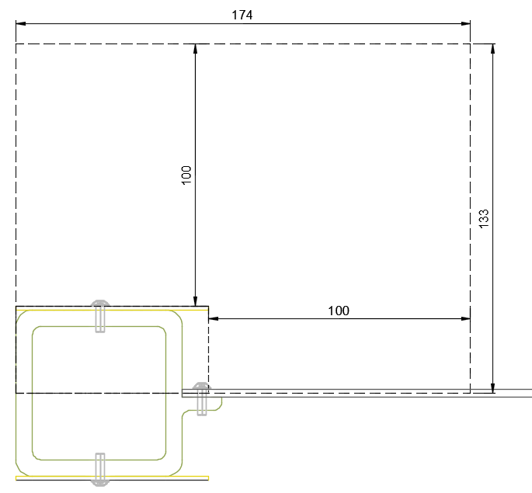
Fiducial Cut on the Thin CPA Design
If we apply a fiducial cut of 100mm around the frame, the area of 174mm x 133mm would be the cut at the cathode every 0.58m (half of the new half width CPA).
This averages to ~40mm over 0.58m instead of ~110mm in the case of the double walled configuration.

Slide 31
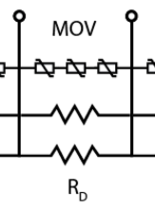
Broken Resistor in a Field Cage Module
Between two adjacent nodes of the resistor divider chain are two 1GOhm resistors in parallel, and 3 serially connected MOVs in parallel. The nominal voltage drop is 3kV.
An open resistor on the divider chain would approximately double the voltage cross the remaining resistor to 6kV. This will force the varistors in parallel to that resistor into conduction mode, results in a voltage drop of roughly 5kV (1.7kV x 3), while the rest of the divider chain remain linear, with a slightly lower voltage gradient.
This voltage profile on one field cage module is modeled in 3D, with the rest of
the “FC modules” in ideal linear form. Instead of using discrete electrodes on
the field cage, plates with perfectly linear voltage distribution are used. This
gives the “ideal” behavior and can then be superimposed with the effect of the
discrete electrodes.
Because the damage to the divider is local to one module, its
impact to the TPC drift field is limited to region near this
module. This is part of the intention of this modular design.
The effect of the resistor values can be scaled from this study.
A 2% change in a resistor value (1% change from the 2R in
parallel) will give ~1.5% of the distortion from a broken resistor.
V
X

Slide 32
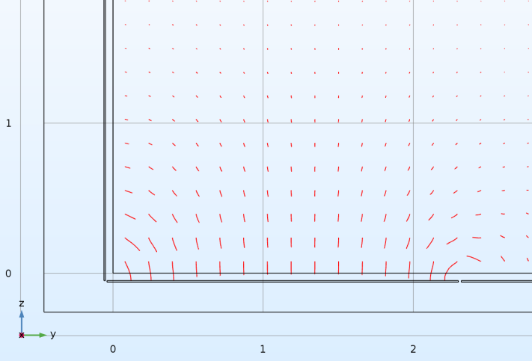
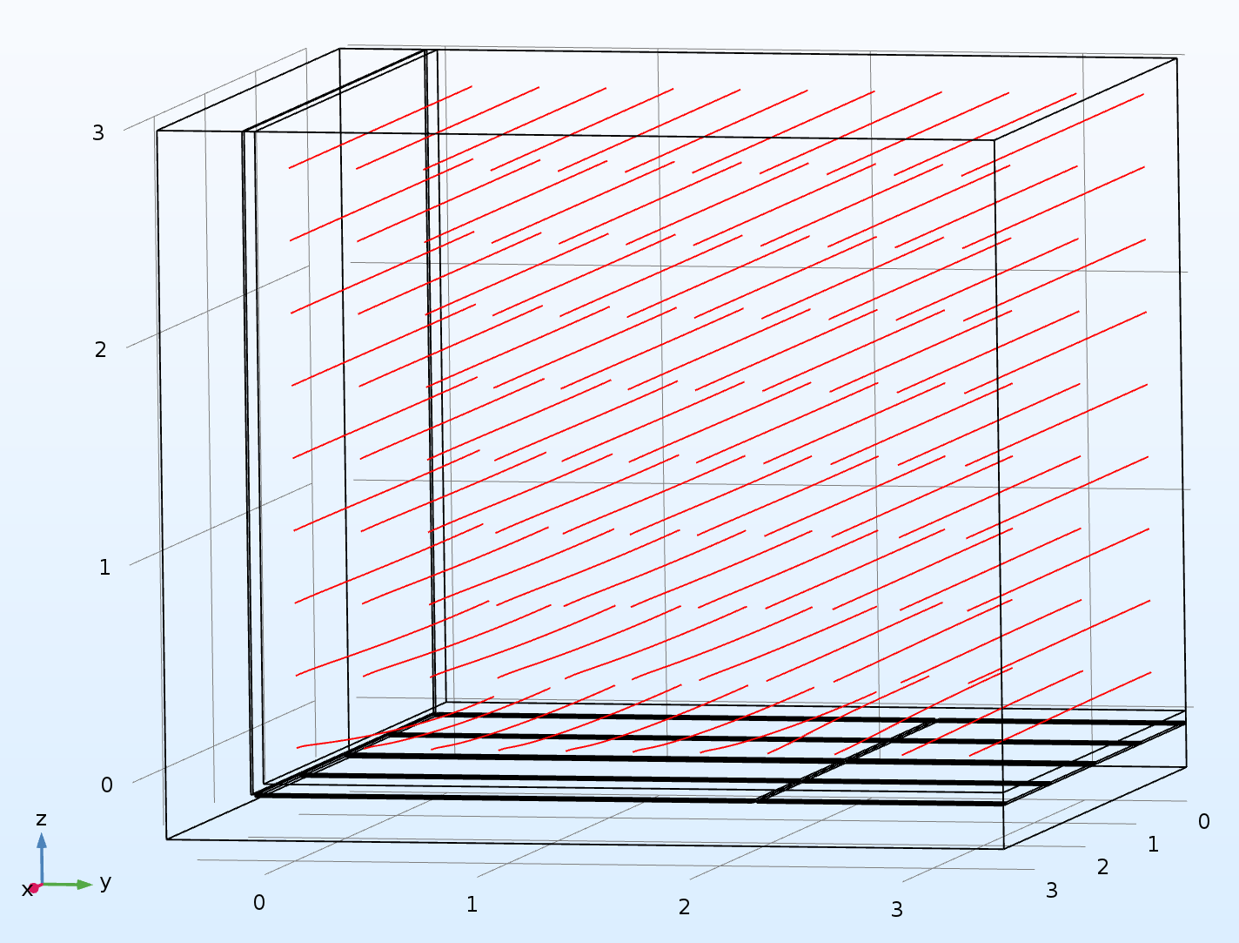
Broken Resistor on First Gap (CPA Side)
Electrons leaving the cathode are deflected toward the field cage module with the broken resistor
APA
Projection of field lines on APA plane
CPA
The maximum deflection is about 15cm

Slide 33

Broken Resistor on First Gap (CPA Side)
Projection of field lines on APA plane
The maximum deflection is about 15cm

Slide 34
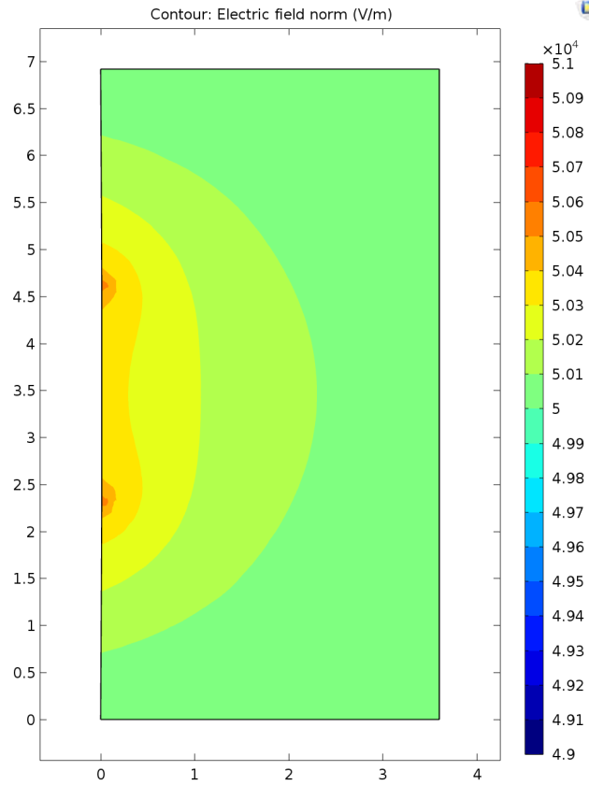
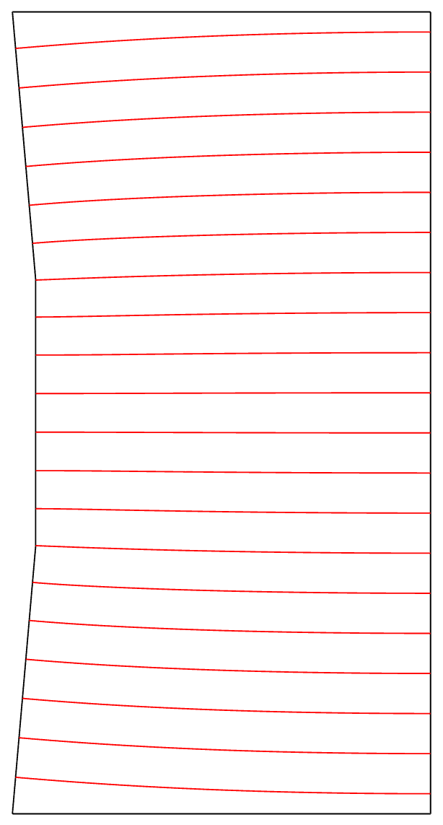
Cathode plane bows in
Central 2.3m x 2m tile bows in by 1cm.
Exaggerated view
1cm
E contour step: 0.2%
2.3m

Slide 35
Cathode plane bows in
Swing: +/- 1cm
Field line distortion (worst case)
1cm
2.3m
Deflection [m]
Drift Distance (from Cathode) [m]

Slide 36

FC profile shift on plane by 10mm

Slide 37
FC profile shift on plane by 10mm
Drift distance [mm]
Distance from the Field Cage [mm]

Slide 38

No charge build up
2 I-beams stacked between the ground plane and field cage profiles.
Corner radius of the I-beams is 1mm, 180kV over 20cm

Slide 39

With charge build up
Applied “zero charge” boundary condition to all surfaces of the I-beam except the top and bottom flat faces.
White contour lines: V
Black contour lines: E

