Slide 1
Nanosurface characterization of nitrogen treated Nb samples
Arti Dangwal Pandey
DESY Nanolab
TTC Topical Workshop 15-17 Nov 2017

Slide 2
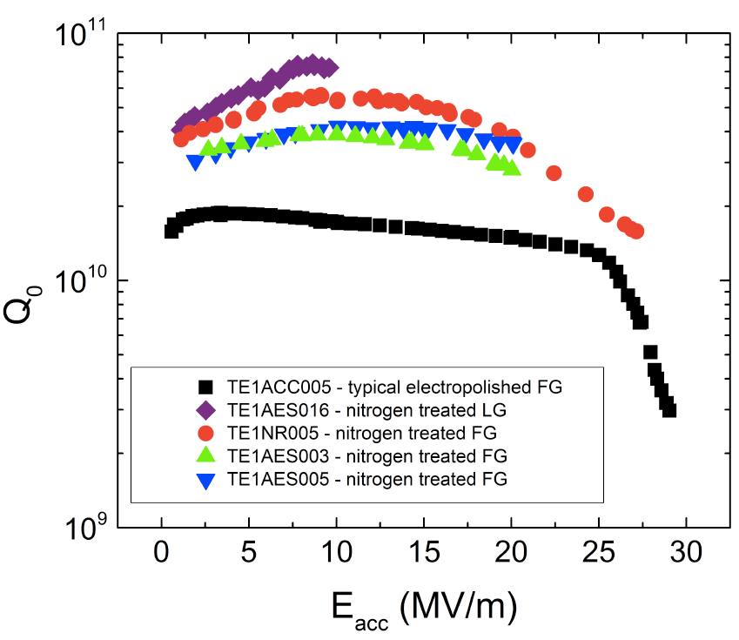
Nitrogen treatments
N-doping
N-infusion
#D5
[A. Grassellino et al., Supercond. Sci. Technol. 26 (2013) 102001]
[A Grassellino et al 2017 Supercond. Sci. Technol. 30 094004]
To investigate the role of nitrogen on Nb surface layer:
Single crytsal Nb(100) samples: as model system
Materials: high-purity single crystal Nb(100) and cavity grade large-grain Nb(100)
Notes:
N-doping: Comparison of quality factors versus accelerating field
for nitrogen-treated cavities and standardly adopted treatment
(electropolishing). Improvements in quality factors up to a factor of
3.5 are found, in the region of accelerating gradients of interest for
CW SCRF accelerators.

Slide 3
Nitrogen treatments: N-doping
#D5
  samples: cavity grade large-grain Nb(100) from Hereaus
  BCP (HF:HNO₃:H₃PO₄ =1:1:2) < 100 µm
  N-doping recipe: heat up to 800°C/ 900°C, hold for 2 hrs. (P ~ 5.10⁻⁶ mbar)
    Insert 30 mTorr (0.039 mbar) of N₂ (99.999%) for 20 minutes
    Anneal without nitrogen for next 30 minutes
    Natural cool down
‘Surface characterization of nitrogen-doped Nb (100) large-grain Superconducting RF cavity material’, - G. D. L. Semione, A. Dangwal Pandey*, T. F. Keller, H. Noei , A. Prudnikava, Y. Tamashevich, V. Vonk, E. Elsen, B. Foster, and A. Stierle, - to be submitted
Notes:
N-doping: Comparison of quality factors versus accelerating field
for nitrogen-treated cavities and standardly adopted treatment
(electropolishing). Improvements in quality factors up to a factor of
3.5 are found, in the region of accelerating gradients of interest for
CW SCRF accelerators.

Slide 4
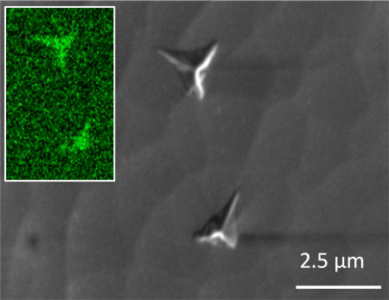
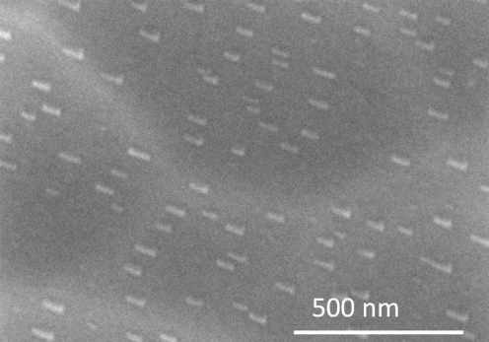
Nb(100): N-doped at 800 °C
SEM+EDX
Element |  |  | Initial | 800 °C
 |  |  |  | A | B
N |  |  | 3.95 | 35.69 | 2.41
O |  |  | 7.21 | 2.25 | 7.82
Nb |  |  | 88.84 | 62.06 | 89.78
Total |  |  | 100.00 | 100.00 | 100.00

Slide 5
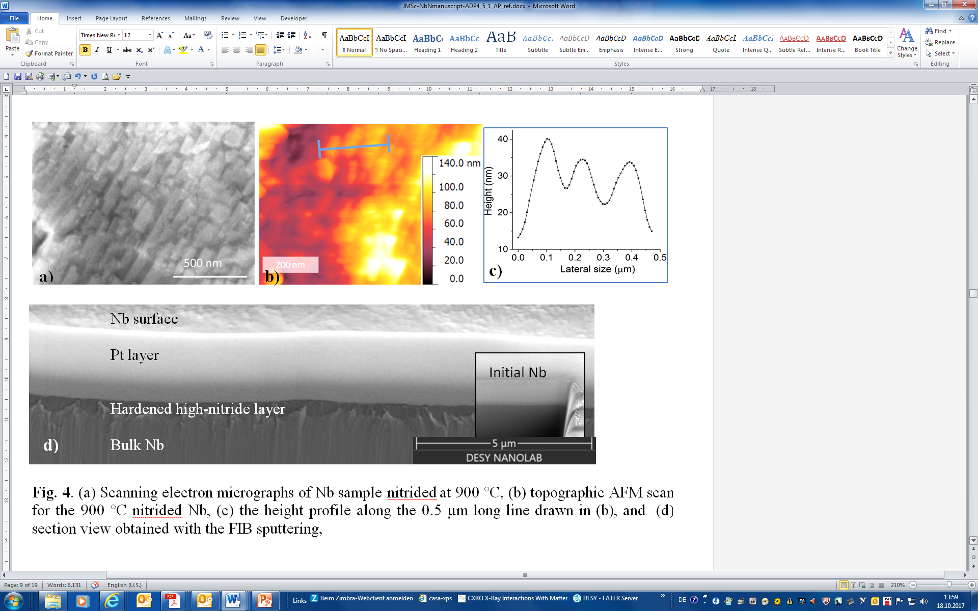
Nb(100): N-doped at 900 °C
SEM, AFM, FIB
0.5 µm
Notes:
(a) Scanning electron micrographs of Nb sample nitrided at 900 °C d)
, (b) topographic AFM scan for the 900 °C nitrided Nb, (c) the height profile along the 0.5 µm long line drawn in (b), and (d) section view obtained with the FIB sputtering,

Slide 6
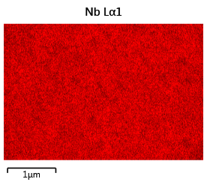
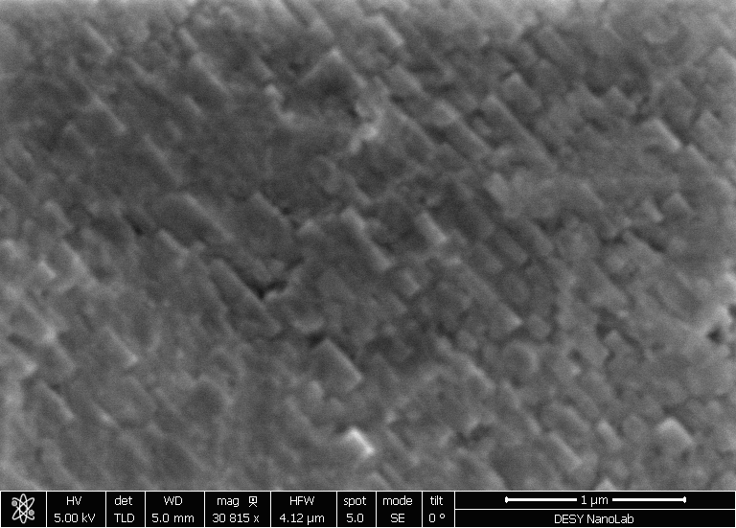
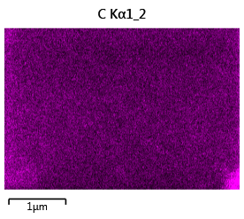
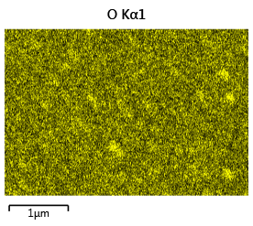
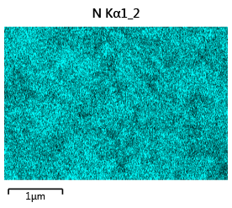
Nb(100): N-doped at 900 °C
courtsey- A. Prudnikava

Slide 7
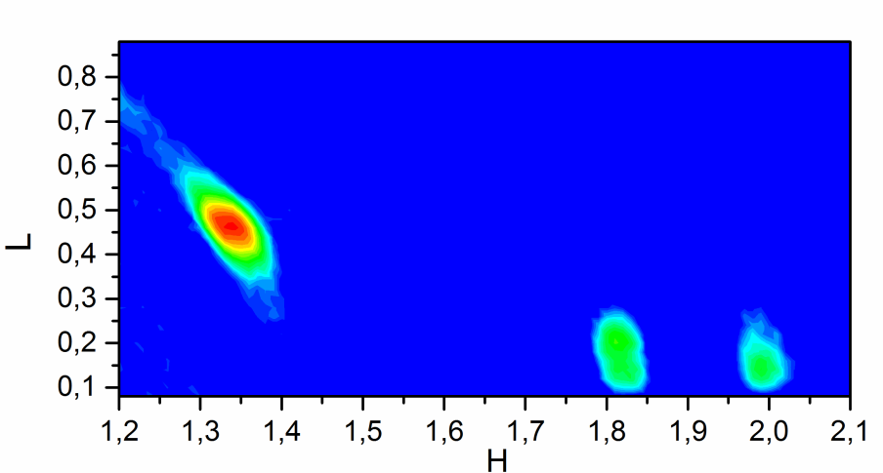
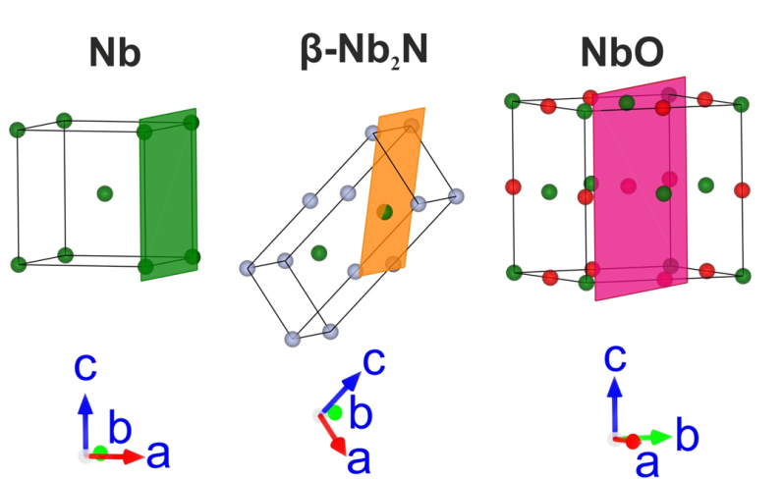
Nb(100): N-doped at 900 °C
XRD
(200)
μ = 1.3°
(-102)
Λ = up to 220 nm
(101) Nb
(002) β-Nb₂N
(200)
(101) Kβ + (-100) β-Nb₂N*
(110)
(-10-1) β-Nb₂N*
(200) Nb
(102) β-Nb₂N
(-10-2) β-Nb₂N*
Notes:
Specular diffraction profile of the 900 °C treated sample. The observed Bragg peaks can be indexed using β-Nb₂N, NbO and bulk Nb phases. (b) Reciprocal space maps in selected areas and the corresponding reciprocal lattice of Nb (green), β-Nb₂N (orange/black) and NbO (magenta) assuming a particular epitaxial orientation and two domains for the nitride: A (orange) and B (black). Open circles represent expected intensities in reciprocal space. (c) Real space model of Nb, β-Nb₂N and NbO, with N atoms depicted in white and O atoms depicted in red. For all real space models dark green atoms represent Nb atoms.

Slide 8
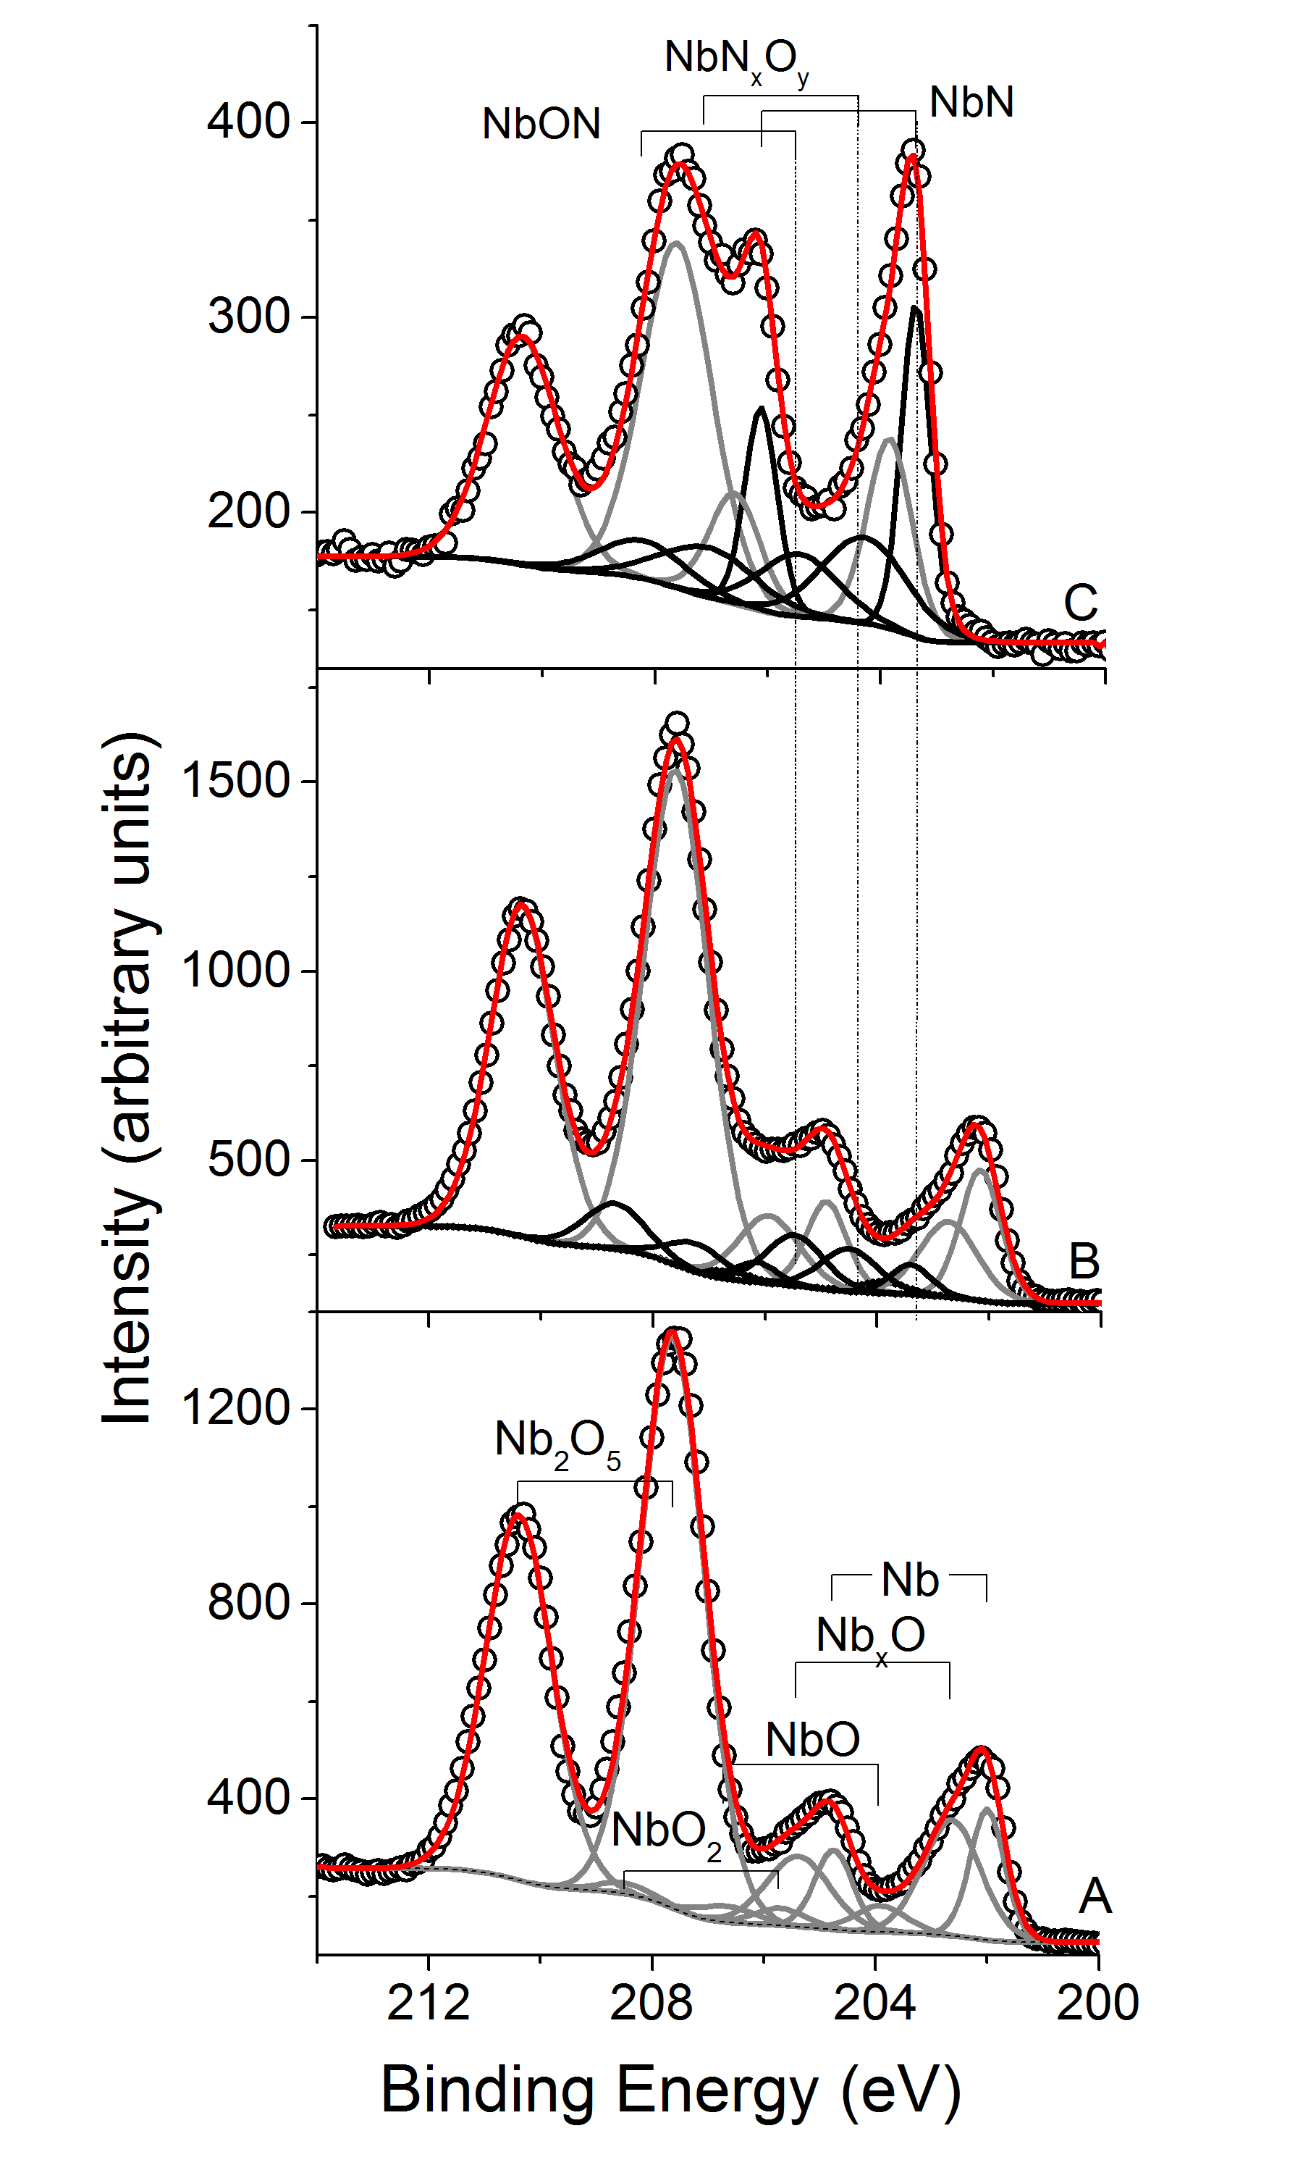
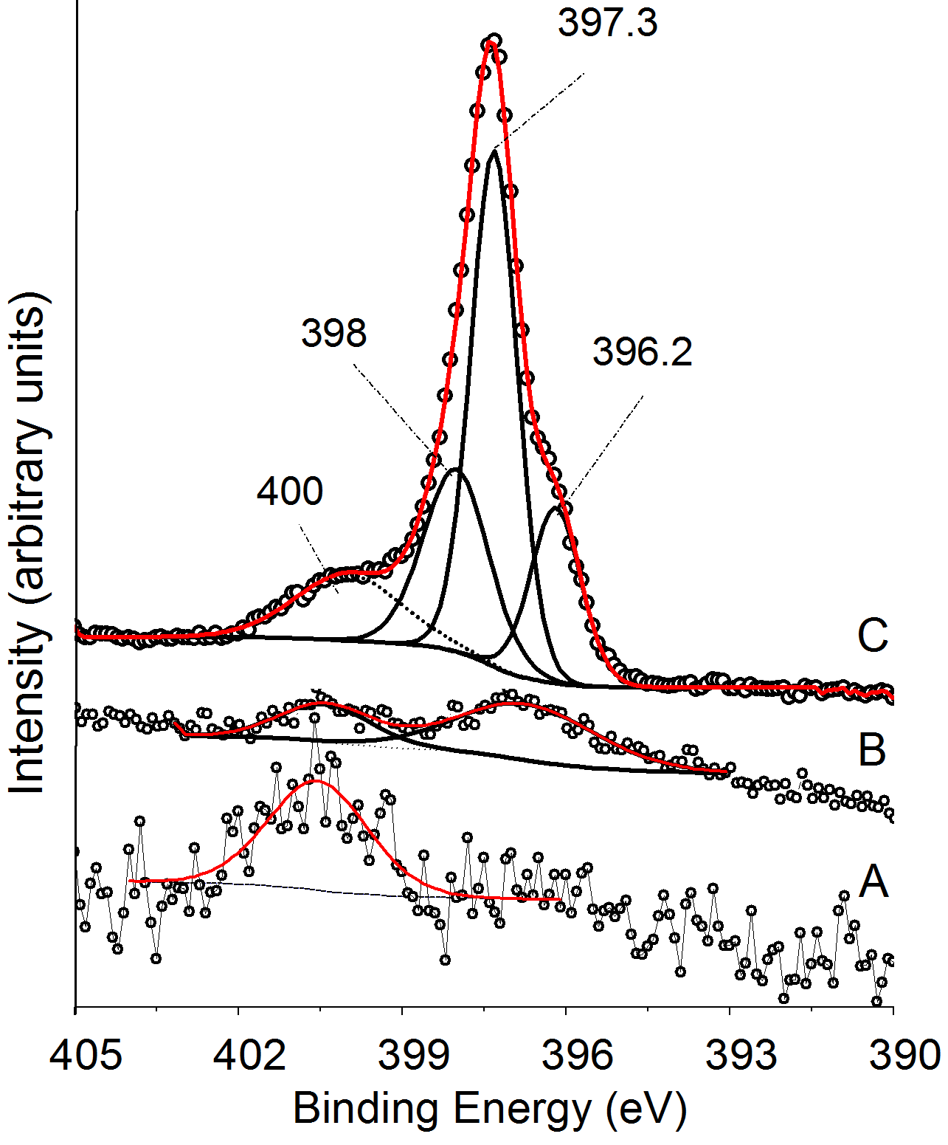
Nb(100): N-doped at 800 °C/ 900 °C
XPS
On Nb-nitride thin films: N 1s core levels located for cubic fcc (δ-NbN) @ 397.2 and hexagonal (β- Nb₂N) @ 397.9 eV.
- Sanjinés R. et al (2006) Thin Solid Films 494:190-195.
N 1s
NbN
N-doped @ 900 °C
N-doped @ 800 °C
initial Nb
β Nb₂N
Nb 3d
NbON
Adsorbed N₂
N-doped @ 900 °C
N-doped @ 800 °C
initial Nb
NbN: not detected in XRD,
  lattice constant very close to that of NbO
or insufficient material (nanoregions)

Slide 9
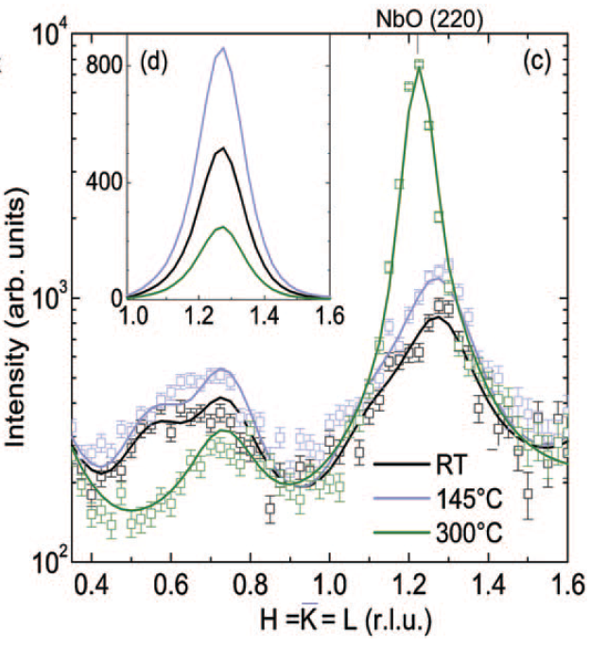
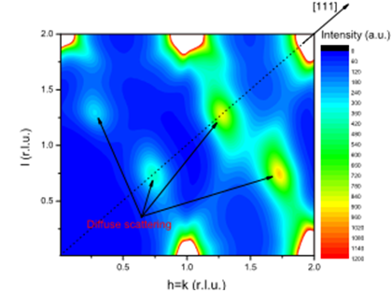
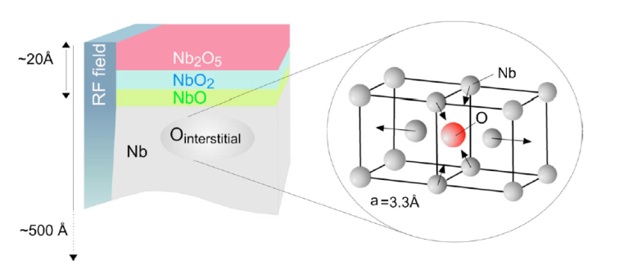
Conclusions 1: N-doping of Nb
Growth of triangular precipitates – nitrogen rich, rectangular precipitates - oxygen rich
Approx. 500 nm thick hardened - irregular top surface layer
Epitaxial relation derived for NbO and Nb₂N by XRD
NbO, Nb₂N, NbN, NbON, NbN_{x}O_{y} identified by XPS in top 10 nm surface
However,
-these phases are not present after few µm EP- to result very high Q of the cavities,
-knowledge about the interstitials’ distribution in the near surface region is missing, to be studied by high energy x-ray diffuse scattering
M. Delheusy, et al., Appl. Phys. Lett . 92, 101911 (2008)

Slide 10
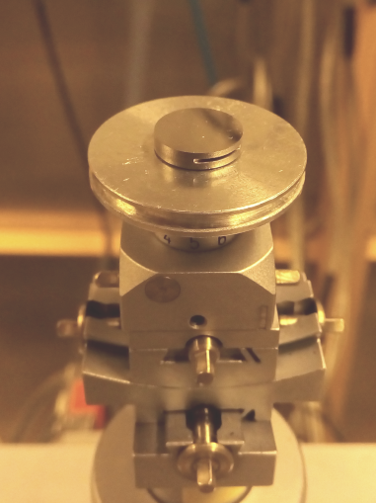
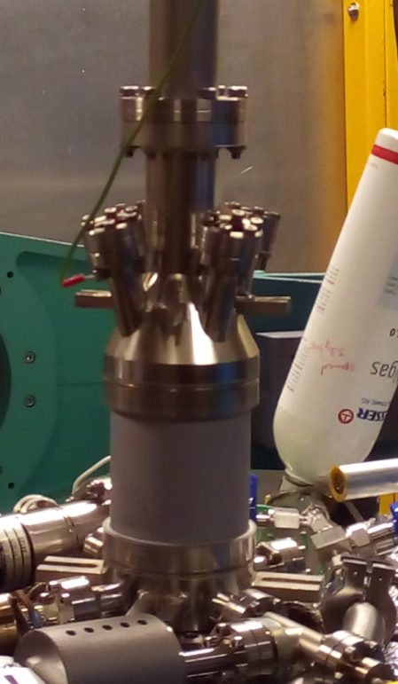
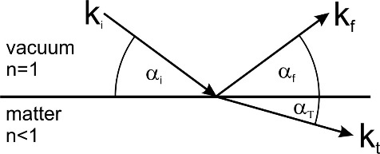
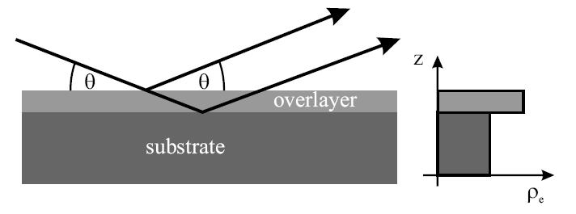
Nitrogen treatments: N-infusion
  N-infusion recipe:
      -heat up to 800°C, hold for 2 hrs.
      -P_{RT} = 3.6x10⁻⁹ mbar / P₈₀₀ = 8.0x10⁻⁷ mbar
      -Cooldown to 120°C (P₁₂₀=2.10⁻⁸ mbar)
        insert 25 mTorr (0.033 mbar) of N₂ (99.999%) for 23 hrs/ 48 hrs
      Natural cool down
#D5
      in-situ x-ray reflectivity (XRR) measurements
  Thickness (d)
  Layer density profile (ρ_{e})
  Surface or interface roughness (σ)
X-rays
Detector
Constructive interference
between layers
Notes:
N-doping: Comparison of quality factors versus accelerating field
for nitrogen-treated cavities and standardly adopted treatment
(electropolishing). Improvements in quality factors up to a factor of
3.5 are found, in the region of accelerating gradients of interest for
CW SCRF accelerators.

Slide 11
In-situ N-infusion experiment -1
      Sample: high purity single crystals from SPL, polished by SPL (Netherlands)
RT
Nb₂O₅
~4.7nm
NbO₂
NbO
Nb
800°C/2h
~4.2nm
NbO
Nb
~14nm
N-infusion
23 hrs
NbO_{x}N_{y}
NbO
~1nm
Nb
-by G. Dalla Lana

Slide 12
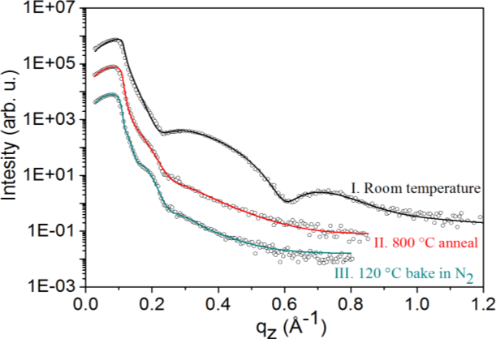
In-situ N-infusion experiment -1
      Sample: high purity single crystals from SPL, polished by SPL (Netherlands)
After air-exposure, XRR curves did not change any more.
- A protective surface layer formed.
Notes:
4.7 nm, 4.2 nm, 14 nm surface layer

Slide 13
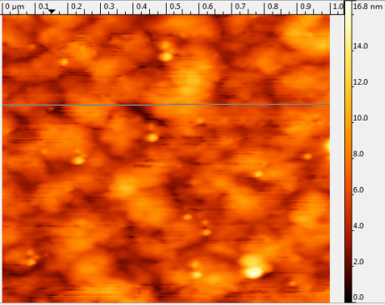
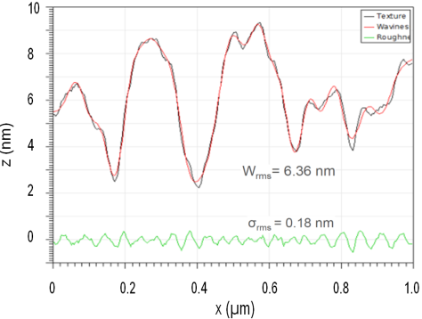
In-situ N-infusion experiment -1
      High purity Nb(100)single crystal from SPL, polished by SPL (Netherlands)
#D5
‚Si‘ contamination- polishing residue!
Si, O by EDX

Slide 14
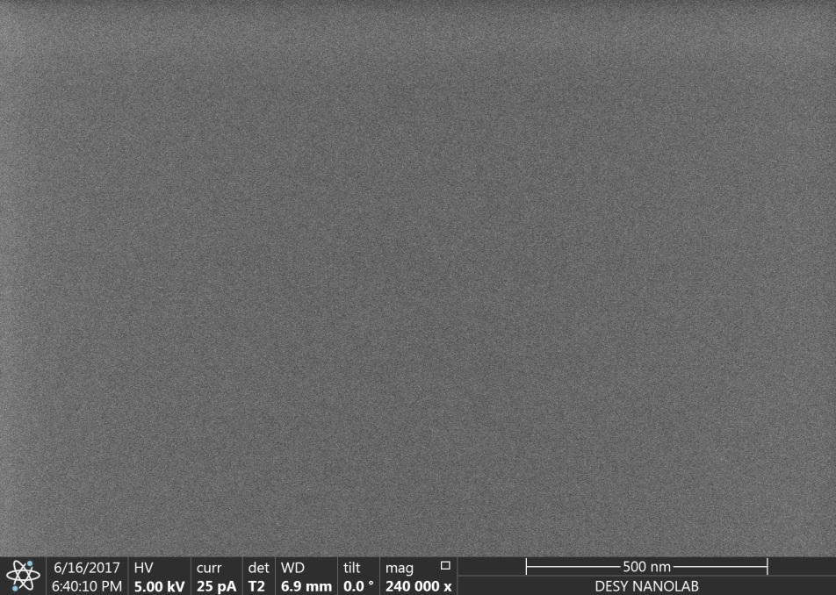
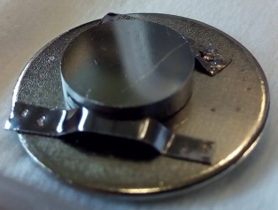
Nb(100) single crystal #2
  After 2000°C annealing of Nb(100) single crystal #1 for 6 hours in a UHV furnace of P₀ = 3,0 x 10⁻¹¹ mbar
#D5
Very clean surface free of Si/other contamination

Slide 15
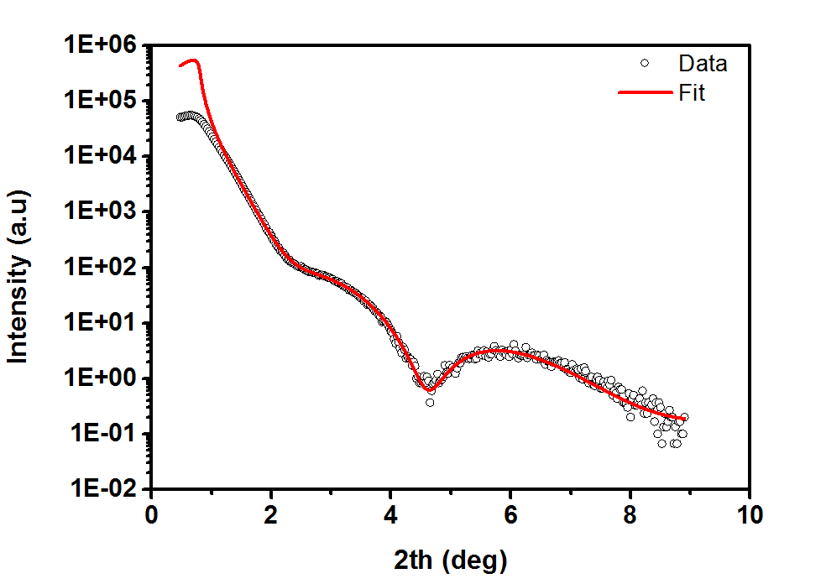
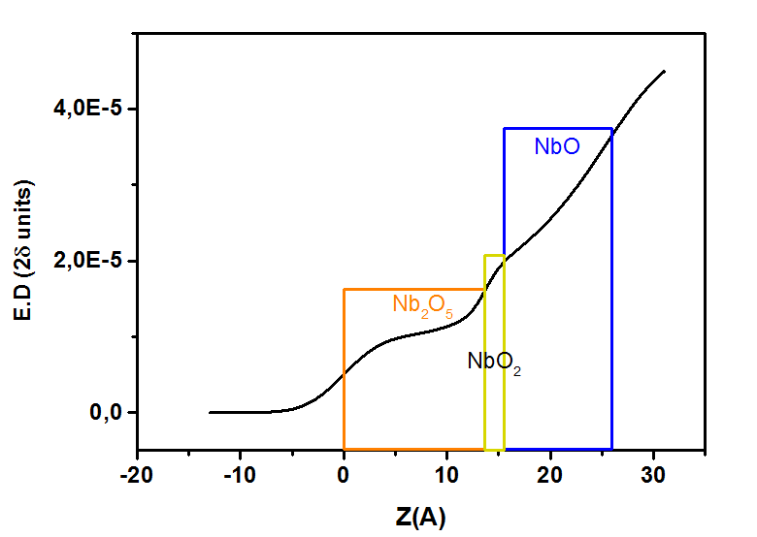
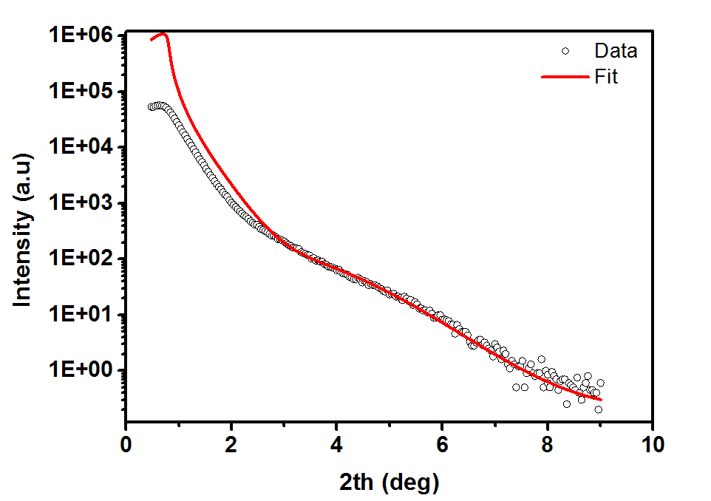
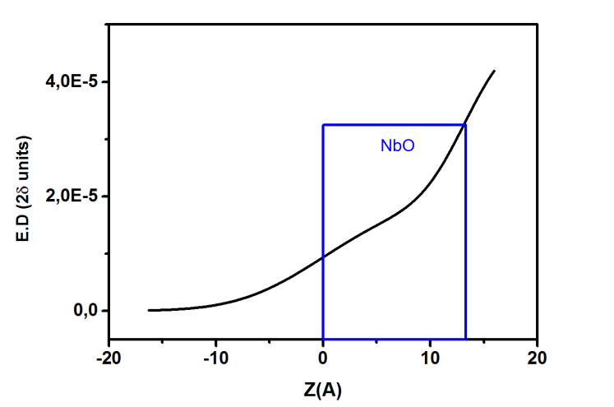
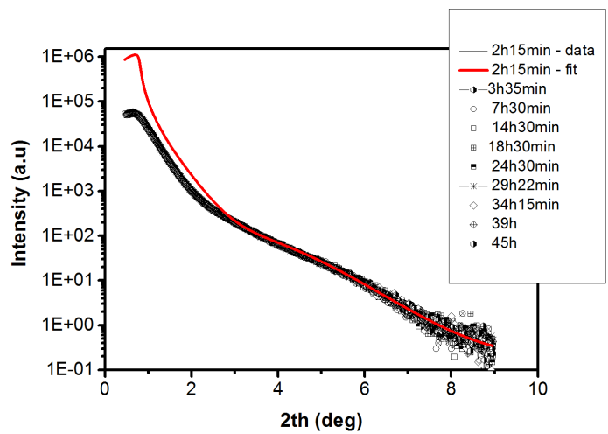
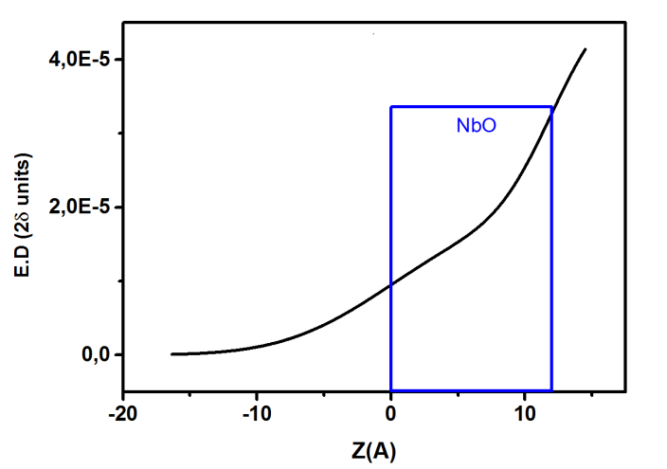
In-situ N-infusion experiment -2
      High purity Nb(100)single crystal #2
RT
Nb₂O₅
NbO₂
~2,5 nm
NbO
Nb
800°C/2h
~1,3 nm
NbO
Nb
N-infusion
48 hrs

Slide 16
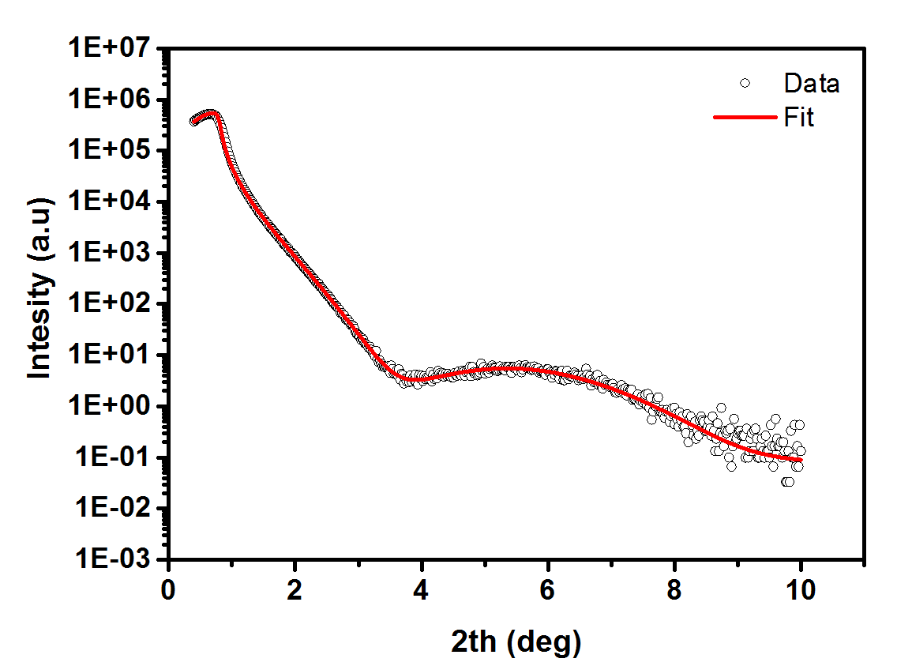
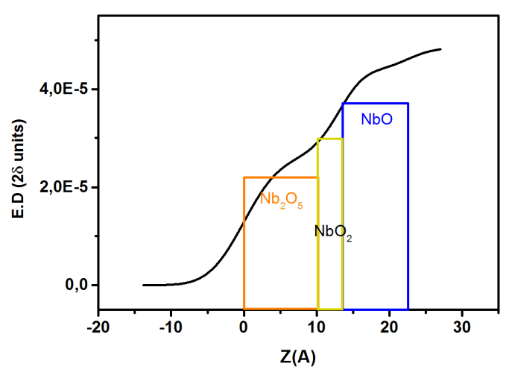
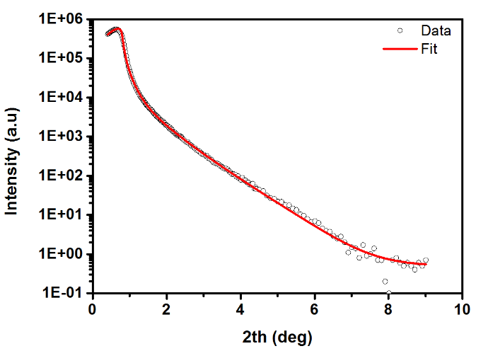
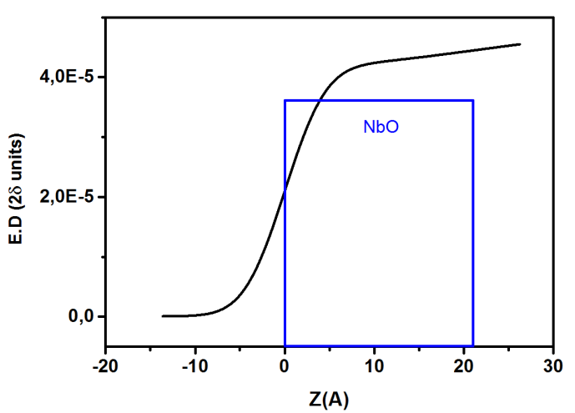
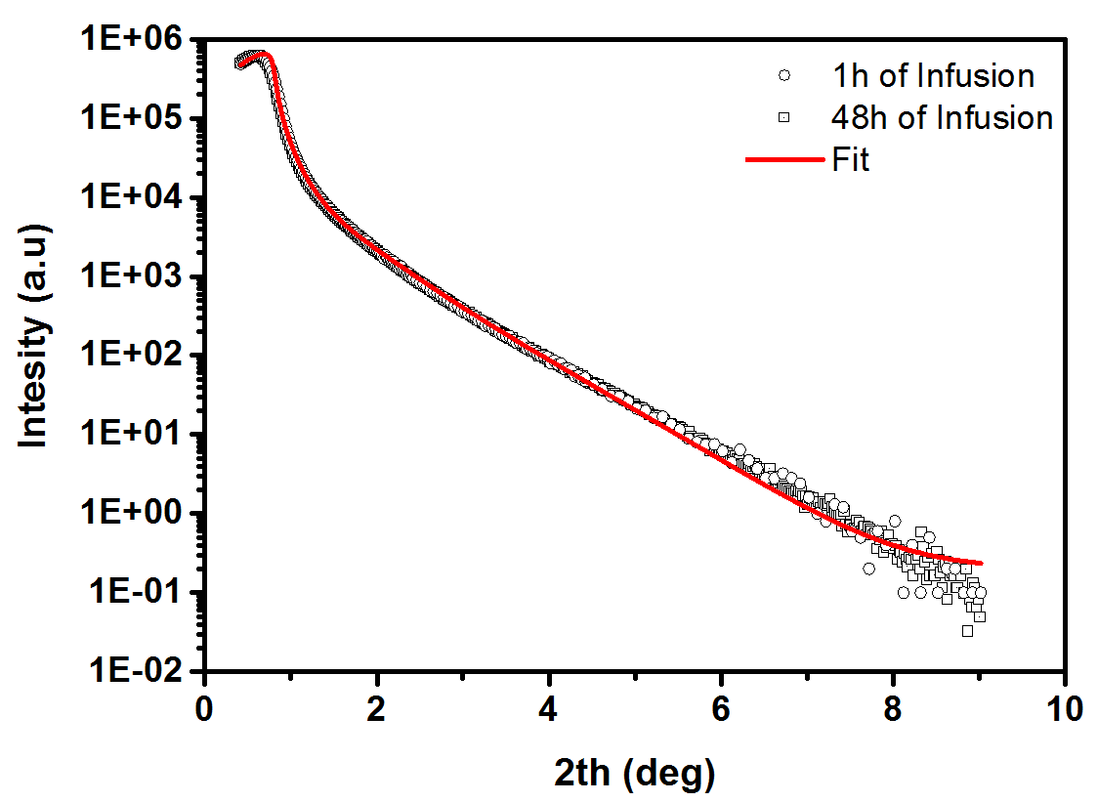
In-situ N-infusion experiment -3
      cavity-grade Nb(100) of RRR 300
Nb₂O₅
NbO₂
~2,3 nm
RT
NbO
Nb
800°C/2h
~2,1 nm
NbO
Nb
N-infusion
48 hrs

Slide 17
Conclusions 2: N-infusion of Nb
N-infused sample #1 showed different result due to polishing residues on the surface
Reproducible in-situ XRR results on UHV cleaned and cavity-grade Nb(100) samples
No changes observed in the XRR curves before and after nitrogen injection at 120 °C
N-infused sample#2,#3 show natural oxide formation after long exposure to air
NbO present, but no nitride phase detected by XRD
Ongoing/proposed data analysis/measurements:
In-situ diffuse scattering experiments with high energy x-rays
XPS (ex-situ)
-HRTEM
…

Slide 18
Acknowledgement:
Entire DESY SRF R&D interdisciplinary team
Thank you very much for your attention!

