Slide 1
Prospective on ultimate gradient limitations in SRF cavities
Alex Gurevich
Department of Physics and Center for Accelerator Science,
Old Dominion University, Norfolk, VA
Supported by DOE under Grant DE-SC100387-020
TTC Meeting, FNAL, November 15-17, 2017

Slide 2
Outline
Nb state of the art: E_{acc} = 45-50 MV/m and Q = (3-5)10¹⁰ @2K and 1.5-2 GHz
What are the fundamental limits of Q and E_{acc} at 2-4K and 1-2 GHz?
We do not really know, a theory must be developed.
Is it a dc superheating field or a dynamic superheating field?
Nonequilibrium quasiparticles but a quasi-equilibrium SC condensate. How can it affect H_{s} at 2K and 1-2 GHz? Clean or dirty surface?
New SRF materials (Nb₃Sn, Fe-pnictides, ... ?), including alloyed Nb:
H_{s} = 500 mT (Nb₃Sn) or H_{s} = 700-900 mT for FBS vs 240 mT for a clean Nb
Potentially serious grain boundary limitations of the RF breakdown field in polycrystalline materials other than Nb
Surface materials nano-structuring, multilayers, impurity management to prevent vortex dissipation.

Slide 3
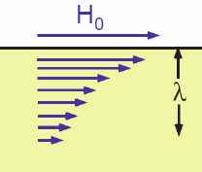
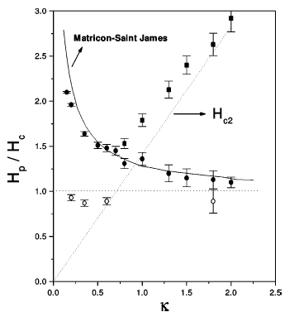
DC superheating field
Meissner state becomes unstable at H > H_{s} as the current density at the surface reaches
the depairing limit J_{d} = H_{s}/λ at the maximum velocity of Cooper pairs, v_{d} = Δ/p_{F}
Surface barrier for
vortices vanishes at H = H_{s}
H_{s} near T_{c}: (Matricon and Saint-James, 1967)
Nb
B_{s} decreases as the surface gets dirtier
and the GL parameter κ = λ/ξ increases.
At T << T_{c}, only H_{s}(0) = 0.84H_{c} at κ >> 1 has been calculated in the clean limit (Galaiko 1966, Catelani and Sethna, 2008) and for an arbitrary impurity concentration (Lin and Gurevich, 2012)
Common ad-hoc extrapolation of the GL results to T << T_{c} underestimates H_{s}

Slide 4
Non-equilibrium effects at 2K and 1 GHz
SRF frequencies 1-2 Gz are well below the gap frequencies = = 0.7-2 THz:
SRF is quasistatic for the SC condensate. DC pairbreaking unless quasiparticles matter.
SRF frequencies at 2K are much smaller than the temperature:
But it does not mean that quasiparticles are in equilibrium
E
E
Quasiparticle density:
If n(T) << n_{0,}
quasiparticles do not
affect the dynamics
of the SC condensate,
but that may change
at H = H_{s}
Stimulated
superconductivity:
Superfluid density
is increased
(but not the gap!)
Eliashberg, 1971
k_{F}
k
k_{F}
k
The case of SRF cavities
Not the case of SRF cavities

Slide 5
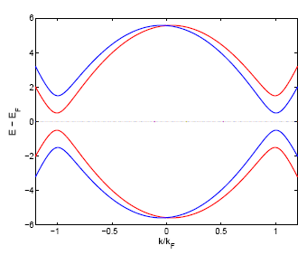
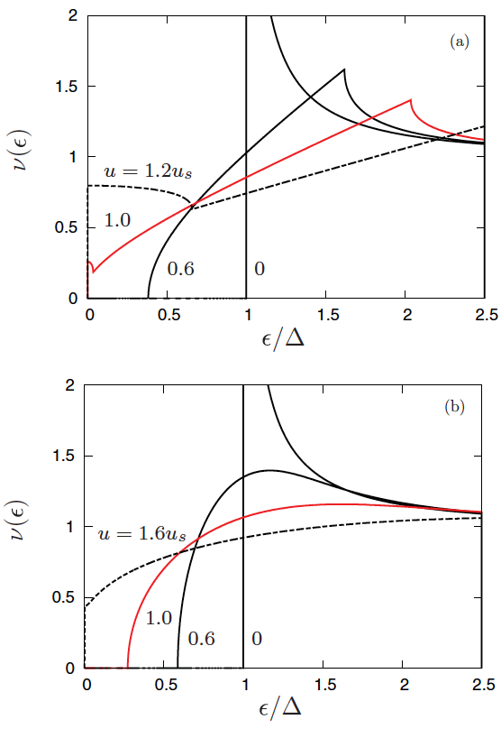
Current-induced broadening of N(ε) in clean limit
J. Bardeen, RMP 34, 667 (1962)
Rocking “tilted” electron spectrum in the
current-carrying rf state, J(t) = J₀cosωt
2Δ - 2vp_{F}
2Δ + 2vp_{F}
Superfluid velocity v_{s}(t) = J/n_{s}e
The energy gap ε_{g} = Δ - p_{F}|v_{s}| < Δ at v_{s} > 0
Density of thermally-dissociated quasiparticles
increases with H. Gapless state at H = H_{s}.
at H = H_{s}, so non-equilibrium
SC can affect the dynamic H_{s} at T << T_{c}
Non-equilibrium quasiparticles produced by a shaking N(ε,t)

Slide 6
Benefits of a dirty layer at the surface
Effect of current on DOS (Bardeen 1964, Maki, 1963, Fulde, 1965)
Clean limit: gap closes at H < H_{s}
Dirty limit: gap remains finite (ε_{g} = 0.3 Δ) at H = H_{s}
Impurities can reduce R_{s} and the high-field Q slope
Moderate reduction of H_{s}
At H = H_{s}, the density of quasiparticles can be small
clean
For Nb @ 2K:
dirty
Impurities reduce the influence
of non-equilibrium effects
on the static H_{s}
P-J Lin and AG, PRB 85, 054513 (2012)

Slide 7
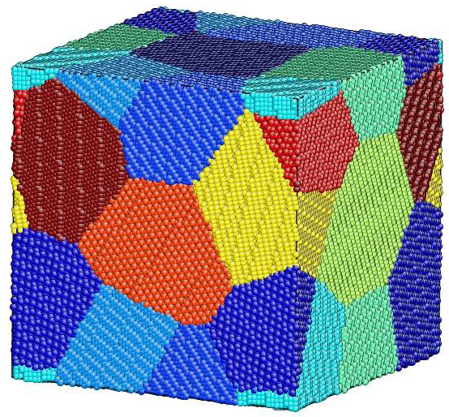
Grain boundaries impeding high SRF currents
H(t)
H(t)
GBs are transparent to the RF current density
GBs are partly transparent to the RF
current density
J_{c} of GB is not large enough to transmit
J(x) above a penetration field:
Critical current density J_{c} of GB is larger than
J(x) up to
For J_{c} = 0.1J_{d}, Abrikosov-Josephson vortices penetrate in and out of GBs in Nb₃Sn at H > 50 mT

Slide 8
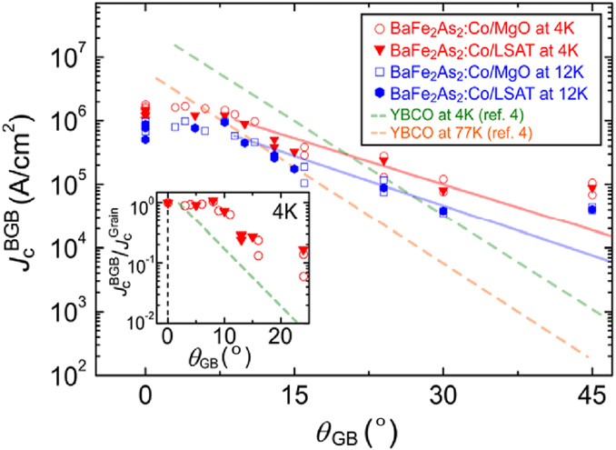
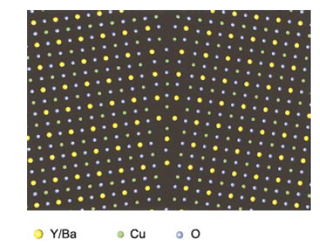
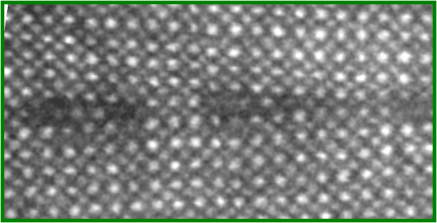
GB problem in cuprates and pnictides
16^{O} [001] tilt grain boundary in YBCO
⊥
J
⊥
Exponential decrease of J_{c} with the misorientation angle
GBs behave as weakly-coupled Josephson junctions
J_{c} = 10⁴ -10⁵ A/cm² at 15-30º are more then 3 orders
of magnitude smaller than the SRF screening
current densities at B_{a} = 100 mT:
1 nm
X. Song et al. Nature Mat. 4, 470 (2005)

Slide 9
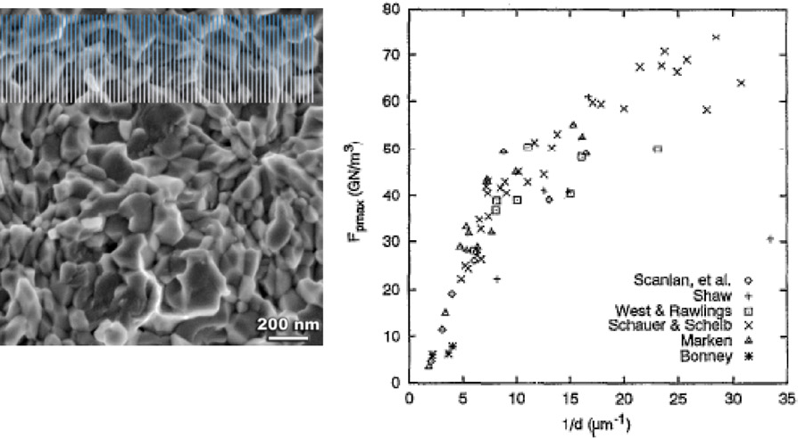
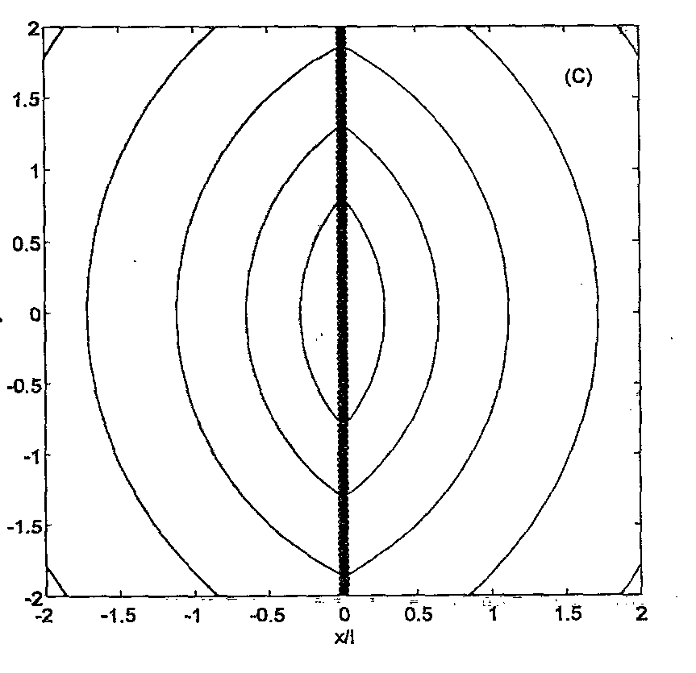
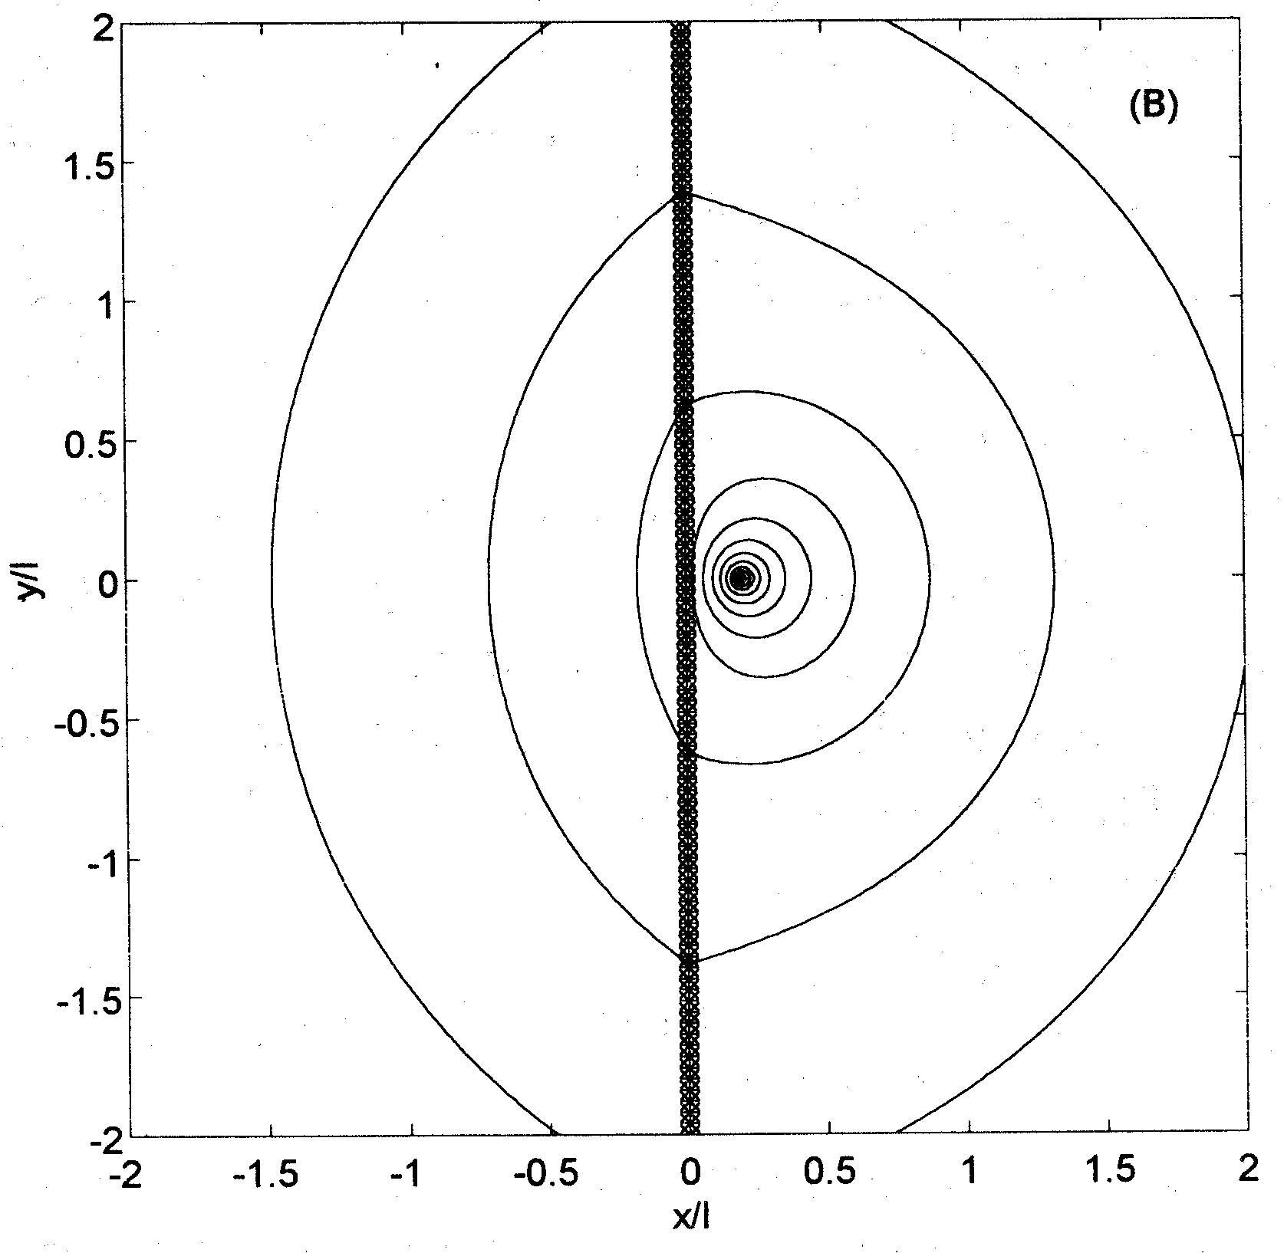
GBs block strong currents and pin vortices in Nb₃Sn
Durrell et al, Rep. Prog. Phys. 74, 124511 (2011)
J
Vortices caged in the grains and pinned by GBs
GBs transmit currents much smaller than the bulk depairing limit:
Bulk pinning force depends on the grain size d:
GB cuts currents circulating around a vortex
causing its attraction to the GB at r < L:
Gurevich and Cooley, PRB 50, 13563 (1994)

Slide 10
H_{c1} and superheating field for GB vortices
GBs as weakly or strongly coupled long Josephson contacts
Weakly coupled GBs with
Both B^{J}_{c1} and B^{J}_{s} are much smaller than B_{c}, particularly for Nb₃Sn with κ = λ/ξ = 20--30
Strongly coupled GBs with
Gurevich, PRB 46, 3187 (1992)
Josephson core length of mixed AJ vortices
Here but the AJ superheating field can be much larger than if:
J_{c} is of the order of J_{d} for a large – κ superconductor like Nb₃Sn
GBs do not have edge defects which locally reduce J_{c} down to

Slide 11
How fast can vortices penetrate and can they be stopped?
Nature Comm. 8, 85 (2017)
75 nm thick Pb film: imaging of penetrating vortices with a nanoscale SQUID on tip
Velocities of vortices can reach 10—20 km/s as J(x,y)
at the edge reaches the depairing current density,
(H = H_{s} in the SRF cavities)
If v = 10 km/s, a vortex penetrates over L = v/f = 10 microns
@ f = 1GHz. Since , vortices penetrate almost instantaneously across the Meissner screening layer.
Hot vortex branching trees ignite global thermal quench. No “natural” materials defects can pin such superfast vortices.

Slide 12
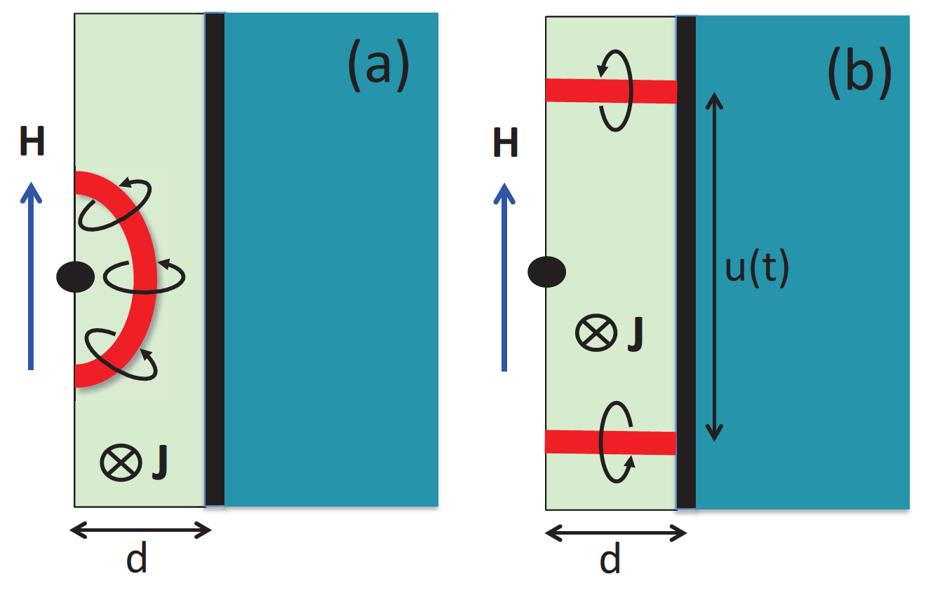
Arresting penetration of vortices in a multilayer
I layer intercepts propagating vortex loops.
No propagation in the bulk if h(d) < H_{c1}
Great reduction of the RF vortex power q
localized in a thin S layer:
Nb₃Sn: ρ_{n} = 0.2 μΩm, d/λ = 0.2, κ = 20,
λ = 100 nm, β = H_{p}/H_{s} = 1/2, f = 2GHz
For Nb₃Sn, u_{m} ≈ 4 μm, and q ≈ 2 μW
Unlike thick Nb₃Sn films, a thin ML only slightly (by ≈ 5%) increases the thermal impedance
of the cavity wall. No deterioration of thermal quench stability.
Experimental progress
NbN overlayer (C Z Antoine et al, APL 102, 102603 (2013); WM Roach, et al, IEEE Trans. Appl. Supercond. 23 (2013))
NbTiN/Al₂O₃/Nb thin film bilayers at Jlab (A-M Valente, SUST, 2017 )
Nb₃Sn and pnictide multilayers are being developed (C-B Eom,UW/ODU)
MgB₂ films coating of Nb (T Tan et al, Sci. Rep. 5, 35879 (2016))

Slide 13
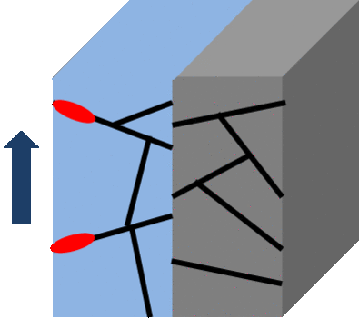
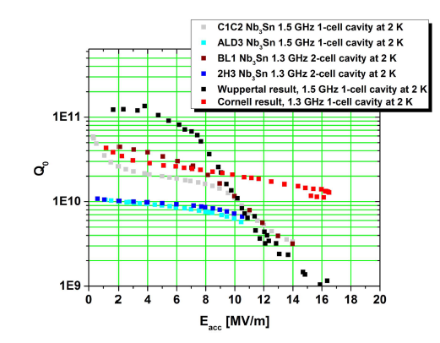
Penetration of vortices along GBs
Field onset of penetration for Josephson vortices
Higher H_{c} = 540 mT for Nb₃Sn can result
in better high-field SRF performance only if
GBs are strongly coupled, J_{c} > 0.2J_{d}
25-30 mT
Mismatch of GB structures in S coating layers and the Nb cavity: I layer intercepts AJ vortices
Penetration of AJ vortices along GBs does not go beyond the first S layer
50-60 mT
H_{c1} or
GBs?

Slide 14
Maximum screening field
The maximum screening field H_{m} at the optimum S thickness d = d_{m}
H_{m} at the optimum thickness exceeds the bulk superheating fields of both Nb and the layer material because of counterflow induced by Nb in the S layers with λ > λ₀
For λ >> λ₀, practically for λ > 160 nm for a S layer on the Nb cavity with λ₀ = 40 nm, H_{m} approaches the limit
A. Gurevich, AIP Advances, 5, 017112 (2015)
T. Kubo, Y. Iwashita, T. Saeki, APL 104, 032603 (2014); T. Kubo, SUST 30, 023001 (2017)

Slide 15
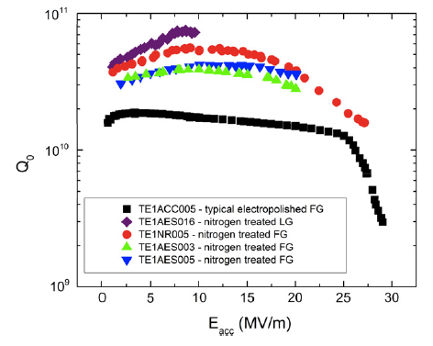
Extending the extended Q(H) rise in N-doped Nb cavities above the superheating field of Nb
FNAL, 2013
Optimized dirty N-doped layer
Alloyed Nb
film of optimum
thickness
H_{s}, H_{c1}?
Cavity grade
bulk Nb
A few nm thick
Al₂O₃ spacer
A few μm thick dirty layer at the surface
decreases both H_{s} and H_{c1}:
Capitalize on the extended Q(B) rise
and reverse the reduction of H_{c1} and H_{s}
JLab, 2013
Use an optimized Nb bilayer to push
the breakdown field above both
superheating fields up to 250-300 mT
H_{s}, H_{c1}?

Slide 16
Path to 70-120-200 MV/m
Maximum screening field H_{m} at optimal thickness
Dirty Nb layer on Nb:
H_{c} = 200 mT, H_{s} = 170 mT, l = 2 nm, and λ =λ(ξ₀ /l)^{1/2} = 180 nm
H_{m} = 288 mT, E_{acc} = 70 MV/m d_{m} = 0.44λ = 79 nm.
20% gain as compared to H_{s} = 240 mT of clean Nb
Nb₃Sn on Nb: H_{s} = 0.84H_{c} = 454 mT and λ = 120 nm (moderately dirty):
H_{m} = 507 mT, E_{acc} = 120 MV/m, d_{m} = 1.1λ = 132 nm
doubles the superheating field of clean Nb
Fe-pnictides on Nb: H_{s} = 0.84H_{c} = 840 mT and λ = 200 nm:
H_{m} = 872 mT, E_{acc} = 206 MV/m, d_{m} = 1.78λ = 356 nm
quadruples the superheating field of clean Nb
GARD-RF Research Roadmap Workshop, Washington DC, March 8-9, 2017

Slide 17
Why is the dielectric barrier important in multilayers?
Artificial I layers (Al₂O₃, etc) in ML structures
Natural oxide interfaces which do not dissolve
during deposition of S layers
Direct deposition of S (dirty Nb, Nb₃Sn, etc) onto Nb
H(t)
dirty 1-2 µm
diffusion layer
Intercept penetrating vortices and arrest
thermomagnetic avalanches
Great reduction of vortex dissipation
Increase H_{s} and H_{c1}
Stop interdiffusion of impurities
Smooth decrease of imp concentration,
reduction of H_{s} and H_{c1} at the surface
No protection against penetration
of vortices an interdiffusion

Slide 18
High-gradient R&D challenges and opportunities
Understanding the fundamental limits of SRF field gradients
Theory of superheating field at low temperatures and GHz frequencies. Manifestations of nonequilibrium effects in a dynamic superheating field.
Physics of vortices driven by strong RF currents
Experimental investigations of dynamic superheating field on small samples and test cavities under controlled conditions of RF and pulsed fields
Getting more out of Nb:
Impurity engineering and surface nanostructuring to optimize 100 nm dirty layer at the surface ( reverse the Q slope and increase H_{s} ). Nb may still bring surprises.
Deposition of N-infused Nb thin films and SIS multilayers on Nb cavities can capitalize on the Q(H) rise and reverse the reduction of breakdown fields. Can it be done on Nb₃Sn?
Beyond the bulk Nb
N-infused Nb-I-Nb ML on Nb (well-developed technology, quick progress appears likely):
Extend the Q(E_{acc}) rise up to 70 mV/m
Nb₃Sn SIS multilayers (more challenging than Nb, current-blocking grain boundaries, low thermal and electrical conductivity, local nonstoichiometry). Higher Q up to 120 mV/m
Pnictides – next level, but a potentially big payoff. Pushing the limit beyond 200 MV/m

