Slide 2
Deposition of NbN and NbTiN thin films
Sergio Calatroni - CERN

Slide 3
Introduction
Lot of literature on thin films of NbN, NbCN, NbTiN etc…
Several studies for devices, but fewer for SRF
Reviews:
V. Palmieri, “New Materials For Superconducting Radiofrequency Cavities”, Proc. of SRF 2001
A.-M. Valente-Feliciano, “Superconducting RF materials other than bulk niobium: a review”, Supercond. Sci. Technol. 29(2016)113002

Slide 4
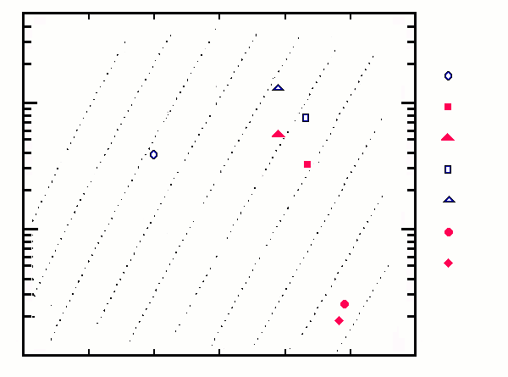
BCS
MoRe
NbTiN (600 °C)
NbTiN (200 °C)
NbN (600 °C)
NbN (200 °C)
Nb₃Sn
V₃Si
Nb
100
10
1
128 nΩ
64
32
16
8
4
2
1 nΩ
Iso-R_{BCS} lines
at 4.2 K and 500 MHz
0.5
0.25
8 10 12 14 16 18

Slide 5
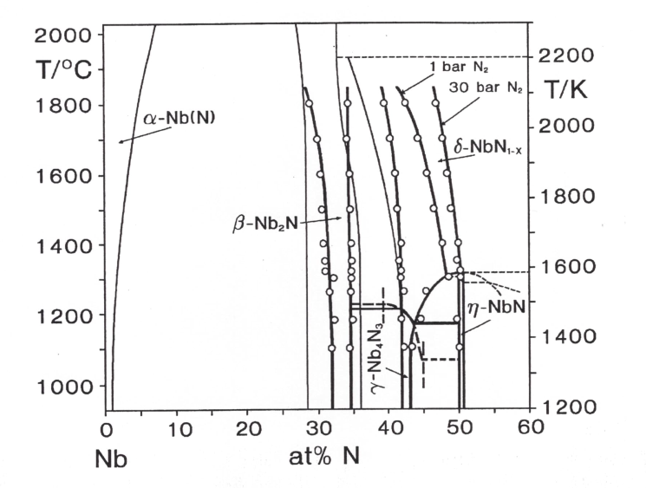
The NbN phase diagram
SC fcc phase
T_{C} = 17.3 K
SC tetragonal phase
T_{C} = 12÷15 K
From: R. Musenich

Slide 6
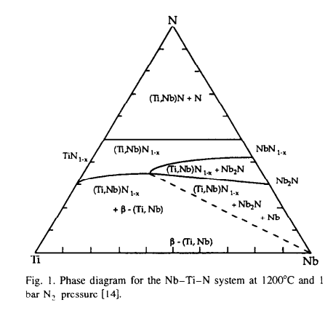
The NbTiN phase diagram at 1200 °C
Equilibrium nitride phase for any Nb,Ti ratio
Segregation of other phases for non optimal composition range
Stabilization of δ-phase at low temperature, associated with equilibrium segregation of TiN
(from Musenich)
Thin-film sputtering is inherently a non-equilibrium process

Slide 7
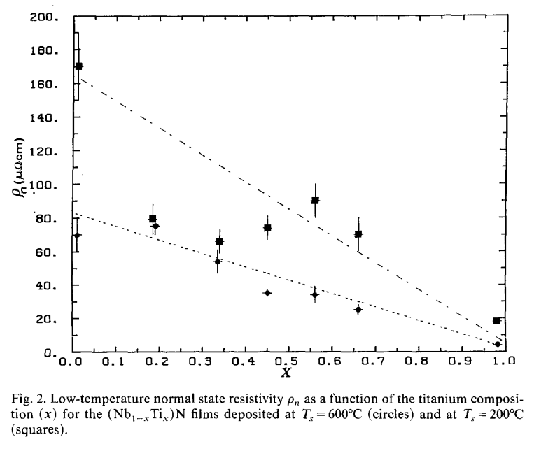
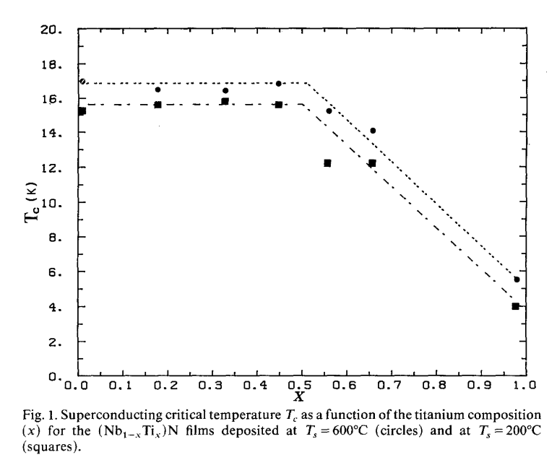
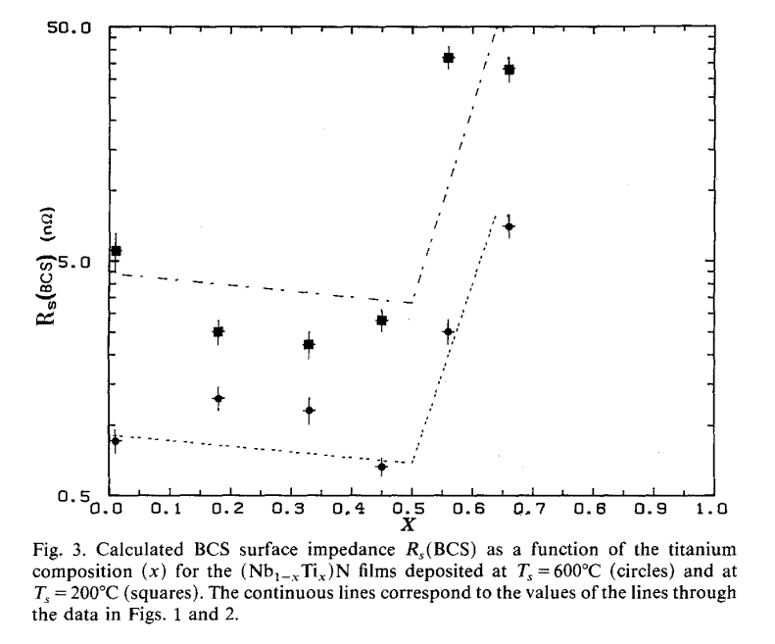
Choosing the right Nb_{1-x}Ti_{x}N composition
Optimum for SRF
SC NbTi magnets

Slide 8
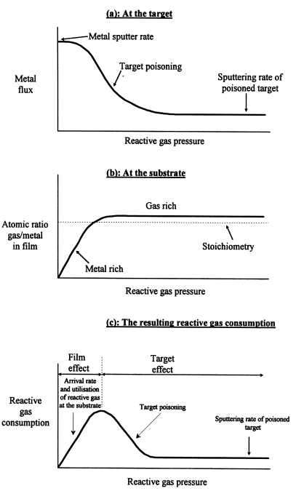
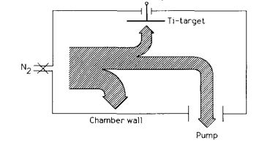
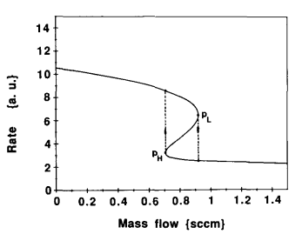
Thin film coatings: reactive sputtering
Ar + N₂→
Sputtering rate [a.u.]
Formation of nitrides
Sputtering yield: Y_{Ti} > Y_{TiN}
Problem understood and techniques devised to control instability and film composition: larger pumping speed, target to substrate surface ratio…

Slide 9
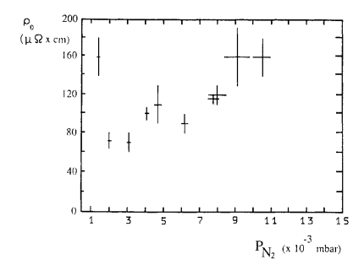
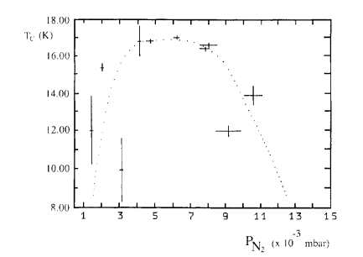
NbN sputtering
T sputtering = 600 °C
Reactive sputtering transition

Slide 10
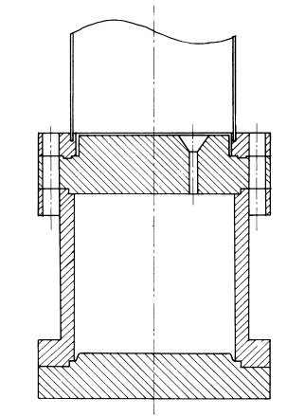
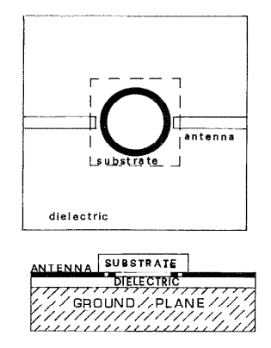
Characterization by simple resonators (examples)
Very promising R_{BCS}
High R_{res}
Little effect of external DC magnetic field
(Lot of work done for SC-RF devices in many labs)
TE011 demountable cavity at 6.5 GHz, NbN
Microstrip resonator at 3.5 GHz, NbTiN

Slide 11
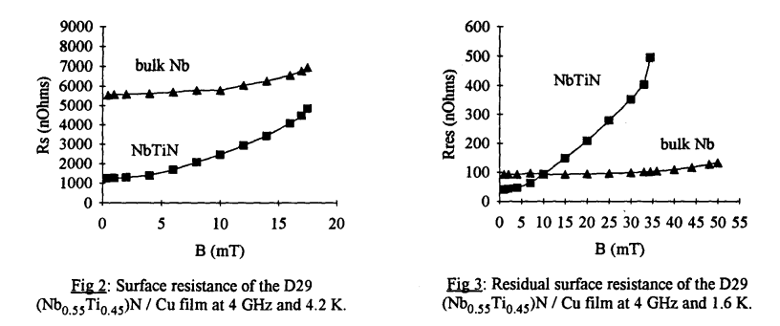
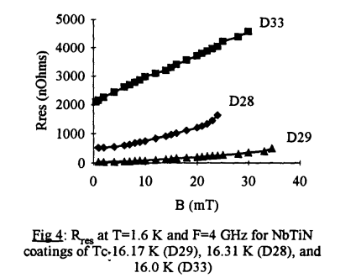
Cavity coatings: CEA-Saclay (TE011 plates at 4 GHz)
Tc = 16.0 K
Tc = 16.31 K
Tc = 16.17 K
Proc. SRF 1993
Development towards 1.5 GHz stopped
Proc. SRF 1991

Slide 12
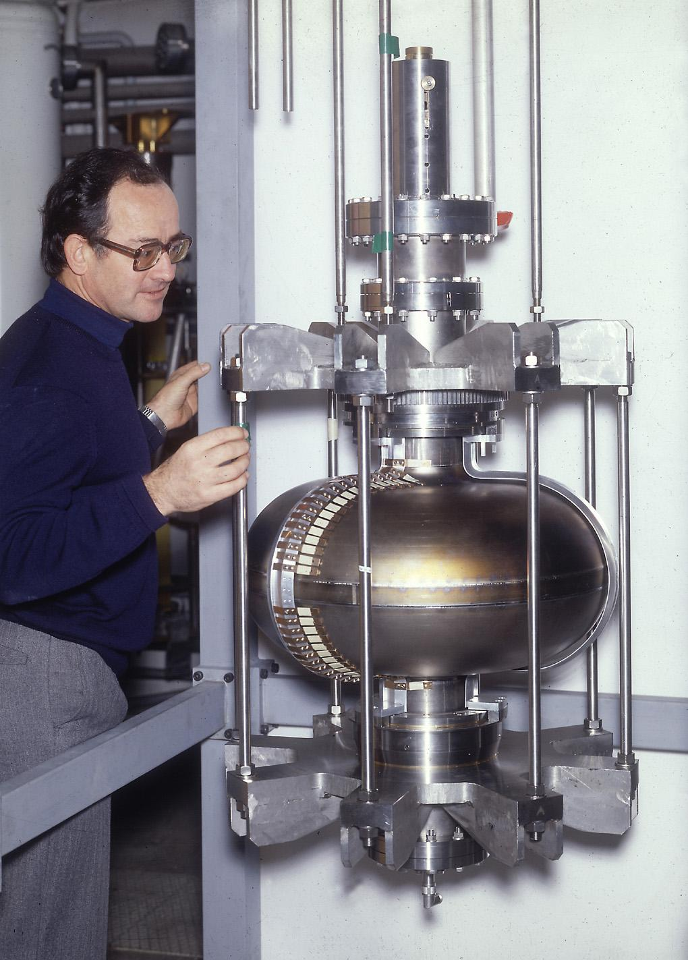
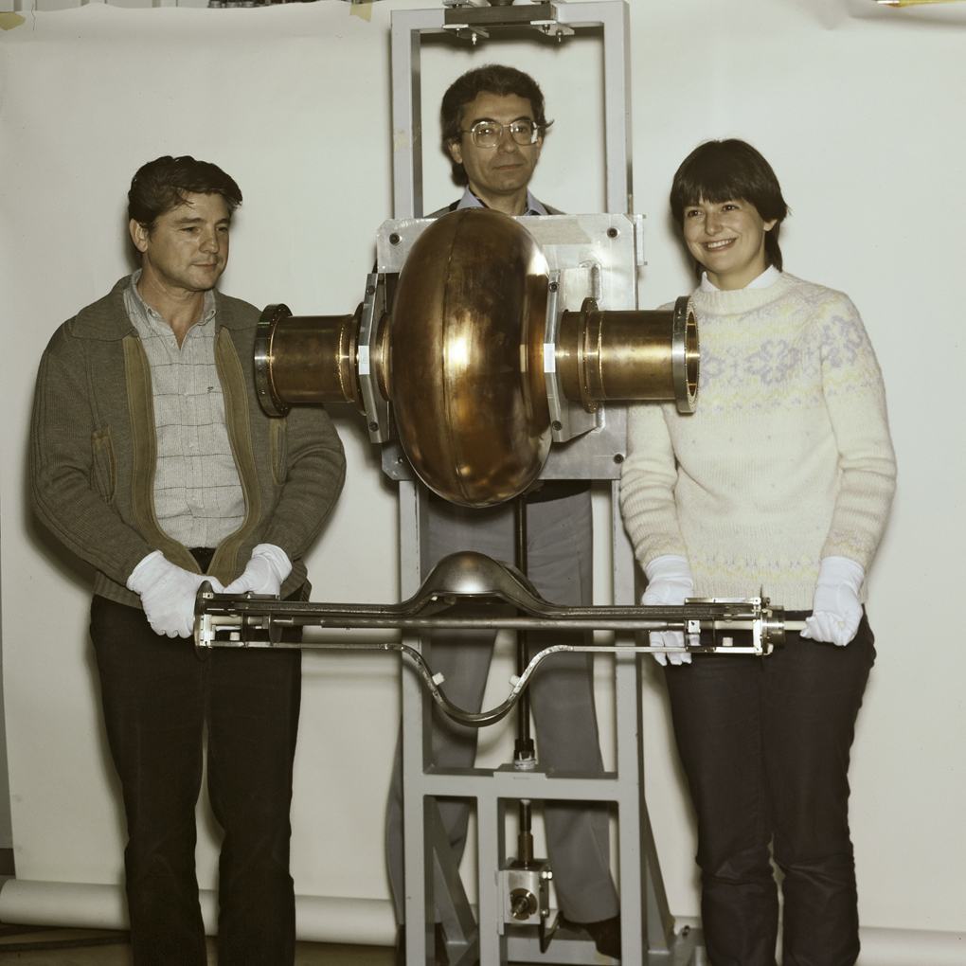
Cavity coatings: CERN – 500 MHz cavities
Nb/Cu
12.1979
12.1983

Slide 13
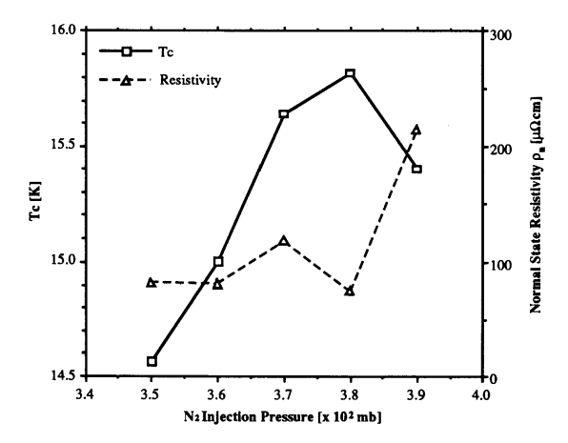
Sputtering of 500 MHz at CERN
T_{coating} ≈ 200 °C
Proc. SRF 1991

Slide 14
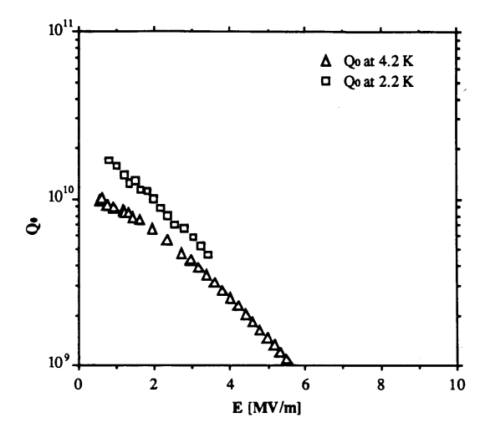
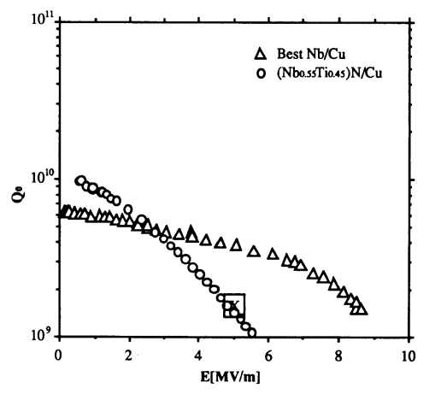
Sputtering of 500 MHz at CERN
Measured T_{c} ≈ 14.5 K
R_{BCS} = 9 nΩ
R_{res} = 18 nΩ
Scaled LEP specs for bulk Nb @ 4.5 K
Proc. SRF 1991

Slide 15
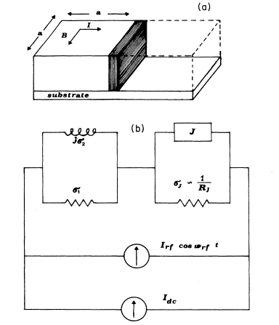
Grain-boundary model
$$ρ=ρ_{i}+ρ_{G.B.}=ρ_{i}+\frac{I_{c}R_{j}}{J_{c}a}$$
Phys.Rev.B 43 (1991) 6128

Slide 16
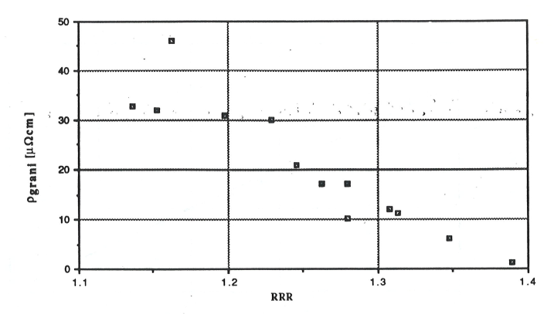
Grain boundaries fit
ρ_{intragrain} ≈ 40÷50 µΩcm
ρ_{G.B.} ≈ 20÷30 µΩcm
30÷40% of total
ρ_{Grain-Boundaries} [µΩcm]
S.C. – Thesis 1990

Slide 17
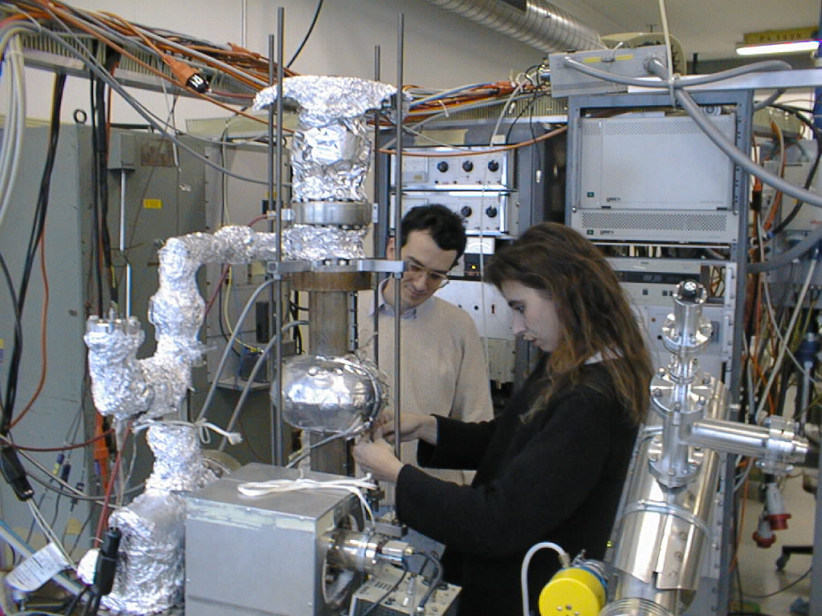
Sputtering of 1.5 GHz at CERN

Slide 18
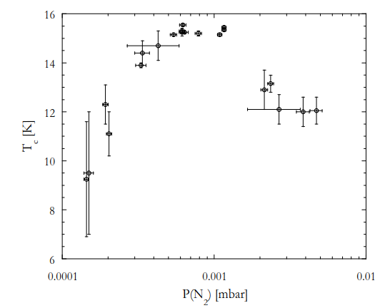
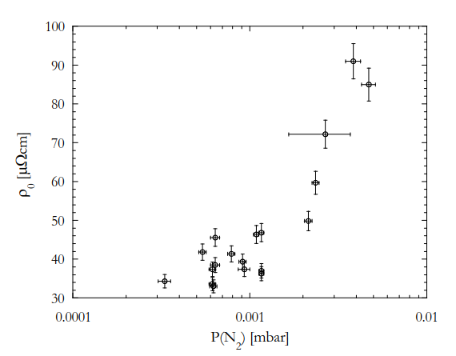
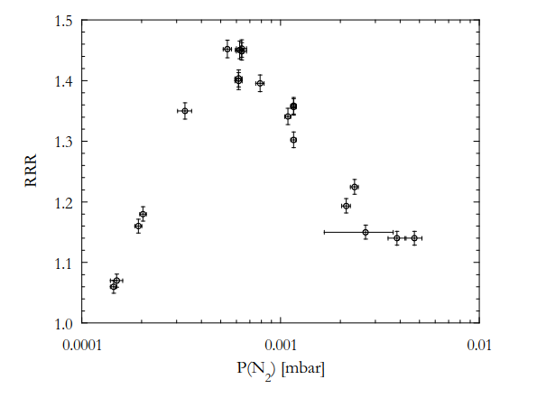
Sputtering of 1.5 GHz at CERN at 350 °C
Analysis: ρ_{G.B.} < 20 % of the total resistivity
M. Marino - Proc. SRF 1997

Slide 19
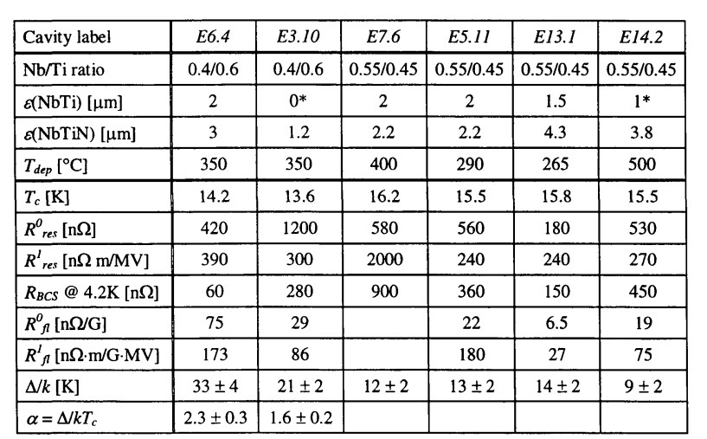
Further developments: increase coating temperature
1.5 GHz
Nb/Cu
150 °C
1÷3 nΩ
400 nΩ
Massimo Marino PhD Thesis 1999

Slide 20
Known limitations
Limit of pumping speed
Cathode temperature and surface ratio
Sputtering profile of cathode, differential adsorption
Atomic composition distribution on cavity Ti/Nb

Slide 21
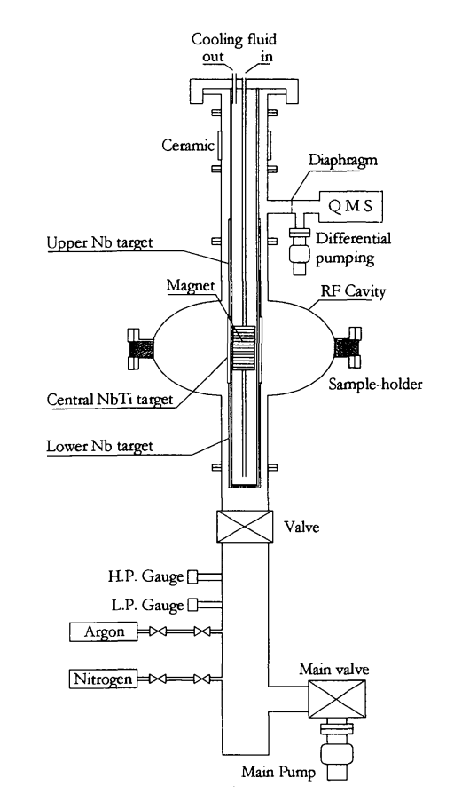
Known limitations
Limit of pumping speed and cathode surface
Cathode temperature and surface ratio
Sputtering profile of cathode, differential adsorption
Atomic composition distribution on cavity Ti/Nb
Control of instabilities problematic
New techniques: pulsed sputtering (loss of efficiency)

Slide 22
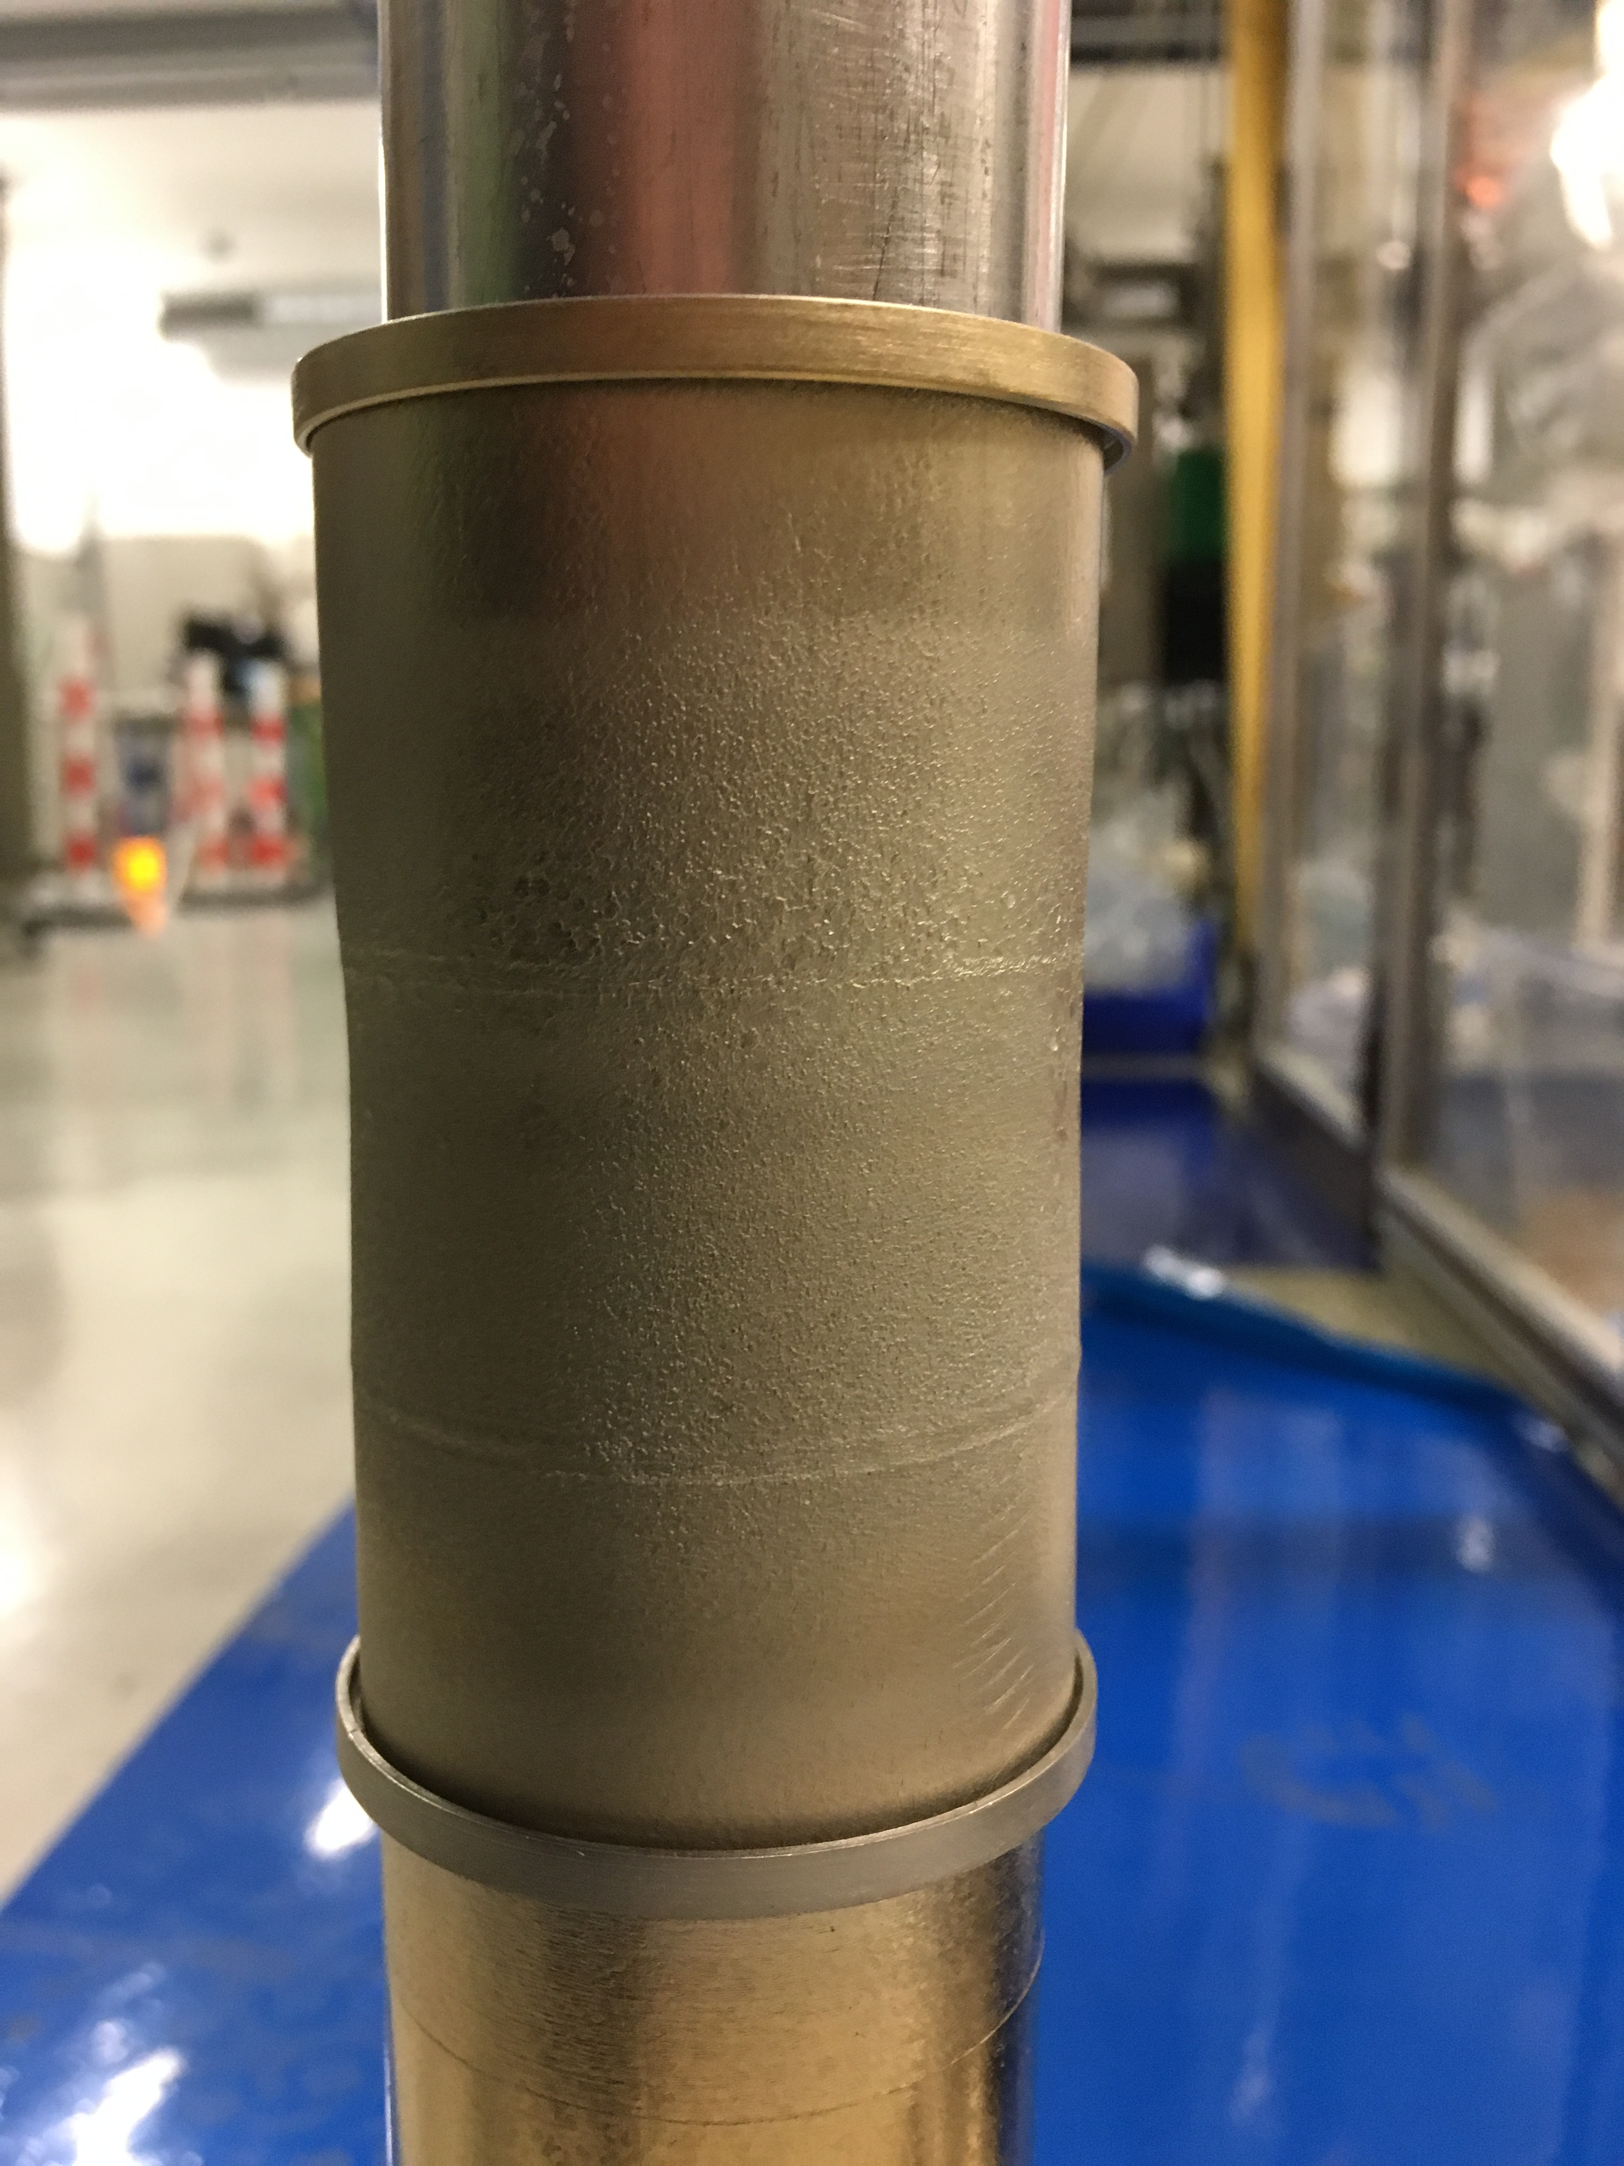
Known limitations
Limit of pumping speed and cathode surface
Cathode temperature
Sputtering profile of cathode, differential adsorption
Atomic composition distribution on cavity Ti/Nb
Evolution of cathode composition during sputtering through N₂ absorption.
Cooling of cathode

Slide 23
Known limitations
Limit of pumping speed
Cathode temperature and surface ratio
Sputtering profile of cathode, differential adsorption
Atomic composition distribution on cavity Ti/Nb
N₂ to NbTi ratio depends on position, can be problematic close to sputtering threshold.
Better designs are possible

Slide 24
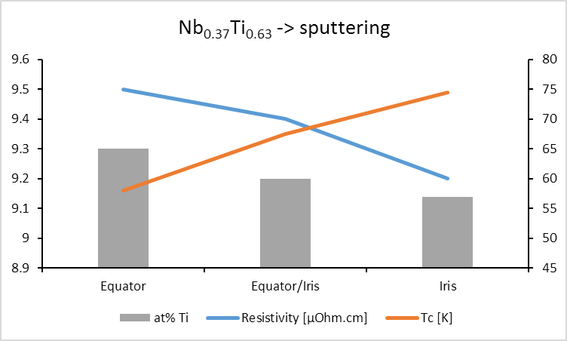
Known limitations
Limit of pumping speed
Cathode temperature and surface ratio
Sputtering profile of cathode, differential adsorption
Atomic composition distribution on cavity Ti/Nb
Non homogenous composition along cavity meridian
(Can be troublesome for Nb₃Sn)
Better cathode design

Slide 25
Conclusion and perspectives
NbTiN thin films have been sputter-coated on real SRF Cu cavities
Low-field performance at 4.2 K better than for Nb/Cu sputtered films
Possible use for circular colliders
(However present R&D is focused on Nb₃Sn)
Roads for further improvements:
Better control of reactive sputtering
Increase of coating temperature
Active cooling of the cathode

Slide 26
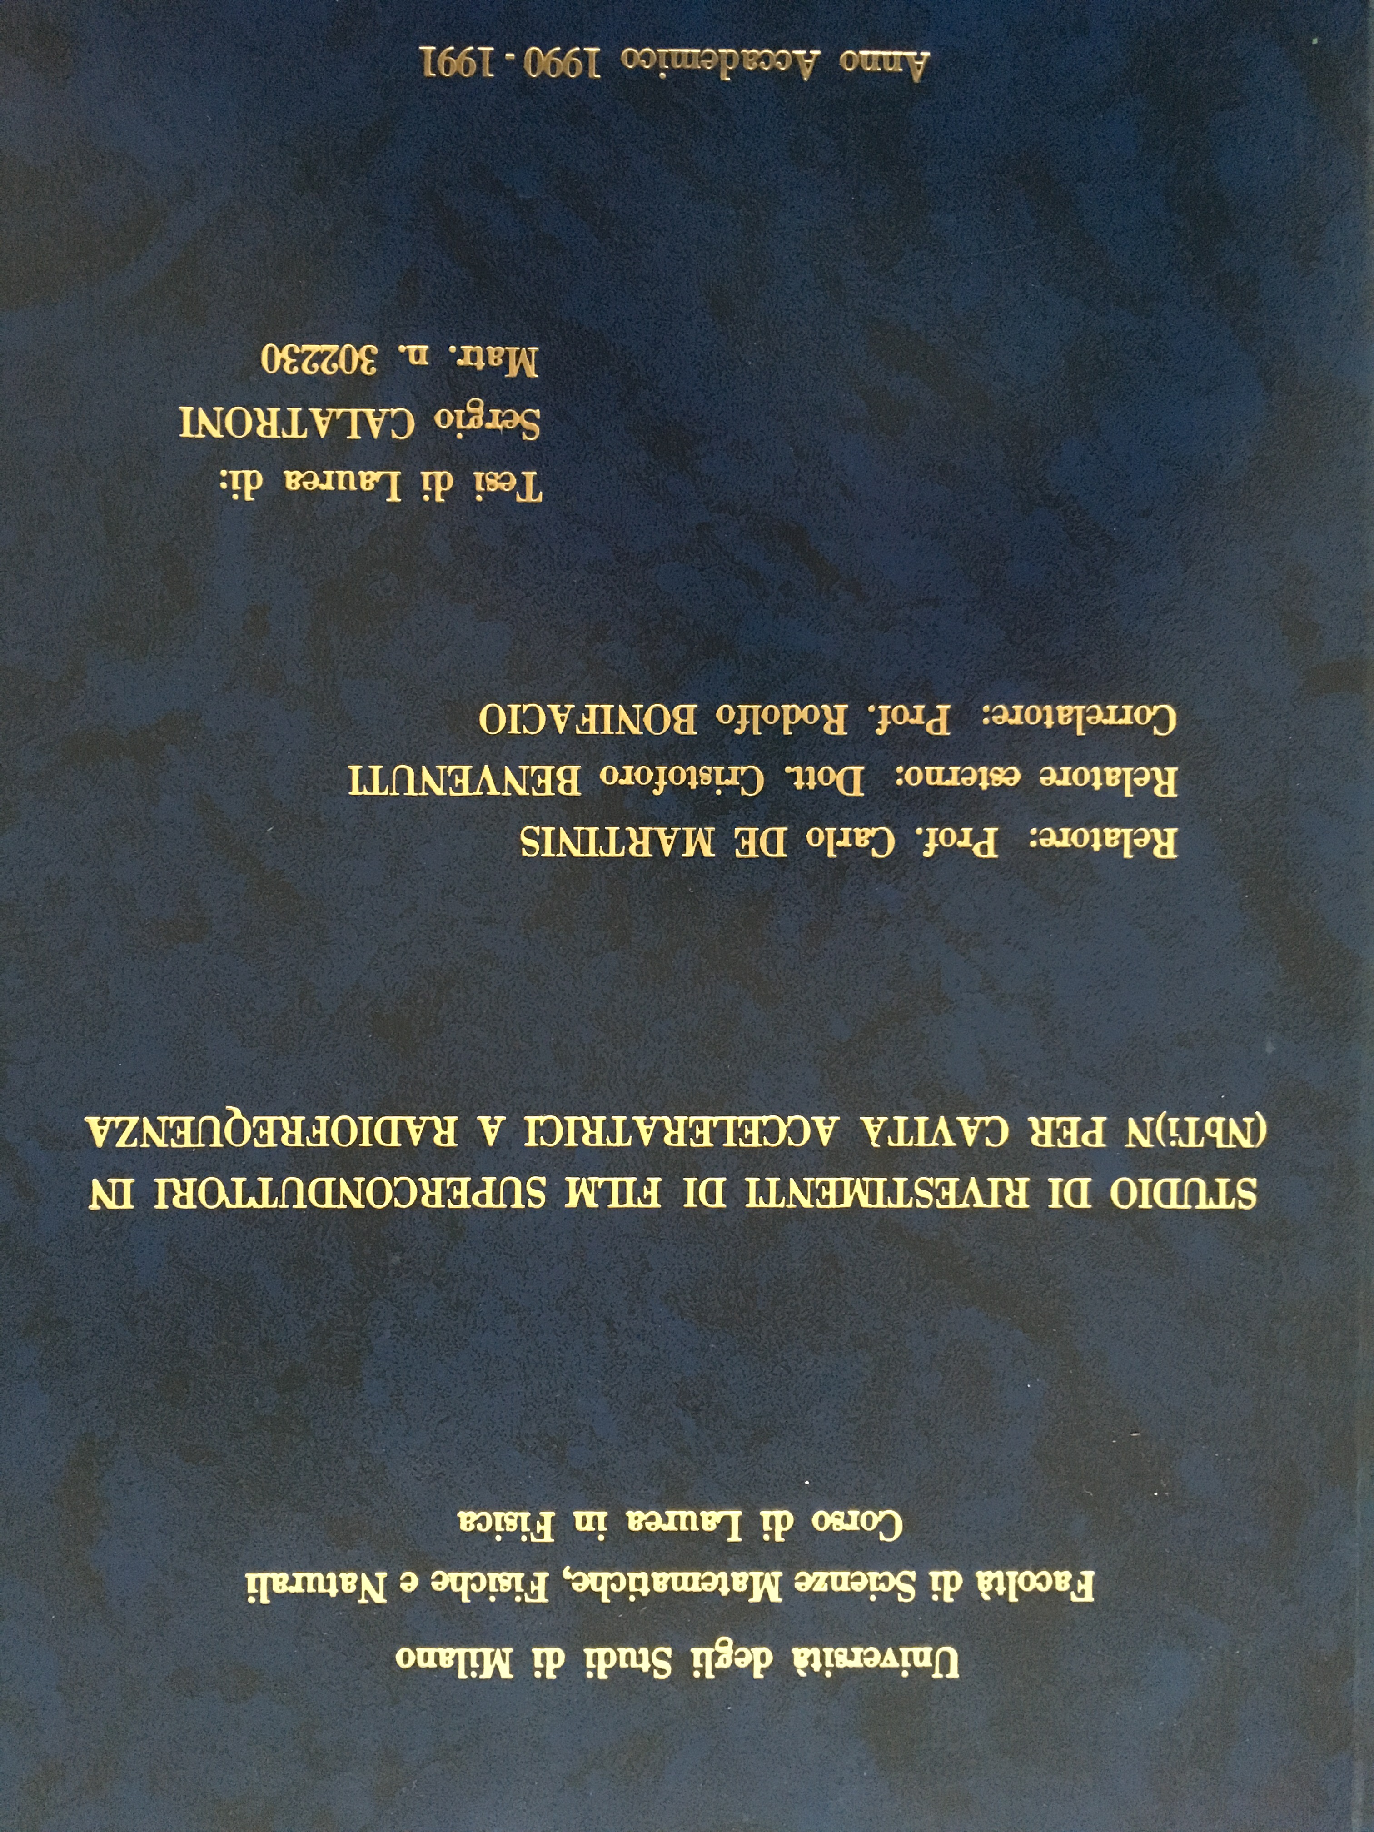
☺

Slide 27
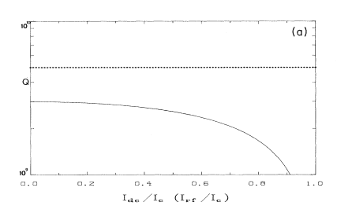
Model Nb/Cu films at 500 MHz
10¹⁰
R_{BCS}
R_{BCS}+R_{residual}
10⁹
Phys.Rev.B 43 (1991) 6128

