Slide 1
Feasibility of new LTS/HTS for SRF applications
Sergio Calatroni, Mattia Checchin
TTC Topical Workshop, FNAL
16 Nov 2017

Slide 2
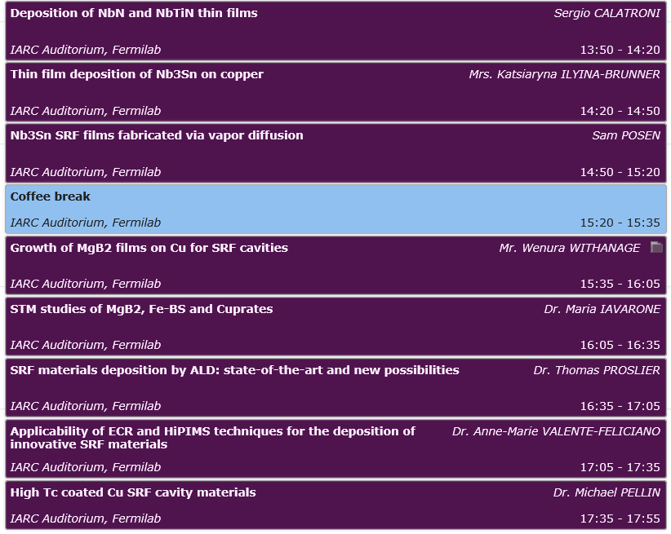
Timetable overview

Slide 3
Session overview
Feasibility of new materials for SRF cavities
Growth techniques applicability
Superconducting properties (e.g. RF tests, STM studies, …)
Materials under discussion:
NbN, NbTiN and other nitrides
Nb₃Sn and other A15
MgB₂
Fe-BS
Cuprates
Deposition techniques for state-of-the-art and innovative materials:
PVD (sputtering, ECR, HiPIMS)
ALD/CVD
Vapor-phase growth

