Slide 1
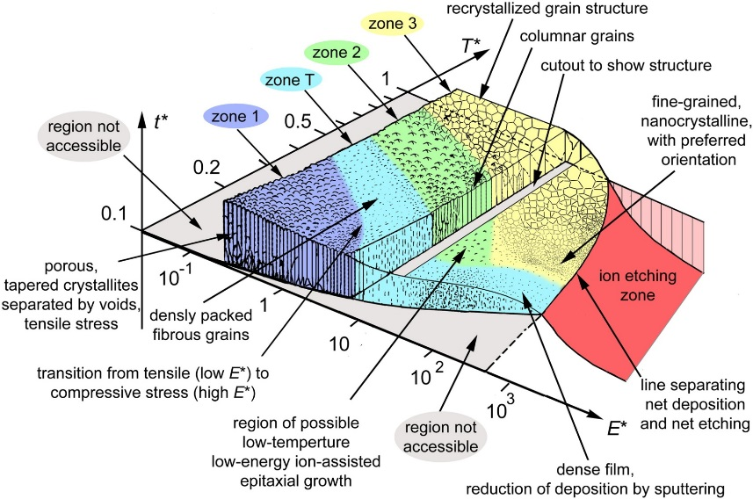
Applicability of ECR and HiPIMS techniques for the deposition of innovative SRF materials
TTC Topical Workshop
RF Superconductivity:
Pushing Cavity Performance Limits
15-17 November 2017
Fermilab
Anne-Marie Valente-Feliciano

Slide 2
Energetic Condensation
Condensing (film-forming) species : hyper-thermal & low energies (>10 eV).
Generalized Structure Zone Diagram
Additional energy provided by fast particles arriving at a surface
⇒number of surface & sub-surface processes ⇒changes in the film growth process:
A. Anders, Thin Solid Films 518 (2010) 4087
residual gases desorbed from the substrate surface
chemical bonds may be broken and defects created thus affecting nucleation processes & film adhesion
enhanced mobility of surface atoms
stopping of arriving ions under the surface
      Film density
      morphology
      microstructure
      Stress
      low-temperature epitaxy
⇒ Changes
&
control in
derived from Thornton’s diagram for sputtering (1974)
A variety of techniques with distinct technologies
Vacuum Arc Plasma & Coaxial Energetic Deposition (CED)
Electron cyclotron Resonance (ECR)
High Impulse Power Magnetron sputtering (HiPIMS)

Slide 3
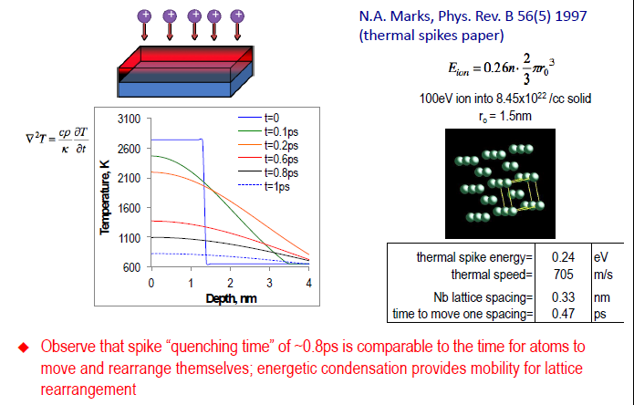
Energetic condensation
Energetic condensation provides mobility for lattice re-arrangement:
spike “quench time” ~0.8ps comparable to time for atoms to move around

Slide 4
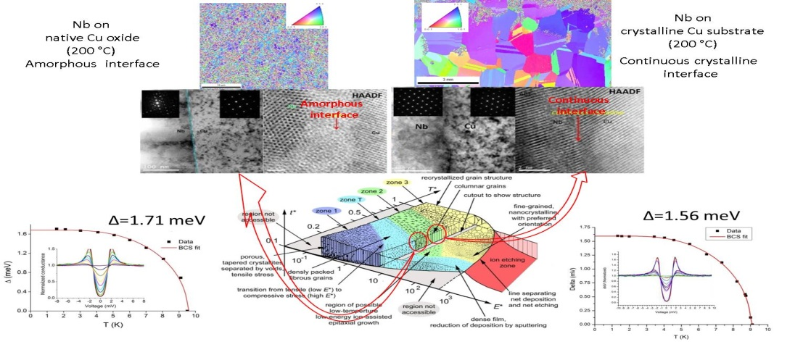
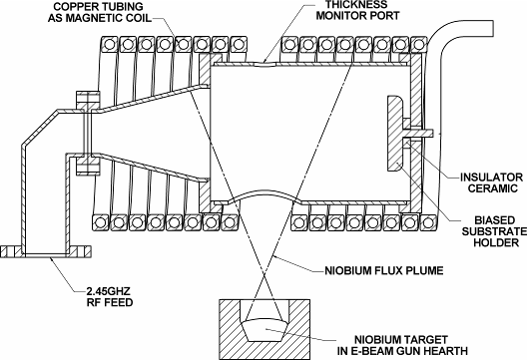
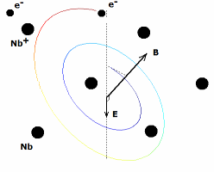
ECR Nb - JLab
Plasma Generation
Neutral Nb vapor
RF power (@ 2.45GHz)
Static B ⊥ E_{RF} with ECR conditions
Control over nucleation & subsequent growth, thus structure
W. M. Holber, et al., JVST A. Vol.11(6), 1993
G. Wu, et al., J. Vac. Sci. Technol. A, Vol. 21, No. 4, (2003)
No working gas
Singly charged ions (64eV) produced in vacuum
Controllable deposition energy with Bias voltage
Excellent bonding , No macro particles
Full control over final SRF performance
with strict process protocols

Slide 5
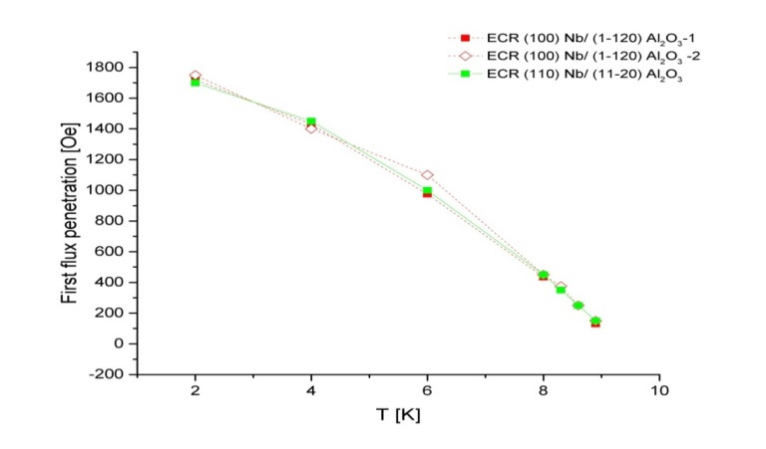
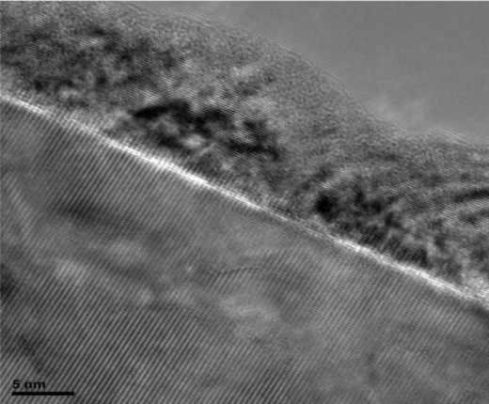
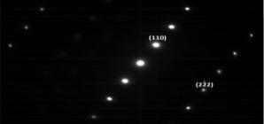
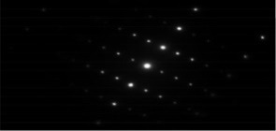
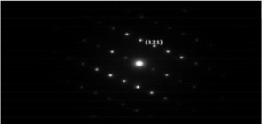
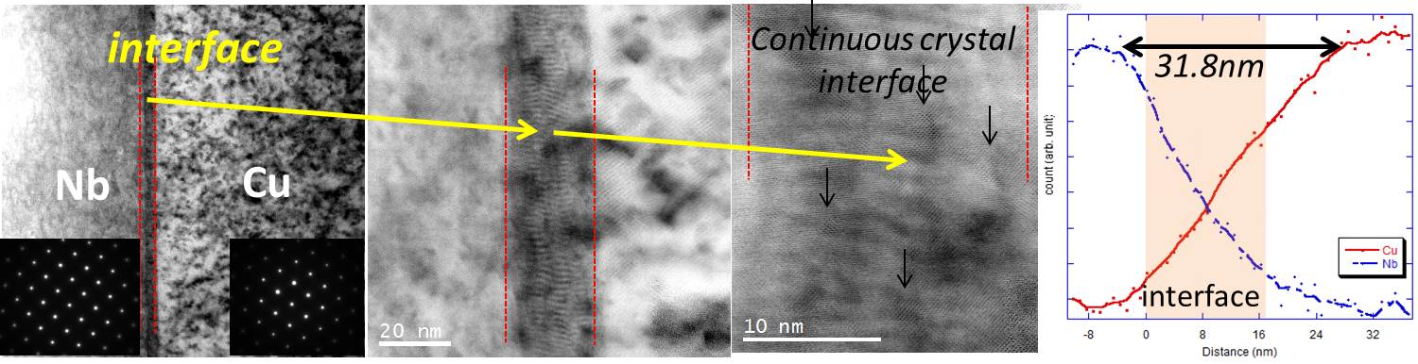
 | Substrate | RRR_{max}
Insulating | a-Al₂O₃ | 591
 | r-Al₂O₃ | 725
 | c-Al₂O₃ | 247
 | MgO (100) | 188
 | MgO (110) | 424
 | MgO (111) | 270
 | Al₂O₃ ceramic | 135
 | AlN ceramic | 110
 | Fused Silica | 84
Metallic | Cu (100) | 181
 | Cu (110) | 275
 | Cu (111) | 245
 | Cu fine grains | 193
 | Cu large grains | 305
Nb film
Interface
Al₂O₃ (11-20)
substrate
Full control of interface for enhanced adhesion

Slide 6
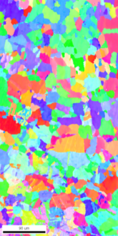
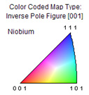
ECR Nb
Hetero-epitaxial film Nb on large grain OFHC Cu, 360 °C bake & coating
184 eV for nucleation/early growth + 64 eV for subsequent growth
 | R_{res} [nΩ] | λ(0K) [nm]
400 MHz | 46.6 ± 0.8 | 40 ± 2
800 MHz | 79 ± 2 | 38 ± 1
1200 MHz | 156 ± 11 | 38 ± 1
400 MHz, 4 K
S. Aull, CERN
ℓ* [nm]
144 ± 20
RRR
67 ± 7
* with λ_{L} = 35 nm and ξ₀ = 39 nm
Sarah Aull

Slide 7
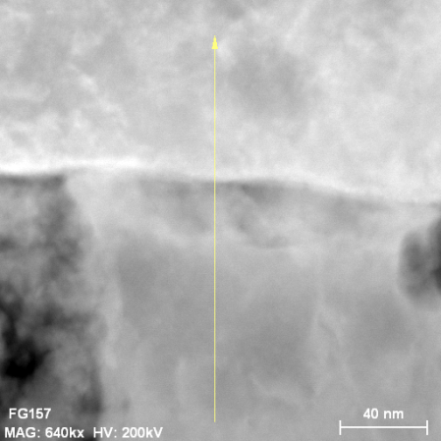
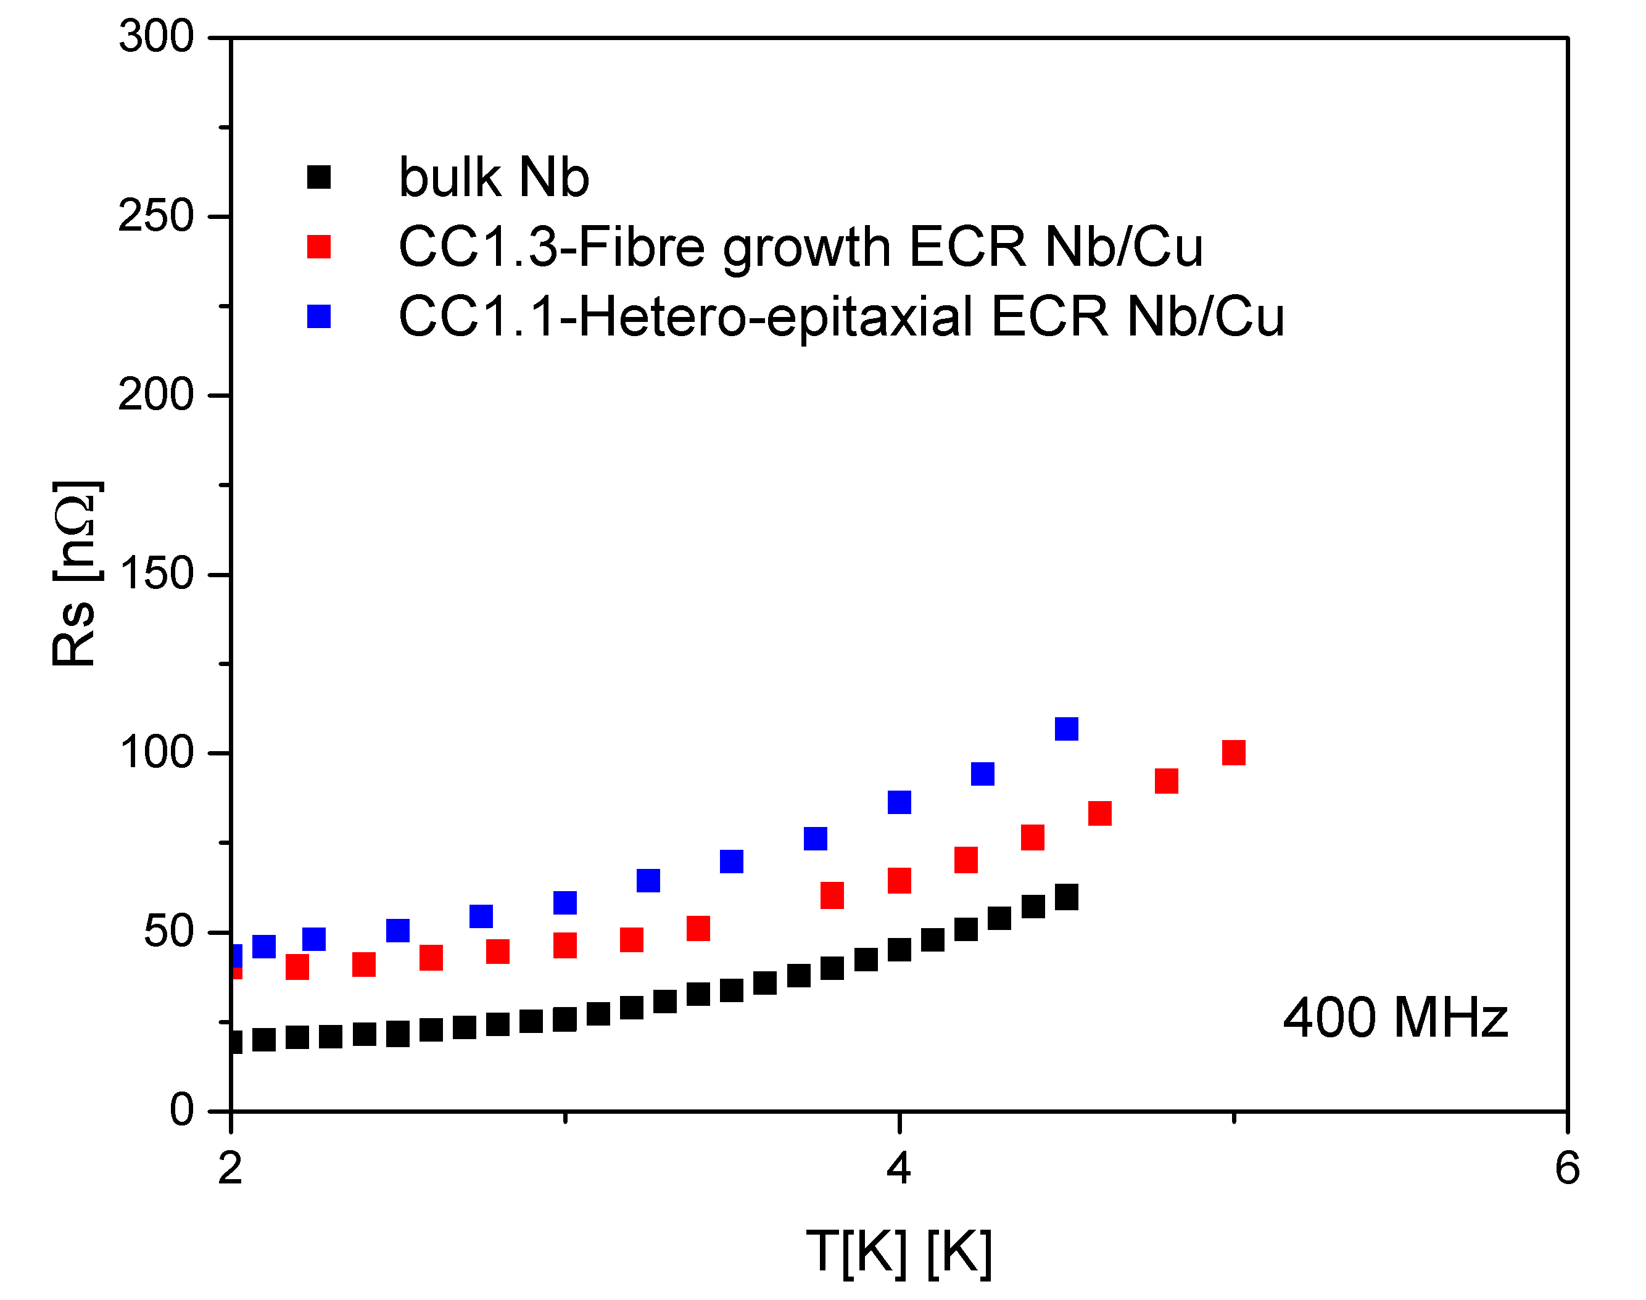
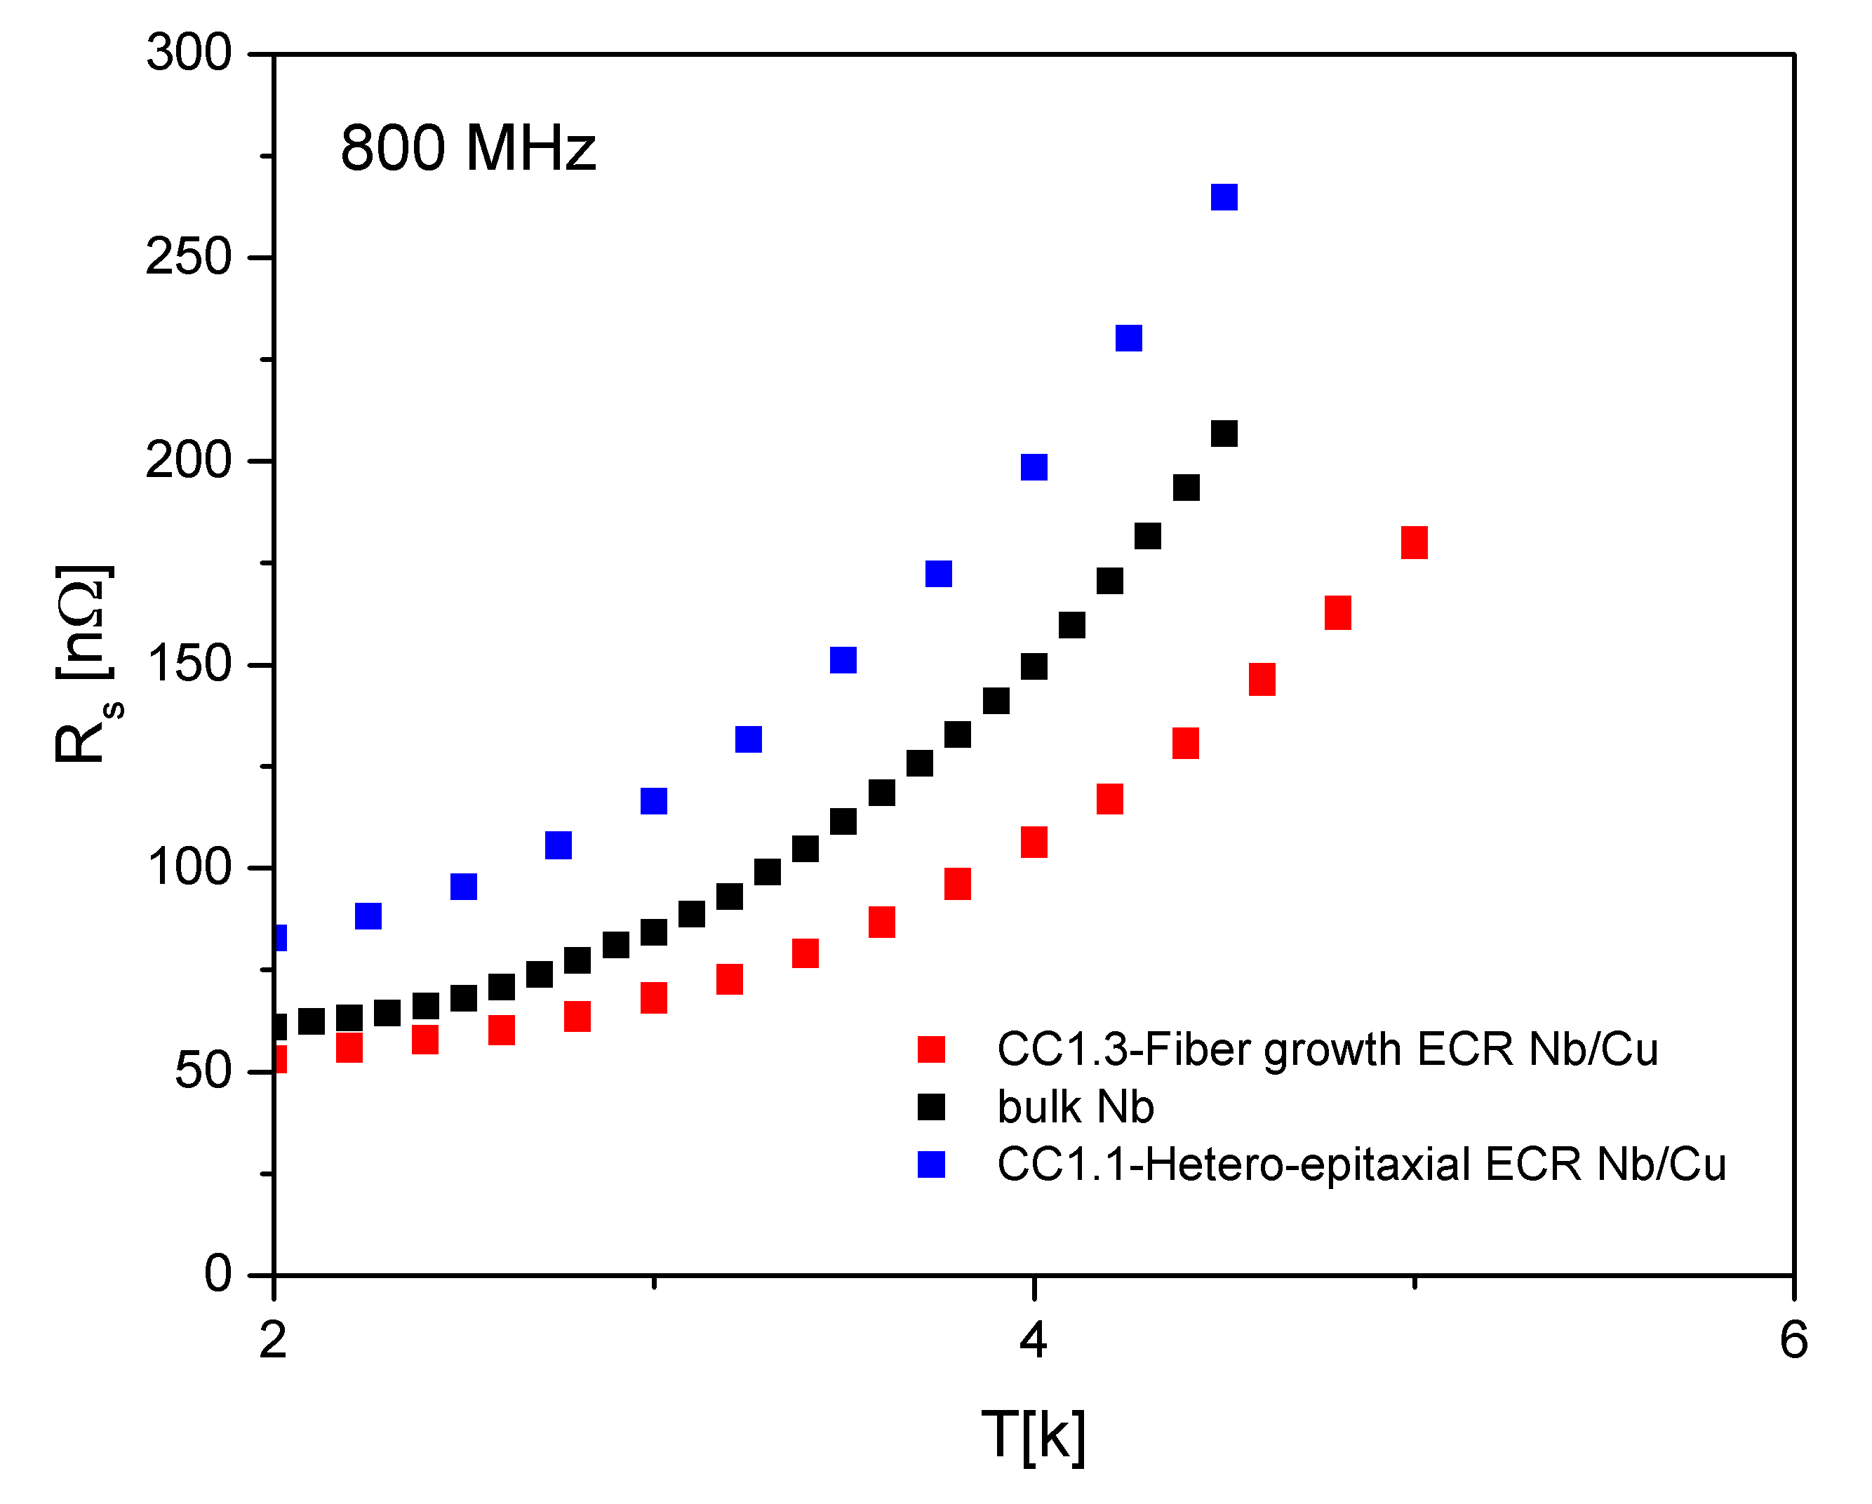
ECR Nb
Fiber growth film Nb on fine grain OFHC Cu (same substrate as before), 200 °C bake & coating
184 eV for nucleation/early growth + 64 eV for subsequent growth
ℓ* [nm]
124 ± 8
RRR
46 ± 3
 | R_{res} [nΩ] | λ(0K) [nm]
400 MHz | 46.6 ± 0.8 | 39 ± 0.5
800 MHz | 79 ± 2 | 37 ± 2
1200 MHz | 156 ± 11 | 38 ± 1
* with λ_{L} = 35 nm and ξ₀ = 39 nm
400 MHz, 4 K
S. Aull, CERN
QPR Measurements: Marcco arzeo

Slide 8
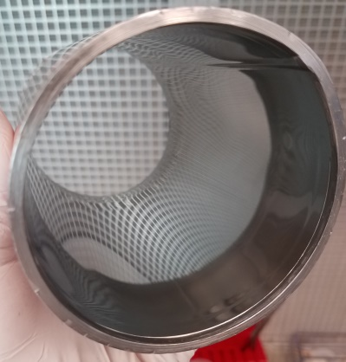
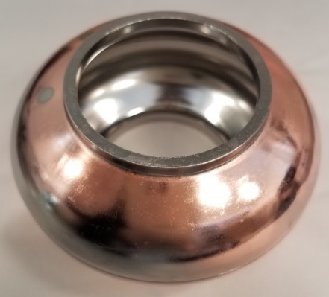
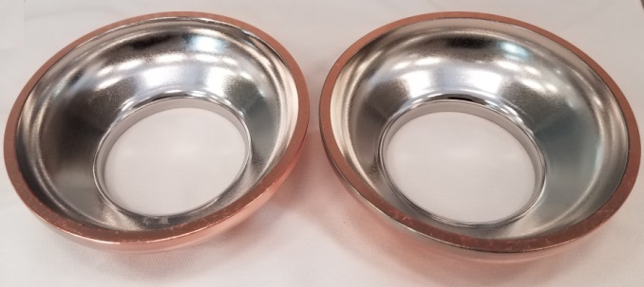
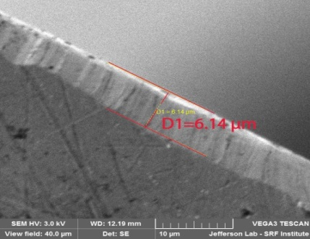
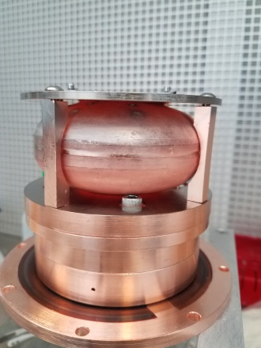
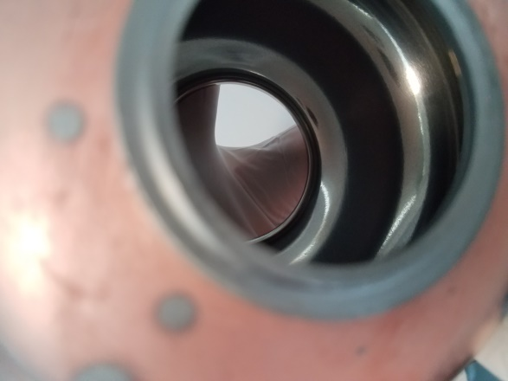
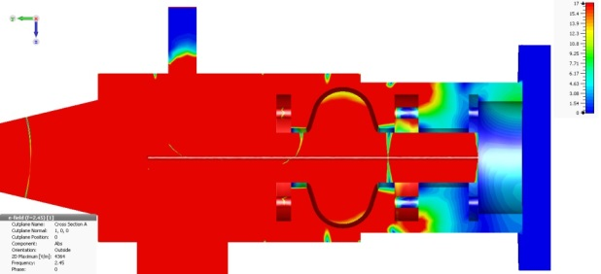
ECR – Process conformality
3.75” Tube
3.9 GHz half cells
Films
under analysis
3 GHz Cavity with beam tubes: 5GHz frequency cut-off
Adjust coating geometry to allow RF fields to penetrate the cell and get adequate plasma conditions
3 GHz half cells
diffusion bonded & fully coated in-situ
RF and plasma simulations needed with Comsol/PIC-MC simulations

Slide 9
ECR Nb – Tailored films
Tune thin film structure and quality with ion energy and substrate temperature on a variety of substrates (amorphous, polycrystalline and single crystal)
Achieve film structures and properties only achievable at higher temperature with classic coating methods
Tune RRR values from single digits to bulk Nb values →No intrinsic limitations
Lower impurity (H) content than bulk Nb
Good adhesion to the substrate (delamination threshold determined as function of ion energy and temperature)
Grain boundaries not necessarily detrimental (if dense) to R_{s}
Tailoring interface with high energy and subsequent growth at energy minimizing defect creation can contribute to lower R_{s}

Slide 10
ECR application to Nb/Cu cavities
Cavity part of ECR chamber
Transported coaxial ECR source
FNAL: cavity coating system under construction
JLab: existing design for cavity coating system
A.Morisaki et al., Surface and Coatings Technology 98 ( 1998) 834-838

Slide 11
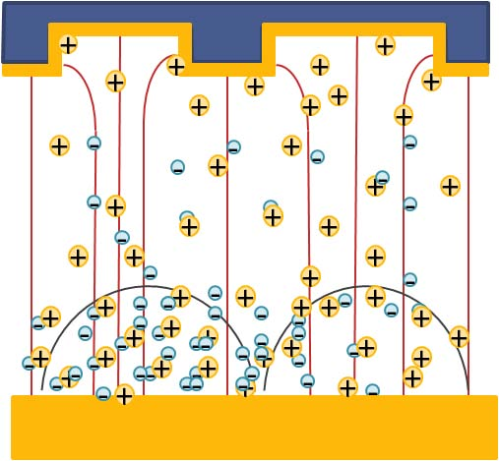
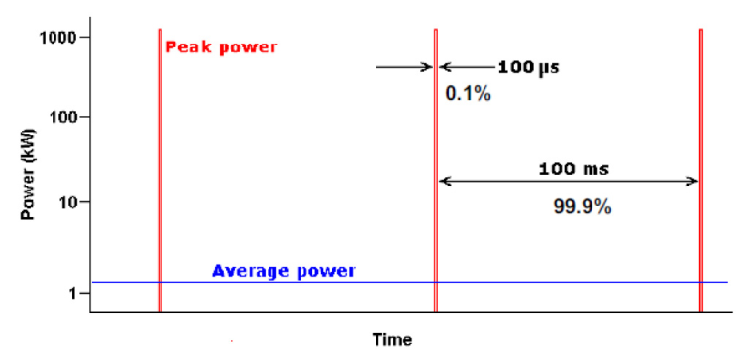
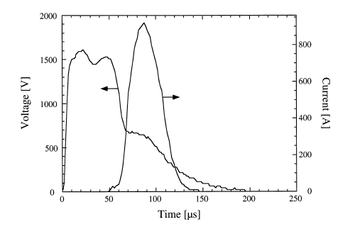
High Power Impulse Magnetron Sputtering (HiPIMS)
Pulsed sputtering with the peak power exceeding the average power by ~2 orders of magnitude.
Lower substrate self heat-up
V. Kouznetsov, et al., Surf. Coat. Technol. 122 (1999) 290
A. Anders, Surf. Coat. Technol. Vol. 205, Supp. 2 (2011)
Produces films with enhanced properties
  very high purity
  Excellent adhesion
  better (normal) conductivity,
  Large crystal grains, low defect density
  Suppression of fiber structure
  Superior density
  Decreased roughness
  Homogeneous coating even on complex-shaped surfaces
  Phase composition tailoring
  Interface engineering
The target material is partly ionized such that the ions will reach the substrate with a higher energy and, in case of an applied bias voltage to the substrate, always normal to the surface.
The intense pulse plasma density provides a large concentration of ions producing high-quality homogeneous films.
The high ionization fraction (up to 90%)
allows fine control of the sputtered species (mostly 2+ ions) during deposition
Lower deposition rate : ions captured at the cathode
Very sensitive to cathode surface state (roughness), induced arcing

Slide 12

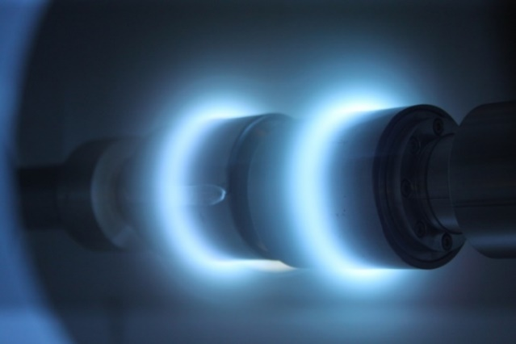
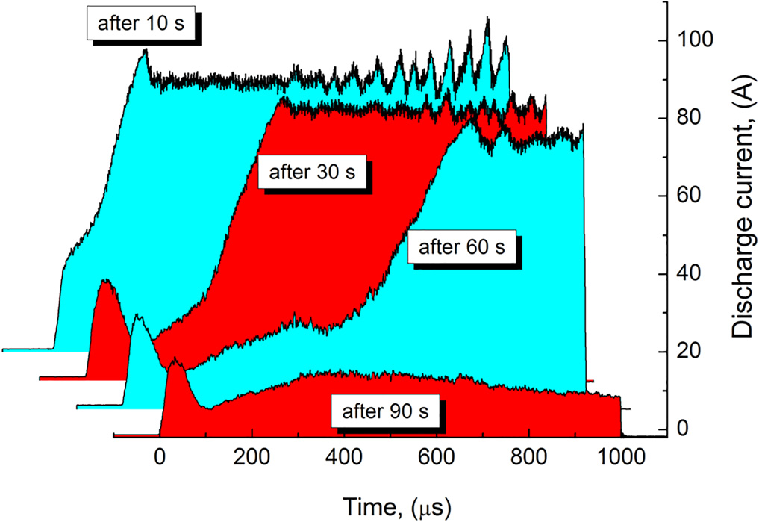
HiPIMS Nb Films
A. Anders
HiPIMS dual magnetron system Most effective for Biasing & influencing Ion Energies & Trajectories
cavity
nearly
perpendicular
incidence!
sheath
V_{bias}
plasma
ion trajectory
possible collision
magnetron 1
magnetron 2
high power mode (above runaway threshold)
Dominated by Nb emission
A.Rauch, High Power Impulse Magnetron Sputtering (HiPIMS) of Niobium Thin Films (2011)
No self-sputtering for Nb
A.Anders, Surf. Coat. Technol. 205, S1 (2011)

Slide 13

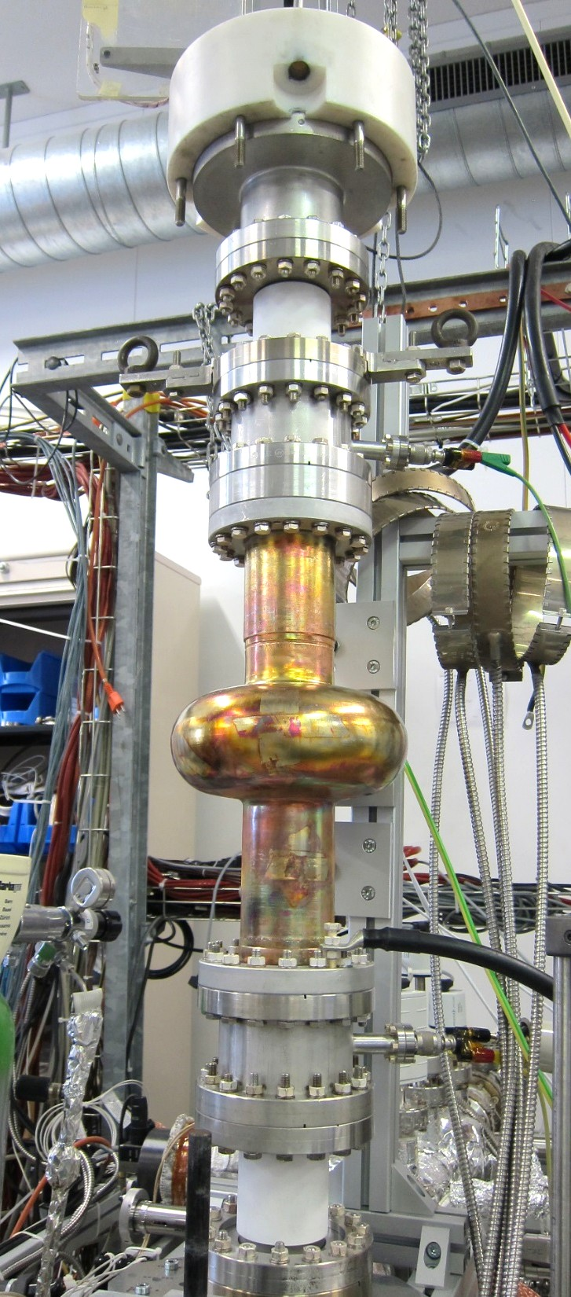
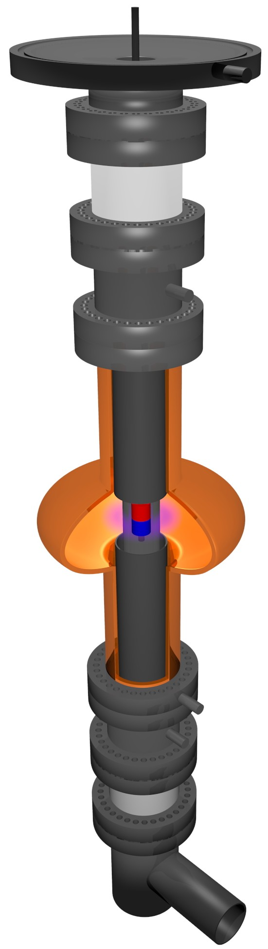
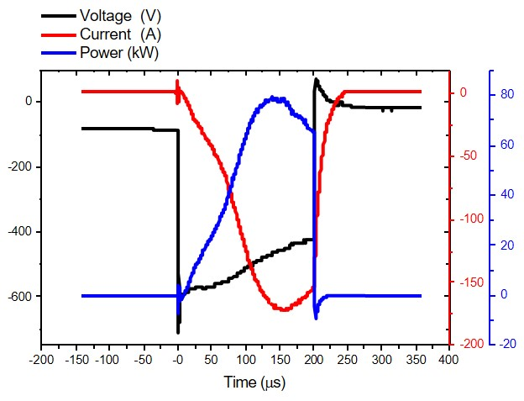
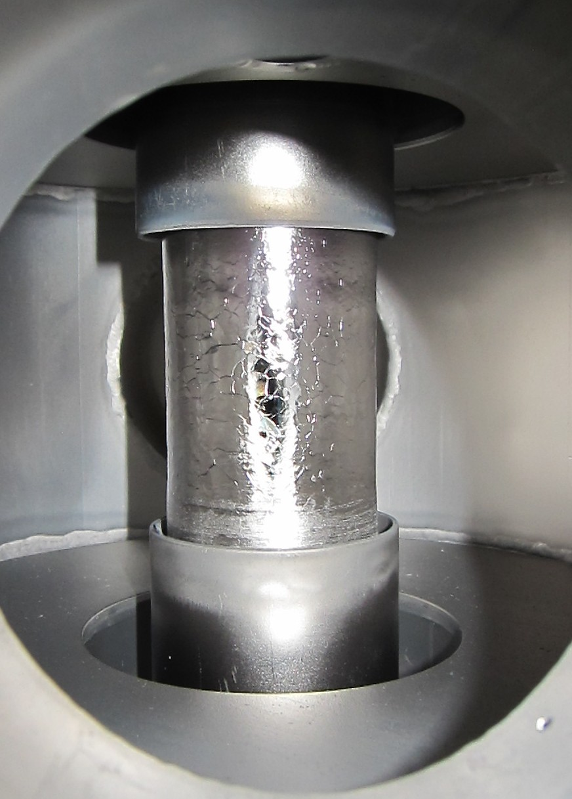
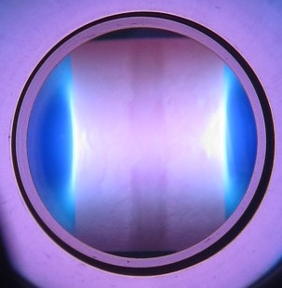
HiPIMS Nb/Cu - CERN
G. Rosaz
HiPIMS discharge
Base pressure ~ 6.10⁻¹⁰ mbar
Nb cathodes and anodes (cut-off coating)
Cell coating by HiPIMS + Bias using Kr
Nb cathode with permanent magnets inside and Nb anodes
1.3 GHz cavity coating setup
Same hardware as for DCMS
Pulsed Power supply
  1% duty cycle
  Short pulses: 200 µs
  High peak current (200 A vs 3 A for DCMS)
  High peak power (80 kW peak for 1kW avg)
Ionization of sputtered species
Lower coating rate than DCMS
Seemingly larger surface features than in DCMS

Slide 14
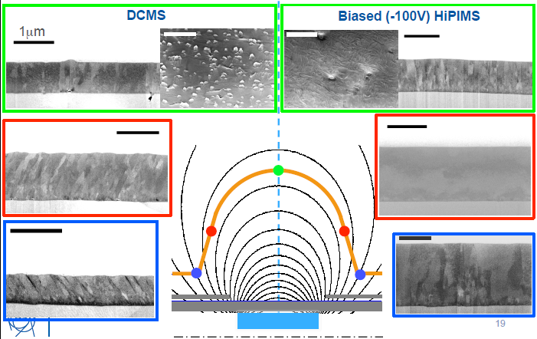
HiPIMS Nb/Cu - CERN
G. Rosaz

Slide 15
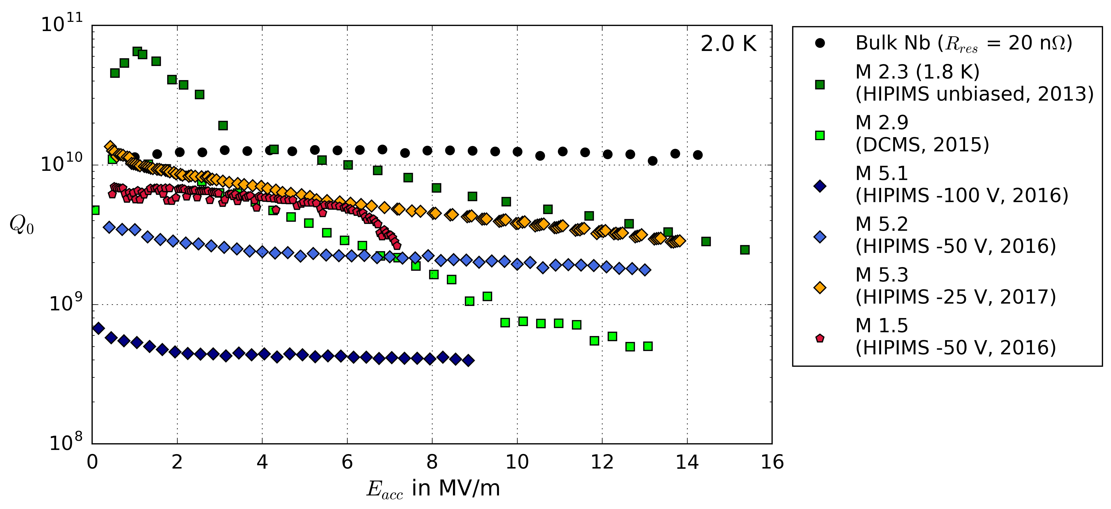
HiPIMS Nb/Cu CERN
G. Rosaz
Q s l o p e l o o k s flatten compared to DCMS
Coating pressure & bias show a strong Q impact.
Up to now best R_{res} = 25 nΩ
Poor substrates quality
10 new substrates delivered @ CERN
Parameter space under investigation
Bias, frequency, magnetic field configuration…

Slide 16
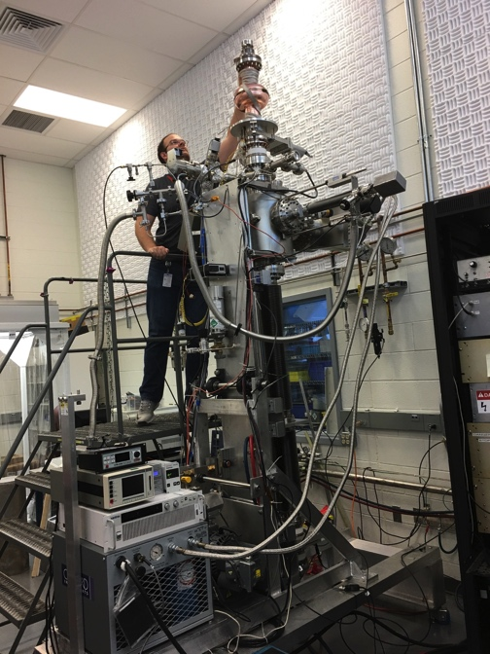
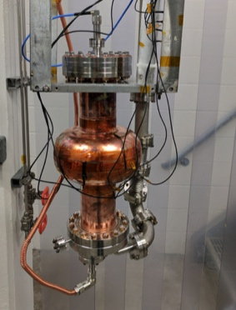
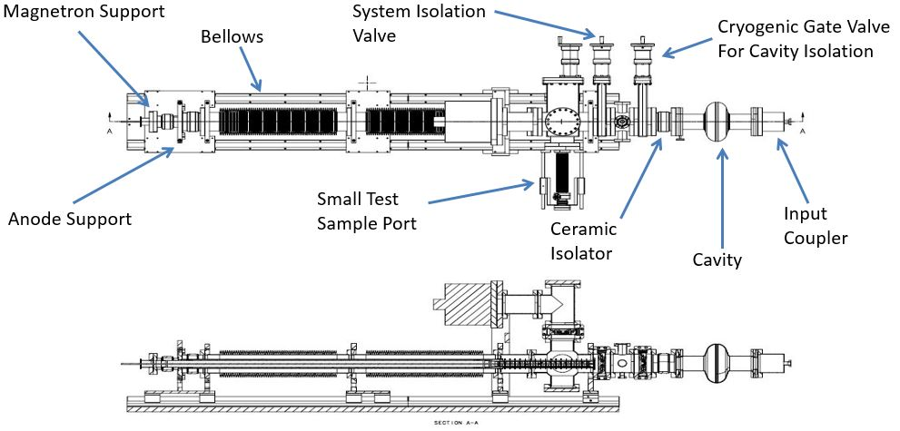
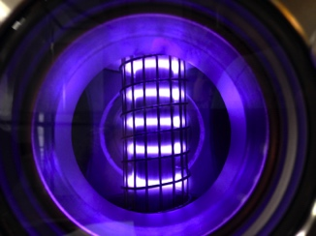
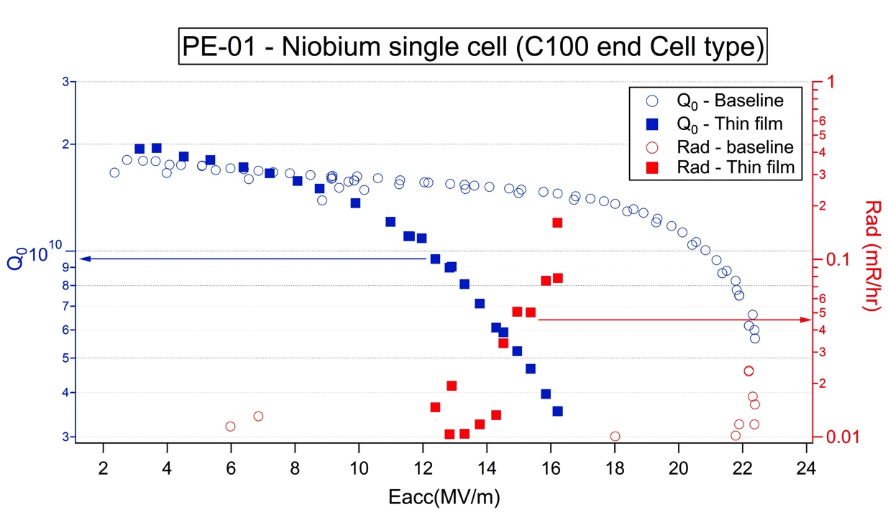
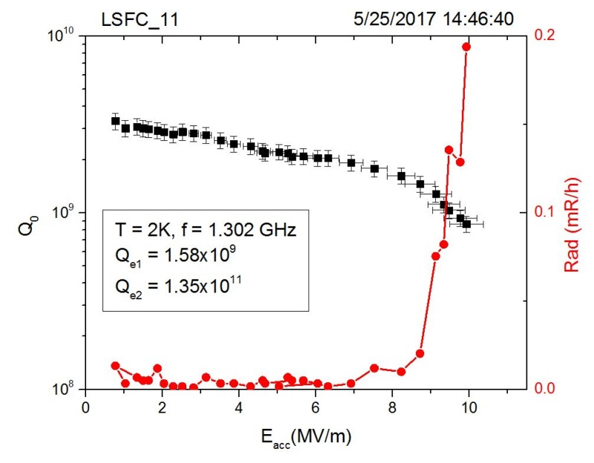
HiPIMS Nb/Cu - JLab
Matt Burton, Larry Phillips, et. al.
Upgraded Deposition System
Custom pulser
Tripled Pulse Power Capability
Very low surface roughness
Hetero-epitaxial Growth
1.3 GHz Nb/Cu cavity
Vertical coating system
HIPIMS discharge
Nb/Nb, Preliminary
C50 spec
Original CEBAF 2K spec

Slide 17
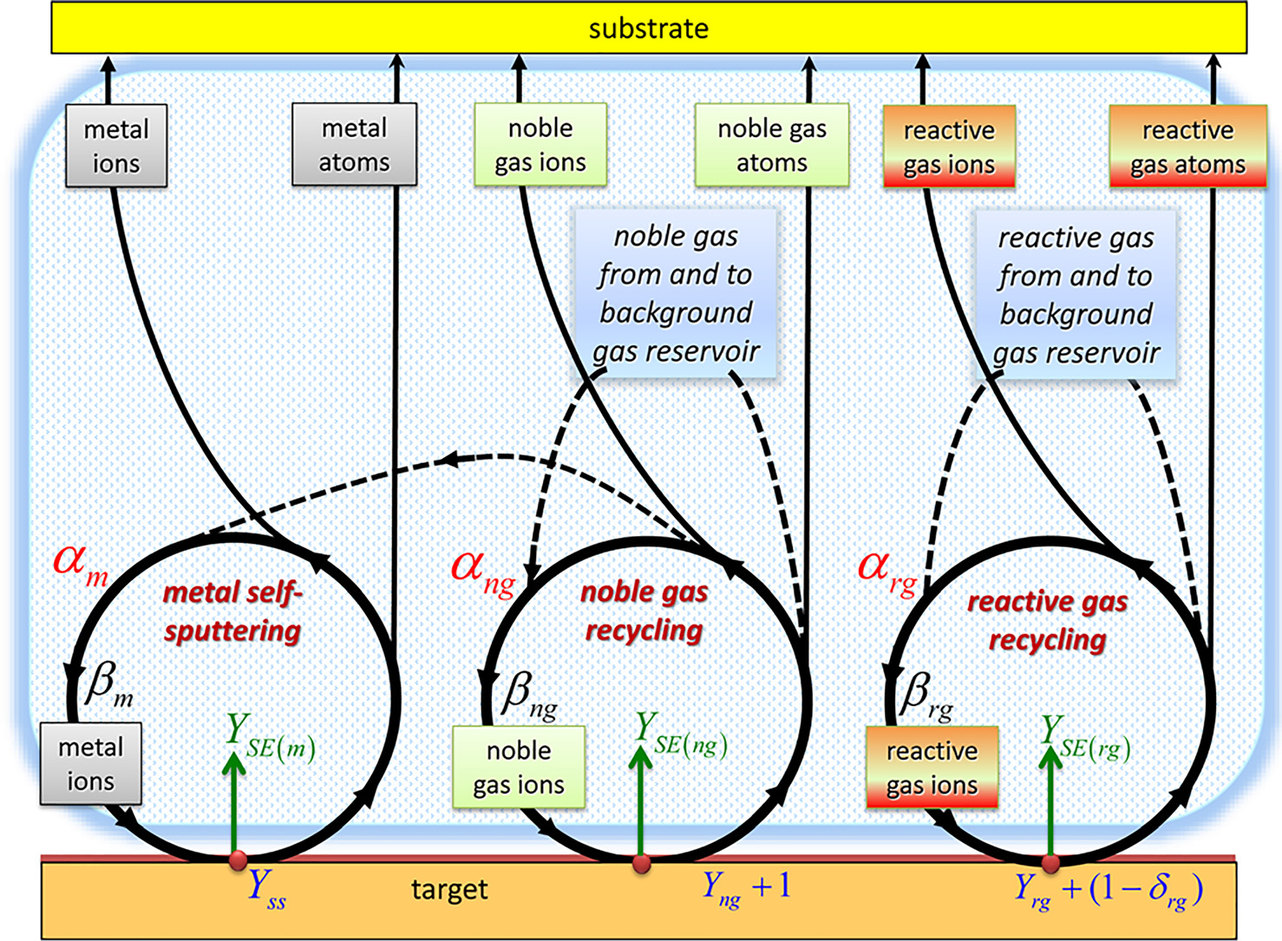
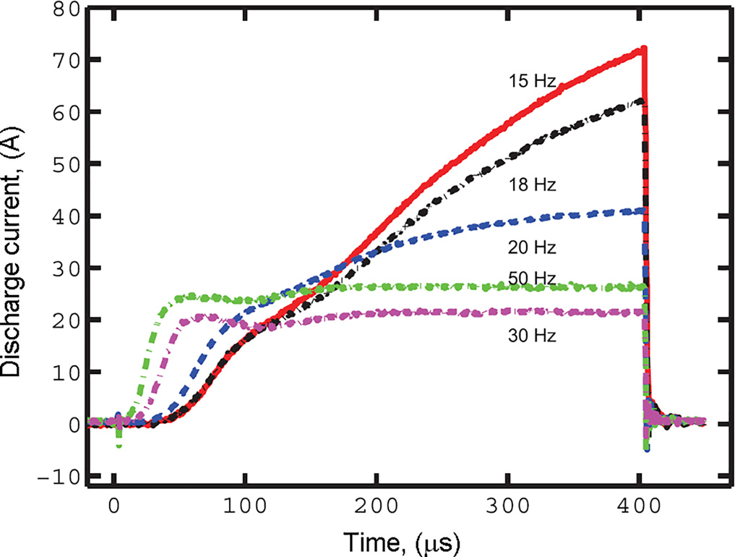
Reactive HiPIMS (R-HiPIMS)
A. Anders, Tutorial: Reactive high power impulse magnetron sputtering (R-HiPIMS), Journal of Applied Physics 121, 171101 (2017)
mixture of noble gas, reactive gas, and metal ions coming to the target
R-HiPIMS with Kr has the least rate reduction
Magnus et al., J. Vac. Sci. Technol.A30, 050601 (2012).

Slide 18
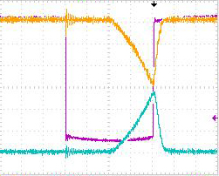
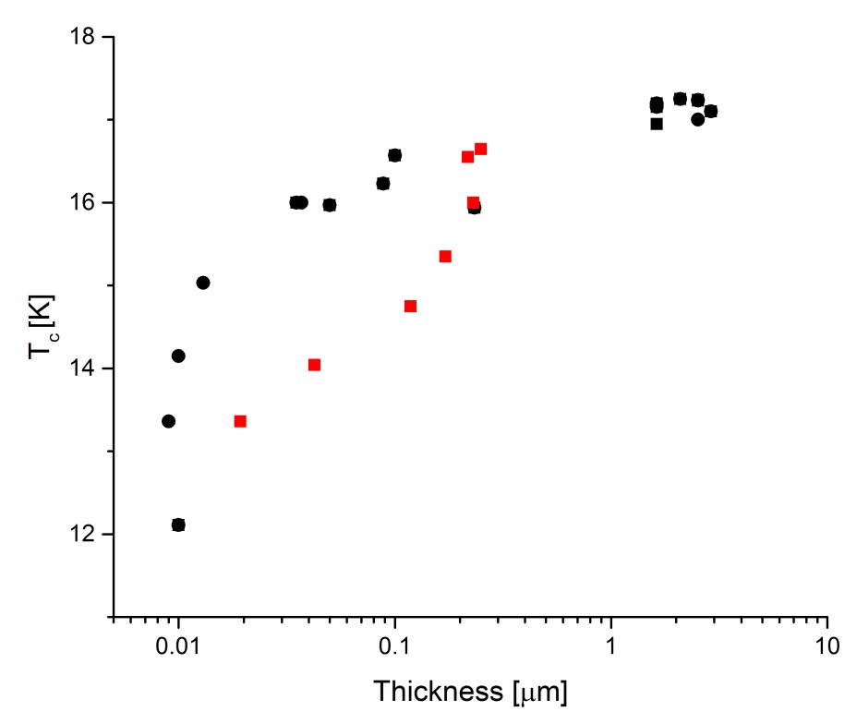
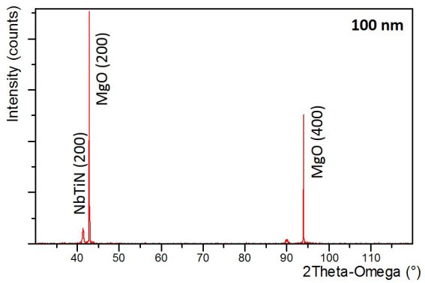
R-HiPIMS NbTiN - JLab
R-HiPIMS of compound NbTi target
Thickness [nm] | Average Power [W] | Peak current [A] | Pulse width [μs] | Repetition rate [Hz] | Coating time [min]
30 | 100 | 115 | 100 | 100 | 120
250 | 400 | 140 | 100 | 200 | 120
230 | 400 | 100 | 150 | 200 | 30
118 | 400 | 150 | 100 | 200 | 30
252 | 400 | 150 | 100 | 200 | 60
218 | 400 | 150 | 100 | 200 | 120
Preliminary HiPIMS NbTiN :only the films produced with an average power of 400 W and repetition rate of 200 Hz have the δ-phase. The measured T_{c} is 16.6 K for a 250 nm thick film.
Some conditions tuning still ahead
250 nm thick
T_{c}= 16.6 K
HiPIMS, No Bias
dc-MS
Typical pulse for reactive HiPIMS of NbTiN

Slide 19
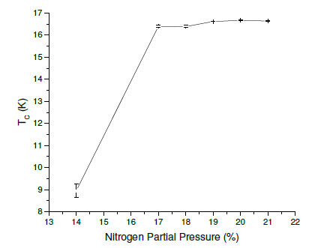
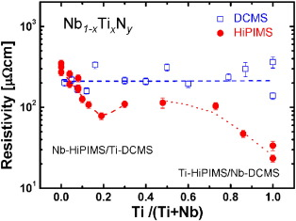
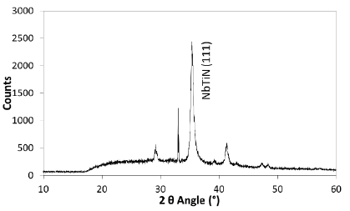
R-HiPIMS NbTiN- STFC
S. Wilde, Proceedings of IPAC2017, Copenhagen, Denmark MOPVA104
Co-sputtering: R-HiPiMS (Nb), 1000Hz, 50 μs
pulsed dc-MS (Ti) 350 kHz, 50% duty cycle

Slide 20
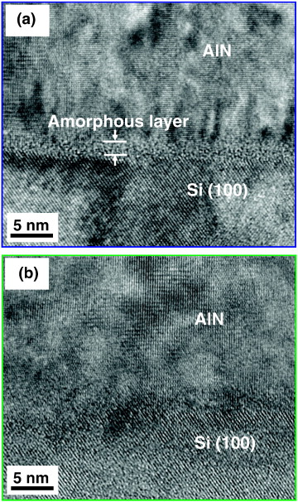

Energetic Condensation : Potential for Multilayers
NbTiN: R-HiPIMS and hybrid technique explored for SRF
NbN
AlN, Al₂O₃
Application for cavity via :
cylindrical R-HiPIMS with stoichiometric target
Hybrid techniques depending on compounds
Done for various applications,
described in literature
K Ait Aissa et al 2015 J. Phys. D: Appl. Phys. 48 145307
P. Eh.Hovsepian et al., Mat.Chem.and Phys. 179, p.110-119 (2016)

Slide 21
Energetic Condensation : Potential for Nb₃Sn
Nb₃Sn readily coated via dc-MS [Thin film deposition of Nb₃Sn on copper – K. Ilyina-Brunner]
Nb₃Sn via energetic condensation :
  cylindrical HiPIMS with stoichiometric target
  Nb target & external source of Sn (ECR & HiPIMS)
  Hybrid R-HiPIMS/dc-MS [G. J.l of Vac. Sc. & Techn. A 30, 061504 (2012)]
  ECR enhanced MS
Potentials:
Achieve Nb₃Sn structures not achieved before
Lower the A15 phase formation temperature
Allow layered structures development based on Nb₃Sn

Slide 22
Energetic Condensation : Potential for Fe-based Superconductors
Common deposition methods:
  Pulse Laser deposition (PLD)
  Reactive Molecular Beam Epitaxy (RMBE)
  Potential EC technique:
  ECR enhanced ALD [W.S. Kim et al. Thin Solid Films 517 (2009) 3900 – 3903]

Slide 23


Energetic Condensation : Potential for SRF Materials
Reactive ECR
Hybrid techniques
ECR enhanced Magnetron Sputtering
ECR enhanced CVD
ECR Plasma enhanced ALD
burst HiPIMS: group 2 or more pulses, making use of the previous pulse’s plasma and its effect on the target state
Hybrid HiPIMS/dc-MS: superimpose pulses with dc-MS or pulsed-dc-MS on the same target (use the time between pulses).
HiPIMS/dc-MS co-sputtering: combine HiPIMS magnetron with dcMS or a pulsed-DC mode , reduced deposition rate of HiPIMS mitigation and also to affect the microstructure of the films.
Dual HiPIMS magnetron configuration to address the “disappearing anode” problem and/or to increase the area that is coated without the need to further increase the peak power.

Slide 24
CONCLUSIONS
Energetic condensation via ECR and HiPIMS mainly explored for Nb
  Results respectively on QPR and cavities are positive:
  Q-slope mitigation is possible at different frequencies & temperature
  Matching bulk Nb properties appears to be within reach
Complex compounds and structures can be deposited via energetic condensation.
  Many compounds and multilayers deposited in industry
  Adequate EC technique(s) depend(s) on deposited compound
  Chose techniques that can scale or be adapted to cavity coating configuration
  No RF measurement available yet on HiPIMS NbTiN
Opportunities for ML structures based on Nb₃Sn, other A15
Opportunities for engineering, enhancing SC film properties:
  Substrate conditioning: remove contaminants by sputtering , produce a mixed-metal interface by shallow ion implantation
  Increase control on layer nucleation, interface, structure, final RF surface, type of grain boundaries

Slide 25







ACKNOLWDGEMENTS
D.R. Beverstock, M. Burton, G. Eremeev, F. Marhauser,, l.Phillips, J. Spradlin , C. Reece
T. Proslier
G. Rosaz, S. Aull, M.Arzeo
V. Khouzenikov
F. Stevie & Group
R. Valizadeh, S. Wilde
T. Junginger
Prof. A. Lukaszew & Group, Prof. M. Kelley

