Slide 1
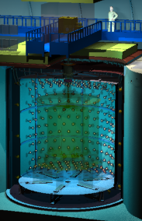
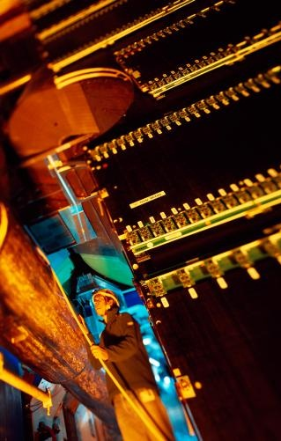
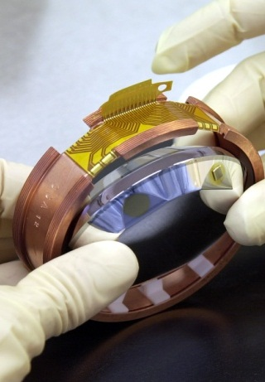
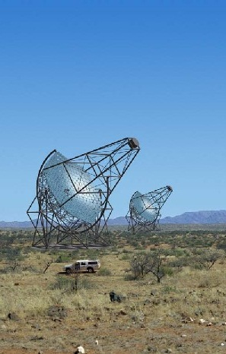
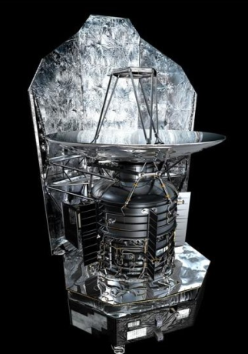
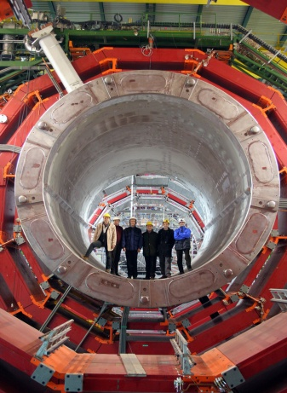
Atomic Layer Deposition
of superconductors:
State of the art and future opportunities
Double Chooz
ALICE
Edelweiss
HESS
Herschel
CMS
Déchiffrer les rayons de l’Univers
Thomas Proslier
16/11/2017
Topical TTC meeting 2017
Notes:
Saisir les champs « Titre », « P. Nom » et « Date.
Laisser ou retirer le bandeau.

Slide 2
Team:
PI: Th. Proslier
Post-doctorants: J. Klug, Nick Groll, K. Chen
Ph.D. Students: C. Cao, N. Becker, M. Weimer
Collaborations:
Theory-ANL: A. Glatz, D. Ford, M. Kharitonov
CEA: C. Antoine, C. Chapelier, P. Joyez
CERN: S. Calatroni
Jlab: A-M. Valente, G. Ciovati
FNAL: S. Posen, A. Romanenko, A. Grassellino
TRIUMPH: T. Junginger
Cornell: M. Liepe
IIT: J. Zasadzinski
ODU: A. Gurevich
Los Alamos: T. Tajima
Notes:
Cliquez sur Insertion puis En-tête/Pied pour saisir les champs « Evènement – Date » et « Service » ; puis cliquer sur Appliquer partout.

Slide 3
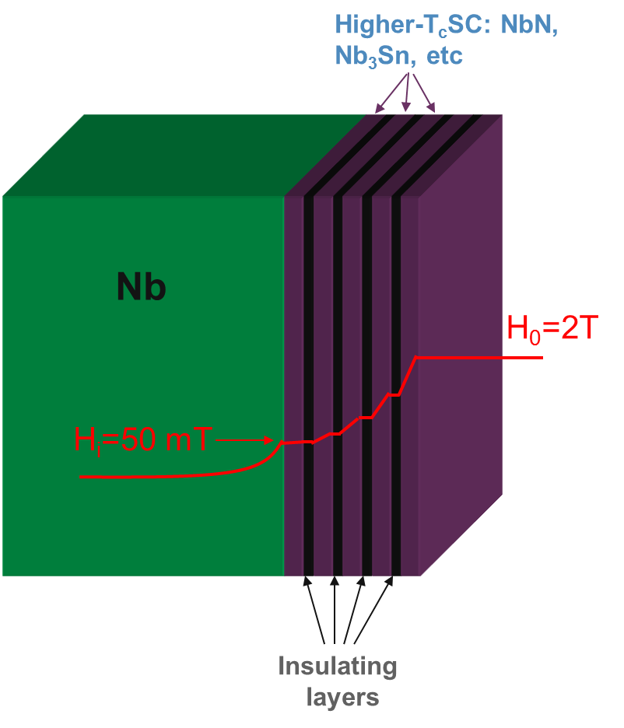
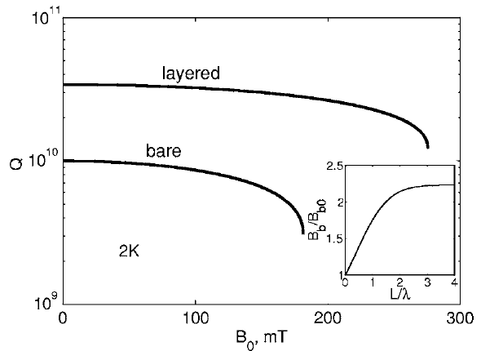
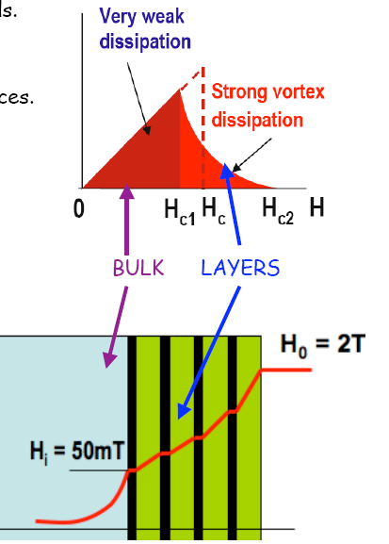
Multilayers:
Fields in bulk Nb cavities approaching dc depairing limit for Nb, H_{c}(0) ≈ 200 mT
Superconductor-Insulator multilayer [Gurevich, Appl. Phys. Lett. 88, 012511 (2006)]
Increase performance
  Move beyond limits of Nb
Decrease cost
  Higher operating temperature
  (reduce cryogen costs)
  Replace bulk Nb with cheaper
  material (Cu/Al)
A. Gurevich, APL 88, 012511
Coat inside Nb SRF cavity with precise, layered structure → ALD

Slide 4
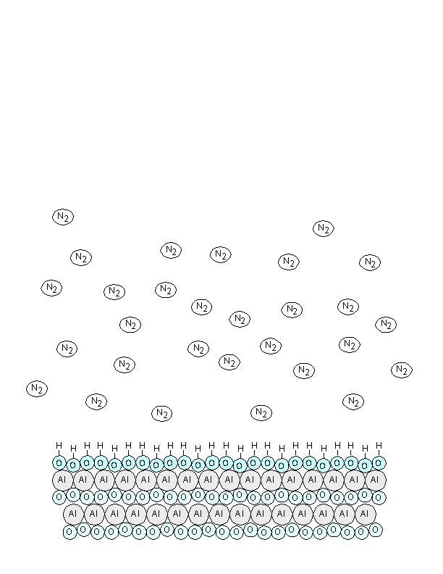
Atomic Layer Deposition
The ALD Reaction Scheme involves two separate reagents applied sequentially
  each reagent reacts saturating the surface completely
    Reactant A == Al(CH₃)₃
    Reactant B == H₂O
  each reagent will not react with itself
Application of each AB pulse sequence
  Reforms the original surface
  Adds precisely 1 monolayer
    Defined by Reactant A coverage
    ~ 0.5 ml of Al₂O₃
Growth rate = Å/cy 0.2 <GR< 5 Å/cy

Slide 5
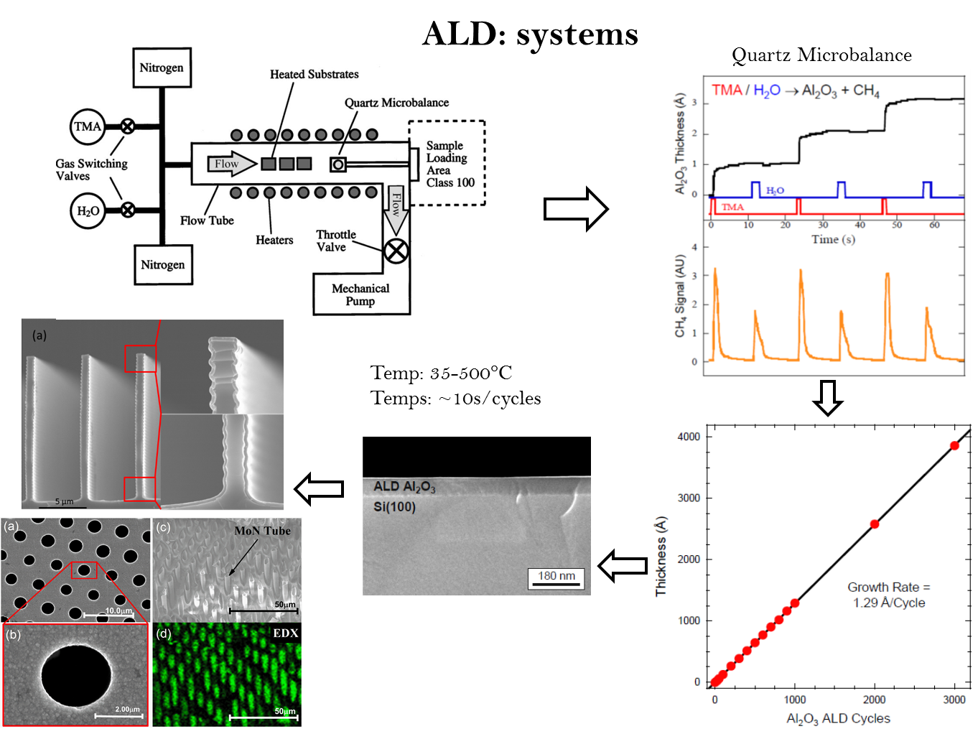
ALD: Systems
Advantages:
Atomic-level control of thickness and composition
Smooth, continuous, pinhole-free coatings on large area substrates
No line-of-sight limits → excellent conformality over complex shaped surfaces
Limits:
Slow
New Alloys means new Chemistries

Slide 6
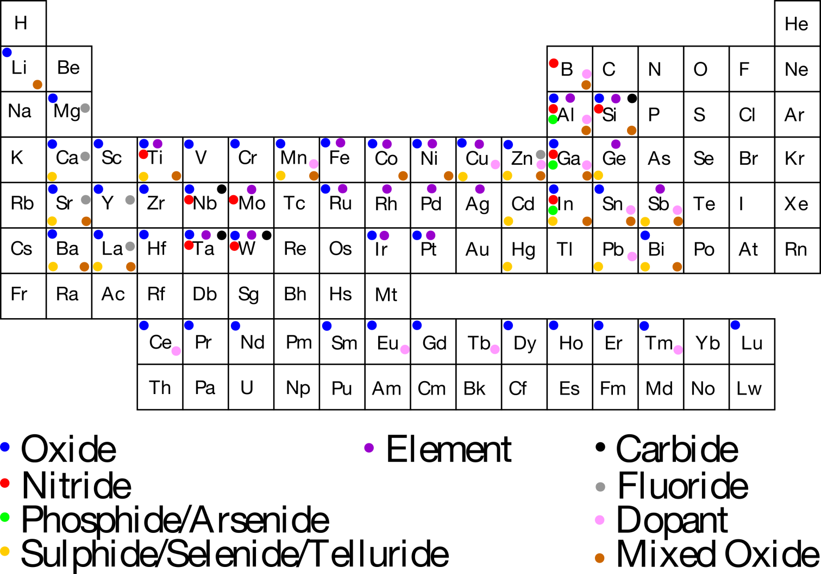
Atomic layer deposition (ALD)
Silicides
Borides
See: Miikulainen et al., J. Appl. Phys. 113, 021301 (2013).
Puurunen, J. Appl. Phys. 97, 121301 (2005).

Slide 7
Few examples of elementals by Atomic layer deposition (ALD)
W and Mo: W/MoF₆ + Si₂H₆ -> W/Mo + SiHxFy(g) – deposition < 200°C
pure Mixture amorphous/crystalline ( T_{C} = 3K for W). Growth rate ~ 5Ǻ/cy.
Pd/Pt/Ir: Pd(hfac)2 + HCOH -> Pd + gas reactants – deposition = 200°C
Pure, crystalline – GR ~ 0.2Ǻ/cy
Pt(MeCp)Me₃ + O₂ -> Pt + gas reactants – deposition = 300°C
Pure, crystalline – GR ~ 0.45 Ǻ/cy
Ir(acac)3 + O₂ -> Pt + gas reactants – deposition = 350°C
Pure, crystalline – GR ~ 0.4 Ǻ/cy
Ni/Co: Ni/Co(dmamb)2 + NH₃ -> Ni/Co + gas reactants – deposition = 300°C
O, crystalline – GR ~0.6 Ǻ/cy
Pure: C, O, N <~ 1%
Cu,Pt, Ir, Pd, Ni, Co: Island growth

Slide 8
Superconductors by ALD
Superconducting alloys grown by ALD
Goal for SRF is a material with a T_{c} higher than bulk Nb (9.2 K)
Niobium Carbide: NbC 1.7 K
  NbF₅ + Al(CH₃)₃
  NbCl₅ + Al(CH₃)₃
Niobium Carbo-Nitride: NbC_{1-x}N_{x} 3.8 K
  Al(CH₃)₃ + NbF₅ + NH₃
  Al(CH₃)₃ + NbCl₅ + NH₃
Niobium Silicide: NbSi 3.1 K
  NbF₅ + Si₂H₆
  NbF₅ + SiH₄
Titanium Nitride: TiN 3.9 K (4 K)
- TiCl₄ + NH₃
Molybdenum Nitride: MoN 12 K (12-13 K)
  MoCl₅ + NH₃
  MoCl₅ + Zn + NH₃
Niobium Titanium Nitride: Nb_{1-x}Ti_{x}N 14 K (17 K)
  (NbF₅, TiCl₄) + NH₃
  (NbCl₅, TiCl₄) + Zn + NH₃

Slide 9
Superconductors by ALD
Superconducting alloys grown by ALD
Goal for SRF is a material with a T_{c} higher than bulk Nb (9.2 K)
Niobium Carbide: NbC 1.7 K
  NbF₅ + Al(CH₃)₃
  NbCl₅ + Al(CH₃)₃
Niobium Carbo-Nitride: NbC_{1-x}N_{x} 3.8 K
  Al(CH₃)₃ + NbF₅ + NH₃
  Al(CH₃)₃ + NbCl₅ + NH₃
Niobium Silicide: NbSi 3.1 K
  NbF₅ + Si₂H₆
  NbF₅ + SiH₄
Titanium Nitride: TiN 3.9 K
- TiCl₄ + NH₃
Molybdenum Nitride: MoN 12 K
  MoCl₅ + NH₃
  MoCl₅ + Zn + NH₃
Niobium Titanium Nitride: Nb_{1-x}Ti_{x}N 14 K
  (NbF₅, TiCl₄) + NH₃
  (NbCl₅, TiCl₄) + Zn + NH₃

Slide 10
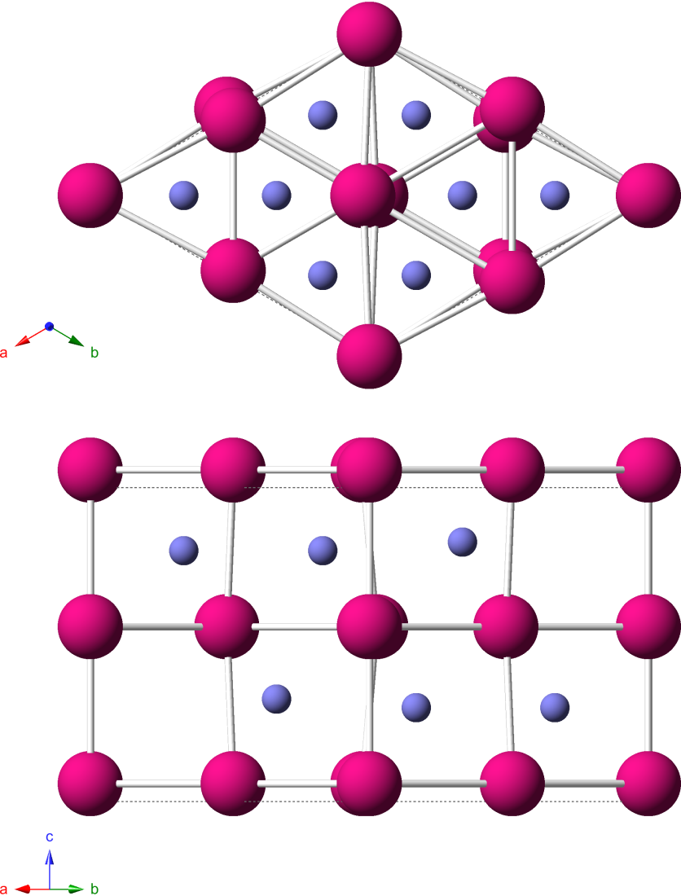
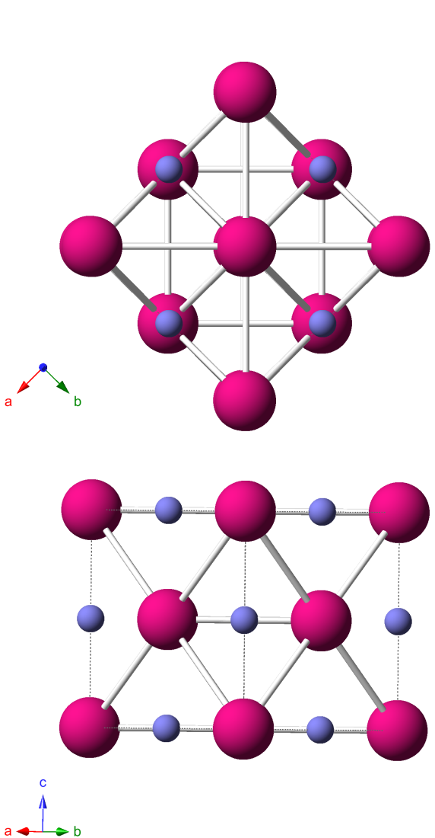
Molybdenum nitride
_
δ-MoN (P6₃mc)
T_{c} = 12 K
γ-Mo₂N (Fm3m)
T_{c} = 5.2 K
Crystal structures: Bull, et al., J. Solid State Chem. 177, 1488 (2004); Bull, et al., J. Solid State Chem. 179, 1762 (2006)

Slide 11
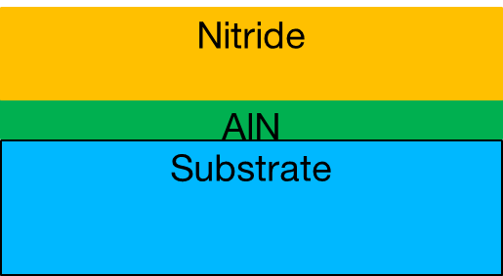
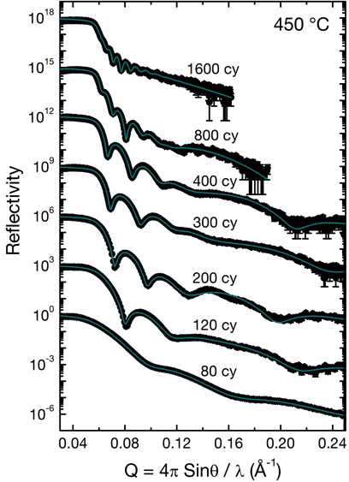
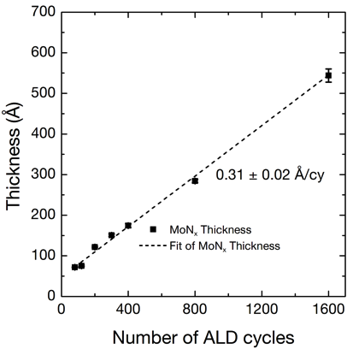
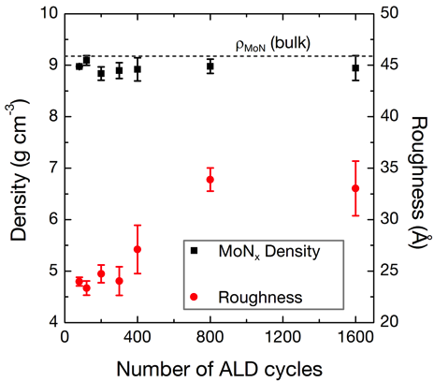
Molybdenum Nitride (MoN)
Growth temperature: 450 ⁰C
MoCl₅ + NH₃ - AlN : AlCl₃ + NH₃
Linear, well controlled growth with fine thickness control
Bulk-like density, roughness 25-35 Å

Slide 12
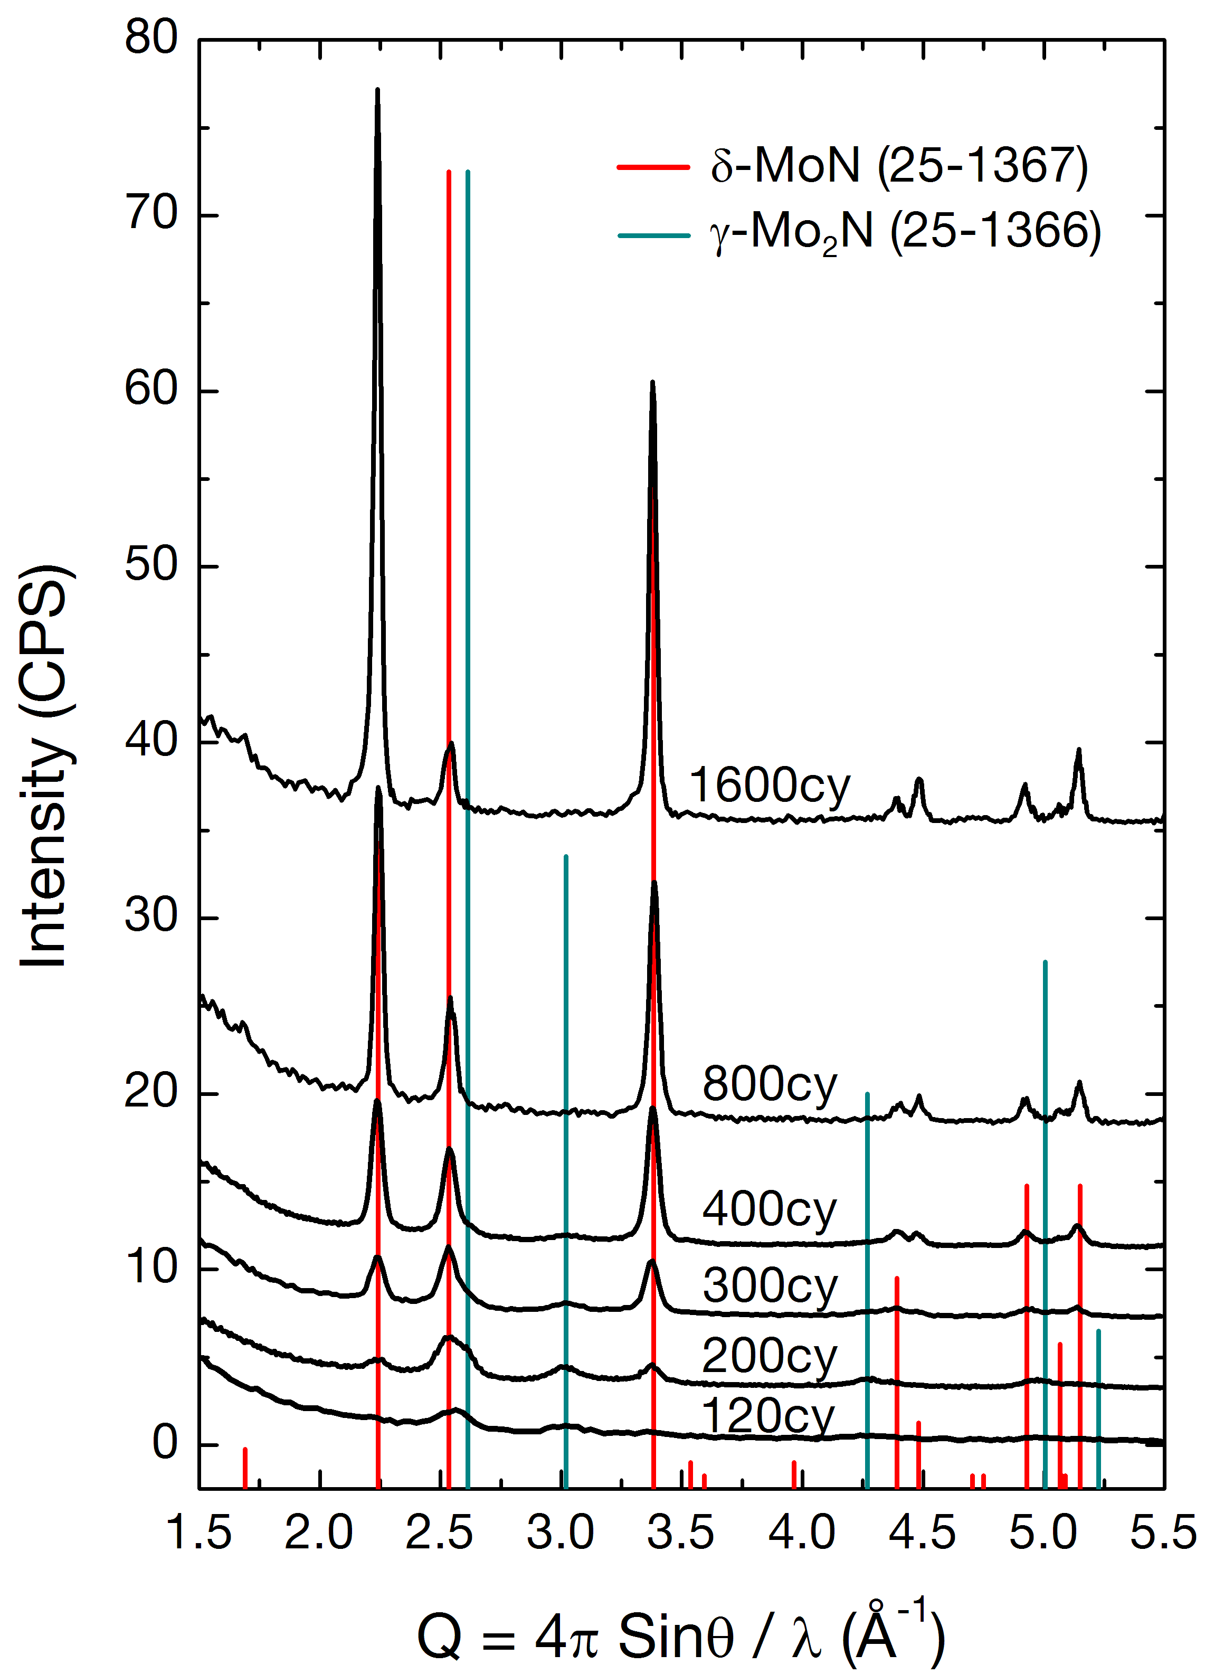
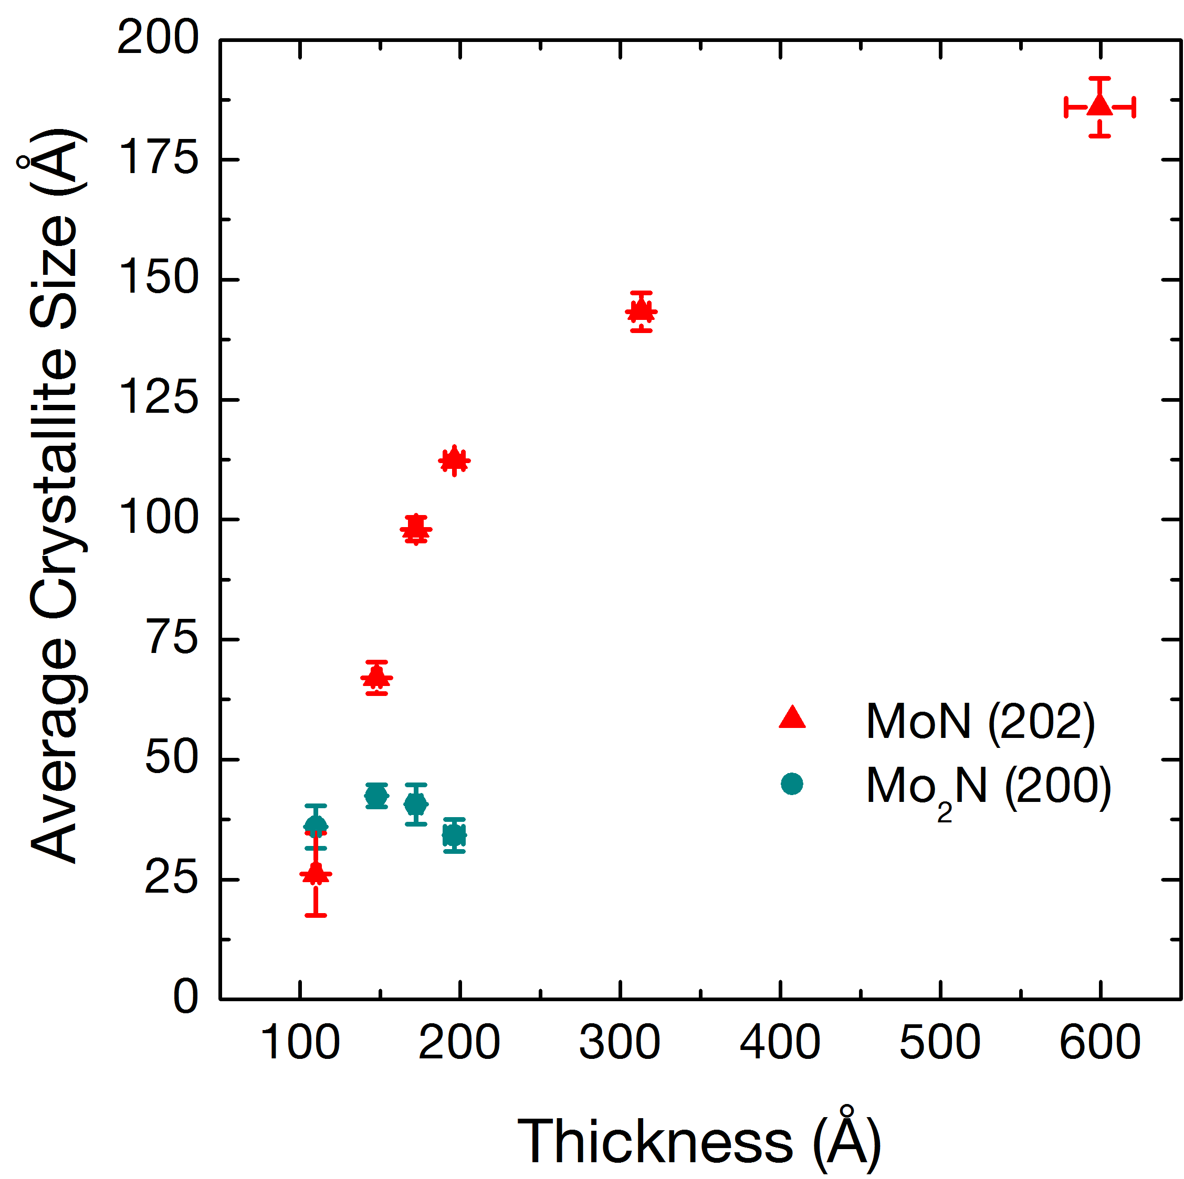
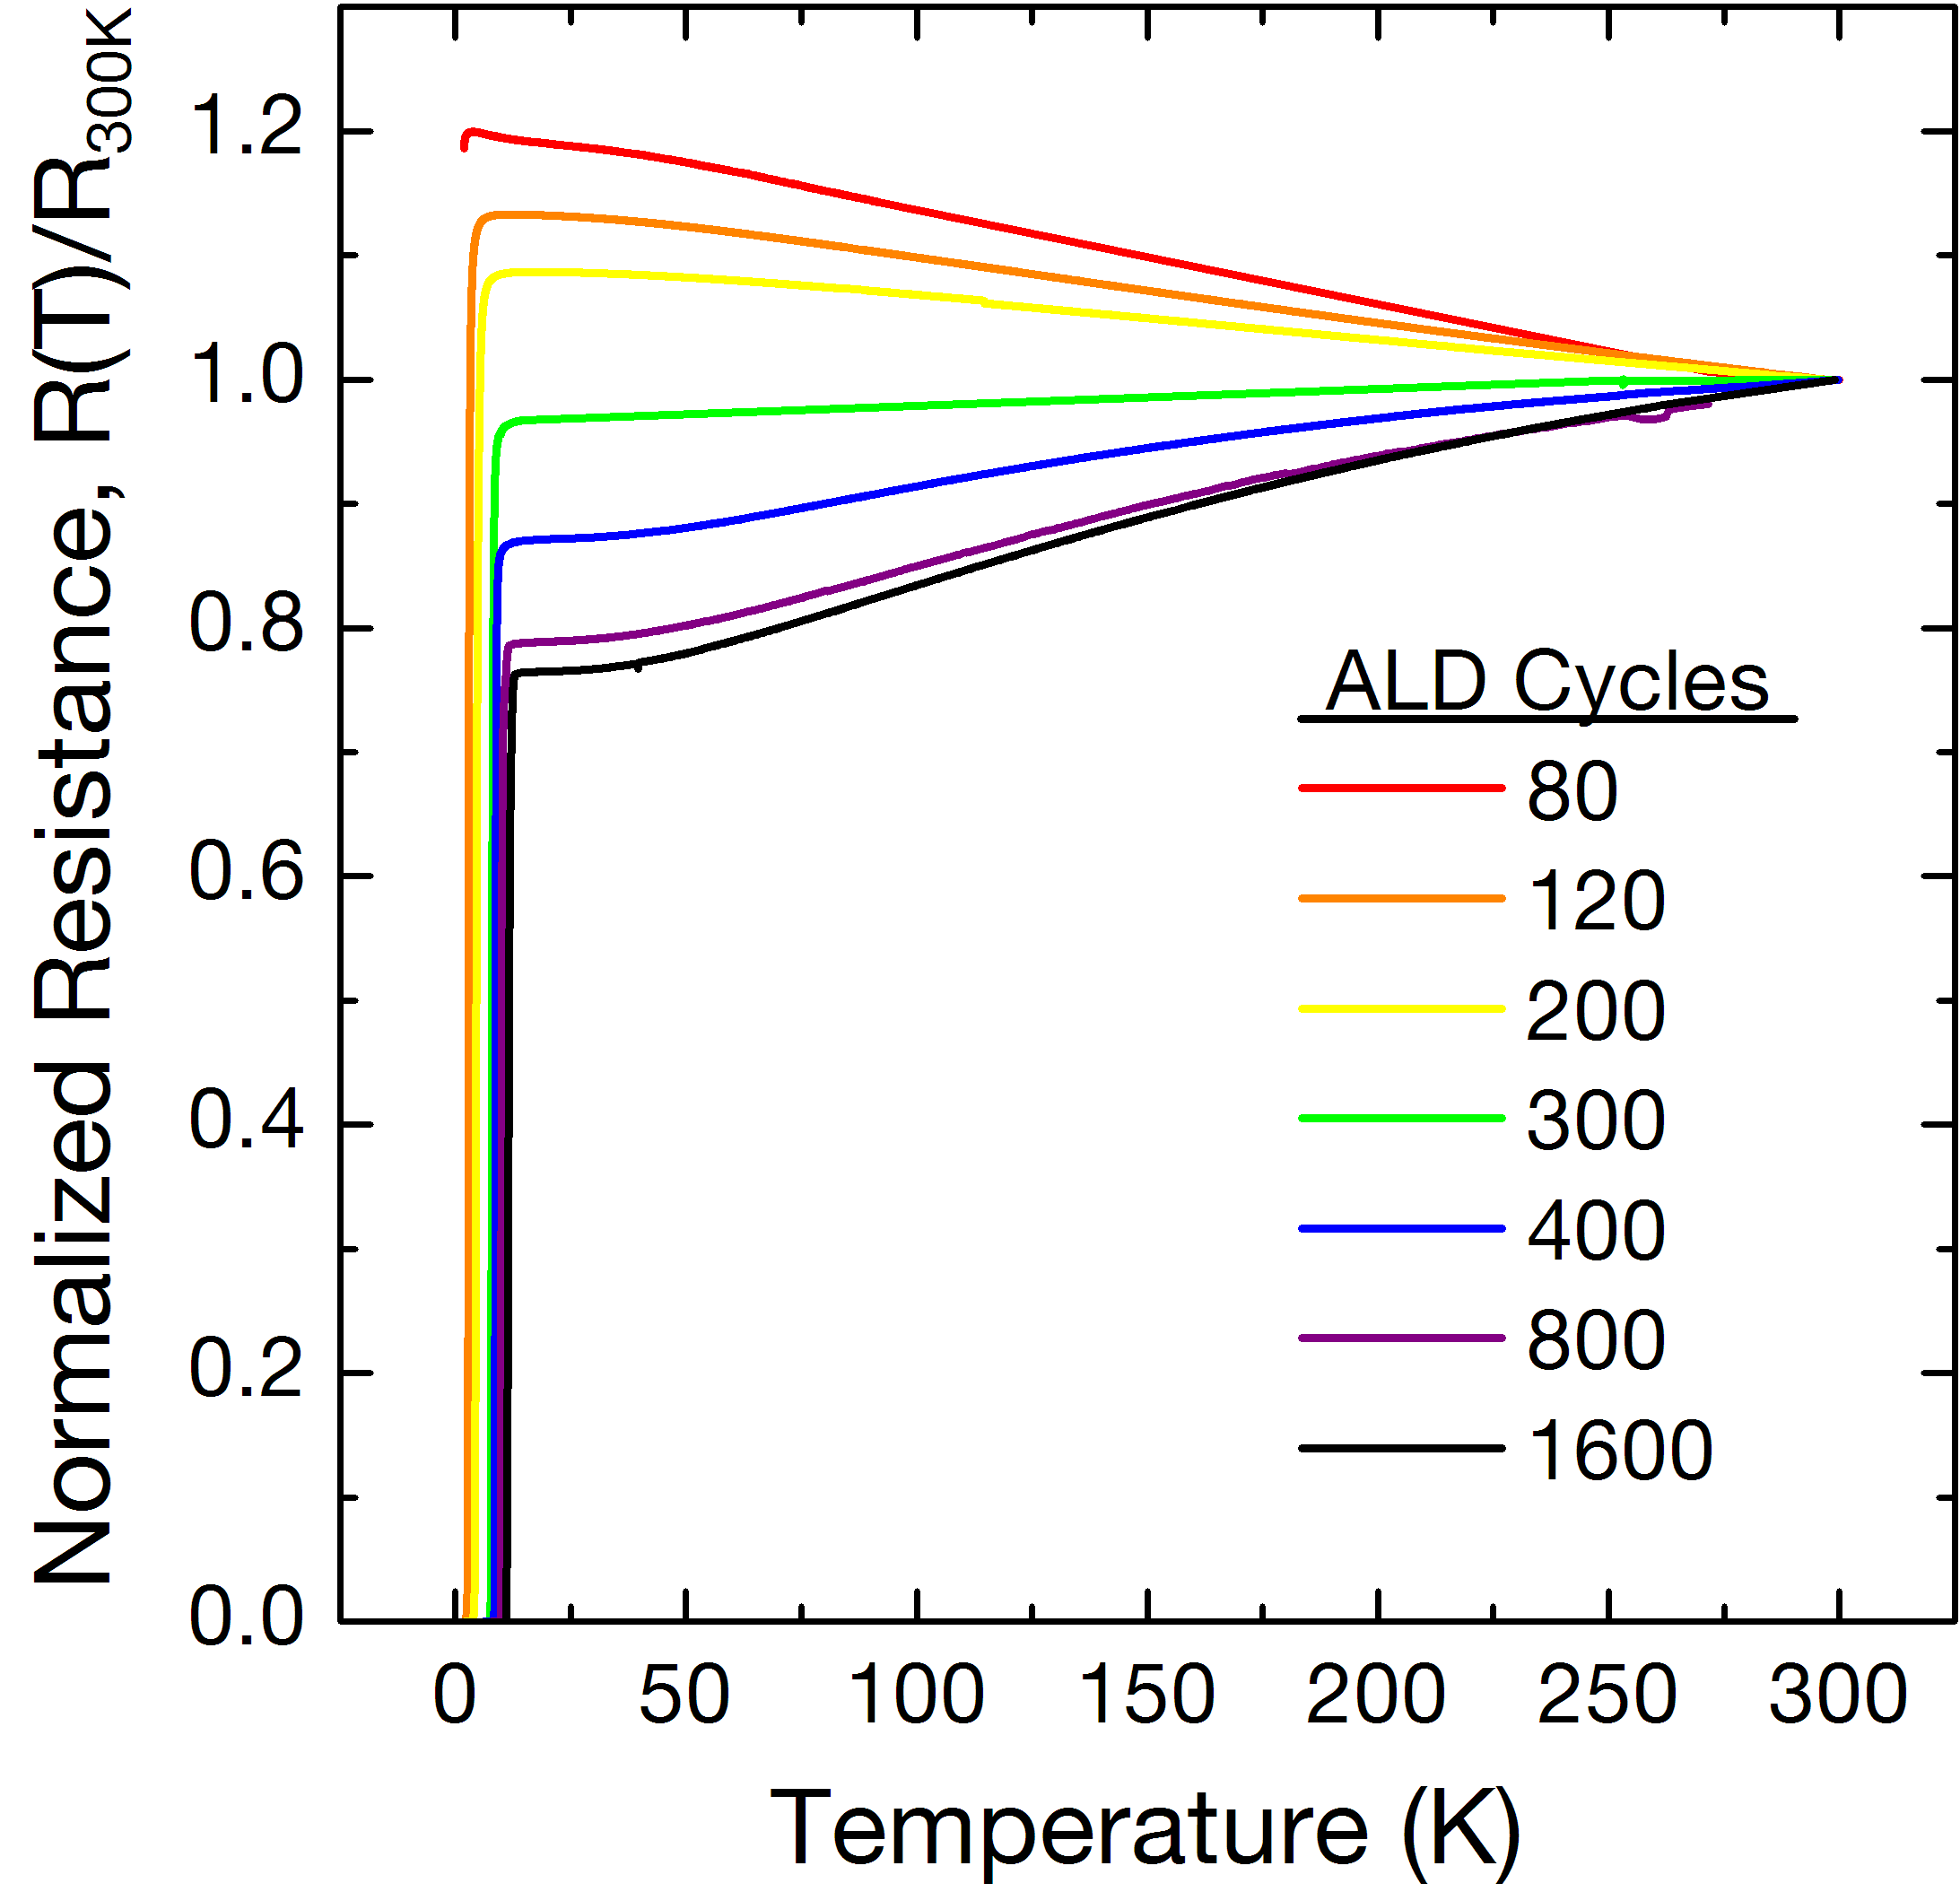
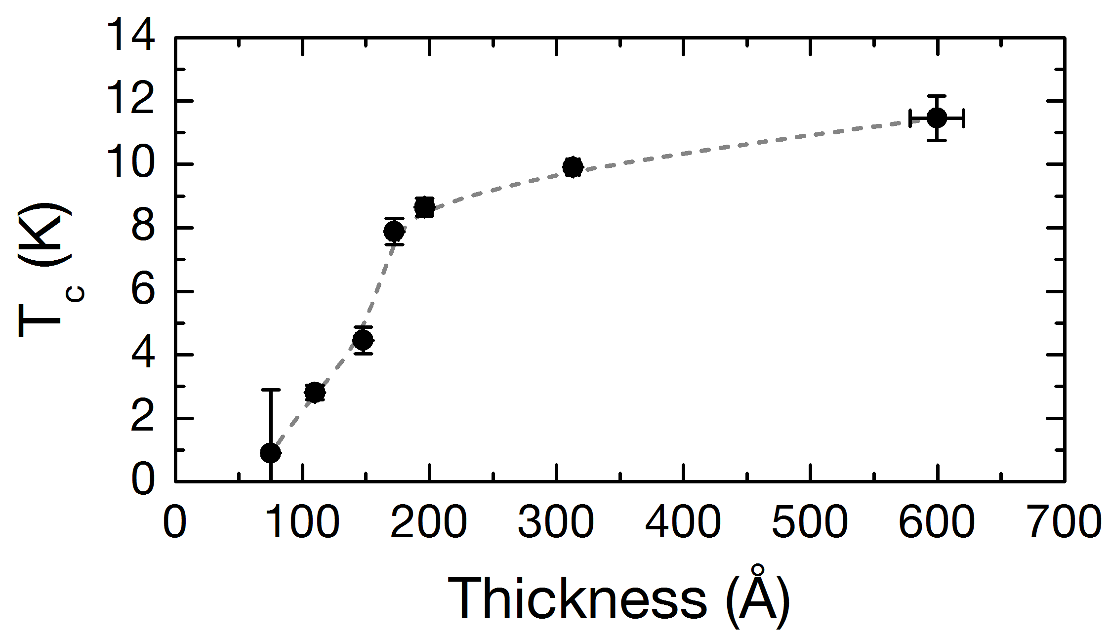
MoN_{x} ALD: T_{c} vs. thickness

Slide 13
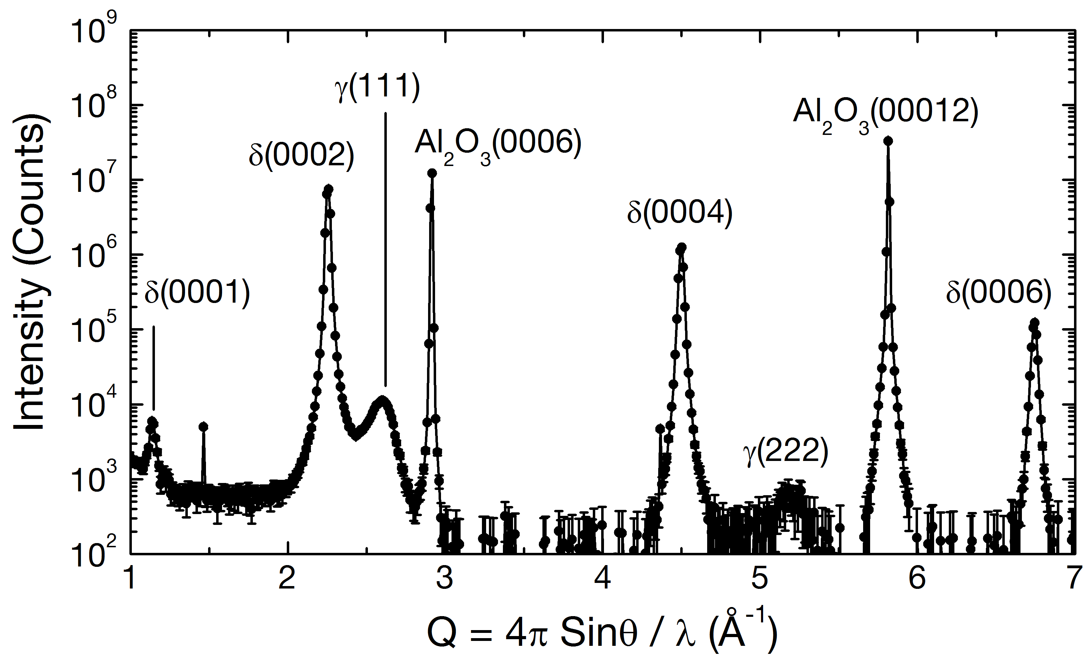
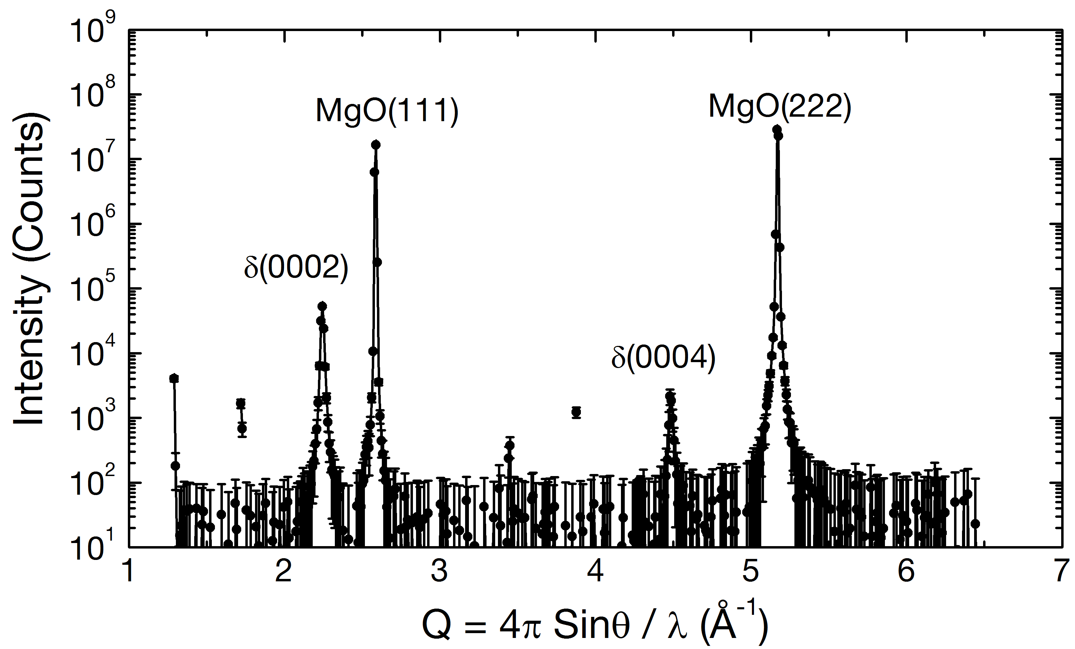
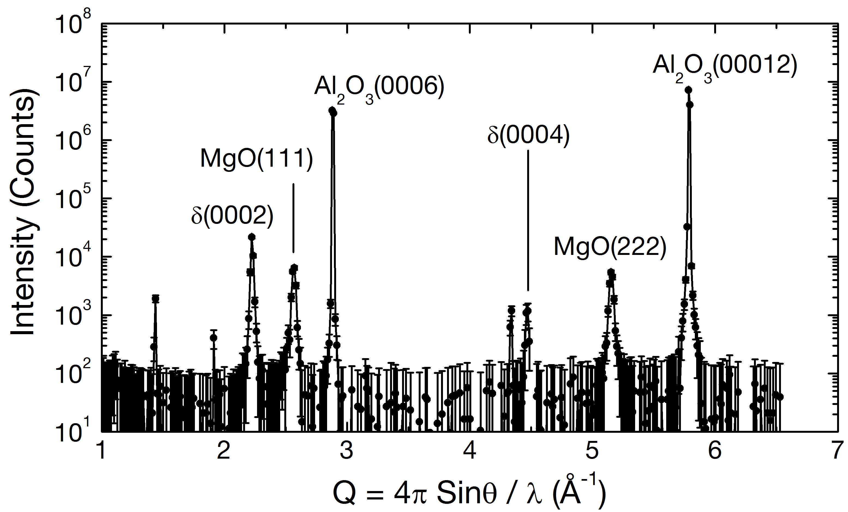
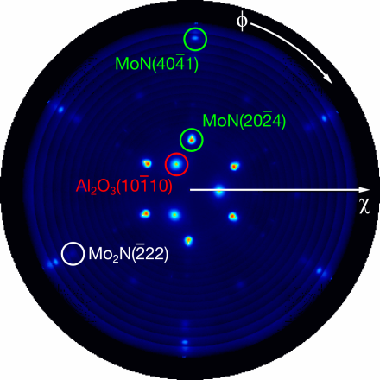
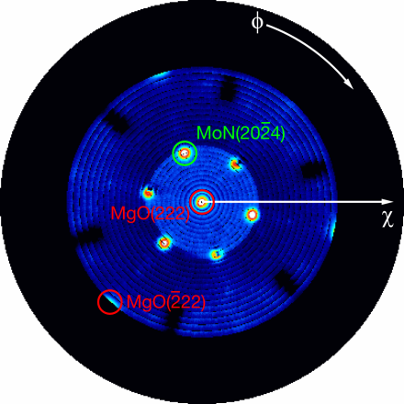
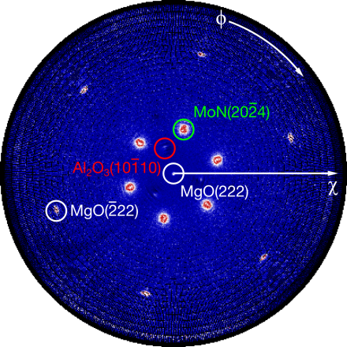
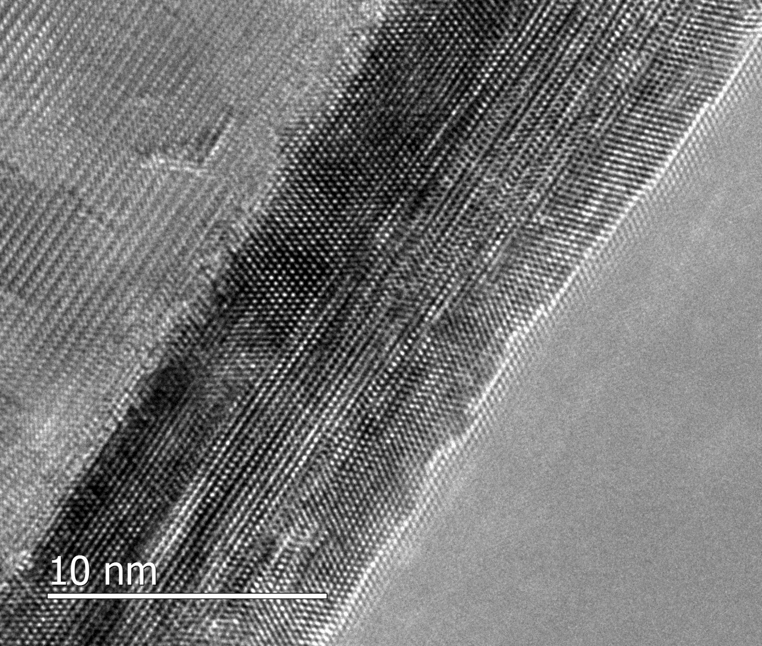

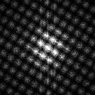
MoN_{x} ALD: MoCl₅ and NH₃ – Epitaxy ?
Open questions:
Unclear why or how structure evolves during nucleation.
Can nucleation be controlled with process parameters?
DFT (D. Ford/P. Zapol, MSD) → structure and coordination in first few layers should have a strong effect.
Al₂O₃
MoN
MgO
TEM: C. Alvarez (ANL/NU)

Slide 14
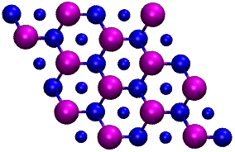
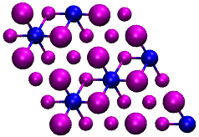
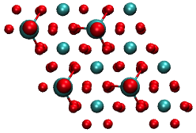
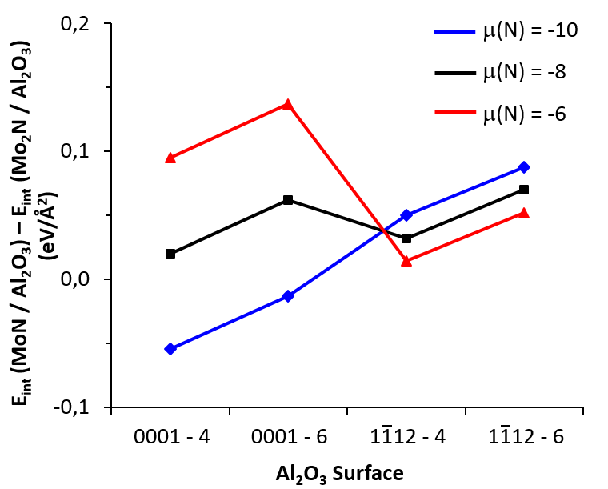
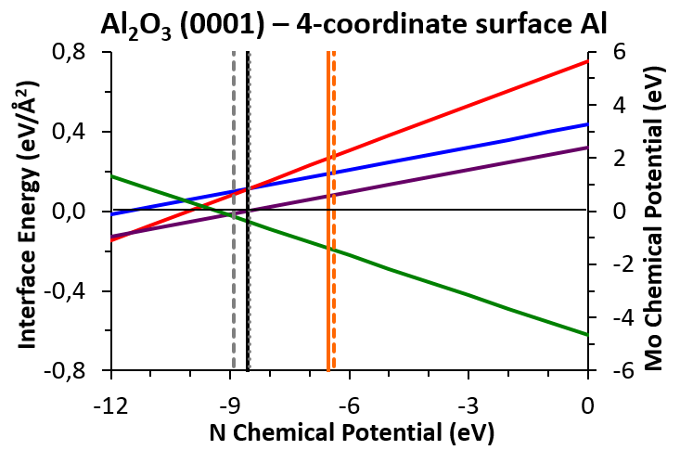
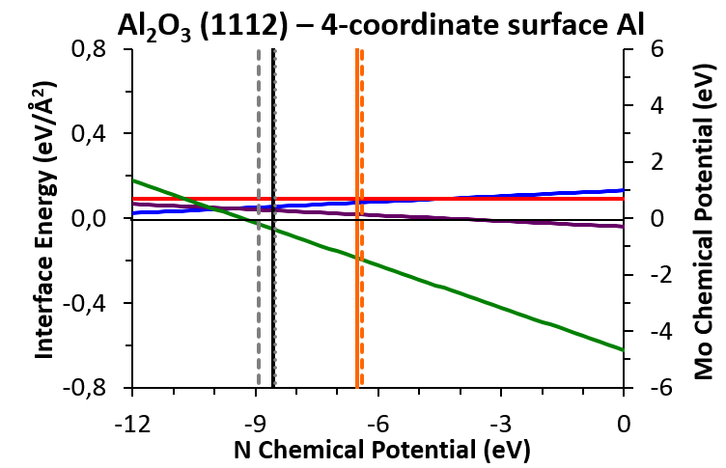
MoN_{x} Density Functional Theory
MoN (0001)
Mo₂N (111)
Al₂O₃ (0001)
MoN/Al₂O₃ Mo₂N/Al₂O₃ MoN,int – Mo₂N,int
μ(N,NH₃) @ 298K,0.1MPa μ(N,NH₃) @ 673K,0.1MPa
DFT shows that: Mo₂N is more favorable on C-Plan and MoN is preferred on R-Plan
Confirm the trend seen experimentally

Slide 15
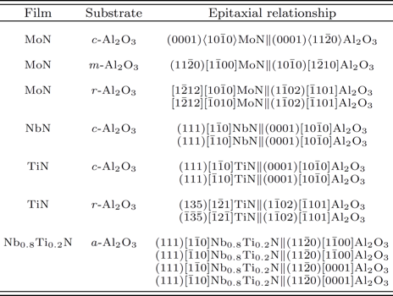
Summary - Epitaxy
High quality epitaxial IV-VI nitrides synthesized by atomic layer deposition at modest temperatures (450°C).
Films on a-Al₂O₃ show superior electrical and superconducting properties compared to those grown concurrently on amorphous SiO₂.
Klug, Becker, et al., Appl. Phys. Lett. 103, 211602 (2013).

Slide 16
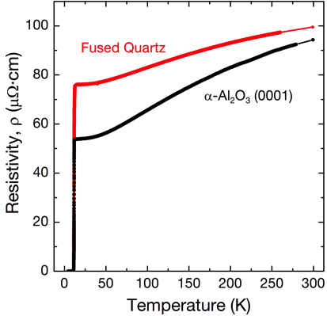
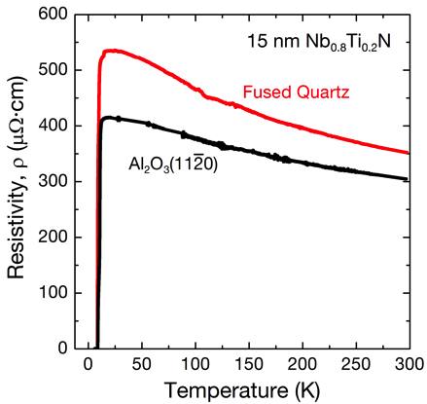
Electrical Properties
60 nm MoN
Klug, Becker, et al., Appl. Phys. Lett. 103, 211602 (2013).

Slide 17
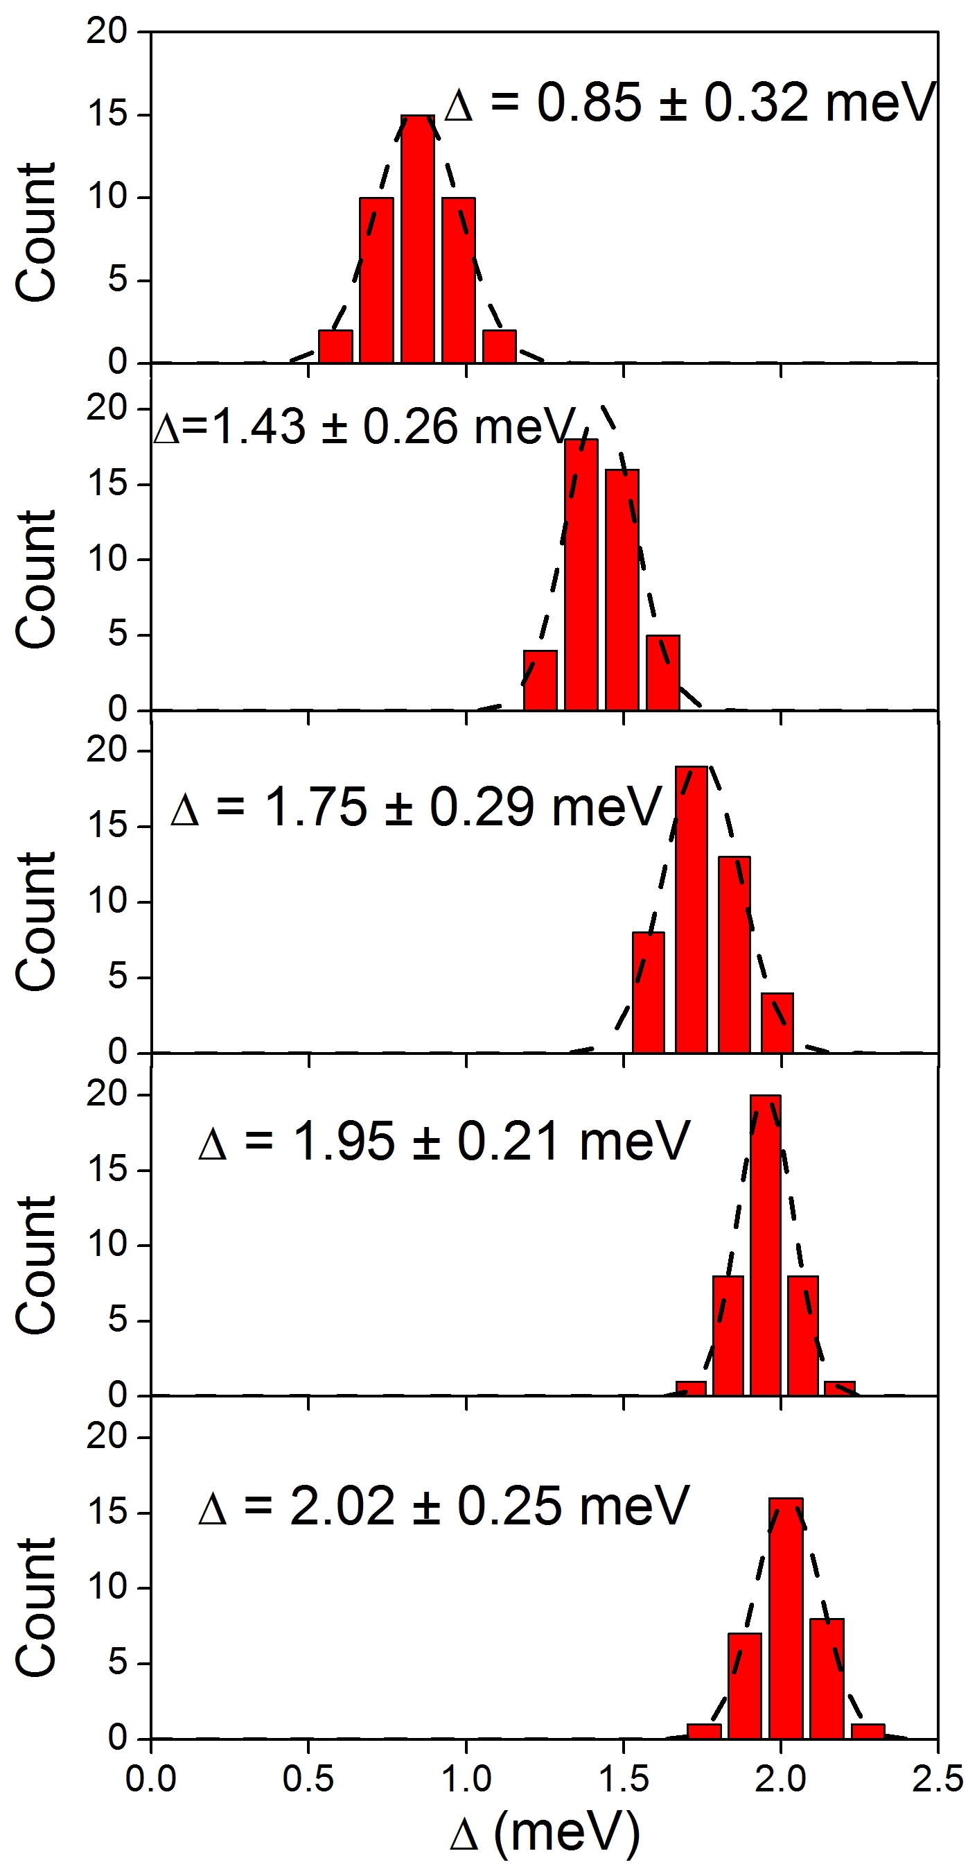
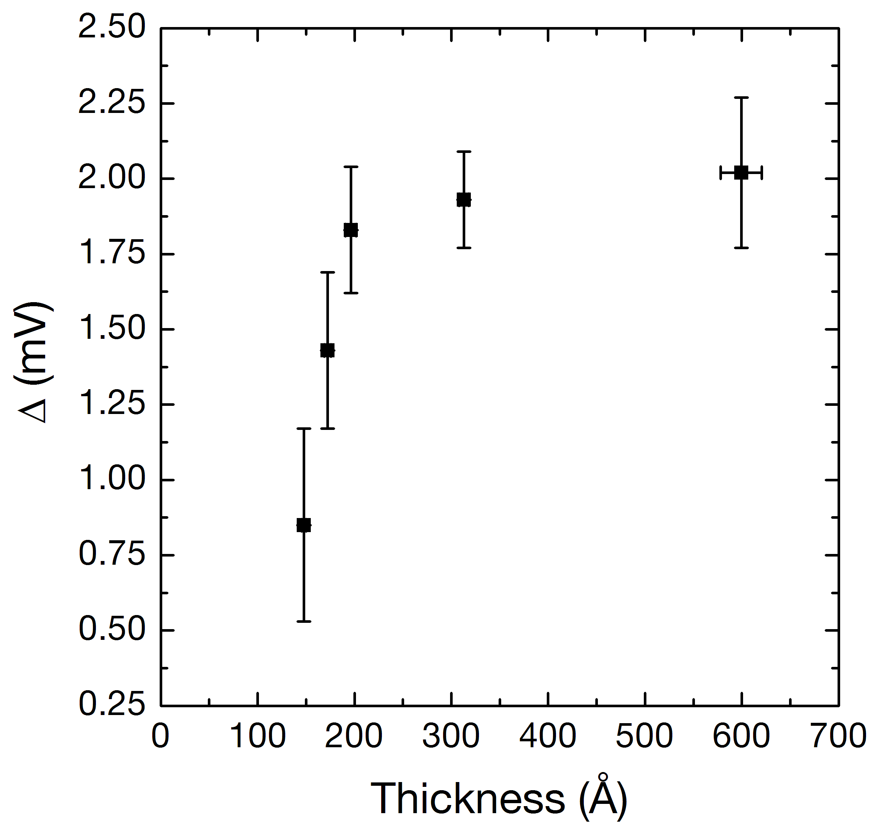
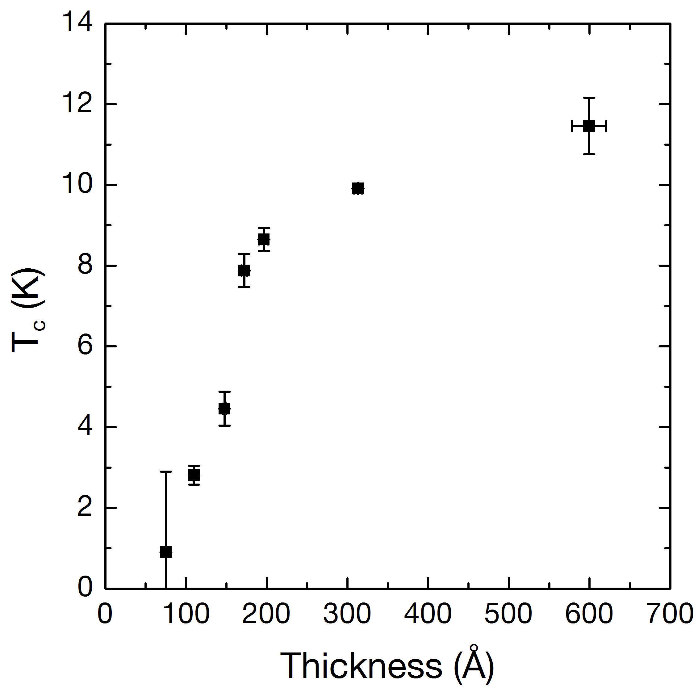
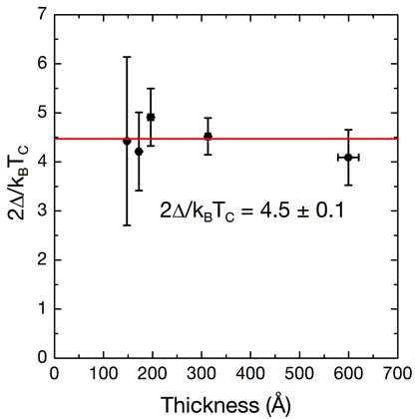
MoN_{x} ALD: T_{c} vs. thickness
15nm
Δ_{Nb} = 1.55 meV
Tc = 9.25 K
18 nm
20 nm
30 nm
60 nm
Thickness > 50 nm

Slide 18
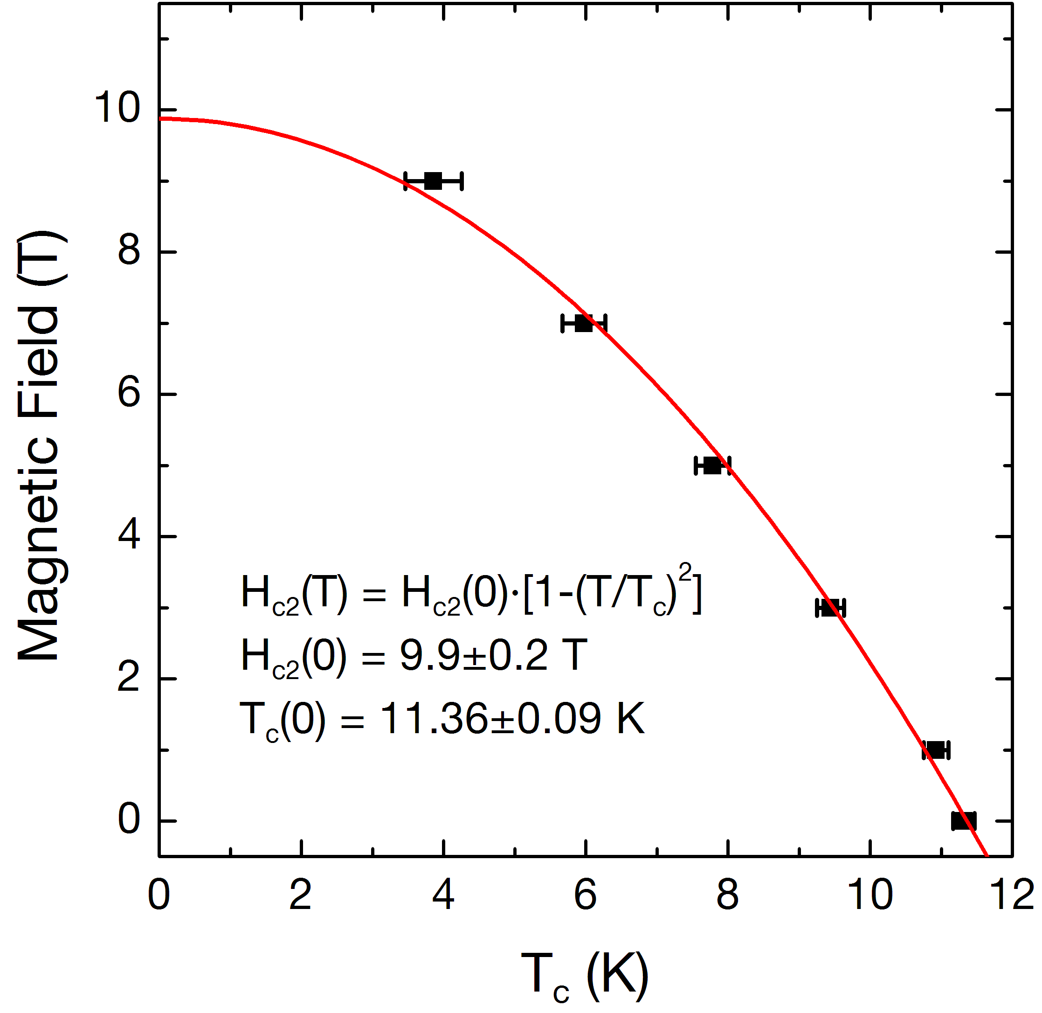
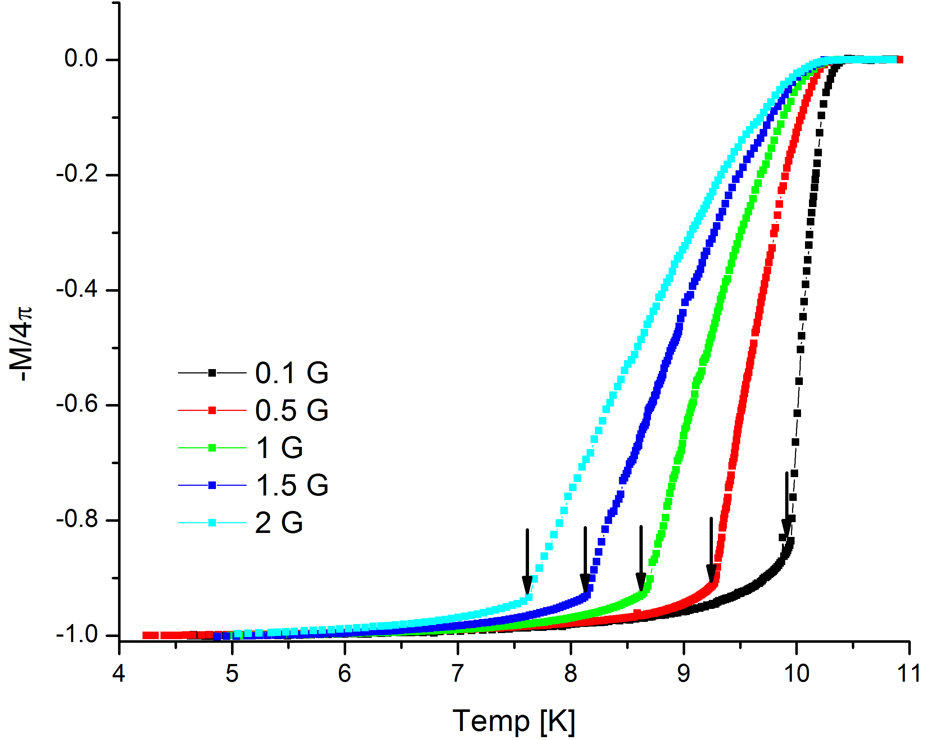
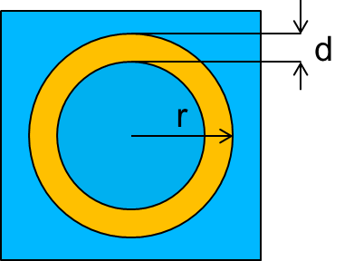
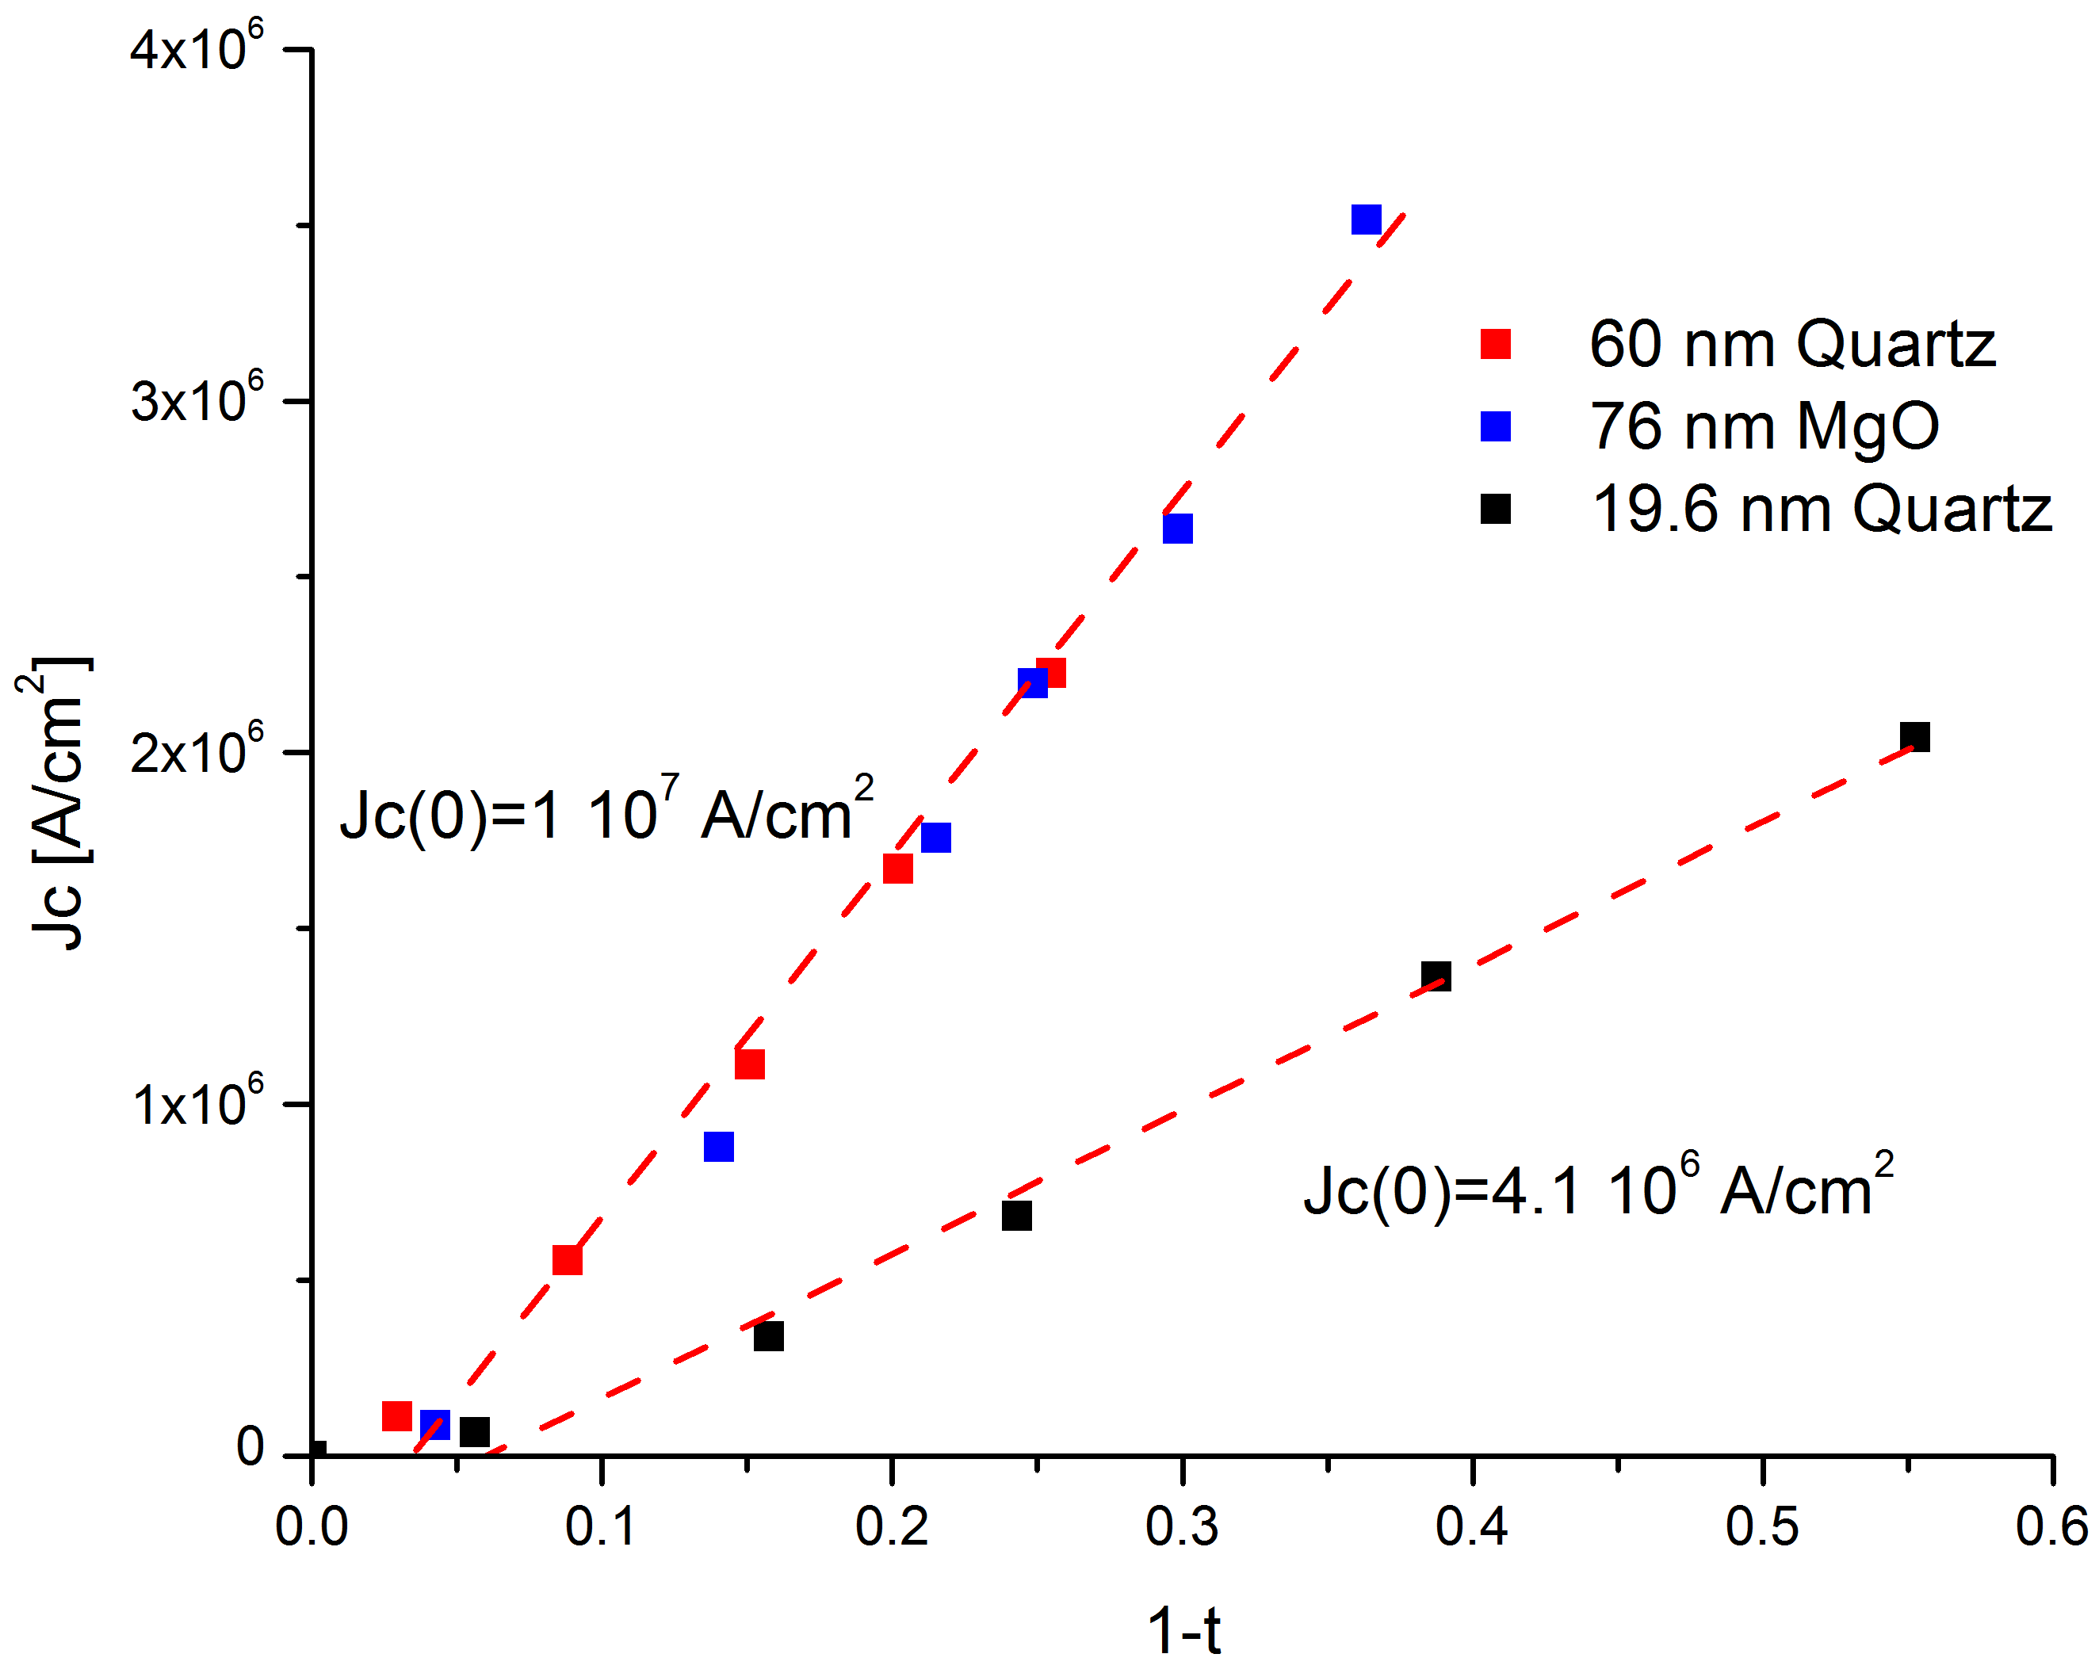
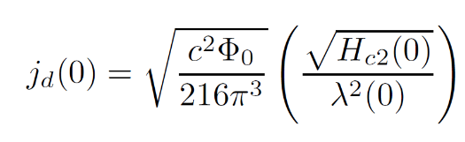
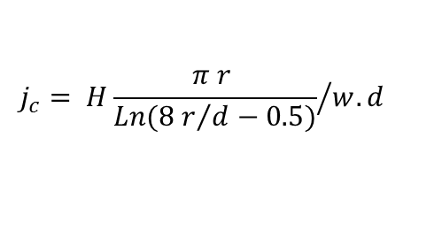
MoN_{x} ALD: Field dependence
H_{c2}(0) → ξ(0) = 5.7 ± 0.1 nm
H
$$j_{c}= {H\frac{π r }{Ln({8 r}/{d−0.5})}}/{w.d}$$
Assume λ ~ 200 nm, estimate J_{D}(0)~1×10⁸ A/cm²; J_{D}(2K)~8×10⁷ A/cm², Jc(0) ~ 10⁷ A/cm²
For MoN (d = 60 nm) on 50 µm Cu wire, I_{MAX} ~ 1,5 A; I_{MAX}(2K) ~ 1,3 A

Slide 19
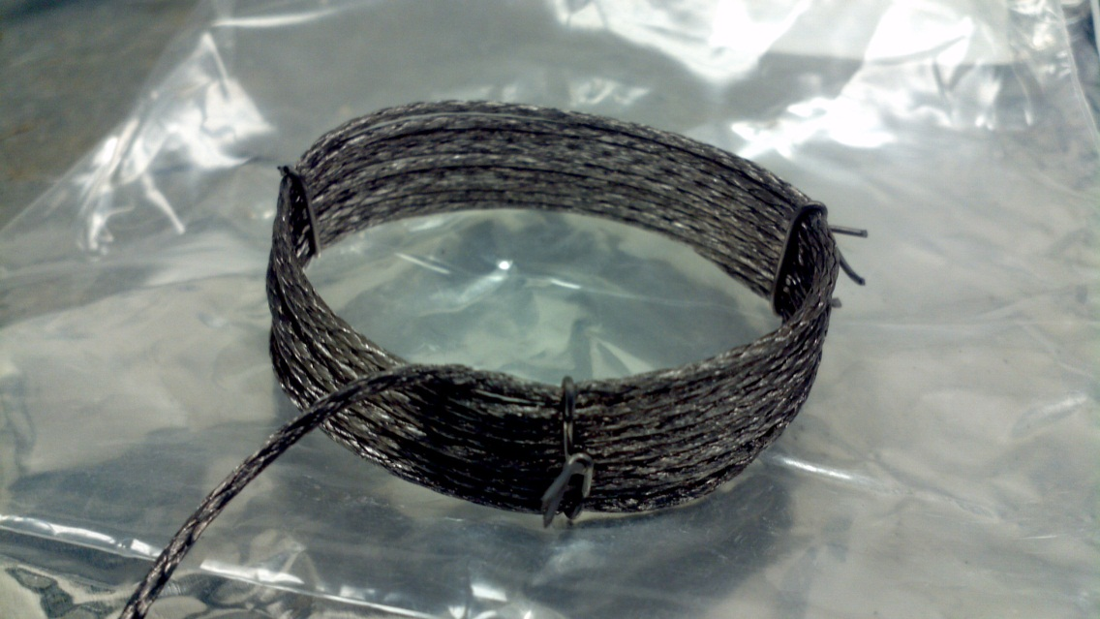



MoN_{x} ALD: Application - magnets ?
Cu/MoN(1000cy)/AlN(300cy) at 450°C : 200 wires/ 50 µm diameter
Copper magnet
2.5 cm
Conformal Deposition
  Multilayer SIS
J_{C EXP} ~ 10% de J_{D},
I_{MAX} ~ 260 A per layer at 2 K

Slide 20



Niobium Titanium (Nb_{1-x}Ti_{x}N) 2:1
(NbCl₅ + Zn + NH₃)_{N} + (TiCl₄ + Zn + NH₃)
-> ZnCl₂ (> 410 ⁰C)
N=2 (2:1 ratio)
XRR
XPS
Decrease temp:
lower density
more impurities ~ 2% Cl @ 350 ⁰C

Slide 21


Niobium Titanium (Nb_{1-x}Ti_{x}N) 2:1
450 ⁰C
350 ⁰C
Resistivity bulk ~ 250 μΩ.cm
Tc bulk ~ 7.8 K
Resistivity bulk ~ 630 μΩ.cm
Tc bulk ~ 4.5 K

Slide 22


Niobium Titanium (Nb_{1-x}Ti_{x}N) 2:1 with Zn
TEM
NbTiN
AlN
Si
Grain size ~ 30 nm
Cubic (200) and (111)
Resistivity bulk ~ 150 μΩ.cm
Tc bulk ~ 12.5 K

Slide 23




Nb_{1-x}Ti_{x}N: Superconducting T_{c}
Achieved superconducting T_{c}=14 K 4:1
  40% higher than previously reported value for ALD NbN
  [Hiltunen et al., Thin Solid Films 166, 149 (1988)]
T= 1.8K
Δ = 2.3 meV +- 0.1
41

Slide 24
Plasma enhanced ALD of NbN
(t-butylimido)tris(diethylamido) Nb(V) –TBTDEN Nb
H₂ plasma-300°C – GR ~ 0.4 Ǻ/Cy – Each Cycle ~ 4 mins
M. Sowa et al. Journal of Vacuum Science and Technol. A. 35, 01B143 (2017)

Slide 25


Controlled composition
TiCl₄/NbCl₅ Ratio ALD Cycles
Atomic control of Composition -> Tune Tc

Slide 26





ALD on Nb cavity - superconductors
Deposition at temp. > 250°C for10 hr to 48 hr on Nb metal require an UHV environment
Clean room(100)
HV Oven : 10⁻⁸T a 500 ⁰C
Automatic growth process
4 solid precuror lines HT (250°C)
1 precursor line UHT (500°C)
4 precursor lines gases/liquids
RGA analysis

Slide 27




ALD on Nb cavity - superconductors
ALD multilayer NbTiN(50 nm)/AlN(10 nm) 450°C – 10 hrs
NbTiN/AlN
ALD
E_{acc} [MV/m]
ALD multilayer MoN(80 nm)/AlN(10 nm) 450°C – 10 hrs
2 K
3.5K
MoN/AlN
E_{acc} [MV/m]

Slide 28
Summary
Tune Tc and transport properties by controlling film thickness
  Tune Tc and transport properties by controlling composition: Nb_{1-x}Ti_{x}N, TiN, MoN, NbSi, NbC, NbCN ...
  Growth temperature : lower Temp for High quality nitrides
  Fundamental interest for Quasi 2D limits + applications: Bolometers, High energy physics accelerators, magnets…
  Future work:
  MgB₂ (40K), FeSeTe (15K), K(FeSe)₂ (31K) etc… More cavity coating/Testing
  functionalizing top surface of Nb (normal metals W, Mo…)

Slide 29

THANKS !
Commissariat à l’énergie atomique et aux énergies alternatives
Centre de Saclay | 91191 Gif-sur-Yvette Cedex
Etablissement public à caractère industriel et commercial | R.C.S Paris B 775 685 019
Direction de la Recherche Fondamentale
Institut de recherche
sur les lois fondamentales de l’Univers
Service
Notes:
Saisir le champ « Service »

Slide 30
Synchrotron tools
Synchrotron techniques offer a suite of probes sensitive to atomic-scale structural and chemical information.
By applying synchrotron measurements in situ to study ALD processes, we can investigate the evolution of crystallinity, microstructure, morphology, and chemical composition in the crucial early stages of film growth.
Crystallinity
Microstructure
Morphology
Composition
ALD
ALD

Slide 31



ALD “Viscous Flow” Reactor
Elam, et al., Rev. Sci. Instrum. 73, 2981 (2002).

Slide 32


ALD on wheels
Remote operation, SPEC/EPICS trigger
3 high vapor pressure precursor channels
2 low vapor pressure precursor channels
Computer controlled flow/pneumatic valves
7 independent PID heater channels

Slide 33




ALD Reactor Modules
X-ray scattering module
grazing-incidence XRF/XAS module
Total transmission (in & out)
Advantages of Graphite
Non-toxic
High temperature
Easy to clean
10x less expensive than Be
Klug, et al., Rev. Scientific Instrum. 86, 113905 (2015).

Slide 34



MoN_{x} ALD: Application ?
TiN(7.5 nm)/MoN(50nm) at 450°C
SQUID

Slide 35




ALD on Nb cavity: Test
10 nm Al2O3 (90°C – 1 hr)
2 nm Al2O3 / 15 nm Nb2O5(250°C – 2 hr)
15 nm Al2O3(250°C – 2 hr) + 450 °C/20 hrs
Remplace Nb₂O₅ by another more stable oxide: l’Al₂O₃
Diffusion/decomposition of Nb₂O₅ into bulk Nb to create a
clean interface.

Slide 36









Hall measurement
MoN_{x} ALD: Hall effect vs. Thickness
Carrier concentration
$$k_{F}= {(3nπ^{2})}^{1/3}$$
$$V_{F}=\frac{l}{τ}$$
$$l= {\frac{k_{F}. ℏ}{(n e^{2} ρ)} }^{}$$
$$τ=\frac{l^{2}}{3 D}$$
Dirty limit: ξ > l
Transition:
Strong disorder k_{F}.l~1 to k_{F}.l >> 1
m_{eff} = 6.4 m_{e}
$$D={−4k_{B}\frac{{dT_{c}}/{dH}}{π e} }^{}$$
$$m_{eff}=m_{e}\frac{ℏ.k_{F}}{V_{F}}$$

Slide 37
Titre intercalaire

Slide 38

Nb_{1-x}Ti_{x}N: Superconducting T_{c}
Achieved superconducting T_{c}=14 K 4:1
  40% higher than previously reported value for ALD NbN
  [Hiltunen et al., Thin Solid Films 166, 149 (1988)]
T= 1.8K
50 nm NbTiN film
Δ = 2.3 meV +- 0.1

Slide 39
In situ X-ray reflectivity: ALD ZnO on Al₂O₃(0001)
Why ZnO?
Wide band-gap semiconductor with may uses (LEDs, TFTs, solar cells, etc.)
Epitaxial growth on α-Al₂O₃ is well established (even by ALD)
ALD ZnO
Well behaved, widely studied ALD chemistry
Low temperature process (<180 °C)
High volatility, liquid precursors ((C₅H₅)₂Zn and H₂O)
Previous in situ study on Si(001) (Fong APL 2010)
A good process to test a new instrument.

Slide 40



In situ X-ray reflectivity: ALD ZnO on Al₂O₃(0001)
Measurement details
Beamline: 33BM-C
Energy: 15.5 keV
Detector: PILATUS 100K
Measurement goal
Observe film structure and
morphology evolve during
epitaxial growth

Slide 41


In situ X-ray reflectivity: ALD ZnO on Al₂O₃(0001)
ALD parameters
Temperature: 150 °C
Pressure: 3 Torr
0.25s-30s-0.25s-30s
(DEZn-purge-H2O-purge)
Measurements
Low angle/1 cycle
Short L-scan/5 cycles
Full L-scan/10 cycles
Klug, et al., Rev. Sci. Instrum. (submitted).

Slide 42

ZnO/Al₂O₃(0001): Low angle X-ray reflectivity
Analysis of every 5th cycle
Transition at ~20 cycles
After 20 cycles:
  Linear 1.7 Å/cycle
  Density ~90% of P6₃mc
  Roughness ~8 Å
Before 20 cycles:
  Growth/cycle ~1 Å/cycle
  Rise in roughness (island
  nucleation – Fong, et al.)
  Non-monotonic change in density → change in either composition or structure
Klug, et al., Rev. Sci. Instrum. (submitted).

Slide 43

ZnO/Al₂O₃(0001): Low angle X-ray reflectivity
Additional complexity
Thickness ~c_{ZnO} for #2-7
Gradual increase in density,
roughness up to #6
Abrupt rise in density,
roughness at #7 followed by
onset of thickness change
Initial growth only on Al2O3,
c_{ZnO}
Klug, et al., Rev. Sci. Instrum. (submitted).
Notes:
This behavior suggests initial ZnO growth primarily on the Al2O3 surface, with the formation and gradual densification of a single unit cell of ZnO up to a critical density, which subsequently leads to an abrupt change in film density, morphology, and structure, as well as the onset of out-of-plane film growth. I like that “multilayer roughness”

Slide 44



ZnO/Al₂O₃(0001): High resolution X-ray reflectivity
Steady growth of ZnO(0002)
peak, thickness fringes
Film is crystalline, oriented
throughout deposition
(in contrast to Si(001)/Fong, et al.)
  Change in lattice constant is further evidence of evolution in composition/structure.
  Need to look at in-plane structure, morphology.
Klug, et al., Rev. Sci. Instrum. (submitted).
Notes:
The agreement between the thickness values extracted from XRR and CTR indicates that c-axis oriented, crystalline ZnO was deposited on Al2O3(0001) from the initial nucleation period onward, in
contrast to the findings of Fong et al., where no evidence of crystalline ZnO was observed within the first 45 A of deposition at 125 C on native oxide Si.

Slide 47
Notes:
Cliquez sur Insertion puis En-tête/Pied pour saisir les champs « Evènement – Date » et « Service » ; puis cliquer sur Appliquer partout.

