Slide 1
Dependence of flux trapping and flux penetration on various treatment
Shreyas Balachandran
Anatolii Polyanskii, Santosh Chetri, Mingmin Wang, Thomas R. Bieler, Pashupati Dhakal, David C. Larbalestier, Peter J. Lee

Slide 2
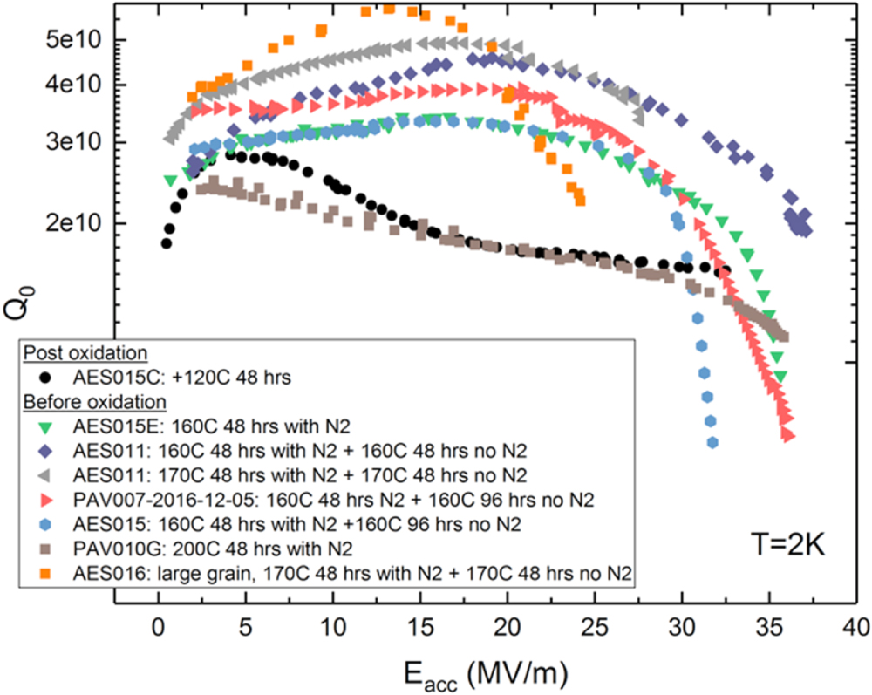

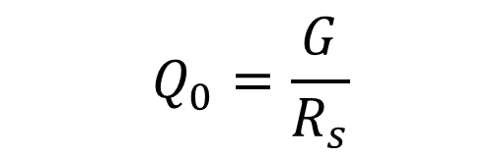
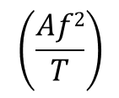
Background- SRF Nb cavities with High Q
$$Q_{0}=\frac{G}{R_{s}}$$
Performance of cavities is given by quality factor Q₀
Residual surface resistance (R_{s})
R_{s} = R_{BCS} + R_{i}
N infusion
$$\left(\frac{Af2}{T}\right)$$
$${e }_{}^{− Δ/kT}$$
Extrinsic Material properties (precipitates, microstructure etc) , trapped magnetic vortices
Baseline
A Grassellino et al 2017 Supercond. Sci. Technol. 30 094004

Slide 3
Trapped vortices increase Rs by several nΩ/mG during operation
Effects of trapped vortices can be reduced by:
Better magnetic shielding
Surface preparation, and reduction in lossy hydride precipitates (2000- present)
  Heat treatments and nitrogen doping reduce hydride precipitates.
Flux expulsion by gradient cooling through Tc (2014- present )
  Temperature gradient creates a thermal force which counteracts the pinning force of defects, and flux is expelled from the superconducting state.

Slide 4
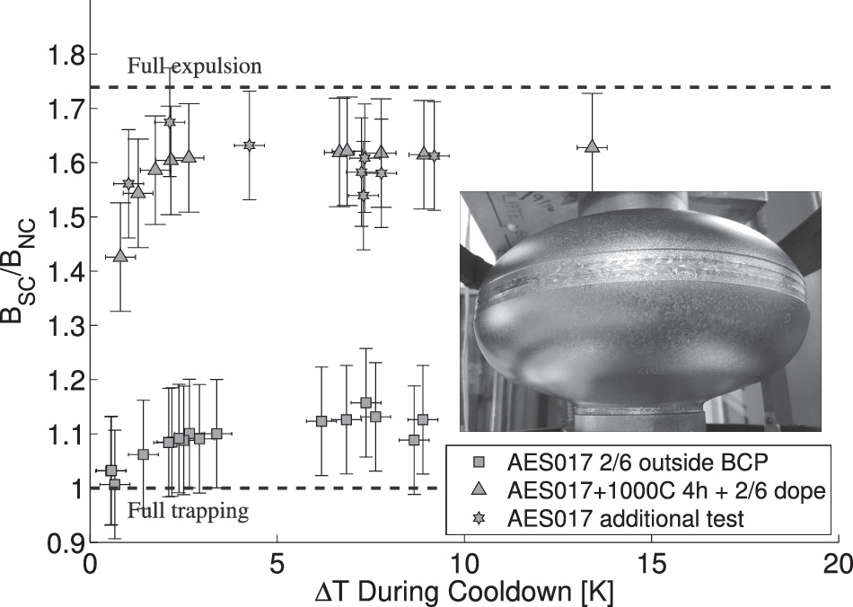
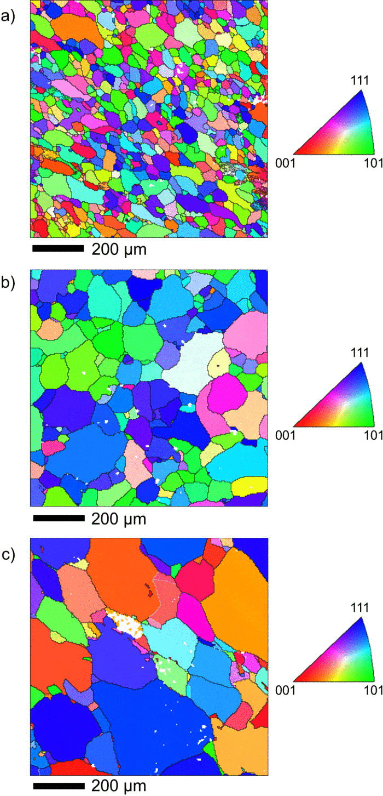
Flux expulsion behavior improves with 1000˚C/4h heat treatment
As received
1000 C/4h
Heat treatment at 900C/3h
Heat treatment at 1000C/3h
S. Posen; et.al Journal of Applied Physics 2016, 119,

Slide 5
Driving questions for our research
Do grain boundaries (GB’s) pin flux, and under what conditions?
Do slip bands and substructures (dislocation networks) affect flux penetration?
Can DC magnetization measurements on coupon samples be used to characterize flux trapping?

Slide 6
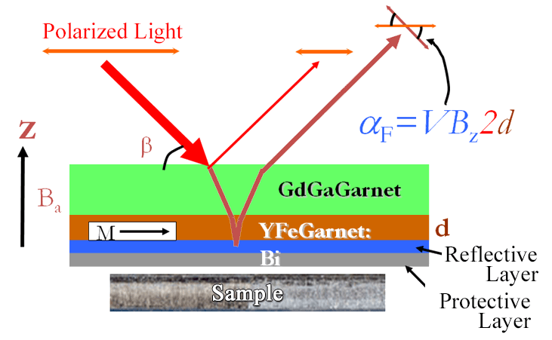
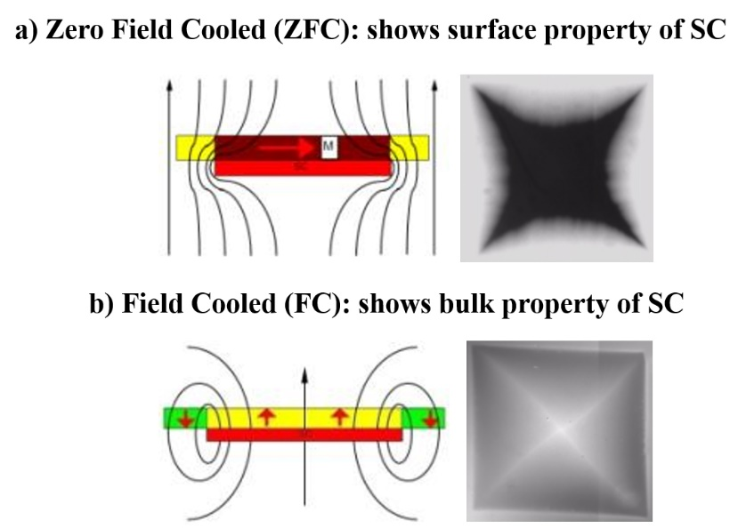
MO imaging- Qualitative understanding of flux behavior in SRF Nb
MOI Schematic and principle
Allows direct Imaging of Bz in plane above superconductor
Double Faraday effect occurs in reflective mode using Bi-doped YFe indicator film with in-plane magnetization
ZFC- Cooled in the absence of external fields to below T_{c}, at T< T_{c} visualized in an external magnetic field.
FC- Sample cooled below Tc in the presence of a magnetic field, and visualized after removing the external field
Notes:
Magneto optical (MO) imaging is a remarkable tool for viewing the local and global flux penetration into a superconductor. It uses the strong Faraday Effect in bismuth doped yttrium iron garnet (B-YIG) to measure the change of vertical magnetic field component above a superconducting sample using a standard polarized light microscope. The garnet imaging film is placed directly on the Nb so as to attain the highest possible sensitivity. The technique is able to resolve fields of the order of 1 mT with ~ 5–10 μm spatial resolution. A continuous flow cryostat is able to cool a sample down to ~5 K, and two external electromagnetic solenoids can apply vertical (H_{z}) and in-plane (H_{x}) fields up to ~ 120 mT to the sample.

Slide 7
Do grain boundaries (GB’s) pin flux, and under what conditions?

Slide 8
Sample description (GBNX9) and procedures flow chart
As received 3mm Ningxia bi-crystal sample, cut from LG sheet from MSU
800˚C/3h + 140C/48h- 25 mTorr Nitrogen infusion
Cool down cycle
MO1
OIM analysis
Below Nb Tc (9.2K)
MO imaging
Mechanical polishing, and 10 µm BCP at FSU
Below Nb Tc (9.2K)
Cool down cycle
Sample was BCP’ed at JLAB
MO imaging
MO2

Slide 9
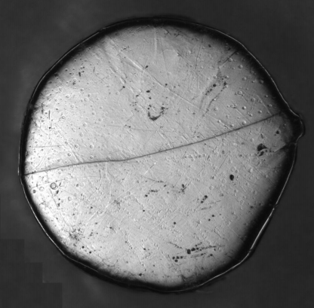
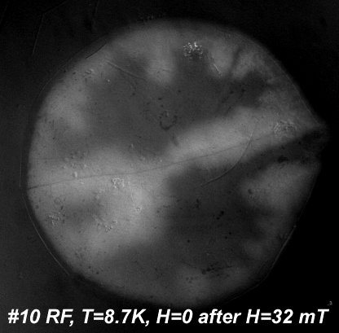
Magneto Optical Image(MO-1) of as received Nb disk after MP +10µm BCP
After BCP at room temperature
MO image, overlaid on optical image
GB oriented parallel to the applied field causes flux penetration (Polyanskii, et.al AIP Conf. Proc. 1352, 186-202 (2011)).
The fork in the sample was unexpected
GB
Flux trapped
GB
Flux trapped “fork”
3 mm diameter: EDM + BCP of as-received Ningxia sample
Applied field H points out of plane

Slide 10
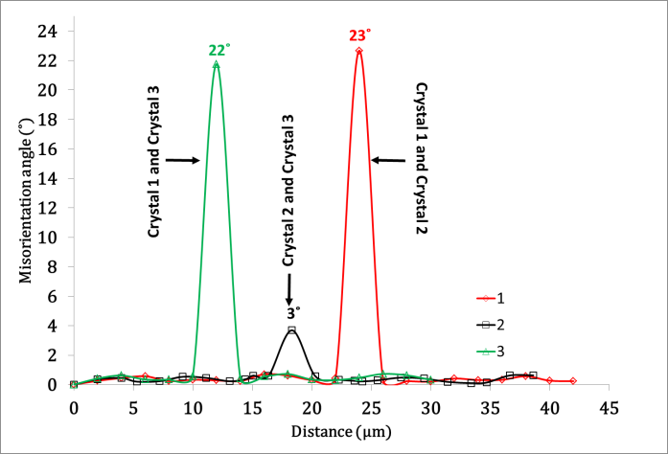
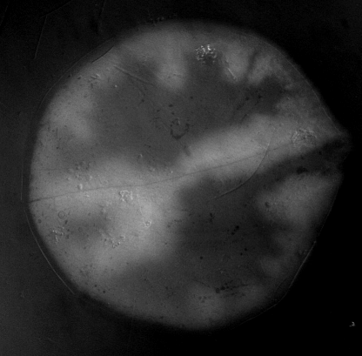

MO1: DC flux trapping can occur due to low angle boundaries in SRF Nb.
Crystal 1
Crystal 2
GB
GB
Hydride pits
Crystal 3
Misorientation measurements across boundaries indicates a low-angle boundary with a misorientation of 3 °
Identifying these boundaries is a challenge
RF, T = 8.7 K, H = 0, after H =32 mT
Hydride remains indicate excess hydrogen in the sample

Slide 11
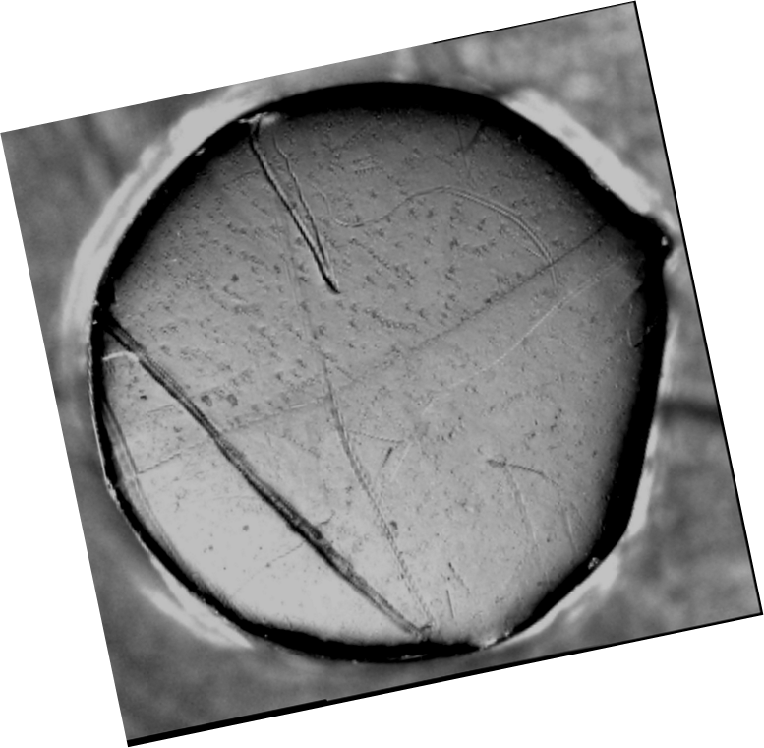
MO2 Flux trapping at GB’s no longer visible after 800˚C/3h + 140˚C/48h-25 mTorr N₂ infusion
After 800˚C/3h + 140⁰C/48h-25 mTorr N₂
MO image
GB
Scratch
Crystal 1
GB
GB
Crystal 2
RF, T = 6.4 K, H = 0, after H =22 mT
GB not distinguishable by MO after 800˚C/3h +140˚C N infusion heat treatment. No micron sized hydride pits

Slide 12
800˚C/3h + 140˚C/48h-25 mTorr N₂ heat treatment removes GB pinning
Summary of Observations:
GB, and LAGB are intact after 800˚C/3h + 140˚C/48h-25 mTorr N₂ infusion heat treatment.
Weak pinning observed after 800˚C/3h + 140˚C/48h-25 mTorr N₂ infusion heat treatment.
Questions:
Do contaminants contribute to GB pinning in SRF Nb?
Does a high temperature heat treatment lead to a cleaner GB?
  Lesser hydrogen, interstitial (O) redistribution?
GB
RF, T = 6.4 K, H = 0, after H =22 mT

Slide 13
1. Do slip bands and substructures (dislocation networks) affect flux penetration?

Slide 14
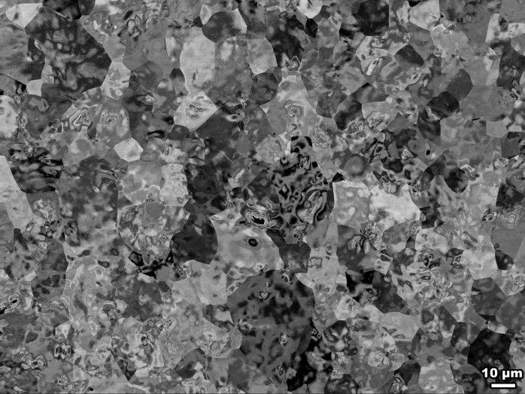
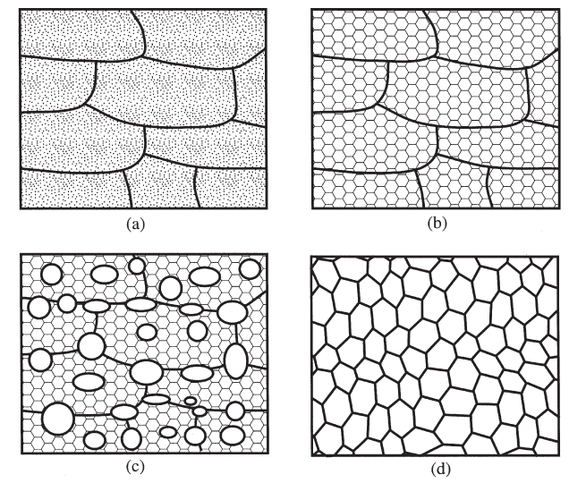
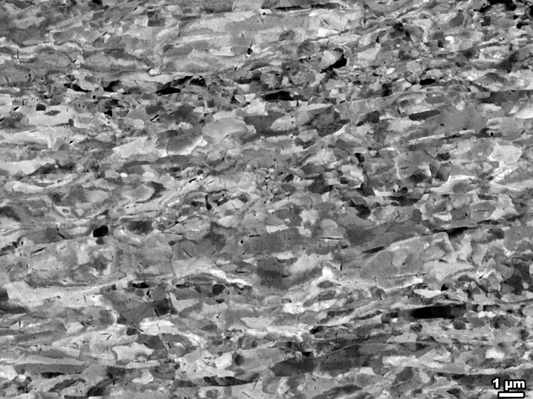
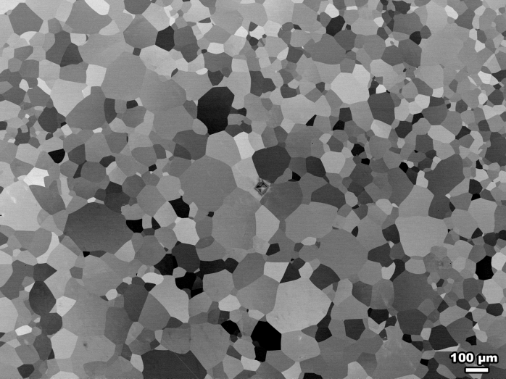
Example- Nb microstructure after deformation and heat treatment
Partial Recrystallization
600C/3h
800C/3h
Full Recrystallization
Heavily deformed Nb- Total Shear Strain of 5.6.
Equivalent Rolling thickness reduction (90%)

Slide 15
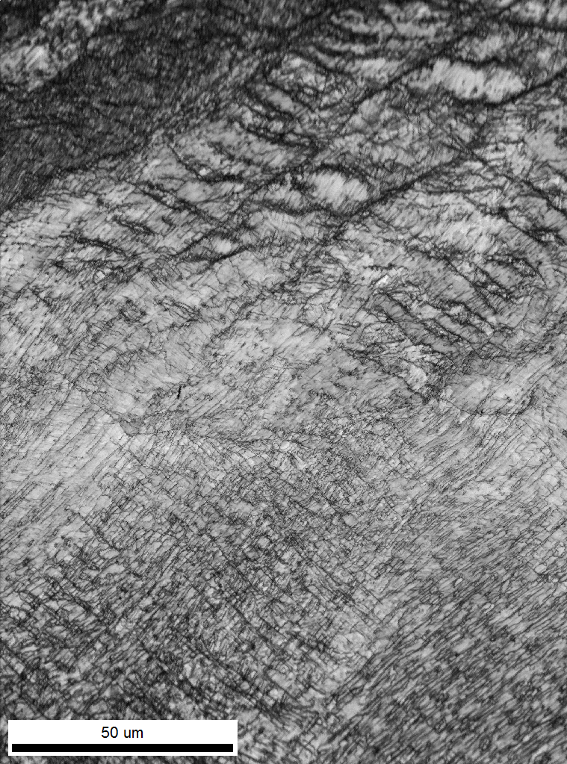
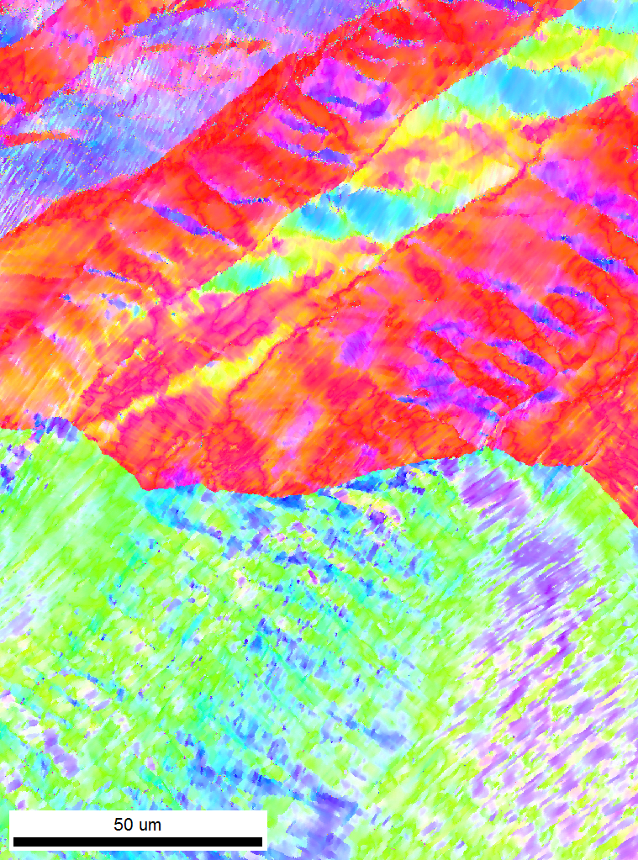
Preliminary MO result on shear-deformed Nb (RRR 130) bi-crystal. Do dislocation networks influence flux penetration?
Deformation features
Crystal 1
Crystal 1
Crystal 1
Crystal 1
GB
GB
Crystal 2
Crystal 2
Crystal 2
Crystal 2
Deformation features
5mm
ZFC, T=6.3K H=52 mT
ZFC, T=6.3K H=100 mT
ZFC, T=6.3K H=112 mT

Slide 16
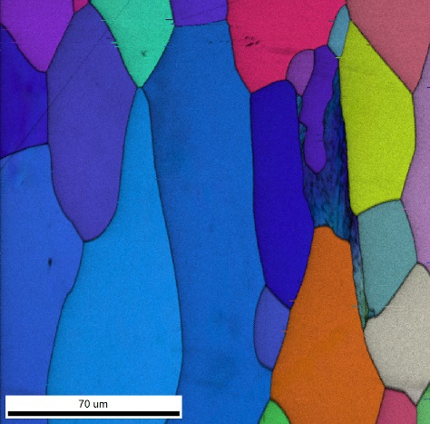
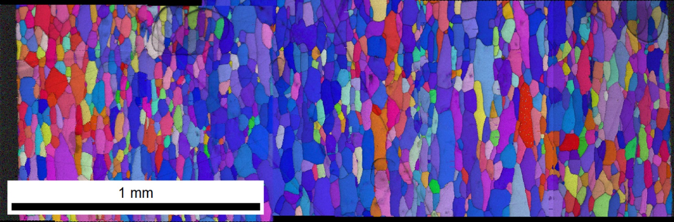
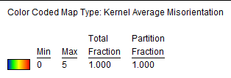
Why are dislocation substructures important? Unrecovered substructure occurs in as received Nb sheets used to fabricate cavities- Example Sheet id: 342104
~3mm
Cross-sectional OIM of sheet id: 342104, Vendor A for LCLS-II
Through thickness scan shows regions where the substructure is unrecovered even after a recrystallization heat treatment

Slide 17
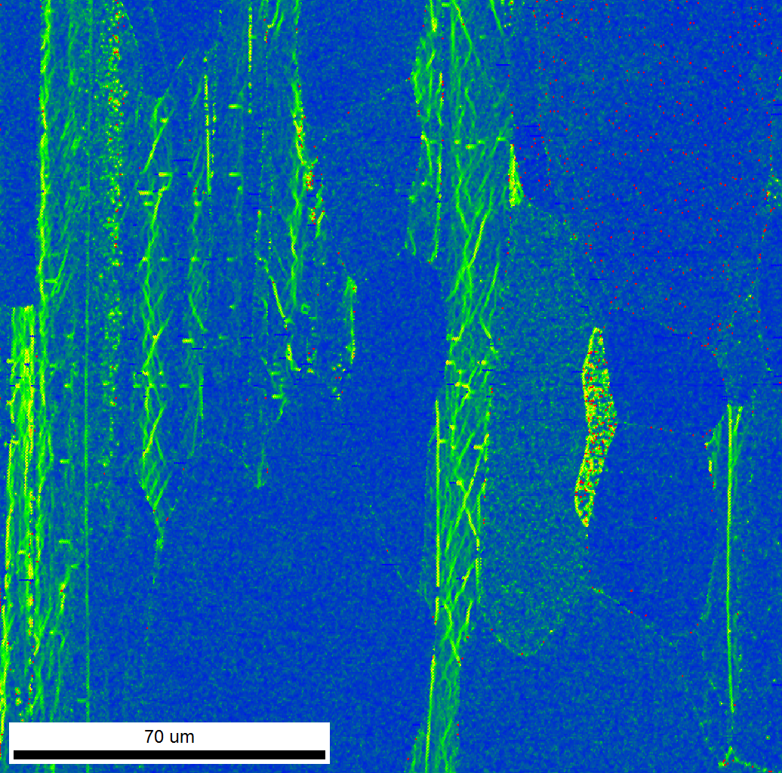
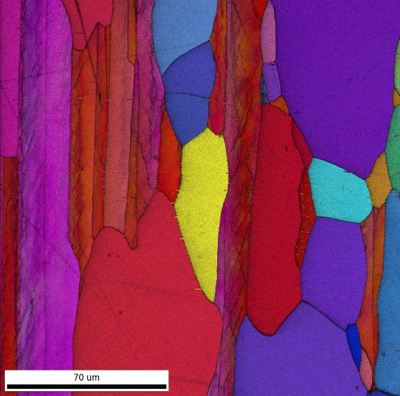
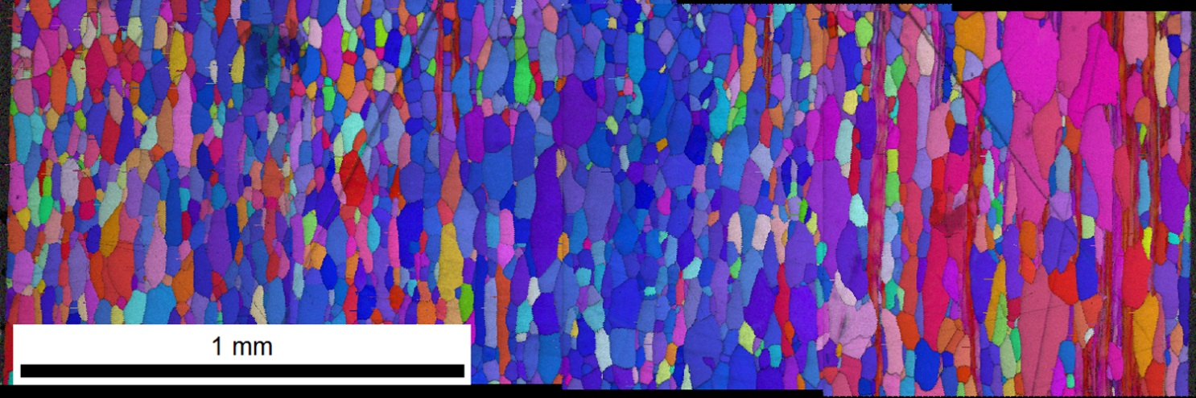
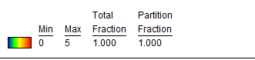
Dislocation substructures are also present in as received sheet id: T11007, Vendor B for LCLS-II.
~3mm
Unrecovered substructure
Cross-sectional OIM of sheet id: T11007
Vendor B for LCLS-II
Through thickness scan shows regions with substructure on near surface layers.

Slide 18
Can DC magnetization measurements on coupon samples be used to characterize flux trapping?

Slide 19
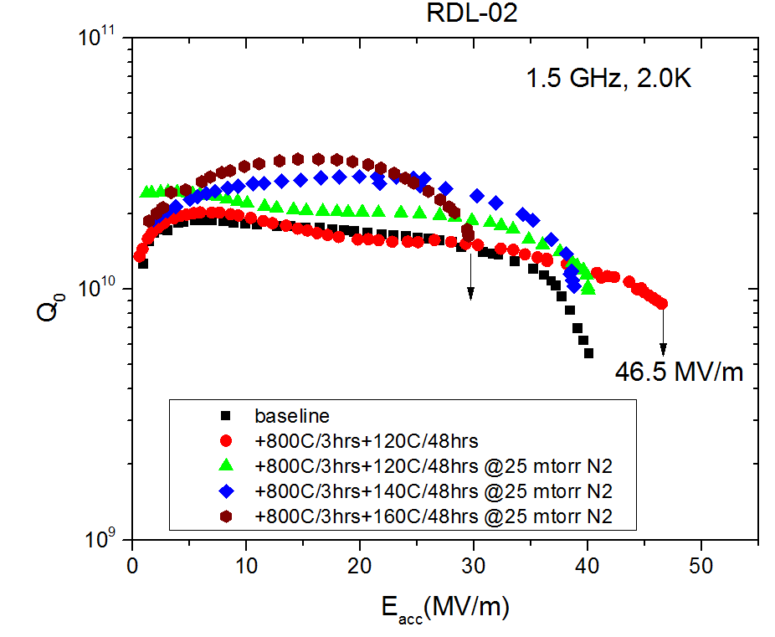
Flux trapping measurements on coupon samples from cavity replica material (JLAB)- Sample description
Test | Δ/k_{B}T_{c} | mfp (nm) | R_{res} (nΩ)
Baseline (ILC) | 1.82 ± 0.02 | 164 ± 27 | 2.2 ± 0.1
+120 °C/48h* | 1.86 ± 0.02 | 26 ± 7 | 4.6 ± 0.2
+800 °C/3h+ 120 °C/48h@25 mTorr N2 | 1.84 ± 0.02 | 28 ± 5 | 1.9 ± 0.1
+10 μm EP | 1.81 ± 0.02 | 164 ± 23 | 1.2 ± 0.1
+800 °C/3h+ 160 °C/48h@25 mTorr N2 | 1.80 ± 0.02 | 54 ± 14 | 1.0 ± 0.1
+10 μm EP | 1.79 ± 0.02 | 122 ± 16 | 0.5 ± 0.1
+800 °C/3h+ 140 °C/48h@25 mTorr N2 | 1.80 ± 0.02 | 26 ± 87 | 0.9 ± 0.1
Cavity performance
3 mm
Φ1 mm
3 mm
Coupon samples also underwent the recipes shown and the same color-scheme will identify the HT
Dhakal. P, et.al,
https://arxiv.org/abs/1711.03991
No post chemistry after each furnace treatment.

Slide 20
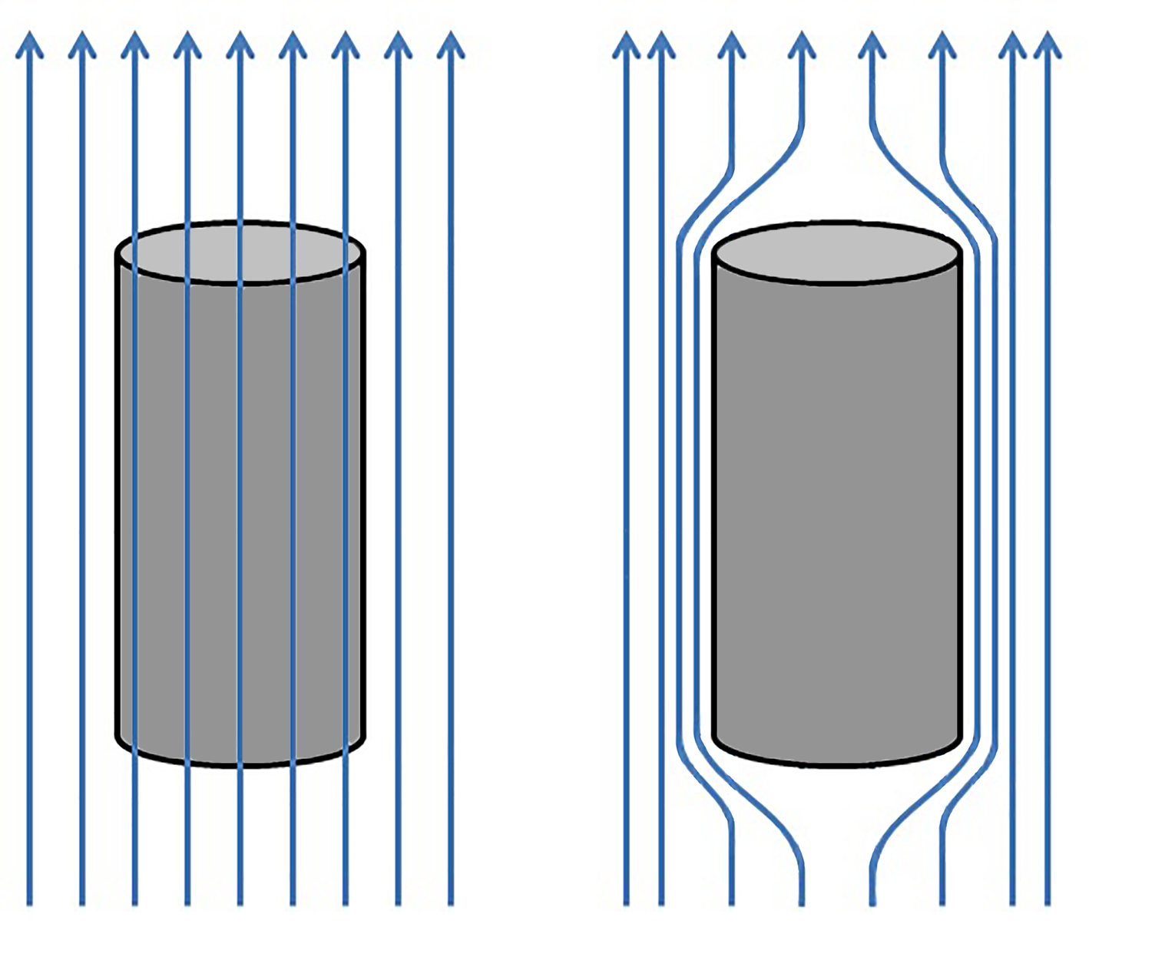
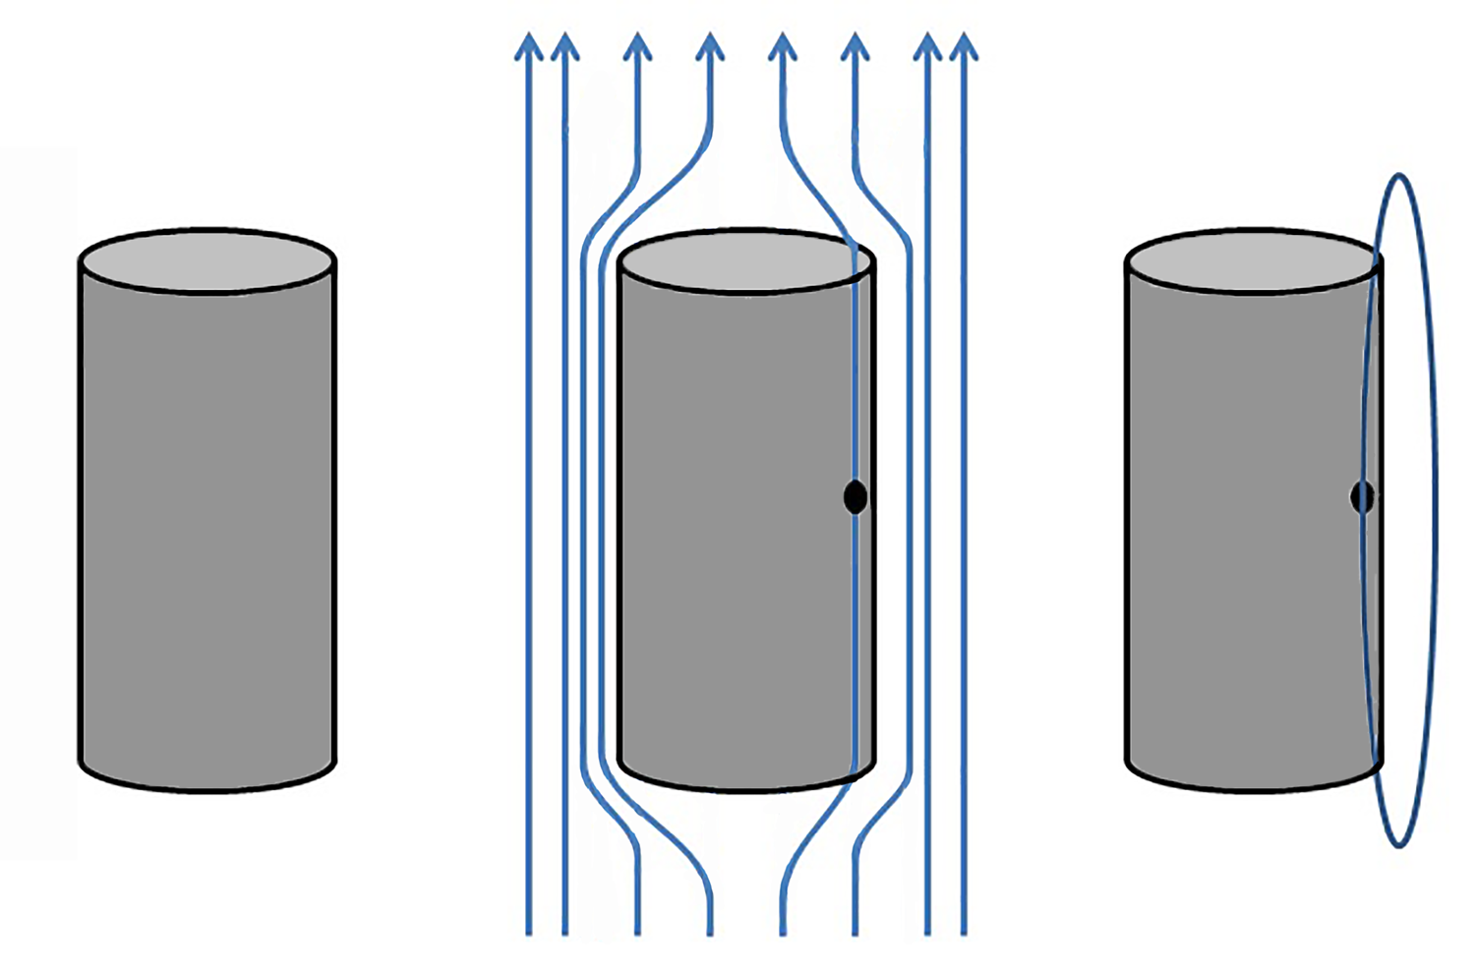
Coupon Flux Trapping: Magnetization measurements
The samples were field cooled (1 mT) to below T_{c} (8.5 K) of Nb. Cooling rate: 5 K/min. Then the field was removed
1 mm diam.
3 mm long
Nb cylinders
M = 0
T = 12 K >9.2 K(T_{c})
B_{ext}= 1 mT
T=8.5 K< 9.2 K(T_{c})
B_{ext} = 1 mT
T=8.5 K< 9.2 K(T_{c})
B_{ext} = 0 mT
Any magnetization observed under this condition is due to the trapped flux
Flux Trapping
  M ≠ 0

Slide 21
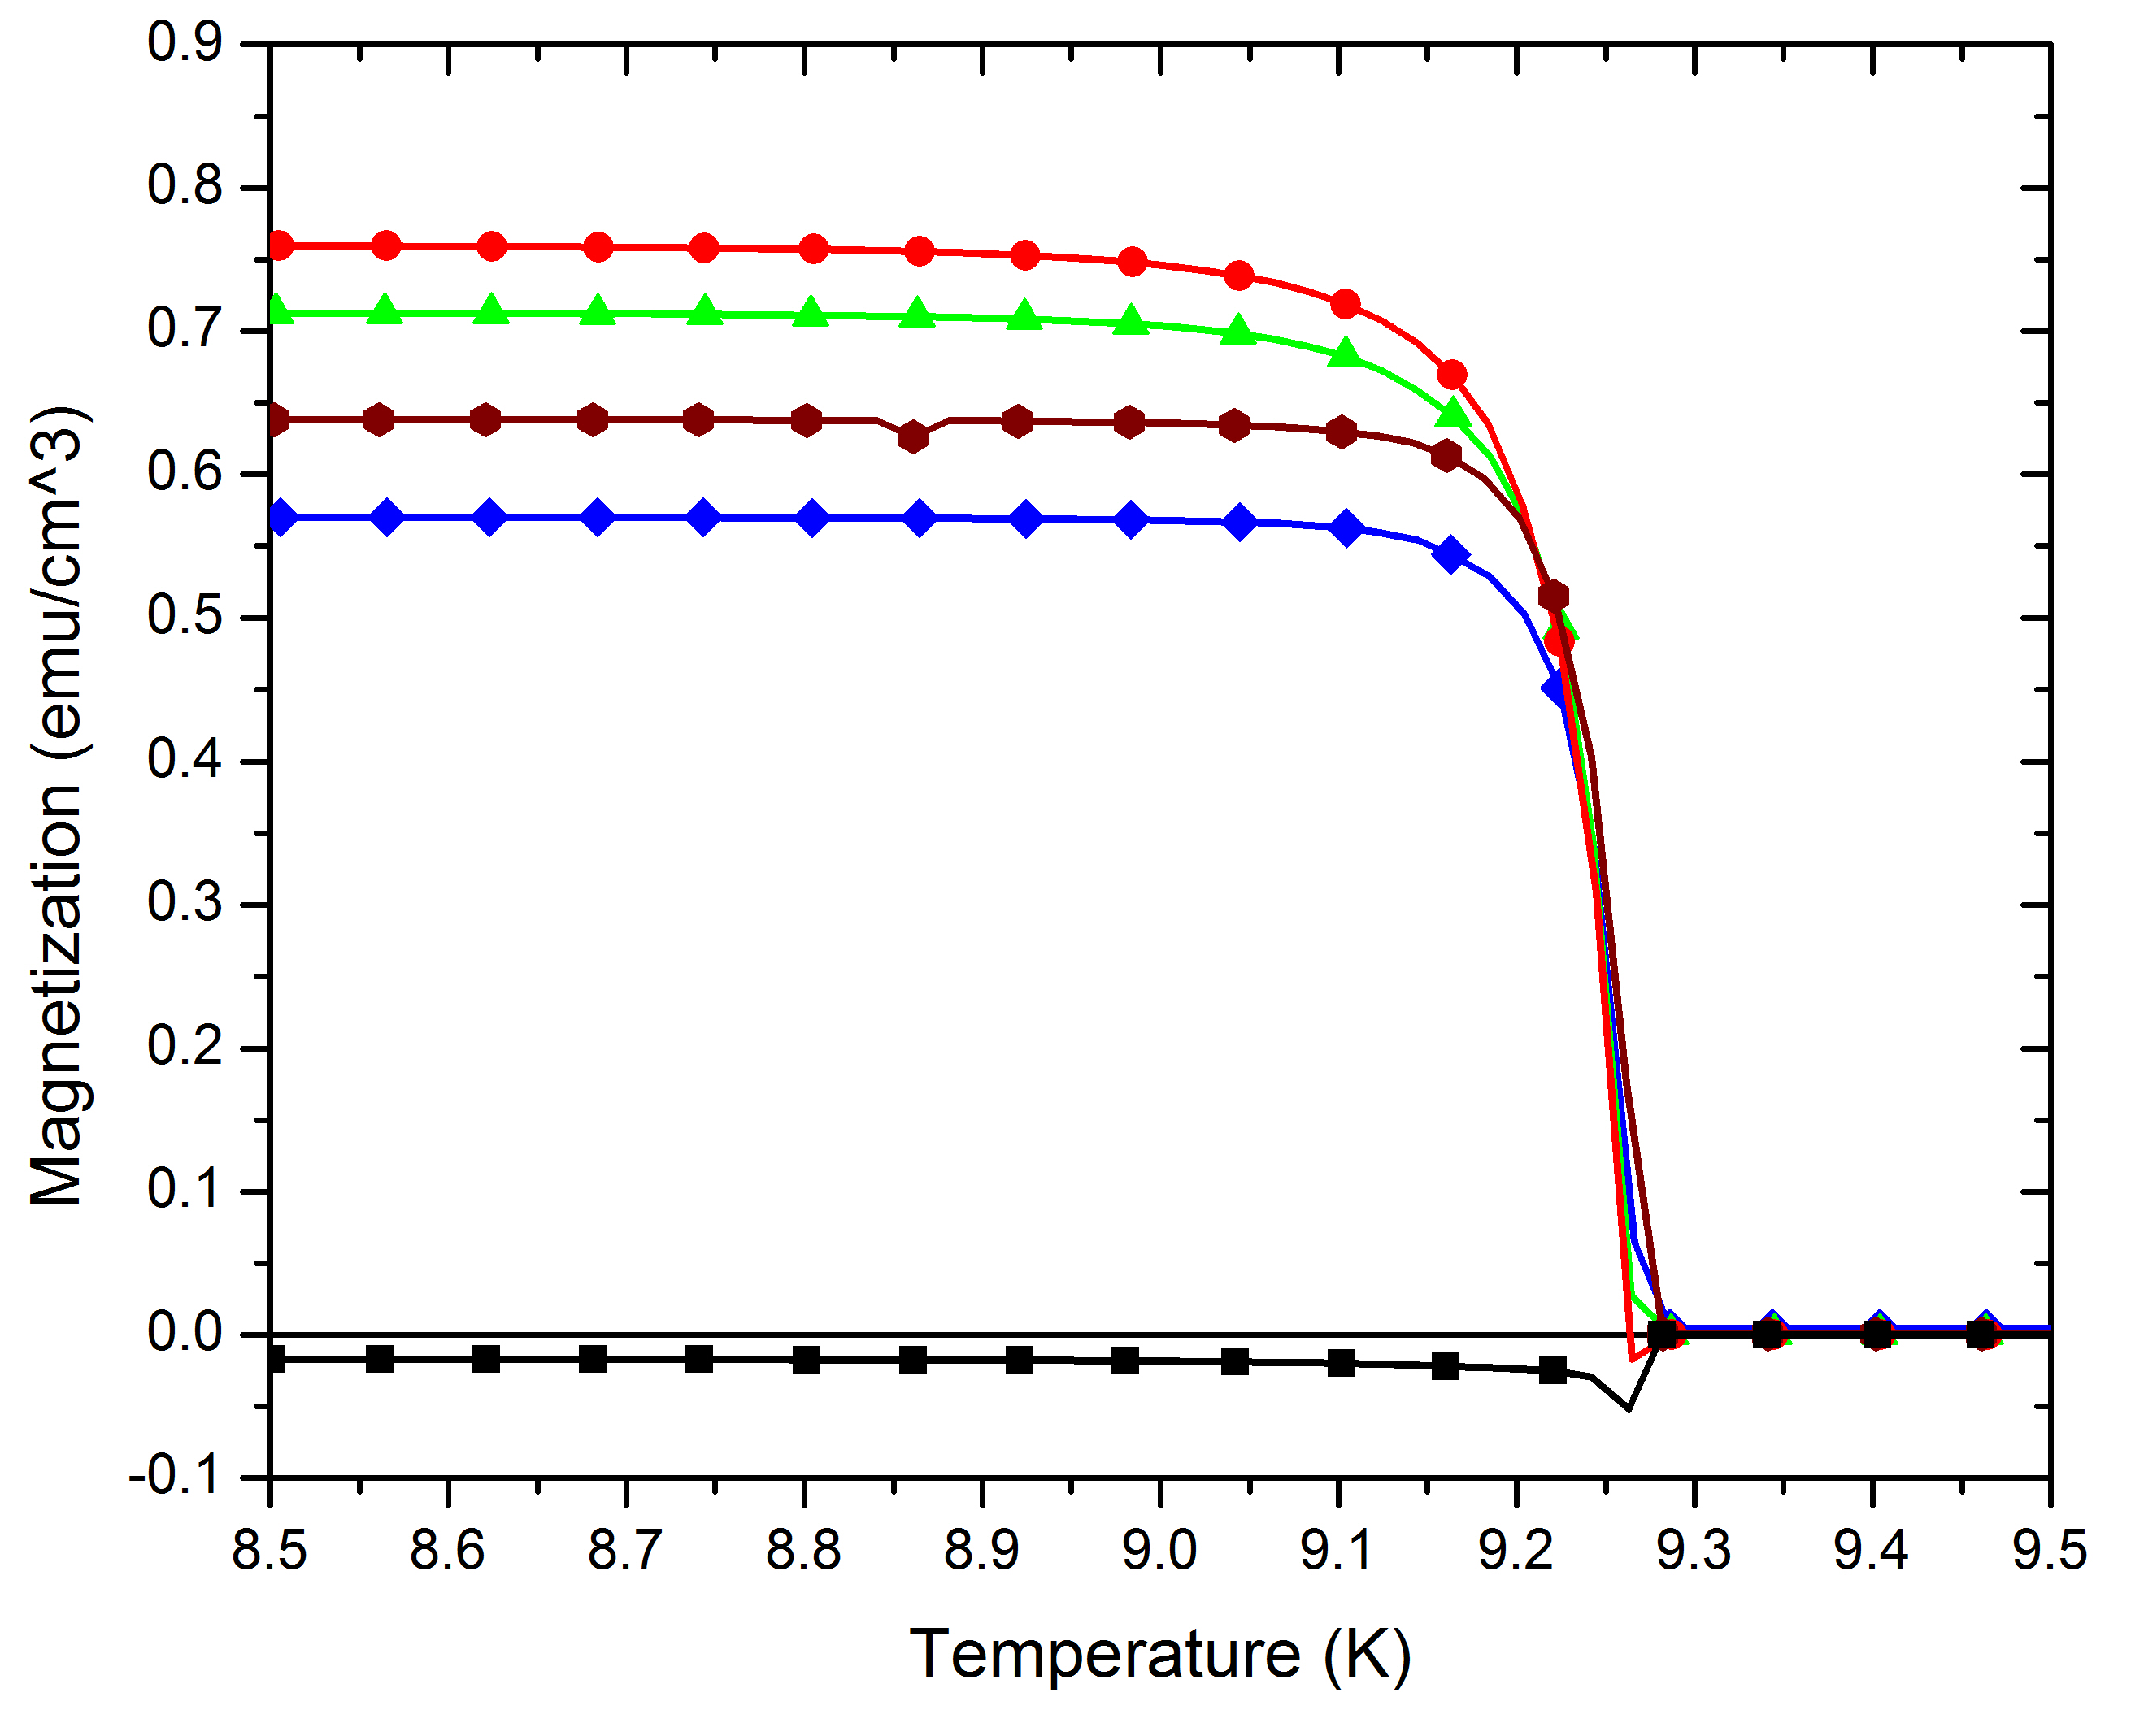
Result: Variations observed in flux expulsion observed with different treatments
800°C/3h+120°C/48h
No DC flux trapping in 800 °C/3h coupon cylinder
Among N infusion samples, low flux trapping was observed in 140 °C/48h+N infused sample
800 °C/3h+N₂ 120 °C/48h
800 °C/3h+N₂ 160 °C/48h
800 °C/3h+N₂ 140 °C/48h
Warming
800˚C/3h

Slide 22
Summary and Discussion Questions
MO imaging indicates that flux trapping behavior is enhanced after mechanical polishing and BCP. After, 800˚C/3h + N infusion heat treatment, the bulk pinning is low.
  Is contamination or normal precipitates at and around GB’s responsible for trapping behavior?
Systematic studies on recovery and recrystallization of deformed Nb bi-crystal is on-going.
  Preliminary results indicate deformation structures could influence flux penetration.
As received sheets from Vendor A, and Vendor B for LCLS-II cavities show presence of dislocation networks and substructure.
  How important are dislocation networks, substructures in final cavity material?
  Is incomplete recrystallization a symptom of residual interstitials?
  Influence of local chemistry on recovery and recrystallization needs evaluation..
Coupon studies could be an option to evaluate flux trapping behavior in SRF Nb.
What bulk properties are relevant for Nb specifications for for High Q and High Gradient material?

Slide 23



Acknowledgements
Thank you!
This material is based upon work supported by the U.S. Department of Energy, Office of Science, Office of High Energy Physics under Award Numbers # DE-SC 0009960 (FSU) and DE-FG02-09ER41638 (MSU) and the State of Florida. Additional support for the National High Magnetic Field Laboratory facilities is from the NSF: NSF-DMR-1157490. We also thank Chris Compton at FRIB for providing a large grain Nb slice used for some of this work

Slide 24
EXTRAS

Slide 25
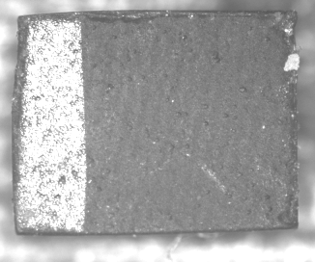
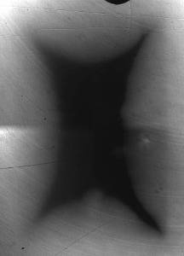
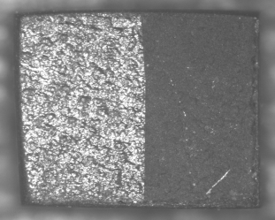
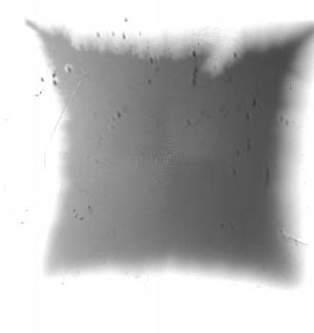
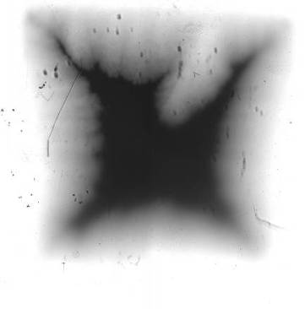
GB and flux penetration- Angular dependence with applied field (H) in SRF grade Nb
GB trace
GB plane normal (n)
H
H
MO indicator
MO indicator
n
n
ZFC , T = 6.4 K
GB trace
ZFC, T= 8.1 K, H = 80 mT,
H = 80 mT
H = 112 mT
H●n ≠ 0
H●n ~ 0

Slide 26
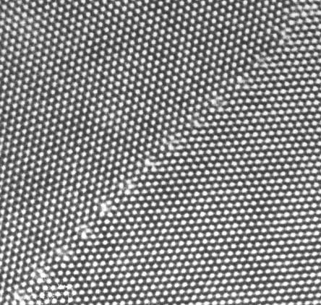
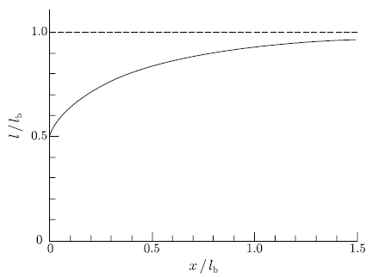
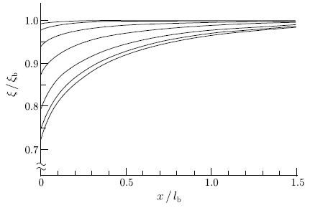
Literature- Grain boundaries as pinning centers.
Zerweck (1981)- Pinning by GB takes place through the electron scattering mechanism.
Electron mean free path (m.f.p) decreases near the GB, and the coherence length (ξ) becomes shorter.
Crystal 1
α=0.01
α=10
α- Impurity parameter
Crystal 2
m.f.p
Distortions only exist on an atomic scale around GB’s
Distance from boundary
Distance from boundary
Image:
http://wwwhrem.msm.cam.ac.uk/gallery/pics/allarge.jpg
Variation in the electron mean free path with the distance from the boundary [Zerweck,1981].
Ref: Fig 6.10. T. Matsushita, Flux Pinning in Superconductors
Variation in the coherence length with the distance from the boundary [Zerweck,1981].
Ref: Fig 6.11, T. Matsushita, Flux Pinning in Superconductors

Slide 27
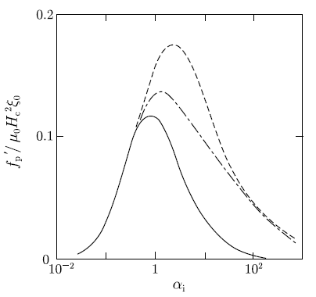
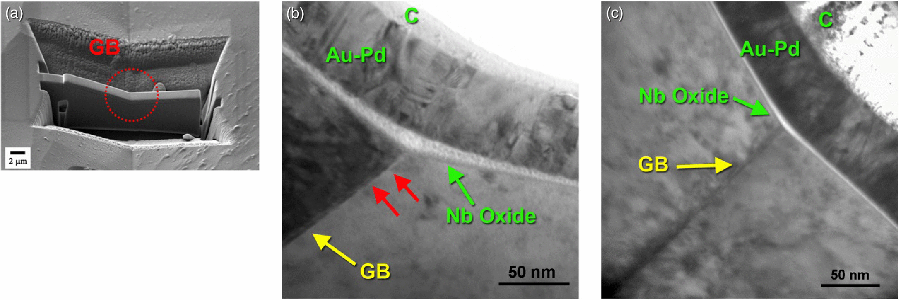
Literature- Pinning force at Grain boundary
Pinning at the GB is attributed to change in the coherence length.
  Could lead to Hc2 enhancement
d = 1.5ξ
Impurity parameter α, is an introduced parameter.
Impurities can be present at GB’s in Nb.
Boundary thickness
Example: GB in SRF Nb can be easily contaminated by a nonsuperconducting phase produced during the chemical treatment.
d = 0
Dependence of the elementary pinning force (per unit length of the flux line) of the grain boundary on the impurity parameter (after Welch (1985)).
Z.Sung et.al, IEEE Trans, 2014
Diffusion of interstitials can occur at a faster rate along GB’s

Slide 28
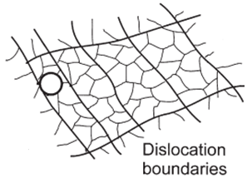
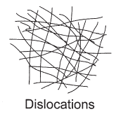
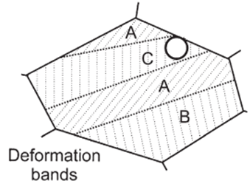
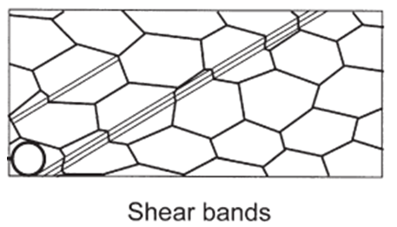
Background- Polycrystalline deformation structures.
10’s of nm
100-1000 nm
Common features in metals deforming where slip (multiple) is the major deformation mechanism.
Nb deforms by multiple slip
mm
10-100 µm
Adapted from Fig 2.8, Humphery, and Hatherly, Recrystallization and Related Annealing Phenomenon, Second Edition

Slide 29

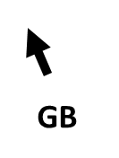
Background- Annealing of Polycrystalline deformation structures- Heat treatment effects
New nuclei
Recovered dislocation structure in grain
Deformation in grain
GB
Deformed state
Partial Recrystallization
Recovery
Full Recrystallization
New GB
Adapted from Fig 1.1, Humphery, and Hatherly, Recrystallization and Related Annealing Phenomenon, Second Edition

