Slide 1
Theoretical Models of Flux Expulsion and Dissipation
Mattia Checchin
15 Nov 2017
TTC Topical Workshop, FNAL

Slide 2
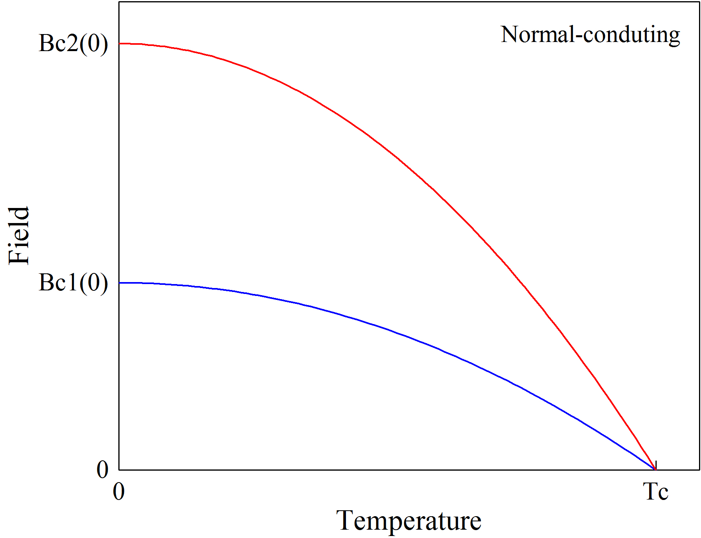
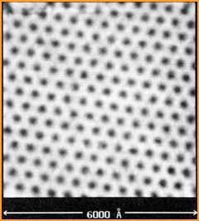

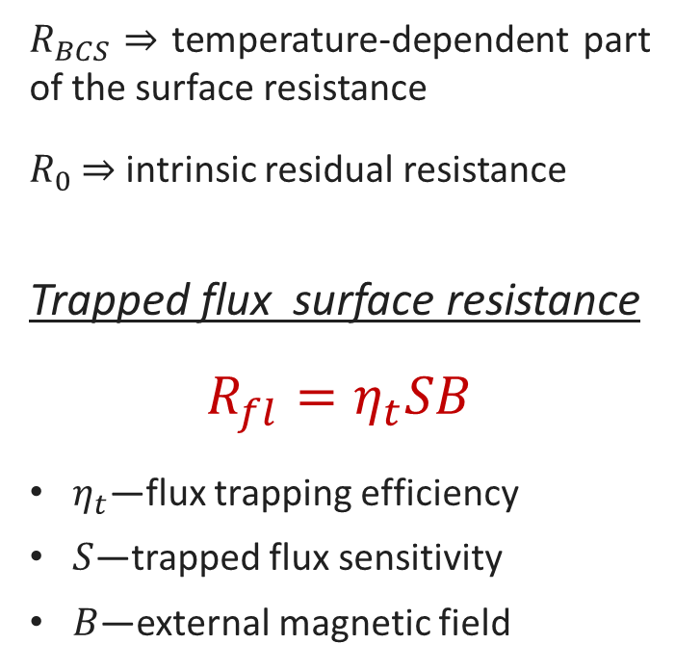





Trapped flux surface resistance
H. F. Hess et al., Phys. Rev. Lett. 62, 214 (1989)
$$R_{s}\left(T, B\right)=R_{BCS}\left(T\right)+R_{fl}\left(B\right)+R_{0}$$
$R_{BCS}$ ⇒ temperature-dependent part of the surface resistance
$R_{0}$ ⇒ intrinsic residual resistance
Trapped flux surface resistance
$$R_{fl}=η_{t}SB$$
$η_{t}$—flux trapping efficiency
$S$—trapped flux sensitivity
$B$—external magnetic field
$$B$$
Cooldown
$$y$$
Pinning points
$$T_{c_{1}}$$
$$T_{c_{2}}$$
$$x$$
Trapped vortices

Slide 3

Flux Trapping Efficiency
—$η_{t}$—

Slide 4
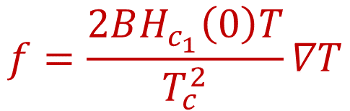
Thermodynamic force during cooldown
The Gibbs free energy density defines the stability of vortices in the SC:
$$g(H)$$
Meissner State
Mixed
State
$$g=B(H_{c_{1}}(T)−H)$$
$$0$$
$$H$$
$$H_{c_{1}}(T)$$
We can define the thermodynamic force acting on the vortex as:
$$f=−\frac{∂g}{∂x}=−\frac{∂g}{∂T}\frac{∂T}{∂x}$$
$$y$$
$$g(x)$$
$$f$$
$$f$$
$$f=\frac{2BH_{c_{1}}\left(0\right)T}{T_{c}^{2}}∇T$$
Meissner State
Mixed State
$$x$$
$$T_{c_{1}}$$

Slide 5

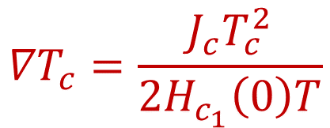
Critical thermal gradient for expulsion
The pinning force acting against the expulsion is defined in terms of critical current density $J_{c}$:
$$f_{p}=\left|{ \overline{J}}_{c}×n{\overline{Φ}}_{0}\right|=J_{c}B$$
The minimum thermal gradient needed to expel vortices is the critical thermal gradient ${∇T}_{c}$ :
Pinning point
$$y$$
$$g(x)$$
$${∇T}_{c}=\frac{J_{c}T_{c}^{2}}{2H_{c_{1}}\left(0\right)T}$$
$$f_{p}$$
$$f$$
Meissner State
Mixed State
$$x$$
$${∇T}_{c}∝J_{c}∝f_{p}$$
$$T_{c_{1}}$$

Slide 6
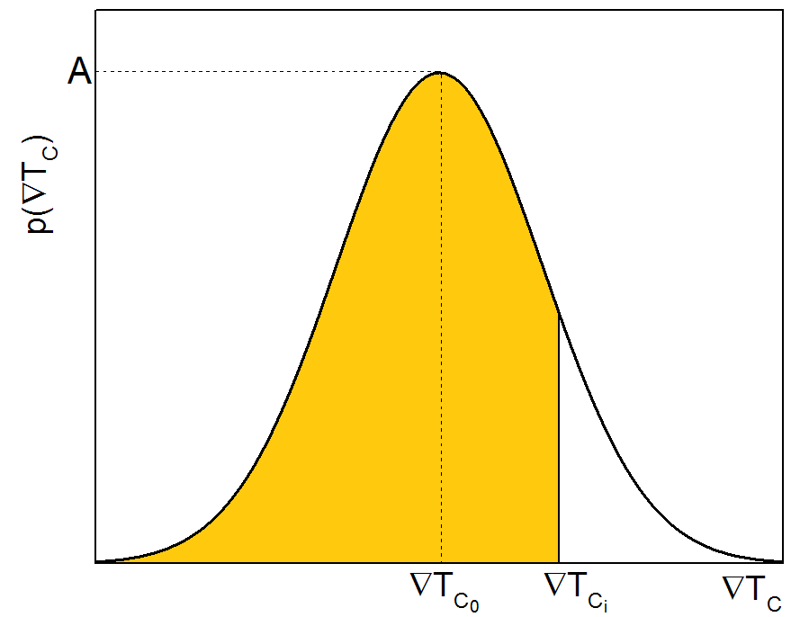

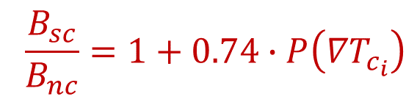
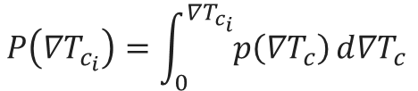

Statistical definition of trapping efficiency
The probability of expelling vortices with the thermal gradient ${∇T}_{c_{i}}$ is $P\left({∇T}_{c_{i}}\right)$
The trapping efficiency $η_{t}$ is function of ${∇T}_{c_{i}}$:
The trapped field is then:
$$P\left({∇T}_{c_{i}}\right)$$
$$η_{t}$$
$$η_{t}=\left[1−P\left({∇T}_{c_{i}}\right)\right]$$
$$P\left({∇T}_{c_{i}}\right)=\int_{0}^{{∇T}_{c_{i}}}{p\left({∇T}_{c}\right)}d{∇T}_{c }$$
For TESLA shape
$$\frac{B_{sc}}{B_{nc}}=1+0.74∙P\left({∇T}_{c_{i}}\right)$$
$$B_{t}=η_{t}B=B\left[1−P\left({∇T}_{c_{i}}\right)\right]$$

Slide 7
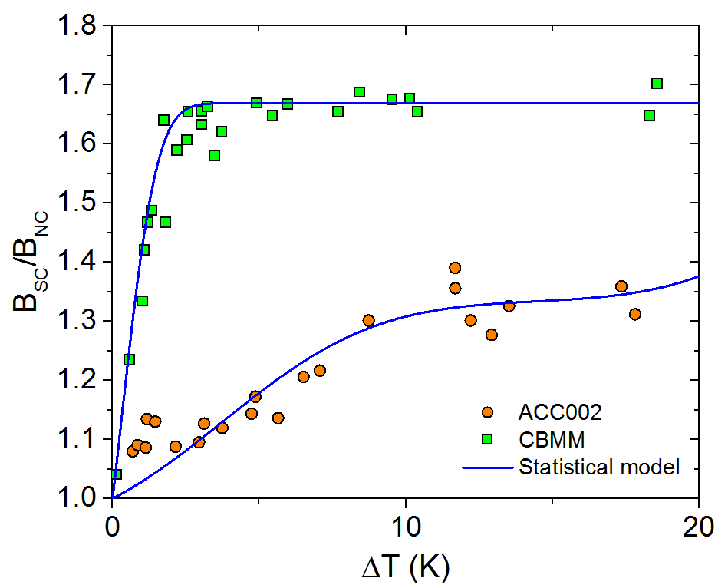
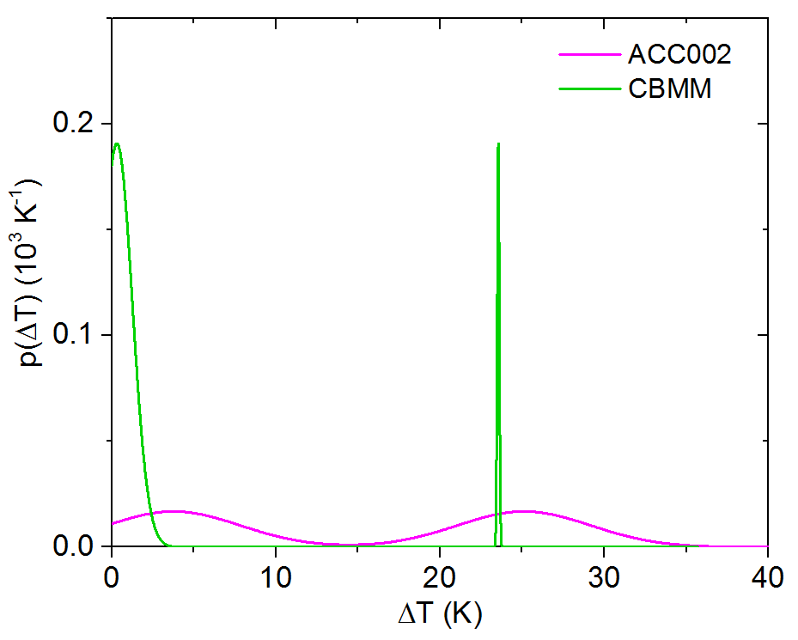
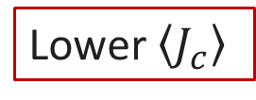
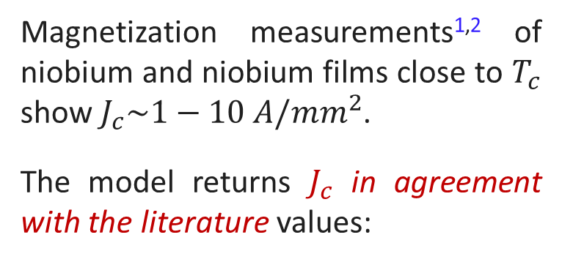
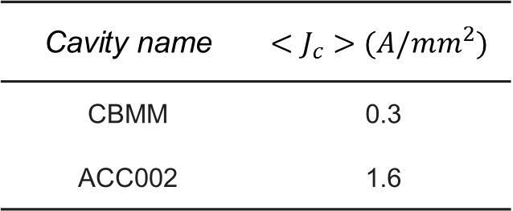
Comparison with experimental data
Magnetization measurements^{1,2} of niobium and niobium films close to $T_{c}$ show $J_{c}\sim 1−10 A/{mm}^{2}$.
The model returns $J_{c}$ in agreement with the literature values:
Lower $\left\langle J_{c}\right\rangle$
Cavity name | $$<J_{c}>(A/{mm}^{2})$$
CBMM | 0.3
ACC002 | 1.6
M. Martinello, M. Checchin et al., to be published
S. Posen et al., J. Appl. Phys. 119, 213903 (2016)
¹ G. Park, C. E. Cunningham and B. Cabrera, Phys. Rev. Lett. 68, 12 (1992)
² L. H. Allen and J. H. Claassen, Phys. Rev. B 39, 4 (1989)

Slide 8

Trapped Flux Sensitivity
—$S$—

Slide 9
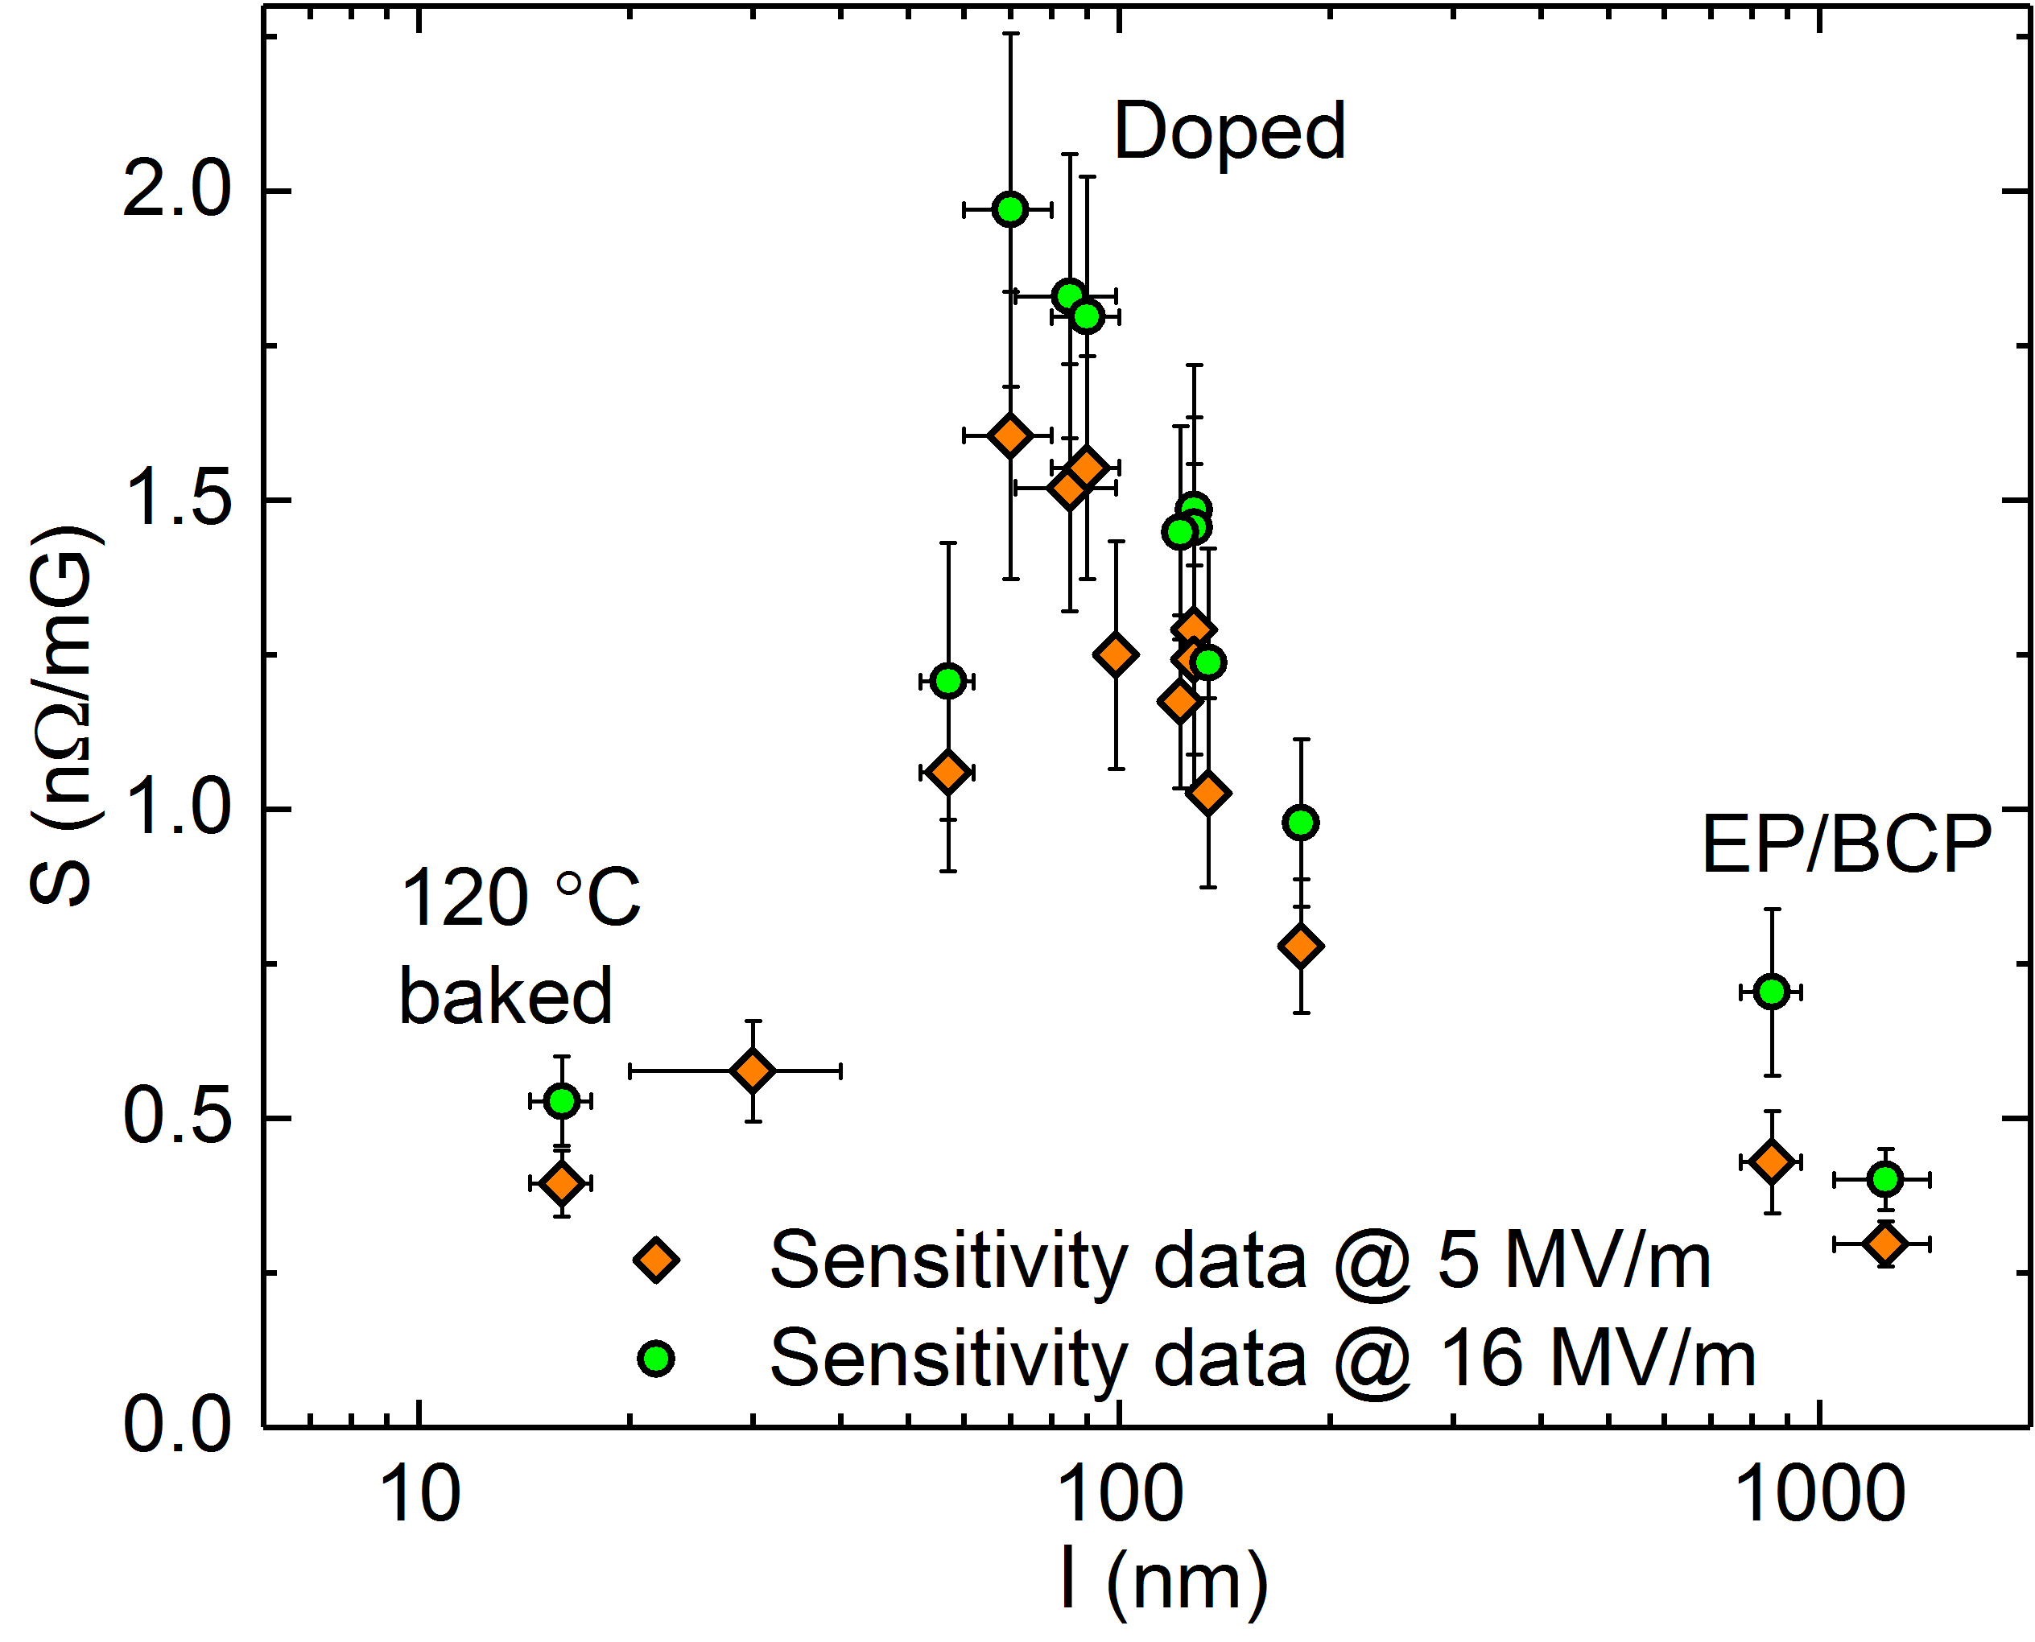
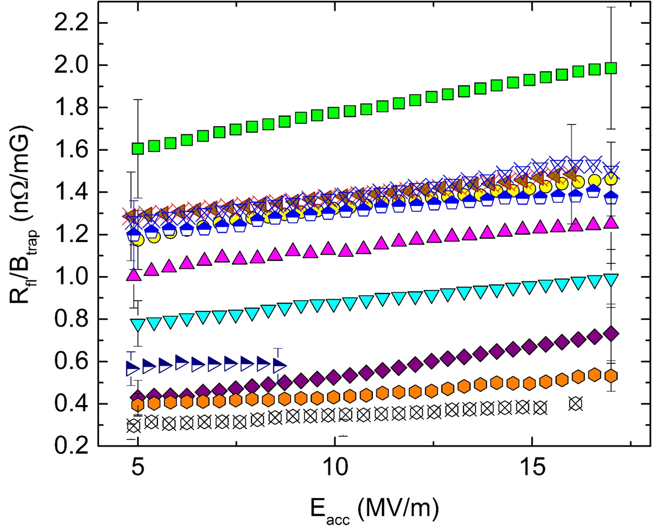
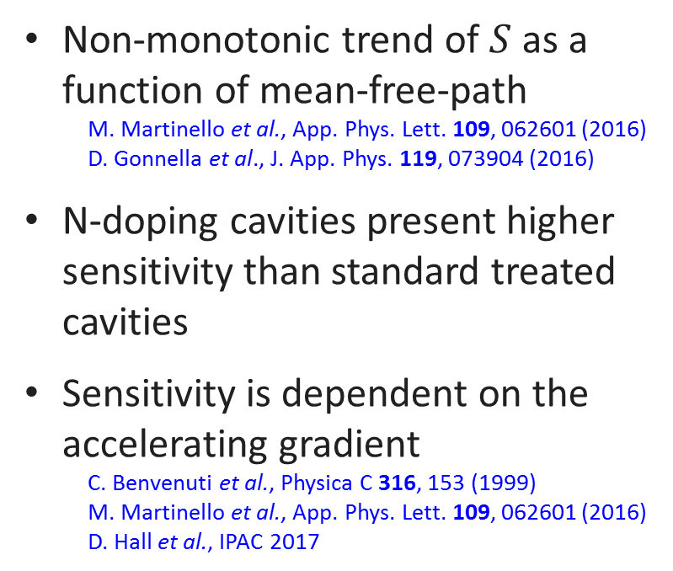
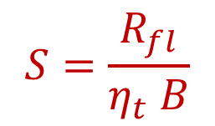
Trapped flux sensitivity at 1.3 GHz
Trapped flux sensitivity:
$$S=\frac{R_{fl}}{η_{t} B}$$
Non-monotonic trend of $S$ as a function of mean-free-path
  M. Martinello et al., App. Phys. Lett. 109, 062601 (2016)
  D. Gonnella et al., J. App. Phys. 119, 073904 (2016)
N-doping cavities present higher sensitivity than standard treated cavities
Sensitivity is dependent on the accelerating gradient
  C. Benvenuti et al., Physica C 316, 153 (1999)
  M. Martinello et al., App. Phys. Lett. 109, 062601 (2016)
  D. Hall et al., IPAC 2017

Slide 10
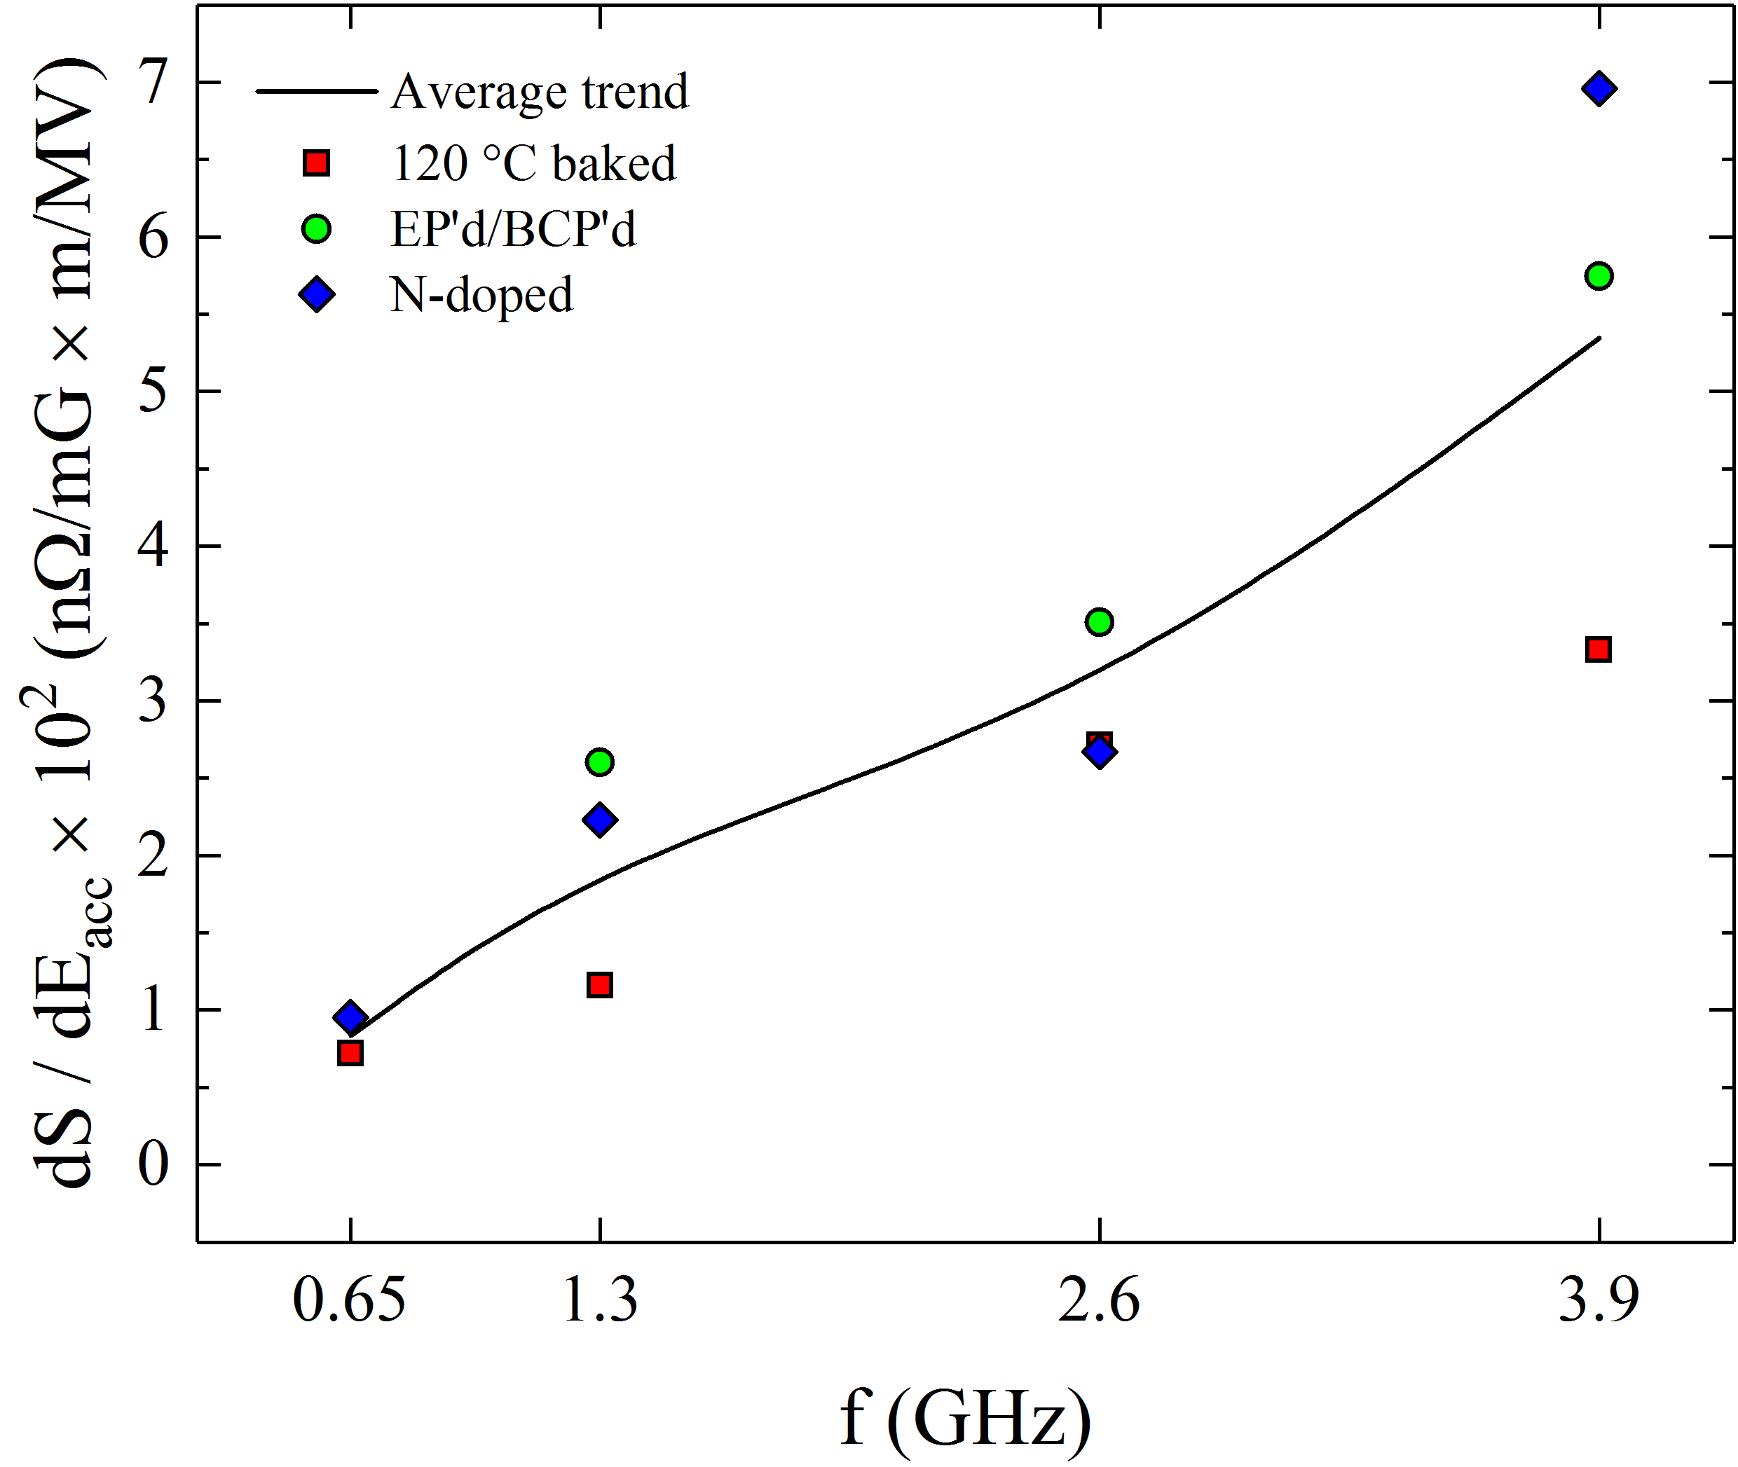
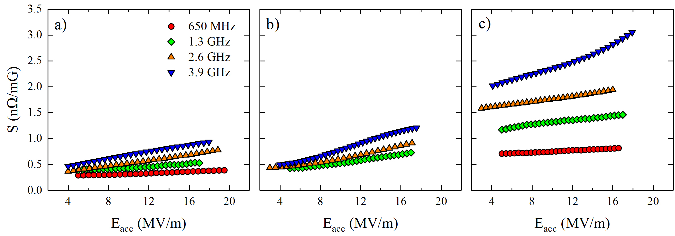
Sensitivity as a function of frequency
Higher low field sensitivity for higher frequency cavities
2/6 N-doped have higher sensitivity, as expected form 1.3 GHz data
Steeper field dependence for high frequency cavities
120 C
EP/BCP
2/6 N-doped
  M. Martinello et al., SRF 2017
  M. Checchin et al., submitted to APL

Slide 11
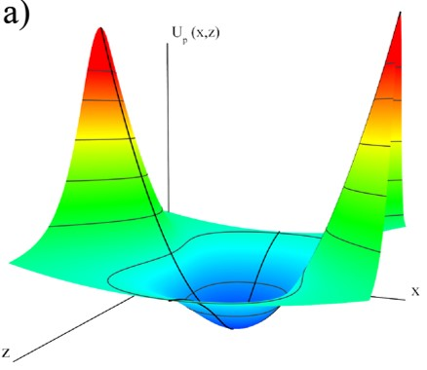
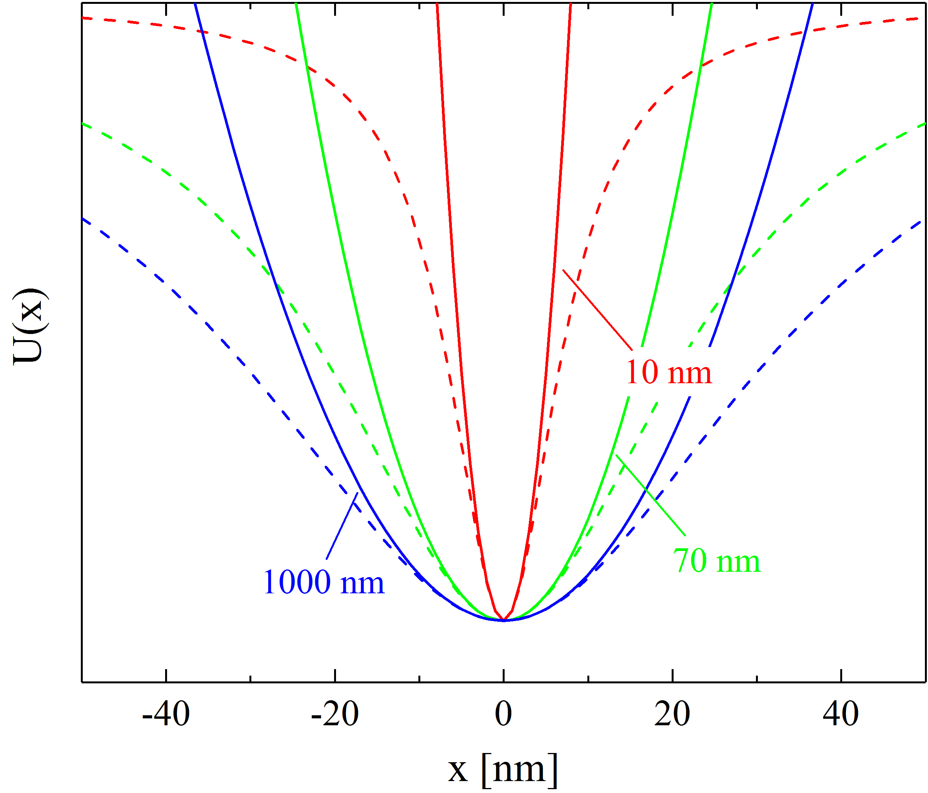


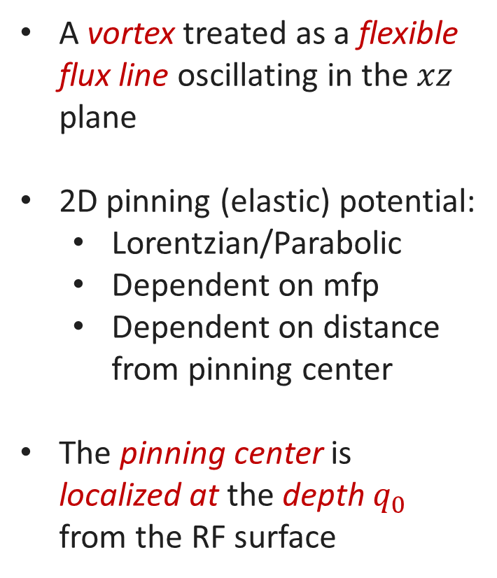



Mean-free-path dependent pinning potential
$$x$$
A vortex treated as a flexible flux line oscillating in the $xz$ plane
2D pinning (elastic) potential:
  Lorentzian/Parabolic
  Dependent on mfp
  Dependent on distance from pinning center
The pinning center is localized at the depth $q_{0}$ from the RF surface
$$j(t)$$
$$y$$
$$q_{0}$$
Pinning center
$$z$$
Pinning potential

Slide 12
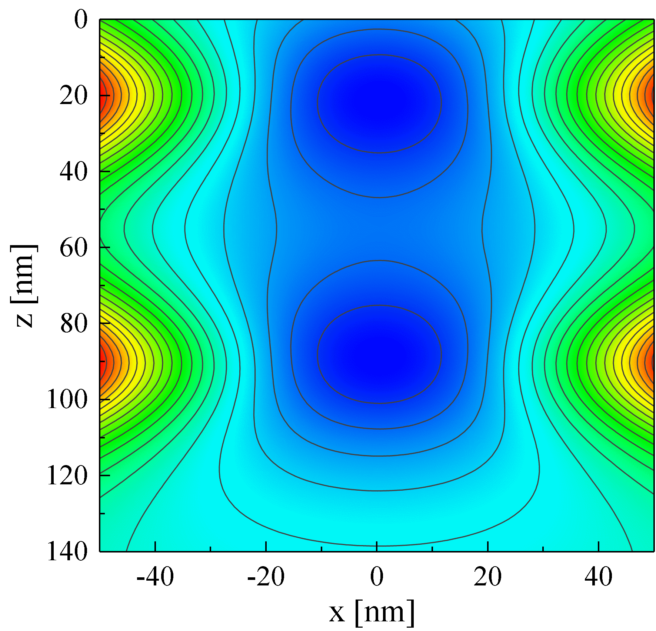
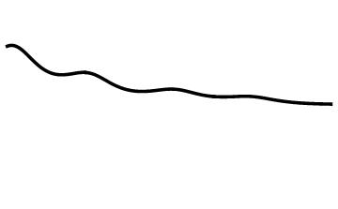


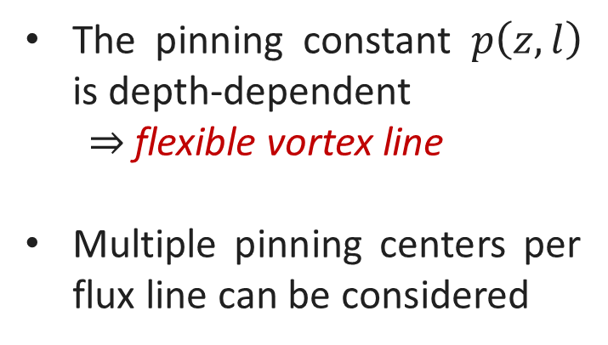

Motion equation of a vortex
$$B_{RF}(t)$$
The motion equation has form:
$$M\left(l\right)\ddot{x}+η\left(l\right)\dot{x}+p\left(z,l\right)x=f_{Lorentz}$$
Pinning Center
Solution valid for $0≤z<∞$ domain
The pinning constant $p\left(z,l\right)$ is depth-dependent
  $⇒$ flexible vortex line
Multiple pinning centers per flux line can be considered
Pinning Center

Slide 13
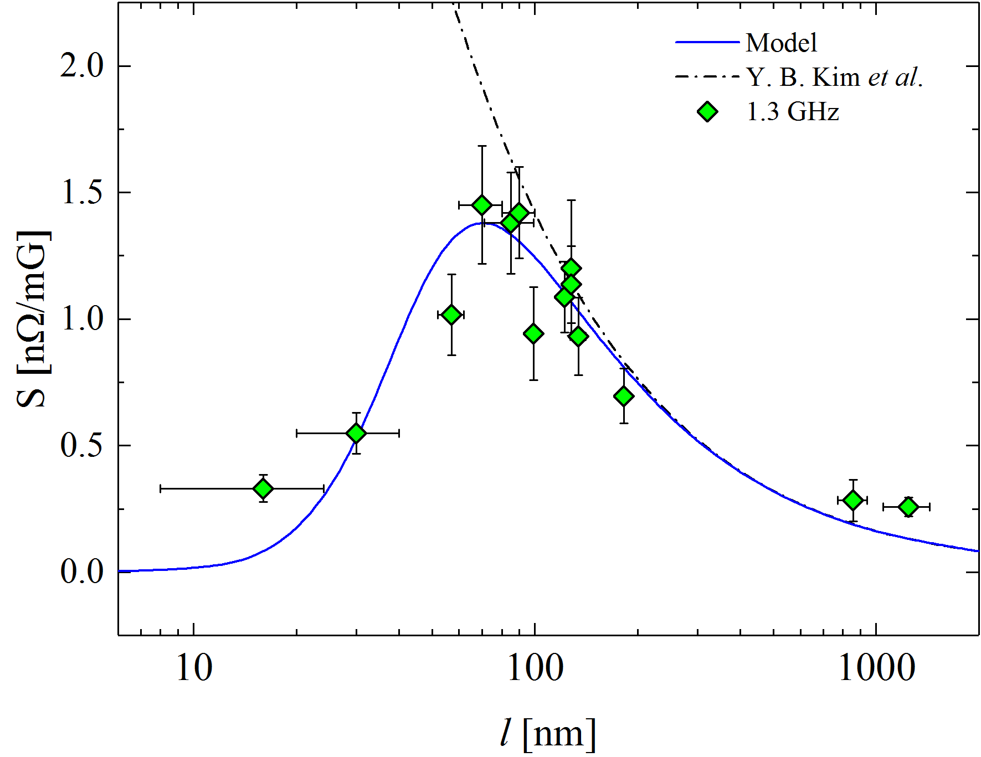
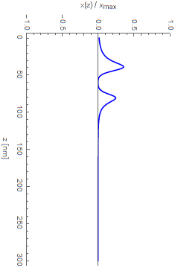
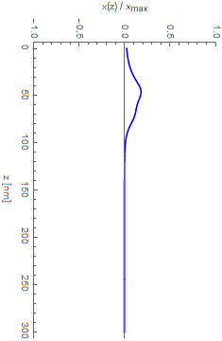
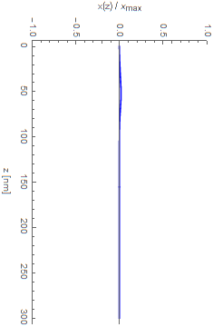
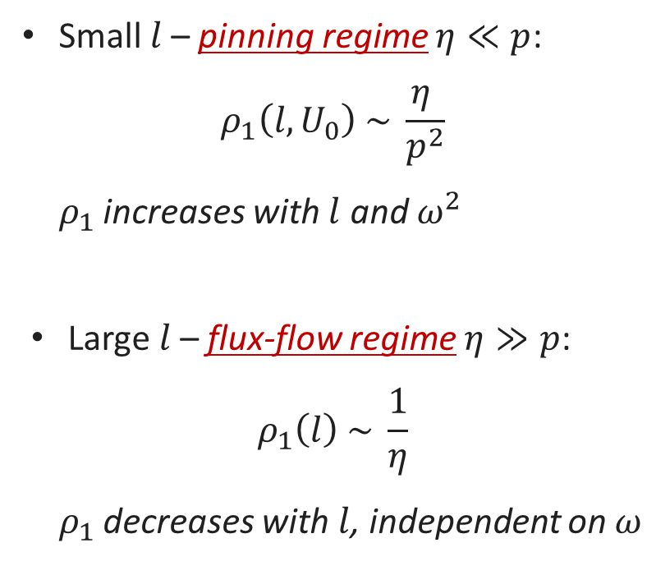



Mean-free-path dependence
Small $l$– pinning regime $η≪p$:
$$ρ_{1}\left(l,U_{0}\right) \sim \frac{η }{p^{2}}$$
  $ρ_{1}$ increases with $l$ and $ω^{2}$
Large $l$– flux-flow regime $η≫p$:
$$ρ_{1}\left(l\right) \sim \frac{1}{η}$$
  $ρ_{1}$ decreases with $l$, independent on $ω$
Pinning
regime
Flux-flow
regime
$$l = 5 nm$$
$$l = 70 nm$$
$$l = 500 nm$$
Pinning
  M. Checchin et al., Supercond. Sci. Technol. 30, 034003 (2017)
  M. Martinello et al., App. Phys. Lett. 109, 062601 (2016)

Slide 14
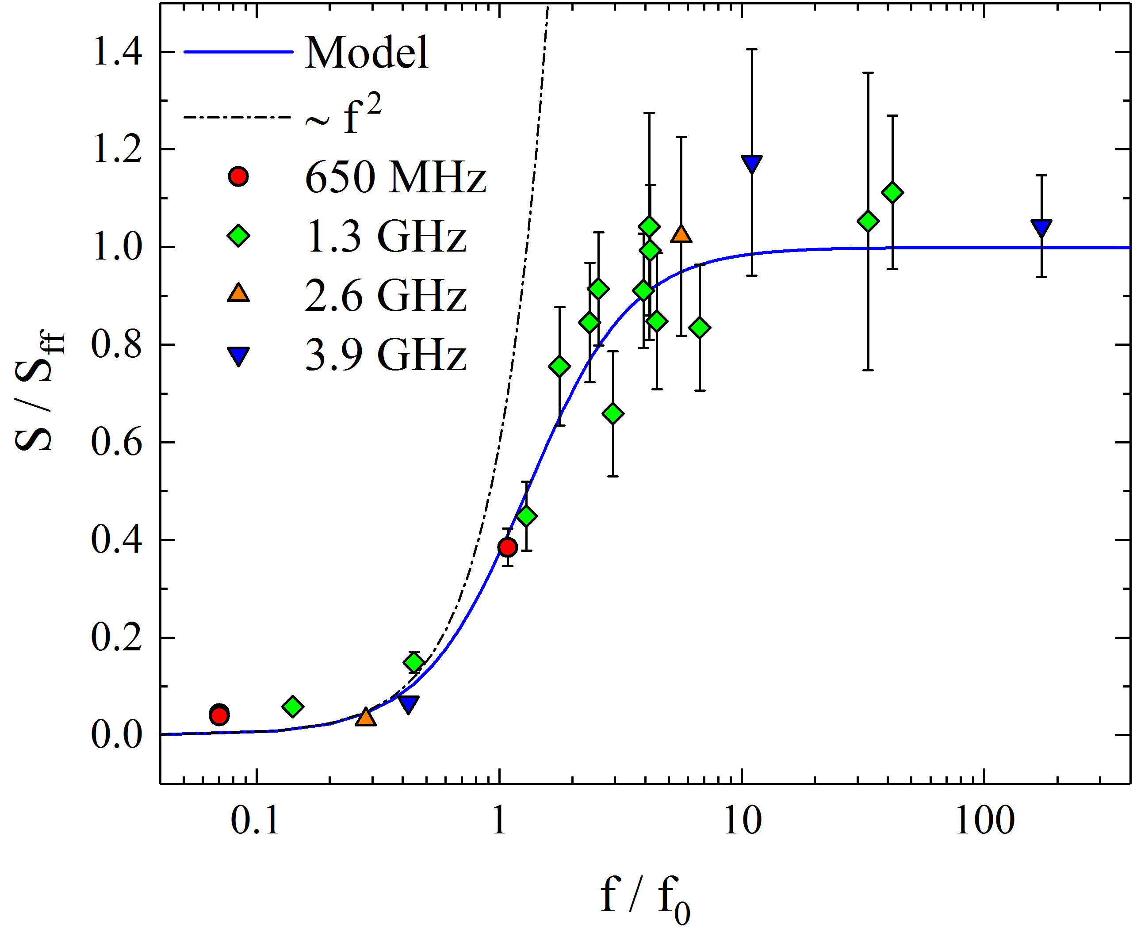
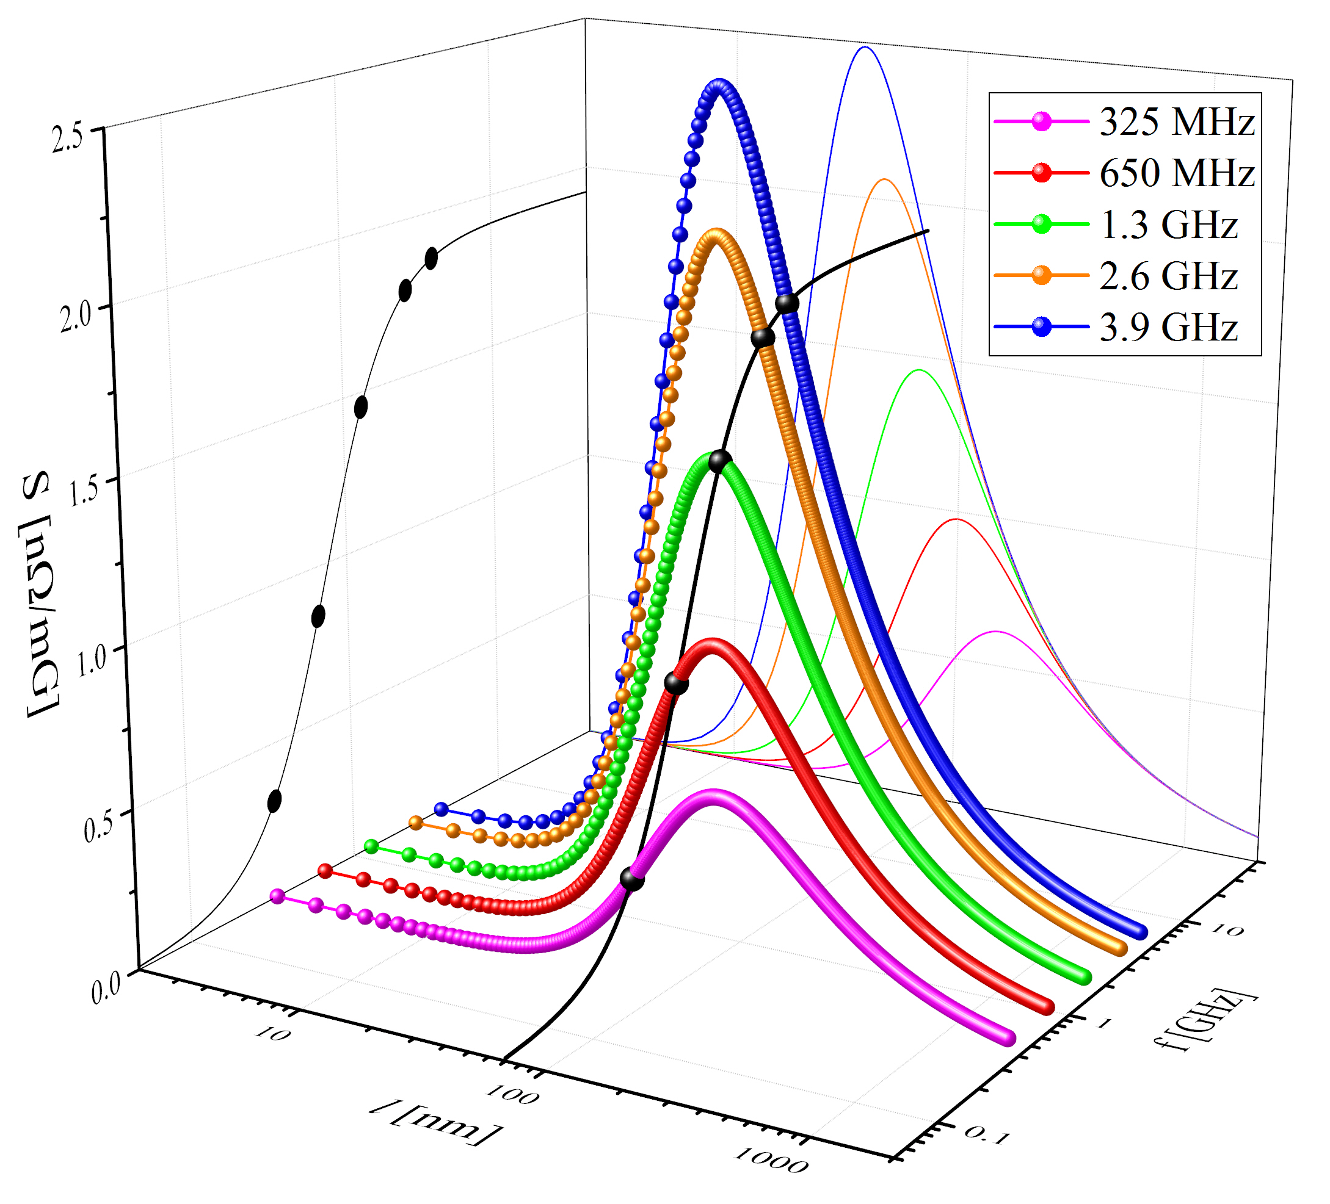
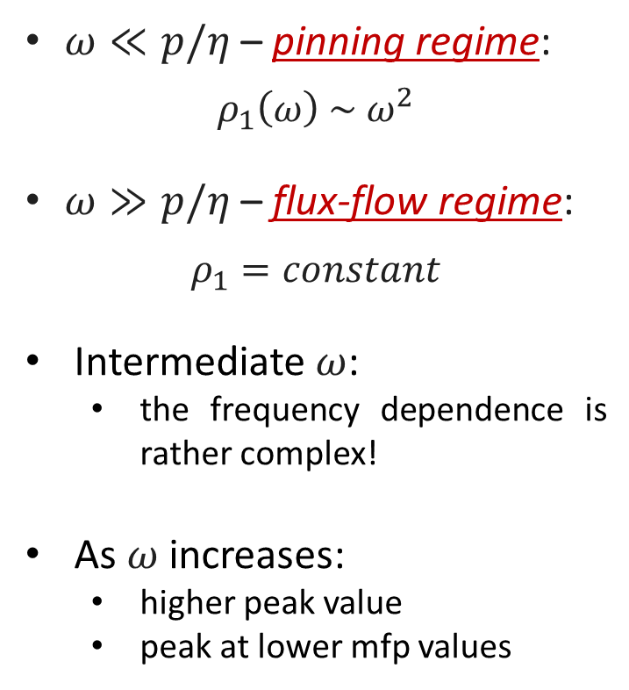
Frequency dependence
$ω≪p/η$ – pinning regime:
$$ρ_{1}\left(ω\right) \sim ω^{2}$$
$ω≫p/η$ – flux-flow regime:
$$ρ_{1}=constant$$
Intermediate $ω$:
  the frequency dependence is rather complex!
As $ω$ increases:
  higher peak value
  peak at lower mfp values
Pinning
regime
Flux-flow
regime
  M. Checchin et al., submitted to APL

Slide 15
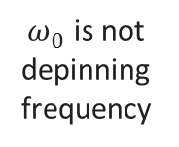
Good agreement between data and models
Point-like vortex approach
  J. I. Gittleman and B. Rosenblum, Phys. Rev. Lett. 16, 734 (1966)
Flexible vortex line approach
  M. Checchin et al., Supercond. Sci. Technol. 30, 034003 (2017)
  M. Checchin et al., submitted to APL
Elastic vortex line approach
  A. Gurevich and G. Ciovati, Phys. Rev. B 87, 054502 (2013)
$ω_{0}$ is not depinning frequency

Slide 16
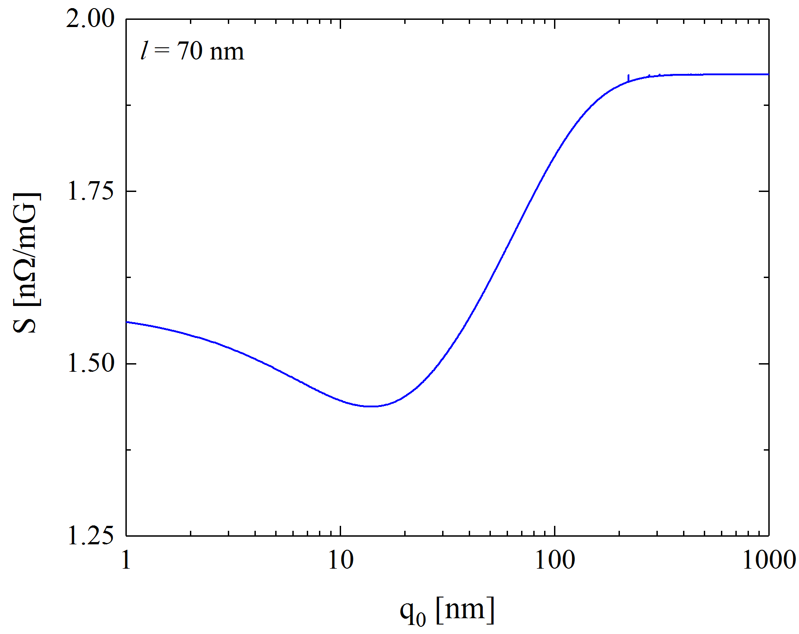
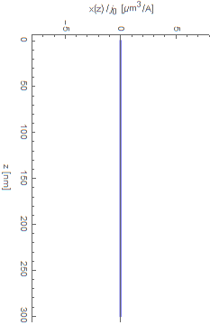
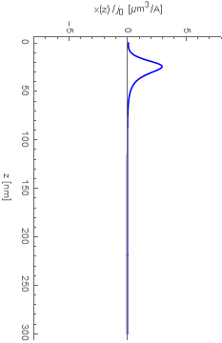
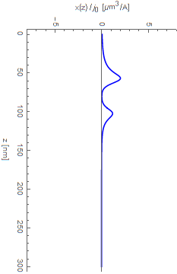




Dependence on the pinning center depth
$$x$$
$$j(t)$$
$$y$$
$$q_{0}$$
Pinning center
$$q_{0}=1000 nm$$
$$z$$
Sensitivity dependent on the pinning site distance from the surface
  Bulk pinning does not affect the vortex oscillation
Pinning
Pinning
$$q_{0}=5 nm$$
$$q_{0}=80 nm$$

Slide 17
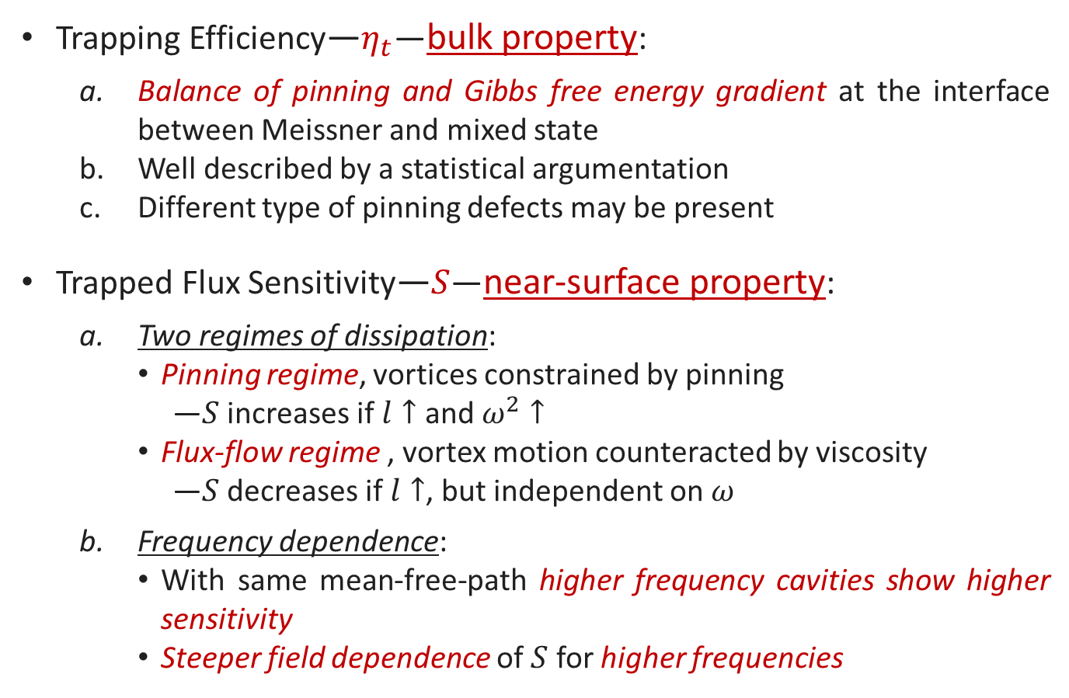
Conclusions
Trapping Efficiency—$η_{t}$—bulk property:
  Balance of pinning and Gibbs free energy gradient at the interface between Meissner and mixed state
  Well described by a statistical argumentation
  Different type of pinning defects may be present
Trapped Flux Sensitivity—$S$—near-surface property:
  Two regimes of dissipation:
    Pinning regime, vortices constrained by pinning
      —$S$ increases if $l↑$ and $ω^{2}↑$
    Flux-flow regime , vortex motion counteracted by viscosity
      —$S$ decreases if $l↑$, but independent on $ω$
  Frequency dependence:
    With same mean-free-path higher frequency cavities show higher sensitivity
    Steeper field dependence of $S$ for higher frequencies

Slide 18
Thank you for your attention

Slide 19
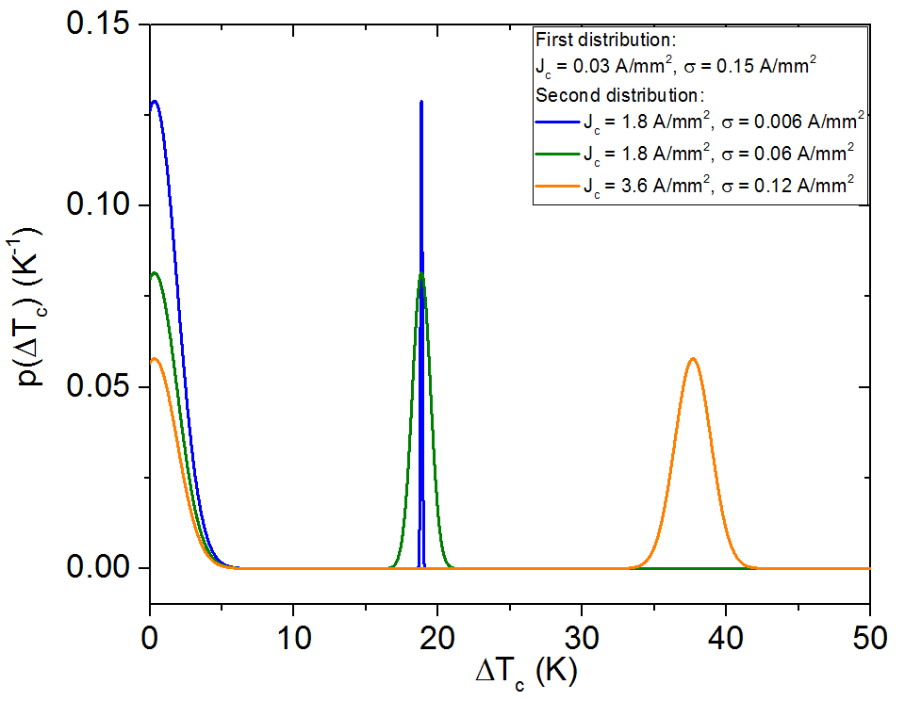
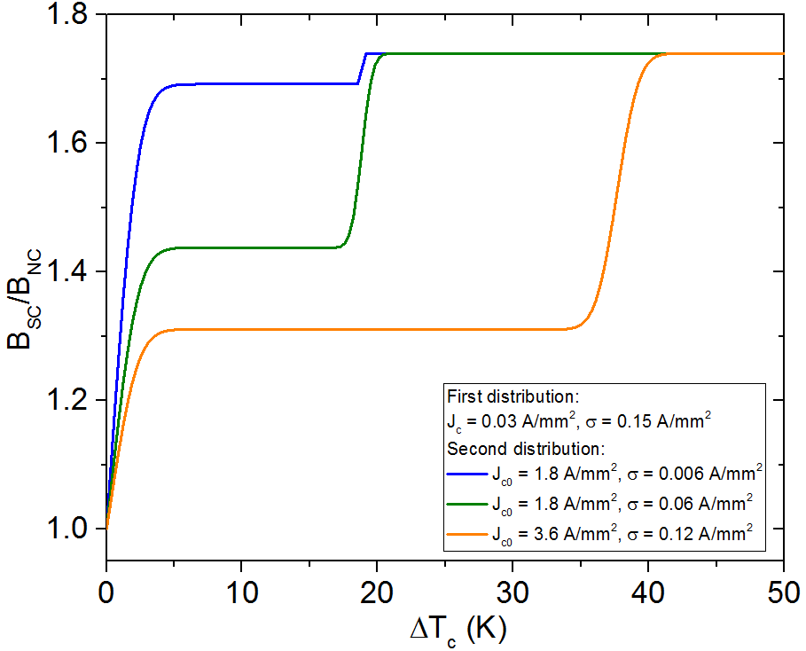
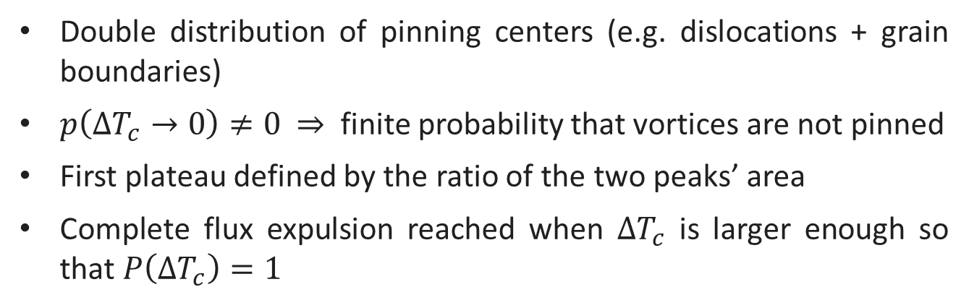
Distribution of pinning defects
Double distribution of pinning centers (e.g. dislocations + grain boundaries)
$p\left({ΔT}_{c}→0\right)≠0$ $⇒$ finite probability that vortices are not pinned
First plateau defined by the ratio of the two peaks’ area
Complete flux expulsion reached when ${ΔT}_{c}$ is larger enough so that $P\left({ΔT}_{c}\right)=1$

Slide 20
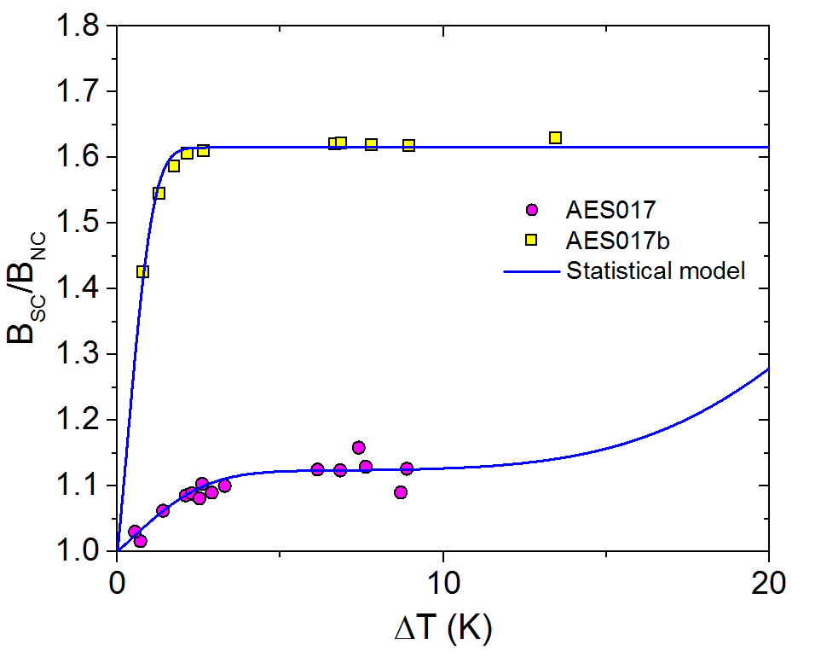
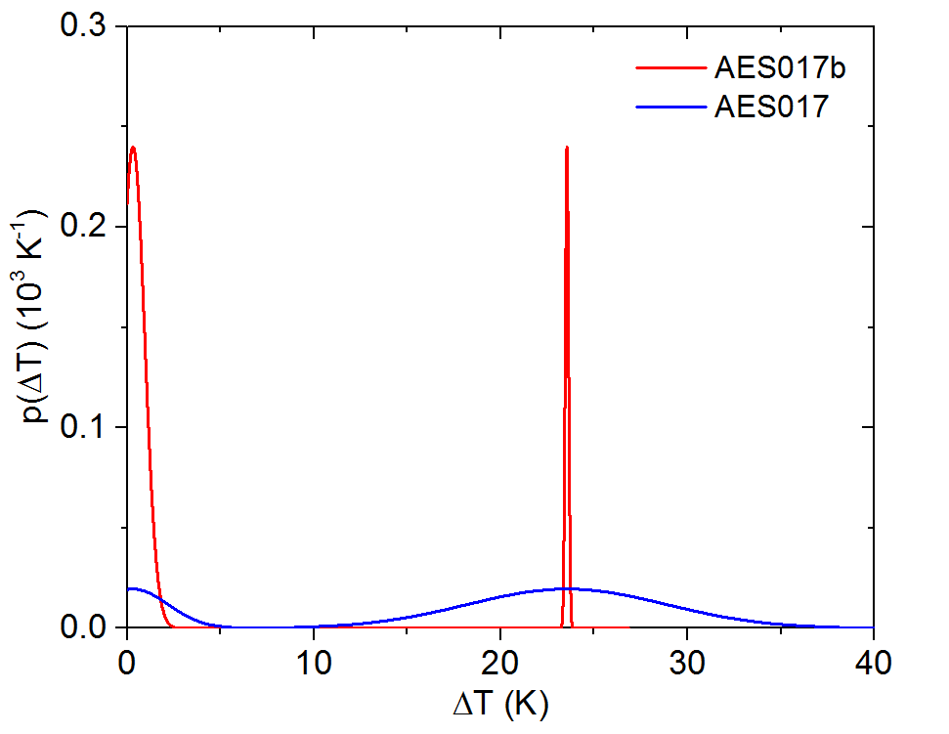
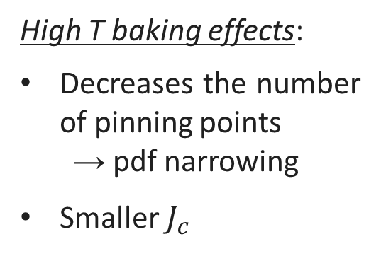
High T baking effects
High T baking effects:
Decreases the number of pinning points
  pdf narrowing
Smaller $J_{c}$
After 1000 C
baking

