Slide 1
Flux Dissipation in Nb₃Sn Films
Ryan Porter, Daniel Hall
Cornell University
Supported by:
U.S. DOE award DE-SC0008431.
This works make use of: Center for Bright Beams , NSF Award PHY-1549132

Slide 2
Outline
Brief introduction
Loss from trapped flux during cooldown
Ambient fields
Thermal gradients
Possible flux entry without quench
Temperature “slip”
Conclusions

Slide 3
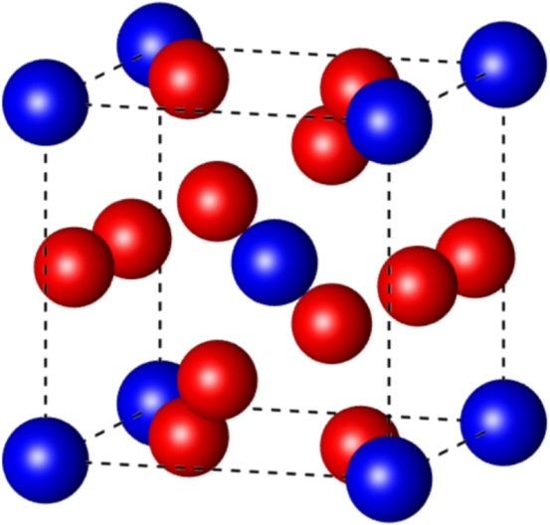
Properties of Nb₃Sn
Higher critical temperature
→ Operation at 4.2 K
Higher superheating field
→ Double the limit of niobium
Blue: tin
Red: niobium
Parameter | Niobium | Nb₃Sn
Transition temperature | 9.2 K | 18 K
Superheating field | 219 mT | 425 mT
Energy gap Δ/k_{b}T_{c} | 1.8 | 2.2
λ at T = 0 K | 50 nm | 111 nm
ξ at T = 0 K | 22 nm | 4.2 nm
GL parameter κ | 2.3 | 26
Lower losses
Higher gradients
~90 MV/m

Slide 4
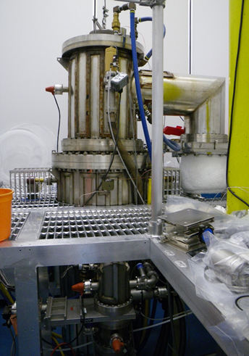
Cornell Nb₃Sn Program
We have a program at Cornell for creating Nb₃Sn coatings
Coat Nb with 2-3 µm of Nb₃Sn
Vaporize tin in high temperature vacuum furnace
Can (currently) coat:
samples
single cells (≥ 1.3 GHz)

Slide 5
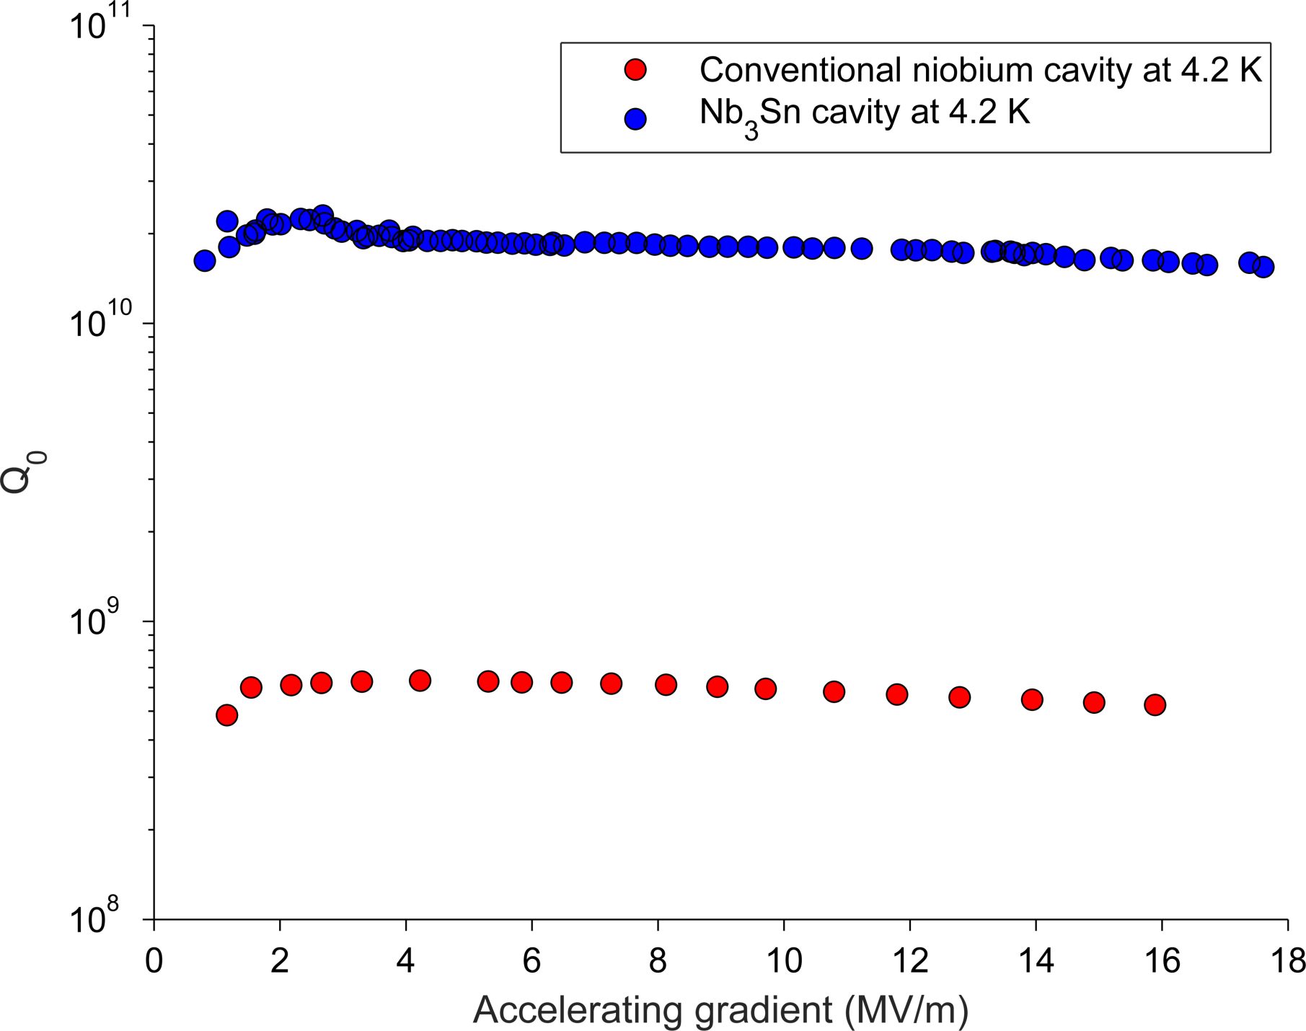
Comparison to niobium
20× more efficient than Nb at 4.2 K!
Notes:
This is 30 times more efficient than Nb at 4.2 K at useable gradients
This is the first time an “alternative” cavity has beaten niobium at useable gradients

Slide 6
Losses from trapped magnetic Flux

Slide 7
Breaking down the Q
Surface resistance at 4.2 K and 10 MV/m
16 nΩ
Ambient fields
Trapped flux
Thin film regions
BCS Resistance
Thermal gradients
0 nΩ

Slide 8
Breaking down the Q
Surface resistance at 4.2 K and 10 MV/m
16 nΩ
Ambient fields
Trapped flux
Thin film regions
BCS Resistance
Thermal gradients
0 nΩ

Slide 9
Thermal currents
Induced thermocurrent
HOT
Nb₃Sn
Nb
$$V=−S ∇T$$
S – Seebeck coefficient
Generated B field
COLD
Cooling in a small thermal gradient will prevent a large amount of trapped flux!

Slide 10
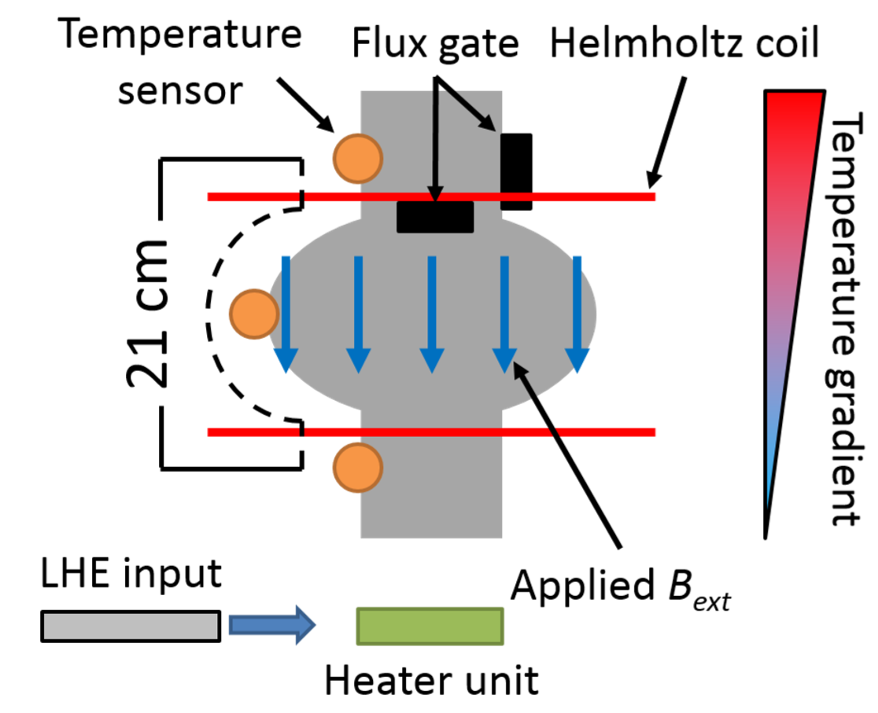
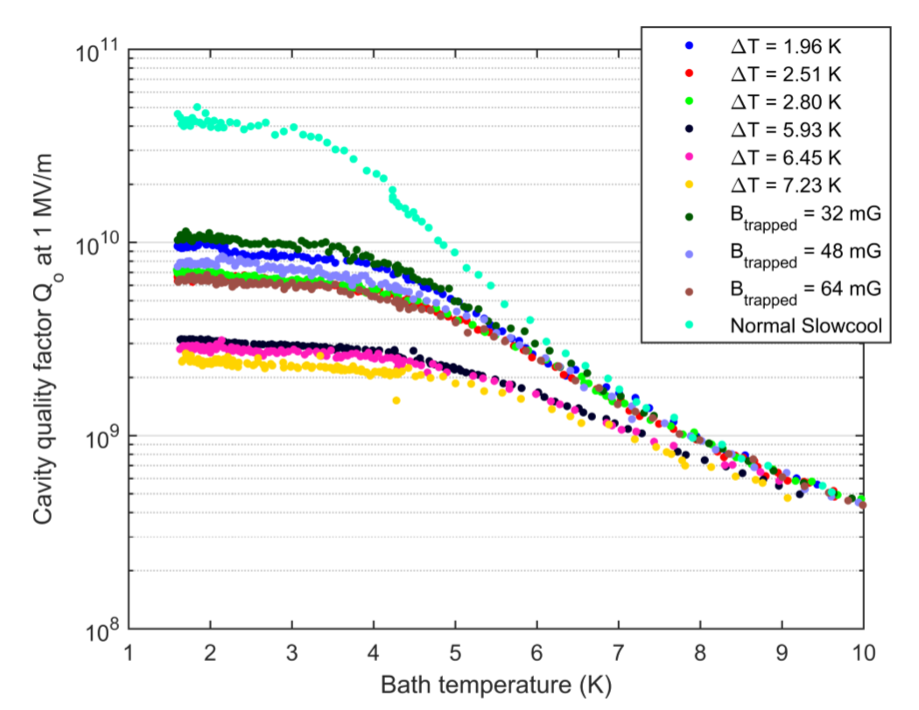
Measuring losses from trapped flux
Want to characterize losses from trapped flux
Helmholtz coil during cooldown to ambient magnetic flux
Adjust cooling rate to change thermal gradient

Slide 11
Losses from trapped flux

Slide 12
Sensitivity with field
$$Sensitivity= \frac{nΩ Residual gained}{mG magnetic flux trapped}=\frac{dR}{dB_{trap}}$$
$$\frac{dR}{dB_{trap}}=\left(21±1\right){{pΩ}/{mG}}/{mT}⋅B_{RF}+\left(0.47±0.02\right) nΩ∕mG$$
Notes:
Define sensitivity

Slide 13
Weak Pinning Scenario
A weak pinning model developed by Danilo Liarte and Jim Sethna discussed earlier
Relevant takeaway:
$$\frac{R_{0}}{B_{trapped}}=A B_{rf}=\frac{4}{3}\frac{fλ^{2}μ_{o}}{B_{c}^{2}ξ}{\left(\frac{j_{o}}{j_{c}}\right)}^{\frac{3}{2}} B_{rf} ∝\frac{fλ^{2}}{j_{c}}B_{rf}$$
Flux trapping sensitivity depends linearly with B_{rf}
Flux trapping sensitivity depends on penetration depth
Penetration depth depends on mean free path
Could reduce Q-slope!
Notes:
BCD 97

Slide 14
Possible Flux Entry

Slide 15
Localised quench
Nb₃Sn cavities are limited by a quench to ~16MV/m
Occurs at a thermal defect
What happens, thermally, right at the defect?

Slide 16
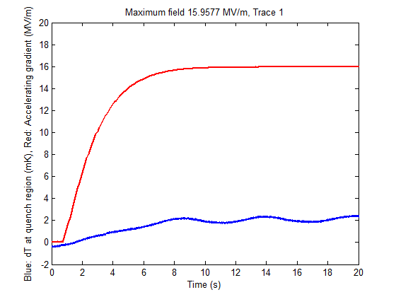
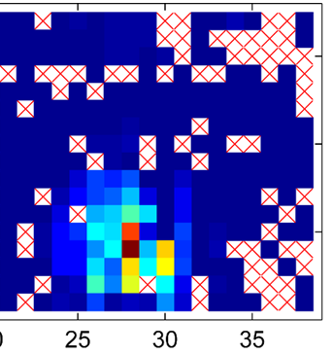
Near quench behavior
Measure temperature of sensor near the quench point as field is increased
Sudden jumps in temperature
Max Field
Temperature
Time

Slide 17
Near quench behaviour
2 K
The sudden nature of these jumps and hysteresis strongly suggests flux entry

Slide 18
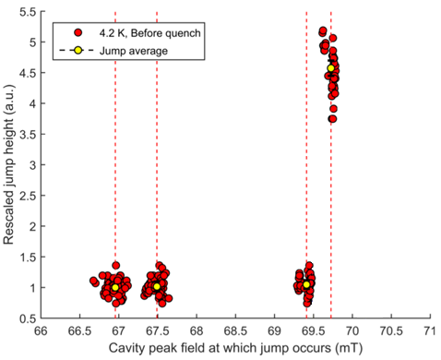
Jump heights
Jump heights from multiple cooldowns (rescaled so first jump heights are equal)
Some changes due to calibration
Quench or re-cool change when jumps occur

Slide 19
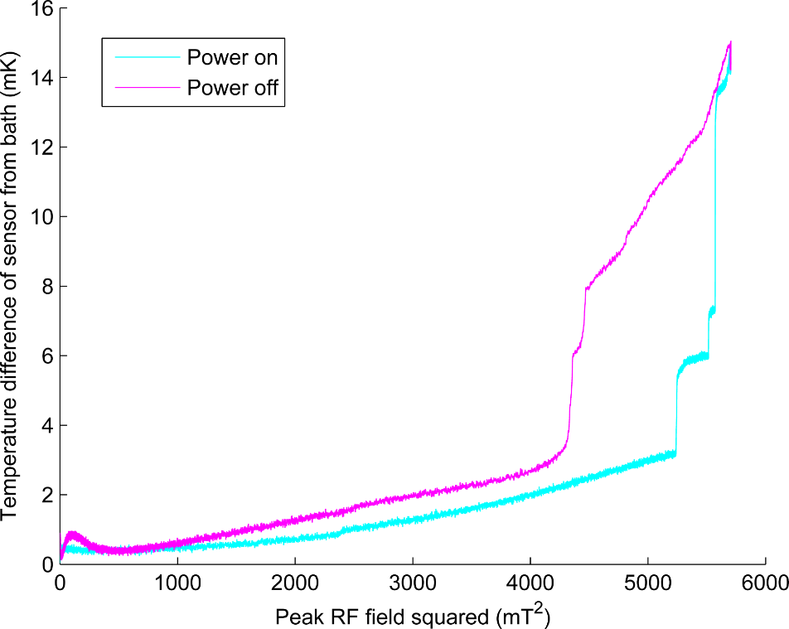
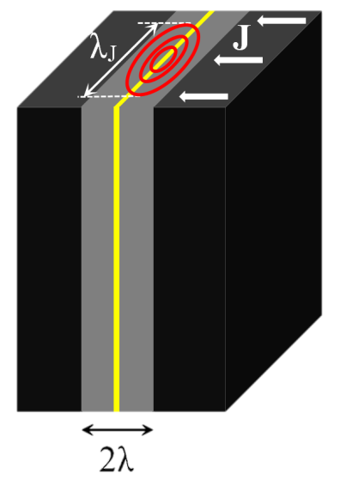
Grain boundary flux penetration
Power dissipated
Increasing current across boundary
Ahmad Sheikhzada and Alex Gurevich
Physical Review B 95, 214507 (2017)
arXiv:1702.02843
Notes:
Grain acts as Josephson Junction. Flux expands across whole boundary. Blocks Current.

Slide 20
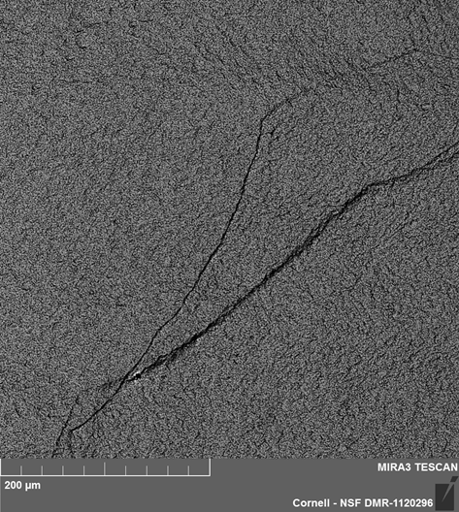
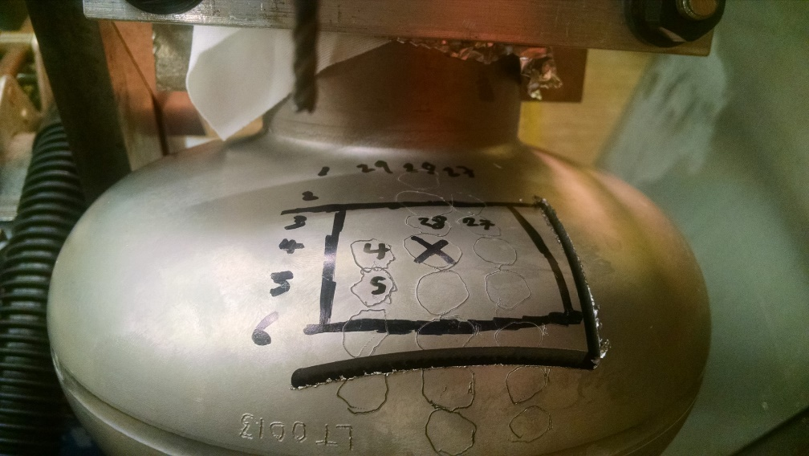
What is happening at the surface?
We cut out this region and examined it with microscopy
Nothing suspicious except cliff
Rough Surface
Field enhancement
Nb₃Sn surface
Nb substrate grain boundary?

Slide 21
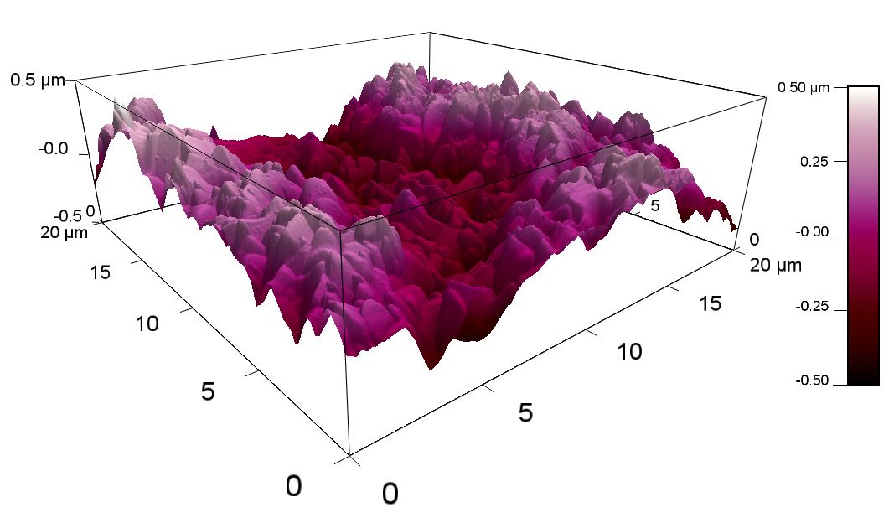
Surface Roughness
Nb₃Sn we create is rougher than electropolished Nb
~1 µm peak to peak
This causes large enhancement of the surface magnetic field

Slide 22
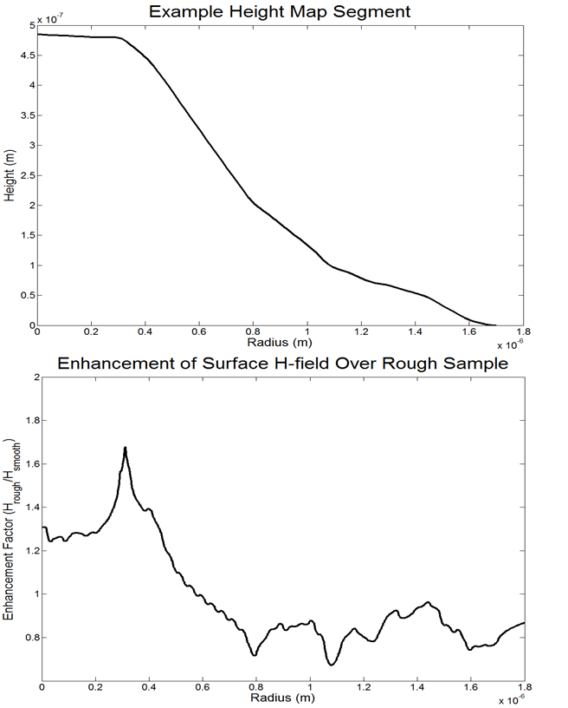
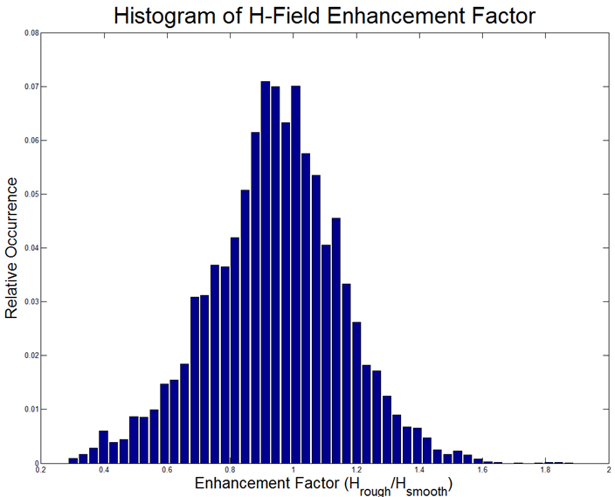
Field Enhancement
1% of the surface has surface fields at least 50% higher than for a flat surface
Possible that flux entry is occurring at a higher magnetic field than accelerating gradient suggests

Slide 23
Temperature Slip

Slide 24
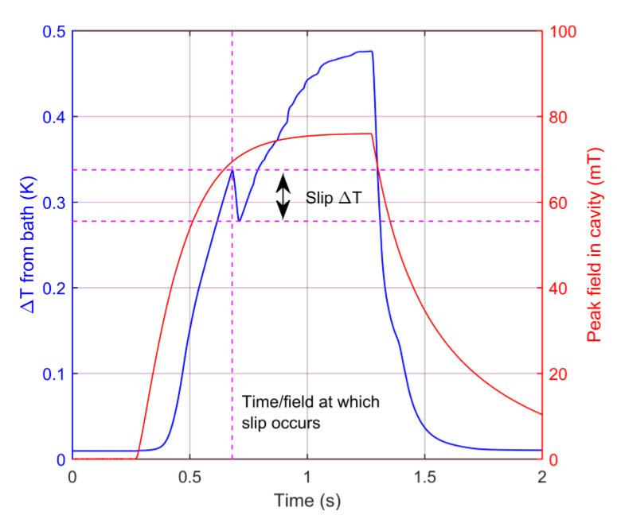
Temperature Slip 2 K
Observe temperature “slip”
First seen at 2 K after many quench
Slip occurs at lower field than jump

Slide 25
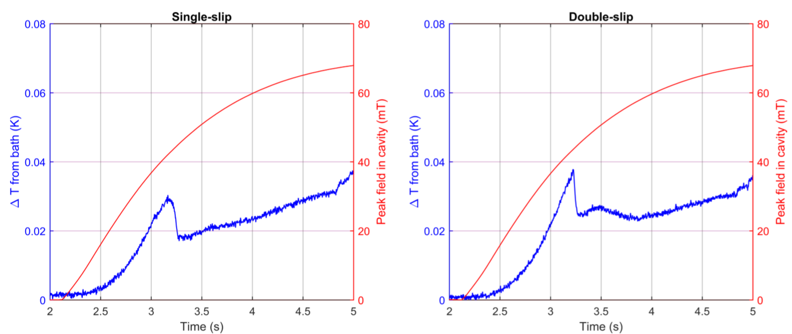
Temperature Slip 4.2 K
Seen at 4.2 K before and after quench
Sometimes 2 slips at 4.2 K

Slide 26
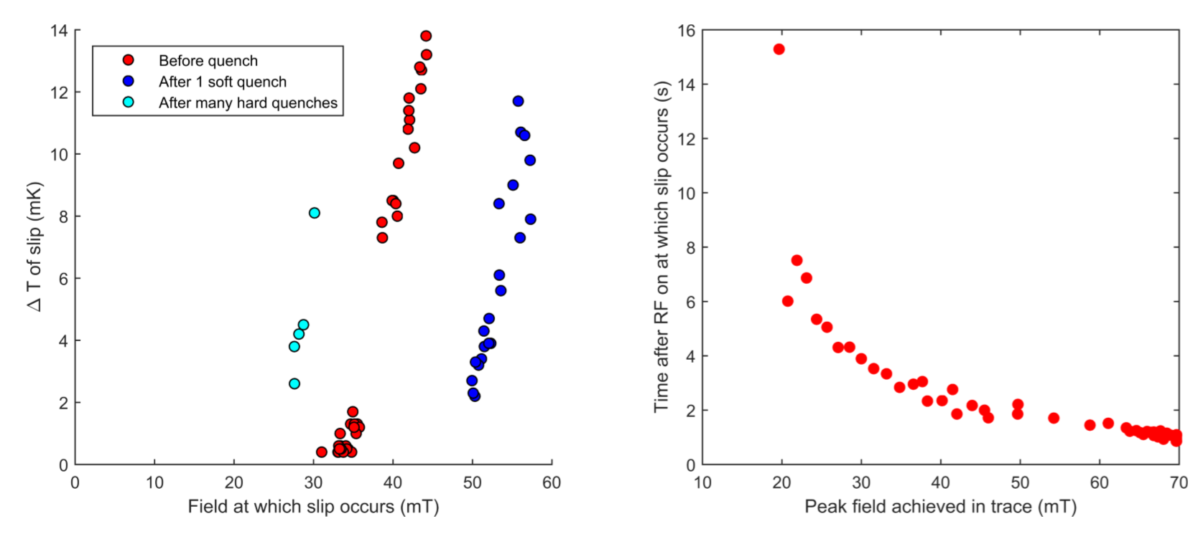
Temperature Slip
Size of slip depends on field when slip occurs
Time of slip depends on filling time/P_{f}
Change after quench -> flux distribution matters

Slide 27
Conclusions
Good Q requires shielding from ambient magnetic field and slow cooling rates
Observed jumps in temperature near quench site
> quantized flux entry likely at grain boundary
Observed temperature slips in areas with high amounts of trapped flux
> flux rearrangement?

Slide 28
Acknowledgements
The Cornell Nb₃Sn program is primarily supported by the U.S. Department of Energy
with special thanks to
Prof. Matthias Liepe
Prof. Tomas Arias
Prof. David A. Muller
Prof. James P. Sethna
Danilo Liarte
Daniel Hall
Paul Cueva
Nathan Sitaraman
James Maniscalco
James Sears
Greg Kulina
John Kaufman
Holly Conklin
Terri Gruber

