Slide 1
Frequency dependence of the BCS surface resistance at high fields
Martina Martinello
TTC Topical Workshop – Pushing Cavity Performance Limits
15 Nov 2017

Slide 2
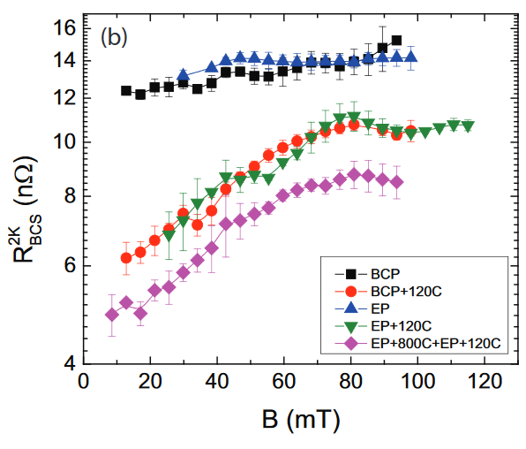
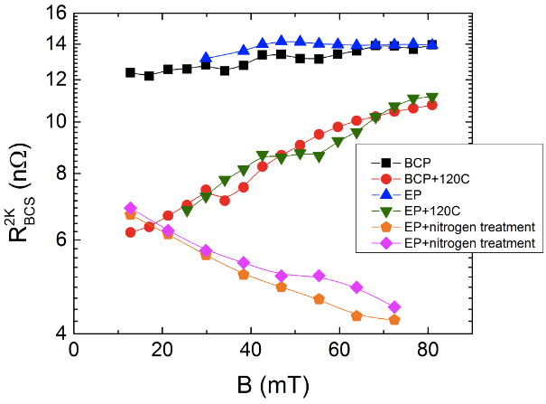
R_{BCS}(Eacc) at 1.3 GHz
A. Romanenko and A. Grassellino, Appl. Phys. Lett. 102, (2013)
A. Grassellino et al., Supercond. Sci. Technol. 26, 102001 (2013)
From 1.3 GHz data we know that:
R_{BCS}(E_{acc}) increases in regular niobium cavities (EP, BCP, 120C baking)
R_{BCS}(E_{acc}) decreases in N-doped niobium cavities

Slide 3
R_{BCS}(Eacc) at 1.3 GHz
A. Romanenko and A. Grassellino, Appl. Phys. Lett. 102, (2013)
A. Grassellino et al., Supercond. Sci. Technol. 26, 102001 (2013)
From 1.3 GHz data we know that:
R_{BCS}(E_{acc}) increases in regular niobium cavities (EP, BCP, 120C baking)
R_{BCS}(E_{acc}) decreases in N-doped niobium cavities
How do these field dependences change with the frequency?

Slide 4
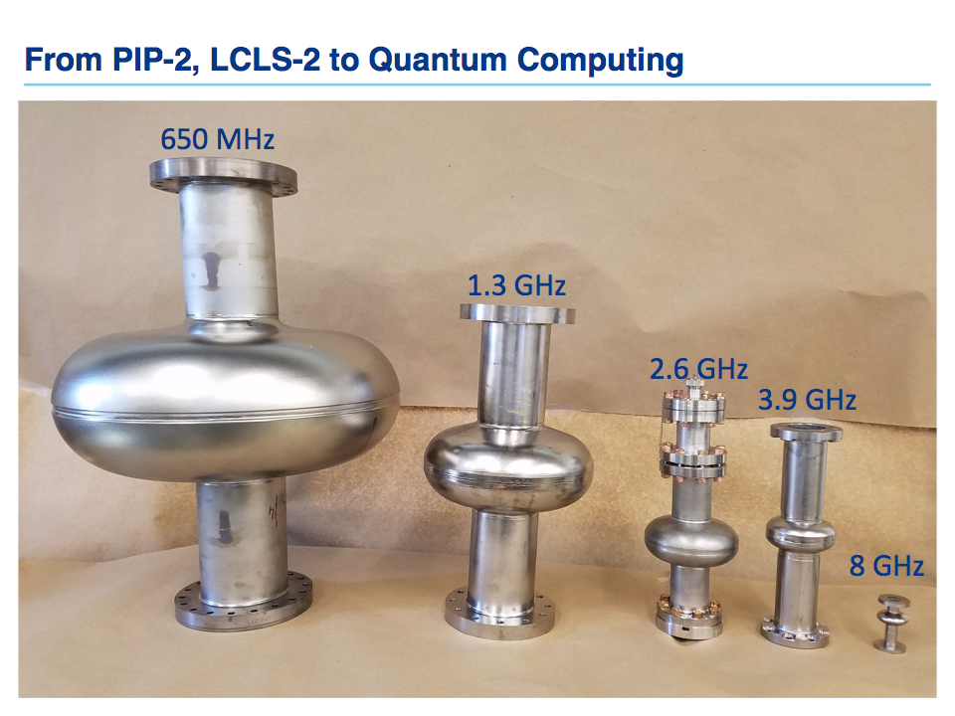

Analyzed Cavities
N-doping
120C baking
EP/BCP
1.3 GHz, 2 K
 | 650 MHz | 1.3 GHz | 2.6 GHz | 3.9 GHz
EP
BCP
120C baking
2/6 N-doping

Slide 5
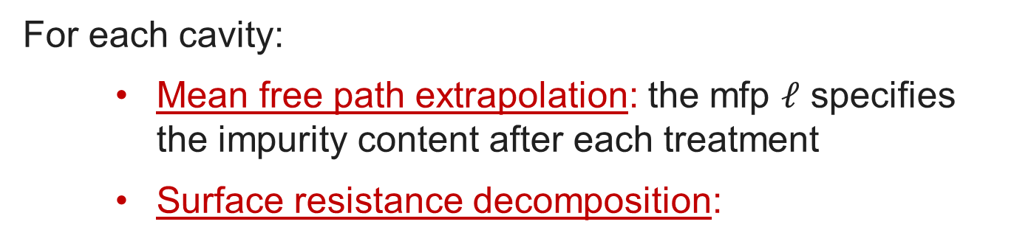
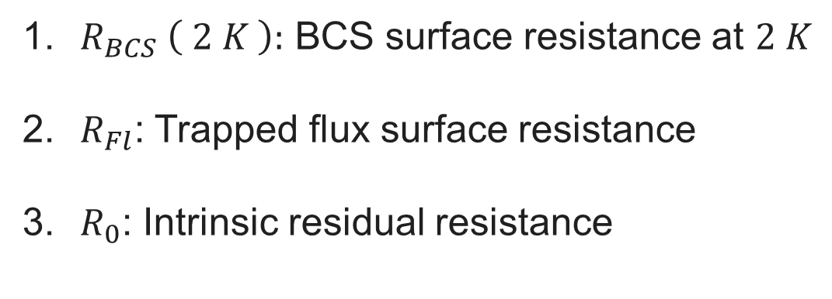
Data Analysis
For each cavity:
      Mean free path extrapolation: the mfp $𝓁$ specifies the impurity content after each treatment
      Surface resistance decomposition:
$$R_{S} \left( 2 K \right)=R_{BCS} \left( 2 K \right)+R_{Fl}+R_{0}$$
$R_{BCS} \left( 2 K \right):$ BCS surface resistance at $2 K$
$R_{Fl}$: Trapped flux surface resistance
$R_{0}$: Intrinsic residual resistance

Slide 6
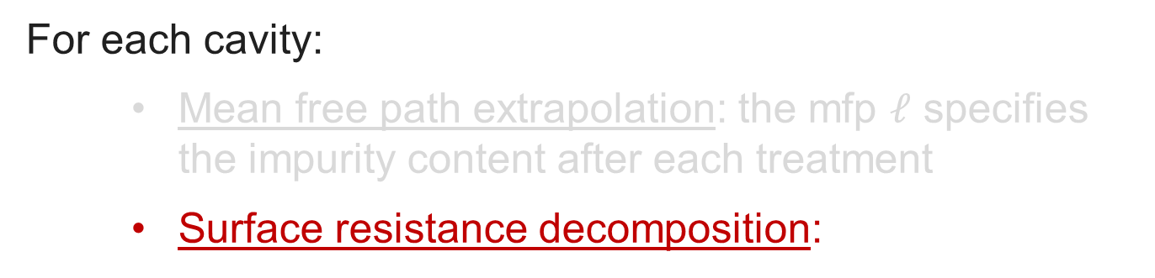
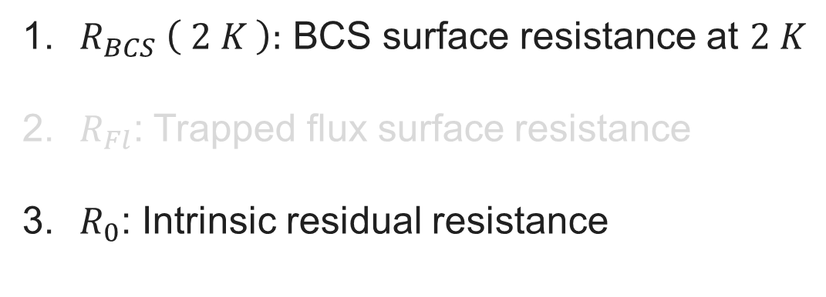
Data Analysis
For each cavity:
      Mean free path extrapolation: the mfp $𝓁$ specifies the impurity content after each treatment
      Surface resistance decomposition:
$$R_{S} \left( 2 K \right)=R_{BCS} \left( 2 K \right)+R_{0}+R_{Fl}$$
$R_{BCS} \left( 2 K \right):$ BCS surface resistance at $2 K$
$R_{Fl}$: Trapped flux surface resistance
$R_{0}$: Intrinsic residual resistance

Slide 7
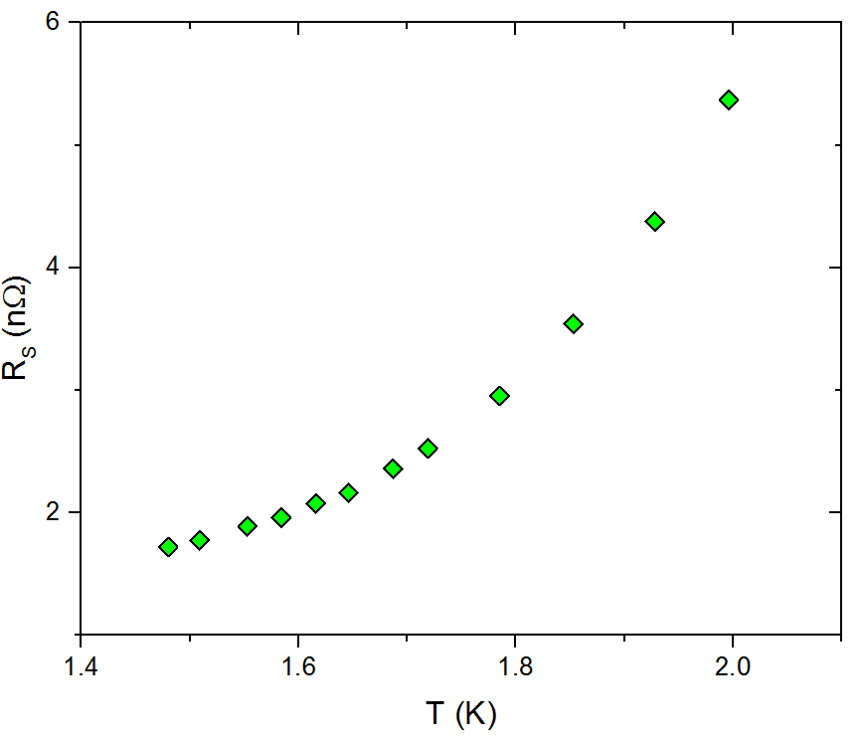


1a. BCS Surface Resistance (650 MHz and 1.3 GHz)
$$R_{S} \left( 2 K \right)={R_{BCS} \left( 2 K \right)+R}_{0}+R_{Fl}$$
$$R_{S} \left( 2 K \right)={R_{BCS} \left( 2 K \right)+R}_{res}$$
1.3 GHz
Because of the exponential decreasing with T, R_{BCS} at 1.5 K is negligible at low frequencies :
$$R_{S} \left( 1.5 K \right) \sim R_{res}$$
R_{res}
R_{BCS} (2 K) can be calculated as:
$$R_{BCS}(2K)=R_{S}\left(2 K\right)−R_{S}\left(1.5 K\right)$$

Slide 8
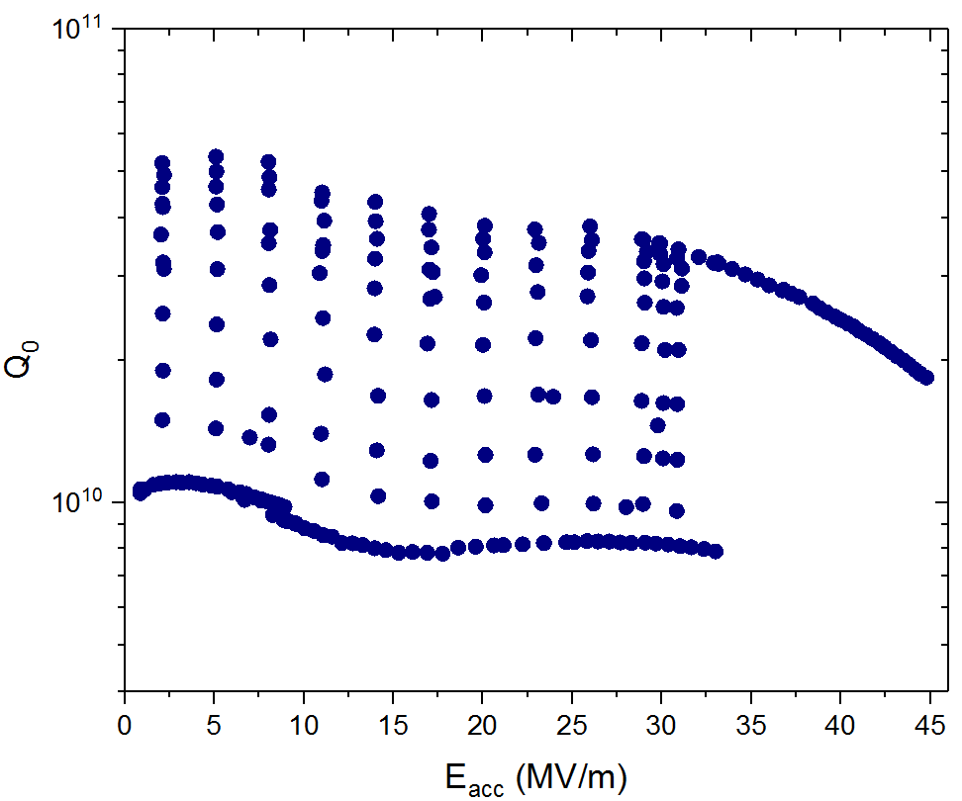
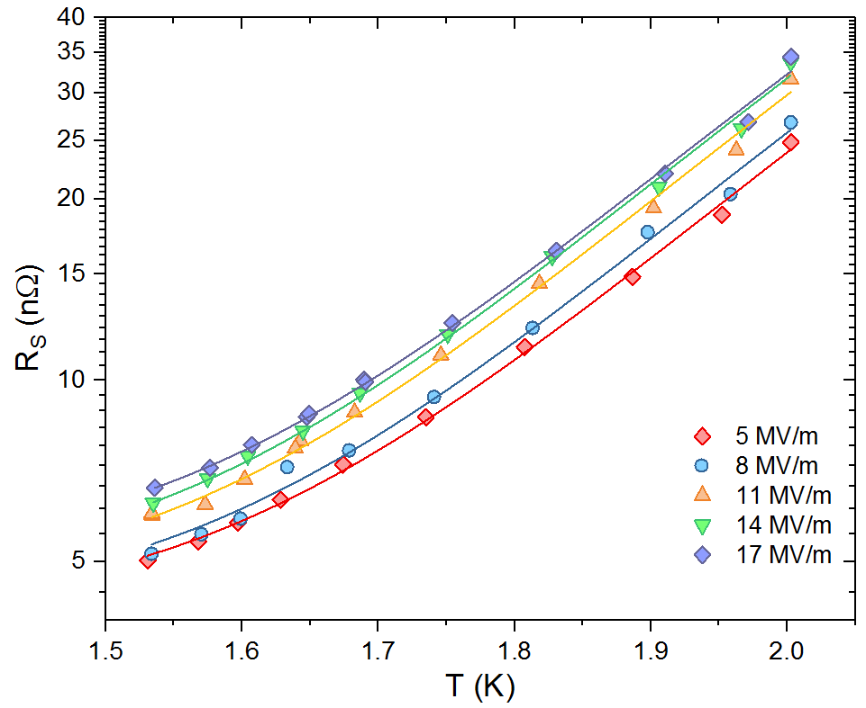


1b. BCS Surface Resistance (2.6 and 3.9 GHz)
2.6 GHz
$$R_{S} \left( 2 K \right)={R_{BCS} \left( 2 K \right)+R}_{0}+R_{Fl}$$
Fit of Rs (T) acquired at different E_{acc} values:
$$R_{S}=A e^{−\frac{∆}{k_{B}T}} + R_{res}$$
2.6 GHz
Accurate determination of R_{res} (E_{acc})
At this point R_{BCS}(2K) can be easily calculated:
$$R_{BCS}(2K)=R_{S}\left(2 K\right)−R_{res}$$

Slide 9
Field Dependence at Different Frequencies
Different thermal treatments were studied at different frequencies:
120 ºC baking
BCP and EP
Nitrogen doping (2/6 recipe)

Slide 10
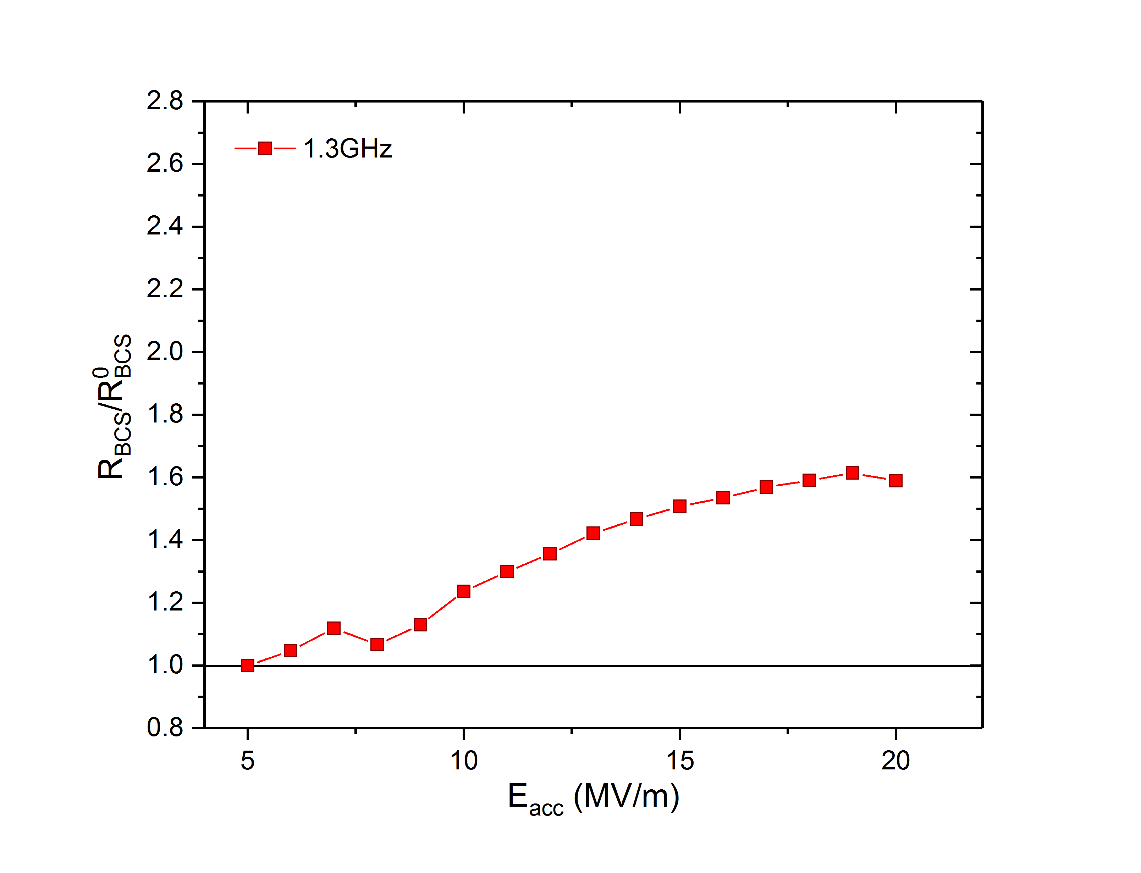
1. Normalized $R_{BCS}\left(2 K\right)$ for 120 C Baking
T=2 K
T=2 K

Slide 11
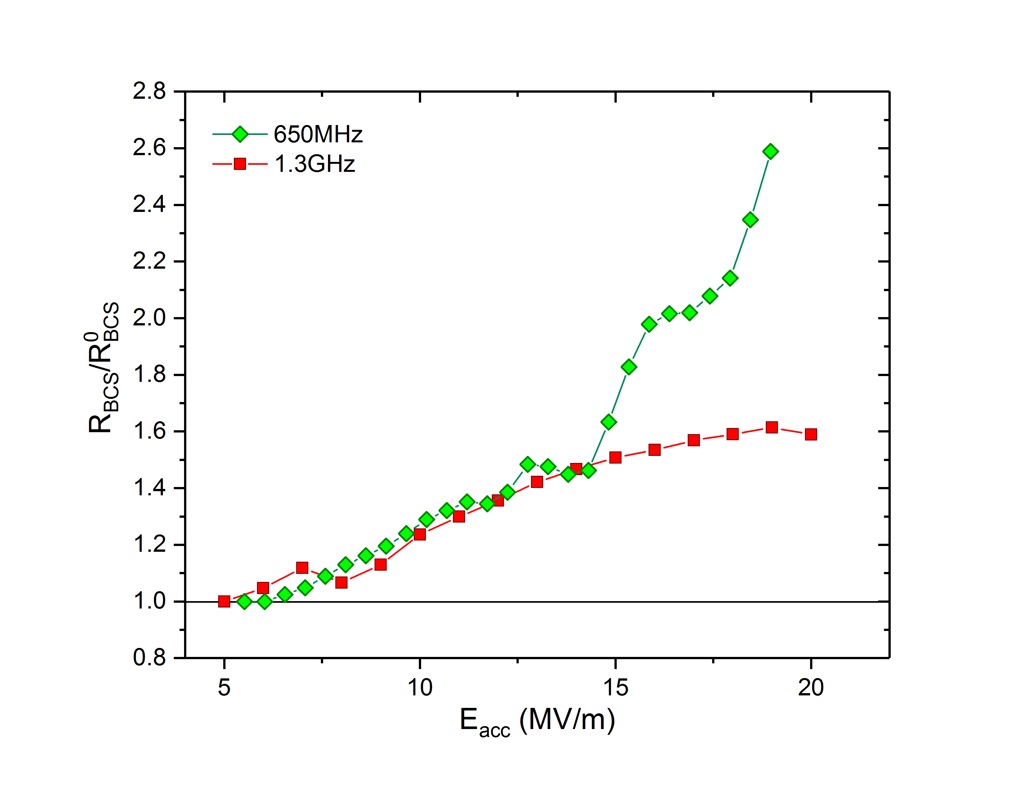
1. Normalized $R_{BCS}\left(2 K\right)$ for 120 C Baking
T=2 K
T=2 K

Slide 12
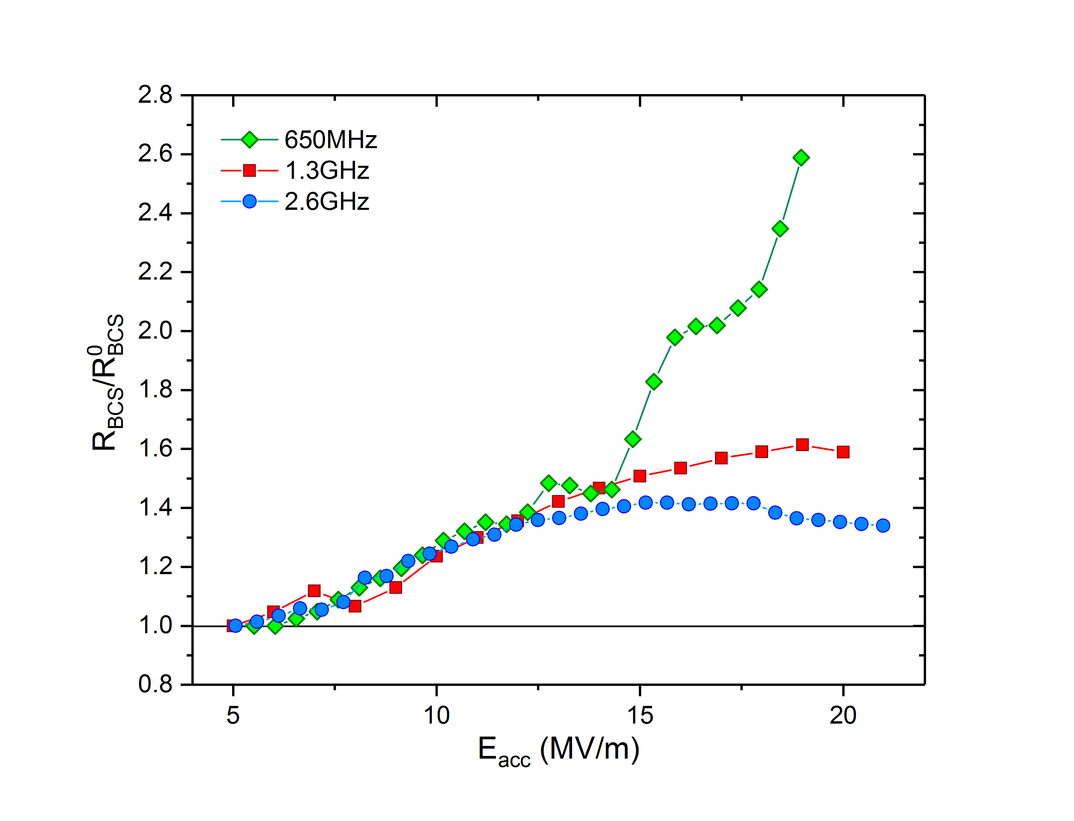
1. Normalized $R_{BCS}\left(2 K\right)$ for 120 C Baking
T=2 K
T=2 K

Slide 13
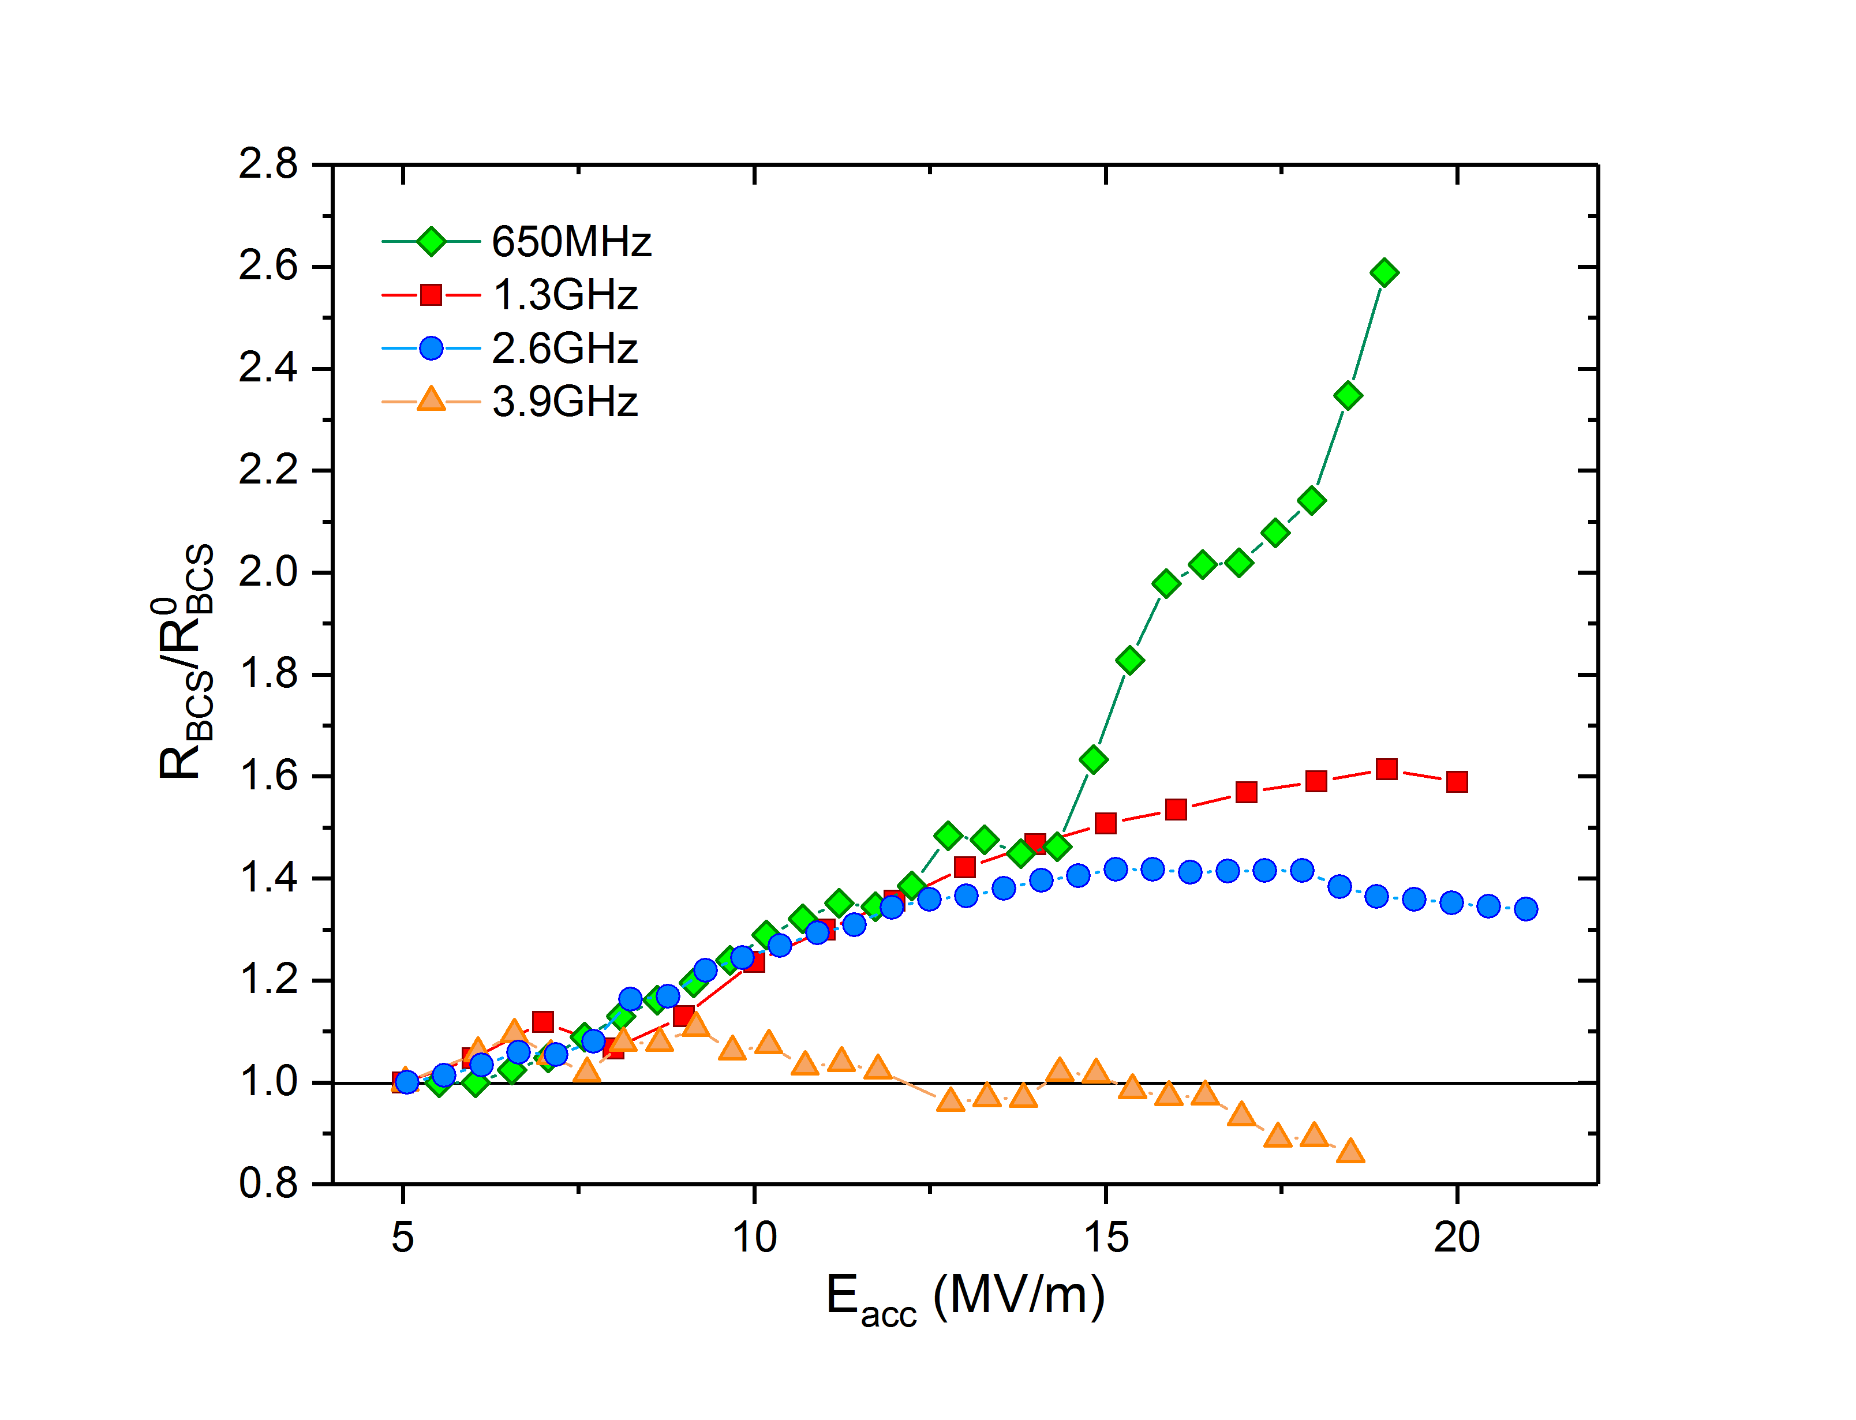
1. Normalized $R_{BCS}\left(2 K\right)$ for 120 C Baking
T=2 K
T=2 K

Slide 14
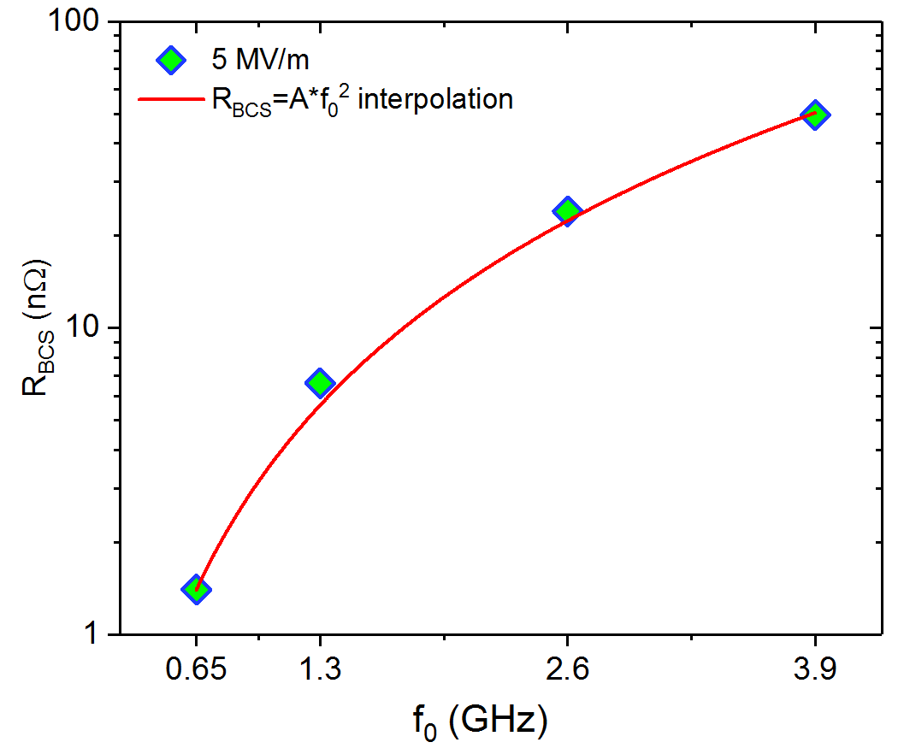
1. Normalized $R_{BCS}\left(2 K\right)$ for 120 C Baking
T=2 K
At low field R_{BCS} follows the ω² trend suggested by the Mattis-Bardeen theory

Slide 15
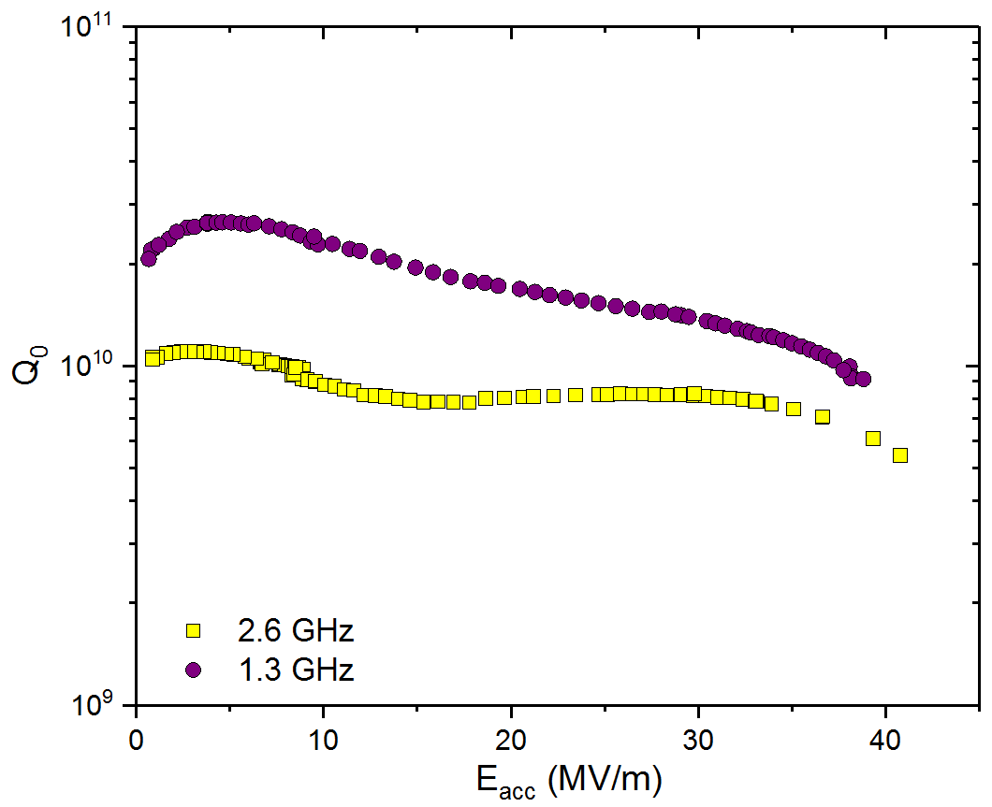
Q-factor of 2.6 GHz at high field tends to the one at 1.3 GHz
Q-factor of 2.6 GHz cavity converge to the one at 1.3 GHz at high gradients
T=2 K
120C baked cavities

Slide 16
Field Dependence at Different Frequencies
Different thermal treatments were studied at different frequencies:
120 ºC baking
BCP and EP
Nitrogen doping (2/6 recipe)

Slide 17
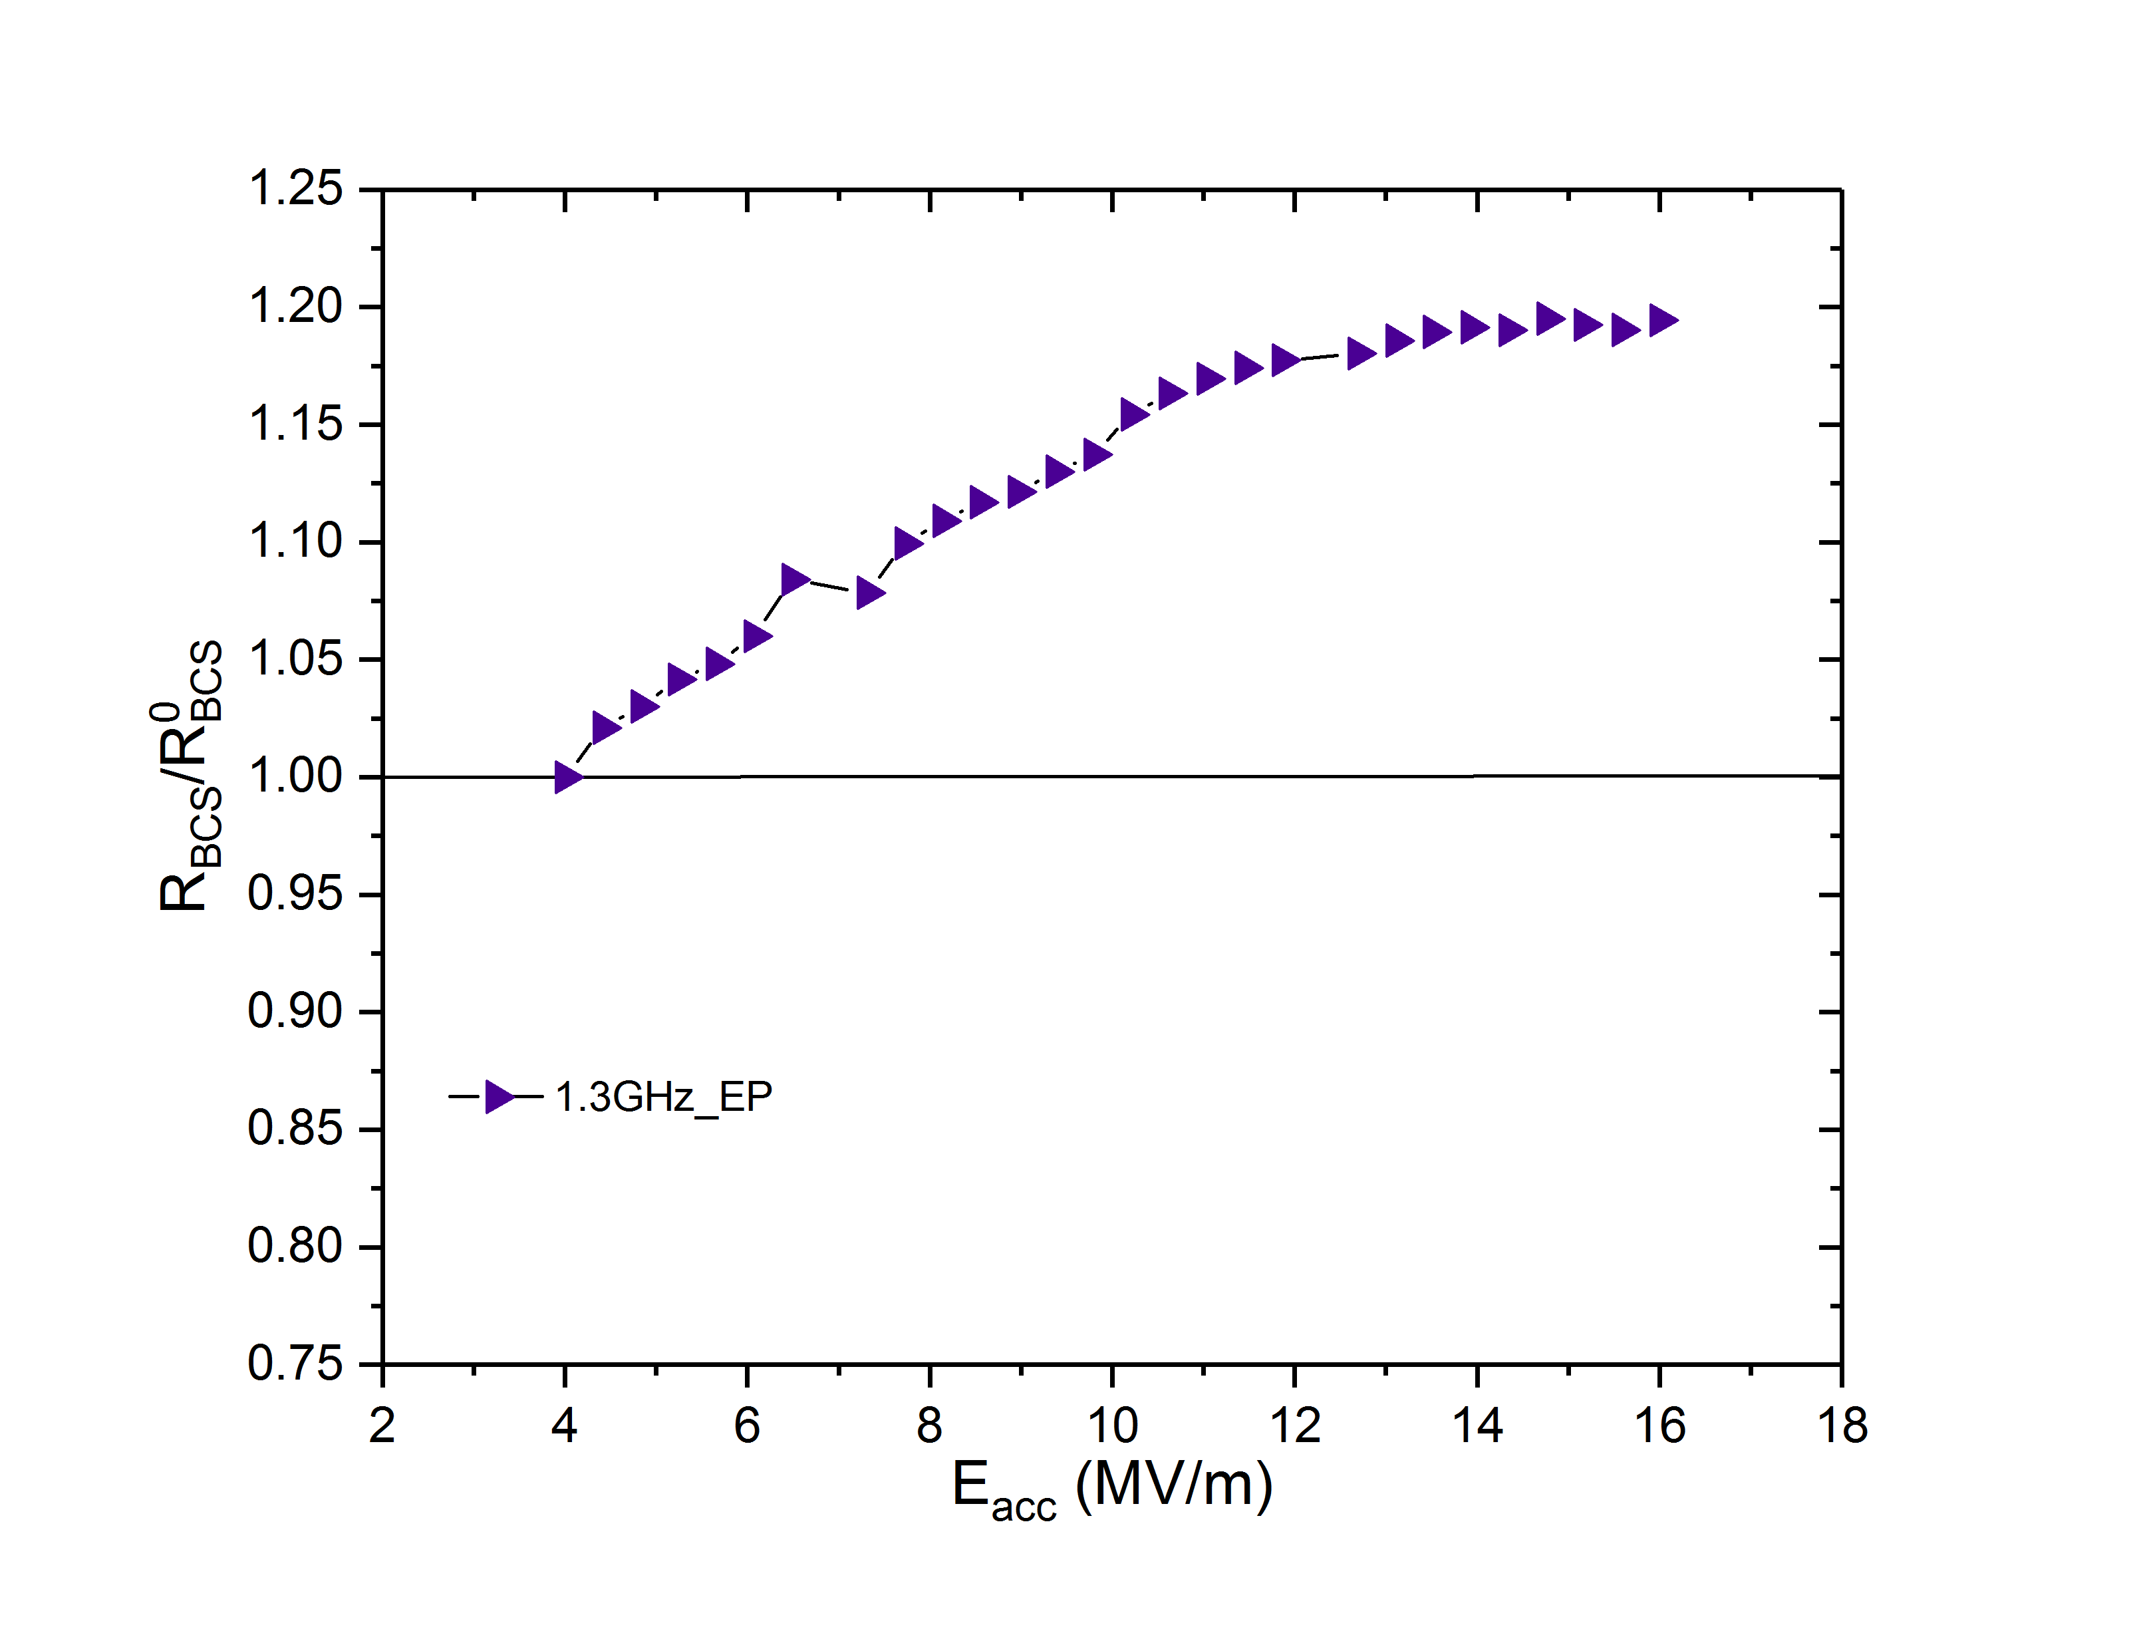
2. Normalized $R_{BCS}\left(2 K\right)$ for EP

Slide 18
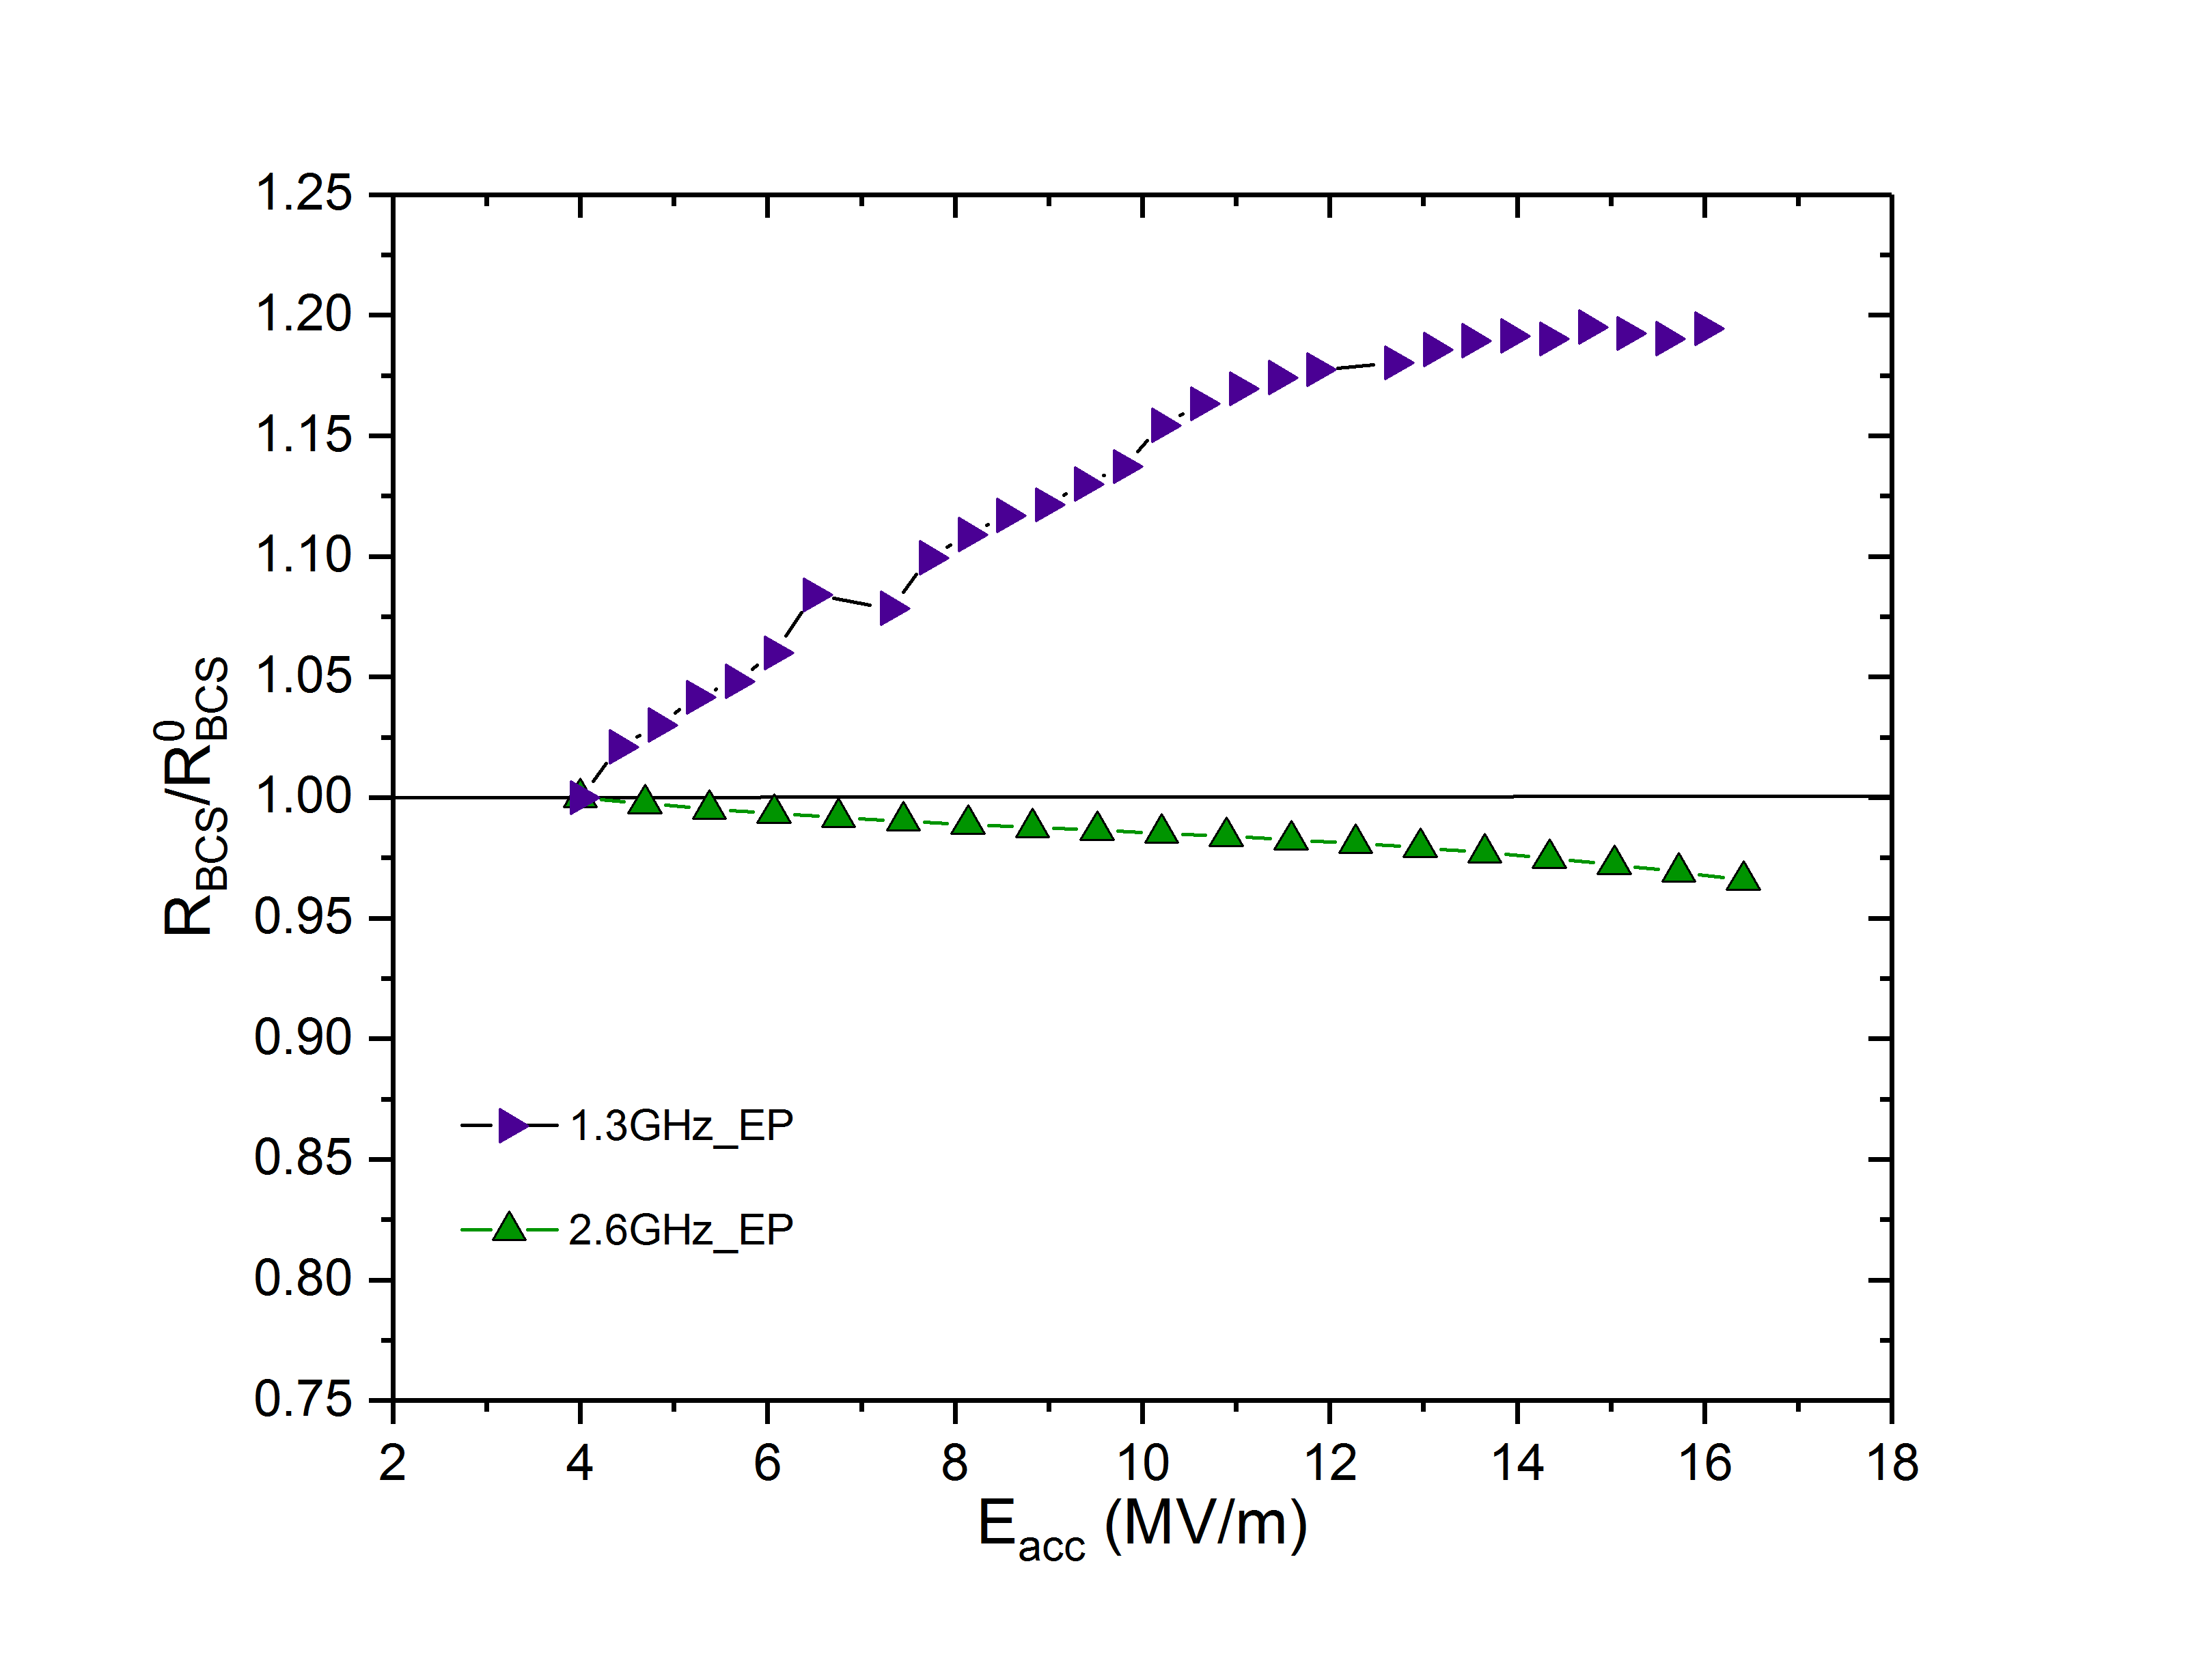
2. Normalized $R_{BCS}\left(2 K\right)$ for EP

Slide 19
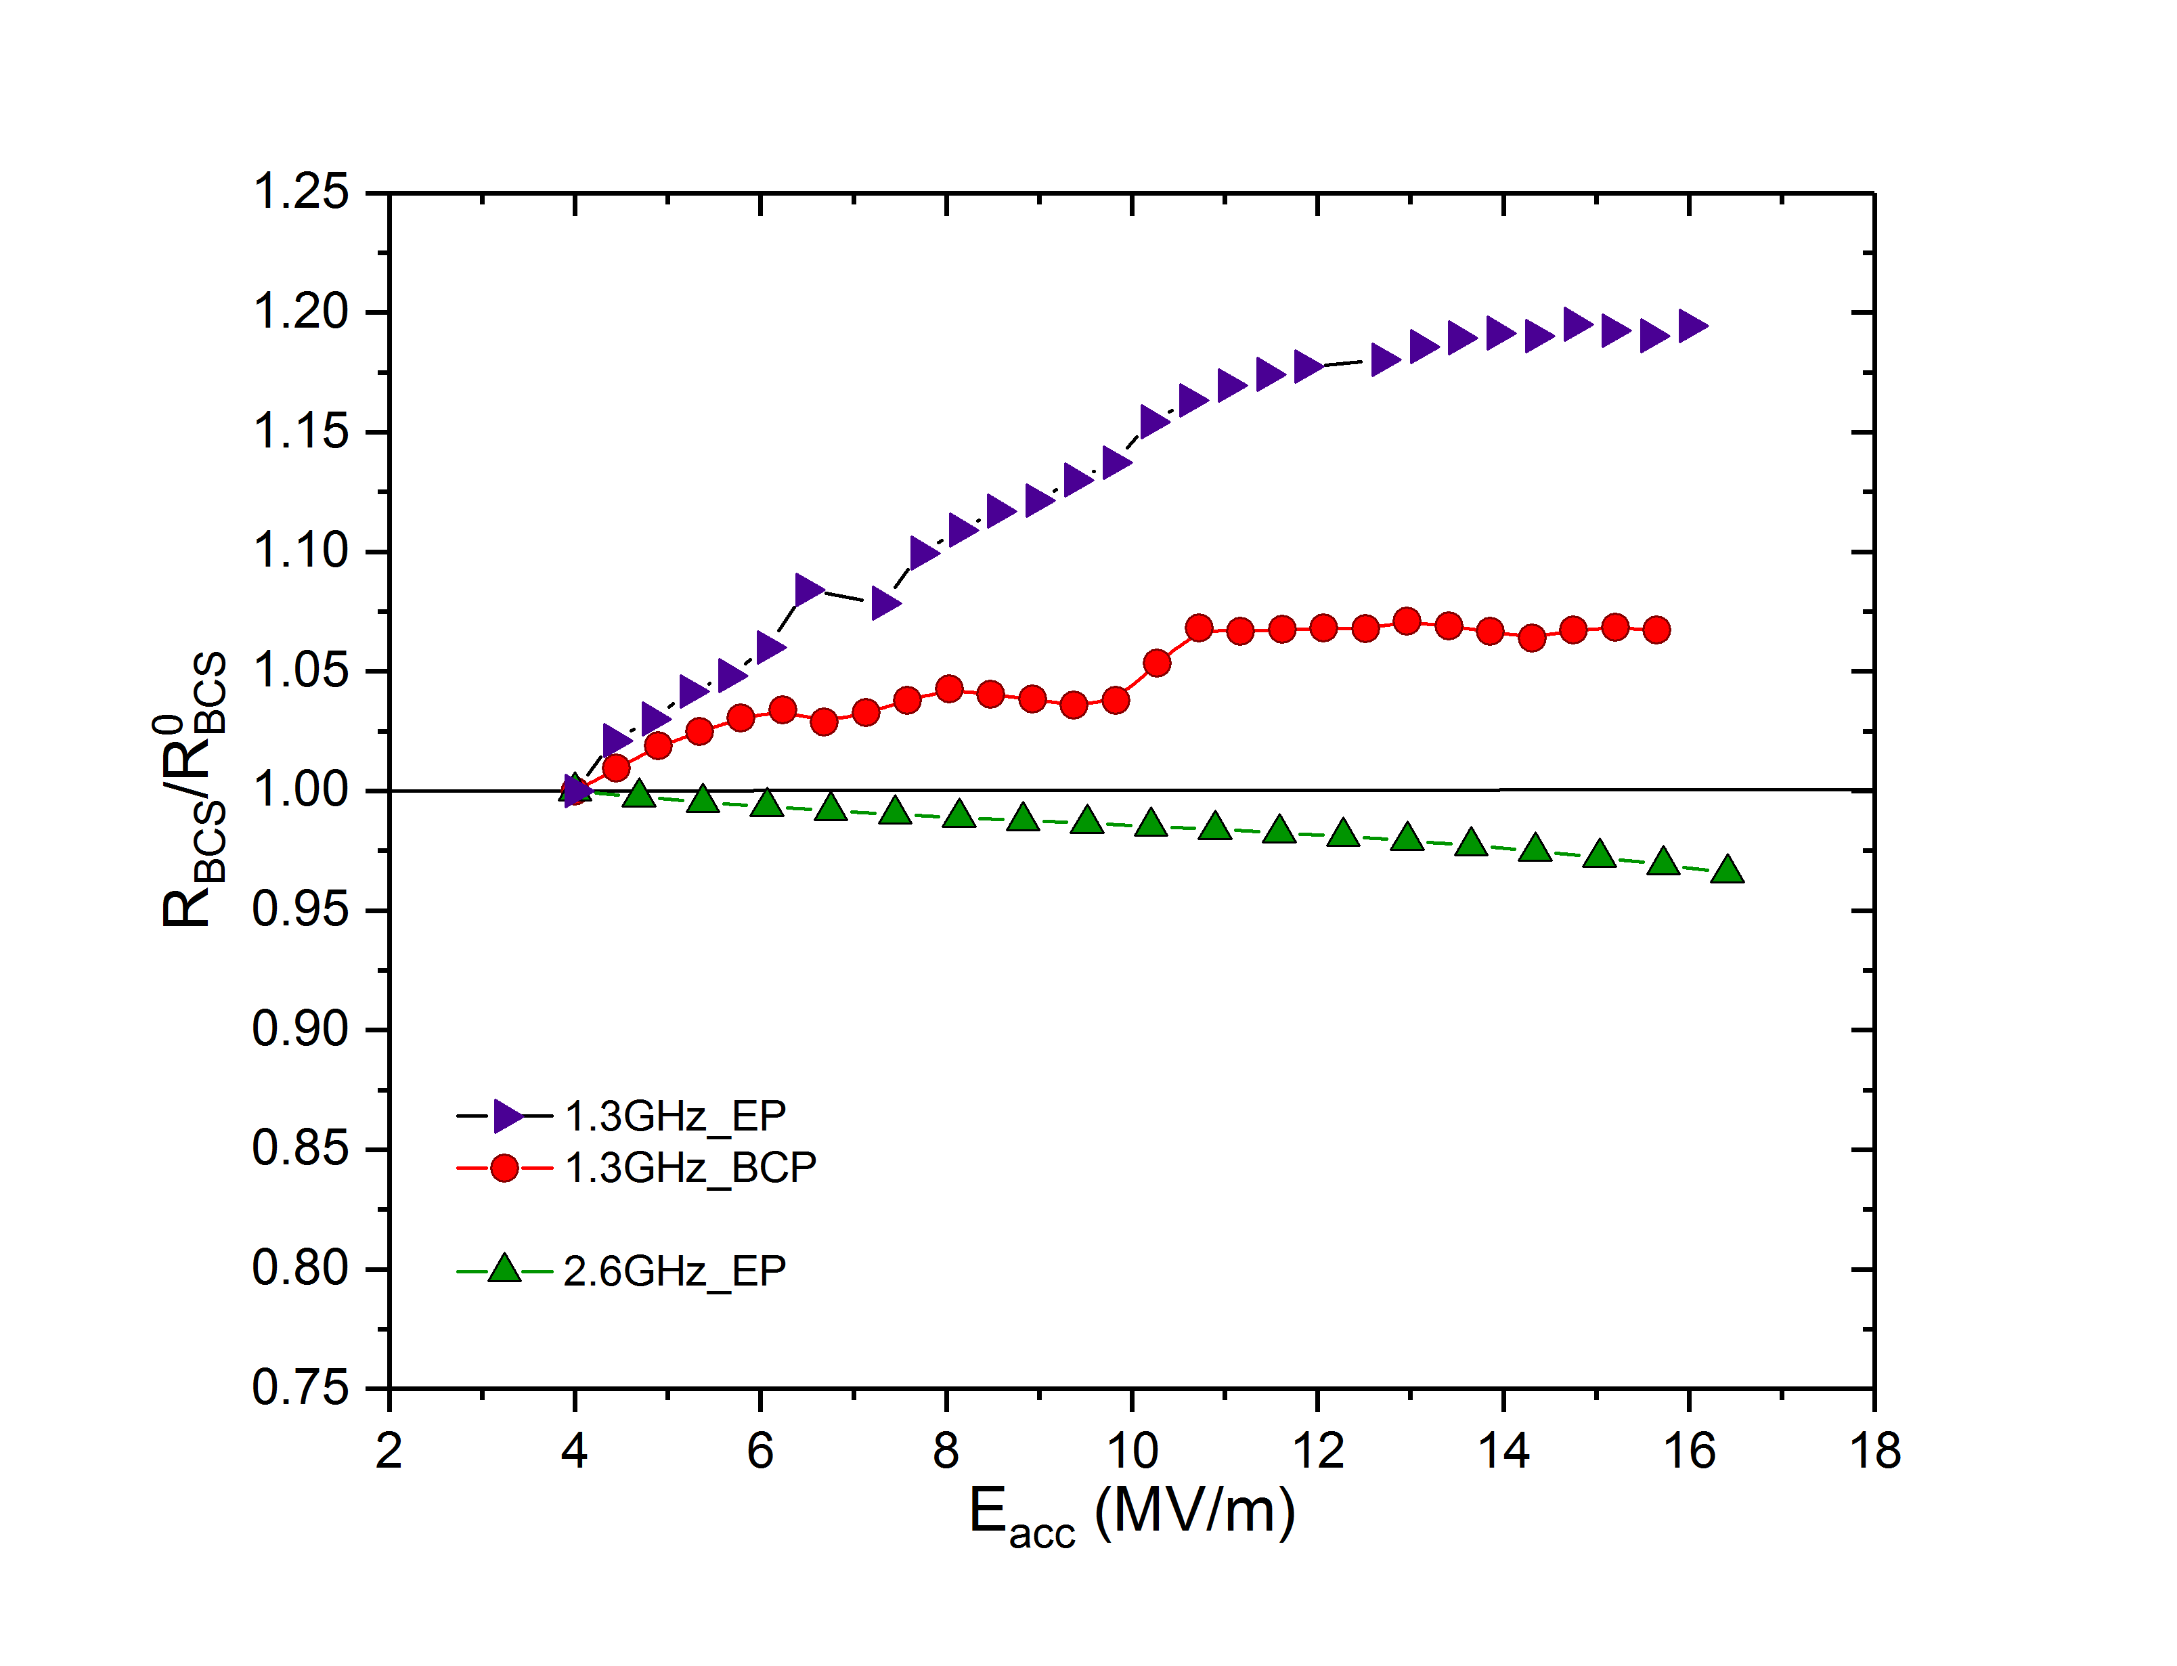
2. Normalized $R_{BCS}\left(2 K\right)$ for EP/BCP

Slide 20
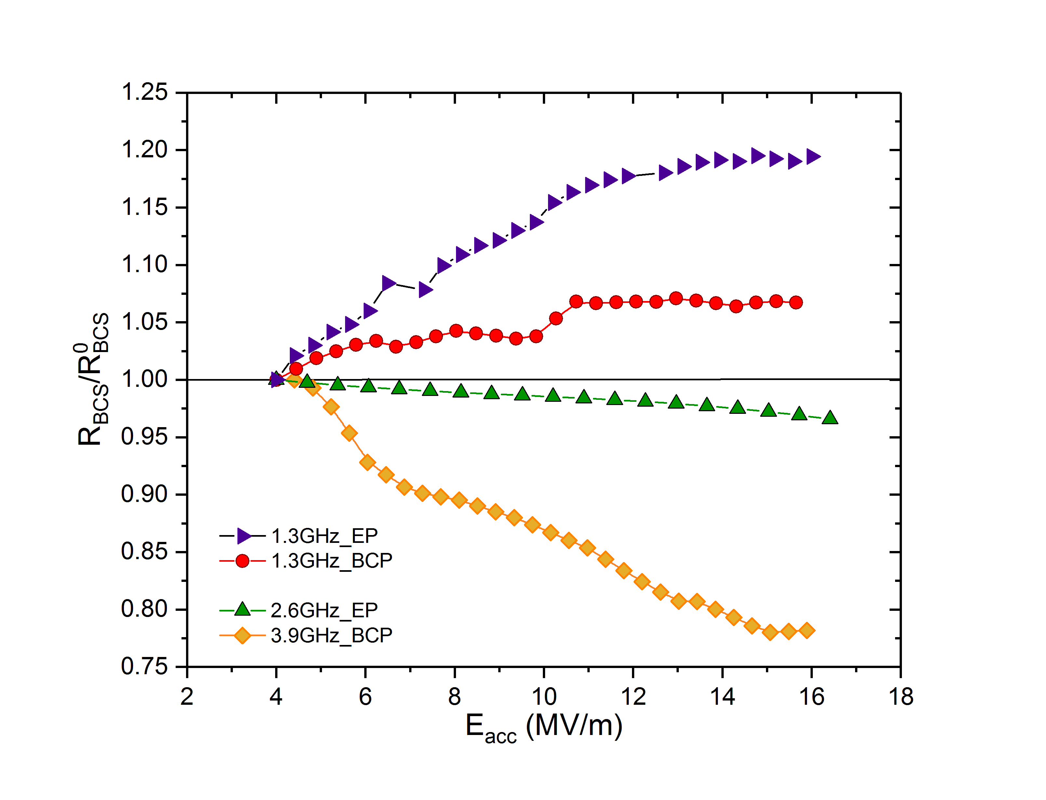
2. Normalized $R_{BCS}\left(2 K\right)$ for EP/BCP

Slide 21
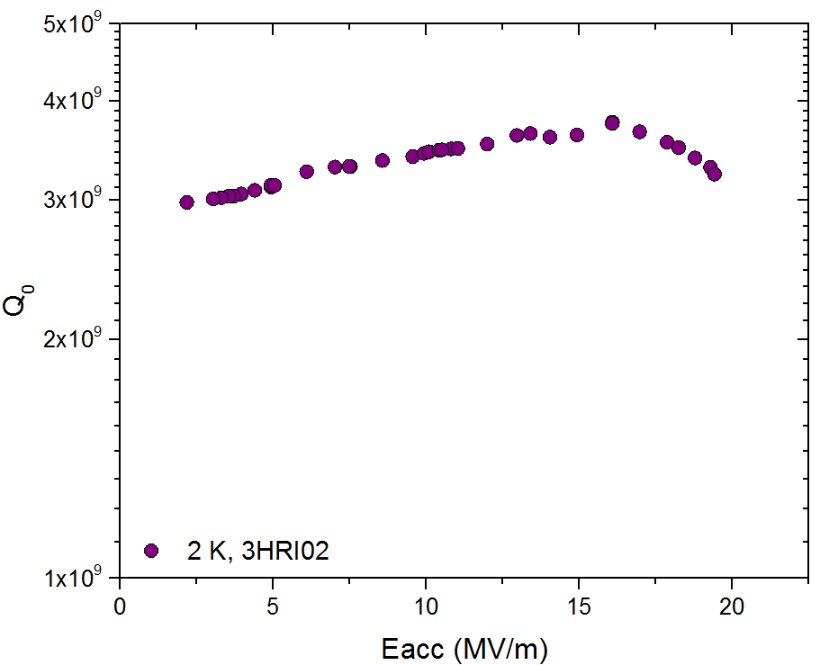
Anti Q-slope in BCP’d 3.9 GHz Cavities
T=2 K
anti Q-slope

Slide 22
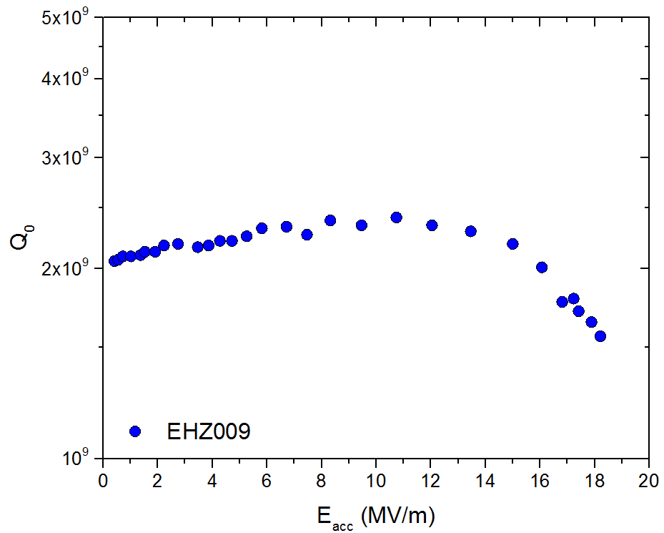
Anti Q-slope in BCP’d 3.9 GHz Cavities
T=2 K
anti Q-slope
Data from E-XFEL database
courtesy of V. Gubarev
also published in D. Sertore et al., Proc. of SRF 2015 MOPB077
anti Q-slope

Slide 23
Field Dependence at Different Frequencies
Different thermal treatments were studied at different frequencies:
120 ºC baking
BCP and EP
Nitrogen doping (2/6 recipe)

Slide 24
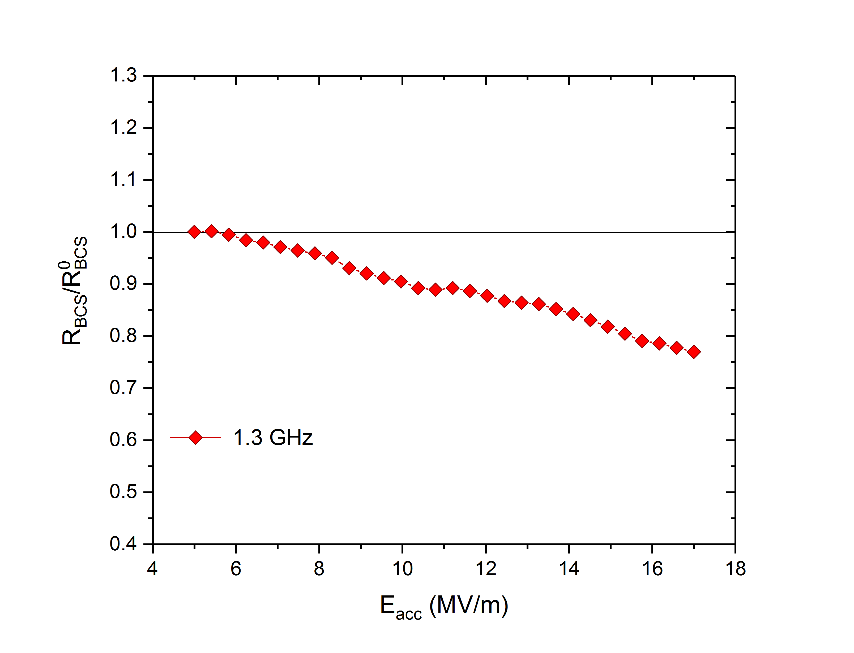
3. Normalized $R_{BCS}\left(2 K\right)$ for N-doping
T=2 K

Slide 25
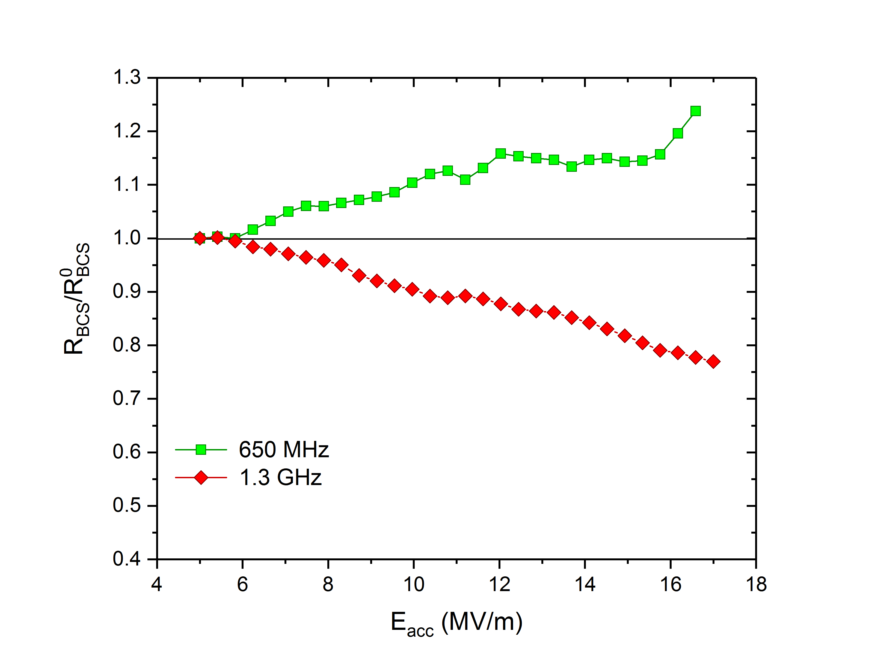
3. Normalized $R_{BCS}\left(2 K\right)$ for N-doping
T=2 K
T=2 K

Slide 26
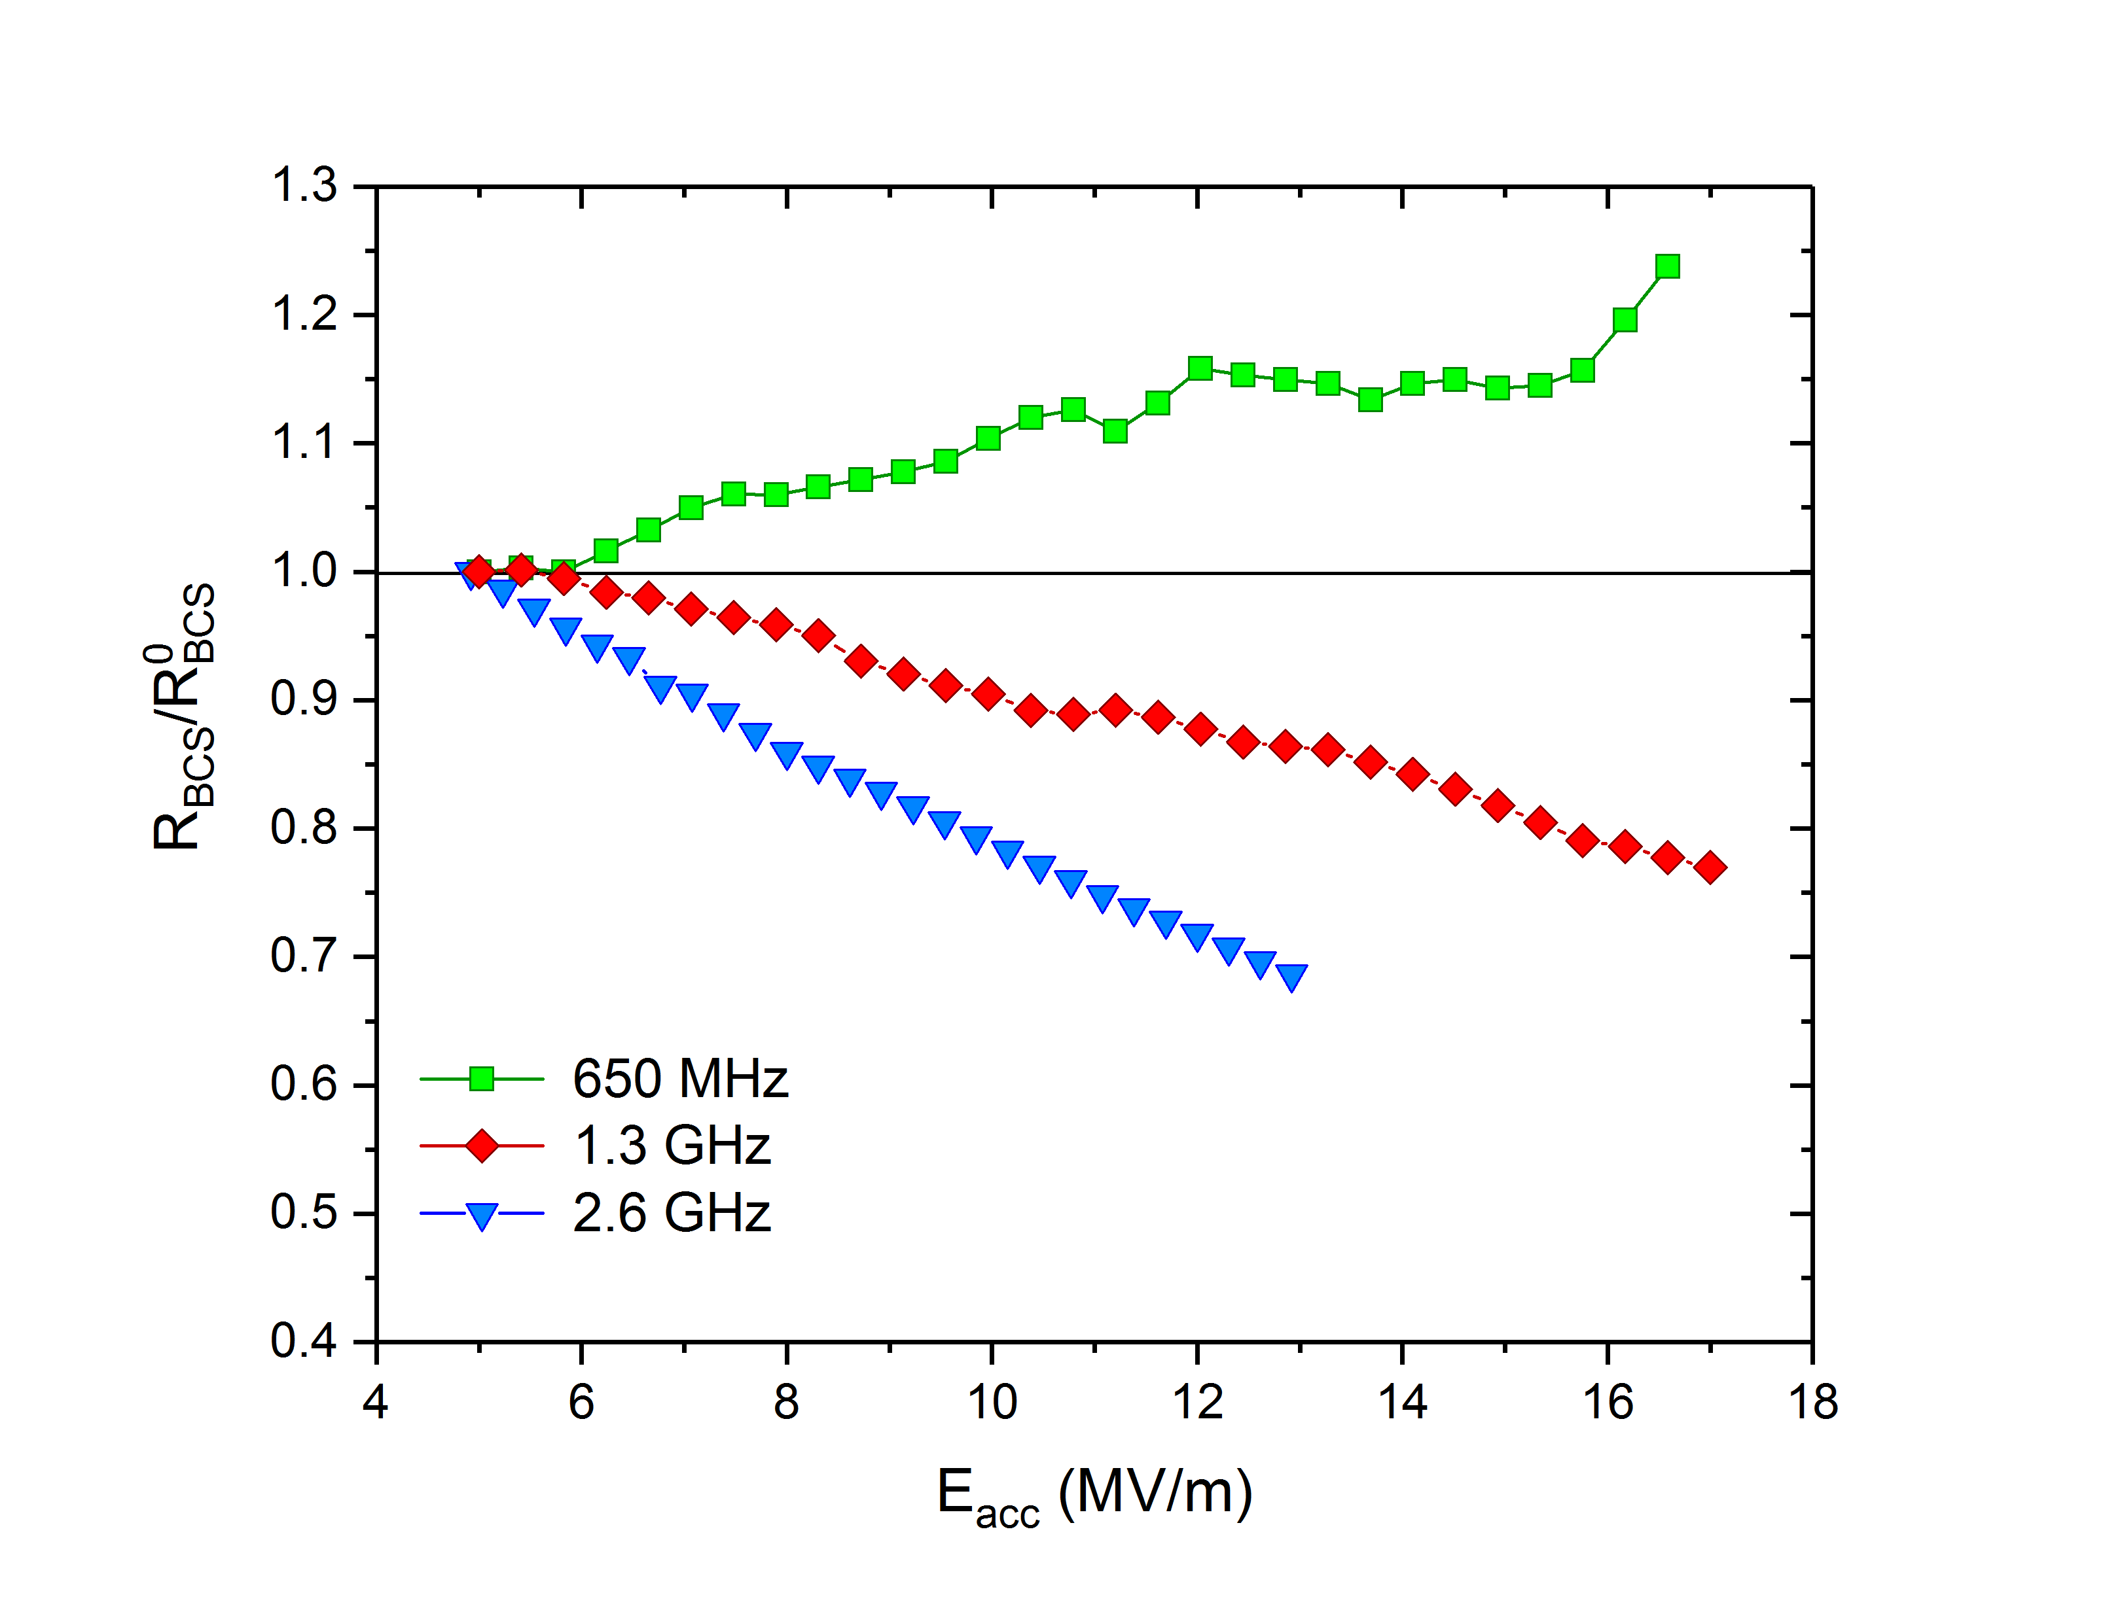
3. Normalized $R_{BCS}\left(2 K\right)$ for N-doping
T=2 K
T=2 K

Slide 27
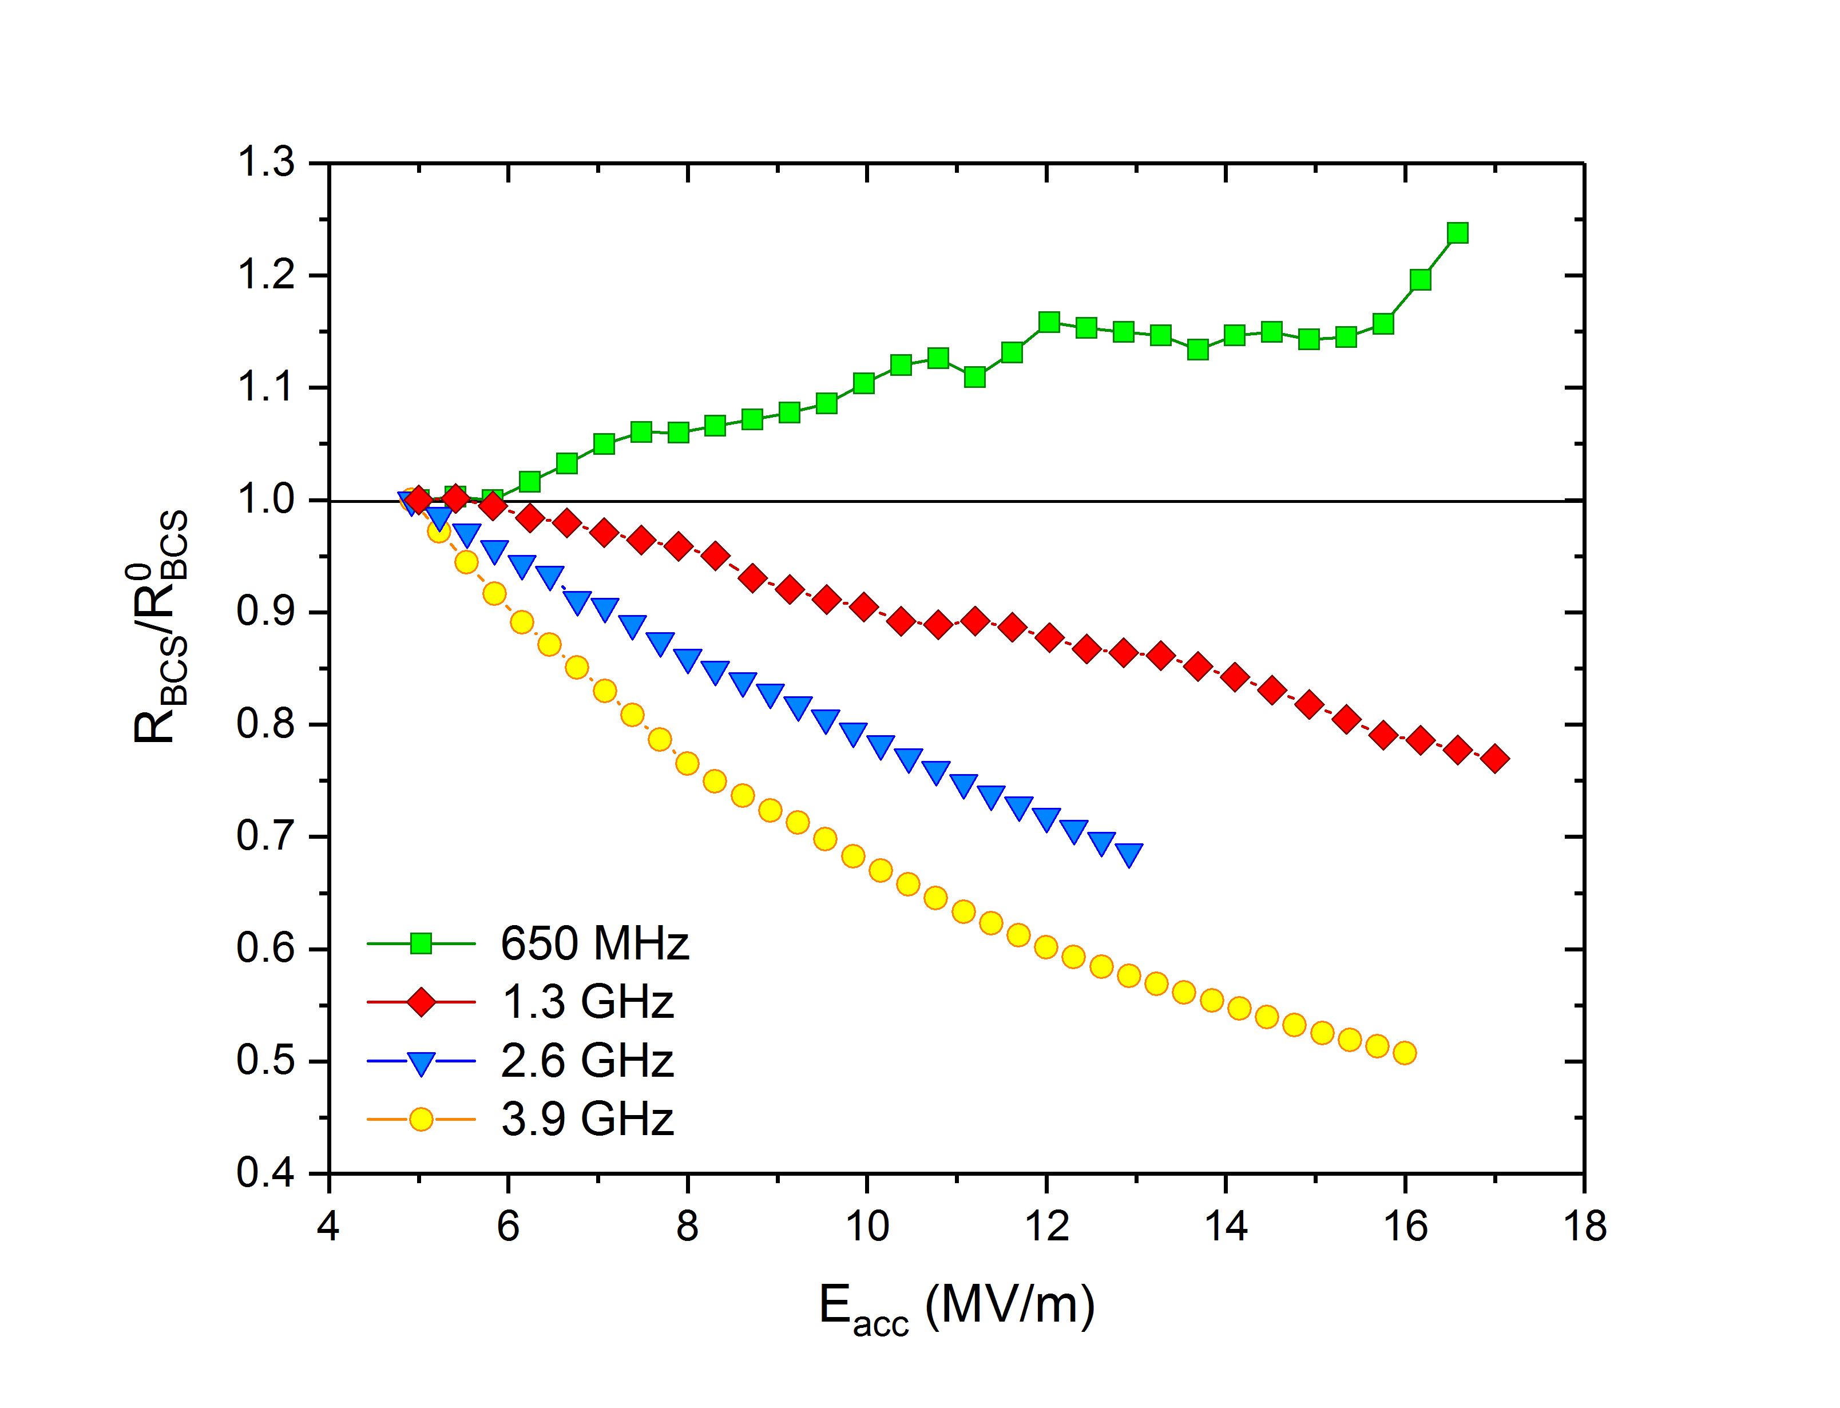
3. Normalized $R_{BCS}\left(2 K\right)$ for N-doping
T=2 K
T=2 K

Slide 28
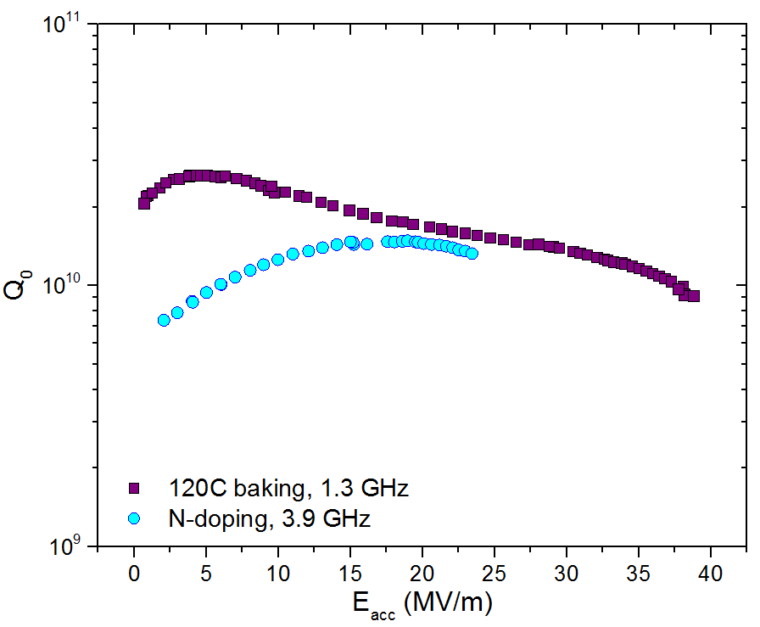

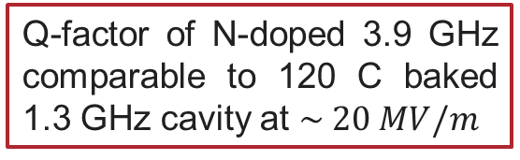
Unprecedented Medium Field Q₀ at 3.9 GHz
Q-factor of N-doped 3.9 GHz comparable to 120 C baked 1.3 GHz cavity at $\sim 20 MV/m$
$$Q_{0}\sim 1.5∙{10}^{10}$$
T=2 K

Slide 29
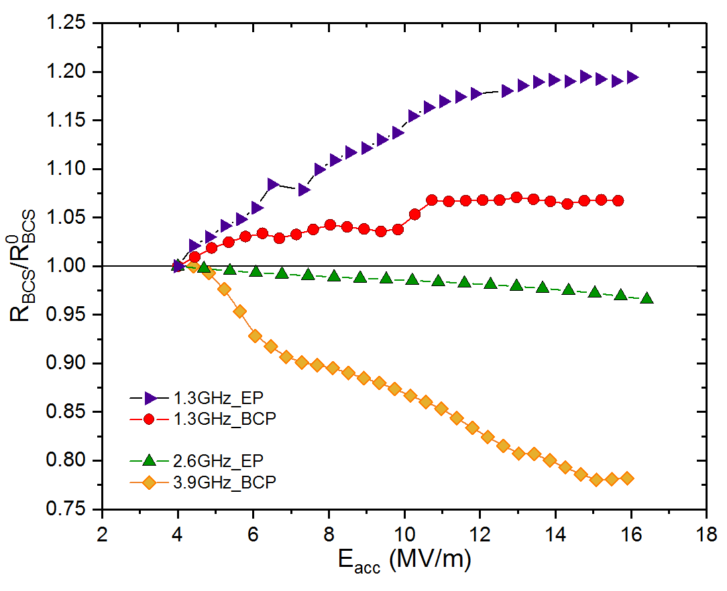
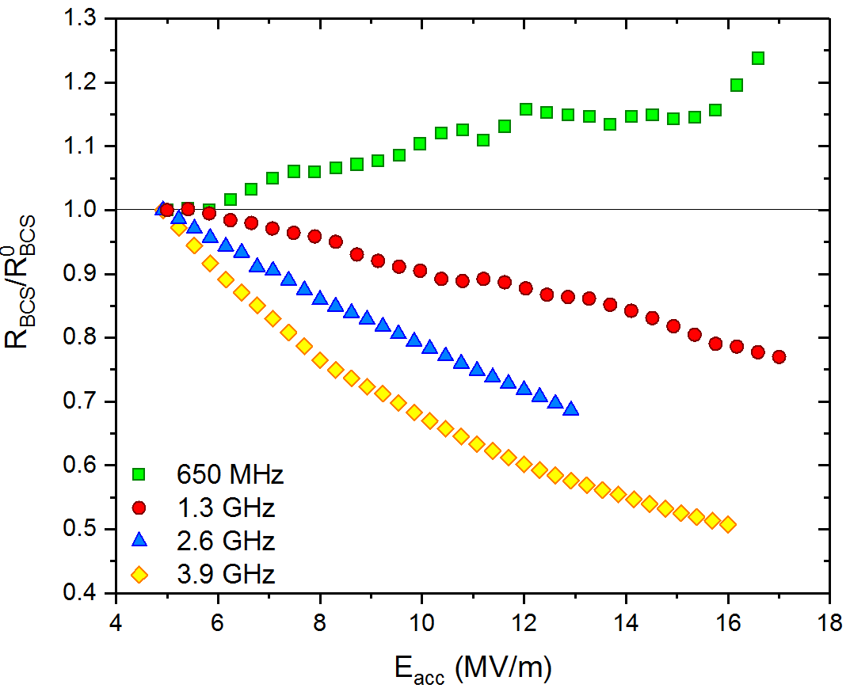
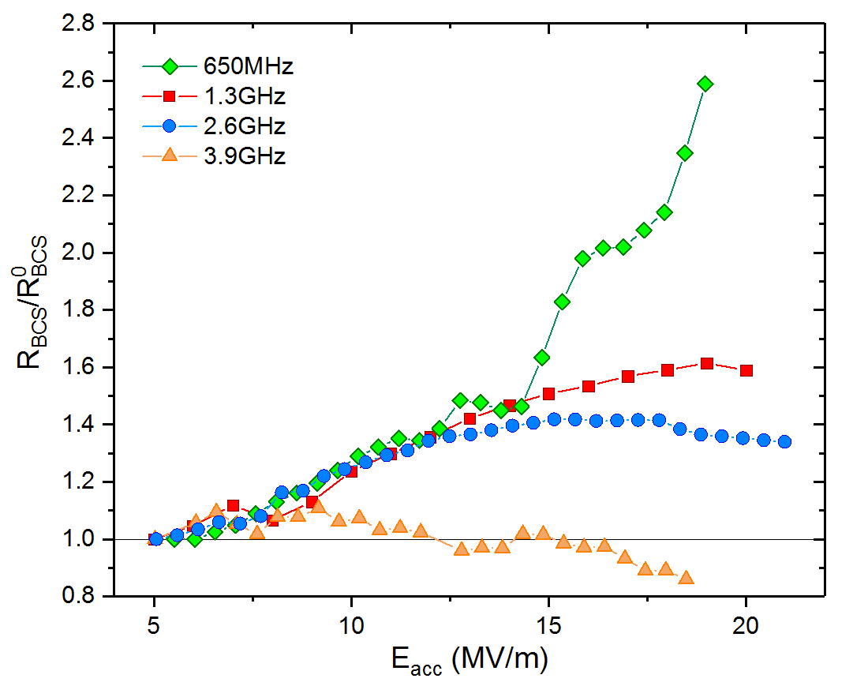
Summary on the frequency dependence of R_{BCS}(Eacc)
EP/BCP
N-doping
120C baking
The physical mechanism underneath the R_{BCS} reversal has a stronger effect at high frequencies
The R_{BCS} reversal, that has been considered the signature of the N-doped treatment, is actually visible also in clean Nb but at high frequency
On the other hand, N-doped cavities at low frequencies do not show the R_{BCS} reversal observed at 1.3 GHz

Slide 30
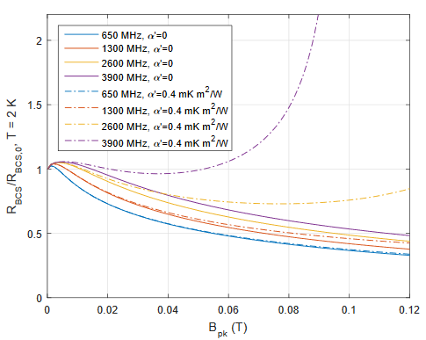
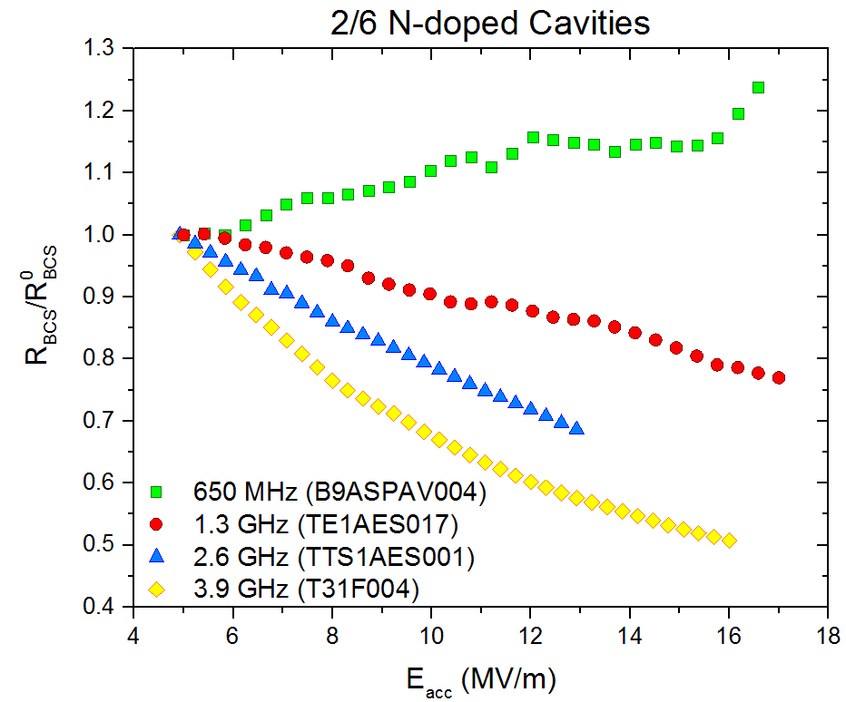
Frequency Dependence NOT Related to QP Overheating
T=2 K
Increasing frequency
Increasing frequency
J. Maniscalco et al. in Proc. of IPAC 2017
Current theoretical description of the N-doping phenomenon not in agreement with experimental findings

Slide 31
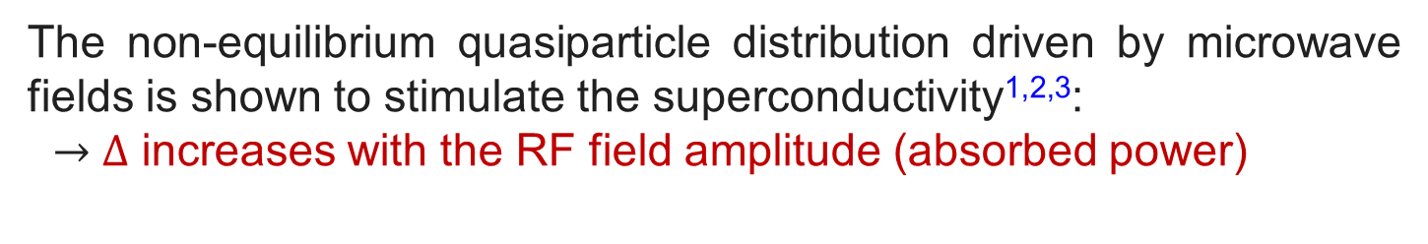
Non-equilibrium QP distribution enhances superconductivity
The non-equilibrium quasiparticle distribution driven by microwave fields is shown to stimulate the superconductivity^{1,2,3}:
$→$ $Δ$ increases with the RF field amplitude (absorbed power)
T. Kommers and J. Clarke,
Phys. Rev. Lett. 38, 1091 (1977)
¹ G.M. Eliashberg, ZhETF Pis. Red. 11, 186 (1970)
² J.-J. Chang and D. J. Scalapino, Phys. Rev. B 15, 2051 (1977)
³ D. J. Goldie and S. Withington, Supercond. Sci. Technol. 26, 015004 (2013)

Slide 32
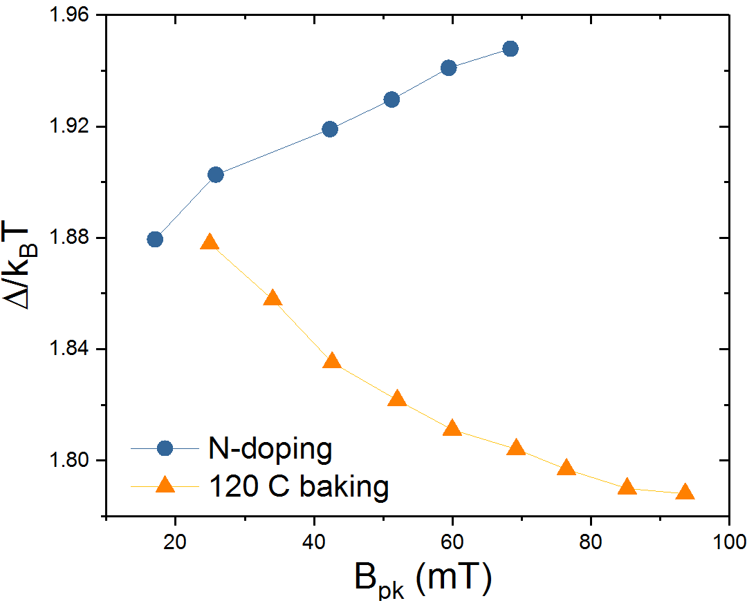
Non-equilibrium QP distribution enhances superconductivity
The non-equilibrium quasiparticle distribution driven by microwave fields is shown to stimulate the superconductivity^{1,2,3}:
$→$ $Δ$ increases with the RF field amplitude (absorbed power)
T. Kommers and J. Clarke,
Phys. Rev. Lett. 38, 1091 (1977)
¹ G.M. Eliashberg, ZhETF Pis. Red. 11, 186 (1970)
² J.-J. Chang and D. J. Scalapino, Phys. Rev. B 15, 2051 (1977)
³ D. J. Goldie and S. Withington, Supercond. Sci. Technol. 26, 015004 (2013)

Slide 33
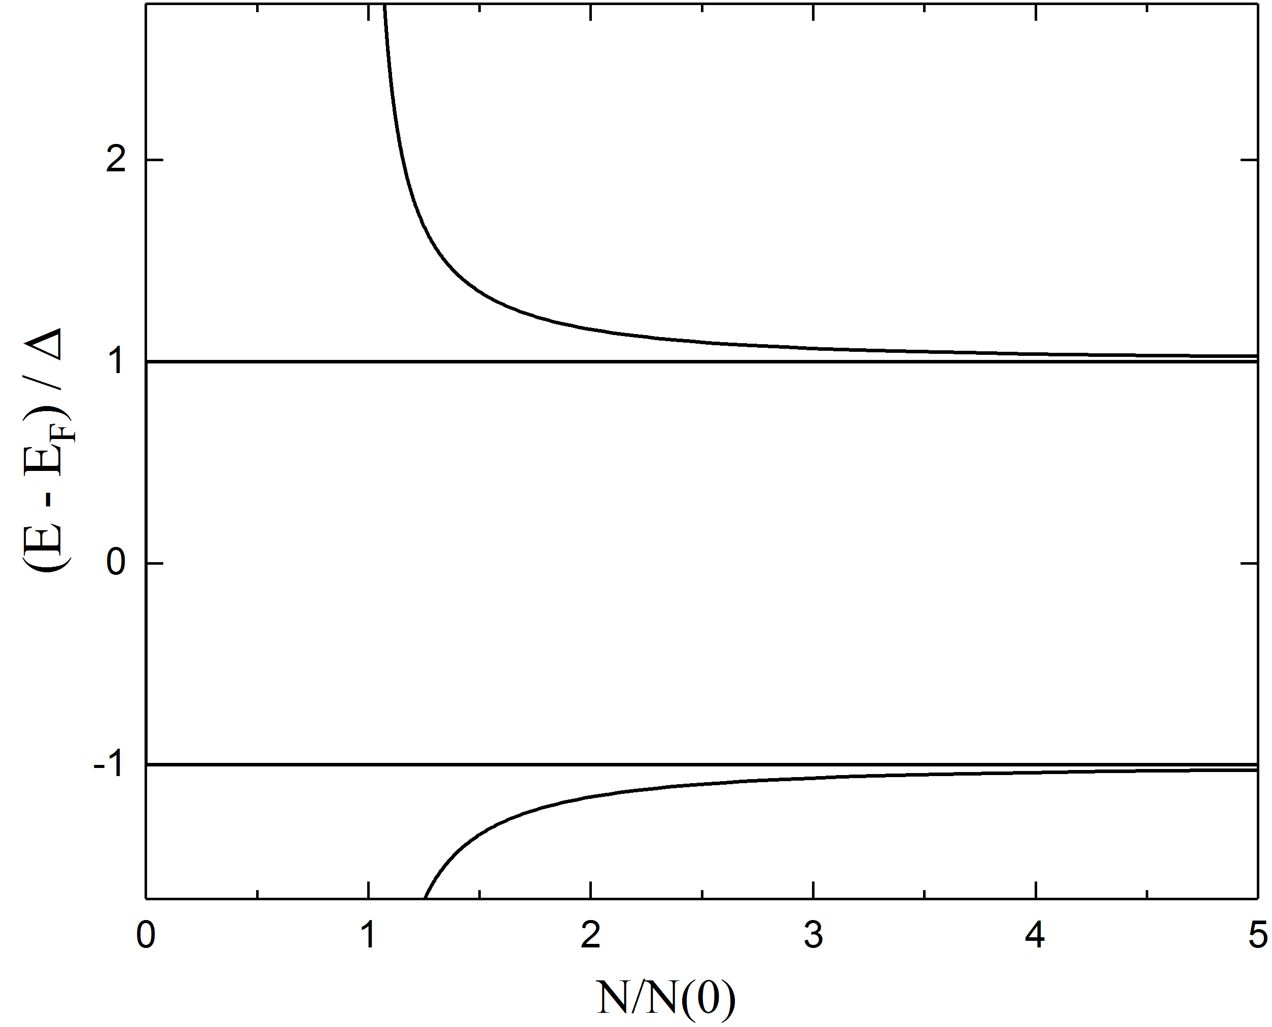


Thermal equilibrium distribution of quasiparticles
$$f(E)$$
$$2∆$$

Slide 34



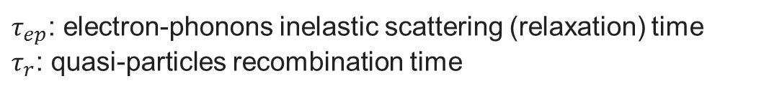




Non-equilibrium distribution of quasiparticles
$$hν$$
$$τ_{ep}$$
$$hν$$
$$hν$$
$$f(E)$$
Condition for non-equilibrium SC:
$$τ_{r}(E)$$
$$τ_{r}(E+nhν)$$
$$2∆$$
$ν>{1/τ}_{r}$, ${1/τ}_{ep}$
$τ_{ep}$: electron-phonons inelastic scattering (relaxation) time
$τ_{r}$: quasi-particles recombination time

Slide 35
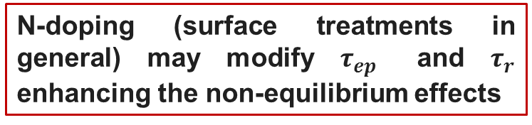
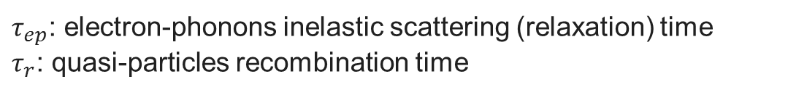
Non-equilibrium distribution of quasiparticles
$$hν$$
$$τ_{ep}$$
$$hν$$
$$hν$$
$$f(E)$$
Condition for non-equilibrium SC:
$$τ_{r}(E)$$
$$τ_{r}(E+nhν)$$
$$2∆$$
$ν>{1/τ}_{r}$, ${1/τ}_{ep}$
N-doping (surface treatments in general) may modify $τ_{ep}$ and $τ_{r}$ enhancing the non-equilibrium effects
$τ_{ep}$: electron-phonons inelastic scattering (relaxation) time
$τ_{r}$: quasi-particles recombination time

Slide 36
Summary and Open Questions
R_{BCS}(E_{acc}) shows a strong frequency dependence: high frequencies are favorable to lower R_{BCS} at high field
The decreasing of R_{BCS}(E_{acc}) can appear also in high-frequencies non-doped cavities and, vice versa, R_{BCS}(E_{acc}) increases in low frequencies N-doped cavities
Non-equilibrium SC may qualitatively explain the decreasing of the surface resistance as a function of the field and its enhancement at higher frequencies
Can the presence of impurities modify the relaxation and recombination time of QPs? How could we measure it?

Slide 37
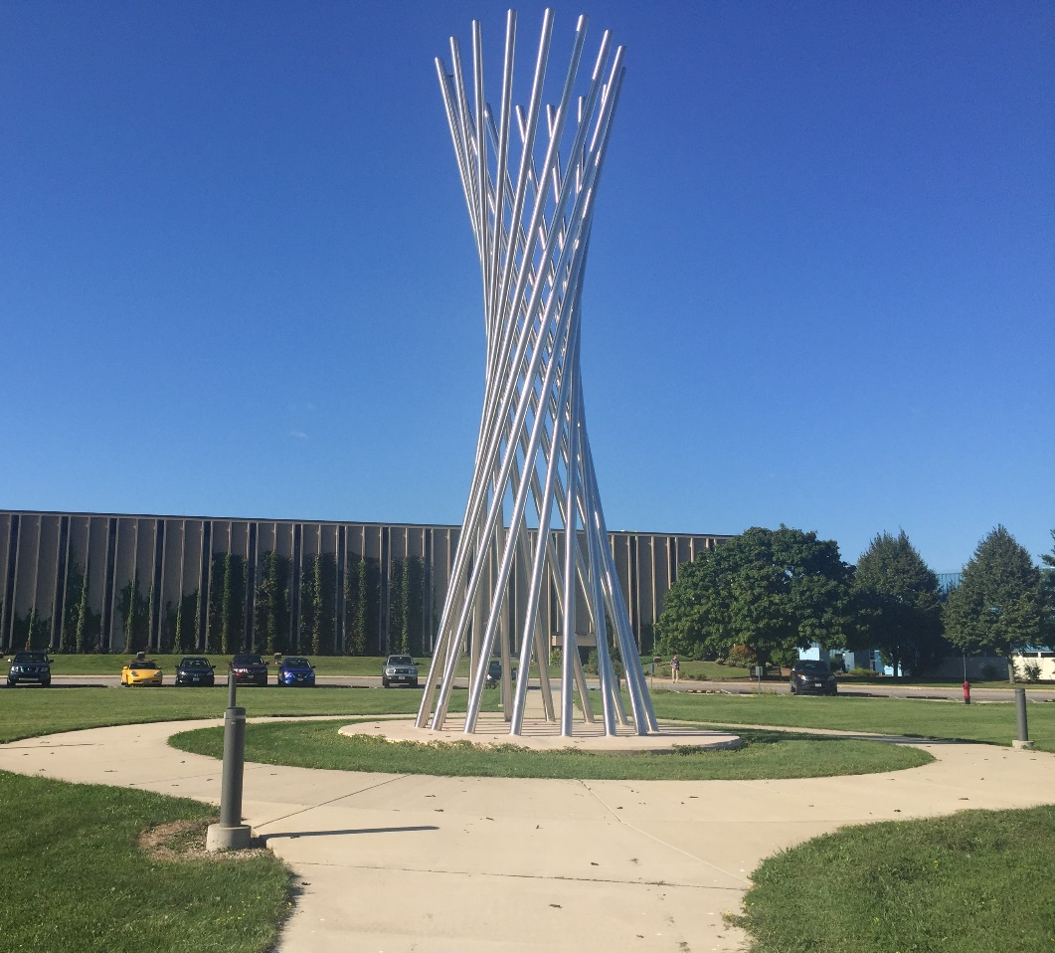
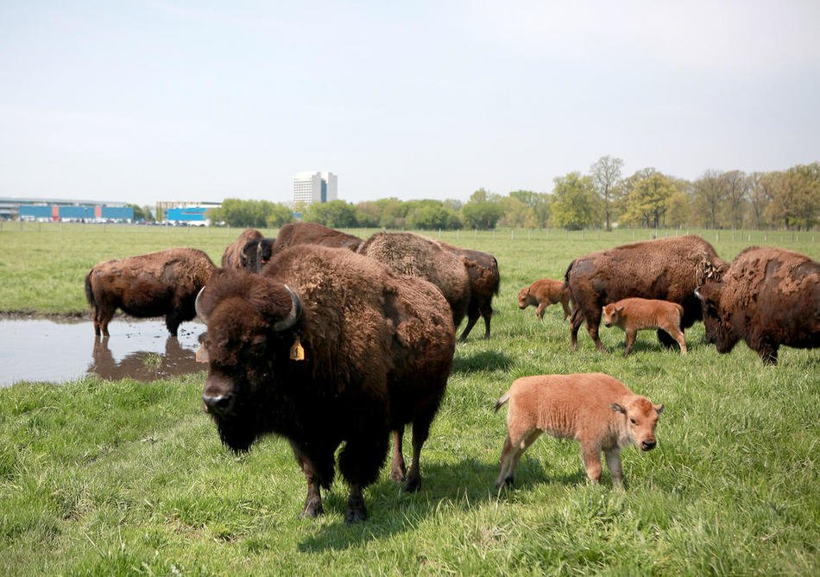
Thank you for your attention!

