Slide 1
Collective weak pinning model of vortex dissipation in SRF cavities
Danilo Liarte,
James Sethna,
Daniel Hall,
Matthias Liepe
Cornell University
TTC Topical Workshop - RF Superconductivity: Pushing Cavity Performance Limits

Slide 2
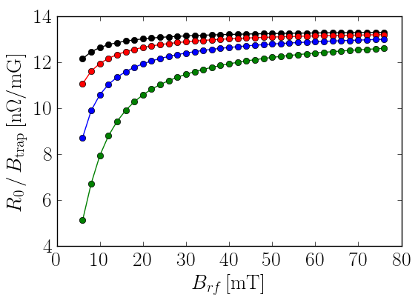
Outline
a)
Introduction
Collective weak pinning
Results
Final remarks
c)
b)

Slide 3
Outline
a)
Introduction
Collective weak pinning
Results
Final remarks
c)
b)

Slide 4
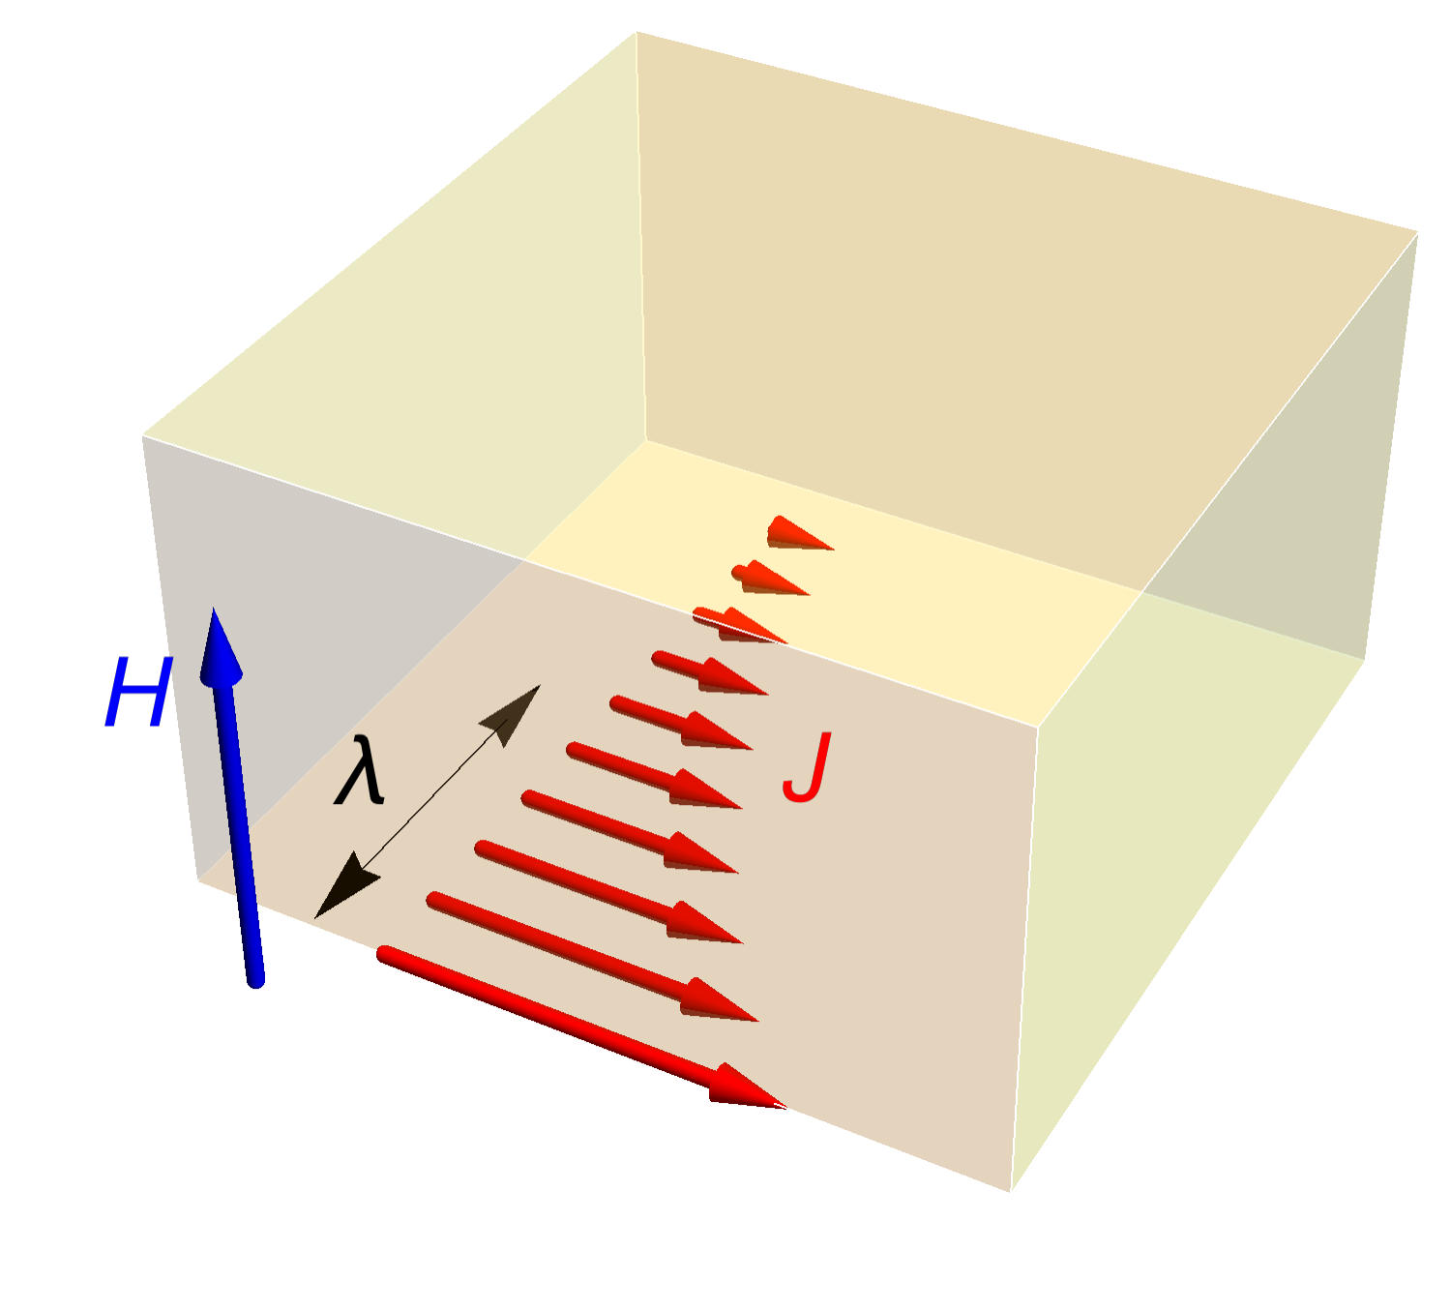
Gaining insight on trapped flux
Gurevich & Ciovati
PRB 2013

Slide 5

Sensitivity of $R_{0}$ to trapped flux
Dependence on MFP (Gonnella)
Dependence on RF field (Hall)
Gonnella et al. J. Appl. Phys. 2016
Hall et al. IPAC 2017

Slide 6
Outline
a)
Introduction
Collective weak pinning
Results
Final remarks
c)
b)

Slide 7
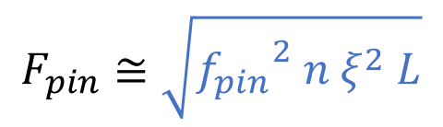

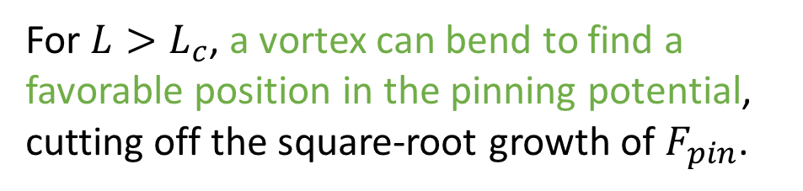


$\sqrt{N}$ fluctuations and collective weak pinning
viscous
pinning
Magnus
$$M\ddot{u}=f_{v}+f_{L}+f_{p}+f_{e}+f_{M}$$
inertial
Lorentz
elastic
Pinning f orces add up randomly; only fluctuations can pin the line.
$$F_{pin}≅\sqrt{{f_{pin}}^{2} n ξ^{2} L}$$
accumulated pinning force
$$ℇ_{pin}\left(L_{c}\right)=ℇ_{elastic}\left(L_{c}\right)$$
For $L>L_{c}$, a vortex can bend to find a favorable position in the pinning potential, cutting off the square-root growth of $F_{pin}$.

Slide 8

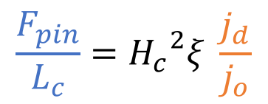
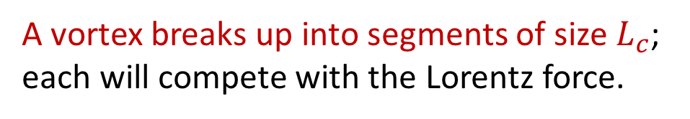
$\sqrt{N}$ fluctuations and collective weak pinning
viscous
pinning
Magnus
$$M\ddot{u}=f_{v}+f_{L}+f_{p}+f_{e}+f_{M}$$
inertial
Lorentz
elastic
A vortex breaks up into segments of size $L_{c}$; each will compete with the Lorentz force.
Pinning force & depinning current…
$$F_{pin}\left(L_{c}\right)=F_{Lorentz}(j_{d}, L_{c})$$
$$ℇ_{pin}\left(L_{c}\right)=ℇ_{elastic}\left(L_{c}\right)$$
$$\frac{F_{pin}}{L_{c}}={H_{c}}^{2}ξ \frac{j_{d}}{j_{o}}$$
(cgs units)

Slide 9
Outline
a)
Introduction
Collective weak pinning
Results
Final remarks
c)
b)

Slide 10


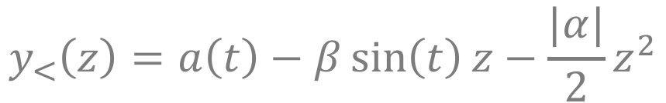

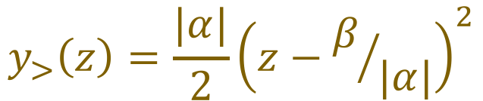




Collective weak pinning at low frequency
Derivation and analytical solution
MF pinning
$$0=f_{L}+f_{p}^{MF}+f_{e}$$
Solution for Nb₃Sn at 20mT RF field and 1mA/µm² depinning current
Lorentz
elastic
$$y^{∗}(t)$$
$$y^{′′}=α−β\sin\left(t\right)δ(z)$$
$$y_{>}(z)$$
$$y_{<}(z)$$
$$y_{<}\left(z\right)=a\left(t\right)−β\sin\left(t\right)z−\frac{|α|}{2}z^{2}$$
for
$$y<y^{∗}$$
$$y_{>}\left(z\right)=\frac{|α|}{2}{\left(z−β/{|α|}\right)}^{2}$$
for
$$y>y^{∗}$$

Slide 11
Collective weak pinning at low frequency
‘Sanity’ tests
Point-like force, collective weak pinning, BC…
Viscous dissipation term
Amplitudes in y and z
Curvature radius
at the surface
At 1.3GHz
Pinning length
At 10 MHz
‘Curvature radius’
at the surface

Slide 12
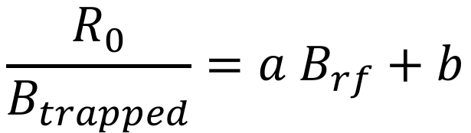
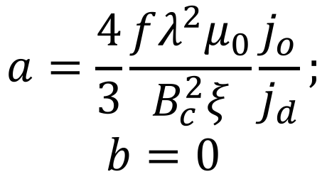
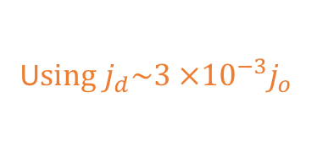
Dependence on RF field
$$\frac{R_{0}}{B_{trapped}}=a B_{rf}+b$$
The linear behavior is consistent with collective weak pinning (but not accurate)
There is a factor of 100 off in comparison with the experimental results. Viscous dissipation is needed.
U$sing j_{d}\sim 3 ×{10}^{−3}j_{o}$
$$a=\frac{4}{3}\frac{fλ^{2}μ_{0}}{B_{c}^{2}ξ}\frac{j_{o}}{j_{d}};$$
$$b=0$$
DBL, Hall, Liepe, Sethna, in progress

Slide 13

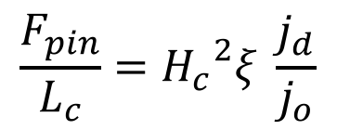
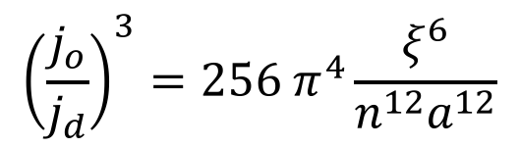
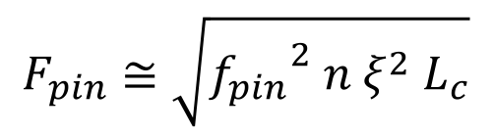
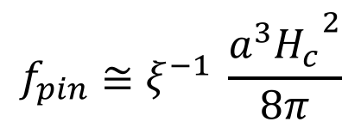

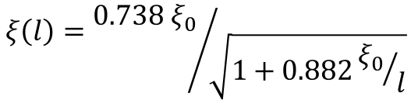
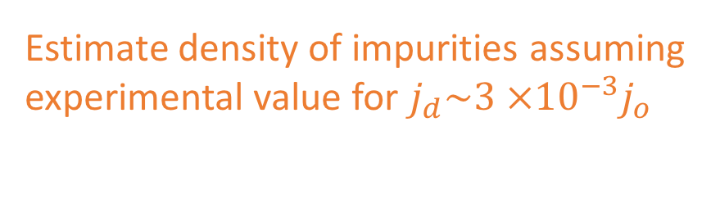



Collective weak pinning at low frequency
‘Sanity’ tests
Estimate density of impurities assuming
experimental value for $j_{d}\sim 3 ×{10}^{−3}j_{o}$
$$n^{1/3}={ξ\left(l\right)}/{10 a^{2}}$$
$$ξ\left(l\right)={0.738 ξ_{0}}/{\sqrt{1+0.882{ξ_{0}}/l}}$$
$$F_{pin}≅\sqrt{{f_{pin}}^{2} n ξ^{2} L_{c}}$$
$$\frac{F_{pin}}{L_{c}}={H_{c}}^{2}ξ \frac{j_{d}}{j_{o}}$$
Atomic scale
$$a=1Å$$
$$a=2Å$$
$$f_{pin}≅ξ^{−1} \frac{{a^{3}H_{c}}^{2}}{8π}$$
Individual
pinning force
$$a=3Å$$
$$a=4Å$$
$${\left(\frac{j_{o}}{j_{d}}\right)}^{3}=256 π^{4}\frac{ξ^{6}}{n^{12}a^{12}}$$

Slide 14
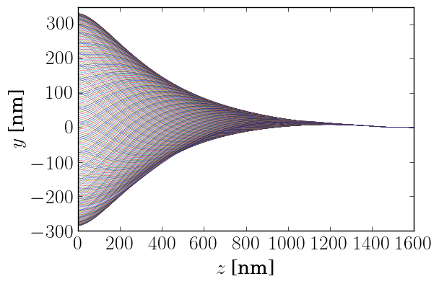
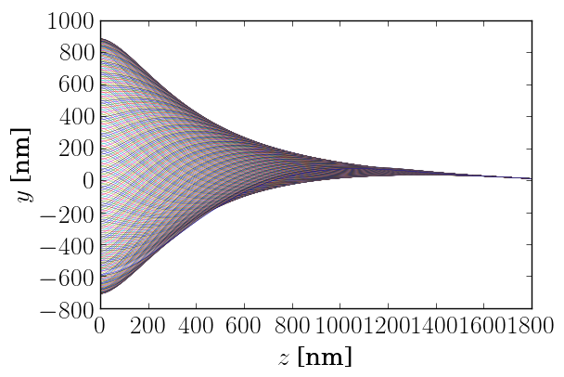



Collective weak pinning at high frequency
Simulated solution
viscous
MF pinning
$$0=f_{v}+f_{L}+f_{p}^{MF}+f_{e}$$
Lorentz
elastic
At $B_{rf}=20$mT
At $B_{rf}=50$mT

Slide 15
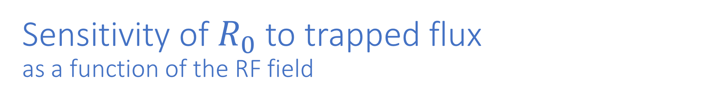
Sensitivity of $R_{0}$ to trapped flux as a function of the RF field
Simulation
Experiment (Hall)
At $j_{d}=1$ (black), 2 (red), 3 (blue), and 4mA/µm² (green)

Slide 16
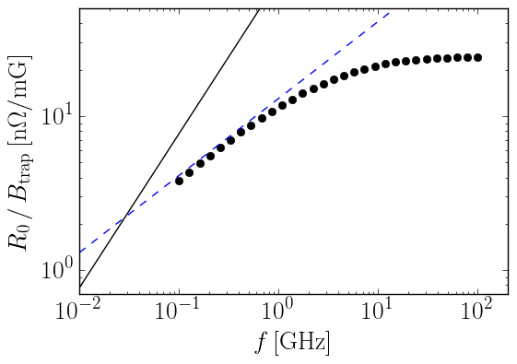
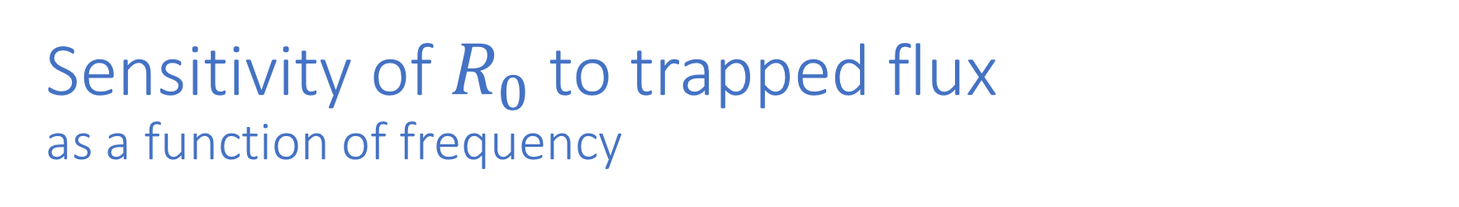
Sensitivity of $R_{0}$ to trapped flux as a function of frequency
Simulation
Experiment (Oseroff)
Square-root
Plateau
Analytical curve

Slide 17
Outline
a)
Introduction
Collective weak pinning
Results
Final remarks
c)
b)

Slide 18
Conclusions and future work
Hysteretic losses might explain the dependence of the residual resistance sensitivity to trapped flux on the RF field.
Our approximations are consistent, though we predict dissipations larger than the experimental ones by a factor of about eight.
The collective weak-pinning model predicts three distinct regimes for the dissipation as a function of frequency: linear, square-root, and a plateau.
Simulations with explicit inclusion of impurities.
Large amplitudes, grain boundaries, and mixed (strong and weak pinning) scenarios.
Experimental check: do most trapped vortices lie perpendicular to the interface? (We have assumed vortices that are normally aligned with respect to the interface.)

Slide 19
Acknowledgments
TTC Topical Workshop Committee, for the invitation.
The Sethna and the Liepe groups in Cornell.
The Center for Bright Beams SRF team.
Prof. Alex Gurevich, for useful consultation.
Financial support from the Center for Bright Beams.
TTC Topical Workshop - RF Superconductivity: Pushing Cavity Performance Limits

