Slide 1
Theoretical calculations of maximum fields in SRF cavities
Danilo Liarte, James Sethna, Daniel Hall, Matthias Liepe
Cornell University
Sam Posen
Fermilab
Mark Transtrum
Brigham Young University
Gianluigi Catelani
Peter Grünberg Institut
TTC Topical Workshop - RF Superconductivity: Pushing Cavity Performance Limits

Slide 2
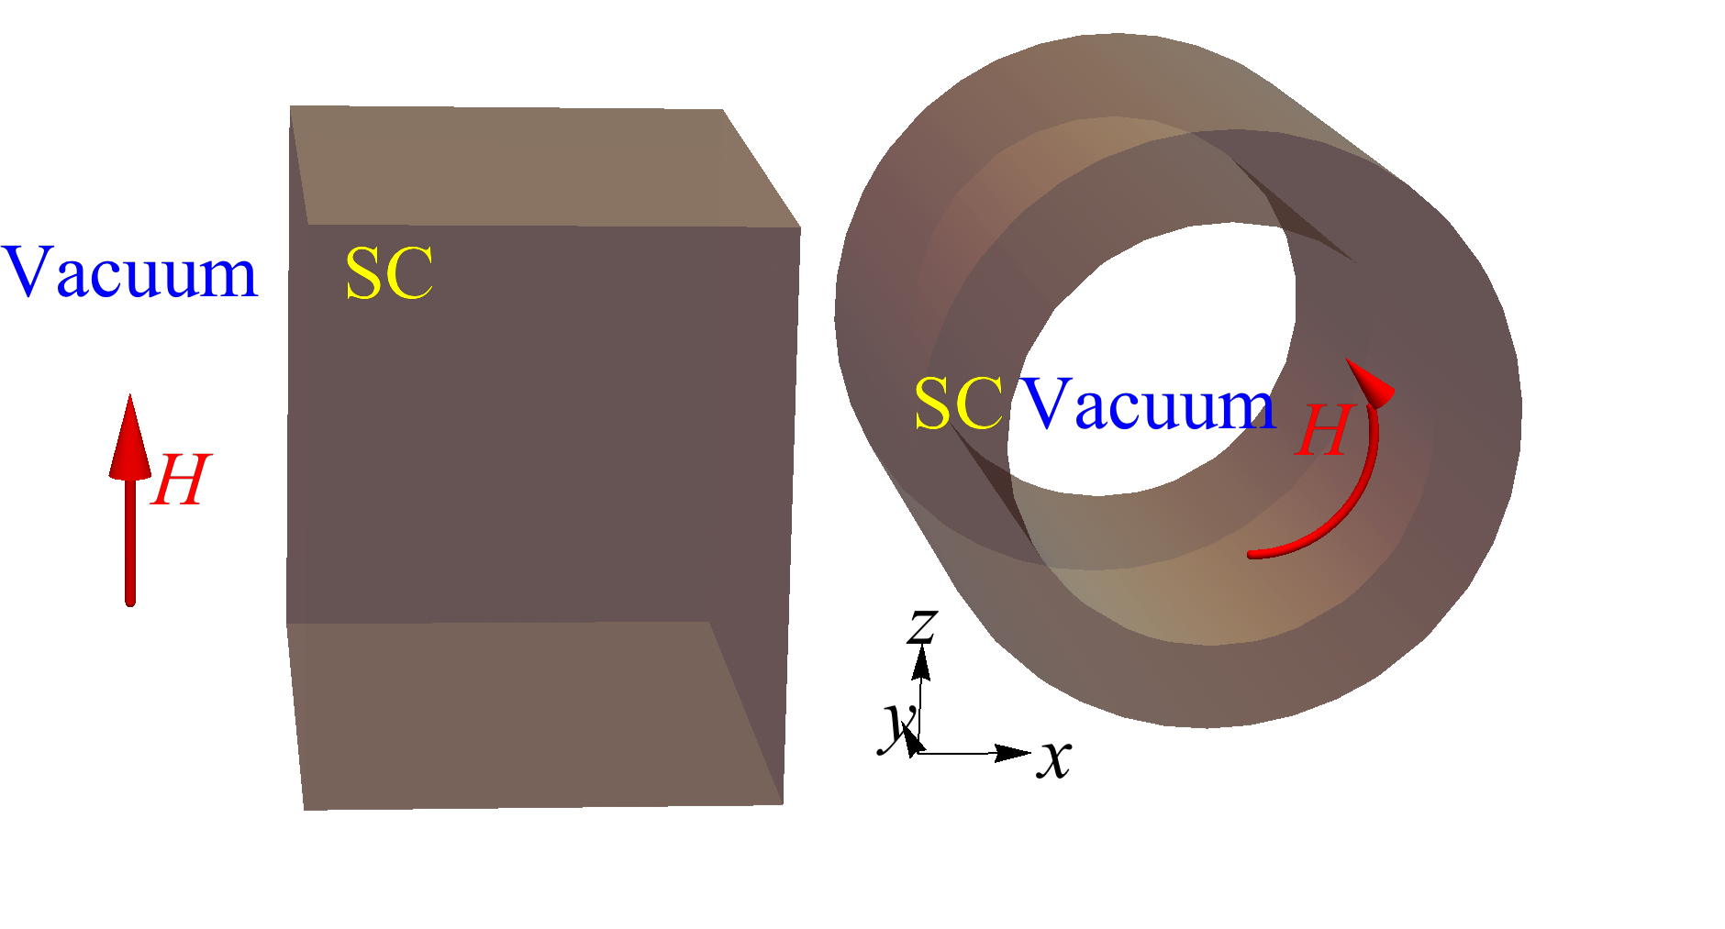
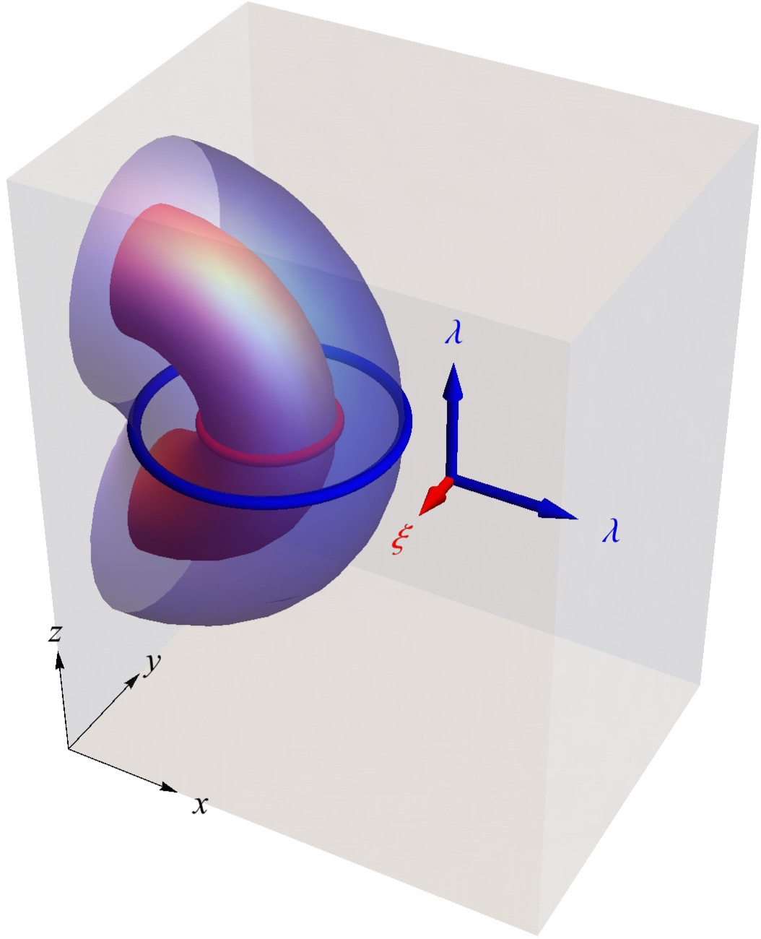
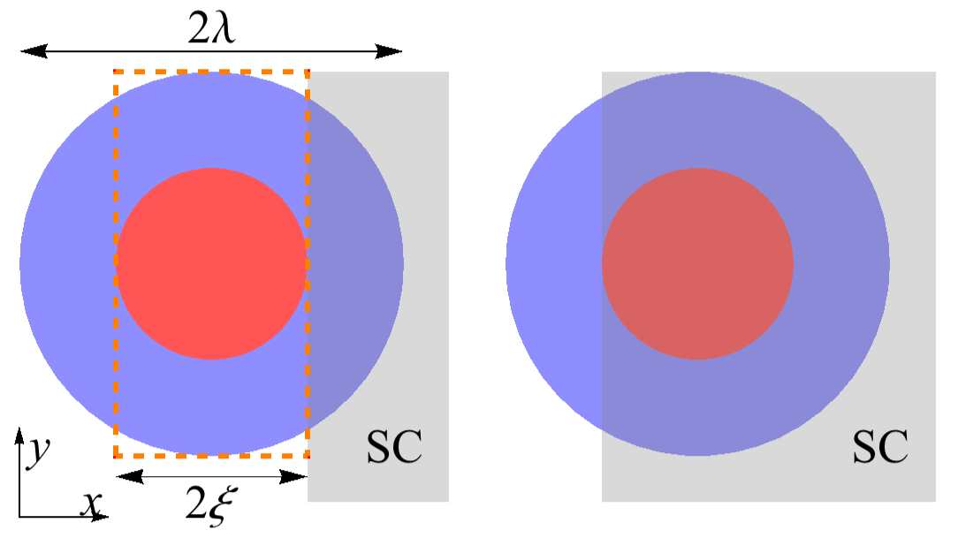
Surface energy barrier & vortex entry fields
Bean & Livingston, PRL 1964
DBL, Posen, Transtrum, Catelani, Liepe, Sethna, SUST 2017

Slide 3
Stability analysis: the superheating field (H_{sh})
In high-field applications, SRF cavities operate above H_{c1}, at the metastable Meissner state.
The Meissner state becomes unstable for fields above H_{sh}.
Sketch of a type II superconductor phase diagram
Kubo, SUST 2016

Slide 4
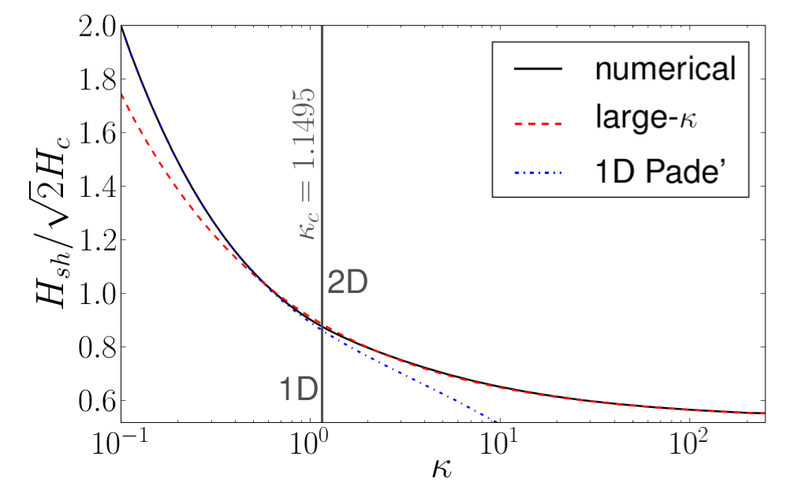
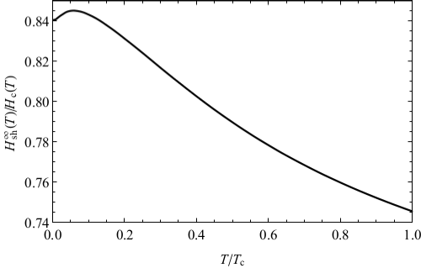
Stability analysis: the superheating field
As a function of κ (near T_{c})
Ginzburg-Landau theory
As a function of T (at high κ):
Eilenberger theory
Transtrum, Catelani, Sethna, PRB 2011
Kramer, PR 1968, etc…
Catelani & Sethna, PRB 2008

Slide 5
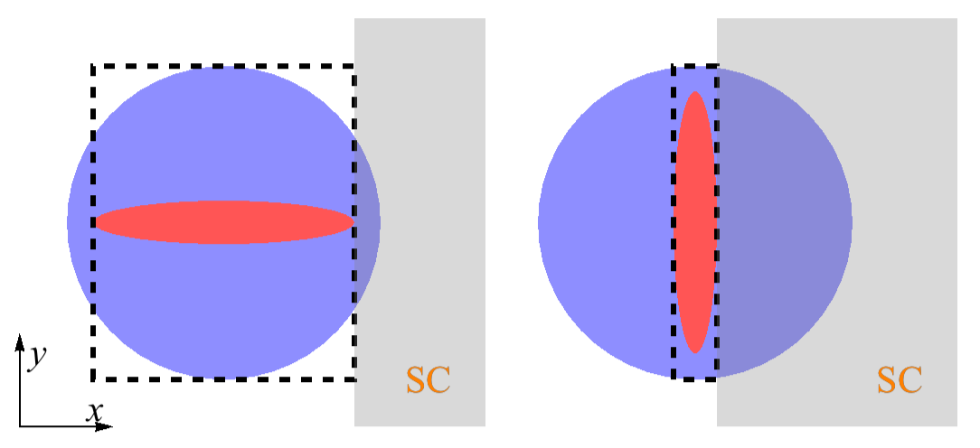
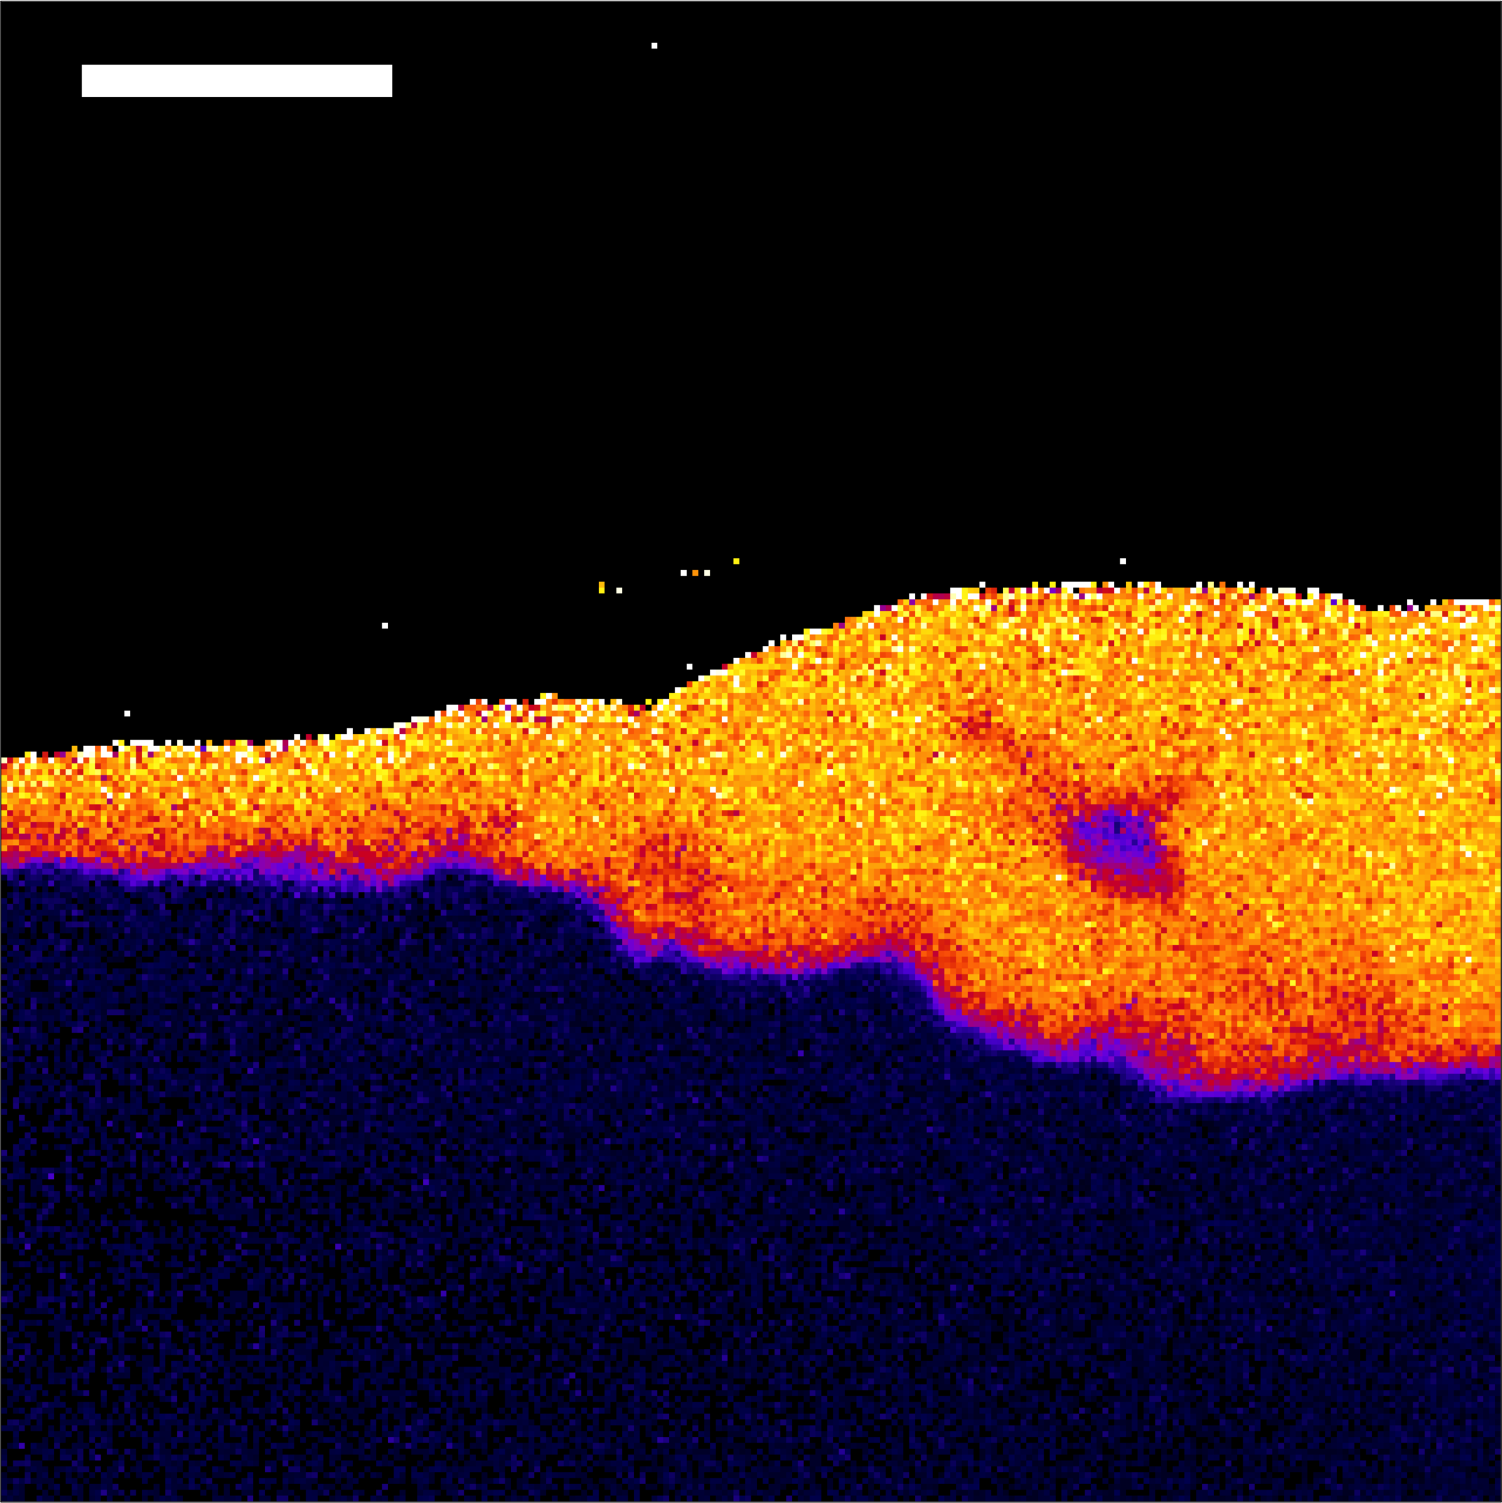
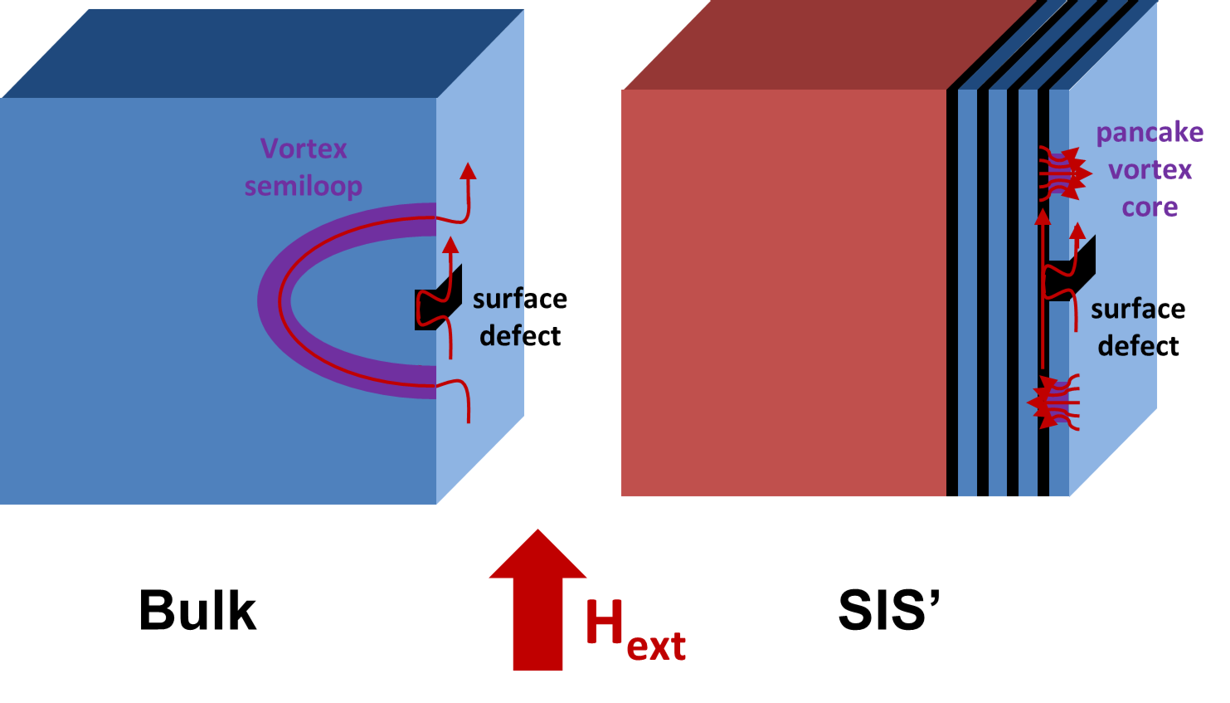
Summary
Anisotropy
Disorder
Laminates
Final considerations

Slide 6
Summary
Anisotropy
Disorder
Laminates
Final considerations

Slide 7
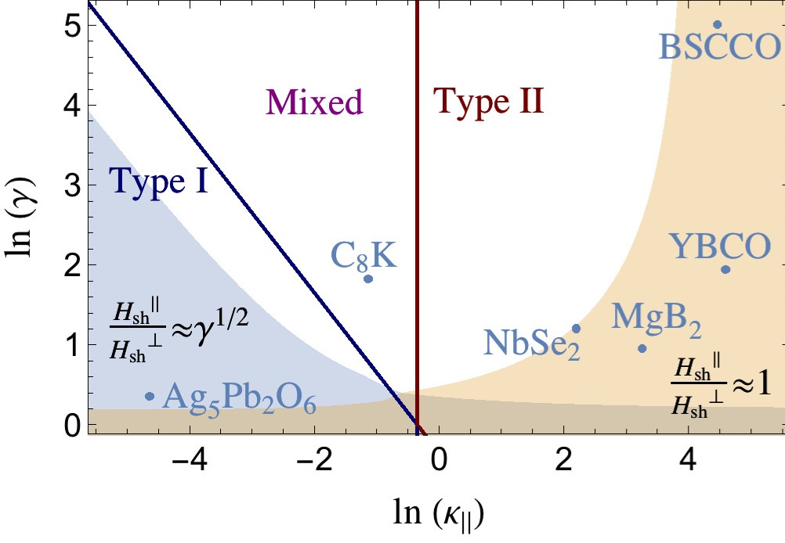
H_{sh} is isotropic (near T_{c}) for new materials
Ginzburg-Landau theory: rescaling and change of coordinates map anisotropic systems into the isotropic one.
H_{sh} is isotropic for high-κ materials (near T_{c}, including MgB₂).
MgB₂ is complicated (Bud’ko & Canfield, Phys. C 2015): two gaps, two distinct anisotropies (see bottom right) conflicting estimates.
Mass anisotropy
GL parameter
DBL, Transtrum, Sethna, PRB 2016

Slide 8
Summary
Anisotropy
Disorder
Laminates
Final considerations

Slide 9
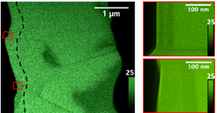
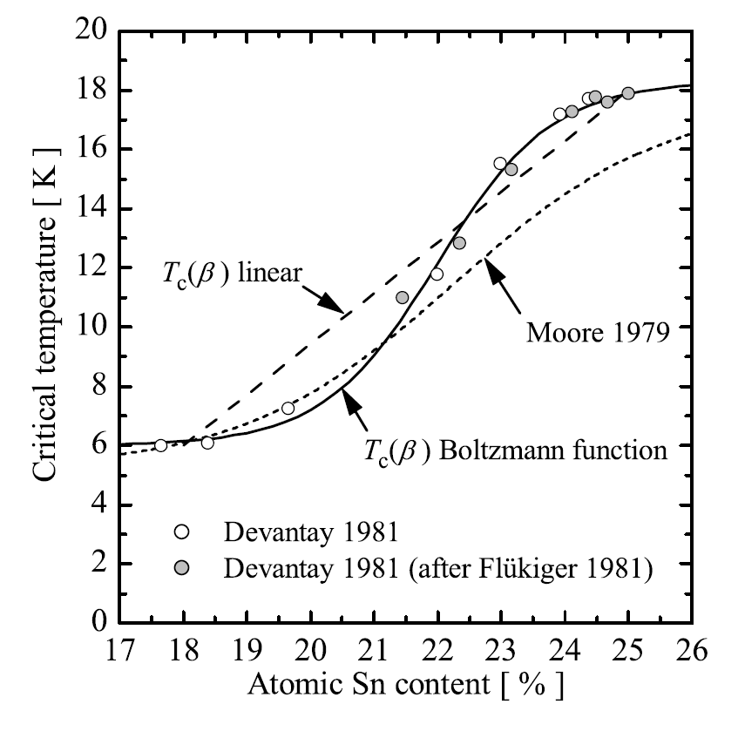
Sn depleted regions and Nb3Sn quenches
Thomas Proslier
(Argonne)
A. Godecke: SUST 2006
Muller Group
(CBB)
Can the tin depleted regions (or something else) facilitate vortex nucleation?

Slide 10
Cavity quenches and reliability
Critical temperature profile that allows vortex nucleation in Nb₃Sn
Quench field of 77mT
We predict a relation between critical temperature drop, defect sizes, and quench fields that is ‘consistent’ with experiments.
Gaussian disorder model: High-κ materials are (almost) as ‘reliable’ to vortex nucleation by disorder as low-κ materials.
The proximity to H_{sh} is dangerous.
DBL, Posen, Transtrum, Catelani, Liepe, Sethna, SUST 2017

Slide 11
Summary
Anisotropy
Disorder
Laminates
Final considerations

Slide 12
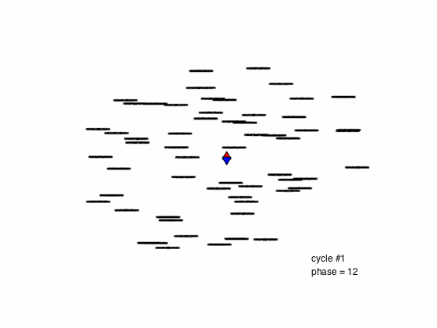
Laminates
Kubo, SUST 2016
Kubo’s review (SUST 2016): multilayer coating. Advances in optimizing thickness and materials assessment.
Gurevich’s proposal (Appl. Phys. Lett. 2006): Can we use SIS structures to increase H_{sh}, and reduce the effects of flux penetration?
Sam Posen (FNAL)
Sam Posen’s simulations (SUST 2017): If there is a mechanism to prevent annihilation after each oscillation, one would expect large losses.

Slide 13
Summary
Anisotropy
Disorder
Laminates
Final considerations

Slide 14
Acknowledgments
TTC Topical Workshop Committee, for the invitation.
The Sethna and the Liepe groups in Cornell.
The Center for Bright Beams SRF team.
Prof. Alex Gurevich, for useful consultation.
Financial support from the Center for Bright Beams.
TTC Topical Workshop - RF Superconductivity: Pushing Cavity Performance Limits

