Slide 1
Understanding the Low Field Q Slope in SRF Cavities
Alexander Romanenko
TTC Topical Meeting
17 Nov 2017

Slide 2
Outline
Low field Q slope
  Manifestation
  Previous studies/models/thoughts
  Importance for ultralow fields applications of high Q SRF cavities
Our recent studies
  Extending the measurement range to very low fields
    Saturation of the Q decrease
  Effect of the oxide growth
  Likely origin

Slide 3
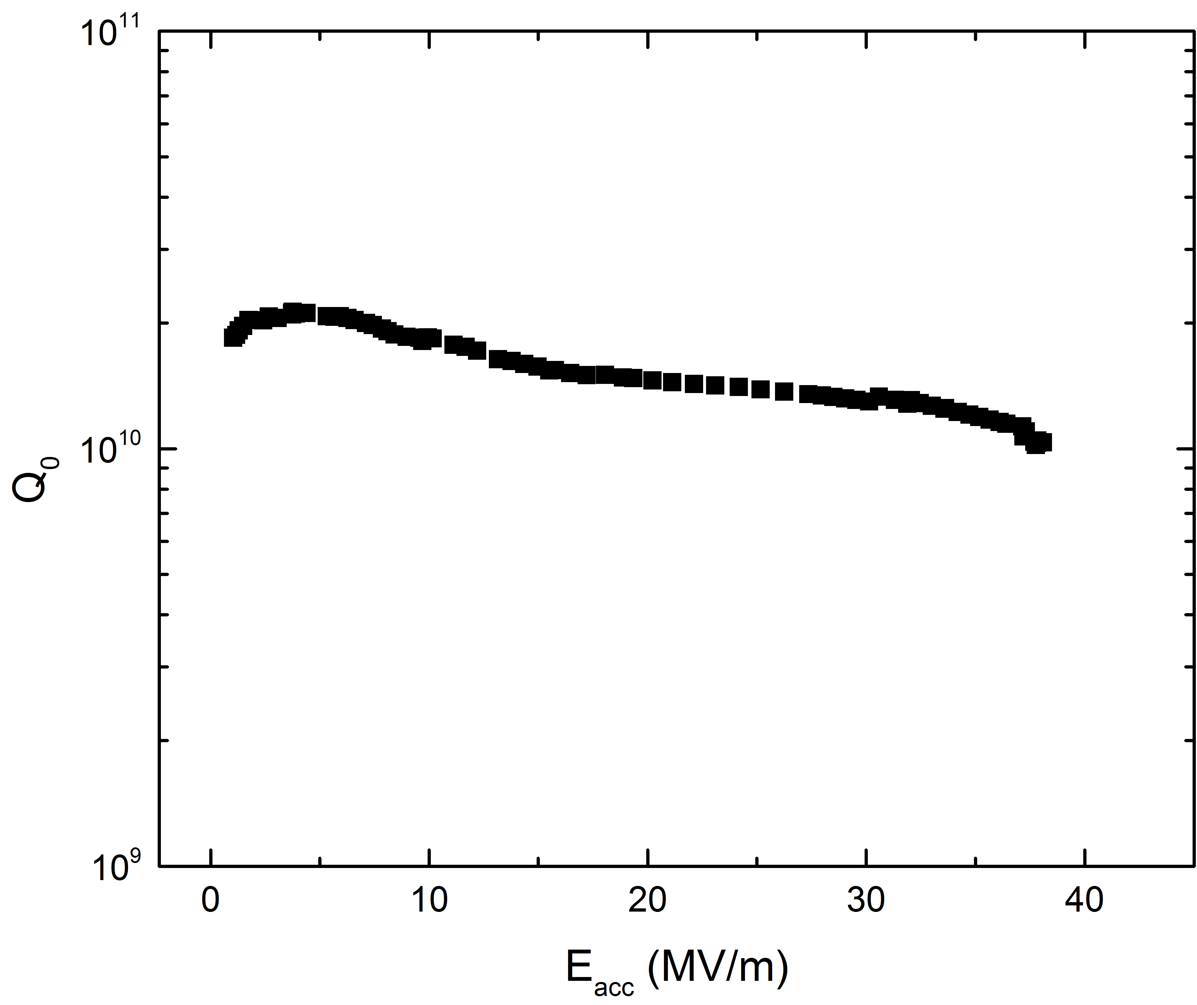
Low field Q slope
Low field Q slope

Slide 4
Previous experimental data/studies
B. Visentin, Pushing the Limits 2006
1.37K
2K
G. Ciovati, J. Appl. Phys. 96, 1591 (2004)

Slide 5
Previous experimental data/studies
A. Romanenko and A. Grassellino, Appl. Phys. Lett. 102, 252603 (2013)
The LFQS comes from residual

Slide 6
Previous models/thoughts
Halbritter
  NbO_{x} clusters inside the penetration depth
    Should show up in BCS part of Rs
Palmieri
  Two layers with top layer having penetration depth dependent on the rf field amplitude
Weingarten
  Weakly superconducting inclusions transitioning 2x per period
R_{s} ~ a/B² + b
R_{s} ~ a/B² + b

Slide 7
Renewed (now practical) importance of the LFQS
How will the best cavities we have behave at ultralow fields for various possible applications?
Quantum Computing
Dark sector searches
Gravitational effects
….
1.3 GHz
1.5K
A. Romanenko et al, Appl. Phys. Lett. 105, 234103 (2014)

Slide 8
LFQS present after all treatments
Effect on low field Q?
A. Grassellino et al, arXiv:1701.06077

Slide 9
What is the cause of the low field Q slope and what happens with Q as we decrease the field further?

Slide 10
Single shot measurements
Q > 10¹⁰ cannot be measured using standard network analyzer techniques
Instead -> decays from PLL state with bandpass filtering (10-1000 Hz around resonance) instead
Q_{L}=2πfτ

Slide 11
Measurements towards quantum regime
1.3 GHz
Low field Q slope stops below ~ 0.1 MV/m with
Q~3 x 10¹⁰
T=1.5K
Now measured down to
<N> ~ 10¹⁰ photons
A. Romanenko and D. I. Schuster, https://arxiv.org/abs/1705.05982

Slide 12
Various cavities/treatments investigated
A. Romanenko and D. I. Schuster, https://arxiv.org/abs/1705.05982
Changes within penetration depth have little effect
Oxide growth/change -> strong increase in very low field dissipation

Slide 13
From 2D resonator world
Two level systems in the dielectric as a cause
Electric field effect: Martinis et al, Phys. Rev. Lett. 95, 210503 (2005)
J. Gao, PhD Thesis, Caltech, 2008
J. Zmuidzinas, Annu. Rev. Condens. Matter Phys. 2012. 3:169–214

Slide 14
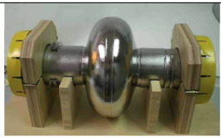
Electric field effect
f = 1.3 GHz, TM₀₁₀ mode
Electric field amplitude

Slide 15
Fit to TLS model
A. Romanenko and D. I. Schuster, https://arxiv.org/abs/1705.05982

Slide 16
Effect of thicker oxide
100 nm oxide added
A. Romanenko and D. I. Schuster, https://arxiv.org/abs/1705.05982

Slide 17
About 2 nOhms added in the whole range of fields > 0.2 MV/m

Slide 18
Thicker oxide has a drastic effect at low fields
~9 nOhm added at low fields!
Nb
Nb₂O₅
100 nm
5 nm
Nb
Nb₂O₅
A. Romanenko and D. I. Schuster, https://arxiv.org/abs/1705.05982

Slide 19
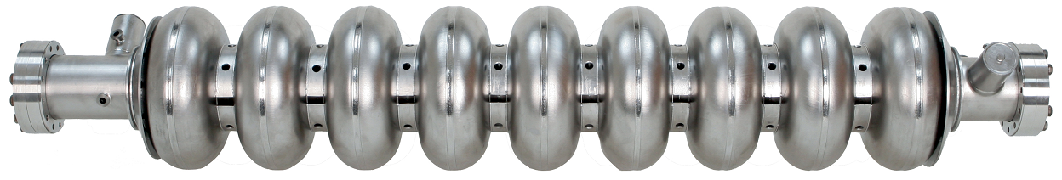
Exploring lower temperatures
Demonstration of T = 10 mK and <N> ~ 1 photon high Q in early 2018
Large dilution refrigerator capable of fitting up to 9-cell 1.3 GHz cavities is being installed
Advanced magnetic shielding
Extensive wiring for exploring all possible applications (quantum computing etc)
Allows to explore fundamental physics of residual resistance of SRF cavities (e.g. hydrides etc could turn SC at low enough T)
1 m

Slide 20
Summary
Low field Q slope saturates below ~0.1 MV/m, Q remains high > 3e10
  Saturation field just below of what was explored in the past
    The key discovery was hiding behind the corner
Growing thicker oxide drastically increases the ultralow field surface resistance
  Much smaller but measurable, almost field-independent change at higher fields – also new, in the past oxide-induced residual resistance was only explored at <5 MV/m
The two above signatures point toward two-level systems in the amorphous Nb₂O₅ as a likely LFQS origin
Are there even more surprises at lower temperatures?
  Dilution refrigerator measurements upcoming

